Slide 1
Computer Vision
CSE 455
Interest Regions, Recognition, and Matching
Linda Shapiro
Professor of Computer Science & Engineering
Professor of Electrical Engineering

Slide 2
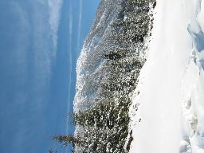
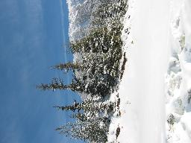
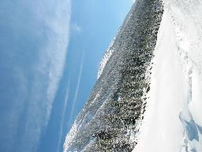
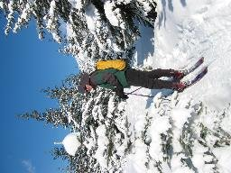
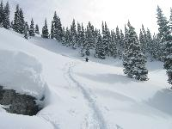
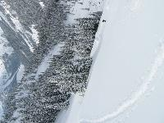
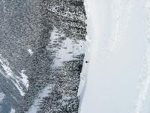
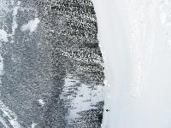
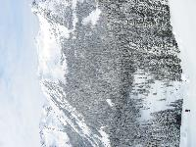
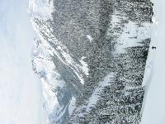
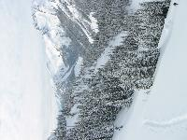
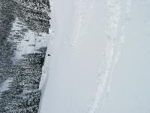
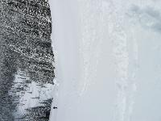
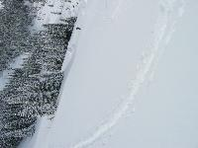
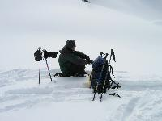
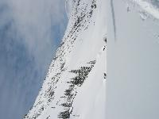
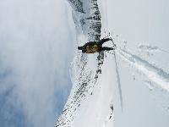
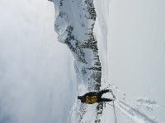
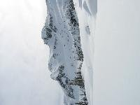
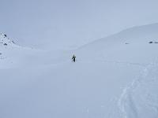
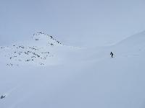
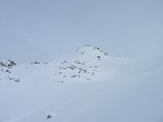
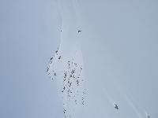
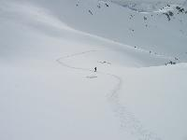
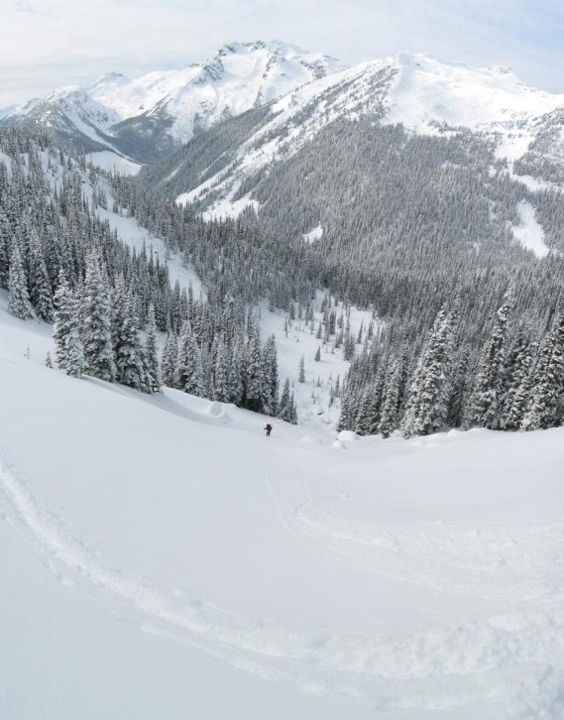
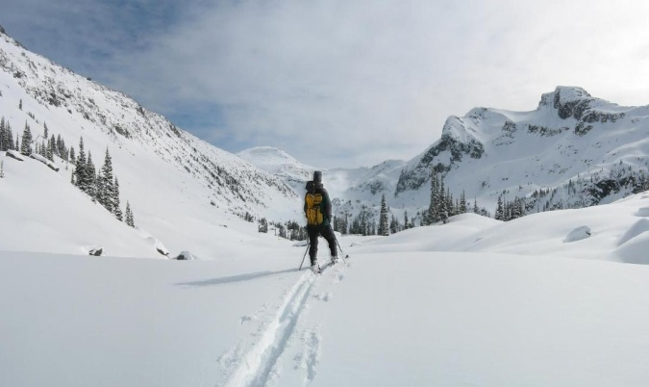
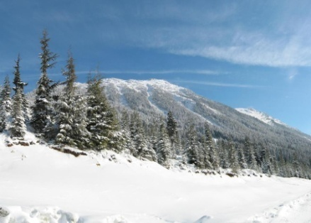
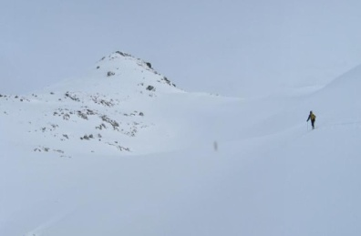
Recognizing Panoramas
Some of following material from Brown and Lowe 2003 talk
Brown and Lowe 2003, 2007

Slide 3
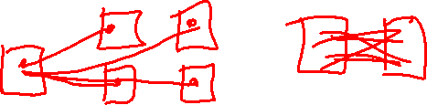
Recognizing Panoramas
Input: N images
Extract SIFT points, descriptors from all images
Find K-nearest neighbors for each point (K=4)
For each image
  Select M candidate matching images by counting matched keypoints (m=6)
  Solve homography H_{ij} for each matched image

Slide 5

Recognizing Panoramas
Input: N images
Extract SIFT points, descriptors from all images
Find K-nearest neighbors for each point (K=4)
For each image
  Select M candidate matching images by counting matched keypoints (m=6)
  Solve homography H_{ij} for each matched image
  Decide if match is valid (n_{i} > 8 + 0.3 n_{f} )
# inliers
# keypoints in overlapping area

Slide 6
Recognizing Panoramas (cont.)
(now we have matched pairs of images)
Make a graph of matched pairs
Find connected components of the graph

Slide 7
Finding the panoramas

Slide 8
Finding the panoramas

Slide 9
Recognizing Panoramas (cont.)
(now we have matched pairs of images)
Find connected components
For each connected component
  Solve for rotation and f
  Project to a surface (plane, cylinder, or sphere)
  Render with multiband blending

Slide 10
Finding the panoramas

Slide 11
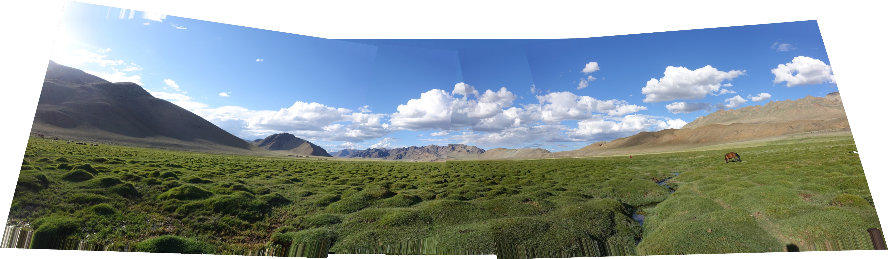
Homework 3
CREATING PANORAMAS!

Slide 12
The Kadir Operator
Saliency, Scale and Image Description
Timor Kadir and Michael Brady
University of Oxford

Slide 13
The issues…
salient – standing out from the rest, noticeable, conspicous, prominent
scale – find the best scale for a feature
image description – create a descriptor for use in object recognition

Slide 14
Early Vision Motivation
pre-attentive stage: features pop out
attentive stage: relationships between features and grouping

Slide 15
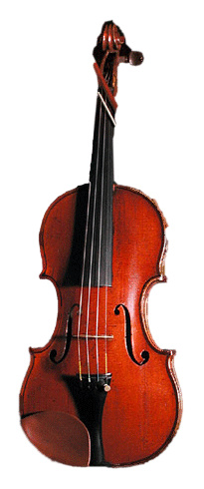
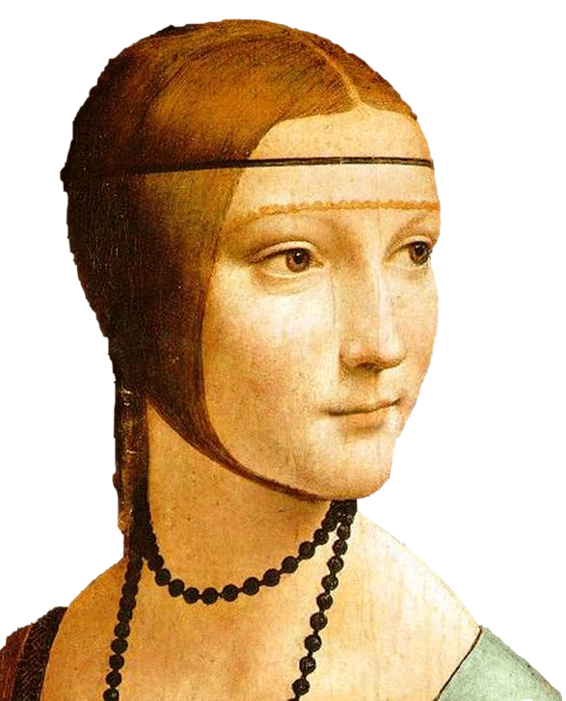
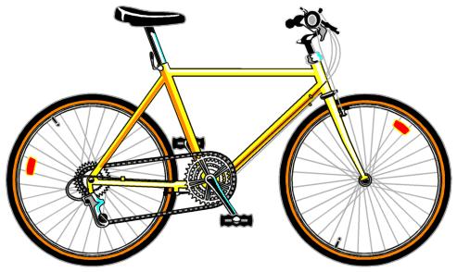
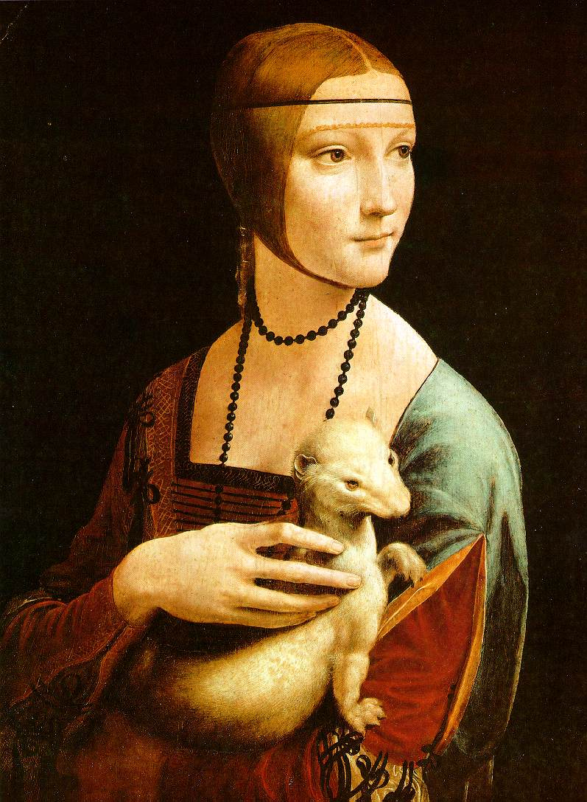
Bags of Words

Slide 16
Detection of Salient Features for an Object Class

Slide 17
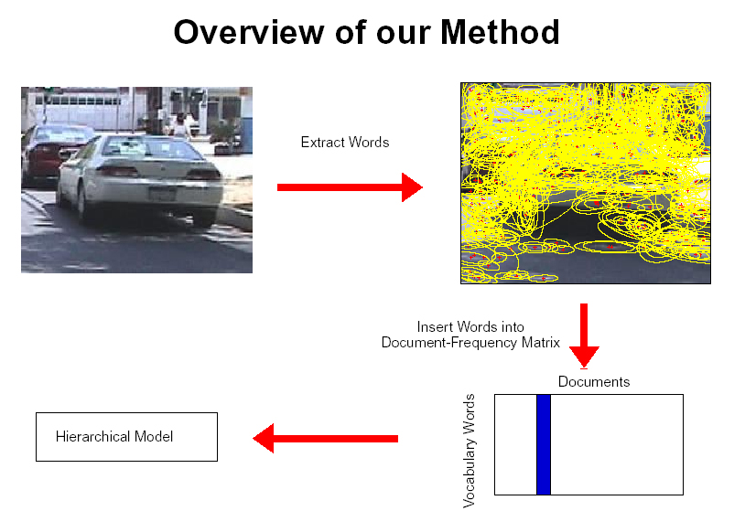
How do we do this?
fixed size windows (simple approach)
Harris detector, Lowe detector, etc.
Kadir’s approach

Slide 18

Kadir’s Approach
Scale is intimately related to the problem of determining saliency and extracting relevant descriptions.
Saliency is related to the local image complexity, ie. Shannon entropy.
entropy definition H = -∑ P_{i} log₂ P_{i}
i in set
of interest

Slide 19
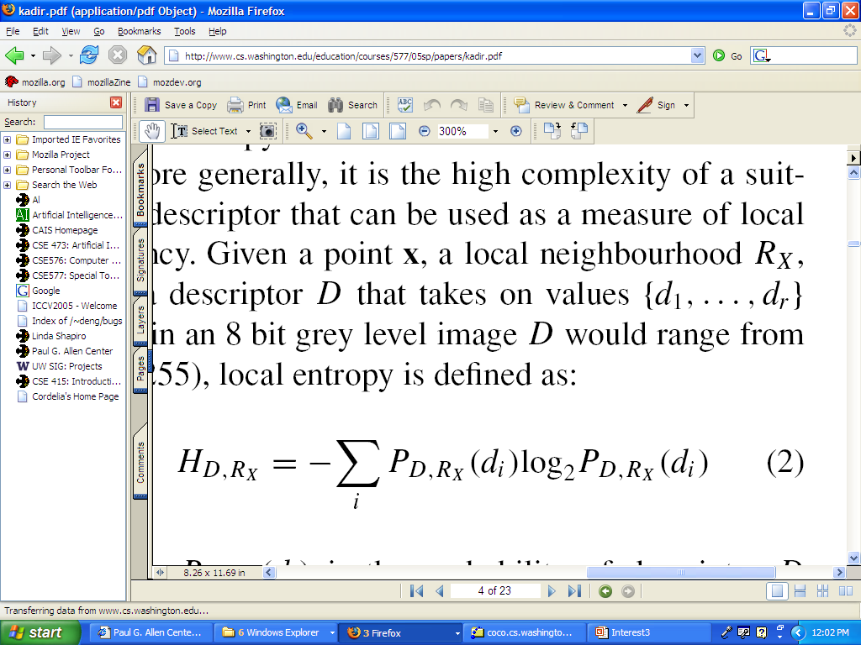
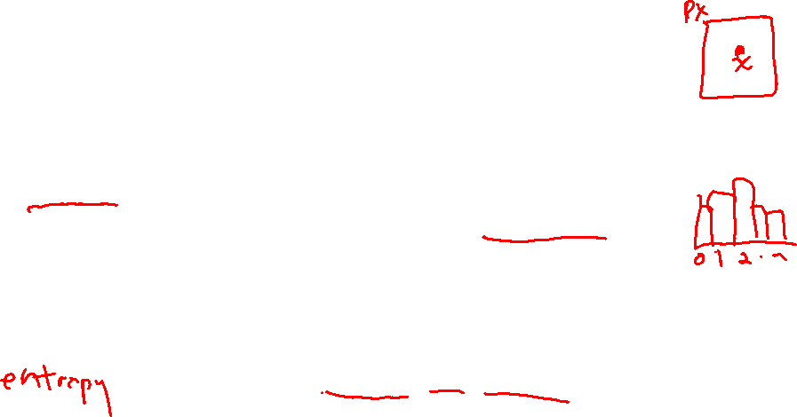
Specifically
x is a point on the image
R_{x} is its local neighborhood
D is a descriptor and has values {d₁, ... d_{r}}.
P_{D,Rx}(d_{i}) is the probability of descriptor D taking the value d_{i} in the local region R_{x}. (The normalized histogram of the gray tones in a region estimates this probability distribution.)

Slide 20
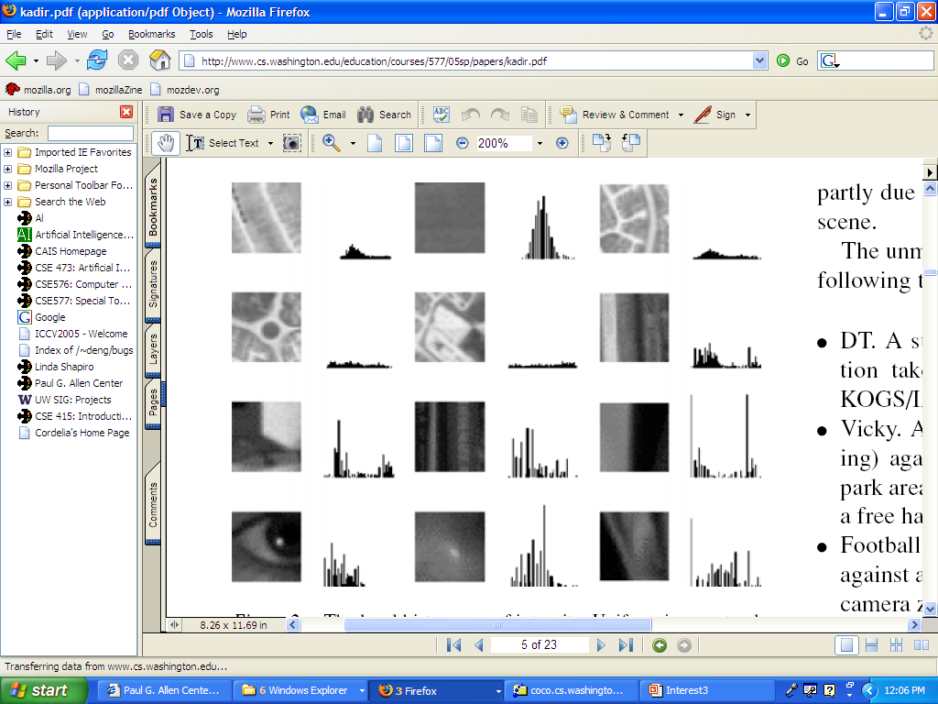

Local Histograms of Intensity
Neighborhoods with structure have flatter distributions
which converts to higher entropy.

Slide 21
Problems Kadir wanted to solve
Scale should not be a global, preselected parameter
Highly textured regions can score high on entropy, but not be useful
The algorithm should not be sensitive to small changes in the image or noise.

Slide 22
Kadir’s Methodology
use a scale-space approach
features will exist over multiple scales
  Berghoml (1986) regarded features (edges) that existed over multiple scales as best.
Kadir took the opposite approach.
  He considers these too self-similar.
  Instead he looks for peaks in (weighted) entropy over the scales.

Slide 23

The Algorithm
For each pixel location x
  For each scale s between smin and smax
    Measure the local descriptor values within a window of scale s
    Estimate the local PDF (use a histogram)
  Select scales (set S) for which the entropy is peaked (S may be empty)
  Weight the entropy values in S by the sum of absolute difference of the PDFs of the local descriptor around S.

Slide 24
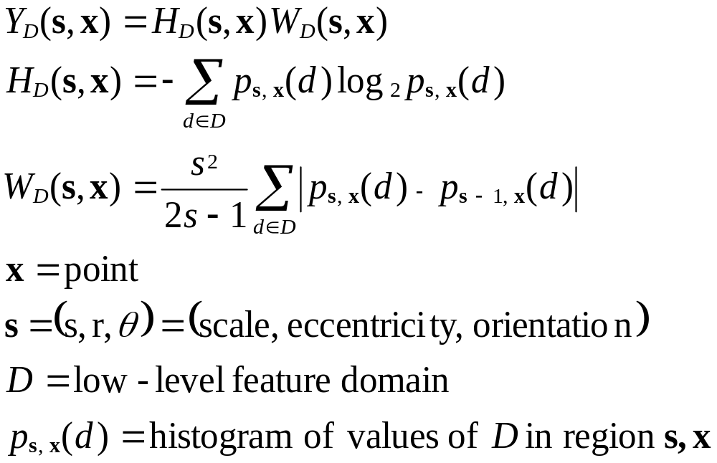
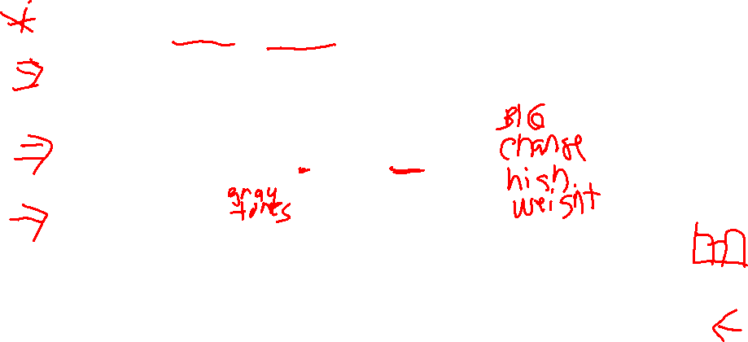
Finding salient points
the math for saliency discretized
saliency
entropy
weight
based on
difference
between
scales
s
(gray tones)
X
probability of descriptor D taking value d in
the region centered at x with scale s
= normalized histogram count for the bin representing gray tone d.

Slide 25
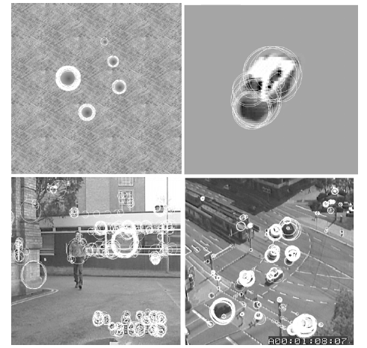
Picking salient points and their scales

Slide 26
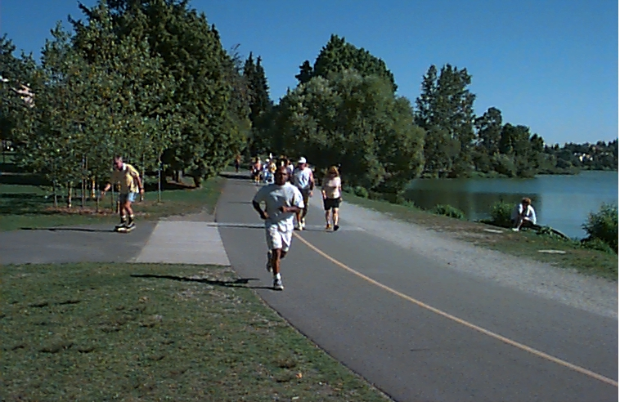
Getting rid of texture
One goal was to not select highly textured regions such as grass or bushes, which are not the type of objects the Oxford group wanted to recognize
Such regions are highly salient with just entropy, because they contain a lot of gray tones in roughly equal proportions
But they are similar at different scales and thus the weights make them go away

Slide 27

Salient Regions
Instead of just selecting the most salient points (based on weighted entropy), select salient regions (more robust).
Regions are like volumes in scale space.
Kadir used clustering to group selected points into regions.
We found the clustering was a critical step.

Slide 28
Kadir’s clustering (VERY ad hoc)
Apply a global threshold on saliency.
Choose the highest salient points (50% works well).
Find the K nearest neighbors (K=8 preset)
Check variance at center points with these neighbors.
Accept if far enough away from existant clusters and variance small enough.
Represent with mean scale and spatial location of the K points
Repeat with next highest salient point

Slide 29
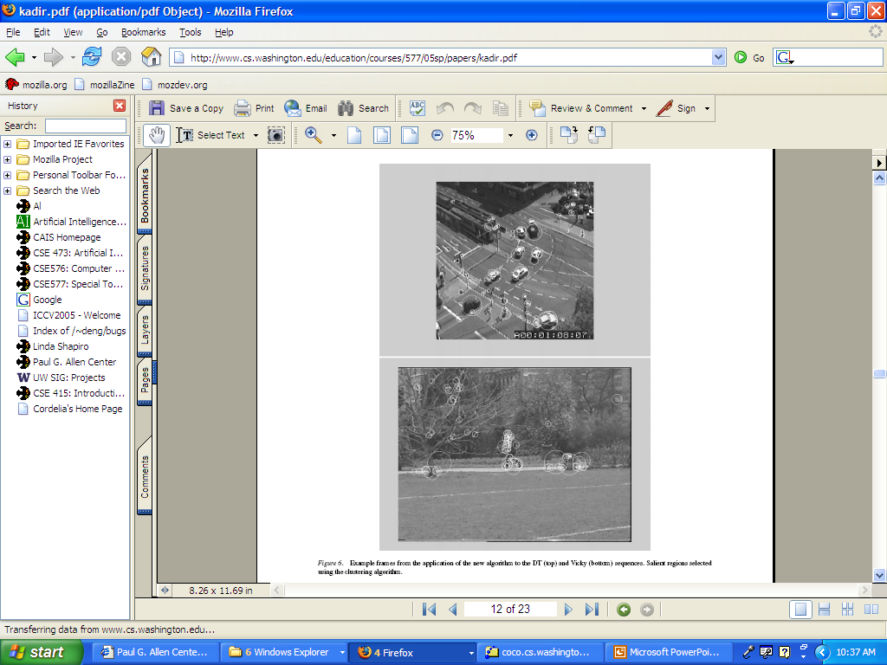
More examples

Slide 30
Robustness Claims
scale invariant (chooses its scale)
rotation invariant (uses circular regions and histograms)
somewhat illumination invariant (why?)
not affine invariant (able to handle small changes in viewpoint)

Slide 31
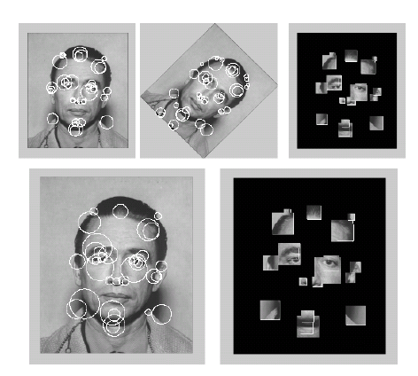
More Examples

Slide 32
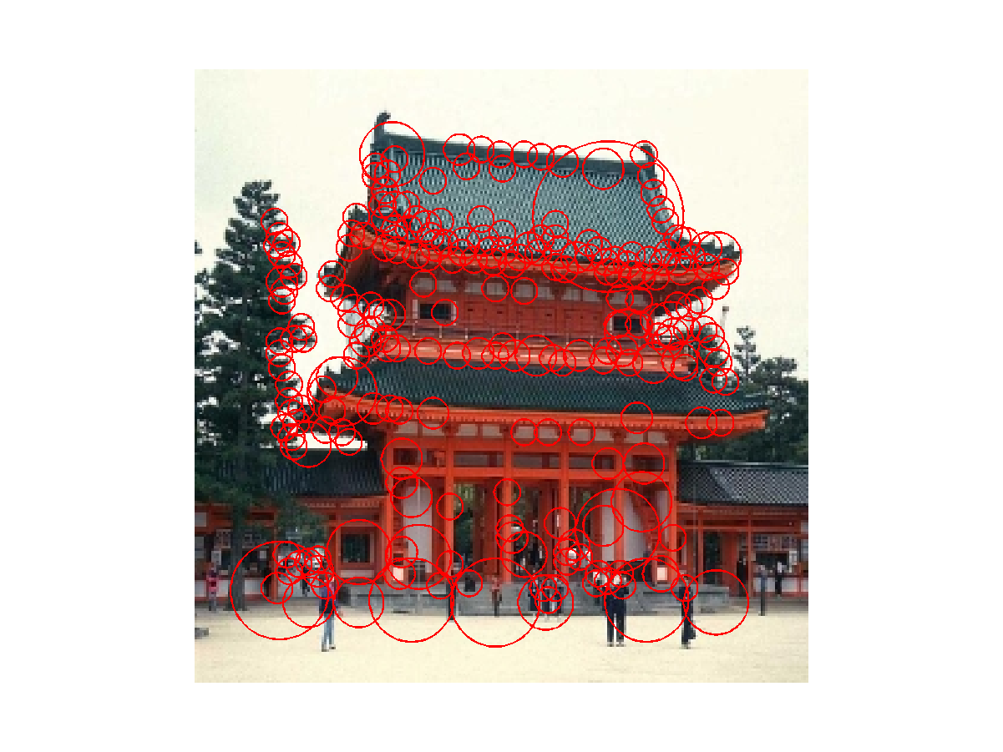
Temple

Slide 33
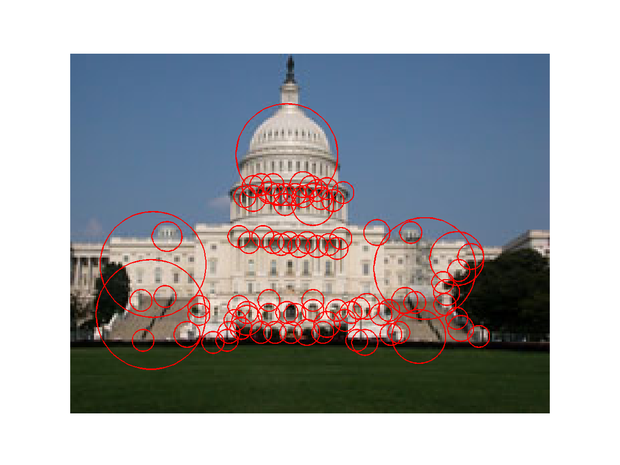
Capitol

Slide 34
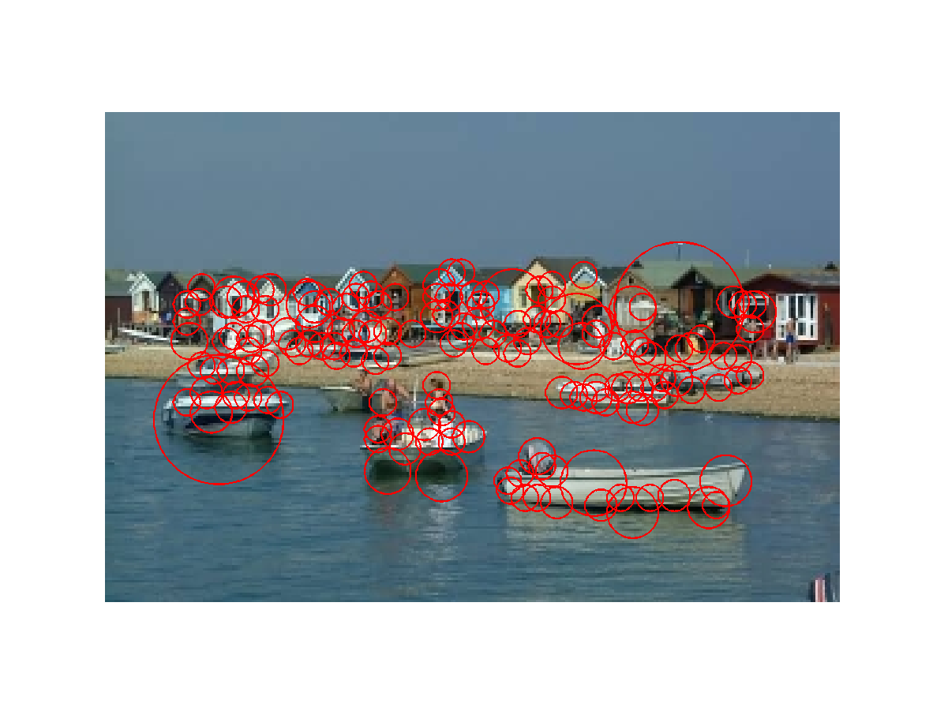
Houses and Boats

Slide 35
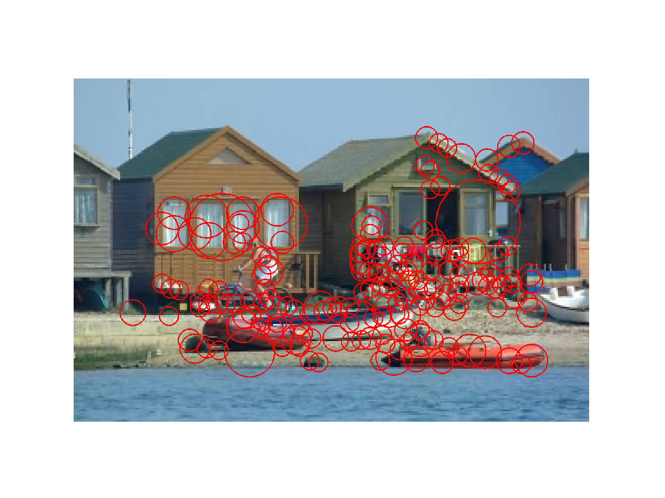
Houses and Boats

Slide 36
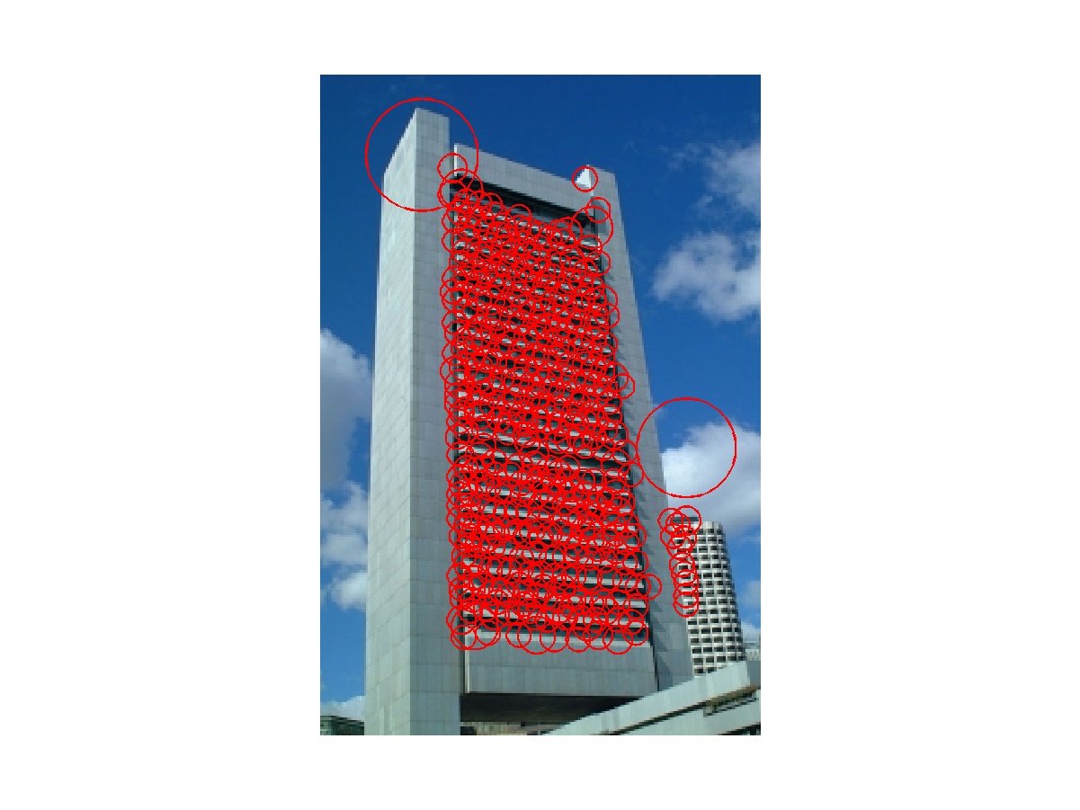
Sky Scraper

Slide 37
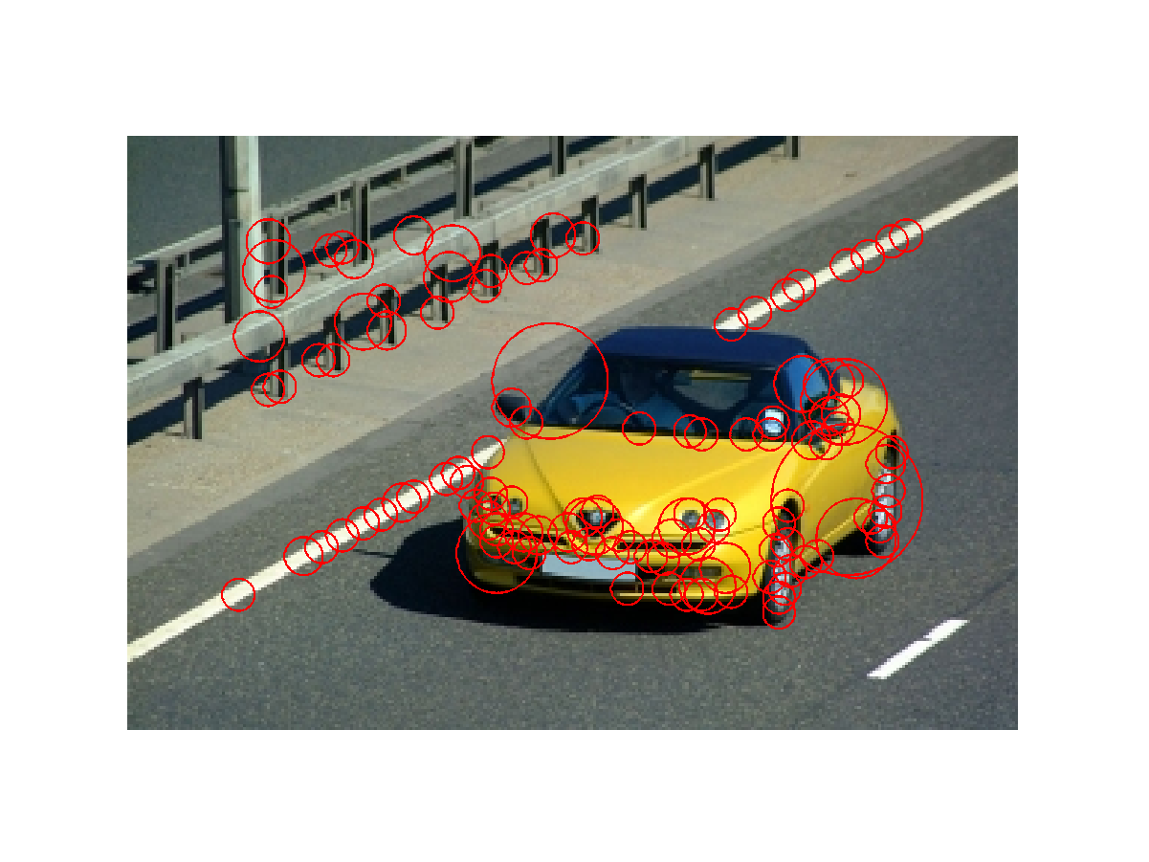
Car

Slide 38

Trucks

Slide 39



Fish

Slide 40



Other …

Slide 41




Symmetry and More

Slide 42
Benefits
General feature: not tied to any specific object
Can be used to detect rather complex objects that are not all one color
Location invariant, rotation invariant
Selects relevant scale, so scale invariant
What else is good?
Anything bad?

Slide 43

Object Recognition with Interest Operators
Object recognition started with line segments.
  - Roberts recognized objects from line segments
  and junctions.
  - This led to systems that extracted linear features.
  - CAD-model-based vision works well for industrial.
An “appearance-based approach” was first developed
for face recognition and later generalized up to a point.
The interest operators have led to a new kind of
recognition by “parts” that can handle a variety of
objects that were previously difficult or impossible.

Slide 44
Object Class Recognition by Unsupervised Scale-Invariant Learning
R. Fergus, P. Perona, and A. Zisserman
Oxford University and Caltech
CVPR 2003
won the best student paper award
CVPR 2013
won the best 10-year award

Slide 45



Goal:
Enable Computers to Recognize Different Categories of Objects in Images.

Slide 46

Notes:
Difficulties: Size Variation,

Slide 47

Approach
An object is a constellation of parts (from Burl, Weber and Perona, 1998).
The parts are detected by an interest operator (Kadir’s).
The parts can be recognized by appearance.
Objects may vary greatly in scale.
The constellation of parts for a given object is learned from training images

Slide 48
Components
Model
  Generative Probabilistic Model including
  Location, Scale, and Appearance of Parts
Learning
  Estimate Parameters Via EM Algorithm
Recognition
  Evaluate Image Using Model and Threshold

Slide 49



Model: Constellation Of Parts
Fischler & Elschlager, 1973
Yuille, 91
Brunelli & Poggio, 93
Lades, v.d. Malsburg et al. 93
Cootes, Lanitis, Taylor et al. 95
Amit & Geman, 95, 99
Perona et al. 95, 96, 98, 00

Slide 50


Parts Selected by
Interest Operator
Kadir and Brady's Interest Operator.
Finds Maxima in Entropy Over Scale and Location

Slide 51


Representation of Appearance
c₁
Projection onto
PCA basis
c₂
11x11 patch
Normalize
121 dimensions was too big, so they used PCA to reduce to 10-15.
c₁₅

Slide 52
Learning a Model
An object class is represented by a generative model with P parts and a set of parameters θ.
Once the model has been learned, a decision procedure must determine if a new image contains an instance of the object class or not.
Suppose the new image has N interesting features with locations X, scales S and appearances A.

Slide 53


Probabilistic Model
X is a description of the shape of the object (in terms of locations of parts)
S is a description of the scale of the object
A is a description of the appearance of the object
θ is the (maximum likelihood value of) the parameters of the object
h is a hypothesis: a set of parts in the image that might be the parts of the object
H is the set of all possible hypotheses for that object in that image.
For N features in the image and P parts in the object, its size is O(N^{P})

Slide 54







Appearance
The appearance (A) of each part p
has a Gaussian density with
mean c_{p} and covariance V_{P}.
Background model has mean c_{bg}
and covariance V_{bg}.
Gaussian Part Appearance PDF
Gausian Appearance PDF
Object Background

Slide 55
Shape as Location
Object shape is represented by a joint Gaussian density of the locations (X)
of features within a hypothesis transformed into a scale-invariant space.
Gaussian Shape PDF
Uniform Shape PDF
Object Background

Slide 56
Scale
The relative scale of each part is modeled by a Gaussian density with
mean t_{p} and covariance U_{p}.
Prob. of detection
Gaussian
Relative Scale PDF
0.8
0.75
0.9
Log(scale)

Slide 57
Occlusion and Part Statistics
This was very complicated and turned out to not work
well and not be necessary, in both Fergus’s work and
other subsequent works.

Slide 58





Learning
Train Model Parameters Using EM:
    Optimize Parameters
    Optimize Assignments
    Repeat Until Convergence
location
occlusion
appearance
scale

Slide 59


Recognition
Make this likelihood ratio:
greater than a threshold.

Slide 60
RESULTS
Initially tested on the Caltech-4 data set
  motorbikes
  faces
  airplanes
  cars
Now there is a much bigger data set: the Caltech-101 http://www.vision.caltech.edu/archive.html

Slide 61



Motorbikes
Equal error rate: 7.5%

Slide 62

Background Images
It learns that these are NOT motorbikes.

Slide 63



Frontal faces
Equal error rate: 4.6%

Slide 64



Airplanes
Equal error rate: 9.8%

Slide 65



Scale-Invariant Cars
Equal error rate: 9.7%

Slide 66

Accuracy
Initial Pre-Scaled Experiments
Early Data Set: The CalTech 4

Slide 67
Available Today
CalTech 101 and Caltech 256
ImageNet
Pascal VOC dataset
CIFAR-10
MS Coco
Cityscapes
https://analyticsindiamag.com/10-open-datasets-you-can-use-for-computer-vision-projects/

Slide 68
Content-Based Image Retrieval
Queries
Commercial Systems
Retrieval Features
Indexing in the FIDS System
Lead-in to Object Recognition

Slide 69
Content-based Image Retrieval (CBIR)
Searching a large database for images that match a query:
  What kinds of databases?
  What kinds of queries?
  What constitutes a match?
  How do we make such searches efficient?

Slide 70
Applications
  Art Collections
  e.g. Fine Arts Museum of San Francisco
  Medical Image Databases
  CT, MRI, Ultrasound, The Visible Human
  Scientific Databases
  e.g. Earth Sciences
  General Image Collections for Licensing
  Corbis, Getty Images
  The World Wide Web
  Google, Microsoft, etc

Slide 71
What is a query?
  an image you already have
  a rough sketch you draw
  a symbolic description of what you want
  e.g. an image of a man and a woman on
  a beach

Slide 72
Some Systems You Can Try
Corbis sells sold high-quality images for use in advertising,
marketing, illustrating, etc. Corbis was sold to a Chinese
company, but
Getty images now provides the image sales.
http://www.gettyimages.com/search/2/image?excludenudity=true&sort=best

Slide 73
Google Image
Google Images
http://www.google.com/imghp
Try the camera icon.

Slide 74
Microsoft Bing
http://www.bing.com/

