Slide 1
Computer Vision
CSE 455
Content-Based Image Retrieval and the EM Algorithm
Linda Shapiro
Professor of Computer Science & Engineering
Professor of Electrical Engineering

Slide 2
Content-Based Image Retrieval
Queries
Commercial Systems
Retrieval Features
Indexing in the FIDS System
Lead-in to Object Recognition

Slide 3
Content-based Image Retrieval (CBIR)
Searching a large database for images that match a query:
  What kinds of databases?
  What kinds of queries?
  What constitutes a match?
  How do we make such searches efficient?

Slide 4
Applications
  Art Collections
  e.g. Fine Arts Museum of San Francisco
  Medical Image Databases
  CT, MRI, Ultrasound, The Visible Human
  Scientific Databases
  e.g. Earth Sciences
  General Image Collections for Licensing
  Corbis, Getty Images
  The World Wide Web
  Google, Microsoft, etc

Slide 5
What is a query?
  an image you already have
  a rough sketch you draw
  a symbolic description of what you want
  e.g. an image of a man and a woman on
  a beach

Slide 6
Some Systems You Can Try
Corbis sells sold high-quality images for use in advertising,
marketing, illustrating, etc. Corbis was sold to a Chinese
company, but
Getty images now provides the image sales.
http://www.gettyimages.com/search/2/image?excludenudity=true&sort=best

Slide 7
Google Image
Google Images
http://www.google.com/imghp
Try the camera icon.

Slide 8
Microsoft Bing
http://www.bing.com/

Slide 9
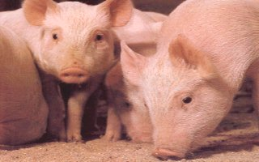
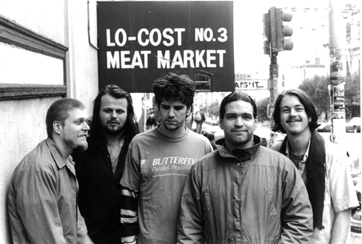
Problem with Text-Based Search
Retrieval for pigs for the color chapter of my book
Small company (was called Ditto)
Allows you to search for pictures from web pages

Slide 10
Features
Color (histograms, gridded layout, wavelets)
Texture (Laws, Gabor filters, local binary pattern)
Shape (first segment the image, then use statistical
or structural shape similarity measures)
Objects and their Relationships
This is the most powerful, but you have to be able to
recognize the objects!

Slide 11
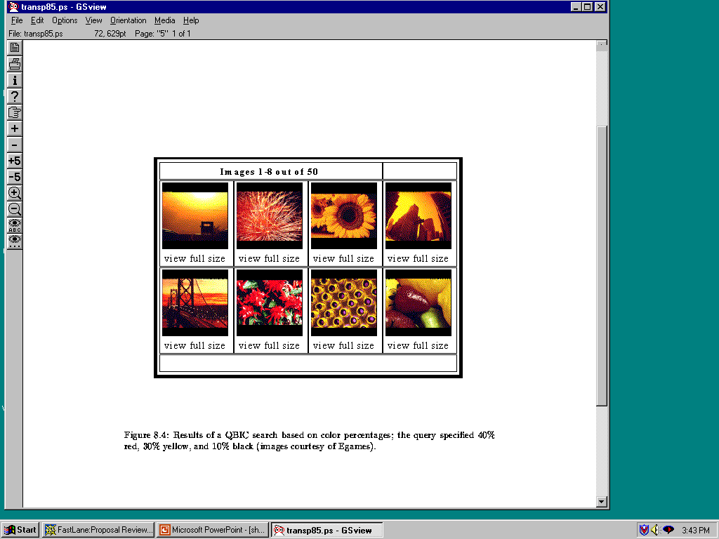
Color Histograms

Slide 12
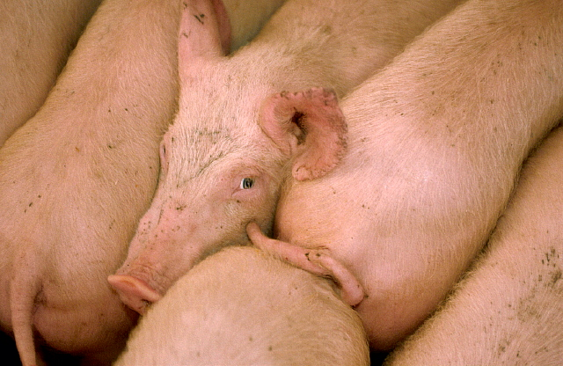
Gridded Color
Gridded color distance is the sum of the color distances
in each of the corresponding grid squares.
1
2
1
2
3
4
3
4
What color distance would you use for a pair of grid squares?

Slide 13
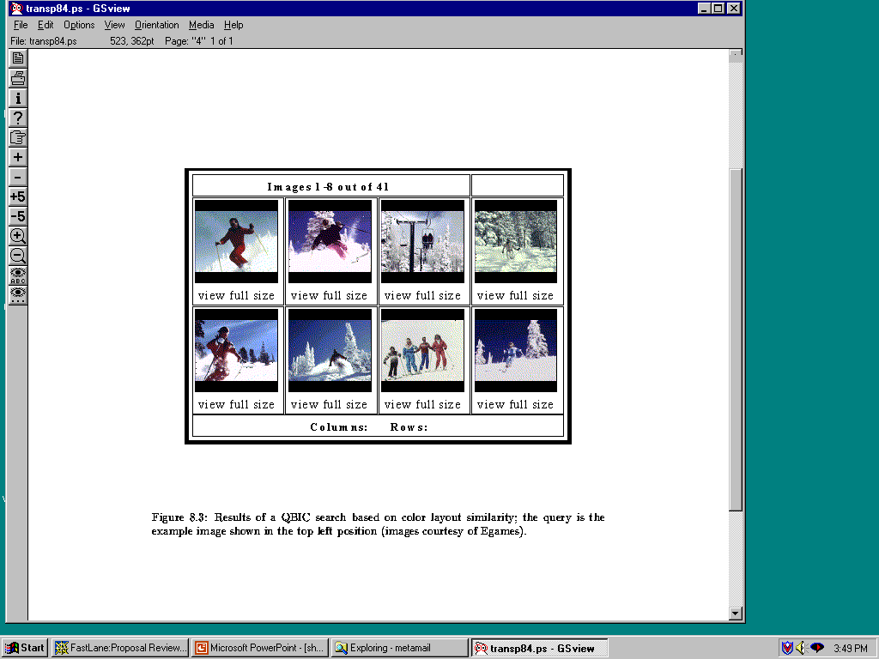
Color Layout
(IBM’s Gridded Color)

Slide 14
Texture Distances
Pick and Click (user clicks on a pixel and system
retrieves images that have in them a region with
similar texture to the region surrounding it.
Gridded (just like gridded color, but use texture).
Histogram-based (e.g. compare the LBP histograms).

Slide 15
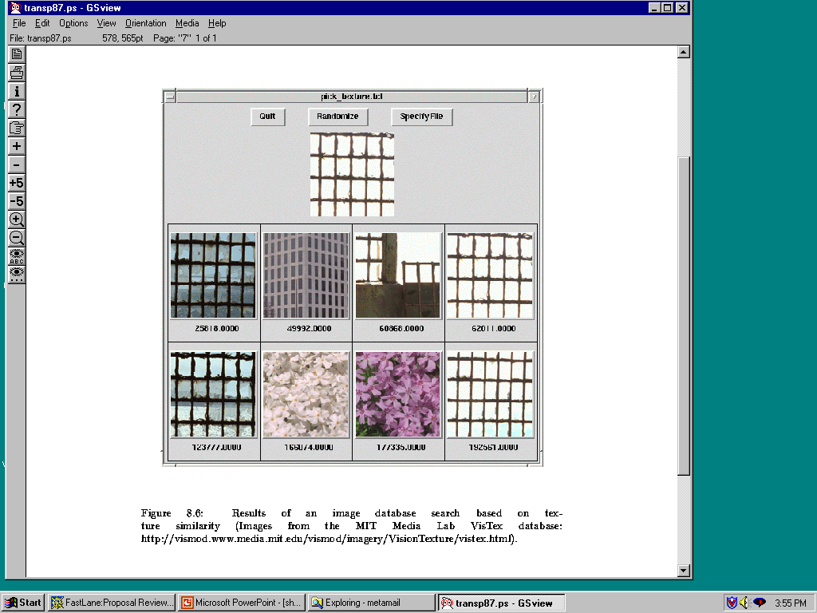
Laws Texture

Slide 16
Shape Distances
Shape goes one step further than color and texture.
It requires identification of regions to compare.
There have been many shape similarity measures
suggested for pattern recognition that can be used
to construct shape distance measures.

Slide 17
Global Shape Properties:
Projection Matching
0
4
1
3
2
0
Feature Vector
(0,4,1,3,2,0,0,4,3,2,1,0)
0 4 3 2 1 0
In projection matching, the horizontal and vertical
projections form a histogram.
What are the weaknesses of this method? strengths?

Slide 18
Global Shape Properties:
Tangent-Angle Histograms
135
0 30 45 135
Is this feature invariant to starting point?
Is it invariant to size, translation, rotation?

Slide 19
Boundary Matching
Fourier Descriptors
Sides and Angles
Elastic Matching
The distance between query shape and image shape
has two components:
1. energy required to deform the query shape into
one that best matches the image shape
2. a measure of how well the deformed query matches
the image

Slide 20
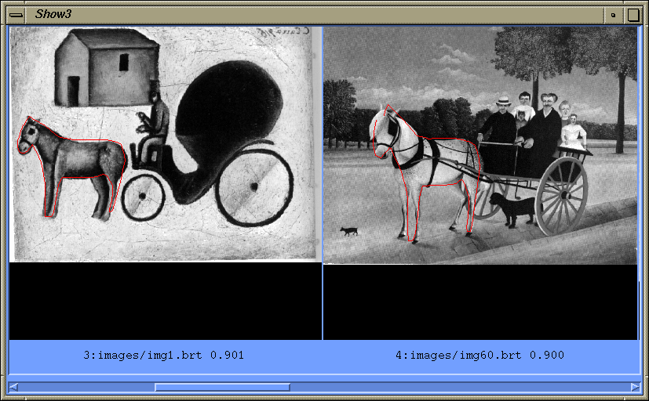
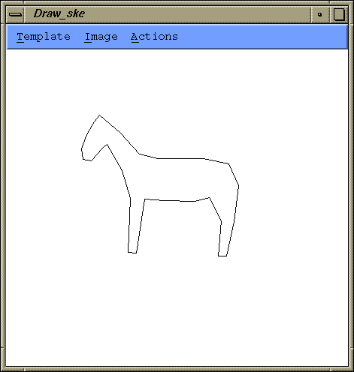
Del Bimbo Elastic Shape Matching
query
retrieved images

Slide 21
Regions and Relationships
Segment the image into regions
Find their properties and interrelationships
Construct a graph representation with
nodes for regions and edges for
spatial relationships
Use graph matching to compare images
Like
what?

Slide 22
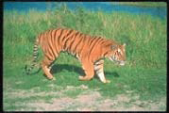

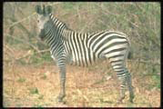

Blobworld (Carson et al, 1999)
Segmented the query (and all database images) using EM on color+texture
Allowed users to select the most important region and what characteristics of it (color, texture, location)
Asked users if the background was also important

Slide 23
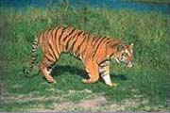
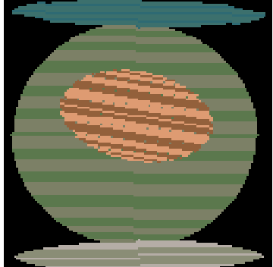
Tiger Image as a Graph
(motivated by Blobworld)
sky
image
above
above
adjacent
inside
tiger
grass
above
above
adjacent
sand
abstract regions

Slide 24
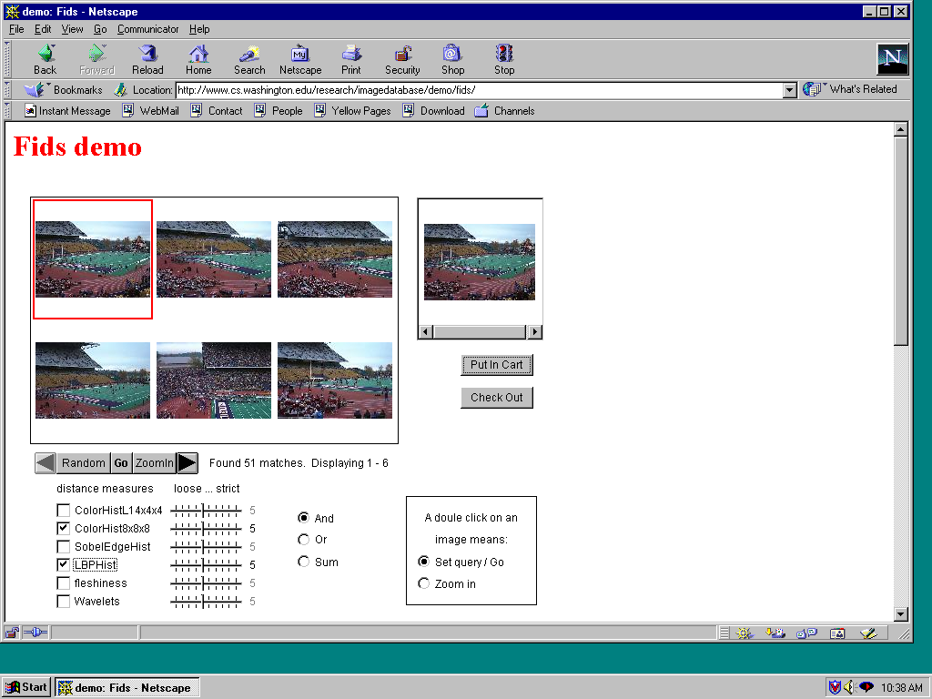
Andy Berman’s FIDS System
multiple distance measures
Boolean and linear combinations
efficient indexing using images as keys

Slide 25
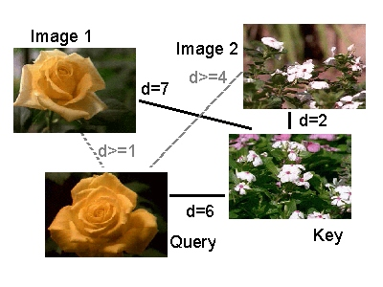
Andy Berman’s FIDS System:
Use of key images and the triangle inequality
for efficient retrieval. d(I,Q) >= |d((I,K) – d(Q,K)|

Slide 26
Andy Berman’s FIDS System:
Bare-Bones Triangle Inequality Algorithm
Offline
1. Choose a small set of key images
2. Store distances from database images to keys
Online (given query Q)
1. Compute the distance from Q to each key
2. Obtain lower bounds on distances to database images
3. Threshold or return all images in order of lower bounds

Slide 27
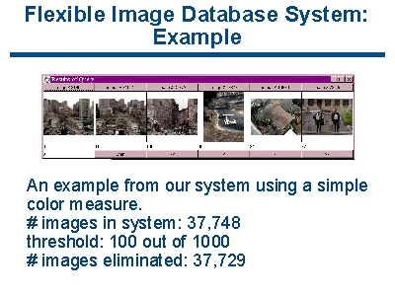
Andy Berman’s FIDS System:

Slide 28
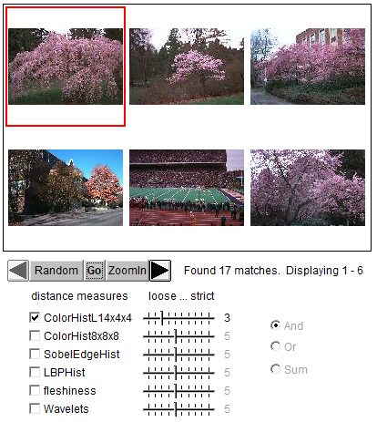
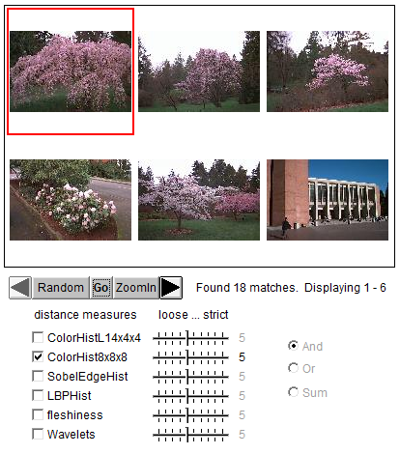
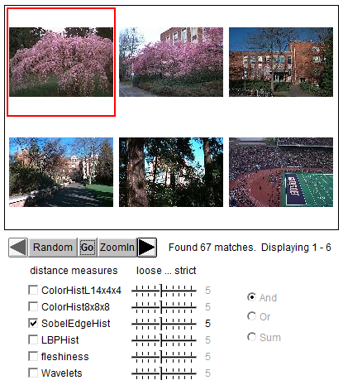
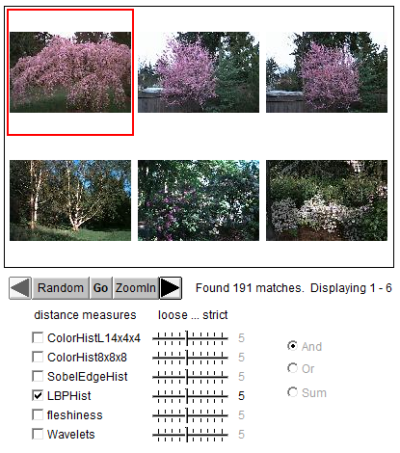
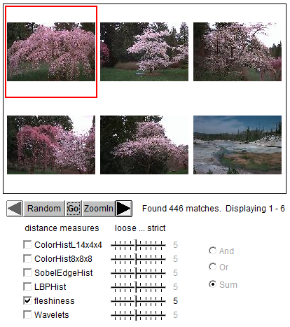
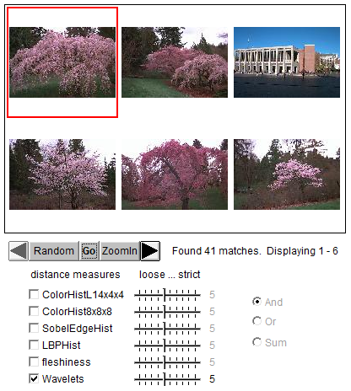
Different Features

Slide 29
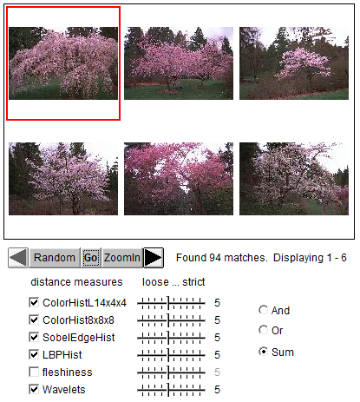
Combined Features

Slide 30
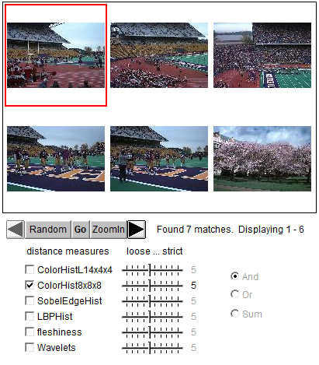
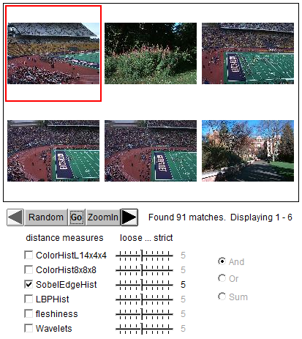
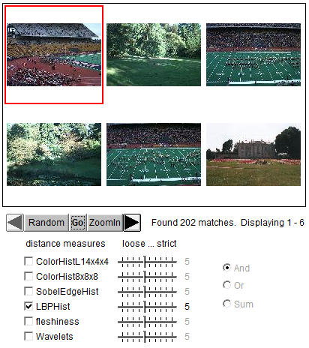
Another example: different features

Slide 31
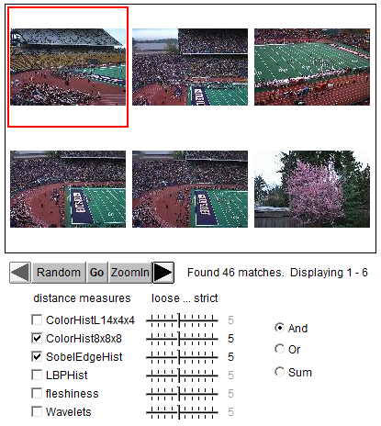
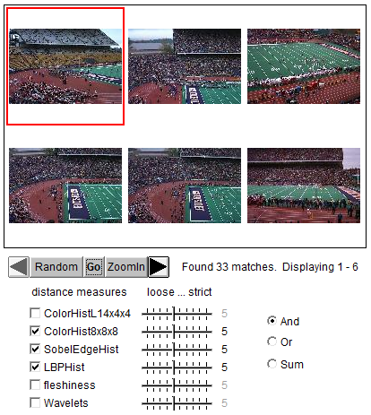
Combined Features

Slide 32
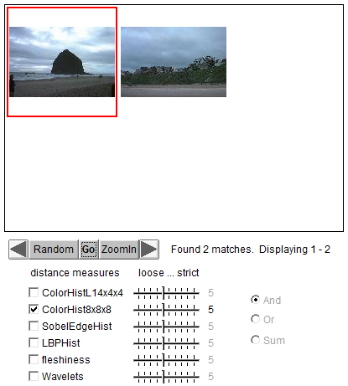
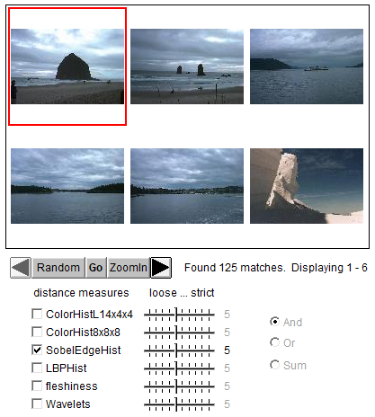
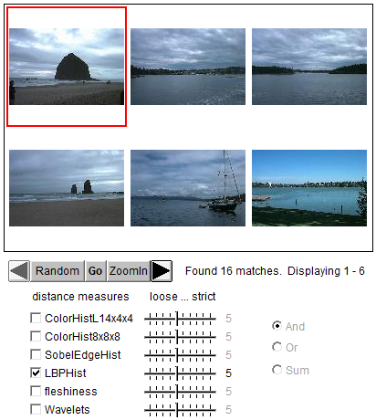
Another example: different features

Slide 33
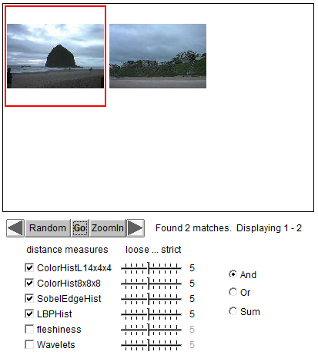
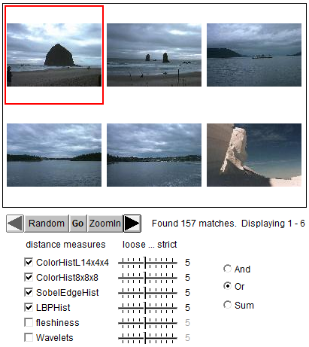
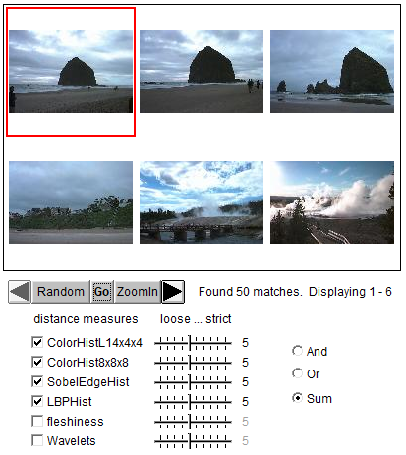
Different ways for combination

Slide 34
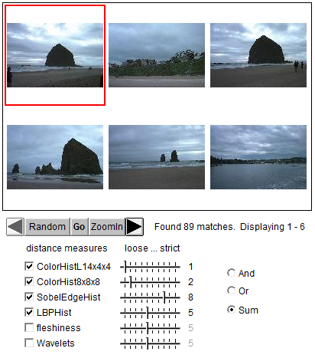
Different weights on features

Slide 35
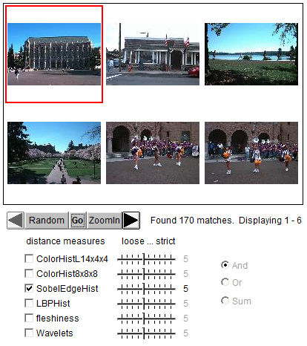
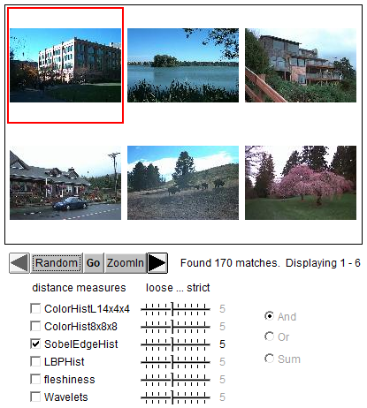

Slide 36
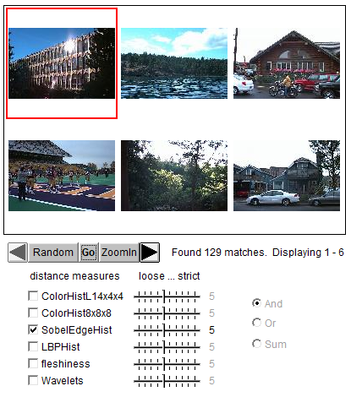
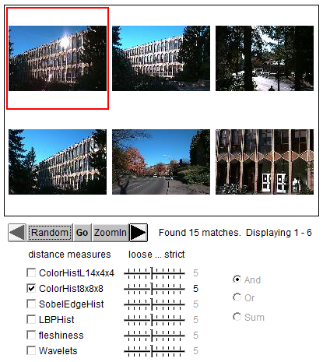

Slide 37
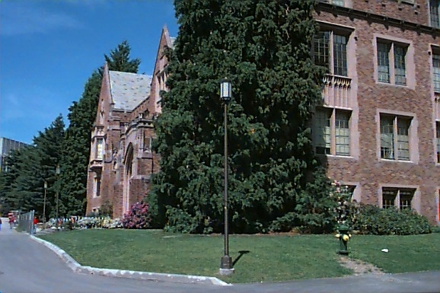
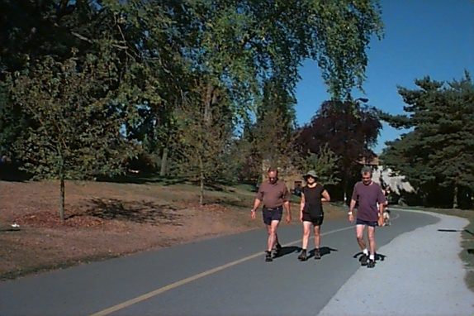
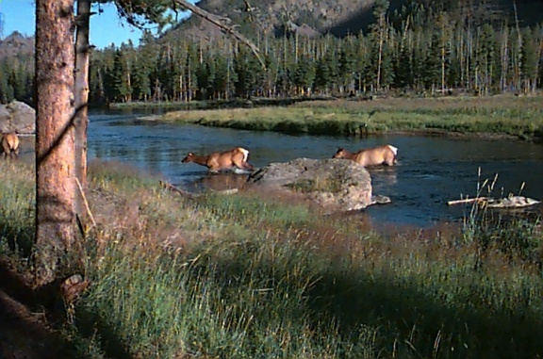
Weakness of Low-level Features
  Can’t capture the high-level concepts

Slide 38
Yi Li’s Overall Approach
Develop object recognizers for common objects
Use these recognizers to design a new set of both
low- and mid-level features
Design a learning system that can use these
features to recognize classes of objects

Slide 39
Building Features:
Consistent Line Clusters (CLC)
A Consistent Line Cluster is a set of lines that are homogeneous in terms of some line features.
  Color-CLC: The lines have the same color feature.
  Orientation-CLC: The lines are parallel to each other or converge to a common vanishing point.
  Spatially-CLC: The lines are in close proximity to each other.

Slide 40
Experimental Evaluation
Object Recognition
  97 well-patterned buildings (bp): 97/97
  44 not well-patterned buildings (bnp): 42/44
  16 not patterned non-buildings (nbnp): 15/16 (one false positive)
  25 patterned non-buildings (nbp): 0/25
CBIR
Notes:
19, 20 , 21, 22

Slide 41
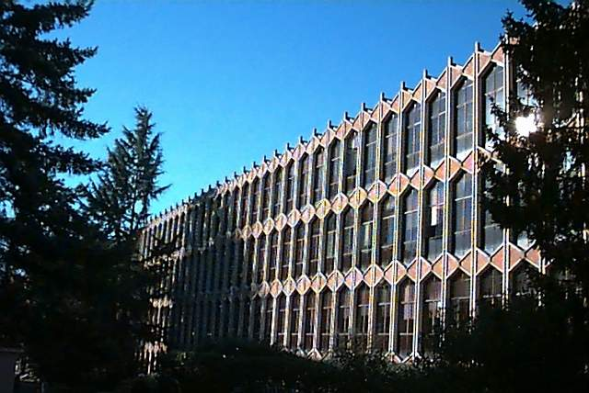
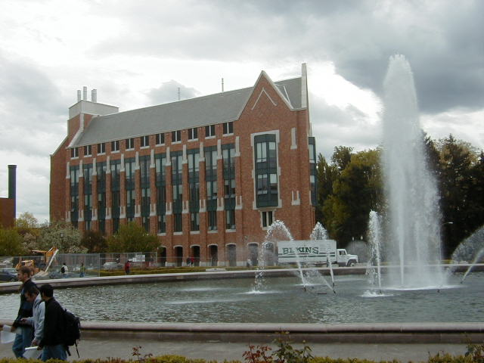
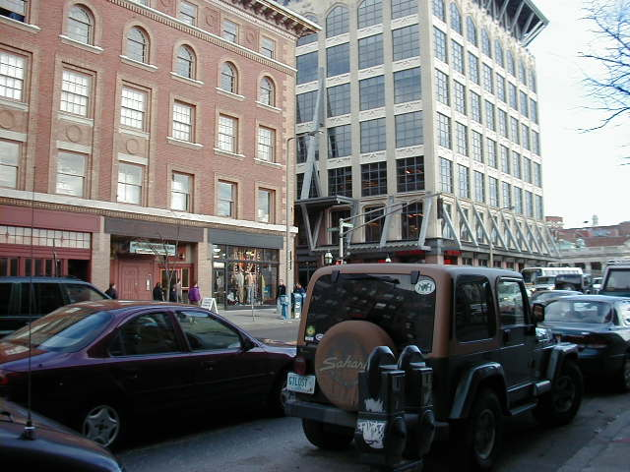
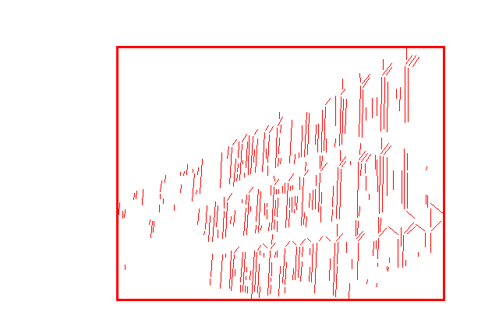

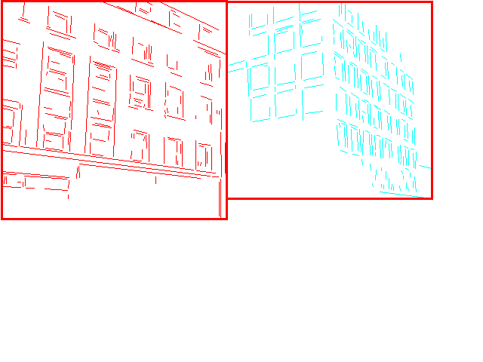
Experimental Evaluation
Well-Patterned Buildings
Notes:
19, 20 , 21, 22

Slide 42
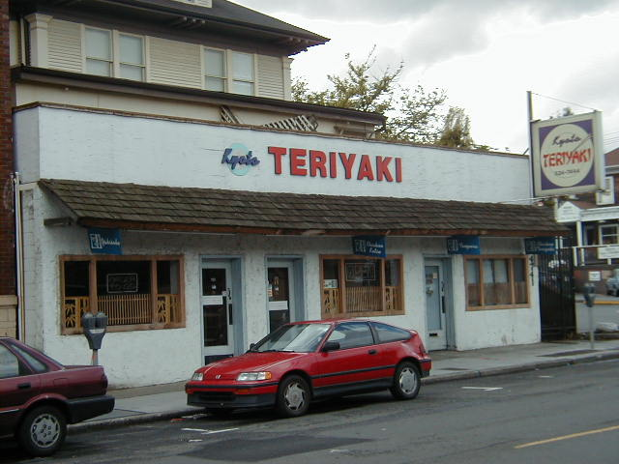
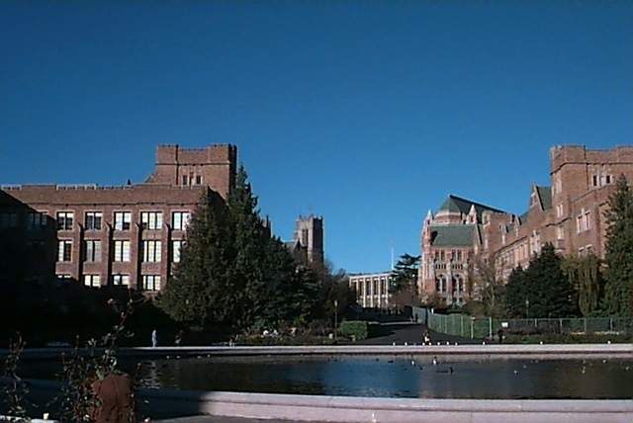
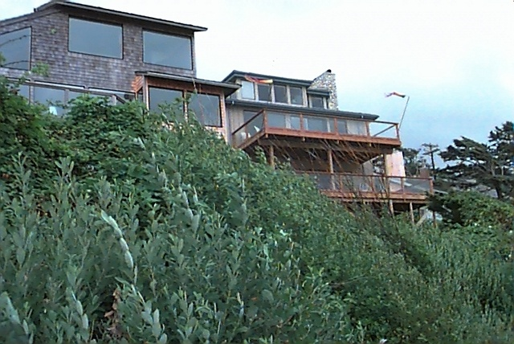
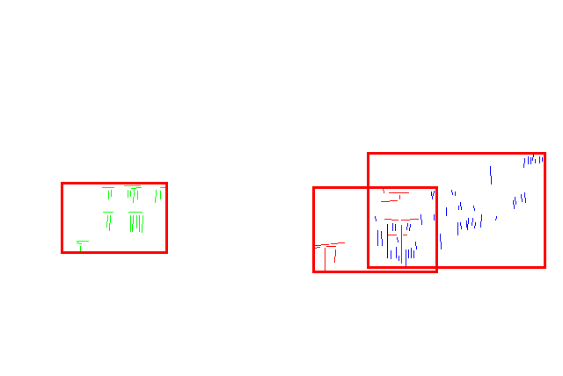


Experimental Evaluation
Non-Well-Patterned Buildings
False negative
False negative
Notes:
19, 20 , 21, 22

Slide 43






Experimental Evaluation
Non-Well-Patterned Non-Buildings
False positive
Notes:
19, 20 , 21, 22

Slide 44






Experimental Evaluation
Well-Patterned Non-Buildings (false positives)
Notes:
19, 20 , 21, 22

Slide 45
Experimental Evaluation (CBIR)
 | Total Positive Classification (#) | Total Negative Classification (#) | False positive (#) | False negative (#) | Accuracy (%)
Arborgreens | 0 | 47 | 0 | 0 | 100
Campusinfall | 27 | 21 | 0 | 5 | 89.6
Cannonbeach | 30 | 18 | 0 | 6 | 87.5
Yellowstone | 4 | 44 | 4 | 0 | 91.7
Notes:
Figure l-4 (false examples)
Figure 23 (false yellowstone)

Slide 46




Experimental Evaluation (CBIR)
False positives from Yellowstone
Notes:
Figure l-4 (false examples)
Figure 23 (false yellowstone)

Slide 47
Machine Learning!
Unsupervised (given the data, no class labels)
Supervised (given data with class labels)
We will look at two unsupervised methods today
  K-means
  EM
We saw that EM was used in Rob Fergus’s work.

Slide 48
Clustering
There are K clusters C₁,…, C_{K} with means m₁,…, m_{K}.
The least-squares error is defined as
Out of all possible partitions into K clusters,
choose the one that minimizes D.
K
2
D = ∑ ∑ || x_{i} - m_{k} || .
k=1 x_{i} ∈ C_{k}
Why don’t we just do this?
If we could, would we get meaningful objects?

Slide 49
K-Means Clustering
Form K-means clusters from a set of n-dimensional vectors
1. Set ic (iteration count) to 1
2. Choose randomly a set of K means m₁(1), …, m_{K}(1).
3. For each vector x_{i} compute D(x_{i} , m_{k}(ic)), k=1,…K
and assign x_{i} to the cluster C_{j} with nearest mean.
4. Increment ic by 1, update the means to get m₁(ic),…,m_{K}(ic).
5. Repeat steps 3 and 4 until C_{k}(ic) = C_{k}(ic+1) for all k.

Slide 50

K-Means Example 1

Slide 51

K-Means Example 2

Slide 52

K-Means Example 3

Slide 53
K-means Variants
Different ways to initialize the means
Different stopping criteria
Dynamic methods for determining the right number of clusters (K) for a given image
The EM Algorithm: a probabilistic formulation

Slide 54

K-Means
Boot Step:
  Initialize K clusters: C₁, …, C_{K}
  Each cluster is represented by its mean m_{j}
Iteration Step:
  Estimate the cluster for each data point
  Re-estimate the cluster parameters
x_{i}
C(x_{i})

Slide 55
K-Means Example

Slide 56
K-Means Example
Where do the red points belong?

Slide 57


K-Means → EM
Boot Step:
  Initialize K clusters: C₁, …, C_{K}
Iteration Step:
  Estimate the cluster of each data point
  Re-estimate the cluster parameters
(μ_{j,} Σ_{j}) and P(C_{j}) for each cluster j.
Expectation
Maximization
For each cluster j

Slide 58
What is a covariance matrix
For a multidimensional distribution of n dimensions (X₁, X₂, … X_{n}):
Its mean µ is a vector µ = (x₁, x₂, …x_{n})
Example: µ = (r, g, b)
Its covariance matrix gives the variances and covariances for pairs of variables:
Σ = a matrix in which Σ_{ii} = σ_{i}² (variance)
and Σ_{ij} = Cov(X_{i},X_{j}) (covariance of two)

Slide 59

1-D EM with Gaussian Distributions
Each cluster C_{j} is represented by a Gaussian distribution N(μ_{j} , σ_{j}).
Initialization: For each cluster C_{j} initialize its mean μ_{j} , variance σ_{j}, and weight α_{j}.
N(μ₁ , σ₁)
α₁ = P(C₁)
N(μ₂ , σ₂)
α₂ = P(C₂)
N(μ₃ , σ₃)
α₃ = P(C₃)

Slide 60
Expectation
For each point x_{i} and each cluster C_{j} compute P(C_{j} | x_{i}).
P(C_{j} | x_{i}) = P(x_{i} | C_{j}) P(C_{j} ) / P(x_{i})
P(x_{i}) = Σ P(x_{i} | C_{j}) P(C_{j})
Where do we get P(x_{i} | C_{j}) and P(C_{j})?
j

Slide 61

Use the pdf for a normal distribution:
Use α_{j} = P(C_{j}) from the current
parameters of cluster C_{j}.

Slide 62



Maximization
Having computed P(C_{j} | x_{i}) for each point x_{i} and each cluster C_{j}, use them to compute new mean, variance, and weight for each cluster.
∑_{j}

Slide 63

Multi-Dimensional Expectation Step for Color Image Segmentation
Input (Known)
Input (Estimation)
Output
x₁={r₁, g₁, b₁}
x₂={r₂, g₂, b₂}
…
x_{i}={r_{i}, g_{i}, b_{i}}
…
Cluster Parameters
(μ₁,Σ₁), p(C₁) for C₁
(μ₂,Σ₂), p(C₂) for C₂
…
(μ_{k},Σ_{k}), p(C_{k}) for C_{k}
Classification Results
p(C₁|x₁)
p(C_{j}|x₂)
…
p(C_{j}|x_{i})
…
+

Slide 64
Multi-dimensional Maximization Step for Color Image Segmentation
Input (Known)
Input (Estimation)
Output
x₁={r₁, g₁, b₁}
x₂={r₂, g₂, b₂}
…
x_{i}={r_{i}, g_{i}, b_{i}}
…
Classification Results
p(C₁|x₁)
p(C_{j}|x₂)
…
p(C_{j}|x_{i})
…
Cluster Parameters
(μ₁,Σ₁), p(C₁) for C₁
(μ₂,Σ₂), p(C₂) for C₂
…
(μ_{k},Σ_{k}), p(C_{k}) for C_{k}
+

Slide 65




Full EM Algorithm
Multi-Dimensional
Boot Step:
  Initialize K clusters: C₁, …, C_{K}
Iteration Step:
  Expectation Step
  Maximization Step
(μ_{j,} Σ_{j}) and P(C_{j}) for each cluster j.

Slide 66
EM Applications
Blobworld: Image segmentation using Expectation-Maximization and its application to image querying
Used both color and texture features with the EM algorithm.

Slide 67








Blobworld: Sample Results

Slide 68
EM Classifier Approach
Object Class Recognition using Images of Abstract Regions
Yi Li, Jeff A. Bilmes, and Linda G. Shapiro
Department of Computer Science and Engineering
Department of Electrical Engineering
University of Washington
Notes:
Our research in the field of CBIR.
Maybe a better title: “Object Class Recognition in CBIR”

Slide 69








Problem Statement
Given: Some images and their corresponding descriptions
•••
{trees, grass, cherry trees}
{cheetah, trunk}
{mountains, sky}
{beach, sky, trees, water}
To solve: What object classes are present in new images
•••
?
?
?
?
Notes:
Remove arrow
Dot!
Our
Give title/description of each system

Slide 70







Image Features for Object Recognition
Color
Texture
Structure
Context

Slide 71










Abstract Regions
Original Images
Color Regions
Texture Regions
Line Clusters
Notes:
Caption!

Slide 72




Abstract Regions
Multiple segmentations whose regions are not labeled;
a list of labels is provided for each training image.
image
various different
segmentations
region
attributes
from several
different
types of
regions
labels
{sky, building}

Slide 73






Model Initial Estimation
Estimate the initial model of an object using all the region features from all images that contain the object
Tree
Sky

Slide 74
EM Classifier: the Idea
Initial Model for “trees”
Final Model for “trees”
EM
Initial Model for “sky”
Final Model for “sky”

Slide 75
EM Algorithm
Start with K clusters, each represented by a probability distribution
Assuming a Gaussian or Normal distribution, each cluster is represented by its mean and variance (or covariance matrix) and has a weight.
Go through the training data and soft-assign it to each cluster. Do this by computing the probability that each training vector belongs to each cluster.
Using the results of the soft assignment, recompute the parameters of each cluster.
Perform the last 2 steps iteratively.

Slide 76
1-D EM with Gaussian Distributions
Each cluster C_{j} is represented by a Gaussian distribution N(μ_{j} , σ_{j}).
Initialization: For each cluster C_{j} initialize its mean μ_{j} , variance σ_{j}, and weight α_{j}.
With no other knowledge, use random means and variances and equal weights.
N(μ₁ , σ₁)
α₁ = P(C₁)
N(μ₂ , σ₂)
α₂ = P(C₂)
N(μ₃ , σ₃)
α₃ = P(C₃)

Slide 77
Standard EM to EM Classifier
That’s the standard EM algorithm.
For n-dimensional data, the variance becomes a co-variance matrix, which changes the formulas slightly.
But we used an EM variant to produce a classifier.
The next slide indicates the differences between what we used and the standard.

Slide 78
EM Classifier
Fixed Gaussian components (one Gaussian per object class) and fixed weights corresponding to the frequencies of the corresponding objects in the training data.
2. Customized initialization uses only the training images that contain a particular object class to initialize its Gaussian.
3. Controlled expectation step ensures that a feature vector only contributes to the Gaussian components representing objects present in its training image.
4. Extra background component absorbs noise.
Gaussian for Gaussian for Gaussian for Gaussian for
trees buildings sky background

Slide 79



1. Initialization Step (Example)
Image & description
I₁
O₁
O₂
I₂
O₁
O₃
I₃
O₂
O₃
W=0.5
W=0.5
W=0.5
W=0.5
W=0.5
W=0.5
W=0.5
W=0.5
W=0.5
W=0.5
W=0.5
W=0.5
Notes:
I use real images with regions. The last histograms mark red, green, blue

Slide 80






2. Iteration Step (Example)
I₁
O₁
O₂
I₂
O₁
O₃
I₃
O₂
O₃
E-Step
W=0.8
W=0.2
W=0.2
W=0.8
W=0.2
W=0.8
W=0.8
W=0.2
W=0.8
W=0.2
W=0.2
W=0.8
M-Step

Slide 81





Recognition
Object Model
Database
Test Image
Color Regions
compare
Tree
Sky
How do you decide if a particular object is in an image?
To calculate p(tree | image)
p( tree| )
f is a function that combines
probabilities from all the color
regions in the image.
e.g. max or mean
p(tree | image) = f
p( tree| )
p( tree| )
p( tree| )

Slide 82
Combining different types of abstract regions: First Try
Treat the different types of regions independently and combine at the time of classification.
1. P(object| a₁, a₂,..,a_{n}) = P(object|a₁)*..*P(object|a_{n})
2. Form intersections of the different types of regions, creating smaller regions that have both color and texture properties for classification.

Slide 83
Experiments (on 860 images)
18 keywords: mountains (30), orangutan (37), track (40), tree trunk (43), football field (43), beach (45), prairie grass (53), cherry tree (53), snow (54), zebra (56), polar bear (56), lion (71), water (76), chimpanzee (79), cheetah (112), sky (259), grass (272), tree (361).
A set of cross-validation experiments (80% as training set and the other 20% as test set)
The poorest results are on object classes “tree,” “grass,” and “water,” each of which has a high variance; a single Gaussian model is insufficient.

Slide 84


ROC Charts:
True Positive vs. False Positive
Independent Treatment of
Color and Texture
Using Intersections of
Color and Texture Regions
Notes:
Add captions
What’s ROC chart?

Slide 85





Sample Retrieval Results
cheetah

Slide 86





Sample Results (Cont.)
grass

Slide 87





Sample Results (Cont.)
cherry tree

Slide 88





Sample Results (Cont.)
lion

Slide 89
Summary
Designed a set of abstract region features: color,
texture, structure, . . .
Developed a new semi-supervised EM-like algorithm to recognize object classes in color photographic images of outdoor scenes; tested on 860 images.
Compared two different methods of combining different types of abstract regions. The intersection method had a higher performance

Slide 90
Weakness of the EM Classifier Approach
It did not generalize well to multiple features
It assumed that object classes could be modeled as Gaussians

