Slide 1
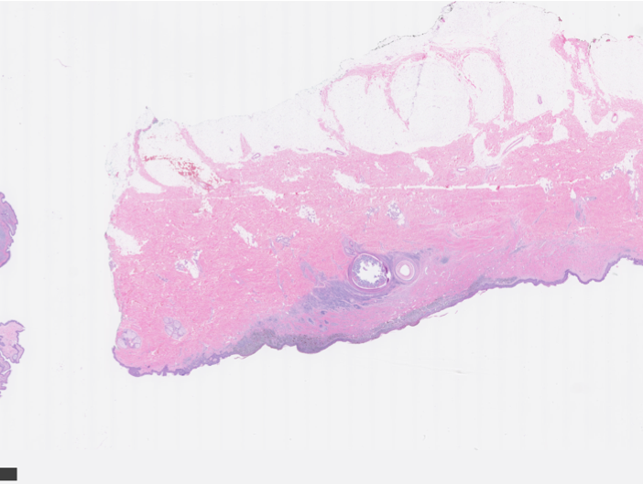
Convolutional Neural Network’s Applications in Skin Cancer Diagnosis
By: Shima Nofallah
Advisor: Prof. Shapiro
Spring 2020

Slide 2
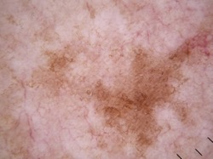
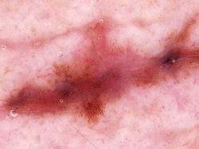
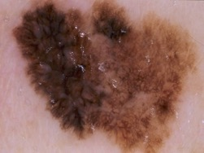
What is Melanoma?

Slide 3
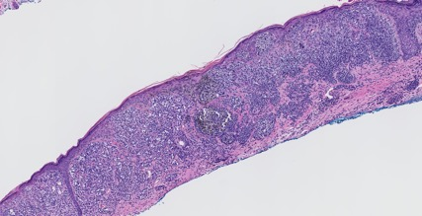
What is Melanoma?
Melanoma is the most aggressive type of skin cancer.
Pathologists look at a skin biopsy slide and determine if its overall structure is normal, abnormal, or malignant.
Diagnostic errors are much more frequently than in other tissues and can lead to under- and over-diagnosis of cancer.
Figure 1. An example of Invasive Melanoma Stage T1b with Hematoxylin and Eosin stain
Notes:
One of the principal stains in histology.

Slide 4
What is Melanoma?
Diagnoses:
Benign
Atypia
Melanoma in situ
Invasive T1a
Invasive T1b
Cellular
entities:
Nuclei
Melanocyte
Mitosis
Structural
entities:
Dermis
Epidermis
Melanocyte nests

Slide 5
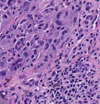


Cellular Level

Slide 6
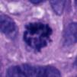
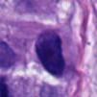
Mitosis Detection
Distinguishing mitoses from normal nuclei is a challenge.
Figure 5. Examples of a sampled Mitosis (Left) and a sampled Nuclei (Right).
Notes:
If the non-mitosis part of the image were to be sampled uniformly, many of non-interesting instances such as background would be in the negative cases, and training a strong classifier would be inefficient.

Slide 7
Preprocessing
Data augmentation:
  Rotations of 45, 90, 135 or 225 degrees.
  Mirroring horizontal and vertical.
The final dataset:
  4364 mitosis samples.
  12640 non-mitosis samples.
Dataset randomly split:
  Training: 60%
  Validation: 20%
  Testing: 20%
Notes:
Mostly non-mitosis

Slide 8
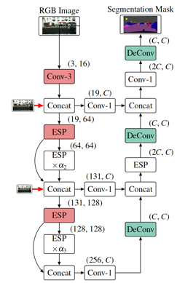
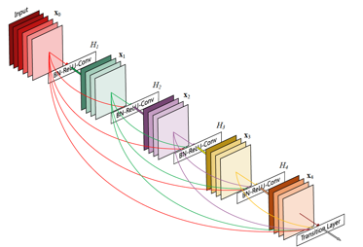
Method and Models

Slide 9
Method and Model
In recent years, with the development of fast and accessible GPUs, Convolutional Neural Networks (CNNs) have dominated computer vision research due to their impressive performance, and mitosis detection is not an exception.
We ran our experiment two separate times on two well-designed CNNs and compared their results:
  Efficient Spatial Pyramid of Dilated Convolutions (ESPNet)
  Densely Connected Convolutional Networks (DenseNet161)

Slide 10
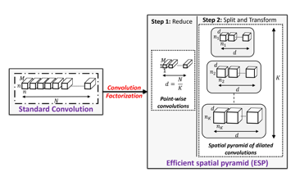
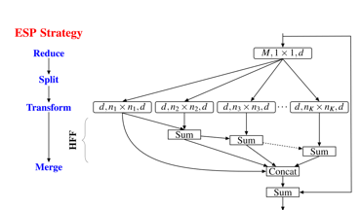
Method and Model
ESPNet
  A fast and efficient convolutional neural network for high resolution inputs.
Figure 7. (Left) Comparing standard convolution and ESP. (Right) Block diagram of ESP module.

Slide 11
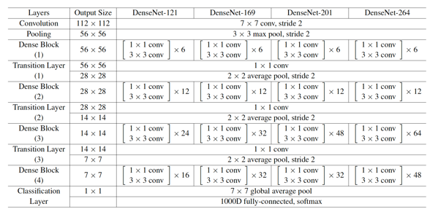
Method and Model
DenseNet:
  Whereas traditional convolutional networks with L layers have L connections—one between each layer and its subsequent layer—the DenseNet network has L(L+1)/2 direct connections.
Figure 8. DenseNet architectures for ImageNet.

Slide 12
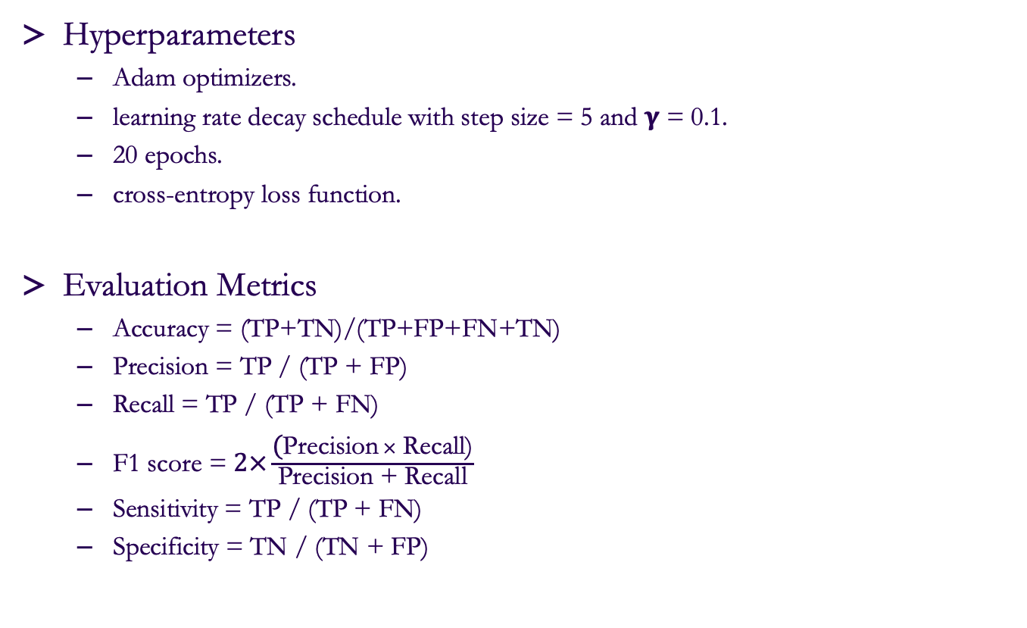
Method and Model
Hyperparameters
  Adam optimizers.
  learning rate decay schedule with step size = 5 and 𝛄 = 0.1.
  20 epochs.
  cross-entropy loss function.
Evaluation Metrics
  Accuracy = (TP+TN)/(TP+FP+FN+TN)
  Precision = TP / (TP + FP)
  Recall = TP / (TP + FN)
  F1 score = $2×\frac{\text{(}\text{Precision} × \text{Recall}\text{)}}{\text{Precision}\text{ + }\text{Recall}}$
  Sensitivity = TP / (TP + FN)
  Specificity = TN / (TN + FP)
Notes:
cross-entropy loss, which increases as the predicted probability diverges from the actual label.

Slide 13

Results

Slide 14
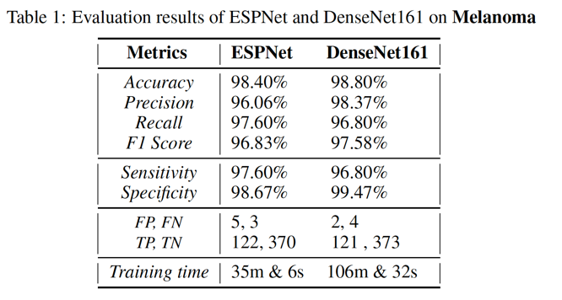
Results
Evaluation results of ESPNet and DenseNet161 on Melanoma
Notes:
Z score: 0.1508
The P-Value is .880133
Not significant

Slide 15
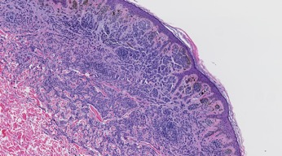
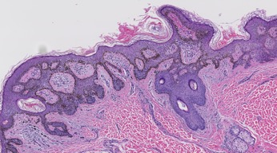
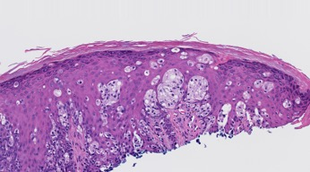
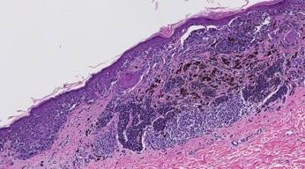
Architectural Level

Slide 16
Dataset
Our dataset comes from 240 H&E stained slides of skin biopsy images, acquired by the University of Washington School of Medicine in the MPATH study (R01 CA151306).
Our dataset contains five different diagnoses:
  1. Benign 2. Atypia 3. Melanoma in Situ
  4. Invasive Melanoma T1a 5. Invasive Melanoma T1b.

Slide 17
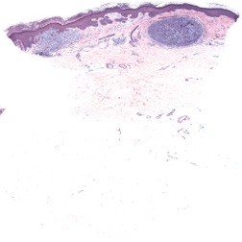
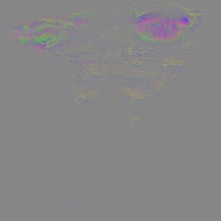
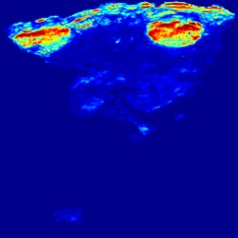
Benign vs. Invasive (1 vs. 5)
Normalized input Gradient Layer 5 heatmap
True Positive (Invasive)

Slide 18
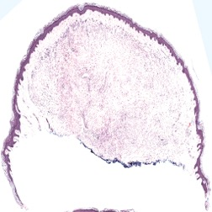

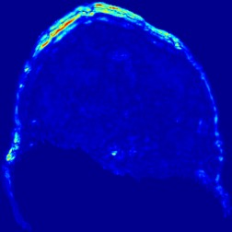
Benign vs. Invasive (1 vs. 5)
Normalized input Gradient Layer 5 heatmap
True Negative (Benign)

Slide 19


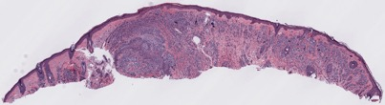
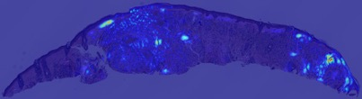


Benign & Atypia vs. Invasive
Atypia
Invasive
Invasive

Slide 20
Latest Results
Class 1 vs. 5
Class 1 &2 vs. 5
Train: 1: 31 slices, 5: 72 slices
Test: 1: 26 slices, 5: 74 slices
Train: 1 & 2: 74 slices, 5: 72 slices
Test: 1 & 2 : 75 slices, 5: 74 slices
 | Accuracy | F1 |  | Precision |  | Recall
1 vs. 5 | Total | 1 | 5 | 1 | 5 | 1 | 5
 | 0.78 | 0.54 | 0.86 | 0.59 | 0.83 | 0.5 | 0.88
1&2 vs. 5 | Total | 1&2 | 5 | 1&2 | 5 | 1&2 | 5
 | 0.819 | 0.83 | 0.81 | 0.80 | 0.84 | 0.85 | 0.78

Slide 21
Thank you for your attention.

