Slide 1
Computer Vision
CSE 455
Stereo and 3D
Linda Shapiro
Professor of Computer Science & Engineering
Professor of Electrical Engineering

Slide 2
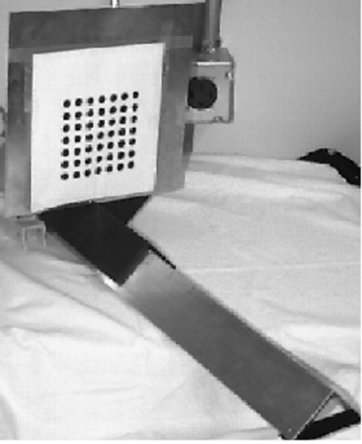
Camera Calibration
The idea is to snap
images at different
depths and get a
lot of 2D-3D point
correspondences.
x1, y1, z1, u1, v1
x2, y2, z1, u2, v2
.
.
xn, yn, zn, un, vn
Then solve a system
of equations to get
camera parameters.

Slide 3

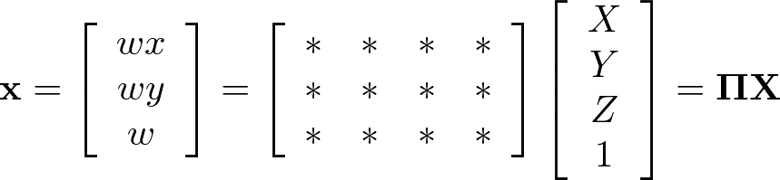




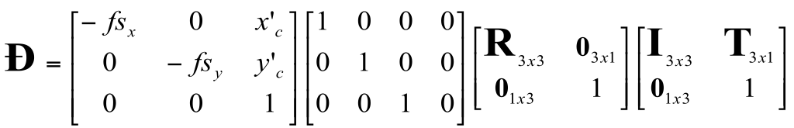
Camera Parameters
A camera is described by several parameters
Translation T of the optical center from the origin of world coords
Rotation R of the image plane
focal length f, principal point (x’_{c}, y’_{c}), pixel size (s_{x}, s_{y})
blue parameters are called “extrinsics,” red are “intrinsics”
Projection equation
The projection matrix models the cumulative effect of all parameters
Useful to decompose into a series of operations
identity matrix
[tx, ty, tz]^{T}
intrinsics
projection
rotation
translation
The definitions of these parameters are not completely standardized
especially intrinsics—varies from one book to another

Slide 4
Stereo

Slide 5
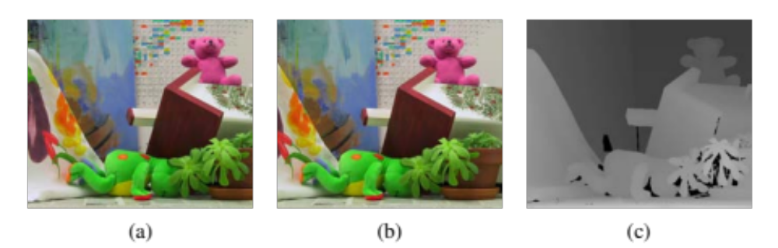

Slide 6
Amount of horizontal movement is …
…inversely proportional to the distance from the camera

Slide 7
Depth from Stereo
Goal: recover depth by finding image coordinate x’ that corresponds to x
X
X
x
z
x
x’
x'
f
f
C
Baseline
B
C’

Slide 8
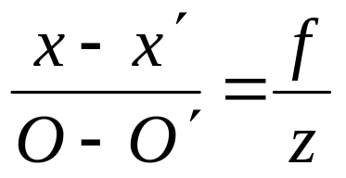
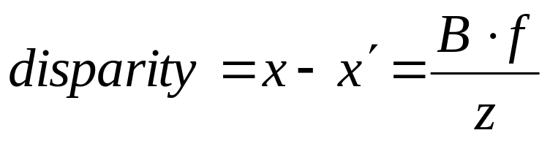
Depth from disparity
X
z
x
x’
f
f
O
Baseline
B
O’
See Chapter 12 of Shapiro and Stockman Text.
Disparity is inversely proportional to depth.

Slide 9
Depth from Stereo
Goal: recover depth by finding image coordinate x’ that corresponds to x
Sub-Problems
  Calibration: How do we recover the relation of the cameras (if not already known)?
  Correspondence: How do we search for the matching point x’?
X
x
x'

Slide 10
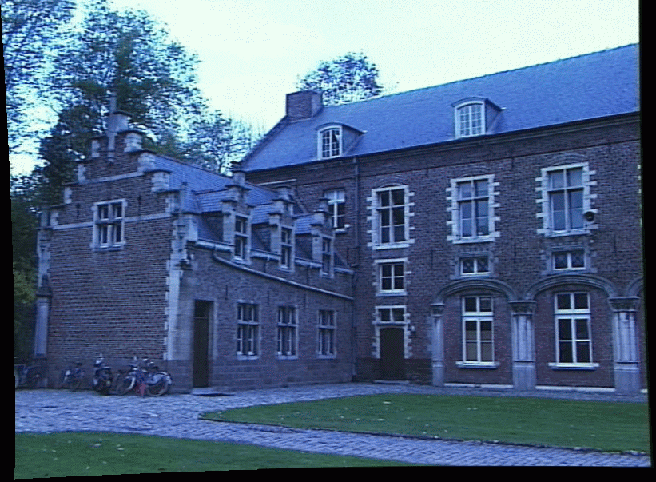
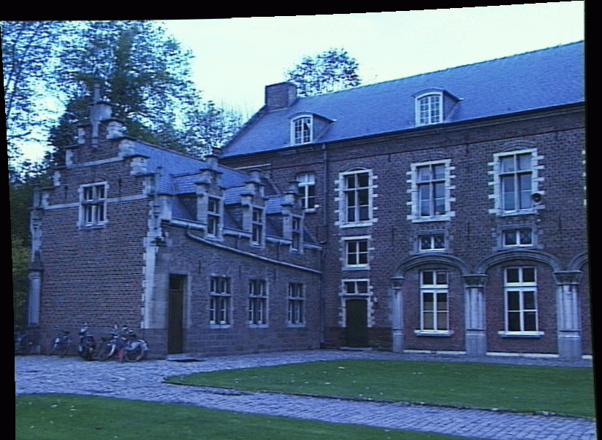
Correspondence Problem
x
?
We have two images taken from cameras with different intrinsic and extrinsic parameters
How do we match a point in the first image to a point in the second? How can we constrain our search?

Slide 11
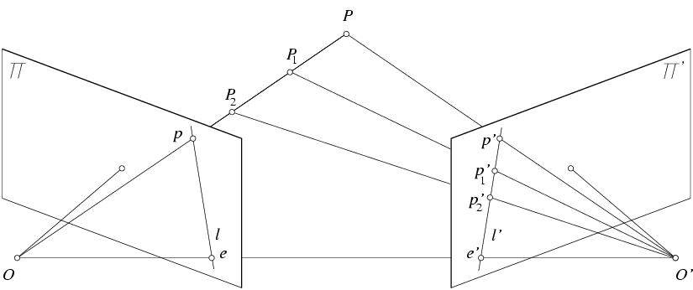
Key idea: Epipolar constraint
X
X
X
x
x’
x’
x’
Potential matches for x have to lie on the corresponding line l’.
Potential matches for x’ have to lie on the corresponding line l.

Slide 12
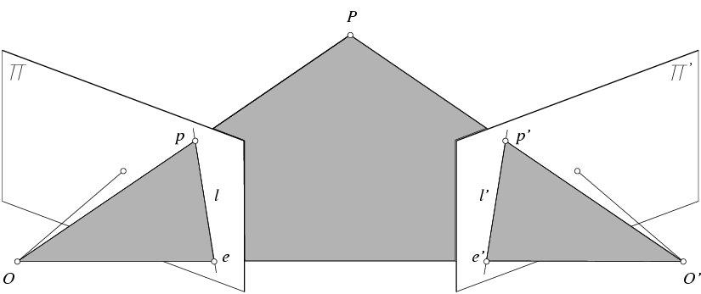
Epipolar geometry: notation
X
x
x’
Baseline – line connecting the two camera centers
Epipoles
= intersections of baseline with image planes
= projections of the other camera center
Epipolar Plane – plane containing baseline (1D family)

Slide 13
Epipolar geometry: notation
X
x
x’
Baseline – line connecting the two camera centers
Epipoles
= intersections of baseline with image planes
= projections of the other camera center
Epipolar Plane – plane containing baseline (1D family)
Epipolar Lines - intersections of epipolar plane with image
planes (always come in corresponding pairs)

Slide 14
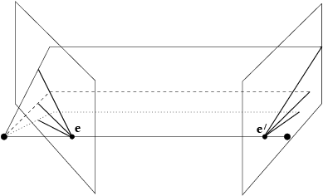
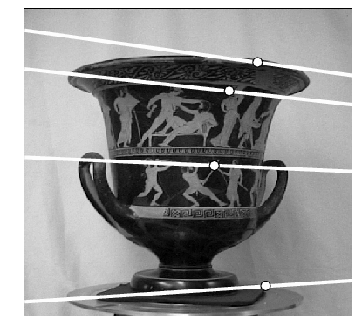
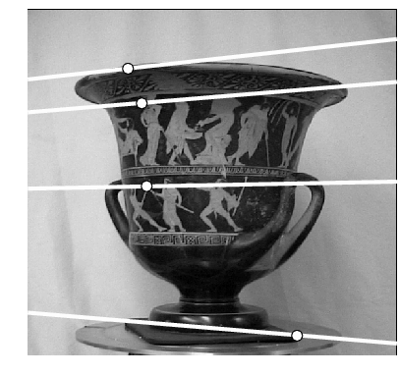
Example: Converging cameras

Slide 15
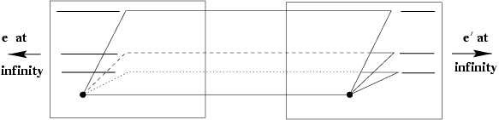
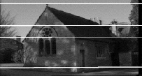
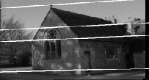
Example: Motion parallel to image plane

Slide 16
Epipolar constraint: Calibrated case
X
x
x’
Assume that the intrinsic and extrinsic parameters of the cameras are known
We can multiply the projection matrix of each camera (and the image points) by the inverse of the calibration matrix to get normalized image coordinates
We can also set the global coordinate system to the coordinate system of the first camera. Then the projection matrices of the two cameras can be written as [I | 0] and [R | t]

Slide 17
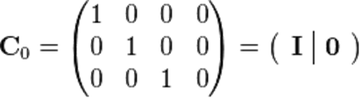

Simplified Matrices for the 2 Cameras
= (R | T)

Slide 18
Epipolar constraint: Calibrated case
X
= (x,1)^{T}
x
x’ = Rx+t
t
R
The vectors Rx, t, and x’ are coplanar
Notes:
X’ is X in the second camera’s coordinate system
We can identify the non-homogeneous 3D vectors X and X’ with the homogeneous coordinate vectors x and x’ of the projections of the two points into the two respective images

Slide 19


Epipolar constraint: Calibrated case
X
x
x’
Essential Matrix E
(Longuet-Higgins, 1981)
The vectors Rx, t, and x’ are coplanar

Slide 20
Epipolar constraint: Calibrated case
X
x
x’
E x is the epipolar line associated with x (l' = E x)
E^{T}x' is the epipolar line associated with x' (l = E^{T}x')
E e = 0 and E^{T}e' = 0
E is singular (rank two)
E has five degrees of freedom

Slide 21
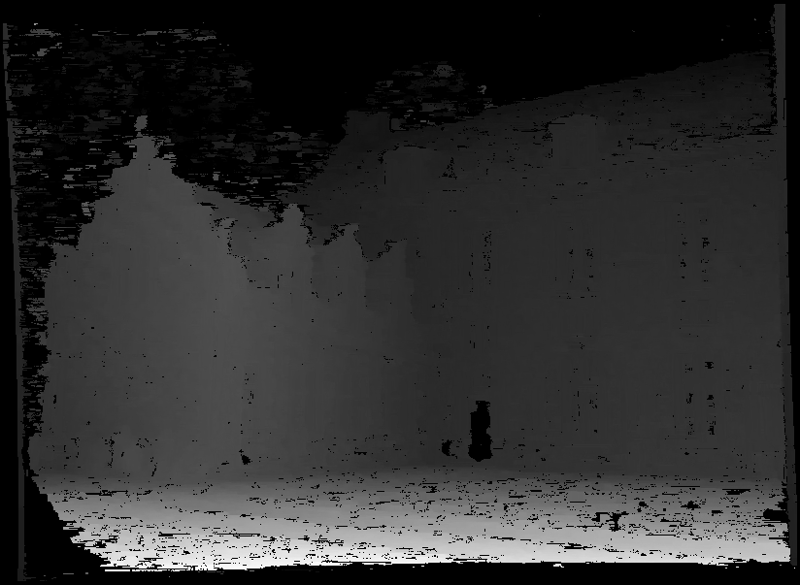
Moving on to stereo…
Fuse a calibrated binocular stereo pair to produce a depth image
image 1
image 2
Dense depth map
Many of these slides adapted from Steve Seitz and Lana Lazebnik

Slide 22
Stereo image rectification
Reproject image planes onto a common plane parallel to the line between camera centers
Pixel motion is horizontal after this transformation
Two homographies (3x3 transform), one for each input image reprojection
C. Loop and Z. Zhang. Computing Rectifying Homographies for Stereo Vision. IEEE Conf. Computer Vision and Pattern Recognition, 1999.

Slide 23
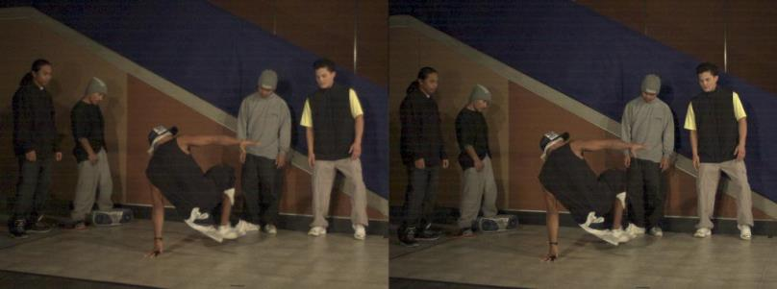
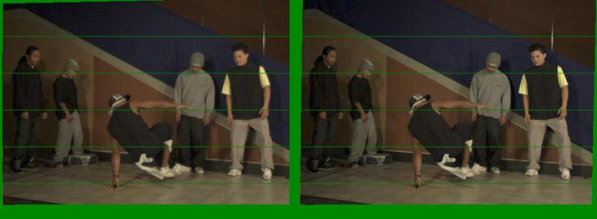
Example
Unrectified
Rectified

Slide 24
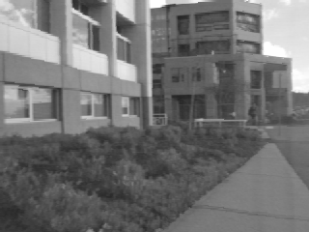
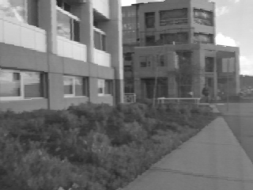
Left
Right
scanline
Matching cost
disparity
Slide a window along the right scanline and compare contents of that window with the reference window in the left image
Matching cost: SSD, SAD, or normalized correlation

Slide 25
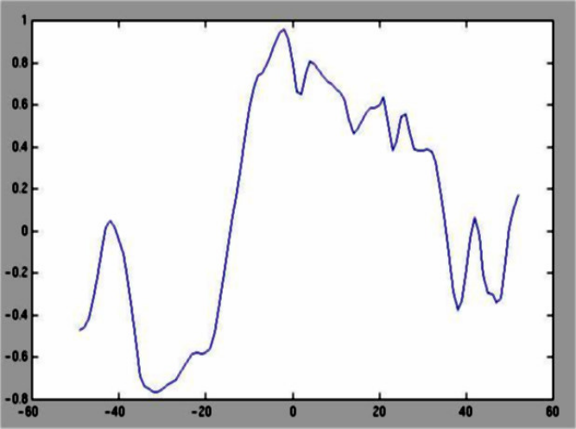
Correspondence search
Left
Right
scanline
Norm. corr

Slide 26
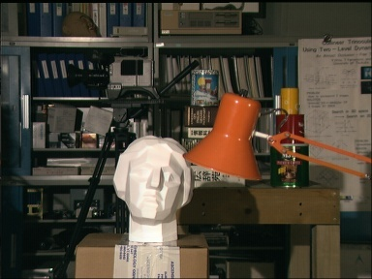
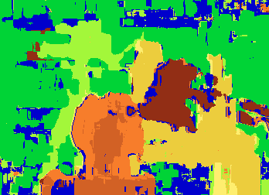

Results with window search
Data
Window-based matching
Ground truth

Slide 27
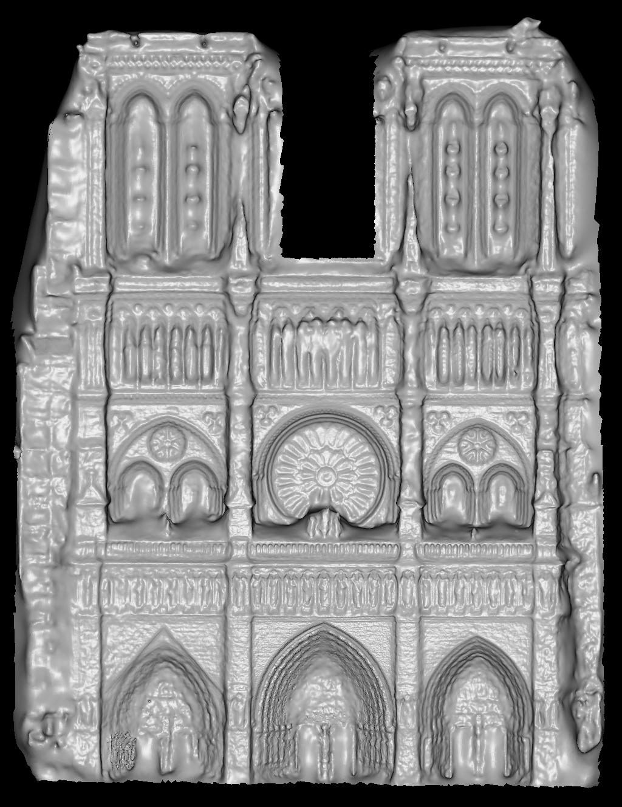
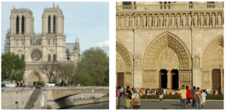
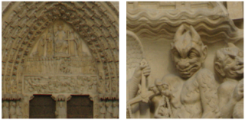
Using more than two images
Multi-View Stereo for Community Photo Collections
M. Goesele, N. Snavely, B. Curless, H. Hoppe, S. Seitz
Proceedings of ICCV 2007,

Slide 28
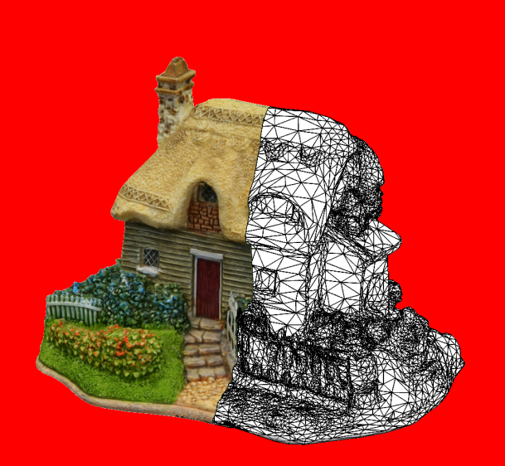
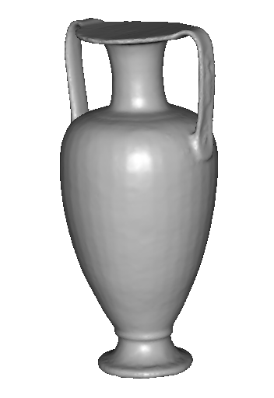
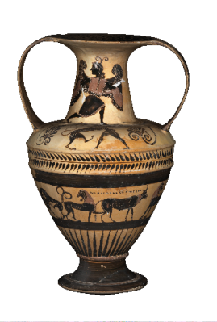
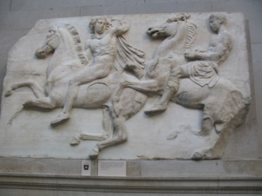
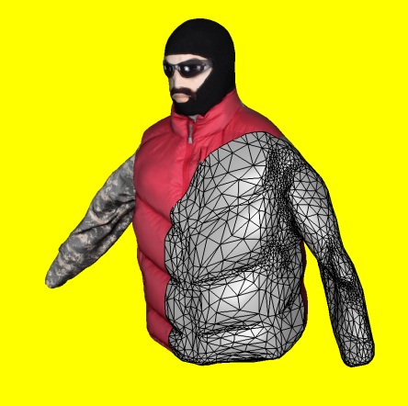
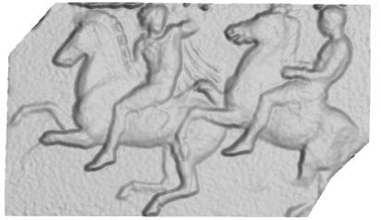
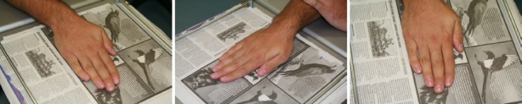
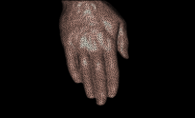
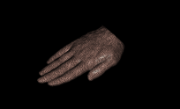
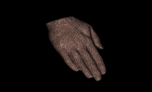
3D model
“Digital copy” of real object
Allows us to
  Inspect details of object
  Measure properties
  Reproduce in different material
Many applications
  Cultural heritage preservation
  Computer games and movies
  City modelling
  E-commerce

Slide 29
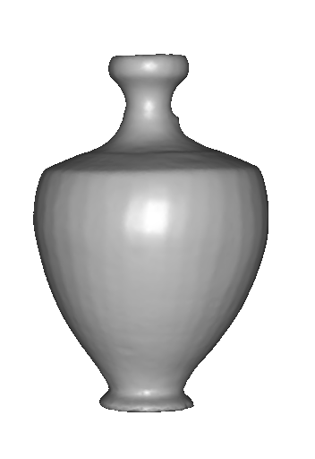
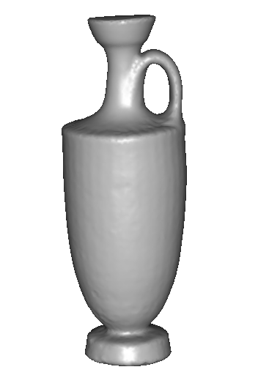
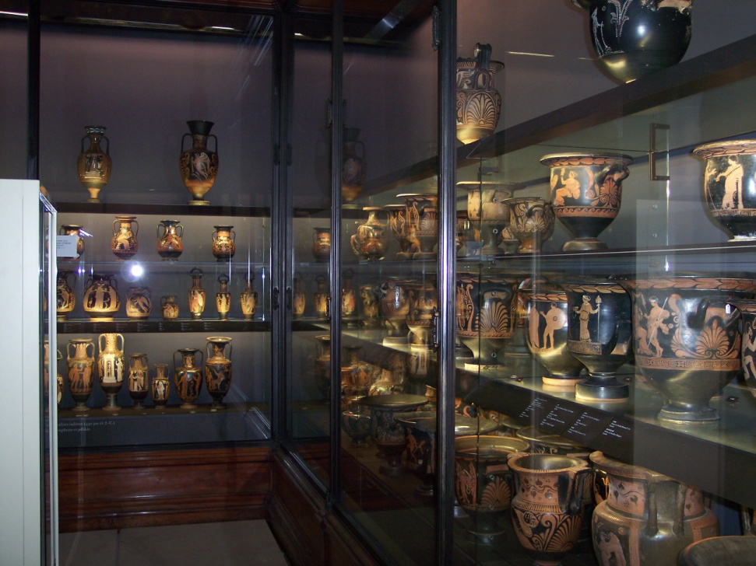
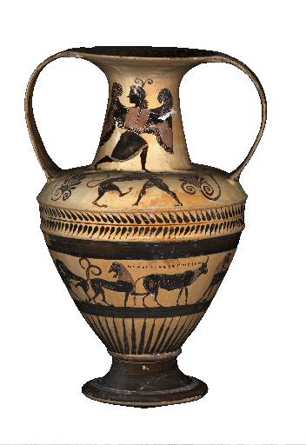
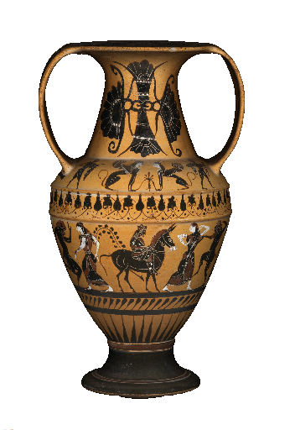
Applications: cultural heritage
SCULPTEUR European project
Notes:
To sum up,

Slide 30
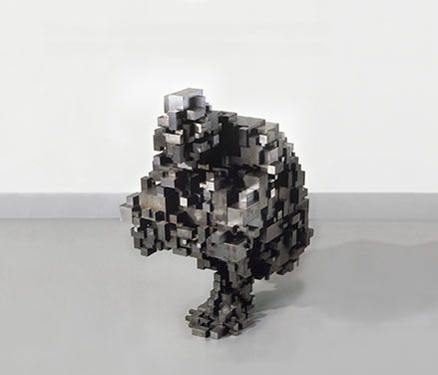
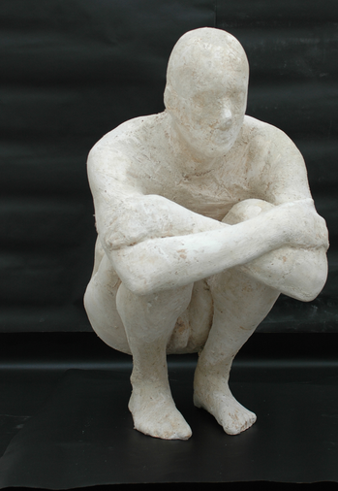
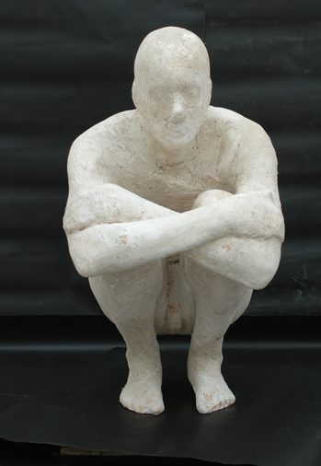
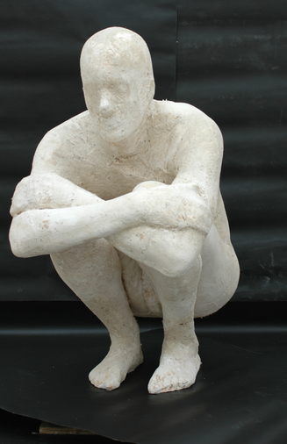
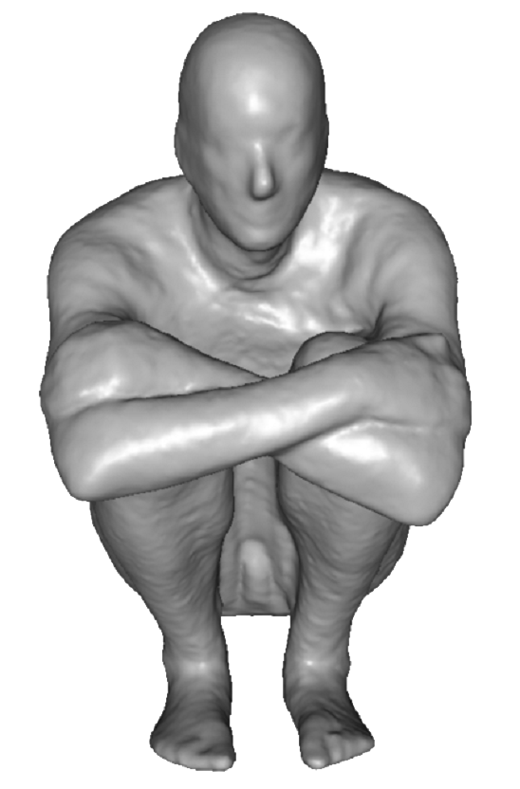
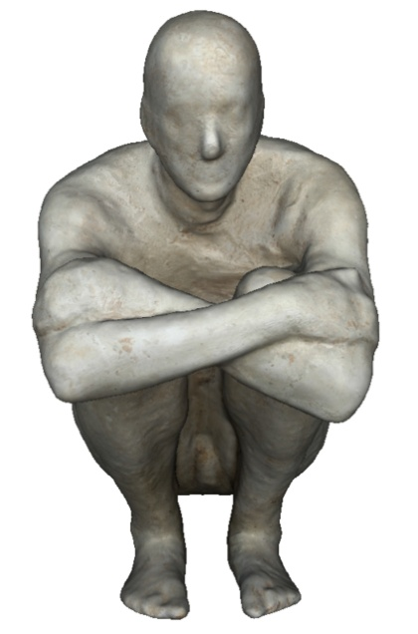
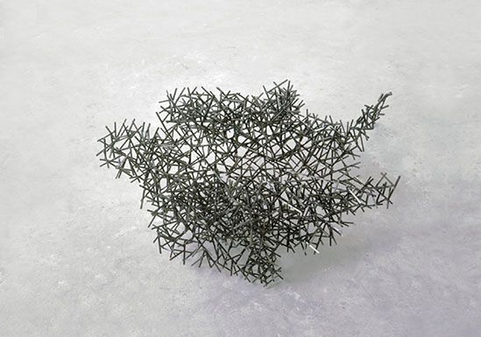
Applications: art
Block Works Precipitate III 2004
Mild steel blocks 80 x 46 x 66 cm
Domain Series Domain VIII Crouching
1999 Mild steel bar 81 x 59 x 63 cm

Slide 31


Applications: structure engineering
BODY / SPACE / FRAME, Antony Gormley, Lelystad, Holland
Notes:
To sum up,

Slide 32








Applications: 3D indexation
? ?
? ? ?
?
? ?
?
SCULPTEUR European project
medical, industrial and cultural heritage indexation

Slide 33


Applications: archaeology
“forma urbis romae” project
Fragments of the City: Stanford's Digital Forma Urbis Romae Project
David Koller, Jennifer Trimble, Tina Najbjerg, Natasha Gelfand, Marc Levoy
Proc. Third Williams Symposium
on Classical Architecture,
Journal of Roman Archaeology
supplement, 2006.
1186 fragments

Slide 34




Applications: large scale modelling
[Furukawa10]
[Pollefeys08]
[Cornelis08]
[Goesele07]

Slide 35



Applications: Medicine

Slide 36



Scanning technologies
Laser scanner, coordinate measuring machine
  Very accurate
  Very Expensive
  Complicated to use
Minolta
“Michelangelo” project
Contura CMM

Slide 37


Medical Scanning System

Slide 38








The “Us” Data Set (subset)

Slide 39


3d shape from photographs
“Estimate a 3d shape that would generate the input photographs given the same material, viewpoints and illumination”
viewpoint
?
geometry
material
illumination
image

Slide 40
Photometric Stereo
Estimate the surface normals of a given scene given multiple 2D images taken from the same viewpoint, but under different lighting conditions.
Basic photometric stereo required a Lambertian reflectance model:
I = ρ n · v
where I is pixel intensity, n is the normal, v is the lighting direction, and ρ is diffuse albedo constant, which is a reflection coefficient.

Slide 41

Basic Photometric Stereo

Slide 42

Basic Photometric Stereo

Slide 43
Basic Photometric Stereo
K light sources
Lead to K images R₁(p,q), ...,R_{K}(p,q) each from just one of the light sources being on
For any (p,q), we get K intensities I₁,...I_{K}
Leads to a set of linear equations of the form
I_{k} = ρn•v_{k}
Solving leads to a surface normal map.

Slide 44


Photometric Stereo
Inputs
3D normals

Slide 45
3d shape from photographs
Photograph based 3d reconstruction is:
  practical
  fast
  non-intrusive
  low cost
  Easily deployable outdoors
  “low” accuracy
  Results depend on material properties

Slide 46



Reconstruction
Generic problem formulation: given several images of the same object or scene, compute a representation of its 3D shape

Slide 47
Reconstruction
Generic problem formulation: given several images of the same object or scene, compute a representation of its 3D shape
“Images of the same object or scene”
  Arbitrary number of images (from two to thousands)
  Arbitrary camera positions (camera network or video sequence)
  Calibration may be initially unknown
“Representation of 3D shape”
  Depth maps
  Meshes
  Point clouds
  Patch clouds
  Volumetric models
  Layered models

Slide 48




Multiple-baseline stereo
I1
I2
I10
M. Okutomi and T. Kanade, “A Multiple-Baseline Stereo System,” IEEE Trans. on Pattern Analysis and Machine Intelligence, 15(4):353-363 (1993).

Slide 49







Reconstruction from silhouettes
Can be computed robustly
Can be computed efficiently
background
+
foreground
background
foreground
-
=

Slide 50
Reconstruction from Silhouettes
The case of binary images: a voxel is photo-consistent if it lies inside the object’s silhouette in all views
Binary Images

Slide 51
Reconstruction from Silhouettes
The case of binary images: a voxel is photo-consistent if it lies inside the object’s silhouette in all views
voxel space
Binary Images
Finding the silhouette-consistent shape (visual hull):
  Backproject each silhouette
  Intersect backprojected volumes

Slide 52





Calibrated Image Acquisition
Selected Dinosaur Images
Calibrated Turntable
360° rotation (21 images)
Selected Flower Images

Slide 53
Space Carving in General
Image 1
Image N
…...
Space Carving Algorithm
  Initialize to a volume V containing the true scene
  Choose a voxel on the outside of the volume
  Project to visible input images
  Carve if not photo-consistent (inside object’s silhouette)
K. N. Kutulakos and S. M. Seitz, A Theory of Shape by Space Carving, ICCV 1999

Slide 54

Our 4-camera light-striping stereo system
(now deceased)
cameras
projector
rotation
table
3D
object

Slide 55

Calibration Object
The idea is to snap
images at different
depths and get a
lot of 2D-3D point
correspondences.

Slide 56


Slide 57


Slide 58


Slide 59


Slide 60
3D space is made up of many cubes.
image plane
depth map
(u,v,d)
(
(x,y,z)
one of many cubes
in virtual 3D cube space
OUTSIDE

Slide 61


Slide 62


Slide 64


Slide 65


Slide 66


Slide 67


Slide 68


Slide 69




More: Space Carving Results: African Violet
Input Image (1 of 45)
Reconstruction
Reconstruction
Reconstruction
Source: S. Seitz

Slide 70



More: Space Carving Results: Hand
Input Image
(1 of 100)
Views of Reconstruction

Slide 71


Stereo from community photo collections
Up to now, we’ve always assumed that camera calibration is known
For photos taken from the Internet, we need structure from motion techniques to reconstruct both camera positions and 3D points.

Slide 72




Slide 73


Head Reconstruction from Uncalibrated Internet Photos
Input: Internet photos in different poses and expressions
Output: 3D model of the head
work of
Shu Liang

Slide 74
Recognizing Deformable Shapes
Salvador Ruiz Correa
(CSE/EE576 Computer Vision I)

Slide 75


Goal
We are interested in developing algorithms for recognizing and classifying deformable object shapes from range data.
3-D Output
Surface Mesh
3-D Laser Scanner
Range
data
Post-
processing
Input
3-D
Object
(Cloud of
3-D points)
This is a difficult problem that is relevant in several application fields.

Slide 76
















What Kind Of Deformations?
Neurocranium
Normal
Mandibles
Abnormal
Normal
Toy animals
Abnormal
3-D Faces
Shape classes: significant
amount of intra-class variability

Slide 77
Component-Based Methodology
1
Numeric
Signatures
Overcomes the limitations
of the alignment-verification
approach
define
2
Components
4
Describe
spatial
configuration
Architecture
of
Classifiers
Recognition And Classification Of
Deformable Shapes
+
3
Symbolic
Signatures

Slide 78
Numeric Signatures
Numeric
Signatures
1
Encode Local
Surface Geometry of an Object
Components
2
4
Architecture
of
Classifiers
+
Symbolic
Signatures
3

Slide 79
The Spin Image Signature
P is the selected vertex.
X is a contributing point
of the mesh.
α is the perpendicular distance from X to P’s surface normal.
β is the signed perpendicular distance from X to P’s tangent plane.
X
n
β
P
α
tangent plane at P

Slide 80
Spin Image Construction
A spin image is constructed
- about a specified oriented point o of the object surface
- with respect to a set of contributing points C, which is
controlled by maximum distance and angle from o.
It is stored as an array of accumulators S(α,β) computed via:
For each point c in C(o)
1. compute α and β for c.
2. increment S (α,β)
o

Slide 81










Numeric Signatures: Spin Images
P
3-D faces
Spin images for point P
Rich set of surface shape descriptors.
Their spatial scale can be modified to include local and non-local surface features.
Representation is robust to scene clutter and occlusions.

Slide 82
Components
Numeric
Signatures
1
define
Components
2
Equivalent Numeric Signatures:
Encode Local Geometry
of a Shape Class
4
Architecture
of
Classifiers
+
Symbolic
Signatures
3

Slide 83




How To Extract Shape Class Components?
…
Training Set
Select
Seed
Points
Compute
Numeric
Signatures
Region
Growing
Algorithm
Component
Detector
…
Grown components
around seeds

Slide 84


Component Extraction Example
Selected 8 seed
points by hand
Labeled
Surface Mesh
Region
Growing
Grow one region at the time
(get one detector
per component)
Detected
components on a
training sample

Slide 85




How To Combine Component Information?
1
…
2
2
2
1
2
2
1
2
2
1
4
3
5
6
7
8
Extracted components on test samples
Note: Numeric signatures are invariant to mirror symmetry;
our approach preserves such an invariance.

Slide 86
Symbolic Signatures
Numeric
Signatures
1
Components
2
4
Architecture
of
Classifiers
Encode Geometrical
Relationships
Among Components
+
Symbolic
Signatures
3

Slide 87

Symbolic Signature
Labeled
Surface Mesh
Symbolic
Signature at P
Critical
Point P
Encode
Geometric
Configuration
4
3
5
8
7
6
Matrix storing component
labels

Slide 88





Symbolic Signatures Are Robust
To Deformations
P
4
3
4
3
3
3
4
3
4
4
5
5
5
5
5
8
8
8
8
8
6
7
6
7
6
7
6
7
6
7
Relative position of components is stable across deformations: experimental evidence

Slide 89
Architecture of Classifiers
Numeric
Signatures
1
Learns Components
And Their
Geometric Relationships
Components
2
4
+
Architecture
of
Classifiers
Symbolic
Signatures
3

Slide 90

Proposed Architecture
Verify spatial configuration
of the components
Identify
Components
Identify
Symbolic
Signatures
Input
Class
Label
Labeled
Mesh
-1
(Abnormal)
Surface
Mesh
Two classification stages

Slide 91


Experimental Validation
Recognition Tasks: 4 (T1 - T4)
Classification Tasks: 3 (T5 – T7)
No. Experiments: 5470
Rotary Table
Setup
Laser
Recognition
Classification

Slide 92

Shape Classes

Slide 93






Enlarging Training Sets Using Virtual Samples
Displacement
Vectors
Morphs
Original
Twist (5deg)
+ Taper
- Push
+ Spherify (10%)
Originals
Morphs
Push
+Twist (10 deg)
+Scale (1.2)
(14)
Global Morphing
Operators
Physical Modeling
Electrical Engineering
University of Washington

Slide 94
Task 1: Recognizing Single Objects (1)
No. Shape classes: 9.
Training set size: 400 meshes.
Testing set size: 200 meshes.
No. Experiments: 1960.
No. Component detectors:3.
No. Symbolic signature detectors: 1.
Numeric signature size: 40x40.
Symbolic signature size: 20x20.
No clutter and occlusion.

Slide 95



Task 1: Recognizing Single Objects (2)
Snowman: 93%.
Rabbit: 92%.
Dog: 89%.
Cat: 85.5%.
Cow: 92%.
Bear: 94%.
Horse: 92.7%.
Human head: 97.7%.
Human face: 76%.
Recognition rates (true positives)
(No clutter, no occlusion, complete models)

Slide 96
Main Contributions (2)
A region growing algorithm for learning shape class components.
A novel architecture of classifiers for abstracting the geometry of a shape class.
A validation of our methodology in a set of large scale recognition and classification experiments aimed at applications in scene analysis and medical diagnosis.

