Slide 1
Computer Vision
CSE 455
Learning I
Linda Shapiro
Professor of Computer Science & Engineering
Professor of Electrical Engineering

Slide 2
Learning
AI/Vision systems are complex and may have many parameters.
It is impractical and often impossible to encode all the knowledge a system needs.
Different types of data may require very different parameters.
Instead of trying to hard code all the knowledge, it makes sense to learn it.

Slide 3
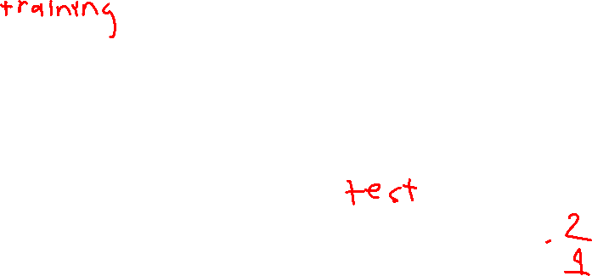
Learning from Observations
Supervised Learning – learn a function from a set of training examples which are preclassified feature vectors.
feature vector class
(shape,color)
(square, red) I
(square, blue) I
(circle, red) II
(circle blue) II
(triangle, red) I
(triangle, green) I
(ellipse, blue) II
(ellipse, red) II
Given a previously unseen
feature vector, what is the
rule that tells us if it is in
class I or class II?
(circle, green) ?
(triangle, blue) ?

Slide 4

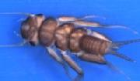
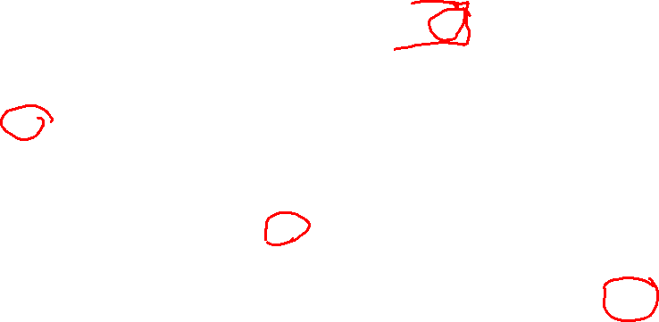
Real Observations
%Training set of Calenouria and Dorenouria
@DATA
0,1,1,0,0,0,0,0,0,1,1,2,3,0,1,2,0,0,0,0,0,0,0,0,1,0,0,1,
0,2,0,0,0,0,1,1,1,0,1,8,0,7,0,0,0,1,0,0,0,0,0,0,0,0,0,0,0,0,1,0,0,
3,3,4,0,2,1,0,1,1,1,0,0,0,0,1,0,0,1,1,cal 0,1,0,0,0,1,0,0,0,4,1,2
,2,0,1,0,0,0,0,0,1,0,0,3,0,2,0,0,1,1,0,0,1,0,0,0,1,0,1,6,1,8,2,0,0,
0,0,1,0,0,0,0,0,0,0,0,0,0,1,1,0,0,1,2,0,5,0,0,0,0,0,0,0,1,3,0,0,0,0,
0,cal
0,0,1,0,1,0,0,1,0,1,0,0,1,0,3,0,1,0,0,2,0,0,0,0,1,3,0,0,0,0,0,0,1,0,
2,0,2,0,1,8,0,5,0,1,0,1,0,1,1,0,0,0,0,0,0,0,0,0,2,2,0,0,3,0,0,2,1,1,
5,0,0,0,2,1,3,2,0,1,0,0,cal 0,0,0,0,0,0,0,0,2,0,0,1,2,0,1,1,0,0,0,1
,0,0,0,0,0,0,0,0,0,1,0,0,0,1,0,0,3,0,0,4,1,8,0,0,0,1,0,0,0,0,0,1,0,1
,0,1,0,0,0,0,0,0,4,2,0,2,1,1,2,1,1,0,0,0,0,2,0,0,2,2,cal
...

Slide 5
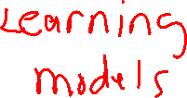
Learning from Observations
Unsupervised Learning – No classes are given. The idea is to find patterns in the data. This generally involves clustering.
Reinforcement Learning – learn from feedback after a decision is made.

Slide 6

Topics to Cover
Inductive Learning
  decision trees
  ensembles
  neural nets
  kernel machines
Unsupervised Learning
  K-Means Clustering
  Expectation Maximization (EM) algorithm

Slide 7
Decision Trees
Theory is well-understood.
Often used in pattern recognition problems.
Has the nice property that you can easily understand the decision rule it has learned.

Slide 8
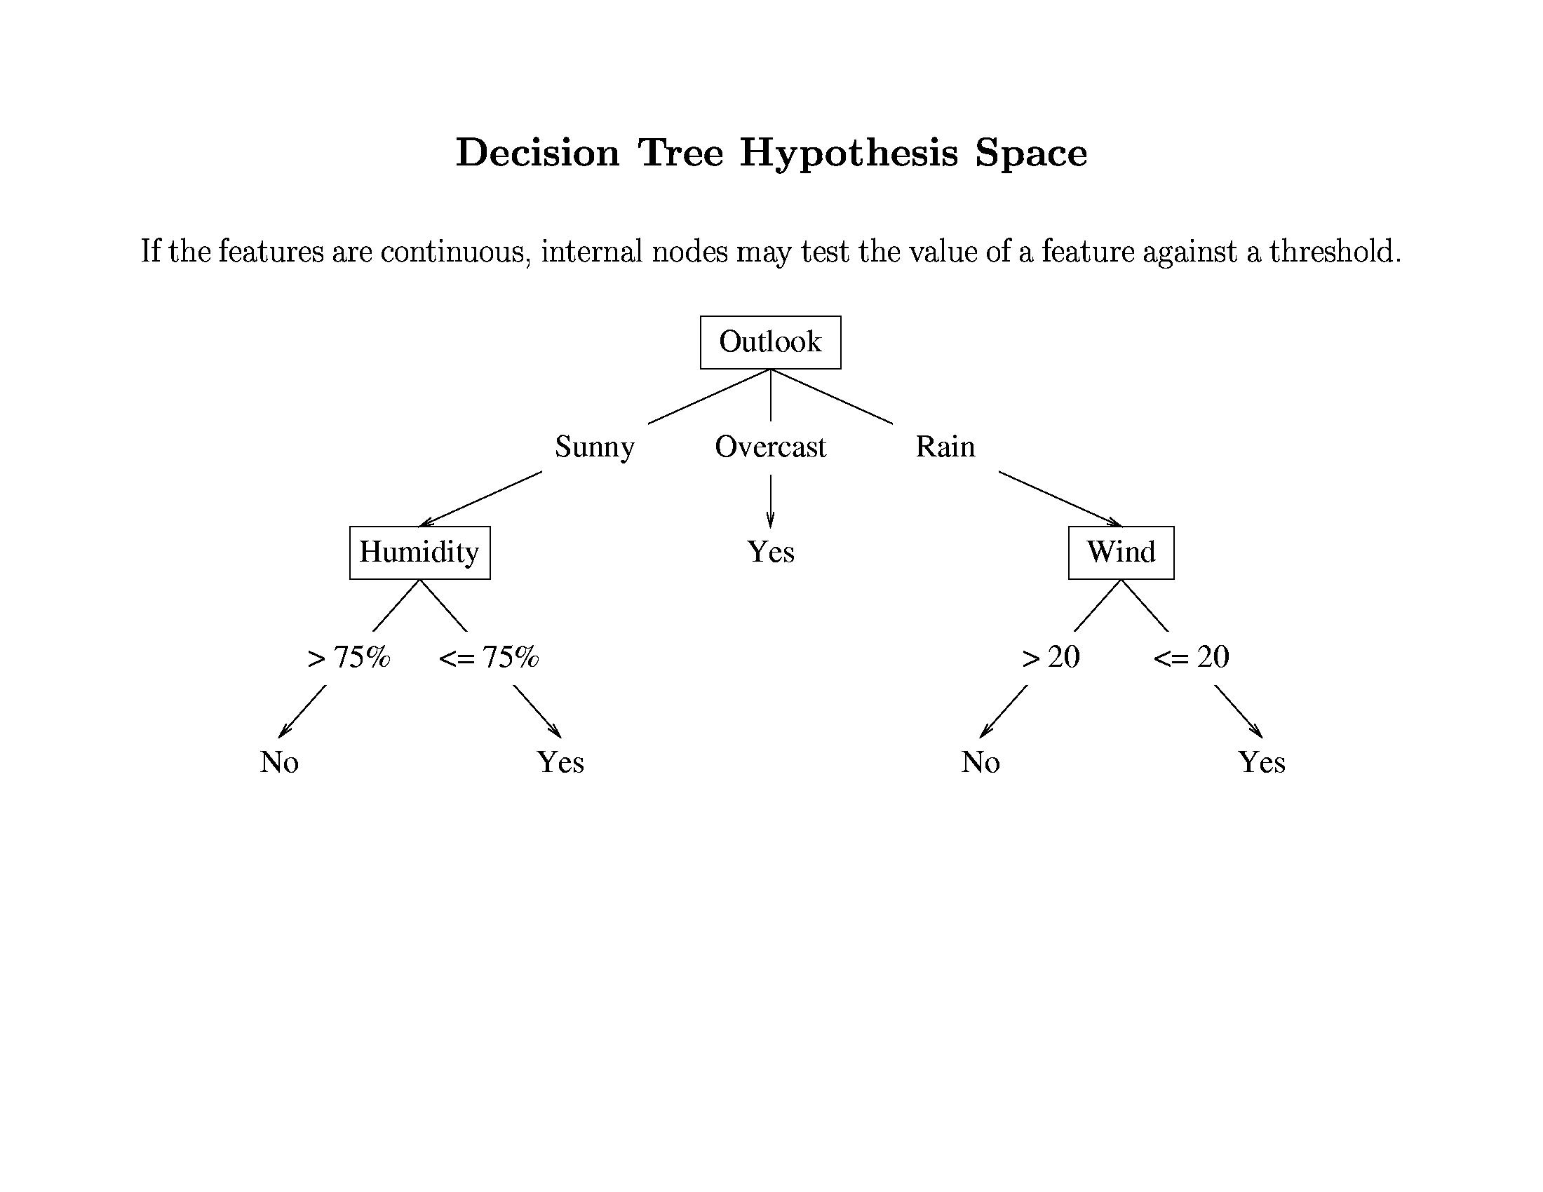
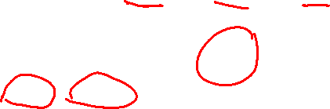
Classic ML example: decision tree for
“Shall I play tennis today?”
from Tom Mitchell’s ML book

Slide 9
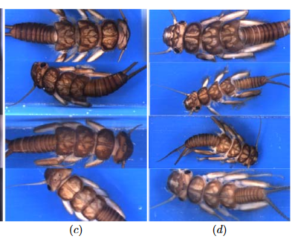
The Stonefly Problem
Calenouria Dorenouria

Slide 10
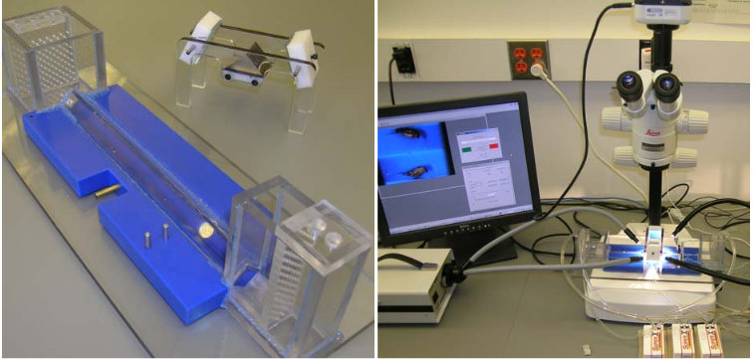
Imaging Setup at OSU
Transportation Apparatus Imaging Setup

Slide 11
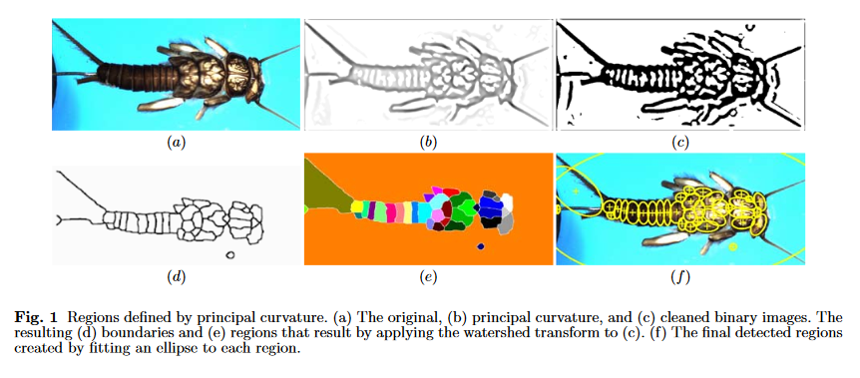
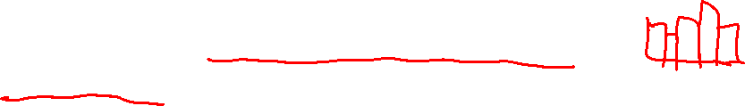
Original Image Analysis
Feature vector: histogram of SIFT descriptors in a
bag of words type of approach.

Slide 12
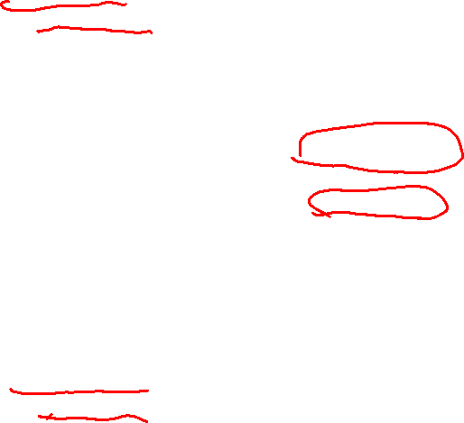
A Real Decision Tree (WEKA)
Dorenouria
part23 < 0.5
| part29 < 3.5
| | part34 < 0.5
| | | part8 < 2.5
| | | | part2 < 0.5
| | | | | part63 < 3.5
| | | | | | part20 < 1.5 : dor (53/12) [25/8]
| | | | | | part20 >= 1.5
| | | | | | | part37 < 2.5 : cal (6/0) [5/2]
| | | | | | | part37 >= 2.5 : dor (3/1) [2/0]
| | | | | part63 >= 3.5 : dor (14/0) [3/0]
| | | | part2 >= 0.5 : cal (21/8) [10/4]
| | | part8 >= 2.5 : dor (14/0) [14/0]
| | part34 >= 0.5 : cal (38/12) [18/4]
| part29 >= 3.5 : dor (32/0) [10/2]
part23 >= 0.5
| part29 < 7.5 : cal (66/8) [35/12]
| part29 >= 7.5
| | part24 < 5.5 : dor (9/0) [4/0]
| | part24 >= 5.5 : cal (4/0) [4/0]
Calenouria

Slide 13
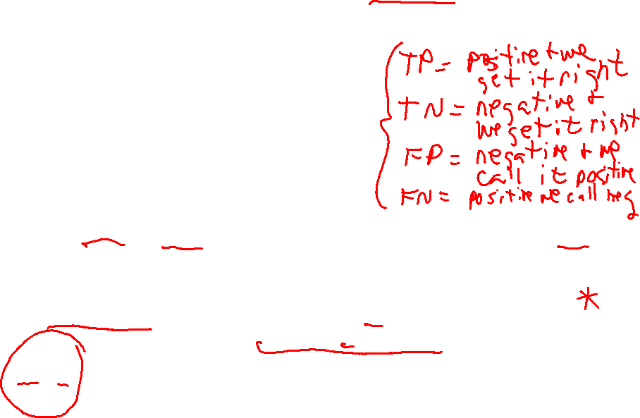
Evaluation
Correctly Classified Instances 281 73.5602 %
Incorrectly Classified Instances 101 26.4398 %
Kappa statistic 0.4718
Mean absolute error 0.3493
Root mean squared error 0.4545
Relative absolute error 69.973 %
Root relative squared error 90.7886 %
Total Number of Instances 382
=== Detailed Accuracy By Class ===
TP Rate FP Rate Precision Recall F-Measure ROC Area Class
0.77 0.297 0.713 0.77 0.74 0.747 cal
0.703 0.23 0.761 0.703 0.731 0.747 dor
Wg Avg. 0.736 0.263 0.737 0.736 0.735 0.747
=== Confusion Matrix ===
a b <-- classified as
144 43 | a = cal
58 137 | b = dor
Precision = TP/(TP+FP)
Recall = TP/(TP+FN)
F-Measure = 2 x Precision x Recall
Precision + Recall

Slide 14
Properties of Decision Trees
They divide the decision space into axis parallel rectangles and label each rectangle as one of the k classes.
They can represent Boolean functions.
They are variable size and deterministic.
They can represent discrete or continuous parameters.
They can be learned from training data.

Slide 15
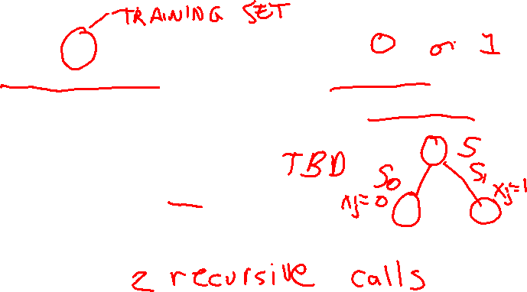
Learning Algorithm for Decision Trees
Growtree(S) /* Binary version */
if (y==0 for all (x,y) in S) return newleaf(0)
else if (y==1 for all (x,y) in S) return newleaf(1)
else
choose best attribute x_{j}
S₀ = (x,y) with x_{j} = 0
S₁ = (x,y) with x_{j} = 1
return new node(x_{j}, Growtree(S₀), Growtree(S₁))
end
How do we choose the best attribute?
What should that attribute do for us?

Slide 16
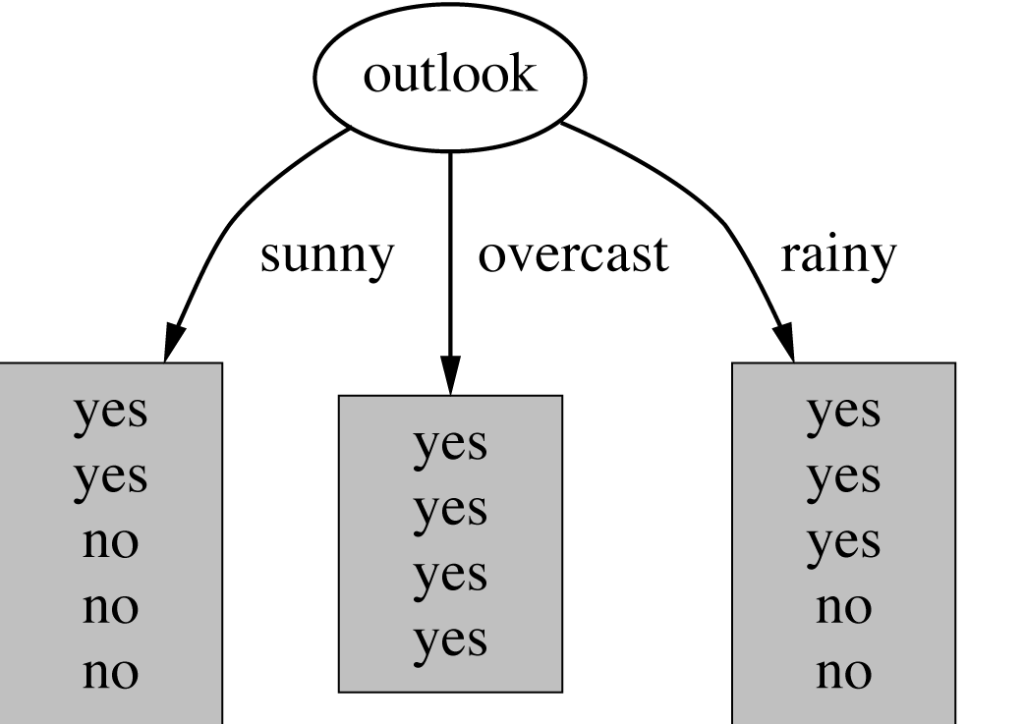
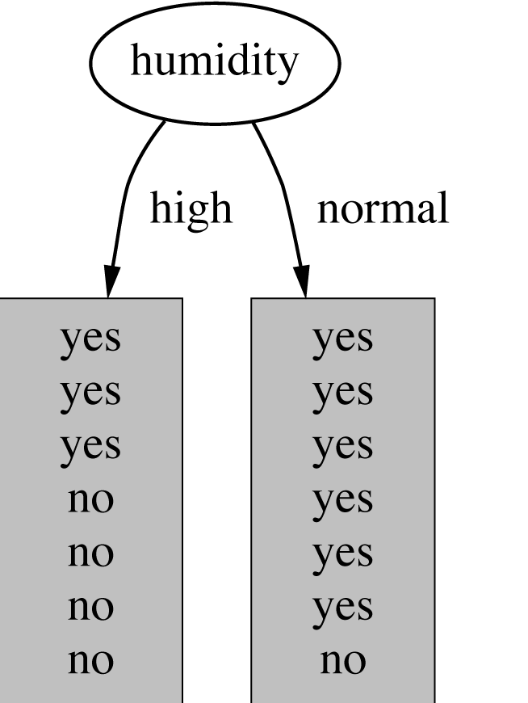
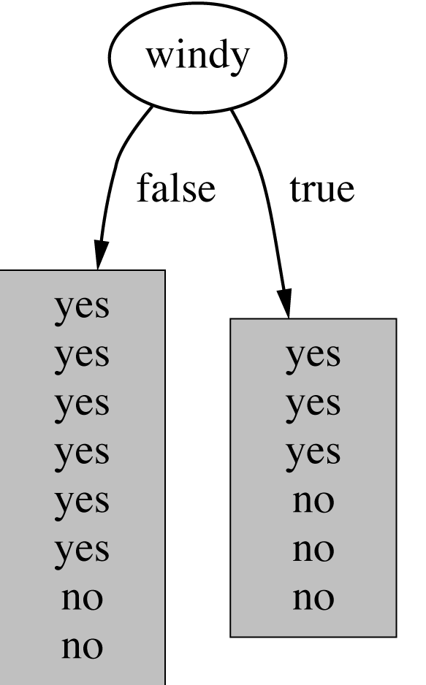
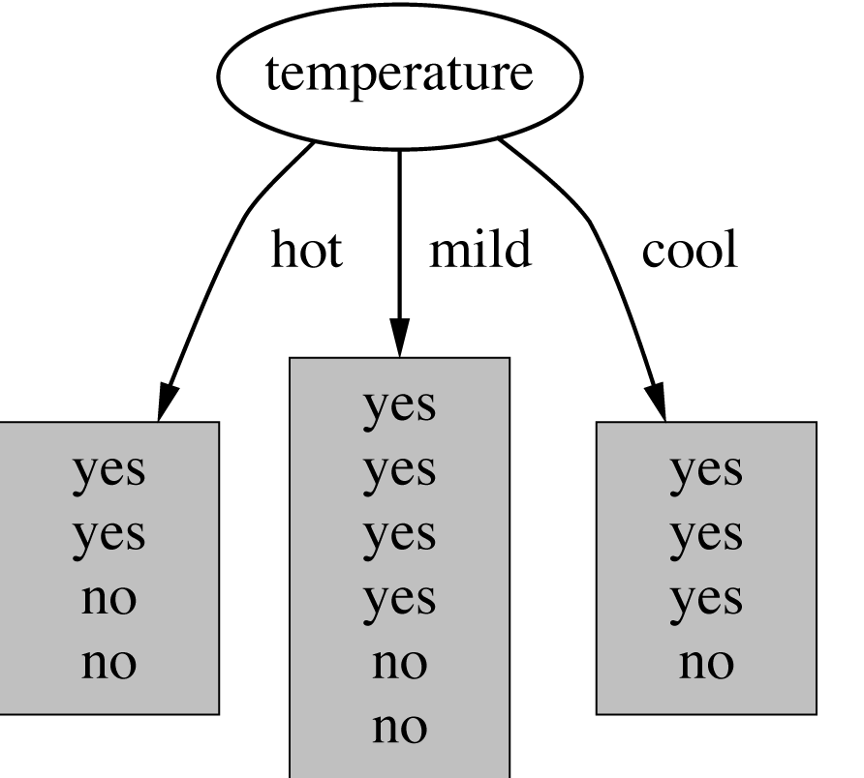
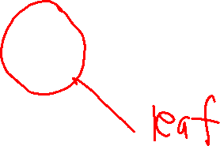
Shall I play tennis today?
Which attribute should be selected?
“training
data”
witten&eibe

Slide 17
Criterion for attribute selection
Which is the best attribute?
  The one that will result in the smallest tree
  Heuristic: choose the attribute that produces the “purest” nodes
Need a good measure of purity!
  Maximal when?
  Minimal when?

Slide 18
Information Gain
Which test is more informative?
Split over whether Balance exceeds 50K
Split over whether applicant is employed
Less or equal 50K
Over 50K
Unemployed
Employed

Slide 19
Information Gain
Impurity/Entropy (informal)
  Measures the level of impurity in a group of examples

Slide 20
Impurity
Very impure group
Less impure
Minimum
impurity

Slide 21
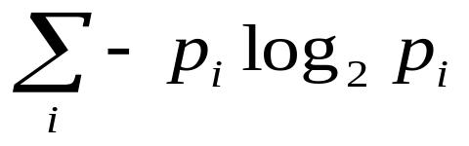
Entropy: a common way to measure impurity
Entropy =
  p_{i} is the probability of class i
  Compute it as the proportion of class i in the set.
Entropy comes from information theory. The higher the entropy the more the information content.
16/30 are green circles; 14/30 are pink crosses
log₂(16/30) = -.9; log₂(14/30) = -1.1
Entropy = -(16/30)(-.9) –(14/30)(-1.1) = .99
What does that mean for learning from examples?

Slide 22
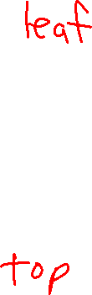
2-Class Cases:
Minimum
impurity
What is the entropy of a group in which all examples belong to the same class?
  entropy = - 1 log₂1 = 0
What is the entropy of a group with 50% in either class?
  entropy = -0.5 log₂0.5 – 0.5 log₂0.5 =1
not a good training set for learning
Maximum
impurity
good training set for learning

Slide 23
Information Gain
We want to determine which attribute in a given set of training feature vectors is most useful for discriminating between the classes to be learned.
Information gain tells us how important a given attribute of the feature vectors is.
We will use it to decide the ordering of attributes in the nodes of a decision tree.

Slide 24
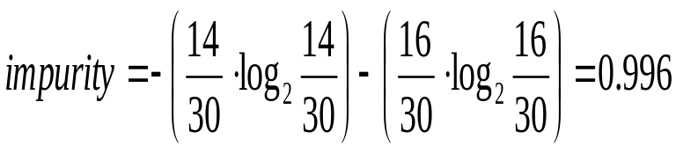
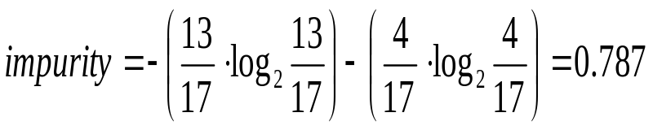
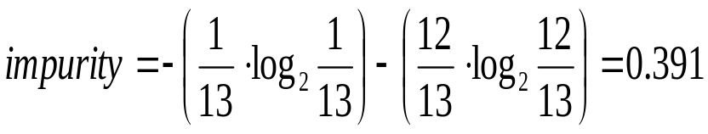
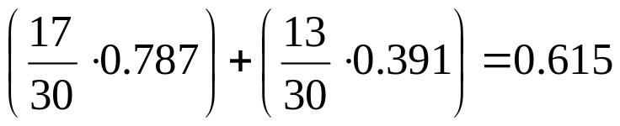
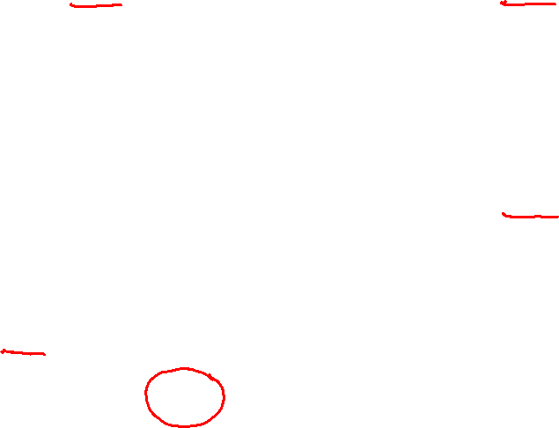
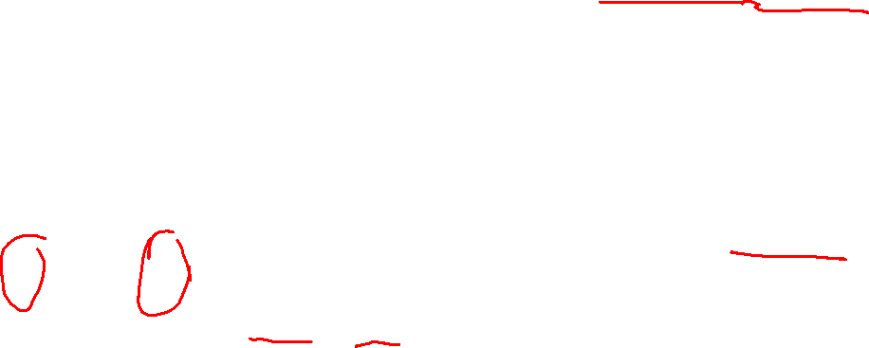
Calculating Information Gain
Information Gain = entropy(parent) – [average entropy(children)]
child
entropy
parent
entropy
Entire population (30 instances)
17 instances
child
entropy
(Weighted) Average Entropy of Children =
13 instances
Information Gain= 0.996 - 0.615 = 0.38 for this split

Slide 25
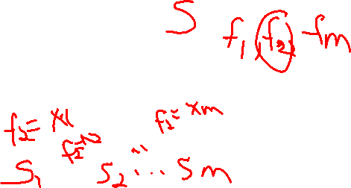
Entropy-Based Automatic Decision Tree Construction
Training Set S
x₁=(f₁₁,f₁₂,…f_{1m})
x₂=(f₂₁,f₂₂, f_{2m})
.
.
x_{n}=(f_{n1},f₂₂, f_{2m})
Node 1
What feature
should be used?
What values?
Quinlan suggested information gain in his ID3 system
and later the gain ratio, both based on entropy.

Slide 26

Using Information Gain to Construct a Decision Tree
1
Choose the attribute A
with highest information
gain for the full training
set at the root of the tree.
Full Training Set S
Attribute A
2
v1
v2
vk
Construct child nodes
for each value of A.
Each has an associated
subset of vectors in
which A has a particular
value.
Set S ′
S′={s∈S | value(A)=v1}
3
repeat
recursively
till when?

Slide 27

Simple Example
Training Set: 3 features and 2 classes
X Y Z C
1 1 I
1 1 0 I
0 0 1 II
1 0 0 II
How would you distinguish class I from class II?

Slide 28
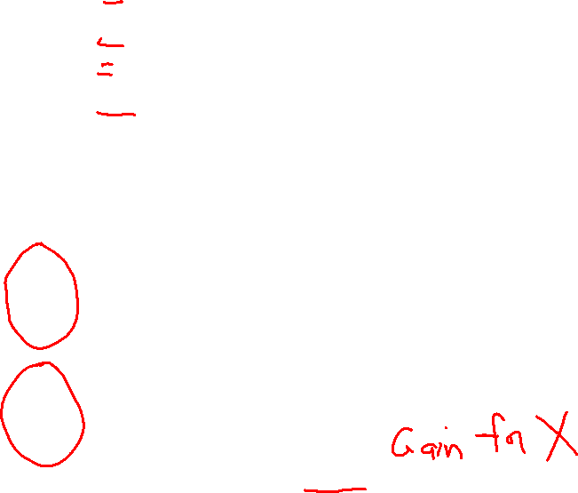
X Y Z C
1 1 I
1 1 0 I
0 0 1 II
1 0 0 II
Eparent= 1
Split on attribute X
If X is the best attribute,
this node would be further split.
I I
II
X=1
E_{child1}= -(1/3)log₂(1/3)-(2/3)log₂(2/3)
= .5284 + .39
= .9184
I I
II II
II
X=0
E_{child2}= 0
GAIN = 1 – ( 3/4)(.9184) – (1/4)(0) = .3112

Slide 29
X Y Z C
1 1 I
1 1 0 I
0 0 1 II
1 0 0 II
Eparent= 1
Split on attribute Y
I I
Y=1
E_{child1}= 0
I I
II II
II
II
Y=0
E_{child2}= 0
GAIN = 1 –(1/2) 0 – (1/2)0 = 1; BEST ONE

Slide 30
X Y Z C
1 1 I
1 1 0 I
0 0 1 II
1 0 0 II
Eparent= 1
Split on attribute Z
I
II
Z=1
E_{child1}= 1
I I
II II
I
II
Z=0
E_{child2}= 1
GAIN = 1 – ( 1/2)(1) – (1/2)(1) = 0 ie. NO GAIN; WORST

Slide 31
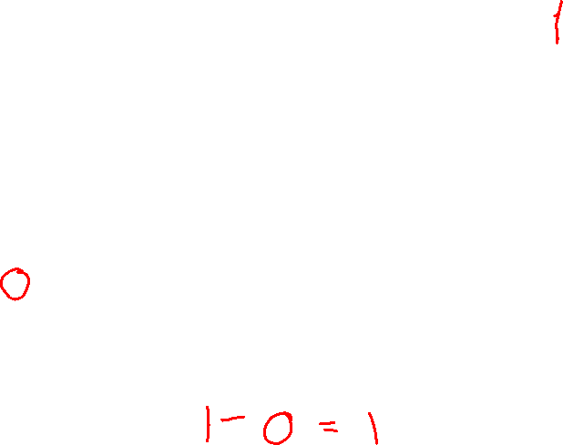
feature vector class
(square, red) I
(square, blue) I
(circle, red) II
(circle blue) II
(triangle, red) I
(triangle, green) I
(ellipse, blue) II
(ellipse, red) II
Try the shape feature
I I I I
II II II II
Entropy?
square ellipse
circle triangle
I I II II I I II II
Entropy? Entropy? Entropy? Entropy?
GAIN?

Slide 32
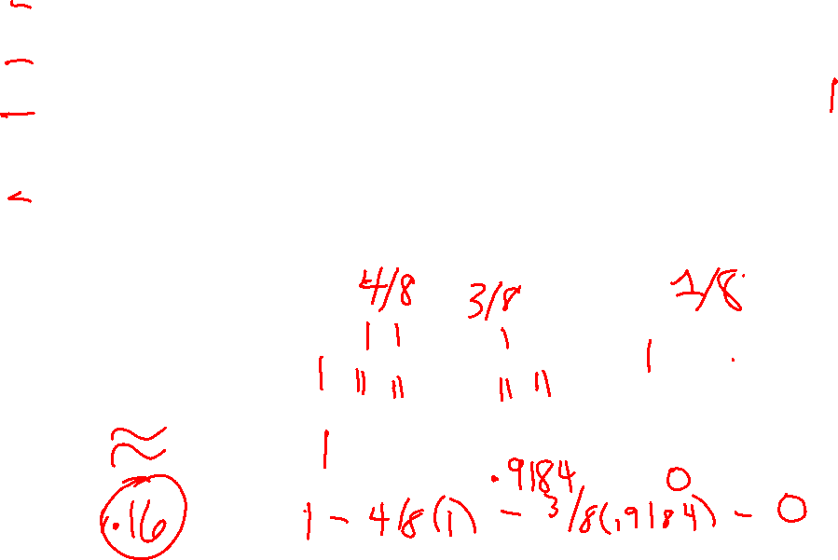
feature vector class
(square, red) I
(square, blue) I
(circle, red) II
(circle blue) II
(triangle, red) I
(triangle, green) I
(ellipse, blue) II
(ellipse, red) II
Try the color feature
I I I I
II II II II
Entropy?
red blue green
Entropy? Entropy? Entropy?
GAIN?

Slide 33
Many-Valued Features
Your features might have a large number of discrete values.
Example: pixels in an image have (R,G,B)
which are each integers between 0 and 255.
Your features might have continuous values.
Example: from pixel values, we compute gradient magnitude, a continuous feature

Slide 34
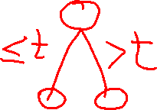
One Solution to Both
We often group the values into bins
What if we want
it to be a binary
decision at each node?
R
Use thresholds in a
binary tree.
[0,32) [32,64) [64,96) [96,128) [128,160] [160,192) [192,224) [224,255]

Slide 35
Training and Testing
Divide data into a training set and a separate testing set.
Construct the decision tree using the training set only.
Test the decision tree on the training set to see how it’s doing.
Test the decision tree on the testing set to report its real performance.

Slide 36
Measuring Performance
Given a test set of labeled feature vectors
e.g. (square,red) I
Run each feature vector through the decision tree
Suppose the decision tree says it belongs to class X and the real label is Y
If (X=Y) that’s a correct classification
If (X<>Y) that’s an error

Slide 37
Measuring Performance
In a 2-class problem, where the classes are positive or negative (ie. for cancer)
  # true positives TP
  # true negatives TN
  # false positives FP
  # false negatives FN
Accuracy = #correct / #total = (TP +TN) / (TP + TN + FP + FN)
Precision = TP / (TP + FP)
How many of the ones you said were cancer really were cancer?
Recall = TP / (TP + FN)
How many of the ones who had cancer did you call cancer?

Slide 38
More Measures
F-Measure = 2*(Precision * Recall) / (Precision + Recall)
Gives us a single number to represent both precision and recall.
In medicine:
Sensitivity = TP / (TP + FN) = Recall
The sensitivity of a test is the proportion of people who have a disease who test positive for it.
Specificity = TN / (TN + FP)
The specificity of a test is the number of people who DON’T have a disease who test negative for it.

Slide 39
Measuring Performance
For multi-class problems, we often look at the confusion matrix.
assigned class
A B C D E F G
A
B
C
D
E
F
G
C(i,j) = number
of times (or
percentage)
class i is given
label j.
true
class

Slide 40
Overfitting
Suppose the classifier h has error (1-accuracy) of error_{train}(h)
And there is an alternate classifier (hypothesis) h’ that has error_{train}(h’)
What if error_{train}(h) < error_{train}(h’)
But error_{D}(h) > error_{D}(h’) for full test set D
Then we say h overfits the training data

Slide 41
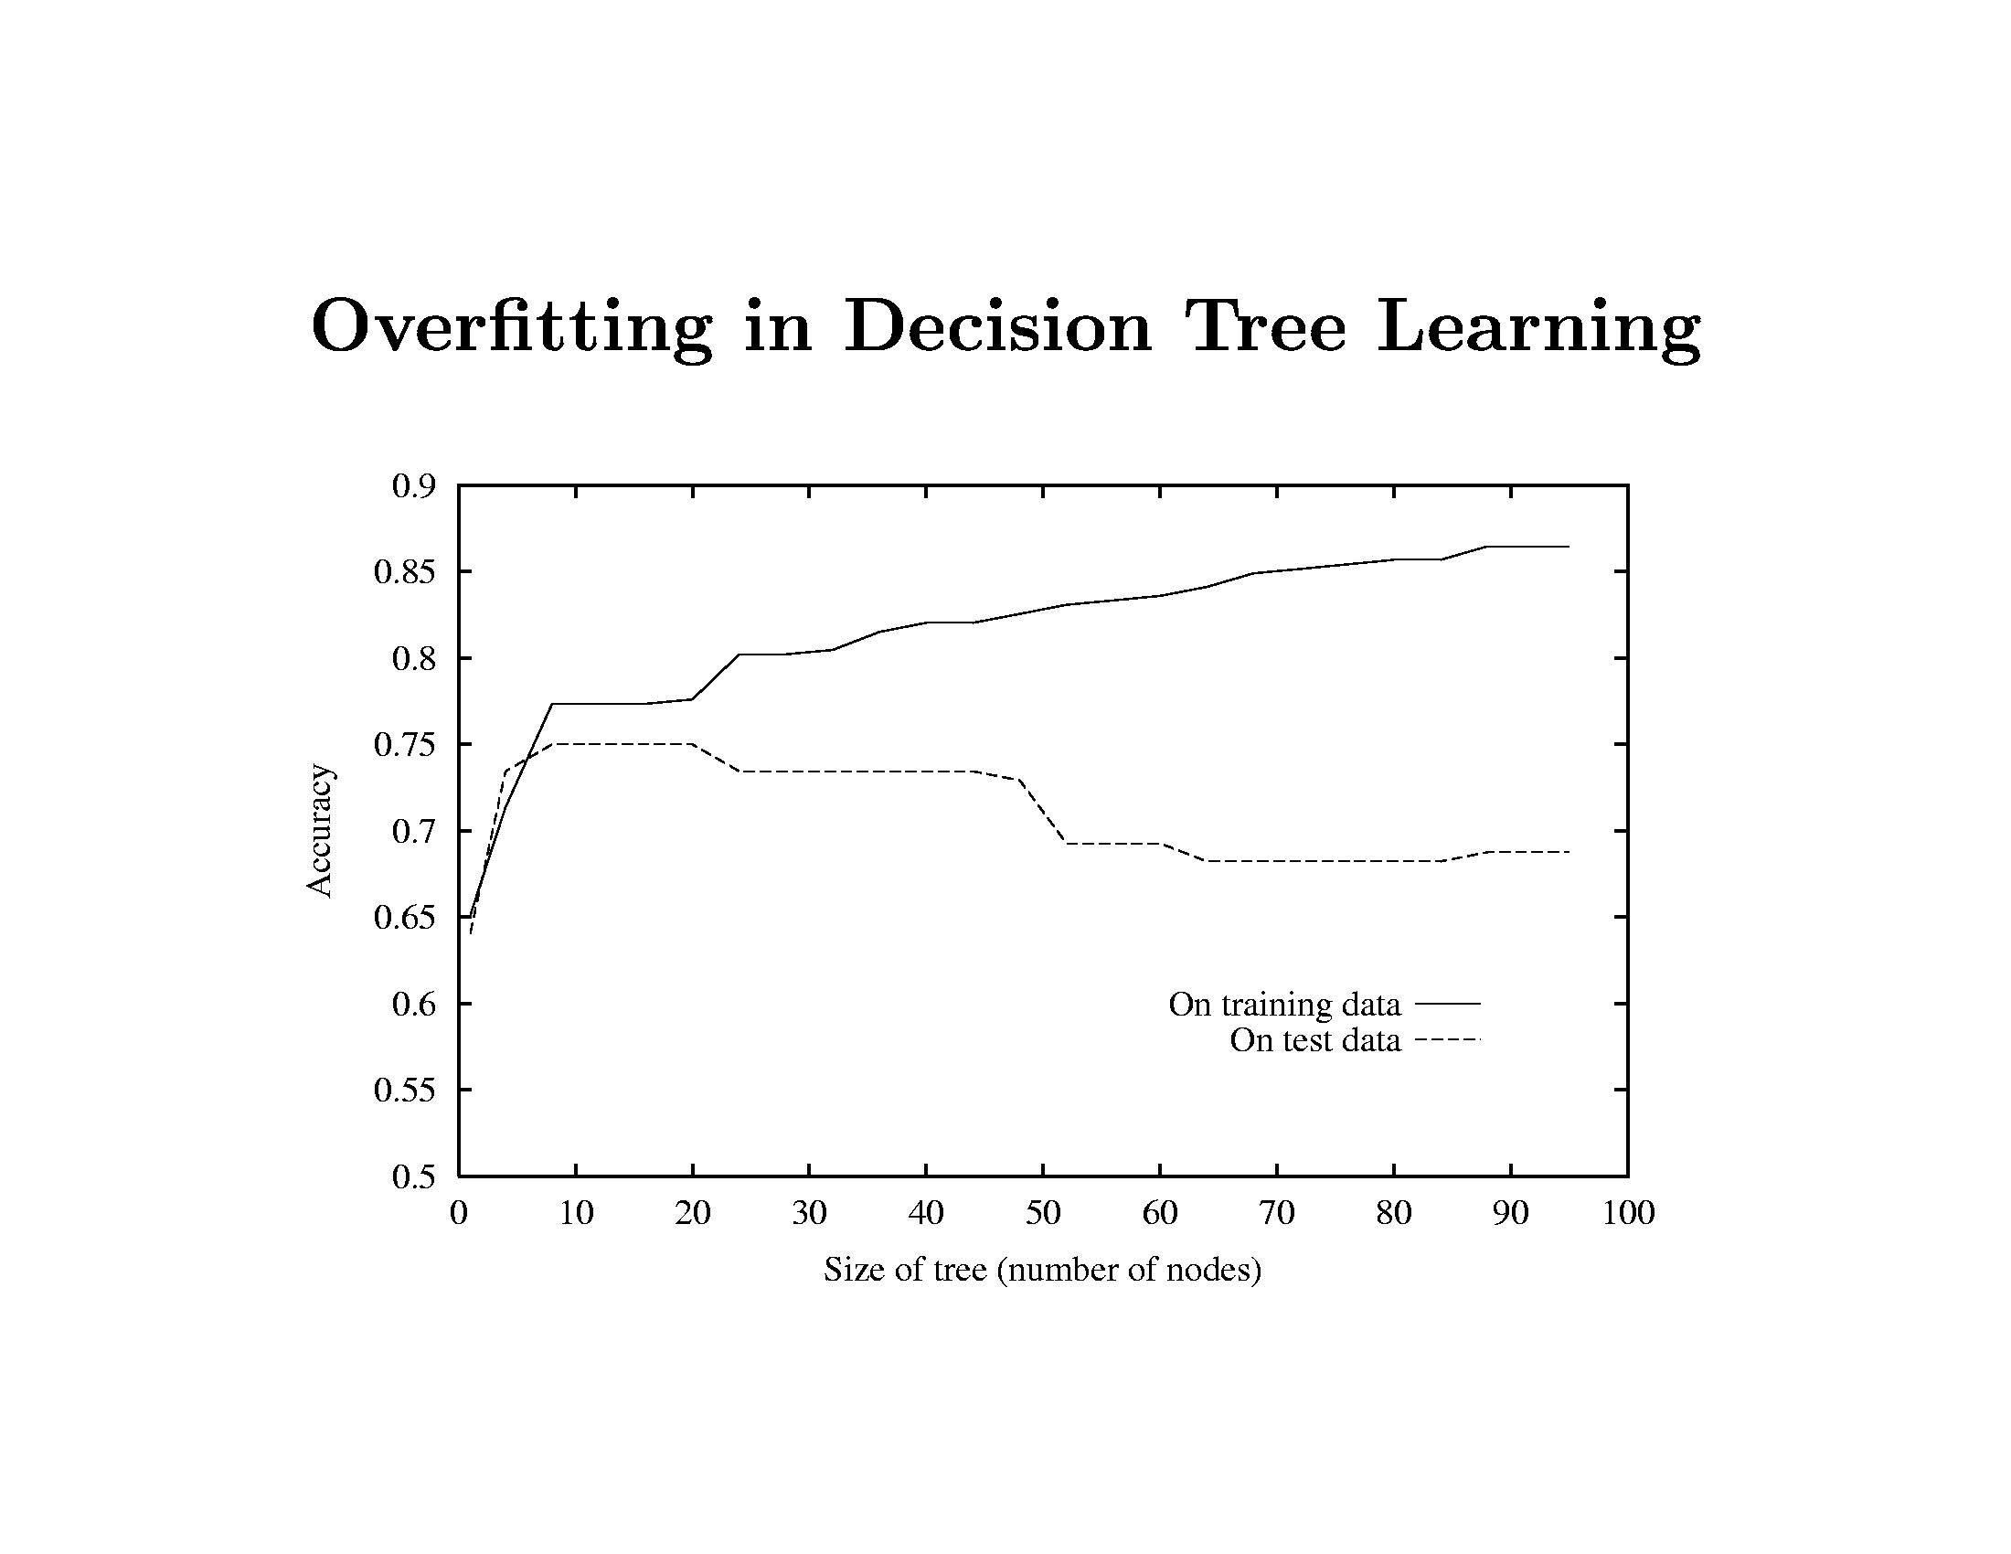
What happens as the decision tree gets bigger and bigger?
Error on training data goes down, on testing data goes up

Slide 42
Reduced Error Pruning
Split data into training and validation sets
Do until further pruning is harmful
  Evaluate impact on validation set of pruning
  each possible node (and its subtree)
  2. Greedily remove the one that most improves
  validation set accuracy
Then you need an additional independent testing set.

Slide 43
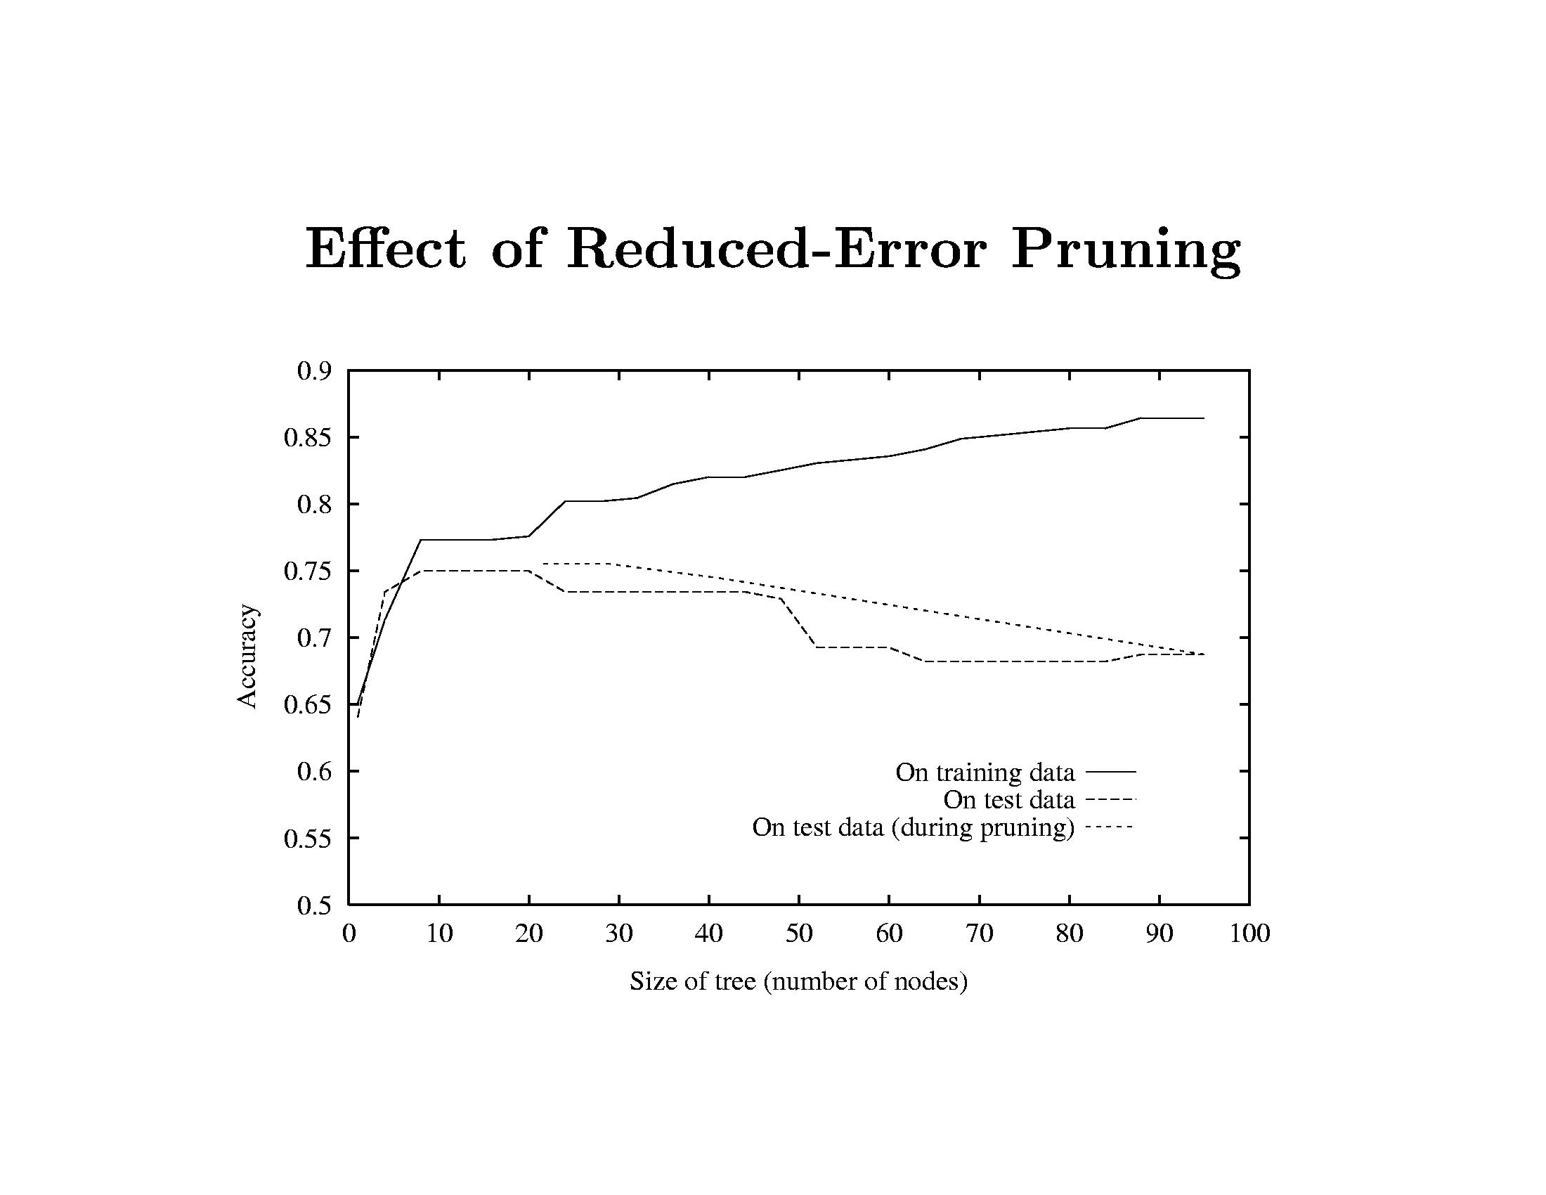
On training data it looks great.
But that’s not the case for the test data.
The tree is pruned back to the red line where
it gives more accurate results on the test data.

Slide 44
The WEKA example with Calenouria and Dorenouria
I showed you used the REPTree classifier with 21 nodes.
The classic decision tree for the same data had 65
nodes.
Performance was similar for our test set.
Performance increased using a random forest of 10
trees, each constructed with 7 random features.

Slide 45
Decision Trees: Summary
Representation=decision trees
Bias=preference for small decision trees
Search algorithm=none
Heuristic function=information gain or
information content or others
Overfitting and pruning
Advantage is simplicity and easy conversion to rules.

Slide 46
Ensembles
An ensemble is a set of classifiers whose combined results give the final decision.
test feature vector
classifier 1
classifier 2
classifier 3
super classifier
result

Slide 47
MODEL* ENSEMBLES
Basic Idea
  Instead of learning one model
  Learn several and combine them
Often this improves accuracy by a lot
Many Methods
  Bagging
  Boosting
  Stacking
*A model is the learned decision rule. It can be as simple as a
hyperplane in n-space (ie. a line in 2D or plane in 3D) or in the
form of a decision tree or other modern classifier.

Slide 48

Bagging
Generate bootstrap replicates of the training set by sampling with replacement
Learn one model on each replicate
Combine by uniform voting

Slide 49
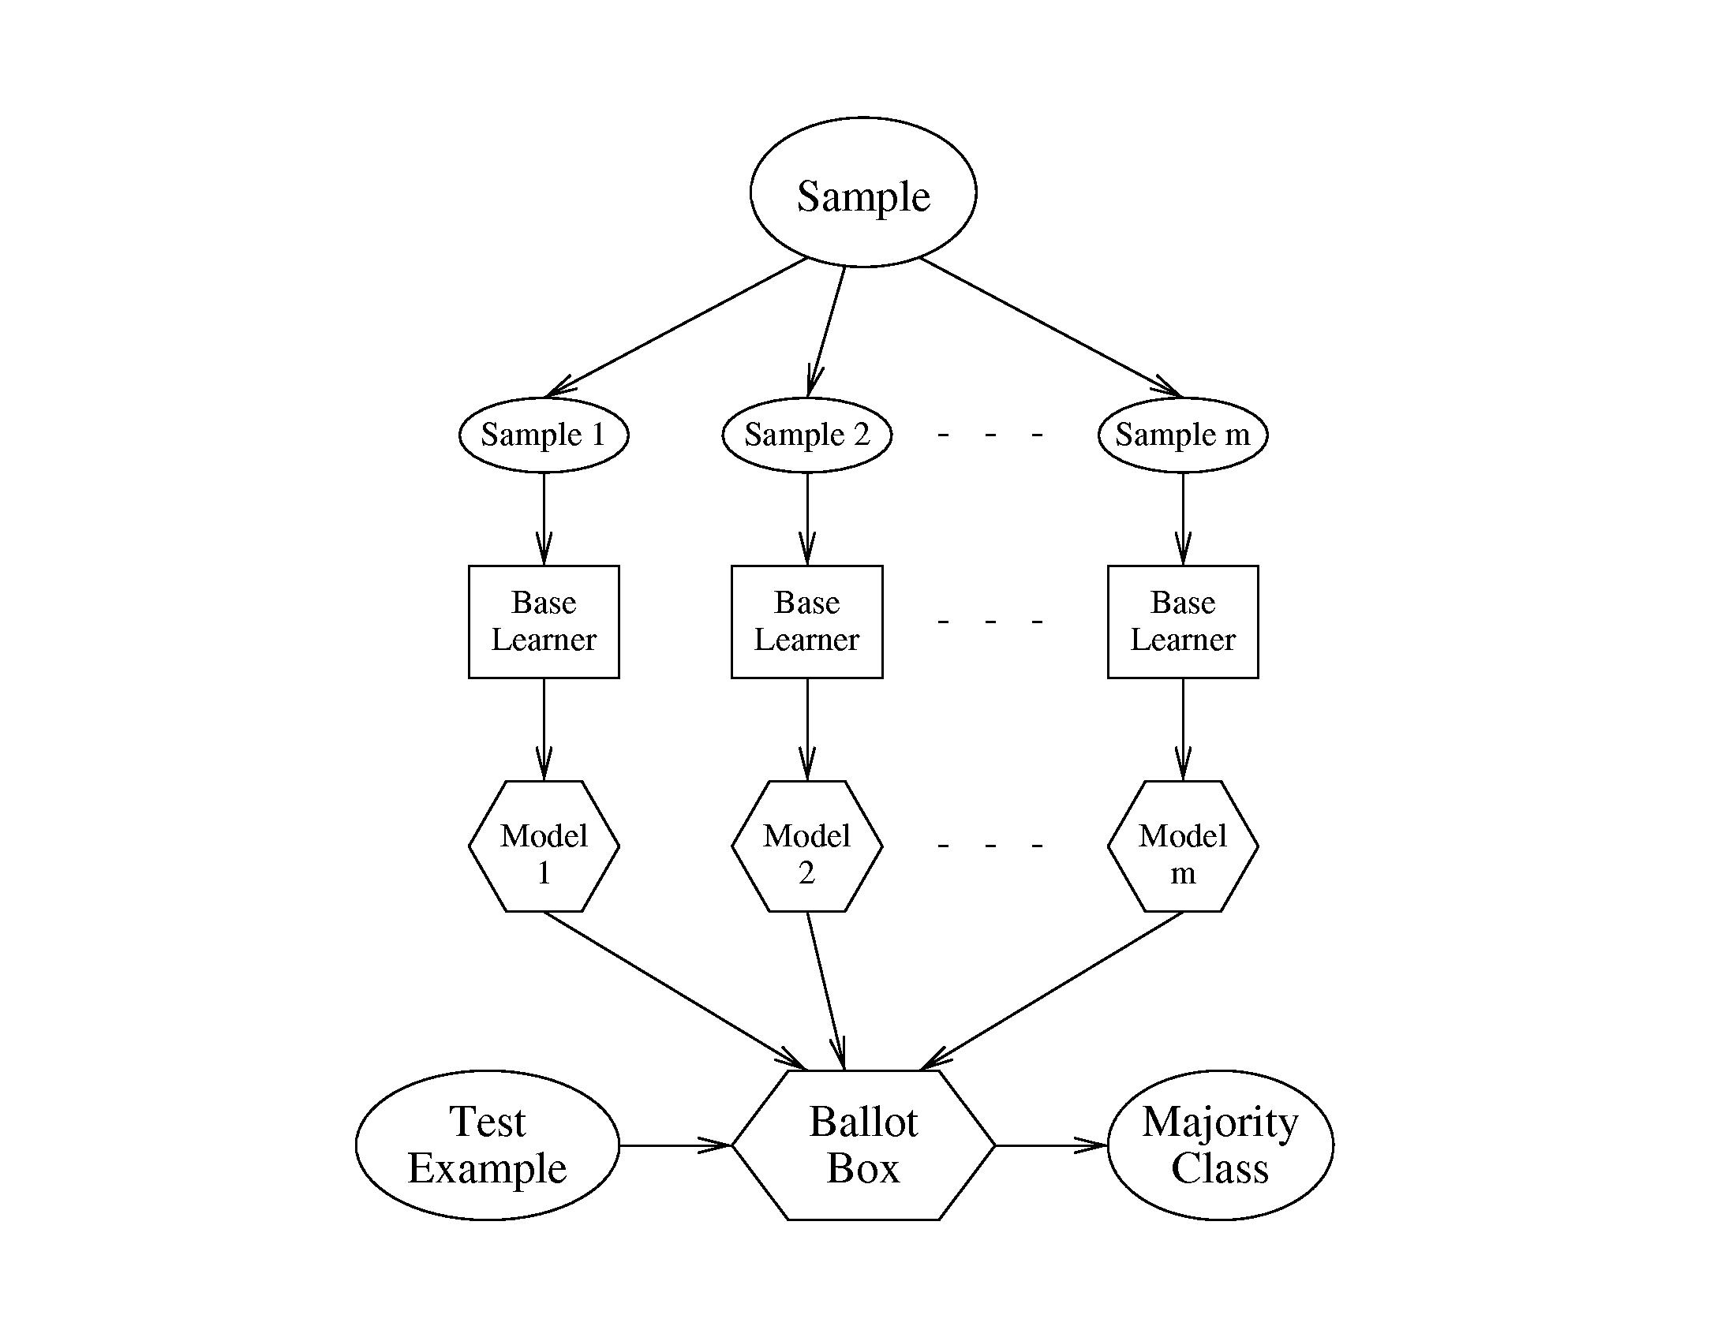
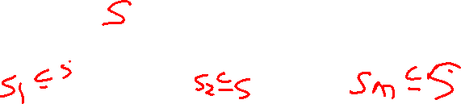

Slide 50
Boosting
Maintain a vector of weights for samples
Initialize with uniform weights
Loop
  Apply learner to weighted samples
  Increase weights of misclassified ones
Combine models by weighted voting

Slide 51
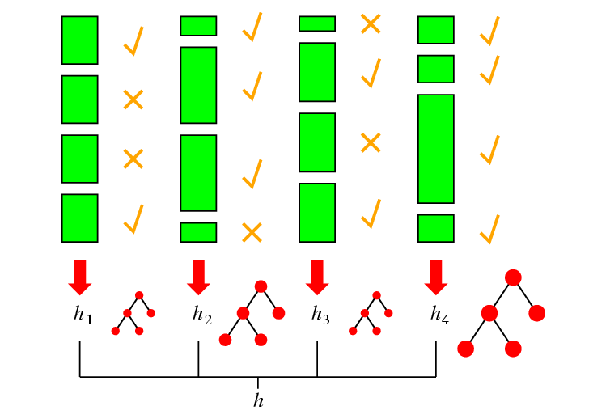
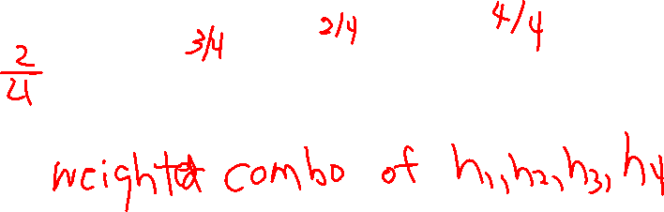
Idea of Boosting

Slide 52
Boosting In More Detail
(Pedro Domingos’ Algorithm)
Set all E weights to 1, and learn H1.
Repeat m times: increase the weights of misclassified Es, and learn H2,…Hm.
H1..Hm have “weighted majority” vote when classifying each test Weight(H)=accuracy of H on the training data

Slide 53
ADABoost
ADABoost boosts the accuracy of the original learning algorithm.
If the original learning algorithm does slightly better than 50% accuracy, ADABoost with a large enough number of classifiers is guaranteed to classify the training data perfectly.

Slide 54

ADABoost Weight Updating
(from Fig 18.34 text)
/* First find the sum of the weights of the misclassified samples */
for j = 1 to N do /* go through training samples */
if h[m](x_{j}) <> y_{j} then error <- error + w_{j}
/* Now use the ratio of error to 1-error to change the
weights of the correctly classified samples */
for j = 1 to N do
if h[m](x_{j}) = y_{j} then w[j] <- w[j] * error/(1-error)

Slide 55
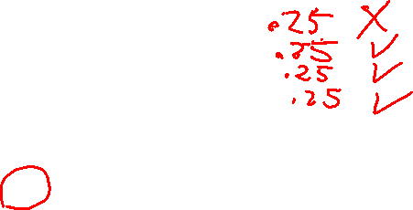
Example
Start with 4 samples of equal weight .25.
Suppose 1 is misclassified. So error = .25.
The ratio comes out .25/.75 = .33
The correctly classified samples get weight of .25*.33 = .0825
.2500
.0825
.0825
.0825
.5000
.1658
.1658
.1658
What’s wrong? What should we do?
We want them to add up to 1, not .4975.
Answer: To normalize, divide each
one by their sum (.4975 or .5).

Slide 56
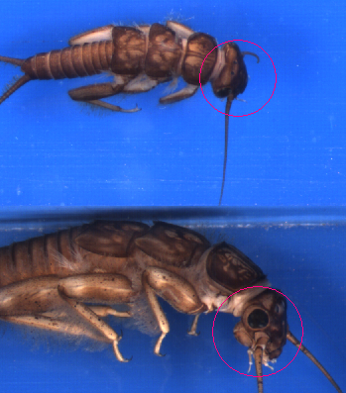
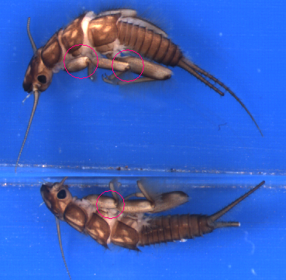
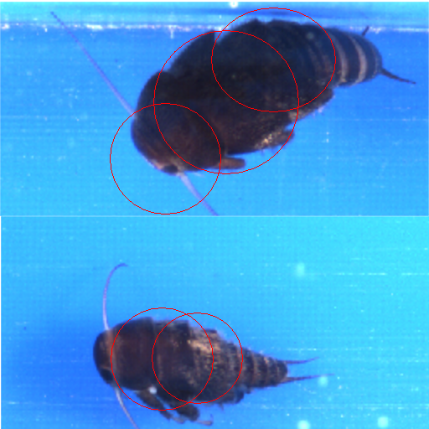
Sample Application: Insect Recognition
Doroneuria (Dor)
Using circular regions of interest selected by an interest operator,
train a classifier to recognize the different classes of insects.

Slide 57
Boosting Comparison
ADTree classifier only (alternating decision tree)
Correctly Classified Instances 268 70.1571 %
Incorrectly Classified Instances 114 29.8429 %
Mean absolute error 0.3855
Relative absolute error 77.2229 %
Classified as -> | Hesperperla | Doroneuria
Real Hesperperlas | 167 | 28
Real Doroneuria | 51 | 136

Slide 58
Boosting Comparison
AdaboostM1 with ADTree classifier
Correctly Classified Instances 303 79.3194 %
Incorrectly Classified Instances 79 20.6806 %
Mean absolute error 0.2277
Relative absolute error 45.6144 %
Classified as -> | Hesperperla | Doroneuria
Real Hesperperlas | 167 | 28
Real Doroneuria | 51 | 136

Slide 59
Boosting Comparison
RepTree classifier only (reduced error pruning)
Correctly Classified Instances 294 75.3846 %
Incorrectly Classified Instances 96 24.6154 %
Mean absolute error 0.3012
Relative absolute error 60.606 %
Classified as -> | Hesperperla | Doroneuria
Real Hesperperlas | 169 | 41
Real Doroneuria | 55 | 125

Slide 60
Boosting Comparison
AdaboostM1 with RepTree classifier
Correctly Classified Instances 324 83.0769 %
Incorrectly Classified Instances 66 16.9231 %
Mean absolute error 0.1978
Relative absolute error 39.7848 %
Classified as -> | Hesperperla | Doroneuria
Real Hesperperlas | 180 | 30
Real Doroneuria | 36 | 144

Slide 61
References
AdaboostM1: Yoav Freund and Robert E. Schapire (1996). "Experiments with a new boosting algorithm". Proc International Conference on Machine Learning, pages 148-156, Morgan Kaufmann, San Francisco.
ADTree: Freund, Y., Mason, L.: "The alternating decision tree learning algorithm". Proceeding of the Sixteenth International Conference on Machine Learning, Bled, Slovenia, (1999) 124-133.

Slide 62
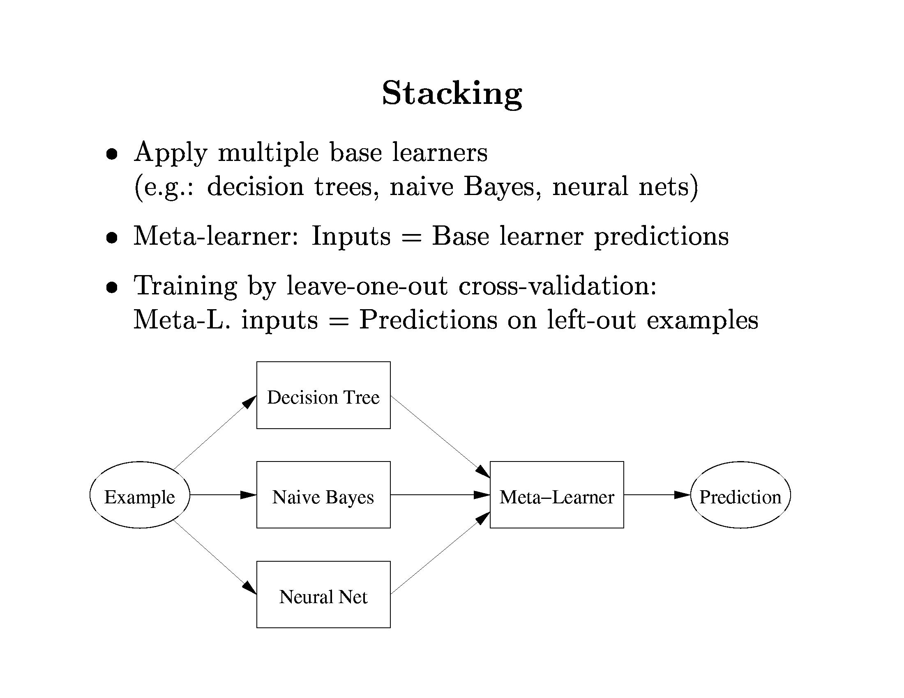

Slide 63
Random Forests
Tree bagging creates decision trees using the bagging technique. The whole set of such trees (each trained on a random sample) is called a decision forest. The final prediction takes the average (or majority vote).
Random forests differ in that they use a modified tree learning algorithm that selects, at each candidate split, a random subset of the features.

Slide 64

Back to Stone Flies
Random forest of 10 trees, each constructed while considering 7 random features.
Out of bag error: 0.2487. Time taken to build model: 0.14 seconds
Correctly Classified Instances 292 76.4398 % (81.4 with AdaBoost)
Incorrectly Classified Instances 90 23.5602 %
Kappa statistic 0.5272
Mean absolute error 0.344
Root mean squared error 0.4069
Relative absolute error 68.9062 %
Root relative squared error 81.2679 %
Total Number of Instances 382
TP Rate FP Rate Precision Recall F-Measure ROC Area Class
0.69 0.164 0.801 0.69 0.741 0.848 cal
0.836 0.31 0.738 0.836 0.784 0.848 dor
WAvg. 0.764 0.239 0.769 0.764 0.763 0.848
a b <-- classified as
129 58 | a = cal
32 163 | b = dor

