Slide 1
Computer Vision
CSE 455
SVMs and Neural Nets
Linda Shapiro
Professor of Computer Science & Engineering
Professor of Electrical Engineering

Slide 2
Kernel Machines
A relatively new learning methodology (1992) derived from statistical learning theory.
Became famous when it gave accuracy comparable to neural nets in a handwriting recognition class.
Was introduced to computer vision researchers by Tomaso Poggio at MIT who started using it for face detection and got better results than neural nets.
Has become very popular and widely used with packages available.

Slide 3
Support Vector Machines (SVM)
Support vector machines are learning algorithms
that try to find a hyperplane that separates
the different classes of data the most.
They are a specific kind of kernel machines based on
two key ideas:
  maximum margin hyperplanes
  a kernel ‘trick’

Slide 4
The SVM Equation
y_{SVM}(x_{q}) = argmax Σ α_{i,c} K(x_{i},x_{q})
x_{q} is a query or unknown object
c indexes the classes
there are m support vectors x_{i} with weights α_{i,c}, i=1 to m for class c
K is the kernel function that compares x_{i} to x_{q}
c i=1,m
*** This is for multiple class SVMs with support vectors
for every class; we’ll see a simpler equation for 2 class.

Slide 5
Maximal Margin (2 class problem)
In 2D space,
a hyperplane is
a line.
In 3D space,
it is a plane.
margin
hyperplane
Find the hyperplane with maximal margin for all
the points. This originates an optimization problem
which has a unique solution.

Slide 6
Support Vectors
The weights α_{i} associated with data points are zero, except for those points closest to the separator.
The points with nonzero weights are called the support vectors (because they hold up the separating plane).
Because there are many fewer support vectors than total data points, the number of parameters defining the optimal separator is small.

Slide 7
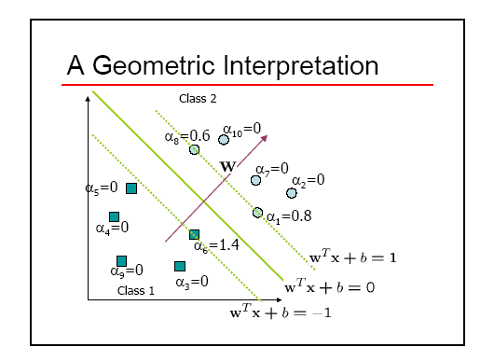
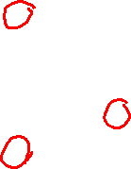

Slide 8

Kernels
A kernel is just a similarity function. It takes 2 inputs and decides how similar they are.
Kernels offer an alternative to standard feature vectors. Instead of using a bunch of features, you define a single kernel to decide the similarity between two objects.

Slide 9
Kernels and SVMs
Under some conditions, every kernel function can be expressed as a dot product in a (possibly infinite dimensional) feature space (Mercer’s theorem)
SVM machine learning can be expressed in terms of dot products.
So SVM machines can use kernels instead of feature vectors.

Slide 10
The Kernel Trick
The SVM algorithm implicitly maps the original
data to a feature space of possibly infinite dimension
in which data (which is not separable in the
original space) becomes separable in the feature space.
Original space R^{k}
Feature space R^{n}
1
0
1
1
0
0
1
0
0
1
0
Kernel
trick
0
1
0
0
0
1
1

Slide 11
Kernel Functions
The kernel function is designed by the developer of the SVM.
It is applied to pairs of input data to evaluate dot products in some corresponding feature space.
Kernels can be all sorts of functions including polynomials and exponentials.
Simplest is just the plain dot product: xi•xj
The polynomial kernel K(xi,xj) = (xi•xj + 1)^{p}, where p is a tunable parameter.

Slide 12
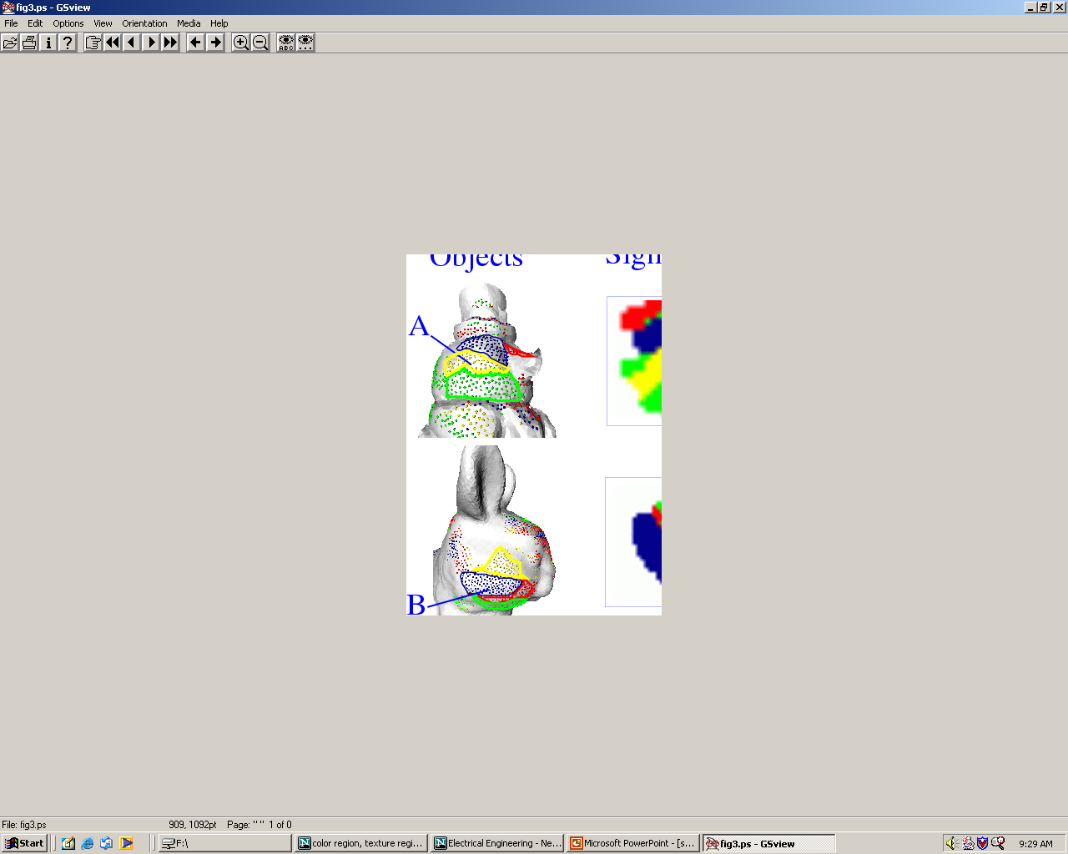
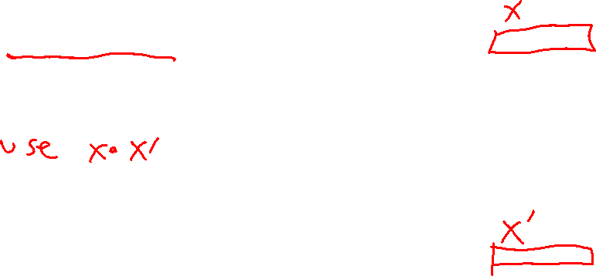
Kernel Function used in our 3D Computer Vision Work
k(A,B) = exp(-θ²_{AB}/σ²)
A and B are shape descriptors (big vectors).
θ is the angle between these vectors.
σ² is the “width” of the kernel.

Slide 13

What does SVM learning solve?
The SVM is looking for the best separating plane in its alternate space.
It solves a quadratic programming optimization problem
argmax Σα_{j} - 1/2 Σα_{j} α_{k} y_{j} y_{k} (x_{j}•x_{k})
subject to α_{j} > 0 and Σα_{j}y_{j} = 0.
The equation for the separator for these optimal α_{j} is
h(x) = sign(Σα_{j} y_{j} (x•x_{j}) – b)
α j j,k
j

Slide 14
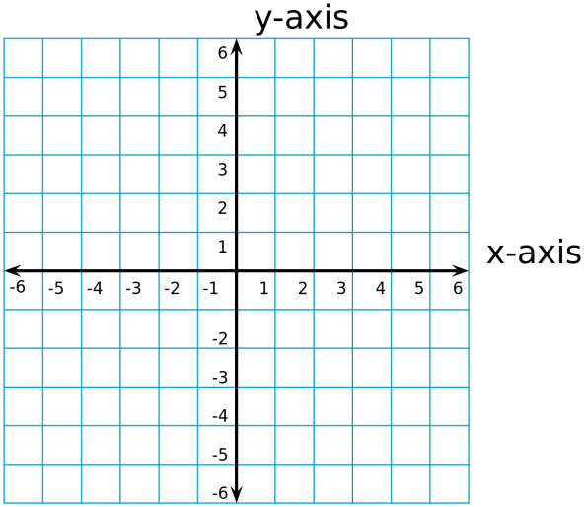
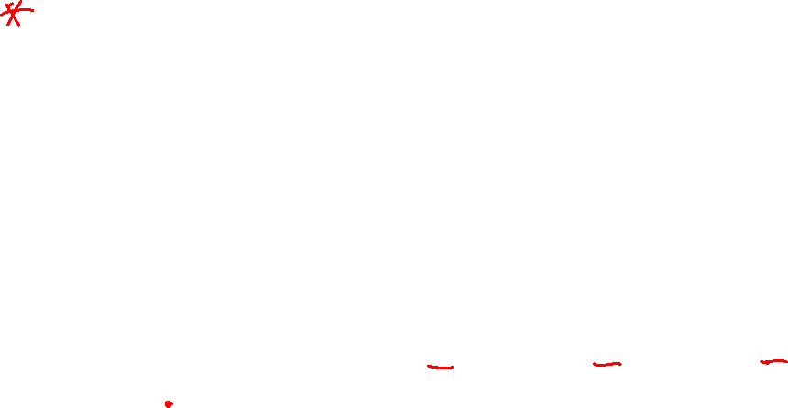
Simple Example of Classification
K(A,B) = A • B
known positive class points {(3,1),(3,-1),(6,1),(6,-1)}
known negative class points {(1,0),(0,1),(0,-1),(-1,0)}
support vectors: s = {(1,0),(3,1),(3,-1)} with weights α = -3.5, .75, .75
classifier equation: f(x) = sign(Σ_{i} [α_{i}*K(s_{i},x)]-b)
b=2
f(1,1) = sign(Σ_{i} α_{i} s_{i} • (1,1) - 2)
= sign(.75*(3,1) • (1,1) + .75*(3,-1)•(1,1)+(-3.5)*(1,0)•(1,1) -2)
= sign(1 – 2) = sign(-1) = - negative class
CORRECT

Slide 15
Time taken to build model: 0.15 seconds
Correctly Classified Instances 319 83.5079 %
Incorrectly Classified Instances 63 16.4921 %
Kappa statistic 0.6685
Mean absolute error 0.1649
Root mean squared error 0.4061
Relative absolute error 33.0372 %
Root relative squared error 81.1136 %
Total Number of Instances 382
TP Rate FP Rate Precision Recall F-Measure ROC Area Class
0.722 0.056 0.925 0.722 0.811 0.833 cal
0.944 0.278 0.78 0.944 0.854 0.833 dor
W Avg. 0.835 0.17 0.851 0.835 0.833 0.833
=== Confusion Matrix ===
a b <-- classified as
135 52 | a = cal
11 184 | b = dor

Slide 16
Neural Net Learning
Motivated by studies of the brain.
A network of “artificial neurons” that learns a function.
Doesn’t have clear decision rules like decision trees, but highly successful in many different applications. (e.g. face detection)
We use them frequently in our research.
I’ll be using algorithms from
http://www.cs.mtu.edu/~nilufer/classes/cs4811/2016-spring/lecture-slides/cs4811-neural-net-algorithms.pdf

Slide 17
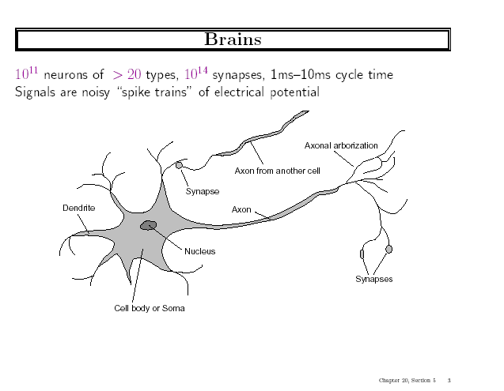

Slide 18
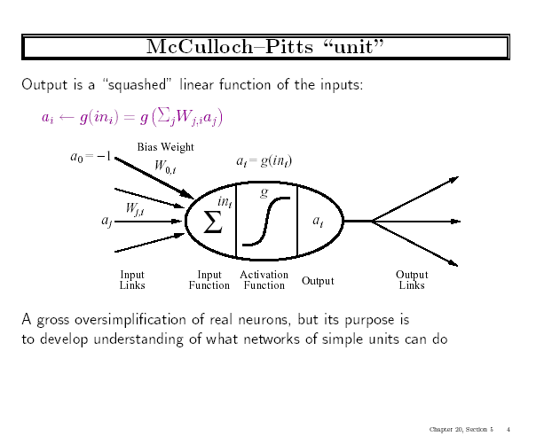


Slide 19
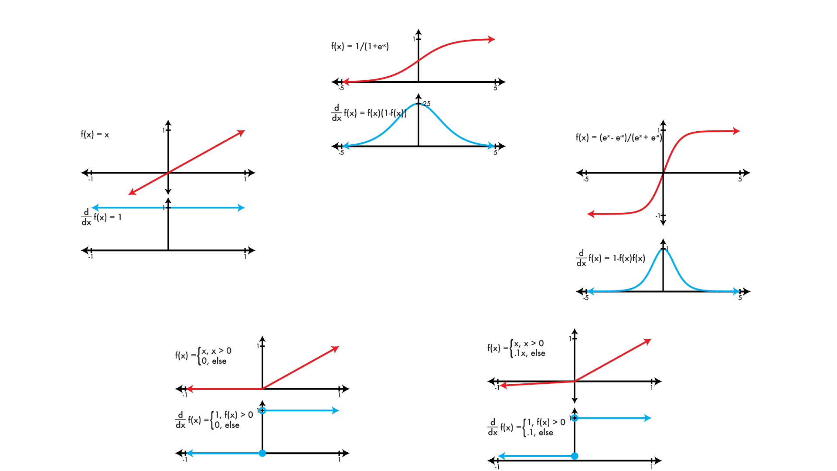
Common activation functions φ
logistic
linear
tanh
REctified Linear Unit (RELU)
Leaky RELU

Slide 20
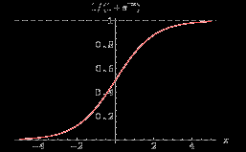

Simple Feed-Forward Perceptrons
in = (∑ W_{j} x_{j}) + θ
out = g[in]
x1
W1
g(in)
out
g is the activation function
It can be a step function:
g(x) = 1 if x >=0 and 0 (or -1) else.
It can be a sigmoid function:
g(x) = 1/(1+exp(-x)).
x2
W2
θ
The sigmoid function is differentiable
and can be used in a gradient descent
algorithm to update the weights.
and other things…

Slide 21
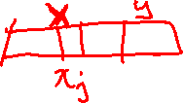
Gradient Descent takes steps proportional to the negative of the gradient of a function to find its local minimum
Let X be the inputs, y the class, W the weights
in = ∑ W_{j} x_{j}
Err = y – g(in)
E = ½ Err² is the squared error to minimize
∂E/∂W_{j} = Err * ∂Err/∂W_{j} = Err * ∂/∂W_{j}(g(in))(-1)
= -Err * g’(in) * x_{j}
The update is W_{j} <- W_{j} + α * Err * g’(in) * x_{j}
α is called the learning rate.

Slide 22


Simple Feed-Forward Perceptrons
x1
W1
repeat
for each e in examples do
in = (∑ W_{j} x_{j}) + θ
Err = y[e] – g[in]
W_{j} = W_{j} + α Err g’(in) x_{j}[e]
until done
g(in)
out
x2
W2
θ
Examples: A=[(.5,1.5),+1], B=[(-.5,.5),-1], C=[(.5,.5),+1]
Initialization: W₁ = 1, W₂ = 2, θ = -2
Note1: when g is a step function, the g’(in) is removed.
Note2: later in back propagation, Err * g’(in) will be called
We’ll let g(x) = 1 if x >=0 else -1

Slide 23

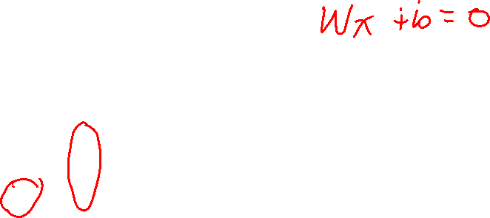
Graphically
Examples: A=[(.5,1.5),+1], B=[(-.5,.5),-1], C=[(.5,.5),+1]
Initialization: W₁ = 1, W₂ = 2, θ = -2
W₂
Boundary is W₁x₁ + W₂x₂ + θ = 0
wrong
boundary
A
B
C
W₁

Slide 24
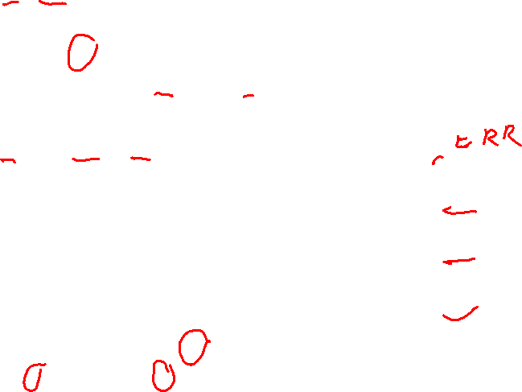
Learning
repeat
for each e in examples do
in = (∑ W_{j} x_{j}) + θ
Err = y[e] – g[in]
W_{j} = W_{j} + α Err g’(in) x_{j}[e]
until done
Examples:
A=[(.5,1.5),+1],
B=[(-.5,.5),-1],
C=[(.5,.5),+1]
Initialization: W₁ = 1, W₂ = 2, θ = -2
A=[(.5,1.5),+1]
in = .5(1) + (1.5)(2) -2 = 1.5
g(in) = 1; Err = 0; NO CHANGE
B=[(-.5,.5),-1]
In = (-.5)(1) + (.5)(2) -2 = -1.5
g(in) = -1; Err = 0; NO CHANGE
Let α=.5
W1 <- W1 + .5(2) (.5) leaving out g’
<- 1 + 1(.5) = 1.5
W2 <- W2 + .5(2) (.5)
<- 2 + 1(.5) = 2.5
<- θ + .5(+1 – (-1))
<- -2 + .5(2) = -1
C=[(.5,.5),+1]
in = (.5)(1) + (.5)(2) – 2 = -.5
g(in) = -1; Err = 1-(-1)=2

Slide 25

Graphically
Examples: A=[(.5,1.5),+1], B=[(-.5,.5),-1], C=[(.5,.5),+1]
Initialization: W₁ = 1, W₂ = 2, θ = -2
W₂
_{a}
Boundary is W₁x₁ + W₂x₂ + θ = 0
wrong
boundary
A
B
C
W₁
approximately correct boundary

Slide 26
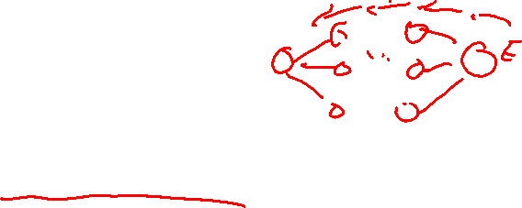
Back Propagation
Simple single layer networks with feed forward learning were not powerful enough.
Could only produce simple linear classifiers.
More powerful networks have multiple hidden layers.
The learning algorithm is called back propagation, because it computes the error at the end and propagates it back through the weights of the network to the beginning.

Slide 27

Let’s break it
into steps.

Slide 28
Initialize
layer 1 2 3=L
x1
w11
w21
n1
w1f
nf
x2
w31
w2f
n2
x3

Slide 29
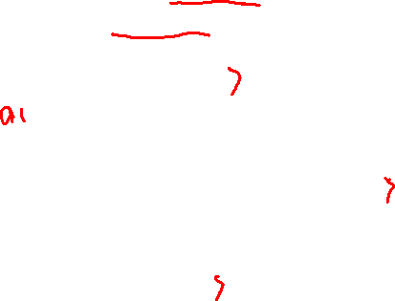
Forward Computation
g(in_{n1}) = a_{n1}
layer 1 2 3=L
x1
w11
w21
n1
w1f
nf
g(in_{nf}) = a_{nf}
x2
w31
w2f
n2
x3
g(in_{n2}) = a_{n2}

Slide 30


Backward Propagation 1
Node nf is the only node in our output layer.
Compute the error at that node and multiply by the derivative of the weighted
input sum to get the change delta.
layer 1 2 3=L
x1
w11
w21
n1
w1f
nf
$Δ$_{nf} = g’(in_{nf}) * (y_{nf} – a_{nf})
x2
w31
w2f
n2
x3

Slide 31
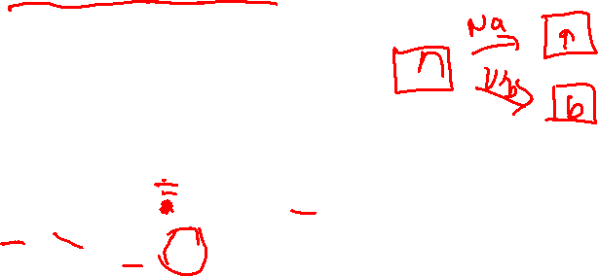

Backward Propagation 2
ht
At each of the other layers, the deltas use
  the derivative of its input sum
  the sum of its output weights
  the delta computed for the output error
layer 1 2 3=L
If there were two output nodes, there would be a summation.
x1
w11
$Δn1=g^{′}\left(inn1\right)w1f Δ$_{nf}
w21
n1
w1f
nf
x2
$$Δnf$$
w31
w2f
n2
x3

Slide 32

Backward Propagation 3
Now that all the deltas are defined, the weight updates just use them.
layer 1 2 3=L
x1
w11
w21
n1
w1f
a_{i}
w_{ij}
nf
$$Δj$$
x2
i
j
w31
w2f
n2
x3

Slide 33
Back Propagation Summary
Compute delta values for the output units using observed errors.
Starting at the output-1 layer
  repeat
    propagate delta values back to previous layer
    till done with all layers
  update weights for all layers
This is done for all examples and multiple epochs, till convergence or enough iterations.

Slide 34
Time taken to build model: 16.2 seconds
Correctly Classified Instances 307 80.3665 % (did not boost)
Incorrectly Classified Instances 75 19.6335 %
Kappa statistic 0.6056
Mean absolute error 0.1982
Root mean squared error 0.41
Relative absolute error 39.7113 %
Root relative squared error 81.9006 %
Total Number of Instances 382
TP Rate FP Rate Precision Recall F-Measure ROC Area Class
0.706 0.103 0.868 0.706 0.779 0.872 cal
0.897 0.294 0.761 0.897 0.824 0.872 dor
W Avg. 0.804 0.2 0.814 0.804 0.802 0.872
=== Confusion Matrix ===
a b <-- classified as
132 55 | a = cal
20 175 | b = dor

Slide 35
Multi-Class Classification

Slide 36
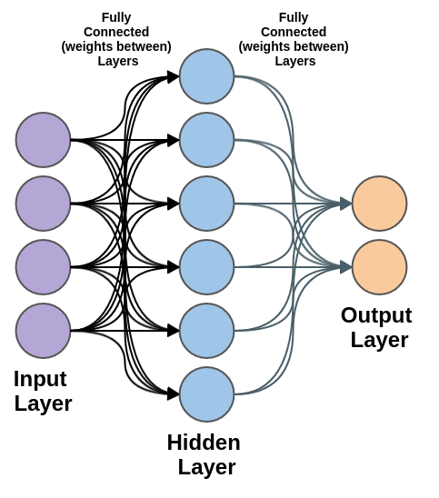
Solution
Traditional Method: 1-vs-other method
  Too slow. If we have n-classes, we need to train n models
  Performance is not great, because the sample size is different for positive and negative classes
Multiple Neurons
  Use n output neuron to correspond n classes.
  Easy, fast, and robust
  Problem: how to model the probability? The values in the neural network can be negative or greater than 1.

Slide 37
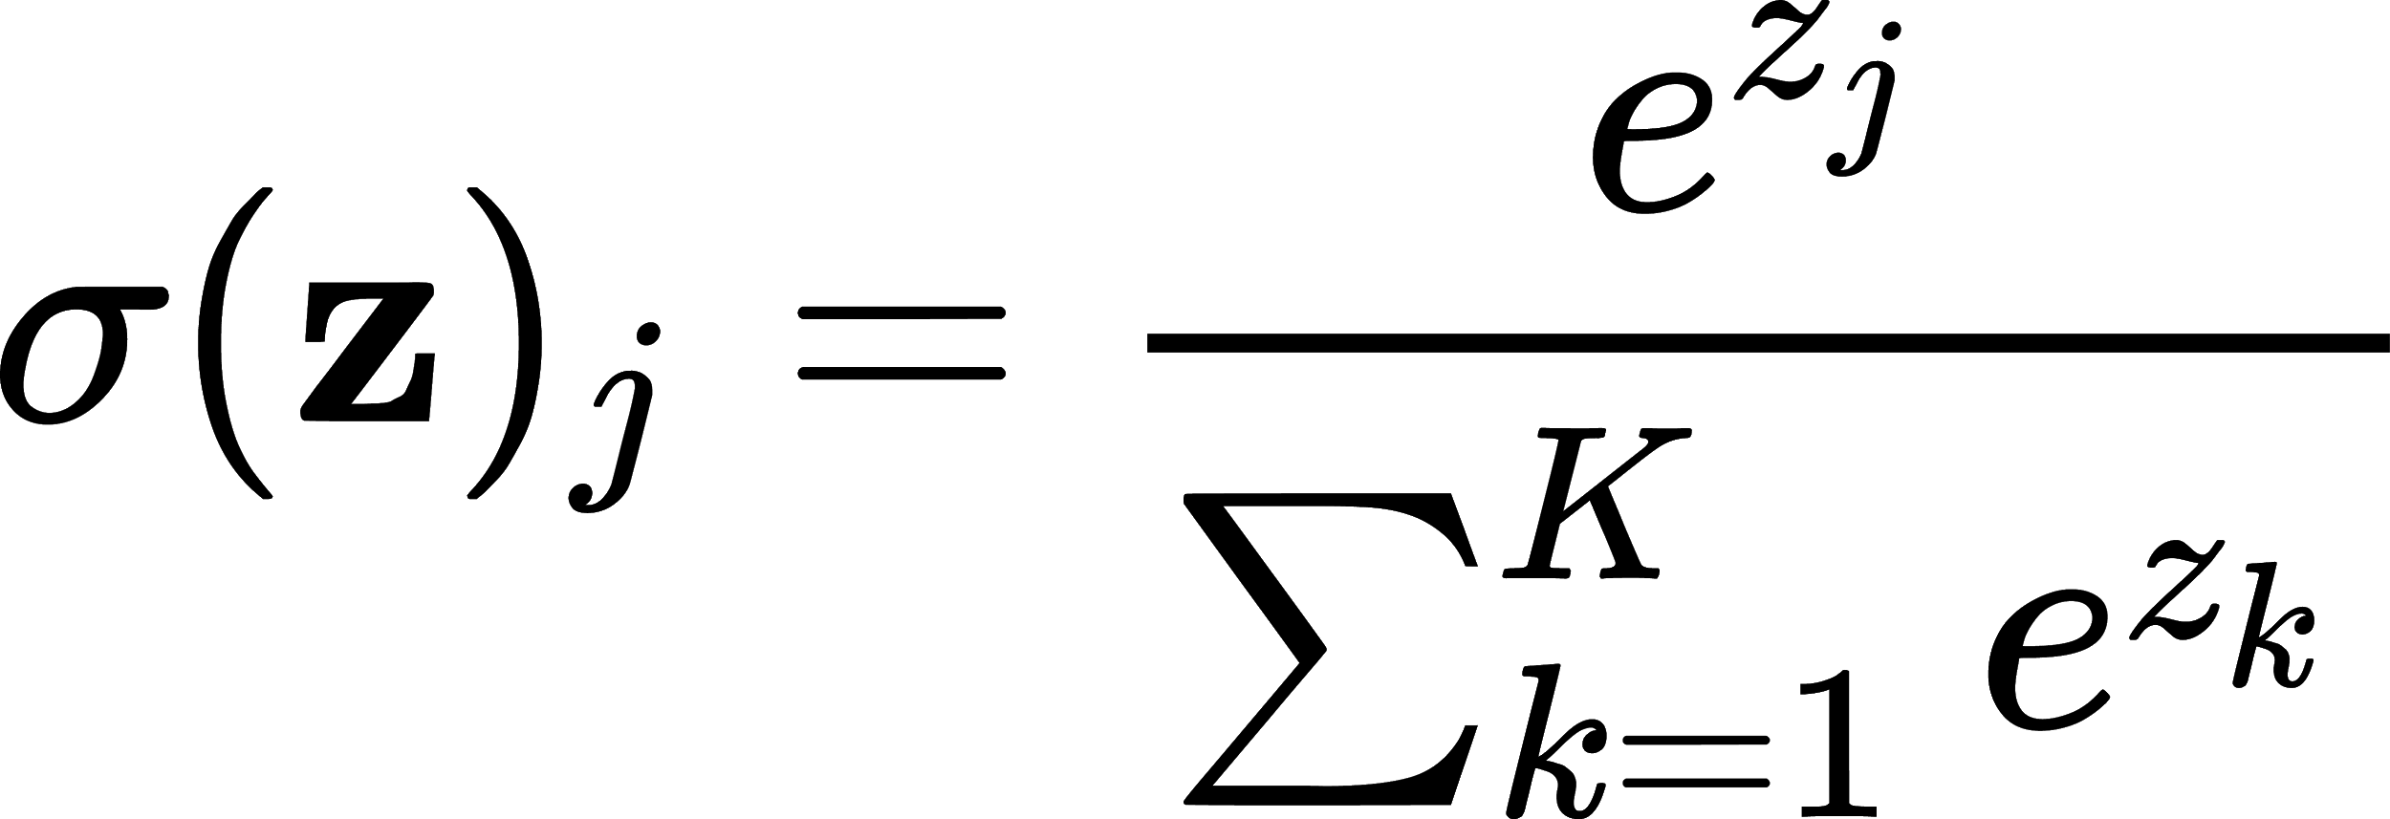
Softmax: normalized exponential
Input: vector of reals
Output: probability distribution
softmax([1,2,7,3,2]):
Calculate e^{x}: [2.72, 7.39, 1096.63, 20.09, 7.39]
Calculate sum(e^{x}): 2.72+7.39+1096.63+20.09+7.39 = 1134.22
Normalize: e^{x}/sum(e^{x}) = [0.002, 0.007, 0.967, 0.017, 0.007]
Result is a vector of reals.
z

Slide 38
A Simple Example
Here, we will go over a simple 2-layer neural network (no bias).

Slide 39
Mini-batch for Machine Learning
We use a matrix to represent data.
If there are 10,000 images, and each image contains 784 features, we can use a 10,000 x 784 matrix to represent the whole dataset.
Hard to load a large dataset at once; so, we can split the dataset into smaller batches.
For instance, in homework 5, we use batch size 128. Then, each batch contains 128 images, and the corresponding data is stored in a 128 x 784 matrix.
Then, we can feed batches one-by-one to the ML model, and train it for each batch.

Slide 40



Neural Network Easy Example
Here, we use batch size of 4, and we only visualize the first sample for simplicity.
1
0.7
First pixel
3
0.1
0.1
-2.3
2
Second pixel
-2.1
0.5
4
1
Third pixel
-0.2
-0.5
1-st Layer (ReLU)
Output Layer
with Softmax
Input Layer
3 | 2 | 4
. | . | .
. | . | .
1 | 0.5
0.1 | 1
-2.3 | -0.5
0.7 | -2.1
0.1 | -0.2
$$X_{in}$$
$$w_{1}$$
$$w_{2}$$

Slide 41




[Example] Forward Pass
-6.0
0.15
0
1
0.7
.61
3
0.1
0.1
-2.3
$$\frac{e^{0.15}}{e^{0.15}+e^{−0.3}}≈\frac{1.16}{1.16+0.74}=0.61$$
2
-0.3
-2.1
0.5
.39
4
1
1.5
1.5
-0.2
$$\frac{e^{−0.3}}{e^{0.15}+e^{−0.3}}≈\frac{0.74}{1.16+0.74}=0.39$$
-0.5
Output Layer
with Softmax
1-st Layer (ReLU)
Input Layer
3 | 2 | 4
. | . | .
. | . | .
0 | 1.5
. | .
. | .
0.61 | 0.39
. | .
. | .
1 | 0.5
0.1 | 1
-2.3 | -0.5
0.7 | -2.1
0.1 | -0.2
$$X_{in}$$
$$w_{1}$$
$$o_{1}$$
$$w_{2}$$
$$o_{2}$$

Slide 42




[Example] Ground Truth and Loss
Ground truth
0.15
0
1
0.7
.61
1
3
0.1
0.1
-2.3
0.39
$$Δ$$
2
$$Δo2$$
-0.3
-2.1
0.5
.39
0
4
1
1.5
-0.2
-0.5
-0.39
$$Δ$$
Label
1-st Layer (ReLU)
Output Layer
with Softmax
Input Layer
3 | 2 | 4
. | . | .
. | . | .
0 | 1.5
. | .
. | .
0.61 | 0.39
. | .
. | .
1 | 0.5
0.1 | 1
-2.3 | -0.5
0.7 | -2.1
0.1 | -0.2
$$X_{in}$$
$$w_{1}$$
$$w_{2}$$
$$o_{1}$$
$$o_{2}$$

Slide 43
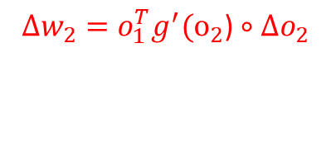

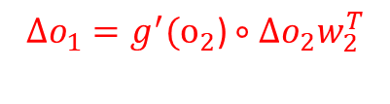
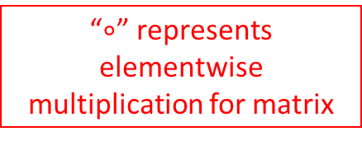
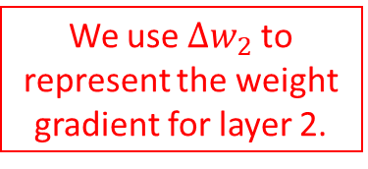
[Example] Backpropagation
“$∘$” represents elementwise multiplication for matrix
$${g^{′}(o_{2}\text{)}∘Δo}_{2}$$
Assume g’(.) = 1
0.39 | -0.39
. | .
. | .
0.15
0
1
0.7
.61
We use ${Δw}_{2}$to represent the weight gradient for layer 2.
3
$${Δw}_{2}=o_{1}^{T}{g^{′}(o_{2}\text{)}∘Δo}_{2}$$
0.1
0.1
-2.3
0.39
0 | 0
0.585 | -0.585
2
-0.3
$${Δo}_{1}={g^{′}(o_{2}\text{)}∘Δo}_{2}w_{2}^{T}$$
-2.1
0.5
.39
1.092 | 0.117
. | .
. | .
4
1
1.5
-0.2
-0.5
-0.39
1-st Layer (ReLU)
Output Layer
with Softmax
Input Layer
3 | 2 | 4
. | . | .
. | . | .
0 | 1.5
. | .
. | .
0.61 | 0.39
. | .
. | .
1 | 0.5
0.1 | 1
-2.3 | -0.5
0.7 | -2.1
0.1 | -0.2
$$X_{in}$$
$$w_{1}$$
$$w_{2}$$
$$o_{1}$$
$$o_{2}$$

Slide 44
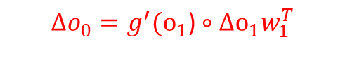
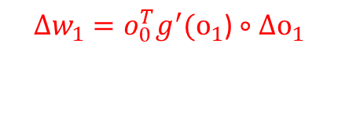
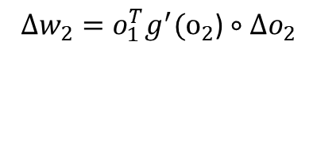
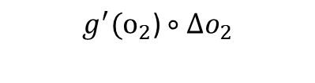
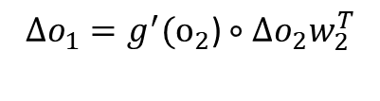

Backpropagation [Cont.]
$$g^{′}(o_{1}\text{)}∘Δo_{1}$$
$${g^{′}(o_{2}\text{)}∘Δo}_{2}$$
0 | 0.117
. | .
. | .
0.39 | -0.39
. | .
. | .
0.15
0
1
0.7
.61
$${Δw}_{1}=o_{0}^{T}g^{′}(o_{1}\text{)}∘Δo_{1}$$
3
$${Δw}_{2}=o_{1}^{T}{g^{′}(o_{2}\text{)}∘Δo}_{2}$$
0.1
1.092 (0)
0.1
0 | 0.351
0 | 0.234
0 | 0.468
-2.3
0.39
0 | 0
0.585 | -0.585
2
-0.3
$${Δo}_{1}={g^{′}(o_{2}\text{)}∘Δo}_{2}w_{2}^{T}$$
$${Δo}_{0}=g^{′}(o_{1}\text{)}∘Δo_{1}w_{1}^{T}$$
-2.1
0.5
.39
1.092 | 0.117
. | .
. | .
0.0585 | 0.117 | -0.0585
. | . | .
. | . | .
4
1
1.5
-0.2
-0.5
-0.39
0.117
Output Layer
with Softmax
Input Layer
1-st Layer (ReLU)
3 | 2 | 4
. | . | .
. | . | .
0 | 1.5
. | .
. | .
0.61 | 0.39
. | .
. | .
1 | 0.5
0.1 | 1
-2.3 | -0.5
0.7 | -2.1
0.1 | -0.2
$$w_{2}$$
$$X_{in}$$
$$w_{1}$$
$$w_{2}$$
$$o_{1}$$
$$o_{2}$$

Slide 45


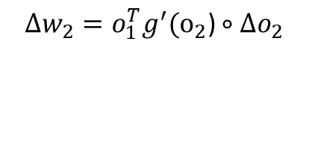
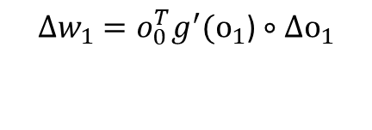
[Example] Update with Learning Rate 0.1
0.15
0
$${Δw}_{1}=o_{0}^{T}g^{′}(o_{1}\text{)}∘Δo_{1}$$
1
0.7
.61
3
$${Δw}_{2}=o_{1}^{T}{g^{′}(o_{2}\text{)}∘Δo}_{2}$$
0 | 0.351
0 | 0.234
0 | 0.468
0.1
1.092 (0)
0.1
-2.3
0.39
0 | 0
0.585 | -0.585
2
-0.3
$$w_{1}=w_{1}+α{Δw}_{1}$$
-2.1
$$w_{2}=w_{2}+α{Δw}_{2}$$
0.5
.39
1 | .5351
0.1 | 1.0234
-2.3 | -0.4532
4
1
0.7 | -2.1
0.1585 | -0.2585
1.5
-0.2
-0.5
-0.39
0.117
Output Layer
with Softmax
Input Layer
1-st Layer (ReLU)
3 | 2 | 4
. | . | .
. | . | .
1 | 0.5
0.1 | 1
-2.3 | -0.5
0.7 | -2.1
0.1 | -0.2
$$w_{2}$$
$$X_{in}$$
$$w_{1}$$
$$w_{2}$$

Slide 46

[Example] Done
1
0.7
3
0.1
-2.3
0.1585
2
-2.1
.5351
4
1.0234
-0.2585
-0.4532
1-st Layer (ReLU)
Output Layer
with Softmax
Input Layer
3 | 2 | 4
. | . | .
. | . | .
1 | 0.5351
0.1 | 1.0234
-2.3 | -0.4532
0.7 | -2.1
0.1585 | -0.2585
$$X_{in}$$
$$w_{1}$$
$$w_{2}$$

Slide 47
Think: What will happen if we go forward again?
1
0.7
3
0.1
-2.3
0.1585
2
-2.1
.5351
4
1.0234
-0.2585
-0.4532
1-st Layer (ReLU)
Output Layer
with Softmax
Input Layer
3 | 2 | 4
. | . | .
. | . | .
1 | 0.5351
0.1 | 1.0234
-2.3 | -0.4532
0.7 | -2.1
0.1585 | -0.2585
$$X_{in}$$
$$w_{1}$$
$$w_{2}$$

Slide 48
Think: What will happen if we go forward again?
0.292
Previous
Output
0
0.15
1
0.7
.68
1
.61
3
0.1
-2.3
0.1585
The final output is closer to the actual label
2
-2.1
-0.475
-0.3
.5351
.32
0
4
.39
1.0234
1.84
-0.2585
-0.4532
1-st Layer (ReLU)
Output Layer
with Softmax
Input Layer
Label
3 | 2 | 4
. | . | .
. | . | .
1 | 0.5351
0.1 | 1.0234
-2.3 | -0.4532
0.7 | -2.1
0.1585 | -0.2585
$$X_{in}$$
$$w_{1}$$
$$w_{2}$$

Slide 49
Tricks for Neural Network

Slide 50
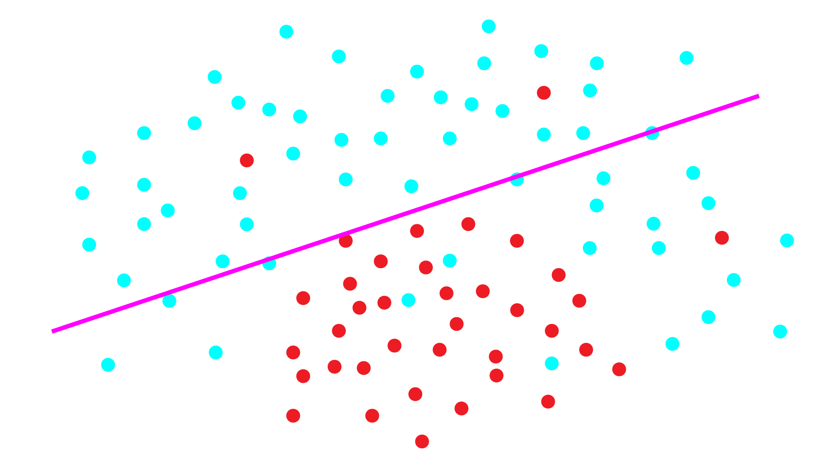
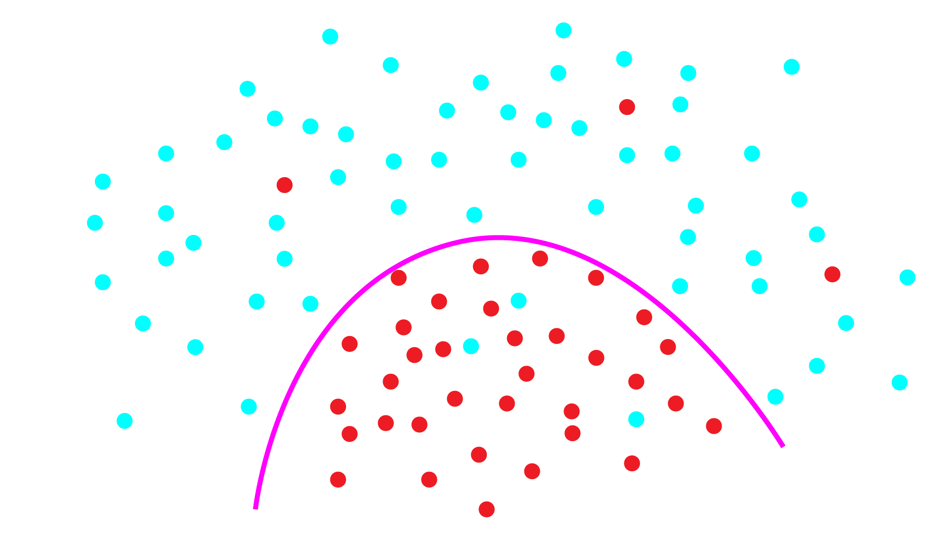
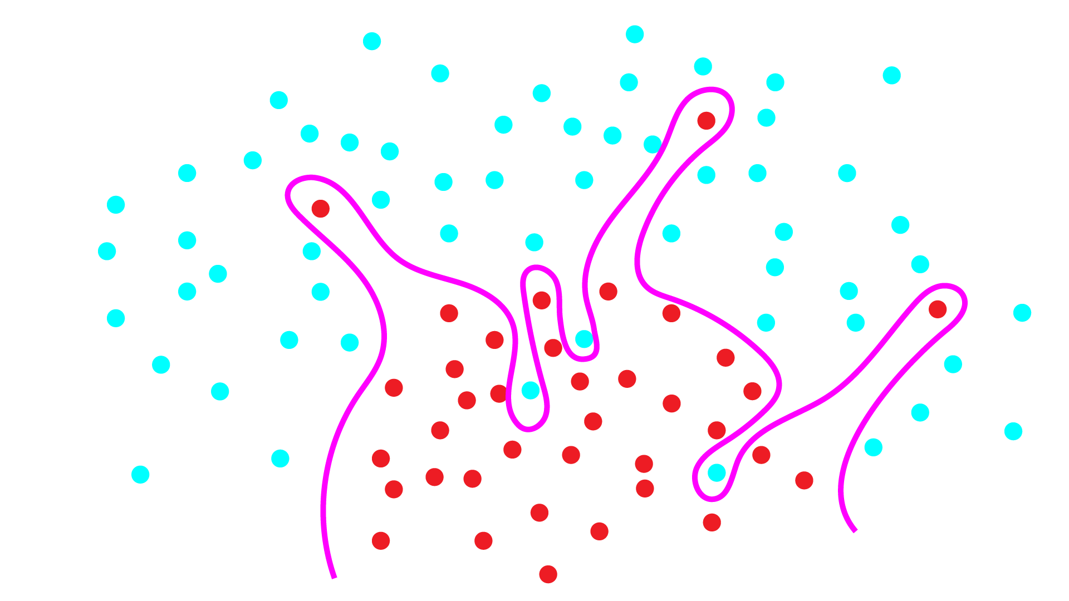
Problem: Under and Overfitting
Underfitting: model not powerful enough, too much bias
Overfitting: model too powerful, fits to noise, doesn’t generalize well
Want the happy medium, how?

Slide 51
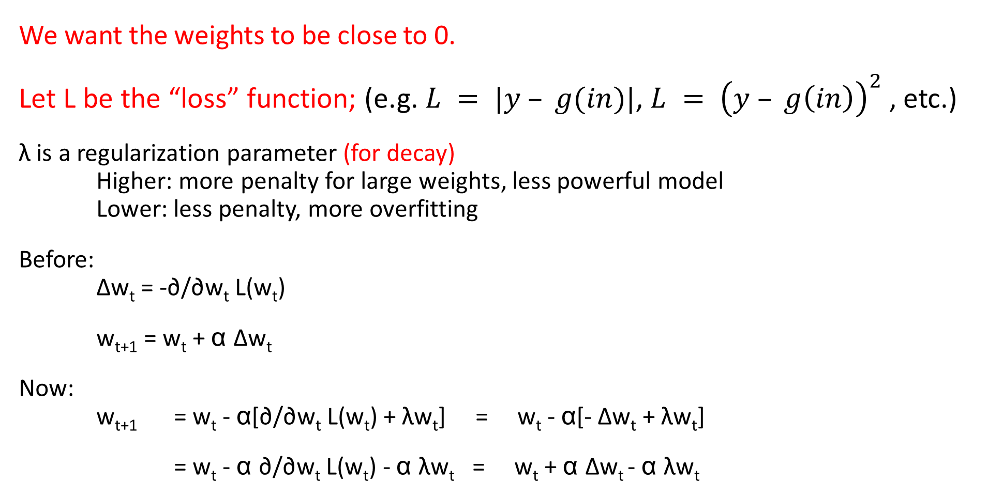

Weight decay: neural network regularization
We use ${Δw}_{t}$to represent the weight gradient for timepoint t (the current step).
We want the weights to be close to 0.
Let L be the “loss” function; (e.g. $L = |y – g(in)|$, $L = {\left(y – g\left(in\right)\right)}^{2}$, etc.)
λ is a regularization parameter (for decay)
Higher: more penalty for large weights, less powerful model
Lower: less penalty, more overfitting
Before:
Δw_{t} = -∂/∂w_{t} L(w_{t})
w_{t+1} = w_{t} + α Δw_{t}
Now:
w_{t+1} = w_{t} - α[∂/∂w_{t} L(w_{t}) + λw_{t}] = w_{t} - α[- Δw_{t} + λw_{t}]
= w_{t} - α ∂/∂w_{t} L(w_{t}) - α λw_{t} = w_{t} + α Δw_{t} - α λw_{t}
Subtract a little bit of weight every iteration

Slide 52
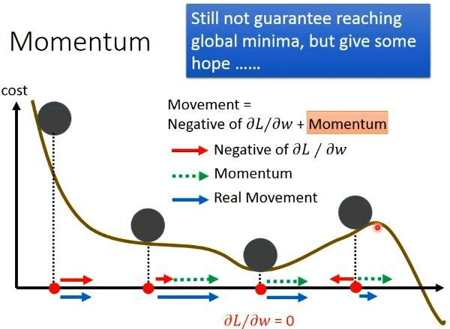
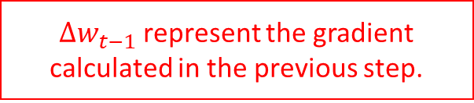
Momentum: speeding up SGD
If we keep moving in same direction we should move further every round
Before:
Δw_{t} = -∂/∂w_{t} L(w_{t})
Now:
Δw_{t} = -∂/∂w_{t} L(w_{t}) + mΔw_{t-1}
w_{t+1} = w_{t} + α Δw_{t}
Side effect: smooths out updates if gradient is in different directions
${Δw}_{t−1}$represent the gradient calculated in the previous step.

Slide 53
NN updates with weight decay and momentum
Δw’_{t} = -∂/∂w_{t} L(w_{t}) - λw_{t} + mΔw’_{t-1}
w_{t+1} = w_{t} + α Δw’_{t}
Momentum
Gradient of loss
Weight decay
Learning rate

Slide 54
Activations

Slide 55
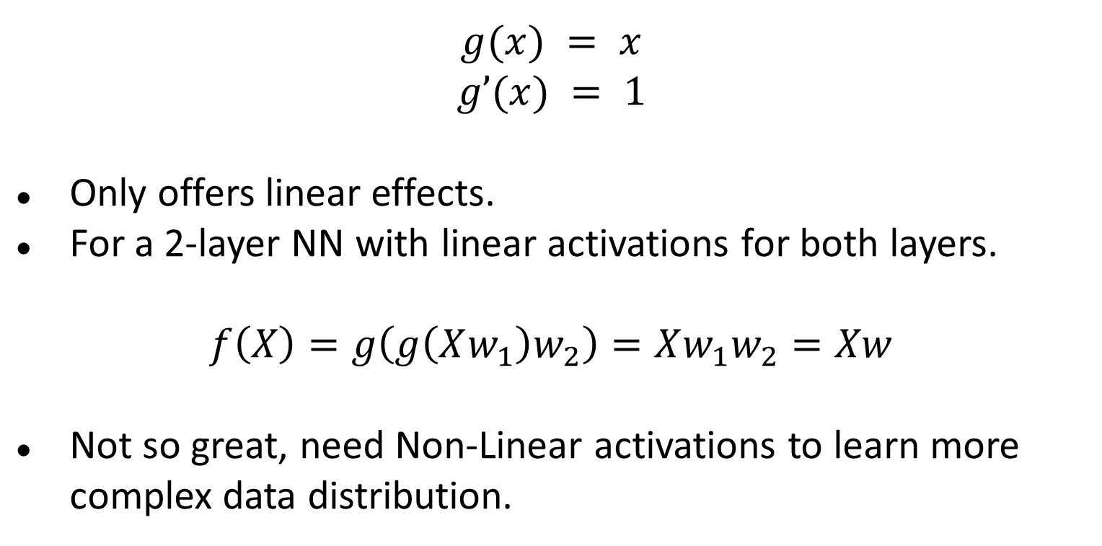
Linear Activation
$$g(x) = x$$
$$g’(x) = 1$$
Only offers linear effects.
For a 2-layer NN with linear activations for both layers.
$$f\left(X\right)=g\left(g\left(Xw_{1}\right)w_{2}\right)=Xw_{1}w_{2}=Xw$$
Not so great, need Non-Linear activations to learn more complex data distribution.

Slide 56
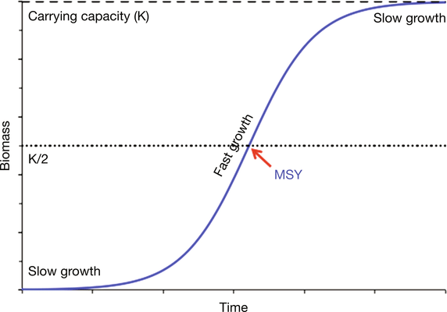
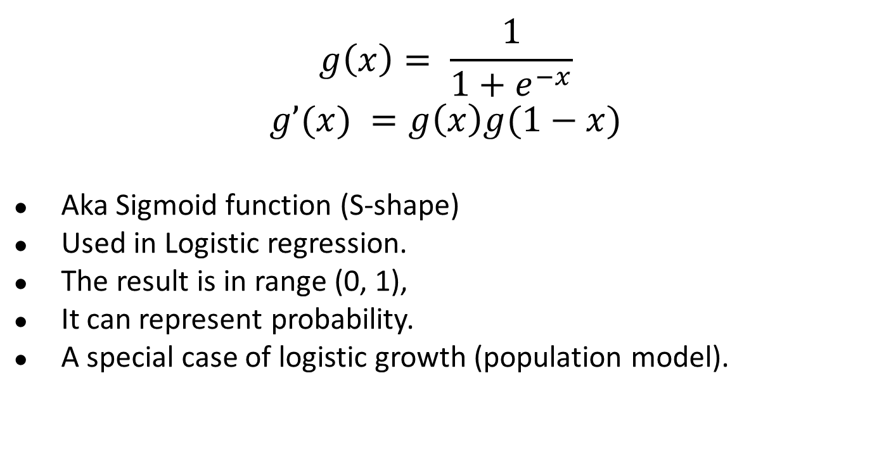
Logistic Activation
$$g\left(x\right)= \frac{1}{1+e^{−x}}$$
$$g’(x) =g\left(x\right)g(1−x)$$
Aka Sigmoid function (S-shape)
Used in Logistic regression.
The result is in range (0, 1),
It can represent probability.
A special case of logistic growth (population model).

Slide 57
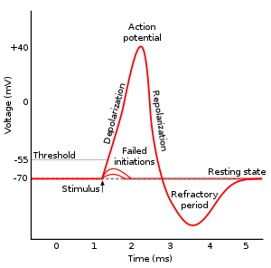
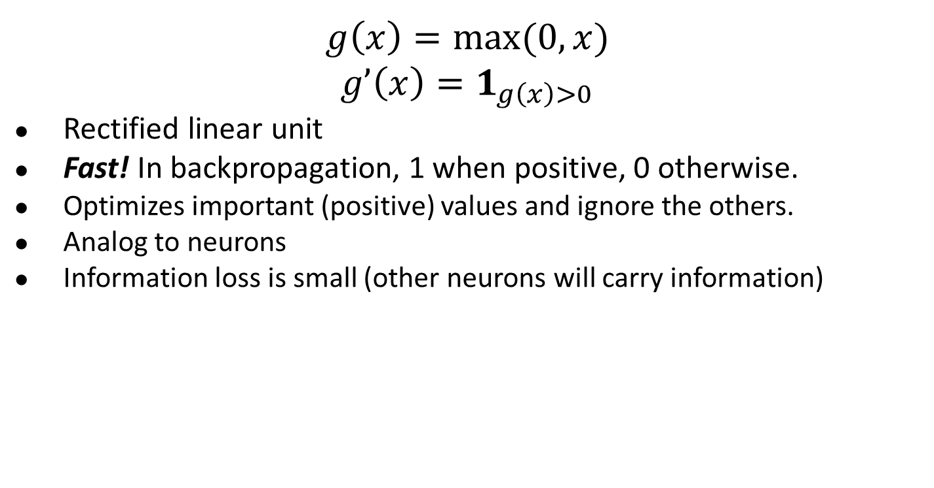
ReLU Activation
$$g\left(x\right)=max⁡(0, x)$$
$$g’\left(x\right)=1_{g\left(x\right)>0}$$
Rectified linear unit
Fast! In backpropagation, 1 when positive, 0 otherwise.
Optimizes important (positive) values and ignore the others.
Analog to neurons
Information loss is small (other neurons will carry information)

Slide 58
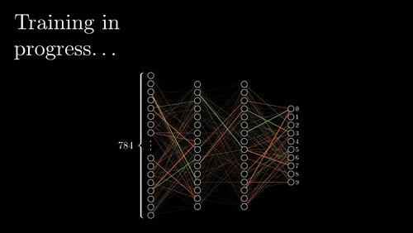
Visualization with ReLU
https://www.youtube.com/channel/UCYO_jab_esuFRV4b17AJtAw

Slide 59
LeakyReLU Activation
No information loss (compared to ReLU)
Solves “dying ReLU” problem (i.e. all neurons output 0)
Similar to ReLU, pays less attention to less important neurons
Not always better than ReLU

Slide 60
CSE 455 Homework 5
Neural Network
Due: 05/28

Slide 61
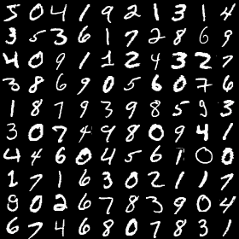
MNIST: Handwriting recognition
50,000 images of handwriting
28 x 28 x 1 (grayscale)
Numbers 0-9
10 class softmax regression
Input is 784 pixel values
Train the model
> 95% accuracy

Slide 62
Functions You need to Code
Functions You need to Code (classifier.c)
void activate_matrix(matrix m, ACTIVATION a)
void gradient_matrix(matrix m, ACTIVATION a, matrix d)
matrix forward_layer(layer *l, matrix in)
matrix backward_layer(layer *l, matrix delta)
void update_layer(layer *l, double rate, double momentum, double decay)
Run Experiments and Write a Report (hw5.pdf)
Play around with tryhw5.py file, and answer the questions.
Save your question to a PDF file and submit to Canvas for grading.

Slide 63
Important Data Structure (image.h)
typedef enum{LINEAR, LOGISTIC, RELU, LRELU, SOFTMAX} ACTIVATION;
typedef struct {
matrix in; // Saved input to a layer
matrix w; // Current weights for a layer
matrix dw; // Current weight updates
matrix v; // Past weight updates (for use with momentum)
matrix out; // Saved output from the layer
ACTIVATION activation; // Activation the layer uses
} layer;
typedef struct {
layer *layers;
int n;
} model;

Slide 64
Useful Matrix manipulation functions (matrix.c)
matrix matrix_mult_matrix(matrix a, matrix b);
matrix transpose_matrix(matrix m);
matrix axpy_matrix(double a, matrix x, matrix y); // a * x + y

Slide 65
Forward Pass in Homework
forward_model
forward_layer
Input: layer l, data in
Input: model m, data X
X = in * l->w
forward_layer
activation_matrix
(X, l->activation)
Output
Output

Slide 66



Backward Pass in Homework
backward_model
backward_layer
Input: layer l, matrix delta
Input: model m, matrix d
gradient_matrix
backward_layer
Calculate $Δw$
Calculate $Δo$
Output
$$Δo$$

Slide 67
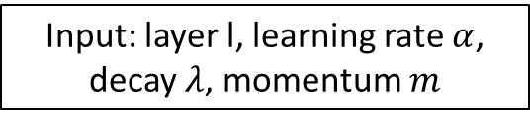

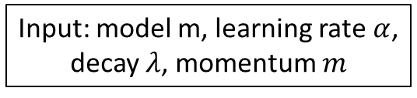
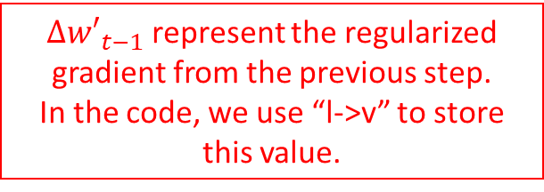

Weight Update in Homework
${Δw′}_{t−1}$represent the regularized gradient from the previous step.
In the code, we use “l->v” to store this value.
update_model
update_layer
Input: layer l, learning rate $α$,
decay $λ$, momentum $m$
Input: model m, learning rate $α$,
decay $λ$, momentum $m$
$$Δw^{′}=Δw−λw+m Δ w_{t−1}^{′}$$
update_layer
Output
$$w=w+αΔw′$$

Slide 68
TODO void activate_matrix(matrix m, ACTIVATION a)
for(i = 0; i < m.rows; ++i){
double sum = 0;
for(j = 0; j < m.cols; ++j){
double x = m.data[i][j];
if(a == LOGISTIC){
// TODO m.data[i][j] should equals 1 / (1 + exp(-x));
} else if (a == RELU){
// TODO m.data[i][j] should equals x if x > 0; otherwise, it should equal 0
} else if (a == LRELU){
// TODO m.data[i][j] should equals x if x > 0; otherwise, it should equal 0.1 * x.
} else if (a == SOFTMAX){
// TODO m.data[i][j] should equals exp(x) here, and we will normalize it later.
}
sum += m.data[i][j];
}
if (a == SOFTMAX) {
// TODO: have to normalize by sum if we are using SOFTMAX
// for all the possible j, we should normalize it as m.data[i][j] /= sum;
}
}
Apply activation “a” to the matrix “m”

Slide 69
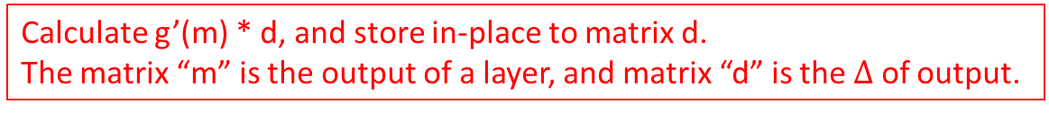
TODO void gradient_matrix(matrix m, ACTIVATION a, matrix d)
Calculate g’(m) * d, and store in-place to matrix d.
The matrix “m” is the output of a layer, and matrix “d” is the $Δ$ of output.
int i, j;
for(i = 0; i < m.rows; ++i){
for(j = 0; j < m.cols; ++j){
double x = m.data[i][j];
// TODO: multiply the correct element of d by the gradient
// if a is SOFTMAX or a is LINEAR, we should do nothing (multiply by 1)
// if a is LOGISTIC, d.data[i][j] should times x * (1.0 - x);
// if a is RELU and x <= 0, d.data[i][j] should be zero
// if a is LRELU and x <= 0, d.data[i][j] should multiple 0.1
}
}

Slide 70
TODO matrix forward_layer(layer *l, matrix in)
Given the input data “in” and layer “l”, calculate the output data.
l->in = in; // Save the input for backpropagation
// TODO: multiply input by weights and apply activation function.
// Calculate out = in * l->w (note: matrix multiplication here)
// Then, apply activate_matrix function to out with l->activation
free_matrix(l->out);// free the old output
l->out = out; // Save the current output for gradient calculation
return out;

Slide 71
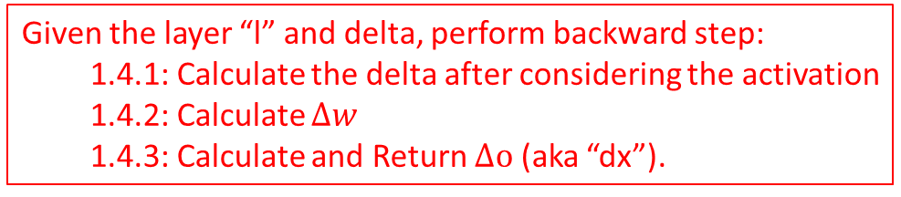
TODO matrix backward_layer(layer *l, matrix delta)
Given the layer “l” and delta, perform backward step:
  1.4.1: Calculate the delta after considering the activation
  1.4.2: Calculate $Δw$
  1.4.3: Calculate and Return $Δo$ (aka “dx”).
// delta is Δout
// TODO: modify it in place to be “g'(out) * delta” out with // gradient_matrix function.
// You can use gradient_matrix function with “l->out” and “l->activation” to “delta”
// TODO: then calculate dL/dw and save it in l->dw
free_matrix(l->dw);
// Calculate xt as the transpose matrix of “l->in”
// Calculate dw as xt times delta (matrix multiplication)
// free matrix xt to avoid memory leak
l->dw = dw;
// TODO: finally, calculate dL/dx and return it. (Similar to 1.4.2. Care memory leak)
// Calculate dx = delta * (l->w)^T, where * is matrix multiplication and ^T is matrix transpose
return dx;

Slide 72
TODO void update_layer(layer *l, double rate, double momentum, double decay)
Given a layer “l”, learning rate, momentum, and decay rate,
Update the weight (i.e. l->w)
// Calculate Δw_t = dL/dw_t - λw_t + mΔw_{t-1}
// save it to l->v
// Note that You can use axpy_matrix to perform the matrix summation/subtraction
// Update l->w
// l->w = rate * l->v + l->w
Note the multiplication and summation in this slides all mean matrix multiplication or matrix summation.

Slide 73
Functions You Need to Know before Experiments
For simplicity, we already filled the following functions for you. You should read and understand these functions (classifier.c) before running experiments.
layer make_layer(int input, int output, ACTIVATION activation)
matrix forward_model(model m, matrix X)
void backward_model(model m, matrix dL)
void update_model(model m, double rate, double momentum, double decay)
double accuracy_model(model m, data d)
double cross_entropy_loss(matrix y, matrix p)
void train_model(model m, data d, int batch, int iters, double rate, double momentum, double decay)

Slide 74
Get the Data
1. Download, Unzip, and Prepare the MNIST Dataset
wget https://pjreddie.com/media/files/mnist_train.tar.gz
wget https://pjreddie.com/media/files/mnist_test.tar.gz
tar xzf mnist_train.tar.gz
tar xzf mnist_test.tar.gz
find train -name \*.png > mnist.train
find test -name \*.png > mnist.test
2. Download, Unzip, and Prepare the CIFAR-10 Dataset
wget http://pjreddie.com/media/files/cifar.tgz
tar xzf cifar.tgz
find cifar/train -name \*.png > cifar.train
find cifar/test -name \*.png > cifar.test

Slide 75
Experiments (Write Your Answers to hw5.pdf)
Coding and Data prepare
MNIST Experiments
  Linear Softmax Model (1-layer)
    Run the basic model
    Tune the learning rate
    Tune the decay
  Neural Network (2-layer NNs and 3-layer NNs)
    Find the best activation
    Tune the learning rate
    Tune the decay
    Tune the decay for 3-layer Neural Network
Experiments for CIFAR-10
  Neural Network (3-layer NNs)
    Tune the learning rate and decay

