Slide 1
Computer Vision
CSE 455
Linda Shapiro
Professor of Computer Science & Engineering
Professor of Electrical Engineering

Slide 2
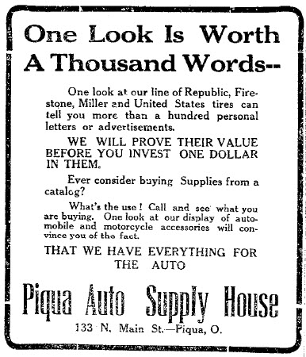
Notes:
Why?

Slide 3
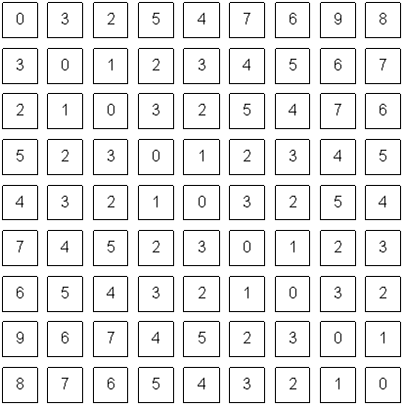
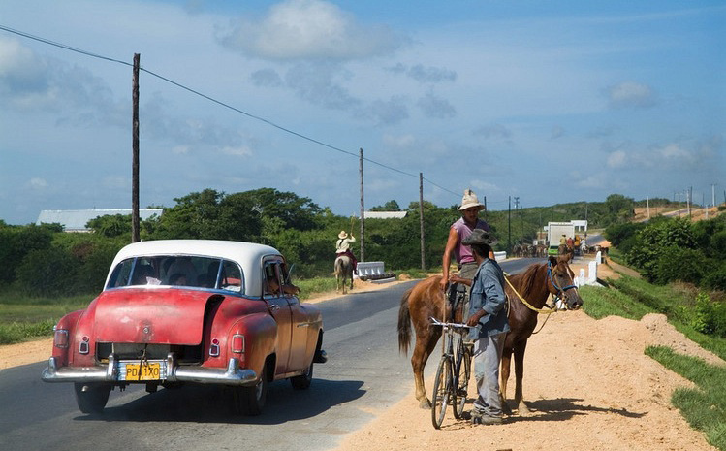
Notes:
pixels

Slide 4
The car is in front of the pole
Sky
Person
White
Horse
Car
Road
Shadow
1m
Wheel
Notes:
What do we care about in this image? color, measurement, foreground/background, potential objects, detecting particular objects

Slide 5
The car is in front of the pole
Sky
Person
Road
White
Horse
Car
Shadow
1m
Wheel

Slide 6
Computer Vision
Low Level Vision
  Measurements
  Enhancements
  Region segmentation
  Features
Mid Level Vision
  Reconstruction
  Depth
  Motion Estimation
High Level Vision
  Category detection
  Activity recognition
  Deep understandings

Slide 7
Computer Vision
Low Level Vision
  Measurements
  Enhancements
  Region segmentation
  Features
Mid Level Vision
  Reconstruction
  Depth
  Motion Estimation
High Level Vision
  Category detection
  Activity recognition
  Deep understandings
White
Shadow
1m

Slide 8
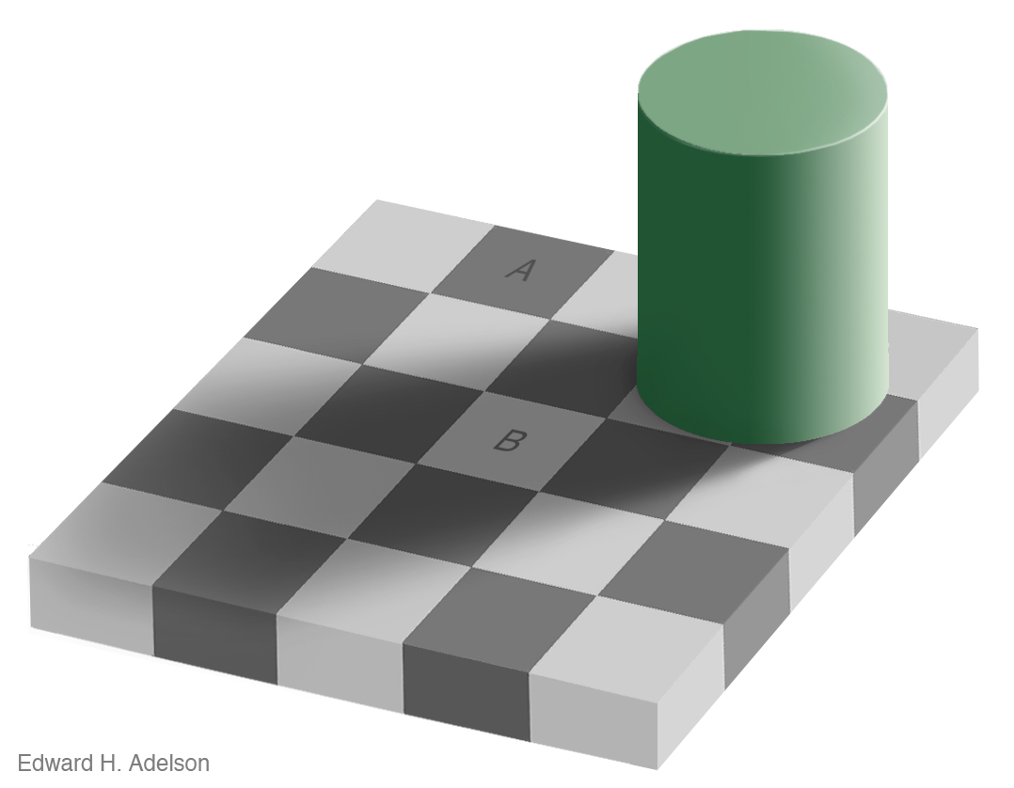
Measurement
Brightness
Notes:
See VIDEO

Slide 9
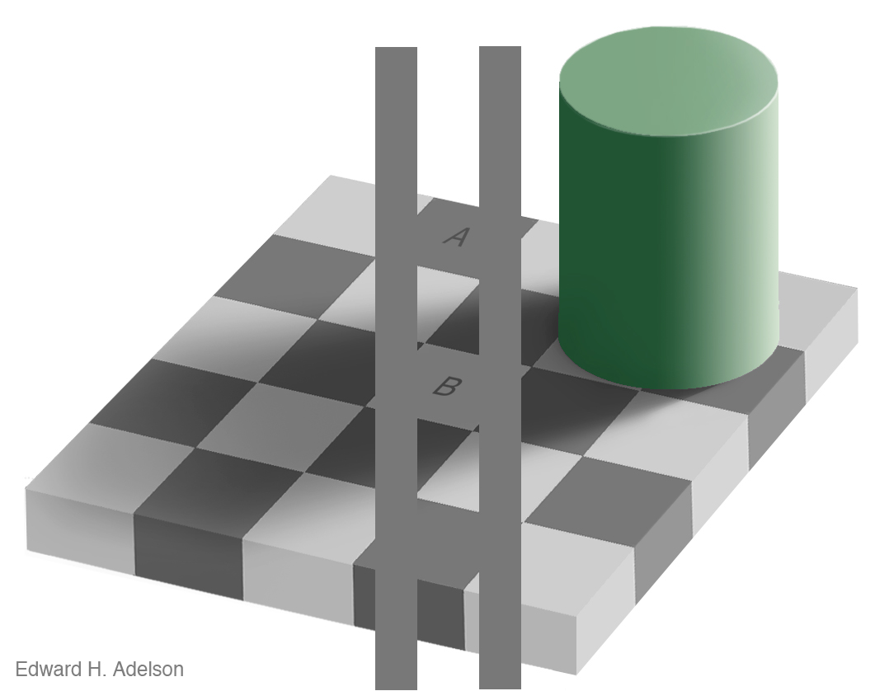
Measurement
Brightness
http://www.newworldencyclopedia.org/entry/Same_color_illusion
Slide Credit: Alyosha Efros

Slide 10
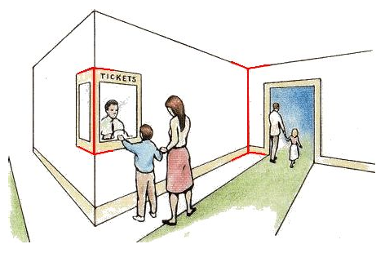
Measurement
Length
Müller-Lyer Illusion
http://www.michaelbach.de/ot/sze_muelue/index.html
Slide Credit: Alyosha Efros
Notes:
red vertical lines look like same length in image but not in reality

Slide 11
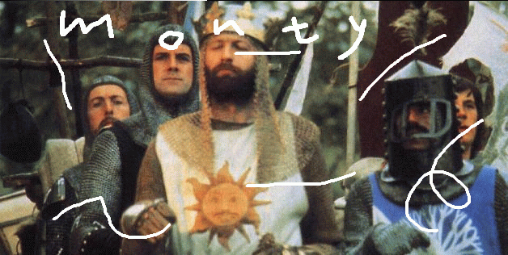
Image Enhancement
Image Inpainting, M. Bertalmío et al.
http://www.iua.upf.es/~mbertalmio//restoration.html
Notes:
About restoration

Slide 12
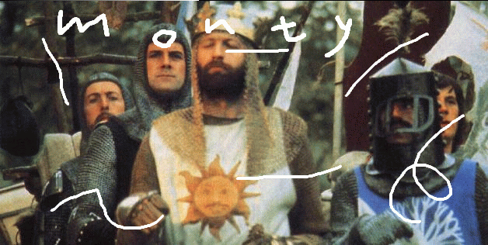
Image Enhancement
Image Inpainting, M. Bertalmío et al.
http://www.iua.upf.es/~mbertalmio//restoration.html

Slide 13
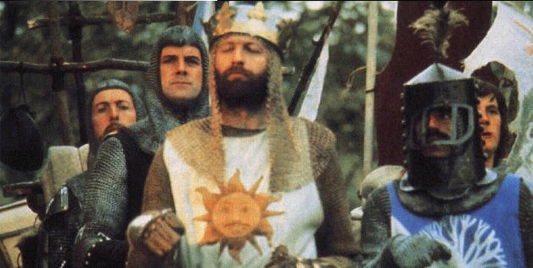
Image Enhancement
Image Inpainting, M. Bertalmío et al.
http://www.iua.upf.es/~mbertalmio//restoration.html

Slide 14
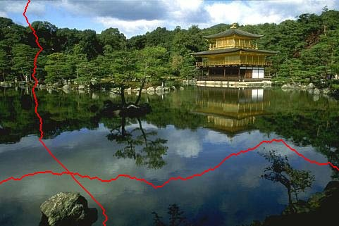
Seam Carving
less
important
[Shai & Avidan, SIGGRAPH 2007]

Slide 15
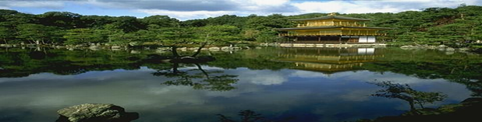
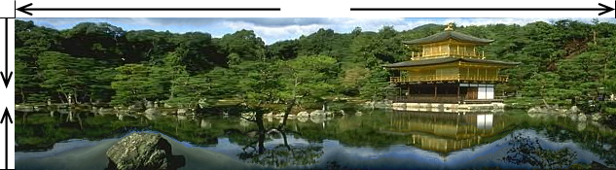
Traditional resizing uses and stretches the whole image.
Content-aware resizing uses important areas.
Extends in horizontal direction and reduces in vertical.
[Shai & Avidan, SIGGRAPH 2007]

Slide 16
Computer Vision
Low Level Vision
  Measurements
  Enhancements
  Region segmentation
  Features
Mid Level Vision
  Reconstruction
  Depth
  Motion Estimation
High Level Vision
  Category detection
  Activity recognition
  Deep understandings
The car is in front of the pole

Slide 17
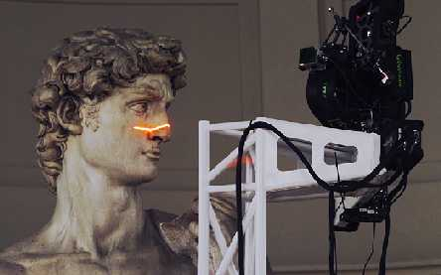
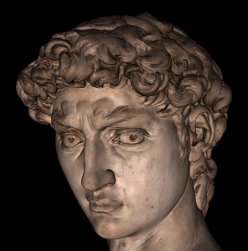
Applications: 3D Scanning
Scanning Michelangelo’s “The David”
  The Digital Michelangelo Project
    - http://graphics.stanford.edu/projects/mich/
  UW Prof. Brian Curless, collaborator
  2 BILLION polygons, accuracy to .29mm

Slide 18
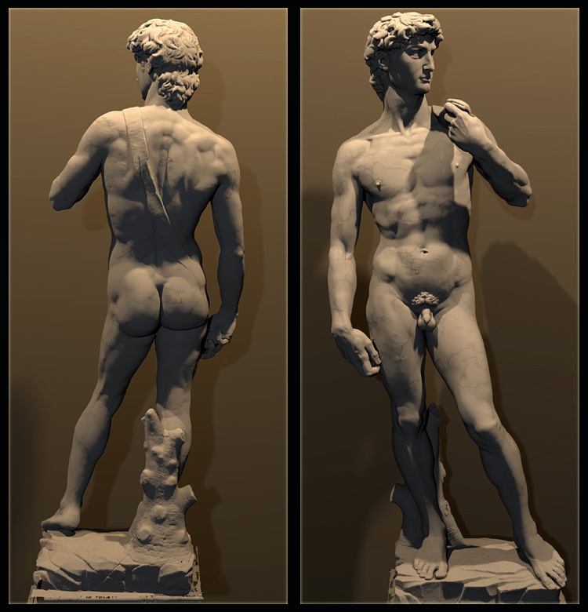
  The Digital Michelangelo Project, Levoy et al.

Slide 19
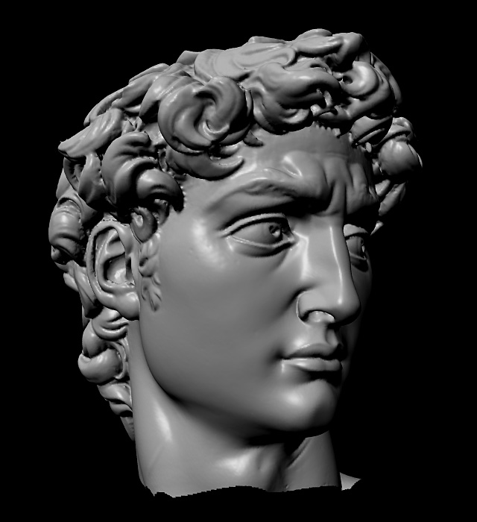

Slide 20
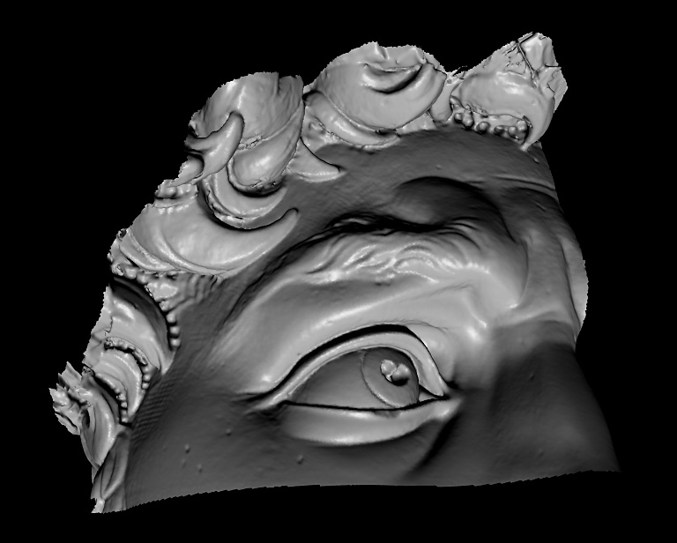

Slide 21
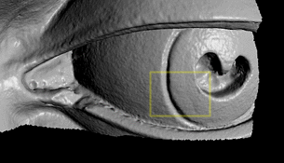

Slide 22
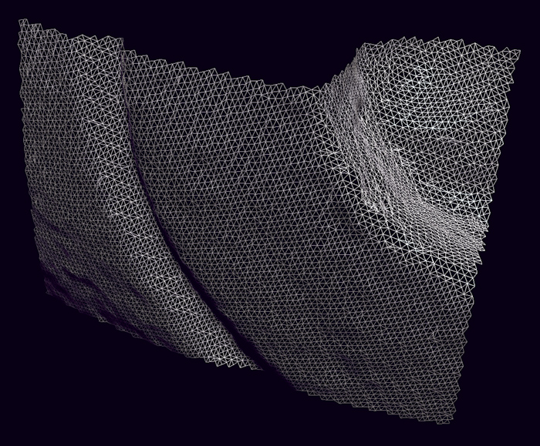

Slide 23
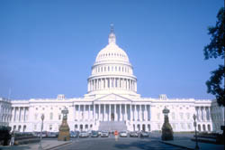
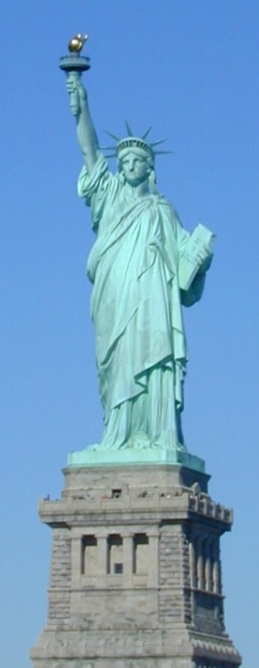
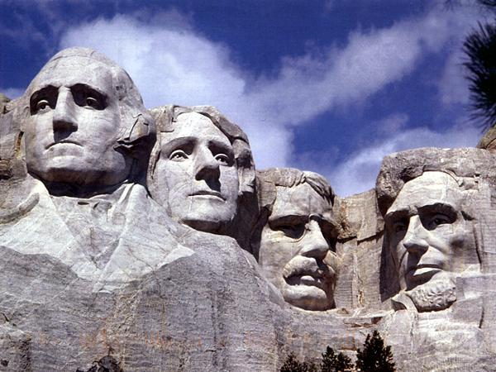
Notes:
Could these be done in the same way as David? NO.

Slide 24
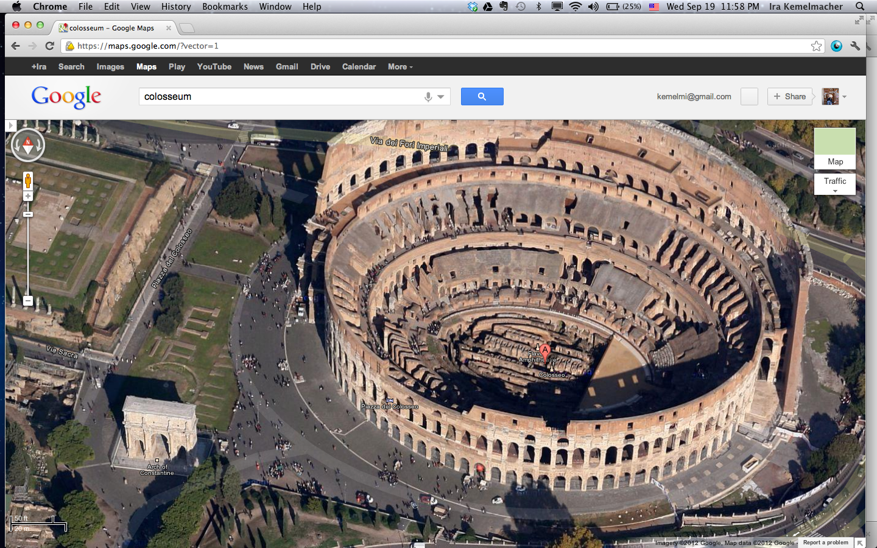
Google’s 3D Maps
Structure estimation from tourist photos

Slide 25
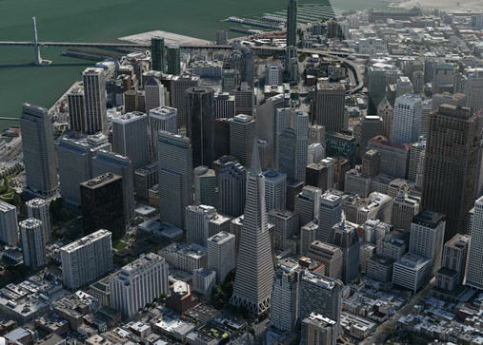
Apple’s 3D maps
https://www.youtube.com/watch?v=InIVv-LsgZE
Notes:
See link to video.

Slide 26
Computer Vision
Low Level Vision
  Measurements
  Enhancements
  Region segmentation
  Features
Mid Level Vision
  Reconstruction
  Depth
  Motion Estimation
High Level Vision
  Category detection
  Activity recognition
  Deep understandings
  Pose estimation
Sky
Person
Road
Car
Horse

Slide 27
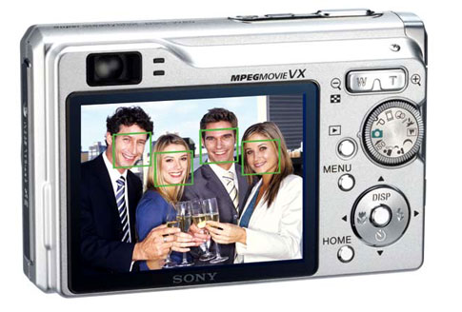
Face detection
Many new digital cameras now detect faces
  Canon, Sony, Fuji, …
Source: S. Seitz
Notes:
Why would this be useful? Main reason is focus. Also enables “smart” cropping.

Slide 28
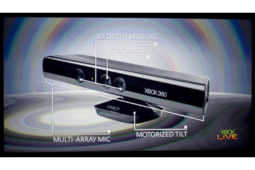
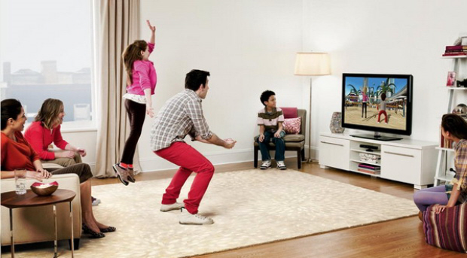
Vision-based interaction: Xbox Kinect

Slide 29
How hard is computer vision?

Slide 30

“In 1966, Minsky hired a first-year undergraduate student and assigned him a problem to solve over the summer: connect a television camera to a computer and get the machine to describe what it sees.”
Crevier 1993, pg. 88
Marvin Minsky, MIT
Turing award,1969

Slide 31
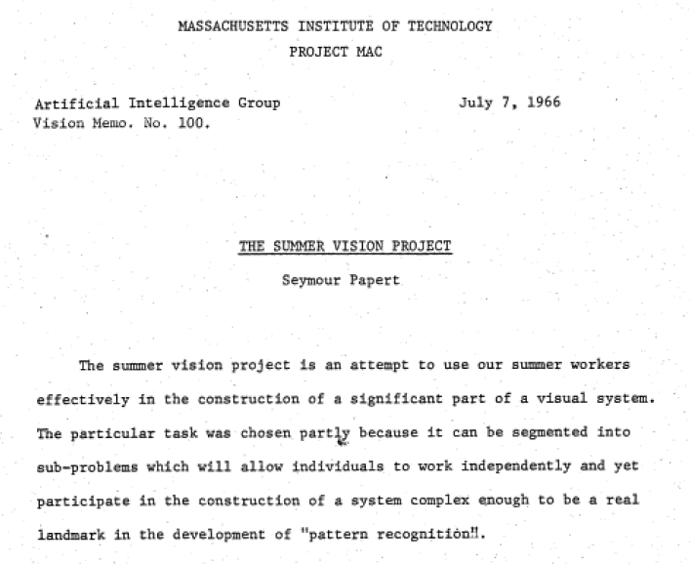

Slide 32
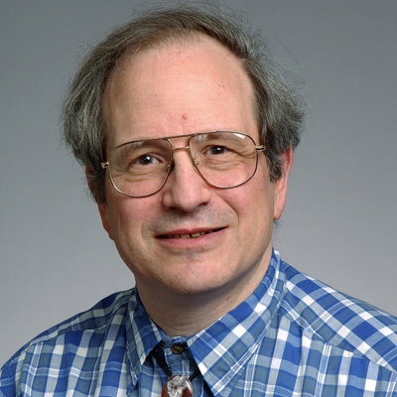
Marvin Minsky, MIT
Turing award,1969
Gerald Sussman, MIT
(the undergraduate)
“You’ll notice that Sussman never worked in vision again!” – Berthold Horn

Slide 33
Why vision is so hard?

Slide 34
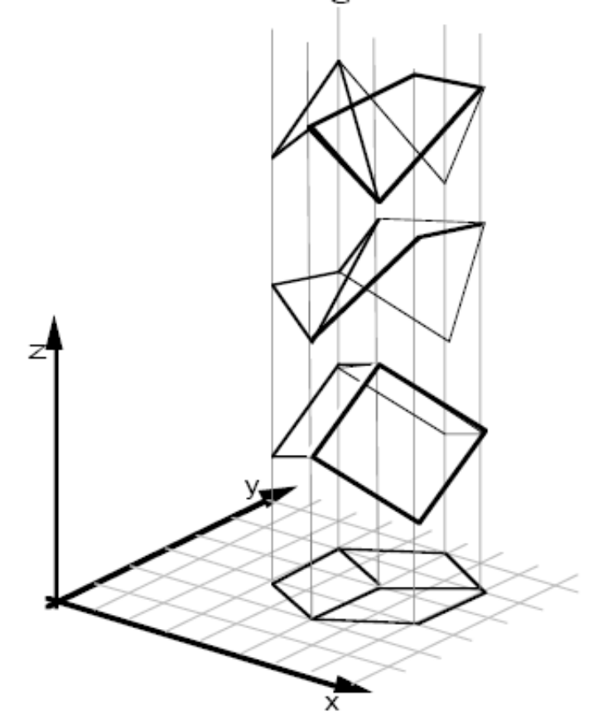
Why is vision so hard?
Ill-posed problem
[Sinha and Adelson 1993]
Notes:
Recovering 3D geometry from a single 2D image is mathematically impossible. A single 2D projection can be produced by any of infinite number of 3D geometrical configurations.

Slide 35
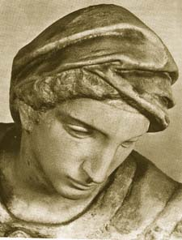
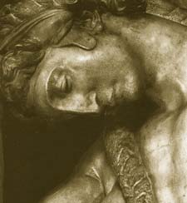
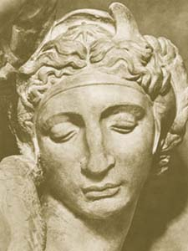
Challenges 1: view point variation
Michelangelo 1475-1564
slide by Fei Fei, Fergus & Torralba

Slide 36
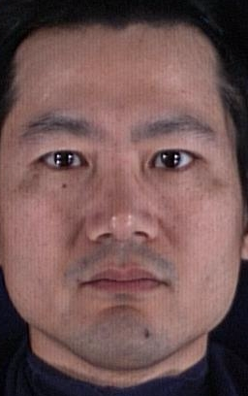
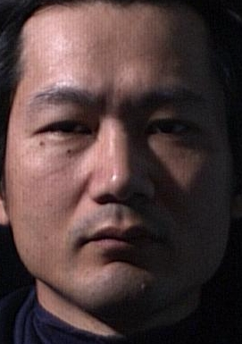
Challenges 2: illumination
slide credit: S. Ullman

Slide 37
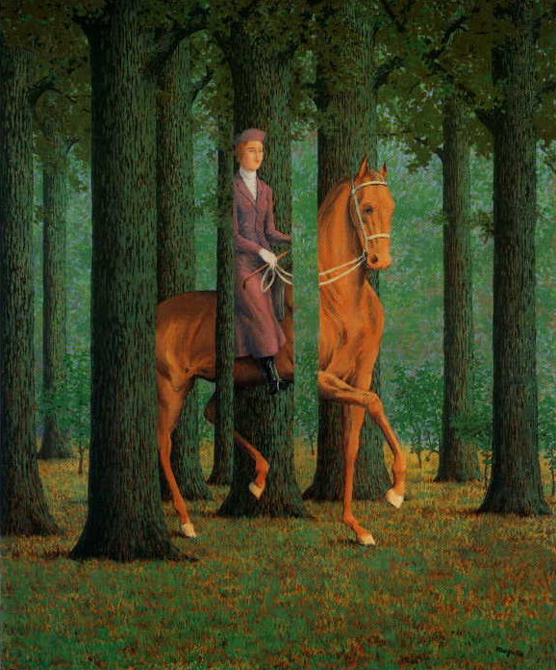
Challenges 3:
occlusion
Magritte, 1957
slide by Fei Fei, Fergus & Torralba

Slide 38
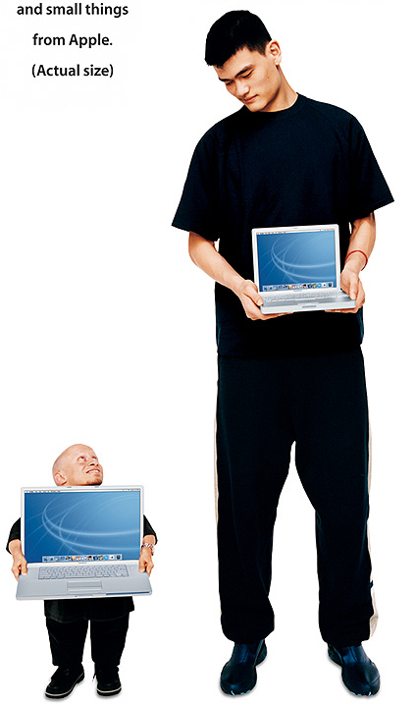
Challenges 4: scale
slide by Fei Fei, Fergus & Torralba

Slide 39
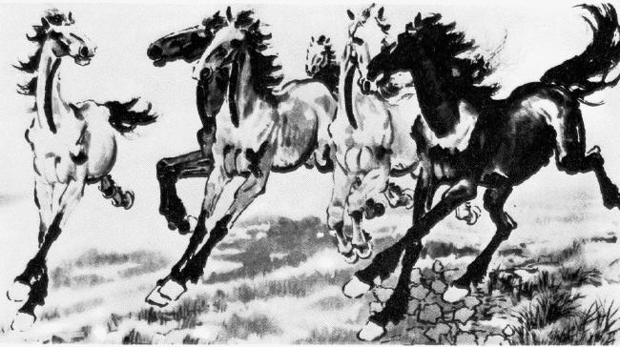
Challenges 5: deformation
slide by Fei Fei, Fergus & Torralba
Xu, Beihong 1943

Slide 40
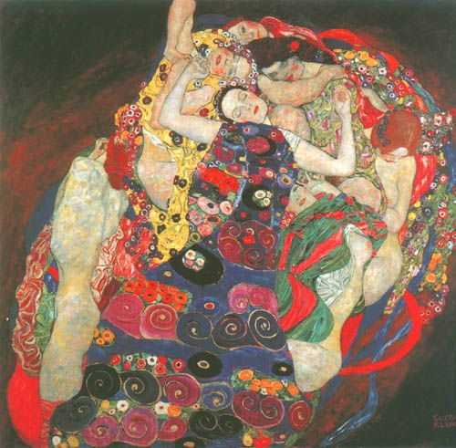
Challenges 6: background clutter
Klimt, 1913
slide by Fei Fei, Fergus & Torralba

Slide 41
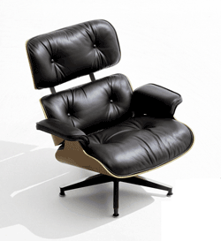
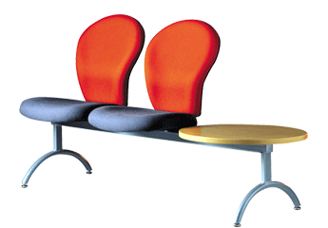
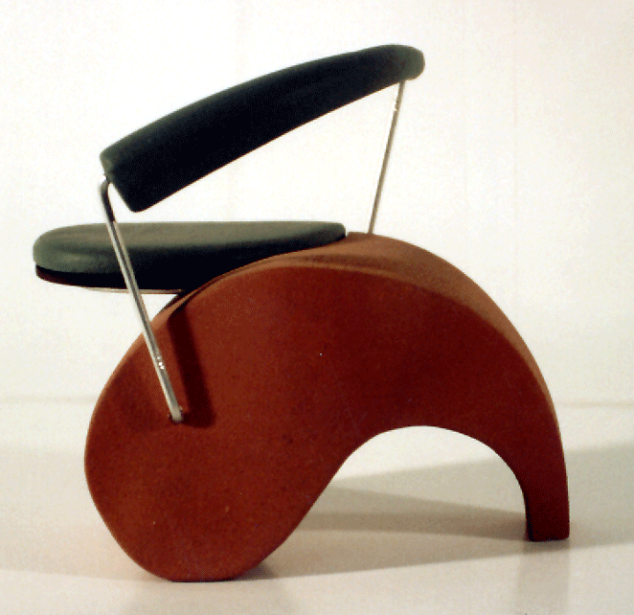
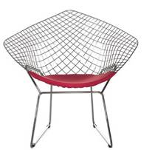
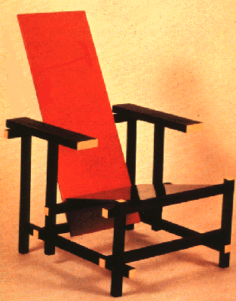
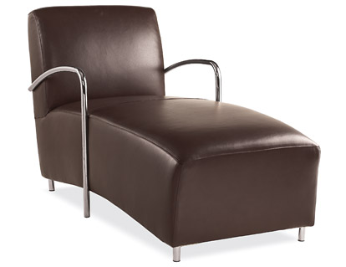
Challenges 7: object intra-class variation
slide by Fei-Fei, Fergus & Torralba

Slide 42




Challenges 8: local ambiguity
slide by Fei-Fei, Fergus & Torralba
Notes:
What is that patch in the different images? hand, shoes person talking on cellphone, car, person

Slide 43
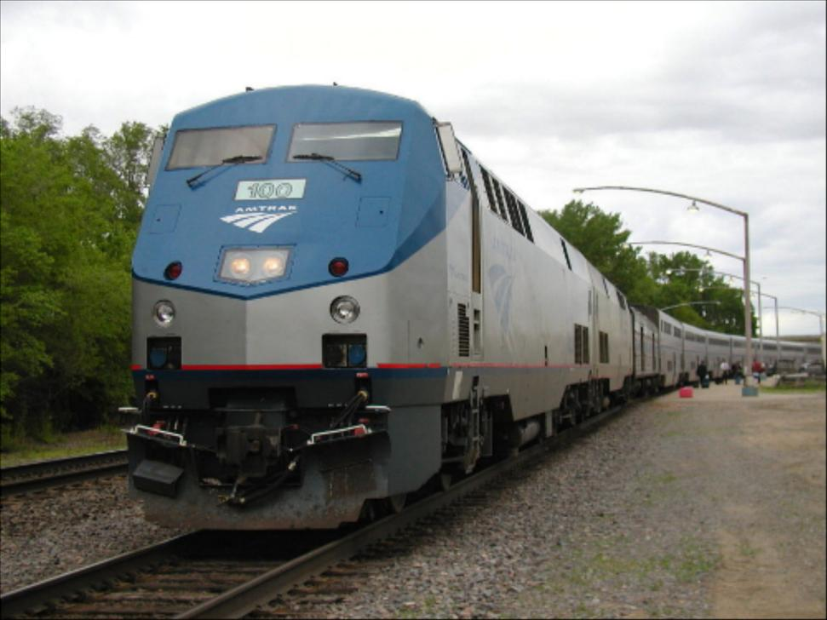
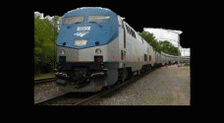
Challenges 9: the world behind the image
Slide Credit: Alyosha Efros
Notes:
Ask Ali.

Slide 44
What Works Today?

Slide 45
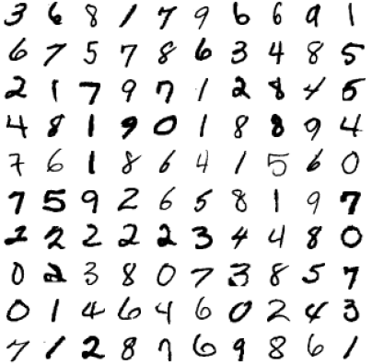
Reading license plates, zip codes, checks
Svetlana Lazebnik

Slide 46
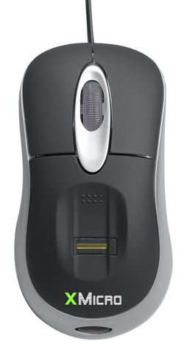

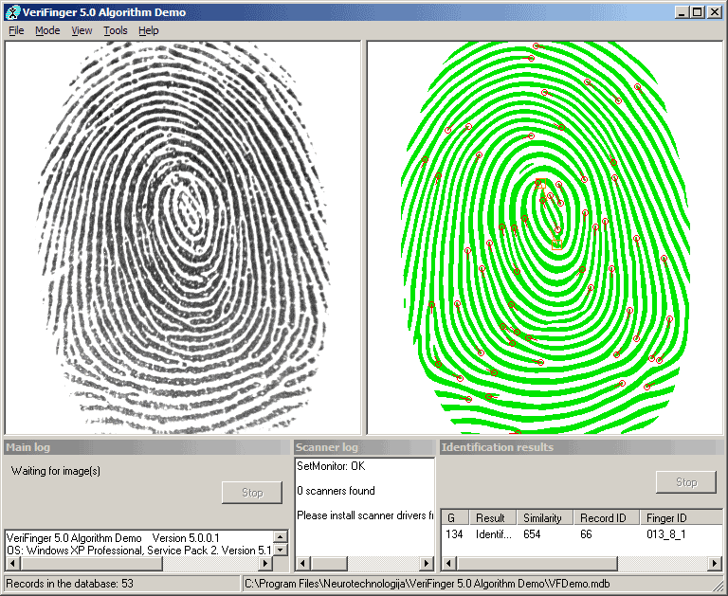

Biometrics
Fingerprint scanners on many new laptops,
other devices
Face recognition systems now beginning to appear more widely
http://www.sensiblevision.com/
Source: S. Seitz

Slide 47


Mobile visual search: Google Goggles

Slide 48
Face detection
Many new digital cameras now detect faces
  Canon, Sony, Fuji, …
Source: S. Seitz
Notes:
Why would this be useful? Main reason is focus. Also enables “smart” cropping.

Slide 49


Smile detection
Sony Cyber-shot® T70 Digital Still Camera
Source: S. Seitz

Slide 50

Face recognition: Apple iPhoto, Facebook, Google, etc

Slide 51

Object recognition (in supermarkets)
LaneHawk by EvolutionRobotics
“A smart camera is flush-mounted in the checkout lane, continuously watching for items. When an item is detected and recognized, the cashier verifies the quantity of items that were found under the basket, and continues to close the transaction. The item can remain under the basket, and with LaneHawk,you are assured to get paid for it… “

Slide 52


Safety

Slide 53


Security

Slide 54

Automotive safety
Mobileye: Vision systems in high-end BMW, GM, Volvo models
  Pedestrian collision warning
  Forward collision warning
  Lane departure warning
  Headway monitoring and warning
Source: A. Shashua, S. Seitz

Slide 55

Google cars
Oct 9, 2010. "Google Cars Drive Themselves, in Traffic". The New York Times. John Markoff
June 24, 2011. "Nevada state law paves the way for driverless cars". Financial Post. Christine Dobby
Aug 9, 2011, "Human error blamed after Google's driverless car sparks five-vehicle crash". The Star (Toronto)

Slide 56
Vision-based interaction: Xbox Kinect

Slide 57

Augmented reality, consumer products
http://nconnex.com/wp/

Slide 58




Special effects: shape and motion capture
Source: S. Seitz
Notes:
vision are used in many special effects. 3D modeling is used to insert synthetic objects in the scene and relight them, so they look realistic. In motion capture, instead of animating the motion from scratch, you can have people performing the motion, then the motion is transferred to the animated character.

Slide 59

Vision for robotics, space exploration
NASA'S Mars Exploration Rover Spirit captured this westward view from atop
a low plateau where Spirit spent the closing months of 2007.
Vision systems (JPL) used for several tasks
  Panorama stitching
  3D terrain modeling
  Obstacle detection, position tracking
Source: S. Seitz

Slide 60


Medical imaging
3D imaging
MRI, CT
Image guided surgery
Grimson et al., MIT

Slide 61

Classification of 22q11.2DS
Treat 2D azimuth-elevation angle
histogram as feature vector
Notes:
We also used the 2D histogram to analyze the 22q11.2DS data.
This figure shows the projection of the histogram bins back onto the face. We can see that there is a difference in the pattern between individuals with 22q11.2DS and controls.
All the experiments were performed using 10 fold cross validation
SVM classifier

Slide 62
Computer vision in other scientific fields

Slide 63


Computer vision research in biology
http://www.vision.caltech.edu/visipedia/
http://leafsnap.com/

Slide 64



Computer vision in cosmology
http://astrometry.net/

Slide 65


Computer vision research in healthcare
assisted living, patient monitoring
[Lan et al, PAMI 2012]
autism screening
http://www.gatech.edu/newsroom/release.html?nid=60509

Slide 66
Computer vision in the real-world
Most examples are less than 5 years old
Very active research area. Many new applications to come.
A website of computer vision industries maintained by Prof. David Lowe (UBC):
http://www.cs.ubc.ca/~lowe/vision.html

Slide 67
Assignments
Assignment 0: Fun with Color
Assignment 1: Image Resizing
Assignment 2: Image Filtering
Assignment 3: Panorama Stitching
Assignment 4: Optical Flow
Assignment 5: Neural Networks
Assignment 6: Pytorch
Course Project: Teams working on Machine Learning Projects

Slide 68
Assignment 0
We’re releasing it today in order for you to get started on downloading and trying out software
It’s about color, which we will cover Tuesday.
It’s meant to be very easy, but you want to start it early.

Slide 69

Assignment 0 Parts
1. data structure for an image
typedef struct{
int h, w, c;
float *data;
} image;
So an image is a 3D array with height, width and channels (like for colors).
data is floating point numbers between 0 and 1

Slide 70
Assignment 0: Parts
Read them on the weekend
TODO #1: get_pixel and set_pixel
TODO #2: copy_image
TODO #3: rgb_to_grayscale
TODO #4: shift_image (shifts values)
TODO #5: clamp_image (get values between 0 and 1)
TODO #6: rgb_to_hsv
TODO #7: hsv_to_rgb

Slide 71
Have Fun

