Slide 1
Computer Vision
CSE 455
Interest Regions, Recognition, and Matching
Linda Shapiro
Professor of Computer Science & Engineering
Professor of Electrical Engineering

Slide 2
The Kadir Operator
Saliency, Scale and Image Description
Timor Kadir and Michael Brady
University of Oxford

Slide 3
The issues…
salient – standing out from the rest, noticeable, conspicous, prominent
scale – find the best scale for a feature
image description – create a descriptor for use in object recognition

Slide 4
Early Vision Motivation
pre-attentive stage: features pop out
attentive stage: relationships between features and grouping

Slide 5
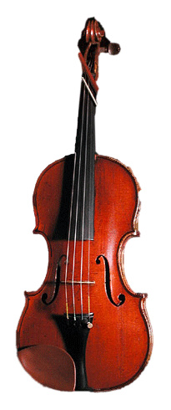
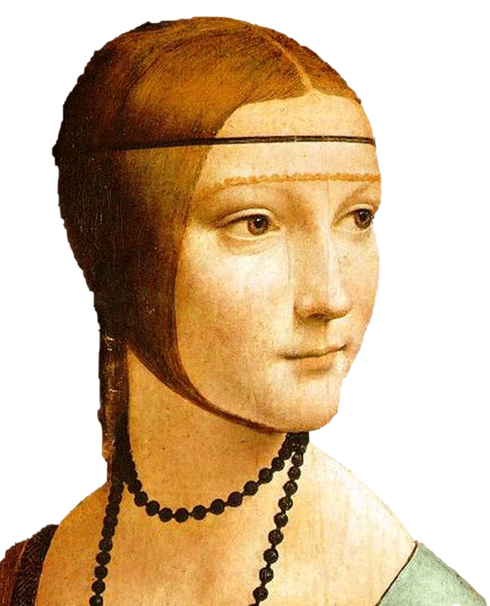
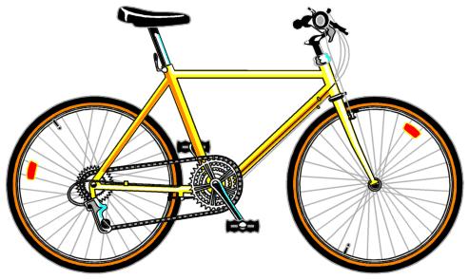
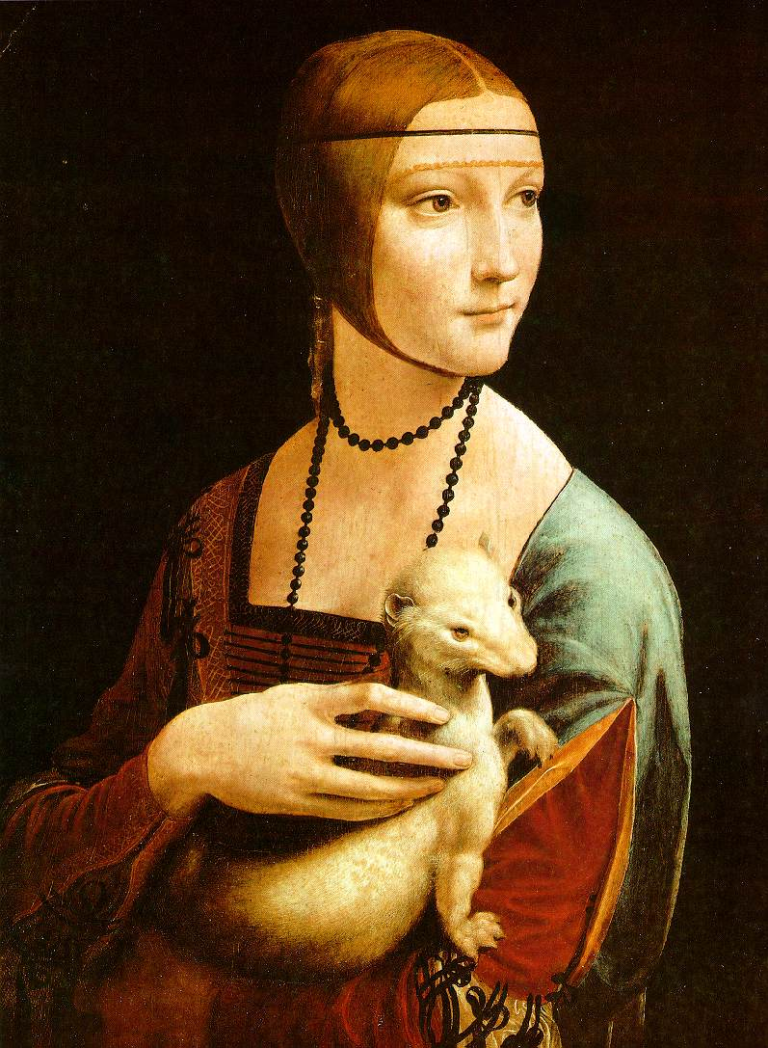
Bags of Words

Slide 6
Detection of Salient Features for an Object Class

Slide 7
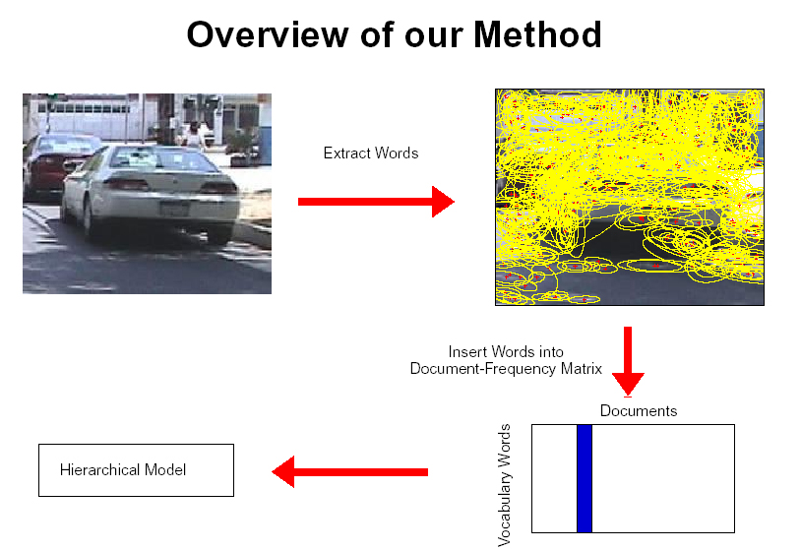
How do we do this?
fixed size windows (simple approach)
Harris detector, Lowe detector, etc.
Kadir’s approach

Slide 8
Kadir’s Approach
Scale is intimately related to the problem of determining saliency and extracting relevant descriptions.
Saliency is related to the local image complexity, ie. Shannon entropy.
entropy definition H = -∑ P_{i} log₂ P_{i}
i in set
of interest

Slide 9
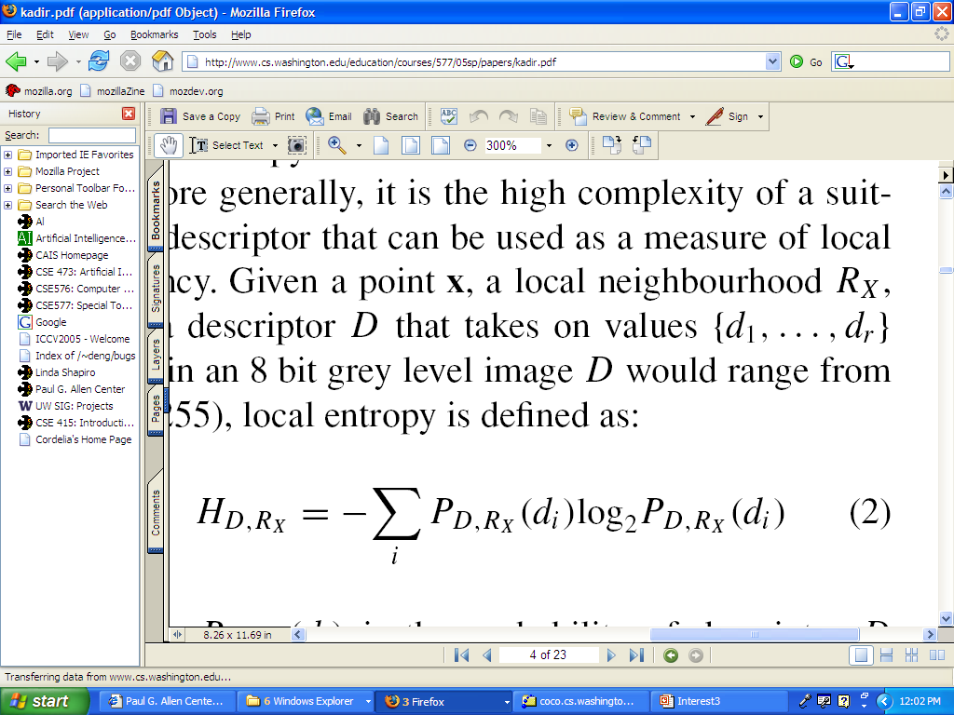
Specifically
x is a point on the image
R_{x} is its local neighborhood
D is a descriptor and has values {d₁, ... d_{r}}.
P_{D,Rx}(d_{i}) is the probability of descriptor D taking the value d_{i} in the local region R_{x}. (The normalized histogram of the gray tones in a region estimates this probability distribution.)

Slide 10
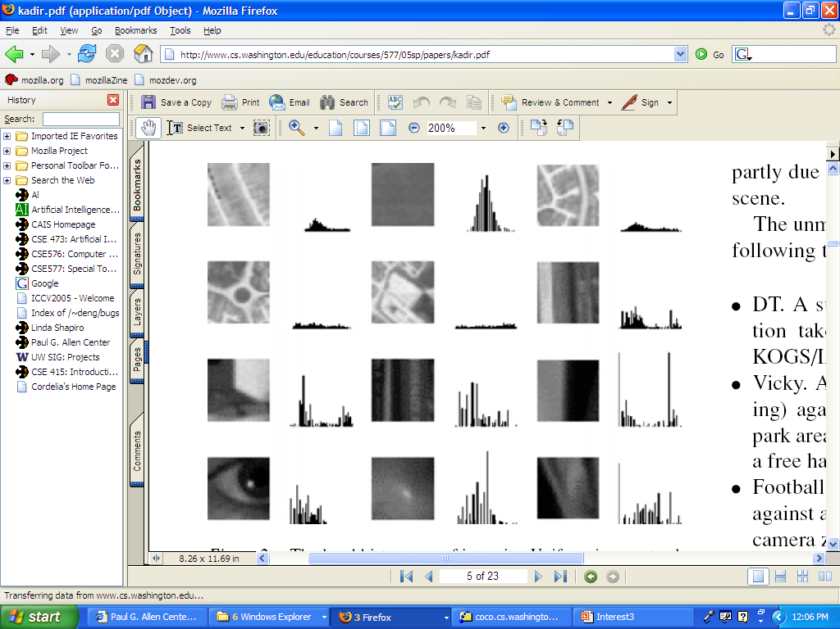
Local Histograms of Intensity
Neighborhoods with structure have flatter distributions
which converts to higher entropy.

Slide 11
Problems Kadir wanted to solve
Scale should not be a global, preselected parameter
Highly textured regions can score high on entropy, but not be useful
The algorithm should not be sensitive to small changes in the image or noise.

Slide 12
Kadir’s Methodology
use a scale-space approach
features will exist over multiple scales
  Berghoml (1986) regarded features (edges) that existed over multiple scales as best.
Kadir took the opposite approach.
  He considers these too self-similar.
  Instead he looks for peaks in (weighted) entropy over the scales.

Slide 13
The Algorithm
For each pixel location x
  For each scale s between smin and smax
    Measure the local descriptor values within a window of scale s
    Estimate the local PDF (use a histogram)
  Select scales (set S) for which the entropy is peaked (S may be empty)
  Weight the entropy values in S by the sum of absolute difference of the PDFs of the local descriptor around S.

Slide 14
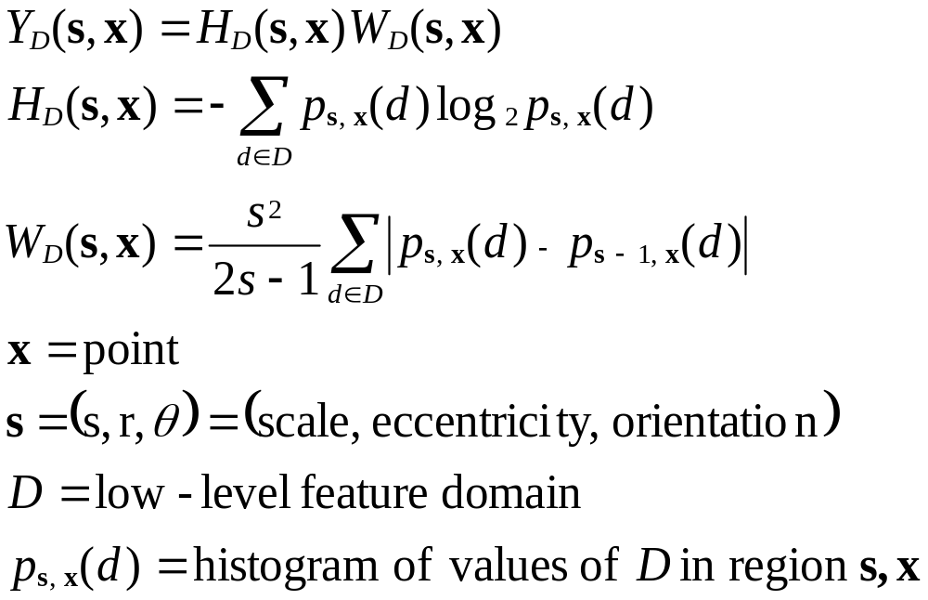
Finding salient points
the math for saliency discretized
saliency
entropy
weight
based on
difference
between
scales
s
(gray tones)
X
probability of descriptor D taking value d in
the region centered at x with scale s
= normalized histogram count for the bin representing gray tone d.

Slide 15
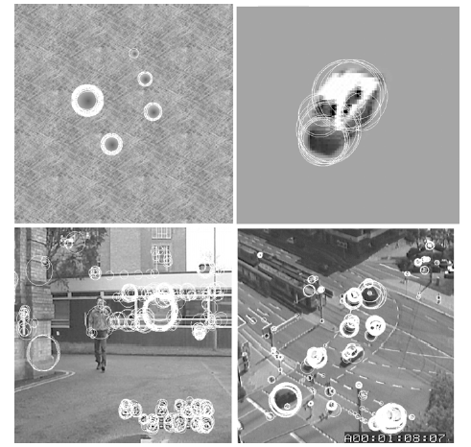
Picking salient points and their scales

Slide 16
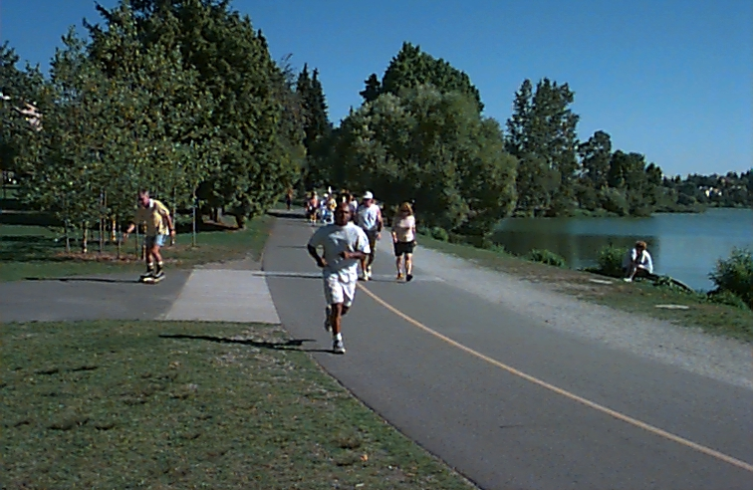
Getting rid of texture
One goal was to not select highly textured regions such as grass or bushes, which are not the type of objects the Oxford group wanted to recognize
Such regions are highly salient with just entropy, because they contain a lot of gray tones in roughly equal proportions
But they are similar at different scales and thus the weights make them go away

Slide 17
Salient Regions
Instead of just selecting the most salient points (based on weighted entropy), select salient regions (more robust).
Regions are like volumes in scale space.
Kadir used clustering to group selected points into regions.
We found the clustering was a critical step.

Slide 18
Kadir’s clustering (VERY ad hoc)
Apply a global threshold on saliency.
Choose the highest salient points (50% works well).
Find the K nearest neighbors (K=8 preset)
Check variance at center points with these neighbors.
Accept if far enough away from existant clusters and variance small enough.
Represent with mean scale and spatial location of the K points
Repeat with next highest salient point

Slide 19
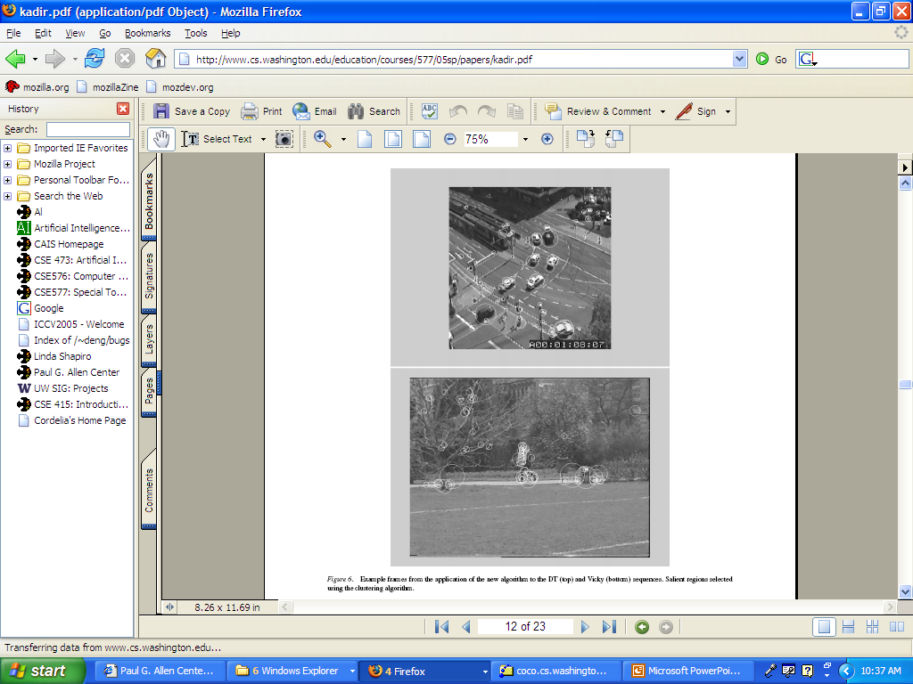
More examples

Slide 20
Robustness Claims
scale invariant (chooses its scale)
rotation invariant (uses circular regions and histograms)
somewhat illumination invariant (why?)
not affine invariant (able to handle small changes in viewpoint)

Slide 21
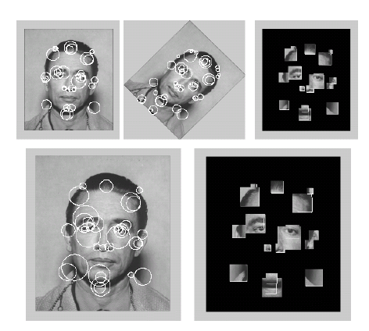
More Examples

Slide 22
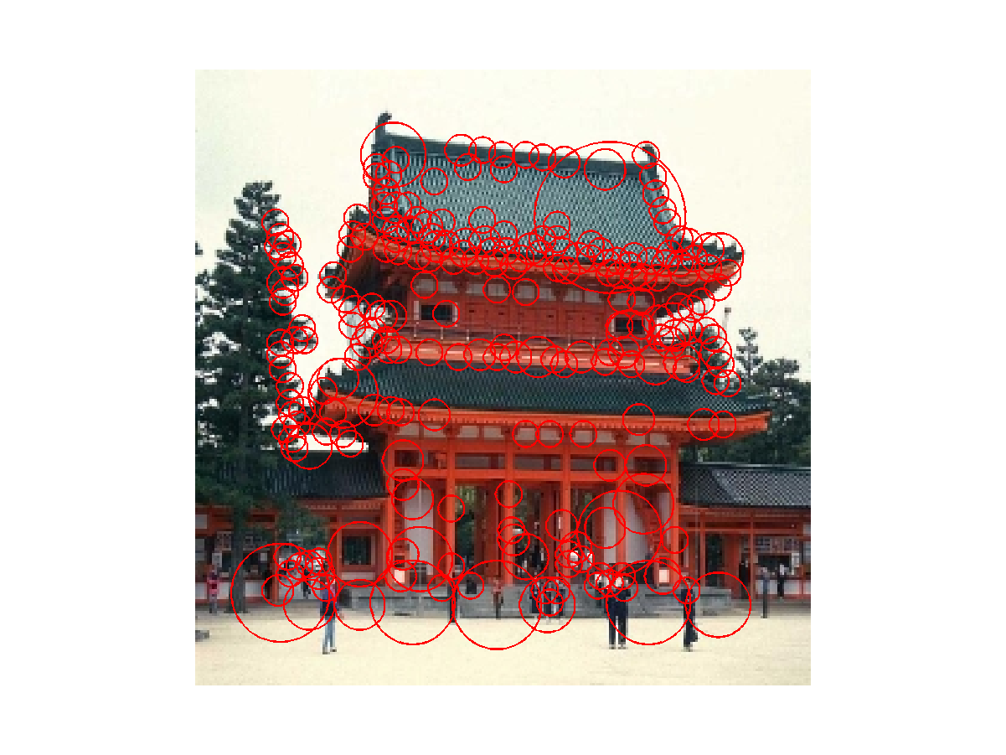
Temple

Slide 23
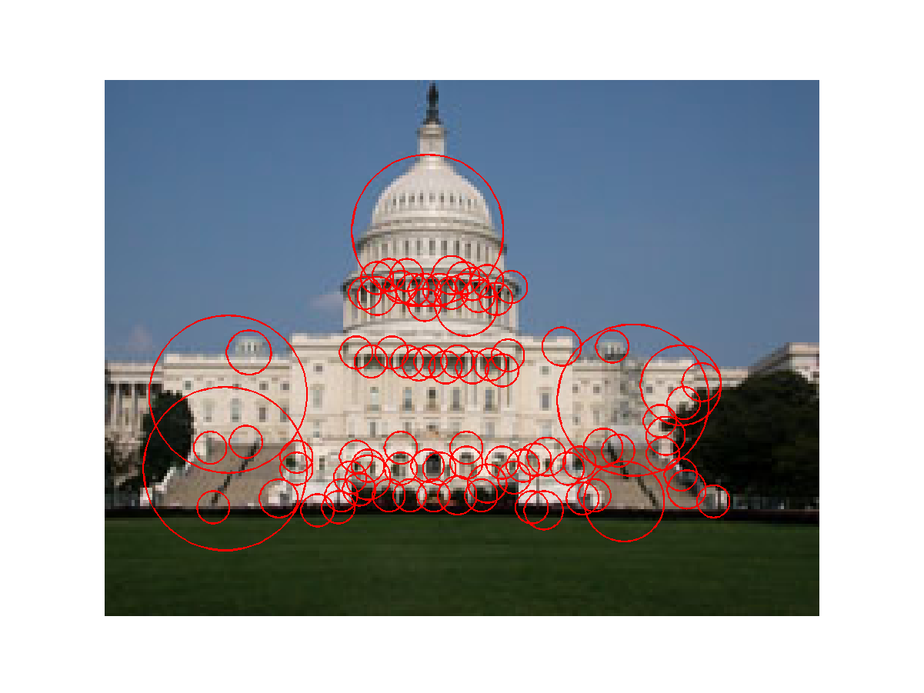
Capitol

Slide 24
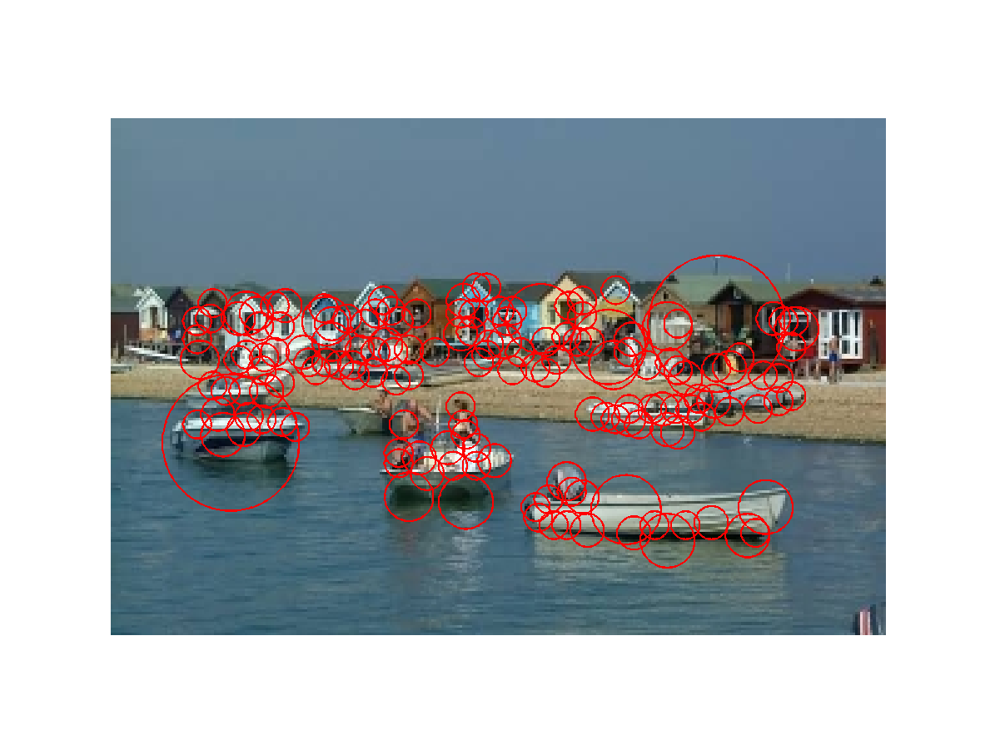
Houses and Boats

Slide 25
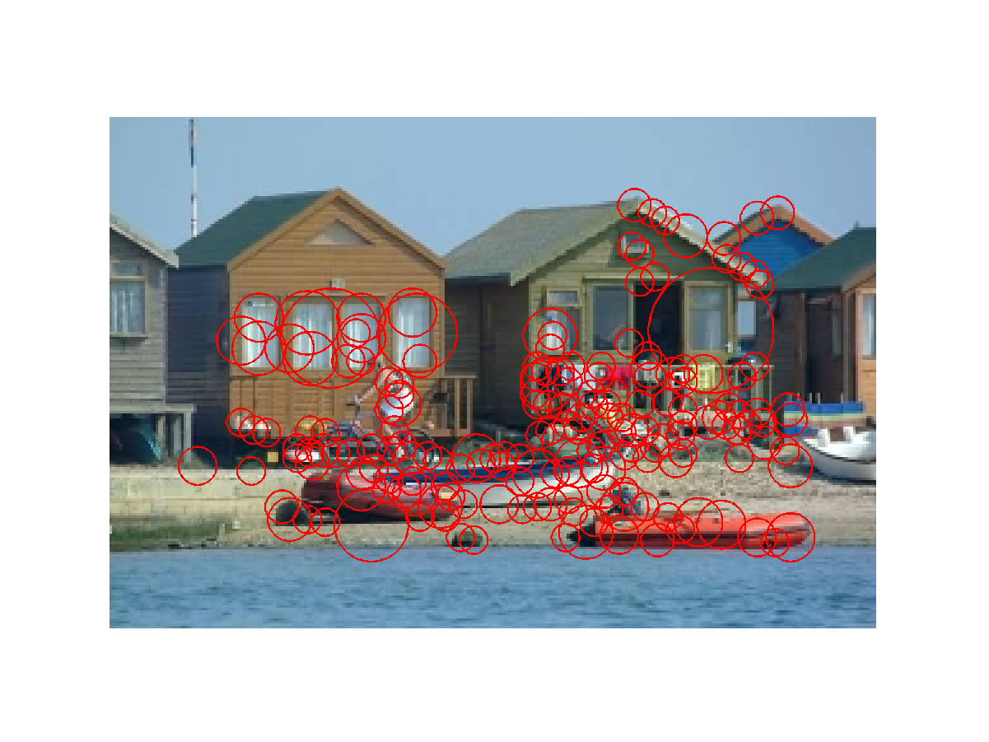
Houses and Boats

Slide 26
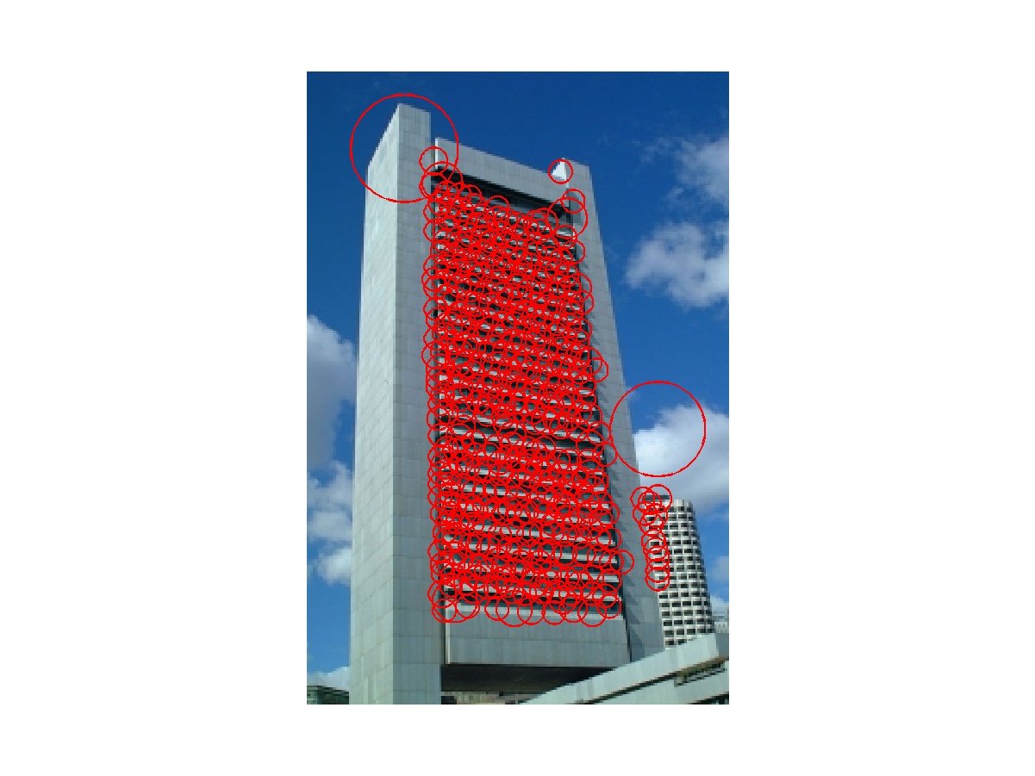
Sky Scraper

Slide 27
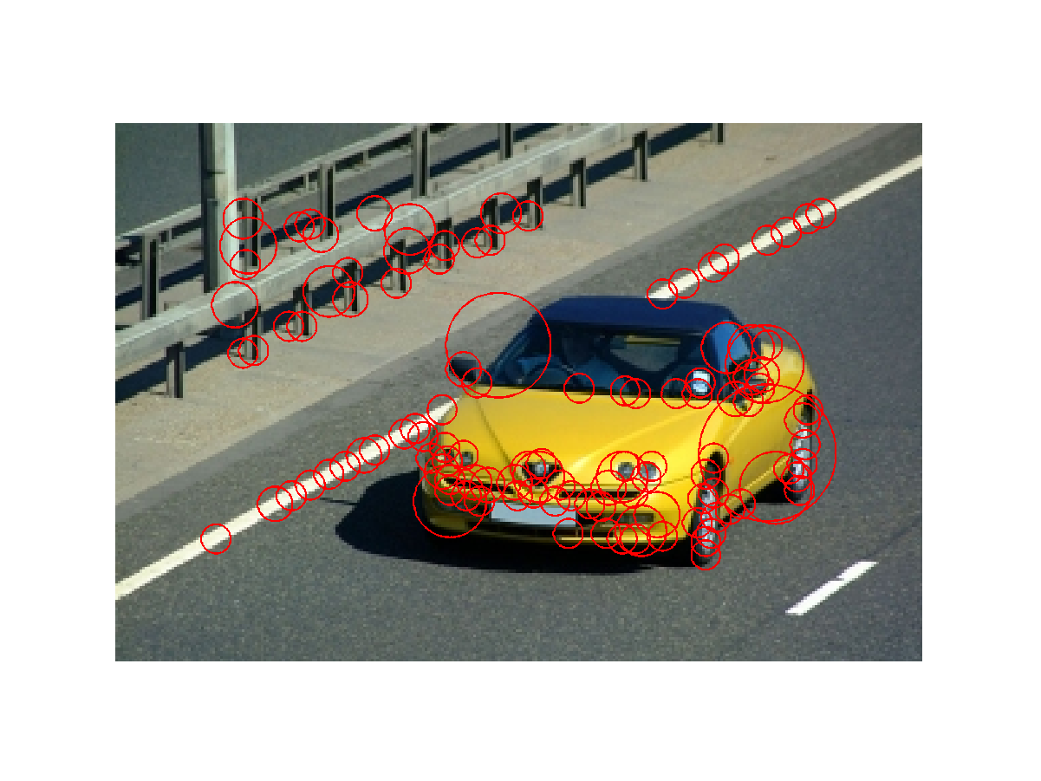
Car

Slide 28
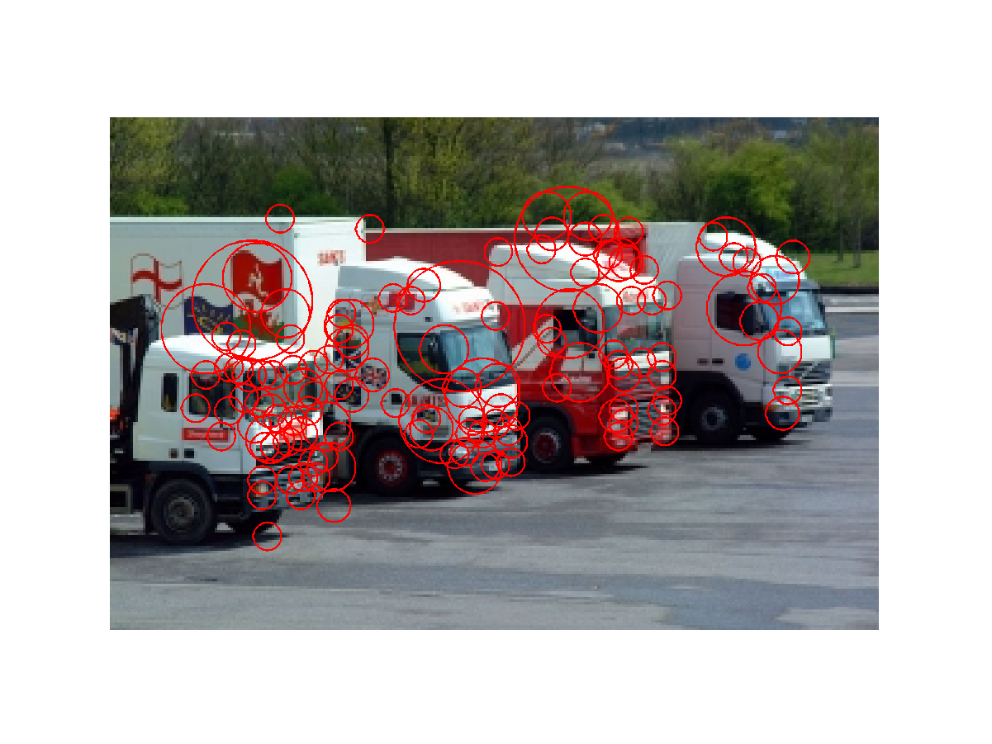
Trucks

Slide 29
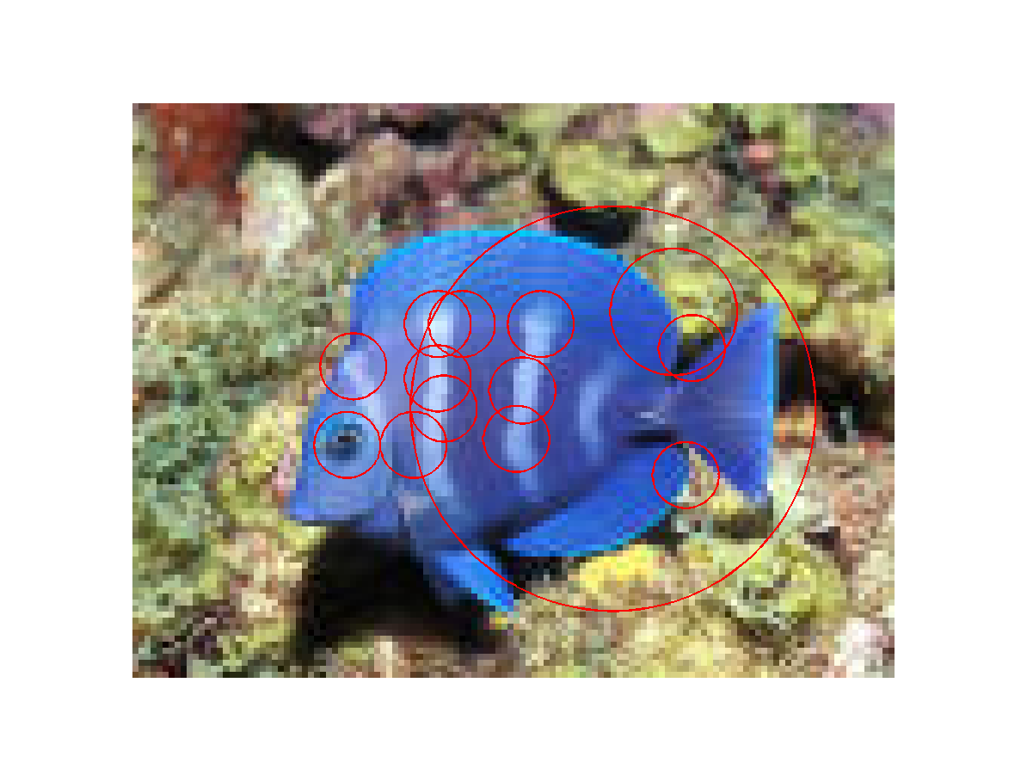
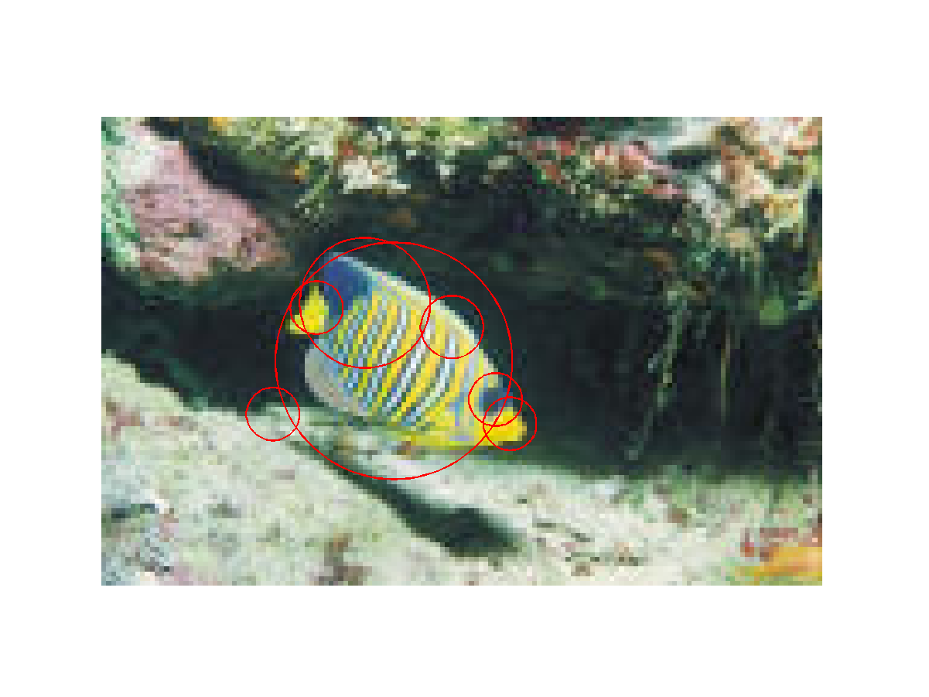
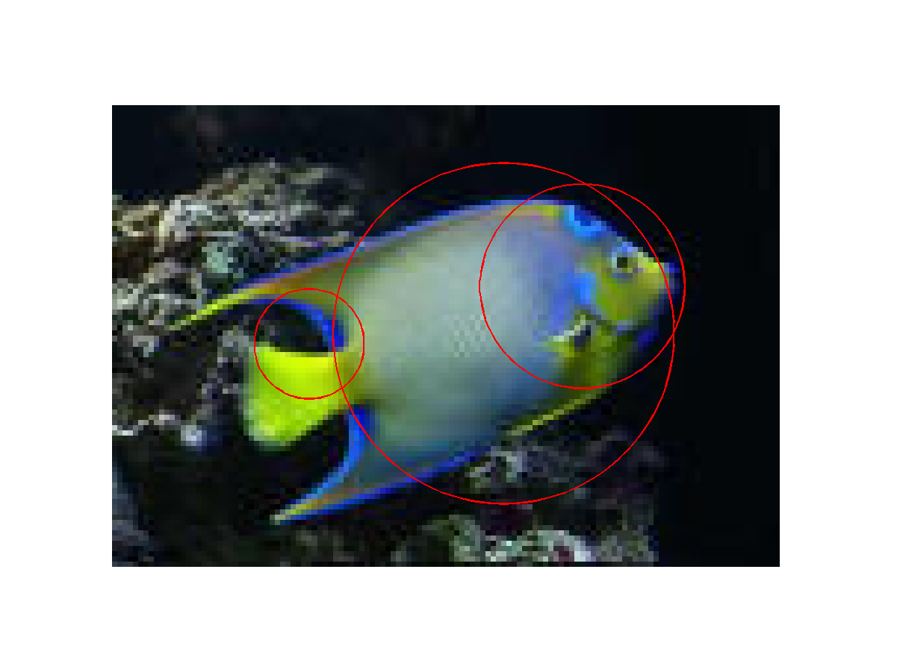
Fish

Slide 30
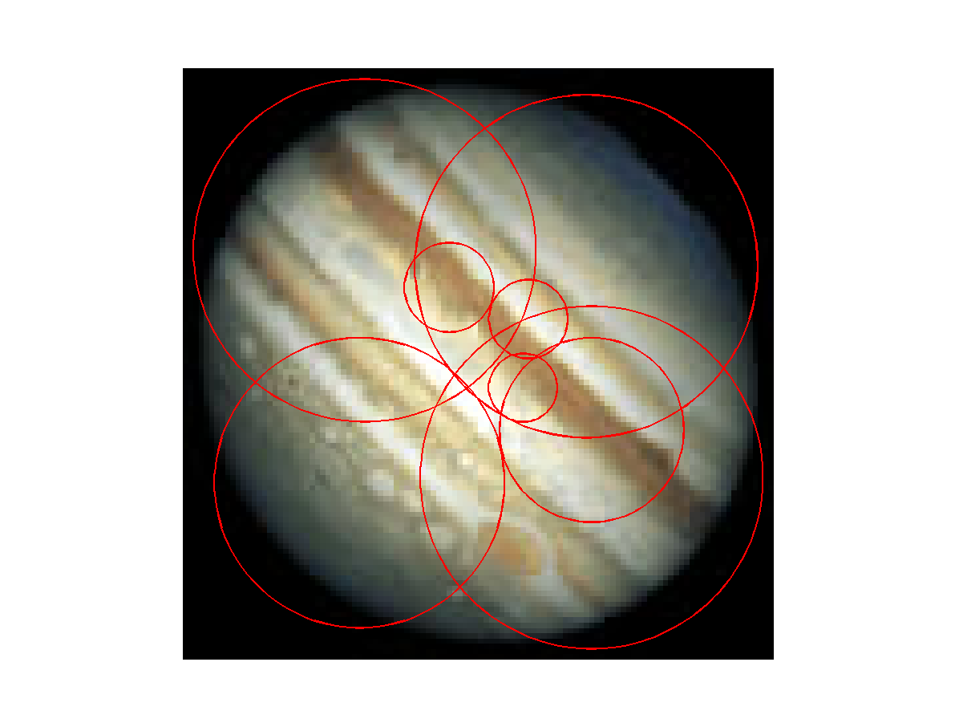
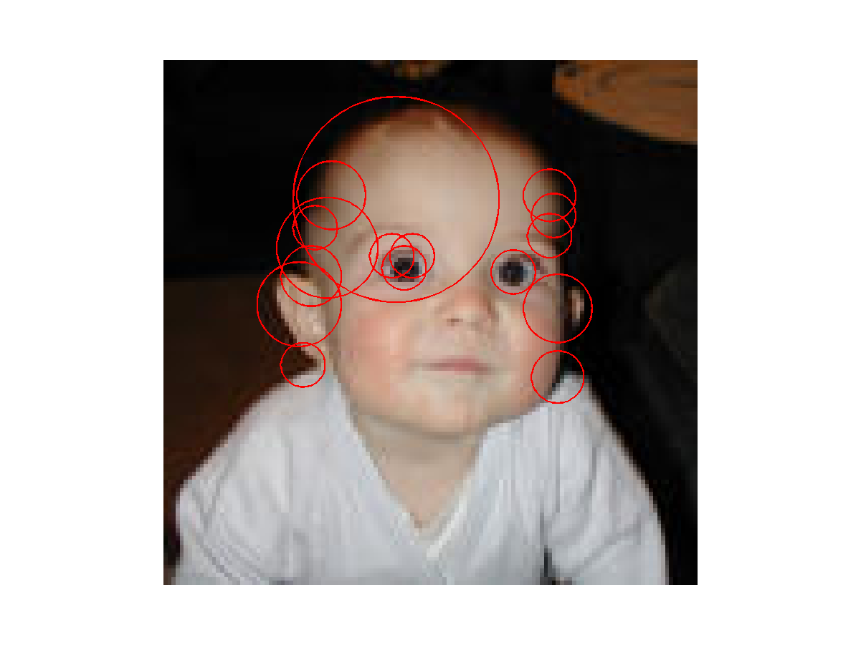
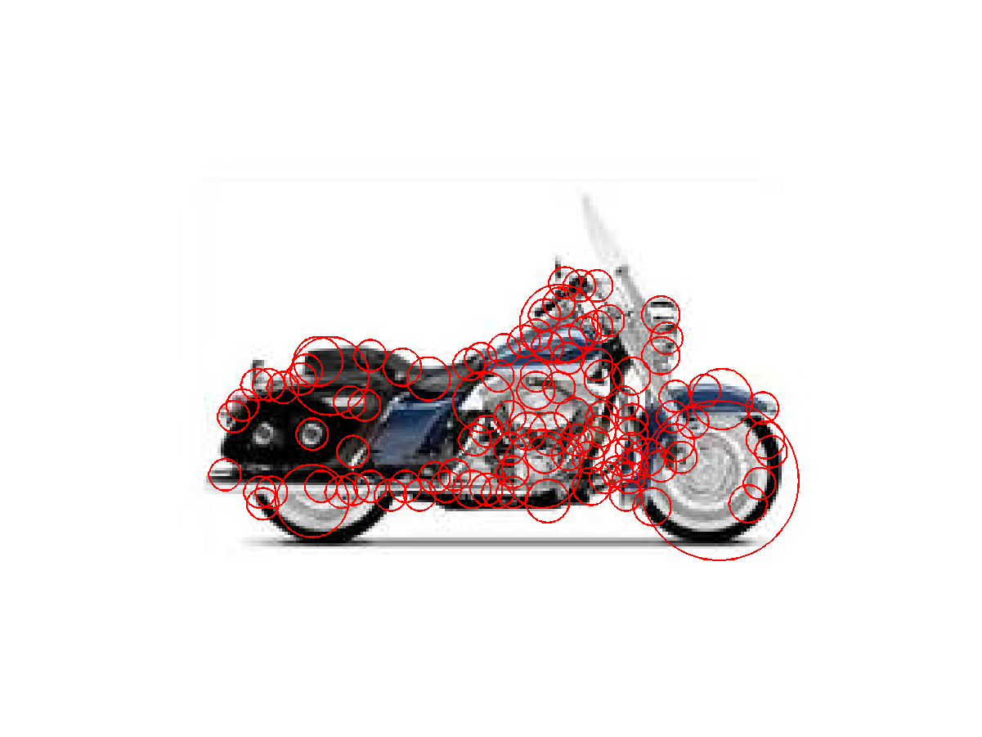
Other …

Slide 31
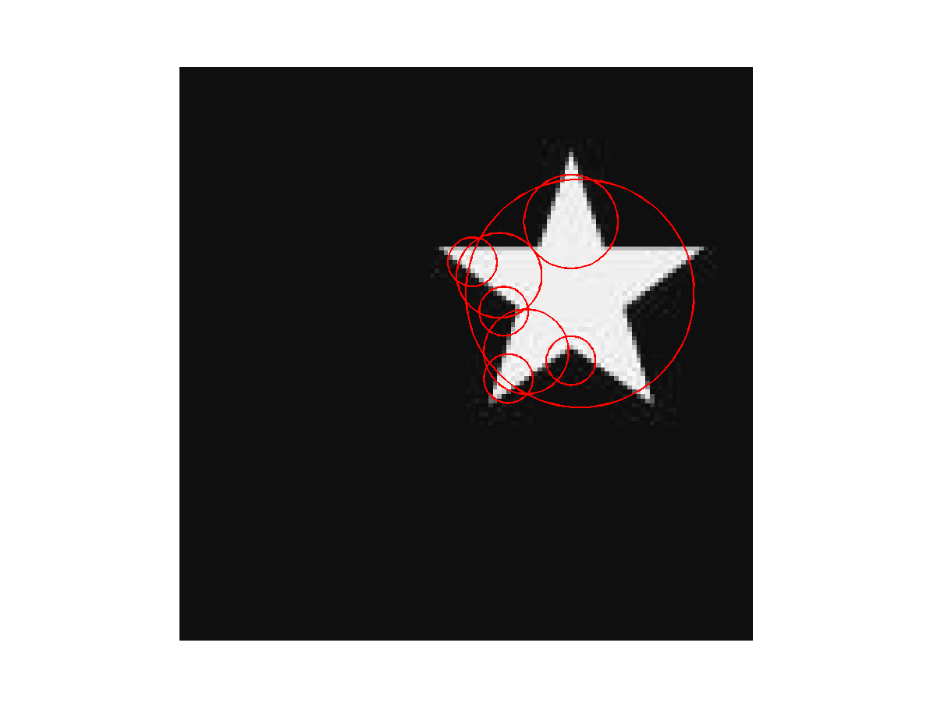
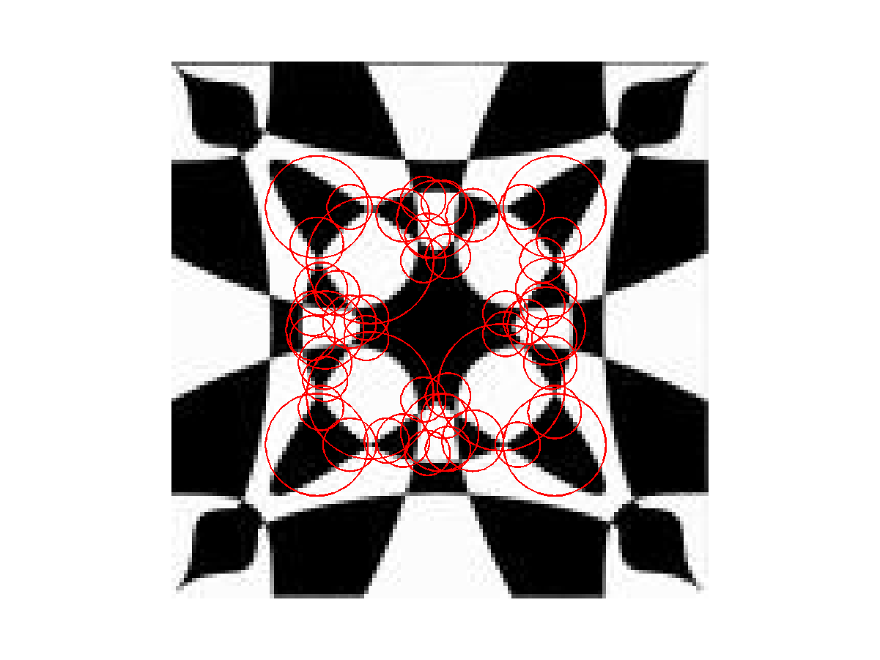
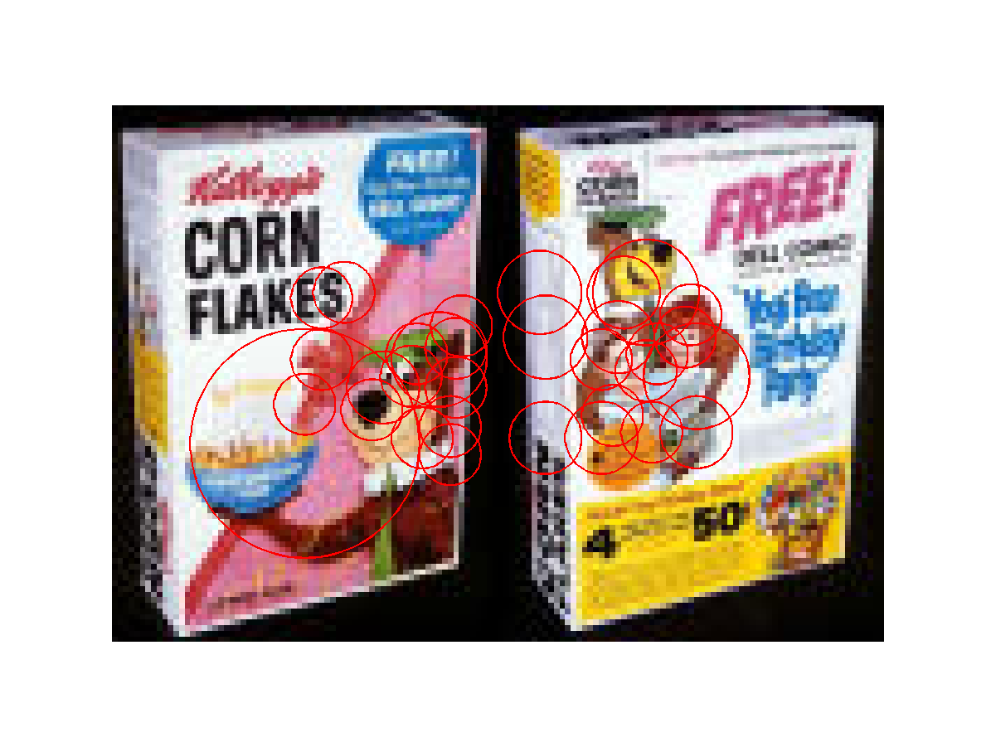
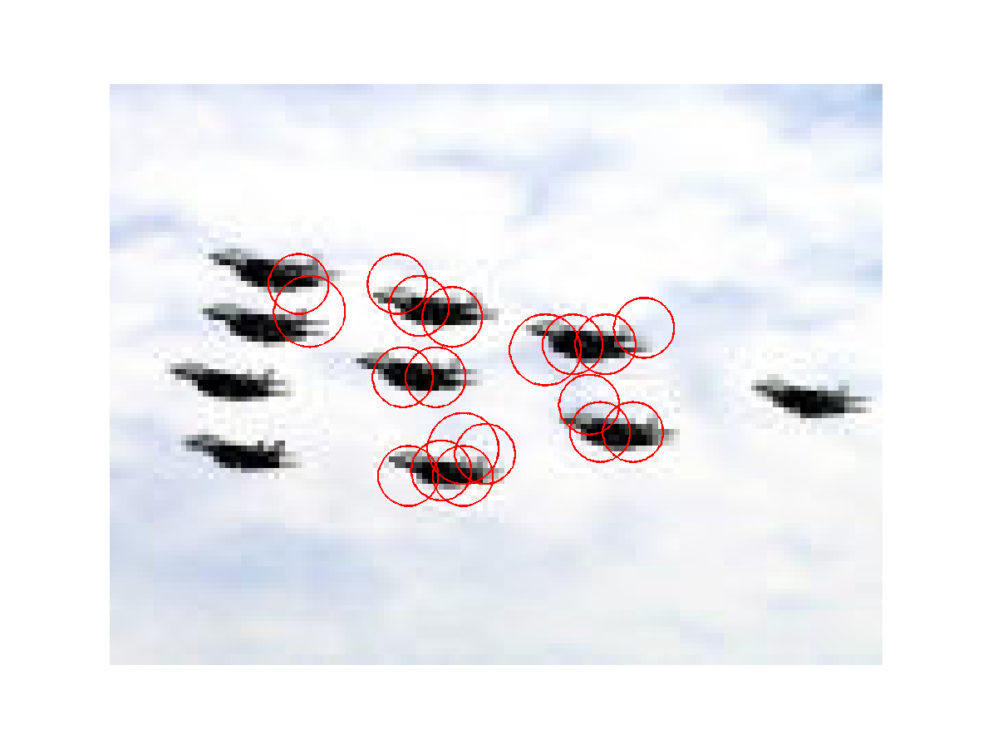
Symmetry and More

Slide 32
Benefits
General feature: not tied to any specific object
Can be used to detect rather complex objects that are not all one color
Location invariant, rotation invariant
Selects relevant scale, so scale invariant
What else is good?
Anything bad?

Slide 33
Object Recognition with Interest Operators
Object recognition started with line segments.
  - Roberts recognized objects from line segments
  and junctions.
  - This led to systems that extracted linear features.
  - CAD-model-based vision works well for industrial.
An “appearance-based approach” was first developed
for face recognition and later generalized up to a point.
The interest operators have led to a new kind of
recognition by “parts” that can handle a variety of
objects that were previously difficult or impossible.

Slide 34
Object Class Recognition by Unsupervised Scale-Invariant Learning
R. Fergus, P. Perona, and A. Zisserman
Oxford University and Caltech
CVPR 2003
won the best student paper award
CVPR 2013
won the best 10-year award

Slide 35
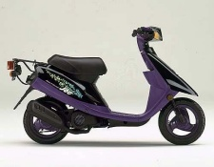
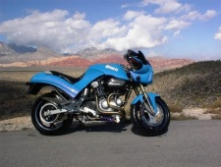
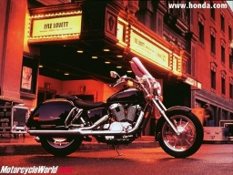
Goal:
Enable Computers to Recognize Different Categories of Objects in Images.

Slide 36
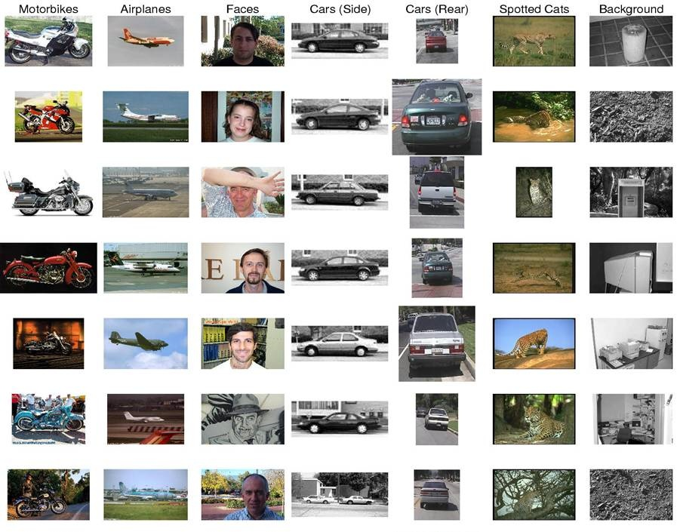
Notes:
Difficulties: Size Variation,

Slide 37
Approach
An object is a constellation of parts (from Burl, Weber and Perona, 1998).
The parts are detected by an interest operator (Kadir’s).
The parts can be recognized by appearance.
Objects may vary greatly in scale.
The constellation of parts for a given object is learned from training images

Slide 38
Components
Model
  Generative Probabilistic Model including
  Location, Scale, and Appearance of Parts
Learning
  Estimate Parameters Via EM Algorithm
Recognition
  Evaluate Image Using Model and Threshold

Slide 39
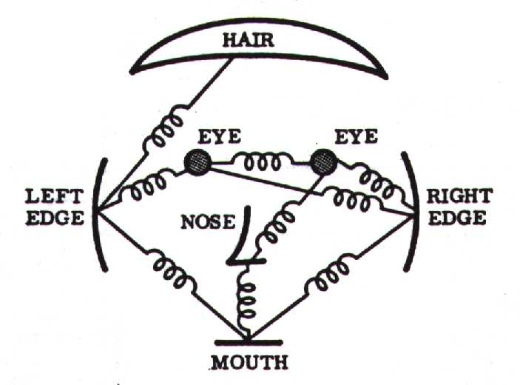
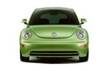
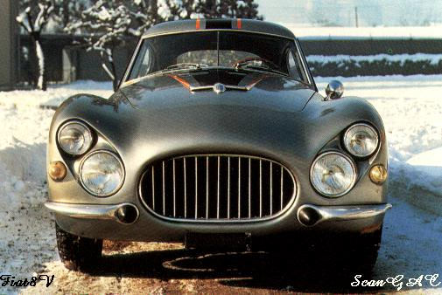
Model: Constellation Of Parts
Fischler & Elschlager, 1973
Yuille, 91
Brunelli & Poggio, 93
Lades, v.d. Malsburg et al. 93
Cootes, Lanitis, Taylor et al. 95
Amit & Geman, 95, 99
Perona et al. 95, 96, 98, 00

Slide 40
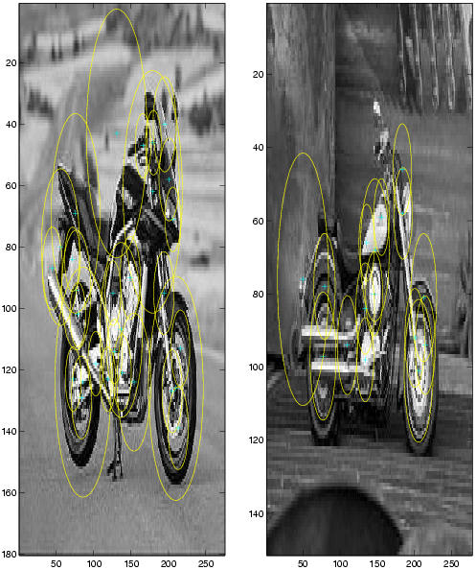
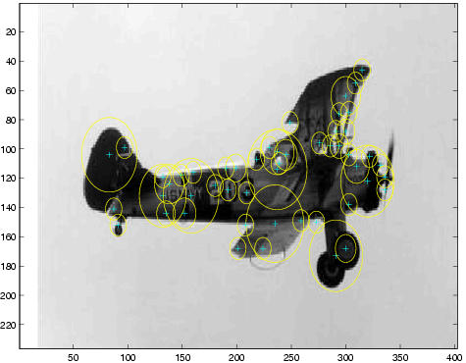
Parts Selected by
Interest Operator
Kadir and Brady's Interest Operator.
Finds Maxima in Entropy Over Scale and Location

Slide 41
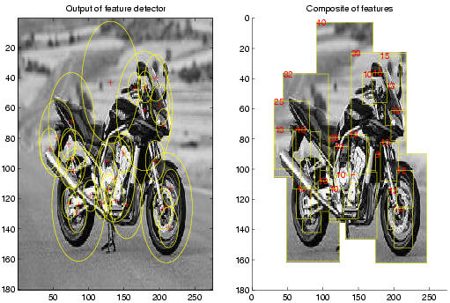

Representation of Appearance
c₁
Projection onto
PCA basis
c₂
11x11 patch
Normalize
121 dimensions was too big, so they used PCA to reduce to 10-15.
c₁₅

Slide 42
Learning a Model
An object class is represented by a generative model with P parts and a set of parameters θ.
Once the model has been learned, a decision procedure must determine if a new image contains an instance of the object class or not.
Suppose the new image has N interesting features with locations X, scales S and appearances A.

Slide 43
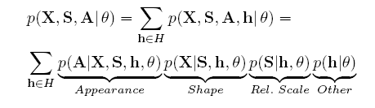
Probabilistic Model
X is a description of the shape of the object (in terms of locations of parts)
S is a description of the scale of the object
A is a description of the appearance of the object
θ is the (maximum likelihood value of) the parameters of the object
h is a hypothesis: a set of parts in the image that might be the parts of the object
H is the set of all possible hypotheses for that object in that image.
For N features in the image and P parts in the object, its size is O(N^{P})

Slide 44







Appearance
The appearance (A) of each part p
has a Gaussian density with
mean c_{p} and covariance V_{P}.
Background model has mean c_{bg}
and covariance V_{bg}.
Gaussian Part Appearance PDF
Gausian Appearance PDF
Object Background

Slide 45
Shape as Location
Object shape is represented by a joint Gaussian density of the locations (X)
of features within a hypothesis transformed into a scale-invariant space.
Gaussian Shape PDF
Uniform Shape PDF
Object Background

Slide 46
Scale
The relative scale of each part is modeled by a Gaussian density with
mean t_{p} and covariance U_{p}.
Prob. of detection
Gaussian
Relative Scale PDF
0.8
0.75
0.9
Log(scale)

Slide 47
Occlusion and Part Statistics
This was very complicated and turned out to not work
well and not be necessary, in both Fergus’s work and
other subsequent works.

Slide 48

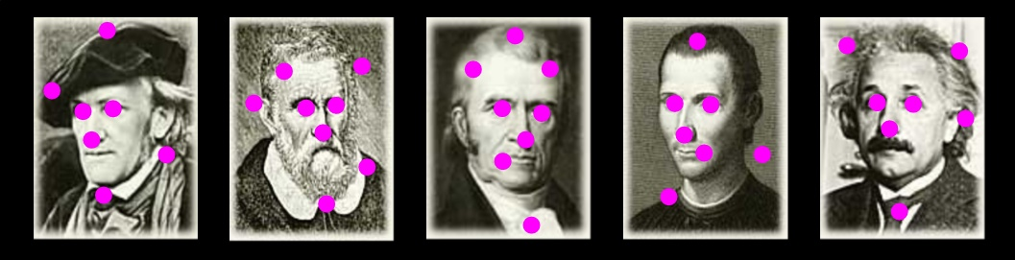
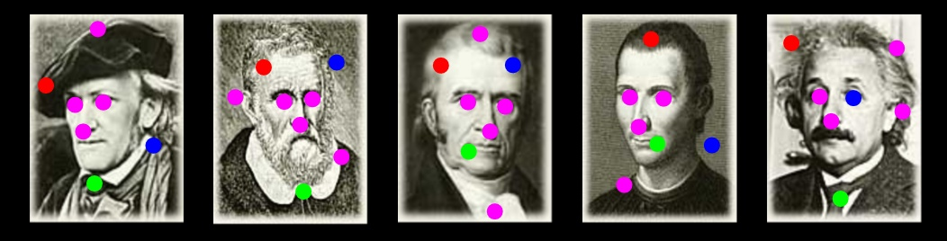
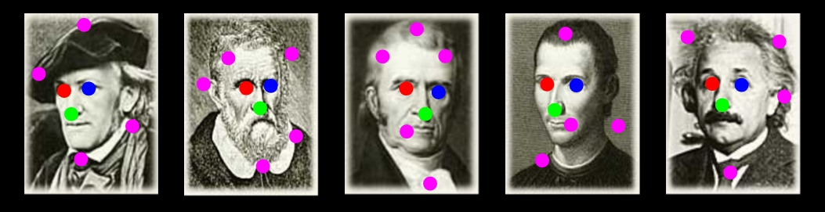
Learning
Train Model Parameters Using EM:
    Optimize Parameters
    Optimize Assignments
    Repeat Until Convergence
location
occlusion
appearance
scale

Slide 49
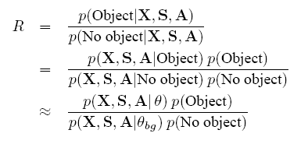
Recognition
Make this likelihood ratio:
greater than a threshold.

Slide 50
RESULTS
Initially tested on the Caltech-4 data set
  motorbikes
  faces
  airplanes
  cars
Now there is a much bigger data set: the Caltech-101 http://www.vision.caltech.edu/archive.html

Slide 51
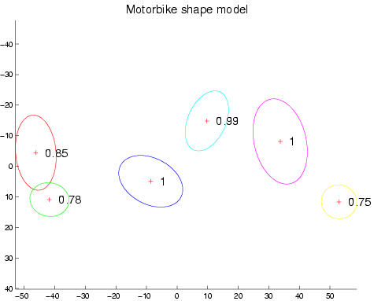
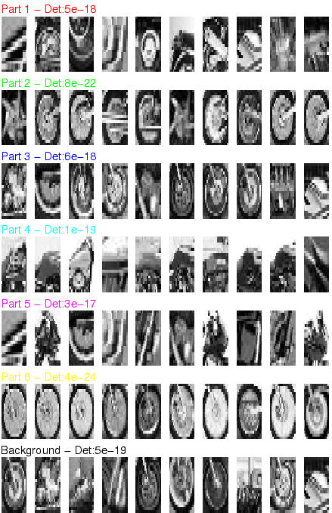
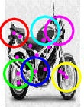
Motorbikes
Equal error rate: 7.5%

Slide 52
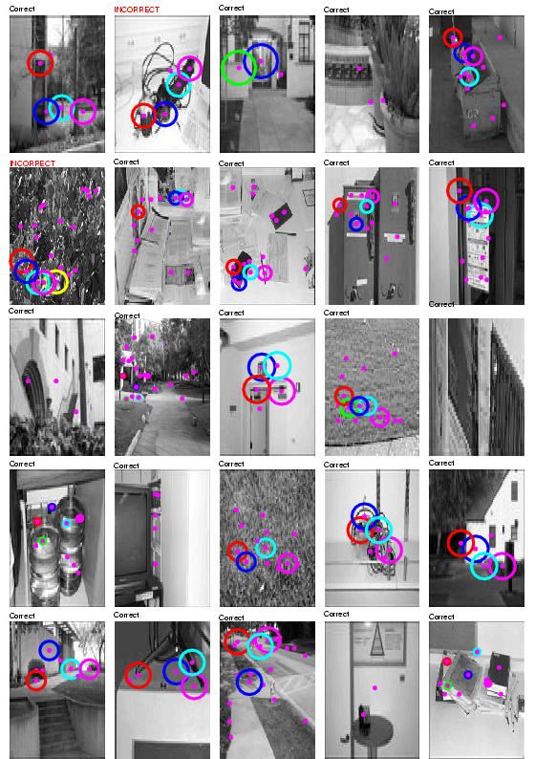
Background Images
It learns that these are NOT motorbikes.

Slide 53
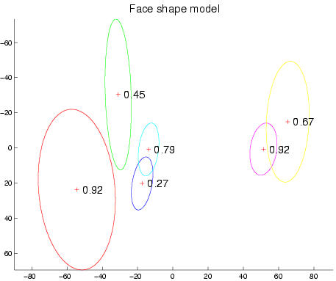
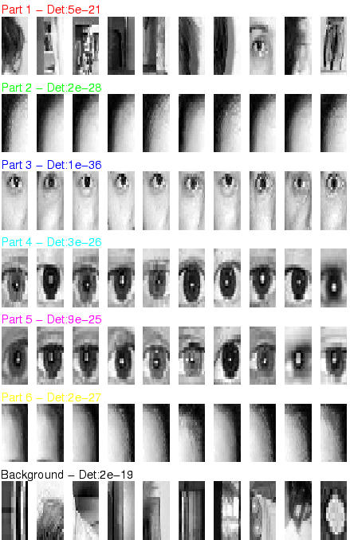

Frontal faces
Equal error rate: 4.6%

Slide 54



Airplanes
Equal error rate: 9.8%

Slide 55



Scale-Invariant Cars
Equal error rate: 9.7%

Slide 56

Accuracy
Initial Pre-Scaled Experiments
Early Data Set: The CalTech 4

Slide 57
Available Today
CalTech 101 and Caltech 256
ImageNet
Pascal VOC dataset
CIFAR-10
MS Coco
Cityscapes
https://analyticsindiamag.com/10-open-datasets-you-can-use-for-computer-vision-projects/

Slide 58
Content-Based Image Retrieval
Queries
Commercial Systems
Retrieval Features
Indexing in the FIDS System
Lead-in to Object Recognition

Slide 59
Content-based Image Retrieval (CBIR)
Searching a large database for images that match a query:
  What kinds of databases?
  What kinds of queries?
  What constitutes a match?
  How do we make such searches efficient?

Slide 60
Applications
  Art Collections
  e.g. Fine Arts Museum of San Francisco
  Medical Image Databases
  CT, MRI, Ultrasound, The Visible Human
  Scientific Databases
  e.g. Earth Sciences
  General Image Collections for Licensing
  Corbis, Getty Images
  The World Wide Web
  Google, Microsoft, etc

Slide 61
What is a query?
  an image you already have
  a rough sketch you draw
  a symbolic description of what you want
  e.g. an image of a man and a woman on
  a beach

Slide 62
Some Systems You Can Try
Corbis sells sold high-quality images for use in advertising,
marketing, illustrating, etc. Corbis was sold to a Chinese
company, but
Getty images now provides the image sales.
http://www.gettyimages.com/search/2/image?excludenudity=true&sort=best

Slide 63
Google Image
Google Images
http://www.google.com/imghp
Try the camera icon.

Slide 64
Microsoft Bing
http://www.bing.com/

Slide 65


Problem with Text-Based Search
Retrieval for pigs for the color chapter of my book
Small company (was called Ditto)
Allows you to search for pictures from web pages

Slide 66
Features
Color (histograms, gridded layout, wavelets)
Texture (Laws, Gabor filters, local binary pattern)
Shape (first segment the image, then use statistical
or structural shape similarity measures)
Objects and their Relationships
This is the most powerful, but you have to be able to
recognize the objects!

Slide 67

Color Histograms

Slide 68

Gridded Color
Gridded color distance is the sum of the color distances
in each of the corresponding grid squares.
1
2
1
2
3
4
3
4
What color distance would you use for a pair of grid squares?

Slide 69

Color Layout
(IBM’s Gridded Color)

Slide 70
Texture Distances
Pick and Click (user clicks on a pixel and system
retrieves images that have in them a region with
similar texture to the region surrounding it.
Gridded (just like gridded color, but use texture).
Histogram-based (e.g. compare the LBP histograms).

Slide 71

Laws Texture

Slide 72
Shape Distances
Shape goes one step further than color and texture.
It requires identification of regions to compare.
There have been many shape similarity measures
suggested for pattern recognition that can be used
to construct shape distance measures.

Slide 73
Global Shape Properties:
Projection Matching
0
4
1
3
2
0
Feature Vector
(0,4,1,3,2,0,0,4,3,2,1,0)
0 4 3 2 1 0
In projection matching, the horizontal and vertical
projections form a histogram.
What are the weaknesses of this method? strengths?

Slide 74
Global Shape Properties:
Tangent-Angle Histograms
135
0 30 45 135
Is this feature invariant to starting point?
Is it invariant to size, translation, rotation?

Slide 75
Boundary Matching
Fourier Descriptors
Sides and Angles
Elastic Matching
The distance between query shape and image shape
has two components:
1. energy required to deform the query shape into
one that best matches the image shape
2. a measure of how well the deformed query matches
the image

Slide 76


Del Bimbo Elastic Shape Matching
query
retrieved images

Slide 77
Regions and Relationships
Segment the image into regions
Find their properties and interrelationships
Construct a graph representation with
nodes for regions and edges for
spatial relationships
Use graph matching to compare images
Like
what?

Slide 78




Blobworld (Carson et al, 1999)
Segmented the query (and all database images) using EM on color+texture
Allowed users to select the most important region and what characteristics of it (color, texture, location)
Asked users if the background was also important

Slide 79


Tiger Image as a Graph
(motivated by Blobworld)
sky
image
above
above
adjacent
inside
tiger
grass
above
above
adjacent
sand
abstract regions

Slide 80

Andy Berman’s FIDS System
multiple distance measures
Boolean and linear combinations
efficient indexing using images as keys

Slide 81

Andy Berman’s FIDS System:
Use of key images and the triangle inequality
for efficient retrieval. d(I,Q) >= |d((I,K) – d(Q,K)|

Slide 82
Andy Berman’s FIDS System:
Bare-Bones Triangle Inequality Algorithm
Offline
1. Choose a small set of key images
2. Store distances from database images to keys
Online (given query Q)
1. Compute the distance from Q to each key
2. Obtain lower bounds on distances to database images
3. Threshold or return all images in order of lower bounds

Slide 83

Andy Berman’s FIDS System:

Slide 84






Different Features

Slide 85

Combined Features

Slide 86



Another example: different features

Slide 87


Combined Features

Slide 88



Another example: different features

Slide 89



Different ways for combination

Slide 90

Different weights on features

Slide 91



Slide 92



Slide 93



Weakness of Low-level Features
  Can’t capture the high-level concepts

Slide 94
Yi Li’s Overall Approach
Develop object recognizers for common objects
Use these recognizers to design a new set of both
low- and mid-level features
Design a learning system that can use these
features to recognize classes of objects

Slide 95
Building Features:
Consistent Line Clusters (CLC)
A Consistent Line Cluster is a set of lines that are homogeneous in terms of some line features.
  Color-CLC: The lines have the same color feature.
  Orientation-CLC: The lines are parallel to each other or converge to a common vanishing point.
  Spatially-CLC: The lines are in close proximity to each other.

Slide 96
Experimental Evaluation
Object Recognition
  97 well-patterned buildings (bp): 97/97
  44 not well-patterned buildings (bnp): 42/44
  16 not patterned non-buildings (nbnp): 15/16 (one false positive)
  25 patterned non-buildings (nbp): 0/25
CBIR
Notes:
19, 20 , 21, 22

Slide 97






Experimental Evaluation
Well-Patterned Buildings
Notes:
19, 20 , 21, 22

Slide 98






Experimental Evaluation
Non-Well-Patterned Buildings
False negative
False negative
Notes:
19, 20 , 21, 22

Slide 99






Experimental Evaluation
Non-Well-Patterned Non-Buildings
False positive
Notes:
19, 20 , 21, 22

Slide 100






Experimental Evaluation
Well-Patterned Non-Buildings (false positives)
Notes:
19, 20 , 21, 22

Slide 101
Experimental Evaluation (CBIR)
 | Total Positive Classification (#) | Total Negative Classification (#) | False positive (#) | False negative (#) | Accuracy (%)
Arborgreens | 0 | 47 | 0 | 0 | 100
Campusinfall | 27 | 21 | 0 | 5 | 89.6
Cannonbeach | 30 | 18 | 0 | 6 | 87.5
Yellowstone | 4 | 44 | 4 | 0 | 91.7
Notes:
Figure l-4 (false examples)
Figure 23 (false yellowstone)

Slide 102




Experimental Evaluation (CBIR)
False positives from Yellowstone
Notes:
Figure l-4 (false examples)
Figure 23 (false yellowstone)

