Slide 1
Facial Motion Retargeting
Bindita Chaudhuri
Paul G. Allen School of Computer Science & Engineering, UW
(Linda Shapiro, Alex Colburn, Barbara Mones, Gary Faigin)
Visual Intelligence Group, Microsoft AI&R, Redmond

Slide 2
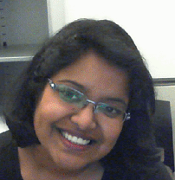
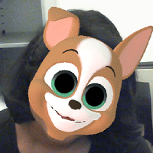

Introduction
Goal: Predict and transfer facial motion from 2D images to 3D models
expression
and pose

Slide 3
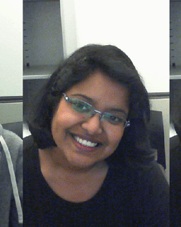
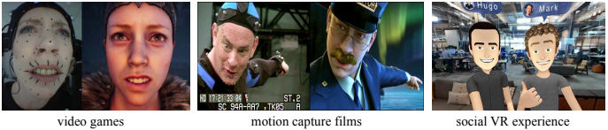
Introduction
Goal: Predict and transfer facial motion from 2D images to 3D models
Recent applications include:
bounding box
detection
and tracking
per-frame expression
and pose

Slide 4
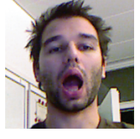
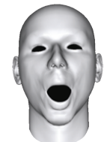
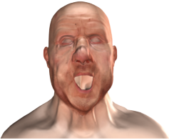

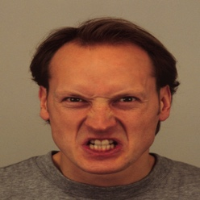
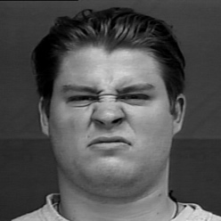
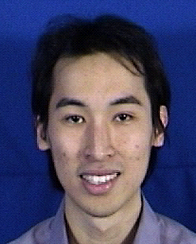
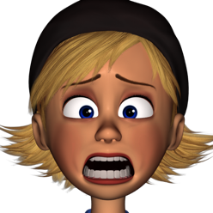
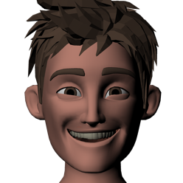
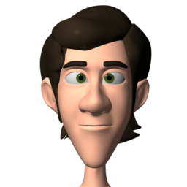
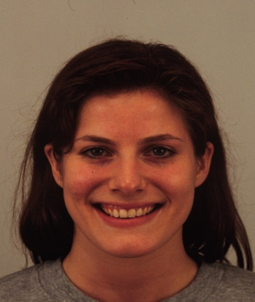
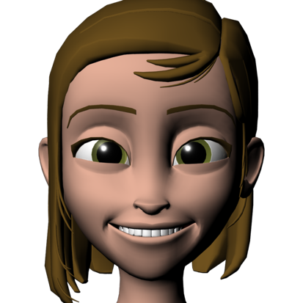
Methodology
Blendshape based approach (better generalizability to multiple characters):
Example based approach (better generalizability to out-of-space expressions):
expression
+ pose
Network
3D Morphable Model (3DMM)
Network

Slide 5

Blendshape based Approach
3DMM tensor
T = V ｘ B_{exp} ｘ B_{id}
identity coefficients w_{id}
user-specific blendshapes
T = V ｘ B_{exp}
expression coefficients w_{exp}
3D vertex coordinates
M = V
pose (R, t) and projection (f) parameters
2D landmarks

Slide 6
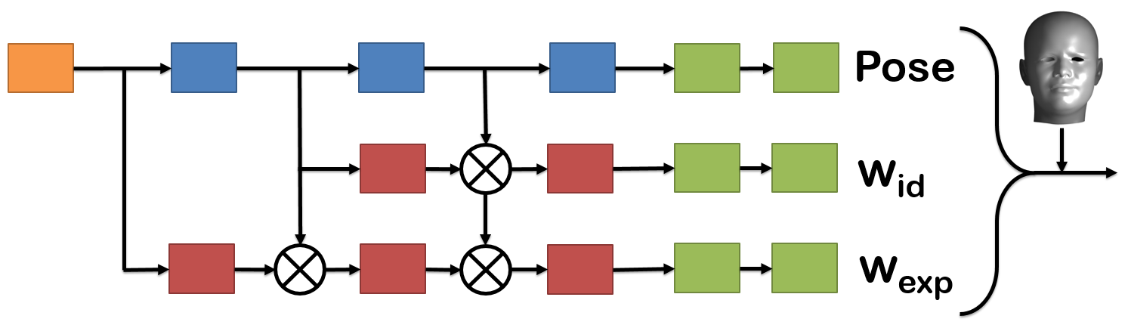
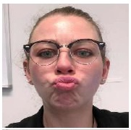
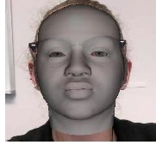

Single Face Network
pose from global features
identity and expression from
local + global features
B. Chaudhuri, N. Vesdapunt, B. Wang, Joint Face Detection and Facial Motion Retargeting for Multiple Faces , CVPR 2019

Slide 7



Multi Face Network
face detection
two sequential networks; memory inefficient
runtime increases linearly with number of faces
B. Chaudhuri, N. Vesdapunt, B. Wang, Joint Face Detection and Facial Motion Retargeting for Multiple Faces , CVPR 2019

Slide 8
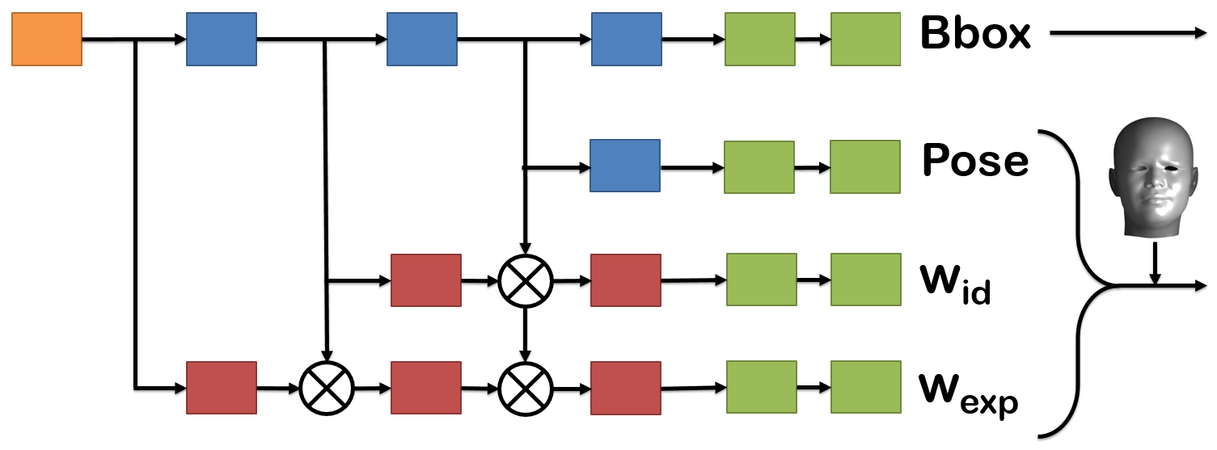
Multi Face Network
YOLO loss function; bounding box and 3D face prediction help each other
B. Chaudhuri, N. Vesdapunt, B. Wang, Joint Face Detection and Facial Motion Retargeting for Multiple Faces , CVPR 2019

Slide 9
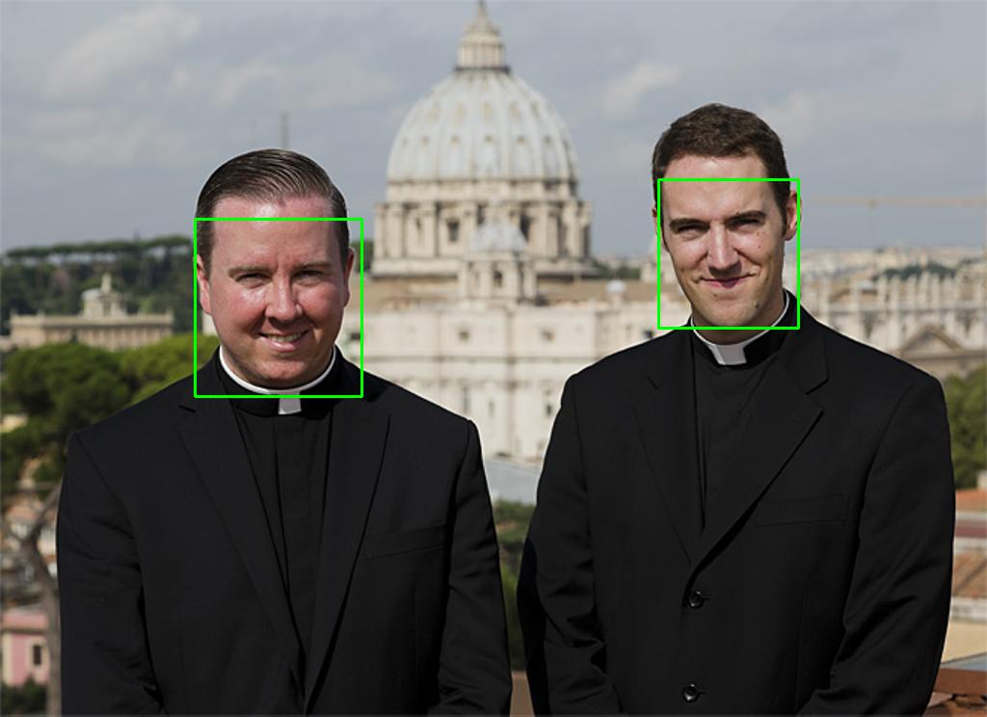
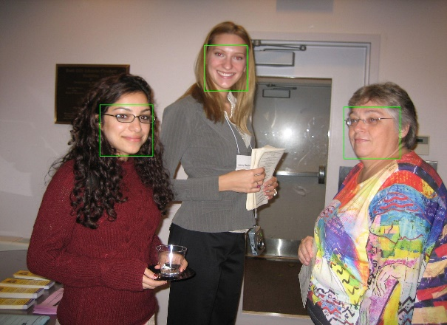
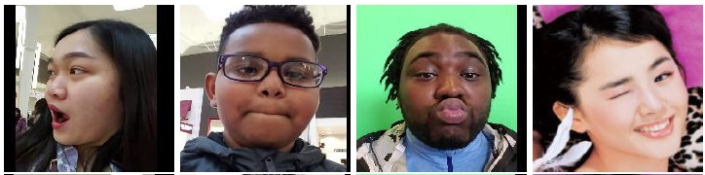
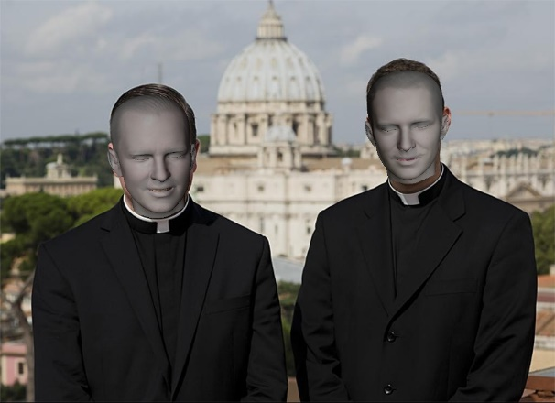
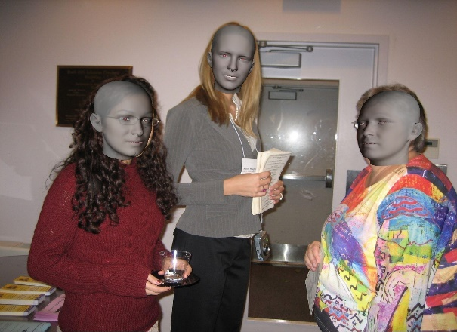
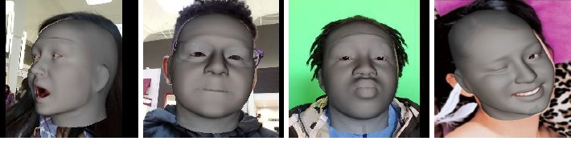
Network Performance for Test Images

Slide 10
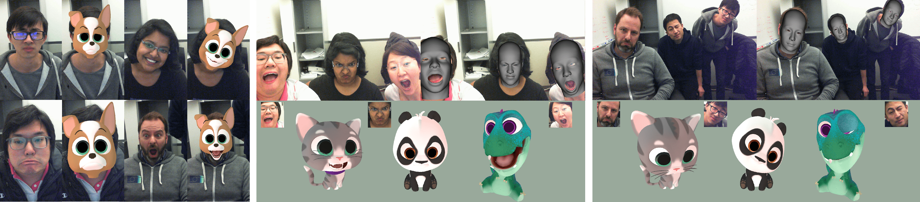
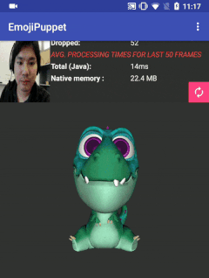
Results for Single Face Based Application
Hardware: Google Pixel 2

Slide 11
Live Performance Capture for Multiple Faces

Slide 12
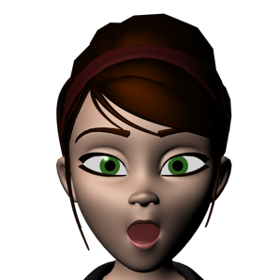
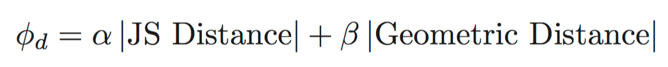
Example based Approach (semi-supervised)
Online triplet generation based on distance metric
(
)
HCNN
Binary similarity score
SCNN
fused-CNN
E E+ E-
Expression feature vectors
Geometry feature vectors
D. Aneja, B. Chaudhuri, A. Colburn, G. Faigin, L. Shapiro, B. Mones, Learning to Generate 3D Stylized Character Expressions from Humans, WACV 2018

Slide 13
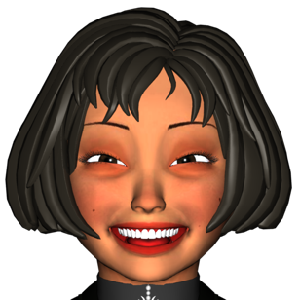

Example based Approach (semi-supervised)
Online triplet generation based on distance metric
(
)
HCNN
Binary similarity score
SCNN
matching pairs
E E+ E-
fused-CNN
256 𝖷 256
3D-CNN
100 𝖷 1
D. Aneja, B. Chaudhuri, A. Colburn, G. Faigin, L. Shapiro, B. Mones, Learning to Generate 3D Stylized Character Expressions from Humans, WACV 2018

Slide 14
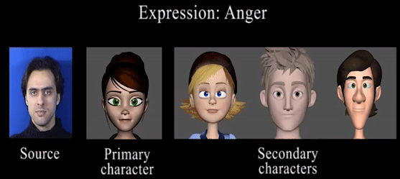
Results for Videos
Frame-by-frame transfer; jitter removed by temporal smoothening using Savitzky-Golay filter

Slide 15
Example based Approach (unsupervised)
Aim:
Use single network that directly regresses 3D vertices of character
Generalize to a broader range of expressions

Slide 16
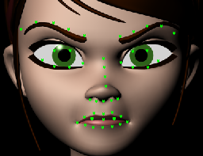
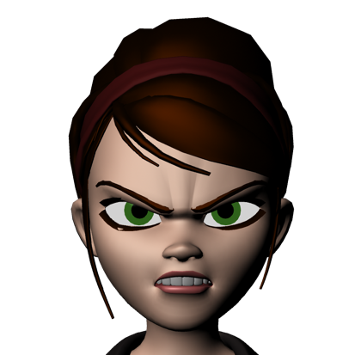


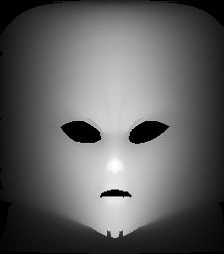
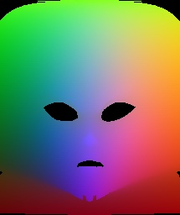
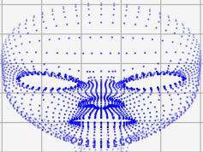
Example based Approach (unsupervised)
Compute facial landmarks:
Convert 3D model to 2D position map:
Train CycleGAN:
landmark loss
generator A→B
2D discriminator
generator B→A
3D
discriminator

Slide 17
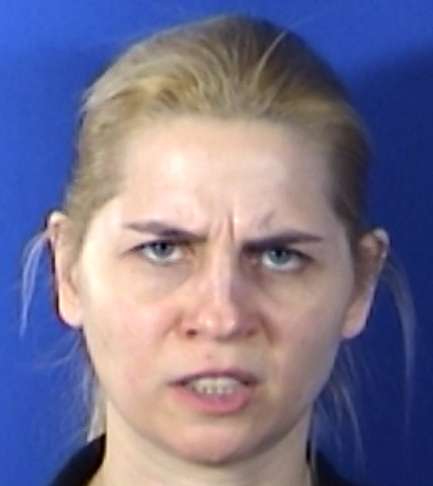
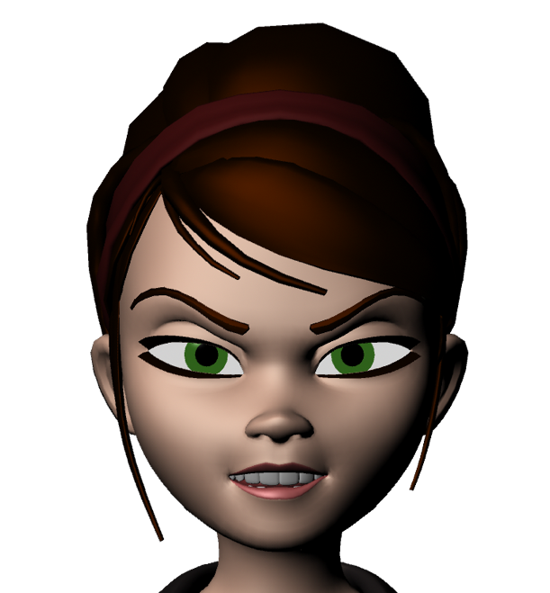
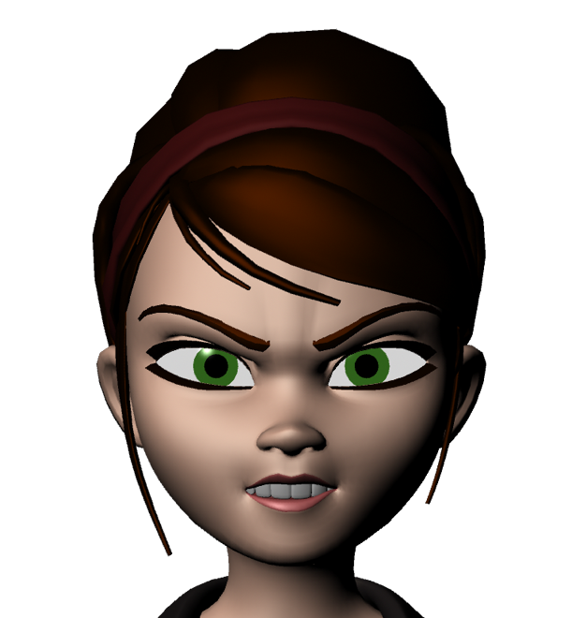
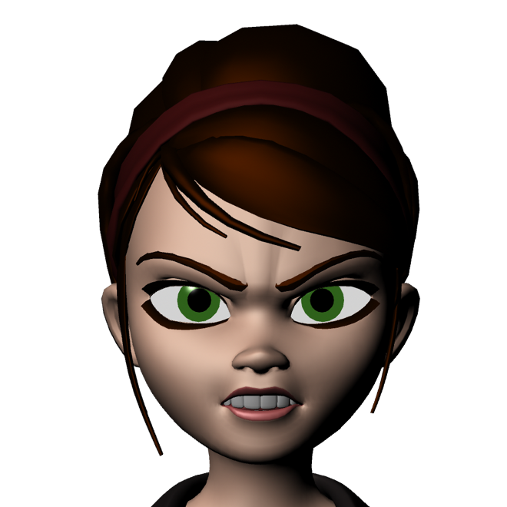
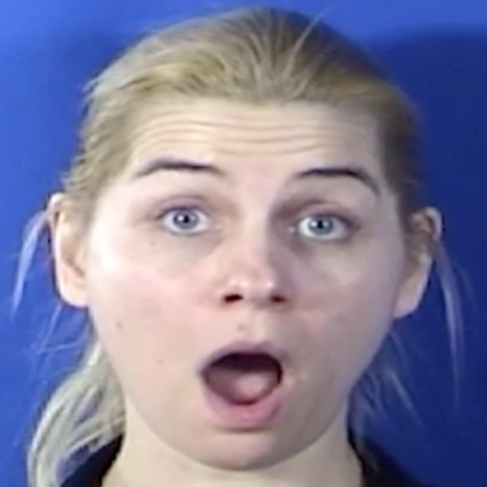
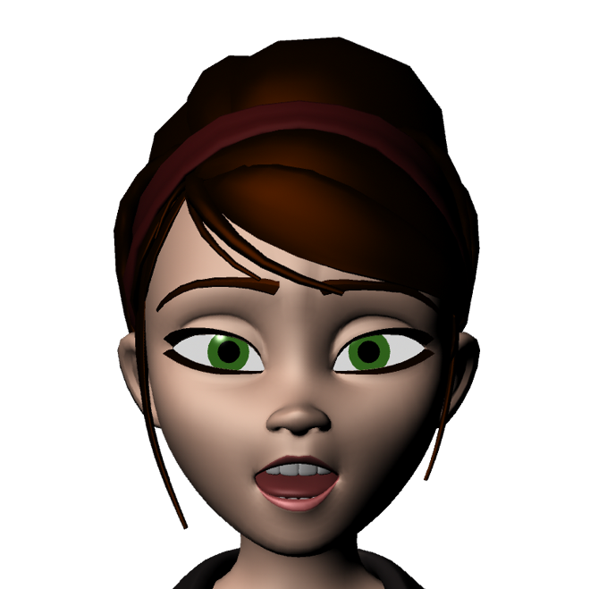

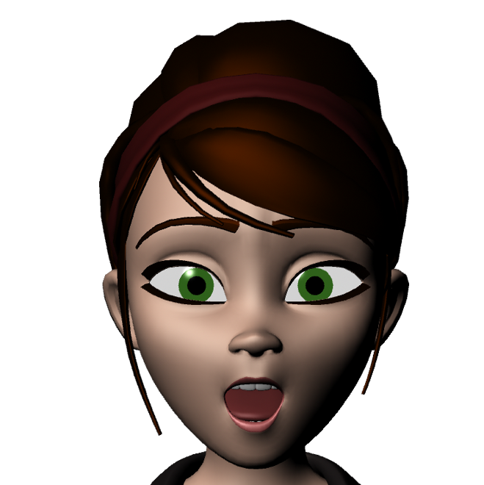
Results
Semi-supervised Example based
Unsupervised
Example based
Input
Blendshape based

Slide 18
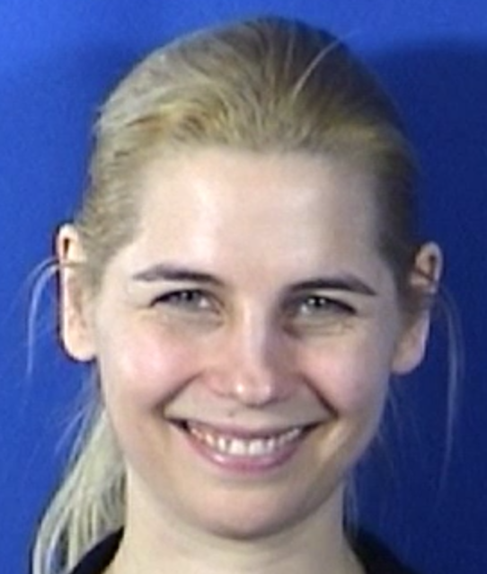
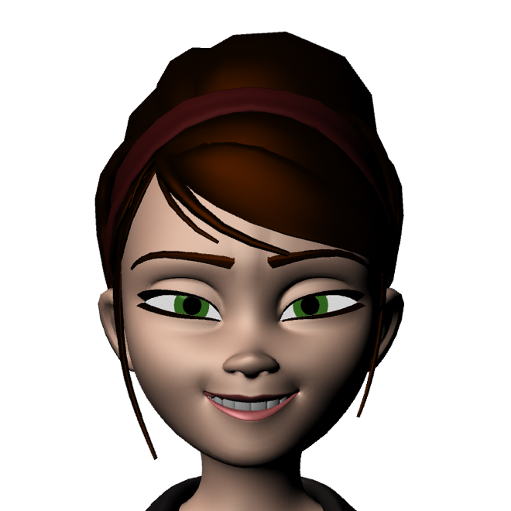
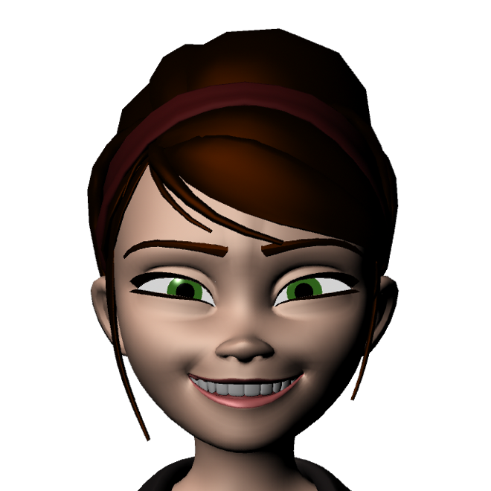
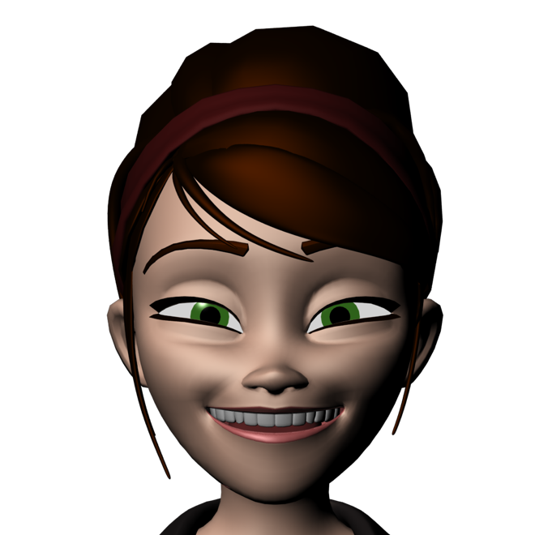
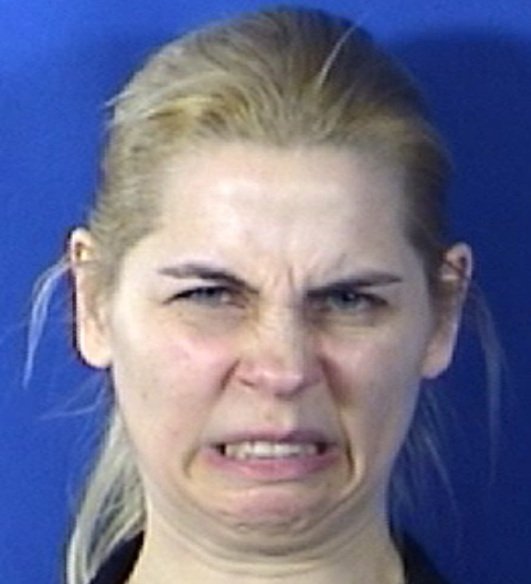
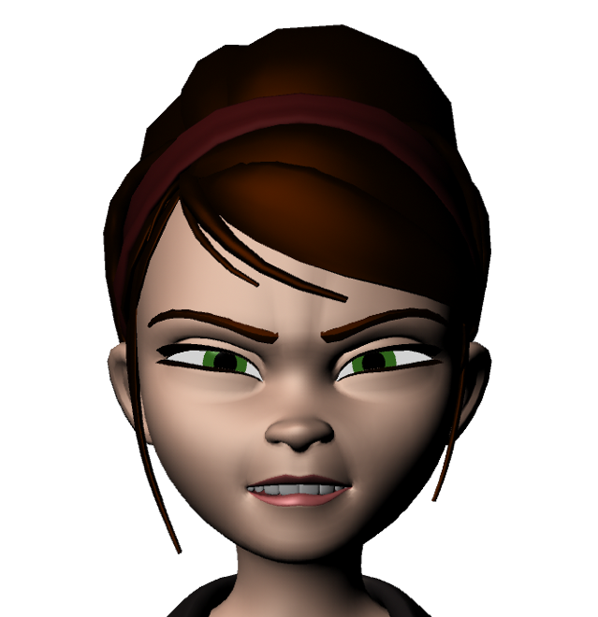
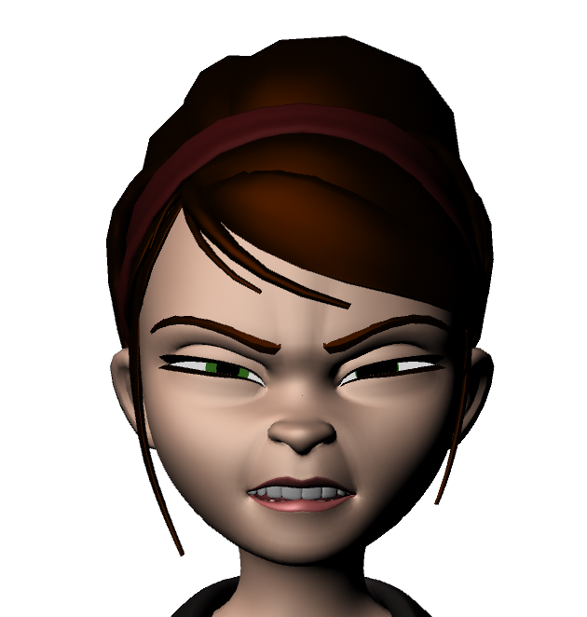

Results
Semi-supervised Example based
Unsupervised
Example based
Input
Blendshape based

Slide 19


