Slide 1
A Facial Affect Analysis System for
Autism Spectrum Disorder
https://arxiv.org/abs/1904.03616
Beibin Li

Slide 2
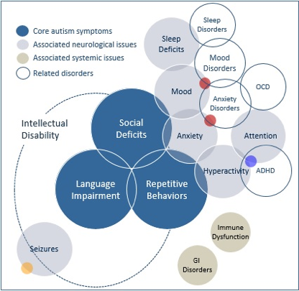
Symptoms of Autism (Motivation)
https://www.autismspeaks.org/what-are-symptoms-autism
Notes:
Bullet points of description

Slide 3

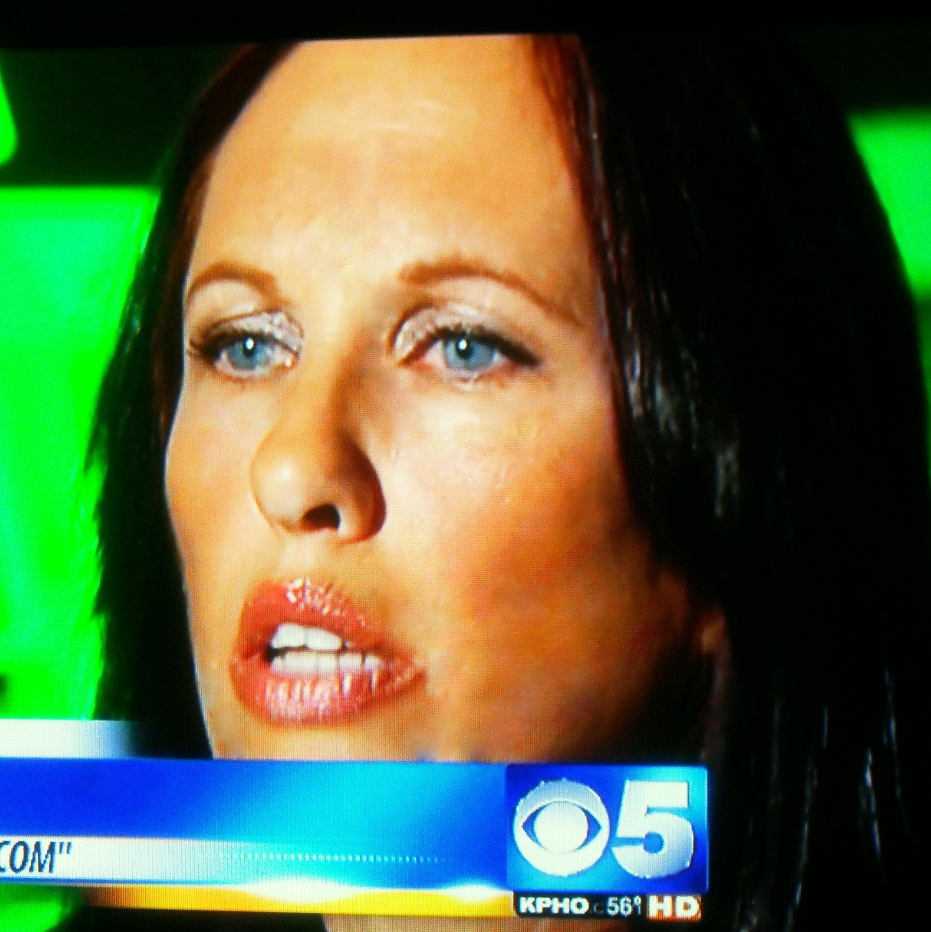
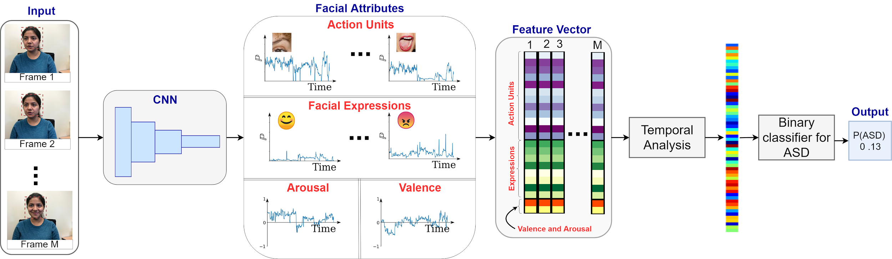
Goal
Constraint Setting
Wild Setting
Create a system for wild data. Analyze facial images from a various setting (illumination, pose, occlusion, etc).
Combine and analyze four domains of facial expression.
Use machine learning and facial affect attributes to classify participants with/without autism.

Slide 4
Our System
Input: Video. No other modality (e.g. voice, EEG, heart rate, EDA, age, etc)
  Comply with IRB/HIPAA restrictions.
  Make the system as simple as possible.
  More challenging.
Output:
  Recognized facial attributes: action units, expression, arousal, and valence.
  Probability that the participant is influenced by autism.

Slide 5
Part I: Facial Affect Analysis

Slide 6

Facial Expression != Emotion
Notes:
Make it shorter 10 seconds.

Slide 7
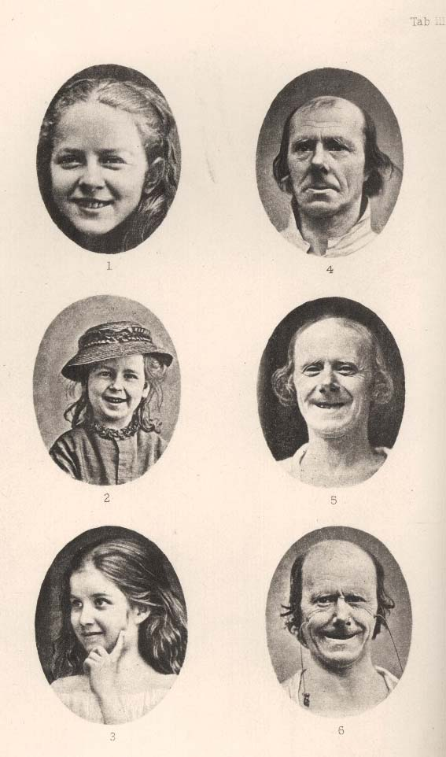
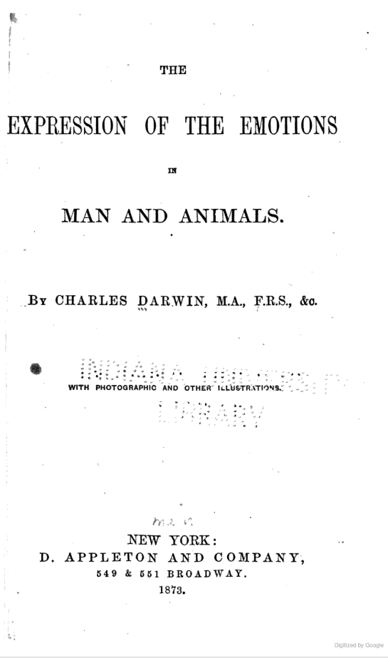
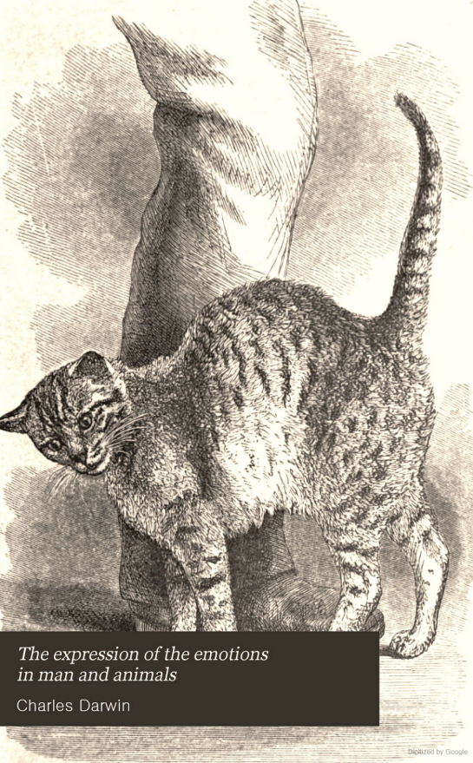

Slide 8
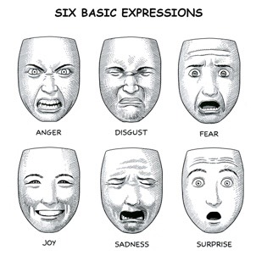
Cardinal Expressions
Total 8 Expression Category
Anger, Disgust, Fear, Joy, Sad, Surprise
Neutral
Contempt
Notes:
Even though there are only 8 categories for facial expression. It is still a challenging problem [next slide]

Slide 9
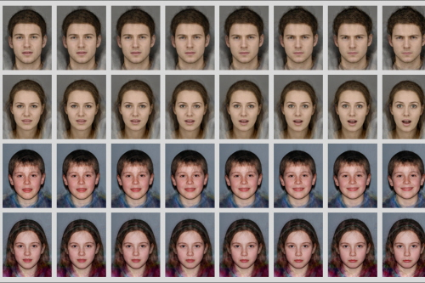
Pixel-wise Difference is Small
Image Source:
University of Bristol. “Children with Autism Find Understanding Facial Expressions Difficult but Make Similar Mistakes as Peers.” What Is Working Memory? | School of Experimental Psychology | University of Bristol, University of Bristol, 31 Mar. 2017, www.bristol.ac.uk/news/2017/march/autism-study.html
Notes:
Make it shorter

Slide 10
Even human wouldn’t agree with each other
Crowd-sourced labels on “expressions” exhibit only 65 ± 5 % accuracy
Goodfellow, Ian J., et al. "Challenges in representation learning: A report on three machine learning contests." International Conference on Neural Information Processing. Springer, Berlin, Heidelberg, 2013.
Barsoum, Emad, et al. "Training deep networks for facial expression recognition with crowd-sourced label distribution." Proceedings of the 18th ACM International Conference on Multimodal Interaction. ACM, 2016.
36,000 images were annotated by two annotators... The results showed that the annotators agreed on 60.7% of the images.
Mollahosseini, Ali, Behzad Hasani, and Mohammad H. Mahoor. "AffectNet: A Database for Facial Expression, Valence, and Arousal Computing in the Wild." IEEE Transactions on Affective Computing (2017).
Notes:
Delete this slide

Slide 11
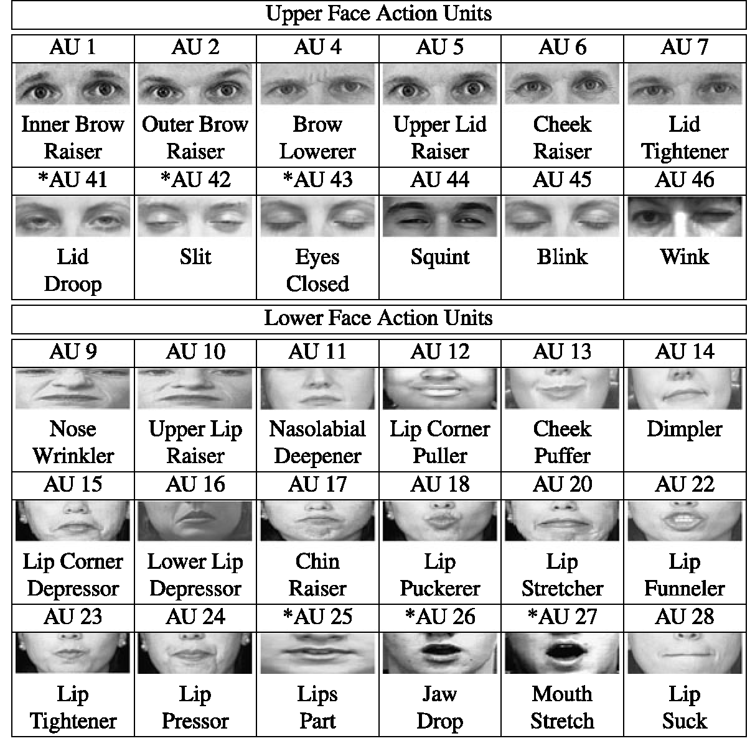
Action Units
Friesen, E., and P. Ekman. "Facial action coding system: a technique for the measurement of facial movement." Palo Alto (1978).
Image Source: https://www.pinterest.com.au/pin/82472236907938447/
Notes:
In this system, the computer can recognize major muscle movements. Then, people can build a classifier to group different muscle movements to different expression.

Slide 12
Cons of Action Units
Expensive to annotate
Small muscle movements (winkles) can make a difference
Same AU can result to different expression

Slide 13
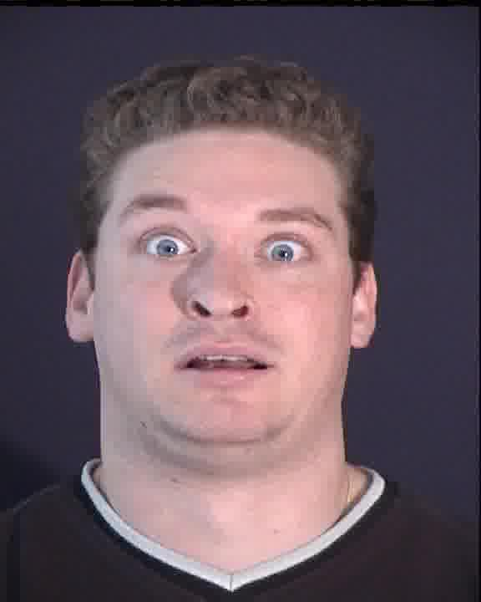

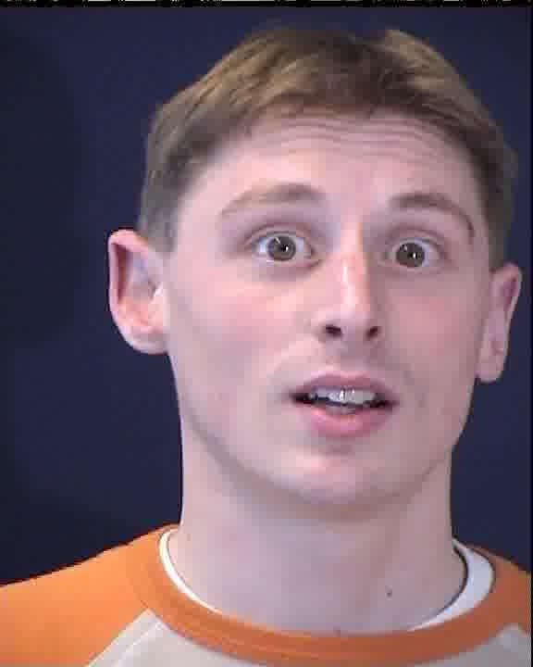

Same Action Units, but ...
Surprise
Surprise
Fear

Slide 14
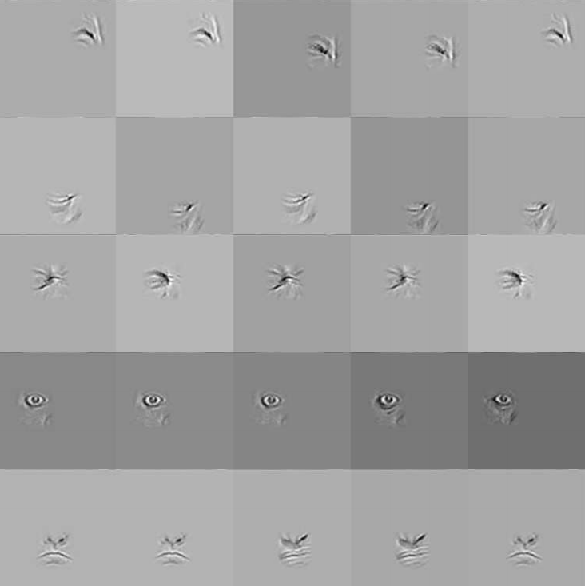
Classify Expression Directly
Khorrami, Pooya, Thomas Paine, and Thomas Huang. "Do deep neural networks learn facial action units when doing expression recognition?." Proceedings of the IEEE International Conference on Computer Vision Workshops. 2015.
Notes:
There are still some critics on this kind of facial expression system, which is compound expression. [next slide]

Slide 15

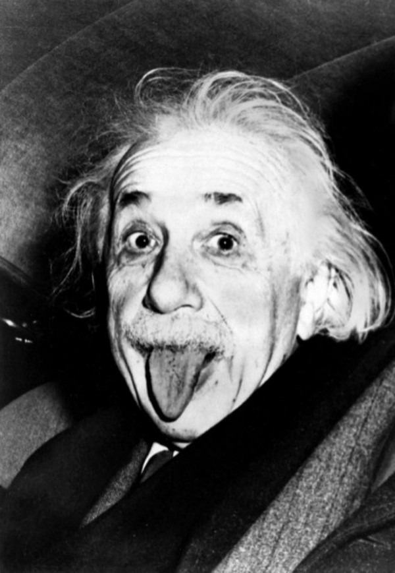
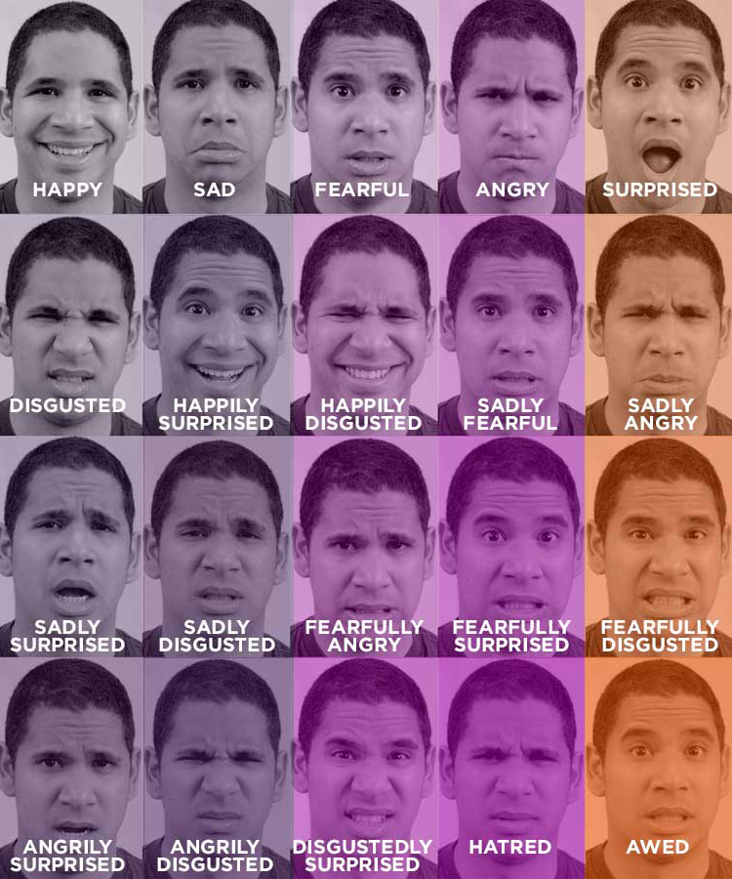
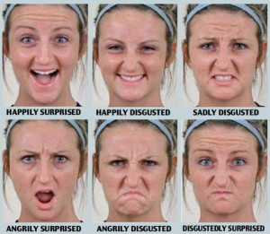

Compound Expression & Micro Expression
Notes:
People have compound expression and micro expression…
…
Some researchers have build compound facial expression, and classify expression into more than 20 different categories. Well… Where is happily sad? [next slides]

Slide 16
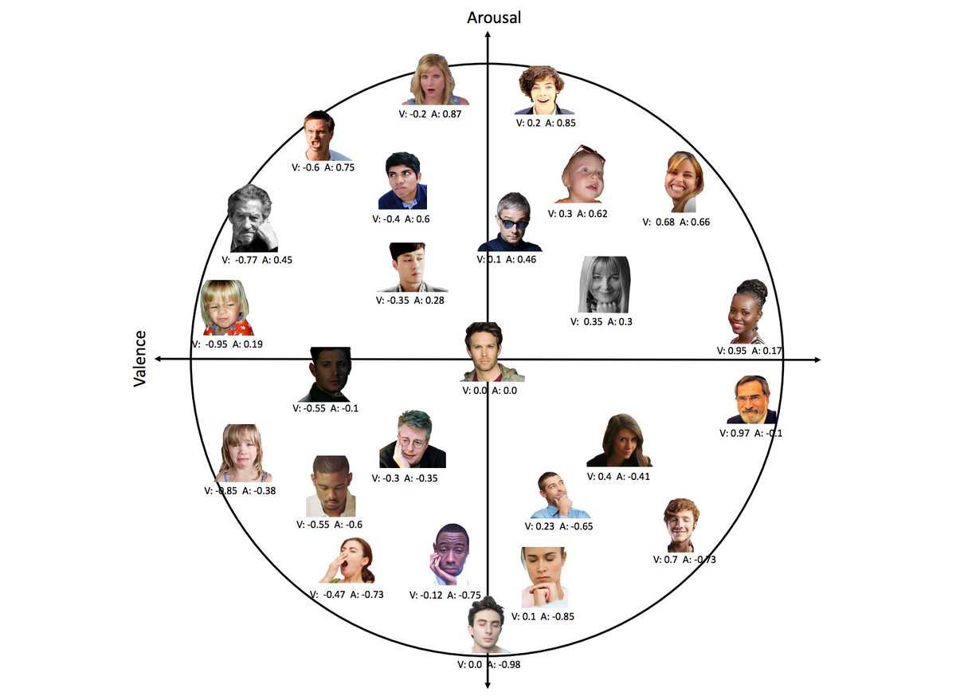
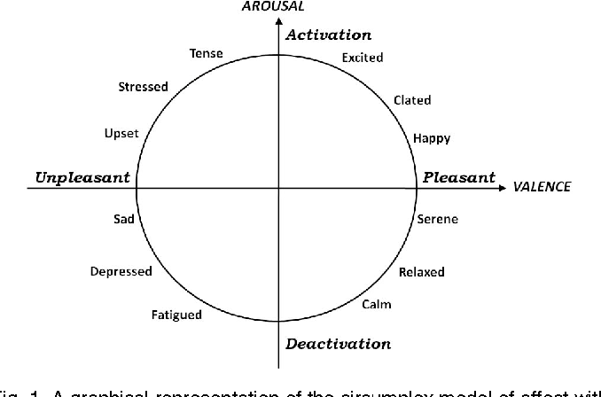
Valence and Arousal
Kensinger, Elizabeth A. "Remembering emotional experiences: The contribution of valence and arousal." Reviews in the Neurosciences 15.4 (2004): 241-252.
Notes:
In 1990s, the definition of valence and arousal gained popularity.

Slide 17
Four Domains of Facial Affect Attributes
Action Units: major muscle movements.
Expression: 8 classes
Arousal: how intense an expression is
Valence: how pleasant an expression is

Slide 18
Dataset
EmotioNet
  975,000 images in the wild
12 Important Action Units:
AU1 Inner Brow Raiser
AU2 Outer Brow Raiser
AU4 Brow Lowerer
AU5 Upper Lid Raise
AU6 Cheek Raise
AU9 Nose Wrinkler
AU12 Lip Corner Puller
AU17 Chin Raiser
AU20 Lip stretcher
AU25 Lips Part
AU26 Jaw Drop
AU43 Eyes Closed
AffectNet
  450,000 images
Eight Expressions
Arousal
Valence
Total: 1.4 million images
Notes:
Don’t say [tiny change]

Slide 19
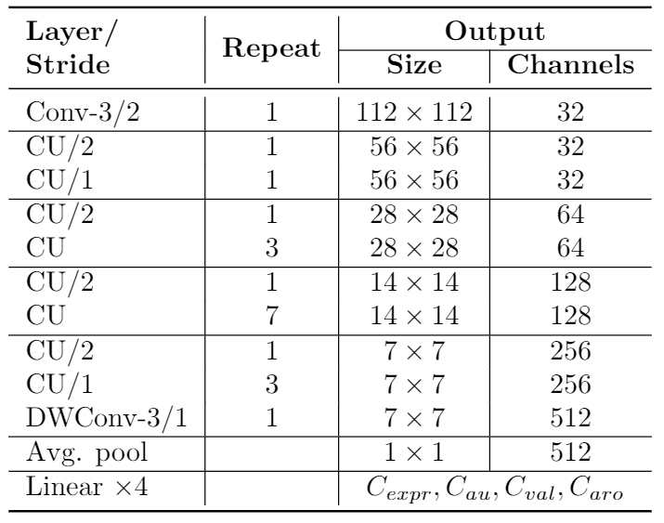
Four Blocks of Convolution

Slide 20

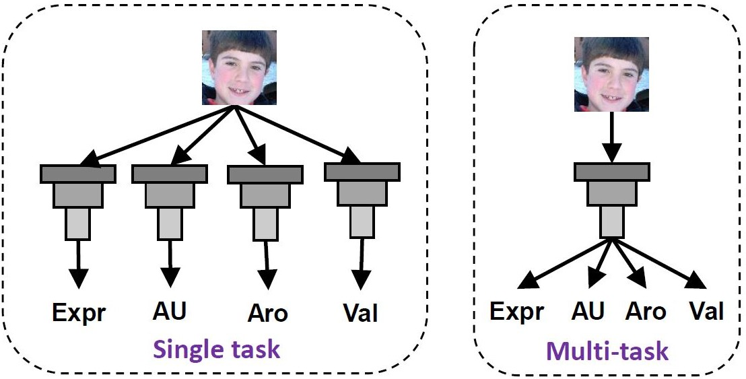
Multi-Task Learning

Slide 21
Engineering Details
Missing Labels
  Weight loss with zero
Loss
  Action Units Recognition: Weighted Binary Cross Entropy Loss
  Expression Classification: Weighted Cross Entropy Loss
  Arousal / Valence: Euclidean + Manhattan Distance
Regularization
  20% Dropout before last layer.
Stochastic Gradient Descent
  Initial Learning Rate: 0.01; 10% decay per epoch.
  Momentum 0.9.
  Total 30 epochs.

Slide 22
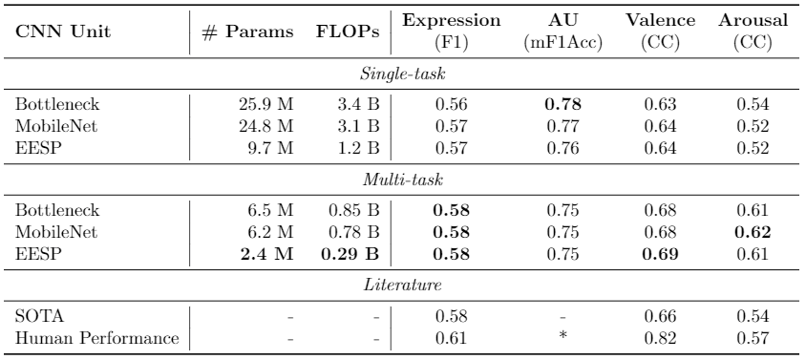
Results
0.82 kappa for CK+ dataset
Benitez-Quiroz, Carlos Fabian, Yan Wang, and Aleix M. Martinez. "Recognition of Action Units in the Wild with Deep Nets and a New Global-Local Loss." ICCV. 2017.
Benitez-Quiroz, C. Fabian, et al. "EmotioNet Challenge: Recognition of facial expressions of emotion in the wild." arXiv preprint arXiv:1703.01210 (2017).
Mollahosseini, Ali, Behzad Hasani, and Mohammad H. Mahoor. "AffectNet: A Database for Facial Expression, Valence, and Arousal Computing in the Wild." IEEE Transactions on Affective Computing (2017).
Notes:
Results [so-far]. Don’t go through the number. Just highlight.

Slide 23
Part II: Application to Autism

Slide 24

Data Collection
About 24 Frames per second for recording
Pause experiment if no face detected by iPad
Valid Data: 88 participants finished the experiment and signed consent.

Slide 25
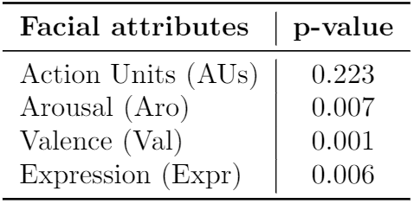
Statistical Analysis
ASD has more joy but less neutral compared to TD.
  ASD may like the stimulus more than the TD.
Expression/Arousal/Valence/Head movements are more various for children with ASD.

Slide 26
Symptoms of Autism (Revisit)
https://www.autismspeaks.org/what-are-symptoms-autism

Slide 27
ASD/TD Classification
Use the 58-dimensional vector to classify ASD/TD
Seven binary classifiers
  Logistic regression, LASSO, LDA, QDA, SVM-rbf, XGBoost, and a two-hidden-layer neural network (NN).
Challenge:
  We have 88 valid participants, and 58-dimensional vector might overfit our data.
Solution:
  Use PCA to reduce dimension first, then apply classifiers.
  Use default hyperparameters for all models.

Slide 28
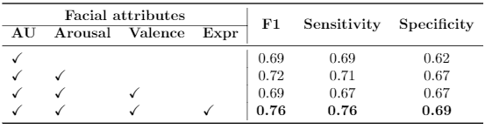
Classification Result v.s. Affect Domain

Slide 29
Limitation
< 100 participants, and participants are not i.i.d from the population.
The analysis is restricted by the training data and public facial images
Lack of testing data from other source, and results might be too optimistic!
Need to correlate affective attributes to the ADOS score.

Slide 30
Takeaway
Create a system for wild data (facial images from a various setting).
Combine and analyze four domains of facial expression.
Extracted features are statistically significant for ASD/TD groups.
Even with simple features, our machine learning results showed there is potential to use facial affect analysis to help classify ASD/TD in the future.

