Slide 1
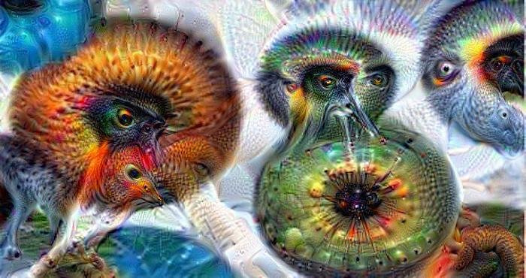
Fall 2024 CS543 / ECE549
Computer Vision
Course webpage URL: http://slazebni.cs.illinois.edu/fall24

Slide 2
Outline
Logistics, requirements
Goal of computer vision
Origins of computer vision
Topics covered in class

Slide 3
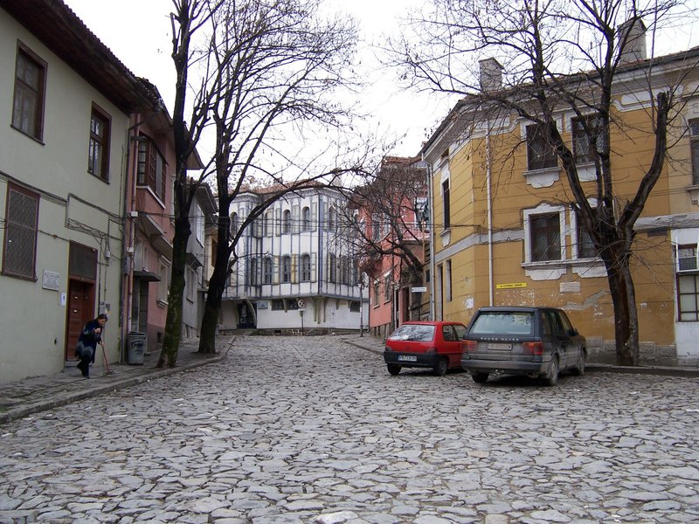
Goal: Image understanding
…

Slide 4
Goal: Image understanding
…
Geometric understanding

Slide 5
Goal: Image understanding
roof
tree
tree
sky
chimney
building
building
window
door
trashcan
car
car
person
Outdoor scene
ground
City
European
…
Semantic understanding

Slide 6


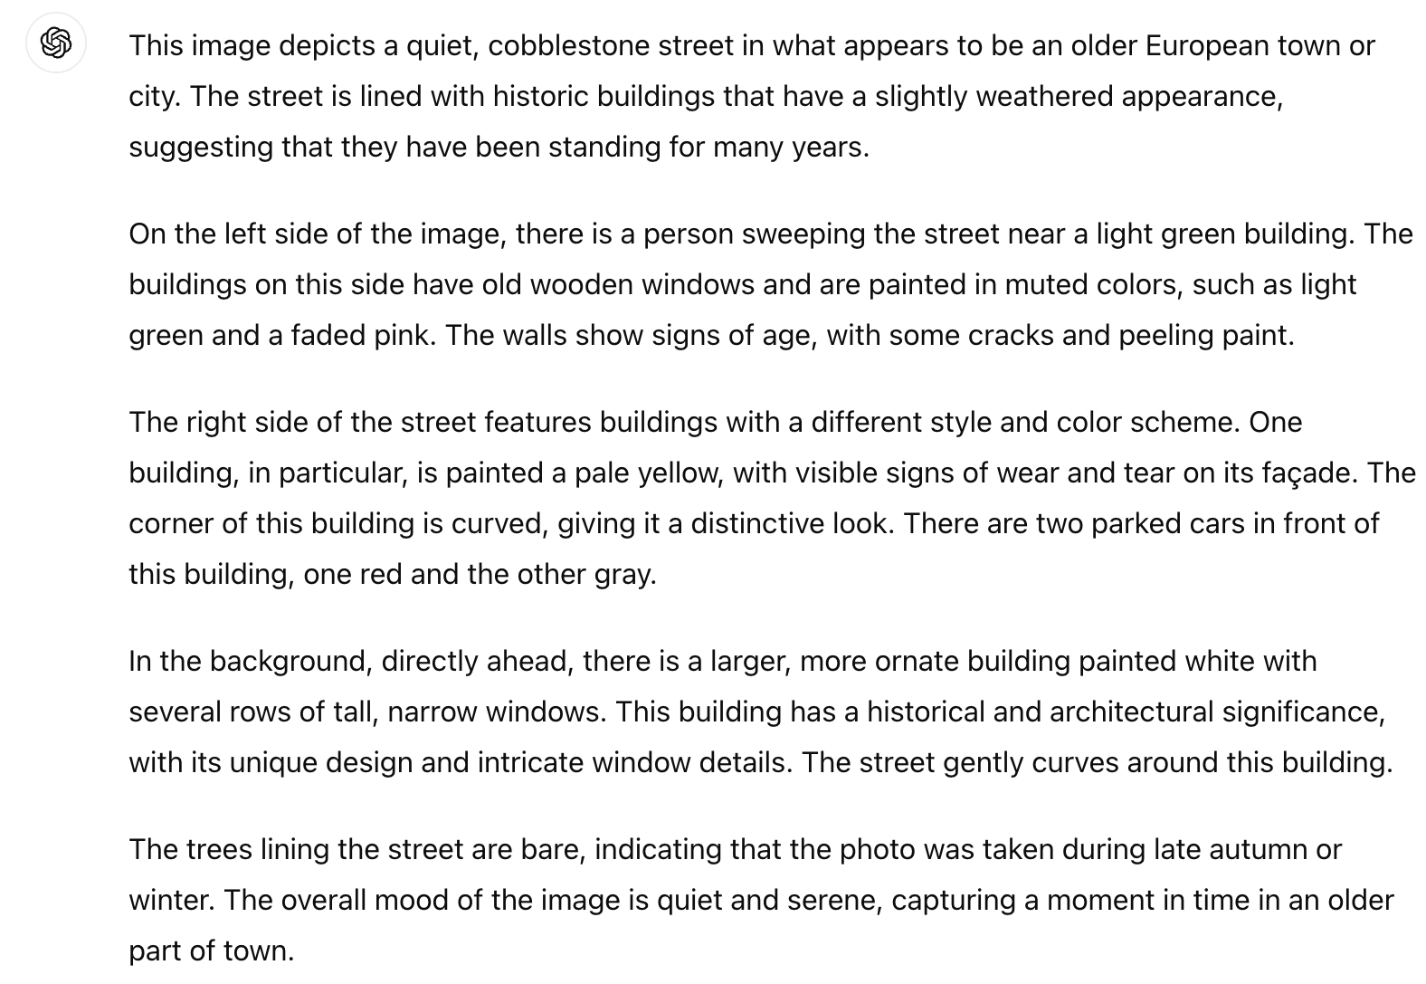

Goal: Image understanding

Slide 7
Goal: Image understanding
…

Slide 8
Goal: Image understanding
Vertical surface
Vertical surface
Can open,
be opened
Can be used to deposit trash
Can move
Walkable
Horizontal surface, rough
Walkable, drivable
Affordances

Slide 9
Goal: Image understanding
Actionable information

Slide 10


Goal: Image understanding
Image generation

Slide 11

Humans are quite good at image understanding
Source: “80 million tiny images” by Torralba et al.

Slide 12
Humans are quite good at image understanding
(most of the time)

Slide 13
Humans are quite good at image understanding
(most of the time)
Image source

Slide 14
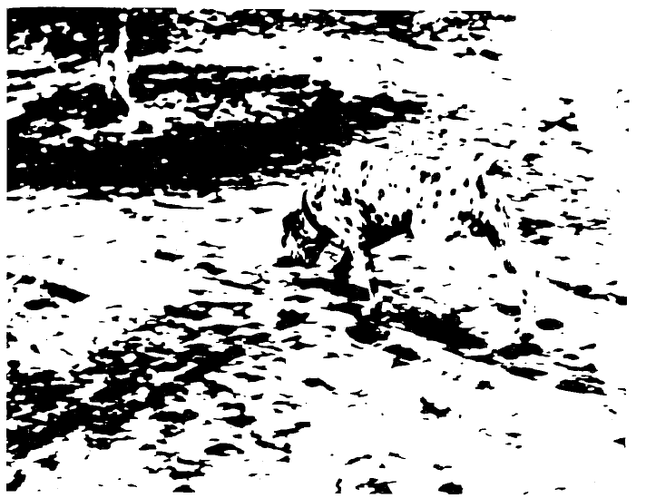
Humans are quite good at image understanding
(most of the time)
Figure from Marr (1982), attributed to R. C. James

Slide 15
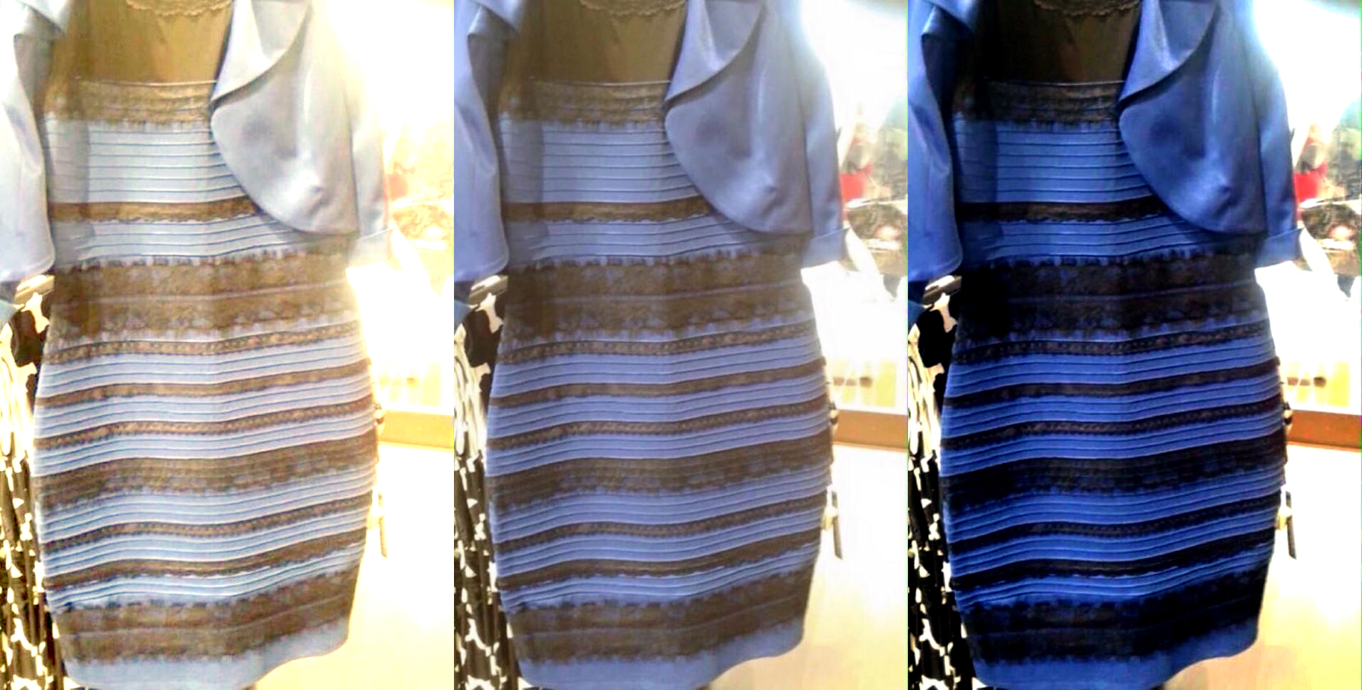
Humans are quite good at image understanding
(most of the time)
What color is this dress?

Slide 16
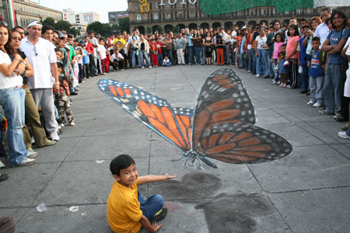
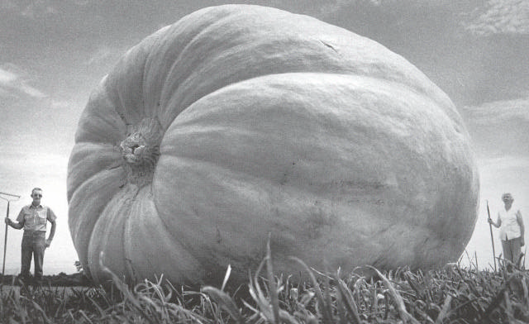
Remember: Images are fundamentally ambiguous!

Slide 17
Outline
Logistics, requirements
Goal of computer vision
Origins of computer vision

Slide 18
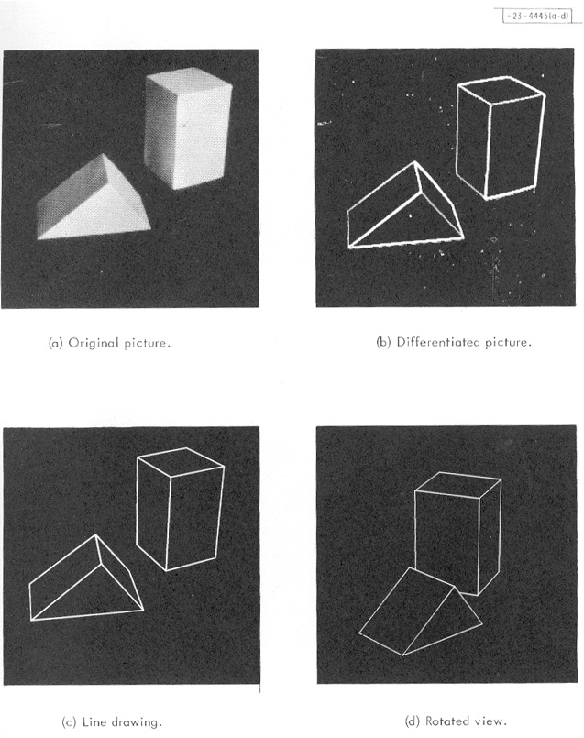
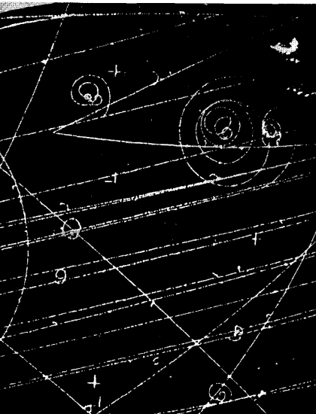
Origins of computer vision
Hough, 1959
Roberts, 1963
Rosenfeld, 1969
Duda & Hart, 1972

Slide 19
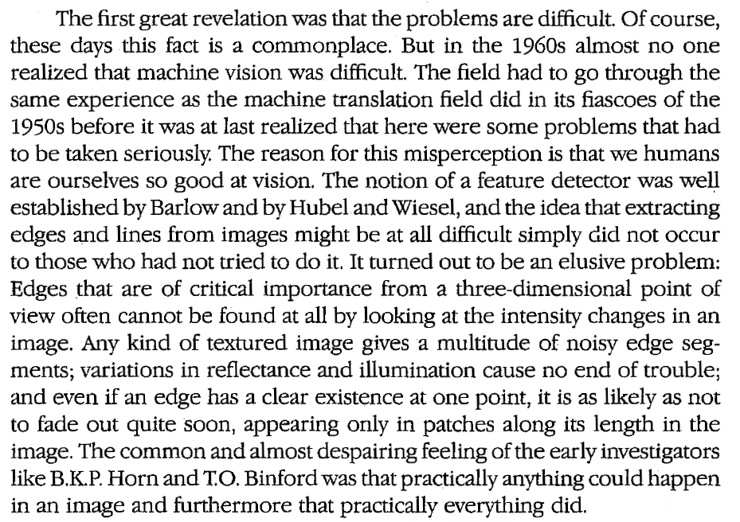
Origins of computer vision
David Marr (1945-1980)

Slide 20
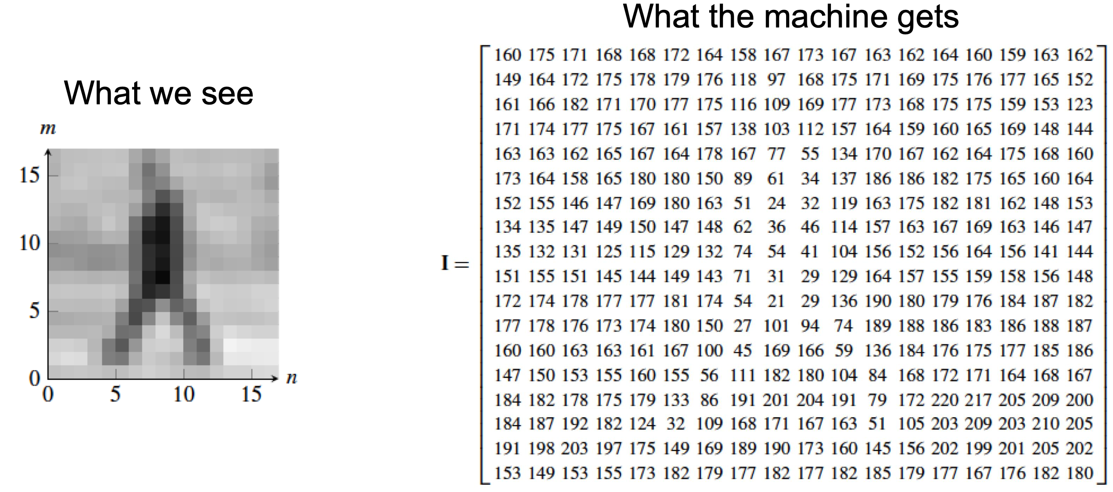
Goal of this class: To get to know the pixels
Source: A. Efros

Slide 21
Outline
Logistics, requirements
Goal of computer vision and why it is hard
Origins of computer vision
Topics covered in class

Slide 22
Topics covered in class
Image processing and early vision
Fitting and alignment
Image formation
3D vision

Slide 23
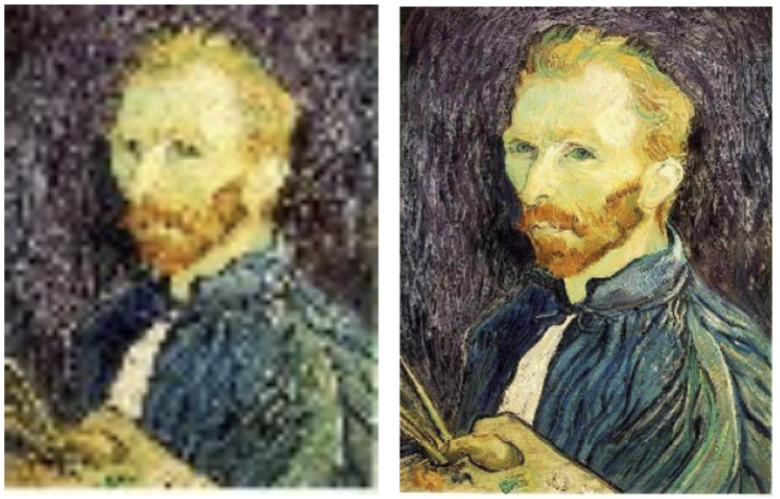


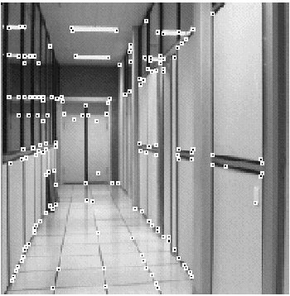
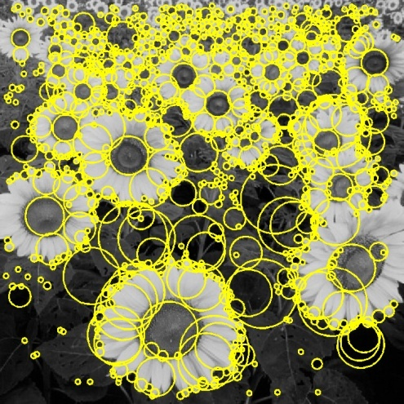
I. Image processing and early vision
*
=
Linear filtering
Edge detection
Sampling, interpolation, Fourier analysis
Feature extraction
Optical flow

Slide 24
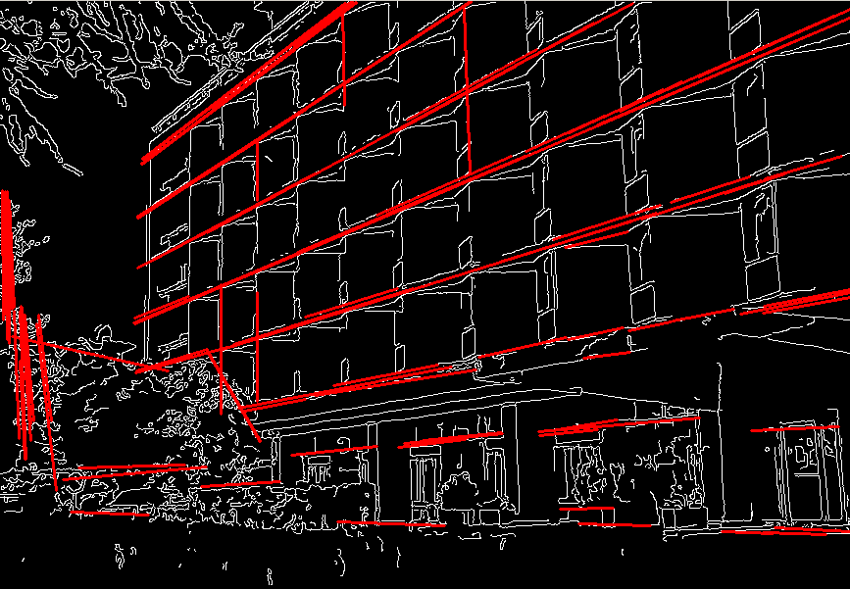
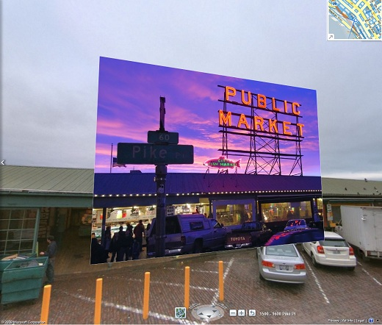
II. Fitting and alignment
Alignment, image stitching
Fitting: Least squares, voting methods

Slide 25
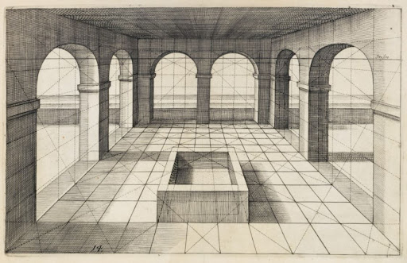
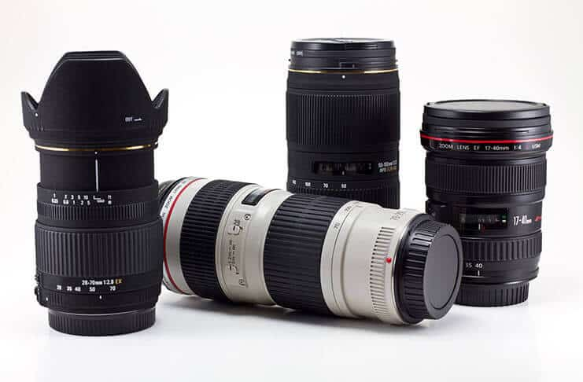
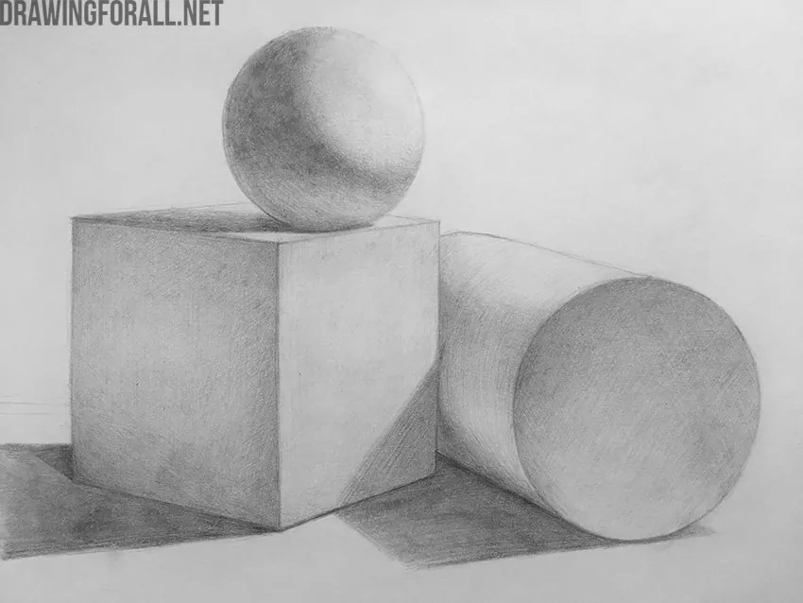
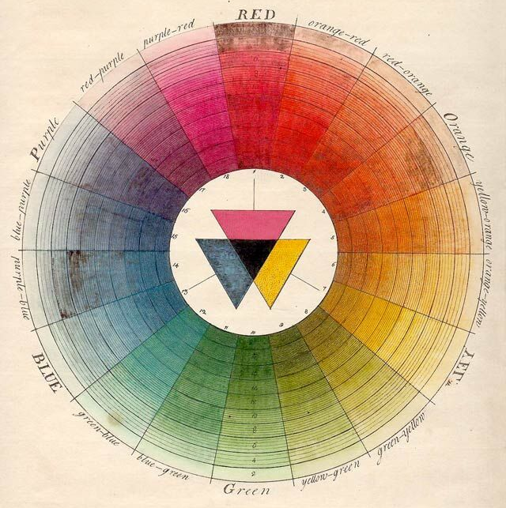
III. Image formation
Perspective projection
Camera optics
Light and shading
Color

Slide 26
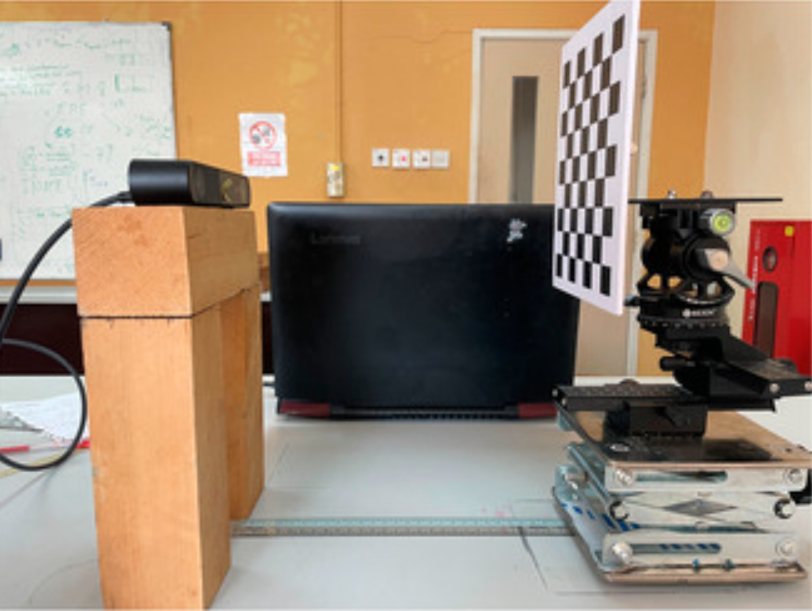
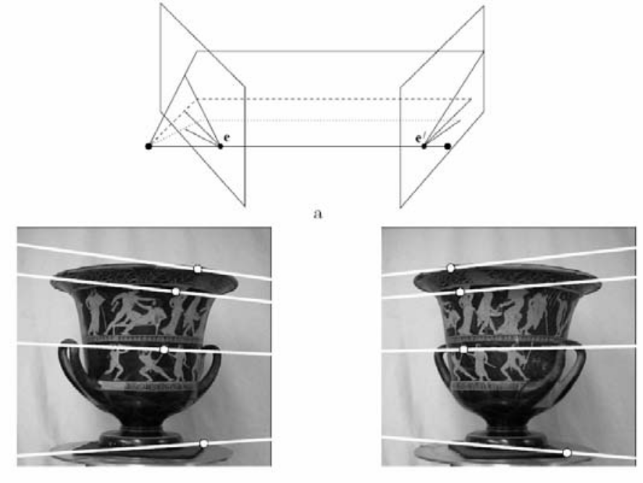
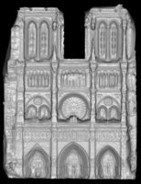
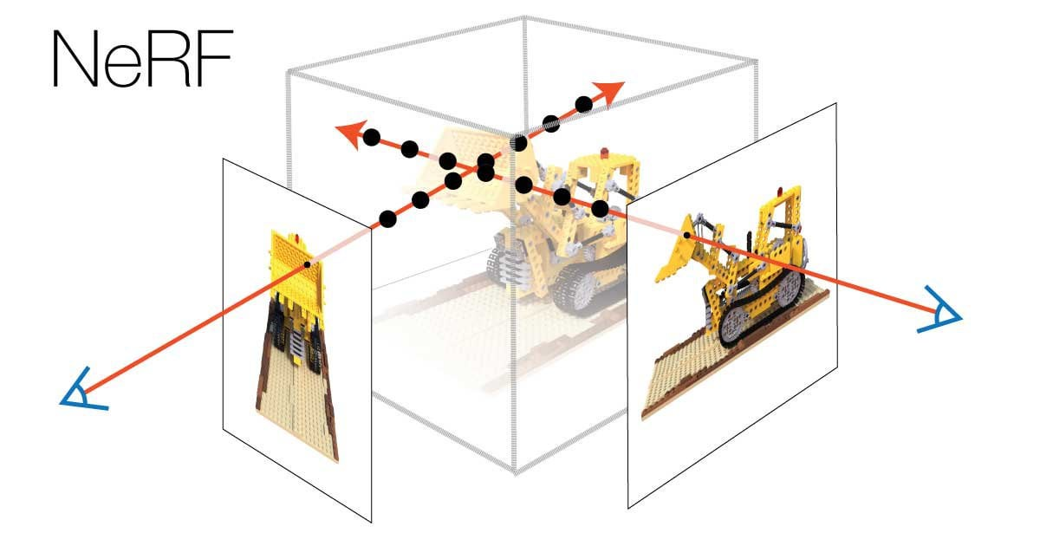
IV. 3D vision
Two-view geometry, structure from motion
Camera calibration
Stereo
Light fields and dense 3D reconstruction

Slide 27
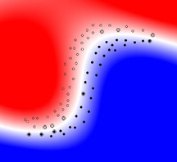
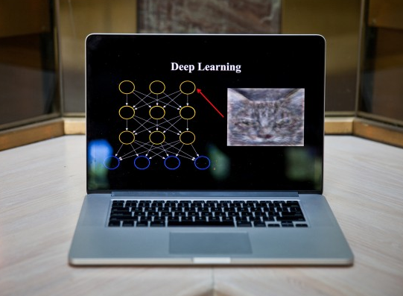
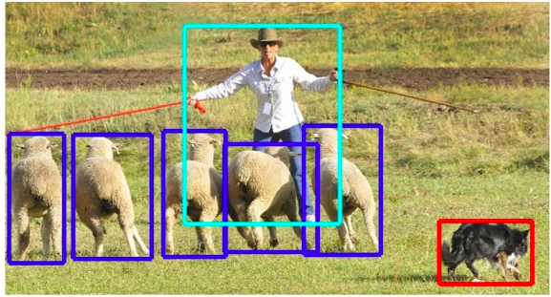
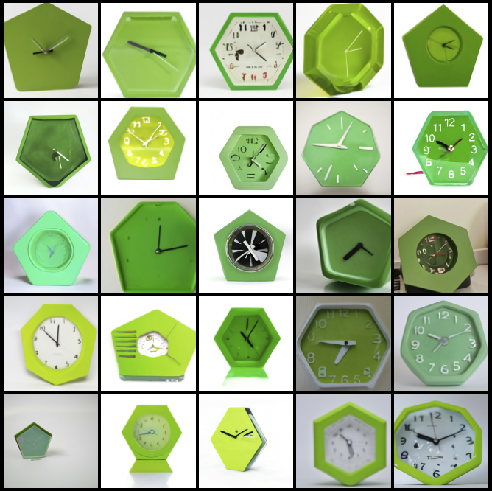
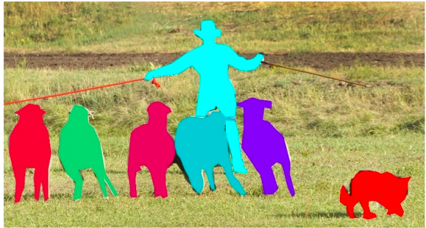
Deep learning stuff
Intro to classification
and neural networks
Deep learning architectures for images
Object detection and segmentation
Image generation

