Slide 1
Image processing basics
Many slides adapted from Alyosha Efros, Derek Hoiem
Andy Warhol, Marilyn Diptych, 1962 (source)

Slide 2
Image processing basics: Outline
Images as sampled functions
Sampling and reconstruction, aliasing
Image resampling, interpolation
Image transformations

Slide 3
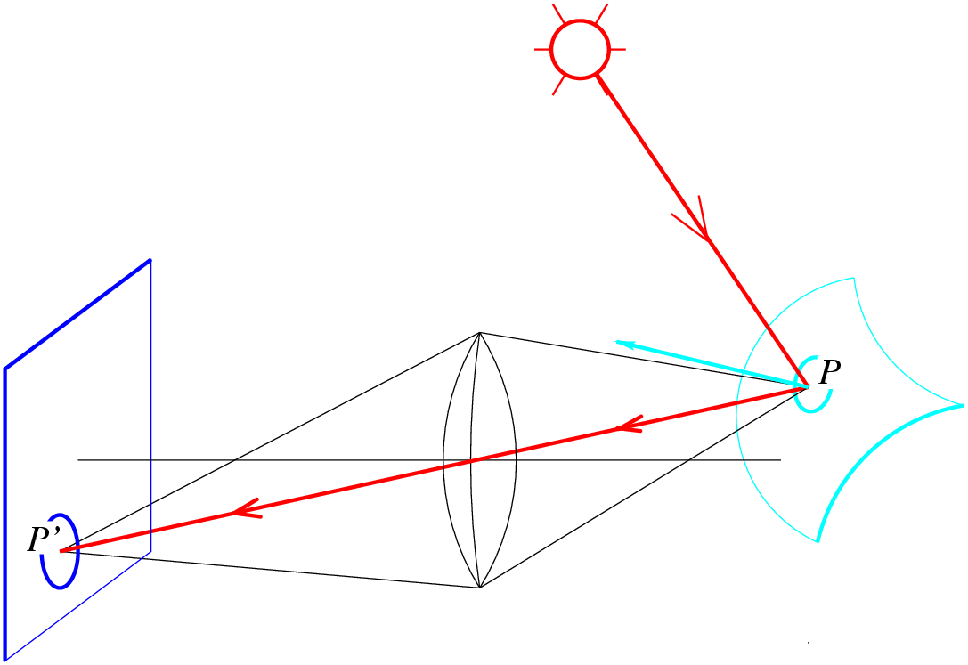
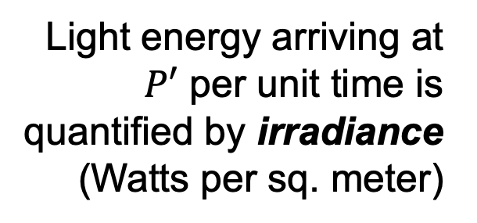
Image formation (preview)
What determines the brightness of an image pixel?
Light source(s)
Image plane
Scene surface
Light energy arriving at $P′$ per unit time is quantified by irradiance (Watts per sq. meter)
To account for light of different wavelengths, we need spectral irradiance
Camera (lenses, shutter)
Notes:
Review slide (skip)

Slide 4
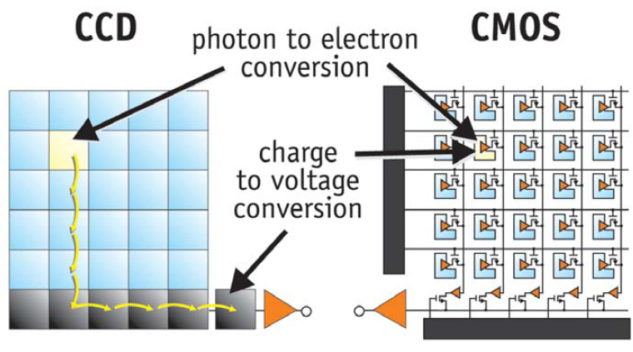
Images as sampled functions

Slide 5
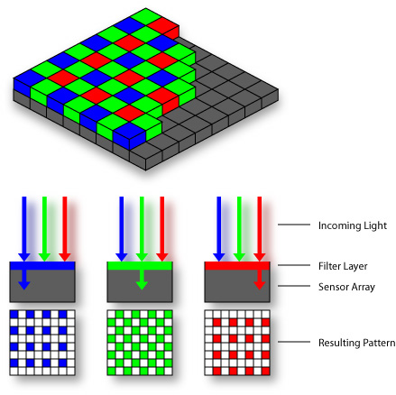
Images as sampled functions
Bayer grid (1976)

Slide 6
Demosaicing: How to fill in the missing values?

Slide 7
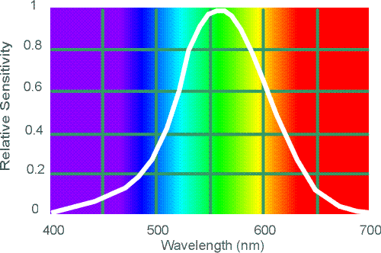

How are the three channels acquired?
Bayer grid (1976)
Why more green?
Human Luminance Sensitivity Function
Demosaicing:
Estimation of missing components from neighboring values
Source: Wikipedia

Slide 8
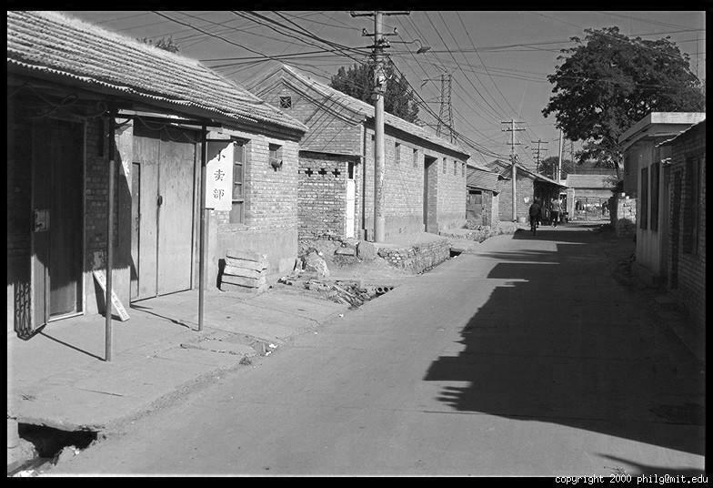
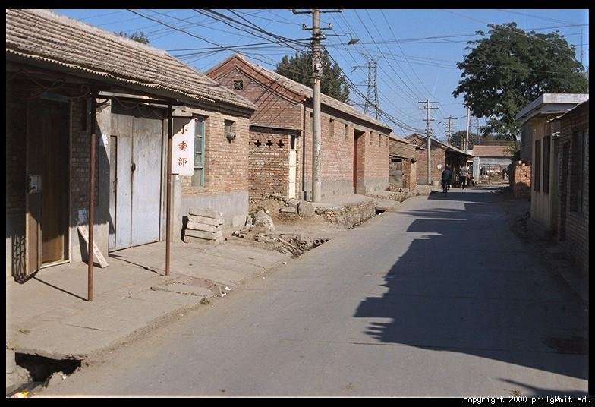
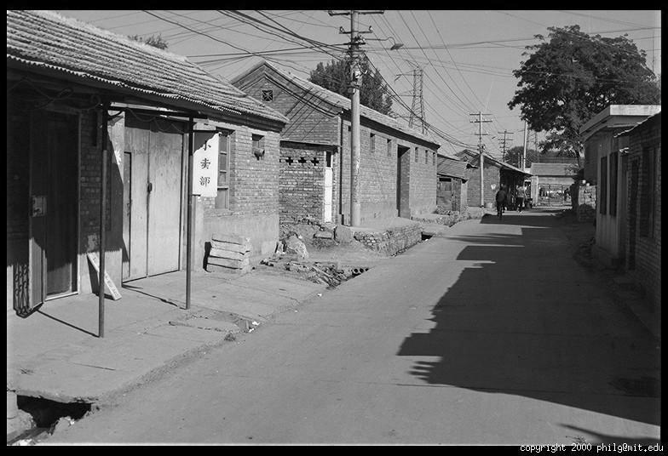
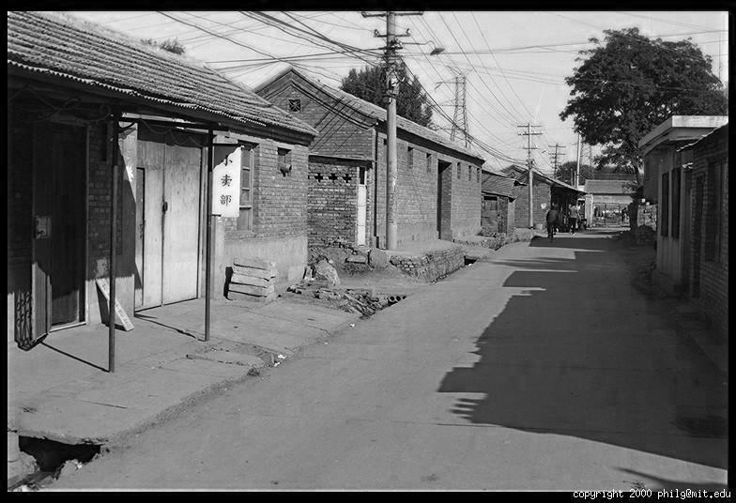
Digital color images
R
G
B

Slide 9
Digital color images in Python
im = cv2.imread(filename) # read image
im = cv2.cvtColor(im, cv2.COLOR_BGR2RGB) # order channels as RGB
im = im / 255 # values range from 0 to 1
RGB image im is a H x W x 3 matrix (numpy.ndarray)
im[0,0,0] is the top-left pixel value in R-channel
im[y, x, c] is the value y+1 pixels down, x+1 pixels to right in the c^{th} channel
im[H-1, W-1, 2] is the bottom-right pixel in B-channel
column
row
R
0.92 | 0.93 | 0.94 | 0.97 | 0.62 | 0.37 | 0.85 | 0.97 | 0.93 | 0.92 | 0.99
0.95 | 0.89 | 0.82 | 0.89 | 0.56 | 0.31 | 0.75 | 0.92 | 0.81 | 0.95 | 0.91
0.89 | 0.72 | 0.51 | 0.55 | 0.51 | 0.42 | 0.57 | 0.41 | 0.49 | 0.91 | 0.92
0.96 | 0.95 | 0.88 | 0.94 | 0.56 | 0.46 | 0.91 | 0.87 | 0.90 | 0.97 | 0.95
0.71 | 0.81 | 0.81 | 0.87 | 0.57 | 0.37 | 0.80 | 0.88 | 0.89 | 0.79 | 0.85
0.49 | 0.62 | 0.60 | 0.58 | 0.50 | 0.60 | 0.58 | 0.50 | 0.61 | 0.45 | 0.33
0.86 | 0.84 | 0.74 | 0.58 | 0.51 | 0.39 | 0.73 | 0.92 | 0.91 | 0.49 | 0.74
0.96 | 0.67 | 0.54 | 0.85 | 0.48 | 0.37 | 0.88 | 0.90 | 0.94 | 0.82 | 0.93
0.69 | 0.49 | 0.56 | 0.66 | 0.43 | 0.42 | 0.77 | 0.73 | 0.71 | 0.90 | 0.99
0.79 | 0.73 | 0.90 | 0.67 | 0.33 | 0.61 | 0.69 | 0.79 | 0.73 | 0.93 | 0.97
0.91 | 0.94 | 0.89 | 0.49 | 0.41 | 0.78 | 0.78 | 0.77 | 0.89 | 0.99 | 0.93
G
0.92 | 0.93 | 0.94 | 0.97 | 0.62 | 0.37 | 0.85 | 0.97 | 0.93 | 0.92 | 0.99
0.95 | 0.89 | 0.82 | 0.89 | 0.56 | 0.31 | 0.75 | 0.92 | 0.81 | 0.95 | 0.91
0.89 | 0.72 | 0.51 | 0.55 | 0.51 | 0.42 | 0.57 | 0.41 | 0.49 | 0.91 | 0.92
0.96 | 0.95 | 0.88 | 0.94 | 0.56 | 0.46 | 0.91 | 0.87 | 0.90 | 0.97 | 0.95
0.71 | 0.81 | 0.81 | 0.87 | 0.57 | 0.37 | 0.80 | 0.88 | 0.89 | 0.79 | 0.85
0.49 | 0.62 | 0.60 | 0.58 | 0.50 | 0.60 | 0.58 | 0.50 | 0.61 | 0.45 | 0.33
0.86 | 0.84 | 0.74 | 0.58 | 0.51 | 0.39 | 0.73 | 0.92 | 0.91 | 0.49 | 0.74
0.96 | 0.67 | 0.54 | 0.85 | 0.48 | 0.37 | 0.88 | 0.90 | 0.94 | 0.82 | 0.93
0.69 | 0.49 | 0.56 | 0.66 | 0.43 | 0.42 | 0.77 | 0.73 | 0.71 | 0.90 | 0.99
0.79 | 0.73 | 0.90 | 0.67 | 0.33 | 0.61 | 0.69 | 0.79 | 0.73 | 0.93 | 0.97
0.91 | 0.94 | 0.89 | 0.49 | 0.41 | 0.78 | 0.78 | 0.77 | 0.89 | 0.99 | 0.93
B
0.92 | 0.93 | 0.94 | 0.97 | 0.62 | 0.37 | 0.85 | 0.97 | 0.93 | 0.92 | 0.99
0.95 | 0.89 | 0.82 | 0.89 | 0.56 | 0.31 | 0.75 | 0.92 | 0.81 | 0.95 | 0.91
0.89 | 0.72 | 0.51 | 0.55 | 0.51 | 0.42 | 0.57 | 0.41 | 0.49 | 0.91 | 0.92
0.96 | 0.95 | 0.88 | 0.94 | 0.56 | 0.46 | 0.91 | 0.87 | 0.90 | 0.97 | 0.95
0.71 | 0.81 | 0.81 | 0.87 | 0.57 | 0.37 | 0.80 | 0.88 | 0.89 | 0.79 | 0.85
0.49 | 0.62 | 0.60 | 0.58 | 0.50 | 0.60 | 0.58 | 0.50 | 0.61 | 0.45 | 0.33
0.86 | 0.84 | 0.74 | 0.58 | 0.51 | 0.39 | 0.73 | 0.92 | 0.91 | 0.49 | 0.74
0.96 | 0.67 | 0.54 | 0.85 | 0.48 | 0.37 | 0.88 | 0.90 | 0.94 | 0.82 | 0.93
0.69 | 0.49 | 0.56 | 0.66 | 0.43 | 0.42 | 0.77 | 0.73 | 0.71 | 0.90 | 0.99
0.79 | 0.73 | 0.90 | 0.67 | 0.33 | 0.61 | 0.69 | 0.79 | 0.73 | 0.93 | 0.97
0.91 | 0.94 | 0.89 | 0.49 | 0.41 | 0.78 | 0.78 | 0.77 | 0.89 | 0.99 | 0.93

Slide 10
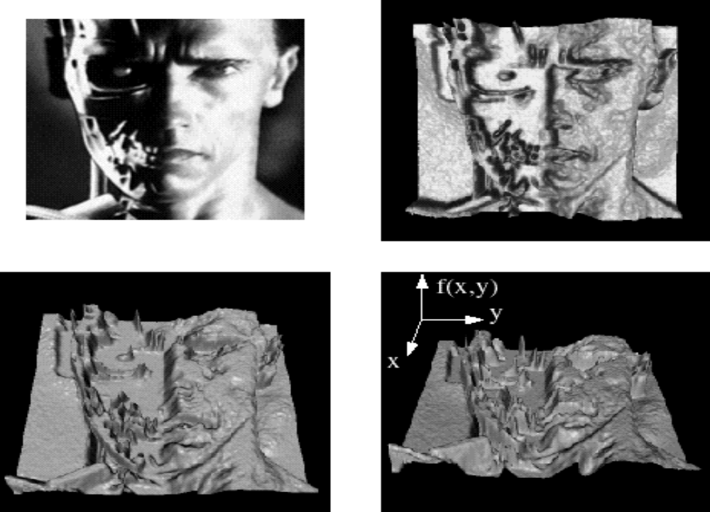
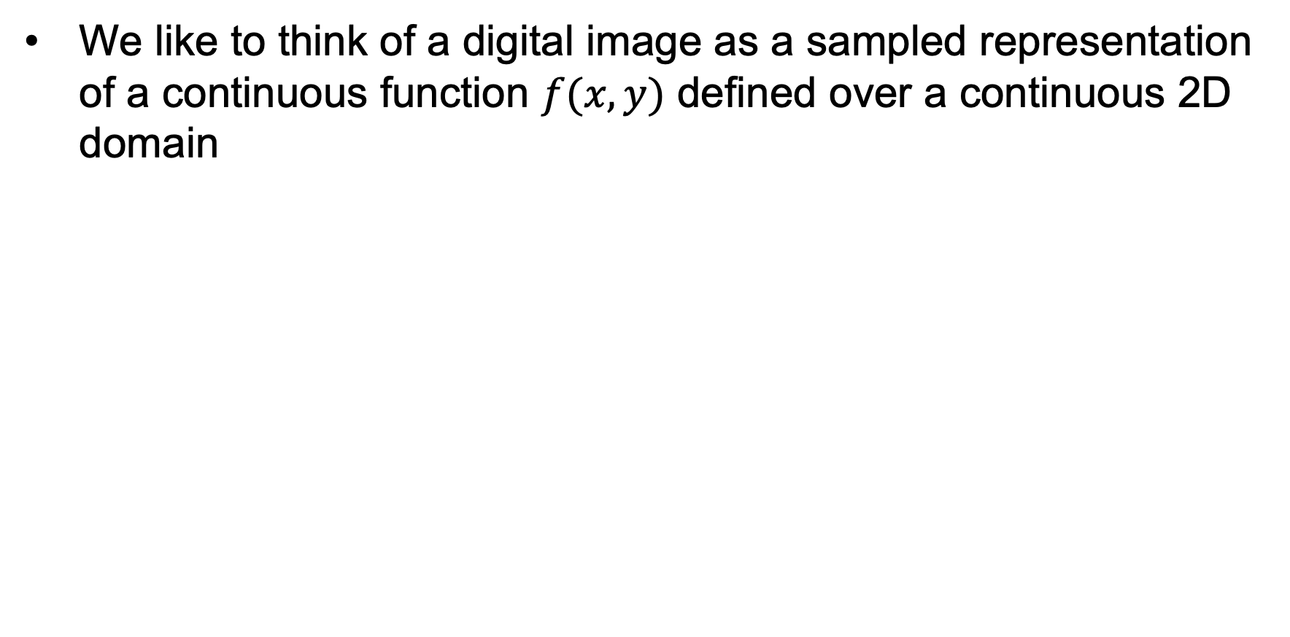
Images as sampled functions
We like to think of a digital image as a sampled representation of a continuous function $f(x,y)$ defined over a continuous 2D domain
Notes:
Render with scanalyze????

Slide 11
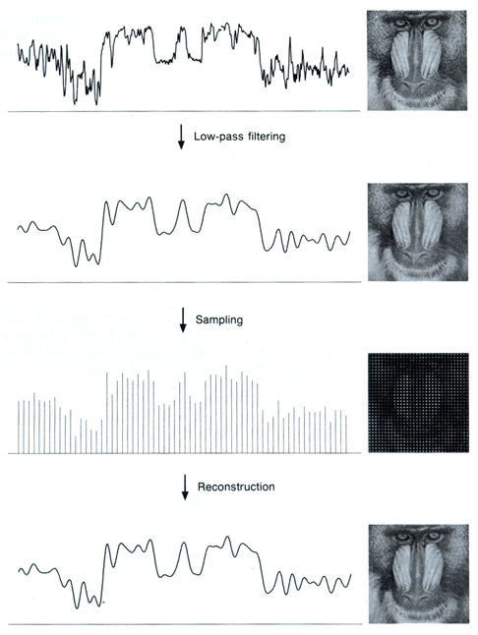
Sampling and reconstruction
  Sampling: recording the function’s values at a discrete set of locations
  Reconstruction: converting a sampled representation back into a continuous function by “guessing” what happens between the samples
Source: S. Marschner (via A. Efros)

Slide 12
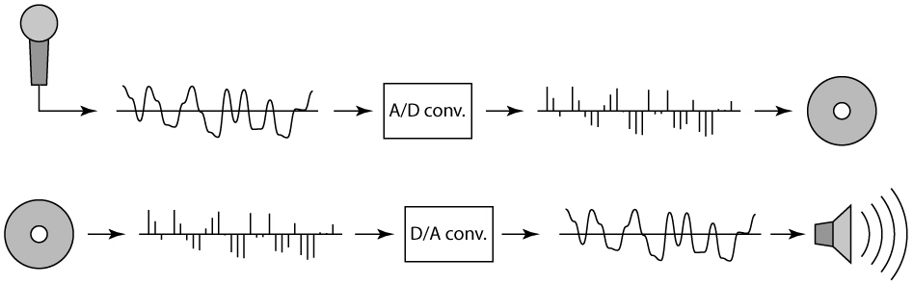
1D example: Digital audio
Recording: sound to analog to samples to disc
Playback: disc to samples to analog to sound again
Source: S. Marschner (via A. Efros)

Slide 13
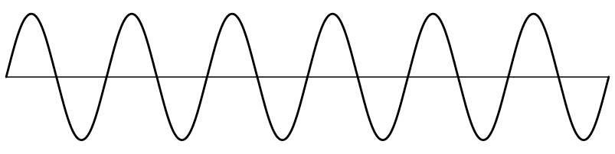
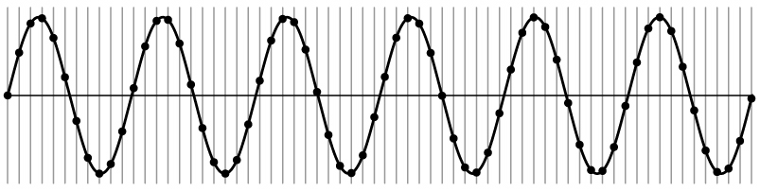
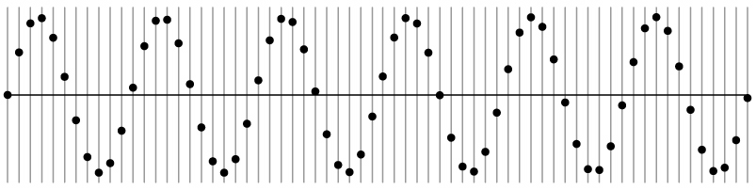
Sampling and reconstruction
Simple example: a sine wave
Source: S. Marschner (via A. Efros)

Slide 14
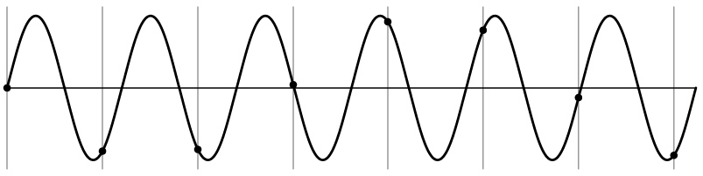
Sampling and reconstruction
Simple example: a sine wave
What if we “missed” things between the samples?
  Unsurprising result: information is lost
Source: S. Marschner (via A. Efros)

Slide 15
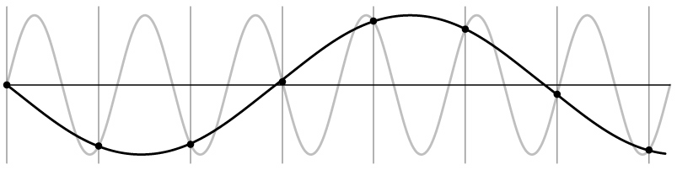
Sampling and reconstruction
Simple example: a sine wave
What if we “missed” things between the samples?
  Unsurprising result: information is lost
  Surprising result: indistinguishable from lower frequencies
Source: S. Marschner (via A. Efros)

Slide 16
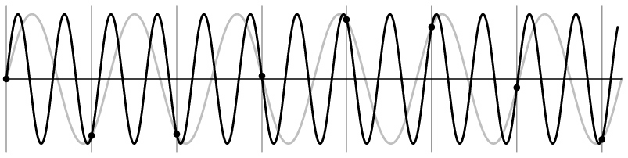
Sampling and reconstruction
Simple example: a sine wave
What if we “missed” things between the samples?
  Unsurprising result: information is lost
  Surprising result: indistinguishable from lower frequencies
  (or even higher frequencies)
Source: S. Marschner (via A. Efros)

Slide 17
Sampling and reconstruction
Simple example: a sine wave
What if we “missed” things between the samples?
  Unsurprising result: information is lost
  Surprising result: indistinguishable from lower frequencies
  (or even higher frequencies)
  Aliasing: signal “traveling in disguise” as other frequencies
Source: S. Marschner (via A. Efros)

Slide 18
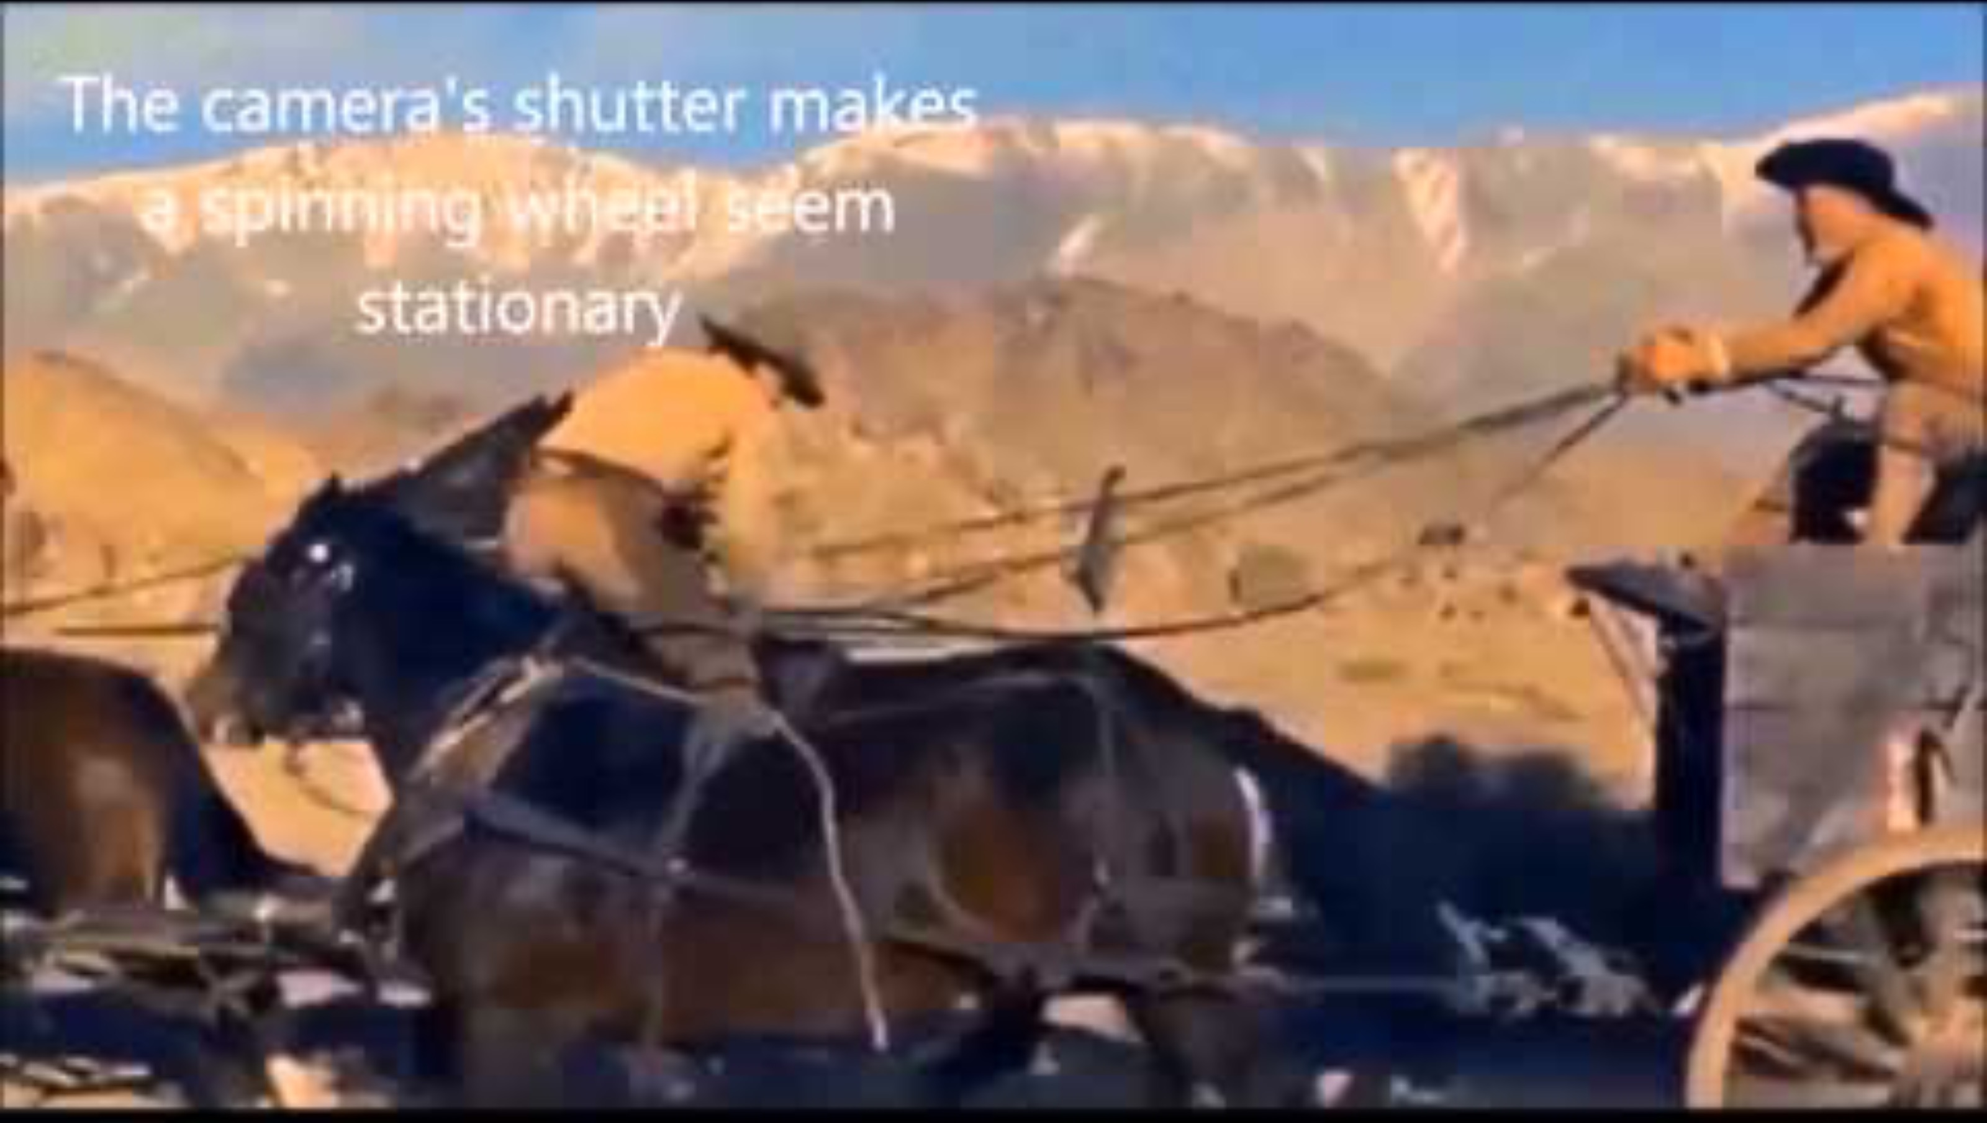
Wagon wheel effect
https://www.youtube.com/watch?v=6XwgbHjRo30

Slide 19
Wagon wheel effect
Actual motion
Perceived motion
https://en.wikipedia.org/wiki/Wagon-wheel_effect
https://maycontainmaths.wordpress.com/2015/02/22/the-wagon-wheel-effect/

Slide 20
Wagon wheel effect
Actual motion
Perceived motion
https://en.wikipedia.org/wiki/Wagon-wheel_effect
https://maycontainmaths.wordpress.com/2015/02/22/the-wagon-wheel-effect/

Slide 21
Last time: Image processing basics
Images as sampled functions
Sampling and reconstruction, aliasing
Image resampling, interpolation
Image transformations

Slide 22
Recall: Aliasing
When a signal is sampled, high-frequency information can get “disguised” as lower frequencies

Slide 23
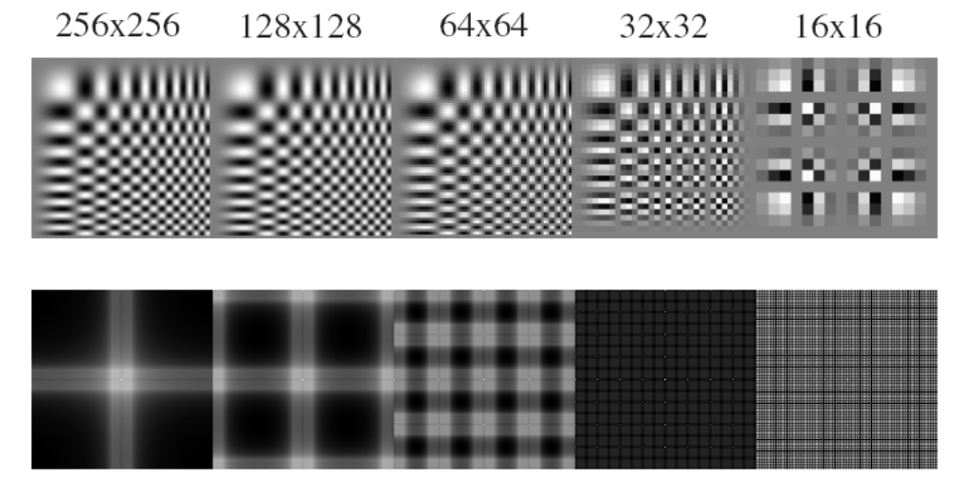
Aliasing in images

Slide 24
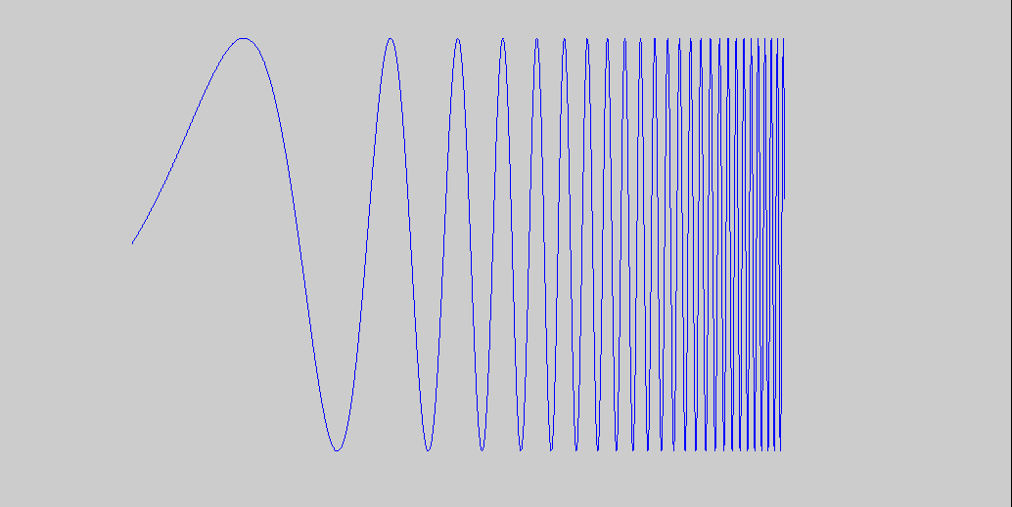
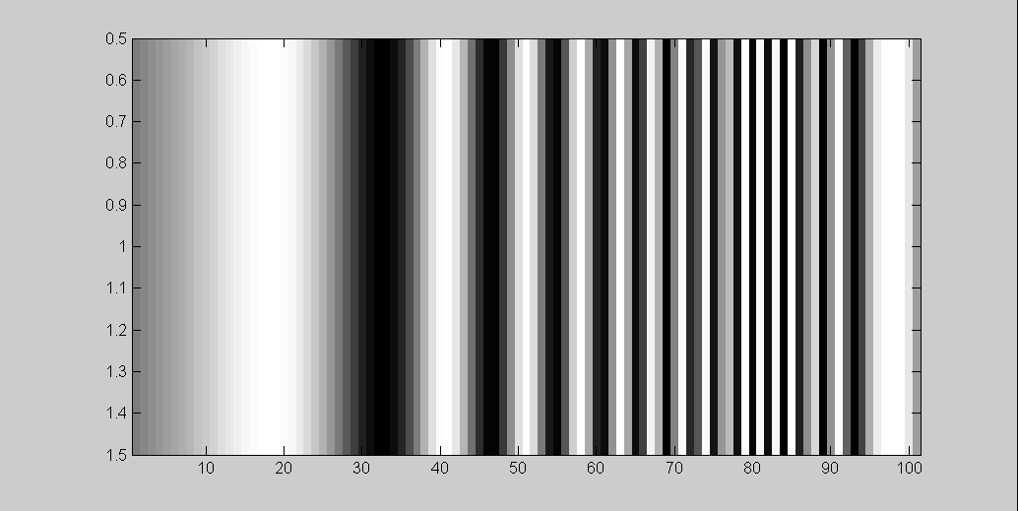
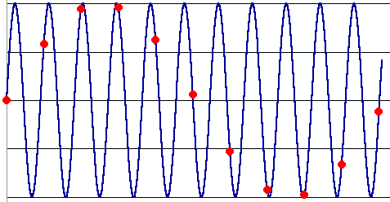
What’s happening?
Input signal:
Plot as image:
Alias!
Not enough samples

Slide 25
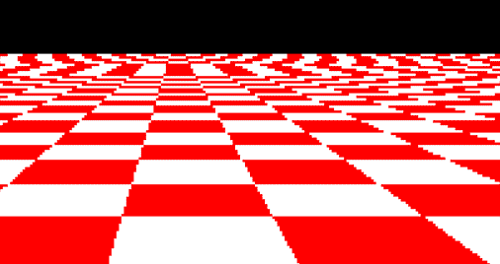
Aliasing “in the wild”
Disintegrating textures
Moire patterns, false color
Source
Source
Source

Slide 26
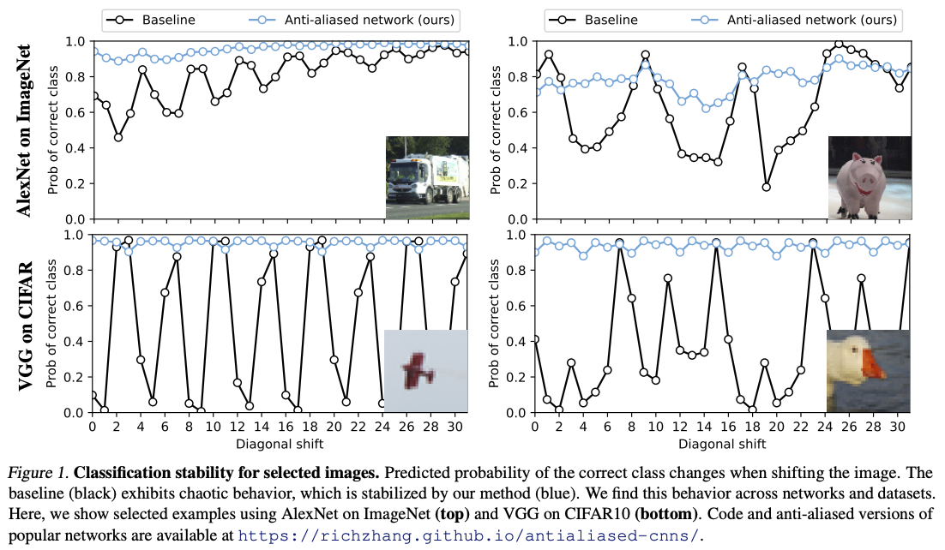
Aliasing in neural networks
R. Zhang. Making convolutional networks shift-invariant again. ICML 2019

Slide 27
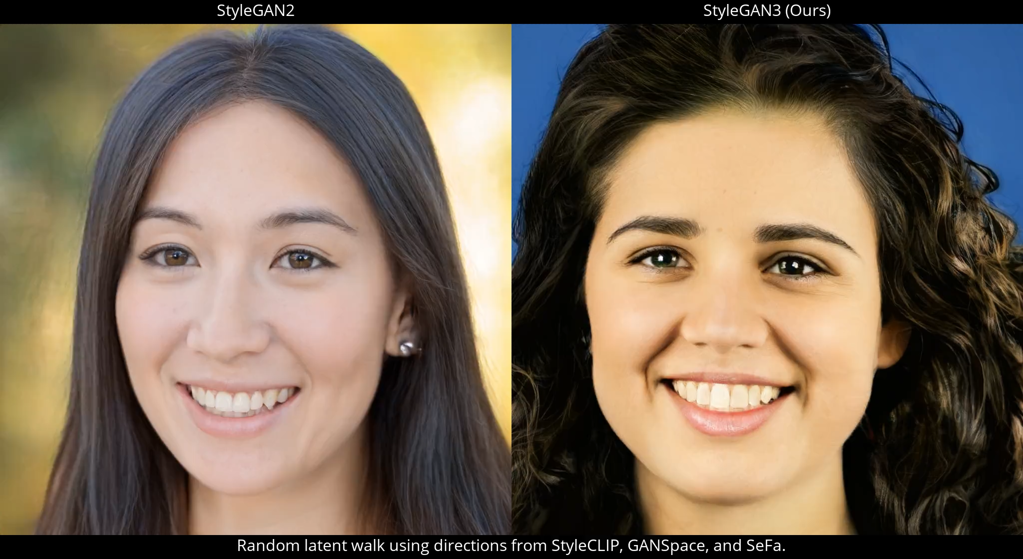
Aliasing in neural networks
Videos
T. Karras et al. Alias-Free Generative Adversarial Networks. NeurIPS 2021

Slide 28
Nyquist-Shannon sampling theorem
When sampling a signal at discrete intervals, the sampling frequency must be at least twice the maximum frequency of the input signal to allow us to reconstruct the original perfectly from the sampled version
bad
good
https://en.wikipedia.org/wiki/Nyquist-Shannon_sampling_theorem

Slide 29
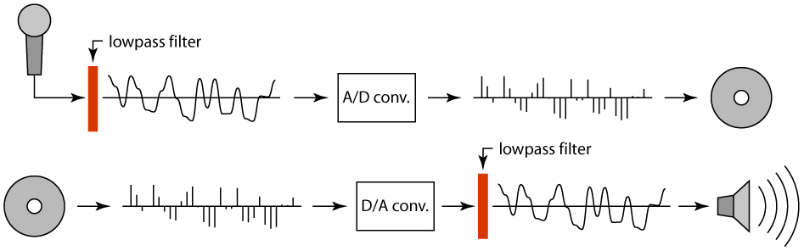
Anti-aliasing
How can we get rid of aliasing?
  Sample more often (if you can)
  Get rid of all frequencies that are greater than half the new sampling frequency
    Will lose information, but that’s better than aliasing
    How to get rid of high frequencies?
      Apply a low-pass filter (to be covered later)

Slide 30
Image processing basics: Outline
Images as sampled functions
Sampling and reconstruction, aliasing
Image resampling, interpolation

Slide 31
Subsampling an image
How do we reduce the size of an image by a factor of two?

Slide 32
Subsampling an image
How do we reduce the size of an image by a factor of two?
  How about throwing away every other row and column to create a half-size image?

Slide 33
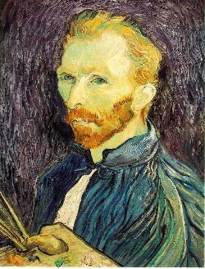
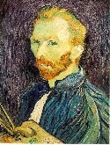

Subsampling without pre-filtering
1/2
1/4 (2x zoom)
1/8 (4x zoom)
Source: S. Seitz (via D. Hoiem)

Slide 34



Subsampling with pre-filtering
1/2
1/4
1/8
Image is smoothed with a Gaussian filter before subsampling
Source: S. Seitz (via D. Hoiem)

Slide 35
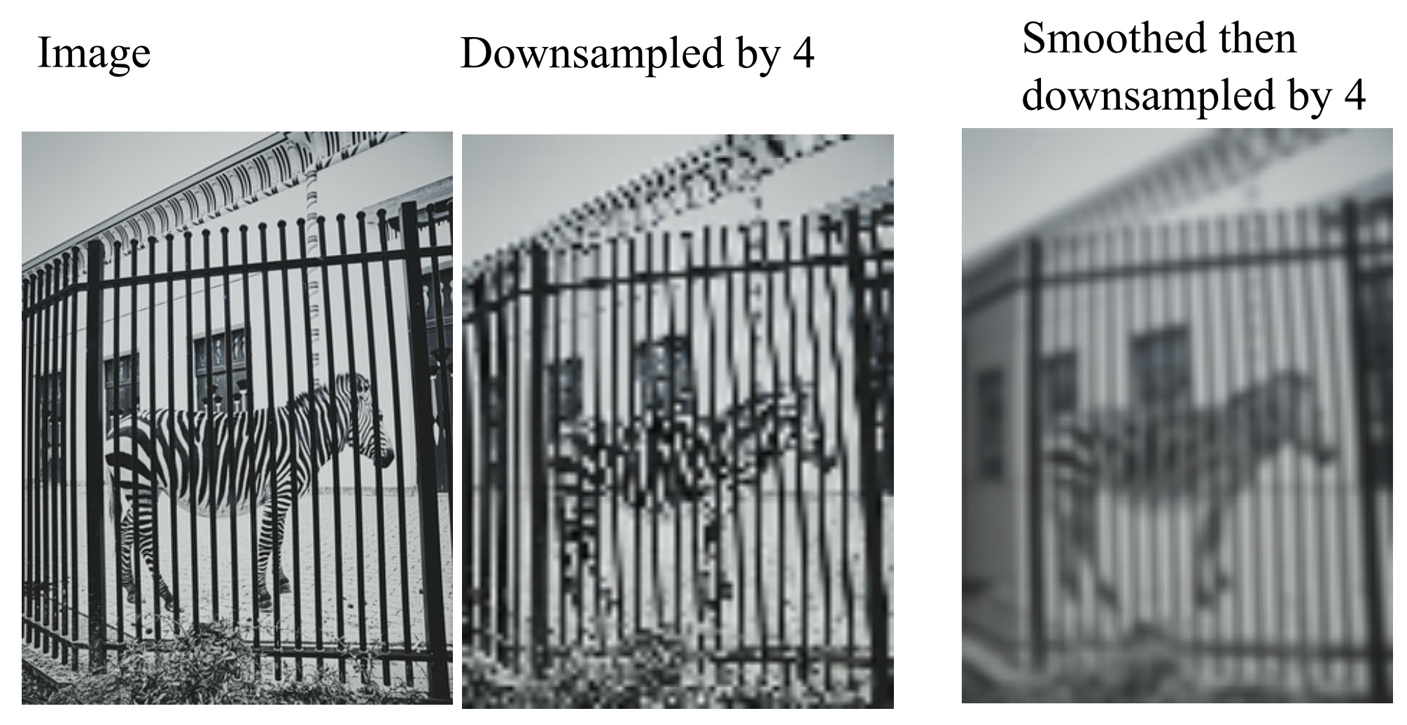
Subsampling with pre-filtering
Source: D. Forsyth

Slide 36
Upsampling an image
How do we increase the size of an image by a factor of two?
Let’s increase the resolution of the sampling grid!

Slide 37
Upsampling an image
How do we increase the size of an image by a factor of two?
What should this value be?
Need to interpolate!

Slide 38

















Upsampling an image
How do we increase the size of an image by a factor of two?
$$(0,0)$$
$$(1,0)$$
$$(2,0)$$
$$(3,0)$$
$$f\left(0.5, 0.5\right)=?$$
$$(0,1)$$
$$(1,1)$$
$$(2,1)$$
$$(3,1)$$
$$(0,2)$$
$$(1,2)$$
$$(2,2)$$
$$(3,2)$$
$$(0,3)$$
$$(1,3)$$
$$(2,3)$$
$$(3,3)$$

Slide 39
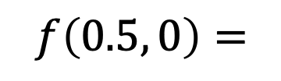
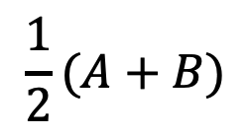
Bilinear interpolation
Let $f\left(0, 0\right)=A, f\left(1, 0\right)=B, f\left(0, 1\right)=C, f\left(1, 1\right)=D$
A
B
$$\frac{1}{2}(A+B)$$
$$f\left(0.5, 0\right)=$$
C
D

Slide 40
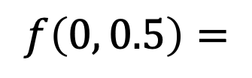
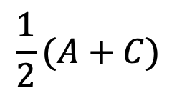
Bilinear interpolation
Let $f\left(0, 0\right)=A, f\left(1, 0\right)=B, f\left(0, 1\right)=C, f\left(1, 1\right)=D$
A
B
$$\frac{1}{2}(A+C)$$
$$f\left(0, 0.5\right)=$$
C
D

Slide 41
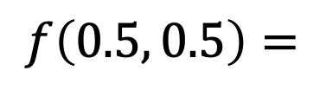
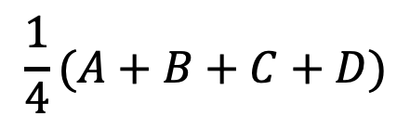
Bilinear interpolation
Let $f\left(0, 0\right)=A, f\left(1, 0\right)=B, f\left(0, 1\right)=C, f\left(1, 1\right)=D$
A
B
$$f\left(0.5, 0.5\right)=$$
C
D
$$\frac{1}{4}(A+B+C+D)$$

Slide 42
Application: Demosaicing

Slide 43
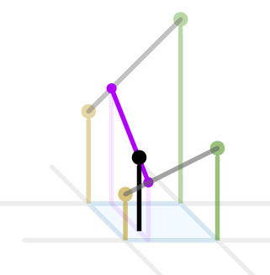
Bilinear interpolation more generally
B
A
D
C
http://en.wikipedia.org/wiki/Bilinear_interpolation

Slide 44

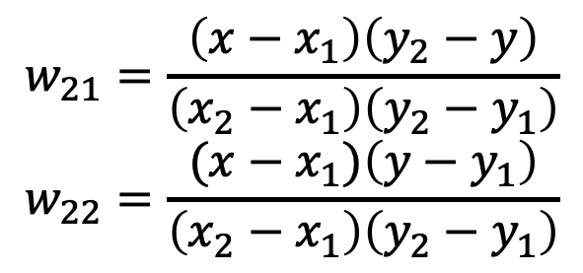
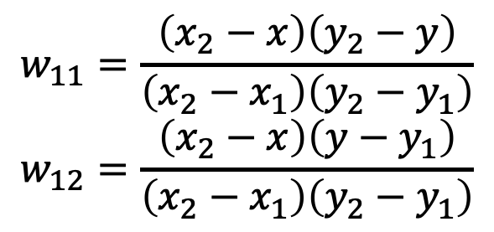



Bilinear interpolation more generally
$$\left(x_{1},y_{1}\right)$$
$$\left(x_{2},y_{1}\right)$$
A
B
$$f\left(x,y\right)=w_{11}A+w_{21}B{+w}_{12}C+w_{22}D$$
C
D
$$\left(x_{1},y_{2}\right)$$
$$\left(x_{2},y_{2}\right)$$
$$w_{11}=\frac{\left(x_{2}−x\right)\left(y_{2}−y\right)}{\left(x_{2}−x_{1}\right)\left(y_{2}−y_{1}\right)}$$
$$w_{12}=\frac{\left(x_{2}−x\right)\left(y−y_{1}\right)}{\left(x_{2}−x_{1}\right)\left(y_{2}−y_{1}\right)}$$
$$w_{21}=\frac{\left(x−x_{1}\right)\left(y_{2}−y\right)}{\left(x_{2}−x_{1}\right)\left(y_{2}−y_{1}\right)}$$
$$w_{22}=\frac{(x−x_{1})\left(y−y_{1}\right)}{\left(x_{2}−x_{1}\right)\left(y_{2}−y_{1}\right)}$$
http://en.wikipedia.org/wiki/Bilinear_interpolation

Slide 45
Bilinear interpolation: Basis function view
Interpolated function is sum of basis functions or “bumps” centered at the four adjacent grid points, weighted by the image values at the corresponding points
B
Bilinear basis function
A
D
C

Slide 46
Other kinds of interpolation
Source: Wikipedia

Slide 47
Interpolation and function extrema
When you use linear interpolation, extrema of the image function can only occur at the original sample points
What about nonlinear interpolation?
Image source

Slide 48
Image processing basics: Outline
Images as sampled functions
Sampling and reconstruction, aliasing
Image resampling, interpolation
Image transformations

Slide 49
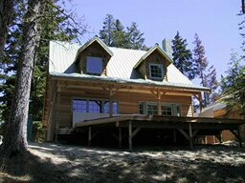
Image transformations
Downsampling
T

Slide 50
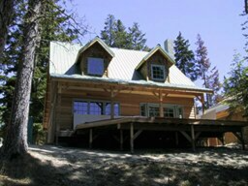
Image transformations
Upsampling
T

Slide 51
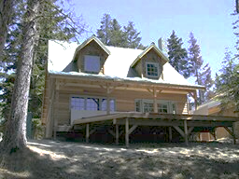
Image transformations
Contrast change
T

Slide 52

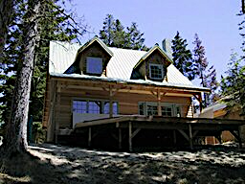
Image transformations
Blurring/sharpening
T

Slide 53
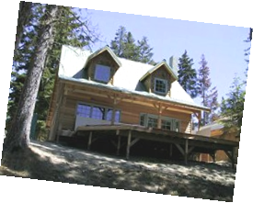
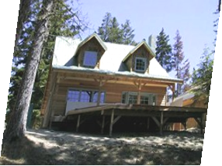
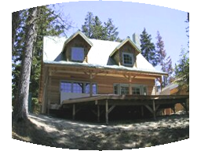
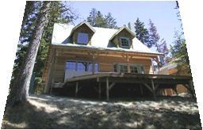
Image transformations
Warping
T

Slide 54
Last time: Image processing basics
Images as sampled functions
Sampling and reconstruction, aliasing
Image resampling, interpolation
Image transformations

Slide 55

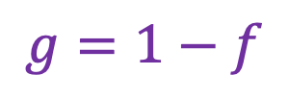
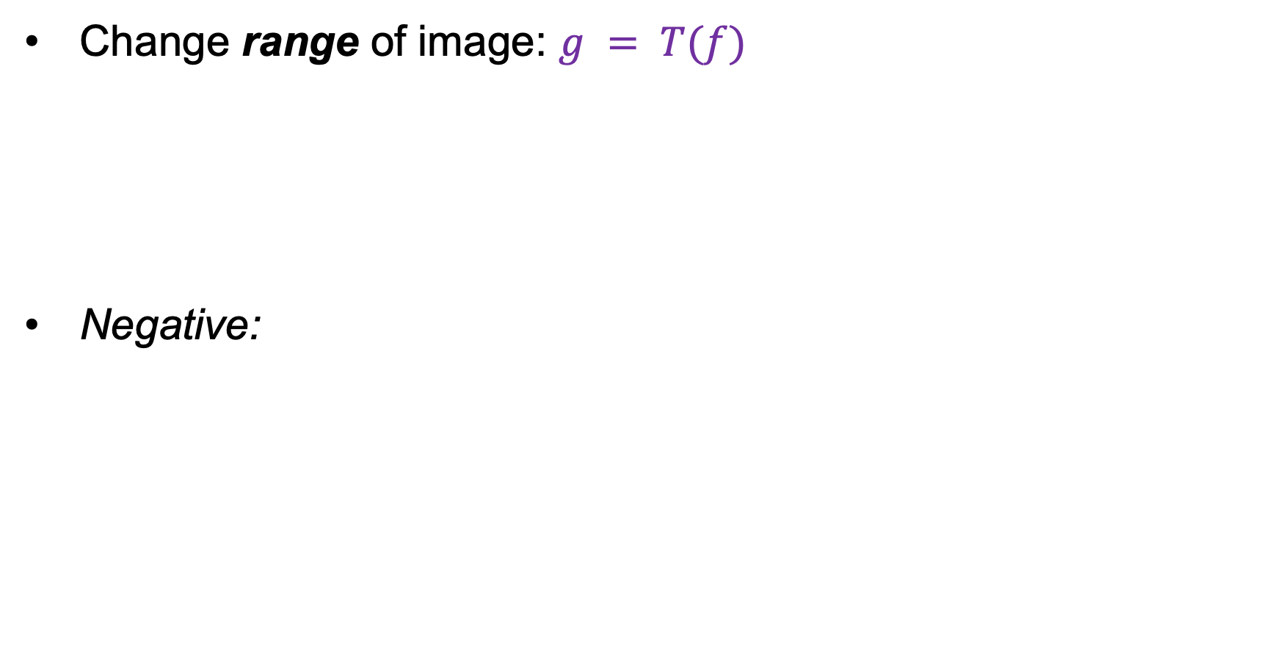
Point processing
Change range of image: $g = T(f)$
Negative:
f
g
T
x
x
$$g=1−f$$
Image source

Slide 56


Point processing
Change range of image: $g = T(f)$
Affine contrast adjustment: $g=af+b$
f
g
T
x
x
f
g
T

Slide 57


Point processing
Change range of image: $g = T(f)$
Piecewise-linear contrast adjustment:
f
g
T
x
x

Slide 58




Point processing
Change range of image: $g = T(f)$
Gamma correction: $g=af^{γ}$
f
g
T
x
x
$$γ=1/2$$
Original
$$γ=2$$
Source

Slide 59

Image filtering
Roughly speaking, replace image value at $x$ with some function of values in its spatial neighborhood $N(x)$:
$$g(x) = T(f(N(x)))$$
f
g
T
N(x)
x

Slide 60

Image filtering
Roughly speaking, replace image value at $x$ with some function of values in its spatial neighborhood $N(x)$:
$$g(x) = T(f(N(x)))$$
f
g
T
Examples: smoothing, sharpening, edge detection, etc.

Slide 61

Image warping
Change domain of image:
$x^{′}=T\left(x\right), g(x′) = f(x)$
f
g
T
x
T(x)

Slide 62
Image warping
Change domain of image:
$x^{′}=T\left(x\right), g(x′) = f(x)$
f
g
T

Slide 63
Image warping
Examples of global parametric warps:
scaling (uniform or non-uniform)
translation
rotation
perspective homography
affine
cylindrical (not covered in this class)

Slide 64



Parametric (global) warping
T
$$p = (x,y)$$
$$p′ = (x′,y′)$$
Transformation $T$ is a coordinate-changing machine:
$$p^{′}= T\left(p\right)$$
$T$ is global: it is the same for any point $p$ and can be described by just a few numbers (parameters)

Slide 65


Translation
$$x^{′}=x+t_{x} \\ y^{′}=y+t_{y}$$
$$tx = 2 \\ ty = 1$$

Slide 66


Uniform scaling
$$x^{′}=s∗x \\ y^{′}=s∗y$$
$$s = 2$$

Slide 67



Non-uniform scaling
$$x^{′}=s_{x}∗x \\ y^{′}=s_{y}∗y$$
In matrix form:
$\left(\begin{aligned}x′ \\ y′\end{aligned}\right)=\left[\begin{matrix}s_{x} & 0 \\ 0 & s_{y}\end{matrix}\right]$ $\left(\begin{aligned}x \\ y\end{aligned}\right)$
$s_{x}$ = 2,
$s_{y}=$ 0.5

Slide 68


Rotation
Rotate the image by an angle of $θ$about the origin:
$$θ$$

Slide 69











Rotation
Rotate the image by an angle of $θ$about the origin:
$$x′ = r cos⁡(φ+θ)$$
$$y′ = r sin⁡(φ+θ)$$
$$= r cos⁡(φ) cos⁡(θ) – r sin⁡(φ) sin⁡(θ)$$
$$= x cos⁡(θ) − y sin⁡(θ)$$
$$= r sin⁡(φ) cos⁡(θ) + r cos⁡(φ) sin⁡(θ)$$
$$= x sin⁡(θ) + y cos⁡(θ)$$
$$(x′, y′)$$
Apply trig identities
Substitute
$$x = r cos⁡(φ)$$
$$y = r sin⁡(φ)$$
$$(x, y)$$
$$r$$
$$θ$$
$$φ$$

Slide 70







Rotation
Rotate the image by an angle of $θ$about the origin:
$$x′= x cos⁡(θ) − y sin⁡(θ)$$
$$y′= x sin⁡(θ) + y cos⁡(θ)$$
$$(x′, y′)$$
$$(x, y)$$
In matrix form:
$\left(\begin{aligned}x′ \\ y′\end{aligned}\right)=\left[\begin{matrix}cos⁡(θ) & −sin⁡(θ) \\ sin⁡(θ) & cos⁡(θ)\end{matrix}\right]$ $\left(\begin{aligned}x \\ y\end{aligned}\right)$
$$θ$$

Slide 71



Rotation
2D rotation in matrix form:
Note: even though $cos⁡(θ)$ and $sin⁡(θ)$ are nonlinear functions of $θ$, $x′$ and $y′$ are linear combinations of $x$ and $y$
What is the inverse transformation?
  Rotation by –$θ$
  For rotation matrices, $R^{−1}=R^{T}$
$\left(\begin{aligned}x′ \\ y′\end{aligned}\right)=\left[\begin{matrix}cos⁡(θ) & −sin⁡(θ) \\ sin⁡(θ) & cos⁡(θ)\end{matrix}\right]$ $\left(\begin{aligned}x \\ y\end{aligned}\right)$
$$R⁡(θ)$$

Slide 72


Affine transformation
Combination of translation, non-uniform scaling, rotation, and shear
$\left(\begin{aligned}x′ \\ y′\end{aligned}\right)=\left[\begin{matrix}a & b \\ c & d\end{matrix}\right]$ $\left(\begin{aligned}x \\ y\end{aligned}\right)+\left(\begin{aligned}e \\ f\end{aligned}\right)$

Slide 73

Projective homography
A transformation that preserves straight lines, but not parallelism
$$x^{′}=\frac{ax+by+c}{gx+hy+i}, y^{′}=\frac{dx+ey+f}{gx+hy+i}$$

Slide 74




Warping pixels
Given a coordinate transform $(x′,y′) = T(x,y)$ and a source image $f(x,y)$, how do we compute a transformed image $g(x′,y′) = f(T(x,y))$?
T(x,y)
y
$$y′$$
x
$$x′$$
f(x,y)
$$g(x′,y′)$$

Slide 75

Forward warping
Send each pixel $f(x,y)$ to its corresponding location $(x′,y′) = T(x,y)$ in the second image
T(x,y)
y
$$y′$$
x
$$x′$$
f(x,y)
$$g(x′,y′)$$

Slide 76

Forward warping
Send each pixel $f(x,y)$ to its corresponding location $(x′,y′) = T(x,y)$ in the second image
  What if $(x′,y′)$is not an integer location on the pixel grid?
  We can “distribute” colors among the neighboring grid locations – known as splatting
T(x,y)
y
$$y′$$
x
$$x′$$
f(x,y)
$$g(x′,y′)$$

Slide 77


Inverse warping
For each pixel grid location $(x′,y′)$ in the second image, get the color from its corresponding location $\left(x,y\right)= T^{−1}\left(x^{′},y^{′}\right)$
in the first image
$$T^{−1}(x^{′},y′)$$
y
$$y′$$
x
$$x′$$
f(x,y)
$$g(x′,y′)$$

Slide 78





Inverse warping
For each pixel grid location $(x′,y′)$ in the second image, get the color from its corresponding location $\left(x,y\right)= T^{−1}\left(x^{′},y^{′}\right)$
in the first image
  What if $\left(x,y\right)$ is not an integer location on the original pixel grid?
  Interpolate!
$$T^{−1}(x′,y′)$$
y
$$y′$$
x
$$x′$$
f(x,y)
$$g(x′,y′)$$
  Inverse warping is usually preferred to forward warping: more efficient, no holes
  However, it requires an invertible warp function, which is not always possible

