Slide 1
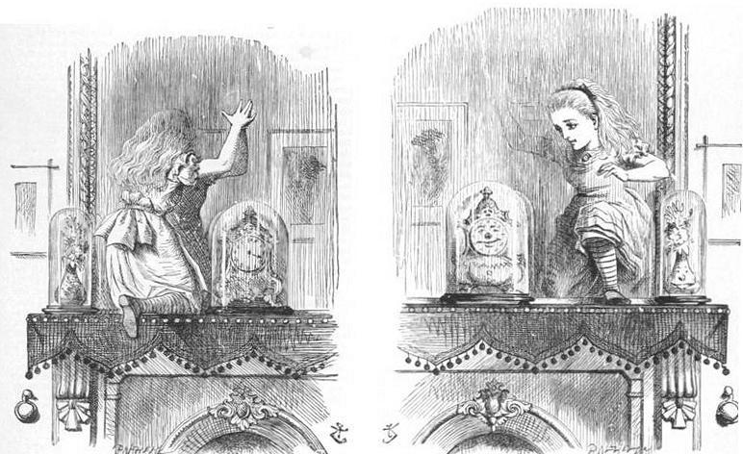
A gentle introduction to Fourier analysis
Image source
Many slides borrowed from S. Seitz, A. Efros, D. Hoiem, B. Freeman, A. Zisserman

Slide 2
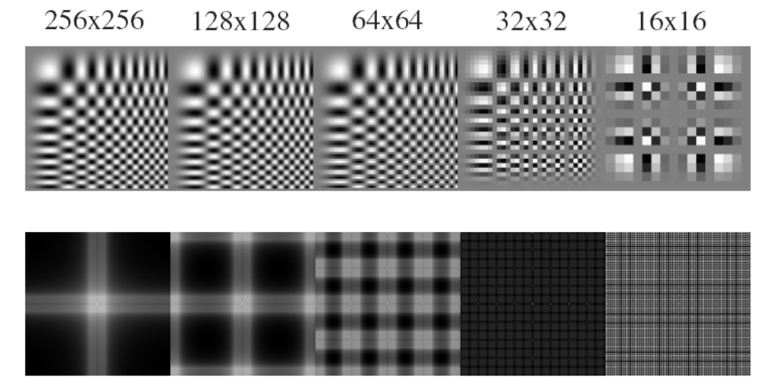
Mystery 1
Why can downsampling sometimes lead to aliasing?

Slide 3
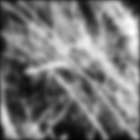

Mystery 2
Why does filtering with a Gaussian give a nice smooth image, but filtering with a box filter gives artifacts?
Gaussian
Box filter
Notes:
Things we can’t understand without thinking in frequency
3

Slide 4
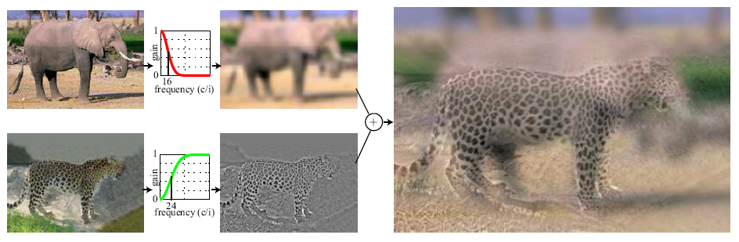
Mystery 3
How do hybrid images work?
“Low frequencies”
“High frequencies”
A. Oliva et al. Hybrid Images. SIGGRAPH 2006

Slide 5
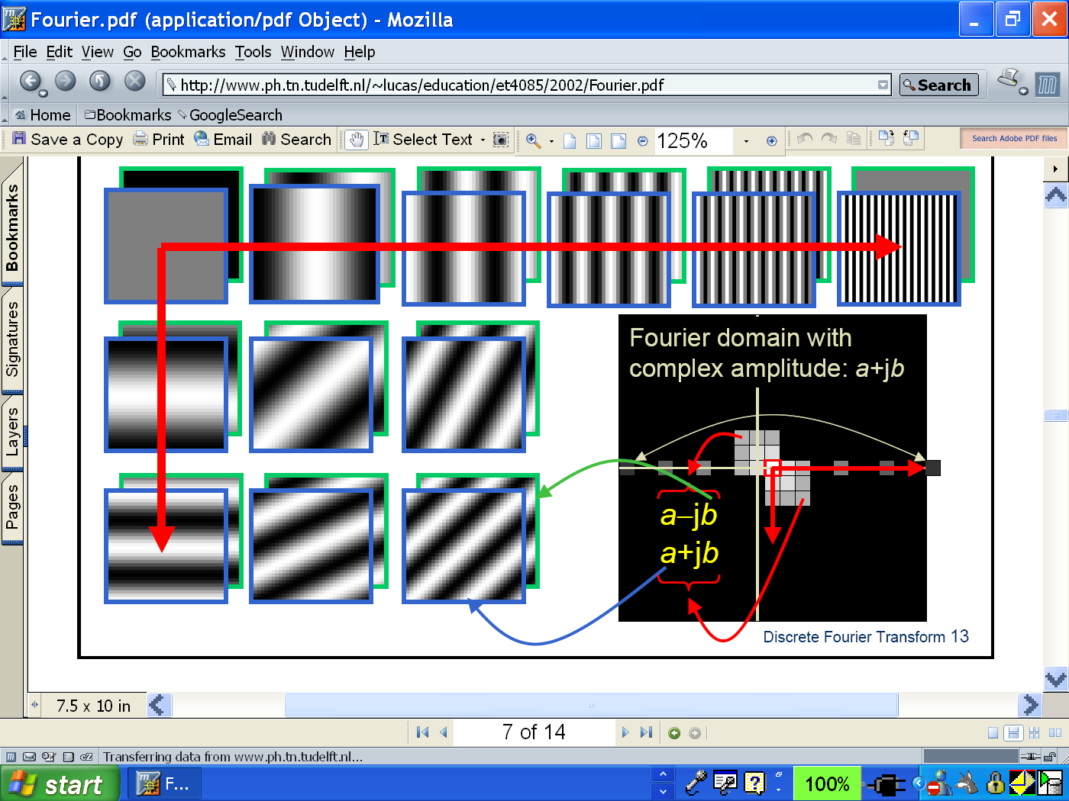
Fourier analysis
To understand such phenomena, we need a representation of images that allows us to tease apart slow and fast changes

Slide 6
Outline
1D Fourier transform
  Definition and properties
  Discrete Fourier transform
2D Fourier transform
  Definition
  Examples and properties
Convolution theorem
Understanding the behavior of filters
Understanding the sampling theorem
More applications of Fourier analysis

Slide 7
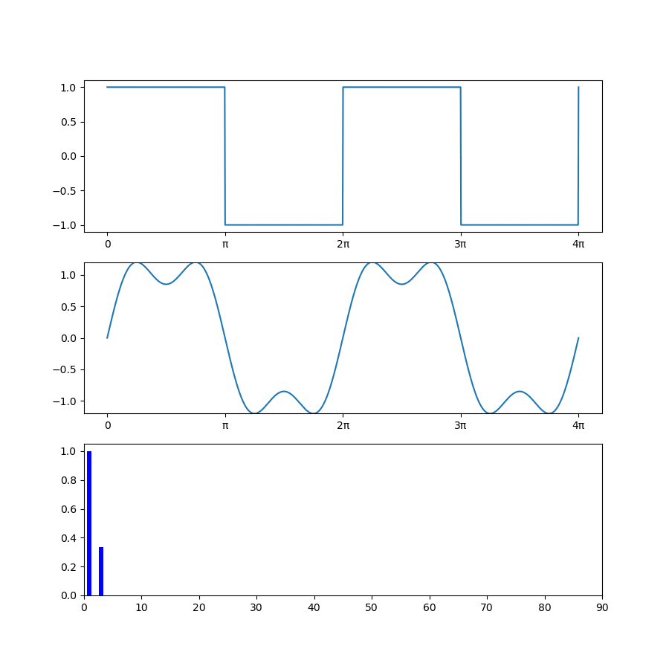
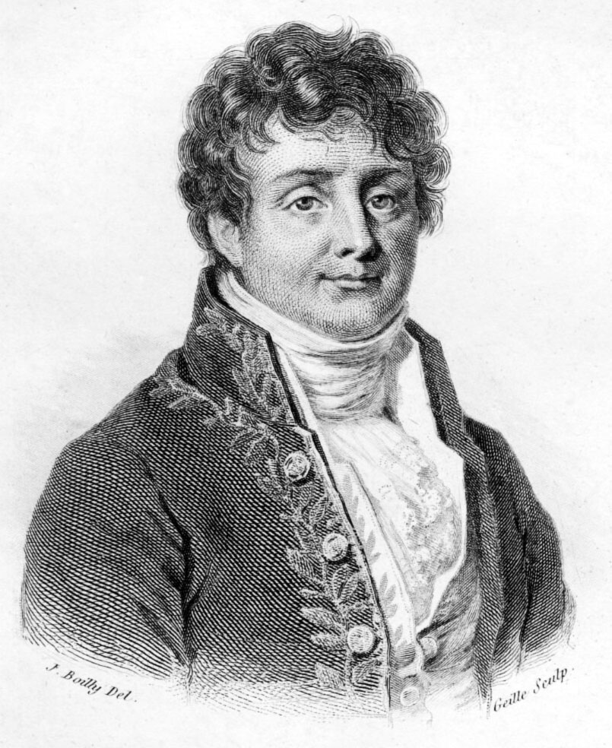
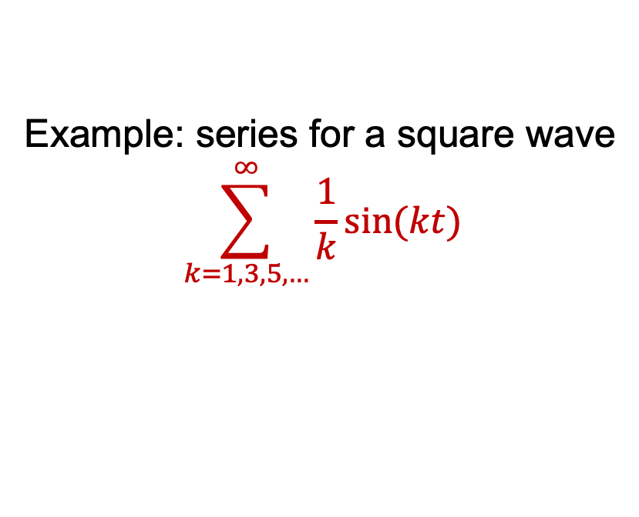

Fourier analysis
Any “reasonable” univariate function can be expressed as a weighted sum of sinusoids of different frequencies (1807)
Example: series for a square wave
$$\sum_{k=1,3,5,…}^{∞}{\frac{1}{k}sin⁡(kt)}$$
Jean-Baptiste Joseph Fourier (1768-1830)
Frequency $k$
Notes:
For conditions, see https://en.wikipedia.org/wiki/Dirichlet%E2%80%93Jordan_test

Slide 8
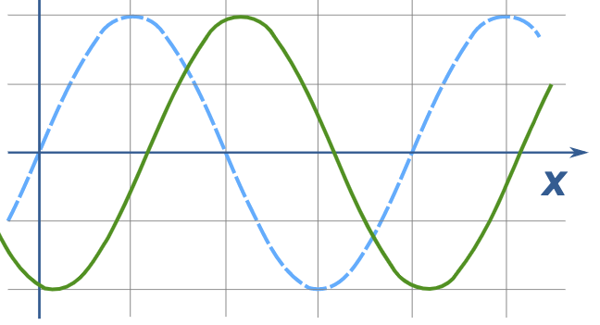

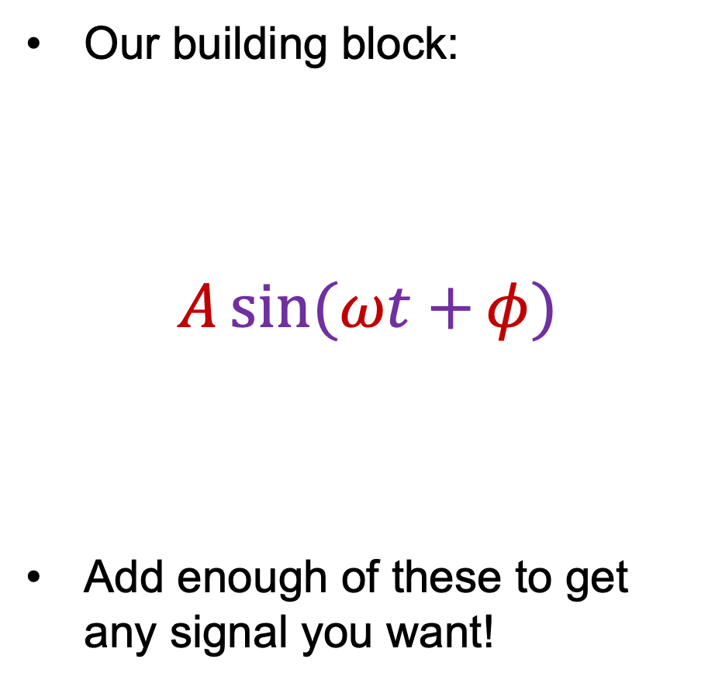


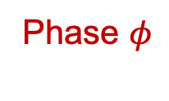
Fourier analysis
Our building block:
$$A\sin{(ωt+}φ)$$
Add enough of these to get any signal you want!
Frequency
Phase $φ$
Amplitude $A$
Amplitude
Phase
$$t$$
Period $\frac{2π}{ω}$

Slide 9
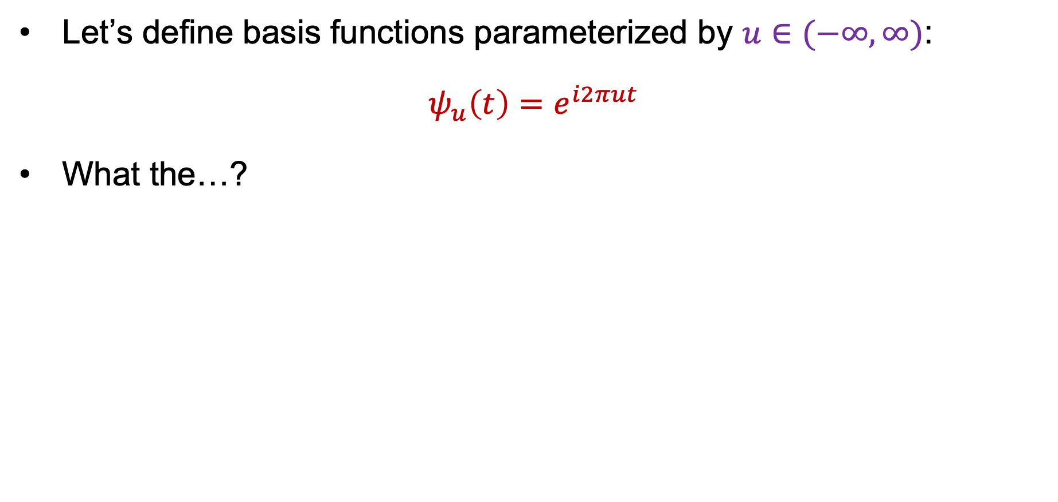
1D Fourier transform
Let’s define basis functions parameterized by $u∈(−∞,∞)$:
$$ψ_{u}\left(t\right)=e^{i2πut}$$
What the…?

Slide 10
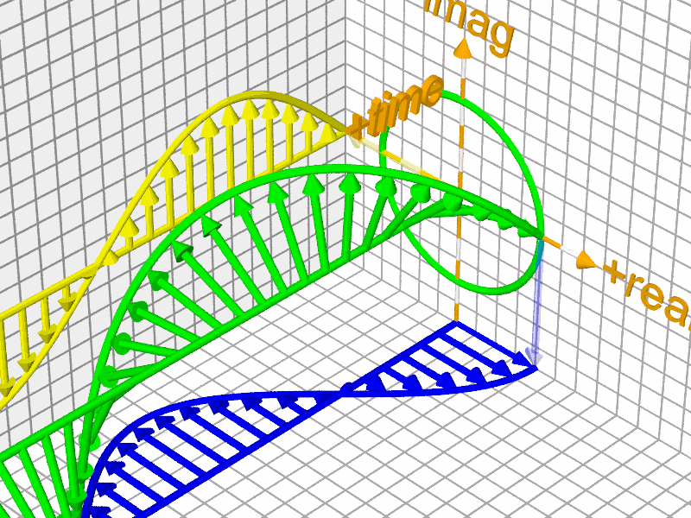

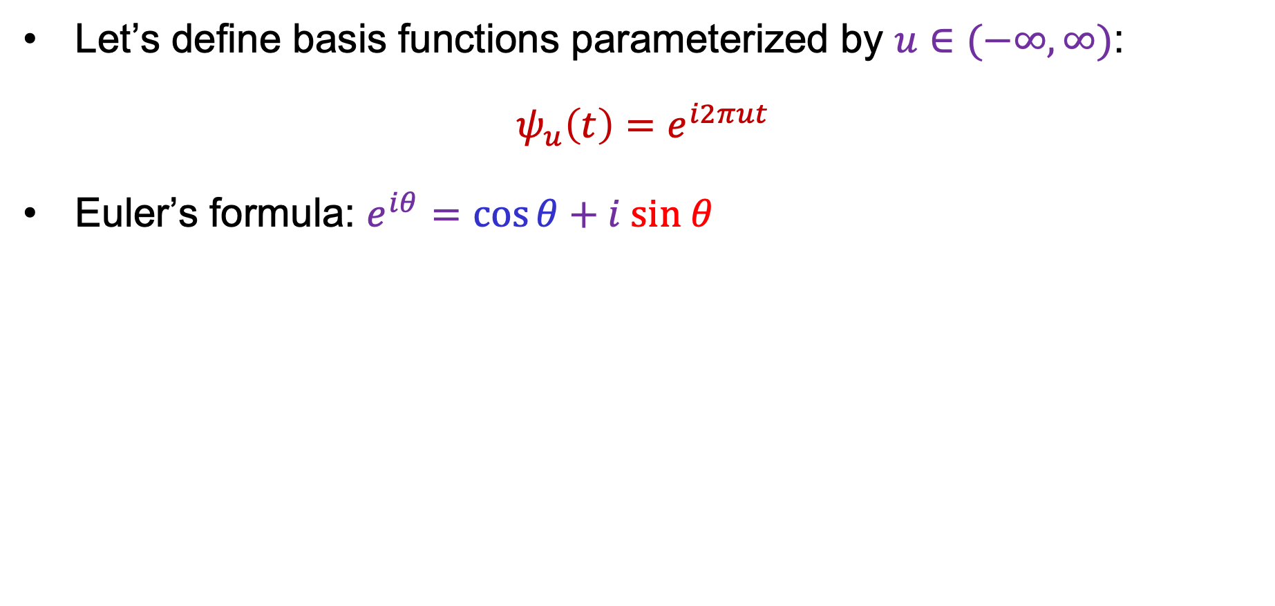







1D Fourier transform
Let’s define basis functions parameterized by $u∈(−∞,∞)$:
$$ψ_{u}\left(t\right)=e^{i2πut}$$
Euler’s formula: $e^{iθ}=\cos{θ}+i sin θ$
$$Im$$
$$i$$
$$e^{iθ}$$
$$\sin{θ}$$
$$θ$$
$$Re$$
Image source
$$\cos{θ}$$
$$1$$
Notes:
$e^{iθ}$is a unit complex number, i.e., it traces out the unit circle in the complex plane as $θ$ ranges through the real numbers.

Slide 11
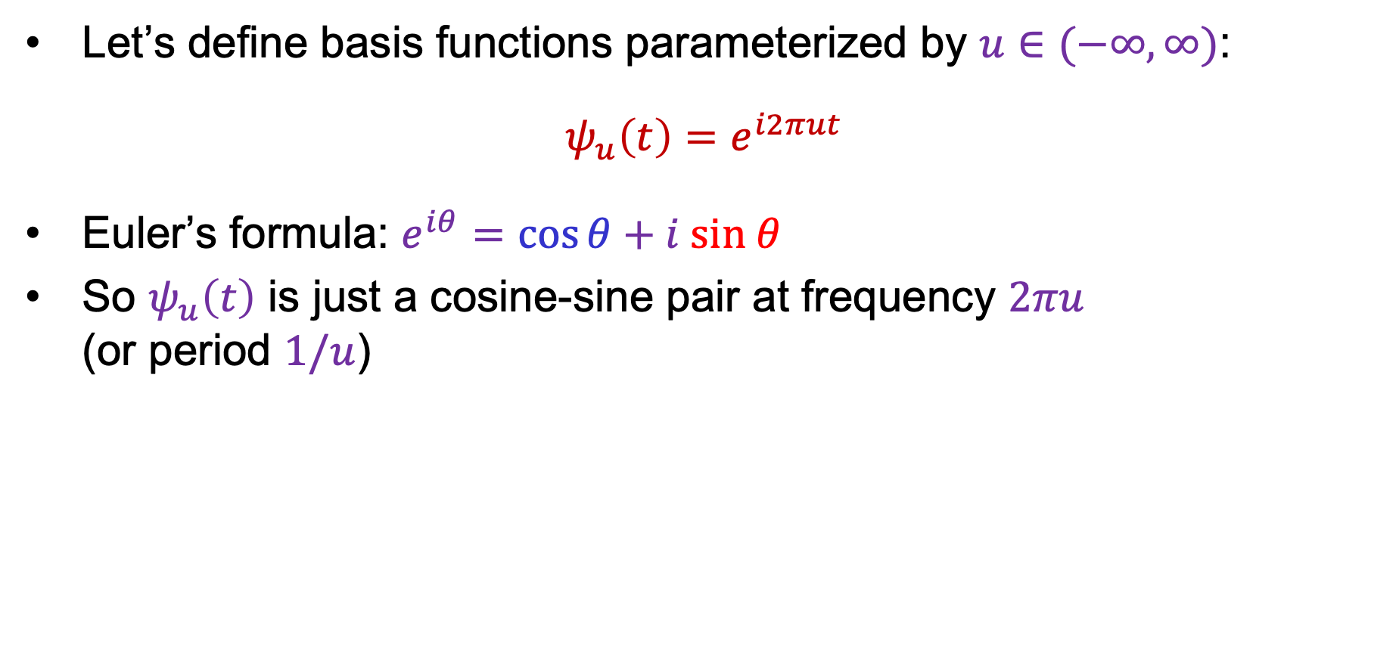
1D Fourier transform
Let’s define basis functions parameterized by $u∈(−∞,∞)$:
$$ψ_{u}\left(t\right)=e^{i2πut}$$
Euler’s formula: $e^{iθ}=\cos{θ}+i sin θ$
So $ψ_{u}\left(t\right)$ is just a cosine-sine pair at frequency $2πu$
(or period $1/u$)

Slide 12
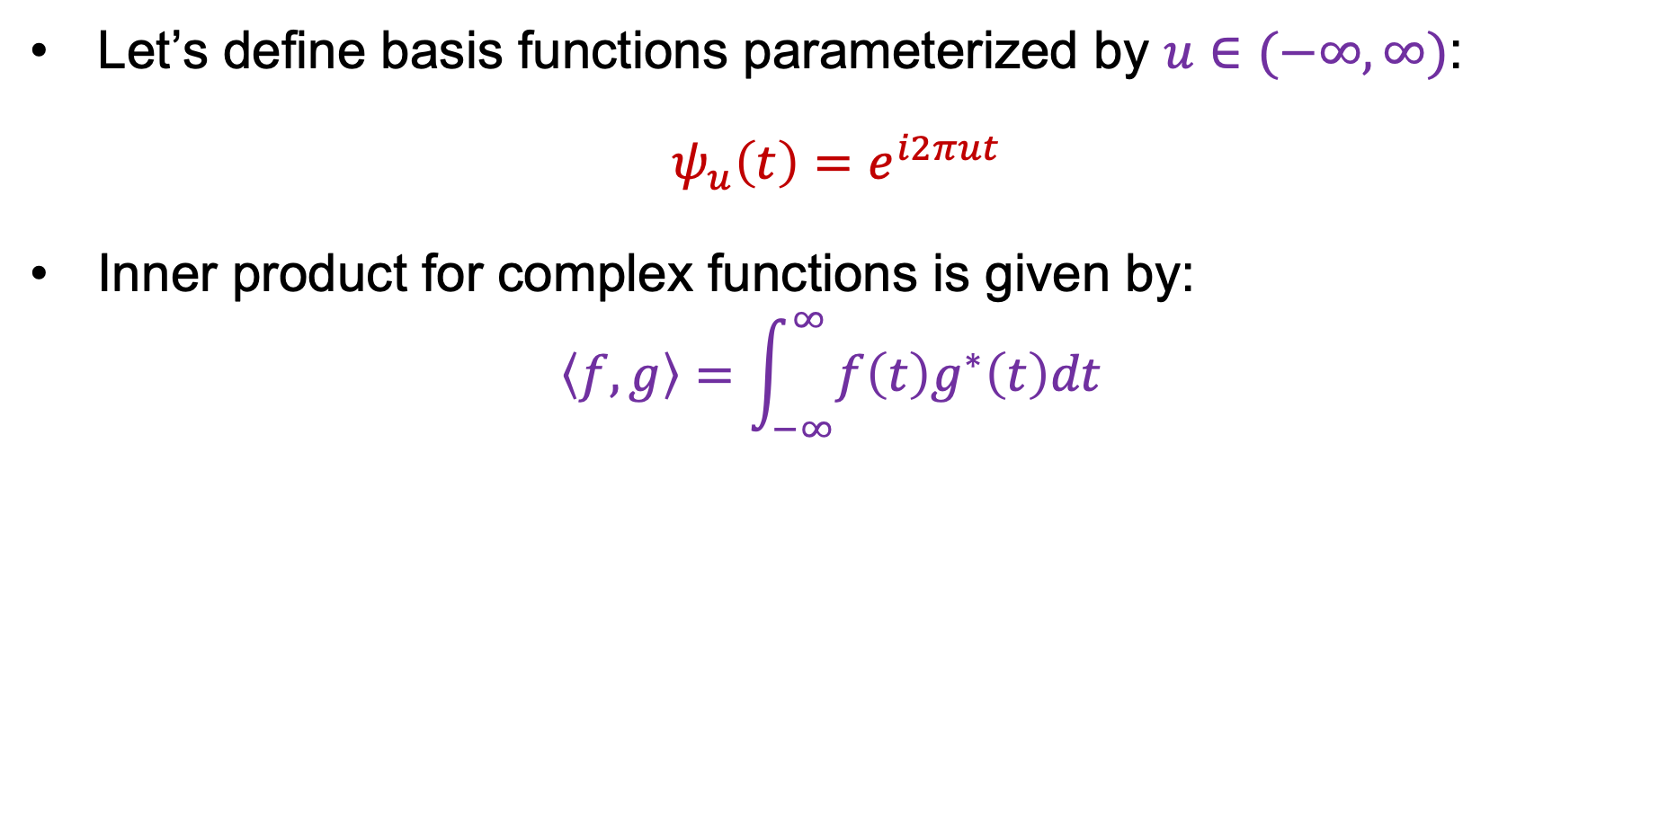
1D Fourier transform
Let’s define basis functions parameterized by $u∈(−∞,∞)$:
$$ψ_{u}\left(t\right)=e^{i2πut}$$
Inner product for complex functions is given by:
$$\left\langle f,g\right\rangle =\int_{−∞}^{∞}{f\left(t\right)g^{∗}\left(t\right)dt }$$
Complex conjugate:
real part stays the same,
imaginary part is flipped

Slide 13
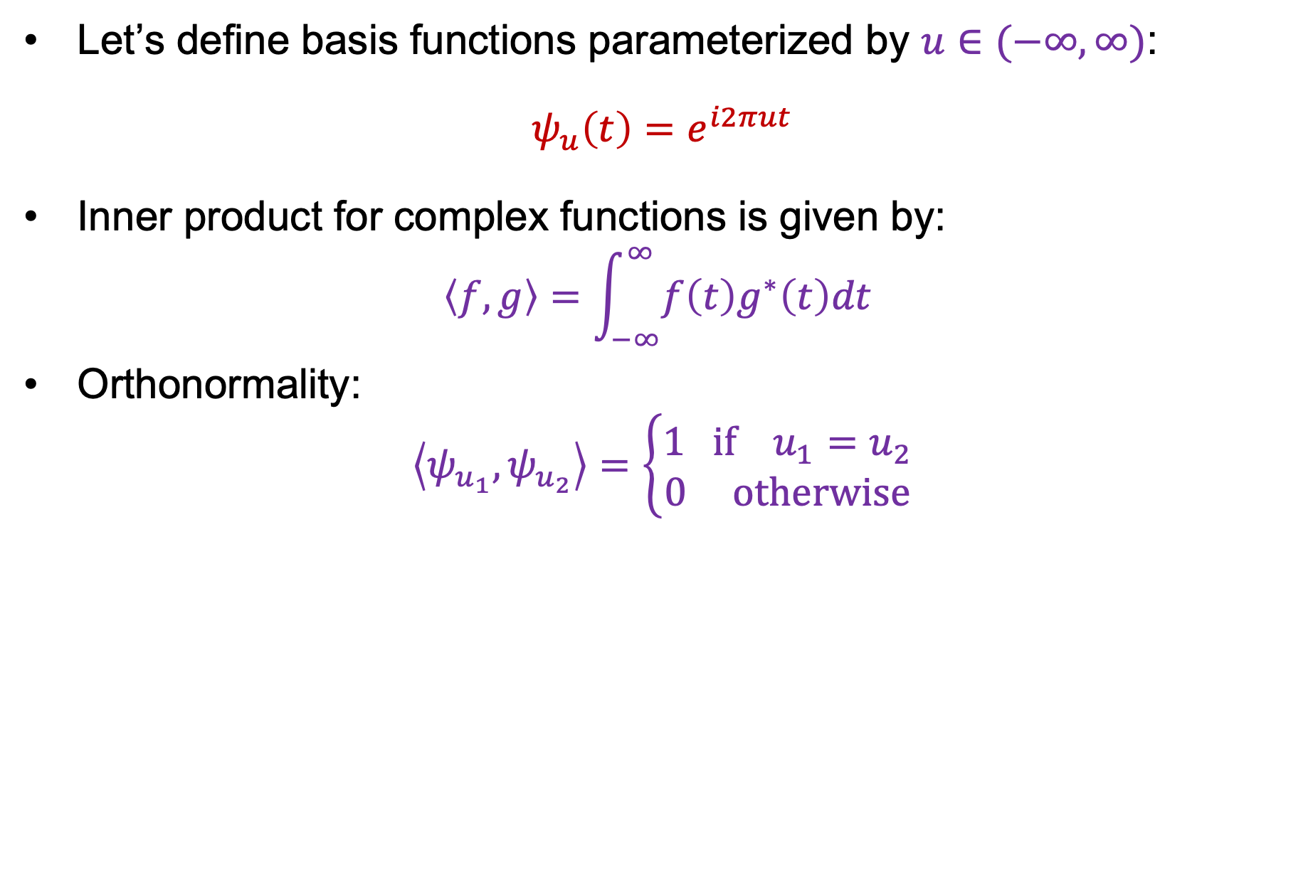
1D Fourier transform
Let’s define basis functions parameterized by $u∈(−∞,∞)$:
$$ψ_{u}\left(t\right)=e^{i2πut}$$
Inner product for complex functions is given by:
$$\left\langle f,g\right\rangle =\int_{−∞}^{∞}{f\left(t\right)g^{∗}\left(t\right)dt }$$
Orthonormality:
$$\left\langle ψ_{u_{1}},ψ_{u_{2}}\right\rangle =\left\{\begin{aligned}1 if{ u}_{1}=u_{2} \\ 0 otherwise\end{aligned}\right.$$

Slide 14
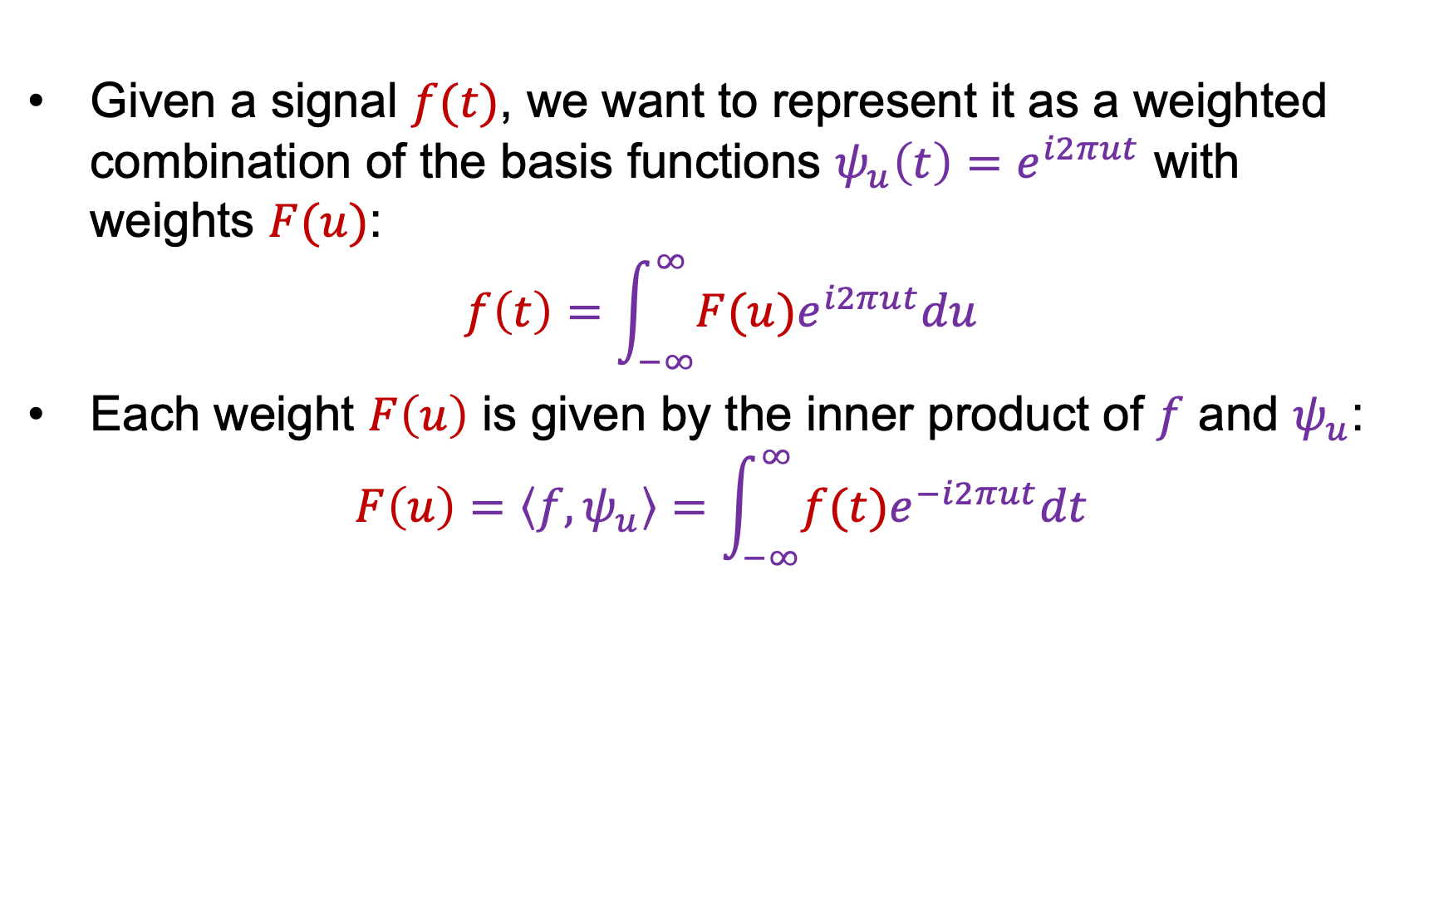
1D Fourier transform
Given a signal $f(t)$, we want to represent it as a weighted combination of the basis functions $ψ_{u}\left(t\right)=e^{i2πut}$ with weights $F(u)$:
$$f\left(t\right)=\int_{−∞}^{∞}{F(u)e^{i2πut}du}$$
Each weight $F\left(u\right)$ is given by the inner product of $f$ and $ψ_{u}$:
$$F\left(u\right)=\left\langle f,ψ_{u}\right\rangle =\int_{−∞}^{∞}{f(t)e^{−i2πut}dt}$$

Slide 15
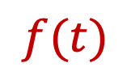
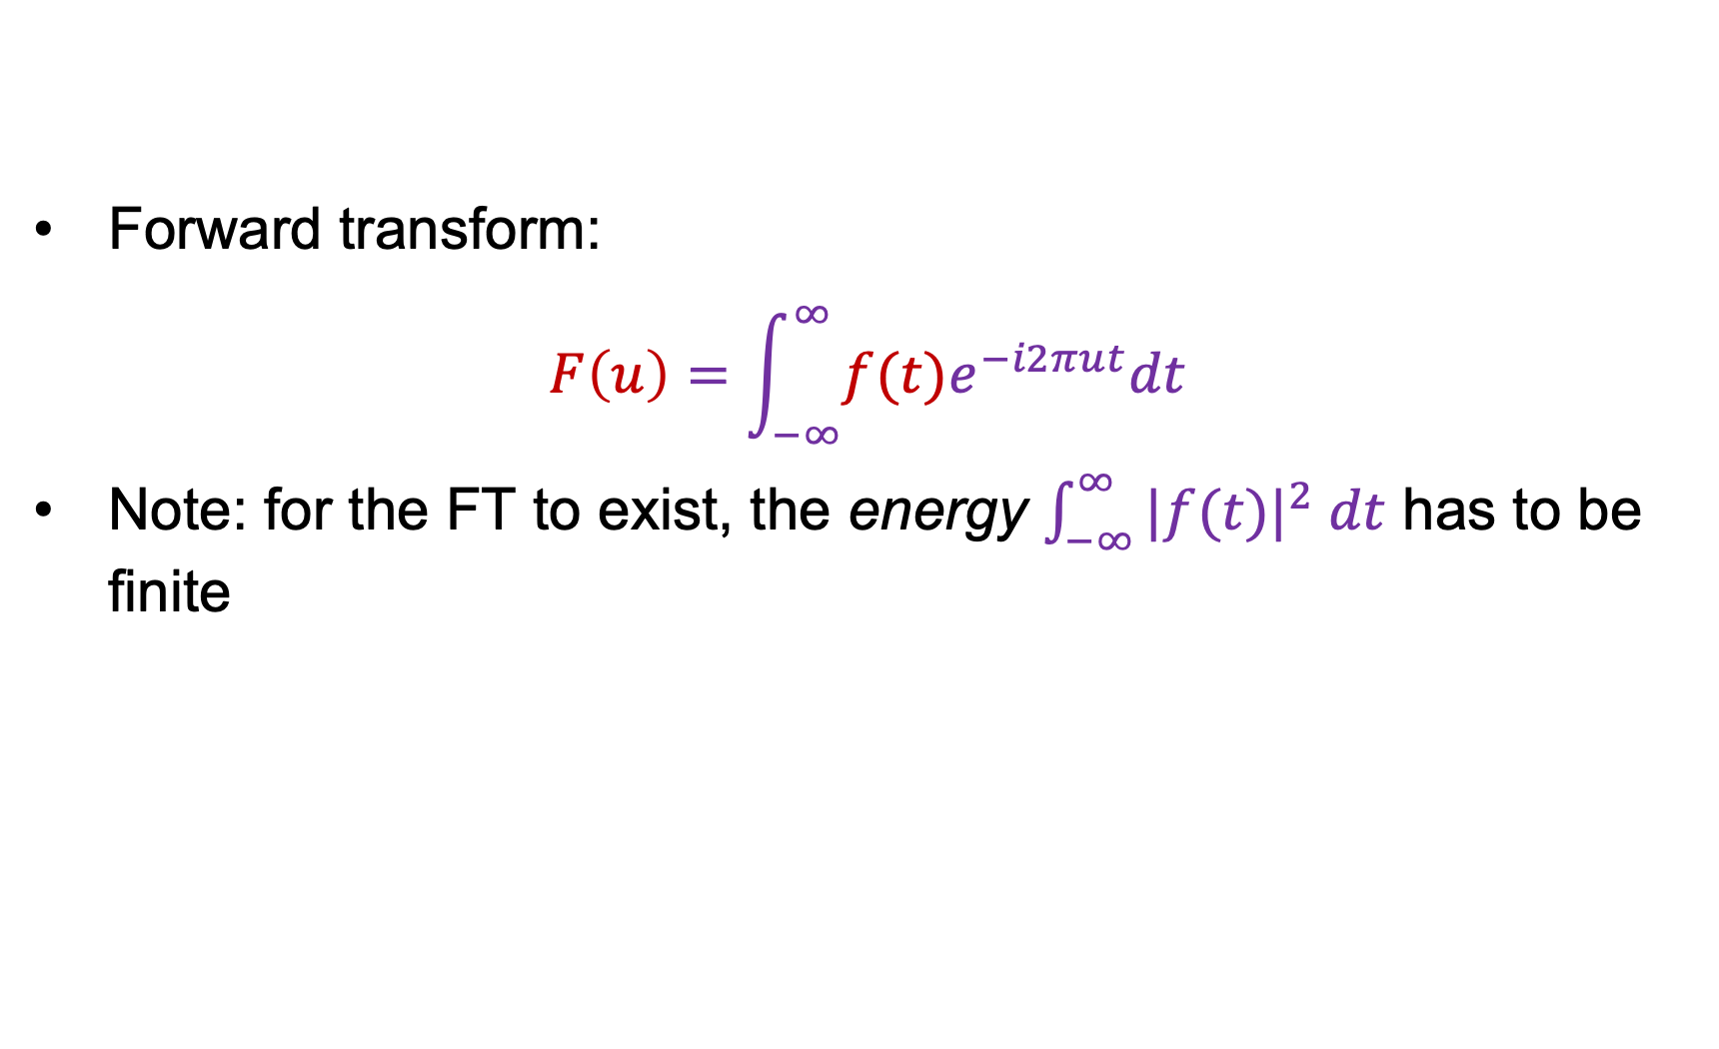

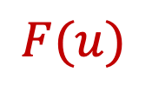
1D Fourier transform
$$ℱ$$
$$f(t)$$
Forward transform:
$$F\left(u\right)=\int_{−∞}^{∞}{f(t)e^{−i2πut}dt}$$
Note: for the FT to exist, the energy $\int_{−∞}^{∞}{|f(t)|^{2} dt}$ has to be finite
$$F(u)$$

Slide 16
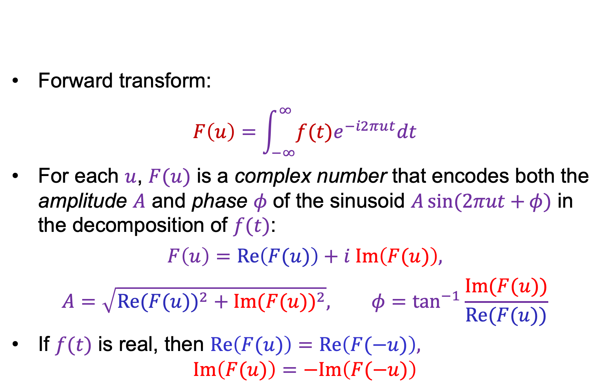
1D Fourier transform
$$ℱ$$
$$f(t)$$
Forward transform:
$$F\left(u\right)=\int_{−∞}^{∞}{f(t)e^{−i2πut}dt}$$
For each $u$, $F(u)$ is a complex number that encodes both the amplitude $A$ and phase $φ$ of the sinusoid $A\sin{(2πut+}φ)$ in the decomposition of $f(t)$:
$$F\left(u\right)=Re\left(F(u)\right)+i Im\left(F(u)\right),$$
$$A=\sqrt{{Re(F(u))}^{2}+{Im(F(u))}^{2}}, φ=\tan^{−1}{\frac{Im(F(u))}{Re(F(u))}}$$
If $f(t)$ is real, then $Re\left(F(u)\right)=Re\left(F(−u)\right),$
$Im\left(F(u)\right)=−Im\left(F(−u)\right)$
$$F(u)$$

Slide 17
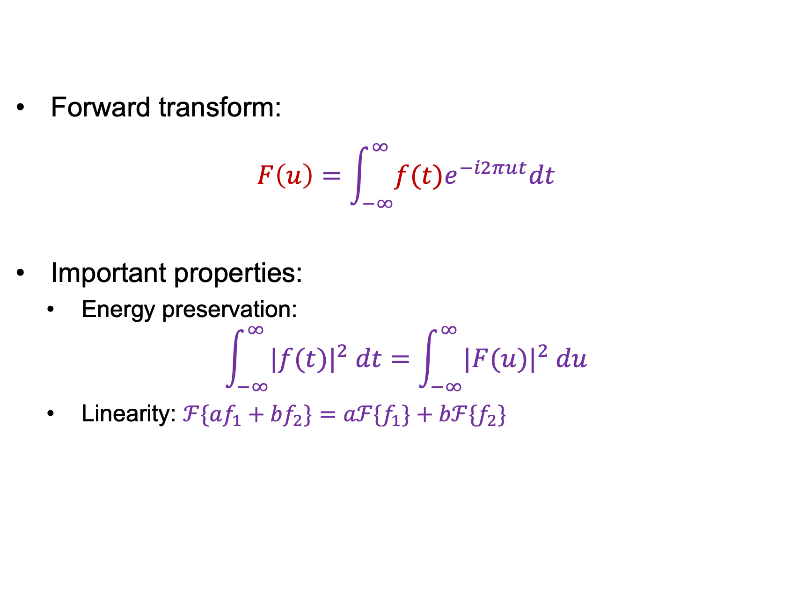
1D Fourier transform
$$ℱ$$
$$f(t)$$
Forward transform:
$$F\left(u\right)=\int_{−∞}^{∞}{f(t)e^{−i2πut}dt}$$
Important properties:
  Energy preservation:
$$\int_{−∞}^{∞}{|f(t)|^{2} dt}=\int_{−∞}^{∞}{|F(u)|^{2} du}$$
  Linearity: $ℱ\{af_{1}+bf_{2}\}=aℱ{\{f}_{1}\}+bℱ{\{f}_{2}\}$
$$F(u)$$

Slide 18

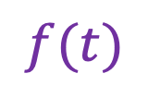
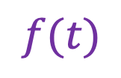
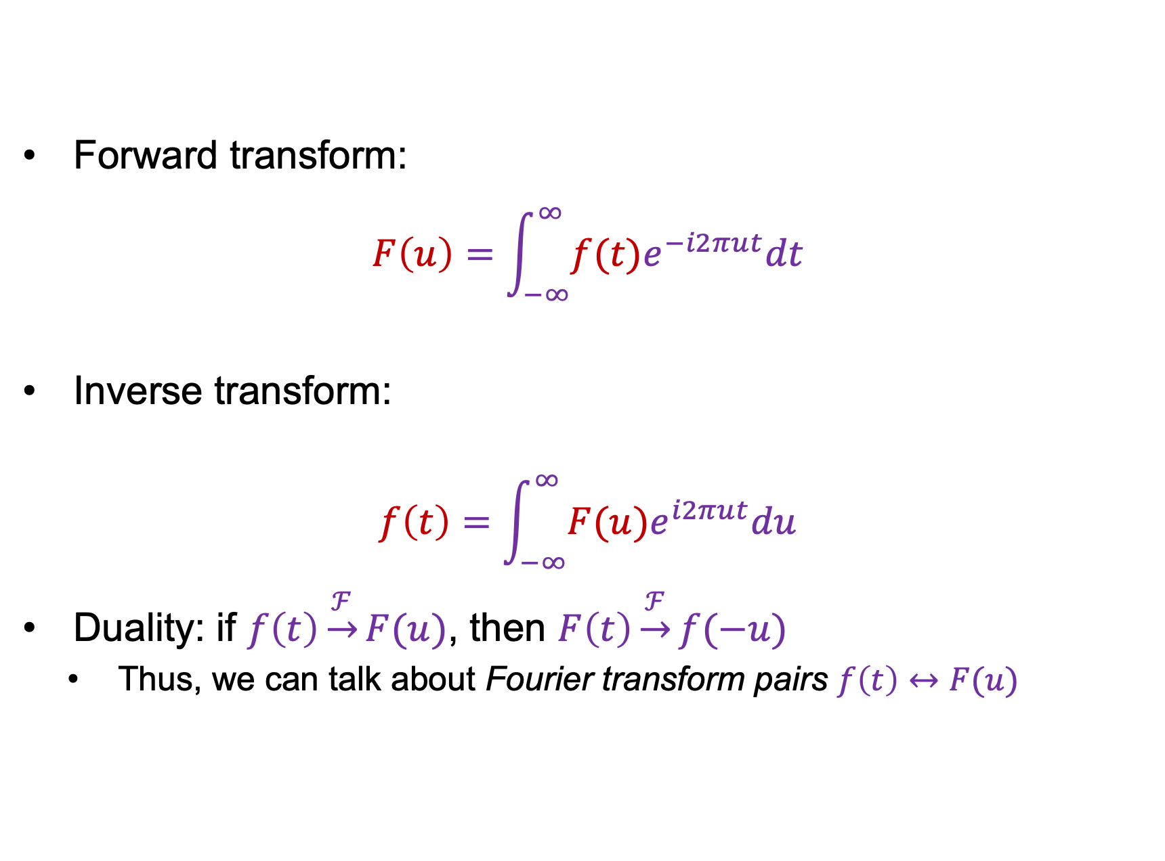
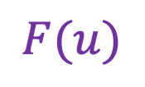


1D Fourier transform
$$ℱ$$
$$f(t)$$
Forward transform:
$$F\left(u\right)=\int_{−∞}^{∞}{f(t)e^{−i2πut}dt}$$
Inverse transform:
$$f\left(t\right)=\int_{−∞}^{∞}{F(u)e^{i2πut}du}$$
Duality: if $f\left(t\right)\underset{→}{ℱ}F(u)$, then $F\left(t\right)\underset{→}{ℱ}f(−u)$
  Thus, we can talk about Fourier transform pairs $f\left(t\right)↔F(u)$
$$F(u)$$
$$ℱ^{−1}$$
$$F(u)$$
$$f(t)$$

Slide 19
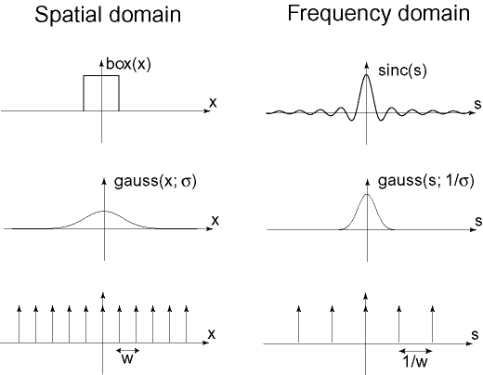



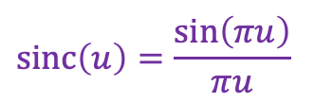
Important Fourier transform pairs
$$box(t)$$
$$sinc\left(u\right)=\frac{\sin\left(πu\right)}{πu}$$
$$−0.5$$
$$0.5$$

Slide 20



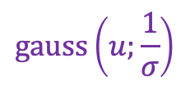

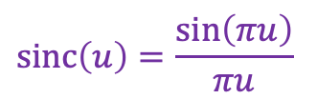
Important Fourier transform pairs
$$box(t)$$
$$sinc\left(u\right)=\frac{\sin\left(πu\right)}{πu}$$
$$−0.5$$
$$0.5$$
$$\operatorname{gauss}\left(u;\frac{1}{σ}\right)$$
$$\operatorname{gauss}\left(t;σ\right)$$

Slide 21


Important Fourier transform pairs
$$box(t)$$
$$sinc\left(u\right)=\frac{\sin\left(πu\right)}{πu}$$
$$−0.5$$
$$0.5$$
$$\operatorname{gauss}\left(u;\frac{1}{σ}\right)$$
$$\operatorname{gauss}\left(t;σ\right)$$
$$f\left(t\right)=1$$
$$unit impulse δ\left(u\right)$$
*The last one is formal since these functions don’t meet the mathematical requirements for FT

Slide 22
Outline
1D Fourier transform
  Definition and properties
  Discrete Fourier transform

Slide 23


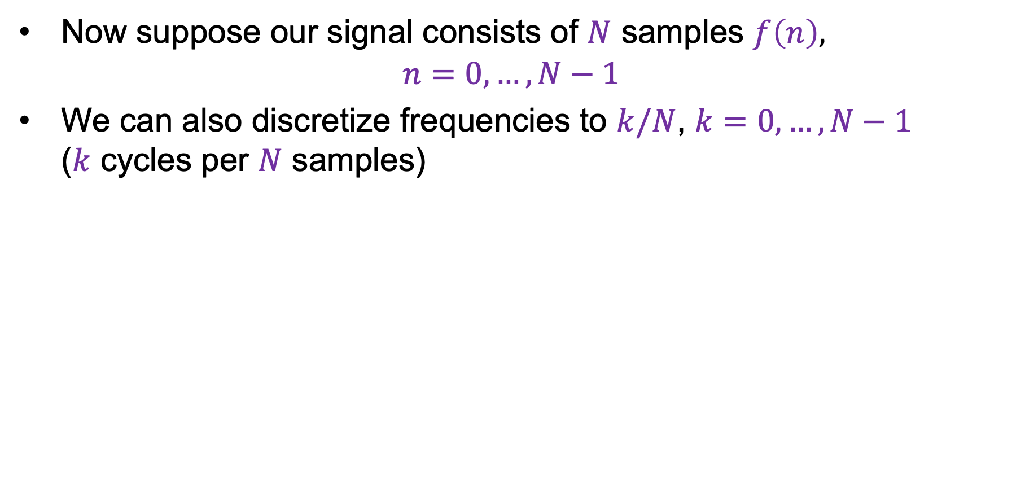


Discrete Fourier transform (DFT)
Now suppose our signal consists of $N$ samples $f\left(n\right)$,
$n=0,…, N−1$
We can also discretize frequencies to $k/N$, $k=0,…, N−1$
($k$ cycles per $N$ samples)
$$f(n)$$
$$|F\left(k\right)|$$
$$n$$
$$k$$
Image source

Slide 24
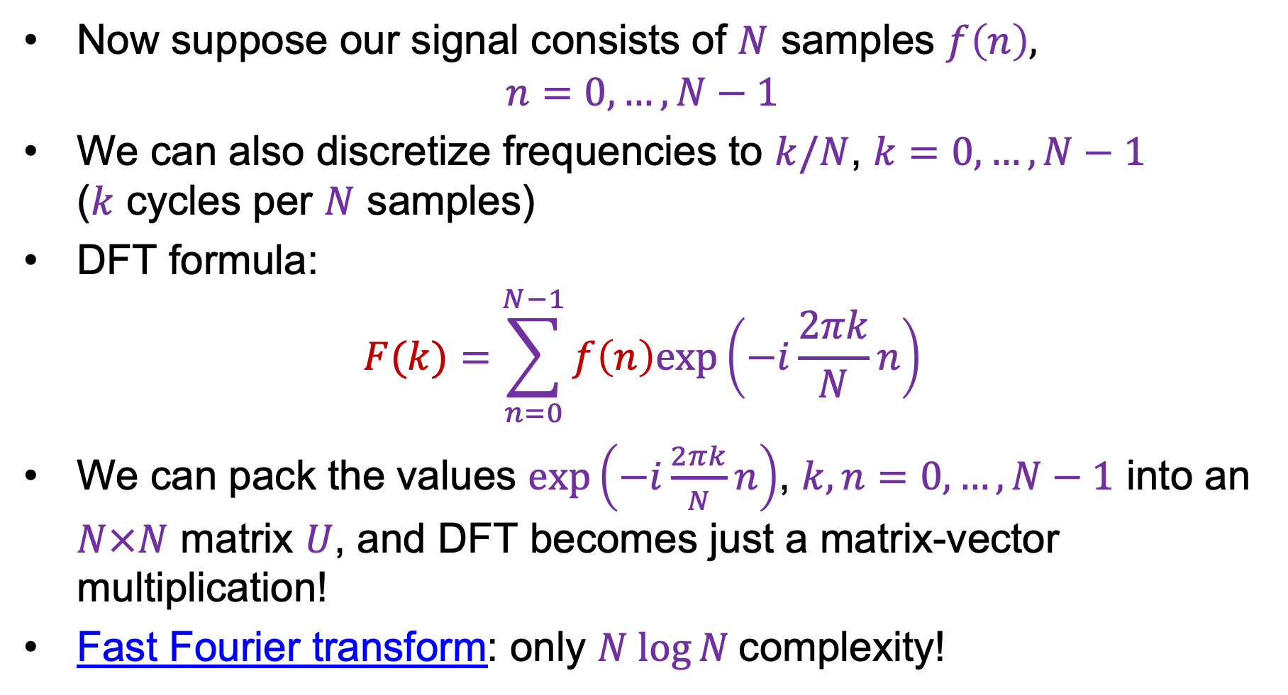
Discrete Fourier transform (DFT)
Now suppose our signal consists of $N$ samples $f\left(n\right)$,
$n=0,…, N−1$
We can also discretize frequencies to $k/N$, $k=0,…, N−1$
($k$ cycles per $N$ samples)
DFT formula:
$$F(k)=\sum_{n=0}^{N−1}{f\left(n\right)exp\left(−i\frac{2πk}{N}n\right)}$$
We can pack the values $exp\left(−i\frac{2πk}{N}n\right)$, $k,n=0,…, N−1$ into an $N×N$ matrix $U$, and DFT becomes just a matrix-vector multiplication!
Fast Fourier transform: only $N log⁡N$complexity!
Image source

Slide 25
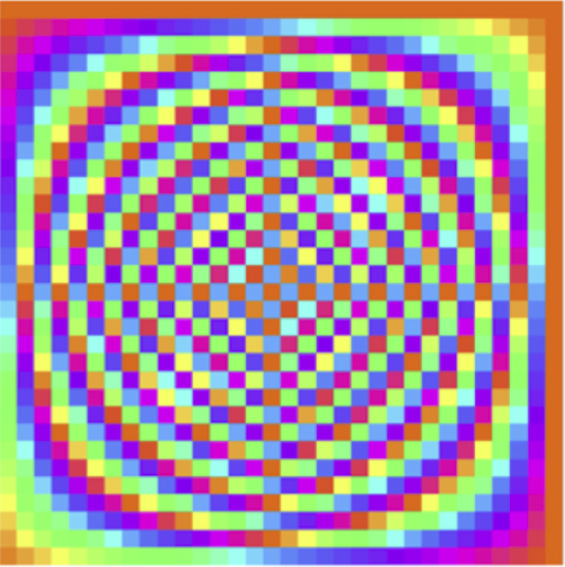
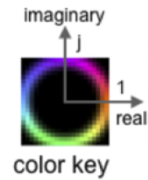


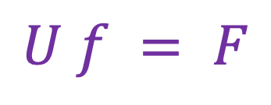


DFT: Just a change of basis!
$$U f = F$$
$$=$$
$$U$$
$$f$$
$$F$$
Source

Slide 26
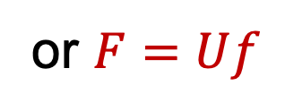
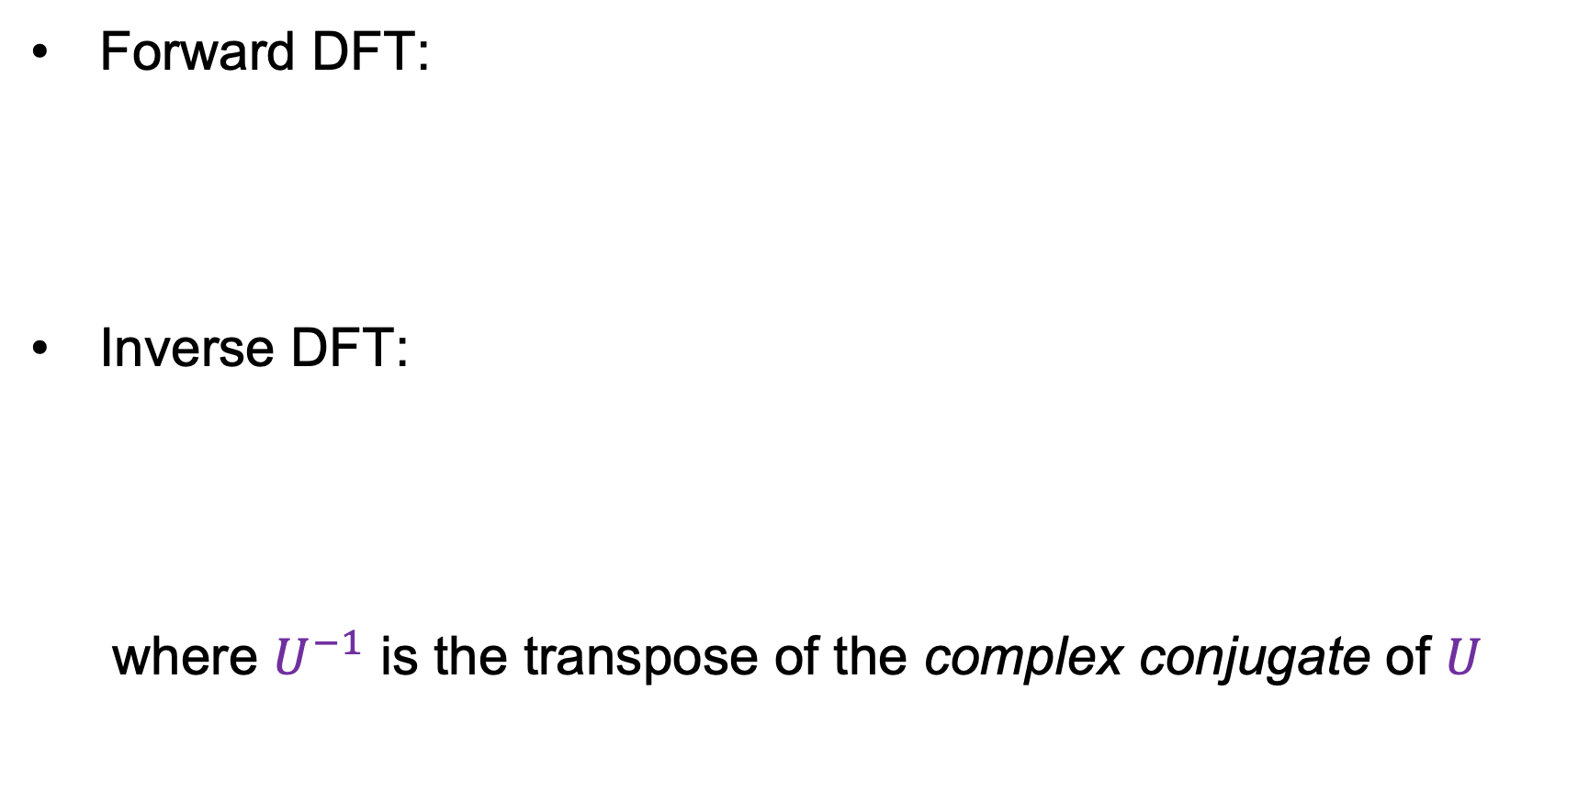
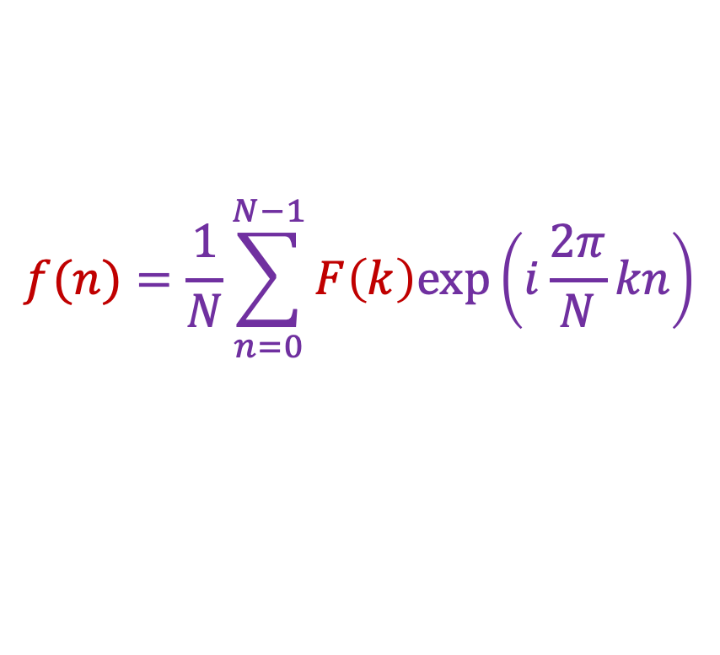
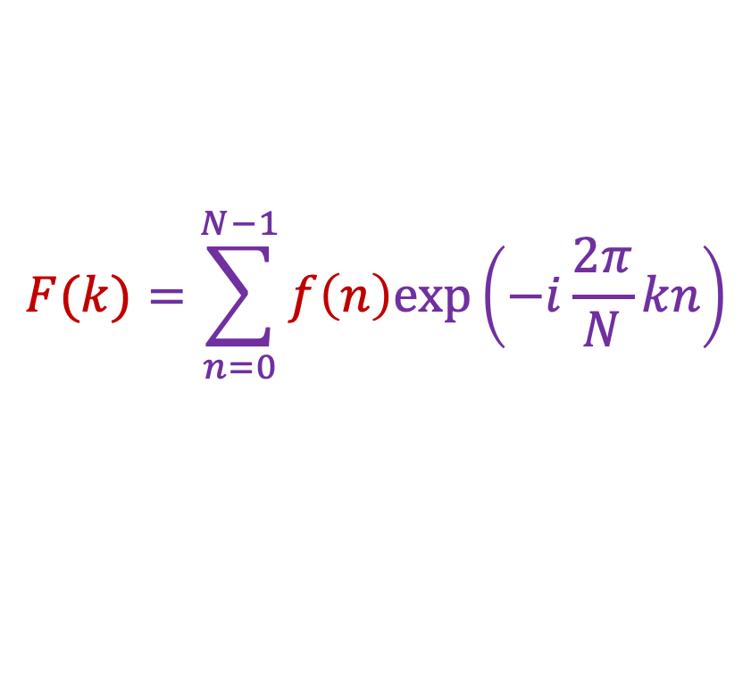
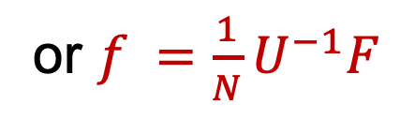
Inverse DFT
Forward DFT:
Inverse DFT:
where $U^{−1}$ is the transpose of the complex conjugate of $U$
$$F(k)=\sum_{n=0}^{N−1}{f\left(n\right)exp\left(−i\frac{2π}{N}kn\right)}$$
or $F=Uf$
$$f(n)=\frac{1}{N}\sum_{n=0}^{N−1}{F\left(k\right)exp\left(i\frac{2π}{N}kn\right)}$$
or $f =\frac{1}{N}U^{−1}F$

Slide 27
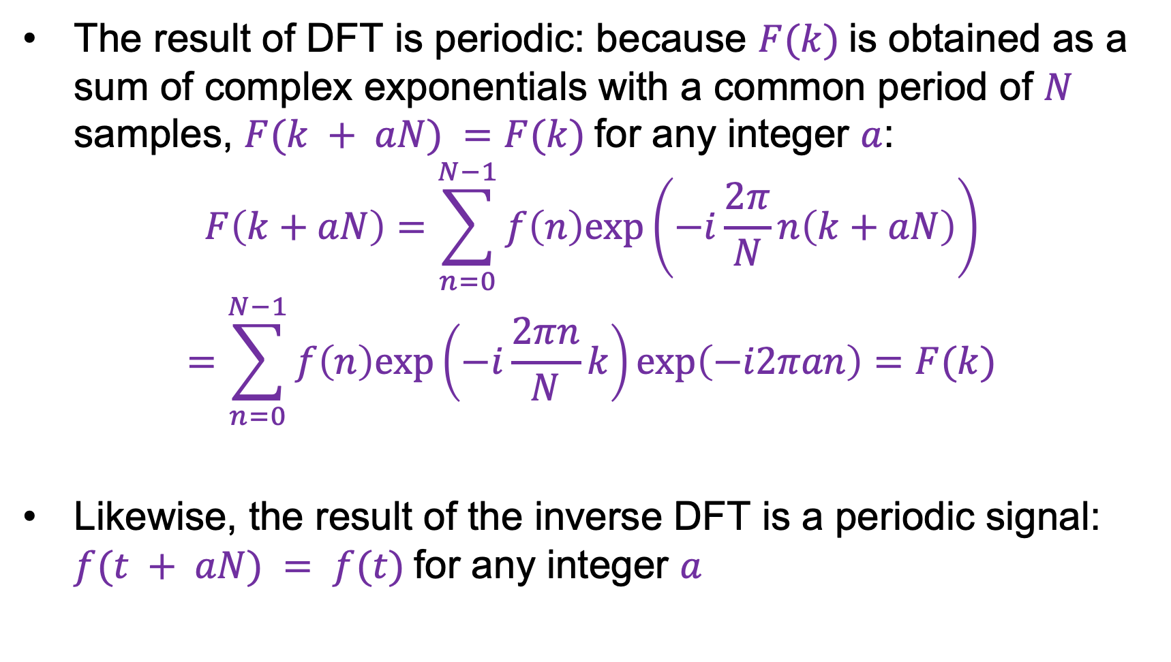
Periodicity of DFT and inverse DFT
The result of DFT is periodic: because $F(k)$is obtained as a sum of complex exponentials with a common period of $N$ samples, $F(k + aN) =F(k)$for any integer $a$:
$$F\left(k+aN\right)=\sum_{n=0}^{N−1}{f\left(n\right)exp\left(−i\frac{2π}{N}n\left(k+aN\right)\right)}$$
$$=\sum_{n=0}^{N−1}{f\left(n\right)exp\left(−i\frac{2πn}{N}k\right)exp\left(−i2πan\right)}=F(k)$$
Likewise, the result of the inverse DFT is a periodic signal: $f(t + aN) = f(t)$for any integer $a$

Slide 28
Outline
1D Fourier transform
  Definition and properties
  Discrete Fourier transform
2D Fourier transform

Slide 29
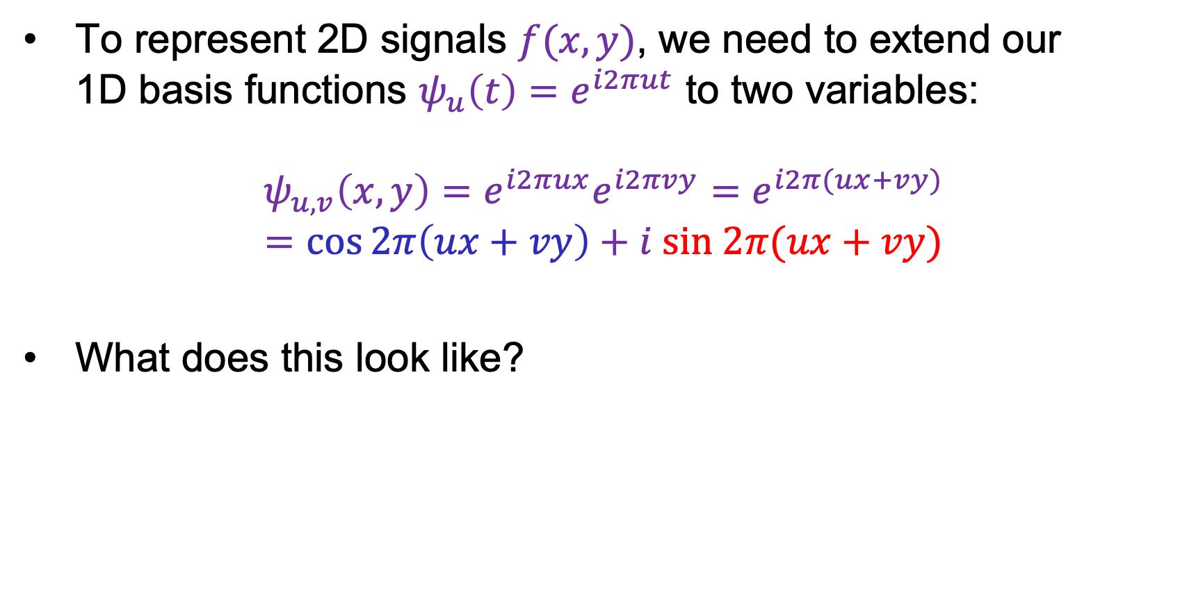
2D Fourier transform
To represent 2D signals $f(x,y)$, we need to extend our
1D basis functions $ψ_{u}\left(t\right)=e^{i2πut}$ to two variables:
$$ψ_{u,v}\left(x,y\right)=e^{i2πux}e^{i2πvy}=e^{i2π(ux+vy)}$$
$$=\cos{2π\left(ux+vy\right)}+i sin 2π(ux+vy)$$
What does this look like?

Slide 30
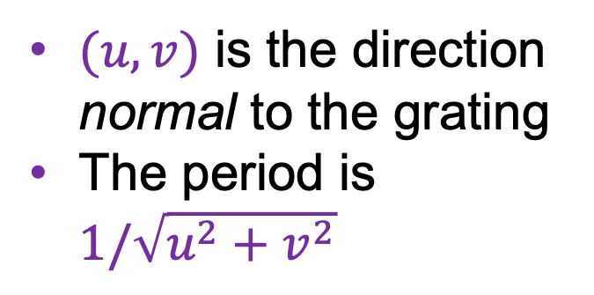


2D Fourier transform
2D basis functions are oriented sinusoidal “gratings”:
$$u$$
$(u,v)$ is the direction normal to the grating
The period is $1/\sqrt{u^{2}+v^{2}}$
$$v$$

Slide 31


Basis function examples
Real component
$$(u,v)$$

Slide 32
Basis function examples
Real component
$$(u,v)$$

Slide 33
Basis function examples
Real component
$$(u,v)$$

Slide 34
Linear combination of basis functions
Real component
$$(u,v)$$

Slide 35
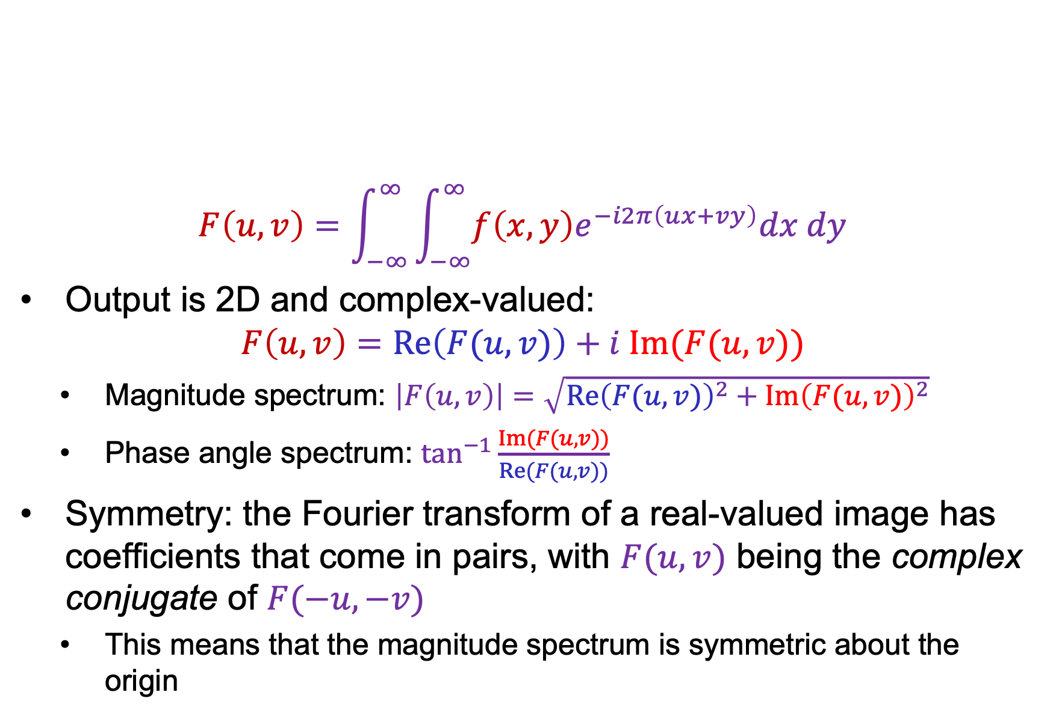
2D Fourier transform
$$F\left(u,v\right)=\int_{−∞}^{∞}{\int_{−∞}^{∞}{f\left(x,y\right)e^{−i2π\left(ux+vy\right)}dx dy}}$$
Output is 2D and complex-valued:
$$F\left(u,v\right)=Re\left(F(u,v)\right)+i Im(F(u,v))$$
  Magnitude spectrum: $\left|F\left(u,v\right)\right|=\sqrt{{Re\left(F(u,v)\right)}^{2}+{Im\left(F(u,v)\right)}^{2}}$
  Phase angle spectrum: $\tan^{−1}{\frac{Im(F(u,v))}{Re(F(u,v))}}$
Symmetry: the Fourier transform of a real-valued image has coefficients that come in pairs, with $F(u, v)$ being the complex conjugate of $F(−u, −v)$
  This means that the magnitude spectrum is symmetric about the origin

Slide 36
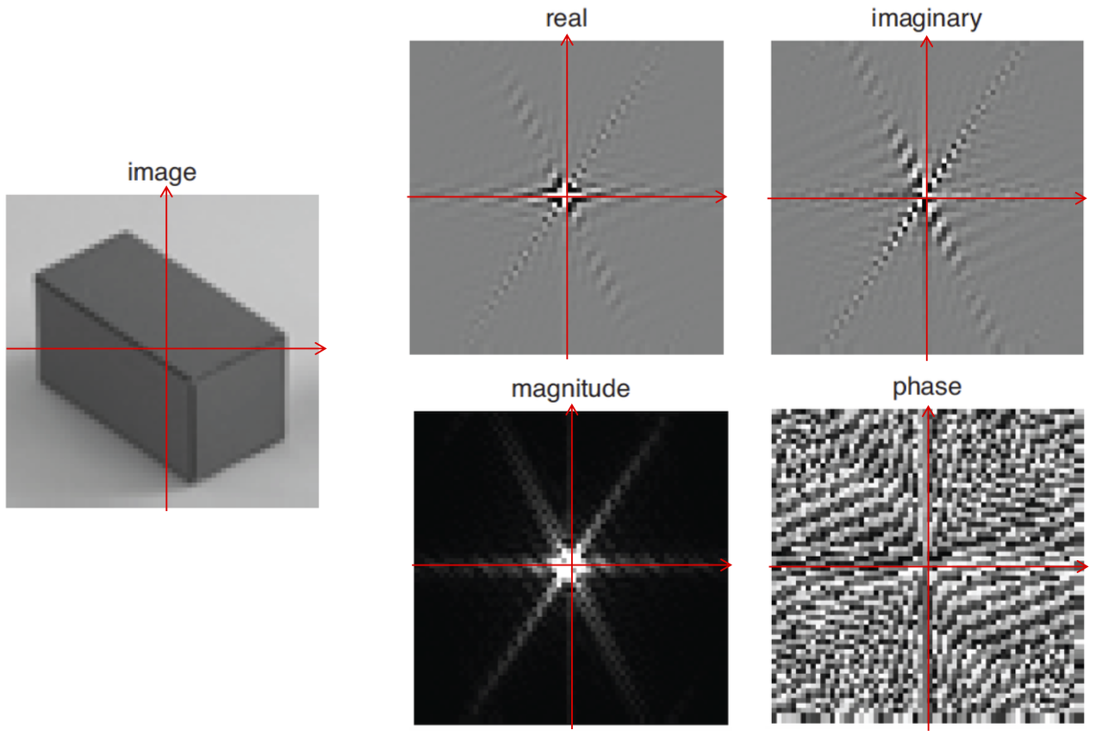

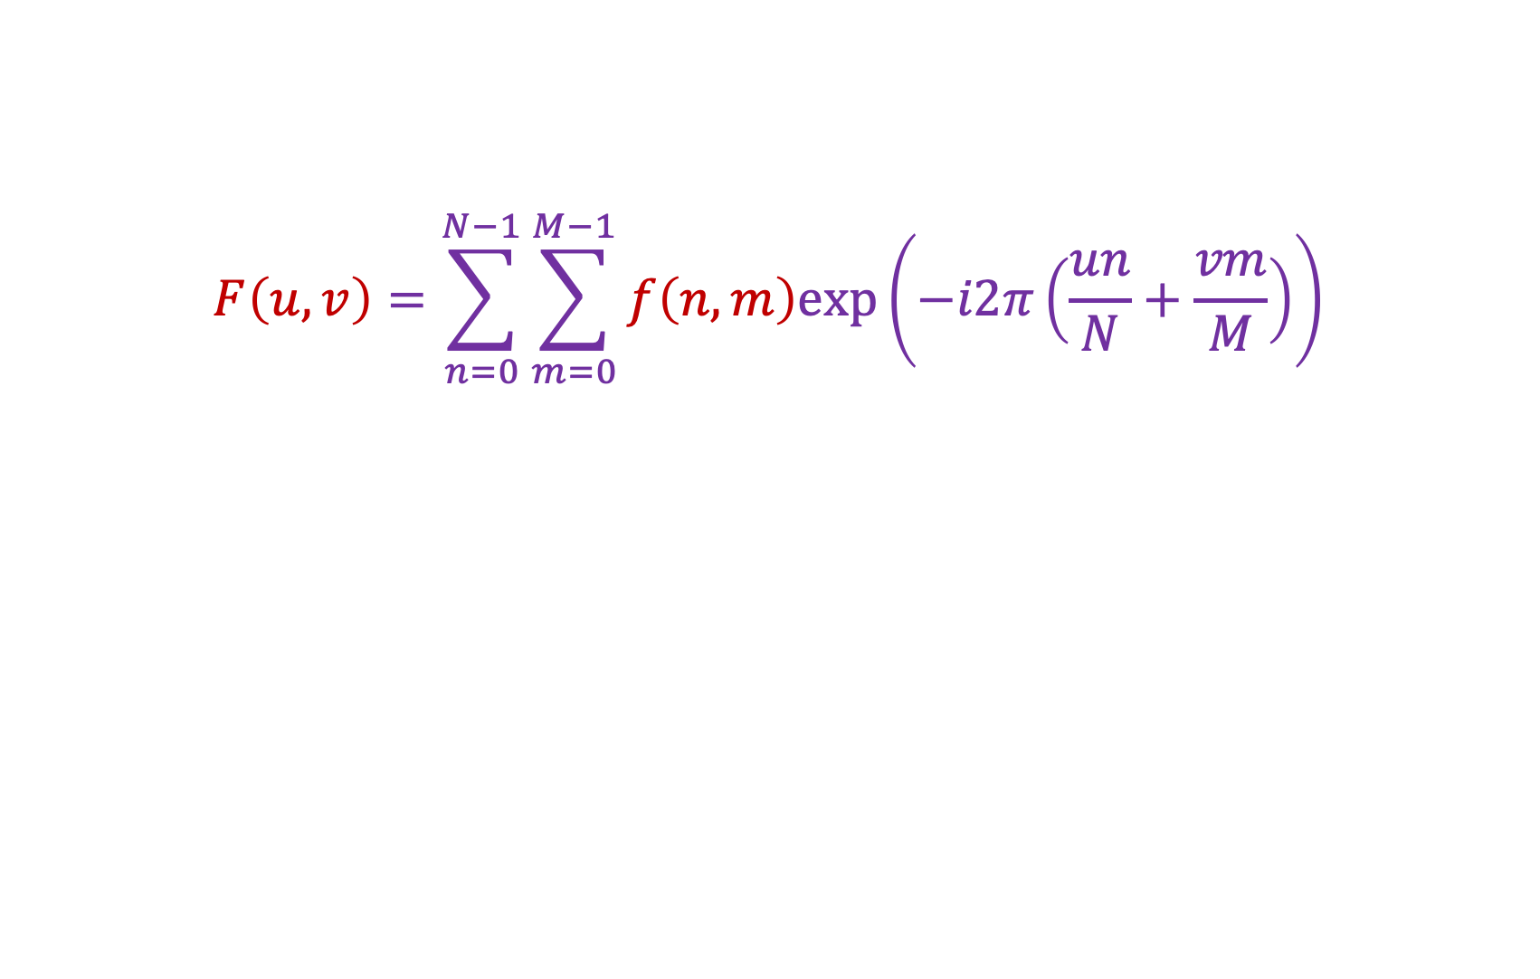



2D discrete Fourier transform
$$F\left(u,v\right)=\sum_{n=0}^{N−1}{\sum_{m=0}^{M−1}{f\left(n,m\right)exp\left(−i2π\left(\frac{un}{N}+\frac{vm}{M}\right)\right)}}$$
$$Re(F\left(u,v\right))$$
$$Im(F\left(u,v\right))$$
$$|F\left(u,v\right)|$$
$$\tan^{−1}{Im(F(u,v))/Re(F(u,v))}$$
Source: B. Freeman

Slide 37
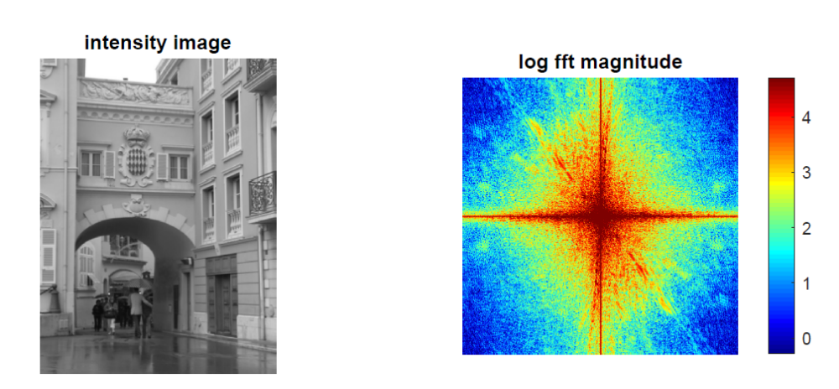
Real image examples

Slide 38
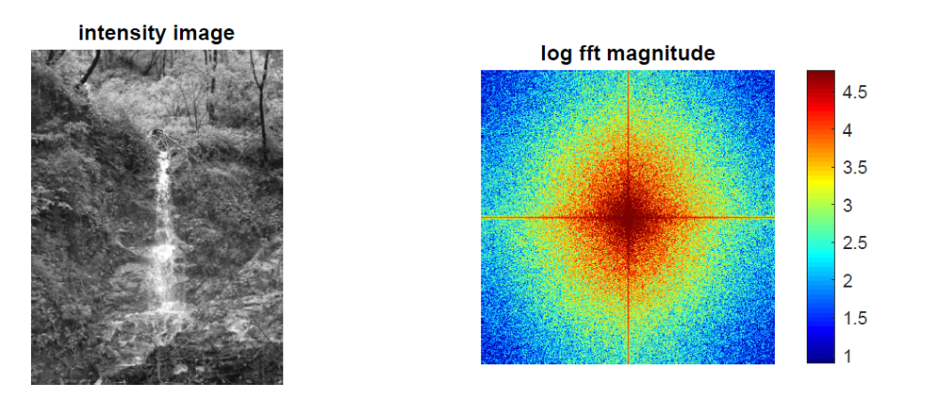
Real image examples

Slide 39
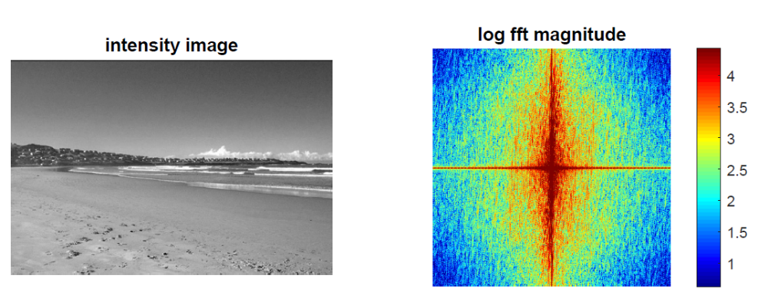

Which image goes with which spectrum?

Slide 40
Phase vs. magnitude
Which has more information, the phase or the magnitude?
Let’s take the phase from one image and combine it with the magnitude from another image

Slide 41



Magnitude
Phase

Slide 42

Phase
Magnitude

Slide 43

Images with periodic patterns
The magnitude image has peaks corresponding to the frequencies of repetition
Image
Magnitude image
Source: A. Zisserman

Slide 44

Application: Removing periodic patterns
Magnitude image
Remove peaks
Source: A. Zisserman

Slide 45


Application: Removing periodic patterns
Lunar orbital image (1966)
Magnitude image
Remove peaks
Join lines removed
Remove peaks
Source: A. Zisserman

Slide 46


Image transformations
How does the FT change when the image is scaled?
Scaled by the inverse factor!

Slide 47


Image transformations
How does the FT change when the image is rotated?
Rotates the same way!

Slide 48
Image transformations
How does the FT change when the image is rotated?
Caution: in real images this is not always the case because of edge artifacts (recall that DFT treats images as periodically tiled)
Image source

Slide 49
Image transformations
How does the FT change when the image is translated?
Magnitude spectrum doesn’t change, phase gets modulated

Slide 50
Last time: Fourier analysis
1D Fourier transform
  Definition and properties
  Discrete Fourier transform
2D Fourier transform
  Definition
  Examples and properties

Slide 51



Review: 2D Fourier transform
2D basis functions are oriented sinusoidal “gratings”:
$$ψ_{u,v}\left(x,y\right)=e^{i2π(ux+vy)}=\cos{2π\left(ux+vy\right)}+i sin 2π(ux+vy)$$
$$u$$
$(u,v)$ is the direction normal to the grating
The period is $1/\sqrt{u^{2}+v^{2}}$
$$v$$
Fourier image decomposition demo

Slide 52

Aside: Discrete Cosine Transform
Real-valued
Fewer basis elements are needed to get a good approximation of the image – more useful for compression
DCT basis functions
https://en.wikipedia.org/wiki/Discrete_cosine_transform

Slide 53

Review: 2D Fourier transform
$$F\left(u,v\right)=\int_{−∞}^{∞}{\int_{−∞}^{∞}{f\left(x,y\right)e^{−i2π\left(ux+vy\right)}dx dy}}$$
Output is 2D and complex-valued:
$$F\left(u,v\right)=Re\left(F(u,v)\right)+i Im(F(u,v))$$
  Magnitude spectrum: $\left|F\left(u,v\right)\right|=\sqrt{{Re\left(F(u,v)\right)}^{2}+{Im\left(F(u,v)\right)}^{2}}$
  Phase angle spectrum: $\tan^{−1}{\frac{Im(F(u,v))}{Re(F(u,v))}}$

Slide 54

Review: 2D Fourier transform
$$F\left(u,v\right)=\int_{−∞}^{∞}{\int_{−∞}^{∞}{f\left(x,y\right)e^{−i2π\left(ux+vy\right)}dx dy}}$$
Inverse transform:
$$f\left(x,y\right)=\int_{−∞}^{∞}{\int_{−∞}^{∞}{F\left(u,v\right)e^{i2π\left(ux+vy\right)}du dv}}$$

Slide 55
Review: 2D discrete Fourier transform
$$F\left(u,v\right)=\sum_{n=0}^{N−1}{\sum_{m=0}^{M−1}{f\left(n,m\right)exp\left(−i2π\left(\frac{un}{N}+\frac{vm}{M}\right)\right)}}$$
$$Re(F\left(u,v\right))$$
$$Im(F\left(u,v\right))$$
$$|F\left(u,v\right)|$$
$$\tan^{−1}{Im(F(u,v))/Re(F(u,v))}$$
Source: B. Freeman

Slide 56


Review: Which image goes with which spectrum?
Swapped magnitude and phase
Source

Slide 57
Outline
1D Fourier transform
  Definition and properties
  Discrete Fourier transform
2D Fourier transform
  Definition
  Examples and properties
Convolution theorem
Understanding the behavior of filters
Understanding the sampling theorem
More applications of Fourier analysis

Slide 58

Convolution theorem
Convolution in the spatial domain translates to multiplication in the frequency domain (and vice versa)
The Fourier transform of the convolution of two functions is the product of their Fourier transforms:
$$ℱ\{f∗g\}=ℱ\{f\} ℱ\{g\}$$
The inverse Fourier transform of the product of two Fourier transforms is the convolution of the two inverse Fourier transforms:
$$ℱ^{−1}\{FG\}=ℱ^{−1}\{F\}∗ℱ^{−1}\{G\}$$

Slide 59









2D convolution theorem example
Image
Filter
Filtered image
$$=$$
*
FT(Image)
FT(Filter)
FT(Filtered image)
$$⊙$$
$$=$$

Slide 60

Convolution theorem
Suppose $f$ and $g$ both consist of $N$ pixels
What is the complexity of computing $f∗g$ in the spatial domain?
  $O(N^{2})$
And what is the complexity of computing $ℱ^{−1}\left\{ℱ\left\{f\right\}ℱ\left\{g\right\}\right\}$?
  $O(N\log{N})$ using FFT
Thus, convolution of an image with a large filter can be more efficiently done in the frequency domain

Slide 61
Outline
1D Fourier transform
  Definition and properties
  Discrete Fourier transform
2D Fourier transform
  Definition
  Examples and properties
Convolution theorem
Understanding the behavior of filters

Slide 62
Understanding the behavior of filters
Why does filtering with a Gaussian give a nice smooth image, but filtering with a box filter gives artifacts?
Gaussian
Box filter
Notes:
Things we can’t understand without thinking in frequency
62

Slide 63
Recall: Fourier transform pairs
$$box(t)$$
$$sinc\left(u\right)=\frac{\sin\left(πu\right)}{πu}$$
$$−0.5$$
$$0.5$$
$$\operatorname{gauss}\left(u;\frac{1}{σ}\right)$$
$$\operatorname{gauss}\left(t;σ\right)$$

Slide 64

Filtering with a Gaussian

Slide 65

Filtering with a box filter

Slide 66

Low-pass filtering
Image
Source (demo)

Slide 67
Low-pass filtering
Image
Low-pass filtered
What can we say about the low-pass filtering result?
Source (demo)

Slide 68
Low-pass filtering
Image
Low-pass filtered
What can we say about the low-pass filtering result?
It has ringing artifacts – why?
  “Hard” low-pass filtering is equivalent to convolving with a sinc function in the spatial domain
This is why Gaussian filtering is preferred
Source (demo)

Slide 69
High-pass filtering
Image
Low-pass filtered
Demo
Source: A. Zisserman

Slide 70
High-pass filtering
Image
Low-pass filtered
High-pass filtered
Demo
Source: A. Zisserman

Slide 71


Hybrid images revisited
Low-pass filter
High-pass filter
A. Oliva et al. Hybrid Images. SIGGRAPH 2006

Slide 72
Hybrid images in the frequency domain
Low-pass filter
High-pass filter
A. Oliva et al. Hybrid Images. SIGGRAPH 2006

Slide 73

Hybrid images in the frequency domain
Having a gap in the frequency content is important for the illusion to be effective
A. Oliva et al. Hybrid Images. SIGGRAPH 2006

Slide 74

Psychophysical explanation
Source

Slide 75

Psychophysical explanation
Source

Slide 76

Psychophysical explanation
Source

Slide 77

Psychophysical explanation
Source

Slide 78

Hybrid painting
Salvador Dali
“Gala Contemplating the Mediterranean Sea,
which at 30 meters becomes the portrait
of Abraham Lincoln”, 1976

Slide 79

Hybrid painting
Salvador Dali
“Gala Contemplating the Mediterranean Sea,
which at 30 meters becomes the portrait
of Abraham Lincoln”, 1976

Slide 80

Hybrid painting
Salvador Dali
“Gala Contemplating the Mediterranean Sea,
which at 30 meters becomes the portrait
of Abraham Lincoln”, 1976

Slide 81
Outline
1D Fourier transform
  Definition and properties
  Discrete Fourier transform
2D Fourier transform
  Definition
  Examples and properties
Convolution theorem
Understanding the behavior of filters
Understanding the sampling theorem

Slide 82
Recall: Sampling and aliasing

Slide 83


Recall: Nyquist-Shannon sampling theorem
When sampling a signal at discrete intervals, the sampling frequency must be at least twice the maximum frequency of the input signal to allow us to reconstruct the original perfectly from the sampled version
bad
good
https://en.wikipedia.org/wiki/Nyquist-Shannon_sampling_theorem

Slide 84









Understanding the sampling theorem
Suppose we have a continuous function $f(t)$ and we want to sample it at discrete intervals with a spacing of $T$
This can be accomplished by multiplying it by the comb function or impulse train:
$$comb\left(t\right)=\sum_{n=−∞}^{∞}{δ(t−nT)}$$
$$f(t)$$
$$⊙$$
$$=$$
$$f_{s}\left(t\right)=\sum_{n=−∞}^{∞}{f(t)δ(t−nT)}$$
$$T$$
Source: A. Zisserman

Slide 85




Understanding the sampling theorem
Let’s (formally) take the Fourier transform:
$$T$$
$$f_{s}\left(t\right)=f\left(t\right) ⊙ comb(t;T)$$
*Officially, the FT of the comb function doesn’t exist since it’s periodic, and since $δ$ is a weird function
Source: A. Zisserman

Slide 86



Understanding the sampling theorem
Let’s (formally) take the Fourier transform:
$$F\left(u\right)$$
$$1/T$$
$$T$$
$$F_{s}\left(u\right)=F\left(u\right) ∗ \frac{1}{T}comb\left(t;\frac{1}{T}\right)$$
$$f_{s}\left(t\right)=f\left(t\right) ⊙ comb(t;T)$$
*Officially, the FT of the comb function doesn’t exist since it’s periodic, and since $δ$ is a weird function
Source: A. Zisserman

Slide 87



Understanding the sampling theorem
Let’s (formally) take the Fourier transform:
$$F\left(u\right)$$
$$1/T$$
$$T$$
$$F_{s}\left(u\right)=F\left(u\right) ∗ \frac{1}{T}comb\left(t;\frac{1}{T}\right)$$
$$f_{s}\left(t\right)=f\left(t\right) ⊙ comb(t;T)$$
*Officially, the FT of the comb function doesn’t exist since it’s periodic, and since $δ$ is a weird function
$$=$$
Source: A. Zisserman
Replicated copies of $F(u)$!

Slide 88





Understanding the sampling theorem
How do we reconstruct $f(t)$?
Let’s apply a box filter in the
frequency domain
  Equivalent to convolving with a
  sinc function in the original domain
When will this work perfectly?
  When the sampling frequency $1/T$exceeds
  twice the greatest frequency contained in $F\left(u\right)$!
$$1/T$$
$$f(t)$$
$$F\left(u\right)$$
Source: A. Zisserman

Slide 89

Understanding the sampling theorem
If the sampling frequency is too small, frequencies above the Nyquist limit are “folded back” onto smaller frequencies, resulting in aliasing
Source: A. Zisserman

Slide 90






Sampling theorem in 2D
If the Fourier transform of a continuous function $f(x,y)$ is zero for all frequencies beyond $u_{b}$ and $v_{b}$, i.e., if the Fourier transform is band-limited, then $f(x,y)$ can be completely reconstructed from its samples as long as the sampling distances $w$and $h$ along the $x$ and $y$ directions are such that $w≤\frac{1}{2u_{b}}$ and $h≤\frac{1}{2v_{b}}$
$$h$$
$$h$$
Source: A. Zisserman
$$w$$
$$w$$

Slide 91
Aside: Analyzing interpolation methods
Perfect reconstruction of the subsampled signal requires convolution with a sinc filter in the spatial domain, which is bad because sinc has infinite support
Instead, faster and cheaper reconstruction (interpolation) methods are typically used

Slide 92



Aside: Analyzing different interpolation methods
Linear reconstruction can be done by convolving the sampled signal with a triangle filter:
However, the Fourier transform of the triangle filter is the ${sinc}^{2}$ function, so multiplying the signal’s spectrum by it introduces high-frequency artifacts
$$∗$$
$$=$$
Image source

Slide 93


Bilinear interpolation closeup
Image source

Slide 94
Outline
1D Fourier transform
  Definition and properties
  Discrete Fourier transform
2D Fourier transform
  Definition
  Examples and properties
Convolution theorem
Understanding the behavior of filters
Understanding the sampling theorem
More applications of Fourier analysis

Slide 95

Accelerating convolutional networks
M. Mathieu, M. Henaff, and Y. LeCun. Fast Training of Convolutional Networks through FFTs. ICLR 2014

Slide 96


Understanding neural network shortcuts
G. Chen et al. Amplitude-Phase Recombination: Rethinking Robustness of Convolutional Neural Networks in Frequency Domain. ICCV 2021
S. Wang et al. What do neural networks learn in image classification? A frequency shortcut perspective. ICCV 2023

Slide 97

Detecting fake images
S.-Y. Wang et al. CNN-generated images are surprisingly easy to spot... for now. CVPR 2020

Slide 98

Analyzing artifacts in fake images
Checkerboard and repetition artifacts in early GANs
https://distill.pub/2016/deconv-checkerboard/

