Slide 1
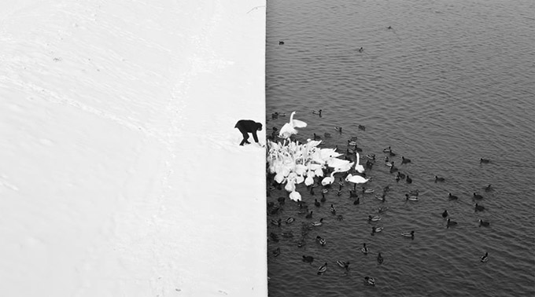
Edge detection
Winter in Kraków photographed by Marcin Ryczek

Slide 2
Overview
Motivating edge detection
Image gradients
Derivative of Gaussian filters
Canny edge detector
Role of edge detection in image understanding

Slide 3
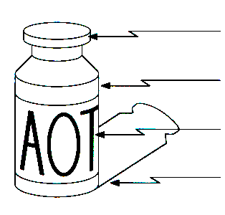
Edge detection
Goal: Identify sudden changes (discontinuities) in an image
Intuitively, edges carry most of the semantic and shape information from the image
surface normal discontinuity
depth discontinuity
surface color discontinuity
illumination discontinuity
Sources: D. Lowe and S. Seitz

Slide 4
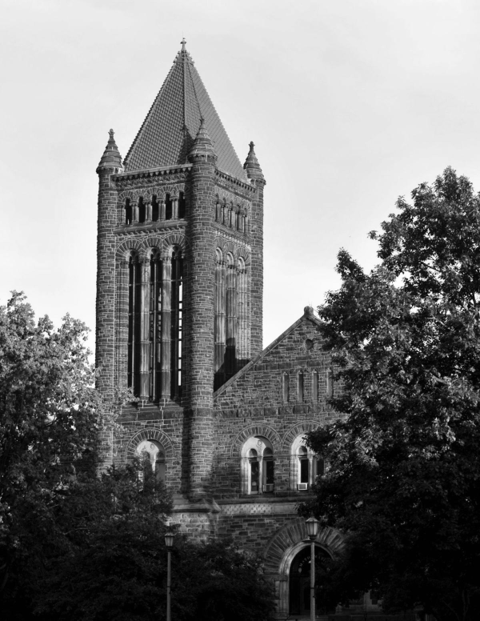

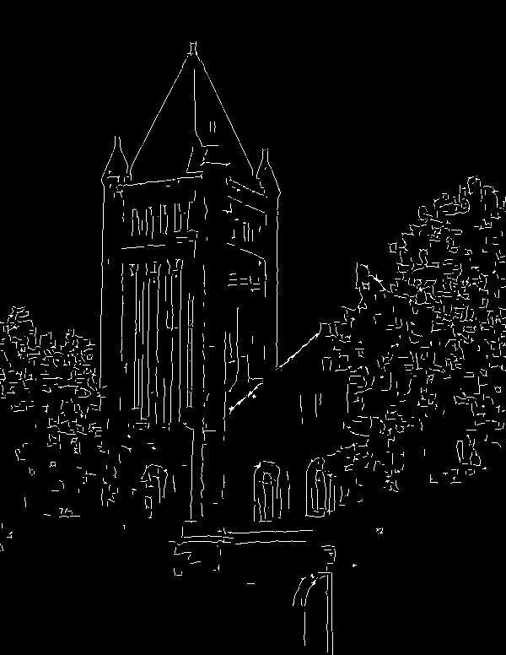
Edge detection
Input photo
Ideal: artist’s line drawing
Reality
Image source
Source: S. Gupta

Slide 5

Characterizing edges
An edge is a place of rapid change in the image intensity function
intensity function
(along horizontal scanline)
image
first derivative
edges correspond to
extrema of derivative

Slide 6
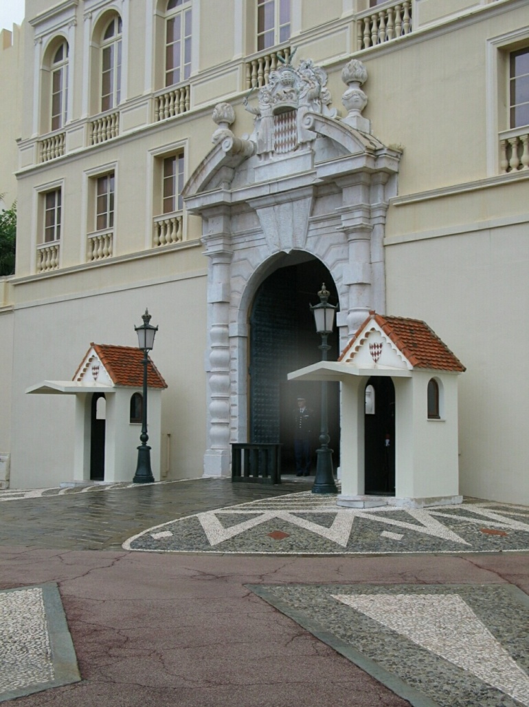
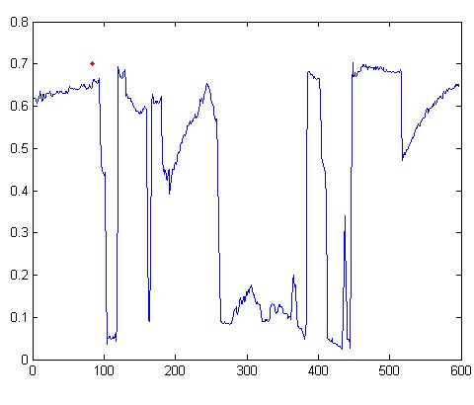
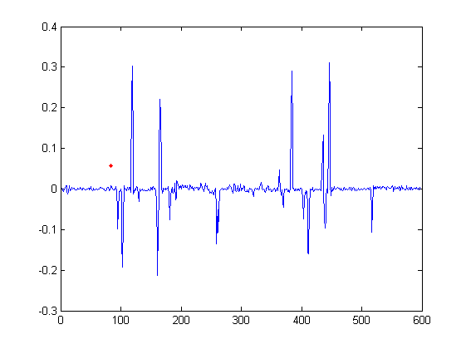
A realistic example
Intensity
Gradient
Source: D. Hoiem

Slide 7
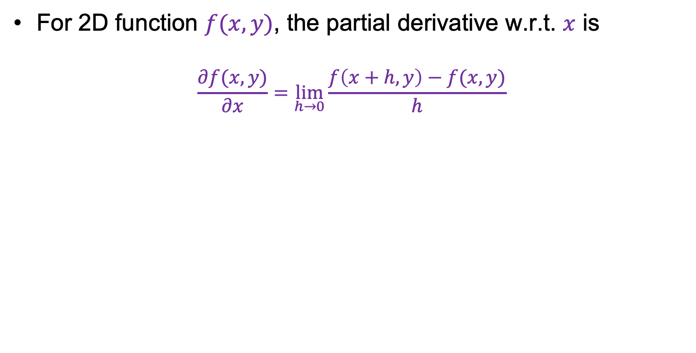
Partial derivatives of an image
For 2D function $f(x,y)$, the partial derivative w.r.t. $x$ is
$$\frac{∂f(x,y)}{∂x}=\lim_{h→0}{\frac{f\left(x+h,y\right)−f(x,y)}{h}}$$
Image source

Slide 8
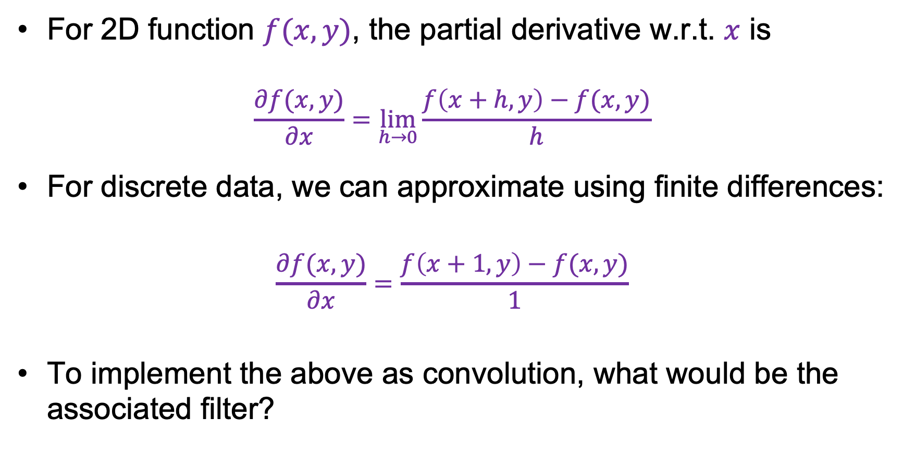
Partial derivatives of an image
For 2D function $f(x,y)$, the partial derivative w.r.t. $x$ is
$$\frac{∂f(x,y)}{∂x}=\lim_{h→0}{\frac{f\left(x+h,y\right)−f(x,y)}{h}}$$
For discrete data, we can approximate using finite differences:
$$\frac{∂f(x,y)}{∂x}=\frac{f\left(x+1,y\right)−f(x,y)}{1}$$
To implement the above as convolution, what would be the associated filter?
Source: K. Grauman

Slide 9
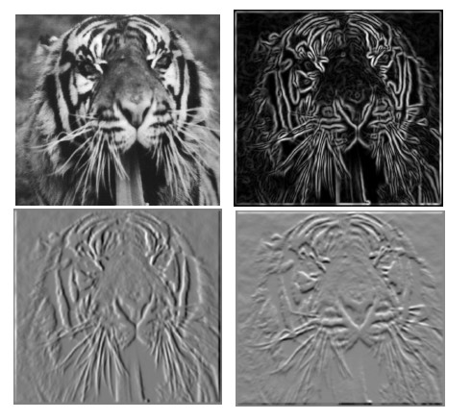



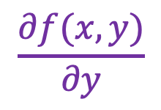

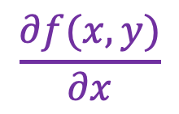

Partial derivatives of an image
$$f(x,y)$$
$$\frac{∂f(x,y)}{∂x}$$
$$\frac{∂f(x,y)}{∂y}$$
$$−1$$
$$−1$$
$$1$$
$$1$$

Slide 10
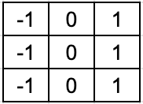
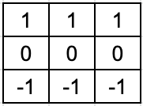


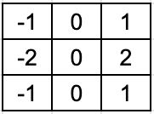
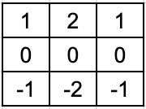


Finite difference filters
Other approximations of derivative filters exist:
Prewitt
Sobel
Roberts
Source: K. Grauman

Slide 11
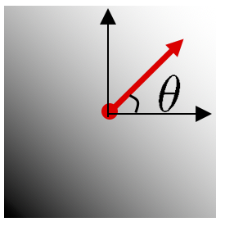
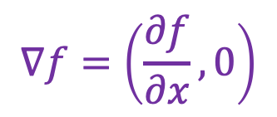
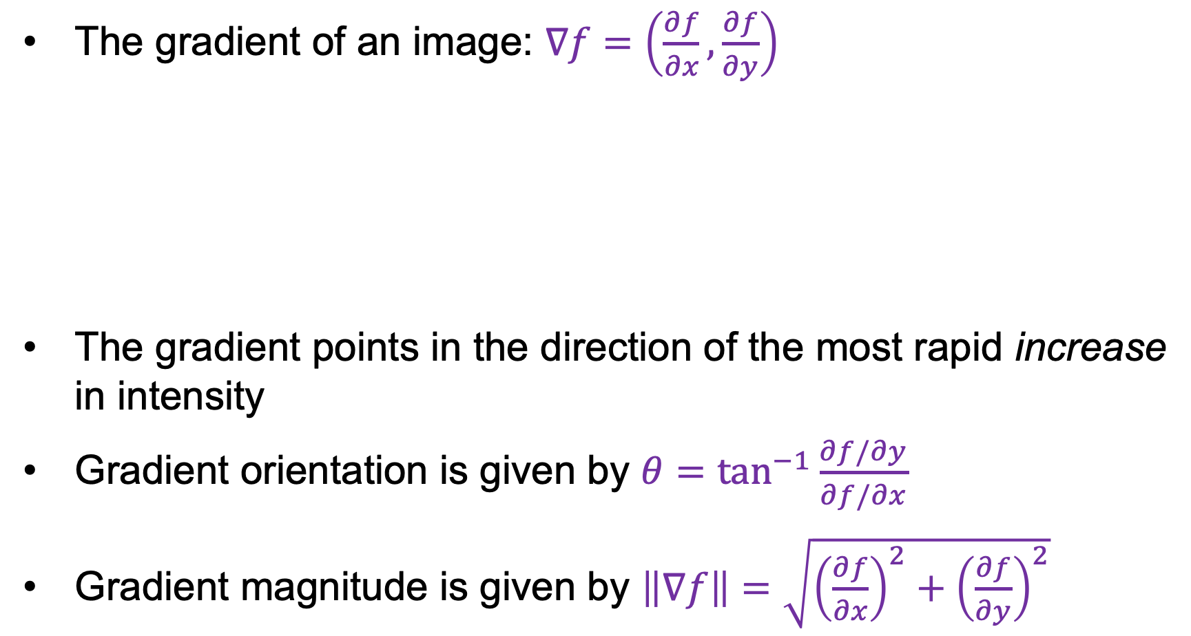
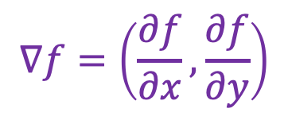
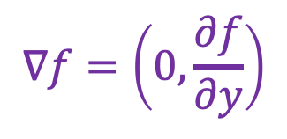
Image gradient
The gradient of an image: $∇f=\left(\frac{∂f}{∂x},\frac{∂f}{∂y}\right)$
The gradient points in the direction of the most rapid increase in intensity
Gradient orientation is given by $θ=\tan^{−1}{\frac{∂f/∂y}{∂f/∂x}}$
Gradient magnitude is given by $\left\|∇f\right\|=\sqrt{{\left(\frac{∂f}{∂x}\right)}^{2}+{\left(\frac{∂f}{∂y}\right)}^{2}}$
$$∇f=\left(\frac{∂f}{∂x},\frac{∂f}{∂y}\right)$$
$$∇f=\left(\frac{∂f}{∂x},0\right)$$
$$∇f=\left(0,\frac{∂f}{∂y}\right)$$

Slide 12
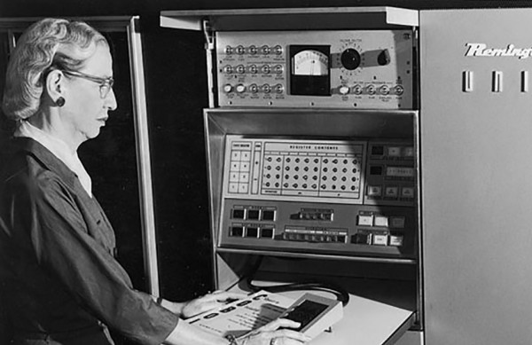
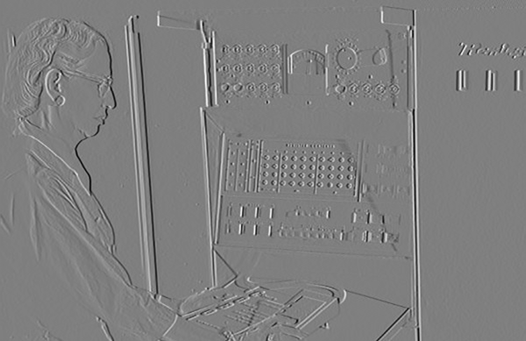
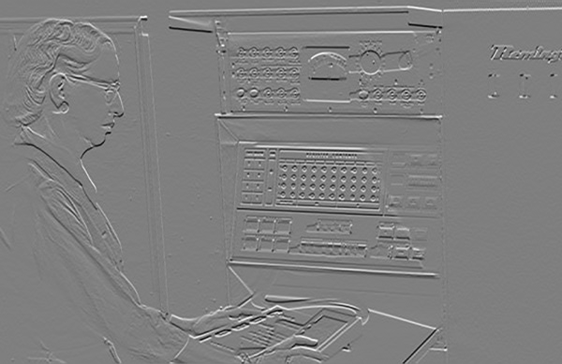

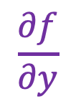
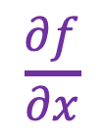
Image gradient: Example
$$f(x,y)$$
$$\frac{∂f}{∂x}$$
$$\frac{∂f}{∂y}$$
Source: D. Fouhey

Slide 13
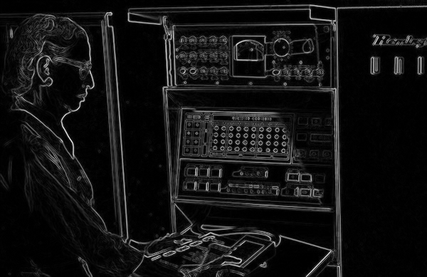

Image gradient: Example
Magnitude: $\left\|∇f\right\|=\sqrt{{\left(\frac{∂f}{∂x}\right)}^{2}+{\left(\frac{∂f}{∂y}\right)}^{2}}$
Source: D. Fouhey

Slide 14
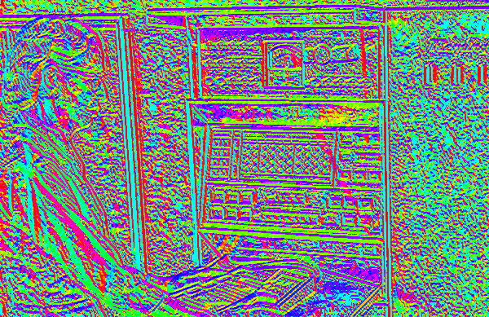


Image gradient: Example
Orientation: $\tan^{−1}{\frac{∂f/∂y}{∂f/∂x}}$
Source: D. Fouhey

Slide 15
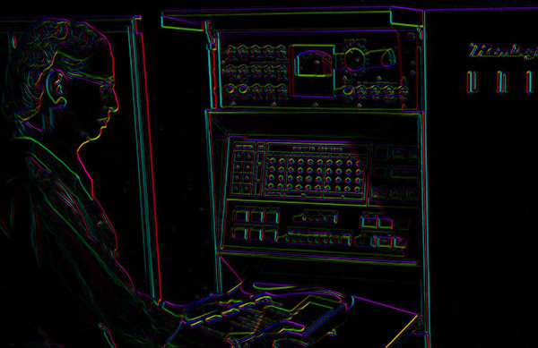
Image gradient: Example
Orientation: $\tan^{−1}{\frac{∂f/∂y}{∂f/∂x}}$
Make lightness equal to gradient magnitude
Source: D. Fouhey

Slide 16
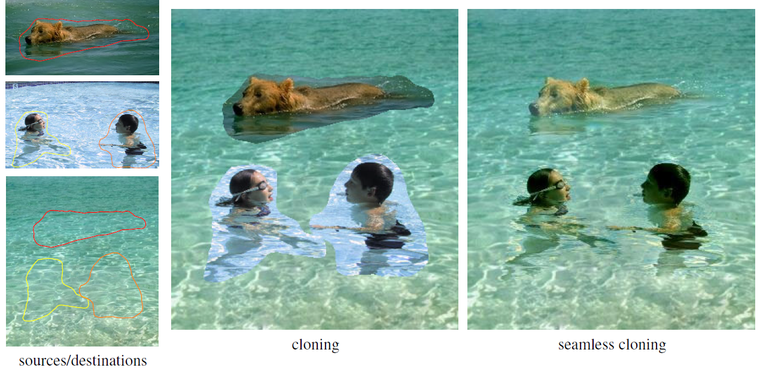
Aside: Gradient-domain image editing
Goal: solve for pixel values in the target region to match gradients of the source region while keeping background pixels the same
P. Perez et al. Poisson Image Editing. SIGGRAPH 2003

Slide 17
Derivatives and noise
Gradient
Source: D. Hoiem

Slide 18
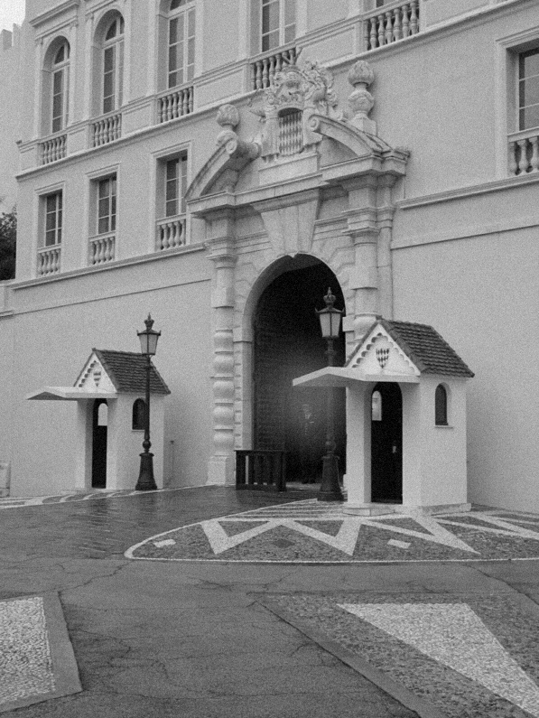
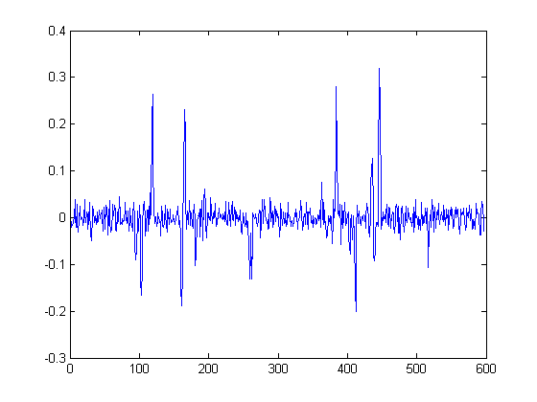
Derivatives and noise
Let’s add a little Gaussian noise
Gradient
Source: D. Hoiem

Slide 19
Derivatives and noise

Slide 20
Derivatives and noise

Slide 21
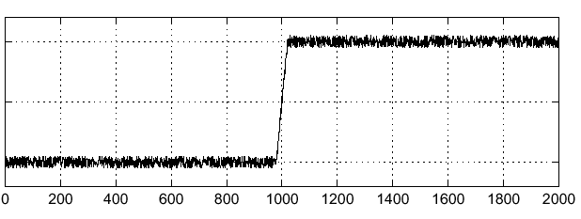

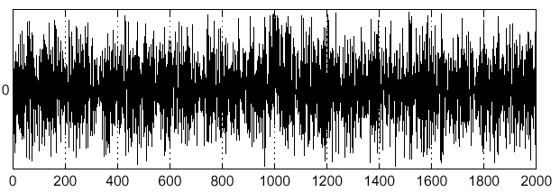
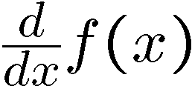
Finding noisy edges
Consider a single row or column of the image:
Where is the edge?
Source: S. Seitz
Notes:
How to fix?

Slide 22

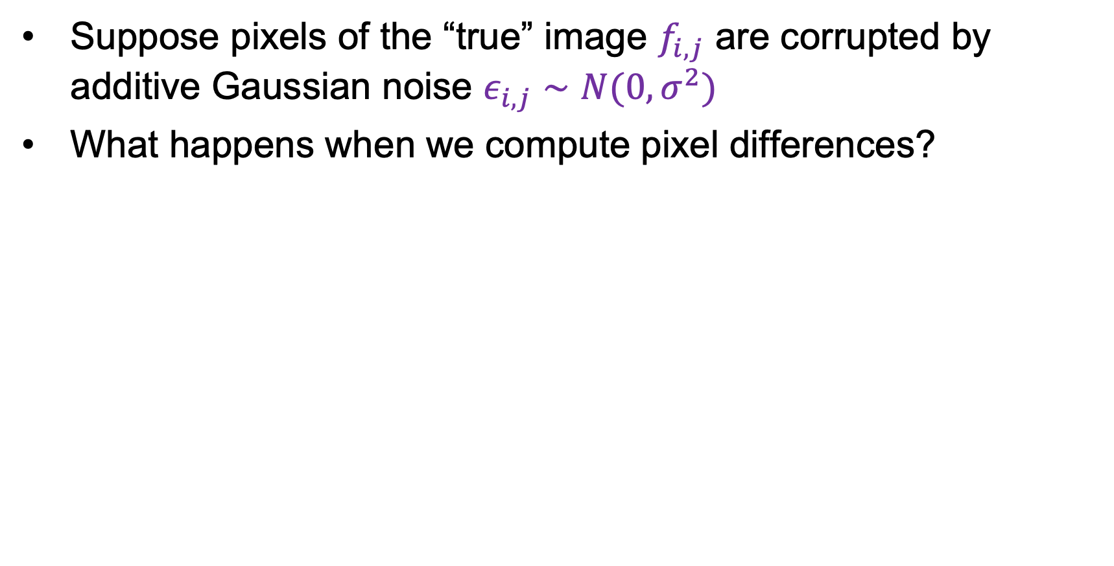

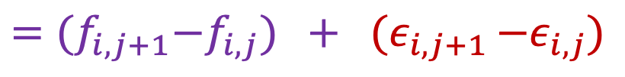
Derivatives and noise
Suppose pixels of the “true” image $f_{i,j}$ are corrupted by additive Gaussian noise $ε_{i,j}∼N(0,σ^{2})$
What happens when we compute pixel differences?
$$D_{i,j}={(f}_{i,j+1}+ε_{i,j+1})−{(f}_{i,j}+ε_{i,j })$$
$$={(f}_{i,j+1}−f_{i,j}) + {(ε}_{i,j+1 }−ε_{i,j})$$
True difference
Difference of two zero-mean Gaussian random variables (same as sum)
$$ε_{i,j+1}−ε_{i,j}∼N\left(0,{2σ}^{2}\right)→$$
Variance doubles!
Adapted from D. Fouhey and J. Johnson

Slide 23
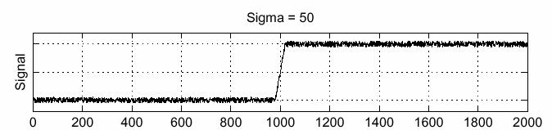
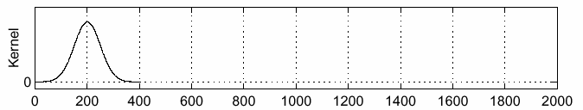
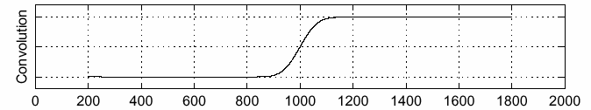
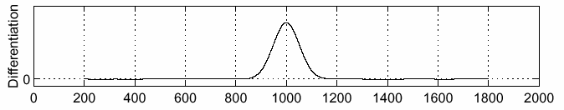
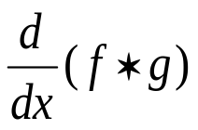
Finding noisy edges: Smooth first
f
g
f * g
To find edges, look for peaks in $\frac{d}{dx}\left(f∗g\right)$
Source: S. Seitz

Slide 24
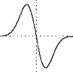
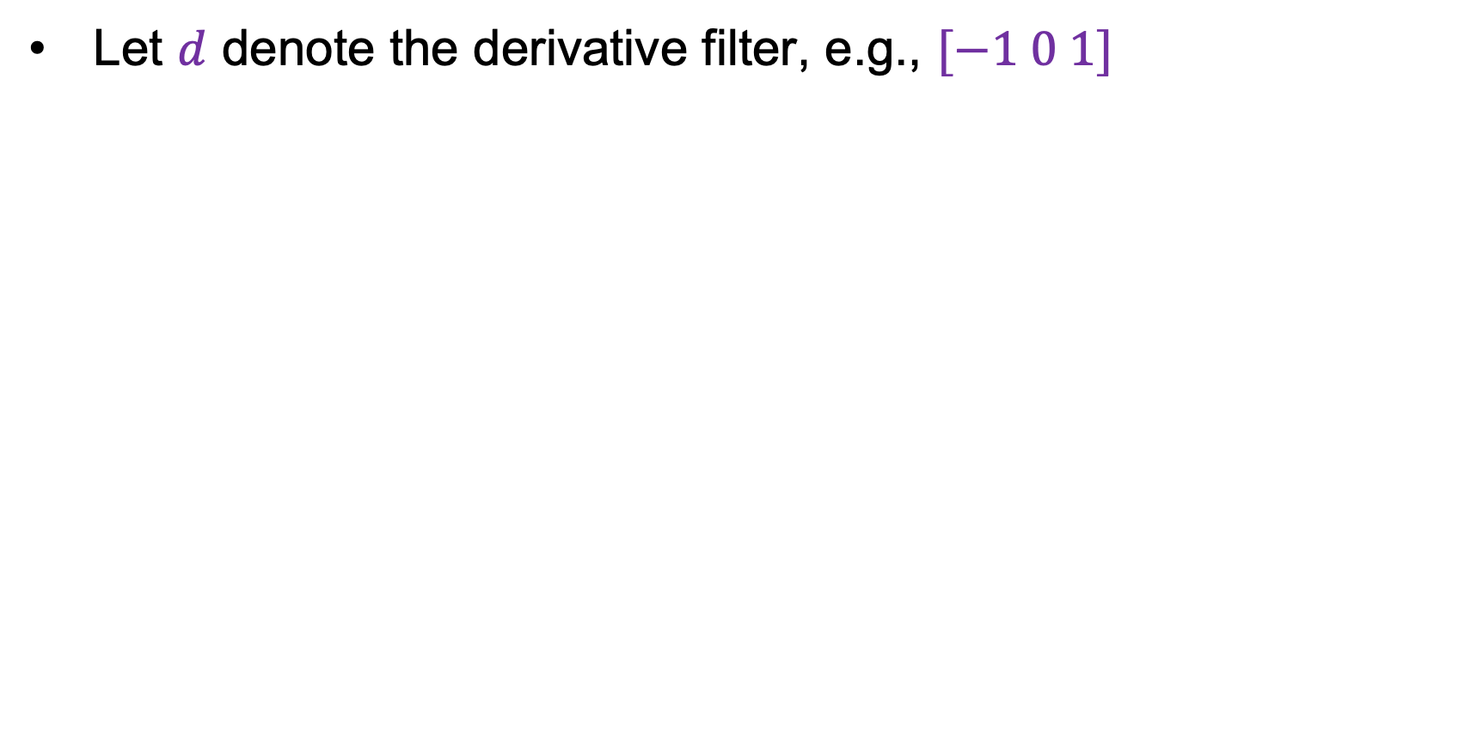
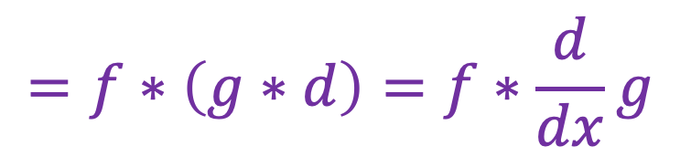
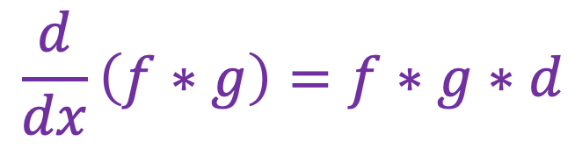
Finding noisy edges: Smooth first
Let $d$ denote the derivative filter, e.g., $[−1 0 1]$
$$\frac{d}{dx}\left(f∗g\right)=f∗g∗d$$
$$=f∗\left(g∗d\right)=f∗\frac{d}{dx}g$$
Derivative of Gaussian filter

Slide 25
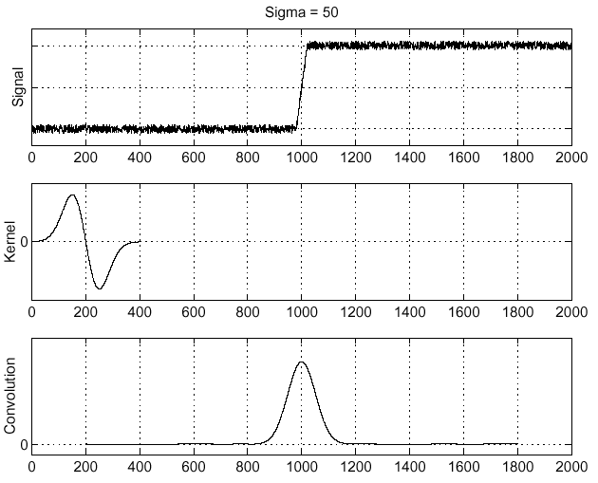
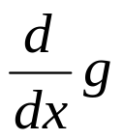
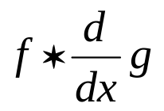
Filtering with derivative of Gaussian
f
Source: S. Seitz

Slide 26
Overview
Motivating edge detection
Image gradients
Derivative of Gaussian filters

Slide 27
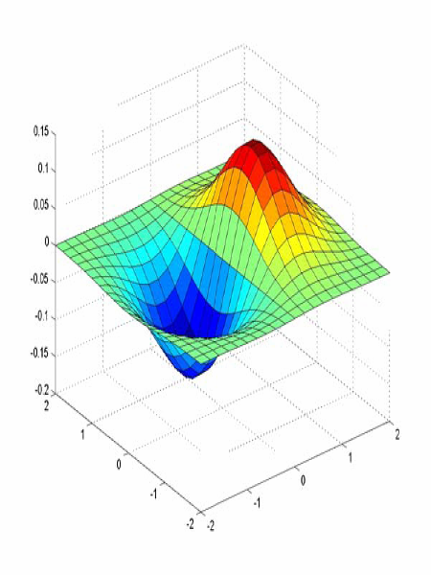



2D Derivative of Gaussian filters
$x$-direction
$y$-direction

Slide 28

Recall: Separability of the Gaussian filter
$$\frac{1}{2πσ^{2}}\exp\left(−\frac{x^{2}+y^{2}}{{2σ}^{2}}\right)=$$
$$\frac{1}{\sqrt{2π}σ}\exp\left(−\frac{x^{2}}{{2σ}^{2}}\right) \frac{1}{\sqrt{2π}σ}exp⁡\left(−\frac{y^{2}}{2σ^{2}}\right)$$
=
⁎
Note: matrix multiplication (outer product) and full convolution are the same in this special case
Adapted from D. Fouhey and J. Johnson

Slide 29



2D Derivative of Gaussian filters
(Unnormalized) 2D Gaussian:
$$g\left(x,y\right)∝\exp\left(−\frac{x^{2}+y^{2}}{{2σ}^{2}}\right)=\exp\left(−\frac{x^{2}}{{2σ}^{2}}\right)exp⁡\left(−\frac{y^{2}}{2σ^{2}}\right)$$
(Unnormalized) Gaussian derivatives:
$$\frac{∂g}{∂x}∝−x exp\left(−\frac{x^{2}}{{2σ}^{2}}\right)exp⁡\left(−\frac{y^{2}}{2σ^{2}}\right)$$
$$\frac{∂g}{∂y}∝−y exp\left(−\frac{y^{2}}{{2σ}^{2}}\right)exp⁡\left(−\frac{x^{2}}{2σ^{2}}\right)$$
These are products of a 1D Gaussian in one direction and 1D derivative of Gaussian in the other direction!

Slide 30

Derivative of Gaussian: Frequency domain
If $F(u)$ is the Fourier transform of $f(t)$, then
$$ℱ\left\{\frac{d}{dt}f(t)\right\}=i2πuF(u)$$
For a 1D Gaussian with $σ=1$, $F(u) = g(u)$, so we have
$$ℱ\left\{\frac{d}{dt}g(t)\right\}=i2πug\left(u\right)=−i2π\frac{d}{du}g(u)$$
This is minus the derivative of Gaussian on the imaginary axis:
(should be flipped upside down)
Image source

Slide 31


Derivative of Gaussian: Frequency domain
If $F(u)$ is the Fourier transform of $f(t)$, then
$$ℱ\left\{\frac{d}{dt}f(t)\right\}=i2πuF(u)$$
For a 1D Gaussian with $σ=1$, $F(u) = g(u)$, so we have
$$ℱ\left\{\frac{d}{dt}g(t)\right\}=i2πug\left(u\right)=−i2π\frac{d}{du}g(u)$$
The magnitude spectrum looks like this:
Functions as a band-pass filter!

Slide 32



Edge detection in frequency domain
Image
Filter
Filtered image
Source: D. Hoiem

Slide 33







Derivative of Gaussian: Scale
Using Gaussian derivatives with different values of $σ$ finds structures at different scales or frequencies
$σ=1$
$σ=3$
$σ=7$
Source: D. Forsyth

Slide 34
Summing up: Types of filters
Smoothing filters
  Gaussian: remove “high-frequency” components;
  “low-pass” filter
  Can the values of a smoothing filter be negative?
  What should the values sum to?
    One: constant regions are not affected by the filter
Derivative filters
  Derivatives of Gaussian: compute smoothed
  differences; “band-pass” filters
  Can the values of a derivative filter be negative?
  What should the values sum to?
    Zero: no response in constant regions

Slide 35
Edge detection: Overview
Motivating edge detection
Image gradients
Derivative of Gaussian filters
Canny edge detector

Slide 36
Building an edge detector
original image
final output
J. Canny. A Computational Approach To Edge Detection. PAMI 1986

Slide 37




Building an edge detector
Compute$x$and $y$ derivative images
Find magnitude and orientation of the gradient
Source: S. Gupta

Slide 38
Building an edge detector
Compute$x$and $y$ derivative images
Find magnitude and orientation of the gradient
Let’s threshold the gradient magnitude
Source: S. Gupta

Slide 39

Building an edge detector
Compute$x$and $y$ derivative images
Find magnitude and orientation of the gradient
We get thick trails, not neat edge curves
Let’s threshold the gradient magnitude
Source: S. Gupta

Slide 40









Non-maximum suppression
$$q$$
$$r$$
$$q$$
$$p$$
$$p$$
$$q$$
$$r$$
1D image “slice” normal to the edge
For each location $q$ above threshold, check that the gradient magnitude is higher than at adjacent points $p$ and $r$ along the direction of the gradient
  Need to interpolate to get the gradient magnitude values at $p$ and $r$
  Can even use nonlinear interpolation to get sub-pixel edge localization!

Slide 41


Non-maximum suppression
NMS
NMS > threshold
Another problem: pixels along this edge didn’t survive the thresholding
Source: S. Gupta

Slide 42
Hysteresis thresholding
Use a high threshold to start edge curves, and a low threshold to continue them
Source: Steve Seitz

Slide 43

Hysteresis thresholding
high threshold
(strong edges)
low threshold
(weak edges)
hysteresis threshold
Source: S. Gupta

Slide 44

Recap: Canny edge detector
Compute$x$and $y$ derivative images
Find magnitude and orientation of the gradient
Non-maximum suppression:
  Thin wide “ridges” down to single pixel width
Linking and thresholding (hysteresis):
  Define two thresholds: low and high
  Use the high threshold to start edge curves and the low threshold to continue them
J. Canny, A Computational Approach To Edge Detection, IEEE Trans. PAMI, 8:679-714, 1986.

Slide 45
Overview
Motivating edge detection
Image gradients
Derivative of Gaussian filters
Canny edge detector
What is the role of edge detection in image understanding?

Slide 46

Top-down vs. bottom-up edge detection
Figure from Marr (1982), attributed to R. C. James

Slide 47






Top-down vs. bottom-up edge detection
Human segmentation
Gradient magnitude
Image
D. Martin, C. Fowlkes, D. Tal, and J. Malik. A Database of Human Segmented Natural Images and its Application to Evaluating Segmentation Algorithms and Measuring Ecological Statistics. ICCV 2001

Slide 48


Trainable edge detection
Input images
Training data
Ground truth
Output
P. Dollar and L. Zitnick. Structured forests for fast edge detection. ICCV 2013

Slide 49

Trainable edge detection
S. Xie and Z. Tu. Holistically-nested edge detection. ICCV 2015

Slide 50

Today: Segmentation instead of edge detection
Classification+regression branch
Mask branch: output binary segmentation for each instance
K. He et al. Mask R-CNN. ICCV 2017

Slide 51


Today: Massively trained promptable segmentation
Task: Promptable segmentation
Data engine
A. Kirilllov et al. Segment anything. ICCV 2023

