Slide 1
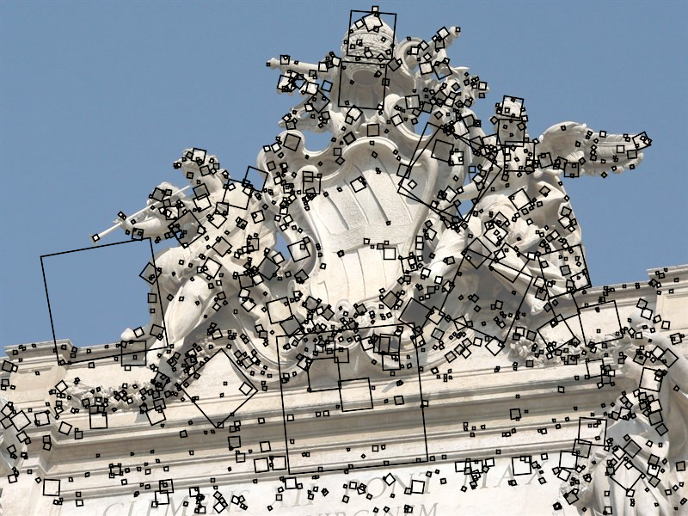
SIFT keypoint detection
D. Lowe, Distinctive image features from scale-invariant keypoints,
IJCV 60 (2), pp. 91-110, 2004

Slide 2
Overview
Multiscale blob detection: Key idea
Laplacian of Gaussian filter
Multiscale blob detection algorithm
SIFT detector
SIFT descriptors

Slide 3
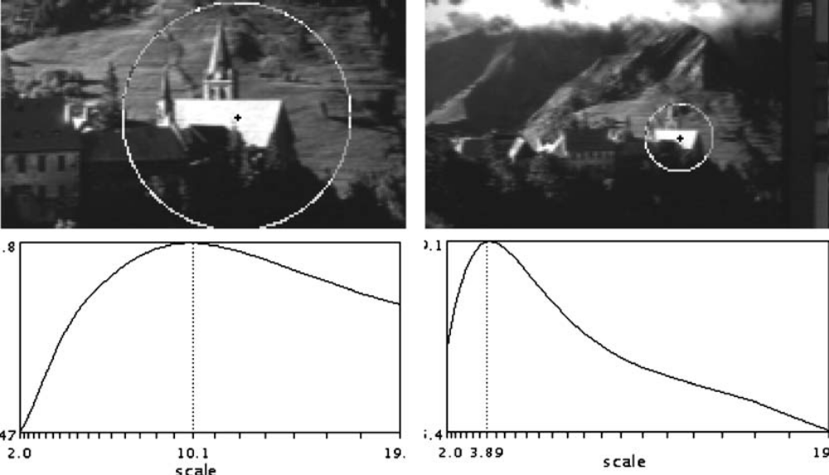
Keypoint detection with scale selection
We want to extract keypoints with characteristic scales that are equivariant (or covariant) w.r.t. to scaling of the image
Scale-invariant response function
K. Mikolajczyk and C. Schmid. Indexing based on scale invariant interest points. ICCV 2001
T. Lindeberg, Feature detection with automatic scale selection, IJCV 30(2), pp. 77-116, 1998

Slide 4
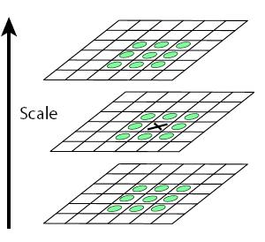
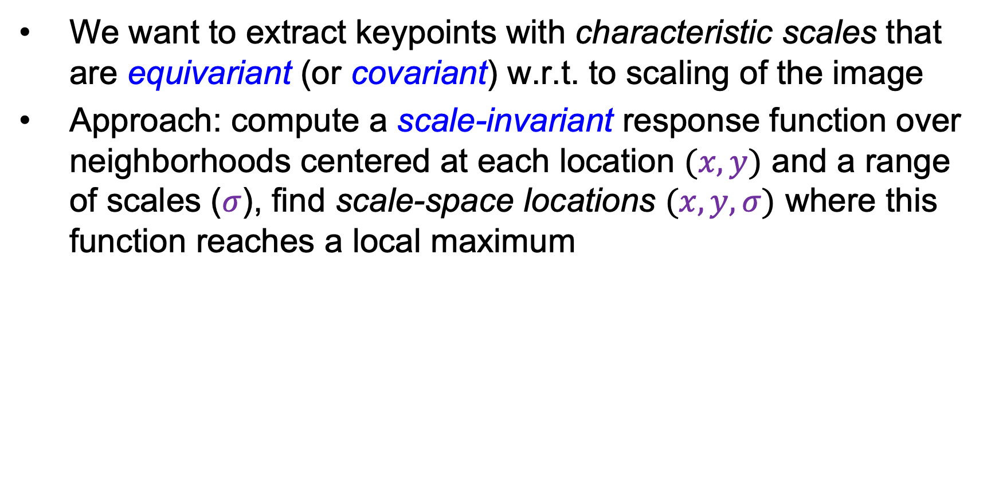
Keypoint detection with scale selection
We want to extract keypoints with characteristic scales that are equivariant (or covariant) w.r.t. to scaling of the image
Approach: compute a scale-invariant response function over neighborhoods centered at each location $(x,y)$ and a range of scales ($σ$), find scale-space locations $(x,y, σ)$ where this function reaches a local maximum
“scale space”

Slide 5
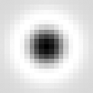
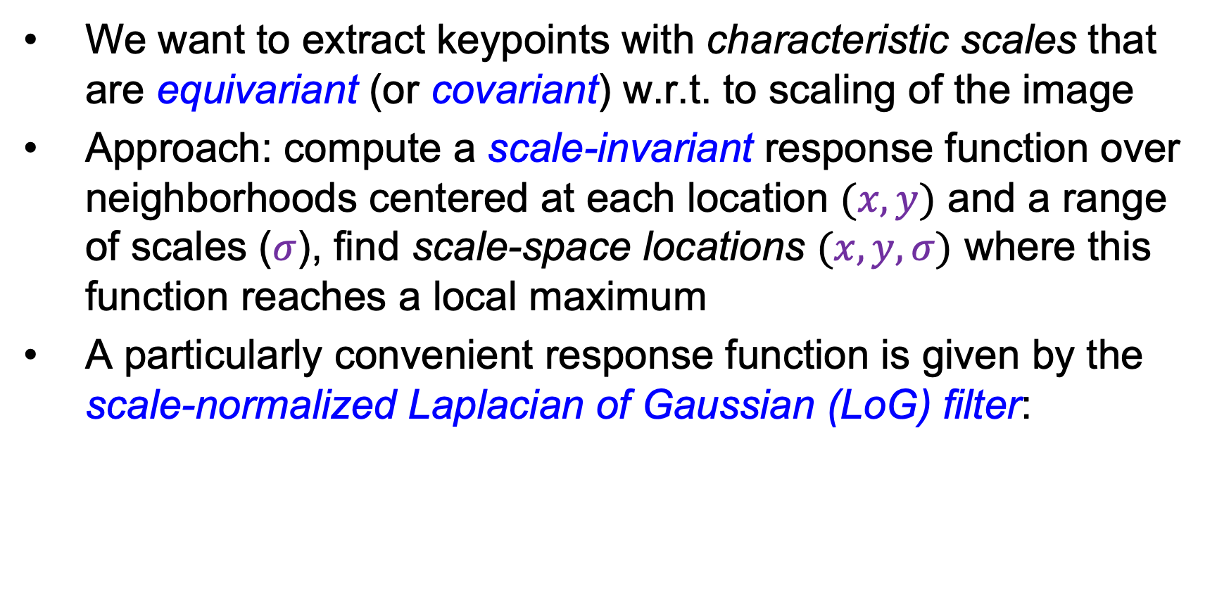
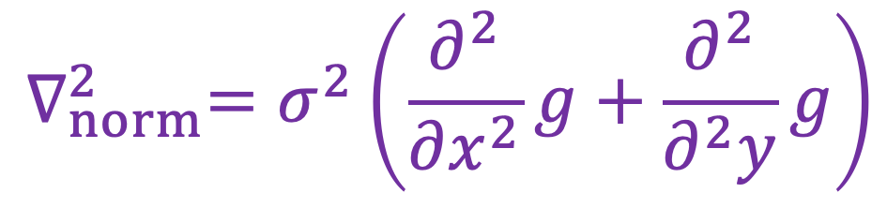
Keypoint detection with scale selection
We want to extract keypoints with characteristic scales that are equivariant (or covariant) w.r.t. to scaling of the image
Approach: compute a scale-invariant response function over neighborhoods centered at each location $(x,y)$ and a range of scales ($σ$), find scale-space locations $(x,y, σ)$ where this function reaches a local maximum
A particularly convenient response function is given by the scale-normalized Laplacian of Gaussian (LoG) filter:
$$∇_{norm}^{2}=σ^{2}\left(\frac{∂^{2}}{∂x^{2}}g+\frac{∂^{2}}{∂^{2}y}g\right)$$

Slide 6


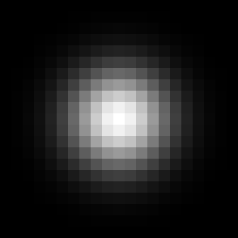
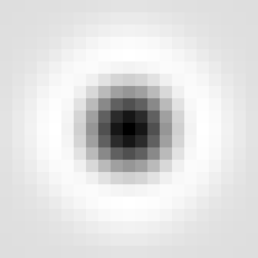

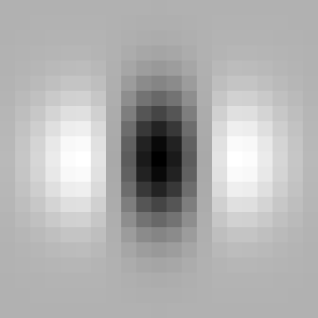
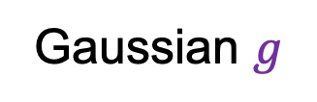
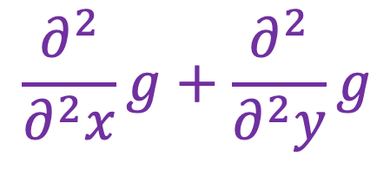
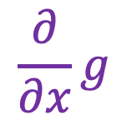
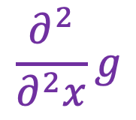
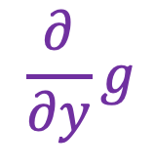
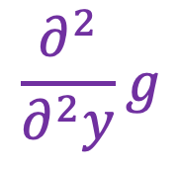
Laplacian of Gaussian
$$\frac{∂}{∂y}g$$
$$\frac{∂^{2}}{∂^{2}y}g$$
Gaussian $g$
+
$$\frac{∂}{∂x}g$$
$$\frac{∂^{2}}{∂^{2}x}g$$
$$\frac{∂^{2}}{∂^{2}x}g+\frac{∂^{2}}{∂^{2}y}g$$
Is this filter separable?
Source: J. Johnson and D. Fouhey

Slide 7
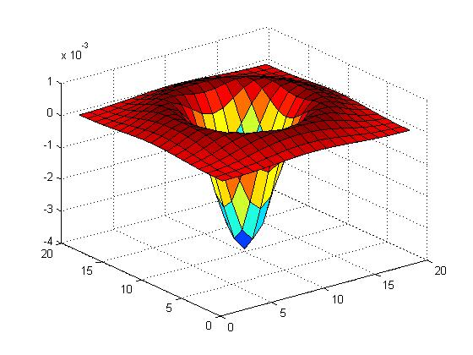
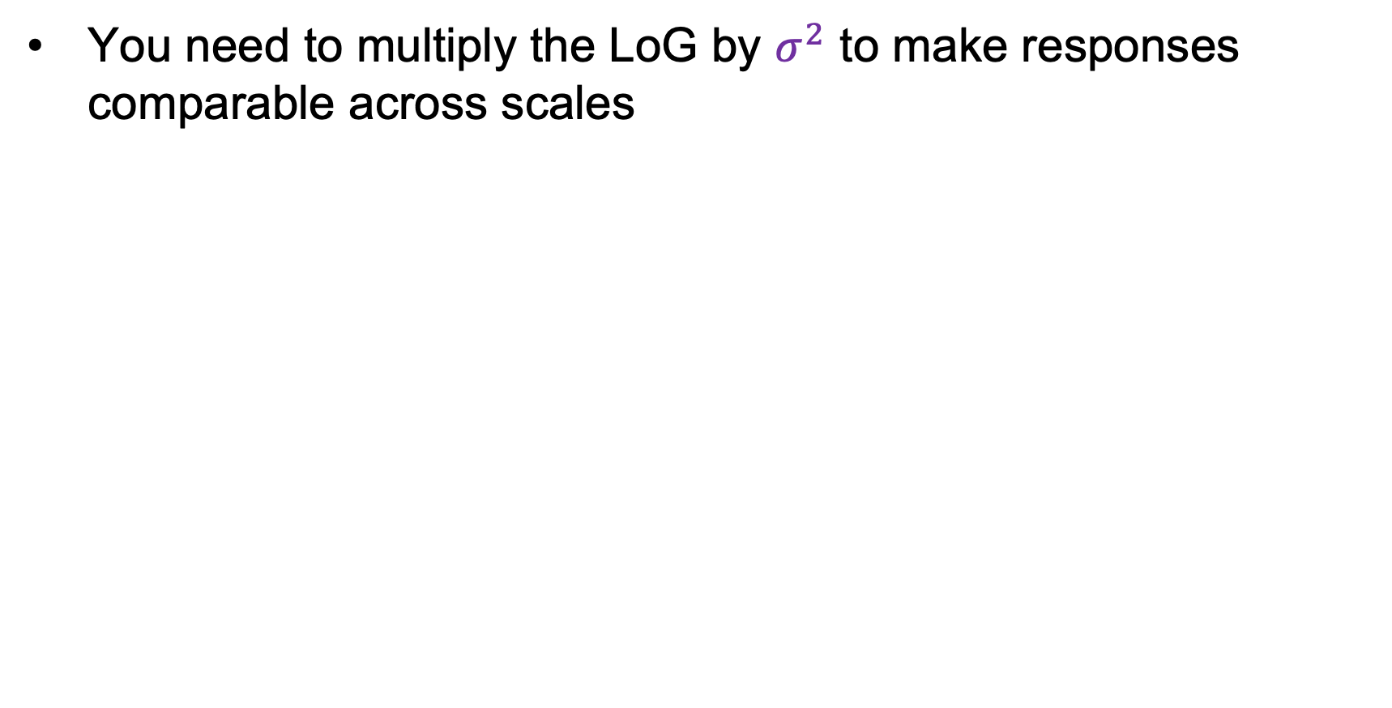
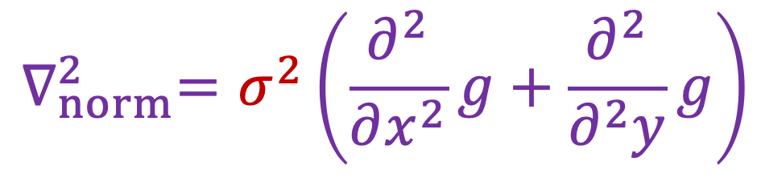
Scale-normalized Laplacian
You need to multiply the LoG by $σ^{2}$ to make responses comparable across scales
$$∇_{norm}^{2}=σ^{2}\left(\frac{∂^{2}}{∂x^{2}}g+\frac{∂^{2}}{∂^{2}y}g\right)$$

Slide 8
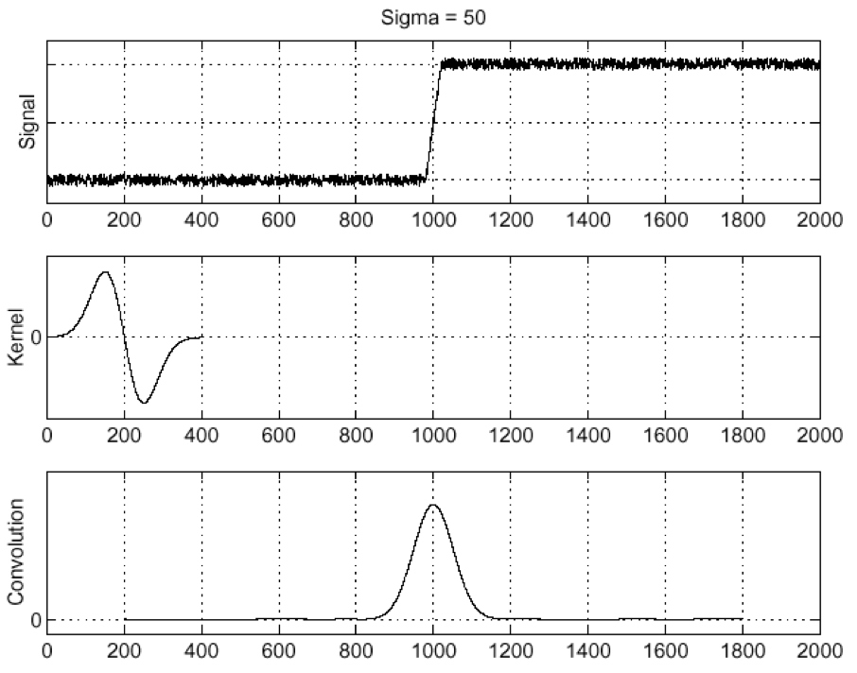
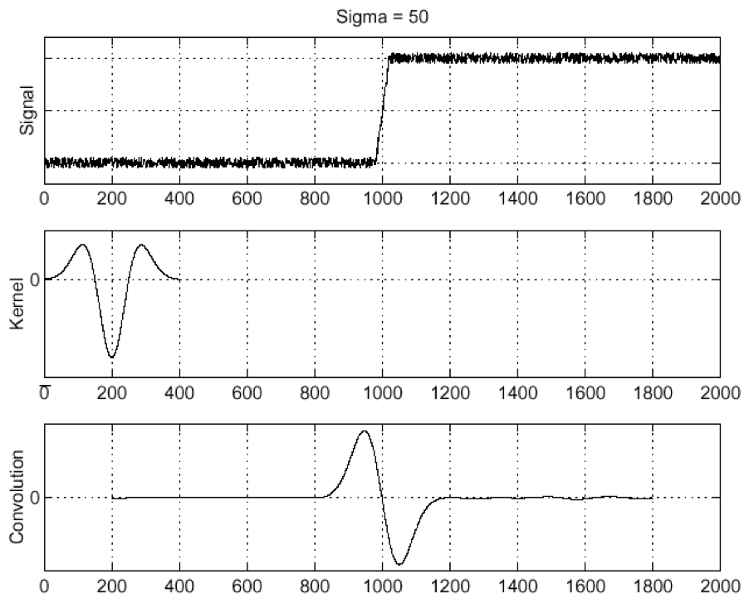
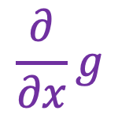
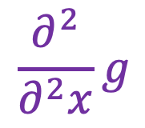
Edge detection with LoG
Edge
Derivative of Gaussian
Laplacian of Gaussian
$$\frac{∂}{∂x}g$$
$$\frac{∂^{2}}{∂^{2}x}g$$
Edge = local maximum of derivative
Edge = zero-crossing of Laplacian
D. Marr and E. Hildreth. Theory of Edge Detection. Proc. of the Royal Society of London. Series B, Biological Sciences, 207 (1167): 187–217, 1980

Slide 9
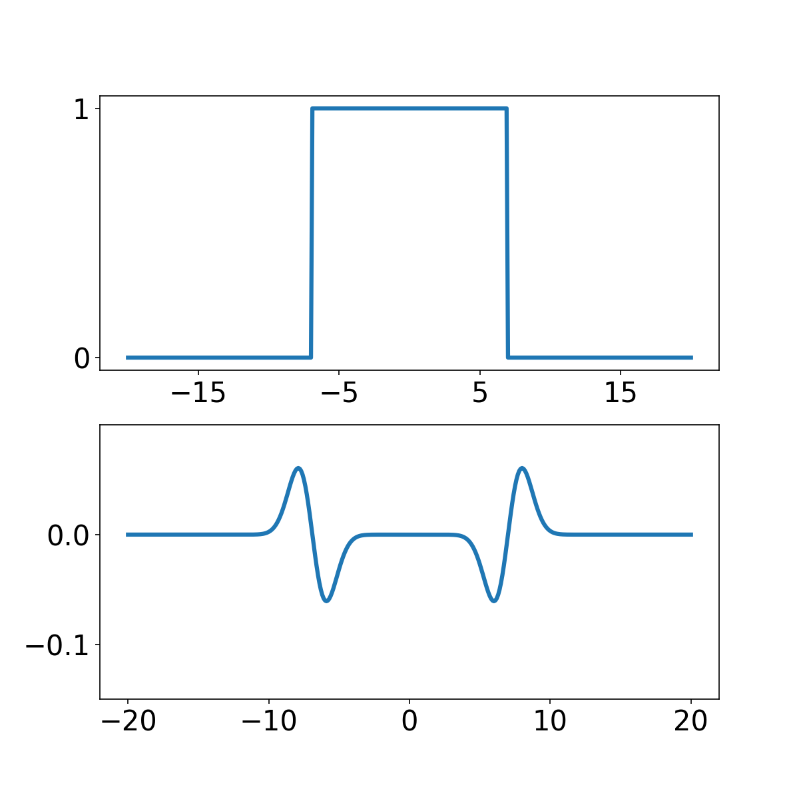

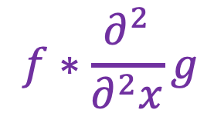
Blob detection with LoG
Let’s convolve a 1D “blob” with the Laplacian:
$$f$$
$$f∗\frac{∂^{2}}{∂^{2}x}g$$
Source: J. Johnson and D. Fouhey

Slide 10
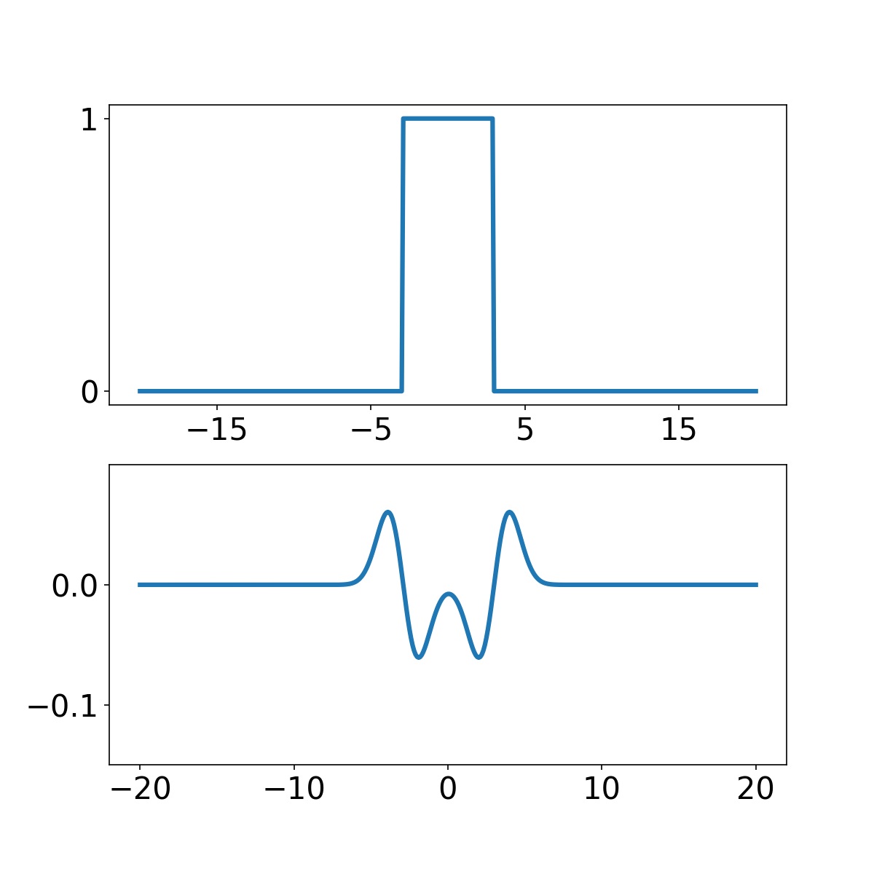
Blob detection with LoG
Let’s convolve a 1D “blob” with the Laplacian:
$$f$$
$$f∗\frac{∂^{2}}{∂^{2}x}g$$
Source: J. Johnson and D. Fouhey

Slide 11
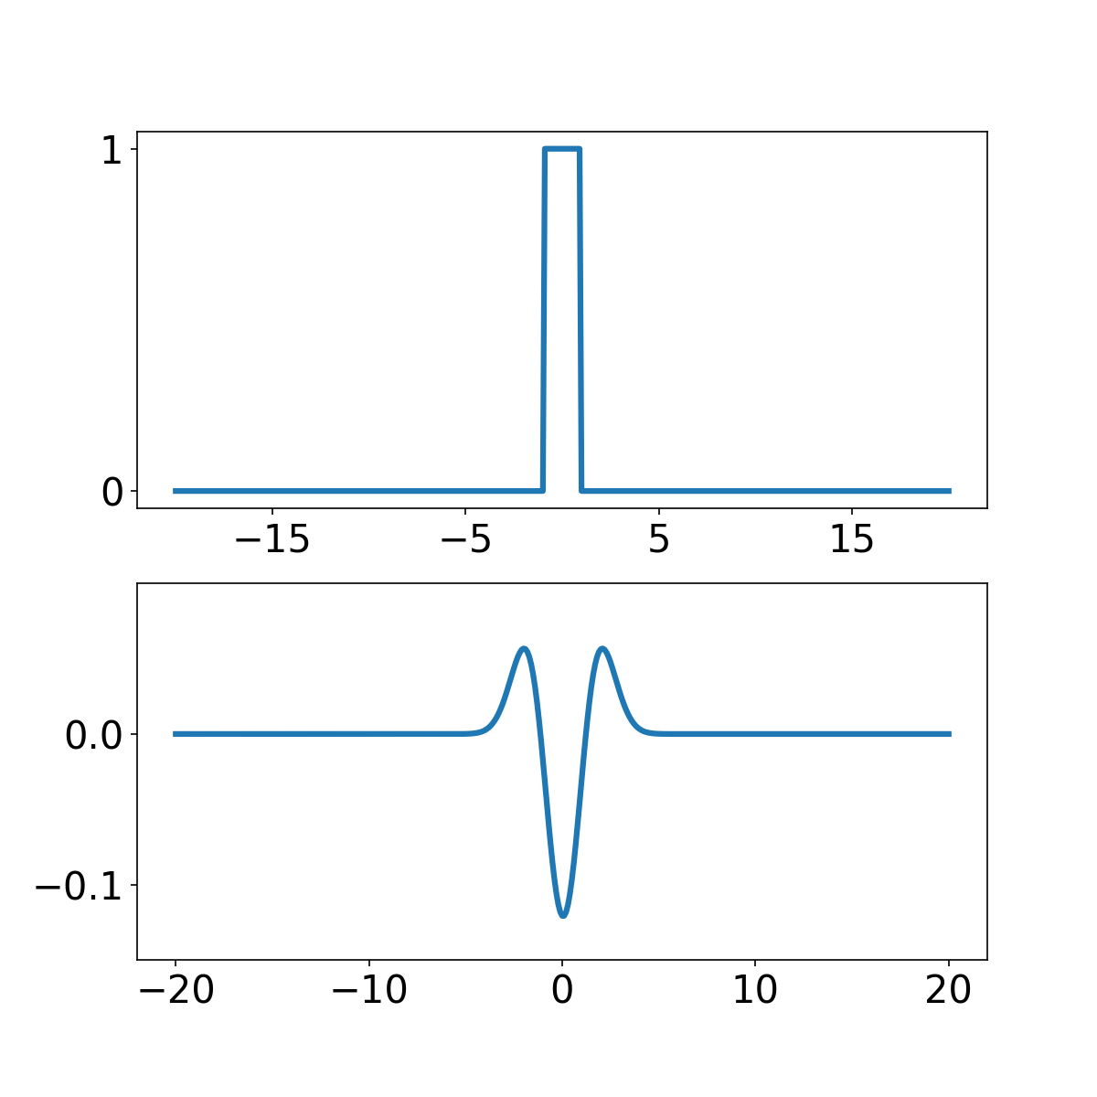
Blob detection with LoG
Let’s convolve a 1D “blob” with the Laplacian:
$$f$$
$$f∗\frac{∂^{2}}{∂^{2}x}g$$
Source: J. Johnson and D. Fouhey

Slide 12
Spatial selection
The magnitude of the Laplacian response will achieve a maximum at the center of the blob, provided the scale of the Laplacian is “matched” to the scale of the blob
maximum

Slide 13
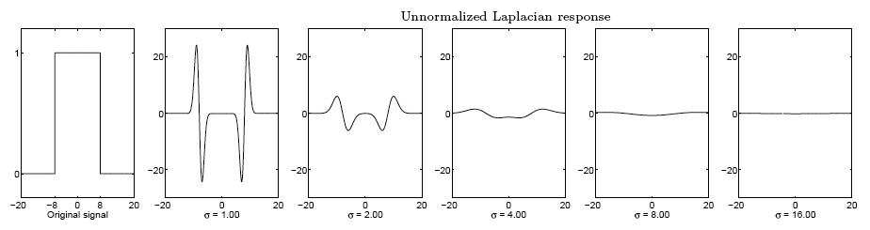
Scale selection
We want to find the characteristic scale of the blob by convolving it with Laplacians at several scales and looking for the maximum response
However, Laplacian response decays as scale increases:
original signal
(radius=8)
increasing σ

Slide 14
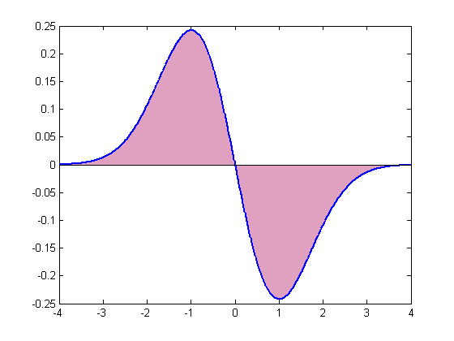
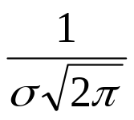
Scale normalization
The response of a derivative of Gaussian filter to a perfect step edge decreases as σ increases:
To keep response the same (scale-invariant), must multiply Gaussian derivative by σ
Laplacian is the second Gaussian derivative, so it must be multiplied by σ²
Notes:
The area under the first derivative of Gaussian from –infinity to 0 is equal to the value of the Gaussian at zero

Slide 15
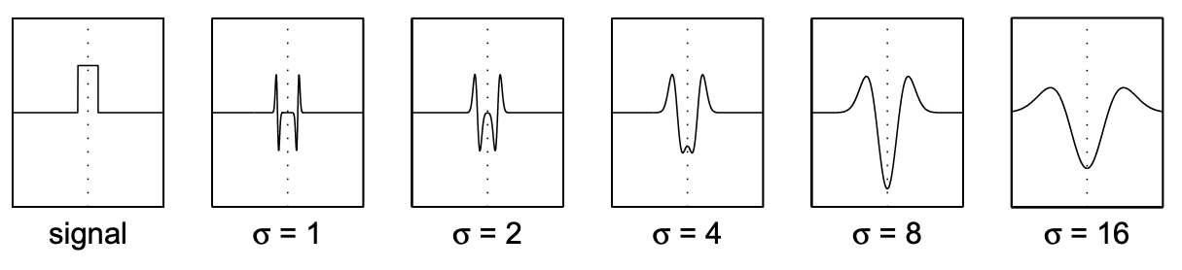
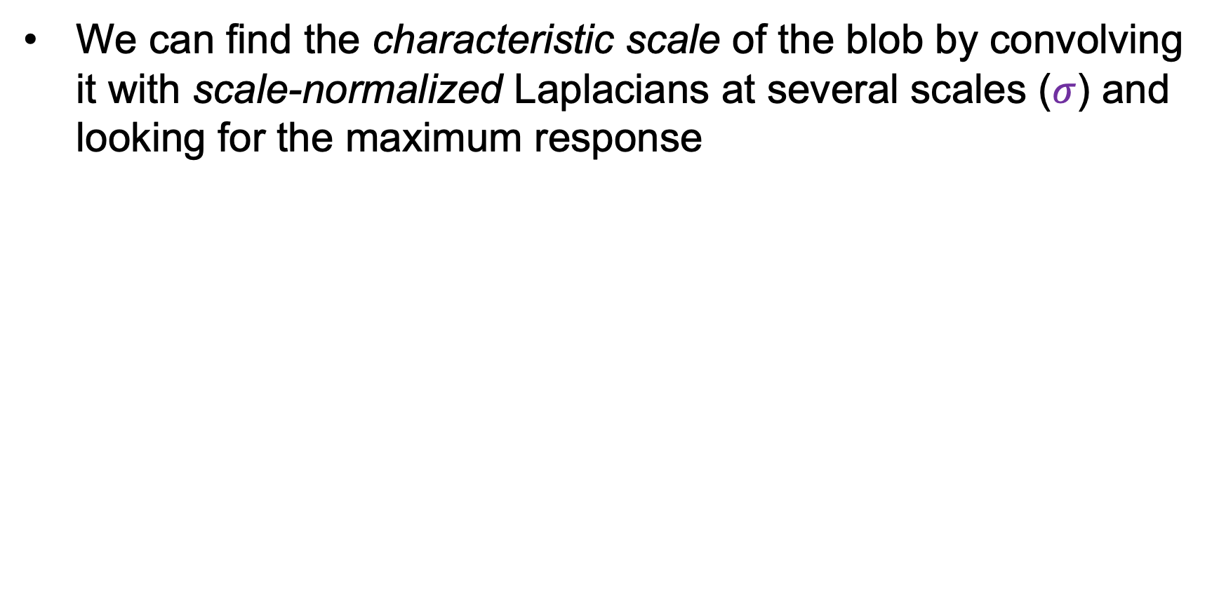
Scale selection
We can find the characteristic scale of the blob by convolving it with scale-normalized Laplacians at several scales ($σ$) and looking for the maximum response
maximum

Slide 16
Overview
Multiscale blob detection: Key idea
Laplacian of Gaussian filter
Multiscale blob detection algorithm

Slide 17
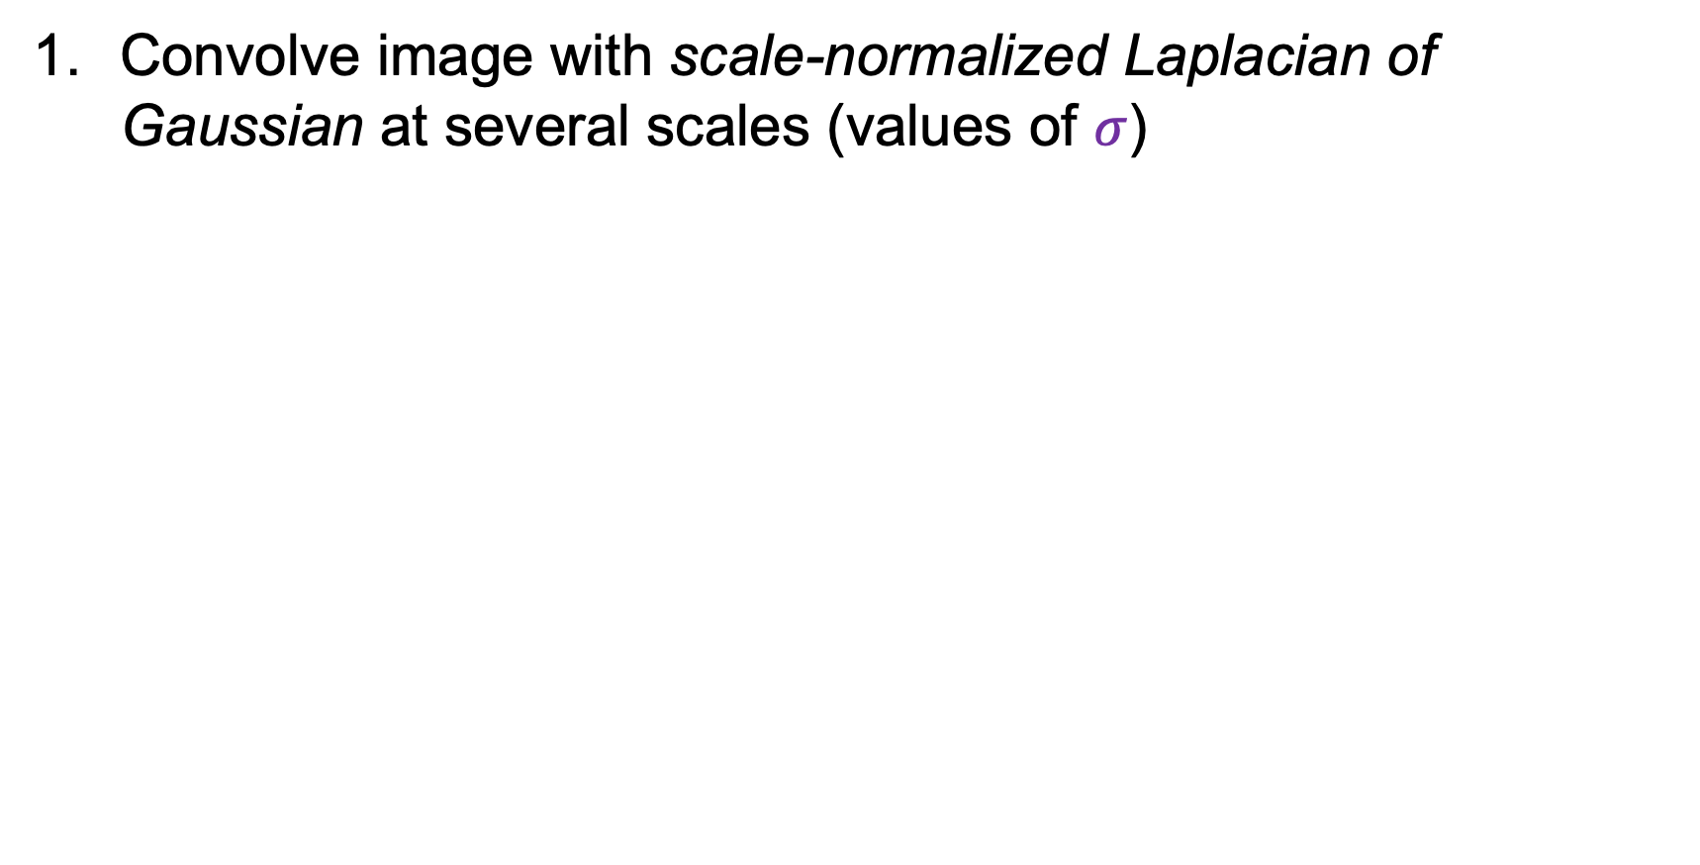
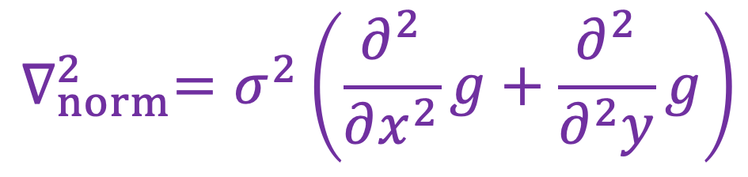
Review: 2D multiscale blob detection
Convolve image with scale-normalized Laplacian of Gaussian at several scales (values of $σ$)
$$∇_{norm}^{2}=σ^{2}\left(\frac{∂^{2}}{∂x^{2}}g+\frac{∂^{2}}{∂^{2}y}g\right)$$

Slide 18
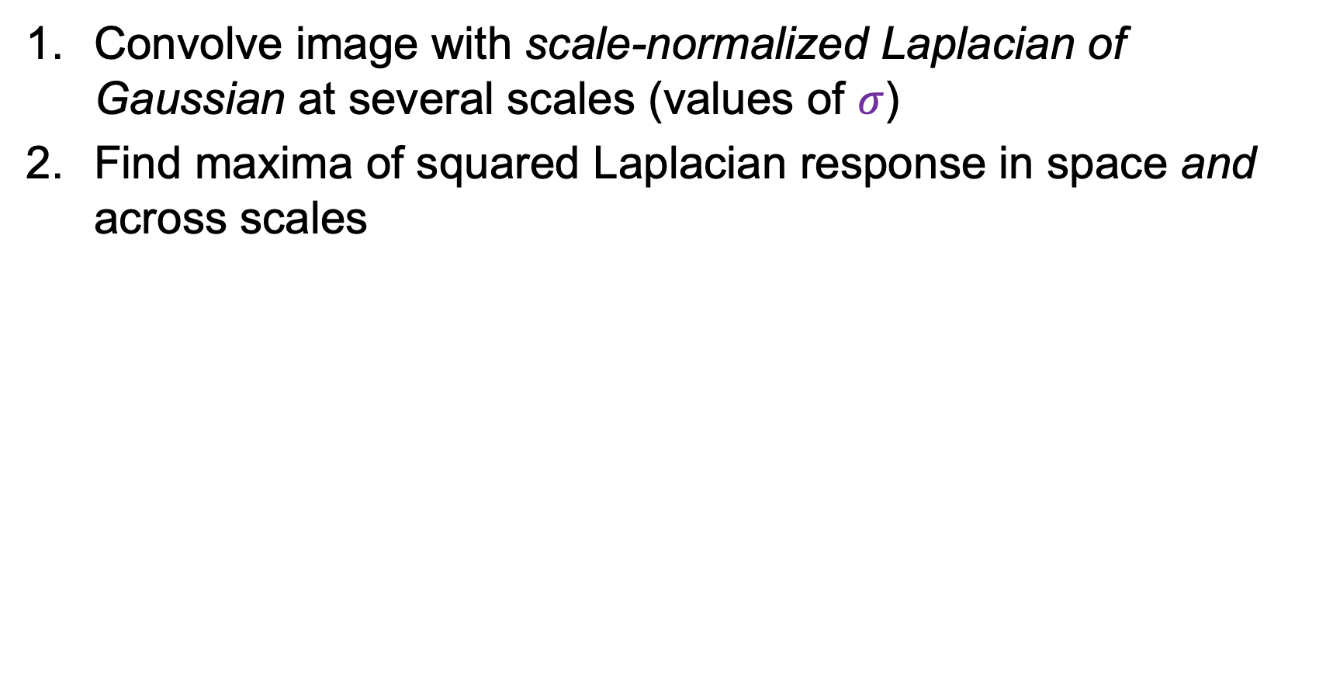

2D multiscale blob detection
Convolve image with scale-normalized Laplacian of Gaussian at several scales (values of $σ$)
Find maxima of squared Laplacian response in space and across scales
$$σ$$
“Scale space”

Slide 19
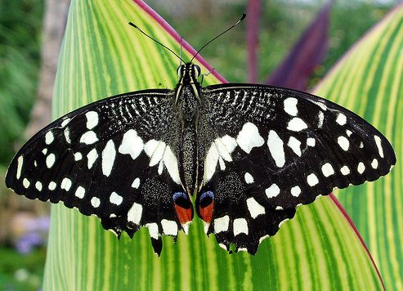
2D multiscale blob detection: Example

Slide 20
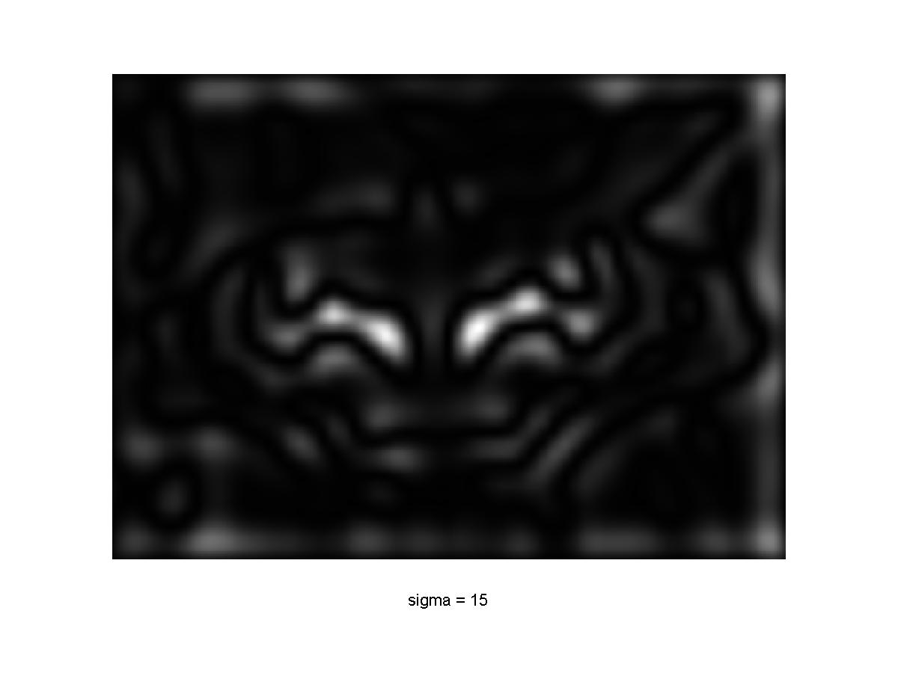
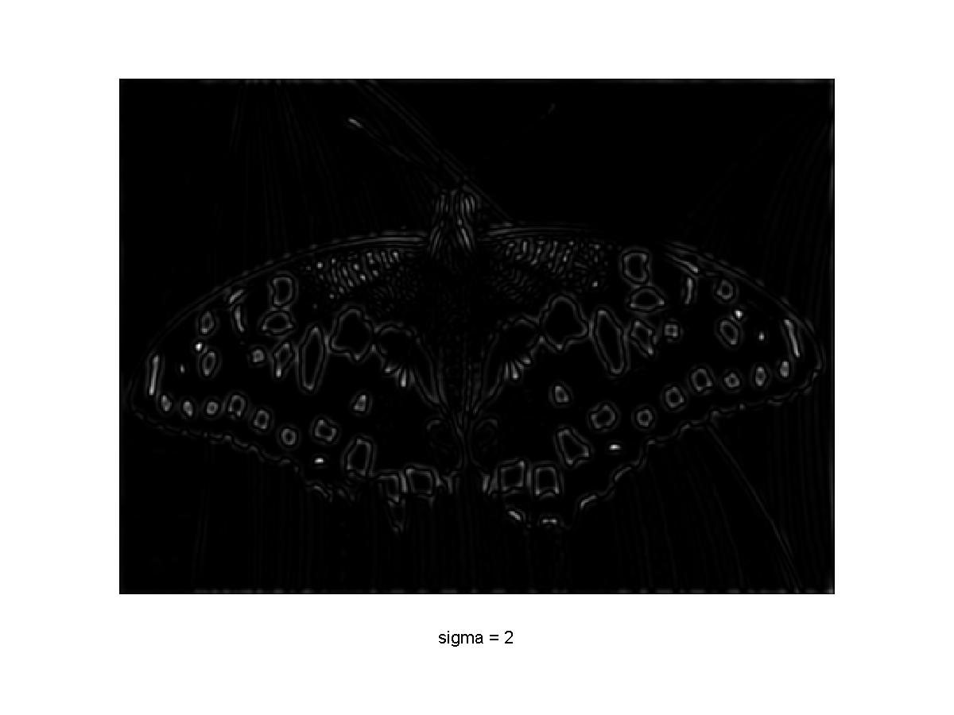
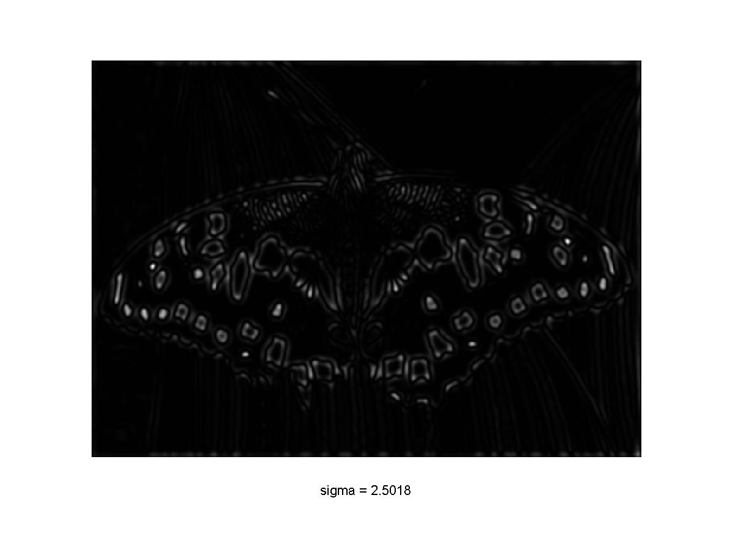
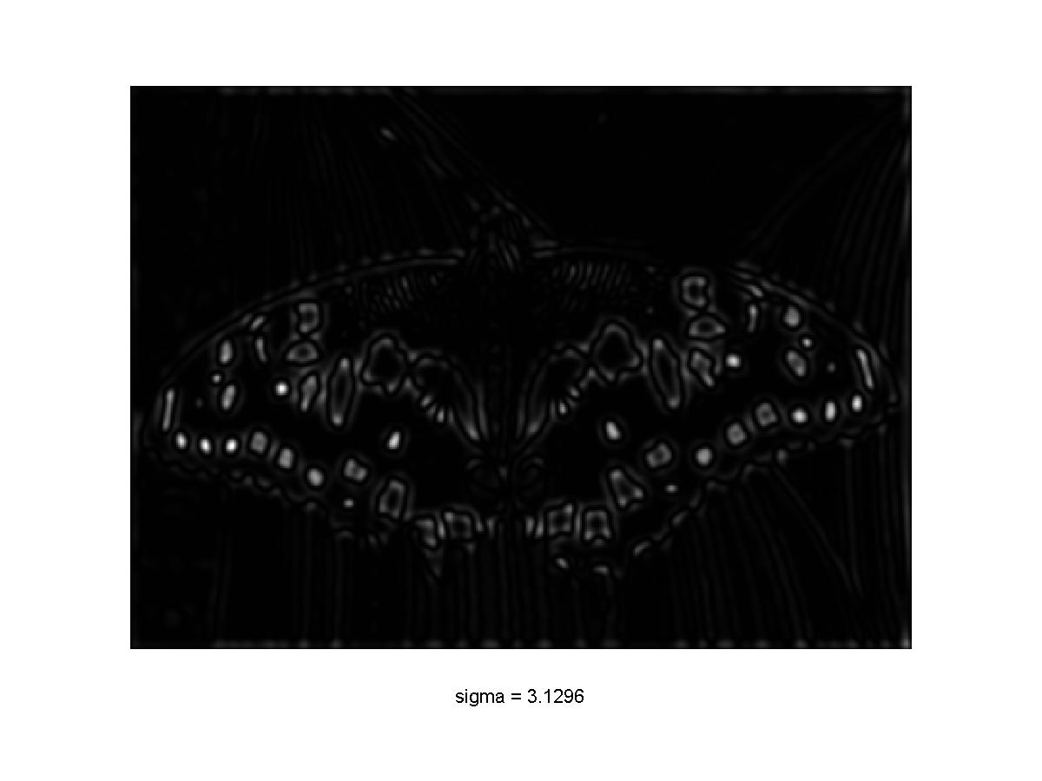
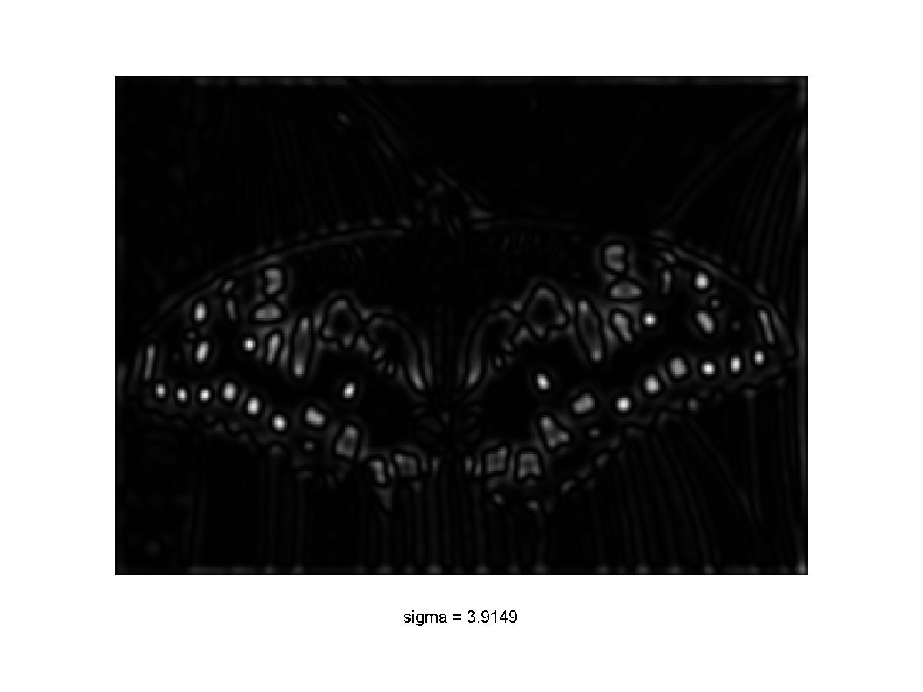
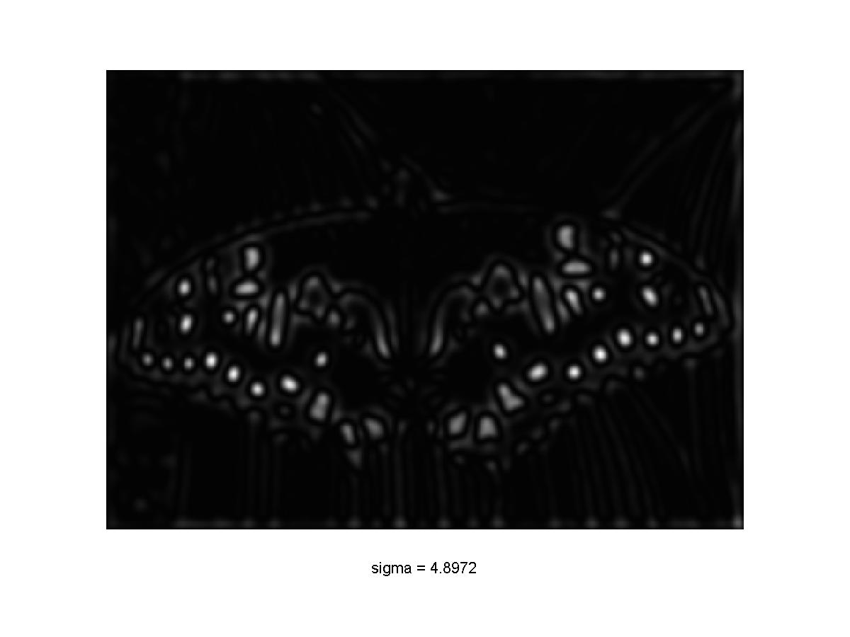

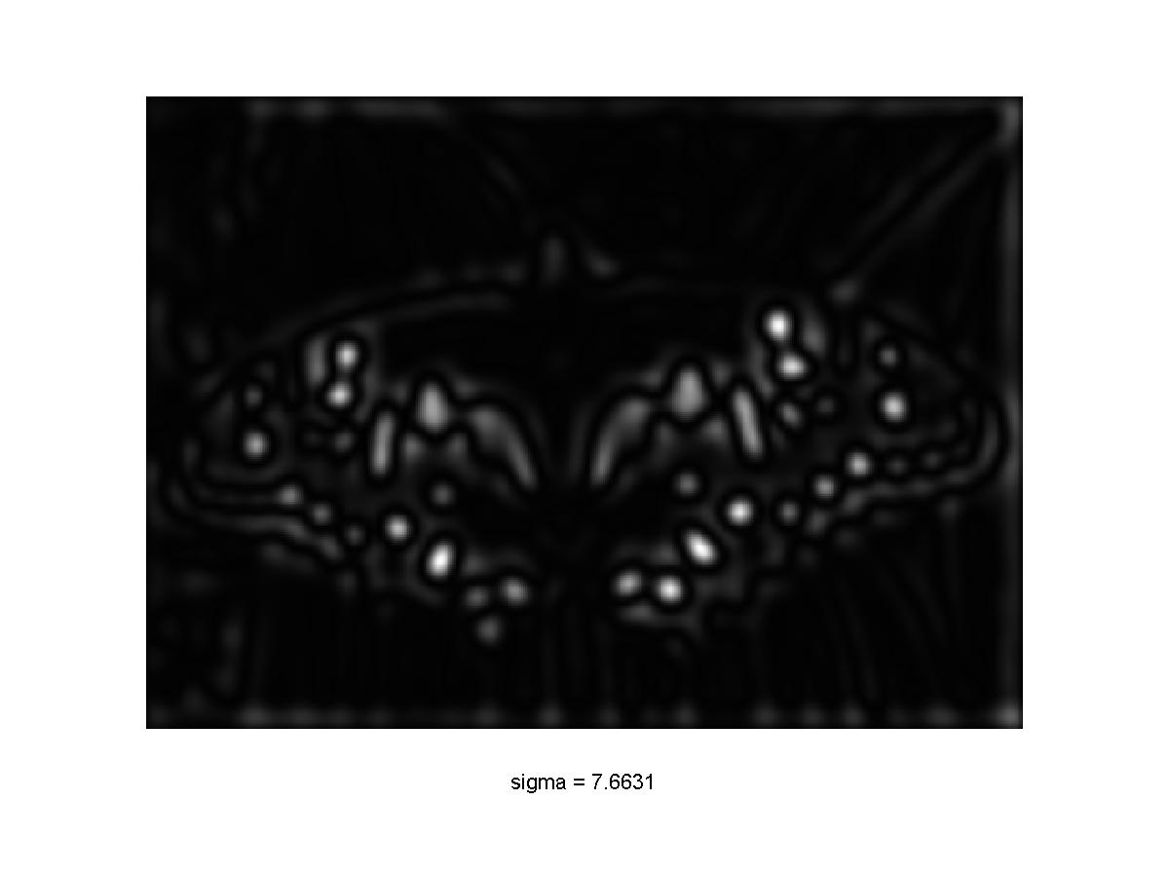
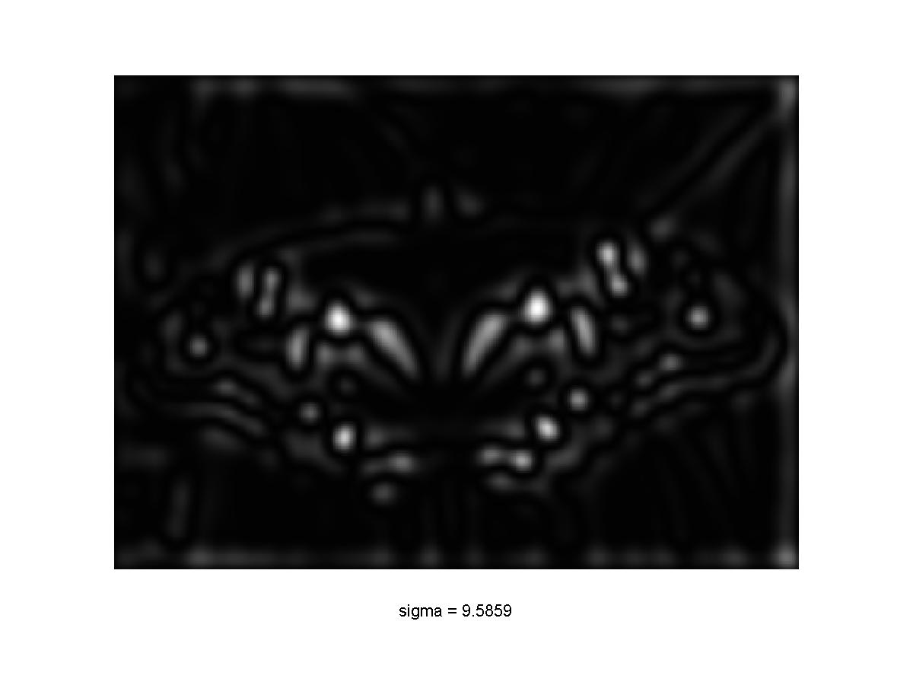
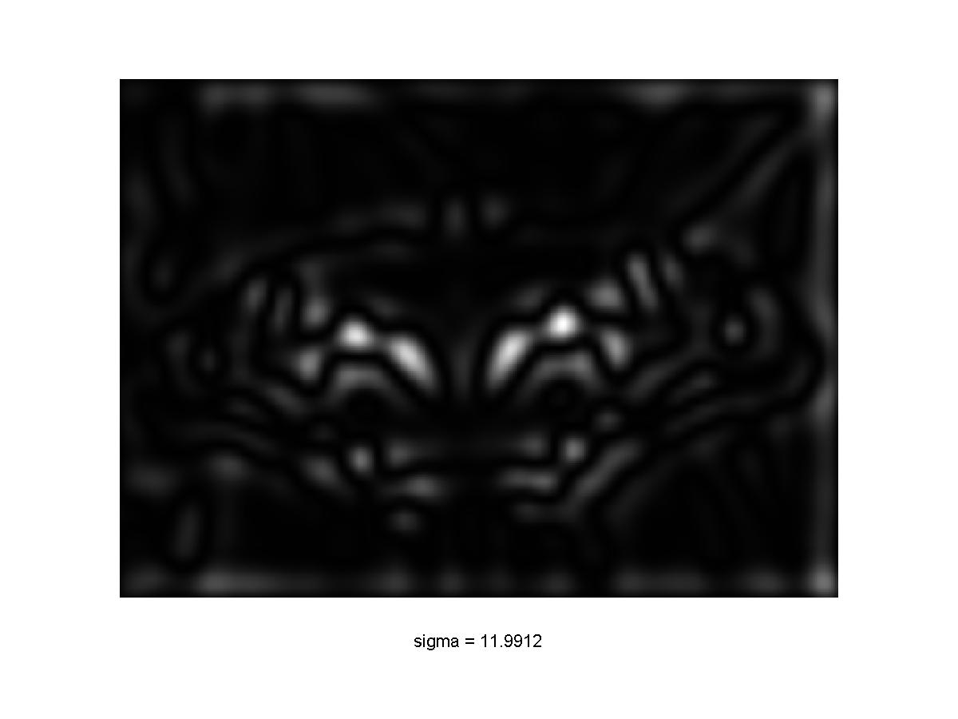
2D multiscale blob detection: Example

Slide 21
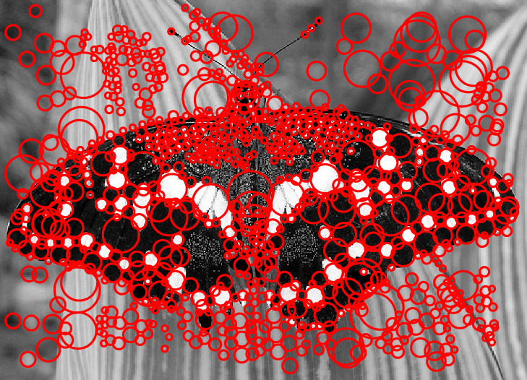
2D multiscale blob detection: Example
After scale-space NMS

Slide 22
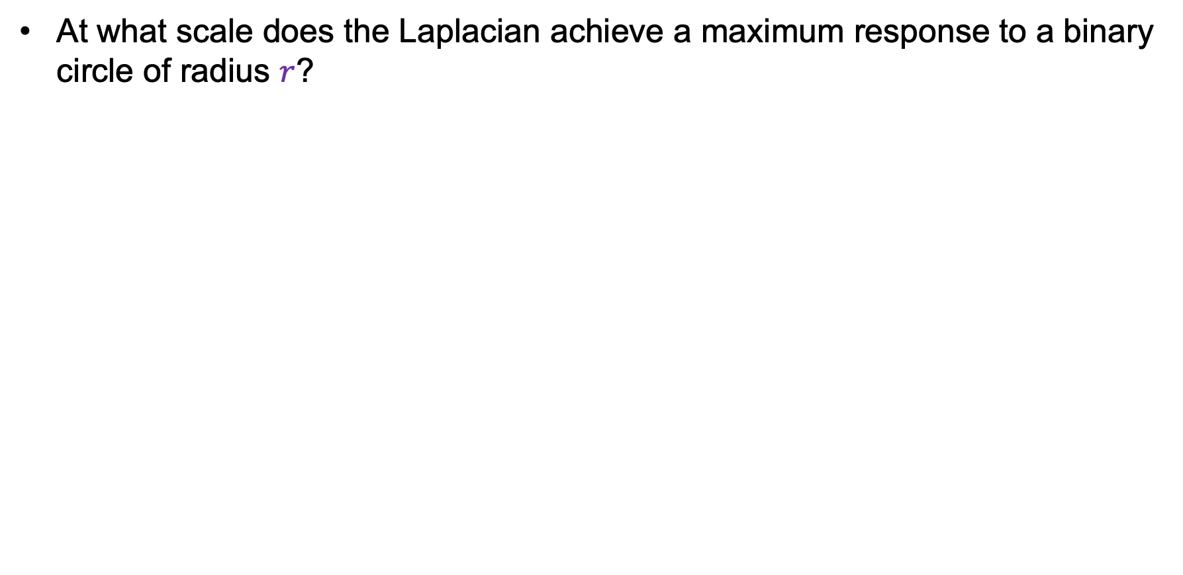
Technical detail 1: Drawing circles
At what scale does the Laplacian achieve a maximum response to a binary circle of radius $r$?
r
image
Laplacian

Slide 23
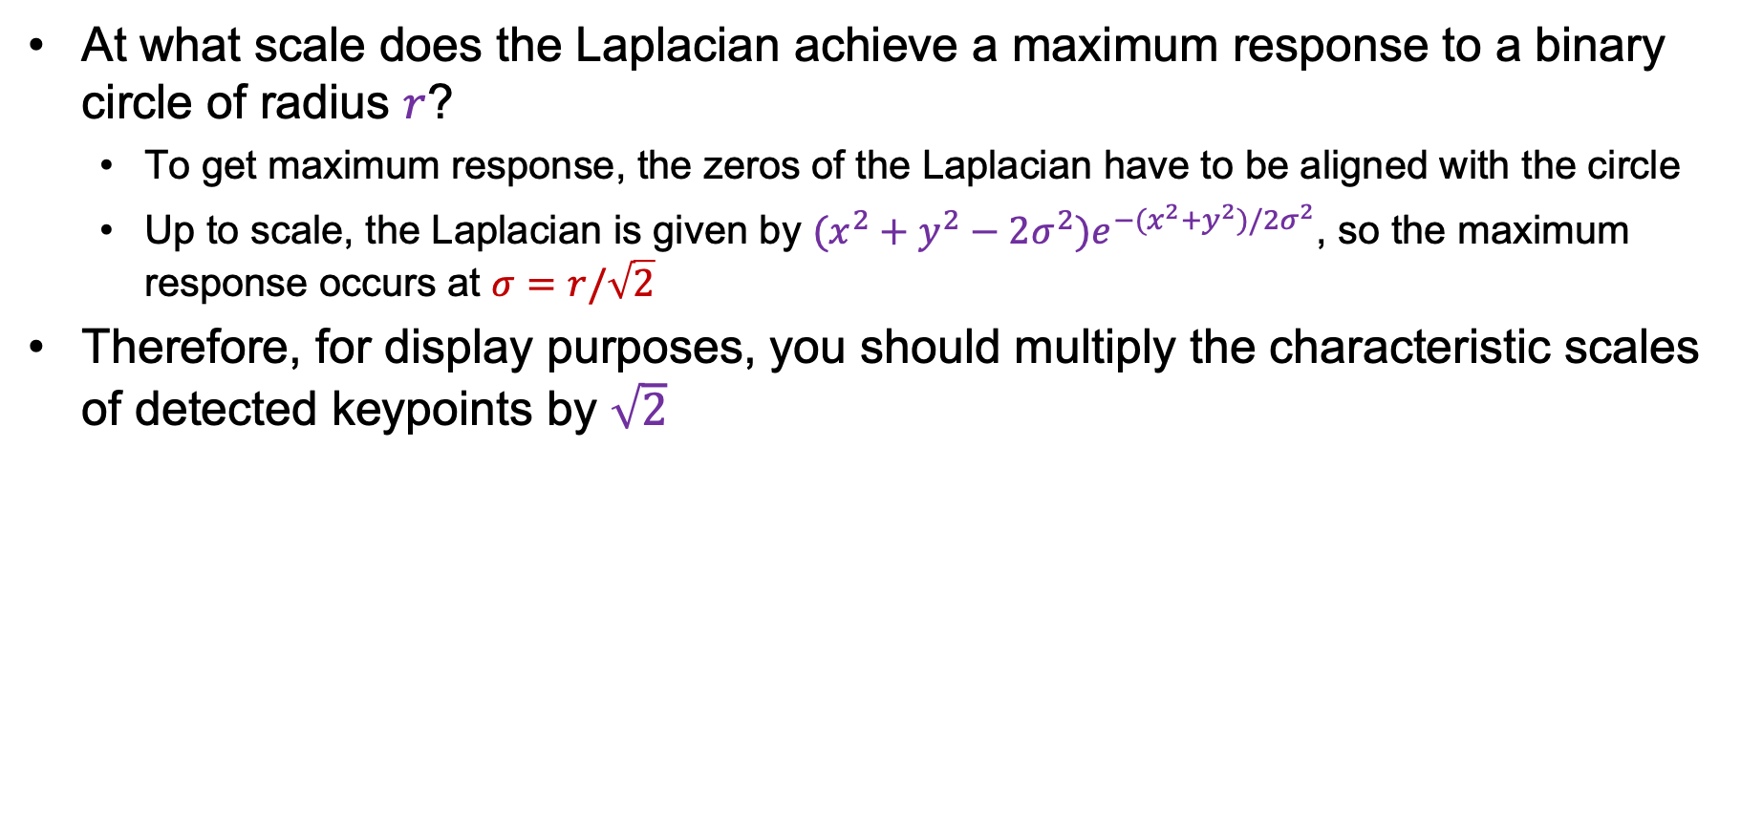
Technical detail 1: Drawing circles
At what scale does the Laplacian achieve a maximum response to a binary circle of radius $r$?
  To get maximum response, the zeros of the Laplacian have to be aligned with the circle
  Up to scale, the Laplacian is given by $(x^{2}+y^{2}−2σ^{2})e^{−(x^{2}+y^{2})/2σ^{2}}$, so the maximum response occurs at $σ=r/\sqrt{2}$
Therefore, for display purposes, you should multiply the characteristic scales of detected keypoints by $\sqrt{2}$
circle
r
0
Laplacian
image

Slide 24
Technical detail 2: Eliminating edge responses
Laplacian has strong response along edges

Slide 25
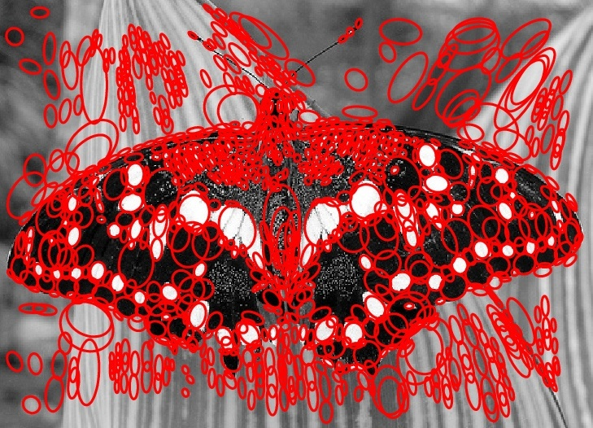
Technical detail 2: Eliminating edge responses
Laplacian has strong response along edges
Solution: filter based on Harris response function over neighborhoods containing the “blobs”

Slide 26
Overview
Multiscale blob detection: Key idea
Laplacian of Gaussian filter
Multiscale blob detection algorithm
SIFT detector
SIFT descriptors

Slide 27
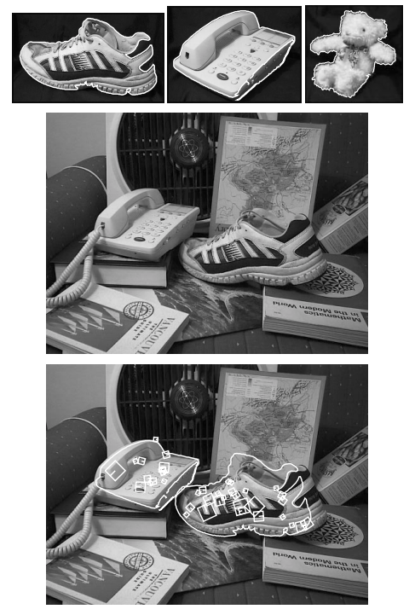

SIFT: Scale-invariant feature transform
D. Lowe. Object recognition from local scale-invariant features. ICCV 1999
D. Lowe. Distinctive image features from scale-invariant keypoints. IJCV 60 (2), pp. 91-110, 2004

Slide 28


SIFT detector: Efficient implementation
Approximate LoG with a difference of Gaussians (DoG)
  Laplacian: $σ^{2}\left(G_{xx}\left(x,y,σ\right)+G_{yy}(x,y,σ)\right)$
  DoG: $G\left(x,y,kσ\right)−G(x,y,σ)$

Slide 29


SIFT detector: Efficient implementation
Approximate LoG with a difference of Gaussians (DoG)
  Laplacian: $σ^{2}\left(G_{xx}\left(x,y,σ\right)+G_{yy}(x,y,σ)\right)$
  DoG: $G\left(x,y,kσ\right)−G\left(x,y,σ\right)$
Compute DoG via an image pyramid:

Slide 30

SIFT for matching
The main goal of SIFT is to enable image matching in the presence of significant transformations
  To recognize the same keypoint in multiple images, we need to match appearance descriptors or “signatures” in their neighborhoods
  Descriptors that are locally invariant w.r.t. scale and rotation can handle a wide range of global transformations

Slide 31


SIFT for matching
SIFT detector returns a characteristic scale that can be normalized out, but no characteristic orientation

Slide 32

SIFT for matching
SIFT detector returns a characteristic scale that can be normalized out, but no characteristic orientation
Hack for finding a reference orientation:
  Create histogram of local gradient directions in the patch
  Assign reference orientation at peak of smoothed histogram
0
2
π

Slide 33

SIFT detector: Example outputs
Detected keypoints with characteristic scales and orientations:

Slide 34

SIFT descriptors
Inspiration: complex neurons in the primary visual cortex
Notes:
From the paper:
The previous operations have assigned an image location, scale, and orientation to each keypoint. These parameters impose a repeatable local 2D coordinate system in which to describe the local image region, and therefore provide invariance to these parameters. The next step is to compute a descriptor for the local image region that is highly distinctive yet is as invariant as possible to remaining variations, such as change in illumination or 3D viewpoint. One obvious approach would be to sample the local image intensities around the keypoint at the appropriate scale, and to match these using a normalized correlation measure. However, simple correlation of image patches is highly sensitive to changes that cause misregistration of samples, such as affine or 3D viewpoint change or non-rigid deformations. A better approach has been demonstrated by Edelman, Intrator, and Poggio (1997). Their proposed representation was based upon a model of biological vision, in particular of complex neurons in primary visual cortex. These complex neurons respond to a gradient at a particular orientation and spatial frequency, but the location of the gradient on the retina is allowed to shift over a small receptive field rather than being precisely localized. Edelman et al. hypothesized that the function of these complex neurons was to allow for matching and recognition of 3D objects from a range of viewpoints. They have performed detailed experiments using 3D computer models of object and animal shapes which show that matching gradients while allowing for shifts in their position results in much better classification under 3D rotation. For example, recognition accuracy for 3D objects rotated in depth by 20 degrees increased from 35% for correlation of gradients to 94% using the complex cell model. Our implementation described below was inspired by this idea, but allows for positional shift using a different computational mechanism.

Slide 35


SIFT for matching
Extraordinarily robust detection and description technique
  Can handle changes in viewpoint
    Up to about 60 degree out-of-plane rotation
  Can handle significant changes in illumination
    Sometimes even day vs. night
  Fast and efficient—can run in real time
  Lots of code available
Source: N. Snavely

Slide 36


A hard matching problem
NASA Mars Rover images

Slide 37


Answer below (look for tiny colored squares…)
NASA Mars Rover images
with SIFT feature matches
Figure by Noah Snavely

Slide 38


Local invariance beyond SIFT
Can we make local descriptors invariant w.r.t. viewpoint changes?

Slide 39
Local invariance beyond SIFT
Can we make local descriptors invariant w.r.t. viewpoint changes?
Affine transformations approximate viewpoint changes for roughly planar objects and roughly orthographic cameras

Slide 40


Affine adaptation
Consider the second moment matrix of the window containing the blob:
direction of the fastest change
Recall:
direction of the slowest change
(λ_{max})^{-1/2}
(λ_{min})^{-1/2}
This ellipse visualizes the “characteristic shape” of the window

Slide 41

Affine adaptation
More cumbersome in practice and not as successful as SIFT
K. Mikolajczyk and C. Schmid. Scale and affine invariant interest point detectors. IJCV 2004

