Slide 1
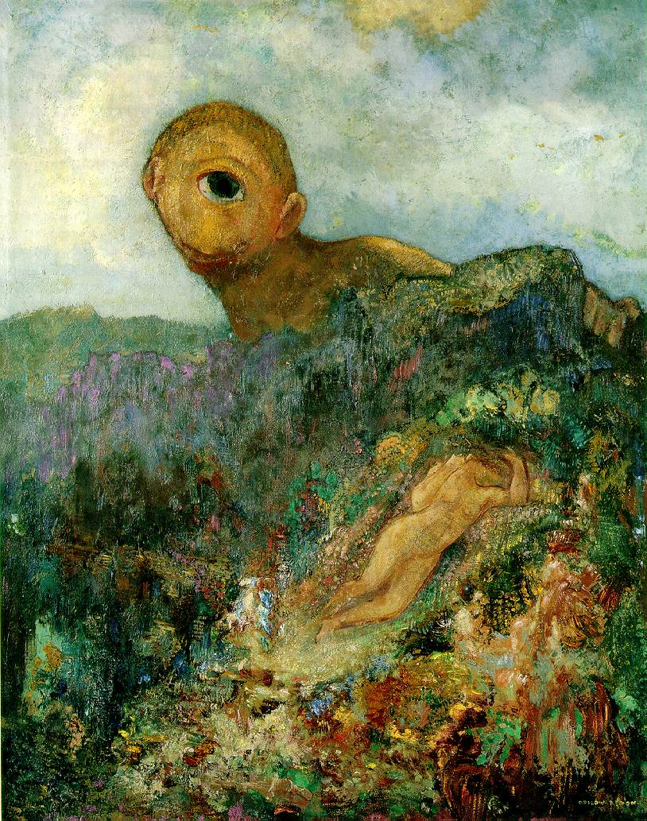
Perspective projection matrix, camera calibration
Odilon Redon, Cyclops, 1914

Slide 2
Overview
Perspective and orthographic projection matrices
Camera parameters
  Intrinsic parameters
  Extrinsic parameters
  Calibration
First taste of 3D reconstruction: triangulation

Slide 3
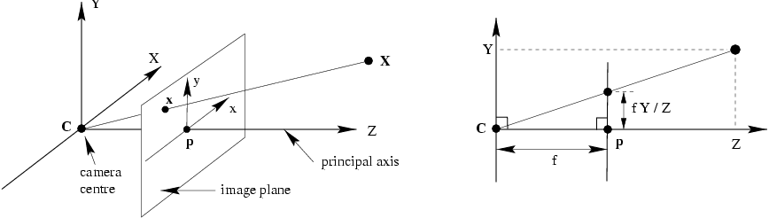
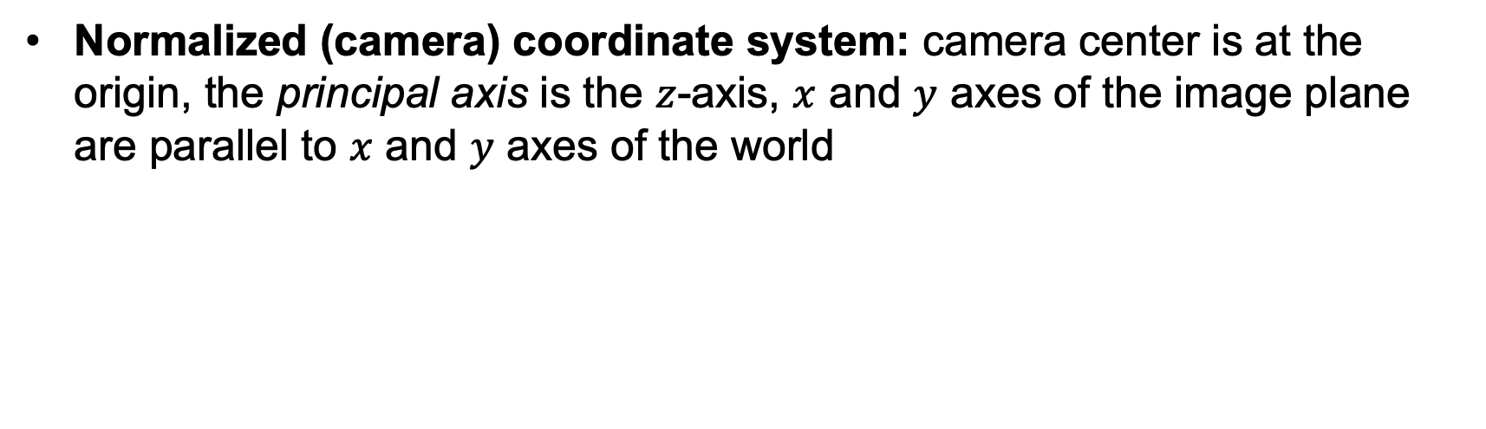
Review: Perspective projection
Normalized (camera) coordinate system: camera center is at the origin, the principal axis is the $z$-axis, $x$ and $y$ axes of the image plane are parallel to $x$ and $y$ axes of the world

Slide 4


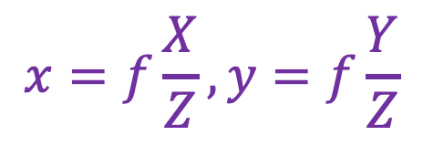
Review: Perspective projection
$$(X,Y,Z)$$
$$(x,y)$$
$$x=f\frac{X}{Z}, y=f\frac{Y}{Z}$$

Slide 5
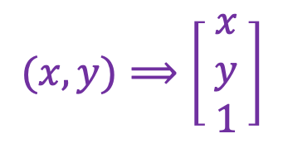
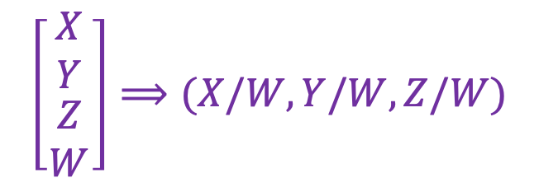
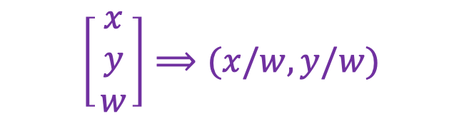
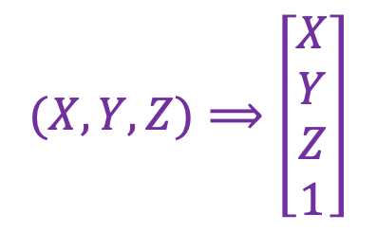
Review: Homogeneous coordinates
To form homogeneous coordinates from Euclidean coordinates, append 1 as the last entry:
$$(X,Y,Z)⟹\left[\begin{aligned}X \\ Y \\ Z \\ 1\end{aligned}\right]$$
$$(x,y)⟹\left[\begin{matrix}x \\ y \\ 1\end{matrix}\right]$$
homogeneous image
coordinates
homogeneous scene
coordinates
To convert from homogeneous coordinates, divide by the last entry:
$$\left[\begin{matrix}X \\ Y \\ \begin{aligned}Z \\ W\end{aligned}\end{matrix}\right]⟹(X/W,Y/W,Z/W)$$
$$\left[\begin{matrix}x \\ y \\ w\end{matrix}\right]⟹(x/w,y/w)$$
In homogeneous coordinates, all scalar multiples represent the same point!

Slide 6
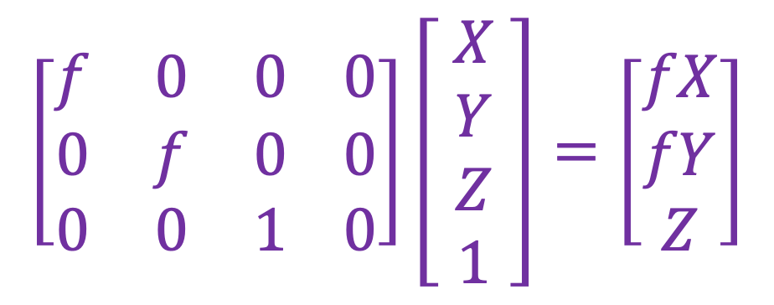
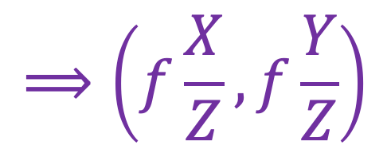
Perspective projection matrix
Projection is a matrix multiplication using homogeneous coordinates:
$$\left[\begin{matrix}f & 0 & 0 0 \\ 0 & f & 0 0 \\ 0 & 0 & 1 0\end{matrix}\right]\left[ \begin{aligned}X \\ Y \\ Z \\ 1\end{aligned} \right]=\left[\begin{matrix}fX \\ fY \\ Z\end{matrix}\right]$$
$$⟹\left(f\frac{X}{Z},f\frac{Y}{Z}\right)$$
divide by the third coordinate

Slide 7
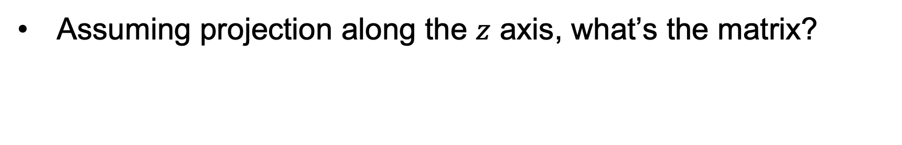
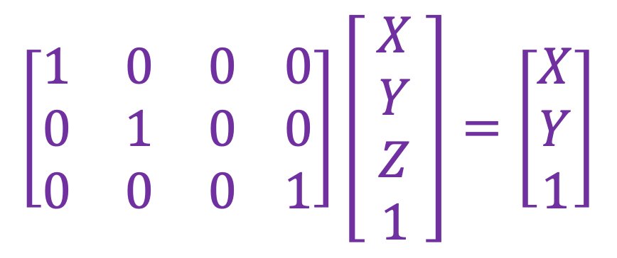
Orthographic projection matrix
Image
World
Assuming projection along the $z$ axis, what’s the matrix?
$$\left[\begin{matrix}1 & 0 & 0 0 \\ 0 & 1 & 0 0 \\ 0 & 0 & 0 1\end{matrix}\right]\left[ \begin{aligned}X \\ Y \\ Z \\ 1\end{aligned} \right]=\left[\begin{matrix}X \\ Y \\ 1\end{matrix}\right]$$
Figure by Steve Seitz
Notes:
Is this a linear function?

Slide 8
Overview
Perspective and orthographic projection matrices
Camera parameters

Slide 9





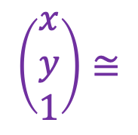

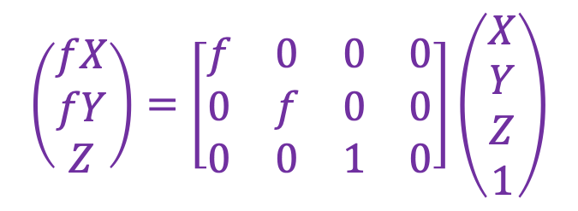
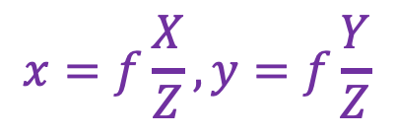
Perspective projection in normalized coordinates
$$(X,Y,Z)$$
$$(x,y)$$
$$x=f\frac{X}{Z}, y=f\frac{Y}{Z}$$
$$\left(\begin{aligned}fX \\ fY \\ Z\end{aligned}\right)=\left[\begin{matrix}f & 0 & 0 & 0 \\ 0 & f & 0 & 0 \\ 0 & 0 & 1 & 0\end{matrix}\right]\left(\begin{aligned}X \\ Y \\ Z \\ 1\end{aligned}\right)$$
$$\left(\begin{aligned}x \\ y \\ 1\end{aligned}\right)≅$$
$$x≅PX$$
$$x$$
$$P$$
$$X$$
Equality up to scale
Homogeneous coord. vec. of image point
Camera projection matrix
Homogeneous coord. vec. of 3D point

Slide 10
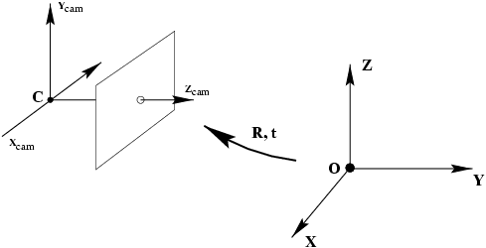

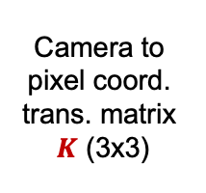
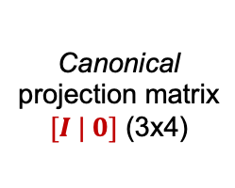
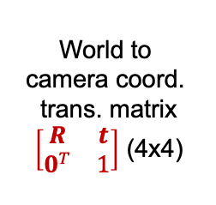


Camera parameters and calibration
world coordinate system
Camera calibration: figuring out transformation from world coordinate system to image coordinate system
World to
camera coord.
trans. matrix
$\left[\begin{matrix}R & t \\ 0^{T} & 1\end{matrix}\right]$ (4x4)
3D
point
(4x1)
2D
point
(3x1)
Camera to
pixel coord.
trans. matrix
$K$ (3x3)
Canonical
projection matrix
$[I | 0]$ (3x4)
$$≅$$
$$x$$
Intrinsic camera parameters: principal point, scaling factors
Extrinsic camera parameters: rotation, translation
$$X$$

Slide 11

Camera parameters and calibration
world coordinate system
Camera calibration: figuring out transformation from world coordinate system to image coordinate system
World to
camera coord.
trans. matrix
$\left[\begin{matrix}R & t \\ 0^{T} & 1\end{matrix}\right]$ (4x4)
3D
point
(4x1)
2D
point
(3x1)
Camera to
pixel coord.
trans. matrix
$K$ (3x3)
Canonical
projection matrix
$[I | 0]$ (3x4)
$$≅$$
$$x$$
$$X$$
$$P=K[R|t]$$
General camera projection matrix

Slide 12
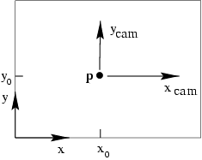
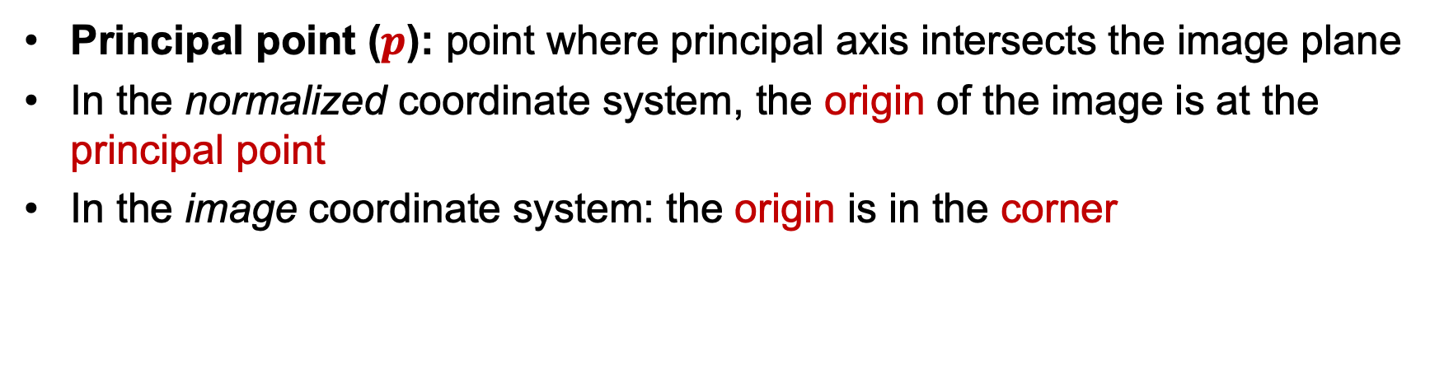
Intrinsic parameters: Principal point
Principal point ($p$): point where principal axis intersects the image plane
In the normalized coordinate system, the origin of the image is at the principal point
In the image coordinate system: the origin is in the corner

Slide 13
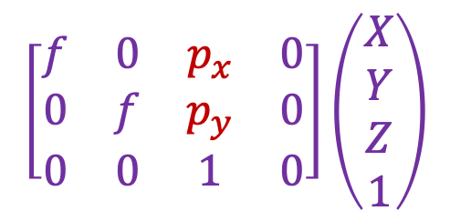
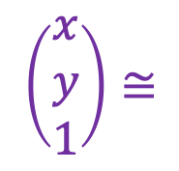
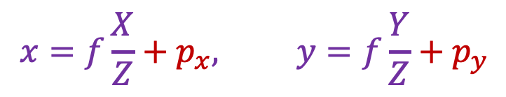
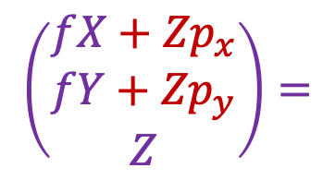
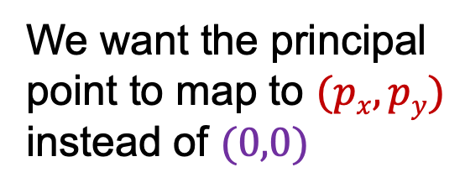
Intrinsic parameters: Principal point
We want the principal point to map to $(px, py)$ instead of $(0,0)$
p_{y}
p_{x}
$$x=f\frac{X}{Z}+p_{x}, y=f\frac{Y}{Z}+p_{y}$$
$$\left[\begin{matrix}f & 0 & p_{x} & 0 \\ 0 & f & p_{y} & 0 \\ 0 & 0 & 1 & 0\end{matrix}\right]\left(\begin{aligned}X \\ Y \\ Z \\ 1\end{aligned}\right)$$
$$\left(\begin{aligned}x \\ y \\ 1\end{aligned}\right)≅$$
$$\left(\begin{aligned}fX+{Zp}_{x} \\ fY+{Zp}_{y} \\ Z\end{aligned}\right)=$$

Slide 14

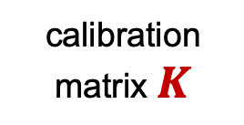
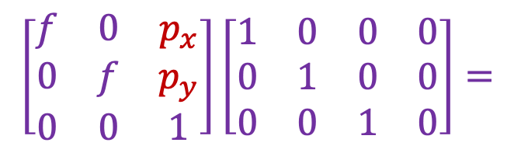
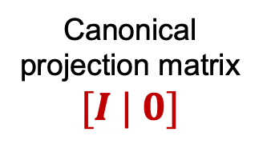

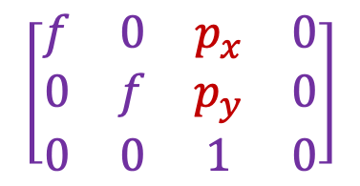
Intrinsic parameters: Principal point
p_{y}
Principal point: $(px, py)$
p_{x}
$$\left[\begin{matrix}f & 0 & p_{x} \\ 0 & f & p_{y} \\ 0 & 0 & 1\end{matrix}\right]\left[\begin{matrix}1 & 0 & 0 & 0 \\ 0 & 1 & 0 & 0 \\ 0 & 0 & 1 & 0\end{matrix}\right]=$$
$$\left[\begin{matrix}f & 0 & p_{x} & 0 \\ 0 & f & p_{y} & 0 \\ 0 & 0 & 1 & 0\end{matrix}\right]$$
calibration matrix $K$
Canonical projection matrix $[I | 0]$
$$P=K[I|0]$$

Slide 15
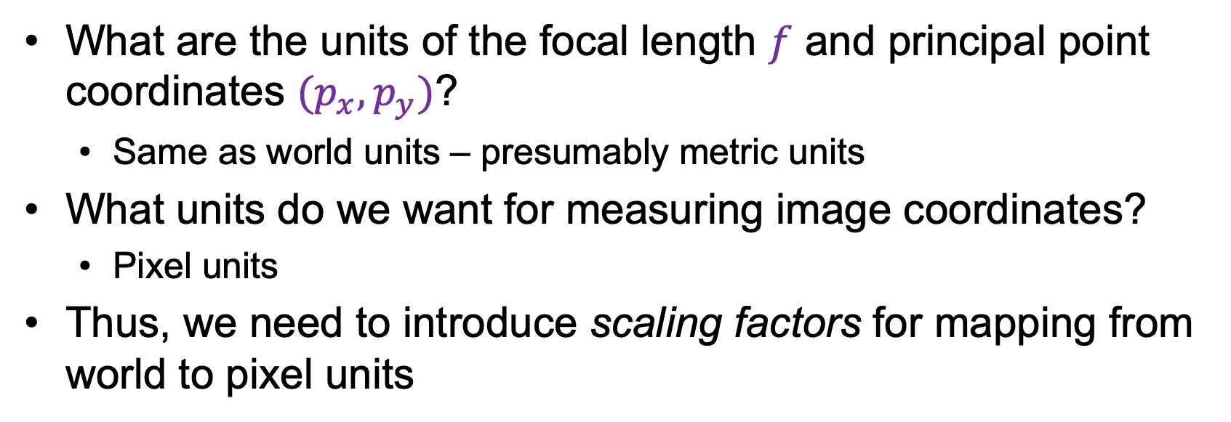
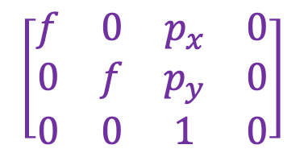
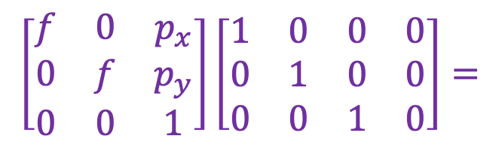
Intrinsic parameters: Principal point
What are the units of the focal length $f$ and principal point coordinates ${(p}_{x},p_{y})$?
  Same as world units – presumably metric units
What units do we want for measuring image coordinates?
  Pixel units
Thus, we need to introduce scaling factors for mapping from world to pixel units
$$\left[\begin{matrix}f & 0 & p_{x} \\ 0 & f & p_{y} \\ 0 & 0 & 1\end{matrix}\right]\left[\begin{matrix}1 & 0 & 0 & 0 \\ 0 & 1 & 0 & 0 \\ 0 & 0 & 1 & 0\end{matrix}\right]=$$
$$\left[\begin{matrix}f & 0 & p_{x} & 0 \\ 0 & f & p_{y} & 0 \\ 0 & 0 & 1 & 0\end{matrix}\right]$$
calibration matrix $K$
Canonical projection matrix $[I | 0]$
$$P=K[I|0]$$

Slide 16
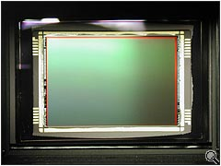
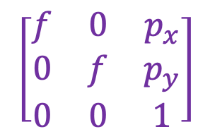
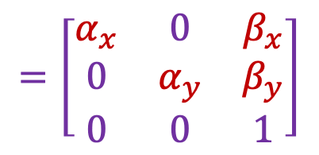
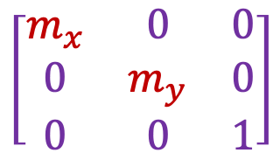
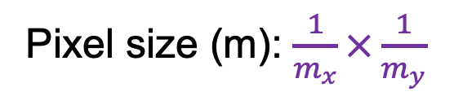
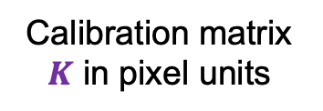

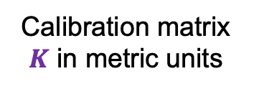
Intrinsic parameters: Scaling factors
Camera sensor
$mx$ pixels/m in horizontal direction,
$my$ pixels/m in vertical direction
Pixel size (m): $\frac{1}{m_{x}}×\frac{1}{m_{y}}$
Calibration matrix $K$ in metric units
Calibration matrix $K$ in pixel units
Scaling factors
$$\left[\begin{matrix}m_{x} & 0 & 0 \\ 0 & m_{y} & 0 \\ 0 & 0 & 1\end{matrix}\right]$$
$$\left[\begin{matrix}f & 0 & p_{x} \\ 0 & f & p_{y} \\ 0 & 0 & 1\end{matrix}\right]$$
$$=\left[\begin{matrix}α_{x} & 0 & β_{x} \\ 0 & α_{y} & β_{y} \\ 0 & 0 & 1\end{matrix}\right]$$
pixels/m
m
pixels
Notes:
To convert from metric image coordinates to pixel coordinates, we have to multiply the x, y coordinates by the x, y pixel magnification factors (pix/m)
Beta_x, beta_y is the principal point coordinates in pixels

Slide 17
Extrinsic parameters: Rotation and translation
In general, the camera coordinate frame will be related to the world coordinate frame by a rotation and a translation
camera coordinate system
world coordinate system

Slide 18


Extrinsic parameters: Rotation and translation
In general, the camera coordinate frame will be related to the world coordinate frame by a rotation and a translation
camera coordinate system
world coordinate system
In non-homogeneous coordinates, the transformation from world to normalized camera coordinate system is given by:
$${\tilde{X}}_{cam}=R\left(\tilde{X}−\tilde{C}\right)$$
$$=R\tilde{X}+t$$
coords. of point
in normalized camera frame
coords. of camera center
in world frame
3x3 rotation matrix
coords. of a point
in world frame

Slide 19
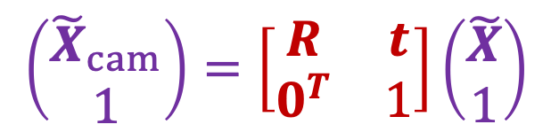

Extrinsic parameters: Rotation and translation
In non-homogeneous coordinates:
In homogeneous coordinates:
$$\left(\begin{aligned}{\tilde{X}}_{cam} \\ 1\end{aligned}\right)=\left[\begin{matrix}R & t \\ 0^{T} & 1\end{matrix}\right]\left(\begin{aligned}\tilde{X} \\ 1\end{aligned}\right)$$
$${\tilde{X}}_{cam}=R\tilde{X}+t$$
3D transformation matrix (4 x 4)

Slide 20

Extrinsic parameters: Rotation and translation
In non-homogeneous coordinates:
In homogeneous coordinates:
$${\tilde{X}}_{cam}=R\tilde{X}+t$$
$$X_{cam}=\left[\begin{matrix}R & t \\ 0^{T} & 1\end{matrix}\right]X$$
3D transformation matrix (4 x 4)

Slide 21
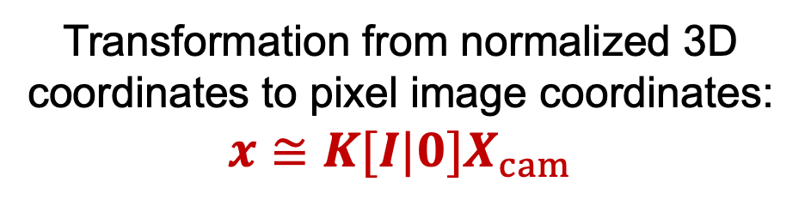
Extrinsic parameters: Rotation and translation
In non-homogeneous coordinates:
In homogeneous coordinates:
$${\tilde{X}}_{cam}=R\tilde{X}+t$$
$$X_{cam}=\left[\begin{matrix}R & t \\ 0^{T} & 1\end{matrix}\right]X$$
Transformation from normalized 3D coordinates to pixel image coordinates:
$$x≅K[I|0]X_{cam}$$

Slide 22

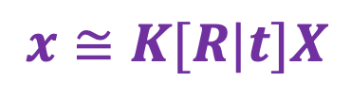
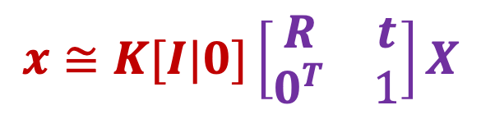
Extrinsic parameters: Rotation and translation
In homogeneous coordinates:
$$x≅K[I|0]\left[\begin{matrix}R & t \\ 0^{T} & 1\end{matrix}\right]X$$
Finally:
$$x≅K[R|t]X$$
$$t=−R\tilde{C}$$

Slide 23

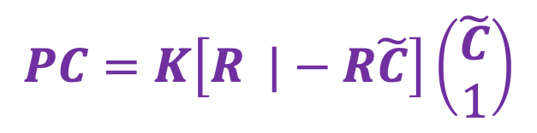


Extrinsic parameters: Rotation and translation
coords. of camera center
in world frame
$$x≅K[R|t]X$$
$$t=−R\tilde{C}$$
What is the projection of the camera center in world coordinates?
$$PC=K\left[R |−R\tilde{C}\right]\left(\begin{aligned}\tilde{C} \\ 1\end{aligned}\right)$$
$$=K\left(R\tilde{C}−R\tilde{C}\right)=0$$
The camera center is the null space of the projection matrix!

Slide 24
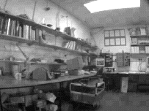
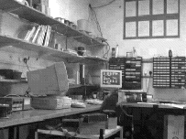
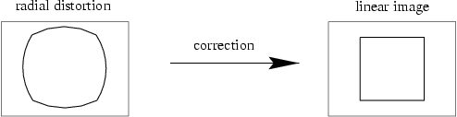
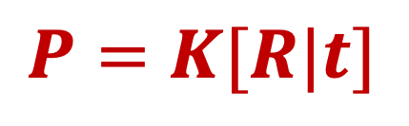
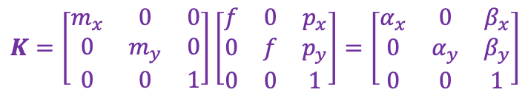
Camera parameters: Summary
$$P=K[R|t]$$
Intrinsic parameters
  Principal point coordinates
  Focal length
  Pixel magnification factors
  Skew (non-rectangular pixels) – not important in practice
  Radial distortion – important in practice!
$$K=\left[\begin{matrix}m_{x} & 0 & 0 \\ 0 & m_{y} & 0 \\ 0 & 0 & 1\end{matrix}\right]\left[\begin{matrix}f & 0 & p_{x} \\ 0 & f & p_{y} \\ 0 & 0 & 1\end{matrix}\right]=\left[\begin{matrix}α_{x} & 0 & β_{x} \\ 0 & α_{y} & β_{y} \\ 0 & 0 & 1\end{matrix}\right]$$

Slide 25
Overview
Perspective and orthographic projection matrices
Camera parameters
  Intrinsic parameters
  Extrinsic parameters
  Calibration

Slide 26


Camera calibration
$$x≅K\left[R t\right]X$$
$$\left(\begin{aligned}x \\ y \\ 1\end{aligned}\right)≅\left[\begin{matrix}p_{11} & p_{12} & p_{13} & p_{14} \\ p_{21} & p_{22} & p_{23} & p_{24} \\ p_{31} & p_{32} & p_{33} & p_{34}\end{matrix}\right]\left(\begin{aligned}X \\ Y \\ Z \\ 1\end{aligned}\right)$$

Slide 27





Camera calibration
Given $n$ points with known 3D coordinates $Xi$ and known image projections $xi$, estimate the camera parameters
$$Xi$$
$$x_{i}≅PX_{i}$$
$$P$$

Slide 28


Camera calibration
Given $n$ points with known 3D coordinates $Xi$ and known image projections $xi$, estimate the camera parameters
Known 2D image coords
Known 3D locations
880 214
43 203
270 197
886 347
745 302
943 128
476 590
419 214
317 335
783 521
235 427
665 429
655 362
427 333
412 415
746 351
434 415
525 234
716 308
602 187
312.747 309.140 30.086
305.796 311.649 30.356
307.694 312.358 30.418
310.149 307.186 29.298
311.937 310.105 29.216
311.202 307.572 30.682
307.106 306.876 28.660
309.317 312.490 30.230
307.435 310.151 29.318
308.253 306.300 28.881
306.650 309.301 28.905
308.069 306.831 29.189
309.671 308.834 29.029
308.255 309.955 29.267
307.546 308.613 28.963
311.036 309.206 28.913
307.518 308.175 29.069
309.950 311.262 29.990
312.160 310.772 29.080
311.988 312.709 30.514
Image credit: J. Hays

Slide 29




Camera calibration: Linear method
Recall homography fitting:
$$\left(\begin{matrix}x_{i} \\ y_{i} \\ 1\end{matrix}\right)×\left(\begin{matrix}P_{1}^{T}X_{i} \\ P_{2}^{T}X_{i} \\ P_{3}^{T}X_{i}\end{matrix}\right)=0$$
$$x_{i}≅PX_{i}$$
$$x_{i}×PX_{i}=0$$
$$\left[\begin{matrix}0^{T} & {−X}_{i}^{T} & {y_{i}X}_{i}^{T} \\ X_{i}^{T} & 0^{T} & −x_{i}X_{i}^{T} \\ −y_{i}X_{i}^{T} & x_{i}X_{i}^{T} & 0^{T}\end{matrix}\right]\left(\begin{matrix}P_{1} \\ P_{2} \\ P_{3}\end{matrix}\right)=0$$
One match gives two linearly independent constraints

Slide 30


Camera calibration: Linear method
Final linear system:
$$\left[\begin{matrix}0^{T} & X_{1}^{T} & −y_{1}X_{1}^{T} \\ X_{1}^{T} & 0^{T} & −x_{1}X_{1}^{T} \\ … & … & … \\ 0^{T} & X_{n}^{T} & −y_{n}X_{n}^{T} \\ X_{n}^{T} & 0^{T} & −x_{n}X_{n}^{T}\end{matrix}\right]\left(\begin{matrix}P_{1} \\ P_{2} \\ P_{3}\end{matrix}\right)=0$$
One 2D/3D correspondence gives two linearly independent equations
  The projection matrix has 11 degrees of freedom
  6 correspondences needed for a minimal solution
Homogeneous least squares: find $p$ minimizing ${\left\|Ap\right\|}^{2}$
  Solution is eigenvector of $ATA$ corresponding to smallest eigenvalue
$$Ap=0$$

Slide 31

Camera calibration: Linear method
Final linear system:
$$\left[\begin{matrix}0^{T} & X_{1}^{T} & −y_{1}X_{1}^{T} \\ X_{1}^{T} & 0^{T} & −x_{1}X_{1}^{T} \\ … & … & … \\ 0^{T} & X_{n}^{T} & −y_{n}X_{n}^{T} \\ X_{n}^{T} & 0^{T} & −x_{n}X_{n}^{T}\end{matrix}\right]\left(\begin{matrix}P_{1} \\ P_{2} \\ P_{3}\end{matrix}\right)=0$$
What if all the $n$ 3D points are coplanar, i.e., there exists a set of plane parameters $Π^{T}={(a,b,c,d)}^{T}$ such that $ΠTX_{i}=0$ for all $i$?
  Then we will get degenerate solutions $(Π,0,0)$, $(0,Π,0)$, or $(0,0,Π)$
$$Ap=0$$

Slide 32


Camera calibration: Linear vs. nonlinear
Linear calibration is easy to formulate and solve, but it doesn’t directly tell us the camera parameters
$$\left(\begin{aligned}x \\ y \\ 1\end{aligned}\right)≅\left[\begin{matrix}p_{11} & p_{12} & p_{13} & p_{14} \\ p_{21} & p_{22} & p_{23} & p_{24} \\ p_{31} & p_{32} & p_{33} & p_{34}\end{matrix}\right]\left(\begin{aligned}X \\ Y \\ Z \\ 1\end{aligned}\right)$$
vs.
$$x≅K\left[R | t\right]X$$

Slide 33

Camera calibration: Linear vs. nonlinear
Linear calibration is easy to formulate and solve, but it doesn’t directly tell us the camera parameters
In practice, non-linear methods are preferred
  Write down objective function in terms of intrinsic and extrinsic parameters, as sum of squared distances between measured 2D points and estimated projections of 3D points:
  $$\sum_{i}{{\left\|proj\left(K\left[R | t\right]X_{i}\right)−x_{i}\right\|}_{2}^{2}}$$
  Can include radial distortion and constraints such as known focal length, orthogonality, visibility of points
  Minimize error using non-linear optimization package
  Can initialize solution with output of linear method (perform QR decomposition to get $K$ and $R$ from $P$)

Slide 34




From image points to rays in space
Calibration gives us a way to map image points to corresponding visual rays in the world
We can define the visual ray using the camera center $C$ (null space of $P$) and any point $X$ such that $x≅PX$
$X$?
$X$?
$X$?
$$x$$
$$C$$

Slide 35

From image points to rays in space
Calibration gives us a way to map image points to corresponding visual rays in the world
We can define the visual ray using the camera center $C$ (null space of $P$) and any point $X$ such that $x≅PX$
In particular, we can let $X=P^{+}x$ where $P^{+}=P^{T}{\left(PP^{T}\right)}^{−1}$ is the pseudoinverse of the camera projection matrix
  It’s a $4×3$ matrix such that $PP^{+}=I$
  If $X=P^{+}x$, then $PX=PP^{+}x=x$

Slide 36
Overview
Perspective and orthographic projection matrices
Camera parameters
  Intrinsic parameters
  Extrinsic parameters
  Calibration
First taste of 3D reconstruction: triangulation

Slide 37


Our goal: Recovery of 3D structure

Slide 38


Single-view ambiguity
$X$?
$X$?
$X$?
$$x$$

Slide 39

Single-view ambiguity
Rashad Alakbarov shadow sculptures

Slide 40
Single-view ambiguity
Image source

Slide 41


Our goal: Recovery of 3D structure
When certain assumptions hold, we can recover structure from a single view
In general, we need multi-view geometry
Image source

Slide 42
Review: Camera projection matrix

Slide 43







Review: Camera projection matrix
$$(X,Y,Z)$$
$$(x,y)$$
$$x=f\frac{X}{Z}, y=f\frac{Y}{Z}$$
$$\left(\begin{aligned}fX \\ fY \\ Z\end{aligned}\right)=\left[\begin{matrix}f & 0 & 0 & 0 \\ 0 & f & 0 & 0 \\ 0 & 0 & 1 & 0\end{matrix}\right]\left(\begin{aligned}X \\ Y \\ Z \\ 1\end{aligned}\right)$$
$$\left(\begin{aligned}x \\ y \\ 1\end{aligned}\right)≅$$
$$x≅PX$$
$$x$$
$$P$$
$$X$$
Equality up to scale
Homogeneous coord. vec. of image point
Camera projection matrix
Homogeneous coord. vec. of 3D point

Slide 44
Review: Camera projection matrix
world coordinate system
Camera calibration: figuring out transformation from world coordinate system to image coordinate system
World to
camera coord.
trans. matrix
$\left[\begin{matrix}R & t \\ 0^{T} & 1\end{matrix}\right]$ (4x4)
3D
point
(4x1)
2D
point
(3x1)
Camera to
pixel coord.
trans. matrix
$K$ (3x3)
Canonical
projection matrix
$[I | 0]$ (3x4)
$$≅$$
$$x$$
Intrinsic camera parameters: principal point, scaling factors
Extrinsic camera parameters: rotation, translation
$$X$$

Slide 45
Review: Camera projection matrix
world coordinate system
Camera calibration: figuring out transformation from world coordinate system to image coordinate system
World to
camera coord.
trans. matrix
$\left[\begin{matrix}R & t \\ 0^{T} & 1\end{matrix}\right]$ (4x4)
3D
point
(4x1)
2D
point
(3x1)
Camera to
pixel coord.
trans. matrix
$K$ (3x3)
Canonical
projection matrix
$[I | 0]$ (3x4)
$$≅$$
$$x$$
$$X$$
$$P=K[R|t]$$
General camera projection matrix

Slide 46


Review: Intrinsic camera parameters
  Principal point coordinates $p_{x},p_{y}$
  Focal length $f$
  Pixel magnification factors $m_{x},m_{y}$
  Skew (non-rectangular pixels) – not important in practice
  Radial distortion – important in practice!
$$K=\left[\begin{matrix}m_{x} & 0 & 0 \\ 0 & m_{y} & 0 \\ 0 & 0 & 1\end{matrix}\right]\left[\begin{matrix}f & 0 & p_{x} \\ 0 & f & p_{y} \\ 0 & 0 & 1\end{matrix}\right]=\left[\begin{matrix}α_{x} & 0 & β_{x} \\ 0 & α_{y} & β_{y} \\ 0 & 0 & 1\end{matrix}\right]$$

Slide 47
Review: Estimating the projection matrix

Slide 48
Review: Estimating the projection matrix
Given $n$ points with known 3D coordinates $Xi$ and known image projections $xi$, estimate the camera parameters
$$Xi$$
$$x_{i}≅PX_{i}$$
$$P$$

Slide 49
Review: Estimating the projection matrix
Homogeneous least squares method:
$$\left(\begin{matrix}x_{i} \\ y_{i} \\ 1\end{matrix}\right)×\left(\begin{matrix}P_{1}^{T}X_{i} \\ P_{2}^{T}X_{i} \\ P_{3}^{T}X_{i}\end{matrix}\right)=0$$
$$x_{i}≅PX_{i}$$
$$x_{i}×PX_{i}=0$$
$$\left[\begin{matrix}0^{T} & {−X}_{i}^{T} & {y_{i}X}_{i}^{T} \\ X_{i}^{T} & 0^{T} & −x_{i}X_{i}^{T} \\ −y_{i}X_{i}^{T} & x_{i}X_{i}^{T} & 0^{T}\end{matrix}\right]\left(\begin{matrix}P_{1} \\ P_{2} \\ P_{3}\end{matrix}\right)=0$$
One match gives two linearly independent constraints

Slide 50

Review: Estimating the projection matrix
Final linear system:
$$\left[\begin{matrix}0^{T} & X_{1}^{T} & −y_{1}X_{1}^{T} \\ X_{1}^{T} & 0^{T} & −x_{1}X_{1}^{T} \\ … & … & … \\ 0^{T} & X_{n}^{T} & −y_{n}X_{n}^{T} \\ X_{n}^{T} & 0^{T} & −x_{n}X_{n}^{T}\end{matrix}\right]\left(\begin{matrix}P_{1} \\ P_{2} \\ P_{3}\end{matrix}\right)=0$$
Homogeneous least squares: find $p$ minimizing ${\left\|Ap\right\|}^{2}$
  Solution is eigenvector of $ATA$ corresponding to smallest eigenvalue
At least six non-planar matches needed for a non-degenerate solution
$$Ap=0$$

Slide 51
From image points to rays in space
Calibration gives us a way to map image points to corresponding visual rays in the world
We can define the visual ray using the camera center $C$ (null space of $P$) and any point $X$ such that $x≅PX$
$X$?
$X$?
$X$?
$$x$$
$$C$$

Slide 52
From image points to rays in space
Calibration gives us a way to map image points to corresponding visual rays in the world
We can define the visual ray using the camera center $C$ (null space of $P$) and any point $X$ such that $x≅PX$
In particular, we can let $X=P^{+}x$ where $P^{+}=P^{T}{\left(PP^{T}\right)}^{−1}$ is the pseudoinverse of the camera projection matrix
  It’s a $4×3$ matrix such that $PP^{+}=I$
  If $X=P^{+}x$, then $PX=PP^{+}x=x$

Slide 53
Overview
Perspective and orthographic projection matrices
Camera parameters
  Intrinsic parameters
  Extrinsic parameters
  Calibration
First taste of 3D reconstruction: triangulation

Slide 54



Triangulation
Given projections of a 3D point in two or more images (with known camera matrices), find the coordinates of the point

Slide 55

Triangulation
Given projections of a 3D point in two or more images (with known camera matrices), find the coordinates of the point
$$X?$$

Slide 56





Triangulation
Given projections of a 3D point in two or more images (with known camera matrices), find the coordinates of the point
$$X?$$
$$x2$$
$$x1$$
$$O1$$
$$O2$$

Slide 57

Triangulation
We want to intersect the two visual rays corresponding to
$x1$ and $x2$, but because of noise and numerical errors, they don’t meet exactly
$$X?$$
$$x2$$
$$x1$$
$$O1$$
$$O2$$

Slide 58


Triangulation: Geometric approach
Find shortest segment connecting the two viewing rays and let $X$ be the midpoint of that segment
$$X$$
$$x2$$
$$x1$$
$$O1$$
$$O2$$

Slide 59




Triangulation: Nonlinear approach
Find $X$ that minimizes
$${\left\|{proj(P}_{1}X)−x_{1}\right\|}_{2}^{2}+{\left\|{proj(P}_{2}X)−x_{2}\right\|}_{2}^{2}$$
$$X?$$
$$P1X$$
$$x2$$
$$x1$$
$$P2X$$
$$O1$$
$$O2$$

Slide 60




Triangulation: Linear approach
$$x_{1}≅P_{1}X$$
$$x_{2}≅P_{2}X$$
$$x_{1}×P_{1}X=0$$
$$x_{2}×P_{2}X=0$$
$$[{x_{1}}_{×}]P_{1}X=0$$
$$[{x_{2}}_{×}]P_{2}X=0$$
Rewrite cross product as matrix multiplication:
$$a×b=\left[\begin{matrix}0 & −a_{3} & a_{2} \\ a_{3} & 0 & −a_{1} \\ {−a}_{2} & a_{1} & 0\end{matrix}\right]\left(\begin{aligned}b_{1} \\ b_{2} \\ b_{3}\end{aligned}\right)=[a_{×}]b$$

Slide 61

Triangulation: Linear approach
$$x_{1}≅P_{1}X$$
$$x_{2}≅P_{2}X$$
$$x_{1}×P_{1}X=0$$
$$x_{2}×P_{2}X=0$$
$$[{x_{1}}_{×}]P_{1}X=0$$
$$[{x_{2}}_{×}]P_{2}X=0$$
Two independent equations each in terms of
three unknown entries of $X$

Slide 62
Preview: Structure from motion
?
Figure credit: Noah Snavely
?
?
?
Given 2D point correspondences between multiple images, compute the camera parameters and the 3D points
Notes:
Structure from motion solves the following problem:
Given a set of images of a static scene with 2D points in correspondence, shown here as color-coded points, find…
a set of 3D points P and
a rotation R and position t of the cameras that explain the observed correspondences. In other words, when we project a point into any of the cameras, the reprojection error between the projected and observed 2D points is low.
This problem can be formulated as an optimization problem where we want to find the rotations R, positions t, and 3D point locations P that minimize sum of squared reprojection errors f. This is a non-linear least squares problem and can be solved with algorithms such as Levenberg-Marquart. However, because the problem is non-linear, it can be susceptible to local minima. Therefore, it’s important to initialize the parameters of the system carefully. In addition, we need to be able to deal with erroneous correspondences.

Slide 63



Preview: Structure from motion
?
Camera 1
Camera 3
$$R1,t1$$
Camera 2
$$R2,t2$$
$$R3,t3$$
Structure: Given known cameras and projections of the same 3D point in two or more images, compute the 3D coordinates of that point
  Triangulation!
Notes:
Structure from motion solves the following problem:
Given a set of images of a static scene with 2D points in correspondence, shown here as color-coded points, find…
a set of 3D points P and
a rotation R and position t of the cameras that explain the observed correspondences. In other words, when we project a point into any of the cameras, the reprojection error between the projected and observed 2D points is low.
This problem can be formulated as an optimization problem where we want to find the rotations R, positions t, and 3D point locations P that minimize sum of squared reprojection errors f. This is a non-linear least squares problem and can be solved with algorithms such as Levenberg-Marquart. However, because the problem is non-linear, it can be susceptible to local minima. Therefore, it’s important to initialize the parameters of the system carefully. In addition, we need to be able to deal with erroneous correspondences.

Slide 64
Preview: Structure from motion
Camera 1
?
Camera 3
$$R1,t1$$
Camera 2
?
?
$$R2,t2$$
$$R3,t3$$
Motion: Given a set of known 3D points seen by a camera, compute the camera parameters
  Calibration!
Notes:
Structure from motion solves the following problem:
Given a set of images of a static scene with 2D points in correspondence, shown here as color-coded points, find…
a set of 3D points P and
a rotation R and position t of the cameras that explain the observed correspondences. In other words, when we project a point into any of the cameras, the reprojection error between the projected and observed 2D points is low.
This problem can be formulated as an optimization problem where we want to find the rotations R, positions t, and 3D point locations P that minimize sum of squared reprojection errors f. This is a non-linear least squares problem and can be solved with algorithms such as Levenberg-Marquart. However, because the problem is non-linear, it can be susceptible to local minima. Therefore, it’s important to initialize the parameters of the system carefully. In addition, we need to be able to deal with erroneous correspondences.

Slide 65

Multi-view geometry “Bible”

