Slide 1
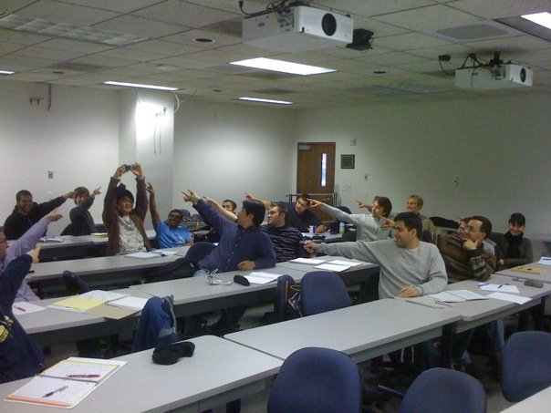
Epipolar geometry
Photo by Frank Dellaert
Many slides adapted from J. Johnson and D. Fouhey

Slide 2
Outline
Motivation
Epipolar geometry setup
Epipolar constraint
Essential matrix
Fundamental matrix
Estimating the fundamental matrix

Slide 3
Consider two views of the same 3D scene
What constraints must hold between two projections of the same 3D point?

Slide 4
Consider two views of the same 3D scene
Given a 2D point in one view, where can we find the corresponding point in the other view?

Slide 5
Consider two views of the same 3D scene
Given only 2D correspondences, how can we calibrate the two cameras, i.e., estimate their relative position and orientation and the intrinsic parameters?

Slide 6
Consider two views of the same 3D scene
Key idea: we want to answer all these questions in 2D,
by considering the projections of camera centers and visual rays into the other view

Slide 7



Epipolar geometry setup
$$O$$
$$O′$$
Suppose we have two cameras with centers $O$, $O′$
The baseline is the line connecting the origins

Slide 8



Epipolar geometry setup
$$O$$
$$e′$$
$$O′$$
$$e$$
Epipoles $e$, $e′$ are where the baseline intersects the image planes, or projections of the other camera in each view

Slide 9



Epipolar geometry setup
$$X$$
$$x$$
$$x′$$
$$O$$
$$e′$$
$$O′$$
$$e$$
Consider a point $X$, which projects to $x$ and $x′$

Slide 10

Epipolar geometry setup
$$X$$
$$x$$
$$x′$$
$$O$$
$$e′$$
$$O′$$
$$e$$
The plane formed by $X$, $O$, and $O′$ is called an epipolar plane
There is a family of planes passing through $O$ and $O′$

Slide 11

Epipolar geometry setup
$$X$$
$$x$$
$$x′$$
$$O$$
$$e′$$
$$O′$$
$$e$$
Epipolar lines connect the epipoles to the projections of $X$
Equivalently, epipolar lines are intersections of the epipolar plane with the image planes – thus, they come in matching pairs

Slide 12
Epipolar geometry setup: Summary
$$X$$
Epipolar plane
$$x$$
$$x′$$
Epipolar lines
$$O$$
Baseline
$$e′$$
$$O′$$
$$e$$
Epipoles

Slide 13
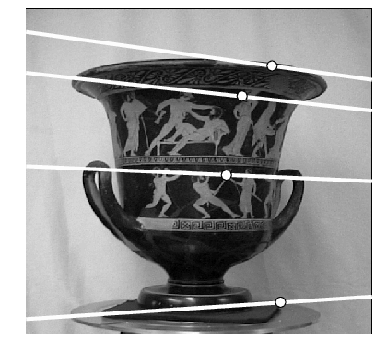
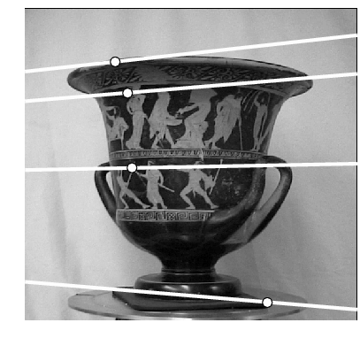
Example configuration: Converging cameras

Slide 14
Example configuration: Converging cameras
$$O$$
$$e′$$
$$O′$$
$$e$$
Epipoles are finite, may be visible in the image

Slide 15


Example configuration: Motion parallel to image plane
$$O$$
$$O′$$
Where are the epipoles and what do the epipolar lines look like?

Slide 16


Example configuration: Motion parallel to image plane
$$e$$
$$e′$$
$$O$$
$$O′$$
Epipoles infinitely far away, epipolar lines parallel

Slide 17
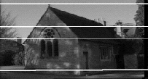
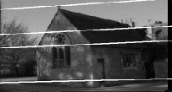
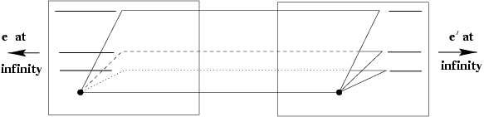
Example configuration: Motion parallel to image plane

Slide 18
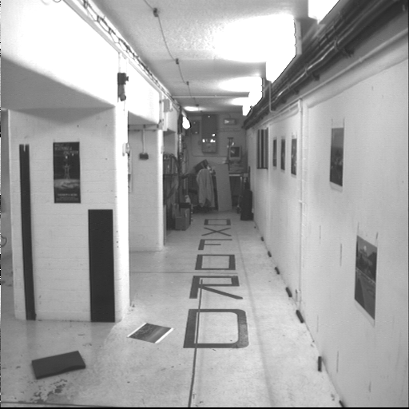
Example configuration: Motion perpendicular to image plane

Slide 19
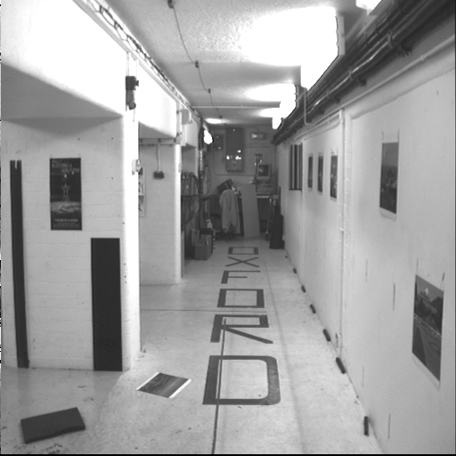
Example configuration: Motion perpendicular to image plane

Slide 20




Example configuration: Motion perpendicular to image plane
$$e′$$
Epipole is “focus of expansion” and coincides with the principal point of the camera
Epipolar lines go out from principal point
$$O′$$
$$e$$
$$O$$

Slide 21
Outline
Motivation
Epipolar geometry setup
Epipolar constraint

Slide 22

Epipolar constraint
$$x$$
$$O$$
Suppose we observe a single point $x$ in one image

Slide 23
Epipolar constraint
$$x$$
$$O$$
$$e′$$
$$O′$$
$$e$$
Where can we find the $x′$ corresponding to $x$ in the other image?

Slide 24

Epipolar constraint
$$x$$
$$O$$
$$e′$$
$$O′$$
$$e$$
Where can we find the $x′$ corresponding to $x$ in the other image?
Along the epipolar line corresponding to $x$ (projection of visual ray connecting $O$ with $x$ into the second image plane)

Slide 25


Epipolar constraint
$$x′$$
$$O$$
$$e′$$
$$O′$$
$$e$$
Similarly, all points in the left image corresponding to $x′$ have to lie along the epipolar line corresponding to $x′$

Slide 26




Epipolar constraint
$$x$$
$$x′$$
$$l$$
$$l′$$
$$O$$
$$e′$$
$$O′$$
$$e$$
Potential matches for $x$ have to lie on the matching epipolar line $l′$
Potential matches for $x′$ have to lie on the matching epipolar line $l$

Slide 27
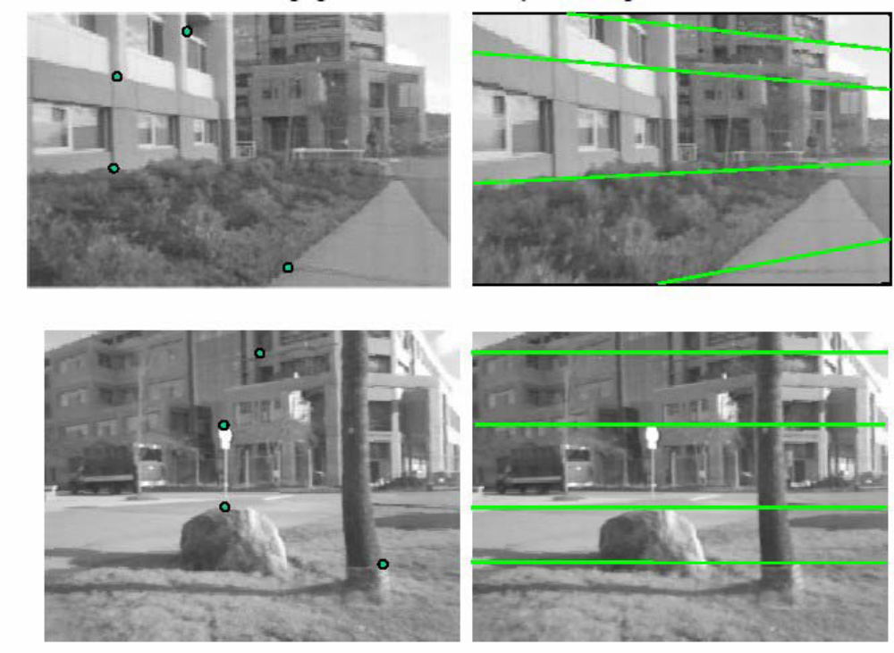
Epipolar constraint: Example

Slide 28
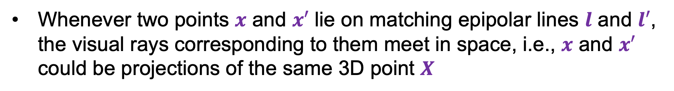
Epipolar constraint
$$X$$
$$x$$
$$x′$$
$$l$$
$$l′$$
$$O$$
$$e′$$
$$O′$$
$$e$$
Whenever two points $x$ and $x′$ lie on matching epipolar lines $l$ and $l′$, the visual rays corresponding to them meet in space, i.e., $x$ and $x′$ could be projections of the same 3D point $X$

Slide 29

Epipolar constraint
$$x$$
$$x′$$
$$O$$
$$e′$$
$$O′$$
$$e$$
Remember: in general, two rays do not meet in space!

Slide 30



Epipolar constraint
$$X′$$
$$X$$
$$x$$
$$x′$$
$$l$$
$$l′$$
$$O$$
$$e′$$
$$O′$$
$$e$$
Caveat: if $x$ and $x′$ satisfy the epipolar constraint, this doesn’t mean they have to be projections of the same 3D point

Slide 31
Outline
Motivation
Epipolar geometry setup
Epipolar constraint
Essential matrix

Slide 32

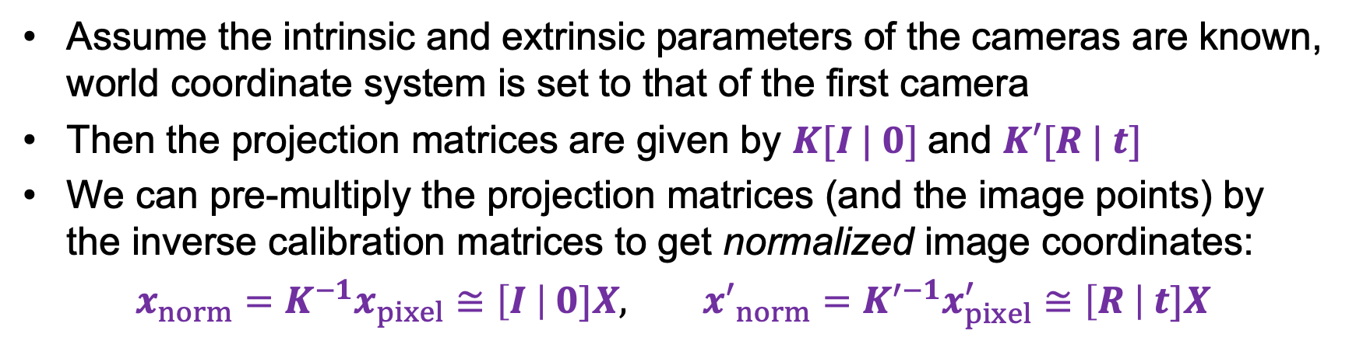




Math of the epipolar constraint: Calibrated case
$$X$$
$$x$$
$$x′$$
$$t$$
$$R$$
Assume the intrinsic and extrinsic parameters of the cameras are known, world coordinate system is set to that of the first camera
Then the projection matrices are given by $K[I | 0]$and $K′[R | t]$
We can pre-multiply the projection matrices (and the image points) by the inverse calibration matrices to get normalized image coordinates:
$x_{norm}=K^{−1}x_{pixel}≅\left[I \right| 0]X,$ ${x′}_{norm}=K^{′−1}x_{pixel}^{′}≅\left[R \right| t]X$

Slide 33
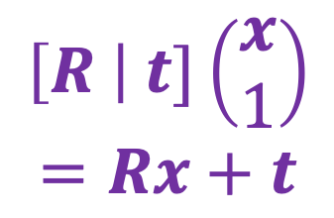
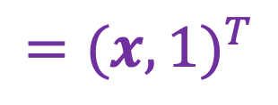
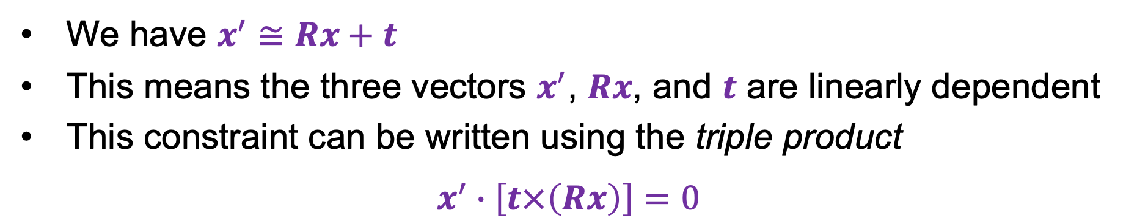




Math of the epipolar constraint: Calibrated case
$$X$$
$$={(x,1)}^{T}$$
$$x_{norm}≅\left[I \right| 0]X$$
$${x′}_{norm}≅\left[R \right| t]X$$
$$\left[I \right| 0]\left(\begin{aligned}x \\ 1\end{aligned}\right)$$
$$x$$
$$x^{′}$$
$$\left[R \right| t]\left(\begin{aligned}x \\ 1\end{aligned}\right)$$
$$=Rx+t$$
$$t$$
$$R$$
We have $x^{′}≅Rx+t$
This means the three vectors $x^{′}$, $Rx$, and $t$ are linearly dependent
This constraint can be written using the triple product
$$x^{′}∙\left[t×\left(Rx\right)\right]=0$$

Slide 34
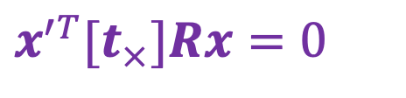
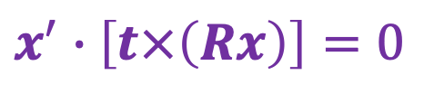
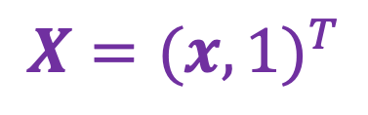
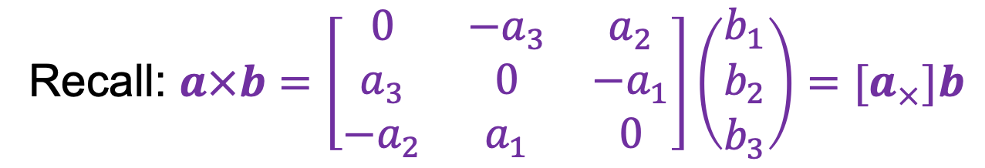
Math of the epipolar constraint: Calibrated case
$$X={(x,1)}^{T}$$
$$\left[I \right| 0]\left(\begin{aligned}x \\ 1\end{aligned}\right)$$
$$x$$
$$x^{′}$$
$$\left[R \right| t]\left(\begin{aligned}x \\ 1\end{aligned}\right)$$
$$=Rx+t$$
$$t$$
$$R$$
$$x^{′}∙\left[t×\left(Rx\right)\right]=0$$
$$x^{′T}{[t}_{×}]Rx=0$$
Recall: $a×b=\left[\begin{matrix}0 & −a_{3} & a_{2} \\ a_{3} & 0 & −a_{1} \\ {−a}_{2} & a_{1} & 0\end{matrix}\right]\left(\begin{aligned}b_{1} \\ b_{2} \\ b_{3}\end{aligned}\right)=[a_{×}]b$

Slide 35
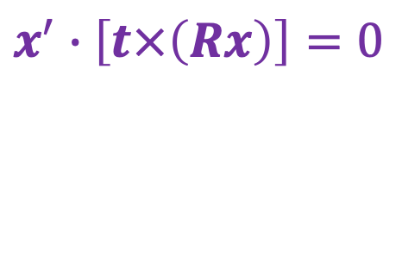
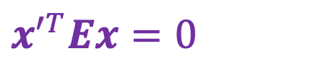
Math of the epipolar constraint: Calibrated case
$$X={(x,1)}^{T}$$
$$\left[I \right| 0]\left(\begin{aligned}x \\ 1\end{aligned}\right)$$
$$x$$
$$x^{′}$$
$$\left[R \right| t]\left(\begin{aligned}x \\ 1\end{aligned}\right)$$
$$=Rx+t$$
$$t$$
$$R$$
$$x^{′}∙\left[t×\left(Rx\right)\right]=0$$
$$x^{′T}{[t}_{×}]Rx=0$$
$$x^{′T}Ex=0$$
Essential Matrix
H. C. Longuet-Higgins. A computer algorithm for reconstructing a scene from two projections. Nature 293 (5828): 133–135, September 1981

Slide 36
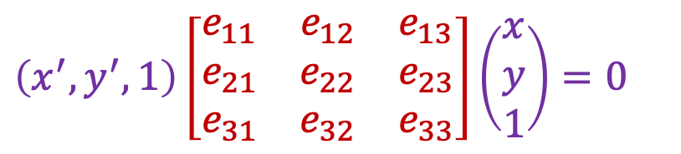

The essential matrix
$$X$$
$$x$$
$$x^{′}$$
$$x^{′T}Ex=0$$
$$\left(x^{′},y^{′},1\right)\left[\begin{matrix}e_{11} & e_{12} & e_{13} \\ e_{21} & e_{22} & e_{23} \\ e_{31} & e_{32} & e_{33}\end{matrix}\right]\left(\begin{aligned}x \\ y \\ 1\end{aligned}\right)=0$$

Slide 37


The essential matrix: Interpretation
$$X$$
$$x$$
$$x^{′}$$
$$x^{′T}Ex=0$$
Call this $l′$

Slide 38
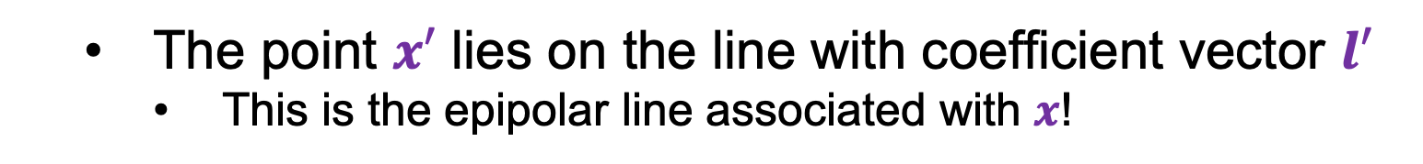




The essential matrix: Interpretation
$$X$$
$$x$$
$$x^{′}$$
$$l^{′}$$
$$x^{′T}Ex=0$$
$$l′$$
What does this expression mean?
  The point $x′$ lies on the line with coefficient vector $l′$
    This is the epipolar line associated with $x$!

Slide 39

The essential matrix: Interpretation
$$X$$
$$x$$
$$x^{′}$$
$$x^{′T}Ex=0$$
$$l=E^{T}x′$$

Slide 40


The essential matrix: Interpretation
$$X$$
$$x$$
$$x^{′}$$
$$l$$
$$x^{′T}Ex=0$$
$${ l}^{T}$$
  $l$ is the epipolar line associated with $x$!

Slide 41
The essential matrix: Properties
$$X$$
$$x$$
$$x^{′}$$
$$x^{′T}Ex=0$$
$$\left(x^{′},y^{′},1\right)\left[\begin{matrix}e_{11} & e_{12} & e_{13} \\ e_{21} & e_{22} & e_{23} \\ e_{31} & e_{32} & e_{33}\end{matrix}\right]\left(\begin{aligned}x \\ y \\ 1\end{aligned}\right)=0$$

Slide 42
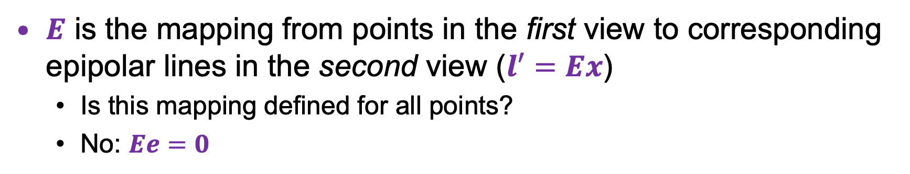

The essential matrix: Properties
$$X$$
$$x$$
$$x^{′}$$
$$l^{′}$$
$$x^{′T}Ex=0$$
$E$ is the mapping from points in the first view to corresponding epipolar lines in the second view ($l′=Ex$)
  Is this mapping defined for all points?
  No: $Ee=0$

Slide 43

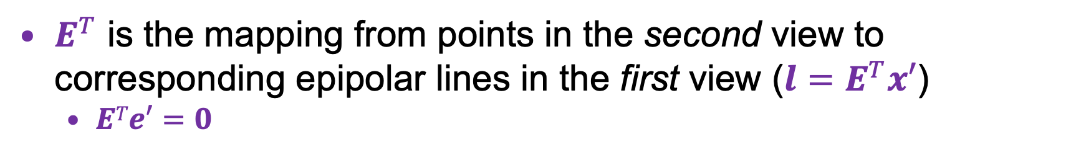
The essential matrix: Properties
$$X$$
$$x$$
$$x^{′}$$
$$l$$
$$x^{′T}Ex=0$$
$E^{T}$ is the mapping from points in the second view to corresponding epipolar lines in the first view ($l=E^{T}x′$)
  $ETe′=0$

Slide 44

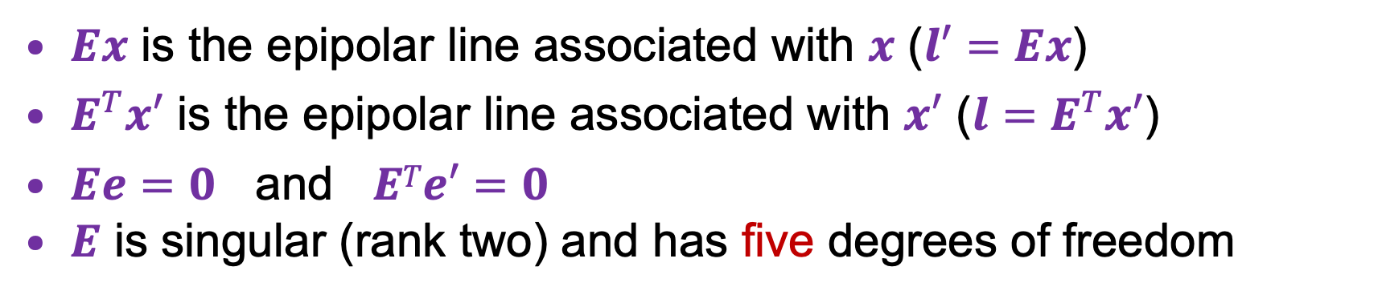
The essential matrix: Properties
$$X$$
$$x$$
$$x^{′}$$
$$l$$
$$x^{′T}Ex=0$$
$Ex$ is the epipolar line associated with $x$ ($l′=Ex$)
$E^{T}x′$ is the epipolar line associated with $x′$ ($l=E^{T}x′$)
$Ee=0$ and $ETe′=0$
$E$ is singular (rank two) and has five degrees of freedom

Slide 45
Outline
Motivation
Epipolar geometry setup
Epipolar constraint
Essential matrix
Fundamental matrix

Slide 46
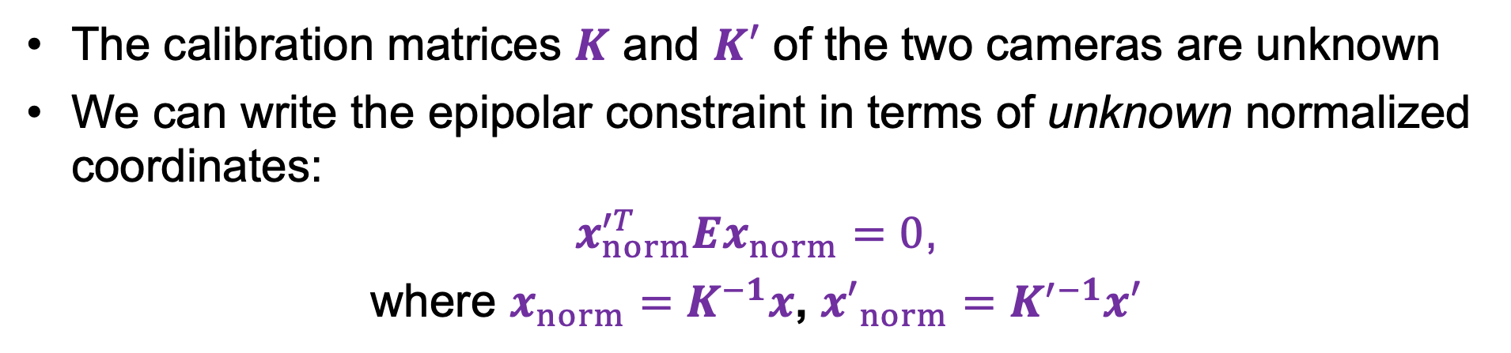
Epipolar constraint: Uncalibrated case
$$X$$
$$x$$
$$x^{′}$$
The calibration matrices $K$ and $K′$ of the two cameras are unknown
We can write the epipolar constraint in terms of unknown normalized coordinates:
$x_{norm}^{′T}Ex_{norm}=0$,
where $x_{norm}=K^{−1}x$, ${x′}_{norm}=K^{′−1}x′$

Slide 47

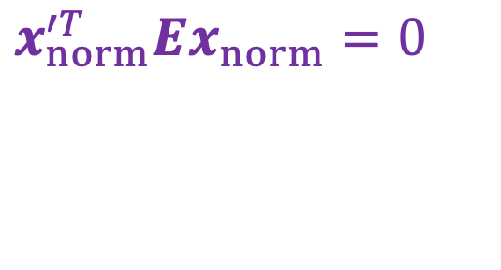


Epipolar constraint: Uncalibrated case
$$X$$
$$x$$
$$x^{′}$$
$$x_{norm}^{′T}Ex_{norm}=0$$
$x^{′T}Fx=0$, where $F={K′}^{−T}EK^{−1}$
$$x_{norm}=K^{−1}x$$
Fundamental Matrix
$${x′}_{norm}=K^{′−1}x′$$
Faugeras et al., (1992), Hartley (1992)

Slide 48


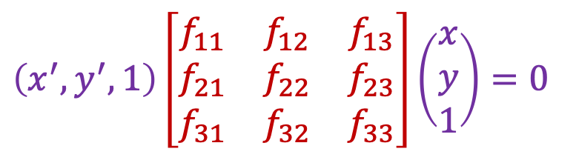
The fundamental matrix
$$X$$
$$x$$
$$x^{′}$$
$$l$$
$$l′$$
$$x^{′T}Fx=0$$
$$\left(x^{′},y^{′},1\right)\left[\begin{matrix}f_{11} & f_{12} & f_{13} \\ f_{21} & f_{22} & f_{23} \\ f_{31} & f_{32} & f_{33}\end{matrix}\right]\left(\begin{aligned}x \\ y \\ 1\end{aligned}\right)=0$$

Slide 49
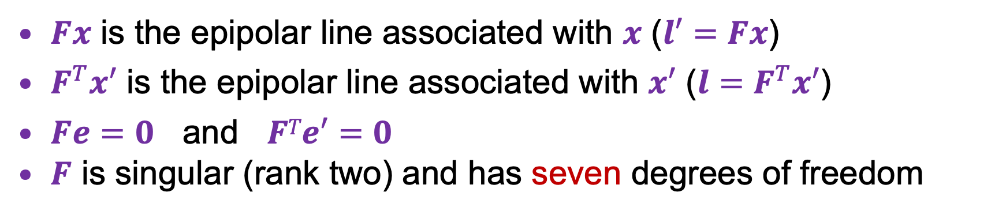
The fundamental matrix: Properties
$$X$$
$$x$$
$$x^{′}$$
$$l$$
$$l′$$
$$x^{′T}Fx=0$$
$Fx$ is the epipolar line associated with $x$ ($l′=Fx$)
$F^{T}x′$ is the epipolar line associated with $x′$ ($l=F^{T}x′$)
$Fe=0$ and $FTe′=0$
$F$ is singular (rank two) and has seven degrees of freedom

Slide 50
So, how do we use the epipolar constraint?
$$X$$
$$x$$
$$x^{′}$$
$$x^{′T}Fx=0$$
$$\left(x^{′},y^{′},1\right)\left[\begin{matrix}f_{11} & f_{12} & f_{13} \\ f_{21} & f_{22} & f_{23} \\ f_{31} & f_{32} & f_{33}\end{matrix}\right]\left(\begin{aligned}x \\ y \\ 1\end{aligned}\right)=0$$

Slide 51
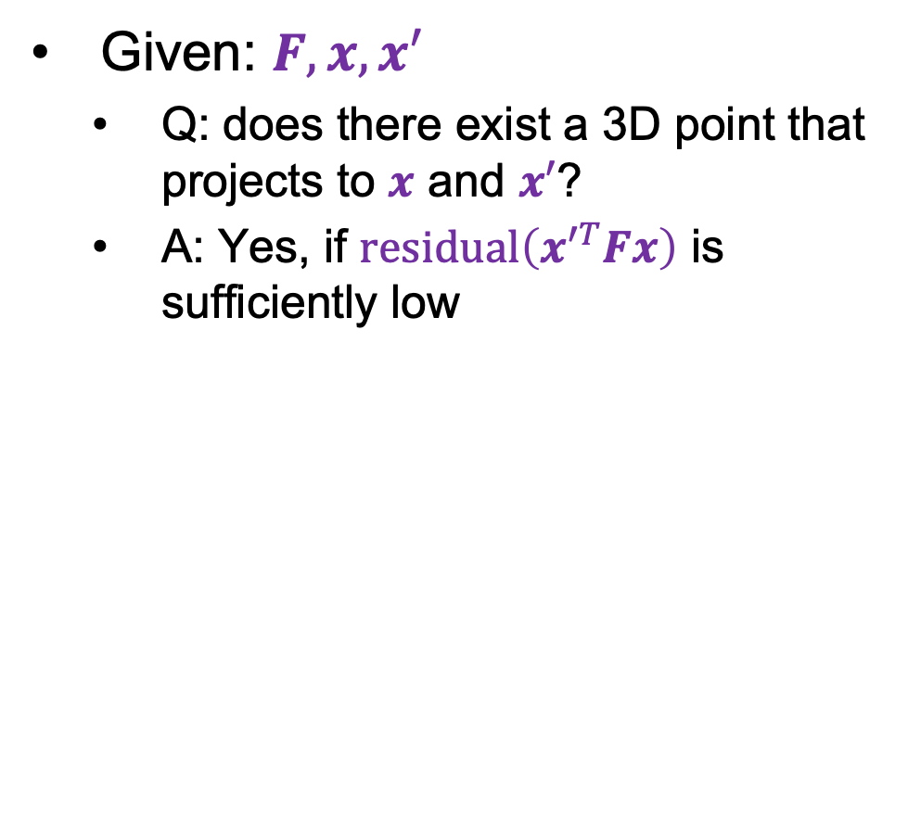


So, how do we use the epipolar constraint?
Given: $F, x, x′$
  Q: does there exist a 3D point that projects to $x$ and $x′$?
  A: Yes, if $residual\left(x^{′T}Fx\right)$ is sufficiently low
$$x$$
$$x^{′}$$

Slide 52

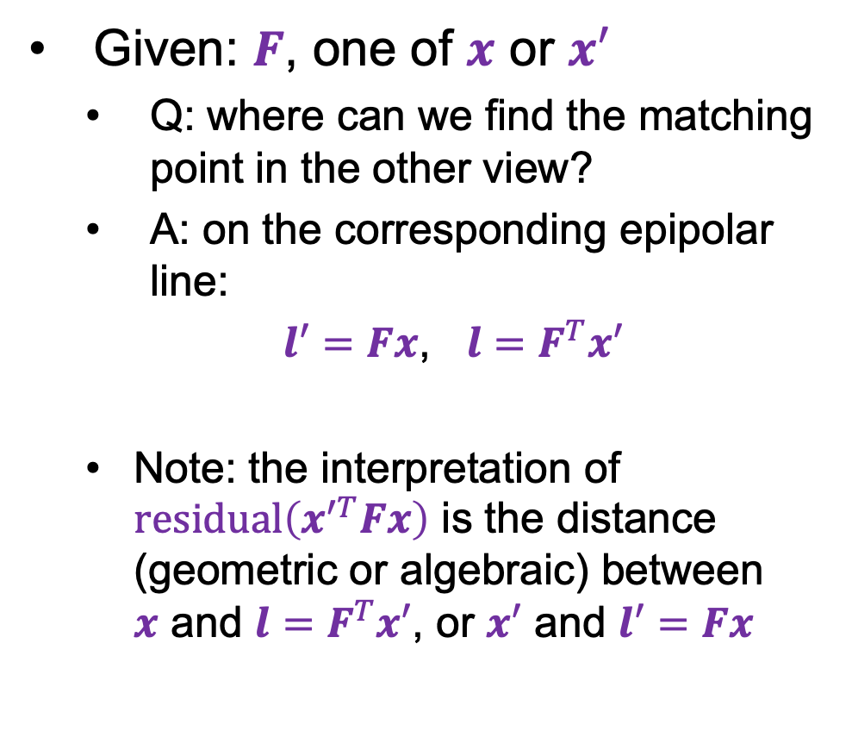

So, how do we use the epipolar constraint?
Given: $F$, one of $x$ or $x′$
  Q: where can we find the matching point in the other view?
  A: on the corresponding epipolar line:
  $l′=Fx$, $l=F^{T}x′$
  Note: the interpretation of $residual\left(x^{′T}Fx\right)$ is the distance (geometric or algebraic) between
  $x$ and $l=F^{T}x′$, or $x′$ and $l′=Fx$
$$l$$
$$l^{′}$$
$$x$$
$$x^{′}$$

Slide 53
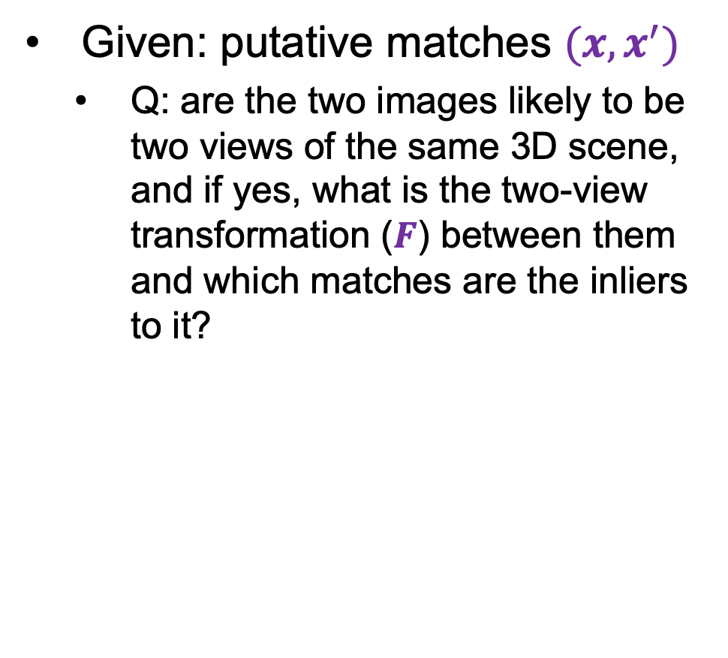
So, how do we use the epipolar constraint?
Given: putative matches $(x, x^{′})$
  Q: are the two images likely to be two views of the same 3D scene, and if yes, what is the two-view transformation ($F$) between them and which matches are the inliers to it?
$$x$$
$$x^{′}$$

Slide 54
Outline
Motivation
Epipolar geometry setup
Epipolar constraint
Essential matrix
Fundamental matrix
Estimating the fundamental matrix

Slide 55
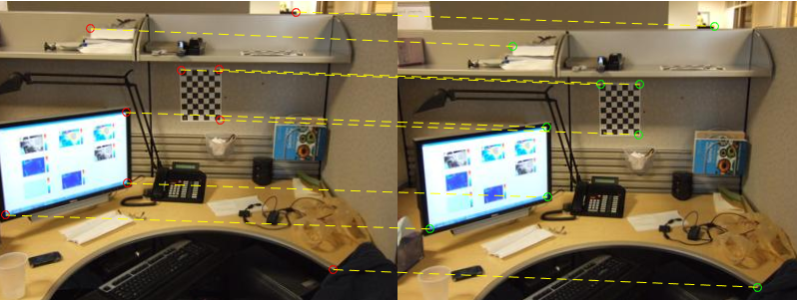
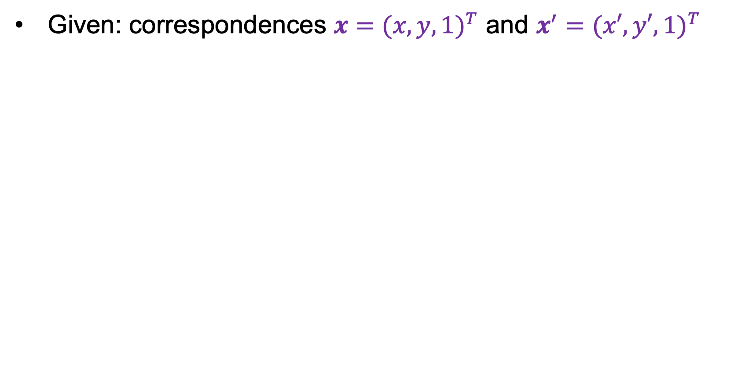
Estimating the fundamental matrix
Given: correspondences $x={(x,y,1)}^{T}$ and $x^{′}={(x′,y′,1)}^{T}$

Slide 56
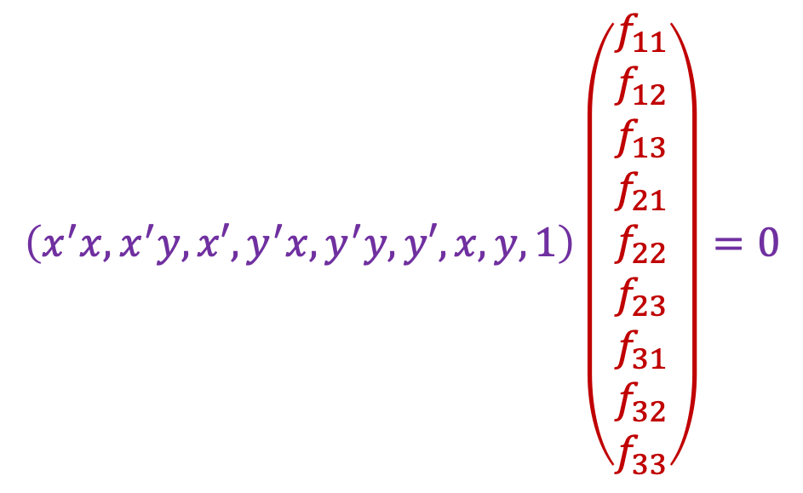
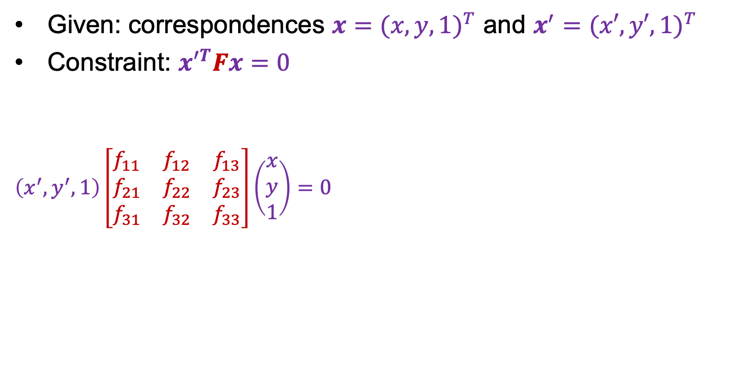
Estimating the fundamental matrix
Given: correspondences $x={(x,y,1)}^{T}$ and $x^{′}={(x′,y′,1)}^{T}$
Constraint: ${x′}^{T}Fx=0$
$$\left(x^{′},y^{′},1\right)\left[\begin{matrix}f_{11} & f_{12} & f_{13} \\ f_{21} & f_{22} & f_{23} \\ f_{31} & f_{32} & f_{33}\end{matrix}\right]\left(\begin{aligned}x \\ y \\ 1\end{aligned}\right)=0$$
$$\left(x^{′}x,x^{′}y, x′,y^{′}x,y^{′}y,y′,x,y,1\right)\left(\begin{aligned}f_{11} \\ f_{12} \\ f_{13} \\ \begin{aligned}f_{21} \\ f_{22} \\ f_{23}\end{aligned} \\ \begin{aligned}f_{31} \\ f_{32} \\ f_{33}\end{aligned}\end{aligned}\right)=0$$

Slide 57
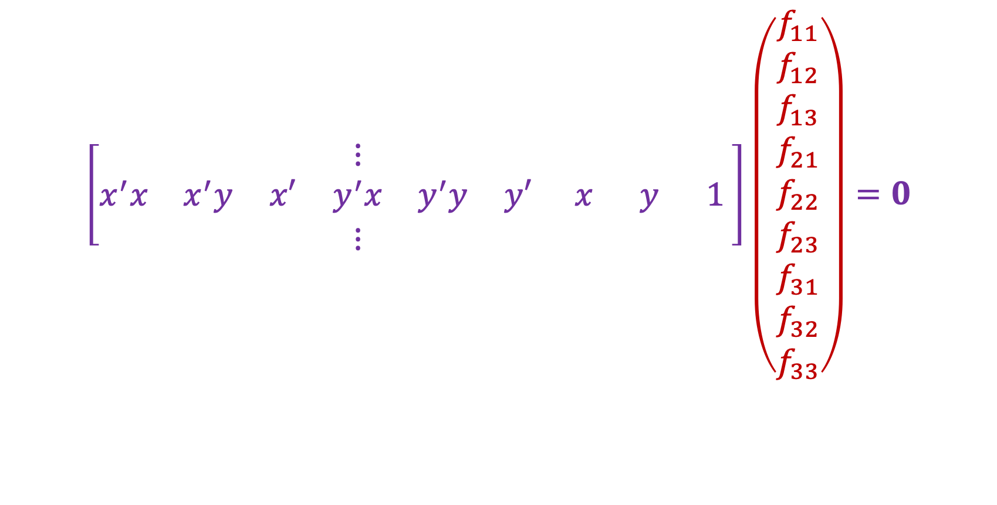



The eight point algorithm
$$\left[\begin{matrix} & & & ⋮ & & & & & \\ x^{′}x & x^{′}y & x′ & y^{′}x & y^{′}y & y′ & x & y & 1 \\ & & & ⋮ & & & & & \end{matrix}\right]\left(\begin{aligned}f_{11} \\ f_{12} \\ f_{13} \\ \begin{aligned}f_{21} \\ f_{22} \\ f_{23}\end{aligned} \\ \begin{aligned}f_{31} \\ f_{32} \\ f_{33}\end{aligned}\end{aligned}\right)=0$$
$$A$$
Homogeneous least squares to find $f$:
$${\arg{\min_{\begin{aligned} \\ \left\|f\right\|=1\end{aligned}}\left\|Af\right\|}}_{2}^{2}$$
Eigenvector of $A^{T}A$ with smallest eigenvalue

Slide 58

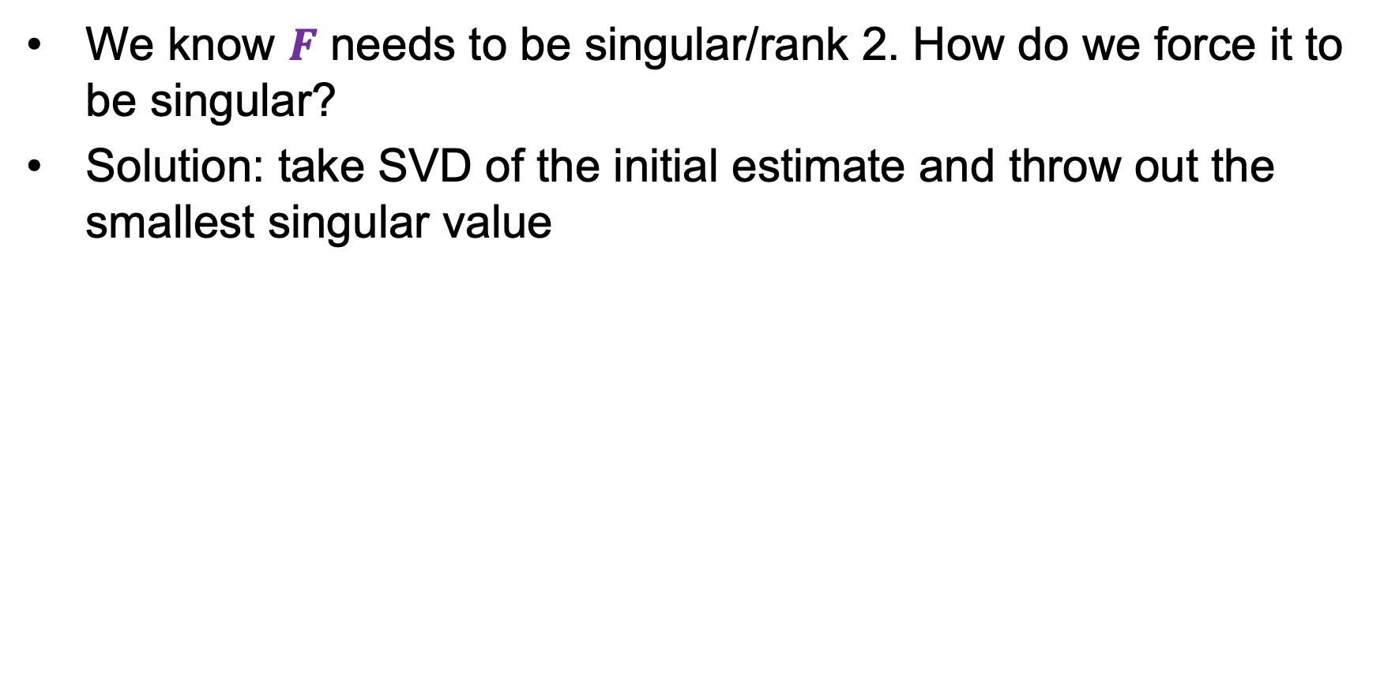
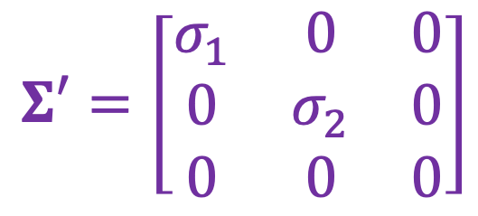

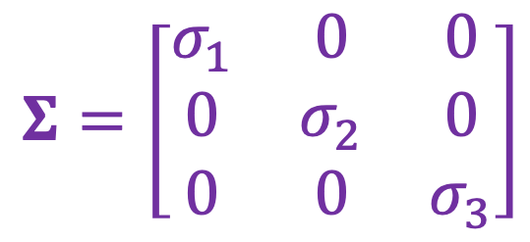
Enforcing rank-2 constraint
We know $F$ needs to be singular/rank 2. How do we force it to be singular?
Solution: take SVD of the initial estimate and throw out the smallest singular value
$$F_{init}=UΣV^{T}$$
$$Σ=\left[\begin{matrix}σ_{1} & 0 & 0 \\ 0 & σ_{2} & 0 \\ 0 & 0 & σ_{3}\end{matrix}\right]$$
$$Σ′=\left[\begin{matrix}σ_{1} & 0 & 0 \\ 0 & σ_{2} & 0 \\ 0 & 0 & 0\end{matrix}\right]$$
$$F=UΣ′V^{T}$$

Slide 59
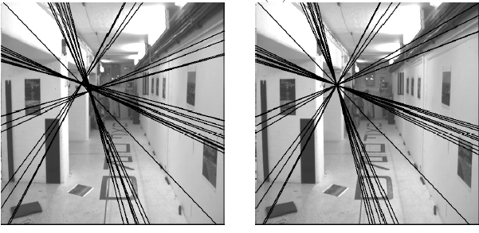

Enforcing rank-2 constraint
Initial $F$ estimate
Rank-2 estimate

Slide 60
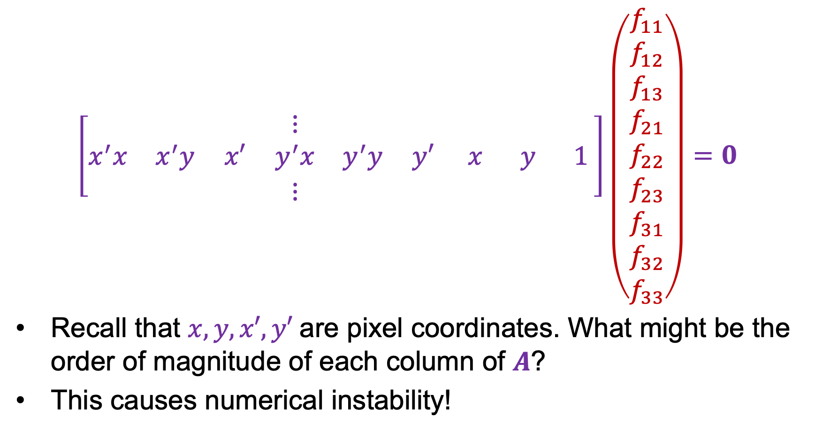
Normalized eight point algorithm
$$\left[\begin{matrix} & & & ⋮ & & & & & \\ x^{′}x & x^{′}y & x′ & y^{′}x & y^{′}y & y′ & x & y & 1 \\ & & & ⋮ & & & & & \end{matrix}\right]\left(\begin{aligned}f_{11} \\ f_{12} \\ f_{13} \\ \begin{aligned}f_{21} \\ f_{22} \\ f_{23}\end{aligned} \\ \begin{aligned}f_{31} \\ f_{32} \\ f_{33}\end{aligned}\end{aligned}\right)=0$$
Recall that $x, y, x′, y′$are pixel coordinates. What might be the order of magnitude of each column of $A$?
This causes numerical instability!
$$\begin{matrix}\begin{matrix}{10}^{6} & {10}^{6} & {10}^{3}\end{matrix} & \begin{matrix}{10}^{6} & {10}^{6} & {10}^{3}\end{matrix} & \begin{matrix}{10}^{3} & {10}^{3} & 1\end{matrix}\end{matrix}$$
$$A$$

Slide 61
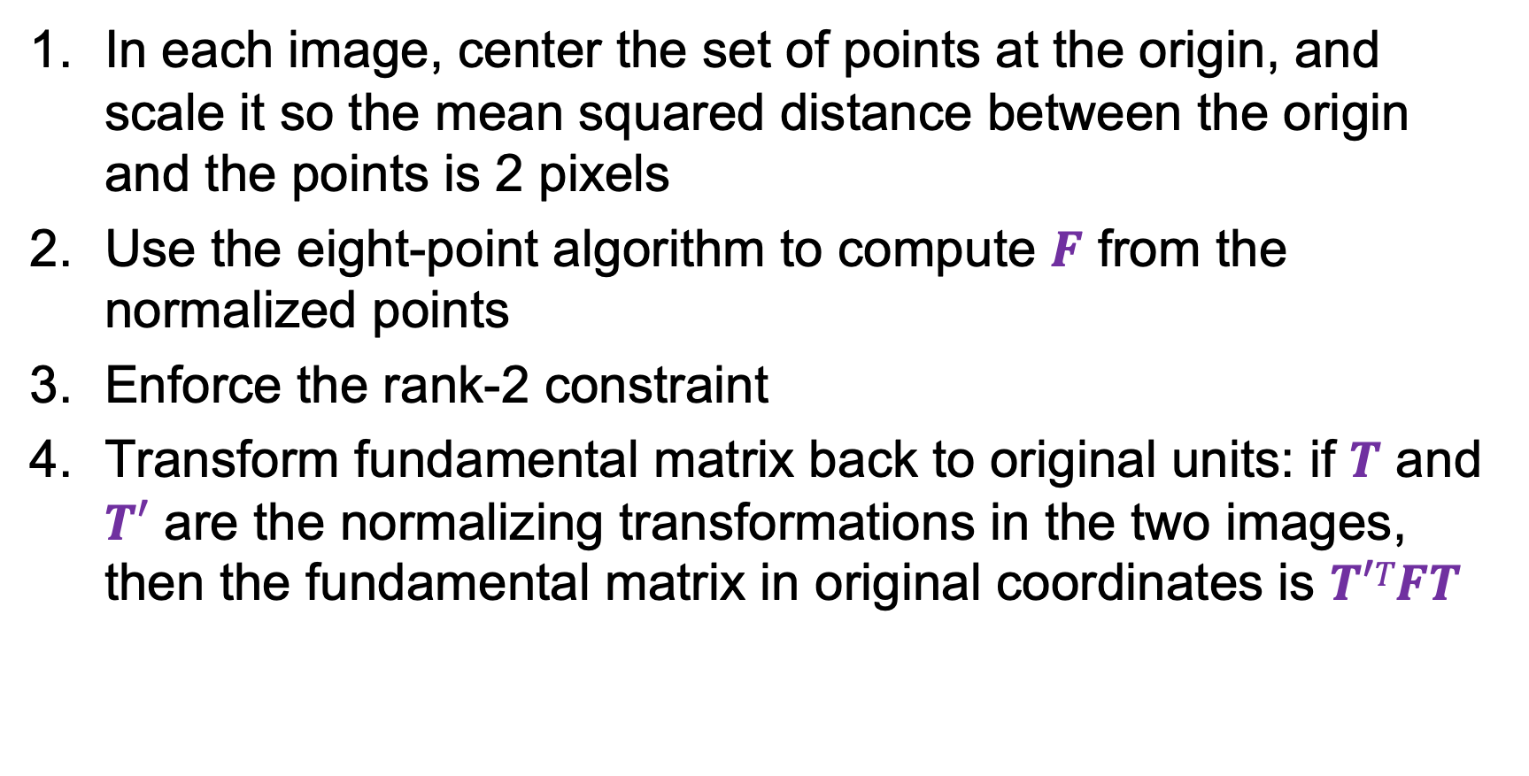
The normalized eight-point algorithm
In each image, center the set of points at the origin, and scale it so the mean squared distance between the origin and the points is 2 pixels
Use the eight-point algorithm to compute $F$ from the normalized points
Enforce the rank-2 constraint
Transform fundamental matrix back to original units: if $T$ and $T′$ are the normalizing transformations in the two images,
then the fundamental matrix in original coordinates is $T′TFT$
R. Hartley. In defense of the eight-point algorithm. TPAMI 1997

Slide 62



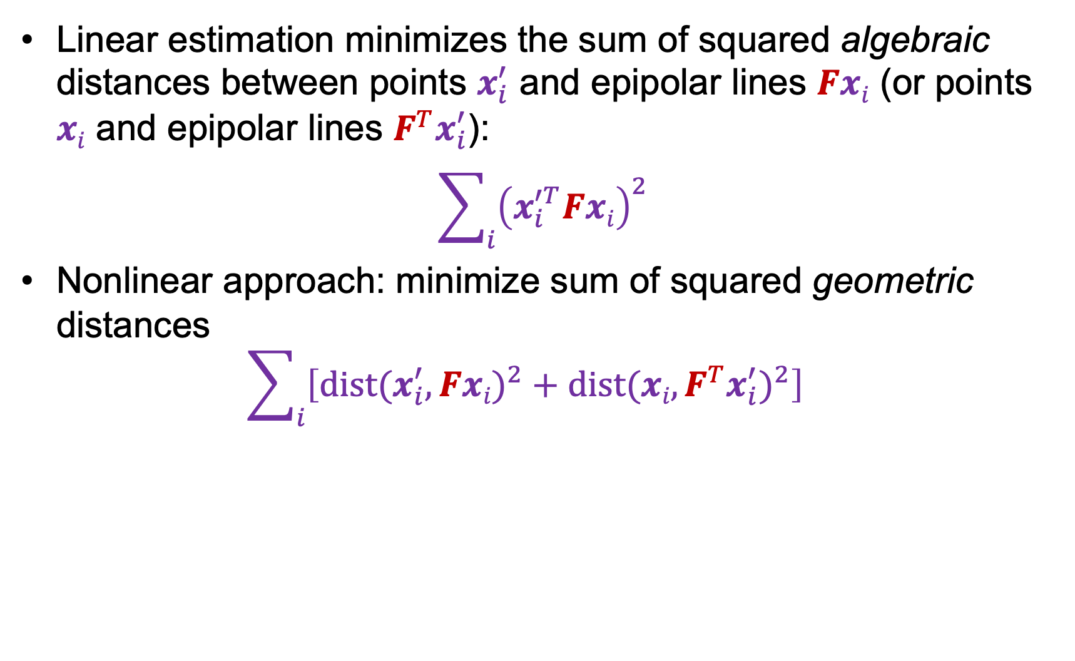
Nonlinear estimation
Linear estimation minimizes the sum of squared algebraic distances between points $x_{i}^{′}$ and epipolar lines $Fxi$ (or points $xi$ and epipolar lines $F^{T}x_{i}^{′}$):
$$\sum_{i}{{\left(x_{i}^{′T}Fxi\right)}^{2}}$$
Nonlinear approach: minimize sum of squared geometric distances
$$\sum_{i}{\left[{dist(x_{i}^{′},Fxi)}^{2}+{dist(xi,F^{T}x_{i}^{′})}^{2}\right]}$$
x_{i}

Slide 63
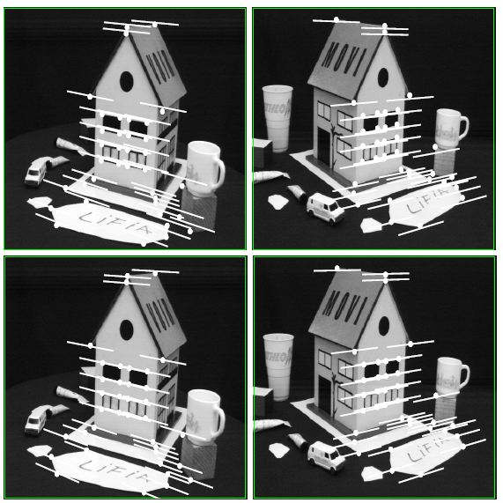
Comparison of estimation algorithms
 | 8-point | Normalized 8-point | Nonlinear least squares
Av. Dist. 1 | 2.33 pixels | 0.92 pixel | 0.86 pixel
Av. Dist. 2 | 2.18 pixels | 0.85 pixel | 0.80 pixel

Slide 64
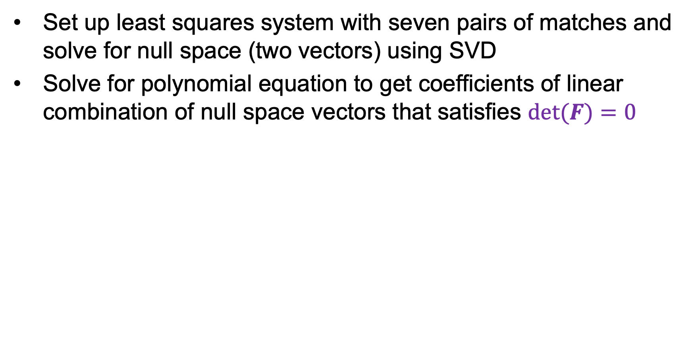
Seven-point algorithm
Set up least squares system with seven pairs of matches and solve for null space (two vectors) using SVD
Solve for polynomial equation to get coefficients of linear combination of null space vectors that satisfies $det⁡(F)=0$
Source: e.g., M. Pollefeys tutorial (2000)

Slide 65
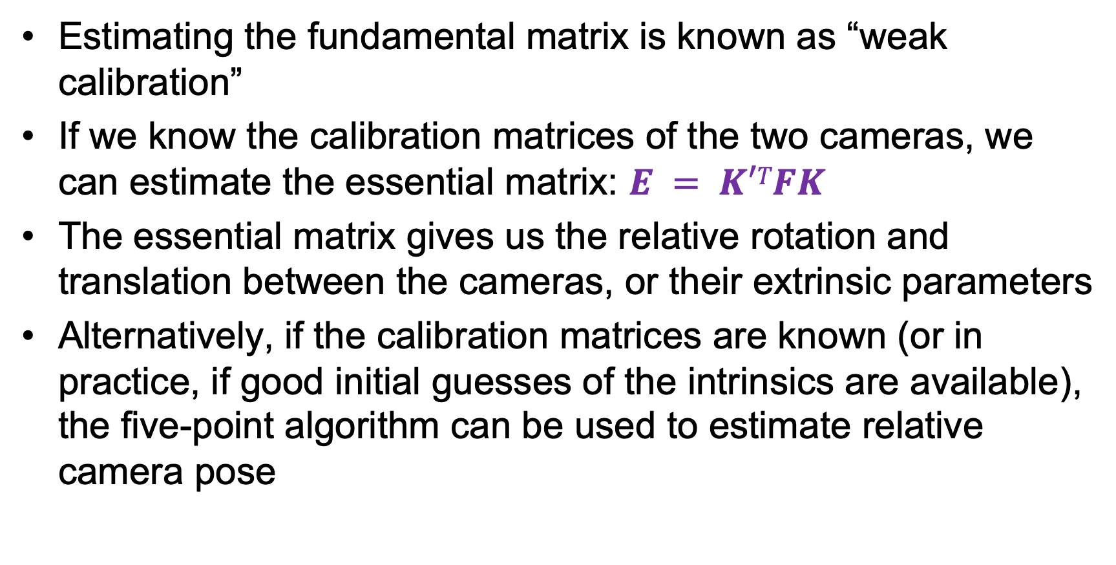
From epipolar geometry to camera calibration
Estimating the fundamental matrix is known as “weak calibration”
If we know the calibration matrices of the two cameras, we can estimate the essential matrix: $E = K′TFK$
The essential matrix gives us the relative rotation and translation between the cameras, or their extrinsic parameters
Alternatively, if the calibration matrices are known (or in practice, if good initial guesses of the intrinsics are available), the five-point algorithm can be used to estimate relative camera pose
D. Nister. An efficient solution to the five-point relative pose problem. IEEE Trans. PAMI, 2004

Slide 66
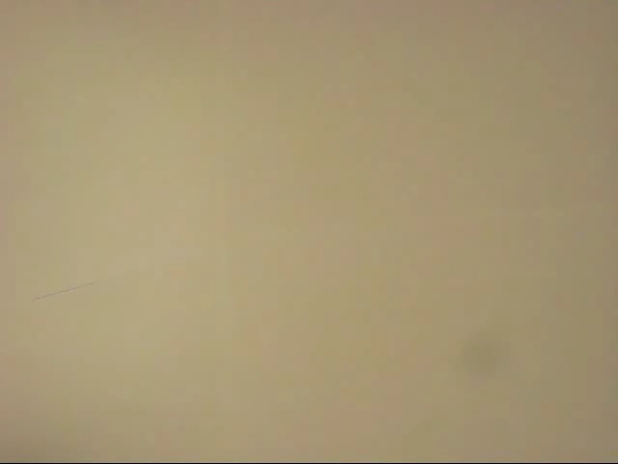
The Fundamental Matrix Song
http://danielwedge.com/fmatrix/

