Slide 1
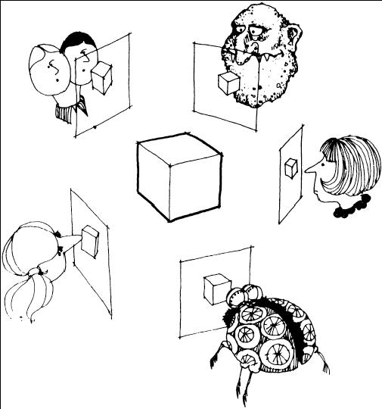
Multi-view stereo
Many slides adapted from S. Seitz, Y. Furukawa, N. Snavely

Slide 2
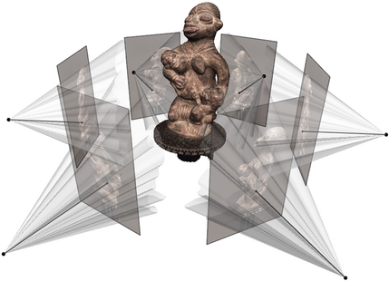
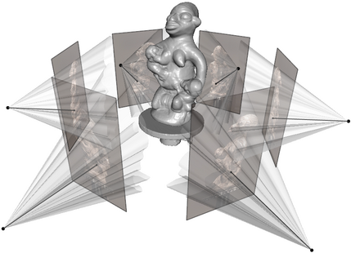
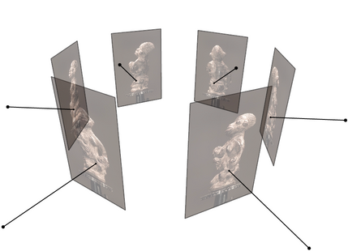
Multi-view stereo
Goal: given several images of the same object or scene, compute a representation of its 3D shape
Source: C. Hernandez, N. Snavely

Slide 3
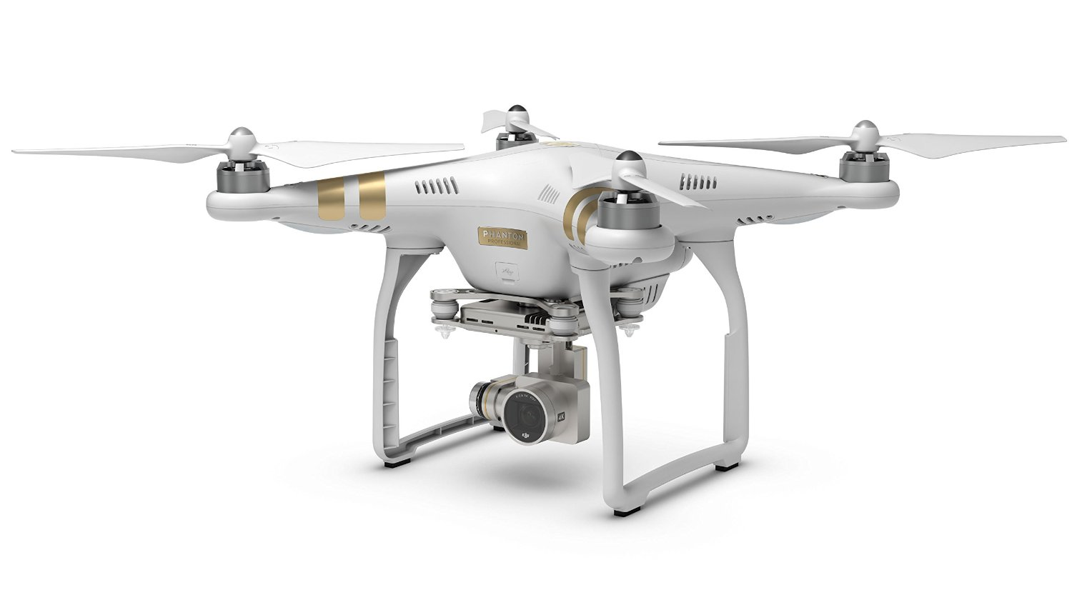
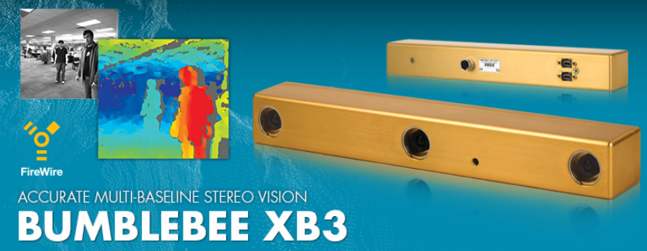
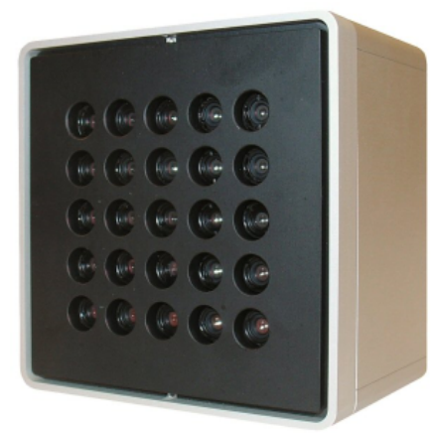
Multi-view stereo
Goal: given several images of the same object or scene, compute a representation of its 3D shape
“Images of the same object or scene”
  Arbitrary number of images (from two to thousands)
  Arbitrary camera positions (special rig, camera network or video)
  Calibration may be known or unknown

Slide 4
Multi-view stereo
Goal: given several images of the same object or scene, compute a representation of its 3D shape
“Images of the same object or scene”
  Arbitrary number of images (from two to thousands)
  Arbitrary camera positions (special rig, camera network or video)
  Calibration may be known or unknown
“Representation of 3D shape”
  Depth maps
  Meshes
  Point clouds
  Patch clouds
  Volumetric models
  Signed distance functions, light fields

Slide 5
Outline
Applications and motivation
Plane sweep stereo
Depth map fusion
Patch-based multi-view stereo (PMVS)
Stereo from Internet photo collections
Recent trends

Slide 6
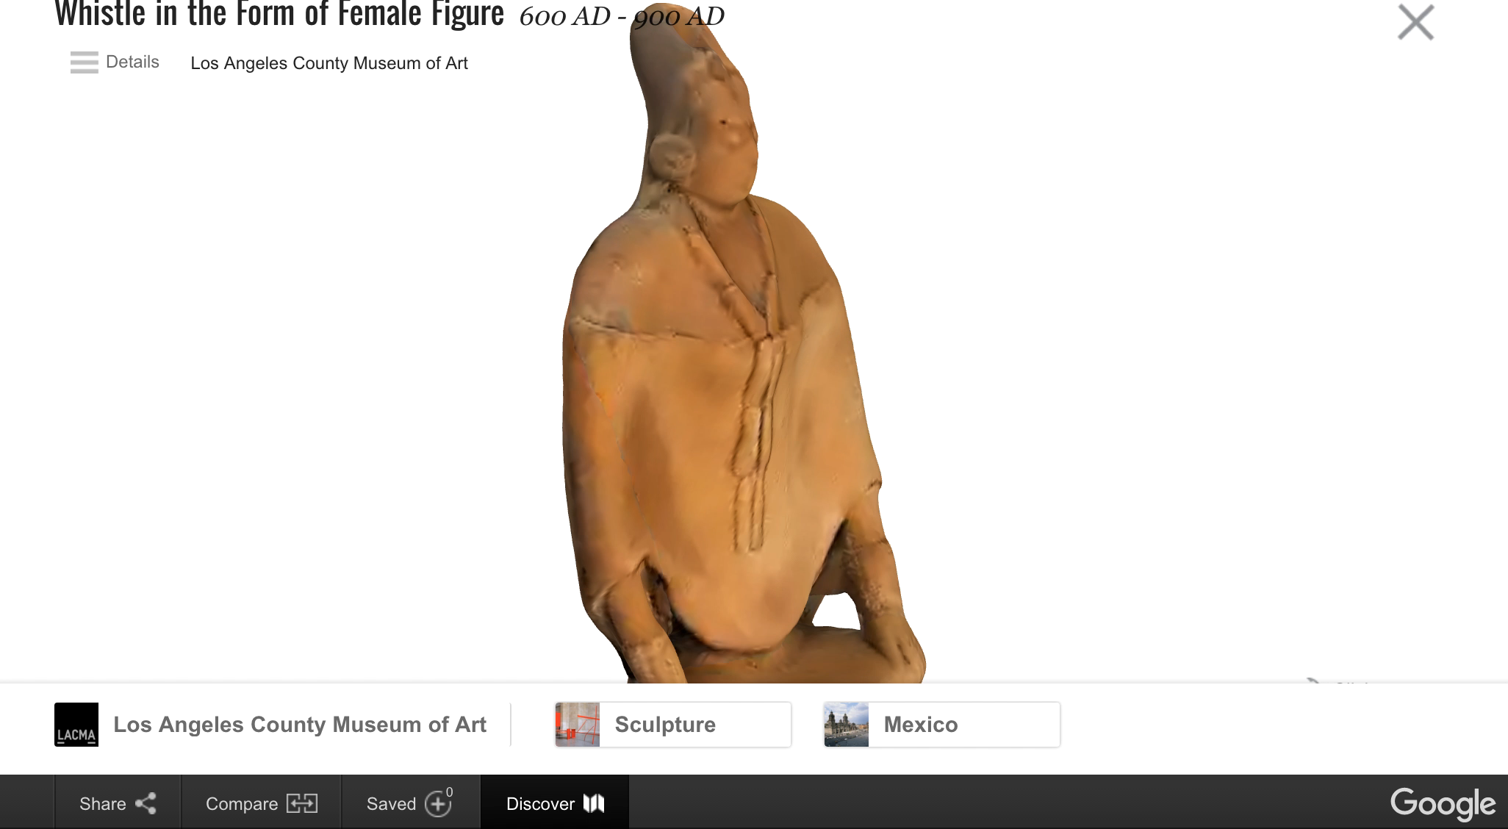
Applications
Source: N. Snavely

Slide 7
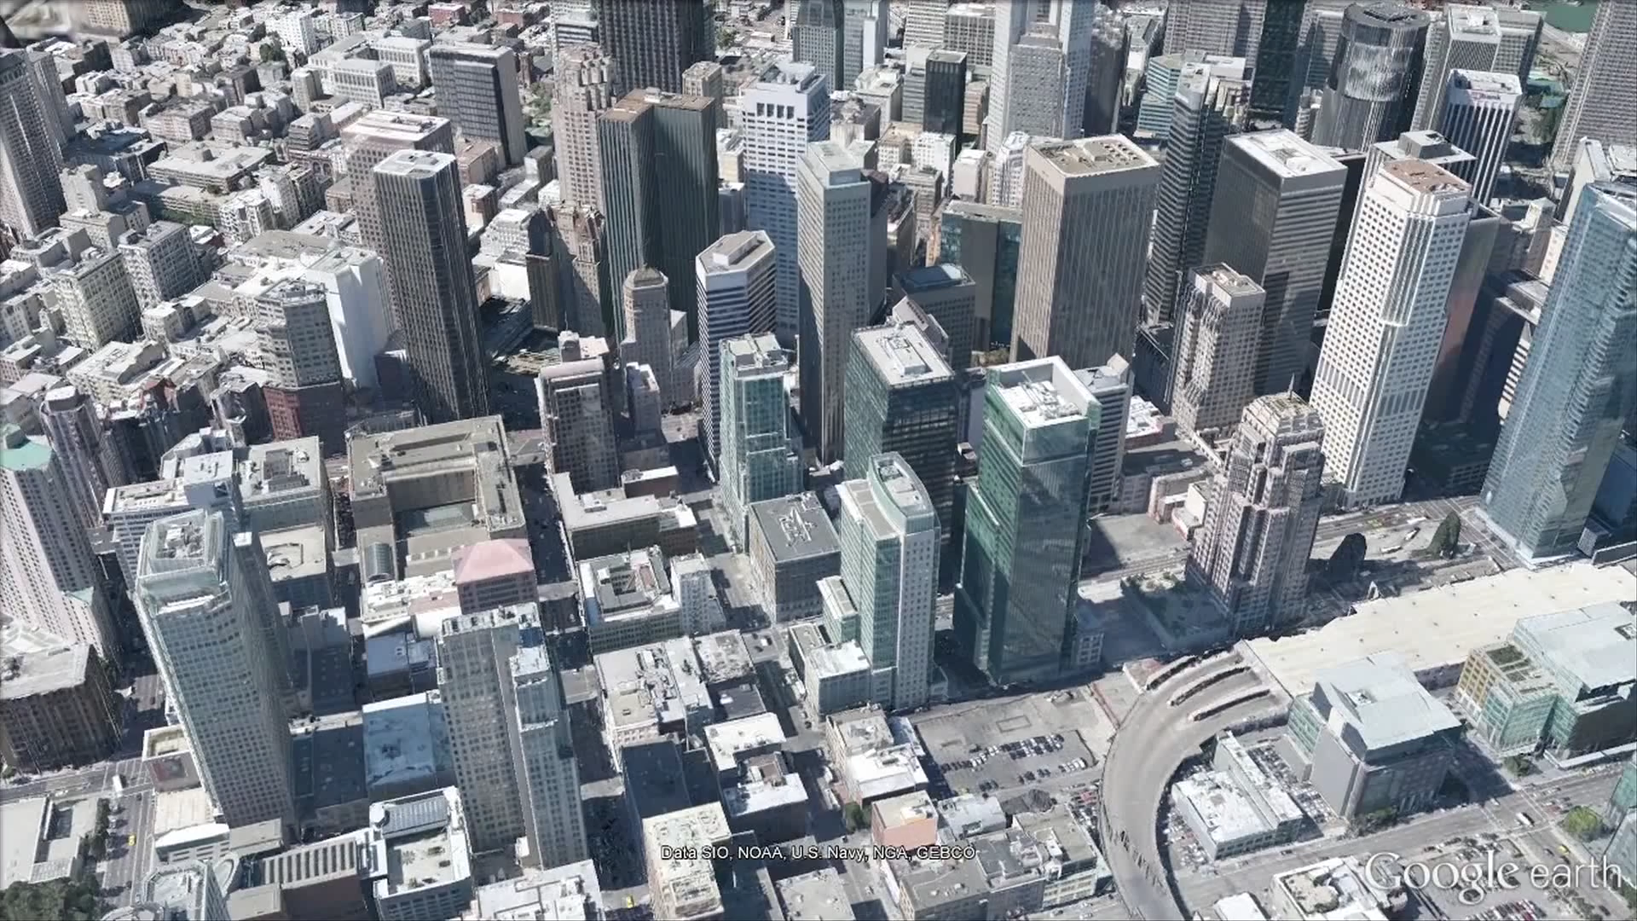
Applications
Source: N. Snavely

Slide 8
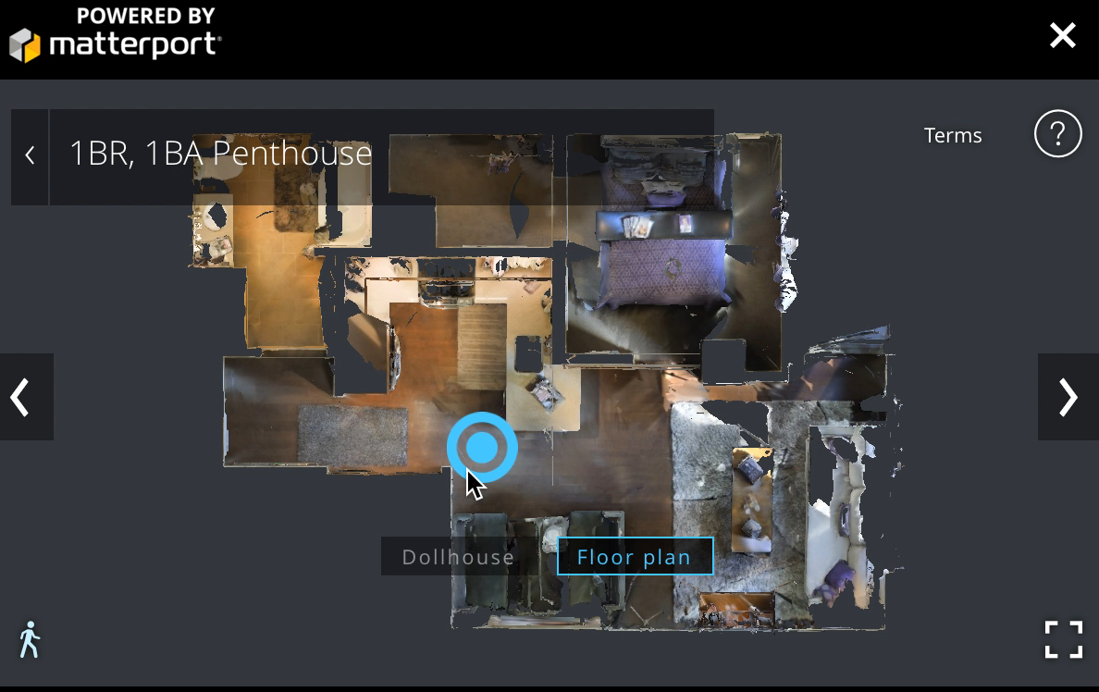
Applications
Source: N. Snavely

Slide 9
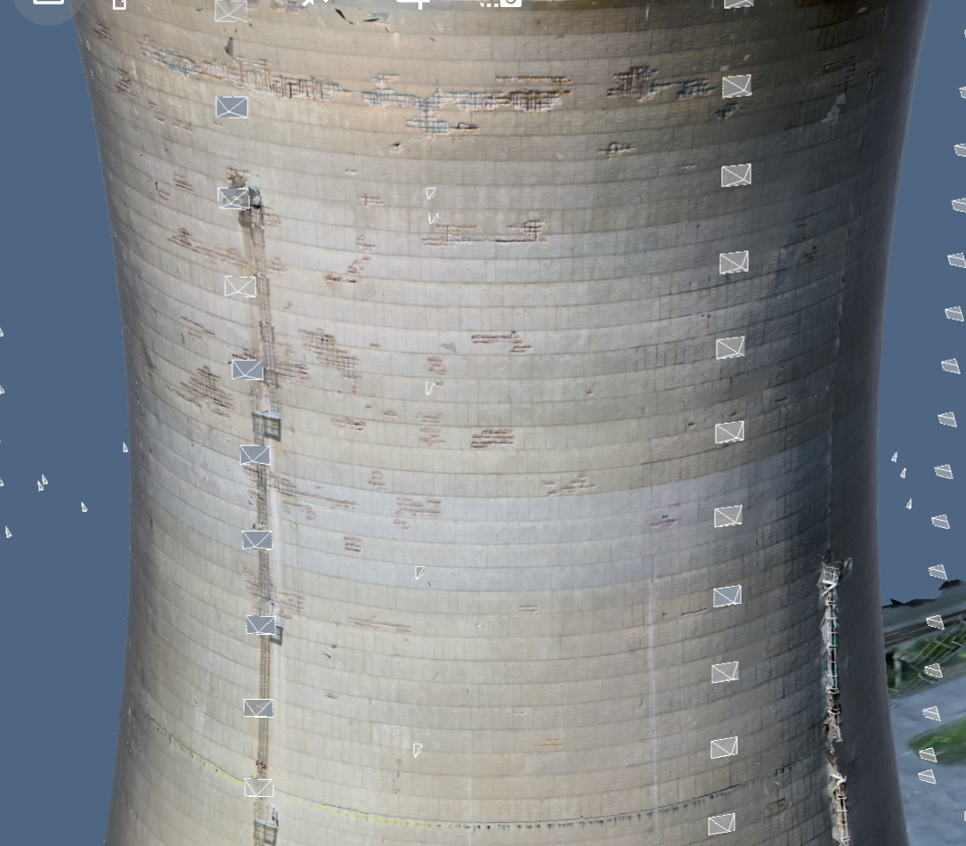
Applications
Enable inspection in hard to reach areas with drone photos and 3D reconstruction
Create 3D model from images
Provide tools to inspect on images and map interactions to 3D
Source: D. Hoiem

Slide 10
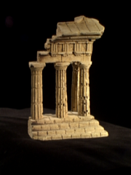
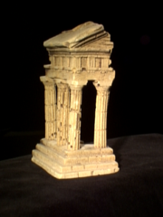
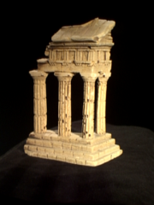
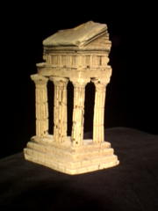
Multi-view stereo: Basic idea
Source: Y. Furukawa

Slide 11
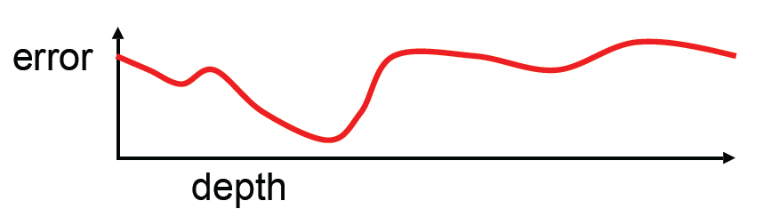
Multi-view stereo: Basic idea
Source: Y. Furukawa

Slide 12
Multi-view stereo: Basic idea
Source: Y. Furukawa

Slide 13
Multi-view stereo: Basic idea
Source: Y. Furukawa

Slide 14
Why MVS?
Different points on the object’s surface will be more clearly visible in some subset of cameras
  Could have high-res closeups of some regions
  Some surfaces are foreshortened from certain views
  Some points may be occluded entirely in certain views
Source: N. Snavely

Slide 15






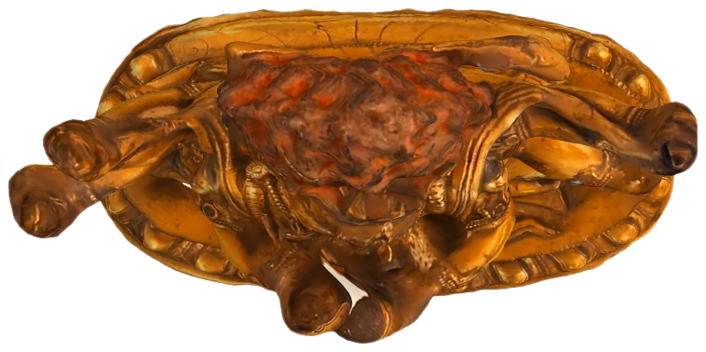

p
1
5
2
3
4
Cameras 4 and 5 can more clearly see point p
Source: N. Snavely

Slide 16
q
1
5
2
3
4
Cameras 3 and 4 can more clearly see point q
Source: N. Snavely

Slide 17
r
1
5
2
3
4
Camera 5 can’t see point r
Source: N. Snavely

Slide 18
s
1
5
2
3
4
Camera 1 can’t see point s
Source: N. Snavely

Slide 19
Why MVS?
Different points on the object’s surface will be more clearly visible in some subset of cameras
  Could have high-res closeups of some regions
  Some surfaces are foreshortened from certain views
  Some points may be occluded entirely in certain views
More measurements per point can reduce error
Source: N. Snavely

Slide 20
More measurements reduce triangulation error
Source: N. Snavely

Slide 21
More measurements reduce triangulation error
Source: N. Snavely

Slide 22
Outline
Applications and motivation
Plane sweep stereo
Depth map fusion

Slide 23
Plane sweep stereo
input image
input image
reference camera
Sweep plane across a range of depths w.r.t. a reference camera
  For each depth, project each input image onto that plane (homography) and compare the resulting stack of images
R. Collins, A space-sweep approach to true multi-image matching, CVPR 1996

Slide 24
Plane sweep stereo
input image
input image
reference camera
Sweep plane across a range of depths w.r.t. a reference camera
  For each depth, project each input image onto that plane (homography) and compare the resulting stack of images
R. Collins, A space-sweep approach to true multi-image matching, CVPR 1996

Slide 25
Plane sweep stereo: Key idea
Scene surface
Sweeping plane
Image 1
Image 2
Reference image

Slide 26
Plane sweep stereo: Key idea
Image 2
Image 1

Slide 27
Plane sweep stereo: Key idea
Image 2
Image 1

Slide 28
Plane sweep stereo: Key idea
Image 2
Image 1

Slide 29
Plane sweep stereo: Key idea
Image 2
Image 1

Slide 30
Plane sweep stereo: Key idea
Image 2
Image 1

Slide 31
Plane sweep stereo: Key idea
✓
Image 1
Image 2
Reference image

Slide 32
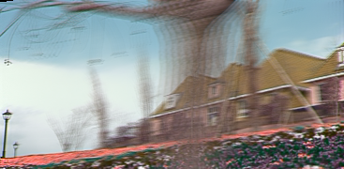
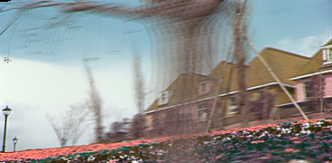
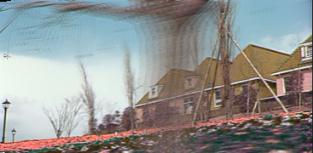
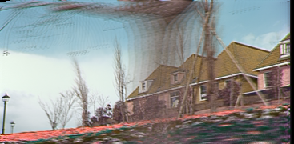
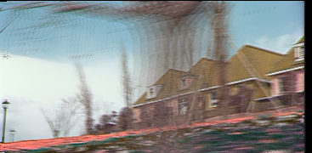
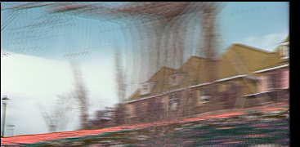
Plane sweep stereo: Fast implementation
For each depth plane
  Compute homographies projecting each image onto that depth plane
  For each pixel in the composite image stack, compute the variance
For each pixel, select the depth that gives the lowest variance
R. Yang and M. Pollefeys, Multi-Resolution Real-Time Stereo on Commodity Graphics Hardware, CVPR 2003

Slide 33
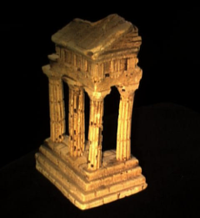
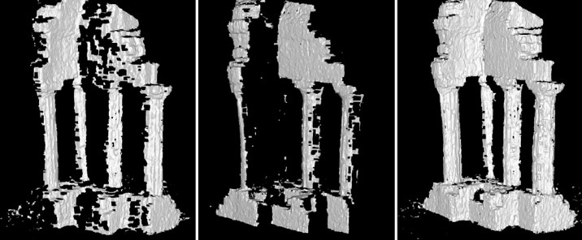
Merging depth maps
Given a group of images, compute a depth map using each view as a reference
Merge multiple depth maps into a volume or a mesh (see, e.g., Curless and Levoy, 1996)
Map 1
Map 2
Merged

Slide 34




Volumetric fusion
Source: N. Snavely

Slide 35
Volumetric fusion
Source: N. Snavely

Slide 36
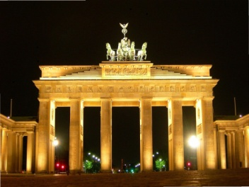
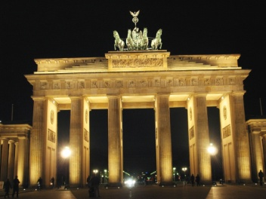
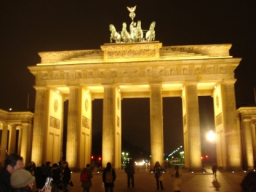
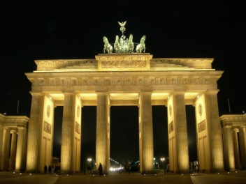
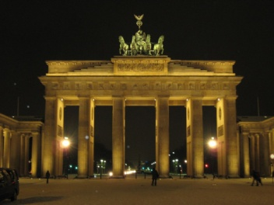
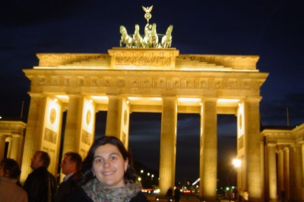
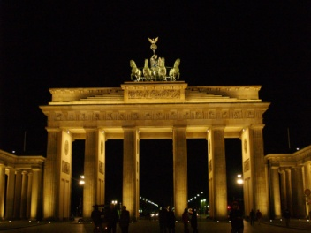
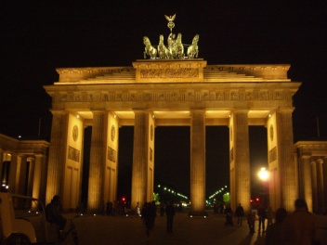
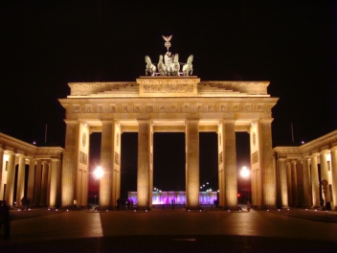
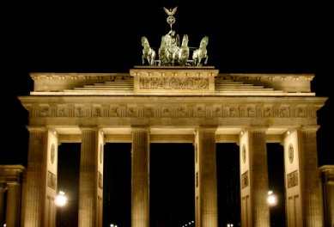
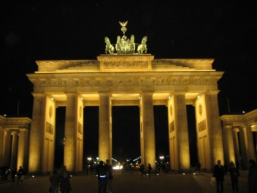
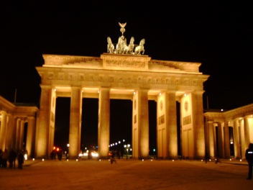
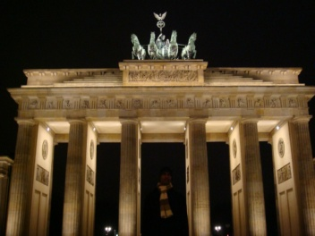
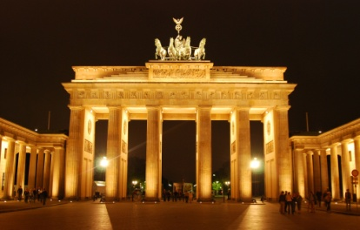
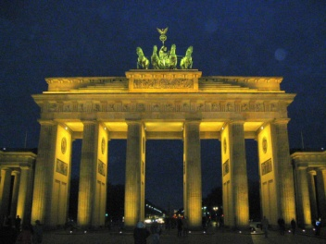
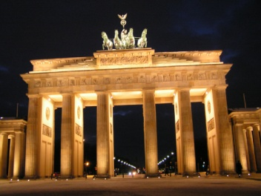
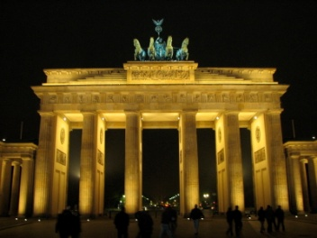
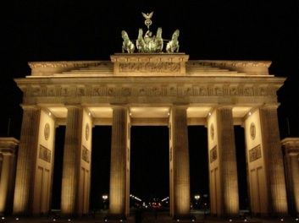
Fast depth map fusion using height maps
Start with a cluster of registered views (from SFM on Internet photo collections)
J.-M. Frahm et al., Building Rome on a Cloudless Day, ECCV 2010
D. Gallup et al. 3D Reconstruction using an n-Layer Heightmap. DAGM 2010
Notes:
stereo is same as for video just NCC instead of SAD

Slide 37

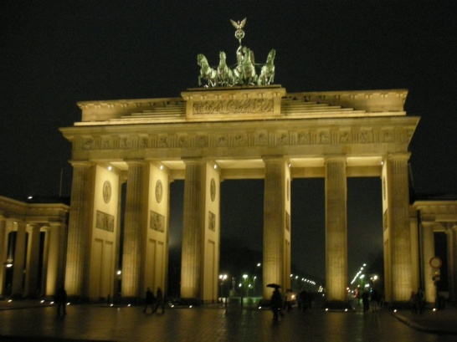
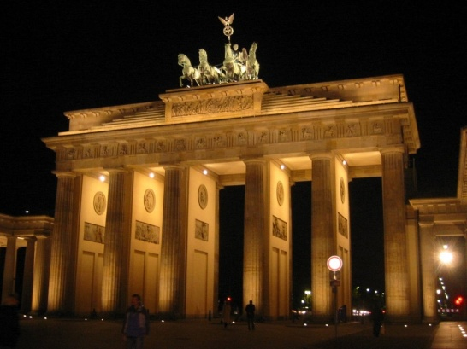
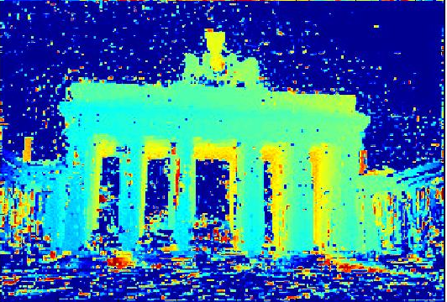
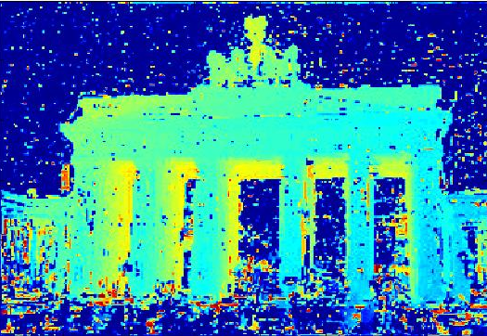
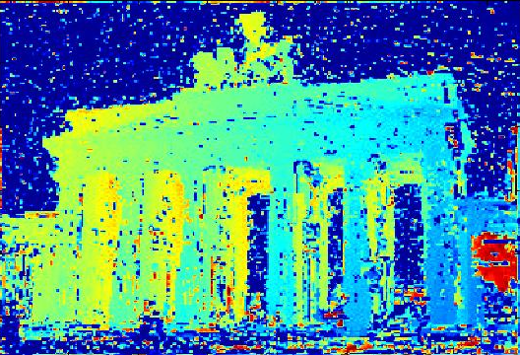
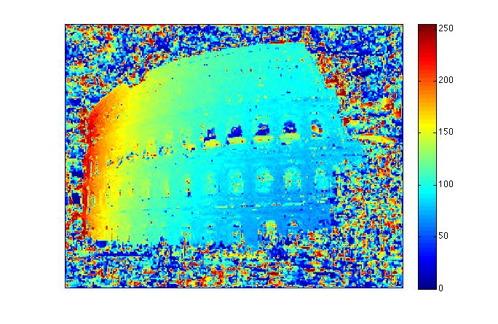
Fast depth map fusion using height maps
Obtain a (noisy) depth map for every view using plane sweeping stereo with normalized cross-correlation
far
near
J.-M. Frahm et al., Building Rome on a Cloudless Day, ECCV 2010
D. Gallup et al. 3D Reconstruction using an n-Layer Heightmap. DAGM 2010
Notes:
stereo is same as for video just NCC instead of SAD

Slide 38
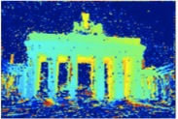


Fast depth map fusion using height maps
Enforces vertical facades
One continuous surface,
no holes
Fast to compute,
low memory complexity
J.-M. Frahm et al., Building Rome on a Cloudless Day, ECCV 2010
D. Gallup et al. 3D Reconstruction using an n-Layer Heightmap. DAGM 2010

Slide 39



Fast depth map fusion using height maps
YouTube Video
J.-M. Frahm et al., Building Rome on a Cloudless Day, ECCV 2010

Slide 40
Outline
Applications and motivation
Plane sweep stereo
Depth map fusion
Patch-based multi-view stereo (PMVS)
Stereo from Internet photo collections

Slide 41

Patch-based multi-view stereo (PMVS)
Detect keypoints
Triangulate a sparse set of initial matches
Iteratively expand matches to nearby locations
Use visibility constraints to filter out false matches
Perform surface reconstruction
Y. Furukawa and J. Ponce, Accurate, Dense, and Robust Multi-View Stereopsis, CVPR 2007.
PMVS software

Slide 42

Patch-based multi-view stereo (PMVS)
Y. Furukawa and J. Ponce, Accurate, Dense, and Robust Multi-View Stereopsis, CVPR 2007.
PMVS software

Slide 43


Stereo from community photo collections
Need structure from motion to recover unknown camera parameters
Need view selection to find good groups of images on which to run dense stereo

Slide 44

Local view selection
M. Goesele et al., Multi-View Stereo for Community Photo Collections, ICCV 2007

Slide 45

Local view selection
M. Goesele et al., Multi-View Stereo for Community Photo Collections, ICCV 2007

Slide 46

Local view selection
M. Goesele et al., Multi-View Stereo for Community Photo Collections, ICCV 2007

Slide 47

Local view selection
Notre Dame de Paris
653 images
313 photographers
M. Goesele et al., Multi-View Stereo for Community Photo Collections, ICCV 2007

Slide 48


Local view selection
M. Goesele et al., Multi-View Stereo for Community Photo Collections, ICCV 2007

Slide 49


Local view selection
Model merged from 72 depth maps
Model from 56 depth maps with laser scan overlaid
(90% of points within 0.25% of ground truth)
M. Goesele et al., Multi-View Stereo for Community Photo Collections, ICCV 2007

Slide 50

Towards Internet-scale multi-view stereo
Y. Furukawa, B. Curless, S. Seitz and R. Szeliski, Towards Internet-scale Multi-view Stereo, CVPR 2010

Slide 51

Towards Internet-scale multi-view stereo
YouTube video, CMVS software
Y. Furukawa, B. Curless, S. Seitz and R. Szeliski, Towards Internet-scale Multi-view Stereo, CVPR 2010

Slide 52

The Visual Turing Test for scene reconstruction
Q. Shan, R. Adams, B. Curless, Y. Furukawa, and S. Seitz, The Visual Turing Test for Scene Reconstruction, 3DV 2013. YouTube video
Notes:
Abstract: We present the first large scale system for capturing and rendering relightable scene reconstructions from massive unstructured photo collections taken under different illumination conditions and viewpoints. We combine photos taken from many sources, Flickr-based ground-level imagery, oblique aerial views, and streetview, to recover models that are significantly more complete and detailed than previously demonstrated. We demonstrate the ability to match both the viewpoint and illumination of arbitrary input photos, enabling a Visual Turing Test in which photo and rendering are viewed side-by-side and the observer has to guess which is which. While we cannot yet fool human perception, the gap is closing.

Slide 53
Last time: Multi-view stereo
Applications and motivation
Plane sweep stereo
Depth map fusion
Patch-based multi-view stereo (PMVS)
Stereo from Internet photo collections

Slide 54

COLMAP MVS
J. Schonberger et al. Pixelwise View Selection for Unstructured Multi-View Stereo. ECCV 2016
Results video

Slide 55
Outline
Applications and motivation
Plane sweep stereo
Patch-based multi-view stereo (PMVS)
Stereo from Internet photo collections
Recent trends, deep learning approaches

Slide 56





Ongoing research directions
Challenging lighting conditions
Ground/aerial
Indoor modeling
Dynamic reconstruction

Slide 57

Deep learning for MVS
Y. Yao et al. MVSNet: Depth Inference for Unstructured Multi-view Stereo. ECCV 2018
Notes:
We present an end-to-end deep learning architecture for depth map inference from multi-view images. In the network, we first extract deep visual image features, and then build the 3D cost volume upon the reference camera frustum via the differentiable homography warping. Next, we apply 3D convolutions to regularize and regress the initial depth map, which is then refined with the reference image to generate the final output. Our framework flexibly adapts arbitrary N-view inputs using a variance-based cost metric that maps multiple features into one cost feature. The proposed MVSNet is demonstrated on the large-scale indoor DTU dataset. With simple post-processing, our method not only significantly outperforms previous state-of-the-arts, but also is several times faster in runtime. We also evaluate MVSNet on the complex outdoor Tanks and Temples dataset, where our method ranks first before April 18, 2018 without any fine-tuning, showing the strong generalization ability of MVSNet.

Slide 58

Deep learning for MVS
Y. Yao et al. MVSNet: Depth Inference for Unstructured Multi-view Stereo. ECCV 2018

Slide 59


DUSt3R: Dense Unconstrained Stereo 3D Reconstruction
S. Wang et al. DUSt3R: Geometric 3D Vision Made Easy. CVPR 2024

Slide 60


DUSt3R: Dense Unconstrained Stereo 3D Reconstruction
Training data: 8.5M image pairs with reference 3D
Training objective: fully supervised 3D regression (scale-normalized, weighted by confidence)
S. Wang et al. DUSt3R: Geometric 3D Vision Made Easy. CVPR 2024

Slide 61

DUSt3R: Dense Unconstrained Stereo 3D Reconstruction
S. Wang et al. DUSt3R: Geometric 3D Vision Made Easy. CVPR 2024

Slide 62

DUSt3R: Dense Unconstrained Stereo 3D Reconstruction
Reconstruction from nearly opposite viewpoints
S. Wang et al. DUSt3R: Geometric 3D Vision Made Easy. CVPR 2024

Slide 63

MAST3R: Matching and Stereo 3D Reconstruction
V. Leroy et al. Grounding image matching in 3D with MASt3R. ECCV 2024

Slide 64

MAST3R: Matching and Stereo 3D Reconstruction
V. Leroy et al. Grounding image matching in 3D with MASt3R. ECCV 2024

Slide 65

MAST3R: Matching and Stereo 3D Reconstruction

Slide 66

MAST3R: Matching and Stereo 3D Reconstruction

