Slide 1
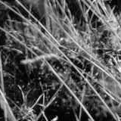
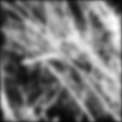
Image filtering

Slide 2
Image filtering: Outline
Linear filtering and its properties
Gaussian filters and their properties
Nonlinear filtering: Median filtering, bilateral filtering
Fun filtering application: Hybrid images

Slide 3
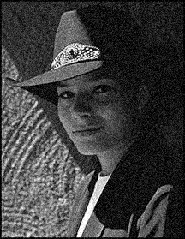
Sliding window operations
Let’s slide a fixed-size window over the image and perform the same simple computation at each window location
Example use case: how do we reduce image noise?
  Let’s take the average of pixel values in each window
  More generally, we can take a weighted sum where the weights are given by a filter kernel

Slide 4









































Applying a linear filter
Input
Filter
Output
$$I11$$
$$I12$$
$$I13$$
$$I14$$
$$I15$$
$$I16$$
$$I21$$
$$I22$$
$$I23$$
$$I24$$
$$I25$$
$$I26$$
$$f11$$
$$f12$$
$$f13$$
$$I31$$
$$I32$$
$$I33$$
$$I34$$
$$I35$$
$$I36$$
$$∗$$
$$f21$$
$$f22$$
$$f23$$
$$=$$
$$I41$$
$$I42$$
$$I43$$
$$I44$$
$$I45$$
$$I46$$
$$f31$$
$$f32$$
$$f33$$
$$I51$$
$$I52$$
$$I53$$
$$I54$$
$$I55$$
$$I56$$
Adapted from D. Fouhey and J. Johnson

Slide 5

Applying a linear filter
Input
Filter
Output
$$I11$$
$$I12$$
$$I13$$
$$I14$$
$$I15$$
$$I16$$
$$I21$$
$$I22$$
$$I23$$
$$I24$$
$$I25$$
$$I26$$
$$f11$$
$$f12$$
$$f13$$
$$O11$$
$$I31$$
$$I32$$
$$I33$$
$$I34$$
$$I35$$
$$I36$$
$$∗$$
$$f21$$
$$f22$$
$$f23$$
$$=$$
$$I41$$
$$I42$$
$$I43$$
$$I44$$
$$I45$$
$$I46$$
$$f31$$
$$f32$$
$$f33$$
$$I51$$
$$I52$$
$$I53$$
$$I54$$
$$I55$$
$$I56$$
$$O11 = I11∙f11 + I12∙f12+ I13∙f13+ … + I33∙f33$$
Adapted from D. Fouhey and J. Johnson

Slide 6

Applying a linear filter
Input
Filter
Output
$$I11$$
$$I12$$
$$I13$$
$$I14$$
$$I15$$
$$I16$$
$$I21$$
$$I22$$
$$I23$$
$$I24$$
$$I25$$
$$I26$$
$$f11$$
$$f12$$
$$f13$$
$$O11$$
$$O12$$
$$I31$$
$$I32$$
$$I33$$
$$I34$$
$$I35$$
$$I36$$
$$∗$$
$$f21$$
$$f22$$
$$f23$$
$$=$$
$$I41$$
$$I42$$
$$I43$$
$$I44$$
$$I45$$
$$I46$$
$$f31$$
$$f32$$
$$f33$$
$$I51$$
$$I52$$
$$I53$$
$$I54$$
$$I55$$
$$I56$$
$$O12 = I12∙f11 + I13∙f12+ I14∙f13+ … + I34∙f33$$
Adapted from D. Fouhey and J. Johnson

Slide 7

Applying a linear filter
Input
Filter
Output
$$I11$$
$$I12$$
$$I13$$
$$I14$$
$$I15$$
$$I16$$
$$I21$$
$$I22$$
$$I23$$
$$I24$$
$$I25$$
$$I26$$
$$f11$$
$$f12$$
$$f13$$
$$O11$$
$$O12$$
$$O13$$
$$I31$$
$$I32$$
$$I33$$
$$I34$$
$$I35$$
$$I36$$
$$∗$$
$$f21$$
$$f22$$
$$f23$$
$$=$$
$$I41$$
$$I42$$
$$I43$$
$$I44$$
$$I45$$
$$I46$$
$$f31$$
$$f32$$
$$f33$$
$$I51$$
$$I52$$
$$I53$$
$$I54$$
$$I55$$
$$I56$$
$$O13 = I13∙f11 + I14∙f12+ I15∙f13+ … + I35∙f33$$
Adapted from D. Fouhey and J. Johnson

Slide 8

Applying a linear filter
Input
Filter
Output
$$I11$$
$$I12$$
$$I13$$
$$I14$$
$$I15$$
$$I16$$
$$I21$$
$$I22$$
$$I23$$
$$I24$$
$$I25$$
$$I26$$
$$f11$$
$$f12$$
$$f13$$
$$O11$$
$$O12$$
$$O13$$
$$O14$$
$$I31$$
$$I32$$
$$I33$$
$$I34$$
$$I35$$
$$I36$$
$$∗$$
$$f21$$
$$f22$$
$$f23$$
$$=$$
$$I41$$
$$I42$$
$$I43$$
$$I44$$
$$I45$$
$$I46$$
$$f31$$
$$f32$$
$$f33$$
$$I51$$
$$I52$$
$$I53$$
$$I54$$
$$I55$$
$$I56$$
$$O14 = I14∙f11 + I15∙f12+ I16∙f13+ … + I36∙f33$$
Adapted from D. Fouhey and J. Johnson

Slide 9

Applying a linear filter
Input
Filter
Output
$$I11$$
$$I12$$
$$I13$$
$$I14$$
$$I15$$
$$I16$$
$$I21$$
$$I22$$
$$I23$$
$$I24$$
$$I25$$
$$I26$$
$$f11$$
$$f12$$
$$f13$$
$$O11$$
$$O12$$
$$O13$$
$$O14$$
$$I31$$
$$I32$$
$$I33$$
$$I34$$
$$I35$$
$$I36$$
$$∗$$
$$f21$$
$$f22$$
$$f23$$
$$=$$
$$O21$$
$$I41$$
$$I42$$
$$I43$$
$$I44$$
$$I45$$
$$I46$$
$$f31$$
$$f32$$
$$f33$$
$$I51$$
$$I52$$
$$I53$$
$$I54$$
$$I55$$
$$I56$$
$$O21 = I21∙f11 + I22∙f12+ I23∙f13+ … + I43∙f33$$
Adapted from D. Fouhey and J. Johnson

Slide 10

Applying a linear filter
Input
Filter
Output
$$I11$$
$$I12$$
$$I13$$
$$I14$$
$$I15$$
$$I16$$
$$I21$$
$$I22$$
$$I23$$
$$I24$$
$$I25$$
$$I26$$
$$f11$$
$$f12$$
$$f13$$
$$O11$$
$$O12$$
$$O13$$
$$O14$$
$$I31$$
$$I32$$
$$I33$$
$$I34$$
$$I35$$
$$I36$$
$$∗$$
$$f21$$
$$f22$$
$$f23$$
$$=$$
$$O21$$
$$O22$$
$$I41$$
$$I42$$
$$I43$$
$$I44$$
$$I45$$
$$I46$$
$$f31$$
$$f32$$
$$f33$$
$$I51$$
$$I52$$
$$I53$$
$$I54$$
$$I55$$
$$I56$$
$$O22 = I22∙f11 + I23∙f12+ I24∙f13+ … + I44∙f33$$
Adapted from D. Fouhey and J. Johnson

Slide 11

Applying a linear filter
Input
Filter
Output
$$I11$$
$$I12$$
$$I13$$
$$I14$$
$$I15$$
$$I16$$
$$I21$$
$$I22$$
$$I23$$
$$I24$$
$$I25$$
$$I26$$
$$f11$$
$$f12$$
$$f13$$
$$O11$$
$$O12$$
$$O13$$
$$O14$$
$$I31$$
$$I32$$
$$I33$$
$$I34$$
$$I35$$
$$I36$$
$$∗$$
$$f21$$
$$f22$$
$$f23$$
$$=$$
$$O21$$
$$O22$$
$$O23$$
$$I41$$
$$I42$$
$$I43$$
$$I44$$
$$I45$$
$$I46$$
$$f31$$
$$f32$$
$$f33$$
$$I51$$
$$I52$$
$$I53$$
$$I54$$
$$I55$$
$$I56$$
$$O23 = I23∙f11 + I24∙f12+ I25∙f13+ … + I45∙f33$$
Adapted from D. Fouhey and J. Johnson

Slide 12




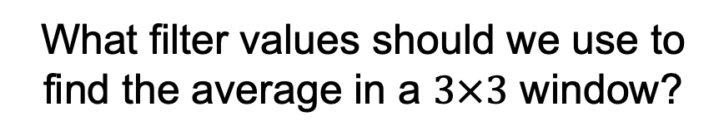

Applying a linear filter
Input
Filter
Output
$$I11$$
$$I12$$
$$I13$$
$$I14$$
$$I15$$
$$I16$$
$$I21$$
$$I22$$
$$I23$$
$$I24$$
$$I25$$
$$I26$$
$$f11$$
$$f12$$
$$f13$$
$$O11$$
$$O12$$
$$O13$$
$$O14$$
$$I31$$
$$I32$$
$$I33$$
$$I34$$
$$I35$$
$$I36$$
$$∗$$
$$f21$$
$$f22$$
$$f23$$
$$=$$
$$O21$$
$$O22$$
$$O23$$
$$O24$$
$$I41$$
$$I42$$
$$I43$$
$$I44$$
$$I45$$
$$I46$$
$$f31$$
$$f32$$
$$f33$$
$$O31$$
$$O32$$
$$O33$$
$$O34$$
$$I51$$
$$I52$$
$$I53$$
$$I54$$
$$I55$$
$$I56$$
What filter values should we use to find the average in a $3×3$ window?
Adapted from D. Fouhey and J. Johnson

Slide 13

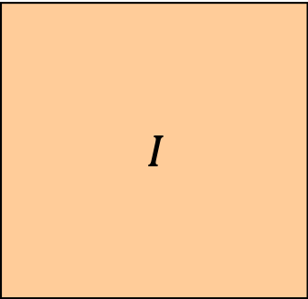


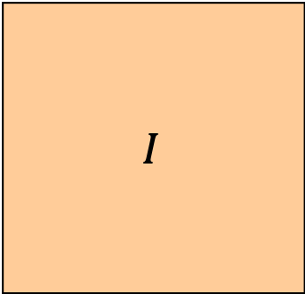

Practical details: Dealing with edges
To control the size of the output, we need to use padding
Output is smaller than input
Output is same size as input
Output is larger than input
$$f$$
$$f$$
$$f$$
$$f$$
$$I$$
$$f$$
$$f$$
$$I$$
$$I$$
$$f$$
$$f$$
$$f$$
$$f$$
$$f$$
$$f$$

Slide 14
Practical details: Dealing with edges
To control the size of the output, we need to use padding
What values should we pad the image with?

Slide 15
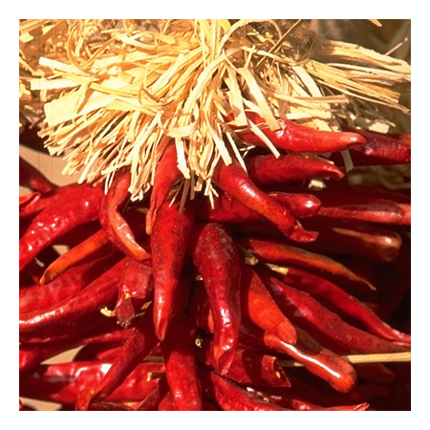
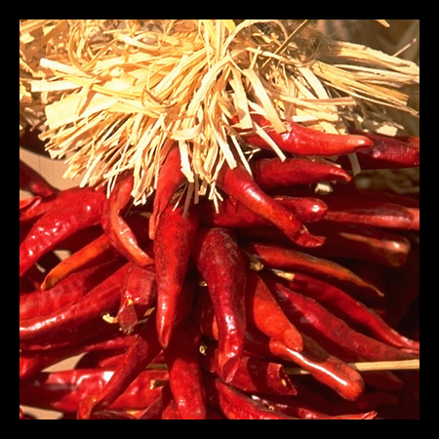




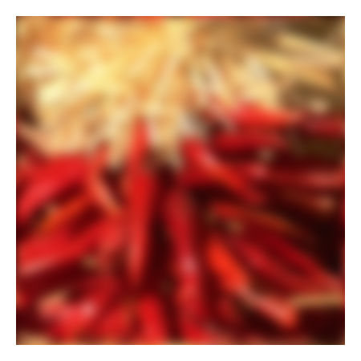






Practical details: Dealing with edges
To control the size of the output, we need to use padding
What values should we pad the image with?
  Zero pad (or clip filter)
  Wrap around
  Copy edge
  Reflect across edge
Source: S. Marschner

Slide 16






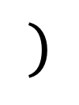

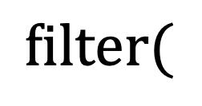


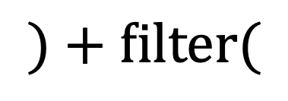
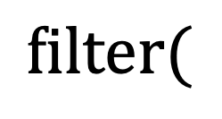

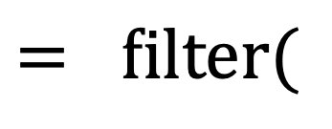

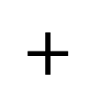


Properties: Linearity
$$filter(I,f1+f2) = filter(I,f1) + filter(I,f2)$$
$$filter($$
$$,$$
$$+$$
$$)$$
$$= filter($$
$$,$$
$$)$$
$$=$$
$$filter($$
$$,$$
$$)+filter($$
$$,$$
$$)$$
$$=$$
$$+$$
$$=$$
Adapted from D. Fouhey and J. Johnson

Slide 17
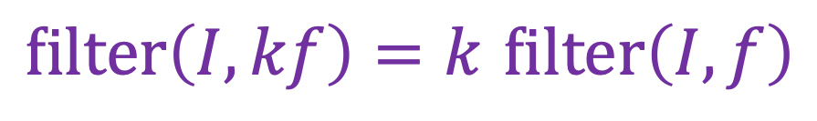
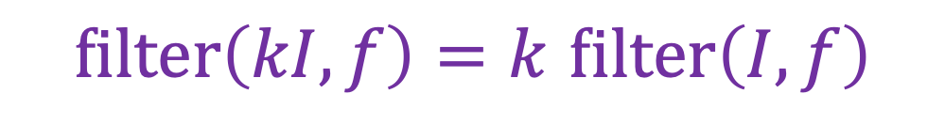
Properties: Linearity
$$filter(I,f1+f2) = filter(I,f1) + filter(I,f2)$$
Also:
$$filter\left(I_{1}+I_{2},f\right)= filter\left(I_{1},f\right)+ filter\left(I_{2},f\right)$$
$filter\left(kI,f\right)=k$ $filter\left(I,f\right)$
$filter\left(I,kf\right)=k$ $filter\left(I,f\right)$
Adapted from D. Fouhey and J. Johnson

Slide 18


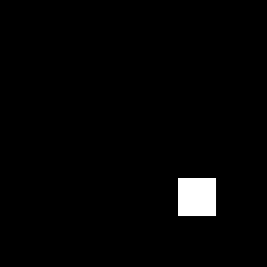

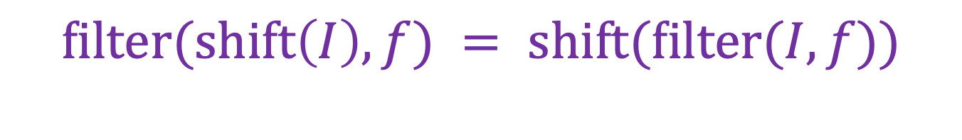
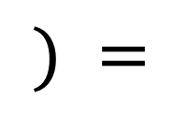
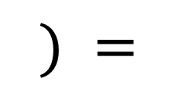


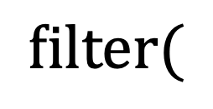
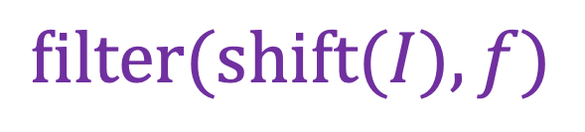
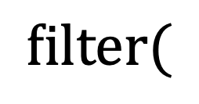
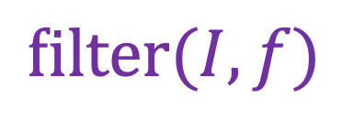
Properties: Shift-invariance
$$filter(shift\left(I\right),f) = shift(filter(I,f))$$
$$filter($$
$$,$$
$$) =$$
$$filter(I,f)$$
$$filter($$
$$,$$
$$) =$$
$$filter(shift(I),f)$$
Adapted from D. Fouhey and J. Johnson

Slide 19
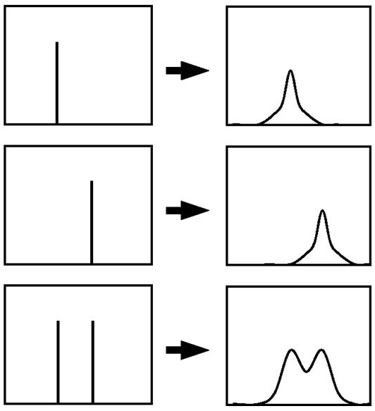
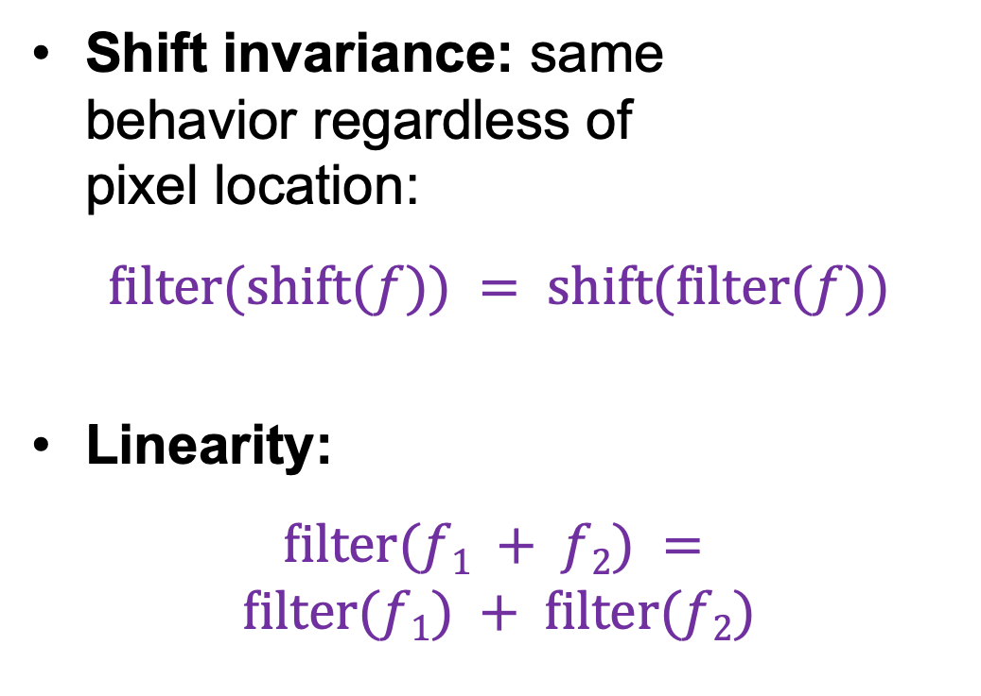
Linear filtering properties
Shift invariance: same
behavior regardless of
pixel location:
$$filter(shift(f)) = shift(filter(f))$$
Linearity:
$$filter(f1 + f2) = \\ filter(f1) + filter(f2)$$
  Any linear shift-invariant operator can be represented as a convolution!

Slide 20
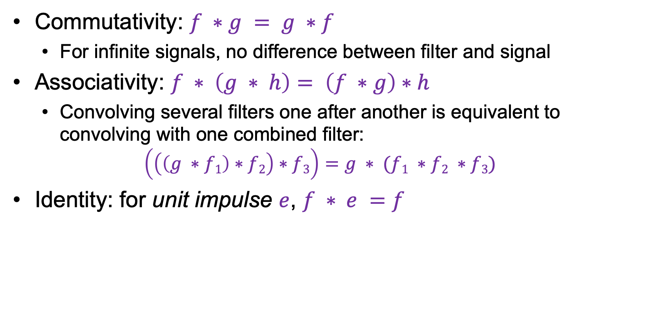
More linear filtering properties
Commutativity: $f ∗g = g ∗f$
  For infinite signals, no difference between filter and signal
Associativity: $f ∗ \left(g ∗ h\right)= \left(f ∗g\right)∗h$
  Convolving several filters one after another is equivalent to convolving with one combined filter:
  $$\left(\left(\left(g ∗f1\right)∗f2\right)∗f3\right)=g ∗ (f1 ∗f2 ∗f3)$$
Identity: for unit impulse $e$, $f ∗ e =f$

Slide 21

Note: Filtering vs. “convolution”
In classical signal processing terminology, convolution is filtering with a flipped kernel, and filtering with an upright kernel is known as cross-correlation
  Check convention of filtering function you plan to use!
Filtering or “cross-correlation”
(Kernel in original orientation)
“Convolution”
(Kernel flipped in x and y)
Adapted from D. Fouhey and J. Johnson

Slide 22
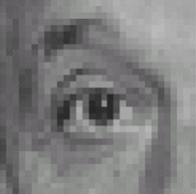
Practice with linear filters
0
0
0
?
0
1
0
0
0
0
Original
Source: D. Lowe

Slide 23
Practice with linear filters
0
0
0
0
1
0
0
0
0
Original
One surrounded by zeros is the identity filter
Filtered
(no change)
Source: D. Lowe

Slide 24
Practice with linear filters
0
0
0
?
0
0
1
0
0
0
Original
Source: D. Lowe

Slide 25
Practice with linear filters
0
0
0
0
0
1
0
0
0
Original
Shifted left
By one pixel
Source: D. Lowe

Slide 26

Practice with linear filters
1
1
1
?
1
1
1
1
1
1
Original
Source: D. Lowe

Slide 27
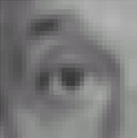
Practice with linear filters
1
1
1
1
1
1
1
1
1
Original
Blur (with a
box filter)
Source: D. Lowe

Slide 28
Image filtering: Outline
Linear filtering and its properties
Gaussian filters and their properties
Nonlinear filtering: Median filtering, bilateral filtering
Fun filtering application: Hybrid images

Slide 29
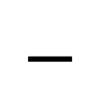
Practice with linear filters
0
0
0
1
1
1
?
$$−$$
0
2
0
1
1
1
0
0
0
1
1
1
Original
Source: D. Lowe

Slide 30
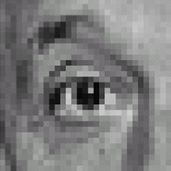
Practice with linear filters
0
0
0
1
1
1
$$−$$
0
2
0
1
1
1
0
0
0
1
1
1
Sharpening filter: Accentuates differences with local average
Original
Sharpened
(Note that filter sums to 1)
Source: D. Lowe

Slide 31
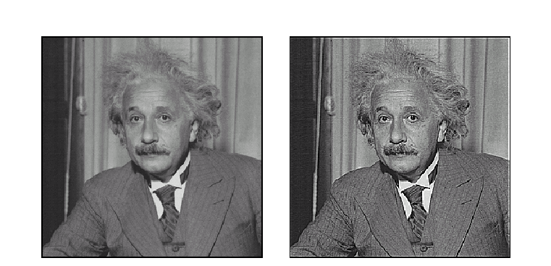
Sharpening
Original
Sharpened
Source: D. Lowe

Slide 32
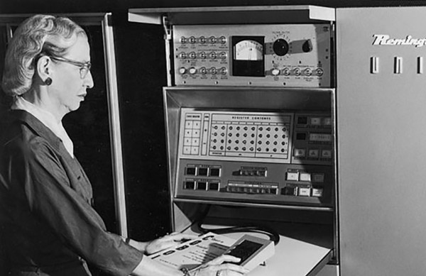

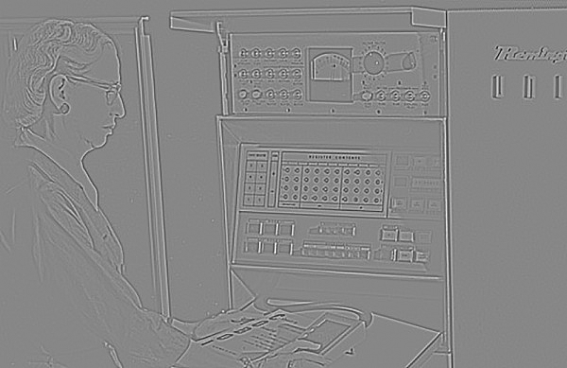

Sharpening in more detail
Original
Smoothed
–
Details
$$=$$
Source: D. Fouhey

Slide 33



Sharpening in more detail
Original
Details
$$+ α$$
Sharpened ($α=1$)
$$=$$
Source: D. Fouhey

Slide 34


Sharpening in more detail
Original
Details
$$+ α$$
Sharpened ($α=2$)
$$=$$
Source: D. Fouhey

Slide 35

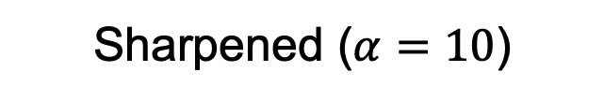
Sharpening in more detail
Original
Details
$$+ α$$
Sharpened ($α=10$)
$$=$$
Source: D. Fouhey

Slide 36
Image filtering: Outline
Linear filtering and its properties
Gaussian filters and their properties

Slide 37

Smoothing revisited
What’s wrong with this picture?
What’s the solution?
Source: D. Forsyth

Slide 38
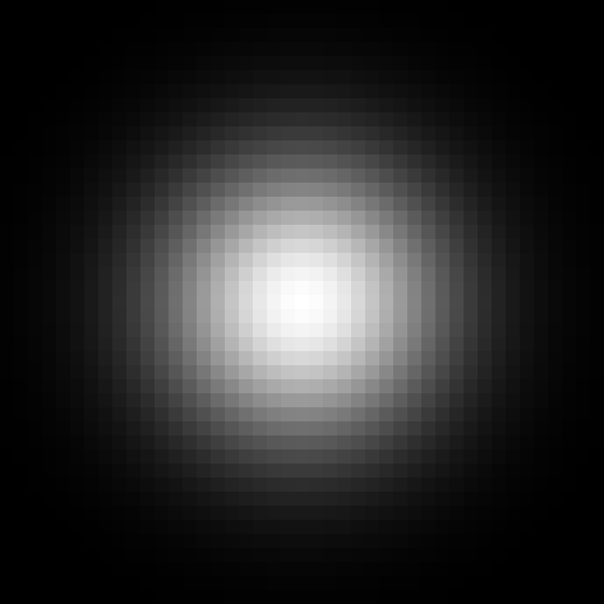
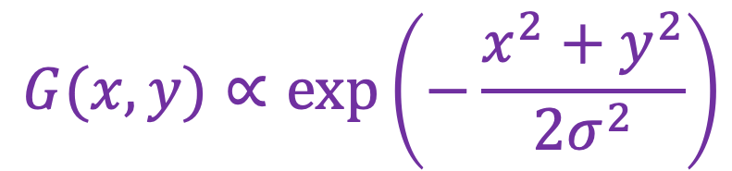
Smoothing revisited
What’s wrong with this picture?
What’s the solution?
  To eliminate box artifacts, weight contribution of neighborhood pixels according to their closeness to the center
“proportional to”
(renormalize values to sum to 1)
Gaussian filter
$$G(x,y)∝exp⁡\left(−\frac{x^{2}+y^{2}}{{2σ}^{2}}\right)$$
standard deviation
(determines size of “blob”)
Adapted from D. Fouhey and J. Johnson

Slide 39
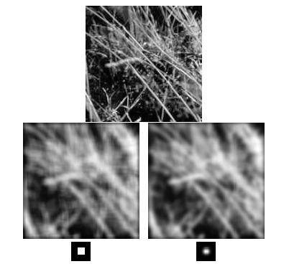
Gaussian vs. box filtering

Slide 40







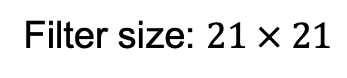

Gaussian filters
$$σ = 1$$
$$σ = 2$$
$$σ = 4$$
$$σ = 8$$
Filter size: $21 × 21$
Adapted from D. Fouhey and J. Johnson

Slide 41

Applying Gaussian filters
Source: D. Fouhey and J. Johnson

Slide 42
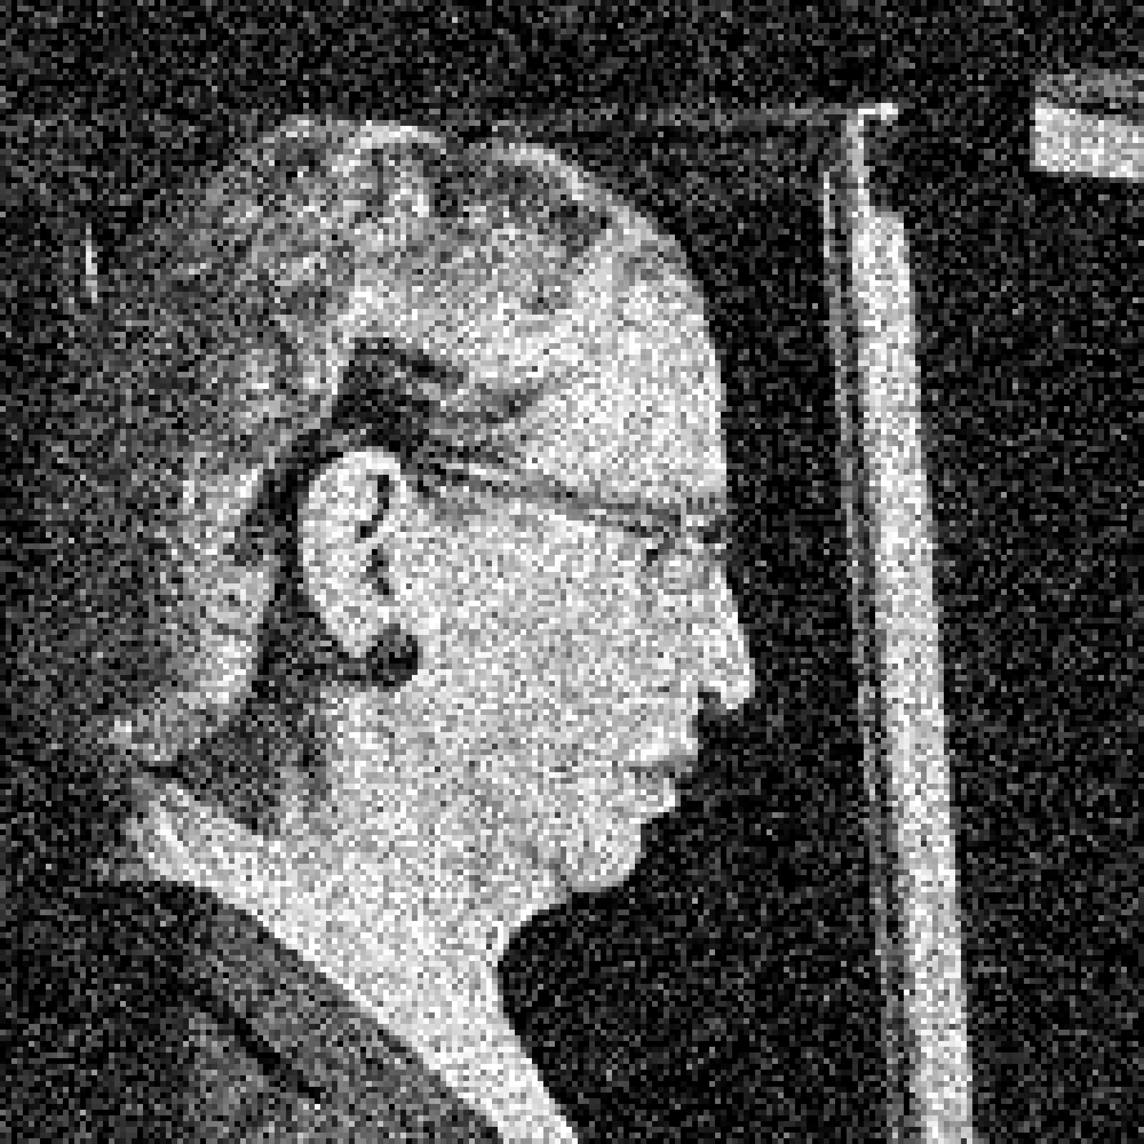
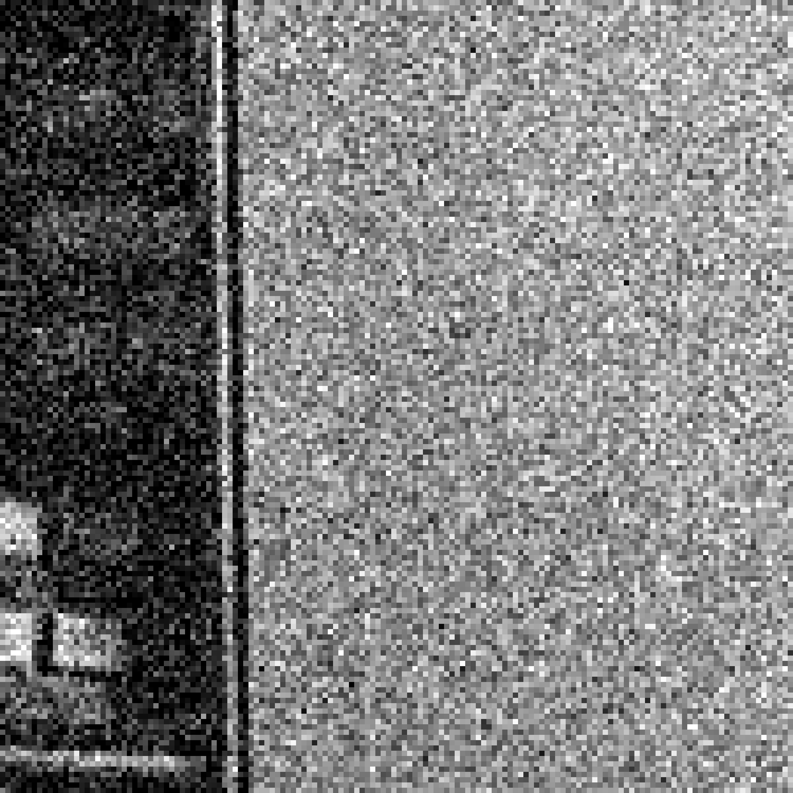
Applying Gaussian filters
Input image
(no filter)
Source: D. Fouhey and J. Johnson

Slide 43

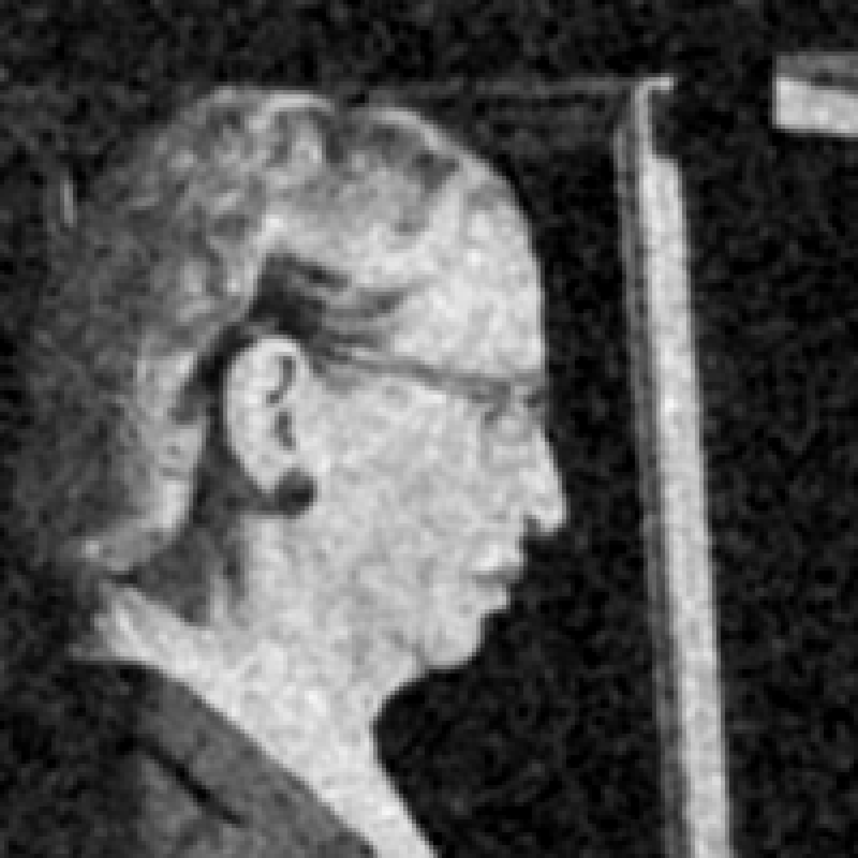
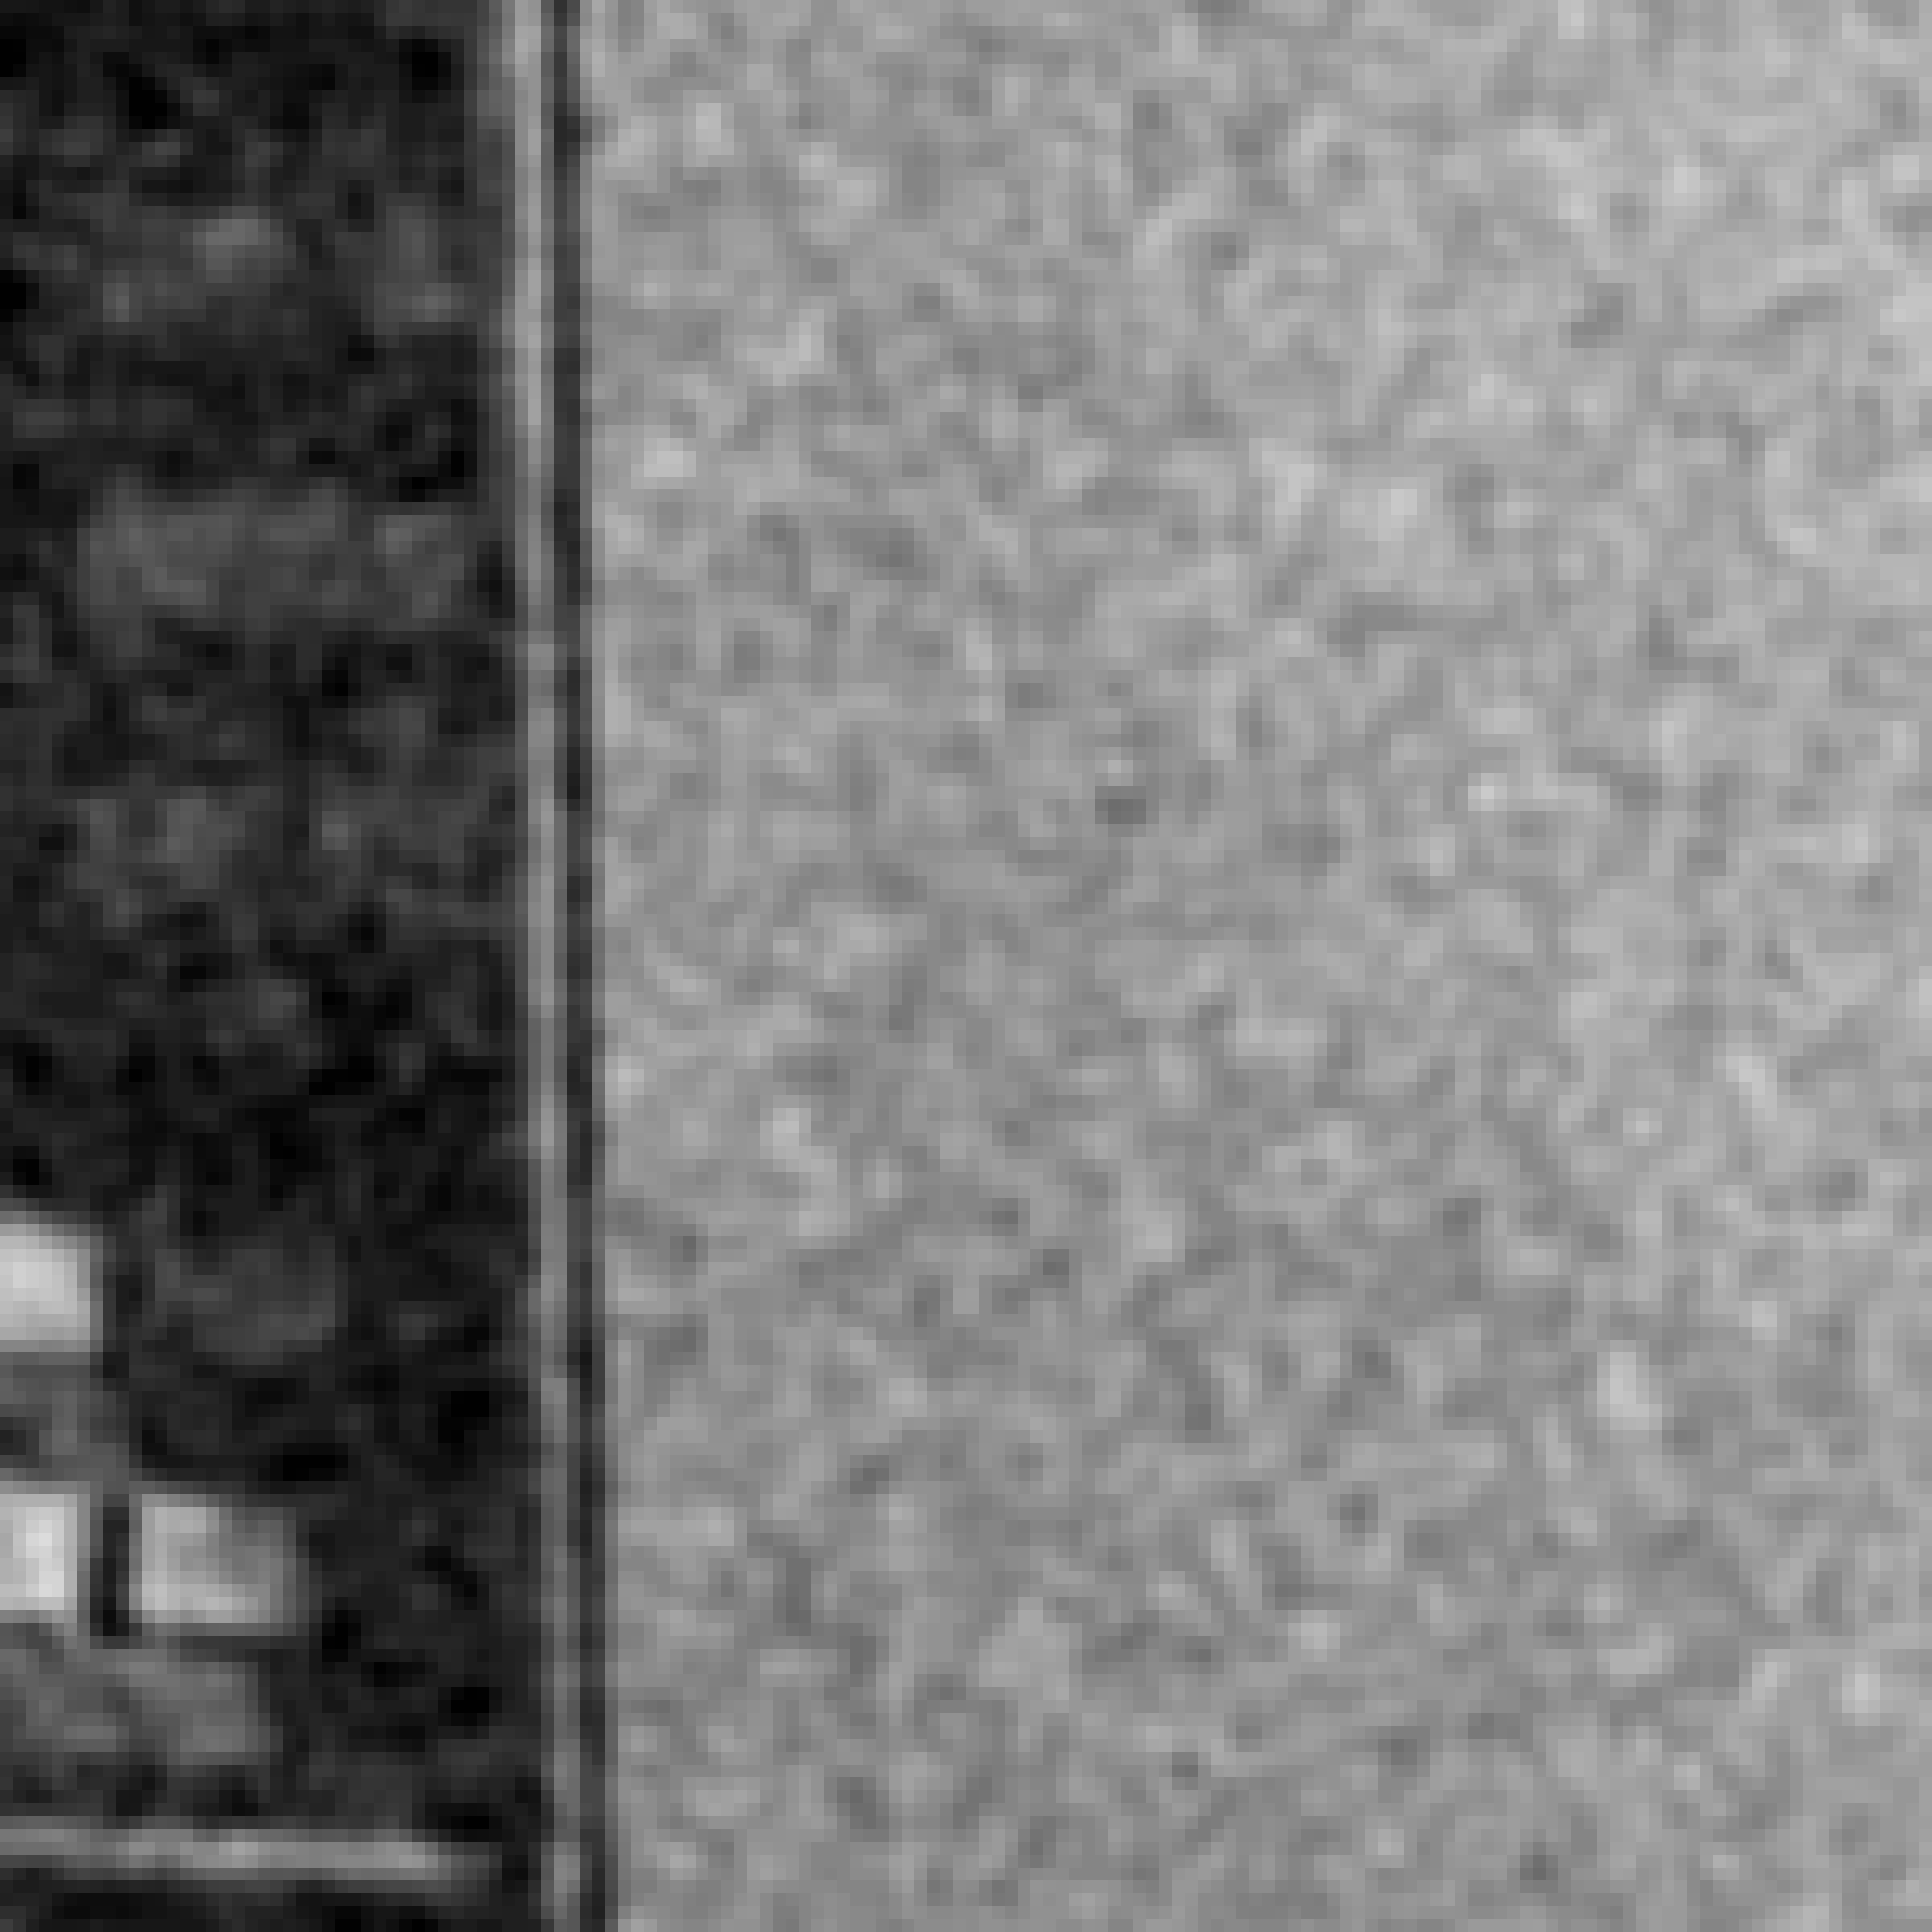

Applying Gaussian filters
$$σ = 1$$
Source: D. Fouhey and J. Johnson

Slide 44




Applying Gaussian filters
$$σ = 2$$
Source: D. Fouhey and J. Johnson

Slide 45




Applying Gaussian filters
$$σ = 4$$
Source: D. Fouhey and J. Johnson

Slide 46


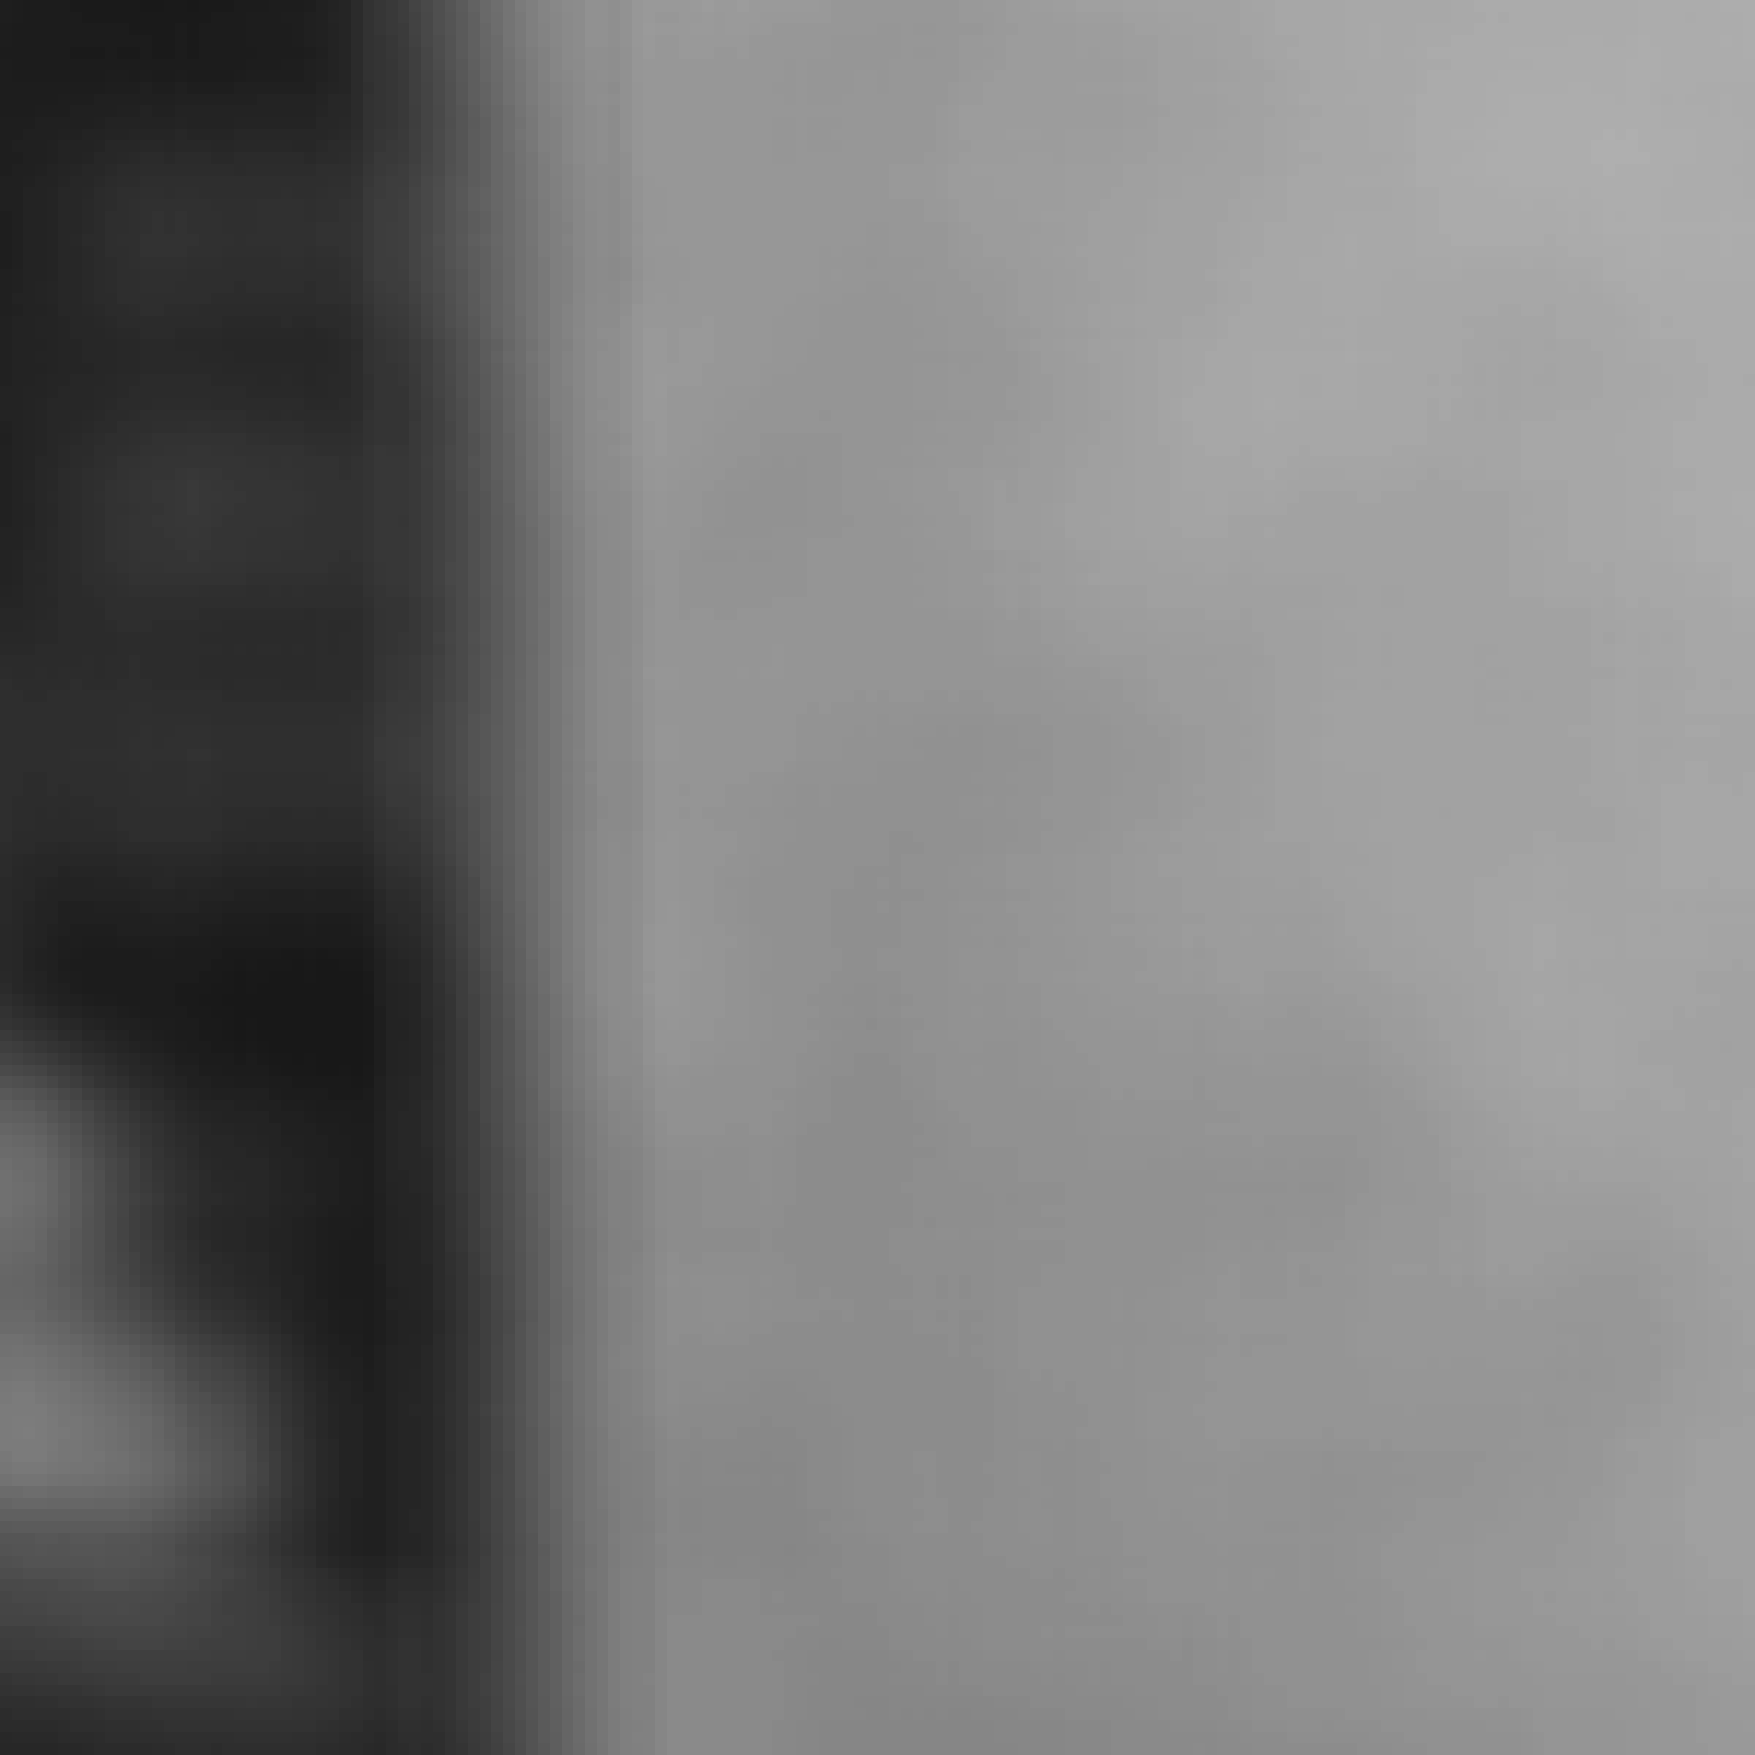

Applying Gaussian filters
$$σ = 8$$
Source: D. Fouhey and J. Johnson

Slide 47
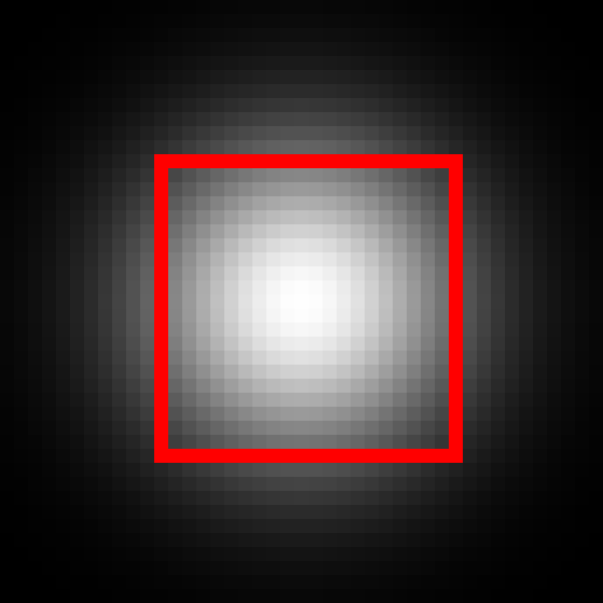
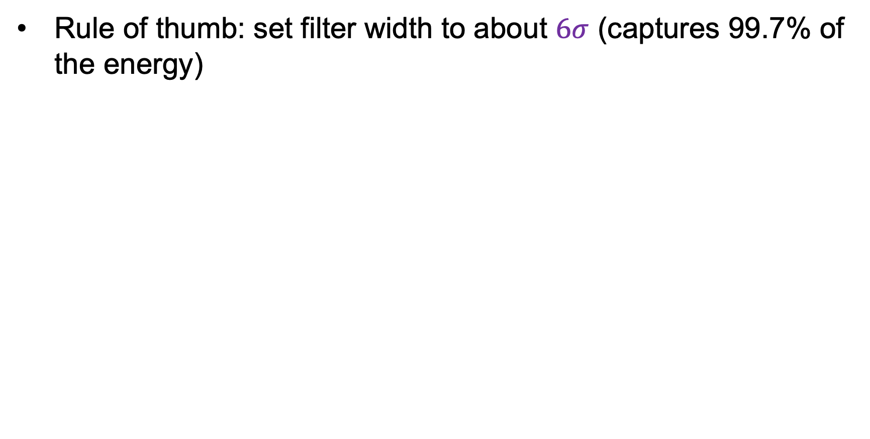


Choosing filter size
Rule of thumb: set filter width to about $6σ$ (captures 99.7% of the energy)
$$σ = 8$$
$$Width=21$$
$$σ = 8$$
$$Width=43$$
Too small!
A bit small (might be OK)
Adapted from D. Fouhey and J. Johnson

Slide 48
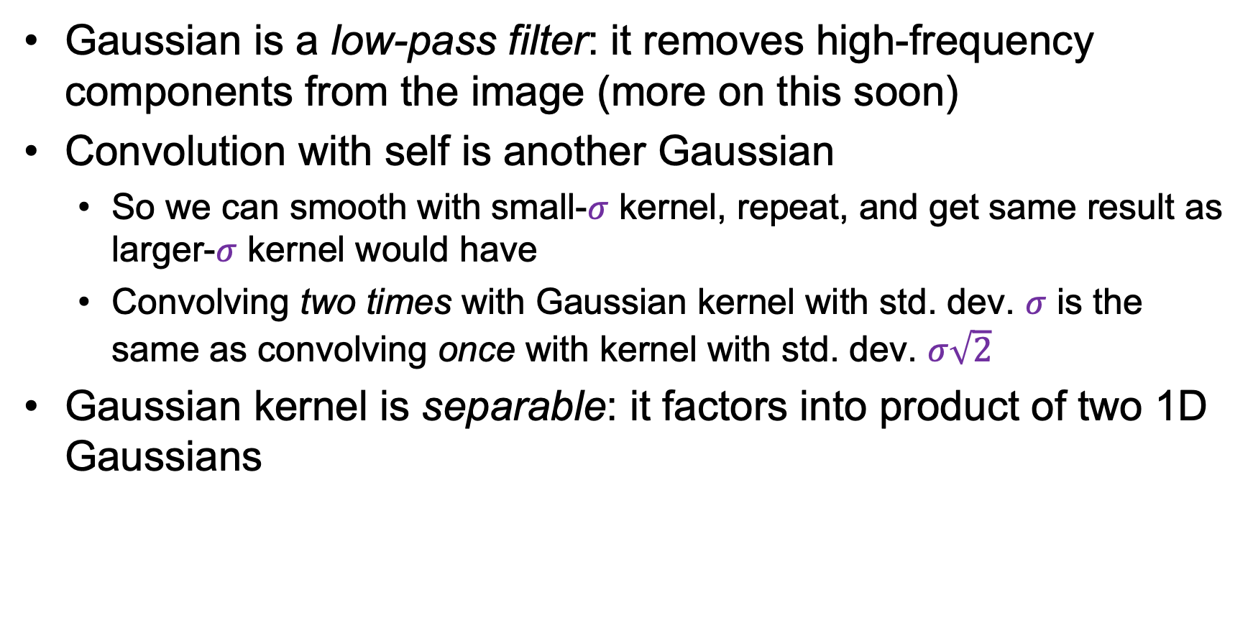
Gaussian filters: Properties
Gaussian is a low-pass filter: it removes high-frequency components from the image (more on this soon)
Convolution with self is another Gaussian
  So we can smooth with small-$σ$ kernel, repeat, and get same result as larger-$σ$ kernel would have
  Convolving two times with Gaussian kernel with std. dev. $σ$ is the same as convolving once with kernel with std. dev. $σ\sqrt{2}$
Gaussian kernel is separable: it factors into product of two 1D Gaussians
Source: K. Grauman
Notes:
Linear vs. quadratic in mask size

Slide 49

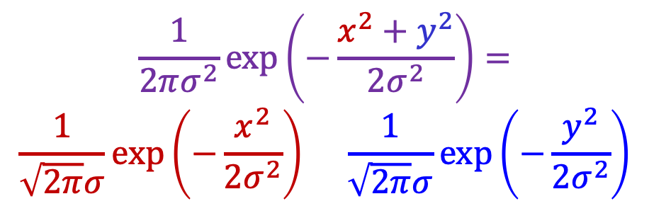
Separability of the Gaussian filter
$$\frac{1}{2πσ^{2}}\exp\left(−\frac{x^{2}+y^{2}}{{2σ}^{2}}\right)=$$
$$\frac{1}{\sqrt{2π}σ}\exp\left(−\frac{x^{2}}{{2σ}^{2}}\right) \frac{1}{\sqrt{2π}σ}exp⁡\left(−\frac{y^{2}}{2σ^{2}}\right)$$
=
⁎
Note: convolution and matrix multiplication (outer product)
are the same in this case
Adapted from D. Fouhey and J. Johnson

Slide 50
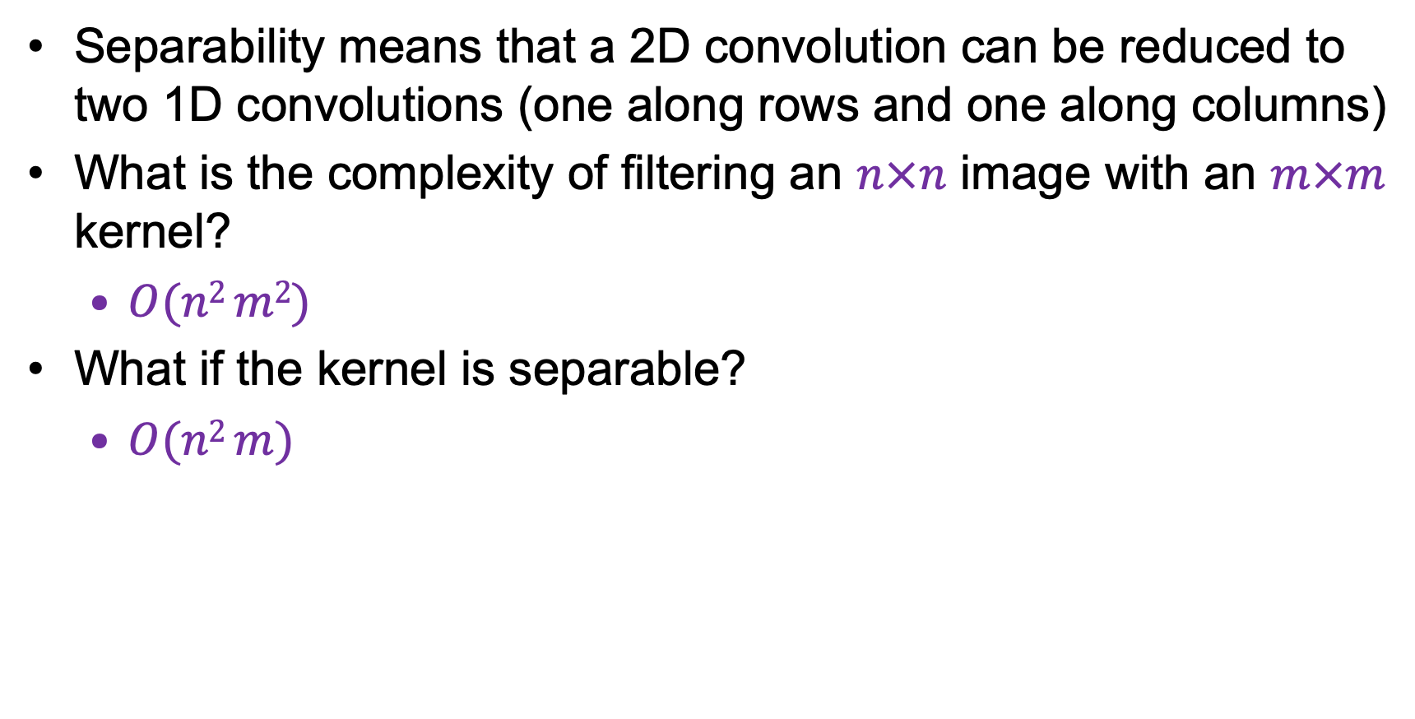
Why is separability useful?
Separability means that a 2D convolution can be reduced to two 1D convolutions (one along rows and one along columns)
What is the complexity of filtering an $n×n$ image with an $m×m$ kernel?
  $O(n2 m2)$
What if the kernel is separable?
  $O(n2 m)$

Slide 51

Gaussian noise
Mathematical model: sum of many independent factors
Good for small standard deviations
Assumption: independent, zero-mean noise
Source: M. Hebert

Slide 52
Image filtering: Outline
Linear filtering and its properties
Gaussian filters and their properties
Nonlinear filtering: Median filtering, bilateral filtering

Slide 53
Different types of noise
What kind of noise is Gaussian filtering appropriate for?
  Additive, zero-mean noise (assuming nearby pixels share the same value)
Adapted from D. Fouhey and J. Johnson

Slide 54

Different types of noise
What about impulse or shot noise, i.e., when some pixels are arbitrarily replaced by spurious values?
Adapted from D. Fouhey and J. Johnson

Slide 55



Where Gaussian filtering fails
$$σ = 1$$
Adapted from D. Fouhey and J. Johnson

Slide 56
























Alternative idea: Median filtering
A median filter operates over a window by selecting the median intensity in the window
$$10$$
$$15$$
$$20$$
$$23$$
$$90$$
$$27$$
Sort
$$33$$
$$31$$
$$30$$
$$10$$
$$15$$
$$20$$
$$23$$
$$27$$
$$30$$
$$31$$
$$33$$
$$90$$
Replace
$$10$$
$$15$$
$$20$$
$$23$$
$$27$$
$$27$$
$$33$$
$$31$$
$$30$$
Notes:
Linearity of median filter: try filter([0 0 0; 0 1 0; 0 0 0] + [1 1 1; 1 1 2; 2 2 2])

Slide 57

Median filter
What advantage does median filtering have over Gaussian filtering?
  Robustness to outliers
Source: K. Grauman

Slide 58



Applying median filter
Input image
(no filter)
Adapted from D. Fouhey and J. Johnson

Slide 59




Applying median filter
median
filter
($width = 3$)
Adapted from D. Fouhey and J. Johnson

Slide 60




Applying median filter
median
filter
($width =5$)
Adapted from D. Fouhey and J. Johnson

Slide 61




Applying median filter
median
filter
($width = 7$)

Slide 62
Is median filtering linear?
Recall: for a linear filter,
$$filter\left(I_{1}+I_{2}\right)= filter\left(I_{1}\right)+ filter\left(I_{2}\right)$$

Slide 63




Is median filtering linear?
Recall: for a linear filter,
$$filter\left(I_{1}+I_{2}\right)= filter\left(I_{1}\right)+ filter\left(I_{2}\right)$$
$$\left[\begin{matrix}1 & 1 & 1 \\ 1 & 1 & 2 \\ 2 & 2 & 2\end{matrix}\right]$$
$$\left[\begin{matrix}0 & 0 & 0 \\ 0 & 1 & 0 \\ 0 & 0 & 0\end{matrix}\right]$$
$$\left[\begin{matrix}1 & 1 & 1 \\ 1 & 2 & 2 \\ 2 & 2 & 2\end{matrix}\right]$$
+
=
median filter
1
+
0
$$≠$$
2
Adapted from D. Fouhey and J. Johnson

Slide 64
Image filtering: Outline
Linear filtering and its properties
Gaussian filters and their properties
Nonlinear filtering: Median filtering, bilateral filtering

Slide 65






What other kinds of filtering are there?
We want something like Gaussian filtering, but with edge preservation
Gaussian filtering: Same kernel everywhere
*
input
output
*
*
Source: SIGGRAPH 2008 tutorial

Slide 66




Bilateral filtering
[Aurich 95, Smith 97, Tomasi 98]
Kernel weights depend on the neighborhood values – no averaging across edges!
*
input
output
*
*
Source: SIGGRAPH 2008 tutorial
https://en.wikipedia.org/wiki/Bilateral_filter

Slide 67


Bilateral filtering
Compute weighted average of pixels, but the weight depends both on the distance of the filter element from the center and the difference of pixel value from the center
normalization
factor
space weight
range weight
I
Source: SIGGRAPH 2008 tutorial

Slide 68









Bilateral filtering
input
σ_{r} = 0.1
σ_{r} = 0.25
σ_{r} = ∞ (Gaussian blur)
σ_{s} = 2
σ_{s} = 6
σ_{s} = 18
Source: SIGGRAPH 2008 tutorial

Slide 69




Denoising comparison
Noisy input
Median 3x3
Median 5x5
Bilateral 7x7
Source: SIGGRAPH 2008 tutorial

Slide 70
Image filtering: Outline
Linear filtering and its properties
Gaussian filters and their properties
Nonlinear filtering: Median filtering, bilateral filtering
Fun filtering application: Hybrid images

Slide 71

Application: Hybrid images
A. Oliva et al. Hybrid Images. SIGGRAPH 2006

Slide 72


Recall: Sharpening
Image
Smoothed
Details
–
$$=$$
Image
Details
Sharpened
$$+ α$$
$$=$$
Source: D. Fouhey

Slide 73




“Detail” filter
$$I−I∗g=I∗(e−g)$$
unit impulse
(identity)
unit impulse
Gaussian
Laplacian of Gaussian
Notes:
f + a(f - f * g) = (1+a)f-af*g = f*((1+a)e-g)

Slide 74

Application: Hybrid images
Gaussian filter
Laplacian filter

Slide 75

Application: Hybrid images

Slide 76

RetroCV workshop at CVPR 2024

Slide 77


Hybrid images with diffusion models
D. Geng et al. Factorized Diffusion: Perceptual Illusions by Noise Decomposition. ECCV 2024

Slide 78


Hybrid images with diffusion models
D. Geng et al. Factorized Diffusion: Perceptual Illusions by Noise Decomposition. ECCV 2024

Slide 79

Hybrid images with diffusion models
Triple hybrids
D. Geng et al. Factorized Diffusion: Perceptual Illusions by Noise Decomposition. ECCV 2024

Slide 80

Hybrid images with diffusion models
Inverse hybrids
D. Geng et al. Factorized Diffusion: Perceptual Illusions by Noise Decomposition. ECCV 2024

Slide 81

Hybrid images with diffusion models
Comparison with Oliva et al. (2006)
“leopard” / “elephant”
Geng et al. (2024)
Oliva et al. (2006)

Slide 82

Hybrid images with diffusion models
Comparison with Oliva et al. (2006)
“sad woman” / “happy woman”
Geng et al. (2024)
Oliva et al. (2006)

Slide 83

Hybrid images with diffusion models
Comparison with Oliva et al. (2006)
“Albert Einstein” / “Marilyn Monroe”
Geng et al. (2024)
Oliva et al. (2006)

Slide 84

Hybrid images with diffusion models
Factorized diffusion
Notes:
Given an image decomposition, we control components of the decomposition through text conditioning during image generation. To do this, we modify the sampling procedure of a pretrained diffusion model. Specifically, at each denoising step, t, we construct a new noise estimate, ϵ~, to use for denoising, whose components come from components of ϵi, which are noise estimates conditioned on different prompts. Here, we show a decomposition into three frequency subbands, used for creating triple hybrid images, but we consider a number of other decompositions, which we explain below.

