Slide 1
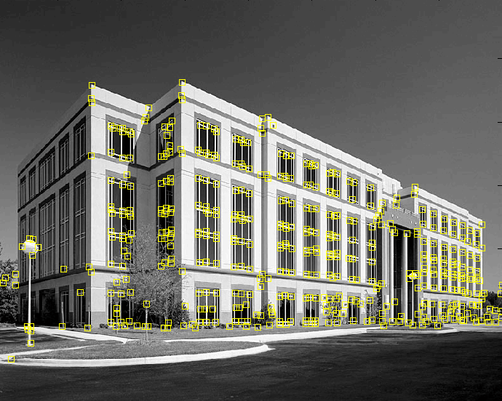
Corner detection
9300 Harris Corners Pkwy, Charlotte, NC

Slide 2
Outline
Keypoint detection: Motivation
Deriving a corner detection criterion
The Harris corner detector
Invariance properties of corners

Slide 3
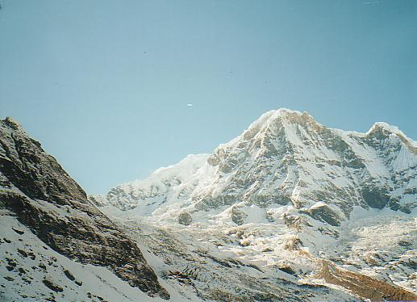
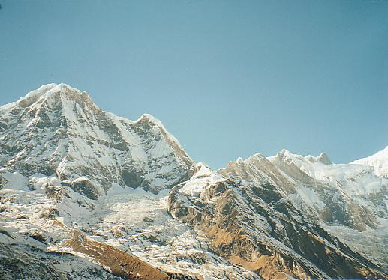
Why extract keypoints?
Motivation: image alignment
  We have two images – how do we combine them?

Slide 4
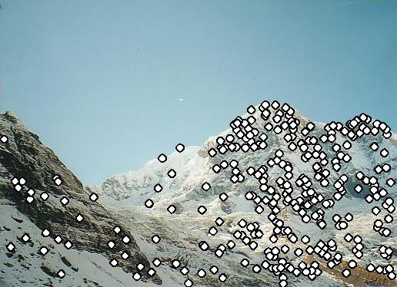
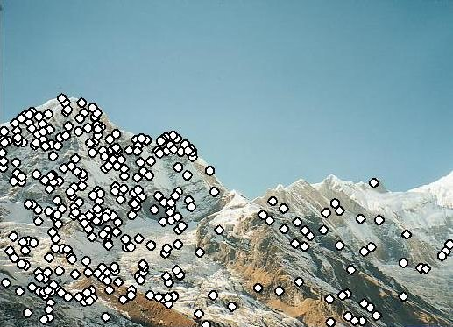
Why extract keypoints?
Motivation: image alignment
  We have two images – how do we combine them?
Step 1: extract keypoints
Step 2: match keypoint features

Slide 5
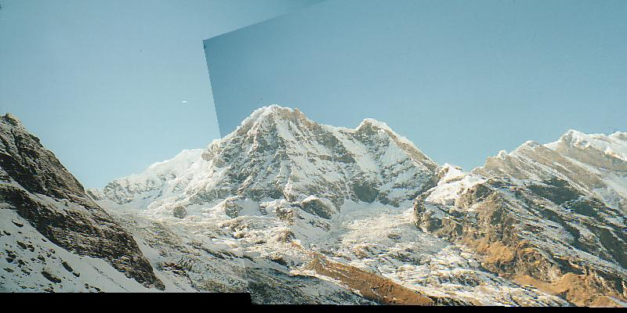
Why extract keypoints?
Motivation: image alignment
  We have two images – how do we combine them?
Step 1: extract keypoints
Step 2: match keypoint features
Step 3: align images

Slide 6
Characteristics of good keypoints
Compactness and efficiency
  Many fewer keypoints than image pixels
Saliency
  Each keypoint is distinctive
Locality
  A keypoint occupies a relatively small area of the image; robust to clutter and occlusion
Repeatability
  The same keypoint can be found in several images despite geometric and photometric transformations

Slide 7
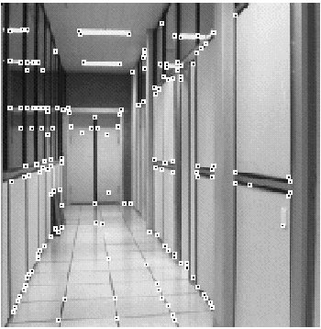
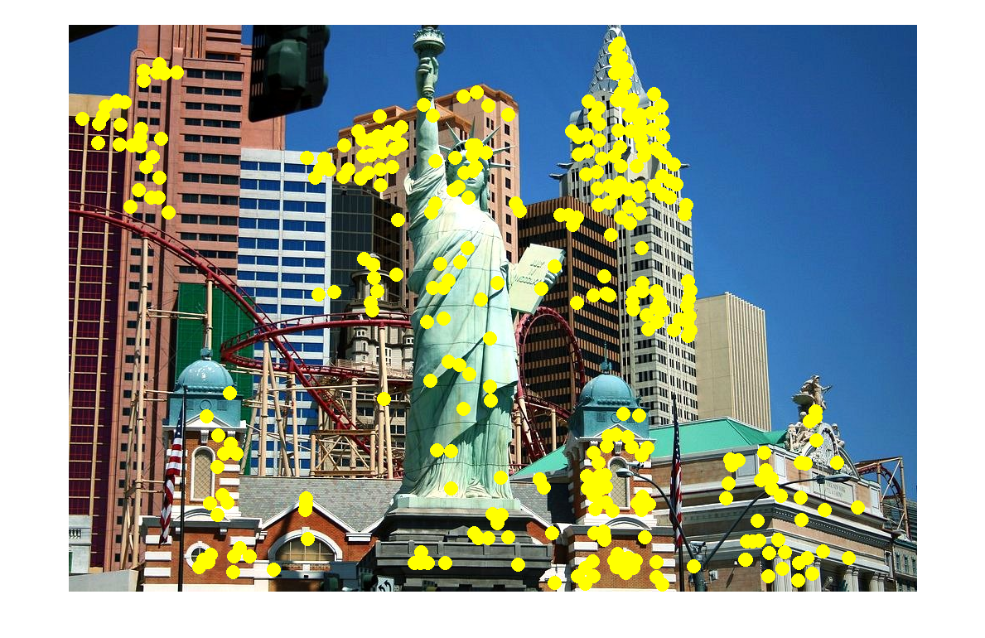
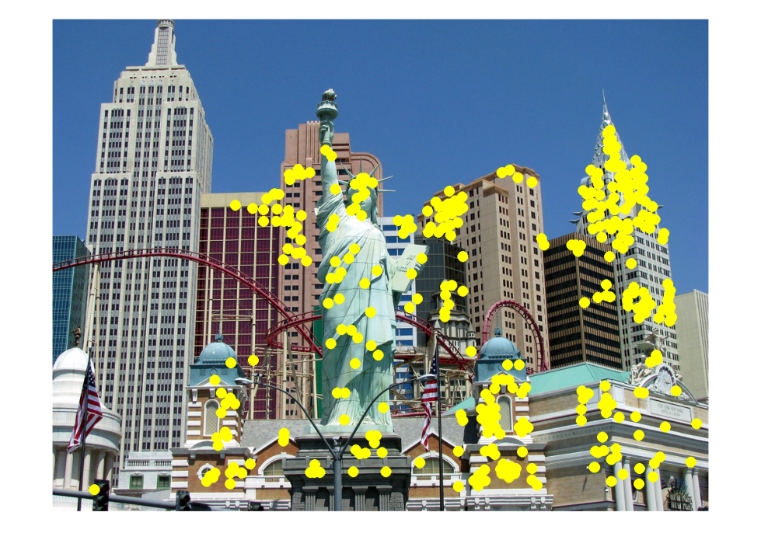
Applications
Keypoints are useful for:
  Image alignment
  3D reconstruction
  Motion tracking
  Robot navigation
  Database indexing and retrieval

Slide 8
Corner detection: Outline
Motivation
Deriving a corner detection criterion

Slide 9

Deriving a corner detection criterion
Basic idea: we should easily recognize the point by looking through a small window
Shifting a window in any direction should give a large change in intensity
“flat” region:
no change in all directions
“edge”:
no change along the edge direction
“corner”:
significant change in all directions

Slide 10
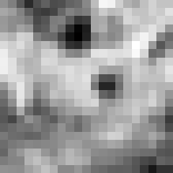

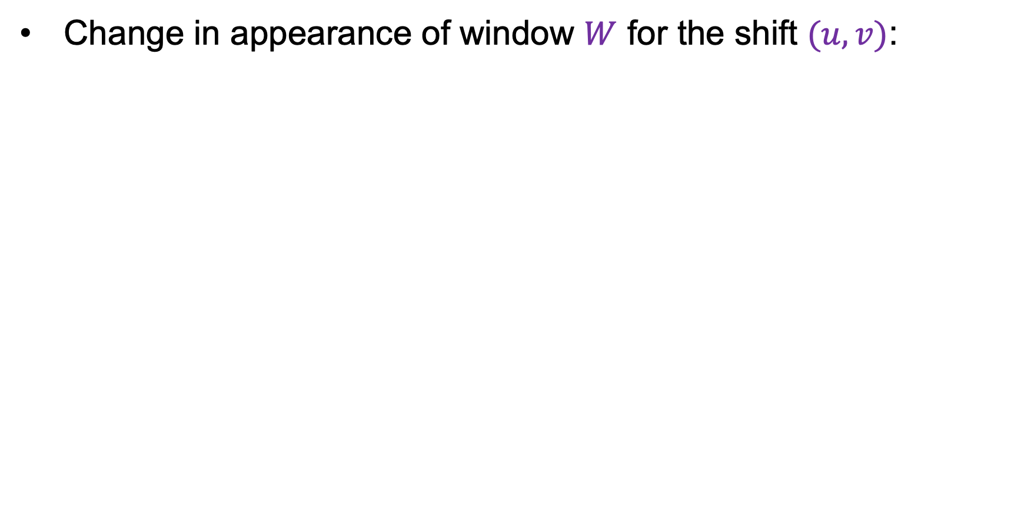
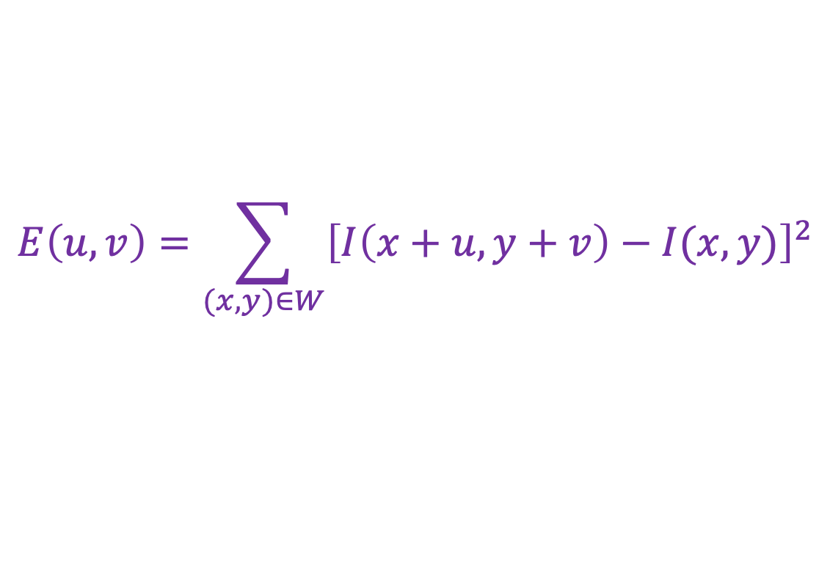
Deriving a corner detection criterion
Change in appearance of window $W$ for the shift $(u,v)$:
$$E\left(u,v\right)=\sum_{(x,y)∈W}{{\left[I\left(x+u,y+v\right)−I(x,y)\right]}^{2}}$$
I(x, y)
E(u, v)
E(3,2)

Slide 11
Deriving a corner detection criterion
Change in appearance of window $W$ for the shift $(u,v)$:
$$E\left(u,v\right)=\sum_{(x,y)∈W}{{\left[I\left(x+u,y+v\right)−I(x,y)\right]}^{2}}$$
I(x, y)
E(u, v)
E(0,0)

Slide 12
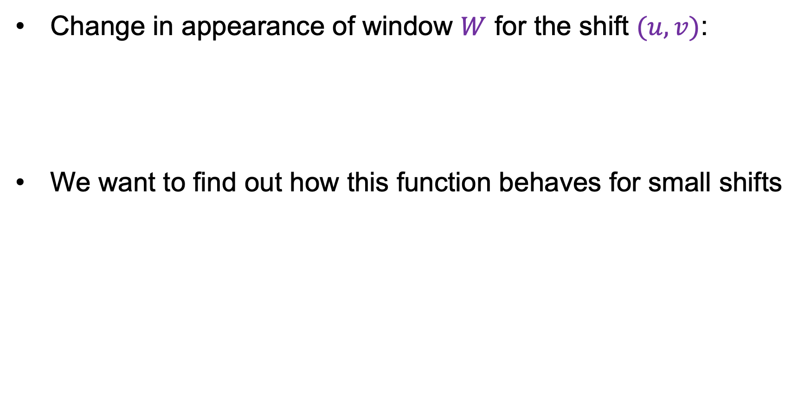
Deriving a corner detection criterion
Change in appearance of window $W$ for the shift $(u,v)$:
We want to find out how this function behaves for small shifts
$$E\left(u,v\right)=\sum_{(x,y)∈W}{{\left[I\left(x+u,y+v\right)−I(x,y)\right]}^{2}}$$
E(u, v)
Notes:
Specifically, E has to have a unique minimum at (0,0)

Slide 13
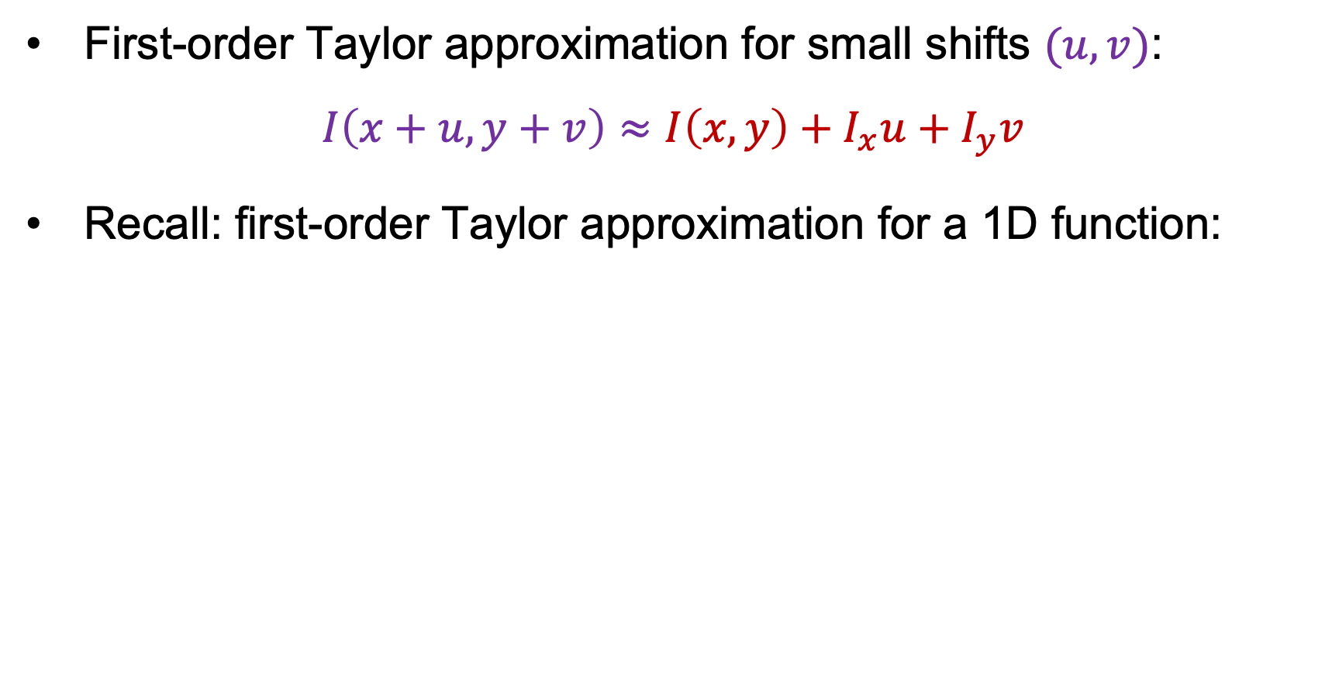



Deriving a corner detection criterion
First-order Taylor approximation for small shifts $(u, v)$:
$$I\left(x+u,y+v\right)≈I\left(x,y\right)+I_{x}u+I_{y}v$$
Recall: first-order Taylor approximation for a 1D function:
$$f\left(x+u\right)≈f\left(x\right)+f^{′}\left(x\right)u$$
$$x$$
$$x+u$$

Slide 14
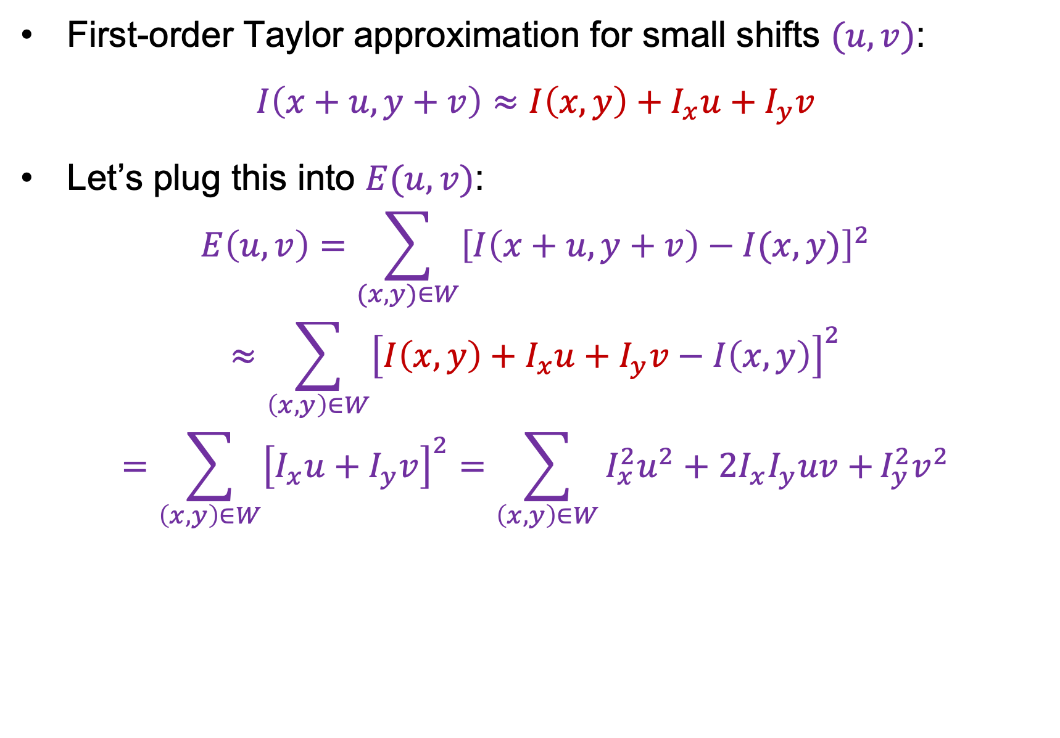
Deriving a corner detection criterion
First-order Taylor approximation for small shifts $(u, v)$:
$$I\left(x+u,y+v\right)≈I\left(x,y\right)+I_{x}u+I_{y}v$$
Let’s plug this into $E(u,v)$:
$$E\left(u,v\right)=\sum_{(x,y)∈W}{{\left[I\left(x+u,y+v\right)−I(x,y)\right]}^{2}}$$
$$≈\sum_{\left(x,y\right)∈W}{{\left[I\left(x,y\right)+I_{x}u+I_{y}v−I\left(x,y\right)\right]}^{2}}$$
$$=\sum_{\left(x,y\right)∈W}{{\left[I_{x}u+I_{y}v\right]}^{2}}=\sum_{\left(x,y\right)∈W}{I_{x}^{2}u^{2}+2I_{x}I_{y}uv+}I_{y}^{2}v^{2}$$

Slide 15
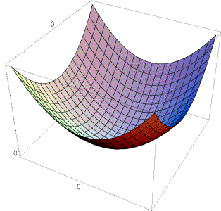
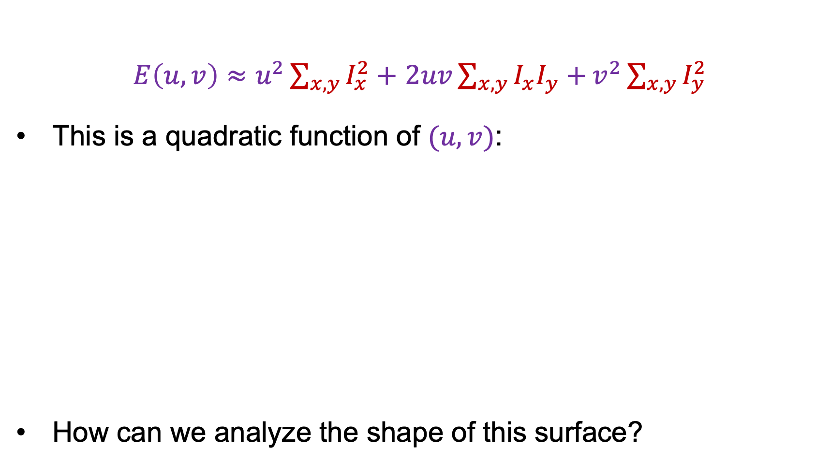

Deriving a corner detection criterion
$E\left(u,v\right)≈u^{2}\sum_{x,y}{I_{x}^{2}}+$ $2uv\sum_{x,y}{I_{x}I_{y}+}v^{2}\sum_{x,y}{I_{y}^{2}}$
This is a quadratic function of $(u,v)$:
How can we analyze the shape of this surface?
E(u, v)
$$≈$$

Slide 16
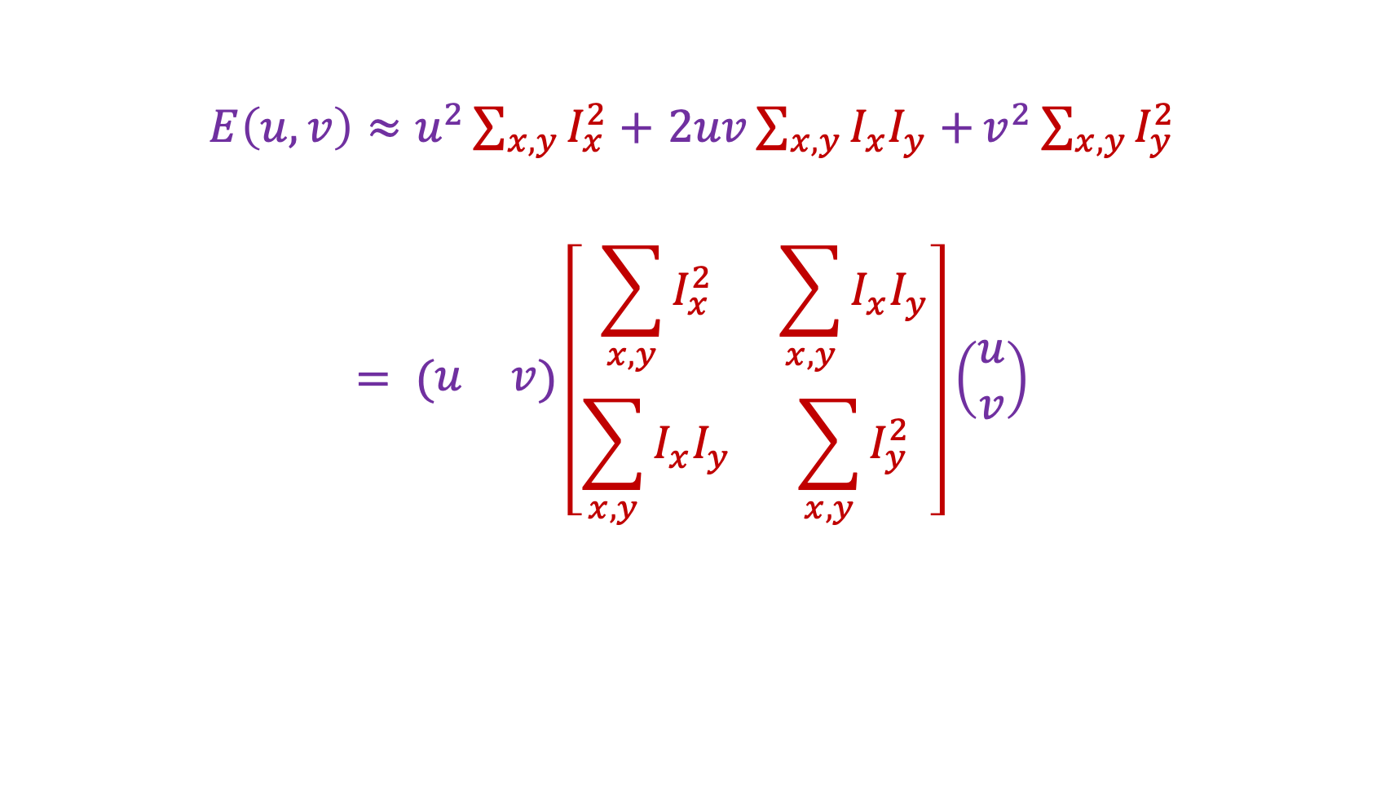

Deriving a corner detection criterion
$E\left(u,v\right)≈u^{2}\sum_{x,y}{I_{x}^{2}}+$ $2uv\sum_{x,y}{I_{x}I_{y}+}v^{2}\sum_{x,y}{I_{y}^{2}}$
$$= (\begin{matrix}u & v\end{matrix})\left[\begin{matrix}\sum_{x,y}{I_{x}^{2}} & \sum_{x,y}{I_{x}I_{y}} \\ \sum_{x,y}{I_{x}I_{y}} & \sum_{x,y}{I_{y}^{2}}\end{matrix}\right]\left(\begin{aligned}u \\ v\end{aligned}\right)$$
Second moment matrix $M$

Slide 17
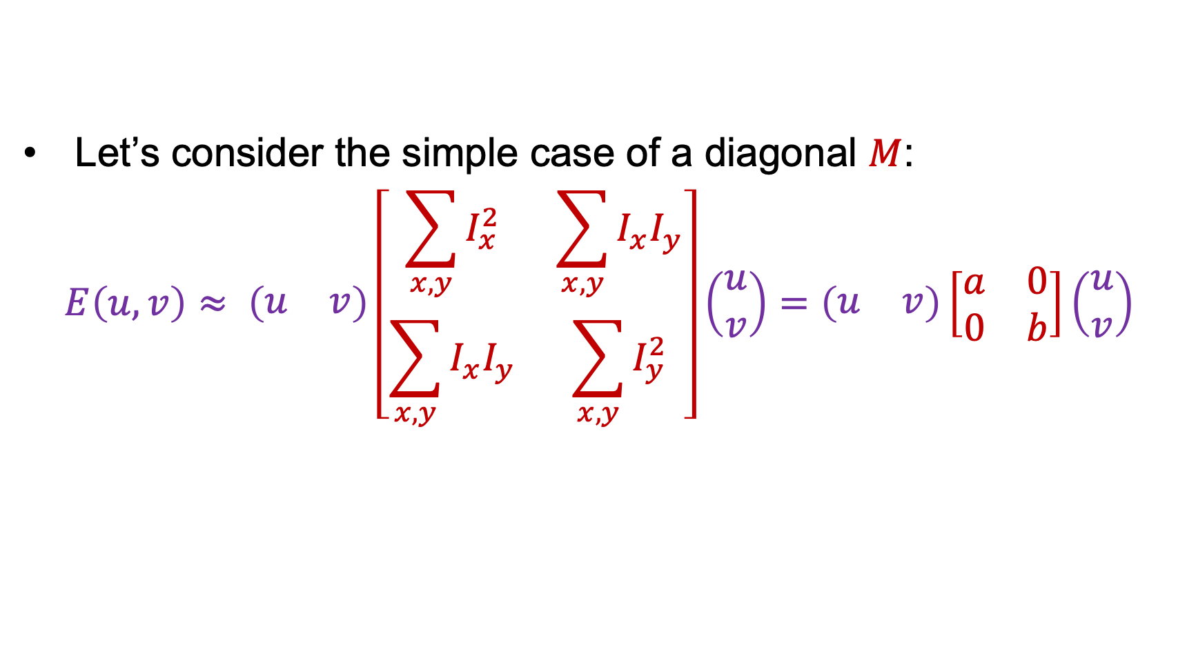




Deriving a corner detection criterion
Let’s consider the simple case of a diagonal $M$:
$$E\left(u,v\right)≈ \left(\begin{matrix}u & v\end{matrix}\right)\left[\begin{matrix}\sum_{x,y}{I_{x}^{2}} & \sum_{x,y}{I_{x}I_{y}} \\ \sum_{x,y}{I_{x}I_{y}} & \sum_{x,y}{I_{y}^{2}}\end{matrix}\right]\left(\begin{aligned}u \\ v\end{aligned}\right)=\left(\begin{matrix}u & v\end{matrix}\right)\left[\begin{matrix}a & 0 \\ 0 & b\end{matrix}\right]\left(\begin{aligned}u \\ v\end{aligned}\right)$$
When does this happen?
$$a=0,b=0$$
$$b=0$$
$$a=0$$
$$a>0,b>0$$

Slide 18

Deriving a corner detection criterion
Let’s consider the simple case of a diagonal $M$:
$$E\left(u,v\right)≈ \left(\begin{matrix}u & v\end{matrix}\right)\left[\begin{matrix}\sum_{x,y}{I_{x}^{2}} & \sum_{x,y}{I_{x}I_{y}} \\ \sum_{x,y}{I_{x}I_{y}} & \sum_{x,y}{I_{y}^{2}}\end{matrix}\right]\left(\begin{aligned}u \\ v\end{aligned}\right)=\left(\begin{matrix}u & v\end{matrix}\right)\left[\begin{matrix}a & 0 \\ 0 & b\end{matrix}\right]\left(\begin{aligned}u \\ v\end{aligned}\right)$$
In general, need to diagonalize $M$ and check its eigenvalues:
$$M=R^{−1}\left[\begin{matrix}λ_{1} & 0 \\ 0 & λ_{2}\end{matrix}\right]R$$

Slide 19
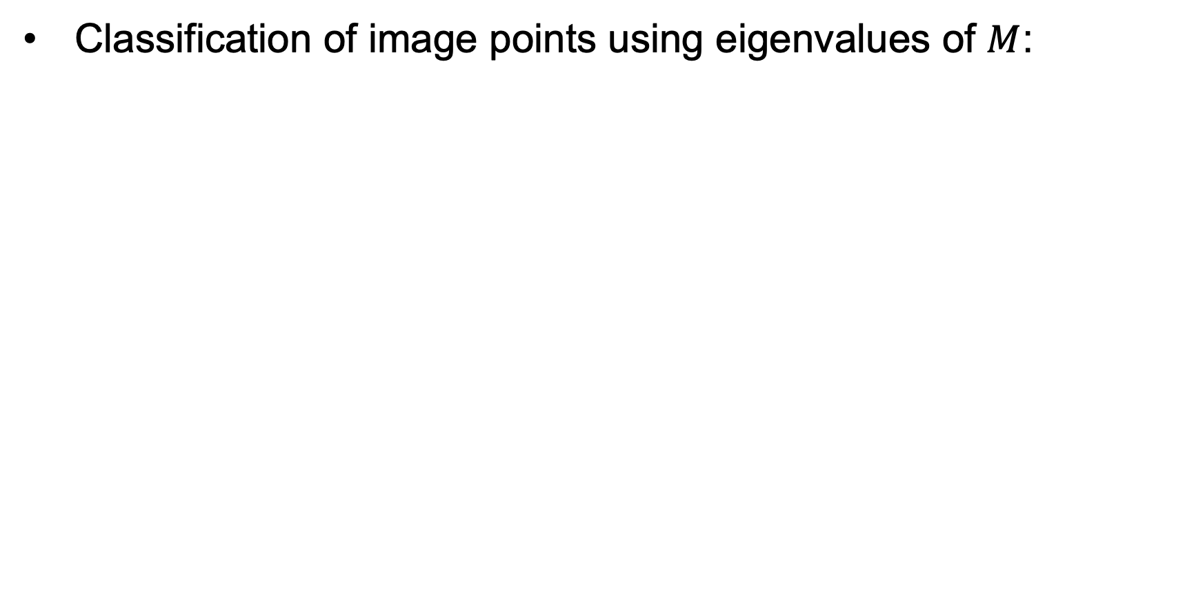
Interpreting the eigenvalues
Classification of image points using eigenvalues of $M$:
λ₂
“Edge”
λ₂ >> λ₁
“Corner”
λ₁ and λ₂ are large,
λ₁ ~ λ₂;
E increases in all directions
λ₁ and λ₂ are small;
E is almost constant in all directions
“Flat” region
“Edge”
λ₁ >> λ₂
λ₁

Slide 20
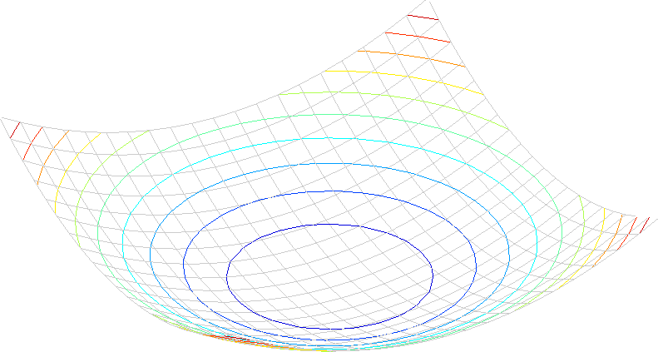
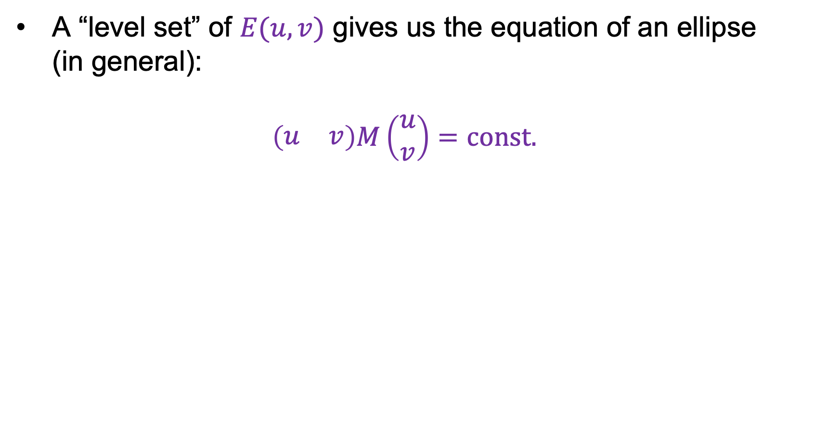
Second moment ellipse
A “level set” of $E(u, v)$ gives us the equation of an ellipse
(in general):
$$\left(\begin{matrix}u & v\end{matrix}\right)M\left(\begin{aligned}u \\ v\end{aligned}\right)=const.$$

Slide 21
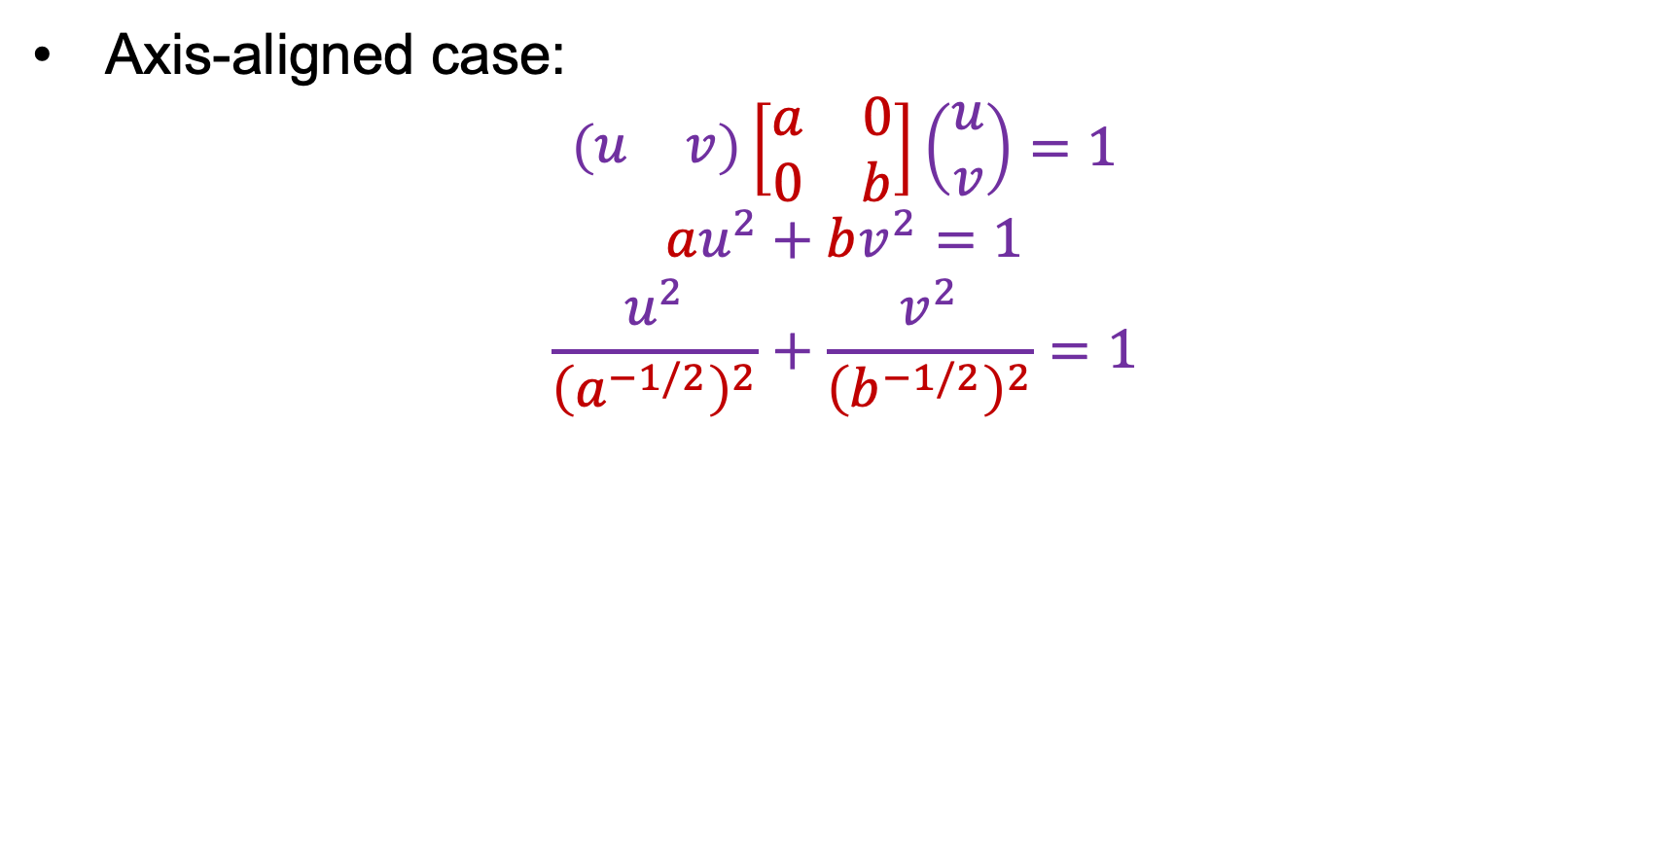
Second moment ellipse
Axis-aligned case:
$$\left(\begin{matrix}u & v\end{matrix}\right)\left[\begin{matrix}a & 0 \\ 0 & b\end{matrix}\right]\left(\begin{aligned}u \\ v\end{aligned}\right)=1$$
$$au^{2}+bv^{2}=1$$
$$\frac{u^{2}}{{\left(a^{−1/2}\right)}^{2}}+\frac{v^{2}}{{\left(b^{−1/2}\right)}^{2}}=1$$
a^{-1/2}
Minor axis
Major axis
b^{-1/2}

Slide 22
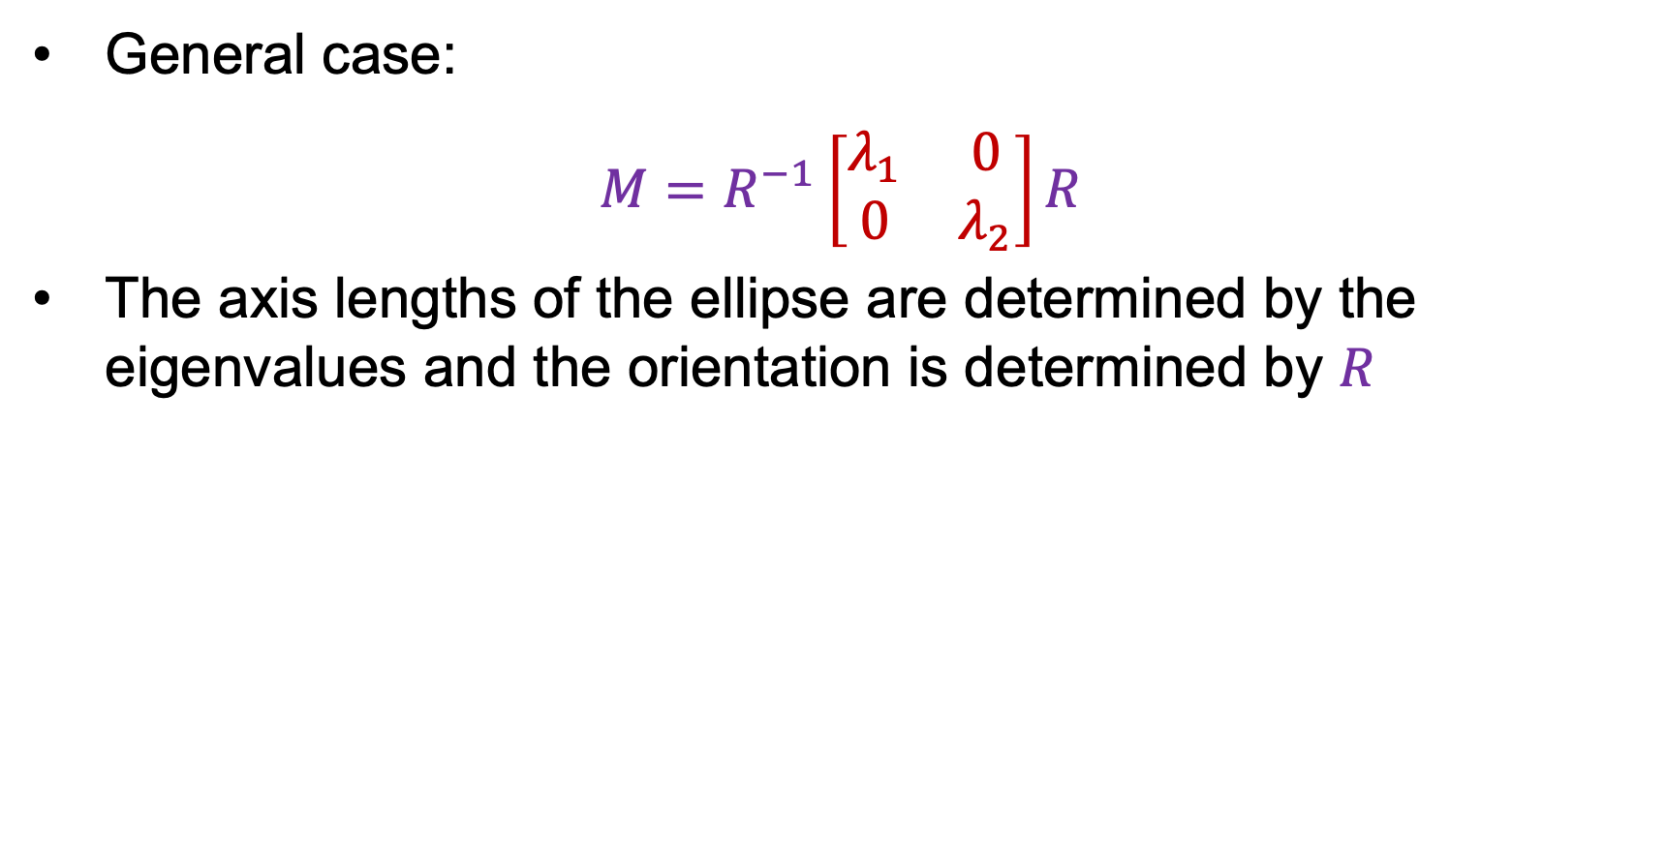
Second moment ellipse
General case:
$$M=R^{−1}\left[\begin{matrix}λ_{1} & 0 \\ 0 & λ_{2}\end{matrix}\right]R$$
The axis lengths of the ellipse are determined by the eigenvalues and the orientation is determined by $R$
direction of the fastest change
direction of the slowest change
(λ_{max})^{-1/2}
(λ_{min})^{-1/2}

Slide 23
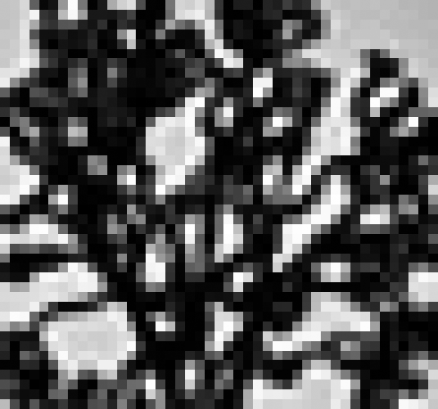
Visualization of second moment ellipses

Slide 24
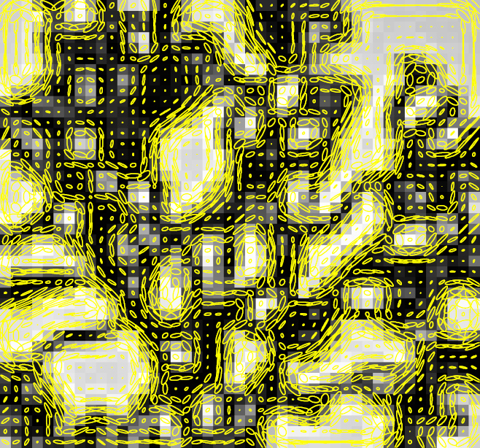
Visualization of second moment ellipses
Note: axes are rescaled so ellipse areas are proportional to edge energy (i.e., bigger ellipses correspond to stronger edges)

Slide 25
Interpreting the eigenvalues
Classification of image points using eigenvalues of $M$:
λ₂
“Edge”
λ₂ >> λ₁
“Corner”
λ₁ and λ₂ are large,
λ₁ ~ λ₂;
E increases in all directions
λ₁ and λ₂ are small;
E is almost constant in all directions
“Flat” region
“Edge”
λ₁ >> λ₂
λ₁

Slide 26

Corner response function
$$R=\det\left(M\right)−α trace{\left(M\right)}^{2}=λ_{1}λ_{2}−α{(λ_{1}+λ_{2})}^{2}$$
$α$: constant (0.04 to 0.06)
“Edge”
R < 0
“Corner”
R > 0
|R| small
“Flat” region
“Edge”
R < 0

Slide 27
Outline
Keypoint detection: Motivation
Deriving a corner detection criterion
The Harris corner detector

Slide 28
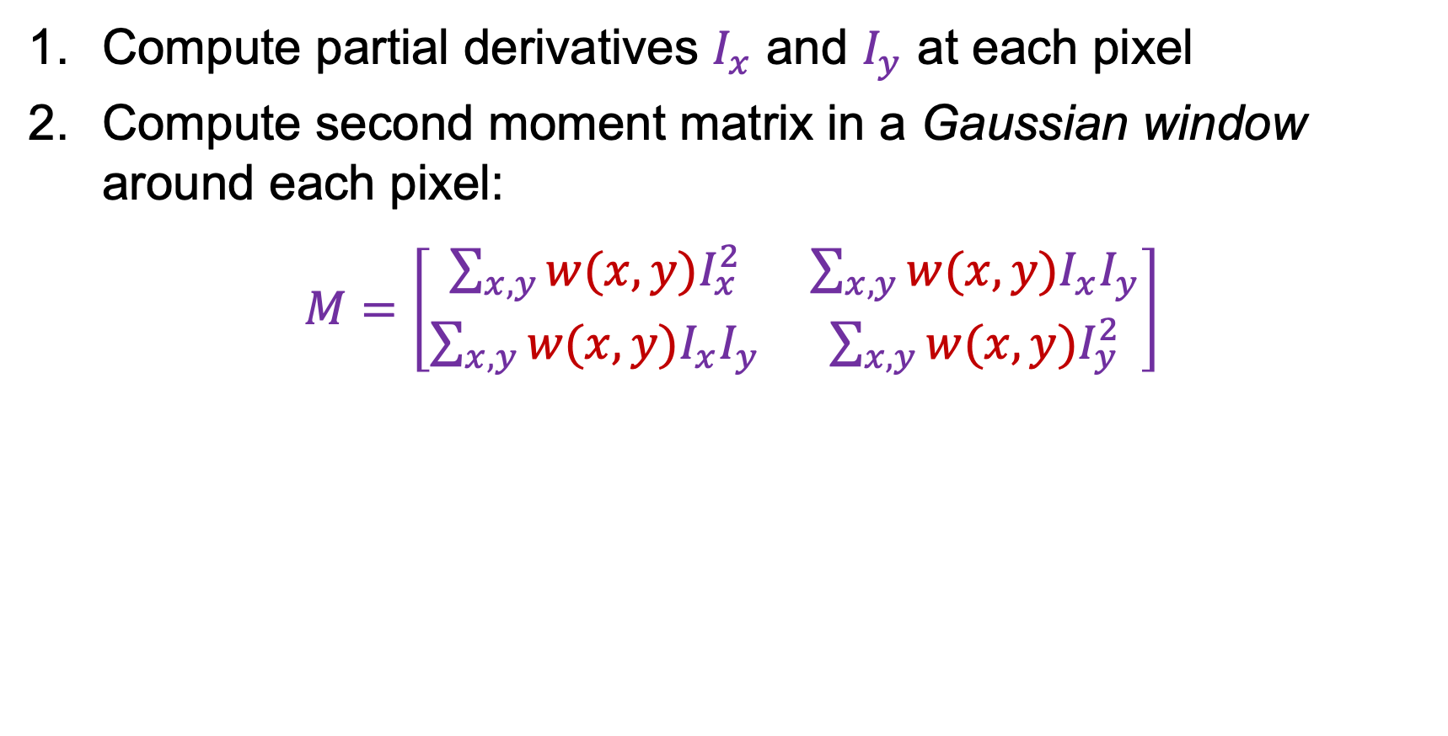
The Harris corner detector
Compute partial derivatives $I_{x}$ and $I_{y}$ at each pixel
Compute second moment matrix in a Gaussian window around each pixel:
$M=\left[\begin{matrix}\sum_{x,y}{w(x,y)I_{x}^{2}} & \sum_{x,y}{{w(x,y)I}_{x}I_{y}} \\ \sum_{x,y}{w(x,y)I_{x}I_{y}} & \sum_{x,y}{w(x,y)I_{y}^{2}}\end{matrix}\right]$
C.Harris and M.Stephens, A Combined Corner and Edge Detector, Proceedings of the 4th Alvey Vision Conference: pages 147—151, 1988.

Slide 29
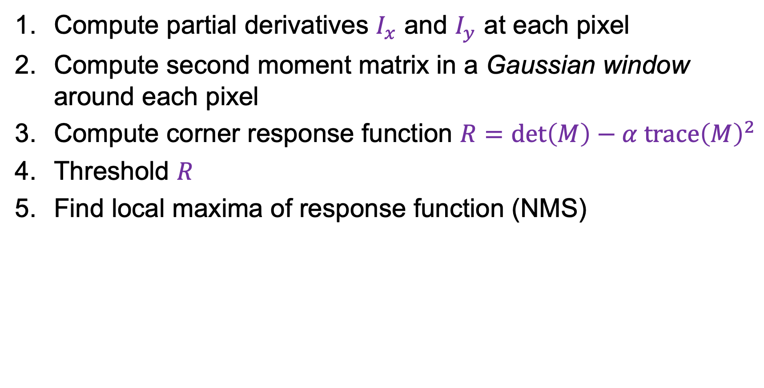
The Harris corner detector
Compute partial derivatives $I_{x}$ and $I_{y}$ at each pixel
Compute second moment matrix in a Gaussian window around each pixel
Compute corner response function $R=\det\left(M\right)−α trace{\left(M\right)}^{2}$
Threshold $R$
Find local maxima of response function (NMS)
C.Harris and M.Stephens, A Combined Corner and Edge Detector, Proceedings of the 4th Alvey Vision Conference: pages 147—151, 1988.

Slide 30
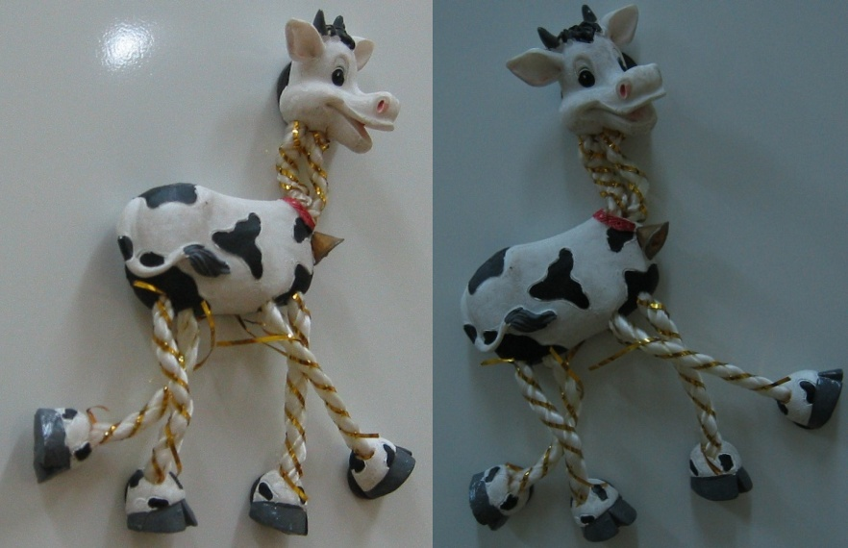
Harris Detector: Example

Slide 31
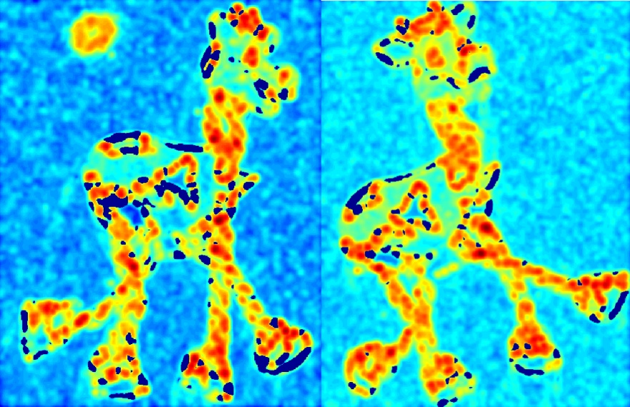

Harris Detector: Example
Compute corner response $R$

Slide 32
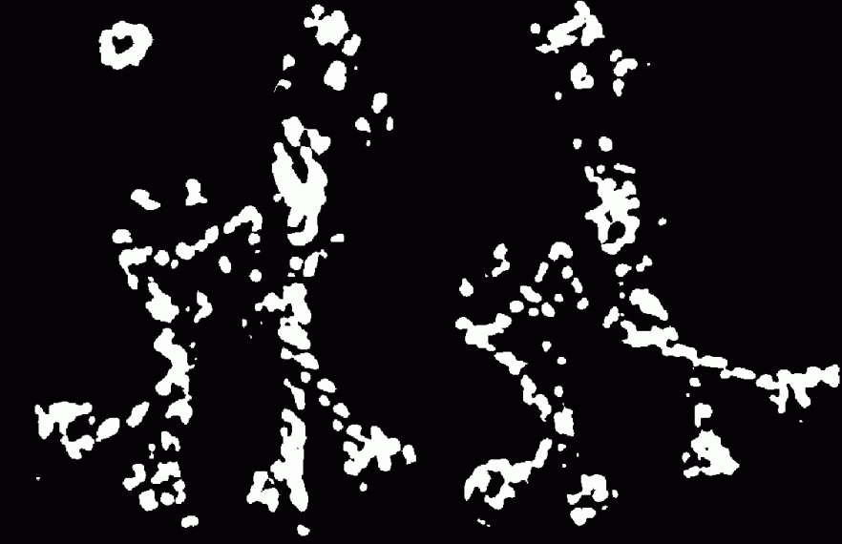
Harris Detector: Example
Find points with large corner response: $R$ > threshold

Slide 33


Harris Detector: Example
Take only the points of local maxima of $R$

Slide 34

Harris Detector: Example

Slide 35
Outline
Keypoint detection: Motivation
Deriving a corner detection criterion
The Harris corner detector
Behavior of corner features w.r.t. image transformations

Slide 36
Behavior w.r.t. image transformations
To be useful for image matching, “the same” corner features need to show up despite geometric and photometric transformations
We need to analyze how
the corner response function and the corner locations change in response to various transformations

Slide 37
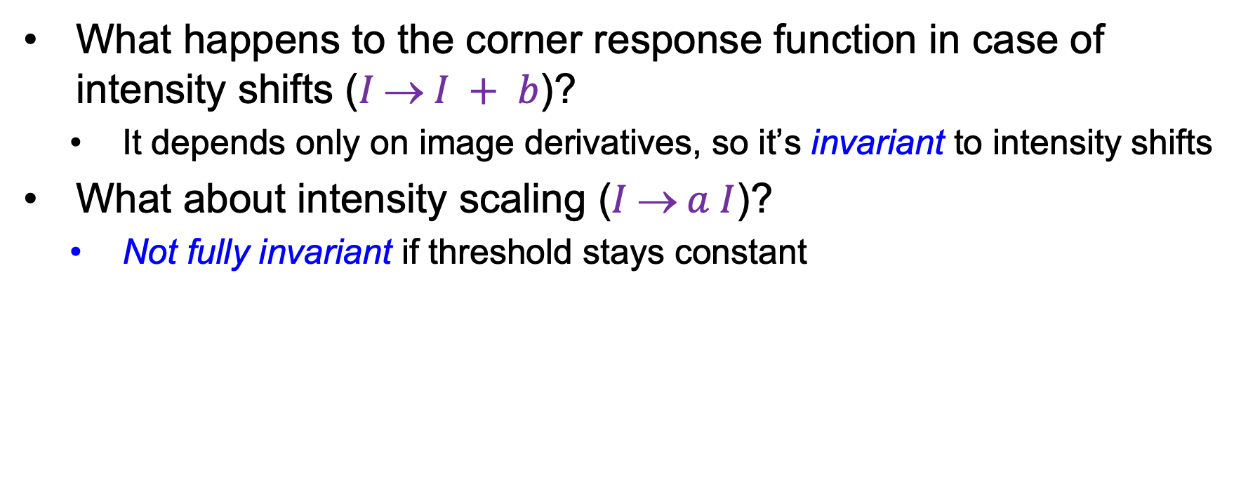
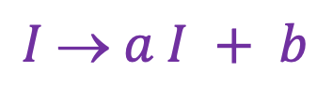
Affine intensity change
$$I  a I + b$$
What happens to the corner response function in case of intensity shifts ($I  I + b$)?
  It depends only on image derivatives, so it’s invariant to intensity shifts
What about intensity scaling ($I  a I$)?
  Not fully invariant if threshold stays constant
R
R
threshold
x (image coordinate)
x (image coordinate)

Slide 38
Image translation
How do the detected corner locations change if the image pattern is translated?
  All the ingredients of the second moment matrix are shift-invariant, and so is the corner response function
  However, the locations of the corners are equivariant (or covariant) w.r.t. shifts

Slide 39
Image rotation
How do the detected corner locations change if the image pattern is rotated?
  Assuming the second moment matrix is calculated over a circular neighborhood (and ignoring resampling issues), the rotation changes but the eigenvalues stay the same, so the response function is invariant
  The locations of the corners are equivariant (or covariant) w.r.t. rotations

Slide 40
Image scaling
How do the detected corner locations change if the image pattern is scaled?

Slide 41
Image scaling
Not corners!
Corner
How do the detected corner locations change if the image pattern is scaled?
  Assuming fixed-size neighborhoods for calculating the second moment matrix, the corner response function is not invariant and the corner locations are not equivariant w.r.t. scaling

Slide 42
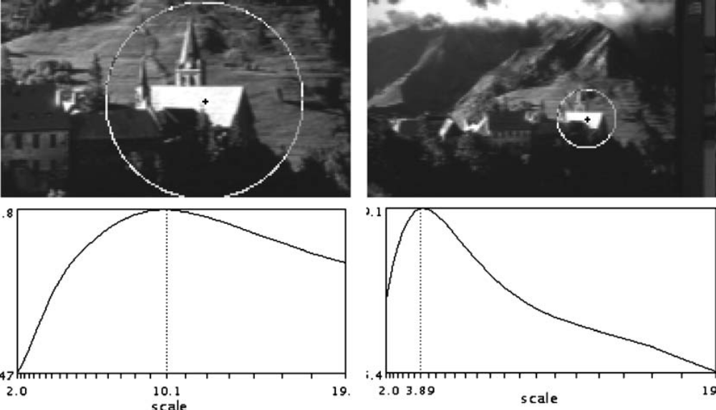
Next: Keypoint detection with scale selection
We want to extract keypoints with characteristic scales that are equivariant (or covariant) w.r.t. to scaling of the image
Scale-invariant response function
K. Mikolajczyk and C. Schmid. Indexing based on scale invariant interest points. ICCV 2001
T. Lindeberg, Feature detection with automatic scale selection, IJCV 30(2), pp. 77-116, 1998

