Slide 1
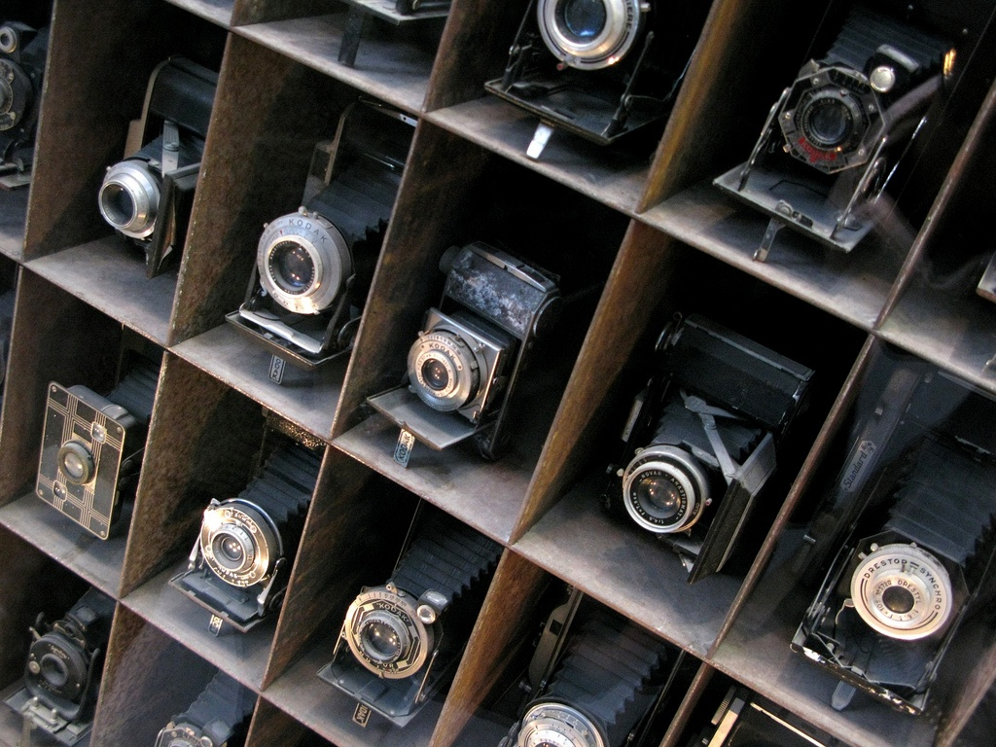
Introduction to cameras

Slide 2
Overview
Pinhole projection
Lenses
Field of view, focal length
Marginal distortion
Lens distortions

Slide 3
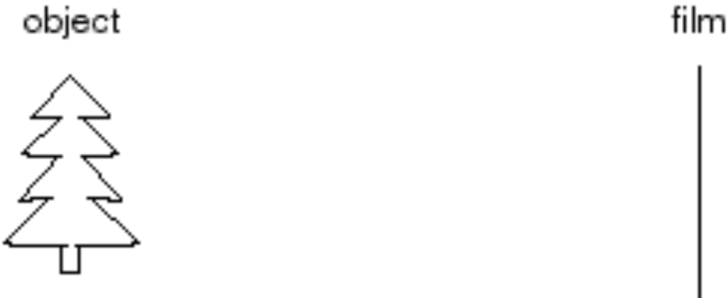
Let’s design a camera
Idea 1: put a piece of film in front of an object
Do we get a reasonable image?
Slide by Steve Seitz

Slide 4
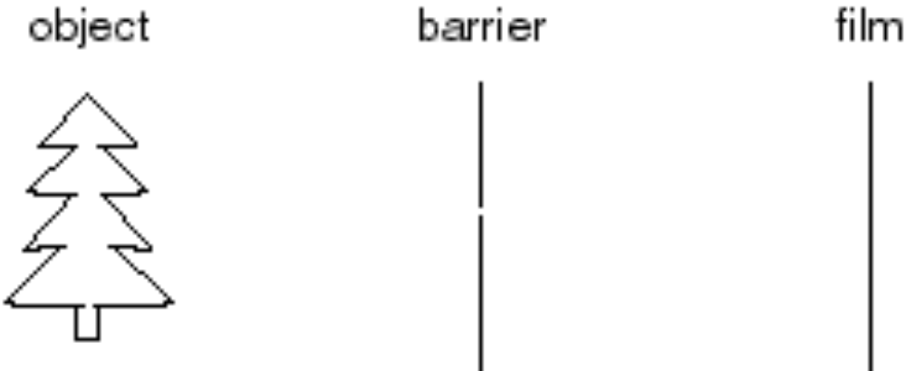
Pinhole camera
Add a barrier to block off most of the rays
Slide by Steve Seitz
Notes:
It gets inverted

Slide 5
Pinhole camera
Captures pencil of rays – all rays through a single point: aperture, center of projection, optical center, focal point, camera center
The image is formed on the image plane
Slide by Steve Seitz

Slide 6
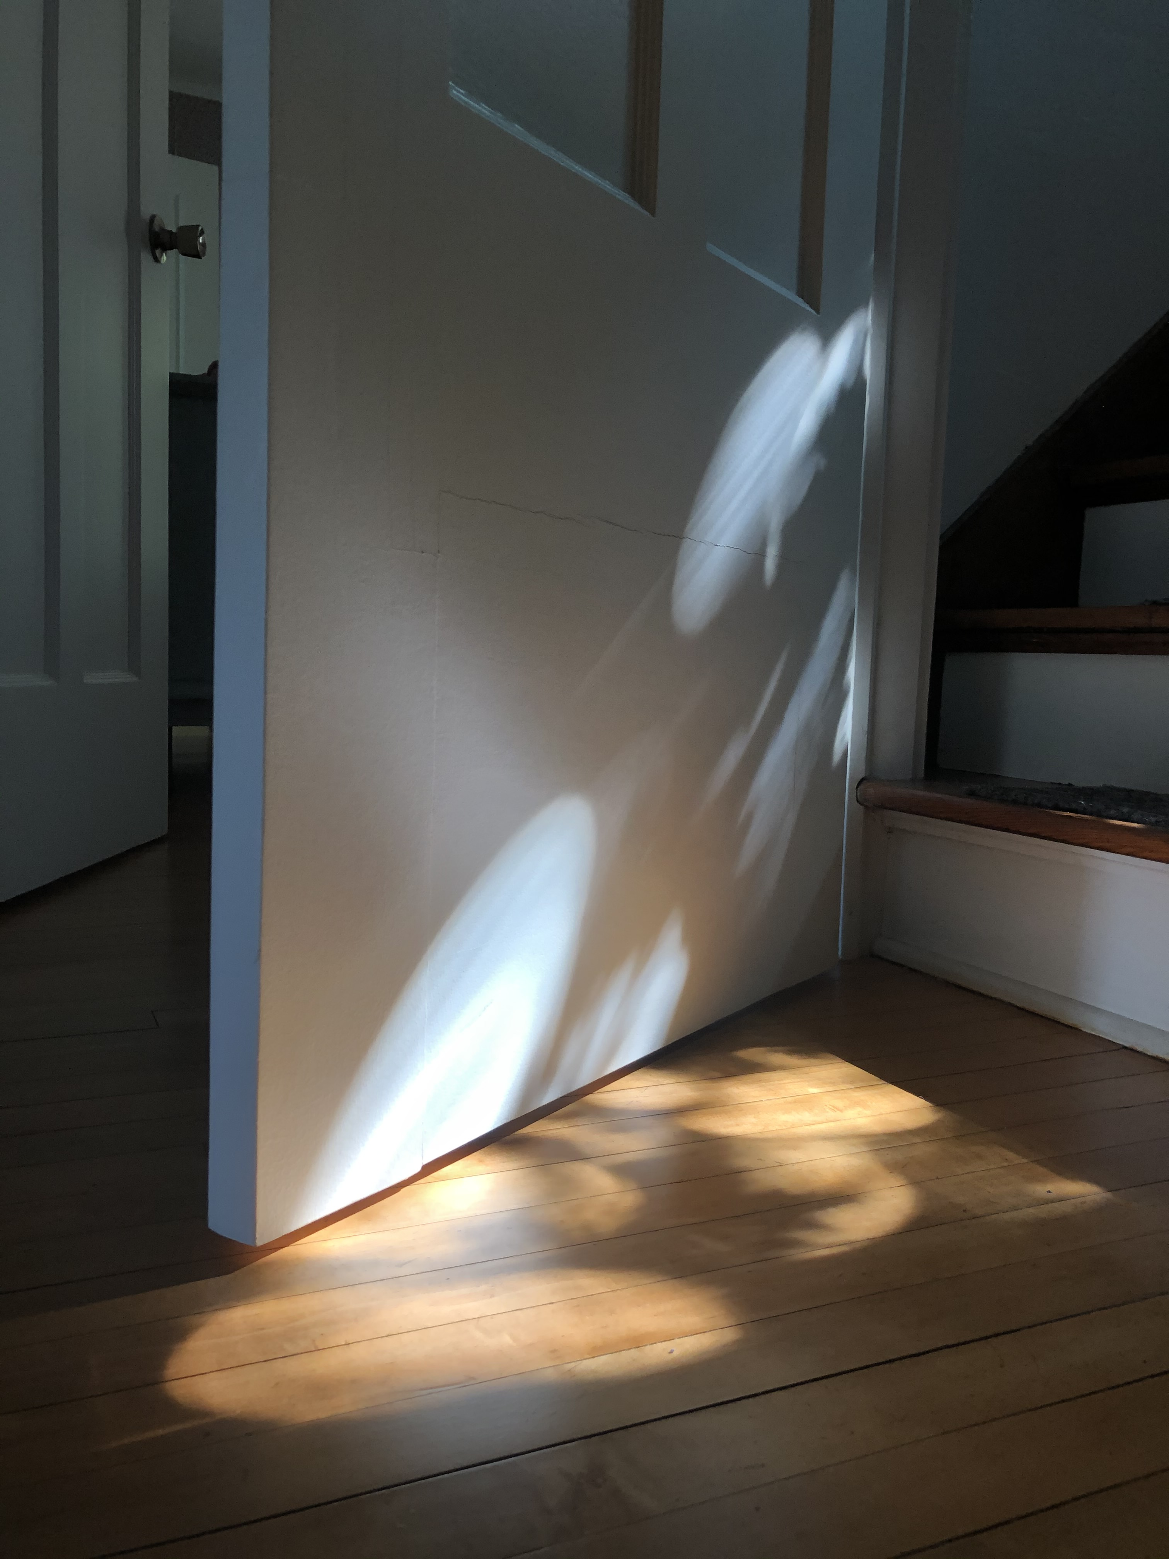
Pinhole cameras are everywhere
My photo during the COVID year (2020)

Slide 7
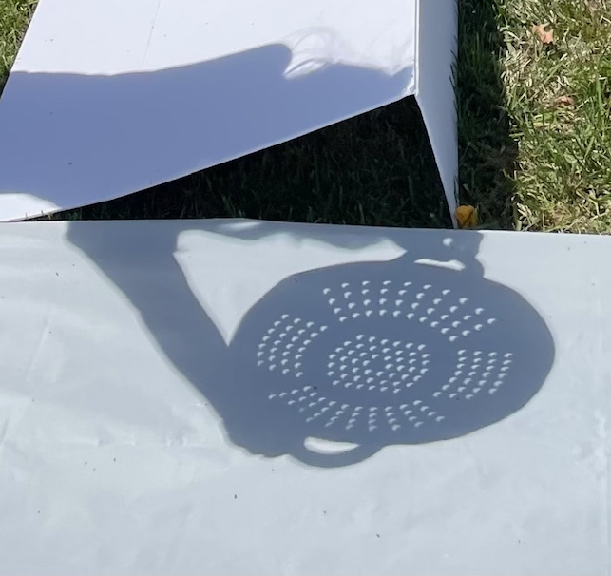
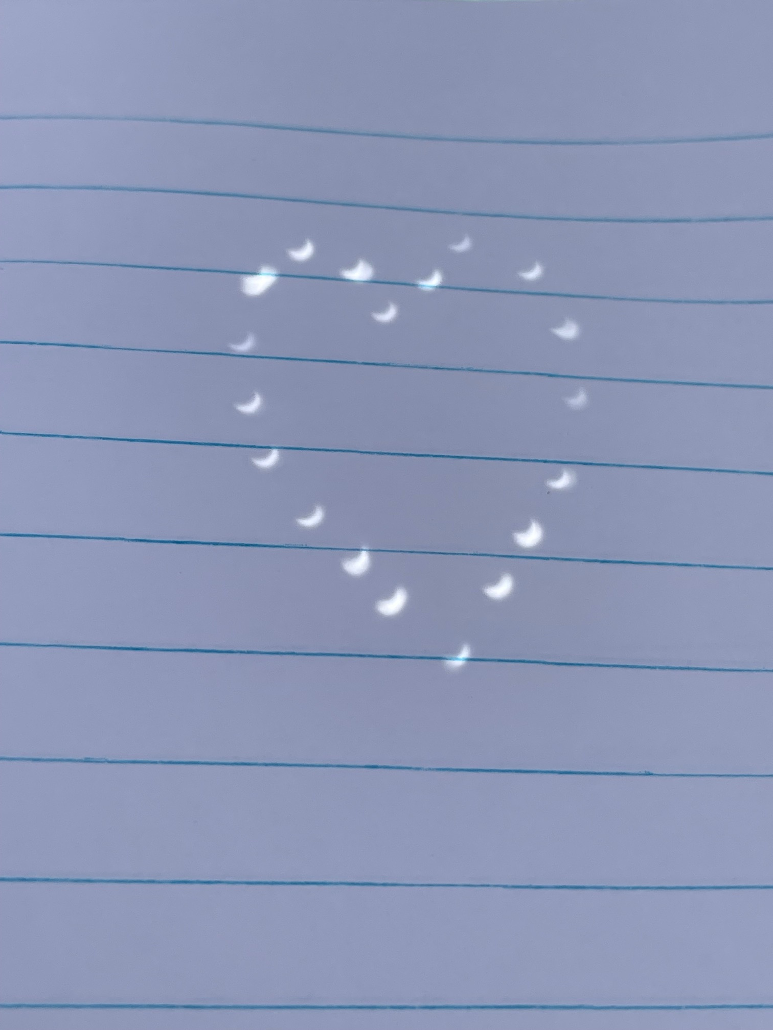
Pinhole cameras are everywhere
My photos during the April 2024 total eclipse

Slide 8
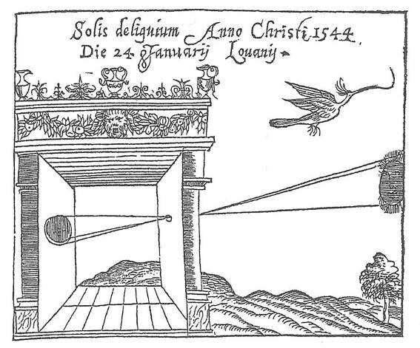
Camera obscura
Basic principle known to Mozi (470-390 BCE), Aristotle (384-322 BCE)
Drawing aid for artists: described by Leonardo da Vinci (1452-1519)
Gemma Frisius, 1558
Source: A. Efros

Slide 9
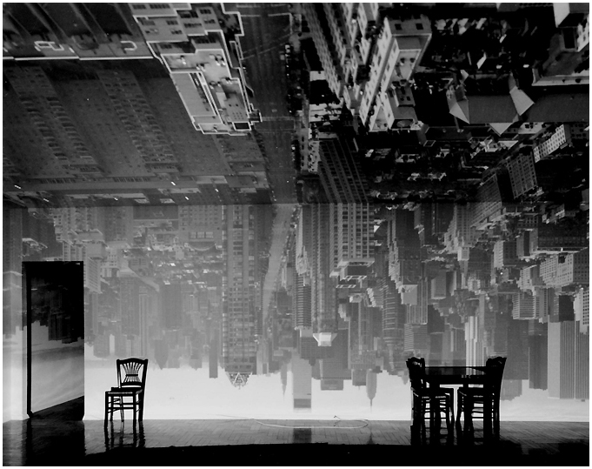
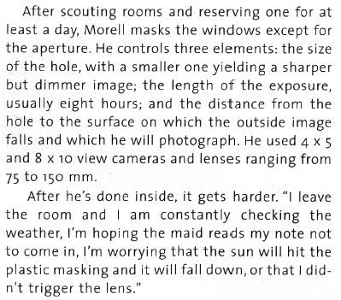
Turning a room into a camera obscura
From Grand Images Through a Tiny Opening, Photo District News, February 2005
Abelardo Morell, Camera Obscura Image of Manhattan View Looking South in Large Room, 1996
https://www.abelardomorell.net/camera-obscura

Slide 10
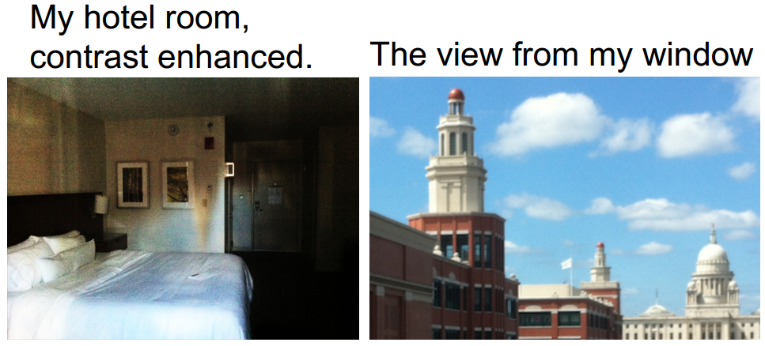

Turning a room into a camera obscura
A. Torralba and W. Freeman. Accidental Pinhole and Pinspeck Cameras. CVPR 2012

Slide 11
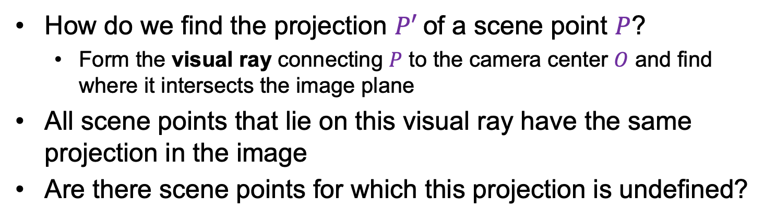



Modeling projection
$$P$$
$$O$$
$$P′$$
How do we find the projection $P′$of a scene point $P$?
  Form the visual ray connecting $P$ to the camera center $O$ and find where it intersects the image plane
All scene points that lie on this visual ray have the same projection in the image
Are there scene points for which this projection is undefined?

Slide 12
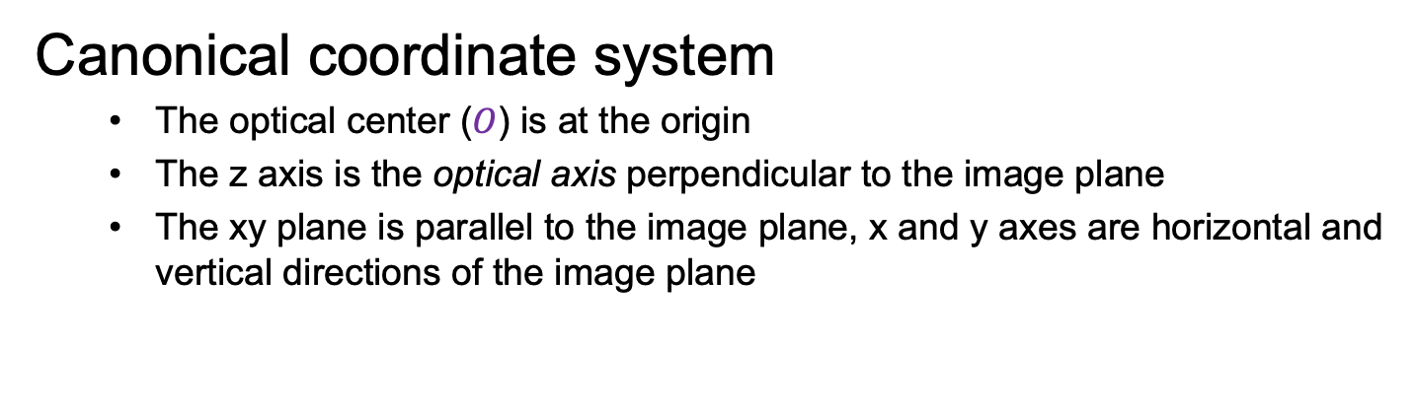



Modeling projection
$$P$$
$$y$$
$$z$$
$$O$$
$$x$$
$$P′$$
Canonical coordinate system
  The optical center ($O$) is at the origin
  The z axis is the optical axis perpendicular to the image plane
  The xy plane is parallel to the image plane, x and y axes are horizontal and vertical directions of the image plane

Slide 13



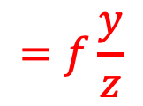
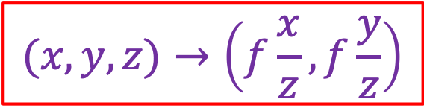

Deriving projected coordinates
$$P$$
$$y$$
$$f$$
$$z$$
$$=f\frac{y}{z}$$
$$O$$
$$y^{′}$$
$$P′$$
$$(x,y,z)→\left(f\frac{x}{z},f\frac{y}{z}\right)$$

Slide 14
Deriving projected coordinates
Note: instead of dealing with an image that is upside down, most of the time we will pretend that the image plane is in front of the camera center

Slide 15
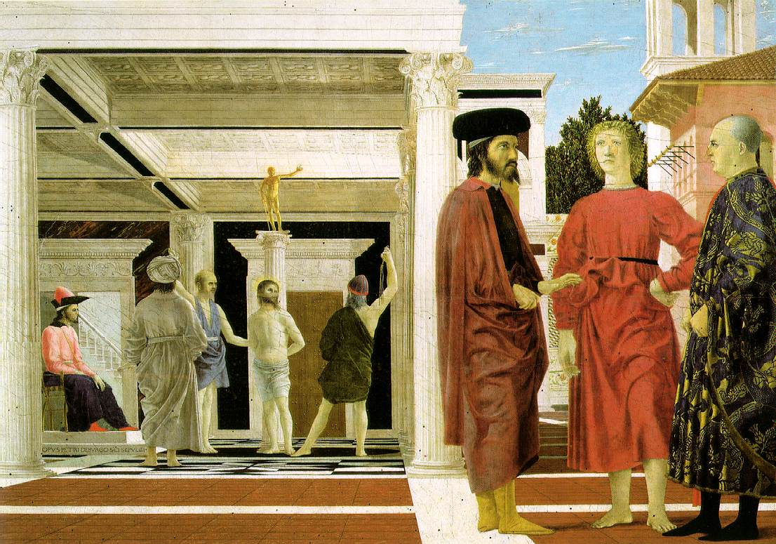
Properties of projection
Real-world sizes (lengths) are not preserved in projection
  What other properties are/are not preserved?
Piero della Francesca, Flagellation of Christ, 1455-1460

Slide 16
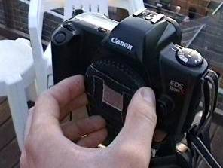
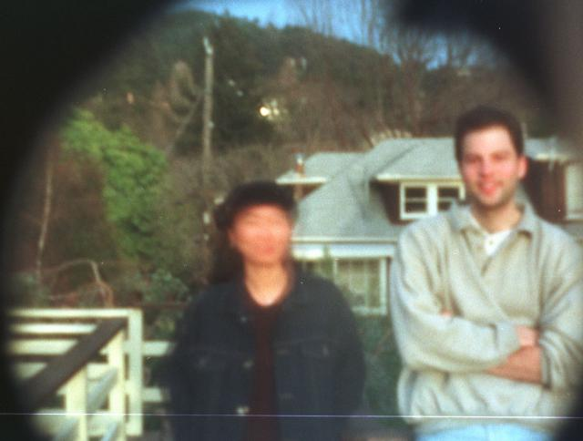
Home-made pinhole camera
Source: P. Debevec via A. Efros

Slide 17
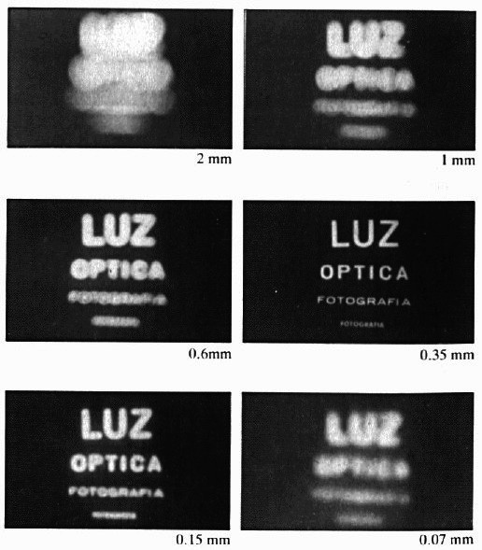
Shrinking the aperture
Why not make the aperture as small as possible?
  Less light gets through
  Diffraction!
Slide by Steve Seitz

Slide 18
Shrinking the aperture

Slide 19
Overview
Pinhole projection
Lenses

Slide 20
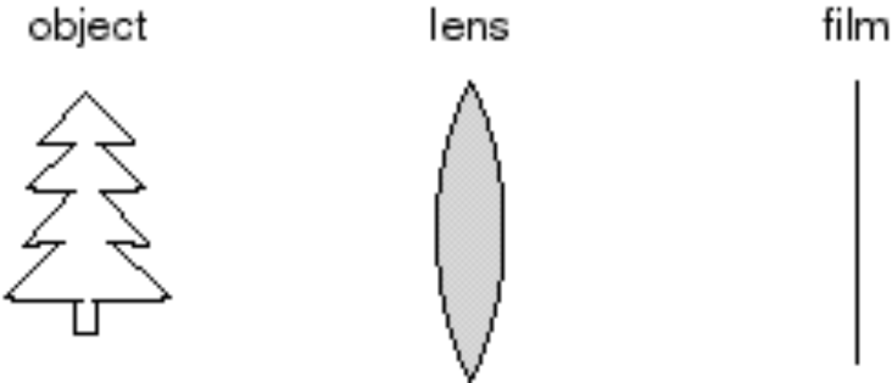
Adding a lens
A lens focuses light onto the film
  Thin lens model:
Slide by Steve Seitz

Slide 21
Adding a lens
A lens focuses light onto the film
  Thin lens model:
    Rays passing through the center are not deviated
    (pinhole projection model still holds)
Slide by Steve Seitz

Slide 22
Adding a lens
focal plane
focal point
f
A lens focuses light onto the film
  Thin lens model:
    Rays passing through the center are not deviated
    (pinhole projection model still holds)
    All rays parallel to the optical axis pass through the focal point
    All parallel rays converge to points on the focal plane
Slide by Steve Seitz

Slide 23
Thin lens formula
Where does the lens focus the rays coming from a given point in the scene?
image plane
lens
scene
Slide by Frédo Durand
Notes:
This is the relation between the focal length (f), the distance of the object from the camera (D), and the distance at which the object will be in focus (D’)

Slide 24
Thin lens formula
What is the relation between the focal length ( f ),
the distance of the object from the optical center (D),
and the distance at which the object will be in focus (D′)?
D′
D
f
image plane
lens
scene
Slide by Frédo Durand
Notes:
This is the relation between the focal length (f), the distance of the object from the camera (D), and the distance at which the object will be in focus (D’)

Slide 25
Thin lens formula
Similar triangles everywhere!
D′
D
f
image plane
lens
scene
Slide by Frédo Durand

Slide 26
Thin lens formula
y′/y = D′/D
Similar triangles everywhere!
D′
D
f
y
y′
image plane
lens
scene
Slide by Frédo Durand

Slide 27
Thin lens formula
y′/y = D′/D
Similar triangles everywhere!
y′/y = (D′−f )/f
D′
D
f
y
y′
image plane
lens
scene
Slide by Frédo Durand

Slide 28
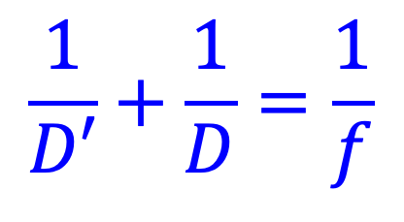
Thin lens formula
$$\frac{1}{D′}+\frac{1}{D}=\frac{1}{f}$$
Any point satisfying the thin lens equation is in focus.
What happens when D is very large?
D′
D
f
image plane
lens
scene
Slide by Frédo Durand
Notes:
And the set of all such points forms a plane parallel to the image (plane of focus).
Uses of the formula: given focal length and depth in scene that you want to be in focus, it tells you where to put the image plane. Given f and distance of image plane from camera center, it tells you which depth in the scene will be in focus.

Slide 29
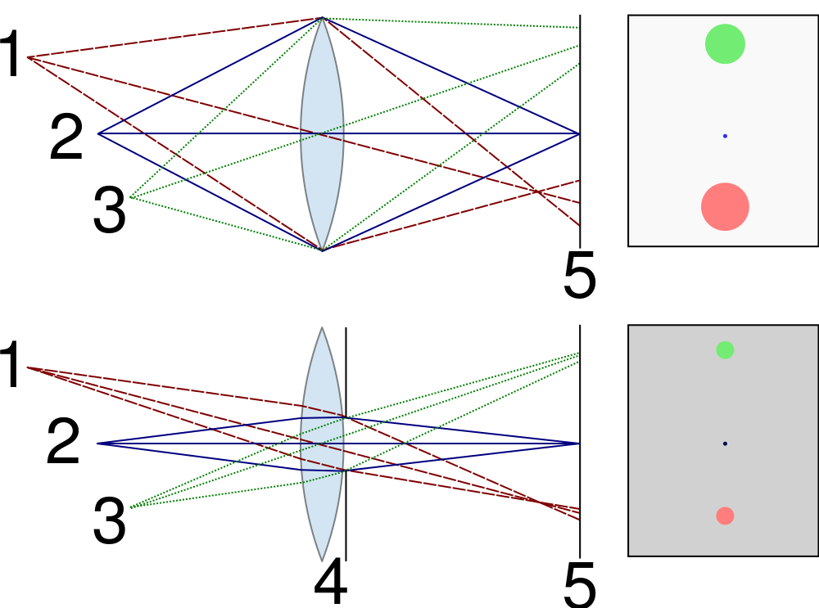
Depth of field
For a fixed focal length and image plane, there is a specific distance at which objects are “in focus”
  Other points project to a “circle of confusion” in the image

Slide 30

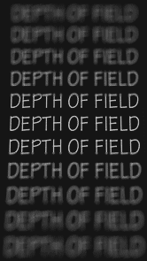
Depth of field
Depth of field is the distance between the nearest and farthest objects in a scene that appear acceptably sharp
in an image (Wikipedia)
Image source
(via A. Efros)

Slide 31
Controlling depth of field
Figure source

Slide 32


Controlling depth of field
Changing the aperture size affects depth of field
  A smaller aperture increases the range in which the object is approximately in focus
  But small aperture reduces amount of light – need to increase exposure
Figure source

Slide 33


Varying the aperture
Large aperture = small DOF
Small aperture = large DOF
Slide by A. Efros

Slide 34
Overview
Pinhole projection
Lenses
Field of view, focal length

Slide 35
Field of view
The field of view is the angular extent of the world observed by the camera (Wikipedia)
What determines the FOV?

Slide 36
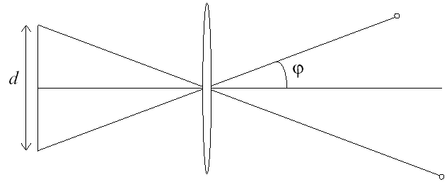
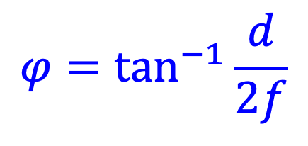
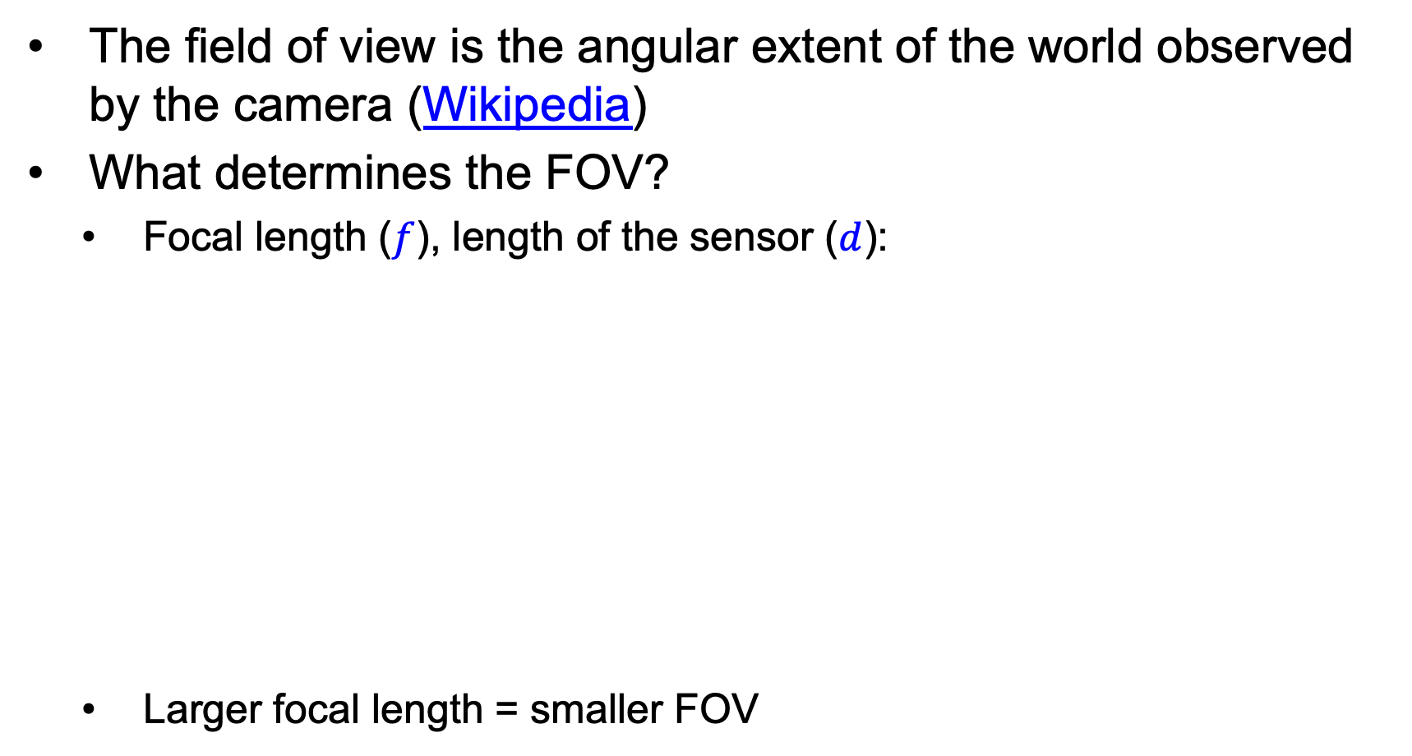
Field of view
The field of view is the angular extent of the world observed by the camera (Wikipedia)
What determines the FOV?
  Focal length ($f$), length of the sensor ($d$):
  Larger focal length = smaller FOV
f
$$φ=\tan^{−1}{\frac{d}{2f}}$$

Slide 37
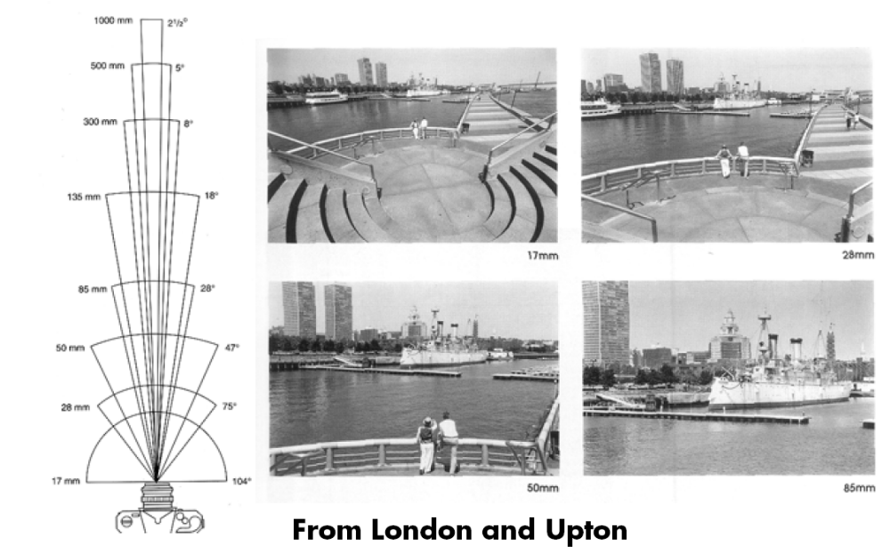
Field of view
Slide by A. Efros
Notes:
The field of view is the angular extent of the world that is observed by the camera.

Slide 38
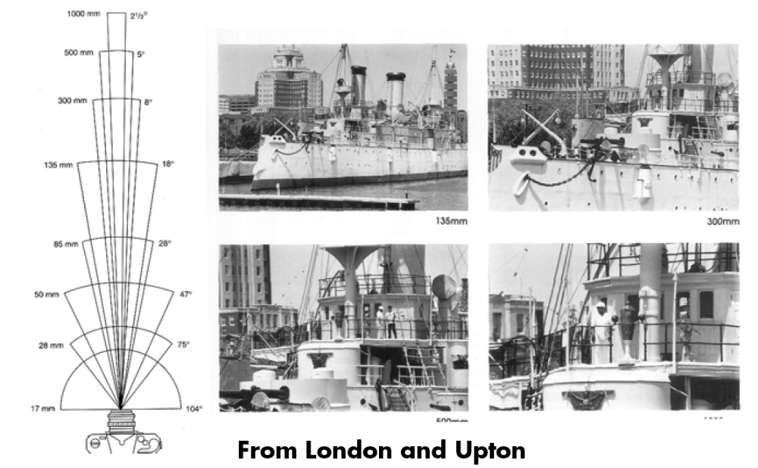
Field of view
Slide by A. Efros

Slide 39

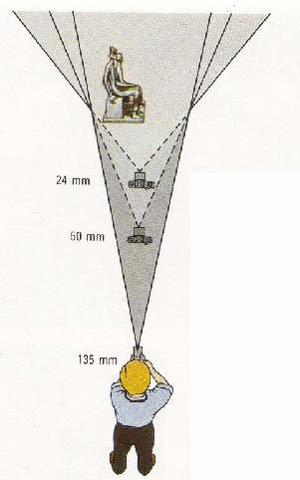

Field of view / focal length
Large FOV, small f
Camera close to car
Small FOV, large f
Camera far from the car
Sources: A. Efros, F. Durand

Slide 40



Same effect for faces
wide-angle
standard
telephoto
Source: F. Durand

Slide 41
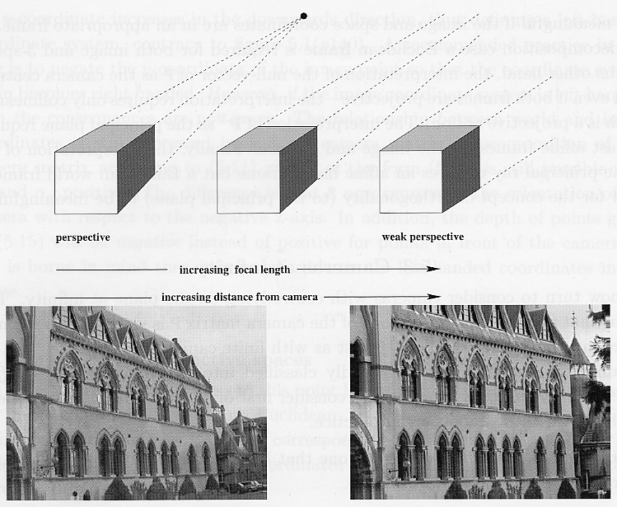
Approximating an orthographic camera
Source: Hartley & Zisserman

Slide 42
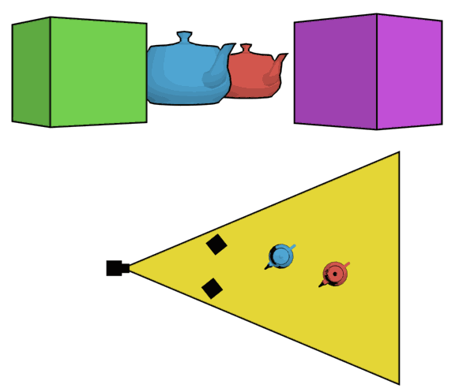
The dolly zoom
Continuously adjusting the focal length while the camera moves away from (or towards) the subject
http://en.wikipedia.org/wiki/Dolly_zoom

Slide 43
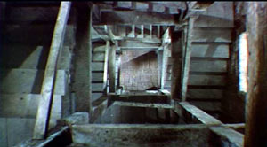
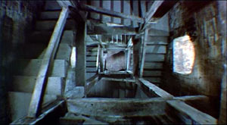
The dolly zoom
Continuously adjusting the focal length while the camera moves away from (or towards) the subject
“The Vertigo shot”
Example of dolly zoom from Goodfellas (YouTube)
Example of dolly zoom from La Haine (YouTube)

Slide 44
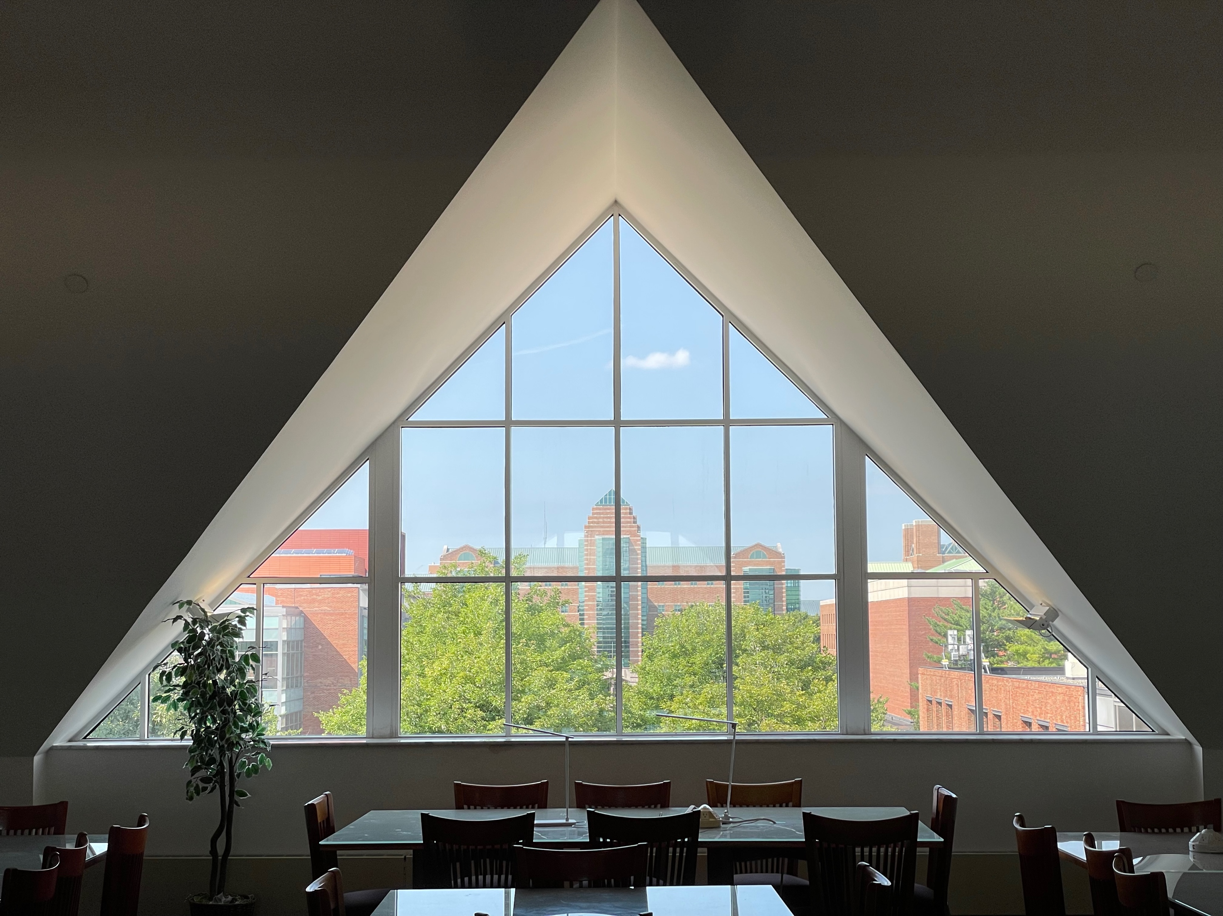

My “dolly zoom”

Slide 45
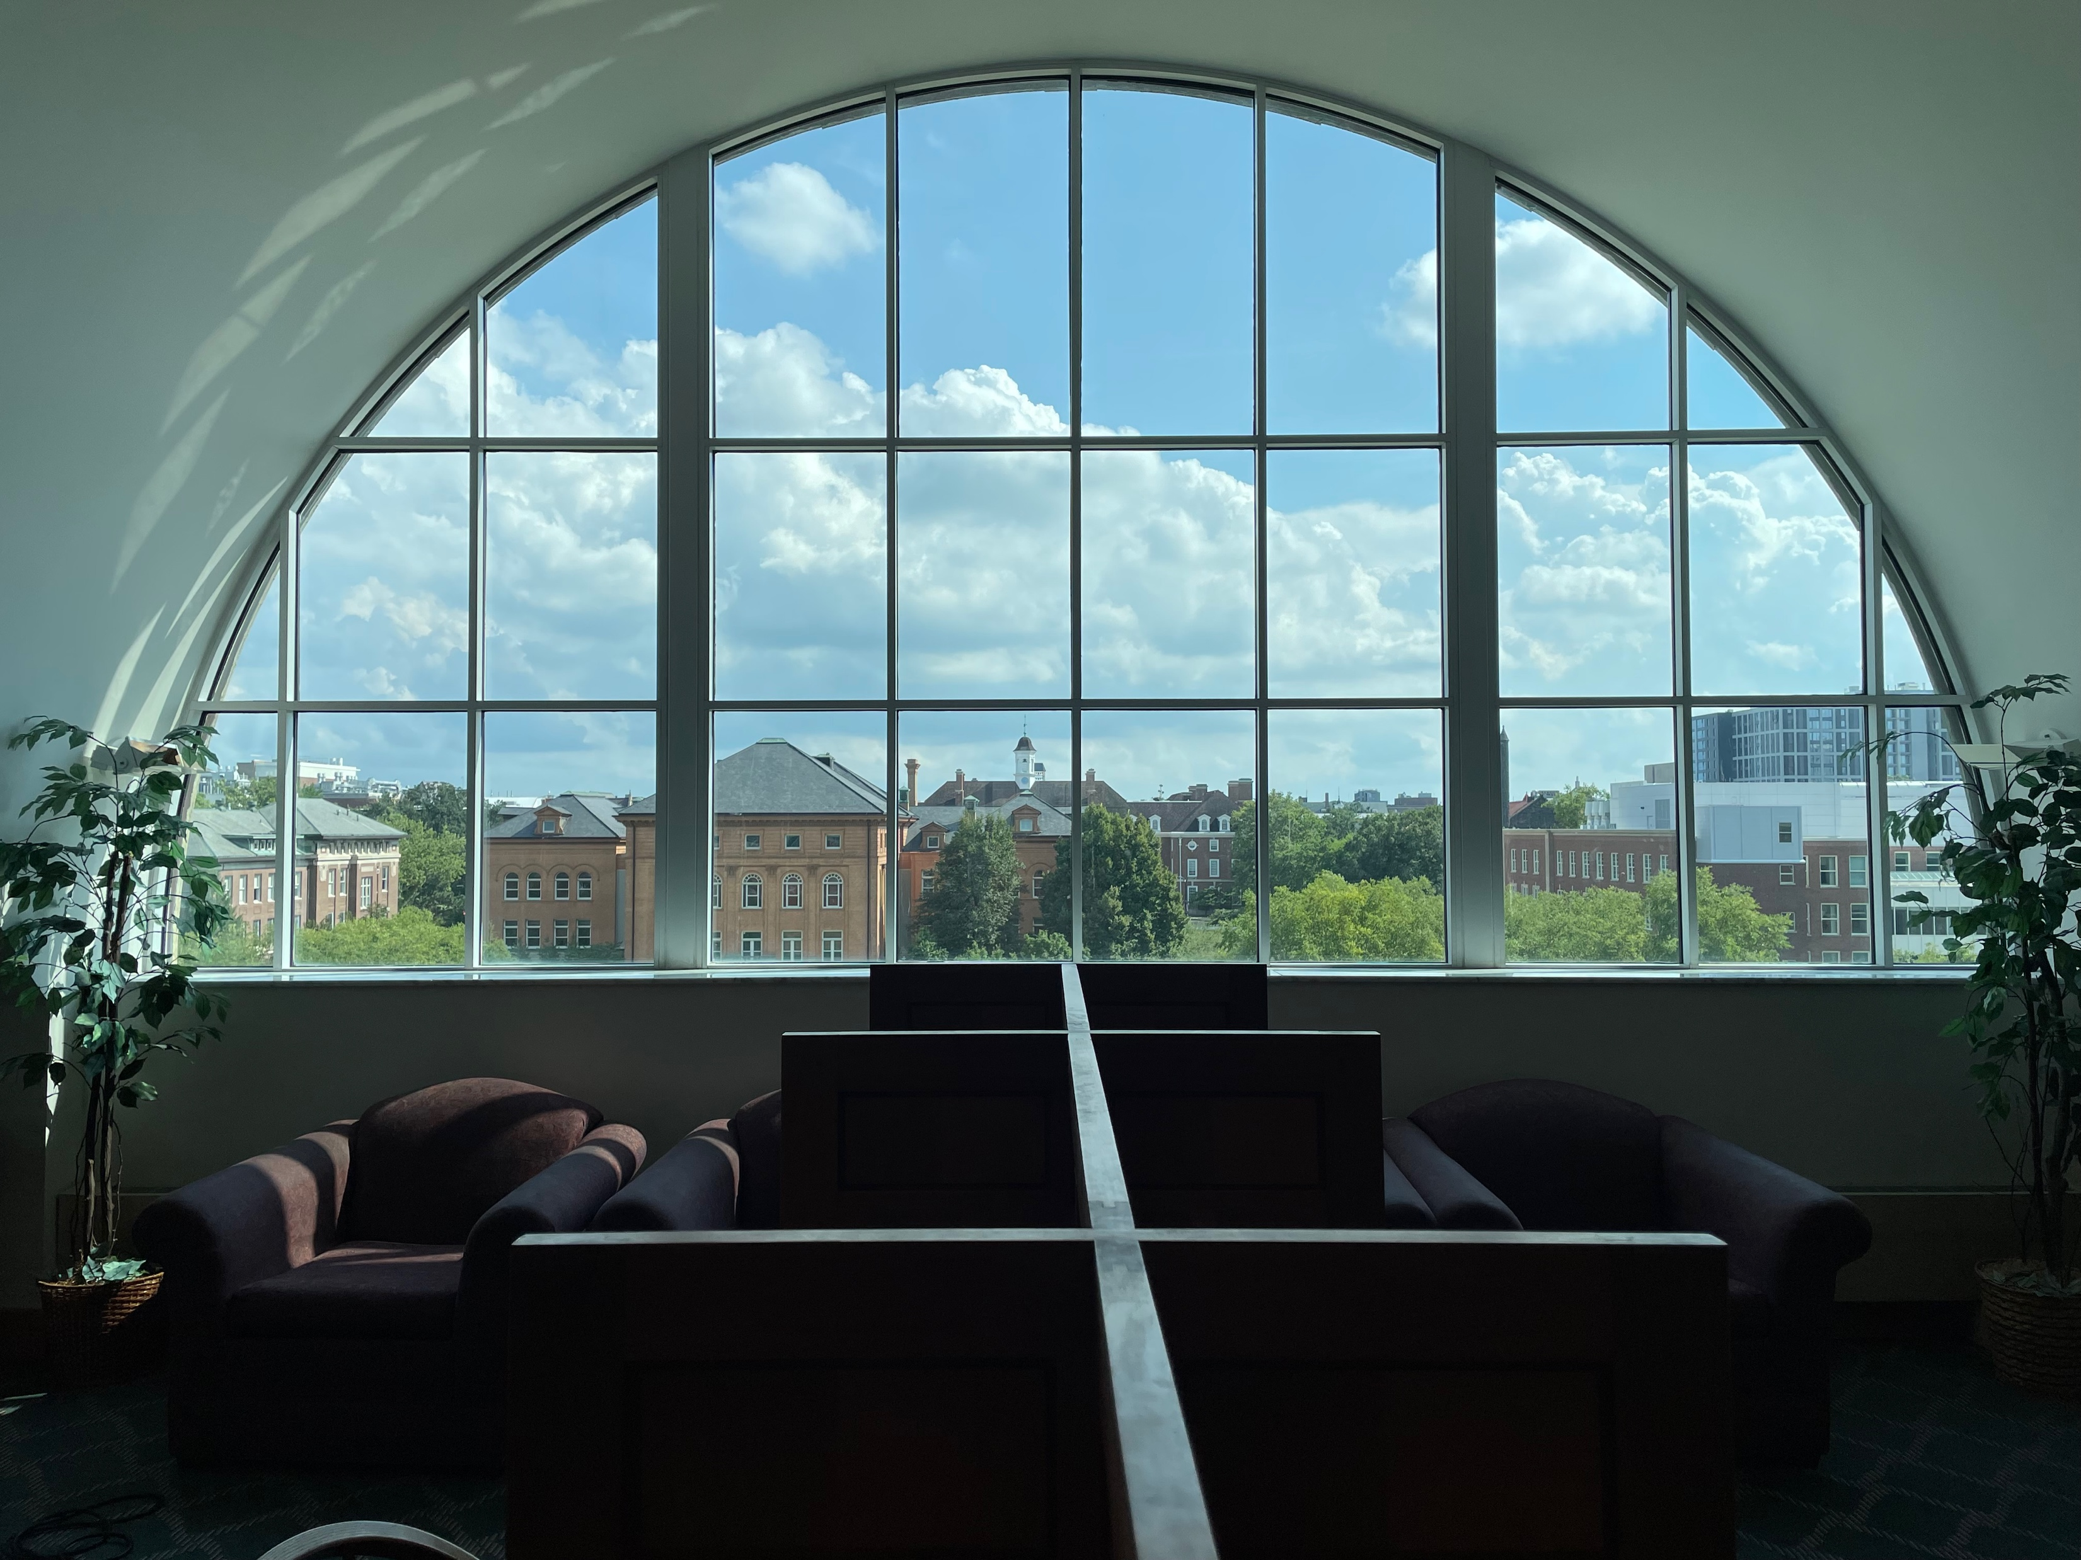
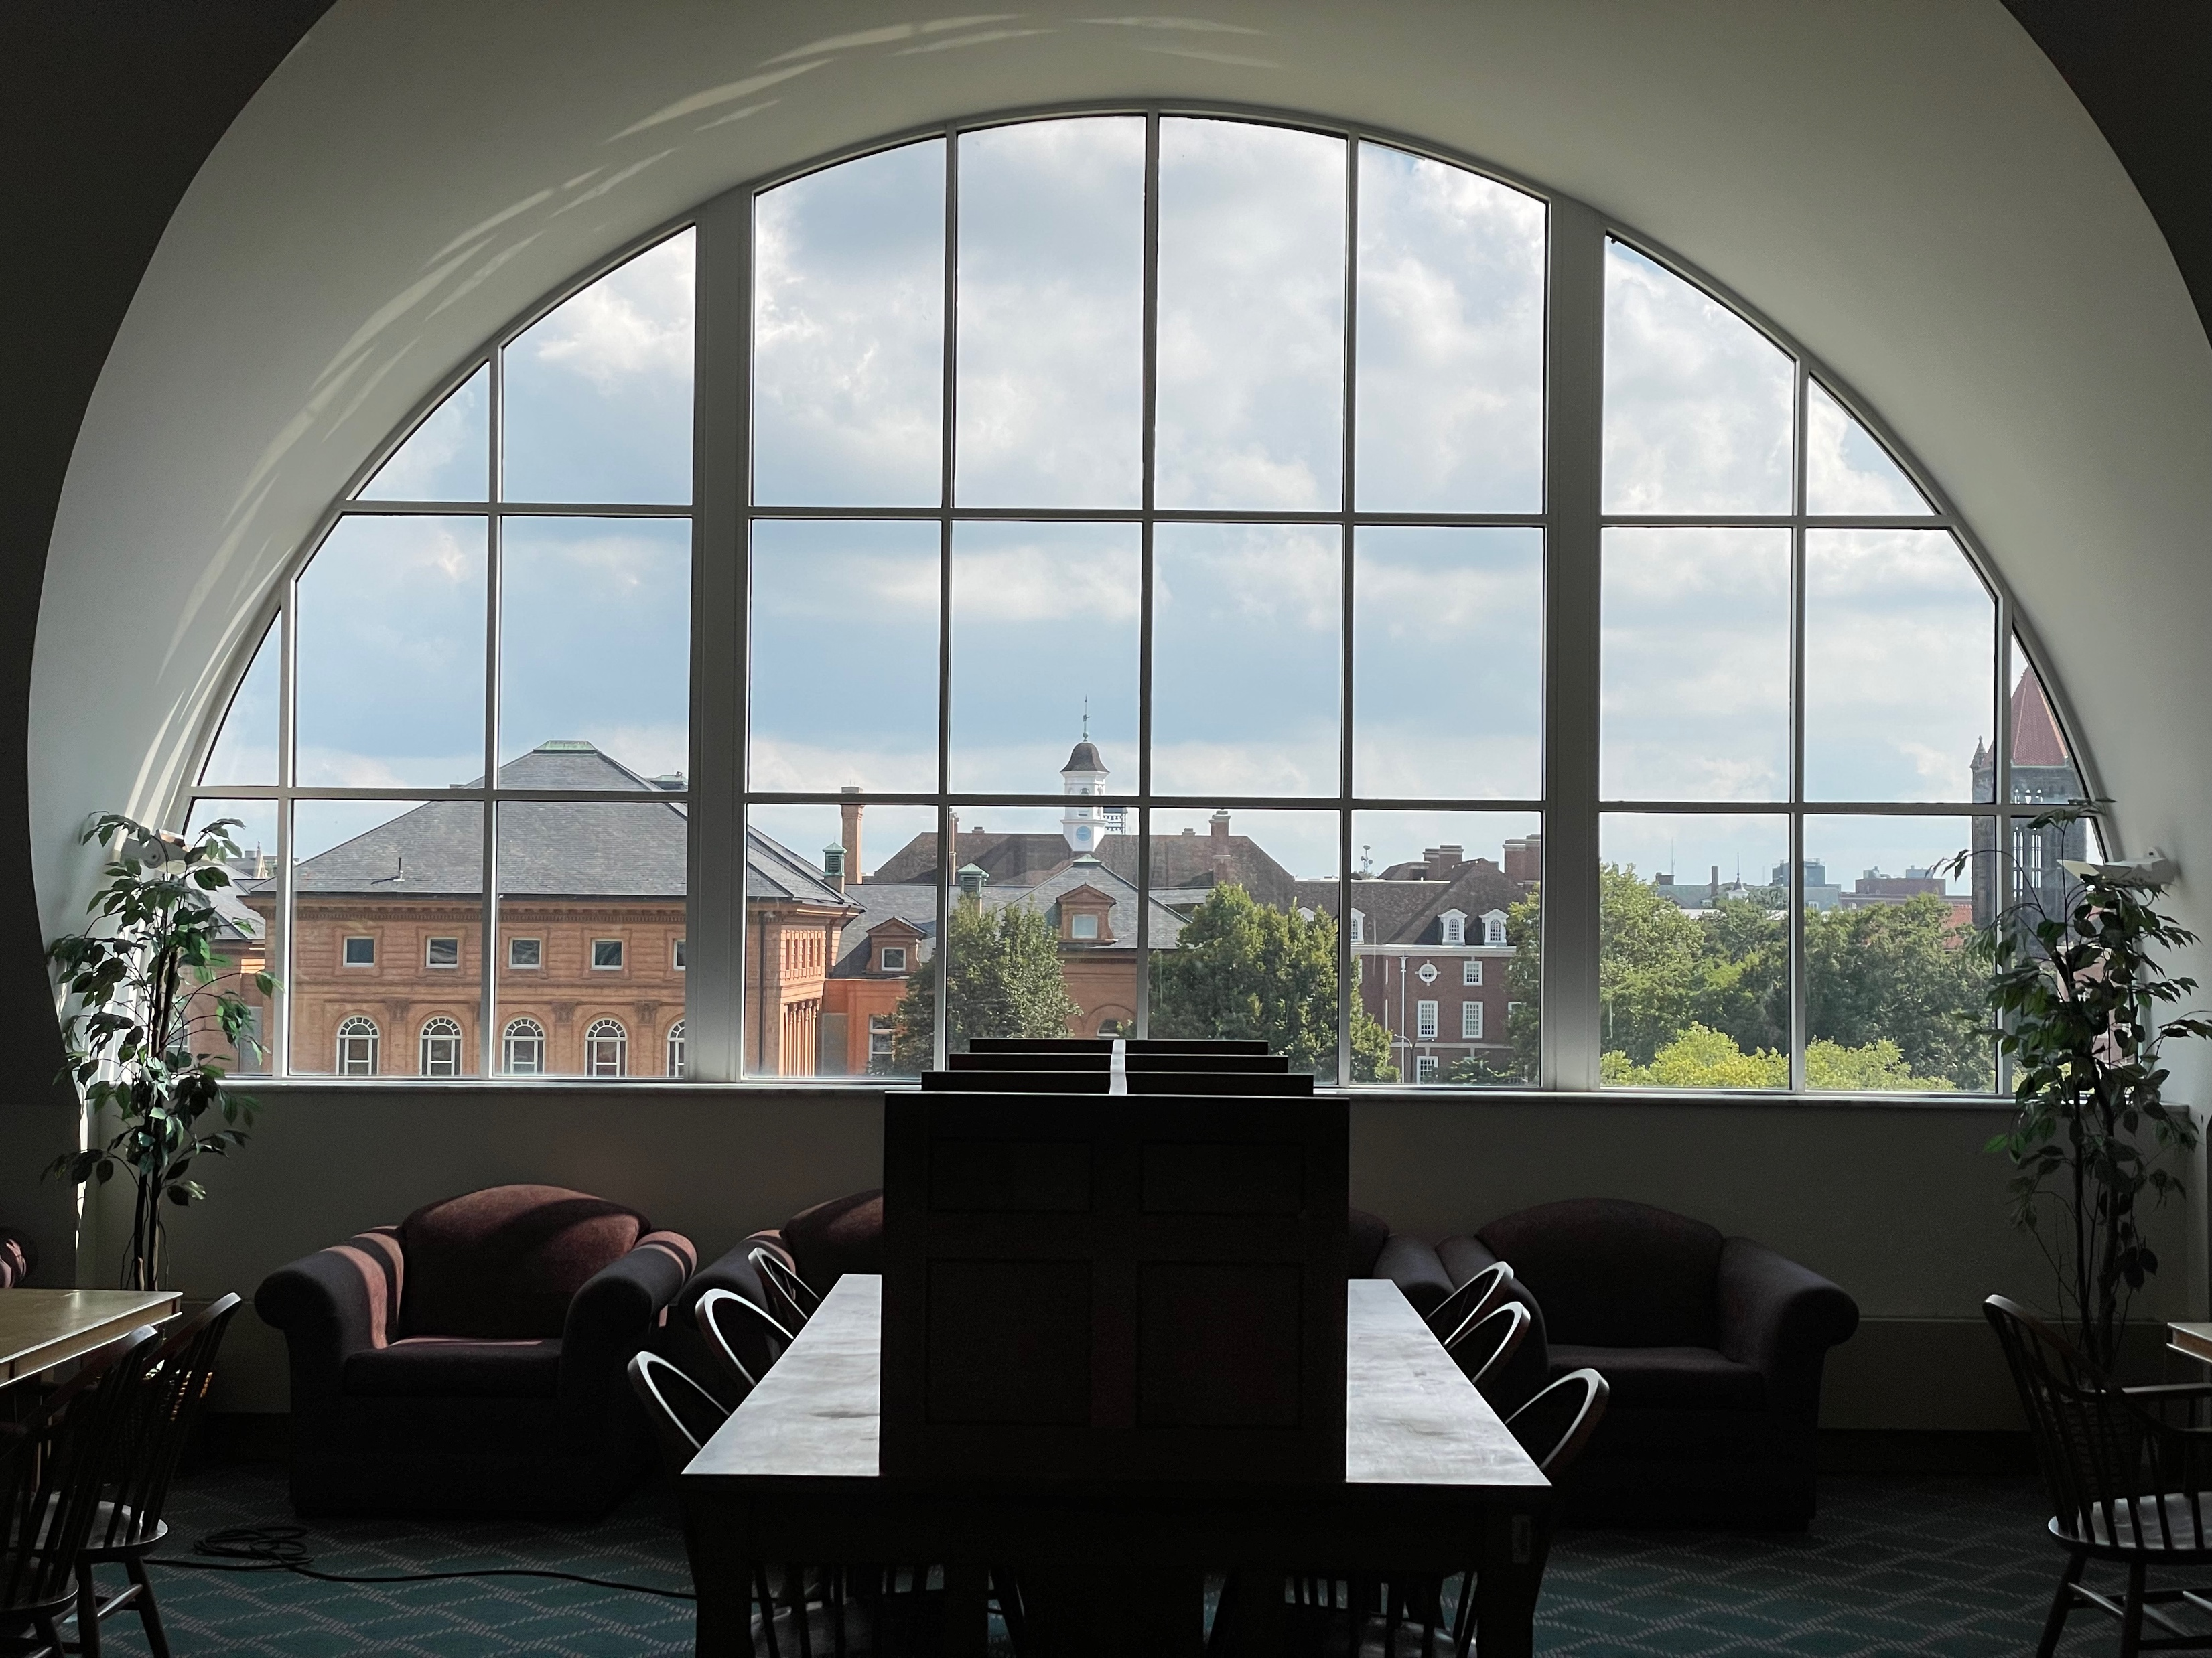
My “dolly zoom”

Slide 46
Choice of lens and viewpoint: A COVID-era illustration
Source

Slide 47
Overview
Pinhole projection
Lenses
Field of view, focal length
Marginal distortion

Slide 48
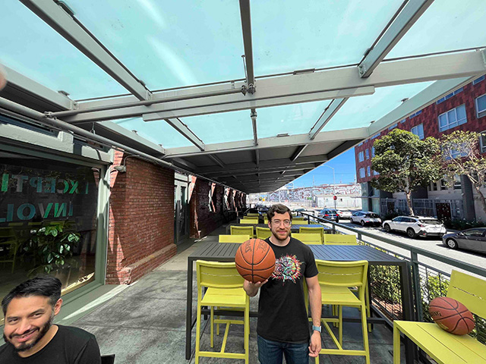
Marginal distortion
In wide-angle photos, objects on the periphery “look wrong”
Image source: A. Hertzmann

Slide 49
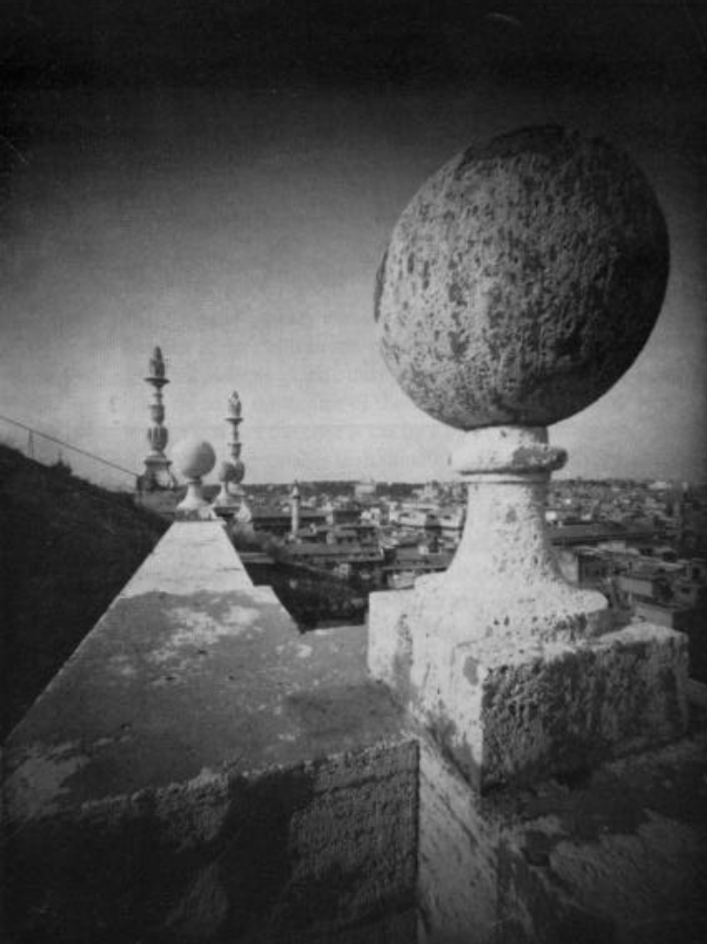
Marginal distortion
What is the shape of the projection of a sphere?
Image source: F. Durand

Slide 50
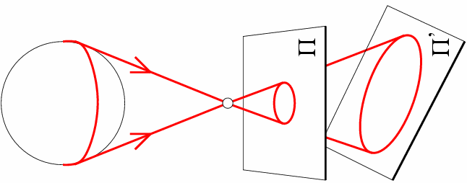
Marginal distortion
What is the shape of the projection of a sphere?

Slide 51
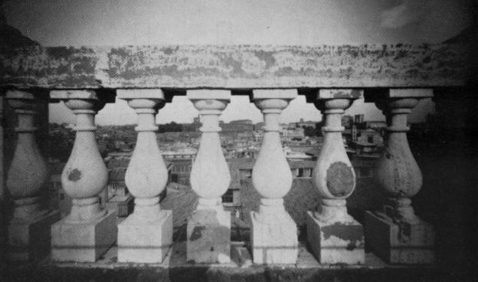
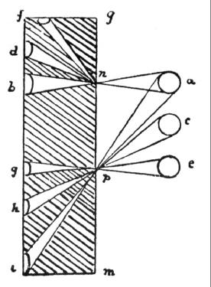
Marginal distortion
Are the widths of the projected columns equal?
  The exterior columns are wider
  This is not an optical illusion, and is not due to lens flaws
  Phenomenon pointed out by Leonardo Da Vinci
Source: F. Durand

Slide 52
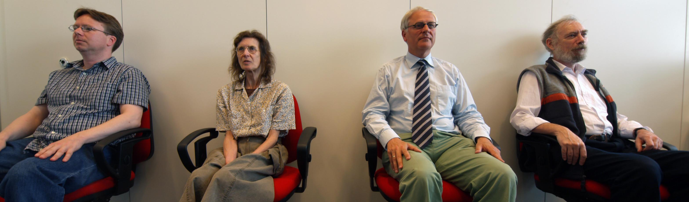
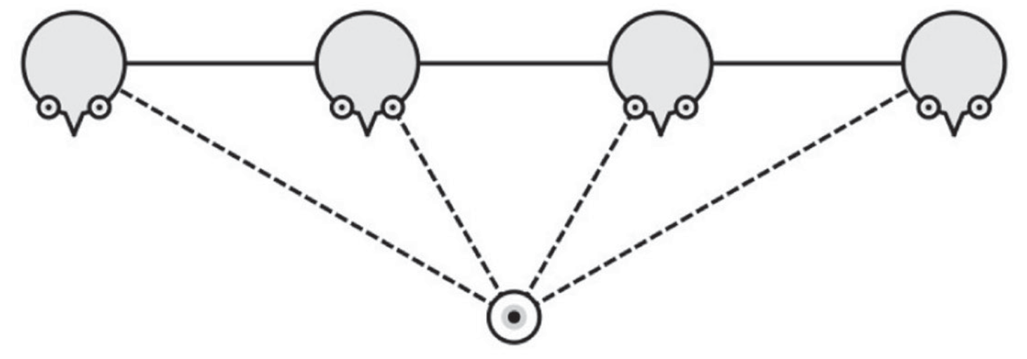
Marginal distortion
Which way are these people facing?
Image source: Koenderink et al. via A. Hertzmann

Slide 53
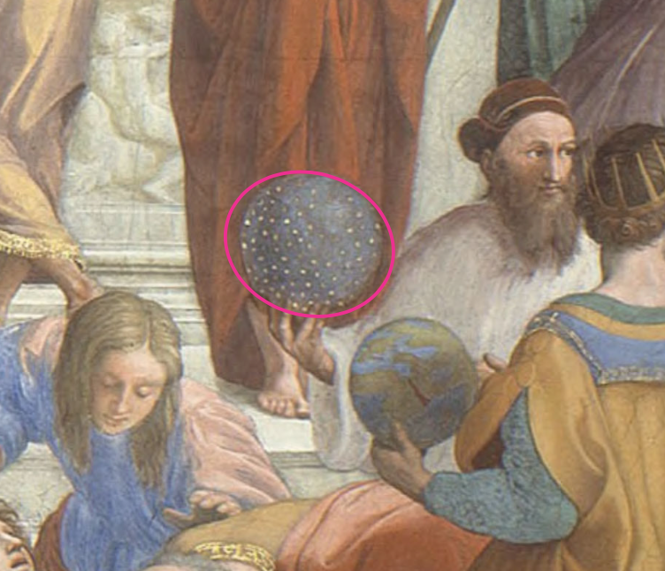
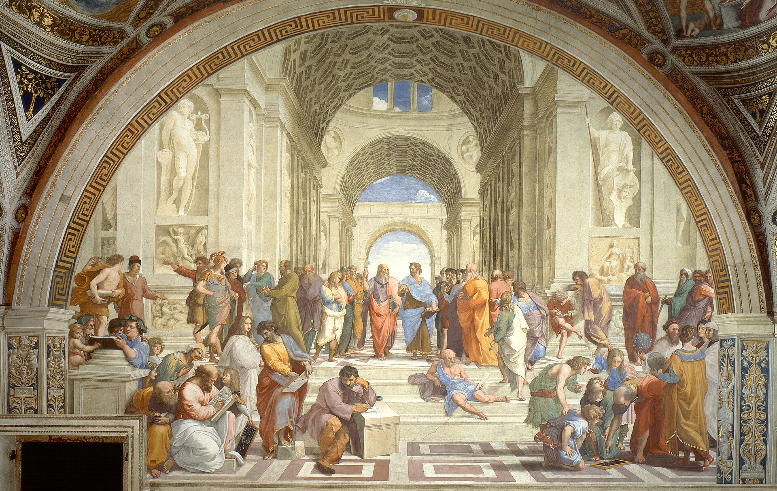
Perspective and art
Raphael, The School of Athens, 1509-1511

Slide 54
Perspective and art
“Large scenes with many faces are common in art… But, in the entire history of painting, I am unaware of any face depicted with the marginal distortions dictated by linear perspective.”
Hertzmann. Toward a theory of perspective perception in pictures. Journal of Vision, 2024
Blog post

Slide 55

Review: Pinhole projection
$$P$$
$$O$$
$$P′$$

Slide 56
Review: Pinhole projection
$$P$$
$$y$$
$$f$$
$$z$$
$$=f\frac{y}{z}$$
$$O$$
$$y^{′}$$
$$P′$$
$$(x,y,z)→\left(f\frac{x}{z},f\frac{y}{z}\right)$$

Slide 57
Review: Pinhole projection
$$P$$
$$y$$
$$z$$
$$O$$
$$x$$
$$P′$$
Canonical coordinate system
  The optical center ($O$) is at the origin
  The z axis is the optical axis perpendicular to the image plane
  The xy plane is parallel to the image plane, x and y axes are horizontal and vertical directions of the image plane

Slide 58

Review: Pinhole projection
$$⟺$$
Note: instead of dealing with an image that is upside down, most of the time we will pretend that the image plane is in front of the camera center

Slide 59
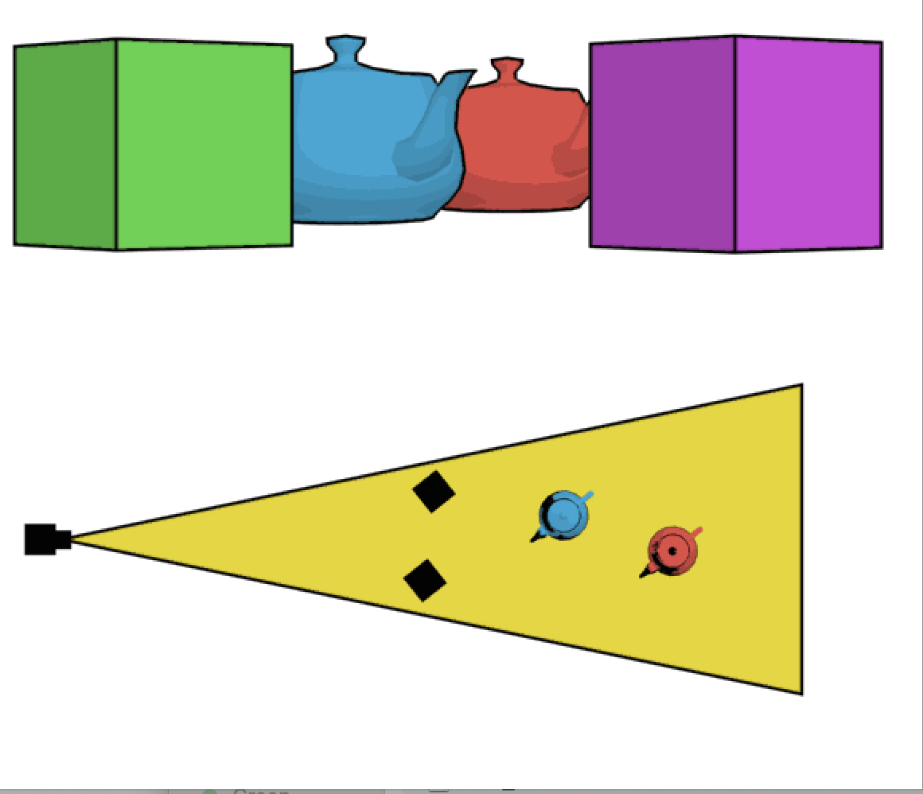
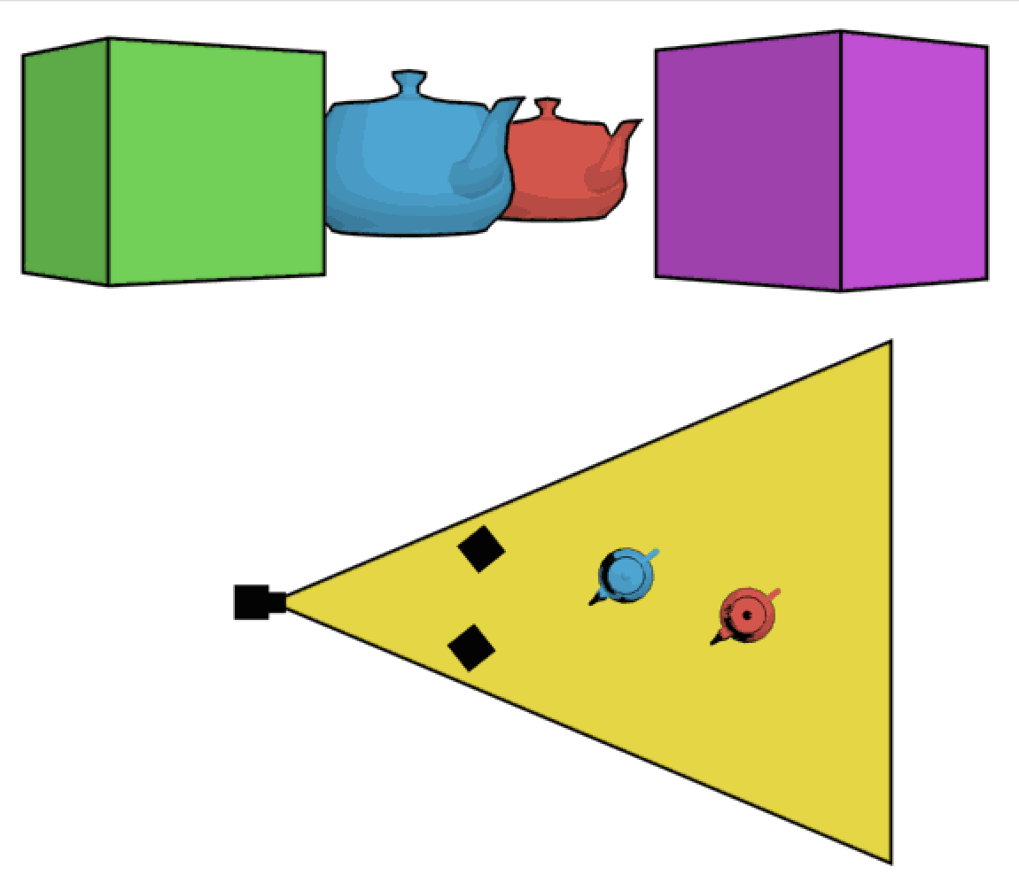
Review: Field of view
Figure source: Wikipedia

Slide 60
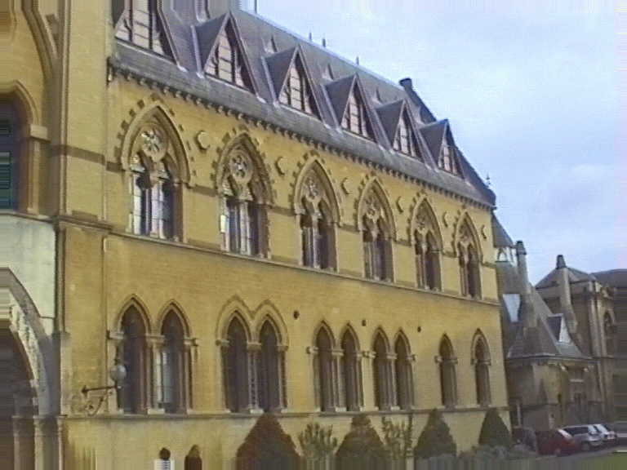
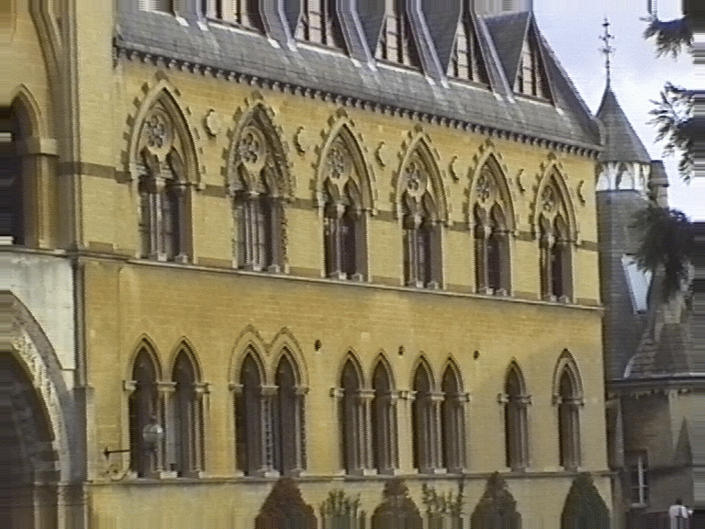
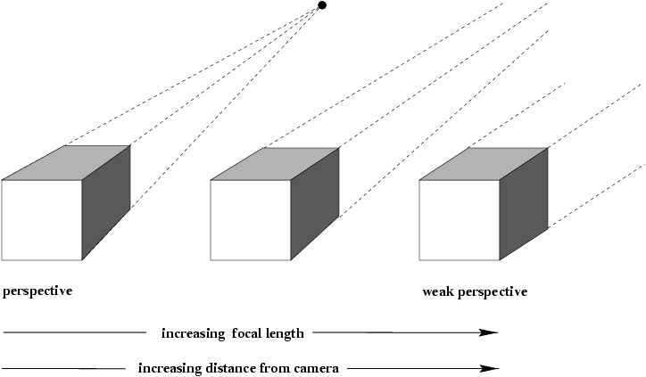
Orthographic or parallel projection
What happens if we walk infinitely far away and zoom infinitely far in?
Source: Hartley & Zisserman

Slide 61



Orthographic or parallel projection
Special case of perspective projection
  Distance from center of projection to image plane is infinite
  Projection equation: simply drop the z coordinate!
$$y$$
Image
World
$$z$$
$$x$$
Slide by Steve Seitz
Notes:
Is this a linear function?

Slide 62

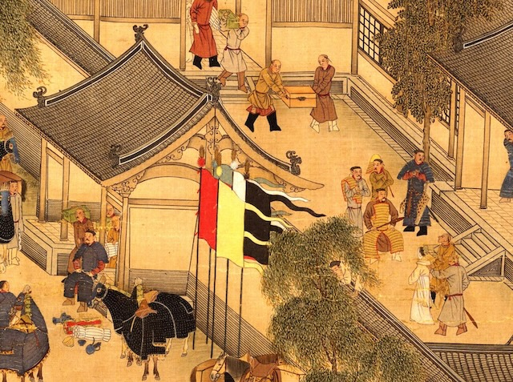
Orthographic or parallel projection
Special case of perspective projection
  Distance from center of projection to image plane is infinite
  Projection equation: simply drop the z coordinate!
SimCity 2000
12th century Chinese scroll
(via A. Hertzmann)
Notes:
Is this a linear function?

Slide 63
Review: Cameras with lenses

Slide 64
Review: Cameras with lenses

Slide 65
Review: Cameras with lenses
Small DOF
Large aperture
Large DOF
Small aperture

Slide 66

Overview
Pinhole projection
Lenses
Field of view, focal length
Marginal distortion
Lens distortions

Slide 67



Vignetting

Slide 68


Radial distortion
Caused by imperfect lenses
Distortion is stronger towards the edges of the photo
No distortion
Pin cushion
Barrel

Slide 69

Spherical aberration
Spherical lenses don’t focus light perfectly
Rays farther from the optical axis focus closer

Slide 70



Lens flaws: Chromatic aberration
Lens has different refractive indices for different wavelengths: causes color fringing
Near Lens Center
Near Lens Outer Edge

Slide 71



Historic milestones
Pinhole model: Mozi (470-390 BCE),
Aristotle (384-322 BCE)
Principles of optics (including lenses):
Alhacen (965-1039 CE)
Camera obscura: Leonardo da Vinci
(1452-1519), Johann Zahn (1631-1707)
First photo: Joseph Nicephore Niepce (1822)
Daguerréotypes (1839)
Photographic film (Eastman, 1889)
Cinema (Lumière Brothers, 1895)
Color Photography (Lumière Brothers, 1908)
Television (Baird, Farnsworth, Zworykin, 1920s)
First consumer camera with CCD
Sony Mavica (1981)
First fully digital camera: Kodak DCS100 (1990)
Alhacen’s notes
Niepce, “La Table Servie,” 1822
https://en.wikipedia.org/wiki/History_of_photography
Old television camera

Slide 72

First digitally scanned photograph
NIST (1957), 176x176 pixels
http://listverse.com/history/top-10-incredible-early-firsts-in-photography/
Notes:
From the website: “Russell Kirsch was a computer pioneer at the National Institute of Standards and Technology in the USA when he developed the system by which a camera could be fed into a computer. The photo is of Kirsch’s three month old son Walden and it measured a mere 176×176 pixels. Baby Walden now works in communications for Intel.”

Slide 73
Overview
Pinhole projection
Lenses
Field of view, focal length
Perspective distortions
Lens distortions
Digital sensors

Slide 74


Digital camera sensors
Each cell in a sensor array is a light-sensitive diode that converts photons to electrons
  Dominant in the past: Charge Coupled Device (CCD)
  Dominant now: Complementary Metal Oxide Semiconductor (CMOS)
http://electronics360.globalspec.com/article/9464/ccd-vs-cmos-the-shift-in-image-sensor-technology

Slide 75



Color filter arrays
Bayer grid (1976)
Demosaicing:
Estimation of missing components from neighboring values
Why more green?
Human Luminance Sensitivity Function
Source: Steve Seitz

Slide 76

Color filter arrays
Bayer grid (1976)
Demosaicing:
Estimation of missing components from neighboring values
Recent cameraphone technology: pixel binning

Slide 77




Misc. digital camera artifacts
Noise
    low light is where you most notice noise
    light sensitivity (ISO) / noise tradeoff
    stuck pixels
In-camera processing
    oversharpening can produce halos
Compression
    JPEG artifacts, blocking
Blooming
    CCD charge overflowing into neighboring pixels
Color artifacts
    Color moire
    Purple fringing from microlenses

Slide 78
Camera sales over time
Source
Notes:
CIPA: Camera & Imaging Products Association

Slide 79
Camera sales over time
The full chart…
Source
Notes:
CIPA: Camera & Imaging Products Association

