Slide 1
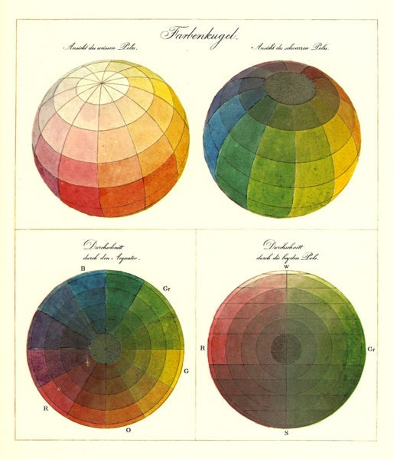
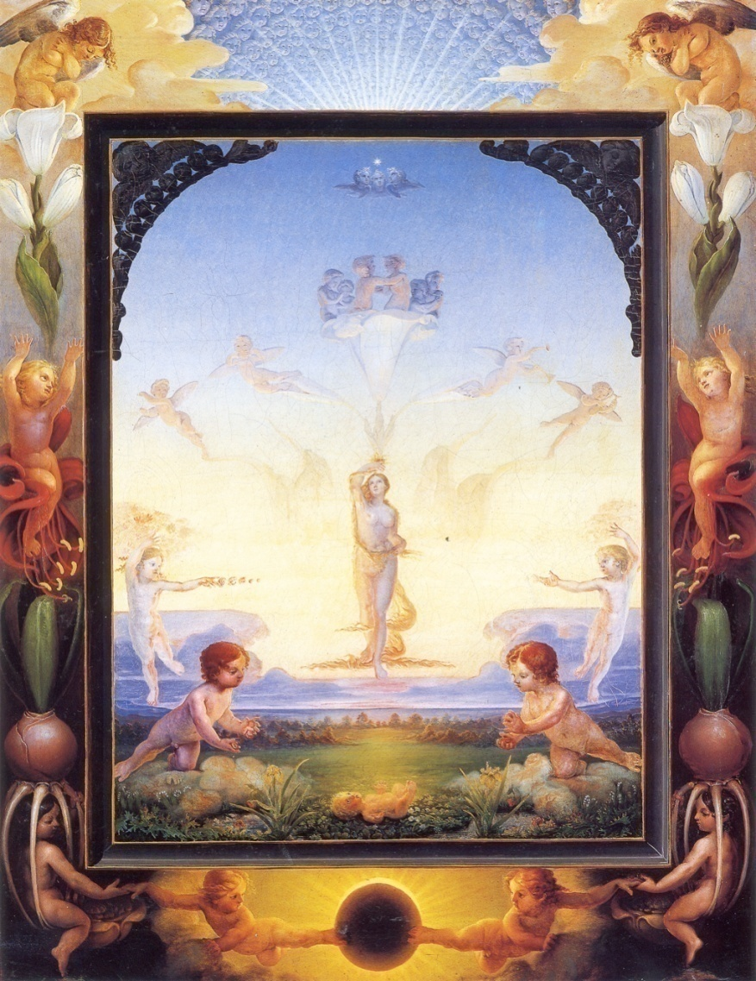
Color
Phillip Otto Runge (1777-1810)

Slide 2
Outline
Physical origin of color
Spectra of sources and surfaces
Physiology of color vision
Quantifying color perception
Color spaces
Color constancy, white balance

Slide 3
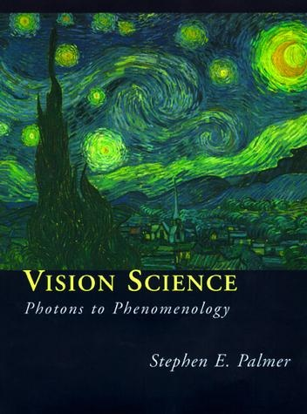
What is color?
Color is the result of interaction between physical light in the environment and our visual system
“Color is a psychological property of our visual experiences when we look at objects and lights, not a physical property of those objects or lights”
-- S. Palmer, Vision Science: Photons to Phenomenology

Slide 4
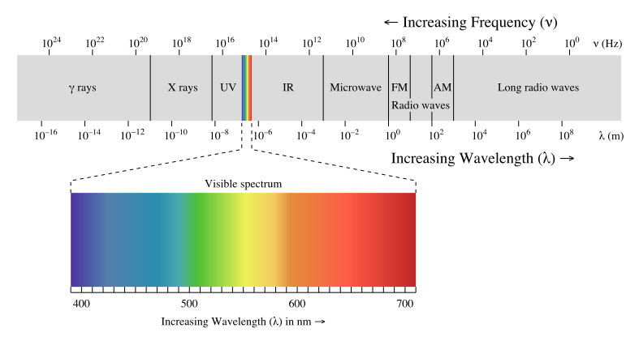
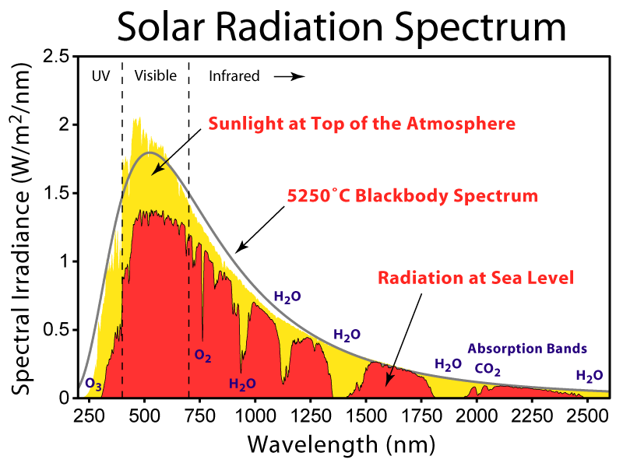
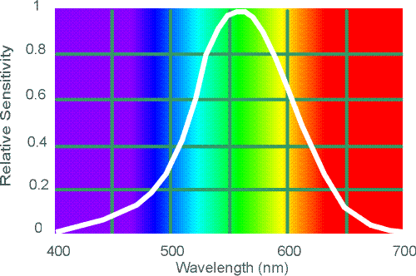
Electromagnetic spectrum
Human Luminance Sensitivity Function

Slide 5
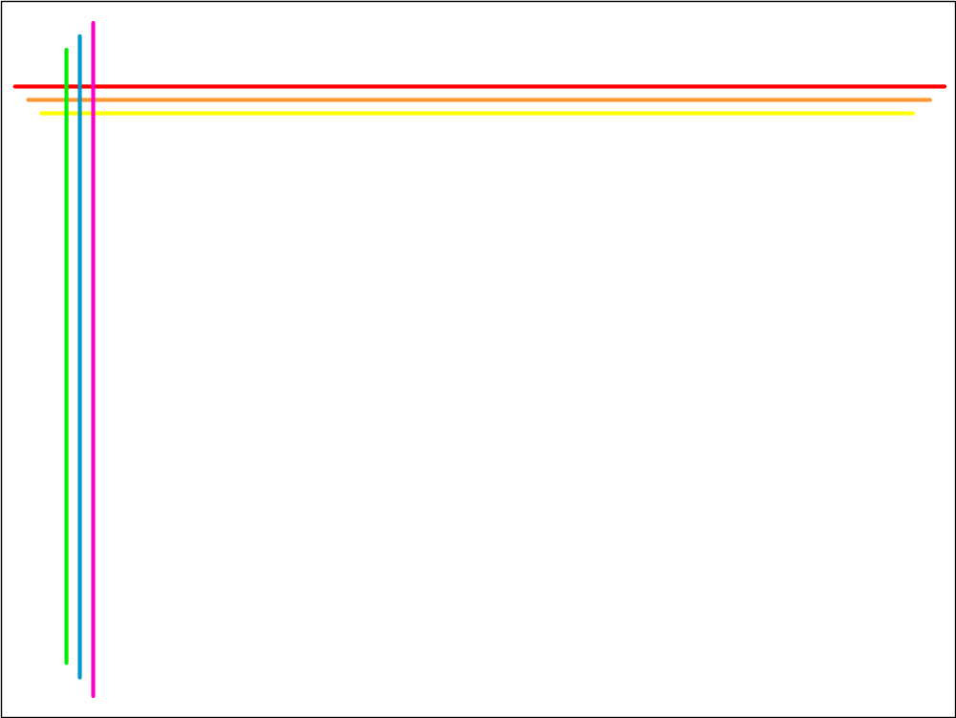
The Physics of Light
Any source of light can be completely described
physically by its spectrum: the amount of energy emitted
(per time unit) at each wavelength 400 - 700 nm.
Relative
spectral
power
© Stephen E. Palmer, 2002

Slide 6
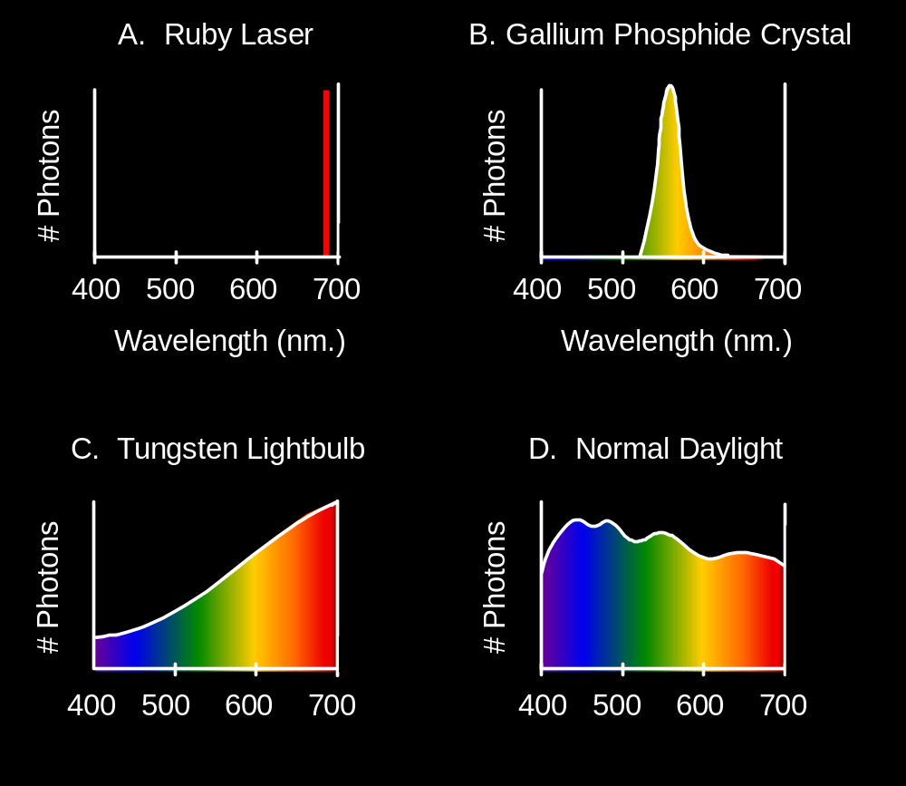
Spectra of Light Sources
Some examples of the spectra of light sources
Rel. power
Rel. power
Rel. power
Rel. power
© Stephen E. Palmer, 2002

Slide 7
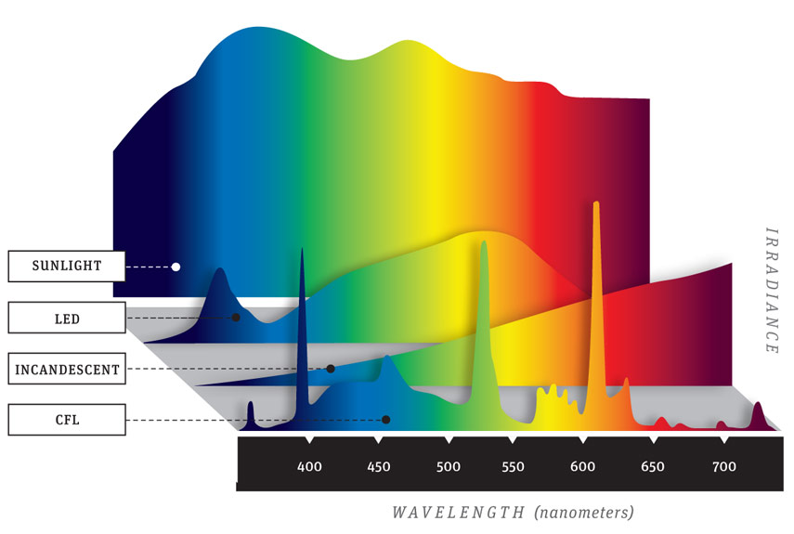
Spectra of light sources
Source: Popular Mechanics

Slide 8
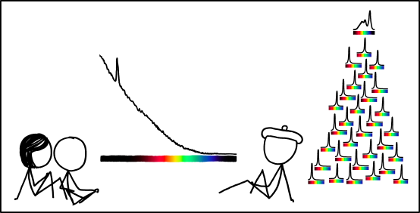
Spectra of light sources
https://www.xkcd.com/1308/
Notes:
From Explain XKCD: The spike toward the left hand side of the spectrum is likely the 4.3 µm resonance wavelength of hot CO2 characteristic of burning hydrocarbons

Slide 9
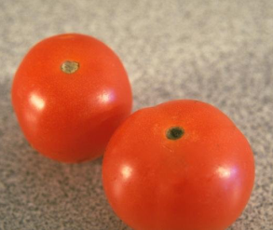
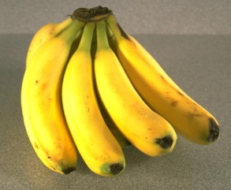
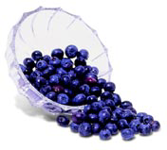
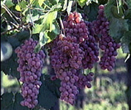
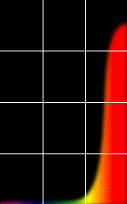
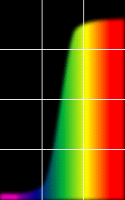
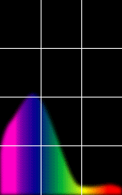
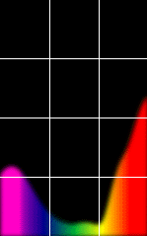
Reflectance Spectra of Surfaces
Some examples of the reflectance spectra of surfaces
Red
Yellow
Blue
Purple
% Light Reflected
400 700
400 700
400 700
400 700
Wavelength (nm)
© Stephen E. Palmer, 2002

Slide 10
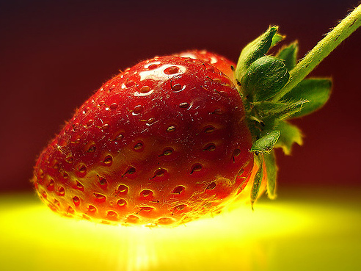
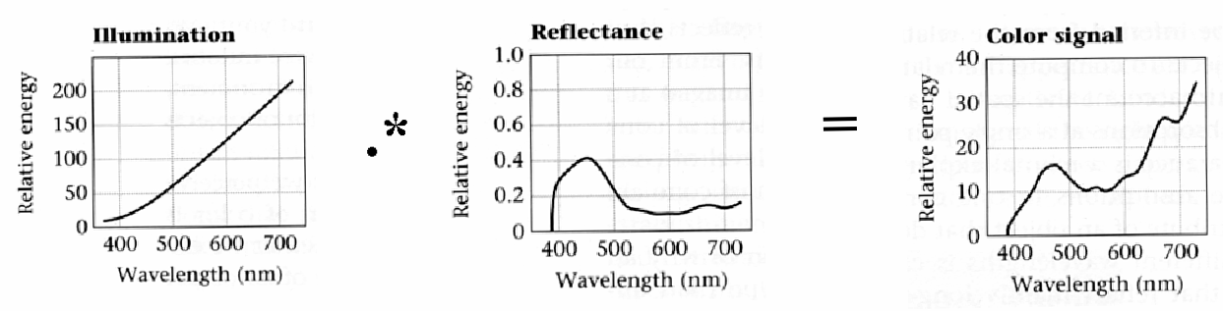
Interaction of light and surfaces
Reflected color is the result of interaction of light source spectrum with surface reflectance

Slide 11
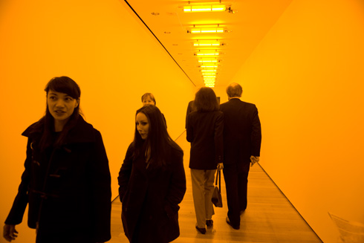
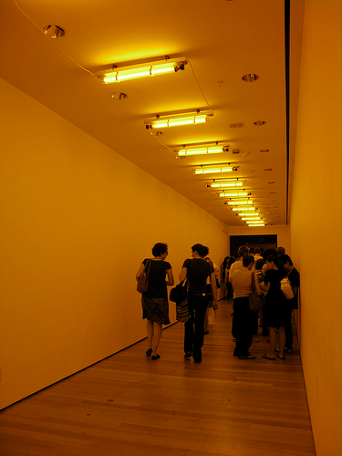
Interaction of light and surfaces
What is the observed color of any surface under monochromatic light?
Olafur Eliasson, Room for one color

Slide 12
Outline
Physical origin of color
Spectra of sources and surfaces
Physiology of color vision

Slide 13
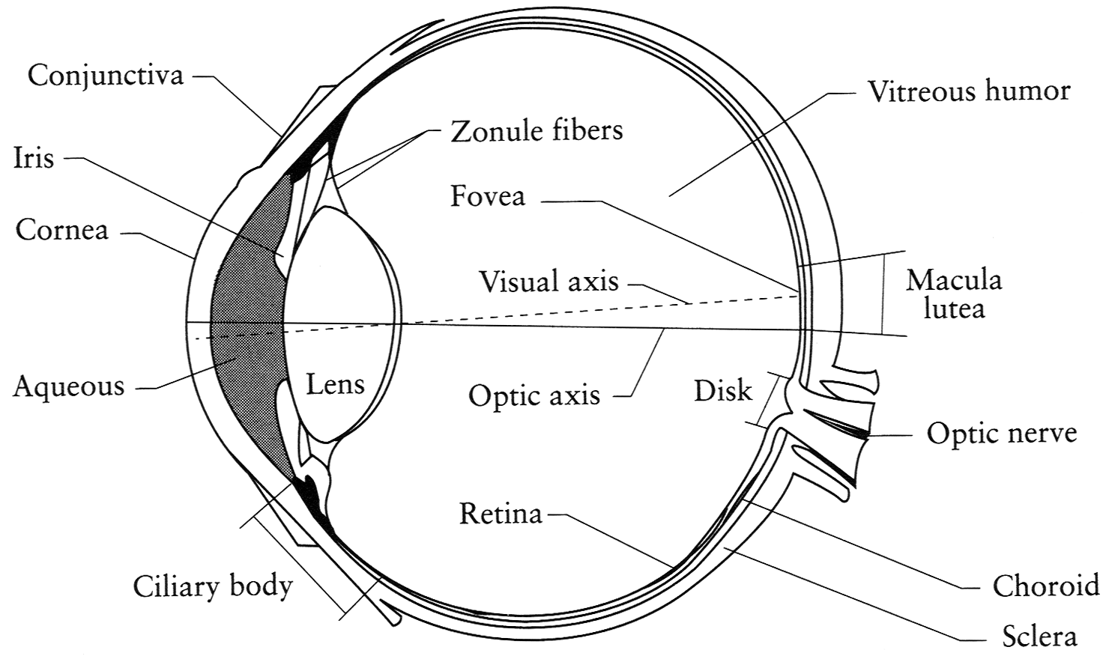
The Eye
The human eye is a camera (sort of)
  Lens - changes shape by using ciliary muscles (to focus on objects at different distances)
  Pupil - the hole (aperture) whose size is controlled by the iris
  Iris - colored annulus with radial muscles
  Retina - photoreceptor cells
Slide by Steve Seitz

Slide 14
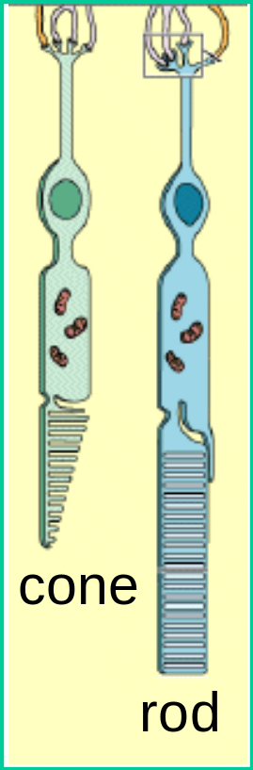
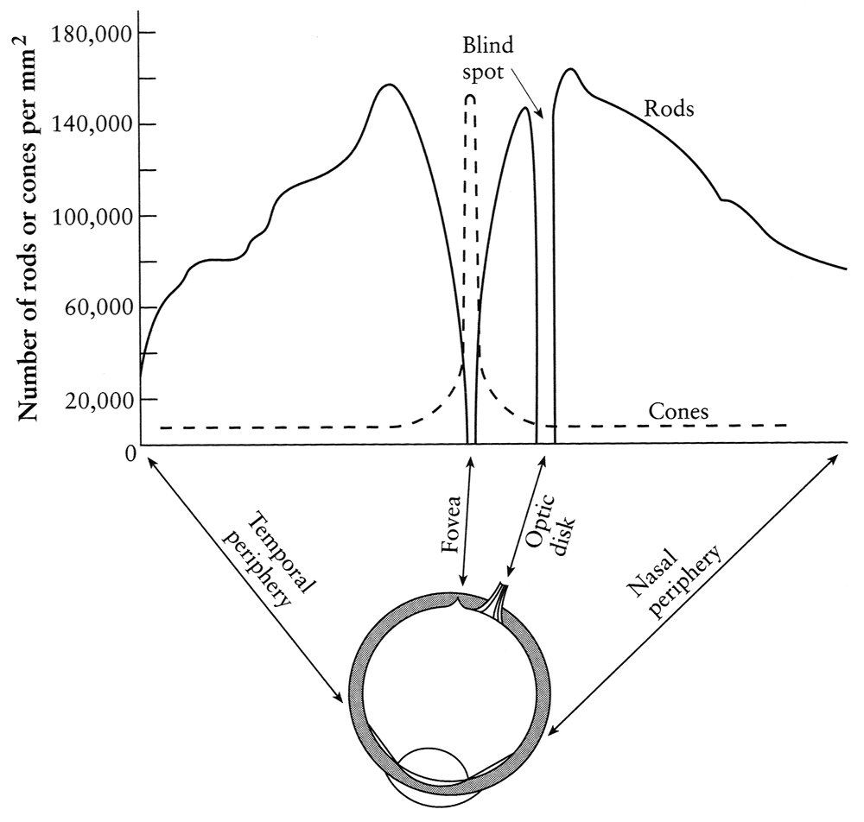
Rods and cones, fovea
pigment
molecules
Rods are responsible for intensity, cones for color perception
Rods and cones are non-uniformly distributed on the retina
  Fovea - Small region (1 or 2°) at the center of the visual field containing the highest density of cones – and no rods
Slide by Steve Seitz

Slide 15
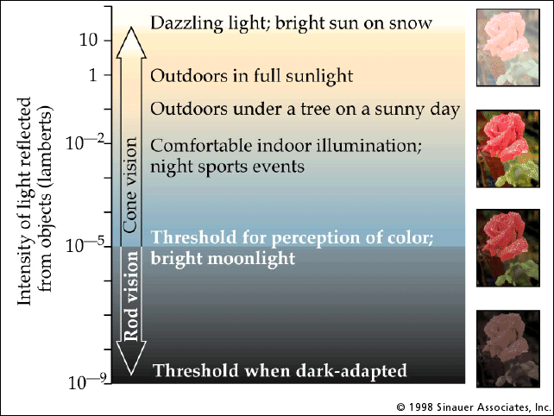
Rod / cone sensitivity
Why can’t we read in the dark?
Slide by A. Efros

Slide 16
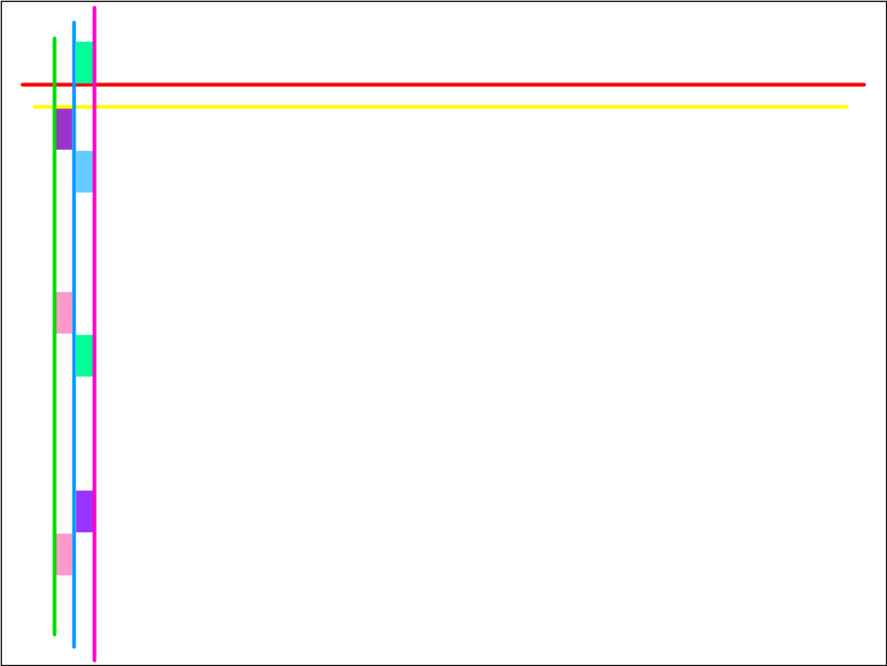
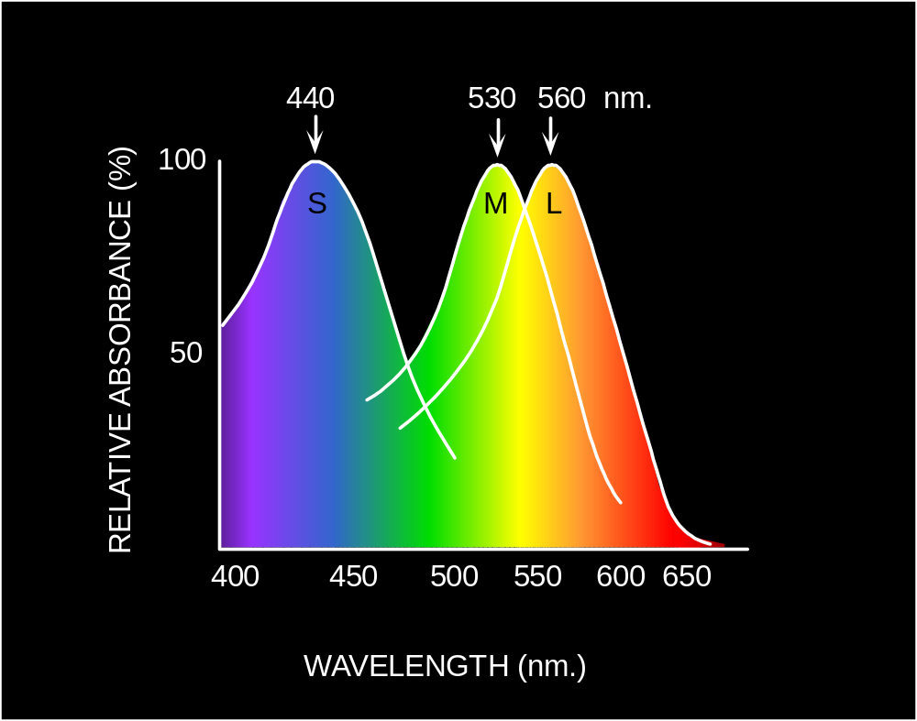
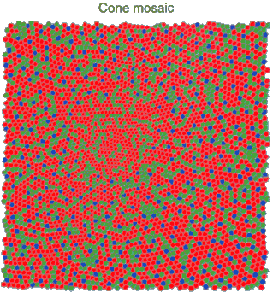
Physiology of Color Vision
Three kinds of cones:
Ratio of L to M to S cones: approx. 10:5:1
Almost no S cones in the center of the fovea
© Stephen E. Palmer, 2002

Slide 17
Physiology of color vision: Fun facts
“M” and “L” pigments are encoded on the X-chromosome
  That’s why men are more likely to be color blind
  “L” gene has high variation, so some women may be tetrachromatic
Some animals have one (night animals), two (e.g., dogs), four (fish, birds), five (pigeons, some reptiles/amphibians), or even 12 (mantis shrimp) types of cones
http://en.wikipedia.org/wiki/Color_vision
Adapted from D. Hoiem

Slide 18


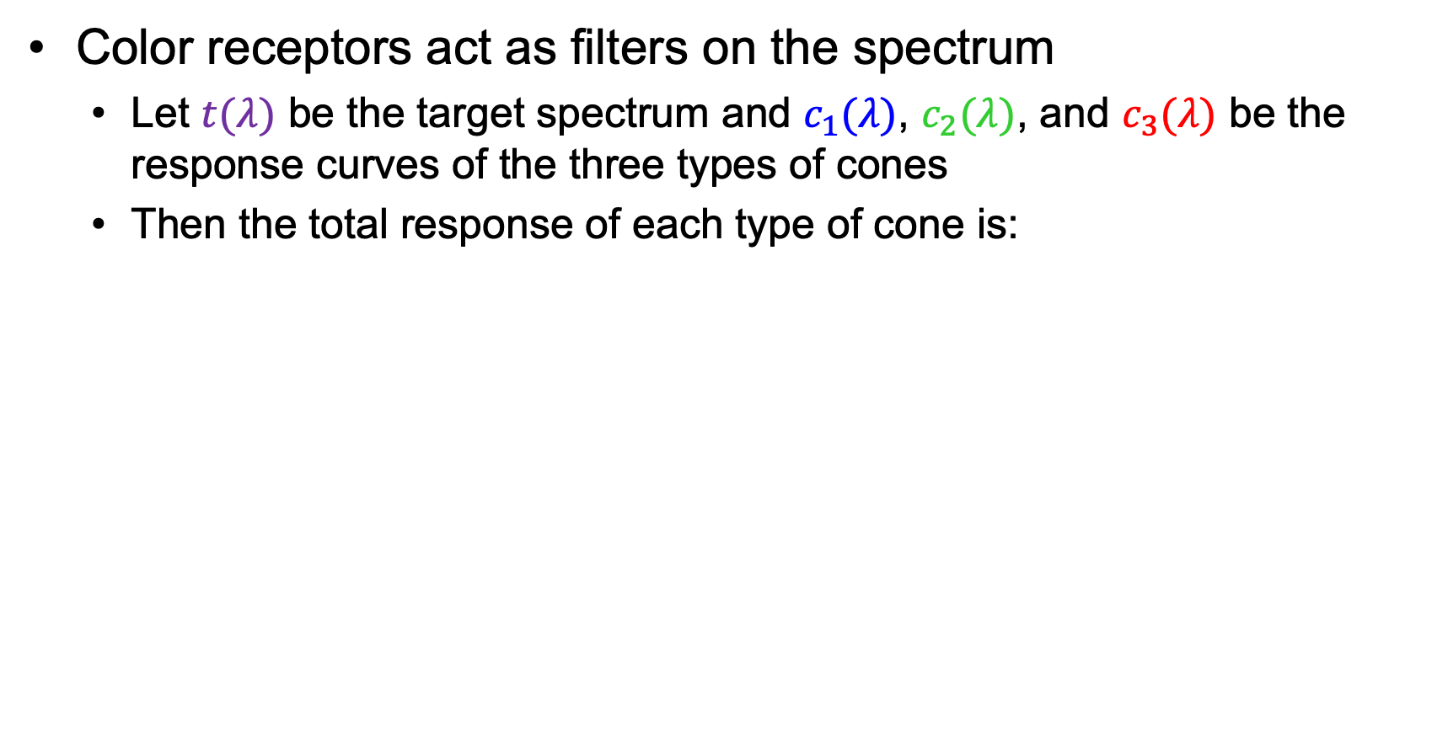



Color perception
Color receptors act as filters on the spectrum
  Let $t(λ)$ be the target spectrum and $c_{1}(λ)$, $c_{2}(λ)$, and $c_{3}(λ)$ be the response curves of the three types of cones
  Then the total response of each type of cone is:
Target spectrum $t(λ)$
$$c_{3}(λ)$$
$$c_{2}(λ)$$
$$c_{1}(λ)$$
$$λ$$

Slide 19
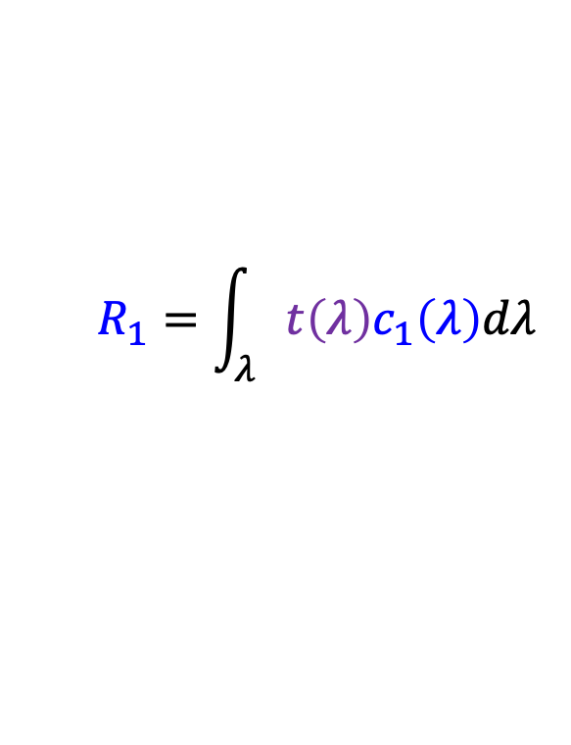
Color perception
Color receptors act as filters on the spectrum
  Let $t(λ)$ be the target spectrum and $c_{1}(λ)$, $c_{2}(λ)$, and $c_{3}(λ)$ be the response curves of the three types of cones
  Then the total response of each type of cone is:
$$R_{1}=\int_{λ}{{t\left(λ\right)c}_{1}\left(λ\right)dλ}$$
$$c_{1}(λ)$$
$$λ$$

Slide 20
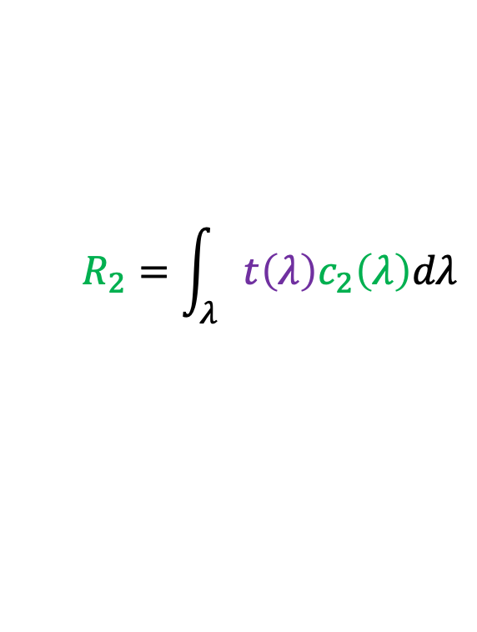
Color perception
Color receptors act as filters on the spectrum
  Let $t(λ)$ be the target spectrum and $c_{1}(λ)$, $c_{2}(λ)$, and $c_{3}(λ)$ be the response curves of the three types of cones
  Then the total response of each type of cone is:
$$R_{1}=\int_{λ}{{t\left(λ\right)c}_{1}\left(λ\right)dλ}$$
$$R_{2}=\int_{λ}{{t\left(λ\right)c}_{2}\left(λ\right)dλ}$$
$$c_{2}(λ)$$
$$λ$$

Slide 21
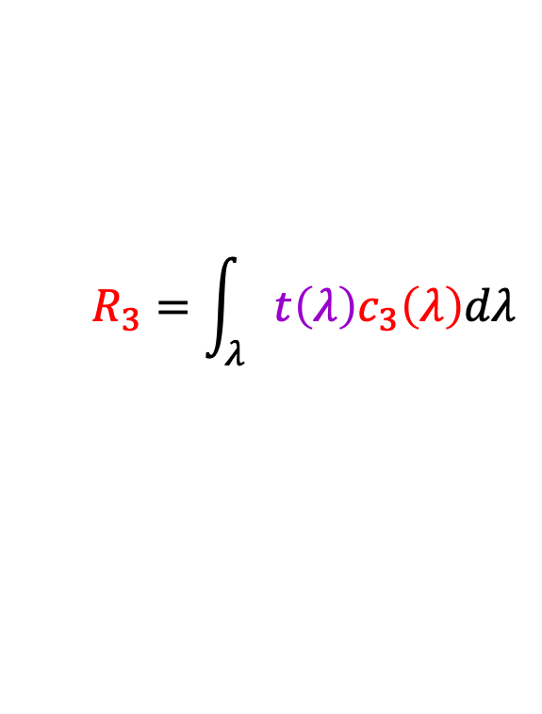
Color perception
Color receptors act as filters on the spectrum
  Let $t(λ)$ be the target spectrum and $c_{1}(λ)$, $c_{2}(λ)$, and $c_{3}(λ)$ be the response curves of the three types of cones
  Then the total response of each type of cone is:
$$R_{1}=\int_{λ}{{t\left(λ\right)c}_{1}\left(λ\right)dλ}$$
$$R_{2}=\int_{λ}{{t\left(λ\right)c}_{2}\left(λ\right)dλ}$$
$$R_{3}=\int_{λ}{{t\left(λ\right)c}_{3}\left(λ\right)dλ}$$
$$c_{3}(λ)$$
$$λ$$

Slide 22
Color perception
Color receptors act as filters on the spectrum
  Each type of cone returns one number
How can we represent an entire spectrum with three numbers?
  We can’t – most of the information is lost!
Target spectrum $t(λ)$
$$c_{3}(λ)$$
$$c_{2}(λ)$$
$$c_{1}(λ)$$
$$λ$$

Slide 23
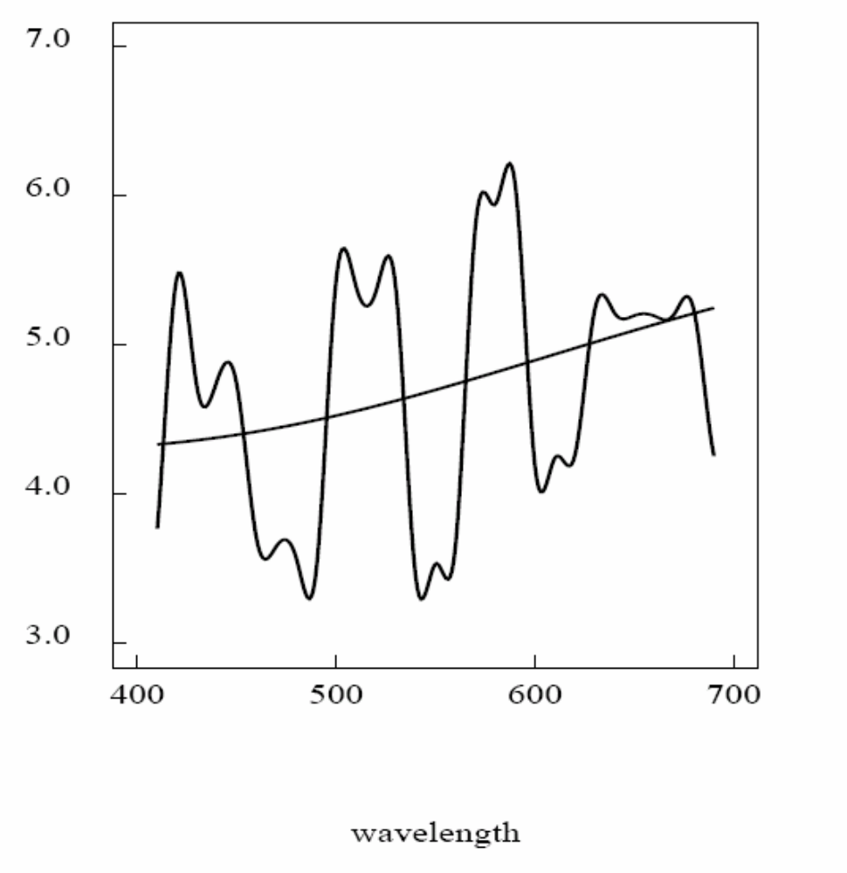
Metamers: Spectra that appear indistinguishable

Slide 24
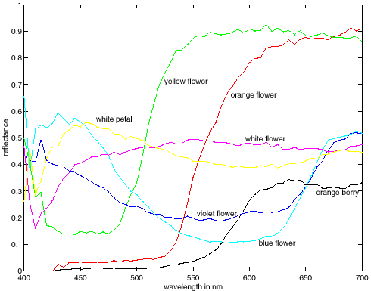
Metamers: Spectra that appear indistinguishable
metamers

Slide 25
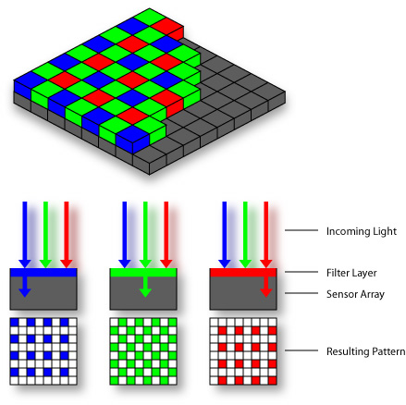
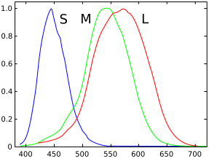
Color sensing in human vs. camera

Slide 26
Color: Outline
Physical origin of color
Spectra of sources and surfaces
Physiology of color vision
Quantifying color perception

Slide 27
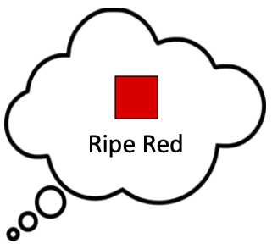
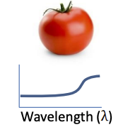
Quantifying color perception
Spectral distributions go through a “black box” (human visual system) and are perceived as color
The only way to quantify the “black box” is to perform a human study
Spectral distribution
“Black box”
Source: M. Brown

Slide 28
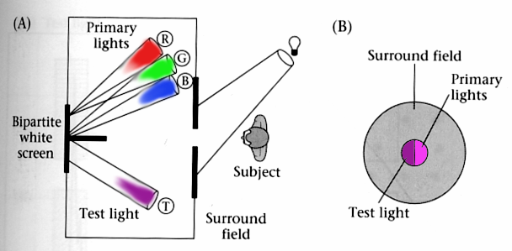
Color matching experiments
We would like to understand which spectra produce the same color sensation in people under similar viewing conditions
Wandell, Foundations of Vision, 1995

Slide 29
Color matching experiment 1
Source: W. Freeman

Slide 30
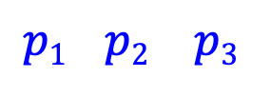
Color matching experiment 1
$$p1 p2 p3$$
Source: W. Freeman

Slide 31
Color matching experiment 1
$$p1 p2 p3$$
Source: W. Freeman

Slide 32
Color matching experiment 1
The primary color amounts needed for a match
$$p1 p2 p3$$
Source: W. Freeman

Slide 33
Color matching experiment 2
Source: W. Freeman

Slide 34
Color matching experiment 2
$$p1 p2 p3$$
Source: W. Freeman

Slide 35
Color matching experiment 2
$$p1 p2 p3$$
Source: W. Freeman

Slide 36
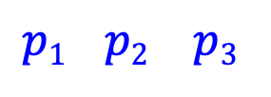
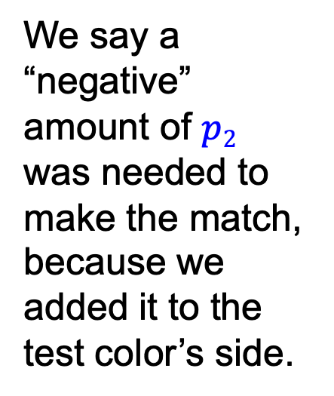
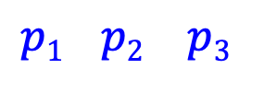
Color matching experiment 2
The primary color amounts needed for a match:
We say a “negative” amount of $p2$ was needed to make the match, because we added it to the test color’s side.
$$p1 p2 p3$$
$$p1 p2 p3$$
$$p1 p2 p3$$
Source: W. Freeman

Slide 37
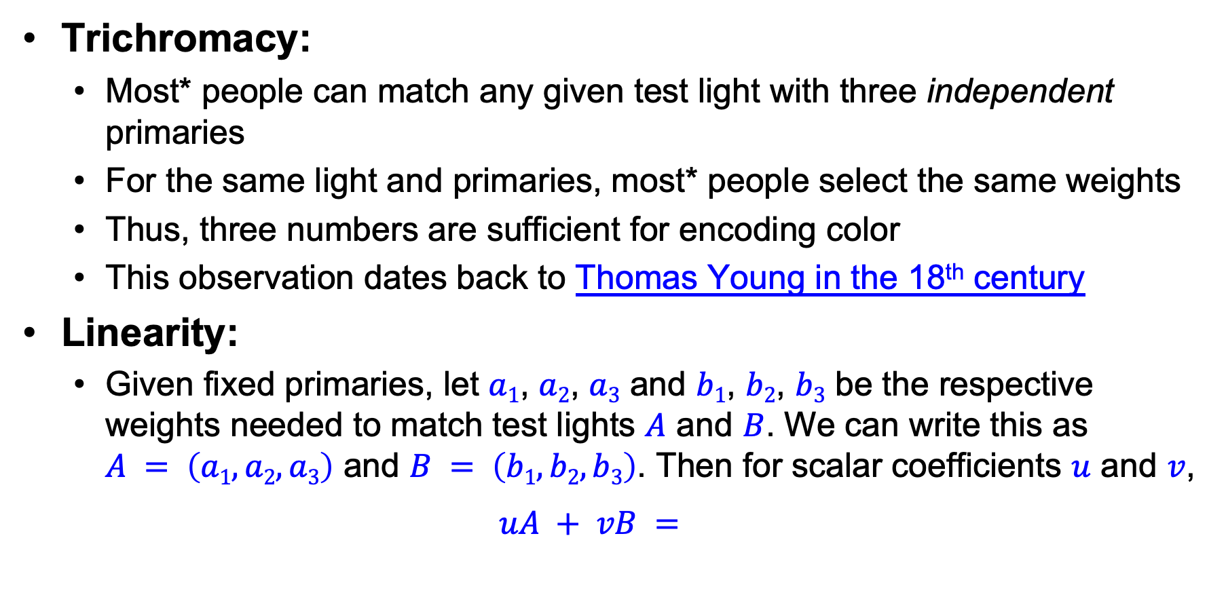

Empirical properties of color matching
Trichromacy:
  Most* people can match any given test light with three independent primaries
  For the same light and primaries, most* people select the same weights
  Thus, three numbers are sufficient for encoding color
  This observation dates back to Thomas Young in the 18th century
Linearity:
  Given fixed primaries, let $a1$, $a2$, $a3$ and $b1$, $b2$, $b3$ be the respective weights needed to match test lights $A$ and $B$. We can write this as
  $A = \left(a1, a2, a3\right)$ and $B = \left(b1, b2, b3\right)$. Then for scalar coefficients $u$ and $v$,
  $$uA + vB =$$
  $$(ua1 + vb1, ua2 + vb2, ua3 + vb3)$$

Slide 38
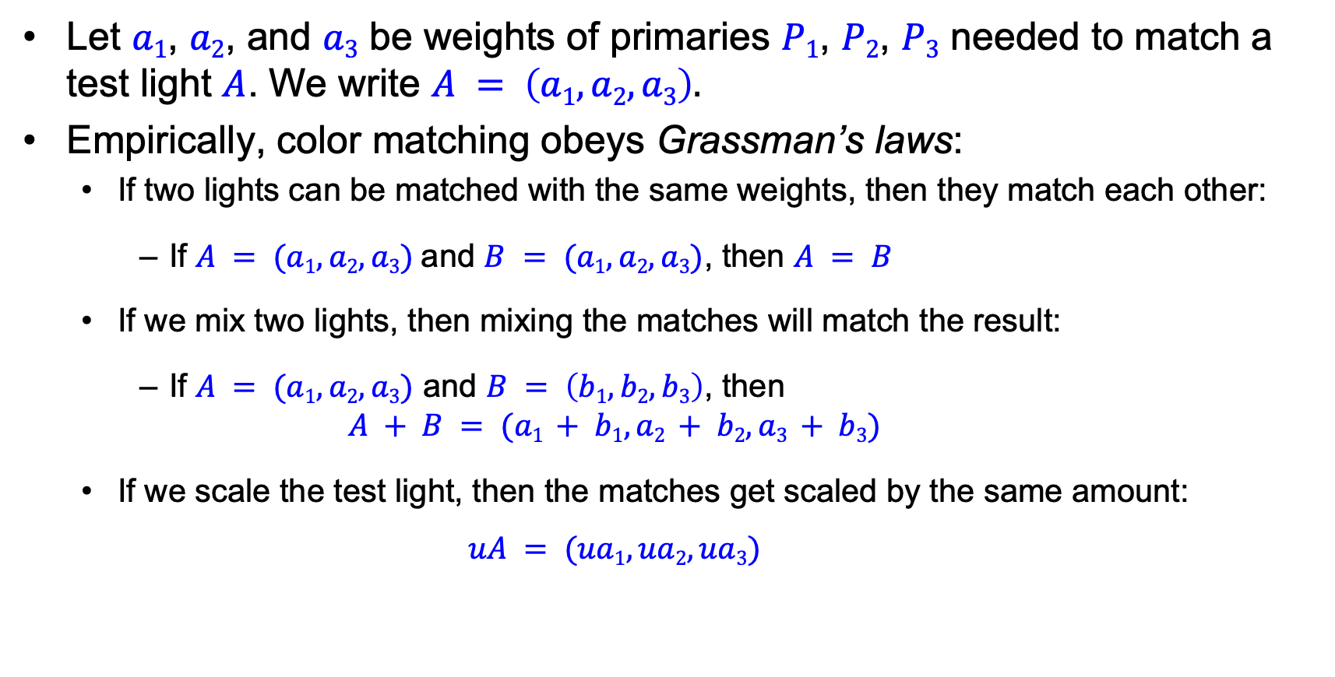
Color matching is linear
Let $a1$, $a2$, and $a3$ be weights of primaries $P1$, $P2$, $P3$ needed to match a test light $A$. We write $A = \left(a1, a2, a3\right).$
Empirically, color matching obeys Grassman’s laws:
  If two lights can be matched with the same weights, then they match each other:
    If $A = (a1, a2, a3)$and $B = (a1, a2, a3)$, then $A = B$
  If we mix two lights, then mixing the matches will match the result:
    If $A = (a1, a2, a3)$ and $B = \left(b1, b2, b3\right)$, then
    $$A + B = (a1 + b1, a2 + b2, a3 + b3)$$
  If we scale the test light, then the matches get scaled by the same amount:
    $$uA = (ua1, ua2, ua3)$$

Slide 39
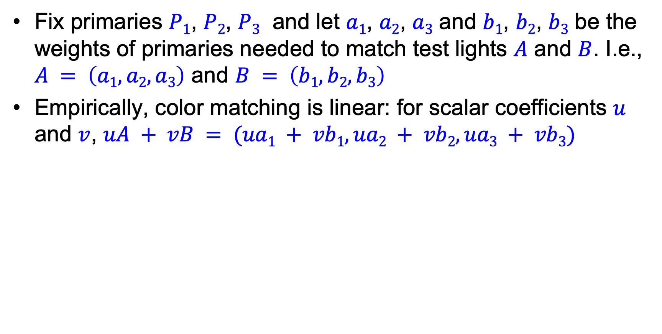
Color matching is linear
Fix primaries $P1$, $P2$, $P3$ and let $a1$, $a2$, $a3$ and $b1$, $b2$, $b3$ be the weights of primaries needed to match test lights $A$ and $B$. I.e., $A = \left(a1, a2, a3\right)$ and $B = \left(b1, b2, b3\right)$
Empirically, color matching is linear: for scalar coefficients $u$ and $v$, $uA + vB = (ua1 + vb1, ua2 + vb2, ua3 + vb3)$

Slide 40
Last time: Color
Physical origin of color
Spectra of sources and surfaces
Physiology of color vision
Quantifying color perception
Color spaces

Slide 41
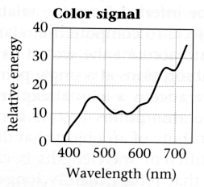
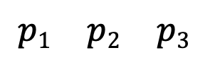
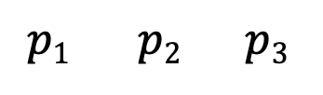
Linear color spaces
Fixing three primaries defines a linear color space in which the coordinates of a color are given by the weights of the primaries used to match it
How can we find the coordinates of an arbitrary color signal?
We need matching functions, or amounts of each primary needed to match monochromatic sources at each wavelength
?
$$p1 p2 p3$$
$$p1 p2 p3$$

Slide 42


Linear color spaces
Let $t(λ)$ be the spectrum of the target signal and $c_{1}(λ)$, $c_{2}(λ)$, and $c_{3}(λ)$ the matching functions
Target signal $t(λ)$
$$c_{3}(λ)$$
$$c_{2}(λ)$$
$$c_{1}(λ)$$
$$λ$$

Slide 43


Linear color spaces
Let $t(λ)$ be the spectrum of the target signal and $c_{1}(λ)$, $c_{2}(λ)$, and $c_{3}(λ)$ the matching functions
Then the weights of the primaries needed to match $t(λ)$ are:
$$w_{1}=\int_{λ}{{t\left(λ\right)c}_{1}\left(λ\right)dλ}$$
Target signal $t(λ)$
$$c_{1}(λ)$$
$$λ$$

Slide 44

Linear color spaces
Let $t(λ)$ be the spectrum of the target signal and $c_{1}(λ)$, $c_{2}(λ)$, and $c_{3}(λ)$ the matching functions
Then the weights of the primaries needed to match $t(λ)$ are:
$$w_{1}=\int_{λ}{{t\left(λ\right)c}_{1}\left(λ\right)dλ}$$
$$w_{2}=\int_{λ}{{t\left(λ\right)c}_{2}\left(λ\right)dλ}$$
Target signal $t(λ)$
$$c_{2}(λ)$$
$$λ$$

Slide 45

Linear color spaces
Let $t(λ)$ be the spectrum of the target signal and $c_{1}(λ)$, $c_{2}(λ)$, and $c_{3}(λ)$ the matching functions
Then the weights of the primaries needed to match $t(λ)$ are:
$$w_{1}=\int_{λ}{{t\left(λ\right)c}_{1}\left(λ\right)dλ}$$
$$w_{2}=\int_{λ}{{t\left(λ\right)c}_{2}\left(λ\right)dλ}$$
$$w_{3}=\int_{λ}{{t\left(λ\right)c}_{3}\left(λ\right)dλ}$$
Target signal $t(λ)$
$$c_{3}(λ)$$
Matching functions act as filters on the target spectrum, like response curves of color receptors!
$$λ$$

Slide 46




Finding coordinates in a linear space
Let $t(λ)$ be the spectrum of the target signal
We can write $t$as a sum of scaled unit-intensity single-wavelength sources $δ\left(λ_{i}\right)$:
$$t=\sum_{i}{t\left(λ_{i}\right)δ\left(λ_{i}\right)}$$
Target signal $t$
$$t\left(λ_{i}\right)δ\left(λ_{i}\right)$$
λ
$$λ_{i}$$

Slide 47

Finding coordinates in a linear space
Let $t(λ)$ be the spectrum of the target signal
We can write $t$as a sum of scaled unit-intensity single-wavelength sources $δ\left(λ_{i}\right)$:
$$t=\sum_{i}{t\left(λ_{i}\right)δ\left(λ_{i}\right)}$$
Suppose that the amount of primary $p$ needed to match $δ\left(λ_{i}\right)$ is $c_{p}(λ_{i})$
By linearity, the coordinates of a linear combination of sources are given by the linear combination of the respective coordinates. Thus, the amount of primary $p$ needed to match $t$ is
$$w_{p}=\sum_{i}{t\left(λ_{i}\right)c_{p}\left(λ_{i}\right)}$$

Slide 48



RGB color space
Primaries are single-wavelength sources, matching functions for R and G have negative values for parts of the spectrum
RGB matching functions
RGB primaries

Slide 49


RGB color space
CRT screen close-up
LCD screen close-up
Source
Source

Slide 50

Comparison of RGB matching functions with best 3x3 transformation of cone responses
Wandell, Foundations of Vision, 1995

Slide 51




Linear color spaces: CIE XYZ
Primaries are imaginary, but matching functions are everywhere positive
The $Y$ parameter corresponds to brightness or luminance
Matching functions
2D visualization:
$x = X/(X+Y+Z)$, $y = Y/(X+Y+Z)$
http://en.wikipedia.org/wiki/CIE_1931_color_space

Slide 52

Linear color spaces: CIE XYZ
CIE XYZ is based on color matching experiments carried out in late 1920s by W. David Wright (Imperial College) and John Guild (National Physical Laboratory, London)
The experiments used 17 “standard observers” (10 by Wright, 7 by Guild)
Source: M. Brown

Slide 53



Uniform color spaces
Unfortunately, differences in $x,y$ coordinates do not reflect perceptual color differences
CIE $u′v′$ is a projective transform of $x,y$ to make the ellipses more uniform
McAdam ellipses: Just noticeable differences in color

Slide 54



Nonlinear color spaces: HSV
Perceptually meaningful dimensions:
Hue, Saturation, Value (Intensity)
RGB cube on its vertex

Slide 55
Outline
Physical origin of color
Spectra of sources and surfaces
Physiology of color vision
Quantifying color perception
Color spaces
Color constancy, white balance

Slide 56

Color perception
Color/lightness constancy
  The ability of the human visual system to perceive the intrinsic reflectance properties of the surfaces despite changes in illumination conditions
J. S. Sargent, The Daughters of Edward D. Boit, 1882

Slide 57
Chromatic adaptation
The visual system changes its sensitivity depending on the luminances prevailing in the visual field
  The exact mechanism is still not fully understood
Adapting to different brightness levels
  Changing the size of the iris opening (i.e., the aperture) changes the amount of light that can enter the eye
  Think of walking into a building from full sunshine
Adapting to different color temperature
  The receptive cells on the retina change their sensitivity
  For example: if there is an increased amount of red light, the cells receptive to red decrease their sensitivity until the scene looks white again
  We actually adapt better in brighter scenes: this is why candlelit scenes still look yellow
http://www.schorsch.com/kbase/glossary/adaptation.html

Slide 58

Checker shadow illusion
https://en.wikipedia.org/wiki/Checker_shadow_illusion

Slide 59

Checker shadow illusion
Possible explanations: simultaneous contrast, reflectance vs. illumination edges
https://en.wikipedia.org/wiki/Checker_shadow_illusion

Slide 60

What color is the dress?
https://www.wired.com/2015/02/science-one-agrees-color-dress/

Slide 61

This strawberry cake has no red pixels!
https://www.digitaltrends.com/photography/non-red-strawberries/
Notes:
From the website: When the brain sees the blueish tint to the photograph, it assumes the blue is not from the objects but from the light source and subtracts that blue as an automatic color correction. “Your brain says, ‘the light source that I am viewing these strawberries under has some blue component to it, so I’m going to subtract that automatically from every pixel.’ And when you take gray pixels and subtract out the blue bias, you end up with red,” the National Eye Institute’s Bevil Conway told Motherboard.

Slide 62


White balance
Analogous to color constancy mechanisms in human vision, cameras have mechanisms to adapt to the illumination in the environment so that neutral (white or gray) objects look neutral
Incorrect white balance
Correct white balance
http://www.cambridgeincolour.com/tutorials/white-balance.htm

Slide 63

White balance
Film cameras:
  Different types of film or different filters for different illumination conditions
Digital cameras:
  Automatic white balance
  White balance settings corresponding to
  several common illuminants
  Custom white balance using a reference
  object
http://www.cambridgeincolour.com/tutorials/white-balance.htm

Slide 64


White balance
Von Kries adaptation: Multiply each channel by a gain factor
Best way: gray card
  Take a picture of a neutral object (white or gray)
  If the object is recorded as $rw, gw, bw$use weights $1/rw, 1/gw, 1/bw$

Slide 65

White balance
Without gray cards: we need to “guess” which pixels correspond to white objects
Gray world assumption
  The image average $\overline{r}, \overline{g}, \overline{b}$ is gray
  Use weights $1/\overline{r}, 1/\overline{g}, 1/\overline{b}$
Brightest pixel assumption
  Highlights usually have the color of the light source
  Use weights inversely proportional to the values of the brightest pixels
Gamut mapping
  Gamut: convex hull of all pixel colors in an image
  Find the transformation that matches the gamut of the image to the gamut of a “typical” image under white light
Use image statistics, learning techniques

Slide 66


Is white balance solved?
New College, Oxford, September 2022

Slide 67

Is white balance solved?
https://petapixel.com/2020/09/10/smartphones-are-ruining-wildfire-sky-photos-with-auto-white-balance/

Slide 68


Is white balance solved?
When there are several types of illuminants in the scene, different reference points will yield different results
Reference: moon
Reference: stone
http://www.cambridgeincolour.com/tutorials/white-balance.htm

Slide 69



Is white balance solved?
When there are several types of illuminants in the scene, different reference points will yield different results
Possible solution: spatially varying white balance
Input
Alpha map
Output
E. Hsu, T. Mertens, S. Paris, S. Avidan, and F. Durand, Light Mixture Estimation for Spatially Varying White Balance, SIGGRAPH 2008

Slide 70


Uses of color in computer vision

