Slide 1
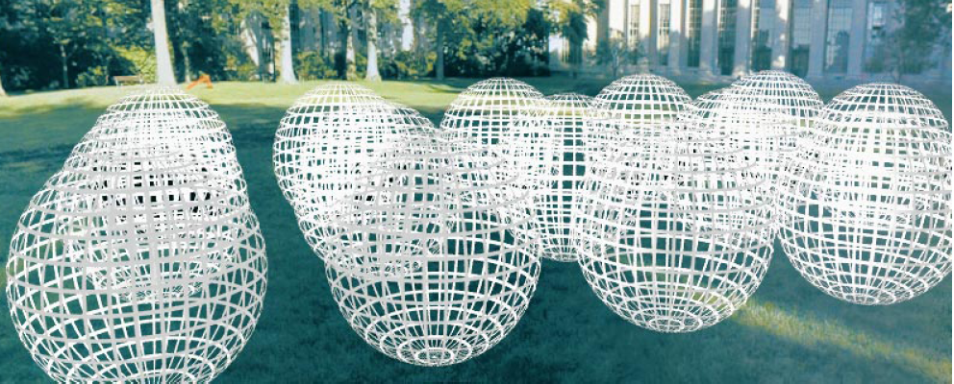
Modeling the plenoptic function
Adopted from: CS194: Intro to Comp. Vision, and Comp. Photo
Alexei Efros & Angjoo Kanazawa, UC Berkeley

Slide 2
Outline
The plenoptic function
Two-plane light fields
Plenoptic camera
Neural methods: NeRFs, 3D Gaussian splatting (next time)

Slide 3
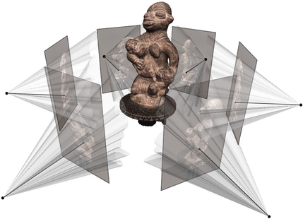
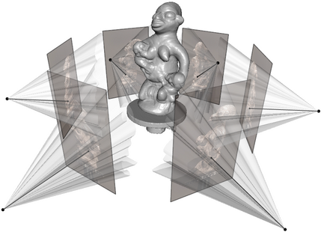
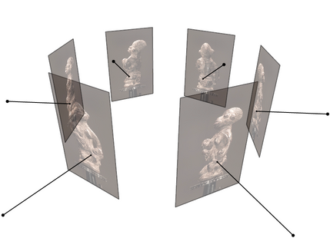
Goal: Novel view rendering
Given several images of the same object or scene from known viewpoints, how can we generate a rendering of the same scene from a novel viewpoint?
Multiview stereo answer: create a textured 3D model from the images, use traditional graphics to render
Figure source: C. Hernandez, N. Snavely

Slide 4
Goal: Novel view rendering
Given several images of the same object or scene from known viewpoints, how can we generate a rendering of the same scene from a novel viewpoint?
Multiview stereo answer: create a textured 3D model from the images, use traditional graphics to render
Alternate answer: model the light field of the scene, sample new views from it

Slide 5
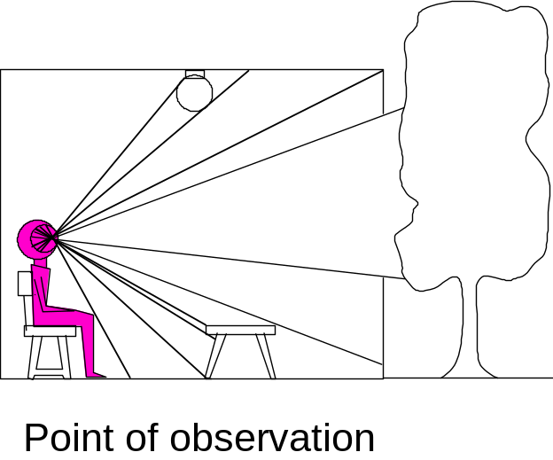
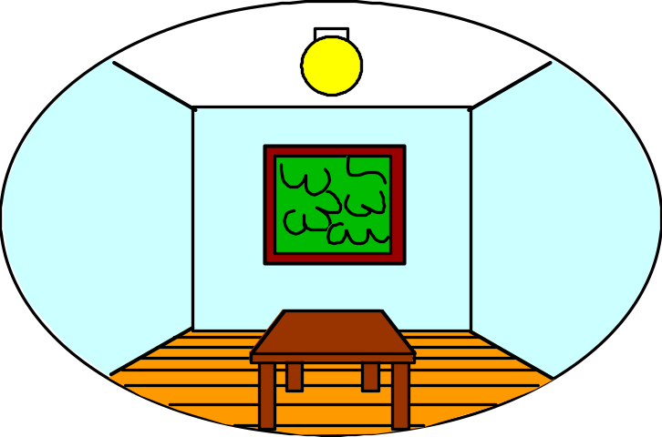
Modeling the light field
3D world
2D image
Figures © Stephen E. Palmer, 2002

Slide 6
Modeling the light field
3D world
2D image
Painted
backdrop

Slide 7
On Simulating the Visual Experience
Just feed the eyes the right data
  No one will know the difference!
Philosophy:
  Ancient question: “Does the world really exist?”
Science fiction:
  Many, many, many books on the subject, e.g. slowglass from “Light of Other Days”
  The Matrix
Physics:
  Slowglass might be possible?
Computer Science:
  Virtual Reality
To simulate we need to know:
What does a person see?
Notes:
already covered this

Slide 8
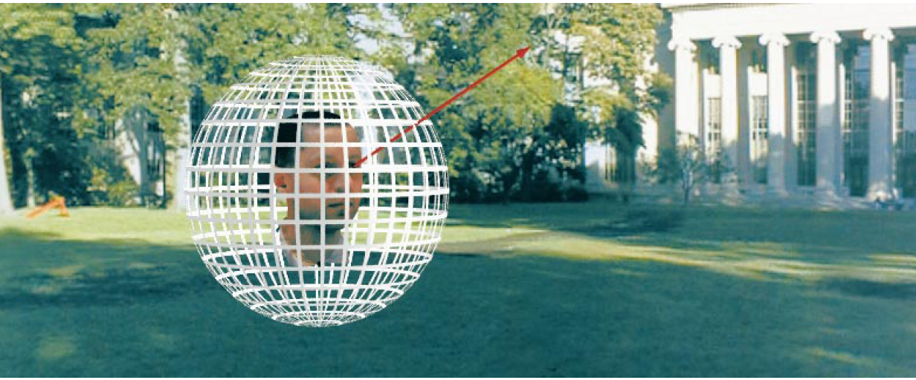
The light field, or plenoptic function
Figure by Leonard McMillan
Q: What is the set of all things that we can ever see?
A: The plenoptic function
E. Adelson and J. Bergen. The plenoptic function and the elements of early vision.
Computational models of visual processing, MIT Press, 1991

Slide 9
The light field, or plenoptic function
Figure by Leonard McMillan
Q: What is the set of all things that we can ever see?
A: The plenoptic function
Let’s start with a stationary person and try to parameterize everything that they can see…

Slide 10
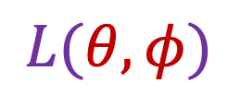
Grayscale snapshot
$$L(θ,φ)$$
Intensity of light
  Seen from a single view point
  At a single time
  Averaged over the wavelengths of the visible spectrum

Slide 11
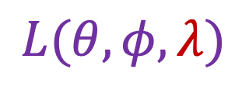
Color snapshot
$$L(θ,φ,λ)$$
Intensity of light
  Seen from a single view point
  At a single time
  As a function of wavelength

Slide 12
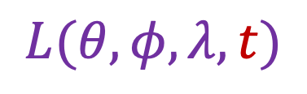
A movie
$$L(θ,φ,λ,t)$$
Intensity of light
  Seen from a single view point
  Over time
  As a function of wavelength

Slide 13
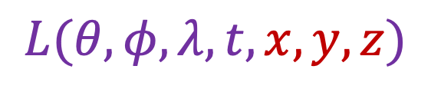
Holographic movie
$$L(θ,φ,λ,t,x,y,z)$$
Intensity of light
  Seen from ANY viewpoint
  Over time
  As a function of wavelength

Slide 14
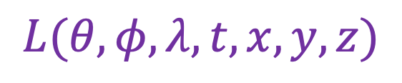
The plenoptic function
$$L(θ,φ,λ,t,x,y,z)$$
  Can reconstruct every possible view, at every moment, from every position, at every wavelength
  Contains every photograph, every movie, everything that anyone has ever seen! it completely captures our visual reality!
  Not bad for a function…

Slide 15
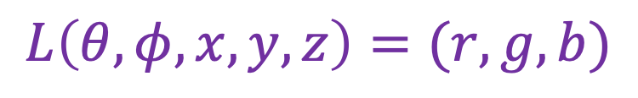
The plenoptic function: More practical version
$$L\left(θ,φ,x,y,z\right)=(r,g,b)$$
  Other simplifications/variants are possible, as we will see

Slide 16
Modeling the plenoptic function
Capture
  Create a special camera setup to capture a slice of the plenoptic function
  Combine captured rays for novel view synthesis, defocus, and other effects
Fitting
  Given a set of multi-view calibrated images, optimize a parametric representation of the plenoptic function of the scene

Slide 17
Outline
The plenoptic function
Two-plane light fields

Slide 18
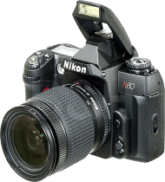
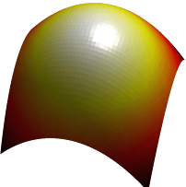
Two-plane light fields
Key idea: assuming light is constant along rays, we can create a 4D parameterization of the light field
No change in
radiance
Surface
Camera
If there is no occlusion or fog
S. Gortler, R. Grzeszczuk, S. Szeliski, M. Cohen. The Lumigraph. Proceedings of the 23rd Annual Conference on Computer Graphics and Interactive Techniques, 1996
M. Levoy and P. Hanrahan. Light field rendering. SIGGRAPH 1996

Slide 19
Two-plane light fields
Two-plane parameterization:
Scene
Observer

Slide 20
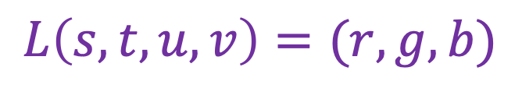






Two-plane light fields
Two-plane parameterization:
$$s,t$$
$$v$$
$$u,v$$
$$t$$
$$L\left(s,t,u,v\right)=(r,g,b)$$
$$u$$
$$s$$

Slide 21


Two-plane light fields
Two-plane parameterization:
$$u,v$$
$$s,t$$
$$L\left(s,t,u,v\right)=(r,g,b)$$

Slide 22
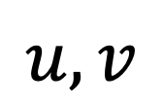

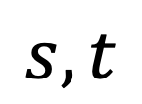
Two-plane light fields
What do we get if we hold
$u, v$ constant and let $s, t$ vary?
An image!
$$u, v$$
$$s, t$$
Observer
Notes:
Novel view synthesis

Slide 23
Two-plane light fields
What do we get if we hold
$u, v$ constant and let $s, t$ vary?
An image!
“Camera plane”
$$u, v$$
$$s, t$$
Observer
Notes:
Novel view synthesis

Slide 24
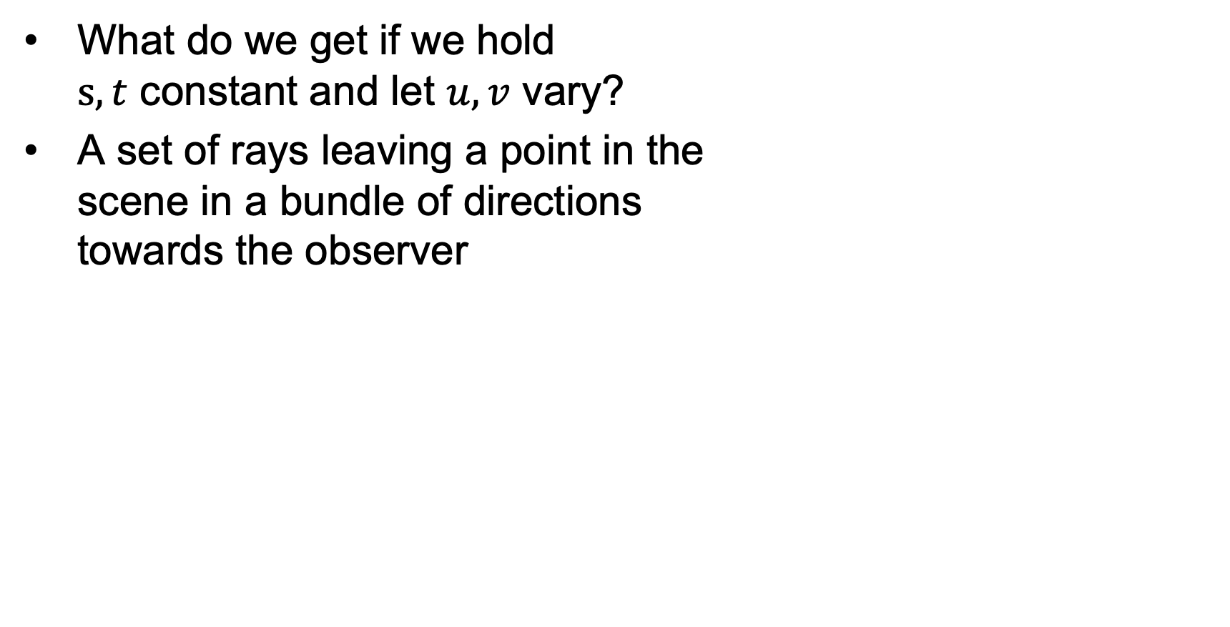
Two-plane light fields
What do we get if we hold
$s, t$ constant and let $u, v$ vary?
A set of rays leaving a point in the
scene in a bundle of directions
towards the observer
“Focal plane”
$$u, v$$
$$s, t$$
Observer
Notes:
Novel view synthesis

Slide 25
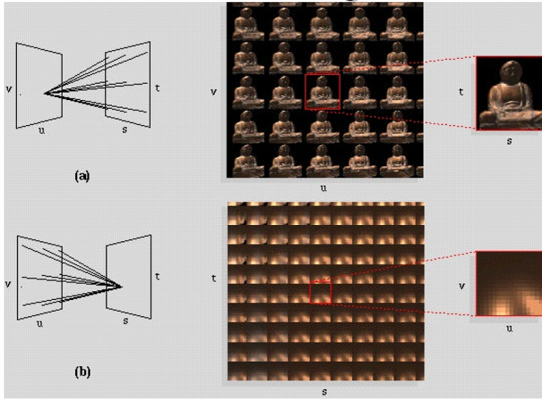
Light field visualization
Figure source: M. Levoy and P. Hanrahan

Slide 26
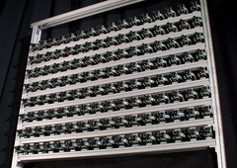
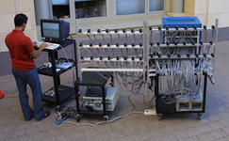


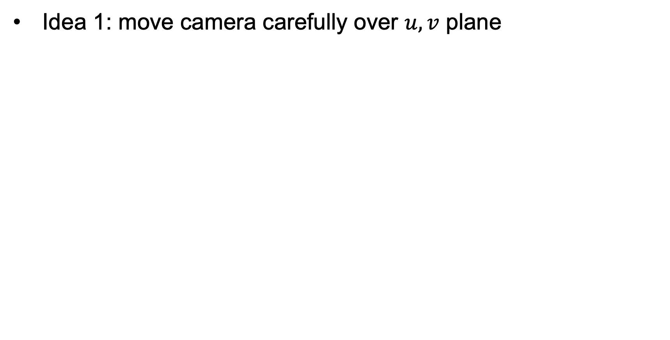
Light field capture
Idea 1: move camera carefully over $u, v$ plane
$$u,v$$
$$s,t$$

Slide 27
Stanford multi-camera array
640 × 480 pixels ×
30 fps × 128 cameras
Synchronized timing
Continuous streaming
Flexible arrangement
http://graphics.stanford.edu/projects/array/

Slide 28
Light field capture
Idea 2: move camera anywhere, use rebinning or resampling

Slide 29
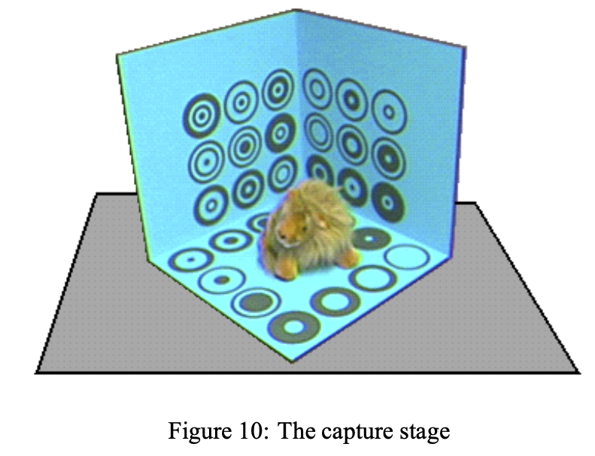
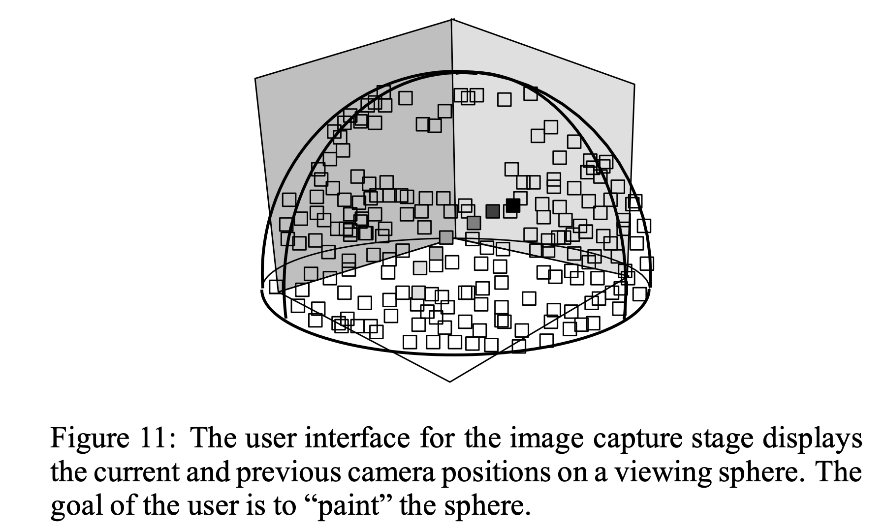


Light field capture
Idea 2: move camera anywhere, use rebinning or resampling
$$u,v$$
$$s,t$$
Figure source: S. Gortler et al.

Slide 30
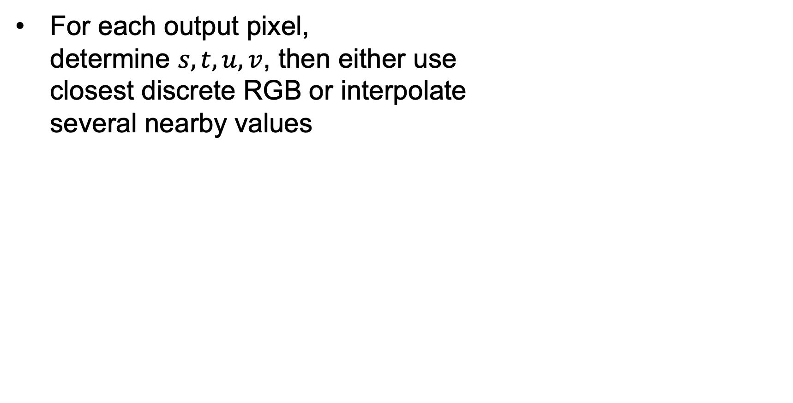
Novel view synthesis
For each output pixel,
determine $s,t,u,v$, then either use
closest discrete RGB or interpolate
several nearby values
Slide by Rick Szeliski and Michael Cohen

Slide 31
Outline
The plenoptic function
Two-plane light fields
Plenoptic camera

Slide 32
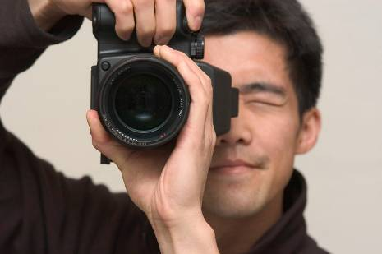
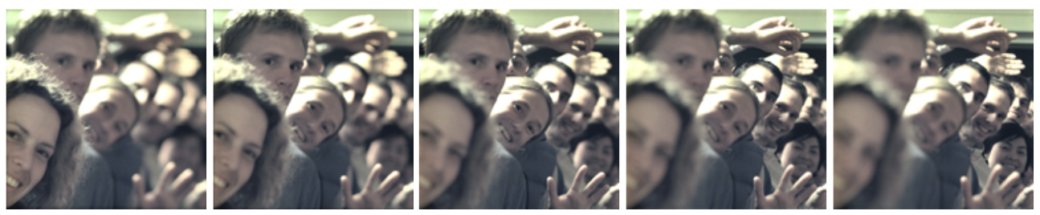
Plenoptic camera
R. Ng et al. Light Field Photography with a Hand-held Plenoptic Camera. 2005

Slide 33
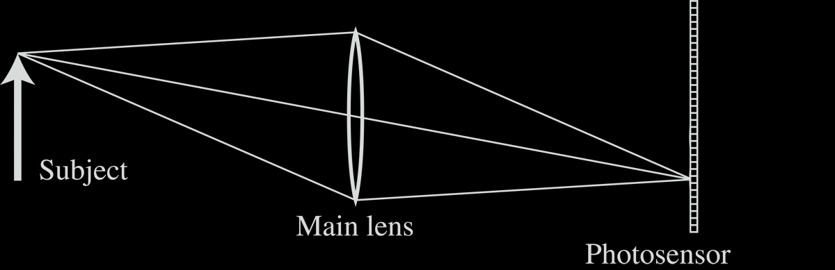
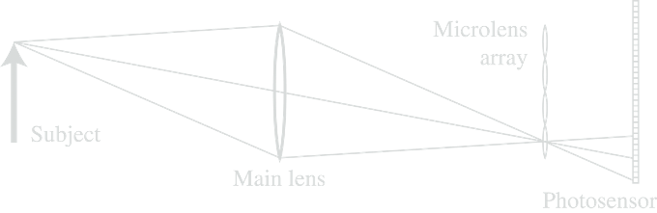
Conventional vs. light field camera
Notes:
minicamera at the back, instead of single plane, we have two planes

Slide 34
Conventional vs. light field camera
Notes:
minicamera at the back, instead of single plane, we have two planes

Slide 35

Conventional vs. light field camera
uv-plane
st-plane

Slide 36
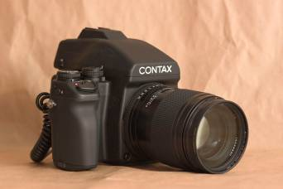
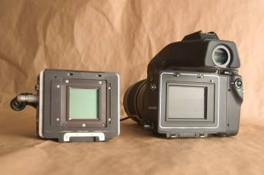
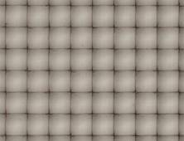
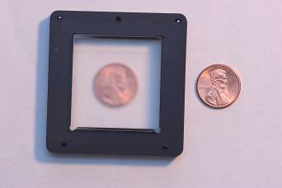
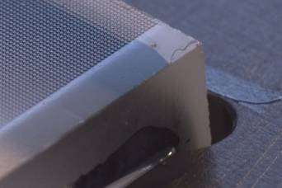
Prototype camera
Contax medium format camera
Kodak 16-megapixel sensor
4000 × 4000 pixels /
292 × 292 lenses =
14 × 14 pixels per lens
Adaptive Optics microlens array
125μ square-sided microlenses

Slide 37

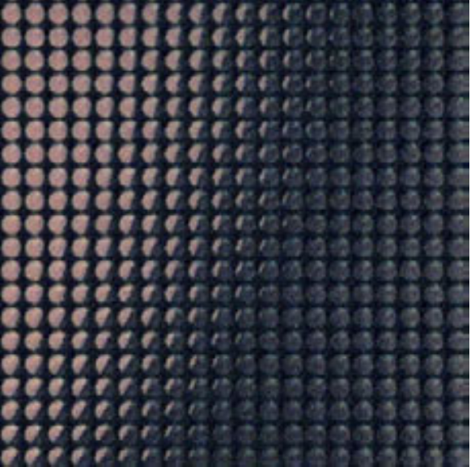
Captured light field

Slide 38
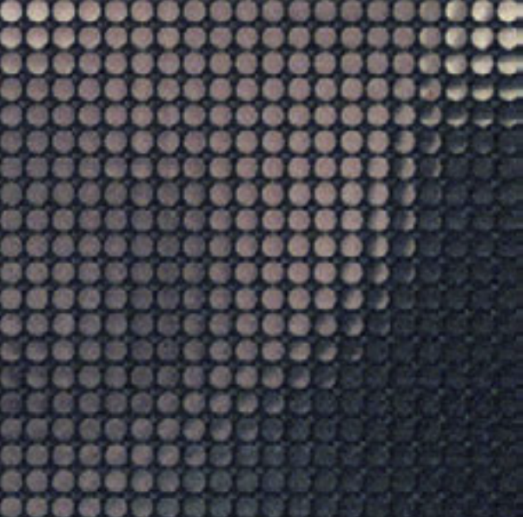
Captured light field

Slide 39
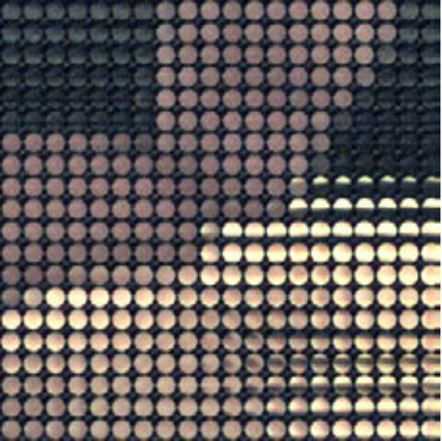
Captured light field

Slide 40


Digitally stopping down (reducing the aperture)
Σ
Σ
stopping down = summing only the central portion of each microlens
Notes:
we can change the image after we capture. Just take the lightfield, decide which ones you want to keep
Stopping down – reducing aperture (remember this creates different depth of field effects), top is the full aperture (just average all rays), well then justsum the center

Slide 41

Digital refocusing
Σ
Σ
refocusing = summing windows extracted from several microlenses
Notes:
What is focus? Focus is where the rays intersect. I fit focuses earlier, you can just mix and patch the correct rays indexed from different place. All this is in there, you need to just re-capture this.

Slide 42





Digital refocusing

Slide 43
Digitally moving the observer
Σ
Σ
moving the observer = moving the window we extract from the microlenses

Slide 44
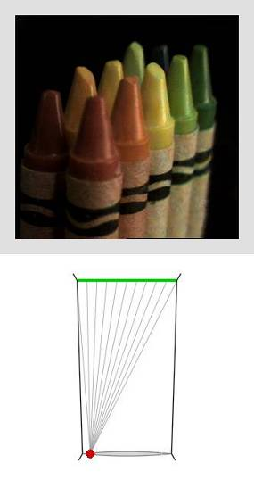
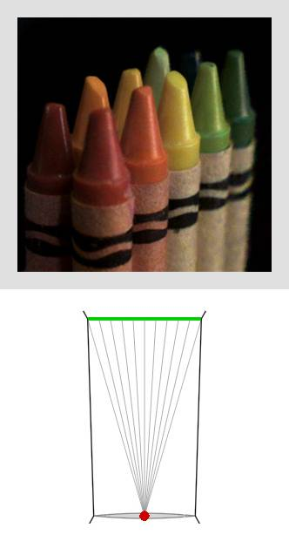
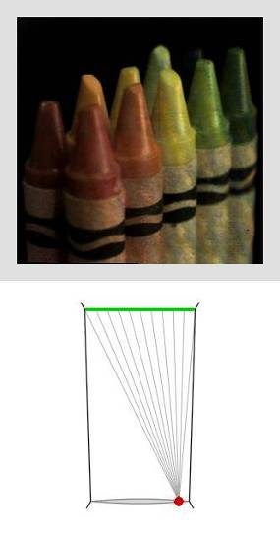
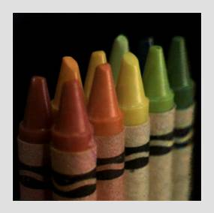
Digitally moving the observer

Slide 45
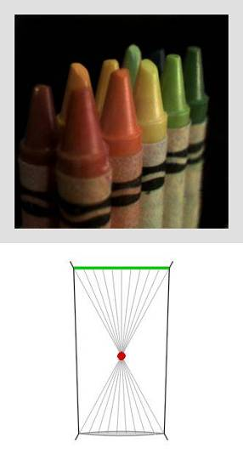
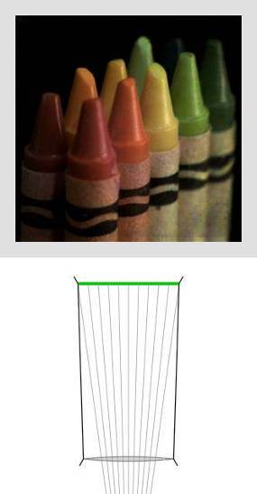
Digitally moving the observer

Slide 46
Lytro (RIP)
https://en.wikipedia.org/wiki/Lytro
What happened to Lytro?

