Slide 1
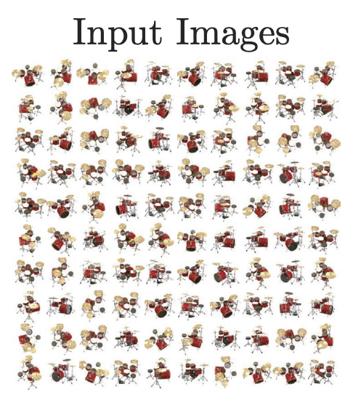
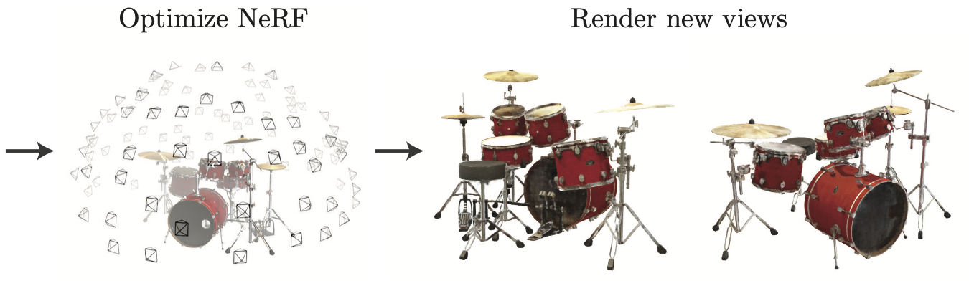
Neural Radiance Fields (NeRFs)
Many slides from Mildenhall et al. and Berkeley CS194

Slide 2


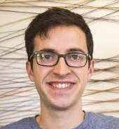

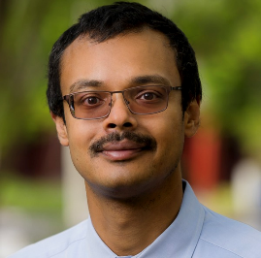
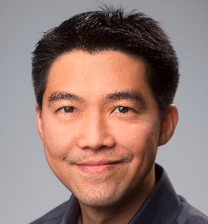





NeRF: Representing Scenes as
Neural Radiance Fields for View Synthesis
ECCV 2020 (best paper honorable mention)
Over 9700 Google Scholar citations as of 12/5/2024
Ben Mildenhall*
Pratul Srinivasan*
Matt Tancik*
Jon Barron
Ravi Ramamoorthi
Ren Ng
UC Berkeley
UC Berkeley
UC Berkeley
Google Research
UC San Diego
UC Berkeley
https://www.matthewtancik.com/nerf

Slide 3


Train a neural network to represent the plenoptic function
Inputs: sparsely sampled images of scene
Outputs: new views of same scene
Slide credit: Jon Barron

Slide 4
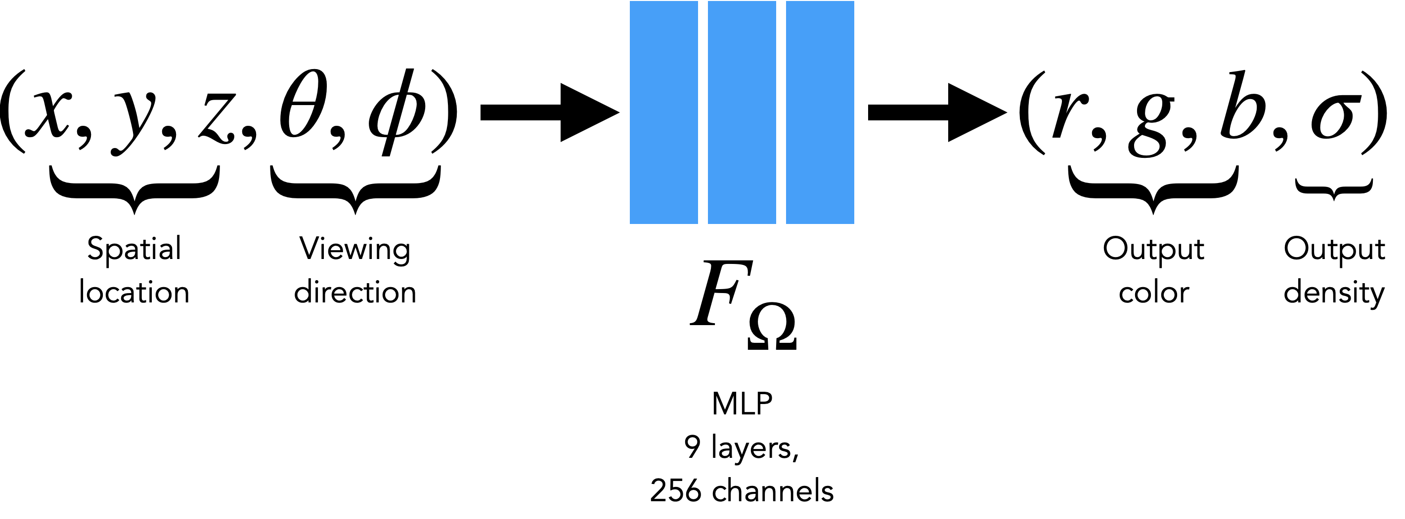
Train a neural network to represent the plenoptic function
Volumetric “fog” model: Every 5D input gets mapped to Color and Density

Slide 5
Train a neural network to represent the plenoptic function

Slide 6
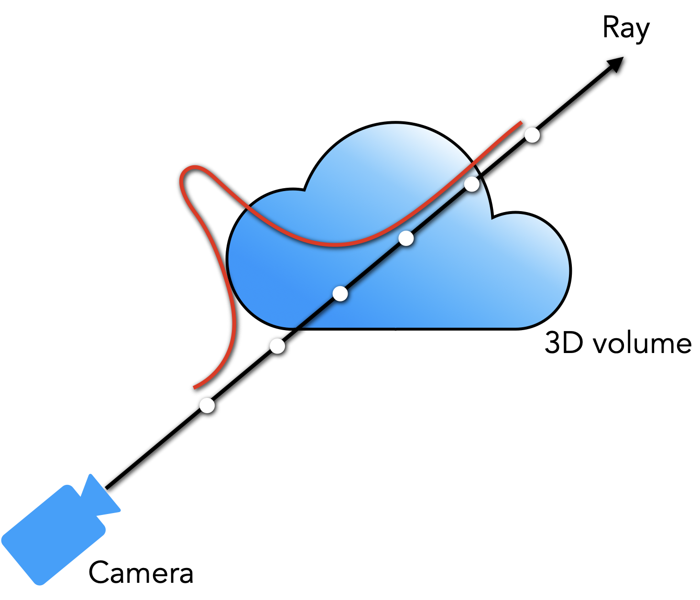
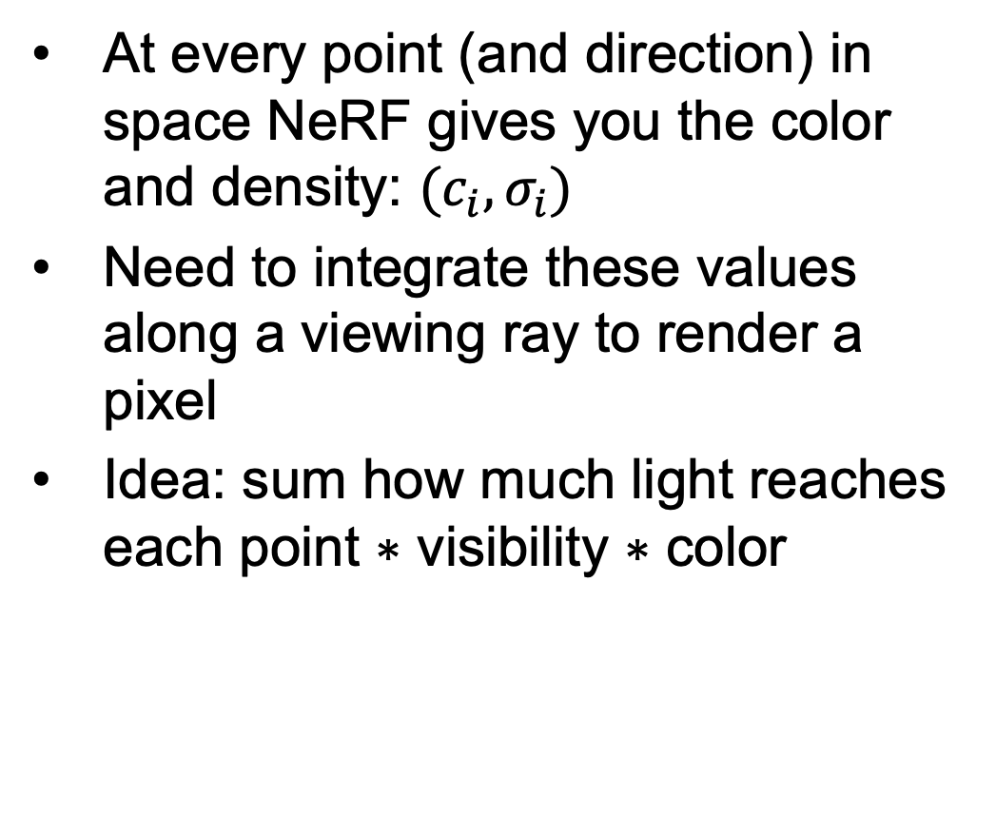
NeRF rendering
At every point (and direction) in space NeRF gives you the color and density: $(c_{i},σ_{i})$
Need to integrate these values along a viewing ray to render a pixel
Idea: sum how much light reaches each point $∗$ visibility $∗$ color
Notes:
illustration of the density

Slide 7


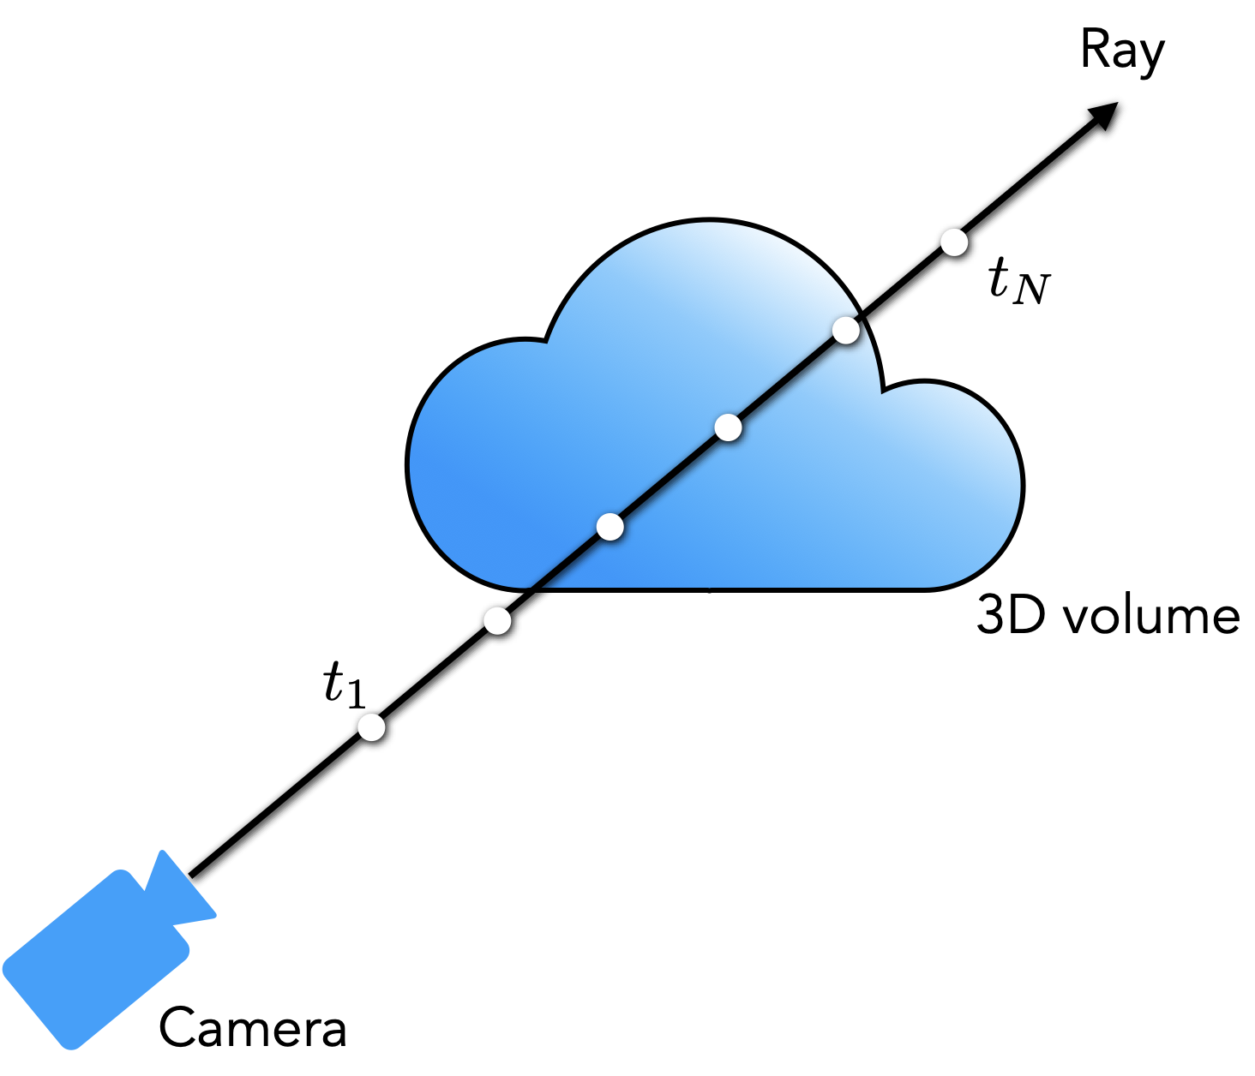
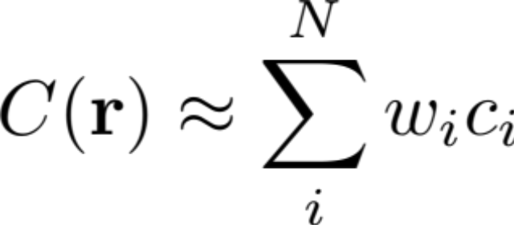


How to render a pixel: Volume rendering
Given: a ray
At every point you know:
Alpha ($α_{i}$): How much light a ray segment contributes
Transmittance ($T_{i}$): how much light reaches point $i$
Notes:
high density value ➔exp(-1000) = 0, so 1-0 = 1, this is a dense point
density = 0 → exp(-00 = 1, so 1-1 = 0

Slide 8

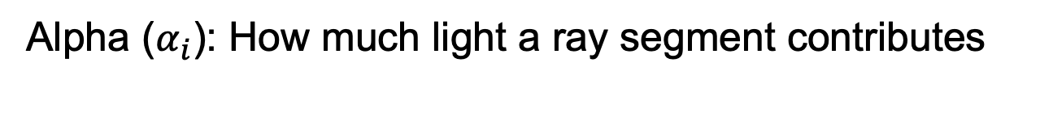
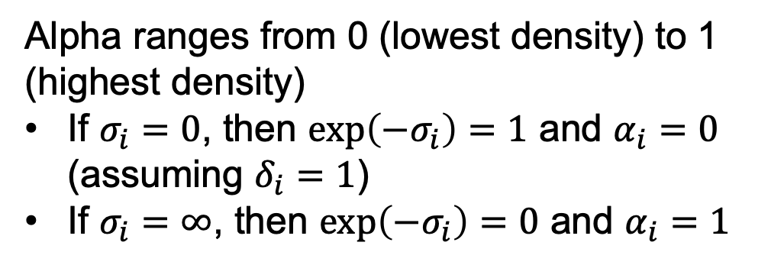
How to render a pixel: Volume rendering
Given: a ray
At every point you know:
Alpha ($α_{i}$): How much light a ray segment contributes
Alpha ranges from 0 (lowest density) to 1 (highest density)
If $σ_{i}=0$, then $\exp\left(−σ_{i}\right)=1$ and $α_{i}=0$
(assuming $δ_{i}=1$)
If $σ_{i}=∞$, then $\exp\left(−σ_{i}\right)=0$ and $α_{i}=1$
Notes:
high density value ➔exp(-1000) = 0, so 1-0 = 1, this is a dense point
density = 0 → exp(-00 = 1, so 1-1 = 0

Slide 9
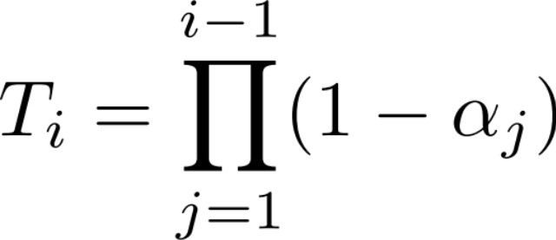
How to render a pixel: Volume rendering
Given: a ray
At every point you know:
Alpha ($α_{i}$): How much light a ray segment contributes
Transmittance ($T_{i}$): how much light reaches point $i$
Notes:
high density value ➔exp(-1000) = 0, so 1-0 = 1, this is a dense point
density = 0 → exp(-00 = 1, so 1-1 = 0

Slide 10
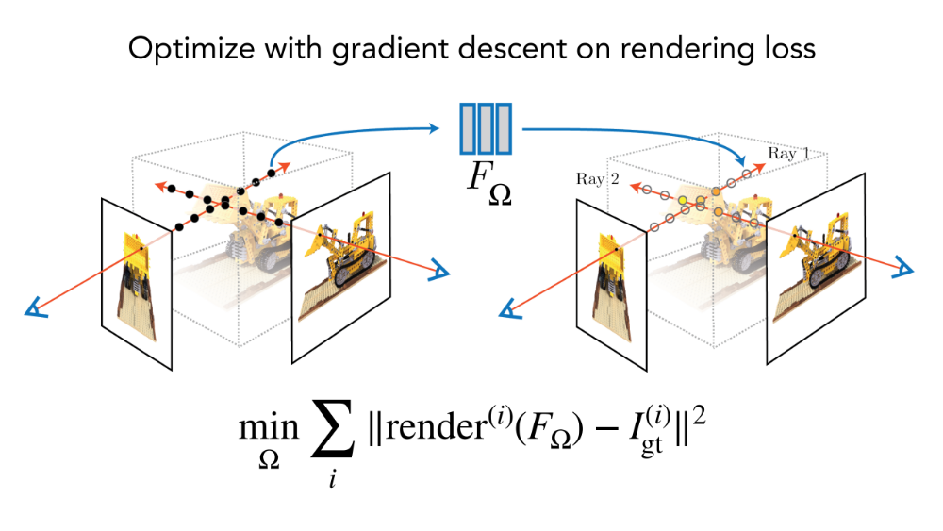
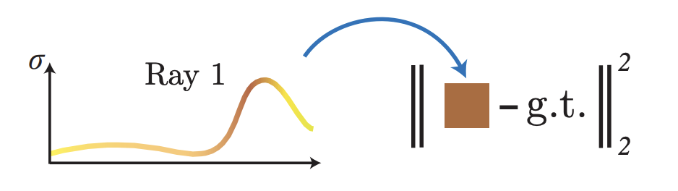
Training: Optimization with reconstruction loss

Slide 11
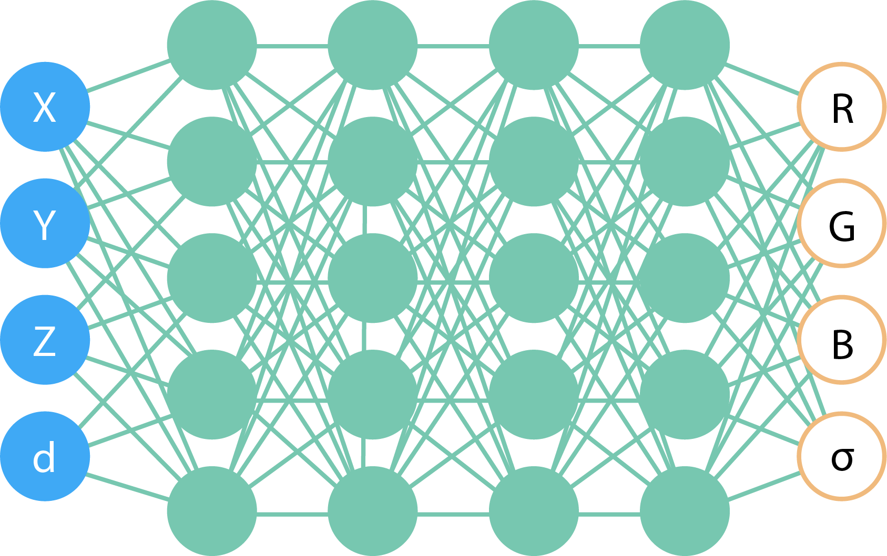

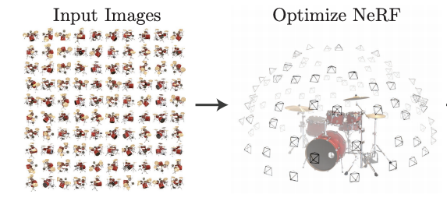

Training
pixel value
transmittance_{i} × alpha_{i} × color_{i}
Notes:
[SKIP]
At the core, a NeRF is a coordinate-based neural network which represents a scene. Given any spatial point and viewing direction it outputs a color and density. //
So to use this network, uou can shoot rays from the camera, // integrate the RGB and density along each ray // by basically alpha compositing. For training, you compare this integrated color to the pixel colors from the image. // Doing this repeatedly, we get a neural network which represents the geometry and appearance of the scene, // which lets you freely render novel views at test time.

Slide 12
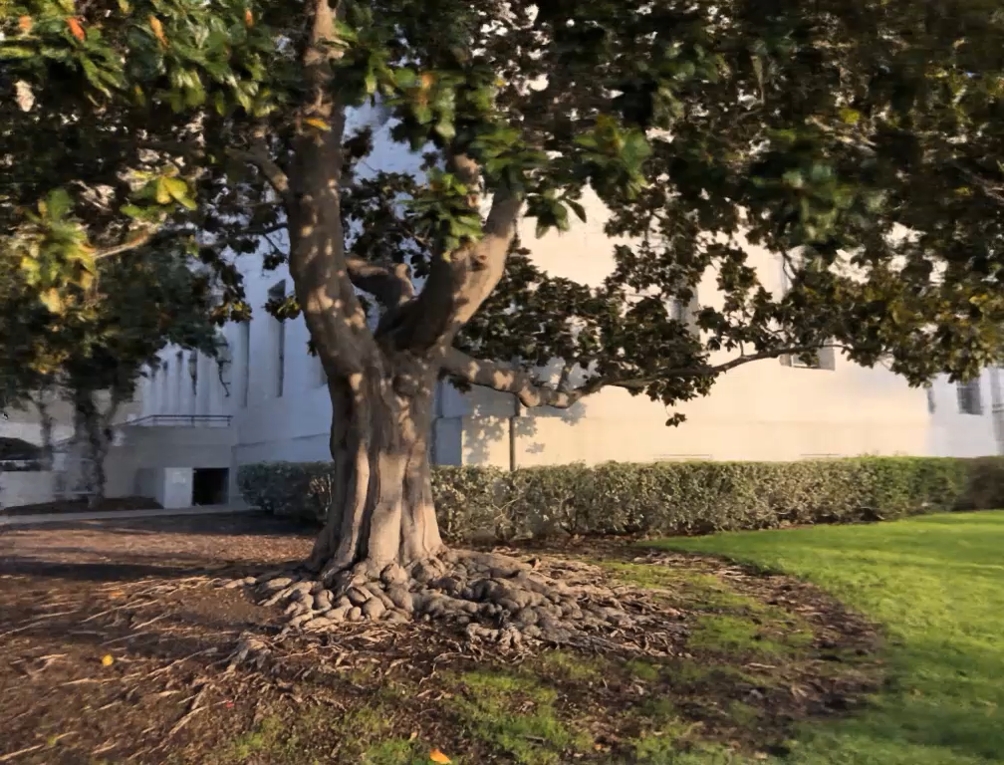
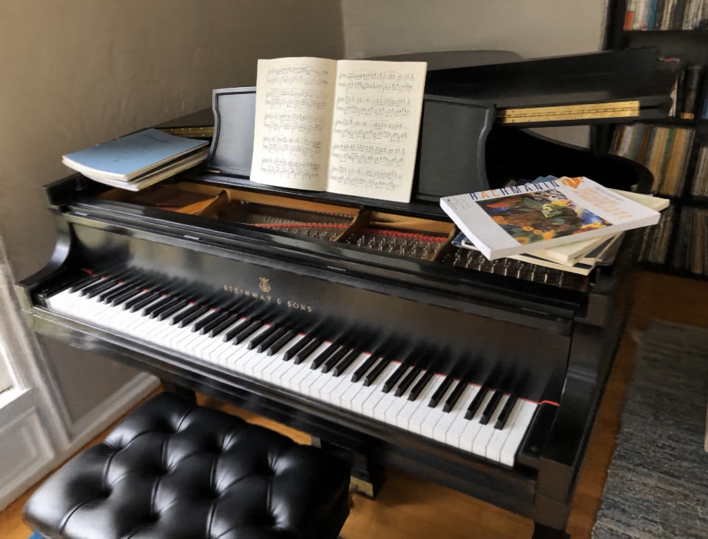
Example results
Notes:
Summer of NeRF. This talk: developments of how things have been developing

Slide 13
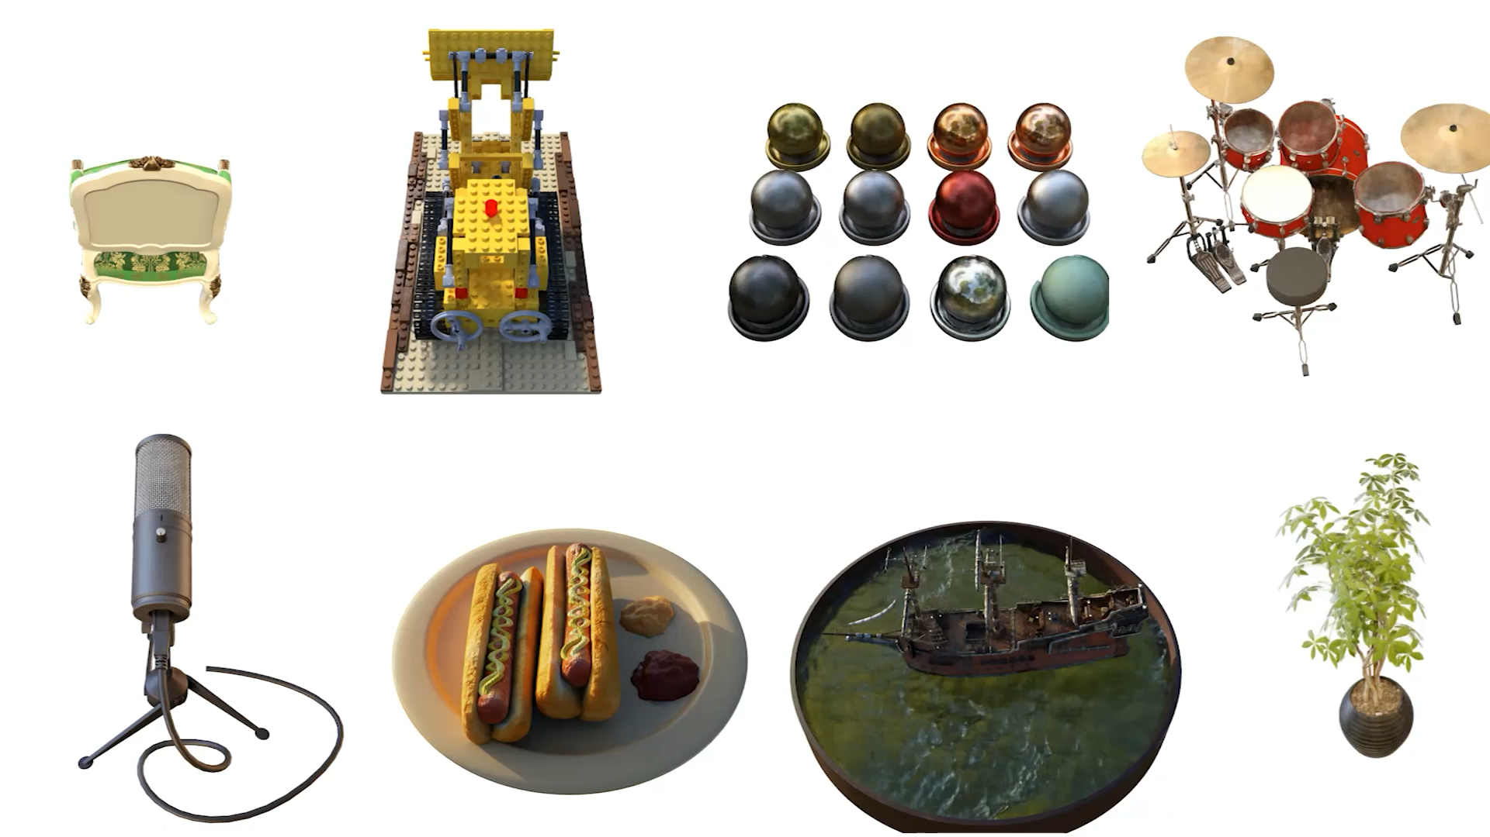

Slide 14
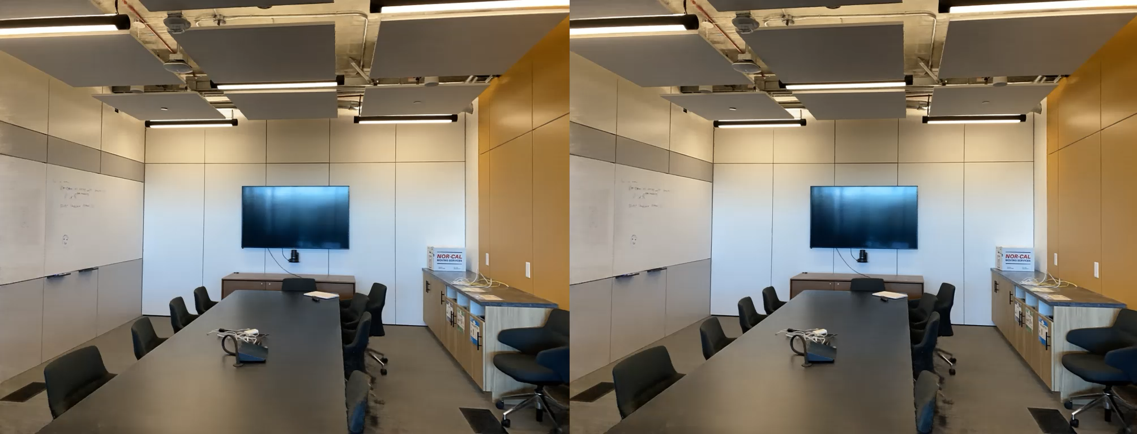
Viewpoint-dependent effects
Notes:
Here we visualize the view-dependent appearance encoded in our NeRF representation by fixing the camera viewpoint but changing the queried viewing direction.

Slide 15
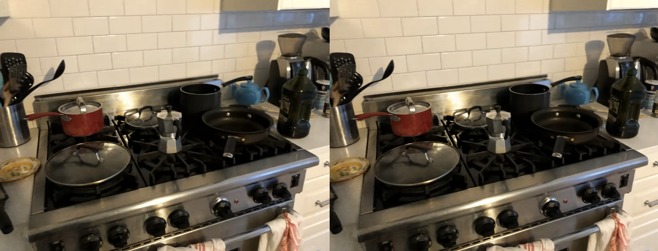
Viewpoint-dependent effects

Slide 16
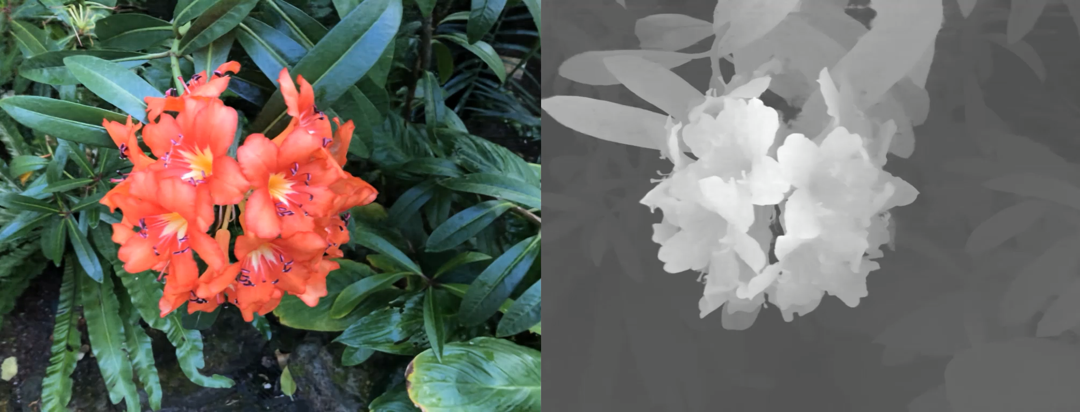
Rendering depth
Depth is given by expected ray termination

Slide 17
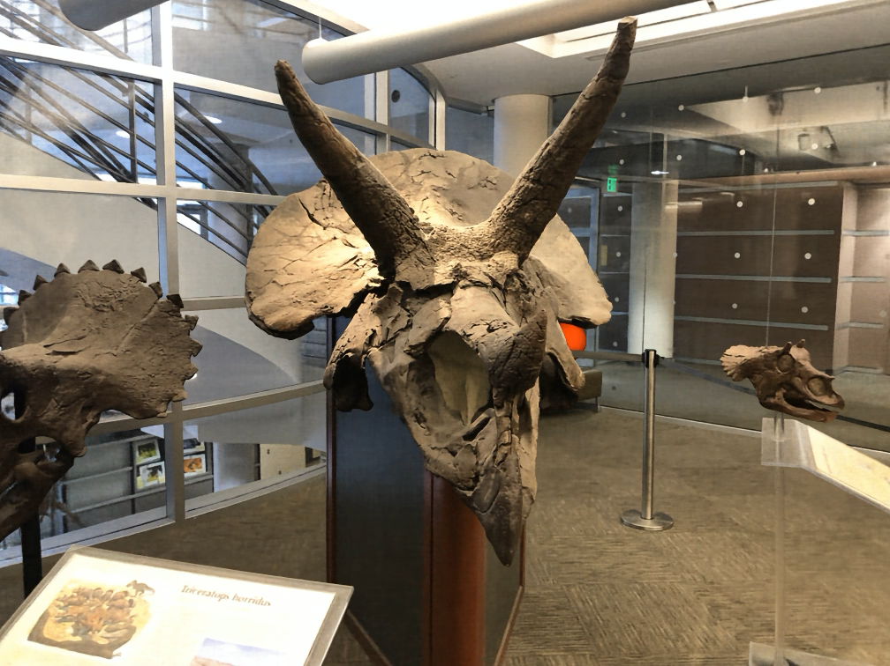
Because it models the entire plenoptic function you can insert objects with proper occlusion effects
(in contrast to lightfields)

Slide 18
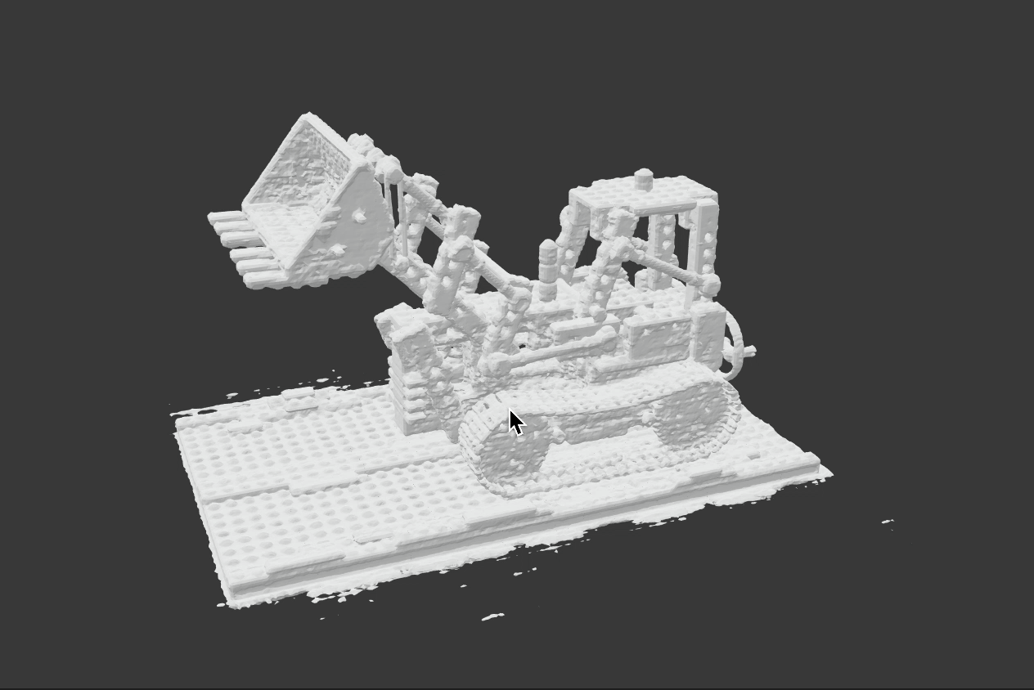
Extract surface on high density regions

Slide 19
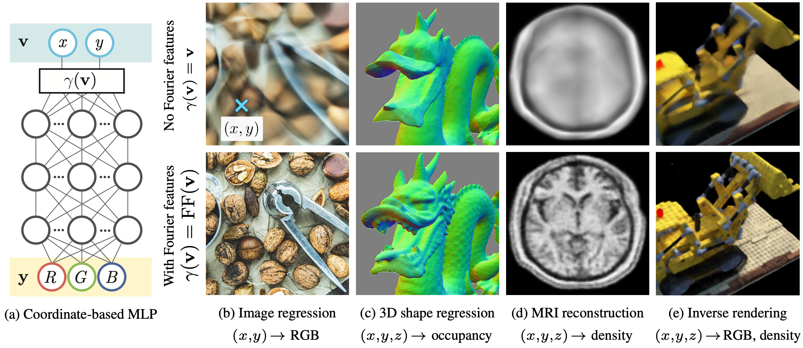
Improving results quality with Fourier features
M. Tancik et al. Fourier Features Let Networks Learn High Frequency Functions in Low Dimensional Domains. NeurIPS 2020

Slide 20
NeRF limitations
Expensive / slow to train and render
Sensitive to sampling strategy
Does not generalize between scenes
Sensitive to pose accuracy
Assumes static scene
Assumes static lighting and camera focus
Not a mesh

Slide 21
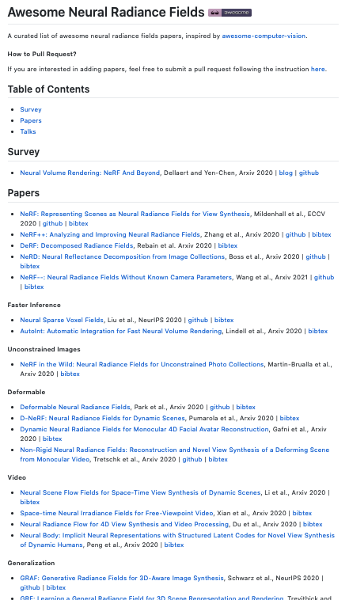
NeRF explosion
https://github.com/yenchenlin/awesome-NeRF
Notes:
Summer of NeRF. This talk: developments of how things have been developing

Slide 22
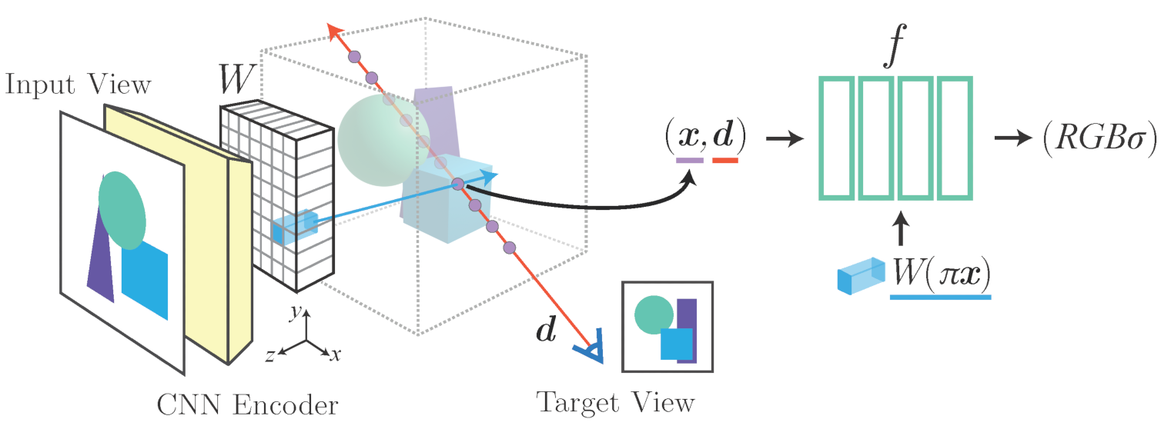
NeRF generalizations
PixelNeRF [Yu et al. CVPR’21]
IBRNet [Wang et al. CVPR’21]
MVSNeRF [Yao et al. ICCV’21]
NerfingMVS [Wei et al. ICCV’21]
NeRFormer [Reizenstein et al. ICCV’21]
GRF [Trevithick et al. ICCV’21]
…
PixelNeRF [Yu et al. CVPR’21]

Slide 23
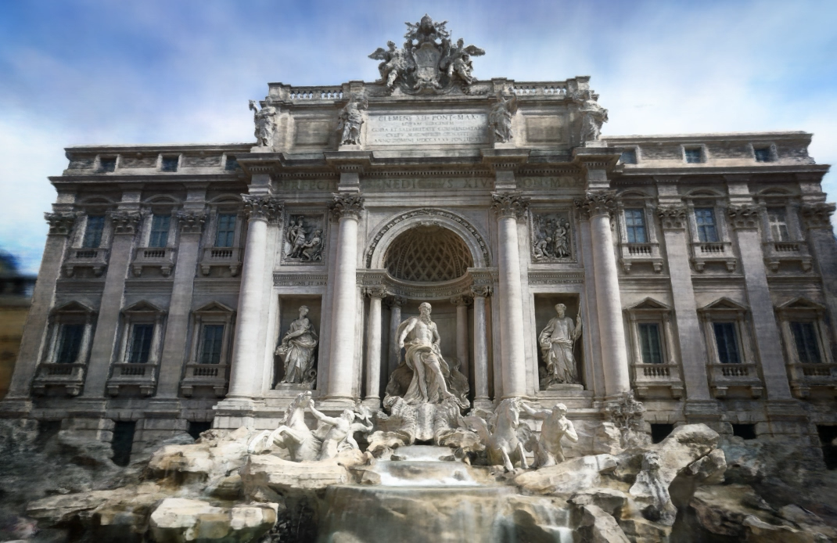
NeRF in the wild
R. Martin-Brualla et al. NeRF in the Wild. CVPR 2021

Slide 24
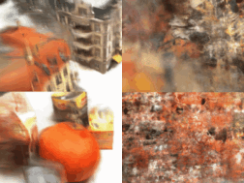
NeRF from one or few images
Three input views
PixelNeRF
3-view NeRF
A. Yu et al. PixelNeRF: Neural Radiance Fields from One or Few Images. CVPR 2021

Slide 25
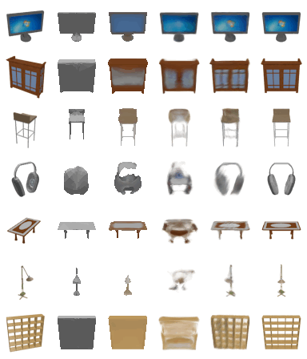
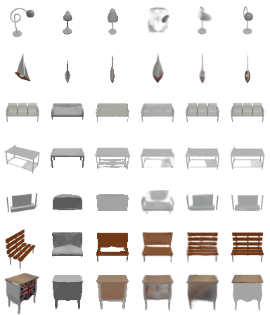
NeRF from one or few images
A. Yu et al. PixelNeRF: Neural Radiance Fields from One or Few Images. CVPR 2021

Slide 26
NeRF from one or few images
A. Yu et al. PixelNeRF: Neural Radiance Fields from One or Few Images. CVPR 2021

Slide 27
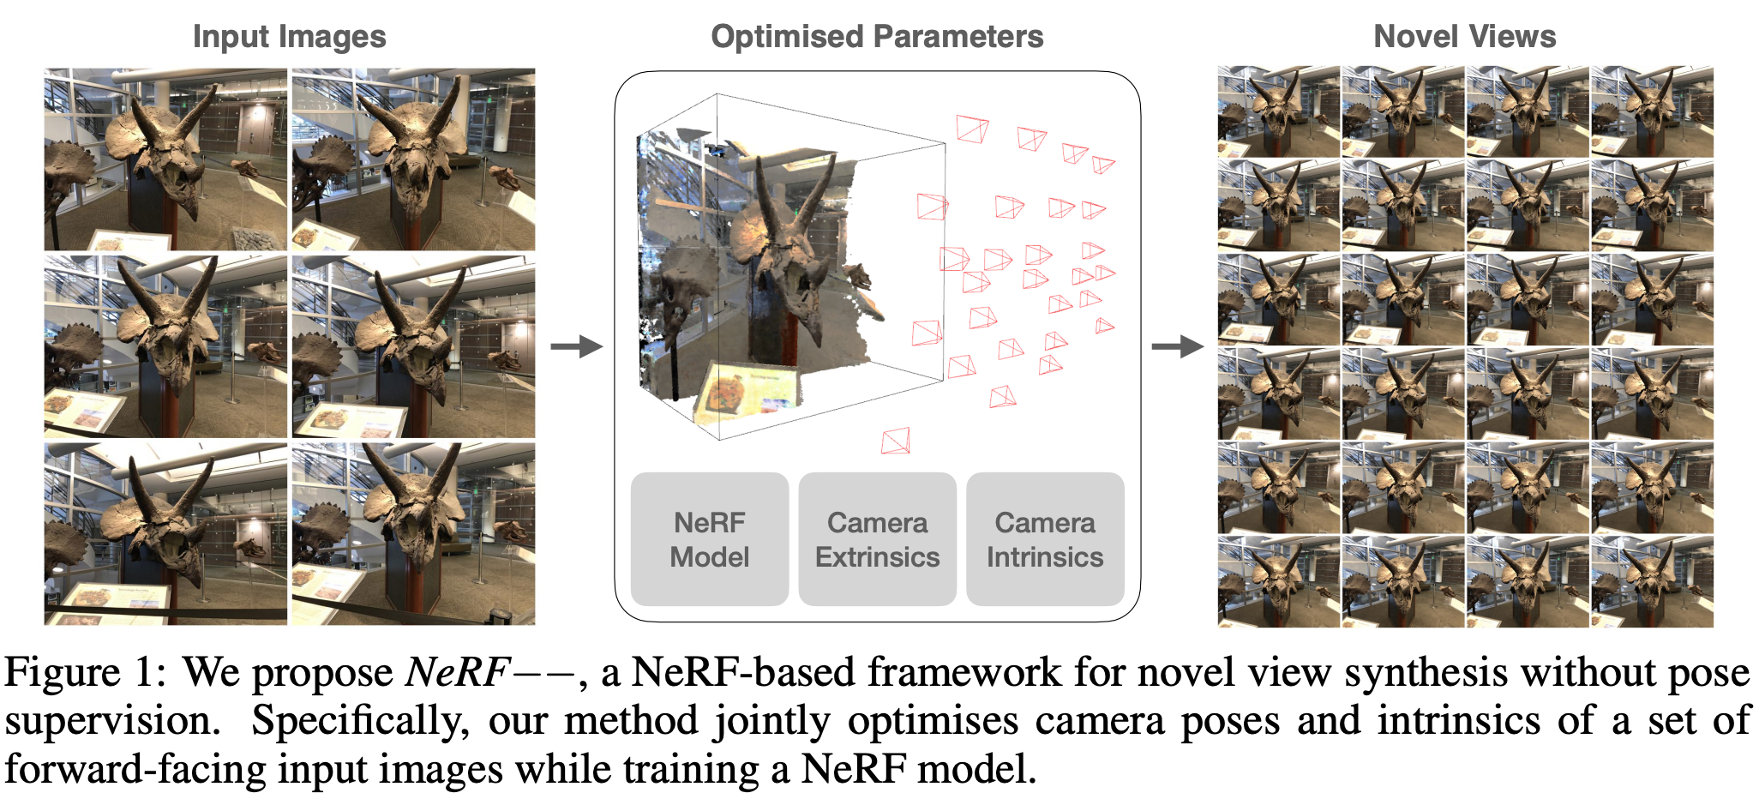
NeRF without calibration
Z. Wang et al. NeRF--: Neural Radiance Fields Without Known Camera Parameters. arXiv 2021

Slide 28
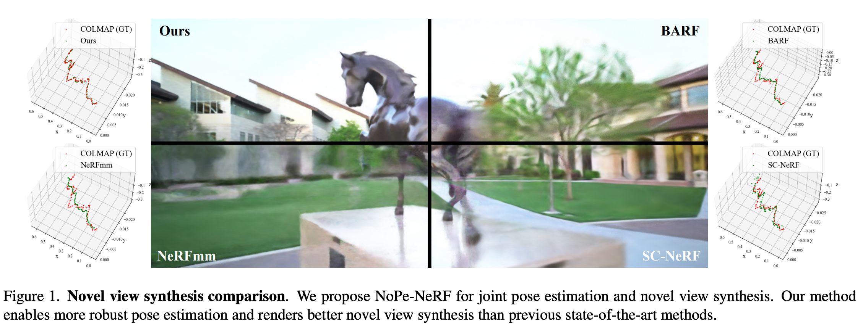
NeRF without calibration
W. Bian et al. NoPe-NeRF: Optimising Neural Radiance Field with No Pose Prior. CVPR 2023

Slide 29
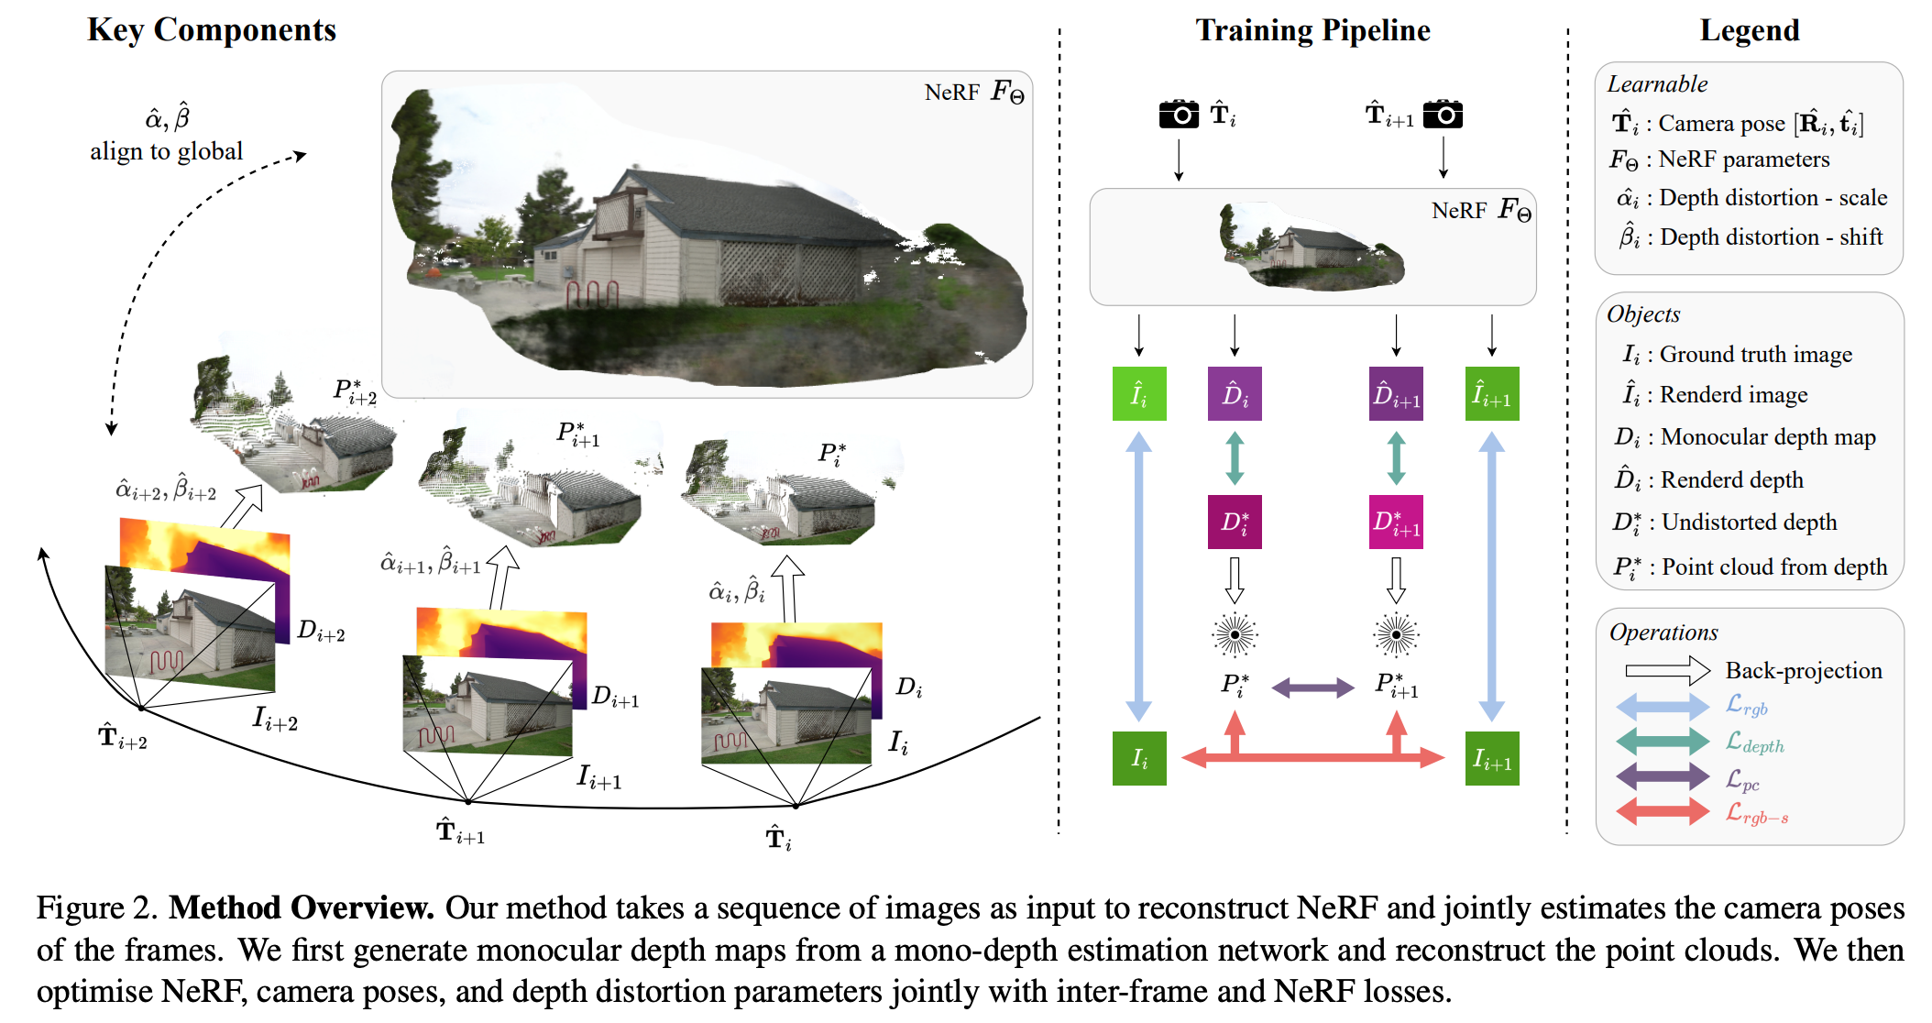
NeRF without calibration
W. Bian et al. NoPe-NeRF: Optimising Neural Radiance Field with No Pose Prior. CVPR 2023

Slide 30
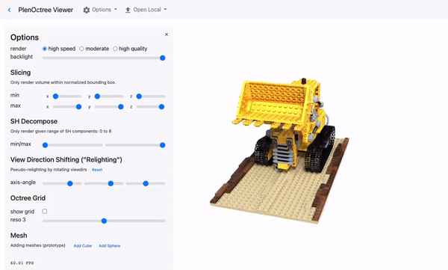
Fast Inference
PlenOctrees [Yu et al. ICCV’21]
SNeRG [Hedman et al. ICCV’21]
FastNeRF [Garbin et al. ICCV’21]
KiloNeRF [Reiser et al. ICCV’21]
AutoInt [Lindell et al. CVPR’21]
…
PlenOctrees [Yu et al. ICCV’21]

Slide 31
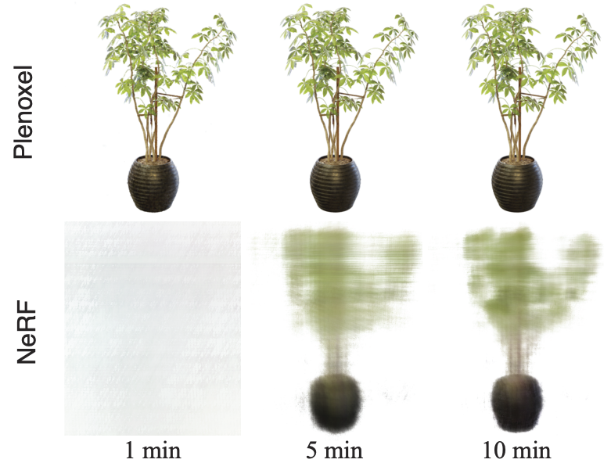
Fast inference: Plenoxels
S. Fridovich-Keil et al. Plenoxels: Radiance Fields without Neural Networks. CVPR 2022

Slide 32
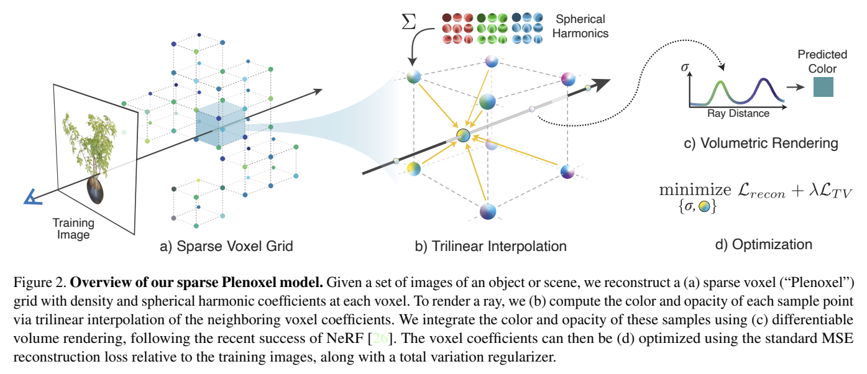
Fast inference: Plenoxels
S. Fridovich-Keil et al. Plenoxels: Radiance Fields without Neural Networks. CVPR 2022

Slide 33
Fast Inference
PlenOctrees [Yu et al. ICCV’21]
SNeRG [Hedman et al. ICCV’21]
FastNeRF [Garbin et al. ICCV’21]
KiloNeRF [Reiser et al. ICCV’21]
AutoInt [Lindell et al. CVPR’21]
…
PlenOctrees [Yu et al. ICCV’21]

Slide 34
Fast inference: Plenoxels
S. Fridovich-Keil et al. Plenoxels: Radiance Fields without Neural Networks. CVPR 2022

Slide 35
Fast inference: Plenoxels
S. Fridovich-Keil et al. Plenoxels: Radiance Fields without Neural Networks. CVPR 2022

Slide 36
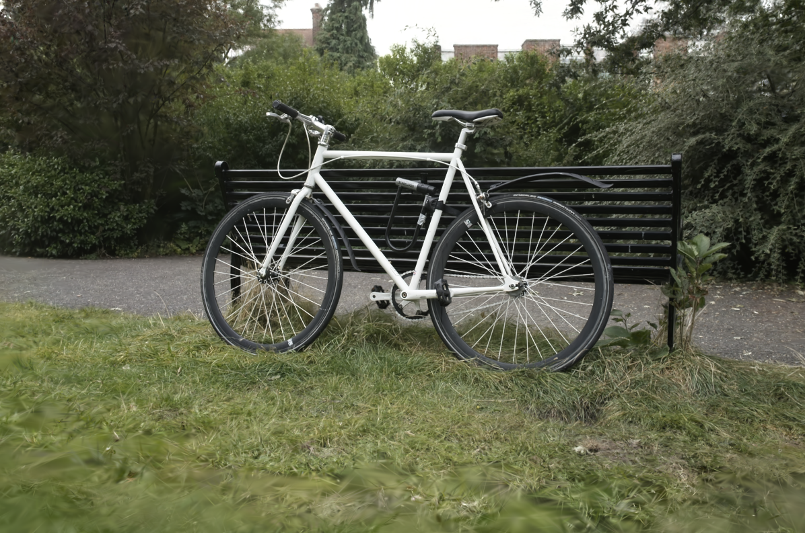
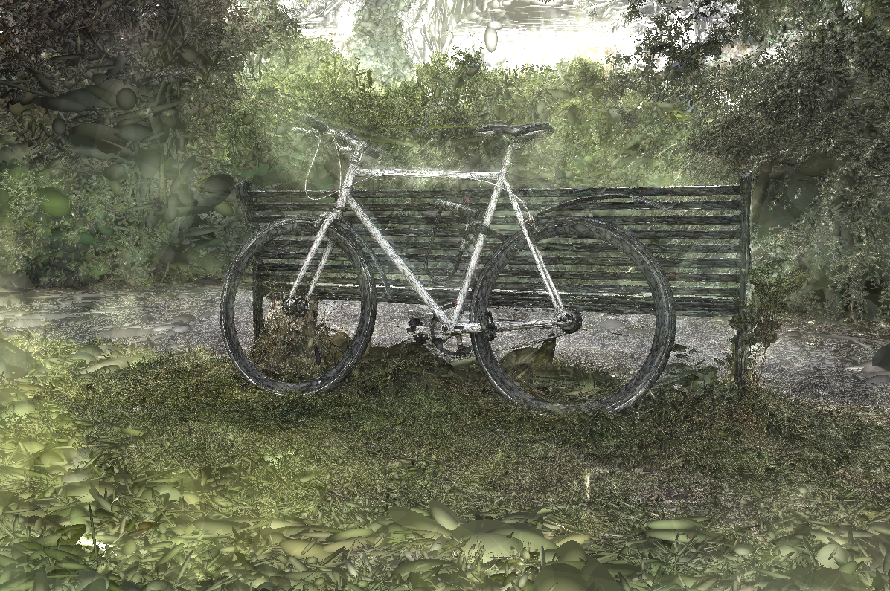
3D Gaussian splatting
Figure source
B. Kerbl et al. 3D Gaussian Splatting for Real-Time Radiance Field Rendering. SIGGRAPH 2023

Slide 37
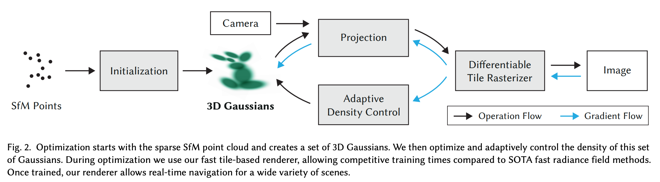
3D Gaussian splatting
B. Kerbl et al. 3D Gaussian Splatting for Real-Time Radiance Field Rendering. SIGGRAPH 2023

Slide 38
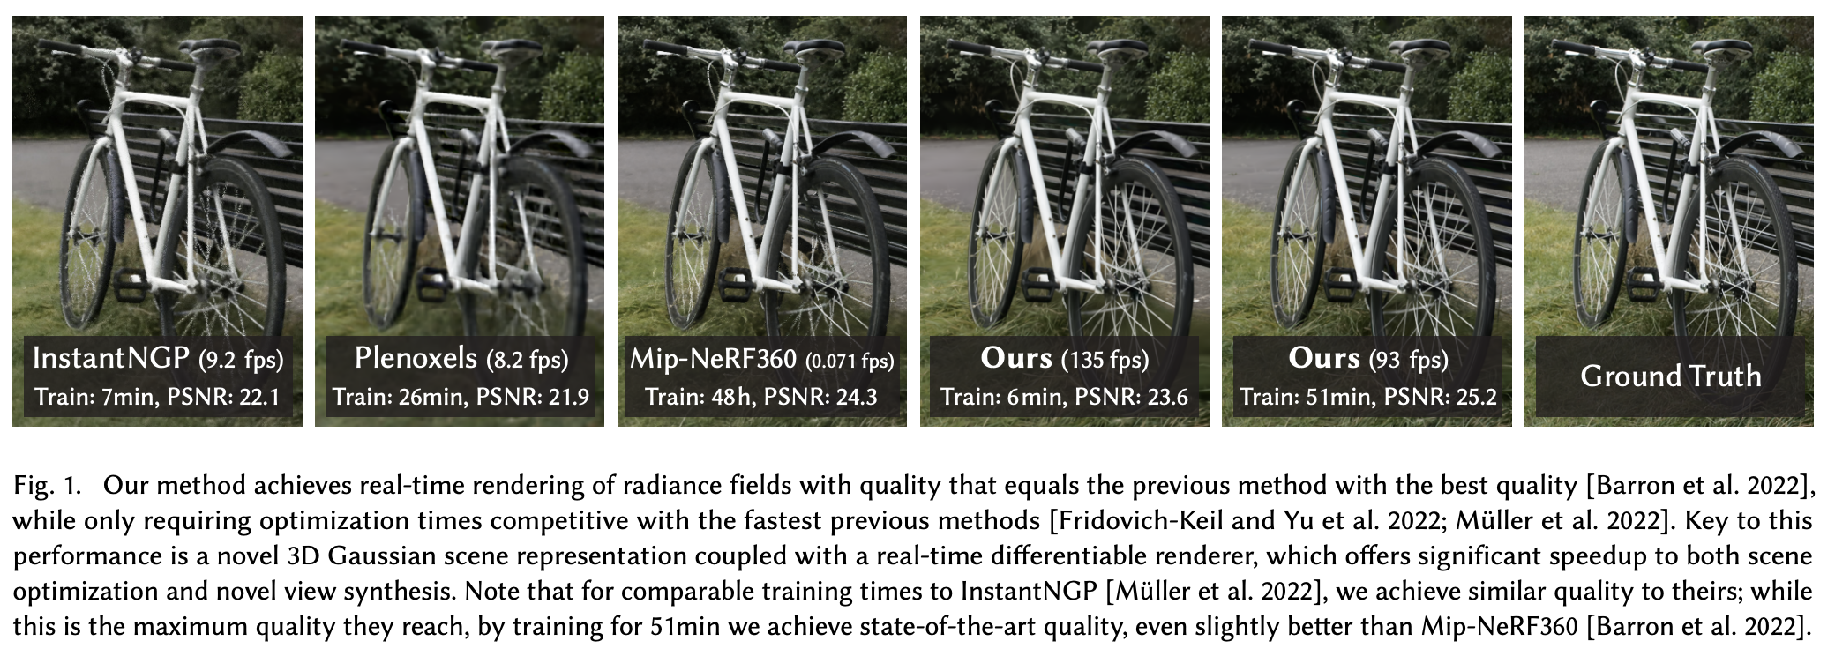
3D Gaussian splatting
B. Kerbl et al. 3D Gaussian Splatting for Real-Time Radiance Field Rendering. SIGGRAPH 2023

Slide 39
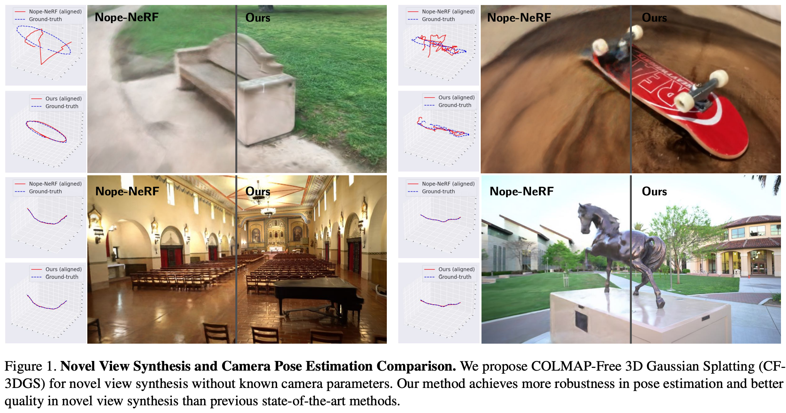
3D Gaussian splatting without calibration
Y. Fu et al. COLMAP-Free 3D Gaussian Splatting. CVPR 2024

Slide 40
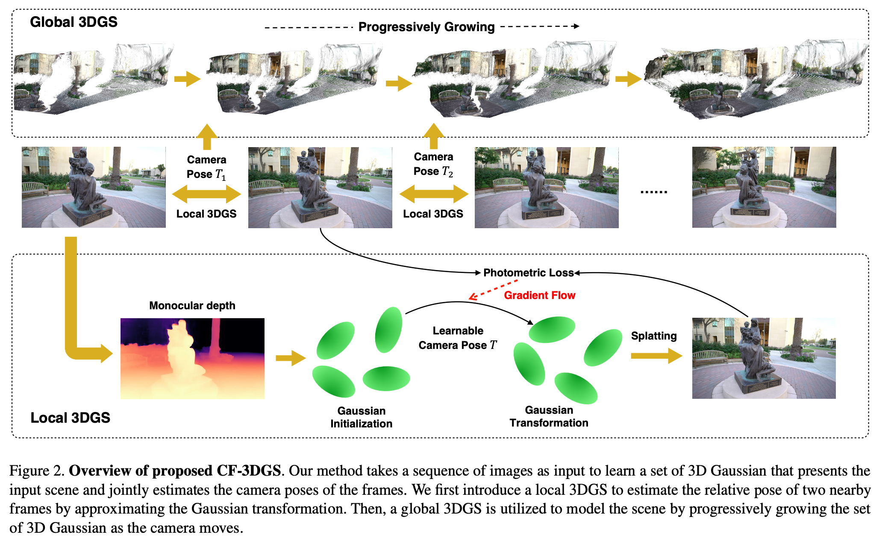
3D Gaussian splatting without calibration
Y. Fu et al. COLMAP-Free 3D Gaussian Splatting. CVPR 2024

Slide 41
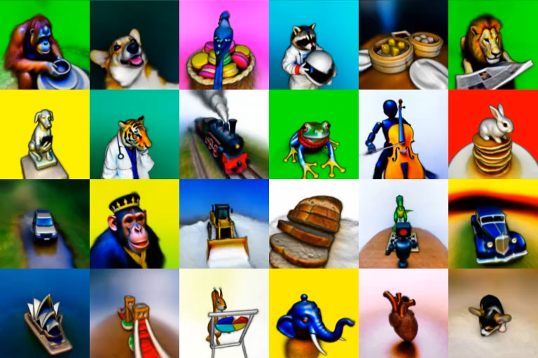
Text-to-NeRF generation
B. Poole, A. Jain, J. Barron, B. Mildenhall. DreamFusion: Text-to-3D using 2D Diffusion. ICLR 2023

Slide 42
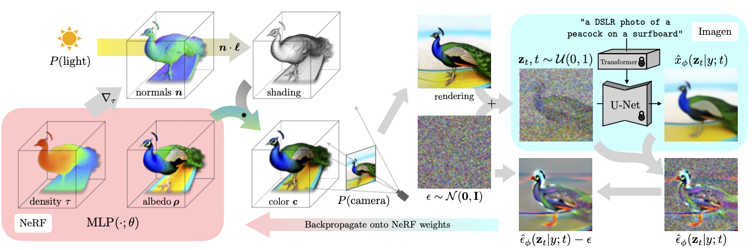
Text-to-NeRF generation
B. Poole, A. Jain, J. Barron, B. Mildenhall. DreamFusion: Text-to-3D using 2D Diffusion. ICLR 2023
Notes:
DreamFusion generates 3D objects from a natural language caption such as “a DSLR photo of a peacock on a surfboard.” The scene is represented by a Neural Radiance Field that is randomly initialized and trained from scratch for each caption. Our NeRF parameterizes volumetric density and albedo (color) with an MLP. We render the NeRF from a random camera, using normals computed from gradients of the density to shade the scene with a random lighting direction. Shading reveals geometric details that are ambiguous from a single viewpoint. To compute parameter updates, DreamFusion diffuses the rendering and reconstructs it with a (frozen) conditional Imagen model to predict the injected noise εˆφ(zt|y; t). This contains structure that should improve fidelity, but is high variance. Subtracting the injected noise produces a low variance update direction stopgrad[εˆφ − ε] that is backpropagated through the rendering process to update the NeRF MLP parameters.

Slide 43
Othe NeRF-related topics
https://github.com/yenchenlin/awesome-NeRF
Notes:
Summer of NeRF. This talk: developments of how things have been developing

