Slide 1
CS124
Introduction to Lab 2:
Logistic Regression
and
Text Classification

Slide 2
Why logistic regression?
Important analytic tool in social and health sciences when we are studying something that is a discrete variable.
Baseline supervised machine learning tool for classification
Foundation of neural networks

Slide 3
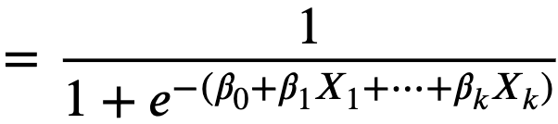
The duality: social/health sciences vs ML
In social sciences
  we care about weights (β) to tell us which factors matter
  don't care about the classification accuracy
In machine learning:
  we care about classification accuracy
  we don't care about the weights w

Slide 4
Neural networks and LLMs
Logistic regression is like a single neural unit
A neural net can be modeled as a set of logistic regression classifier chained together
Prediction in LLMs is based on softmax, generalization of the sigmoid to more than 2 output classes

Slide 5
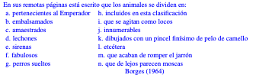
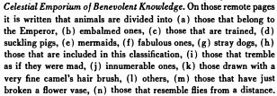
What can we classify? A lot!

Slide 6
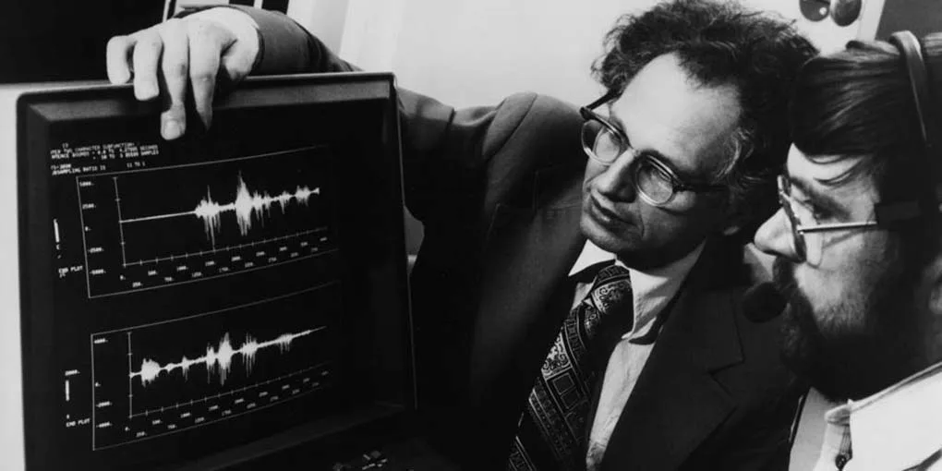
Historical story::
Logistic regression and early LLMs
1970s
IBM: world's leading speech recognition group
Predicting transcript using recently declassified statistical models

Slide 7
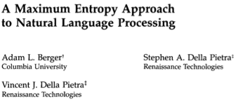
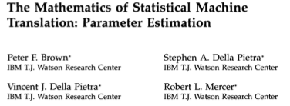
1990: They switch to text!
Reinvented logistic regression
Applied it as a classifier for machine translation

Slide 8
1992 IBM team switches to language modeling
They realize that a language model is just classifying the context into possible next words

Slide 9


1993, predicting more than words
Realized predicting words was like predicting the stock market.
Peter Brown, Robert Mercer, Stephen and Vincent della Pietra leave to join a tiny new hedge fund called Renaissance
Predict tiny changes in the market based on context
Became most successful fund in history

Slide 10
Today's Lab
Get solid intuitions about the sigmoid
  In addition to being the core of LR
  Sigmoid is also the basis of softmax, which is how LLMs produce probabilities
Get solid intuitions about gradient descent
Think about the ethics of classification, and especially about thresholds

Slide 11
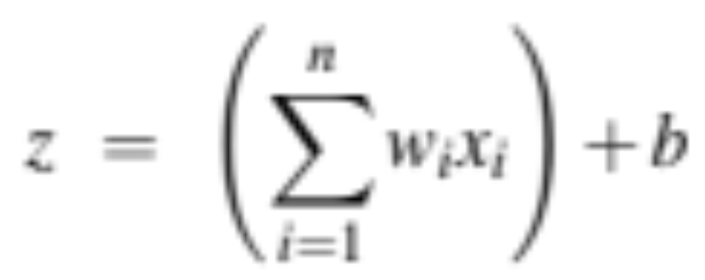
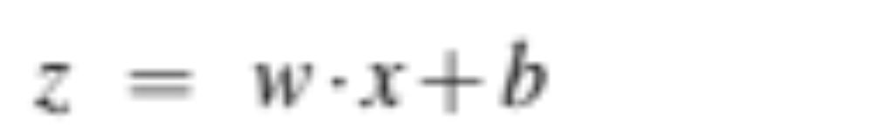
Reminder: Classification with sigmoid
Each feature x_{i} weight w_{i} tells us importance of x_{i}
Score: sum the weighted features and the bias
If this sum is high, we say y=1; if low, then y=0
Notes:
The bias term, also called the intercept, is another real number that’s added to the weighted inputs.
(We'll represent such sums using the dot product notation. The dot product of two vectors a and b, is the sum of the products of the corresponding elements of each vector.)

Slide 12
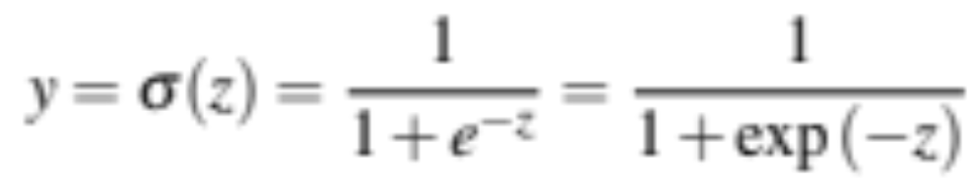
How to make a probability from z
Use a function of z that goes from 0 to 1
Notes:
Nothing forces z to be a legal probability, that is, to lie between 0 and 1. In fact, since weights are real-valued, the output might even be negative; z ranges from −∞ to ∞.

Slide 13
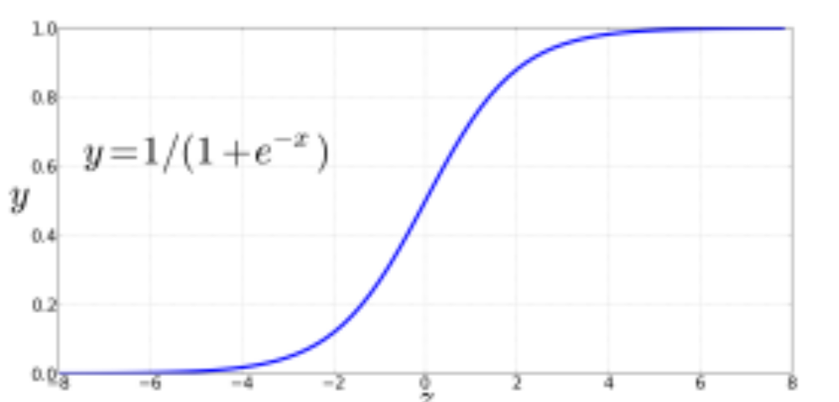
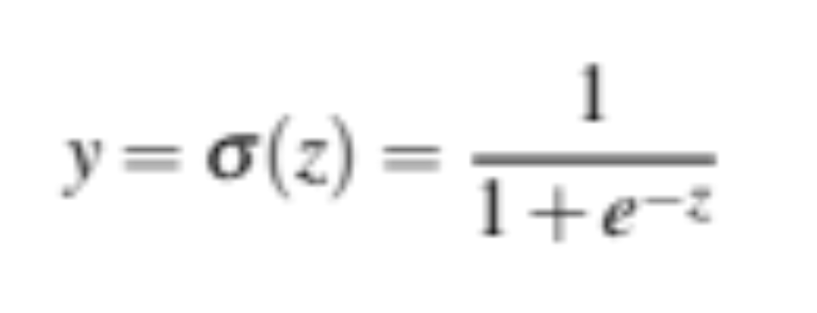
The very useful sigmoid or logistic function
Notes:
The sigmoid function The 1/1+e^-z (so-named because it looks like an s) is also called the logistic function. It takes a real value and maps it to the range [0, 1
It is nearly linear around 0 but outlier values get squashed toward 0 or 1.

Slide 14
Summary of logistic regression:
We compute w∙x+b
Pass it through sigmoid function:
σ(w∙x+b)
And we'll treat it as a probability

Slide 15
Turning a probability into a classifier
0.5 here is called the decision boundary

Slide 16
Reminder: gradient descent for learning weights

Slide 17
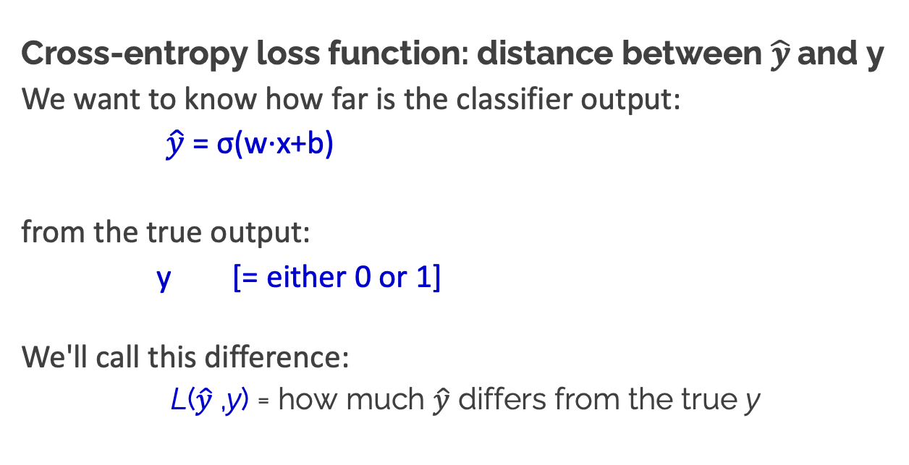
Reminder: gradient descent for learning weights
Cross-entropy loss function: distance between $\hat{y}$and y
We want to know how far is the classifier output:
$\hat{y}$= σ(w∙x+b)
from the true output:
y [= either 0 or 1]
We'll call this difference:
L($\hat{y}$,y) = how much $\hat{y}$ differs from the true y
Notes:
We need a loss function that expresses, for an observation x, how close the classifier output (yˆ = σ (w · x + b)) is to the correct output (y, which is 0 or 1).

Slide 18
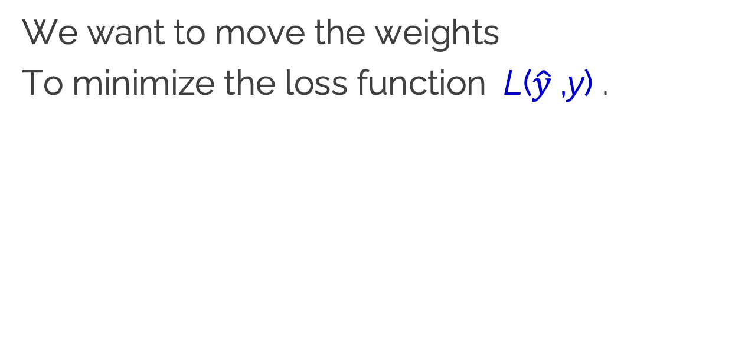
Goal of learning
We want to move the weights
To minimize the loss function L($\hat{y}$,y) .

Slide 19
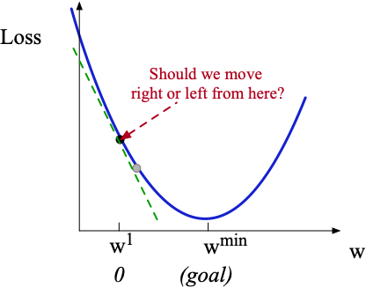
Let's visualize for a single scalar w
Q: Given current w, should we make it bigger or smaller?
A: Move w in the reverse direction from the slope of the function
Notes:
Although the algorithm (and the concept of gradient) are designed for direction vectors, let’s first consider a visualization of the case where the parameter of our system is just a single scalar w. Given a random initialization of w at some value w1, and assuming the loss function L happened to have this shape, we need the algorithm to tell us whether at the next iteration we should move left (making w2 smaller than w1) or right (making w2 bigger than w1) to reach the minimum. The gradient descent algorithm answers this question by finding the gradient of the loss function at the current point and moving in the opposite direction.

Slide 20
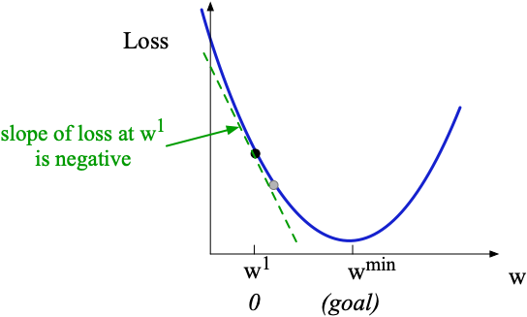
Let's visualize for a single scalar w
Q: Given current w, should we make it bigger or smaller?
A: Move w in the reverse direction from the slope of the function
  So we'll move positive
Notes:
The gradient of a function of many variables is a vector pointing in the direction of the greatest increase in a function. The gradient is a multi-variable generalization of the slope, so for a function of one variable like the one in this figure, we can informally think of the gradient as the slope. The dotted line shows the slope of this hypothetical loss function at point w = w1 . You can see that the slope of this dotted line is negative.

Slide 21
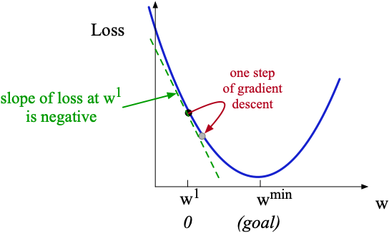
Let's visualize for a single scalar w
Q: Given current w, should we make it bigger or smaller?
A: Move w in the reverse direction from the slope of the function
  So we'll move positive
Notes:
Thus to find the minimum, gradient descent tells us to go in the opposite direction: moving w in a positive direction.

