Slide 1
Vector Semantics & Embeddings
Word Meaning
Notes:
Let's begin with some linguistic background on word meaning

Slide 2
What do words mean?
N-gram or text classification methods we've seen so far
  Words are just strings (or indices w_{i} in a vocabulary list)
  That's not very satisfactory!
Introductory logic classes:
  The meaning of "dog" is DOG; cat is CAT
  ∀x DOG(x) ⟶ MAMMAL(x)
Old linguistics joke by Barbara Partee in 1967:
  Q: What's the meaning of life?
  A: LIFE
That seems hardly better!
Notes:
How do we represent the meaning of words in NLP systems? in classical NLP applications, our only representation of a word is as a string of letters, or an index in a vocabulary list.
This representation is not that different from a tradition in philosophy, perhaps you’ve seen it in introductory logic classes, in which the meaning of words is represented by just spelling the word with small capital letters; representing the meaning of “dog” as DOG, and “cat” as CAT.
Representing the meaning of a word by capitalizing it is a pretty unsatisfactory model. You might have seen a joke due originally to semanticist Barbara Partee (Carlson, 1977):
Q: What’s the meaning of life? A: LIFE’
Surely we can do better than this

Slide 3
Desiderata
What should a theory of word meaning do for us?
Let's look at some desiderata
From lexical semantics, the linguistic study of word meaning

Slide 4
Lemmas and senses
lemma
mouse (N)
1. any of numerous small rodents...
2. a hand-operated device that controls a cursor...
sense
Modified from the online thesaurus WordNet
A sense or “concept” is the meaning component of a word
Lemmas can be polysemous (have multiple senses)

Slide 5
Relations between senses: Synonymy
Synonyms have the same meaning in some or all contexts.
  filbert / hazelnut
  couch / sofa
  big / large
  automobile / car
  vomit / throw up
  water / H₂0

Slide 6
Relations between senses: Synonymy
Note that there are probably no examples of perfect synonymy.
  Even if many aspects of meaning are identical
  Still may differ based on politeness, slang, register, genre, etc.

Slide 7
Relation: Synonymy?
  water/H₂0
  "H₂0" in a surfing guide?
  big/large
  my big sister != my large sister
Notes:
For example, the word H2O is used in scientific contexts and would be inappropriate in a surfing guide—water would be more appropriate— and this genre difference is part of the meaning of the word. In practice, the word synonym is therefore used to describe a relationship of approximate or rough synonymy.

Slide 8
The Linguistic Principle of Contrast
Difference in form → difference in meaning
Notes:
In practice, the word synonym is therefore used to describe a relationship of approximate or rough synonymy,

Slide 9
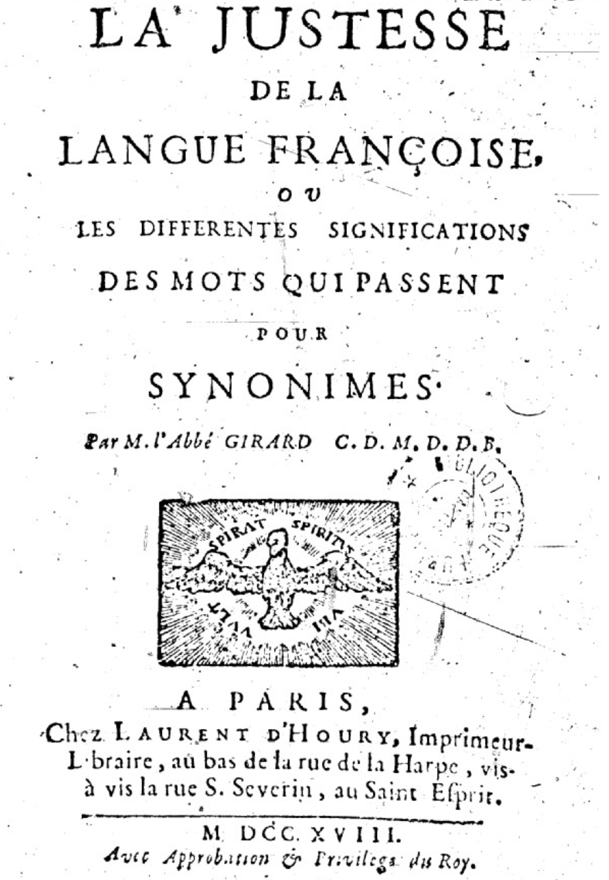
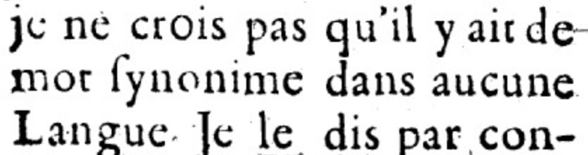
Abbé Gabriel Girard 1718
Re: "exact" synonyms
"
"
[I do not believe that there is a synonymous word in any language]
Thanks to Mark Aronoff!
Notes:
One of the fundamental tenets of semantics, called the principle of contrast, states that a difference in linguistic form is always associated with some difference in meaning.

Slide 10
Relation: Similarity
    Words with similar meanings. Not synonyms, but sharing some element of meaning
    car, bicycle
    cow, horse
Notes:
While words don’t have many synonyms, most words do have lots of similar words. Cat is not a synonym of dog, but cats and dogs are certainly similar words. The notion of word similarity is very useful in larger semantic tasks. Know- ing how similar two words are can help in computing how similar the meaning of two phrases or sentences are, a very important component of natural language un- derstanding tasks like question answering, paraphrasing, and summarization.

Slide 11
Ask humans how similar 2 words are
word1 | word2 | similarity
vanish | disappear | 9.8
behave | obey | 7.3
belief | impression | 5.95
muscle | bone | 3.65
modest | flexible | 0.98
hole | agreement | 0.3
SimLex-999 dataset (Hill et al., 2015)
Notes:
One way of getting values for word similarity is to ask humans to judge how similar one word is to another. A number of datasets have resulted from such experiments. For example the SimLex-999 dataset (Hill et al., 2015) gives values on a scale from 0 to 10, from near-synonyms (vanish, disappear) to pairs that scarcely seem to have anything in common (hole, agreement):

Slide 12
Relation: Word relatedness
Also called "word association"
Words can be related in any way, perhaps via a semantic frame or field
    coffee, tea: similar
    coffee, cup: related, not similar
Notes:
The meaning of two words can be related in ways other than similarity. One such class of connections is called word relatedness (Budanitsky
and Hirst, 2006), also traditionally called word association in psychology. Coffee is similar to tea. But coffee is not similar to cup; they share practically no features (coffee is a plant or a beverage, while a cup is a manufactured object with a particular shape). But coffee and cup are clearly related; they are associated by co-participating in an everyday event (the event of drinking coffee out of a cup). Similarly scalpel and surgeon are not similar but are related
eventively (a surgeon tends to make use of a scalpel).

Slide 13
Semantic field
Words that
  cover a particular semantic domain
  bear structured relations with each other.
  hospitals
  surgeon, scalpel, nurse, anaesthetic, hospital
  restaurants
  waiter, menu, plate, food, menu, chef
  houses
  door, roof, kitchen, family, bed
Notes:
One common kind of relatedness between words is if they belong to the same
semantic field. A semantic field is a set of words which cover a particular semantic domain and bear structured relations with each other. For example, words might be related by being in the semantic field of hospitals (surgeon, scalpel, nurse, anes- thetic, hospital), restaurants (waiter, menu, plate, food, chef), or houses (door, roof, kitchen, family, bed).

Slide 14
Relation: Antonymy
Senses that are opposites with respect to only one feature of meaning
Otherwise, they are very similar!
  dark/light short/long fast/slow rise/fall
  hot/cold up/down in/out
More formally: antonyms can
  define a binary opposition or be at opposite ends of a scale
    long/short, fast/slow
  Be reversives:
    rise/fall, up/down

Slide 15
Connotation (sentiment)
Words have affective meanings
  Positive connotations (happy)
  Negative connotations (sad)
Connotations can be subtle:
  Positive connotation: copy, replica, reproduction
  Negative connotation: fake, knockoff, forgery
Evaluation (sentiment!)
  Positive evaluation (great, love)
  Negative evaluation (terrible, hate)
Notes:
Finally, words have affective meanings or connotations. The word connotation has different meanings in different fields, but here we use it to mean the aspects of a word’s meaning that are related to a writer or reader’s emotions, sentiment, opinions, or evaluations. For example some words have positive conno- tations (happy) while others have negative connotations (sad). Even words whose meanings are similar in other ways can vary in connotation; consider the difference in connotations between fake, knockoff, forgery, on the one hand, and copy, replica, reproduction on the other
Some words describe positive evaluation (great, love) and others neg- ative evaluation (terrible, hate). Positive or negative evaluation language is called sentiment, as we saw already, and word sentiment plays a role in important tasks like sentiment analysis, stance detection, and applications of NLP to the lan- guage of politics and consumer reviews.

Slide 16
Connotation
Osgood et al. (1957)
Words seem to vary along 3 affective dimensions:
  valence: the pleasantness of the stimulus
  arousal: the intensity of emotion provoked by the stimulus
  dominance: the degree of control exerted by the stimulus
 | Word | Score |  | Word | Score
Valence | love | 1.000 |  | toxic | 0.008
 | happy | 1.000 |  | nightmare | 0.005
Arousal | elated | 0.960 |  | mellow | 0.069
 | frenzy | 0.965 |  | napping | 0.046
Dominance | powerful | 0.991 |  | weak | 0.045
 | leadership | 0.983 |  | empty | 0.081
Values from NRC VAD Lexicon (Mohammad 2018)
Notes:
Early work on affective meaning (Osgood et al., 1957) found that words varied along three important dimensions of affective meaning:

Slide 17
So far
Concepts or word senses
  Have a complex many-to-many association with words (homonymy, multiple senses)
Have relations with each other
  Synonymy
  Antonymy
  Similarity
  Relatedness
  Connotation

Slide 18
Vector Semantics & Embeddings
Word Meaning
Notes:
We've introduced some basic aspects of word meaning, which give us some desiderata for building a computational model.

Slide 19
Vector Semantics & Embeddings
Vector Semantics
Notes:
Here we introduce Vector Semantics, the standard way to represent word meaning in language processing

Slide 20
Computational models of word meaning
Can we build a theory of how to represent word meaning, that accounts for at least some of the desiderata?
We'll introduce vector semantics
The standard model in language processing!
Handles many of our goals!
Notes:
Vector semantics is the standard way to represent word meaning in NLP, helping us model many of the aspects of word meaning we saw in the previous section. The roots of the model lie in the 1950s when two big ideas converged:

Slide 21
Ludwig Wittgenstein
PI #43:
  "The meaning of a word is its use in the language"
Notes:
The first draws on the philosopher Wittgenstein's idea that the meaning of a word should be tied to how it is used

Slide 22
Let's define words by their usages
One way to define "usage":
words are defined by their environments (the words around them)
Zellig Harris (1954):
If A and B have almost identical environments we say that they are synonyms.
Notes:
linguists like Joos (1950), Harris (1954), and Firth (1957) had the related idea of defining the meaning of a word by its distribution in language use, meaning its neighboring words or grammatical environments.

Slide 23
What does recent English borrowing ongchoi mean?
Suppose you see these sentences:
  Ong choi is delicious sautéed with garlic.
  Ong choi is superb over rice
  Ong choi leaves with salty sauces
And you've also seen these:
  …spinach sautéed with garlic over rice
  Chard stems and leaves are delicious
  Collard greens and other salty leafy greens
Conclusion:
  Ongchoi is a leafy green like spinach, chard, or collard greens
    We could conclude this based on words like "leaves" and "delicious" and "sauteed"
Notes:
For example, suppose you didn’t know the meaning of the word ongchoi (a recent borrowing from Cantonese) but you see it in the following contexts:
…
We can do the same thing computationally by just counting words in the context of ongchoi.

Slide 24
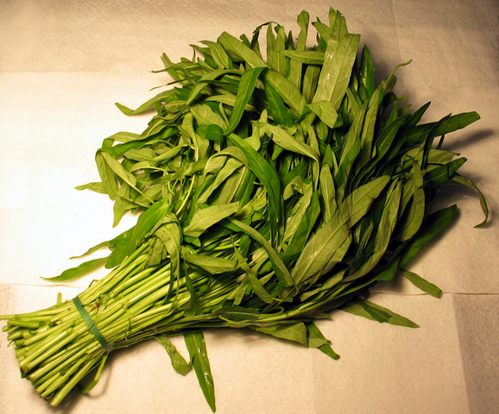
Ongchoi: Ipomoea aquatica "Water Spinach"
空心菜
kangkong
rau muống
…
Yamaguchi, Wikimedia Commons, public domain
Notes:
Here's a picture of ongchoi for you food fans

Slide 25
Idea 1: Defining meaning by linguistic distribution
Let's define the meaning of a word by its distribution in language use, meaning its neighboring words or grammatical environments.
Notes:
So we can express this first intuition as Idea 1:

Slide 26
Idea 2: Meaning as a point in space (Osgood et al. 1957)
3 affective dimensions for a word
  valence: pleasantness
  arousal: intensity of emotion
  dominance: the degree of control exerted
Hence the connotation of a word is a vector in 3-space
 | Word | Score |  | Word | Score
Valence | love | 1.000 |  | toxic | 0.008
 | happy | 1.000 |  | nightmare | 0.005
Arousal | elated | 0.960 |  | mellow | 0.069
 | frenzy | 0.965 |  | napping | 0.046
Dominance | powerful | 0.991 |  | weak | 0.045
 | leadership | 0.983 |  | empty | 0.081
NRC VAD Lexicon
(Mohammad 2018)
Notes:
And the second idea is Osgood’s (1957) idea mentioned in the prior lecture, in which the connotation of a word is represented by 3 numbers, it's valence, arousal, and dominance. That means we are essentially representing a word's connotation by a point in three-dimensional space! But suppose we represent more than just a word's connotation

Slide 27
Idea 1: Defining meaning by linguistic distribution
Idea 2: Meaning as a point in multidimensional space
Notes:
So we're going to combine these two ideas:

Slide 28
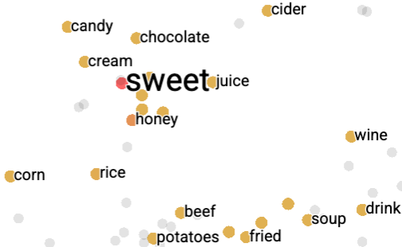
Defining meaning as a point in space based on distribution
Each word = a vector (not just "good" or "w₄₅")
Similar words are "nearby in semantic space"
We build this space automatically by seeing which words are nearby in text
Notes:
In vector semantics, we define meaning as a point in space based on distribution. Each word is a vector, not just a string like "good" or an index like "w_45". Similar words are nearby in semantic space, and, crucially, as we'll see, we build this space automatically by seeing which words are nearby in text. Here we see shows a visualization of embeddings learned for sentiment analysis, showing the location of selected words projected down from 60-dimensional space into a two dimensional space. Notice the distinct regions containing positive words, negative words, and neutral function words.

Slide 29
We define meaning of a word as a vector
Called an "embedding" because it's embedded into a space (see textbook)
The standard way to represent meaning in NLP
Every modern NLP algorithm uses embeddings as the representation of word meaning
Fine-grained model of meaning for similarity

Slide 30
Intuition: why vectors?
Consider sentiment analysis:
  With words, a feature is a word identity
    Feature 5: 'The previous word was "terrible"'
    requires exact same word to be in training and test
  With embeddings:
    Feature is a word vector
    'The previous word was vector [35,22,17…]
    Now in the test set we might see a similar vector [34,21,14]
    We can generalize to similar but unseen words!!!

Slide 31
We'll discuss 2 kinds of embeddings
Simple count embeddings
  Sparse vectors
  Words are represented by the counts of nearby words
  Later for information retrieval we'll augment this model to create the tf-idf model of weighting those counts.
Word2vec
  Dense vectors
  Representation is created by training a classifier to predict whether a word is likely to appear nearby
  Later we'll discuss extensions called contextual embeddings

Slide 32
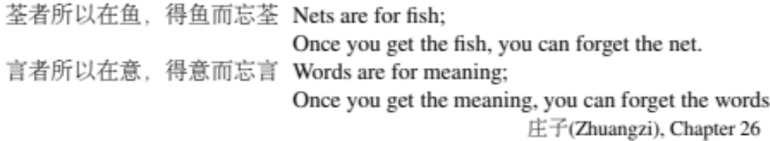
From now on:
Computing with meaning representations instead of string representations

Slide 33
Vector Semantics & Embeddings
Vector Semantics

Slide 34
Vector Semantics & Embeddings
Count-based embeddings
Notes:
Let's talk about how to represent words as simple vectors of context counts

Slide 35
Remember the intuition: words with similar neighborhoods have similar meanings
How to measure a word's neighborhood?
Word-context matrix (a kind of co-occurrence matrix)
  each row represents a word in the vocabulary
  each column represents how often each other word in the vocabulary appears nearby

Slide 36
Word-Context Matrix
aardvark
abacus
adept
affect
agate
…
zydeco
How often does
agate occur near abacus?
aardvark
abacus
adept
affect
agate
…
zydeco

Slide 37
Word-Context Matrix
What does "nearby" mean?
For right now let's say "within 4 words"

Slide 38
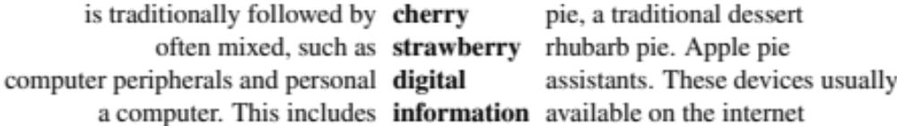
The word-context matrix
One set of 4-word contexts
Notes:
An alternative to using the term-document matrix to represent words as vectors of document counts, is to use the term-term matrix, also called the word-word matrix or the term-context matrix, in which the columns are labeled by words rather than documents. This matrix is thus of dimensionality |V | × |V | and each cell records the number of times the row (target) word and the column (context) word co-occur in some context in some training corpus.
The context could be the document, in which case the cell represents the number of times the two words appear in the same document. It is most common, however, to use smaller contexts, generally a window around the word, for example of 4 words to the left and 4 words to the right, in which case the cell represents the number of times (in some training corpus) the column word occurs in such a ±4 word window around the row word. For example here is one example each of some words in their windows with counts from a Wikipedia corpus. Note that digital and information are more similar to each other than, say, to strawberry.

Slide 39
Let's consider a mini-matrix of 3 words.
How often do "a", "computer", and "pie occur in the context of "cherry"?
Notes:
An alternative to using the term-document matrix to represent words as vectors of document counts, is to use the term-term matrix, also called the word-word matrix or the term-context matrix, in which the columns are labeled by words rather than documents. This matrix is thus of dimensionality |V | × |V | and each cell records the number of times the row (target) word and the column (context) word co-occur in some context in some training corpus.
The context could be the document, in which case the cell represents the number of times the two words appear in the same document. It is most common, however, to use smaller contexts, generally a window around the word, for example of 4 words to the left and 4 words to the right, in which case the cell represents the number of times (in some training corpus) the column word occurs in such a ±4 word window around the row word. For example here is one example each of some words in their windows with counts from a Wikipedia corpus. Note that digital and information are more similar to each other than, say, to strawberry.

Slide 40

The word-context mini-matrix for just 4 words and 3 contexts
Notes:
An alternative to using the term-document matrix to represent words as vectors of document counts, is to use the term-term matrix, also called the word-word matrix or the term-context matrix, in which the columns are labeled by words rather than documents. This matrix is thus of dimensionality |V | × |V | and each cell records the number of times the row (target) word and the column (context) word co-occur in some context in some training corpus.
The context could be the document, in which case the cell represents the number of times the two words appear in the same document. It is most common, however, to use smaller contexts, generally a window around the word, for example of 4 words to the left and 4 words to the right, in which case the cell represents the number of times (in some training corpus) the column word occurs in such a ±4 word window around the row word. For example here is one example each of some words in their windows with counts from a Wikipedia corpus. Note that digital and information are more similar to each other than, say, to strawberry.

Slide 41
The word-context mini-matrix for just 4 words and 3 contexts
This 4x3 matrix is a subset of full |V| x |V| matrix
Each word is represented by a row vector with dimensionality [1 x |V|]
With co-occurrence counts with each other word
Notes:
An alternative to using the term-document matrix to represent words as vectors of document counts, is to use the term-term matrix, also called the word-word matrix or the term-context matrix, in which the columns are labeled by words rather than documents. This matrix is thus of dimensionality |V | × |V | and each cell records the number of times the row (target) word and the column (context) word co-occur in some context in some training corpus.
The context could be the document, in which case the cell represents the number of times the two words appear in the same document. It is most common, however, to use smaller contexts, generally a window around the word, for example of 4 words to the left and 4 words to the right, in which case the cell represents the number of times (in some training corpus) the column word occurs in such a ±4 word window around the row word. For example here is one example each of some words in their windows with counts from a Wikipedia corpus. Note that digital and information are more similar to each other than, say, to strawberry.

Slide 42
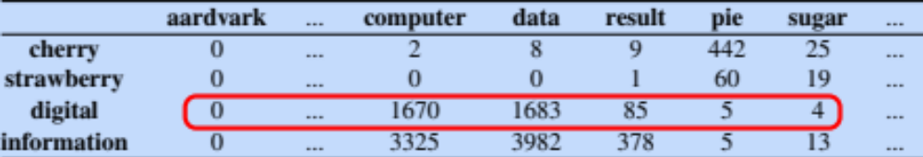
A selection from a larger word-context matrix
Notes:
An alternative to using the term-document matrix to represent words as vectors of document counts, is to use the term-term matrix, also called the word-word matrix or the term-context matrix, in which the columns are labeled by words rather than documents. This matrix is thus of dimensionality |V | × |V | and each cell records the number of times the row (target) word and the column (context) word co-occur in some context in some training corpus.
The context could be the document, in which case the cell represents the number of times the two words appear in the same document. It is most common, however, to use smaller contexts, generally a window around the word, for example of 4 words to the left and 4 words to the right, in which case the cell represents the number of times (in some training corpus) the column word occurs in such a ±4 word window around the row word. For example here is one example each of some words in their windows with counts from a Wikipedia corpus. Note that digital and information are more similar to each other than, say, to strawberry.

Slide 43
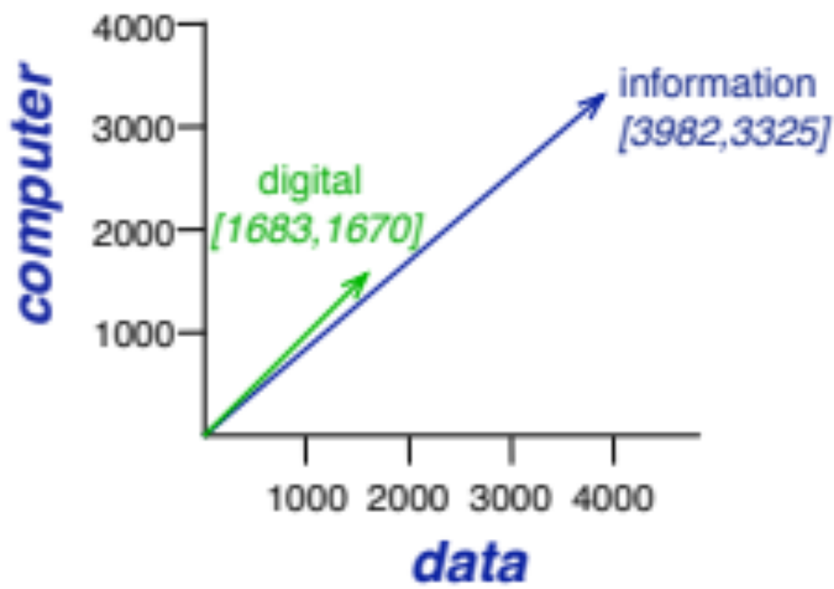
Notes:
Here's a spatial visualization of word vectors for digital and information, showing just two of the dimensions, corresponding to the words data and computer.
Of course in real life these vectors aren't just of length 2. |V |, the length of the vector, is generally the size of the vocabulary, of- ten between 10,000 and 50,000 words (using the most frequent words in the training corpus; keeping words after about the most frequent 50,000 or so is generally not helpful). Since most of these numbers are zero these are sparse vector representations; there are efficient algorithms for storing and computing with sparse matrices.

Slide 44
The word-context matrix
Word context matrix is |V| x |V|
This could be 50,000 x 50,000
Most of these numbers are zero!
So these are sparse vectors
There are efficient algorithms for storing and computing with sparse matrices

Slide 45
Vector Semantics & Embeddings
Count-based embeddings
Notes:
Let's talk about how to represent words as simple vectors of context counts

Slide 46
Vector Semantics & Embeddings
Cosine for computing word similarity
Notes:
. To measure similarity between two words, we need a metric that compares two vectors. By far the most common similarity metric is the cosine of the angle between the vectors.

Slide 47
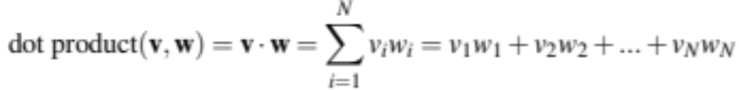
Computing word similarity: Dot product and cosine
The dot product between two vectors is a scalar:
The dot product tends to be high when the two vectors have large values in the same dimensions
Dot product can thus be a useful similarity metric between vectors
Notes:
The cosine—like most measures for vector similarity used in NLP—is based on the dot product operator from linear algebra, also called the inner product in which we multiply the vectors elementwise and add up to get a scalar value. The dot product acts as a similarity metric because it will tend to be high just when the two vectors have large values in the same dimensions. Alternatively, vectors that have zeros in different dimensions—orthogonal vectors—will have a dot product of 0, representing their strong dissimilarity.

Slide 48
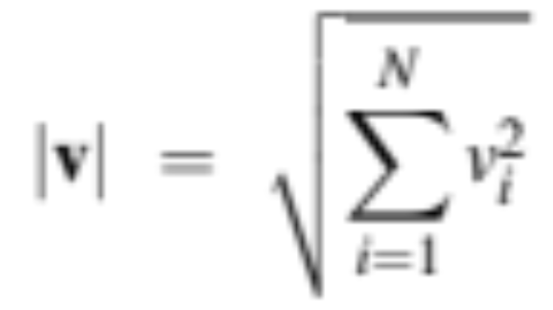
Problem with raw dot-product
Dot product favors long vectors
Dot product is higher if a vector is longer (has higher values in many dimension)
Vector length:
Frequent words (of, the, you) have long vectors (since they occur many times with other words).
So dot product overly favors frequent words
Notes:
This raw dot product, however, has a problem as a similarity metric: it favors long vectors. The vector length is defined as the square root of the sum of the square of the values
The dot product is higher if a vector is longer, with higher values in each dimension. More frequent words have longer vectors, since they tend to co-occur with more words and have higher co-occurrence values with each of them. The raw dot product thus will be higher for frequent words. But this is a problem; we’d like a similarity metric that tells us how similar two words are regardless of their frequency.

Slide 49
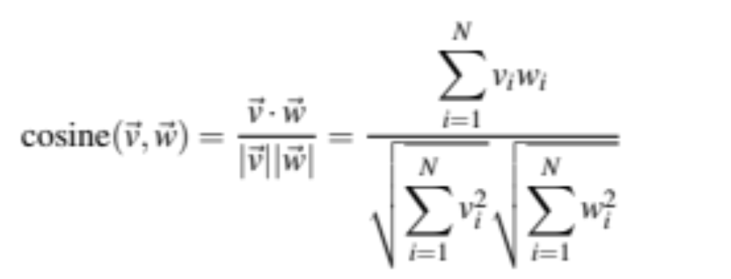
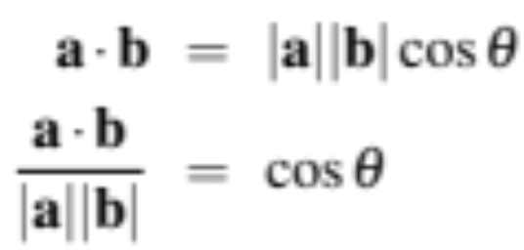
Alternative: cosine for computing word similarity
Based on the definition of the dot product between two vectors a and b
Notes:
We modify the dot product to normalize for the vector length by dividing the dot product by the lengths of each of the two vectors. This normalized dot product turns out to be the same as the cosine of the angle between the two vectors (Geometrically, it is the product of the Euclidean magnitudes of the two vectors and the cosine of the angle between them).

Slide 50
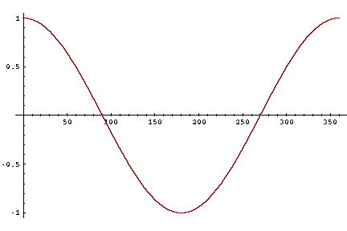
Cosine as a similarity metric
-1: vectors point in opposite directions
+1: vectors point in same directions
0: vectors are orthogonal
But since raw frequency values are non-negative, the cosine for term-term matrix vectors ranges from 0–1
Notes:
The cosine value ranges from 1 for vectors pointing in the same direction, through 0 for orthogonal vectors, to -1 for vectors pointing in opposite directions. But since raw frequency values are non-negative, the cosine for these vectors ranges from 0–1.

Slide 51
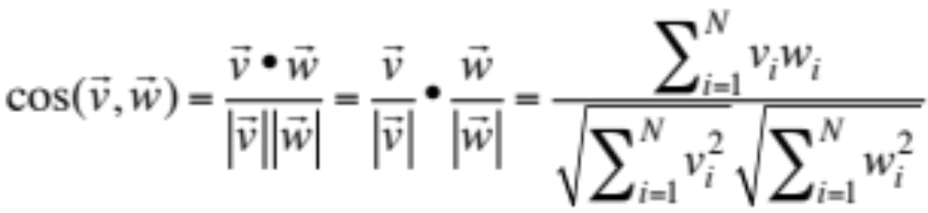
Cosine examples
 | pie | data | computer
cherry | 442 | 8 | 2
digital | 5 | 1683 | 1670
information | 5 | 3982 | 3325
Notes:
Let’s see how the cosine computes which of the words cherry or digital is closer in meaning to information, just using raw counts from the following shortened table.
The model decides that information is way closer to digital than it is to cherry, a result that seems sensible.

Slide 52
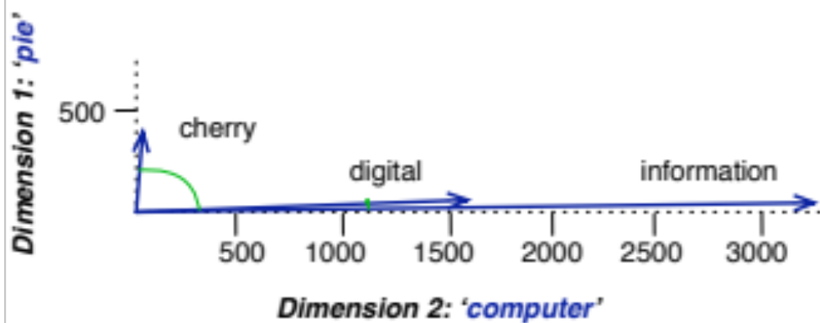
Visualizing cosines
(well, angles)
Notes:
Here's a rough graphical demonstration of cosine similarity, showing vectors for the words cherry, digital, and information in the two dimensional space defined by counts of the words computer and pie nearby. Note that the angle between digital and information is smaller than the angle between cherry and information. When two vectors are more similar, the cosine is larger but the angle is smaller; the cosine has its maximum (1) when the angle between two vectors is smallest (0◦); the cosine of all other angles is less than 1.

Slide 53
Vector Semantics & Embeddings
Cosine for computing word similarity
Notes:
We've seen in detail the vector cosine, the most common algorithm for computing word similarity.

Slide 54
Vector Semantics & Embeddings
Word2vec
Notes:
Let's now introduce the important word2vec embeddings.

Slide 55
Sparse versus dense vectors
Count vectors (even if weighted by tf-idf)
  long (length |V|= 20,000 to 50,000)
  sparse (most elements are zero)
Alternative: learn vectors which are
  short (length 50-1000)
  dense (most elements are non-zero)
Notes:
In the previous lectures we saw how to represent a word as a sparse, long vector with dimensions corresponding to words in the vocabulary or documents in a collection. We now introduce a more powerful word representation: embeddings, short dense vectors. Unlike the vectors we’ve seen so far, embeddings are short, with number of dimensions d ranging from 50-1000, rather than the much larger vocabulary size |V | or number of documents D we’ve seen. These d dimensions don’t have a clear interpretation. And the vectors are dense: instead of vector entries being sparse, mostly-zero counts or functions of counts, the values will be real-valued numbers that can be negative.

Slide 56
Sparse versus dense vectors
Why dense vectors?
  Short vectors may be easier to use as features in machine learning (fewer weights to tune)
  Dense vectors may generalize better than explicit counts
  Dense vectors may do better at capturing synonymy:
    car and automobile are synonyms; but are distinct dimensions
      a word with car as a neighbor and a word with automobile as a neighbor should be similar, but aren't
  In practice, they work better
Notes:
It turns out that dense vectors work better in every NLP task than sparse vectors. While we don’t completely understand all the reasons for this, we have some intu- itions. Representing words as 700-dimensional dense vectors requires our classifiers to learn far fewer weights than if we represented words as 50,000-dimensional vec- tors, and the smaller parameter space possibly helps with generalization and avoid- ing overfitting. Dense vectors may also do a better job of capturing synonymy. For example, in a sparse vector representation, dimensions for synonyms like car and automobile dimension are distinct and unrelated; sparse vectors may thus fail to capture the similarity between a word with car as a neighbor and a word with automobile as a neighbo

Slide 57
Common methods for getting short dense vectors
“Neural Language Model”-inspired models
  Word2vec (skipgram, CBOW), GloVe
Singular Value Decomposition (SVD)
  A special case of this is called LSA – Latent Semantic Analysis
Alternative to these "static embeddings":
  Contextual Embeddings (ELMo, BERT)
  Compute distinct embeddings for a word in its context
  Separate embeddings for each token of a word
Notes:
In this section we introduce one method for computing embeddings: skip-gram with negative sampling, sometimes called SGNS. The skip-gram algorithm is one of two algorithms in a software package called word2vec, and so sometimes the al- gorithm is loosely referred to as word2vec. The word2vec methods are fast, efficient to train, and easily available online with code and pretrained embeddings. Word2vec embeddings are static embeddings, meaning that the method learns one fixed embedding for each word in the vocabulary. An lternative to these static embeddings are more recent methods for learning dynamic contextual em-beddings like the popular BERT representations, in which the vector for each word is different in different contexts.

Slide 58
Simple static embeddings you can download!
Word2vec (Mikolov et al)
https://code.google.com/archive/p/word2vec/
GloVe (Pennington, Socher, Manning)
http://nlp.stanford.edu/projects/glove/

Slide 59
Word2vec
Popular embedding method
Very fast to train
Code available on the web
Idea: predict rather than count
Word2vec provides various options. We'll do:
skip-gram with negative sampling (SGNS)

Slide 60
Word2vec
Instead of counting how often each word w occurs near "apricot"
  Train a classifier on a binary prediction task:
    Is w likely to show up near "apricot"?
We don’t actually care about this task
    But we'll take the learned classifier weights as the word embeddings
Big idea: self-supervision:
    A word c that occurs near apricot in the corpus cats as the gold "correct answer" for supervised learning
    No need for human labels
    Bengio et al. (2003); Collobert et al. (2011)
Notes:
The intuition of word2vec is that instead of counting how often each word w oc- curs near, say, apricot, we’ll instead train a classifier on a binary prediction task: “Is word w likely to show up near apricot?” We don’t actually care about this prediction task; instead we’ll take the learned classifier weights as the word embeddings. The revolutionary intuition here is that we can just use running text as implicitly supervised training data for such a classifier; a word c that occurs near the target word apricot acts as gold ‘correct answer’ to the question “Is word c likely to show up near apricot?” This method, often called self-supervision, avoids the need for any sort of hand-labeled supervision signal. This idea was first proposed in the task of neural language modeling, when Bengio et al. (2003) and Collobert et al. (2011) showed that a neural language model (a neural network that learned to predict the next word from prior words) could just use the next word in running text as its supervision signal, and could be used to learn an embedding representation for each word as part of doing this prediction task. word2vec is a much simpler model than the neural network language model, in two ways. First, word2vec simplifies the task (making it binary classification instead of word pre- diction). Second, word2vec simplifies the architecture (training a logistic regression classifier instead of a multi-layer neural network with hidden layers that demand more sophisticated training algorithms)

Slide 61
Approach: predict if candidate word c is a "neighbor"
Treat the target word t and a neighboring context word c as positive examples.
Randomly sample other words in the lexicon to get negative examples
Use logistic regression to train a classifier to distinguish those two cases
Use the learned weights as the embeddings
Notes:
The intuition of skip-gram is:

Slide 62
Skip-Gram Training Data
Assume a +/- 2 word window, given training sentence:
  …lemon, a [tablespoon of apricot jam, a] pinch…
c1 c2 c3 c4
[target]
Notes:
Let’s start by thinking about the classification task, and then turn to how to train. Imagine a sentence like the following, with a target word apricot, and assume we’re using a window of ±2 context words:

Slide 63
Skip-Gram Classifier
(assuming a +/- 2 word window)
  …lemon, a [tablespoon of apricot jam, a] pinch…
c1 c2 [target] c3 c4
Goal: train a classifier that is given a candidate (word, context) pair
(apricot, jam)
(apricot, aardvark)
…
And assigns each pair a probability:
P(+|w, c)
P(−|w, c) = 1 − P(+|w, c)
Notes:
Our goal is to train a classifier such that, given a tuple (w,c) of a target word w paired with a candidate context word c (for example (apricot, jam), or perhaps (apricot, aardvark)) it will return the probability that c is a real context word (true for jam, false for aardvark):
The probability that word c is not a real context word for w is just 1 minus

Slide 64
Similarity is computed from dot product
Remember: two vectors are similar if they have a high dot product
  Cosine is just a normalized dot product
So:
  Similarity(w,c) ∝ w ∙ c
We’ll need to normalize to get a probability
  (cosine isn't a probability either)
Notes:
he intuition of the skip- gram model is to base this probability on embedding similarity: a word is likely to occur near the target if its embedding is similar to the target embedding. To compute similarity between these dense embeddings, we rely on the intuition that two vectors are similar if they have a high dot product (after all, cosine is just a normalized dot product). In other words: Similarity(w,c) ∝ w ∙ c

Slide 65
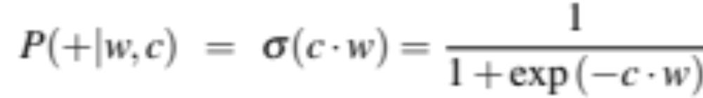
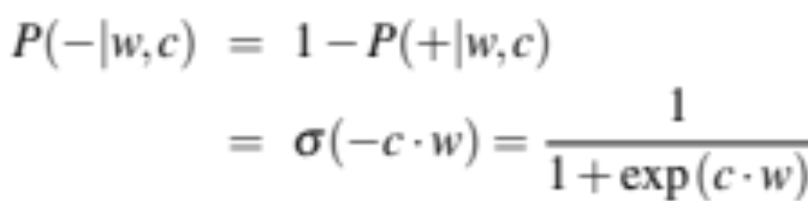
Turning dot products into probabilities
Sim(w,c) ≈ w ∙ c
To turn this into a probability
We'll use the sigmoid from logistic regression:
Notes:
The dot product c · w is not a probability, it’s just a number ranging from −∞ to ∞ (since the elements in word2vec embeddings can be negative, the dot product can be negative). To turn the dot product into a probability, we’ll use the logistic or sigmoid function σ (x) from logistic regression
We model the probability that word c is a real context word for target word w as:
to make it a probability we’ll also need the total probability of the two possible events (c is a context word, and c isn’t a context word) to sum to 1. We thus estimate the probability that word c is not a real context word for w as:

Slide 66
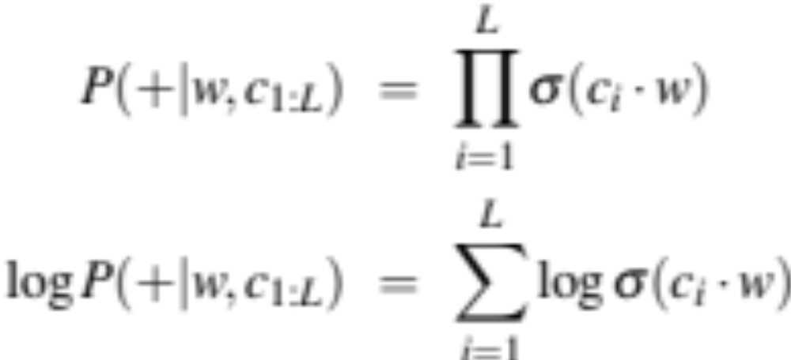
How Skip-Gram Classifier computes P(+|w, c)
This is for one context word, but we have lots of context words.
We'll assume independence and just multiply them:
Notes:
This equation gives us the probability for one word, but there are many context words in the window. Skip-gram makes the simplifying assumption that all context words are independent, allowing us to just multiply their probabilities:

Slide 67
Skip-gram classifier: summary
A probabilistic classifier, given
  a test target word w
  its context window of L words c_{1:L}
Estimates probability that w occurs in this window based on similarity of w (embeddings) to c_{1:L} (embeddings).
To compute this, we just need embeddings for all the words.
Notes:
In summary, skip-gram trains a probabilistic classifier that, given a test target word w and its context window of L words c1:L, assigns a probability based on how similar this context window is to the target word. The probability is based on applying the logistic (sigmoid) function to the dot product of the embeddings of the target word with each context word. To compute this probability, we just need embeddings for each target word and context word in the vocabulary.

Slide 68
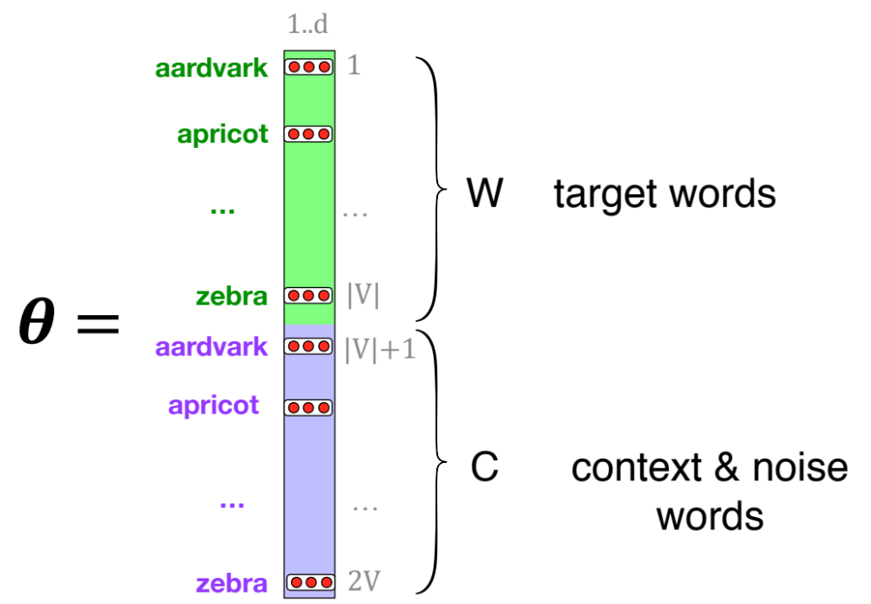
These embeddings we'll need: a set for w, a set for c
Notes:
Here's the intuition of parameters we’ll need. Skip-gram actually stores two embeddings for each word, one for the word as a target, and one for the word considered as context. Thus the parameters we need to learn are two matrices W and C, each containing an embedding for every one of the |V | words in the vocbulary

Slide 69
Vector Semantics & Embeddings
Word2vec
Notes:
We've seen how the skipgram classifier functions. In the next section we'll turn to learning its weights, which is the goal of building the classifier

Slide 70
Vector Semantics & Embeddings
Word2vec: Learning the embeddings
Notes:
Let's see how word2vec uses sigmoids and gradient descent to learn embeddings

Slide 71
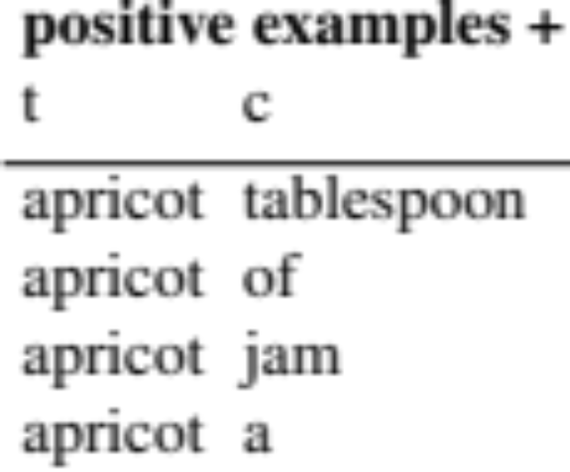
Skip-Gram Training data
  …lemon, a [tablespoon of apricot jam, a] pinch…
c1 c2 [target] c3 c4
Notes:
Skip-gram learns embeddings by starting with random embedding vectors and then iteratively shifting the embedding of each word w to be more like the embeddings of words that occur nearby in texts, and less like the embeddings of words that don’t occur nearby. Let’s start by considering a single piece of training data
This example has a target word w (apricot), and 4 context words in the L = ±2 window, resulting in 4 positive training instances (on the left below):

Slide 72
Skip-Gram Training data
  …lemon, a [tablespoon of apricot jam, a] pinch…
c1 c2 [target] c3 c4
For each positive example we'll grab k negative examples, sampling by frequency
Notes:
For training a binary classifier we also need negative examples. In fact skip- gram with negative sampling (SGNS) uses more negative examples than positive examples (with the ratio between them set by a parameter k). So for each of these (w,cpos) training instances we’ll create k negative samples, each consisting of the target w plus a ‘noise word’ cneg. A noise word is a random word from the lexicon, constrained not to be the target word w.

Slide 73
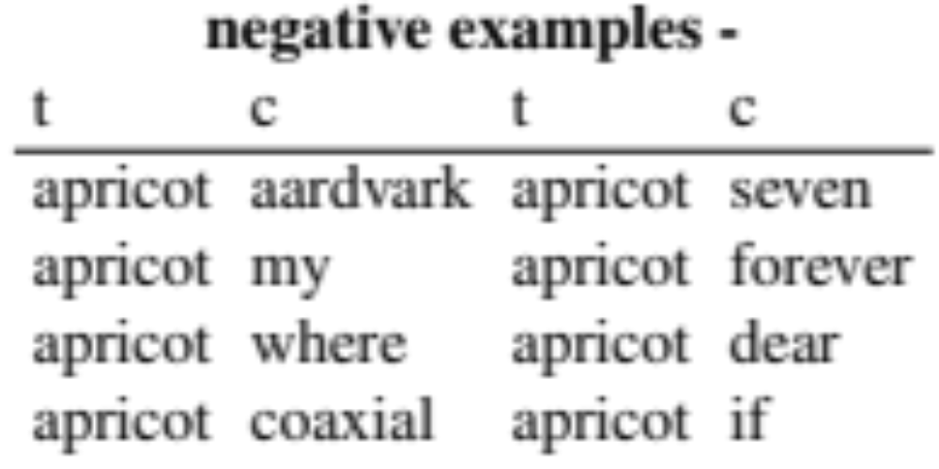
Skip-Gram Training data
  …lemon, a [tablespoon of apricot jam, a] pinch…
c1 c2 [target] c3 c4
Notes:
Here's the setting where k = 2, so we’ll have 2 negative examples in the negative training set − for each positive example w,cpos. The noise words are chosen according to their weighted unigram frequency.

Slide 74
Word2vec: how to learn vectors
Given the set of positive and negative training instances, and an initial set of embedding vectors
The goal of learning is to adjust those word vectors such that we:
  Maximize the similarity of the target word, context word pairs (w , c_{pos}) drawn from the positive data
  Minimize the similarity of the (w , c_{neg}) pairs drawn from the negative data.
Notes:
Given the set of positive and negative training instances, and an initial set of embeddings, the goal of the learning algorithm is to adjust those embeddings to
• Maximize the similarity of the target word, context word pairs (w,cpos) drawn from the positive examples
• Minimize the similarity of the (w,cneg) pairs from the negative examples.

Slide 75
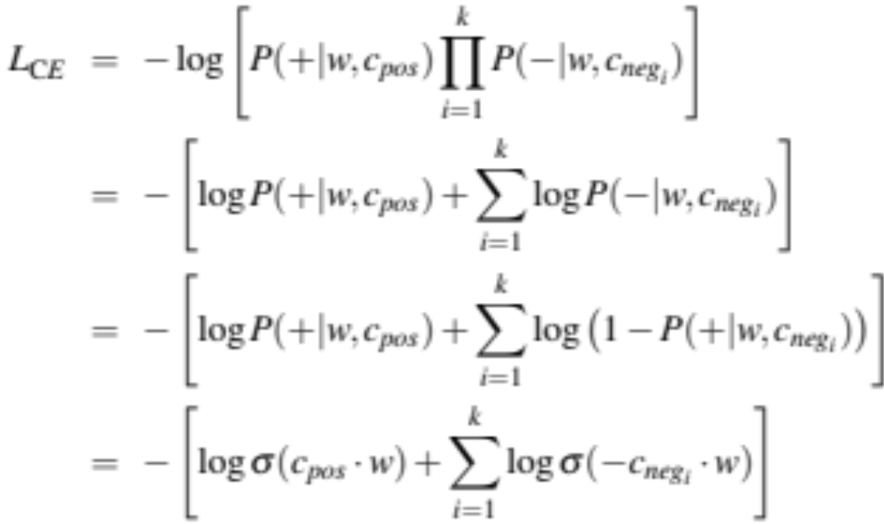
Loss function for one w with c_{pos} , c_{neg1} ...c_{negk}
Maximize the similarity of the target with the actual context words, and minimize the similarity of the target with the k negative sampled non-neighbor words.
Notes:
If we consider one word/context pair (w, cpos ) with its k noise words cneg1 ...cnegk , our goal is to maximize the similarity of the target with the actual context words, andn minimize the similarity of the target with the k negative sampled non-neighbor words. We can express these two goals as the following loss function L to be minimized (hence the −); here the first term expresses that we want the classifier to assign the real context word cpos a high probability of being a neighbor, and the second term expresses that we want to assign each of the noise words cnegi a high probability of being a non-neighbor, all multiplied because we assume independence:
If we substitute in our sigmoid of the dot product estimate for P, we want to maximize the dot product of the word with the actual context words, and minimize the dot products of the word with the k negative sampled non- neighbor words.
􏰼

Slide 76
Learning the classifier
How to learn?
  Stochastic gradient descent!
We’ll adjust the word weights to
  make the positive pairs more likely
  and the negative pairs less likely,
  over the entire training set.
Notes:
We minimize this loss function using stochastic gradient descent.

Slide 77
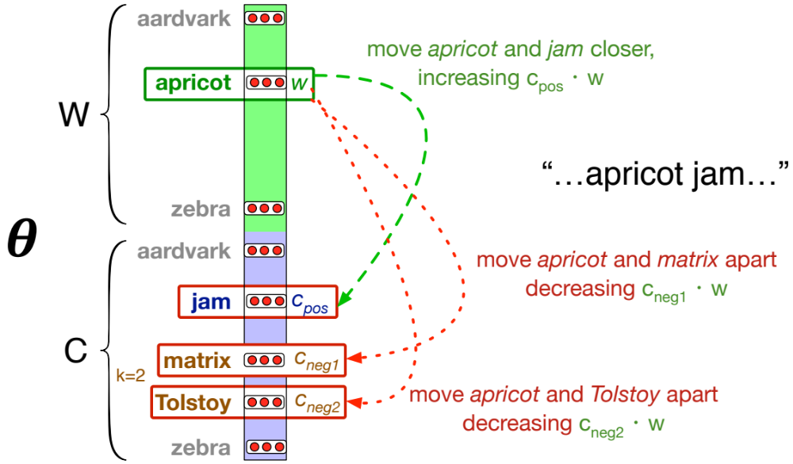
Intuition of one step of gradient descent
Notes:
Let's look at the intuition of one step of gradient descent. The skip-gram model tries to shift embeddings so the target embeddings (here for apricot) are closer to (have a higher dot product with) context embeddings for nearby words (here jam) and further from (lower dot product with) context embeddings for noise words that don’t occur nearby (here Tolstoy and matrix).

Slide 78
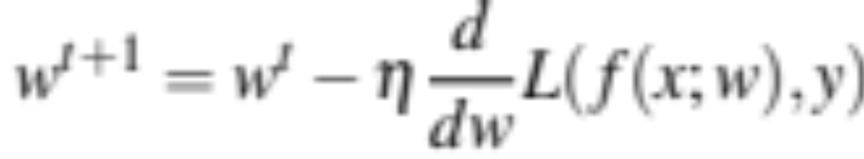
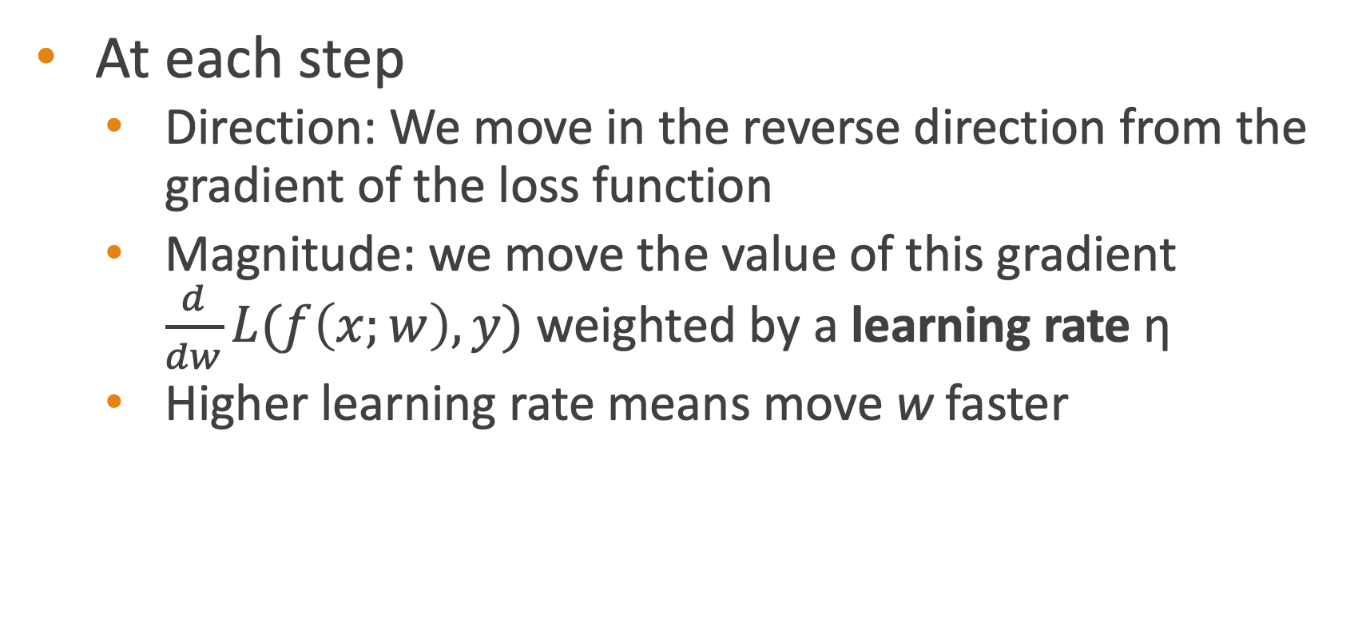
Reminder: gradient descent
At each step
  Direction: We move in the reverse direction from the gradient of the loss function
  Magnitude: we move the value of this gradient $\frac{d}{dw}L(f\left(x;w\right),y)$ weighted by a learning rate η
  Higher learning rate means move w faster

Slide 79
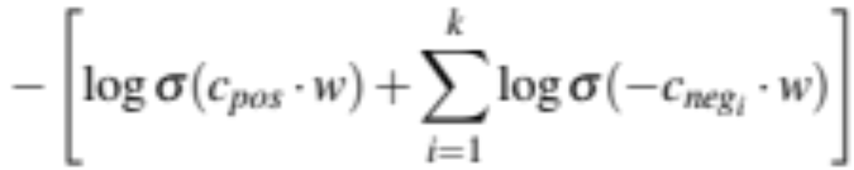
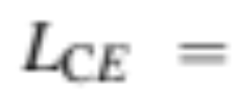
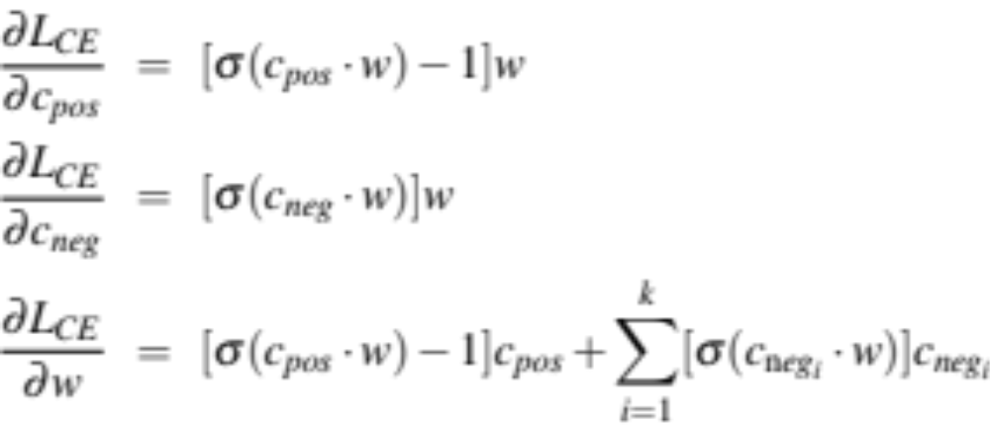
The derivatives of the loss function
Notes:
To get the gradient, we need to take the derivative of this equation with respect to the different embeddings. We'll need a derivate for the C embeddings and for the W embeddings. And we'll want a different derivative for the weights for the positive context examples and the nevative context examples, since we want to move them in opposite directions. It turns out the derivatives are the following elegant functions.

Slide 80
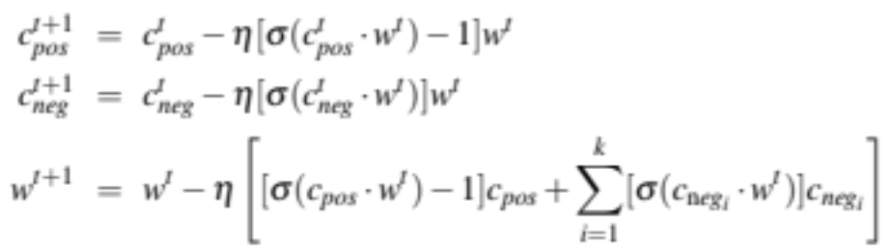
Update equation in SGD
Start with randomly initialized C and W matrices, then incrementally do updates
Notes:
The update equations going from time step t to t + 1 in stochastic gradient descent are thus:
Just as in logistic regression, then, the learning algorithm starts with randomly initialized W and C matrices, and then walks through the training corpus using gradient descent to move W and C so as to maximize the objective we saw earlier by making the updates here.

Slide 81
Two sets of embeddings
SGNS learns two sets of embeddings
Target embeddings matrix W
Context embedding matrix C
It's common to just add them together, representing word i as the vector w_{i} + c_{i}
Notes:
As we've just seen, the skip-gram model learns two separate embeddings for each word i: the target embedding w and the context embedding c , stored in two matrices, the target matrix W and the context matrix C. Ibut if we just need one vector to represent a word, what should we use? t’s common to just add them together, representing word i with the vector wi + ci .

Slide 82
Summary: How to learn word2vec (skip-gram) embeddings
Start with V random d-dimensional vectors as initial embeddings
Train a classifier based on embedding similarity
  Take a corpus and take pairs of words that co-occur as positive examples
  Take pairs of words that don't co-occur as negative examples
  Train the classifier to distinguish these by slowly adjusting all the embeddings to improve the classifier performance
  Throw away the classifier code and keep the embeddings.

Slide 83
Vector Semantics & Embeddings
Word2vec: Learning the embeddings
Notes:
We've seen how to learn word2vec embeddings, one of the most popular static embedding method

Slide 84
Vector Semantics & Embeddings
Properties of Embeddings
Notes:
Let's talk about various properties and parameters of embeddings

Slide 85
The kinds of neighbors depend on window size
Small windows (C= +/- 2) : nearest words are syntactically similar words in same taxonomy
  Hogwarts nearest neighbors are other fictional schools
    Sunnydale, Evernight, Blandings
Large windows (C= +/- 5) : nearest words are related words in same semantic field
  Hogwarts nearest neighbors are Harry Potter world:
    Dumbledore, half-blood, Malfoy
Notes:
One parameter of vector semantic models that is relevant to both sparse tf-idf vectors and dense word2vec vectors is the size of the context window used to collect counts. This is generally between 1 and 10 words on each side of the target word (for a total context of 2-20 words).
The choice depends on the goals of the representation. Shorter context windows tend to lead to representations that are a bit more syntactic, since the information is coming from immediately nearby words. When the vectors are computed from short context windows, the most similar words to a target word w tend to be semantically similar words with the same parts of speech. When vectors are computed from long context windows, the highest cosine words to a target word w tend to be words that are topically related but not similar. For example Levy and Goldberg (2014a) showed that using skip-gram with a window of ±2, the most similar words to the word Hogwarts (from the Harry Potter series) were names of other fictional schools: Sunnydale (from Buffy the Vampire Slayer) or Evernight (from a vampire series). With a window of ±5, the most similar words to Hogwarts were other words topically related to the Harry Potter series: Dumbledore, Malfoy, and half-blood.

Slide 86
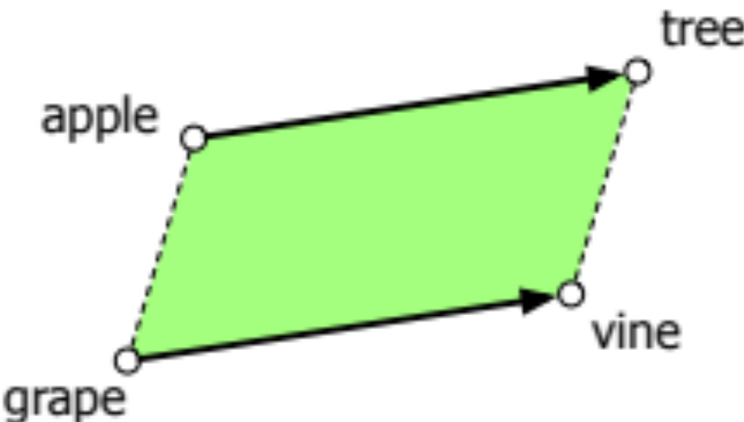
Analogical relations
The classic parallelogram model of analogical reasoning (Rumelhart and Abrahamson 1973)
To solve: "apple is to tree as grape is to _____"
Add tree – apple to grape to get vine
Notes:
Another semantic property of embeddings is their ability to capture relational meanings. In an important early vector space model of cognition, Rumelhart and Abrahamson (1973) proposed the parallelogram model for solving simple analogy problems of the form a is to b as a* is to what?. In such problems, a system given a problem like apple:tree::grape:?, i.e., apple is to tree as grape is to , and must fill in the word vine.
In the parallelogram model, the vector from the word apple ito the word tree (= apple − tree)
is added to the vector for grape (grape); the nearest word to that point is returned

Slide 87
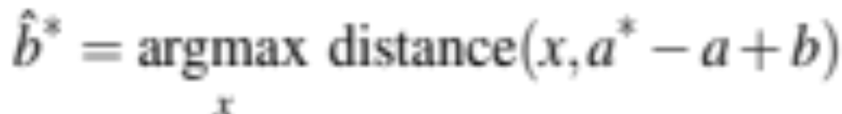
Analogical relations via parallelogram
The parallelogram method can solve analogies with both sparse and dense embeddings (Turney and Littman 2005, Mikolov et al. 2013b)
king – man + woman is close to queen
Paris – France + Italy is close to Rome
For a problem a:a*::b:b*, the parallelogram method is:
Notes:
For a a:b::a*:b* problem, meaning the algorithm is given a, b, and a* and must find b*, the parallelogram method is thus: EQUATION
with the distance function defined either as cosine or as Euclidean distance.

Slide 88
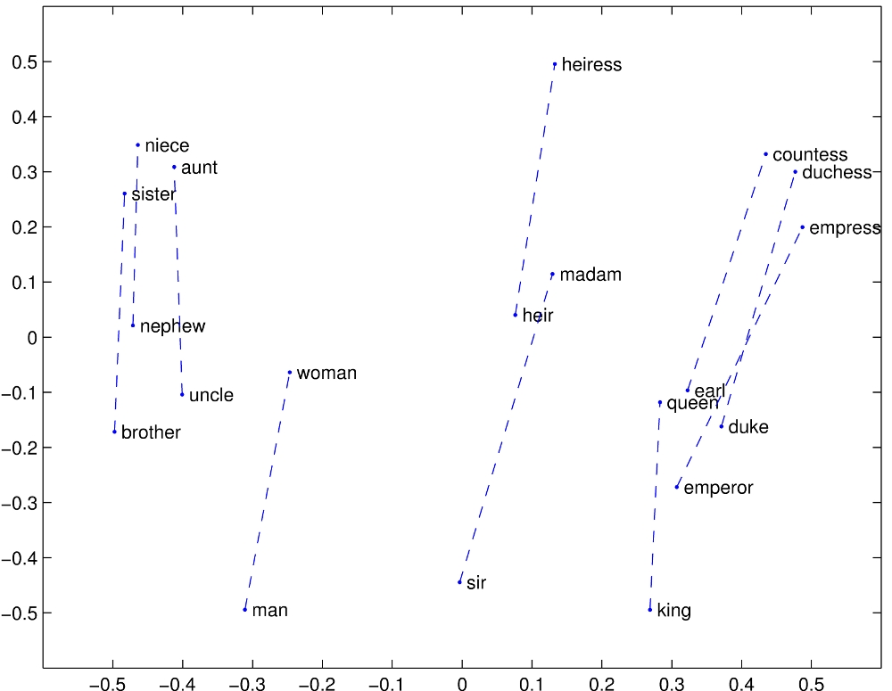
Structure in GloVE Embedding space

Slide 89
Caveats with the parallelogram method
It only seems to work for frequent words, small distances and certain relations (relating countries to capitals, or parts of speech), but not others. (Linzen 2016, Gladkova et al. 2016, Ethayarajh et al. 2019a)
Understanding analogy is an open area of research (Peterson et al. 2020)

Slide 90
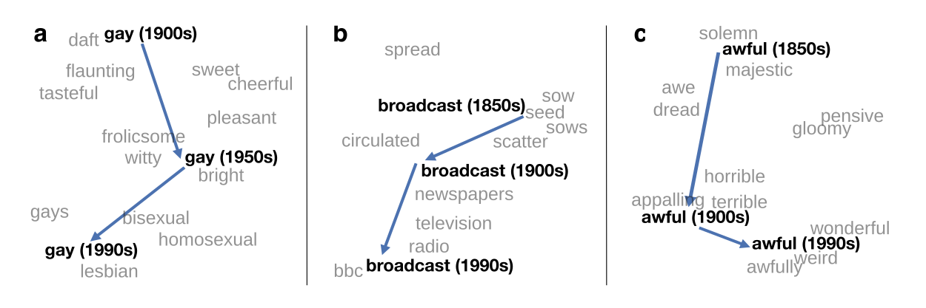
Embeddings as a window onto historical semantics
Train embeddings on different decades of historical text to see meanings shift
~30 million books, 1850-1990, Google Books data
William L. Hamilton, Jure Leskovec, and Dan Jurafsky. 2016. Diachronic Word Embeddings Reveal Statistical Laws of Semantic Change. Proceedings of ACL.
Notes:
Embeddings can also be a useful tool for studying how meaning changes over time, by computing multiple embedding spaces, each from texts written in a particular time period. For example these figures shows a visualization of changes in meaning in English words over the last two centuries, computed by building separate embedding spaces for each decade from historical corpora like Google N-grams and the Corpus of Historical American English.

Slide 91
Embeddings reflect cultural bias!
Bolukbasi, Tolga, Kai-Wei Chang, James Y. Zou, Venkatesh Saligrama, and Adam T. Kalai. "Man is to computer programmer as woman is to homemaker? debiasing word embeddings." In NeurIPS, pp. 4349-4357. 2016.
Ask “Paris : France :: Tokyo : x”
  x = Japan
Ask “father : doctor :: mother : x”
  x = nurse
Ask “man : computer programmer :: woman : x”
  x = homemaker
Algorithms that use embeddings as part of e.g., hiring searches for programmers, might lead to bias in hiring
Notes:
In addition to their ability to learn word meaning from text, embeddings, alas, also reproduce the implicit biases and stereotypes that were latent in the text. As the prior section just showed, embeddings can roughly model relational similar- ity: ‘queen’ as the closest word to ‘king’ - ‘man’ + ‘woman’ implies the analogy man:woman::king:queen. But these same embedding analogies also exhibit gender stereotypes. For example the embeddings suggest the analogy ‘father’ is to ‘doctor’ as ‘mother’ is to ‘nurse’, and the closest occupation to ‘man’ - ‘computer programmer’ + ‘woman’ in word2vec embeddings trained on news text is ‘homemaker'
This could result in what Crawford calls an allocational harm, when a system allo- cates resources (jobs or credit) unfairly to different groups. For example algorithms that use embeddings as part of a search for hiring potential programmers or doctors might thus incorrectly downweight documents with women’s names.

Slide 92
Historical embedding as a tool to study cultural biases
Garg, N., Schiebinger, L., Jurafsky, D., and Zou, J. (2018). Word embeddings quantify 100 years of gender and ethnic stereotypes. Proceedings of the National Academy of Sciences 115(16), E3635–E3644.
  Compute a gender or ethnic bias for each adjective: e.g., how much closer the adjective is to "woman" synonyms than "man" synonyms, or names of particular ethnicities
  Embeddings for competence adjective (smart, wise, brilliant, resourceful, thoughtful, logical) are biased toward men, a bias slowly decreasing 1960-1990
  Embeddings for dehumanizing adjectives (barbaric, monstrous, bizarre) were biased toward Asians in the 1930s, bias decreasing over the 20th century.
These match the results of old surveys done in the 1930s
Notes:
Historical embeddings are also being used to measure biases in the past. Garg et al. (2018) used embeddings from historical texts to measure the association be- tween embeddings for adjectives and embeddings for names of various ethnici- ties or genders. embeddings for adjectives related to competence (‘smart’, ‘wise’, ‘thoughtful’, ‘resourceful’) had a higher cosine with male than fe- male words, and showed that this bias has been slowly decreasing since 1960, and that Historical embeddings also repli- cated old surveys of ethnic stereotypes; Embeddings for Chinese names were biased twoare dehumanizing adjectives like ‘barbaric’ in the 1930s, matching the results of old surveys done in the 1930s, but this bias decreased in both text and surveys over the 20th century.

Slide 93
Vector Semantics & Embeddings
Properties of Embeddings
Notes:
We've seen various properties of embeddings, include how they reflect cultural biases in the text they are trained on.

Slide 94
Embeddings
Contextual Embeddings

Slide 95
Reminder: Static word embeddings (GLoVe, word2vec)
Meaning defined as a point in space
Each word = one fixed (static) vector
Similar words are "nearby in semantic space"
Learned by seeing which words are nearby in text
Notes:
Each word has a fixed vector , not just a string like "good" or an index like "w_45". Similar words are nearby in semantic space. We build the space automatically by seeing which words are nearby in text.
Here is a 2-D visualization of embeddings for some food-related words, showing their distance .

Slide 96
Static embeddings
Each word is represented by a fixed vector = same in all contexts!
We had a picnic on the grassy river bank
Bank = [35, -1.8, 22, 0.006,… ]
I went to the bank and withdrew some cash.
Bank = [35, -1.8, 22, 0.006,… ]

Slide 97
In static embeddings, we get a fixed dictionary
So we get our embeddings from
a Dict
that maps each string ("bank")
to an np.array of length, say, 50

Slide 98
Contextual embeddings
Each word in context is represented by a vector (different in every context)
We had a picnic on the grassy river bank
Bank = [1.11, -1.7, -205, 0.006,… ]
I went to the bank and withdrew some cash.
Bank = [-42.7, 9.8, -0.88, -2.559,… ]

Slide 99
Contextual embeddings
Each word in context is represented by a vector
1 point for each sentence!
We had a picnic on the grassy river bank
I went to the bank and withdrew some cash.
My friend works at the local branch of the bank
I sat on the damp bank and watched the river

Slide 100
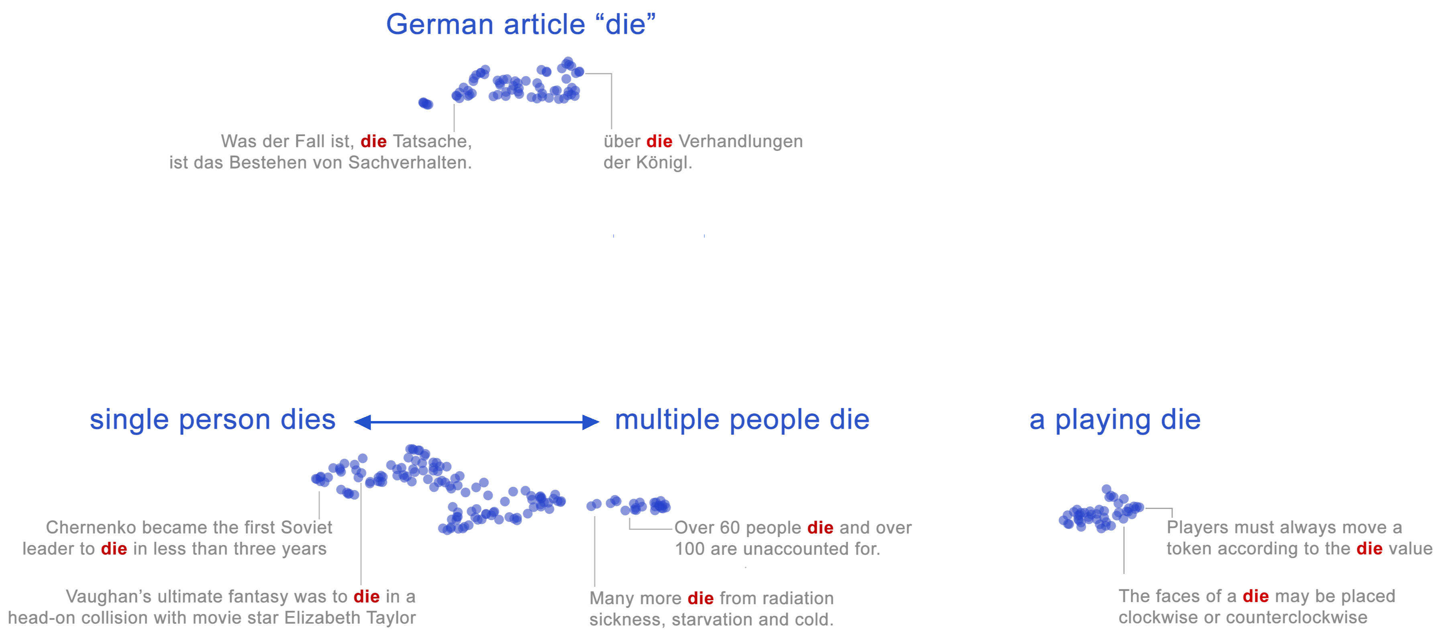
An actual BERT embedding example
Each word instance in context is represented as a single point in space
The meaning of a whole word is a region (a cloud of points) in 1000-dim space!
The word "die" in 2D, showing two regions for two senses
Coenen et al. (2019)
Notes:
What do these vectors look like?

Slide 101
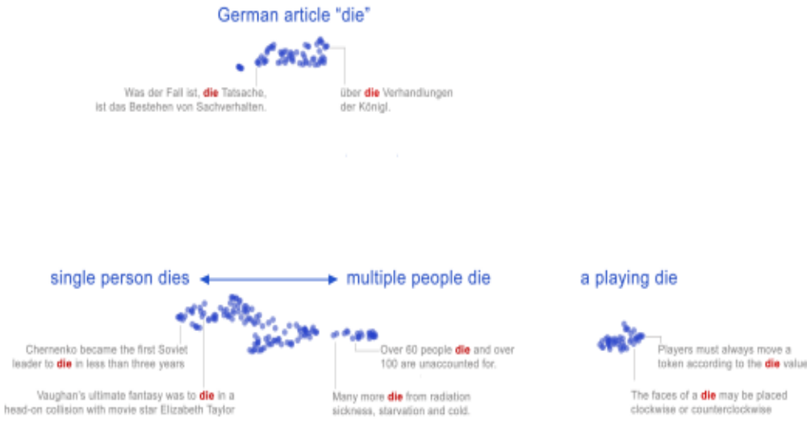
Most modern models are multilingual!
Contextual Embedding for "die" including German!

Slide 102
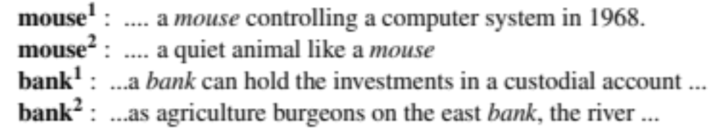
Word sense: words are ambiguous
We say that a word with many meanings is polysemous
A word sense in a dictionary is a discrete representation of one aspect of meaning
Contextual embeddings offer a more sophisticated model: a continuous high-dimensional model of meaning
more fine grained than discrete senses.

Slide 103
Summary: Static vs Contextual Embeddings
Static embeddings represent word types (dictionary entries)
Look up a word in a Dict
Returns a vector of shape for example (50,)
Contextual embeddings represent word instances (one for each time the word occurs in any context/sentence)
More correctly, token instances. We first tokenize the sentence.
Then pass a sentence through a language model
Get out one vector of shape for example (768,) for each word in the sentence

Slide 104
How do we compute contextual embeddings?
From the internals of large language model!
Large language models learn them during training
LLMs are trained to predict tokens from context
Transformers (upcoming lecture) will have representations for each token at each layer
For this lecture we'll use BERT, which is an encoder-only Masked Language Model

Slide 105
How do we compute contextual embeddings?
We pass a tokenized sentence to a pretrained transformer
We have a static embedding for each token
Then, layer by layer, the transformer will modify that static embedding
  Incorporating into to the meanings of other words around it in the context of the sentence
Then we'll take the embedding at the last BERT layer to represent the word in this context.

Slide 106
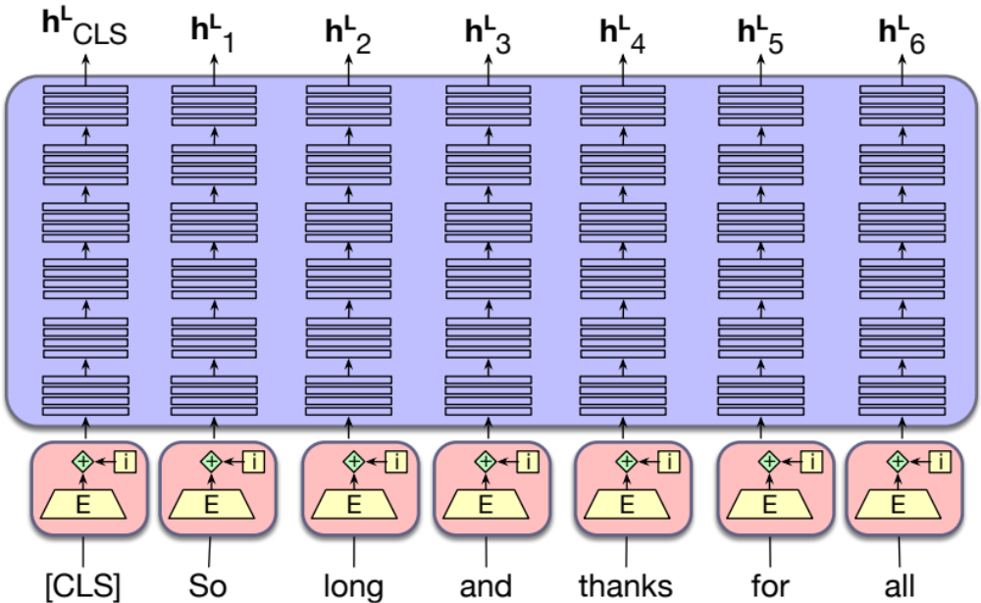
BERT contextual embeddings to represent tokens
768-dimensional embedding for "thanks" in "So long and thanks for all"
(768,)
Stacked
Transformer
Layers
768
static
Notes:
We begin

Slide 107
BERT contextual embeddings to represent tokens
768-dimensional embedding for each word of "So long and thanks for all"
(768,)
(768,)
(768,)
(768,)
(768,)
(768,)
Stacked
Transformer
Layers

Slide 108
The special CLS token of BERT
CLS is a special token that represents the meaning of the sentence
Stacked
Transformer
Layers

Slide 109
The special CLS token of BERT
768-dimensional embedding for the CLS token of "So long and thanks for all"
(768,)
Stacked
Transformer
Layers

Slide 110
BERT is generally run on a batch of sentences
All input sentences must be the same length.
  So each sentence is padded with a special PAD token to a max sentence length like 512
CLS thanks for all the fish SEP PAD PAD PAD…
There can be many sentences in one batch = batch_size
So a call to the BERT model usually returns an output of shape
(batch_size, max_sentence_length, 768)
  An embedding vector of length 768 for each of the max_sentence_length tokens in each of the batch_size sentences

Slide 111
Embeddings
Contextual Embeddings

Slide 112
Embeddings
Computing token and sentence similarity with contextual embeddings

Slide 113
Computing word (well, token) similarity:
Reminder about dot product and cosine
Dot product between two vectors is a scalar:
Dot product is high when both vectors have large values in same dimensions
92
0
40
35
2
85
= 92*35 + 0*2 + 40+85 = 3345

Slide 114
Reminder: cosine fixes problem with raw dot-product
Dot product is higher if a vector is longer, higher magnitude (has higher values in many dimension)
Vector length:
Cosine normalizes for vector length:

Slide 115
Reminder: Computing similarity between two tokens
Look up their embedding vectors
Take the cosine (or other vector similarity metric) between them

Slide 116
But how to take similarity of two sentences?
First, represent each sentence with a single embedding:
CLS token: a special token for BERT models that represents the whole sentence
Mean-pooling: Average the embeddings of all the tokens
Max-pooling: Create a new embedding each of whose dimensions is the max of the values for that dimension from the embeddings of all the tokens

Slide 117
The CLS token can represent the meaning of the sentence
Stacked
Transformer
Layers

Slide 118
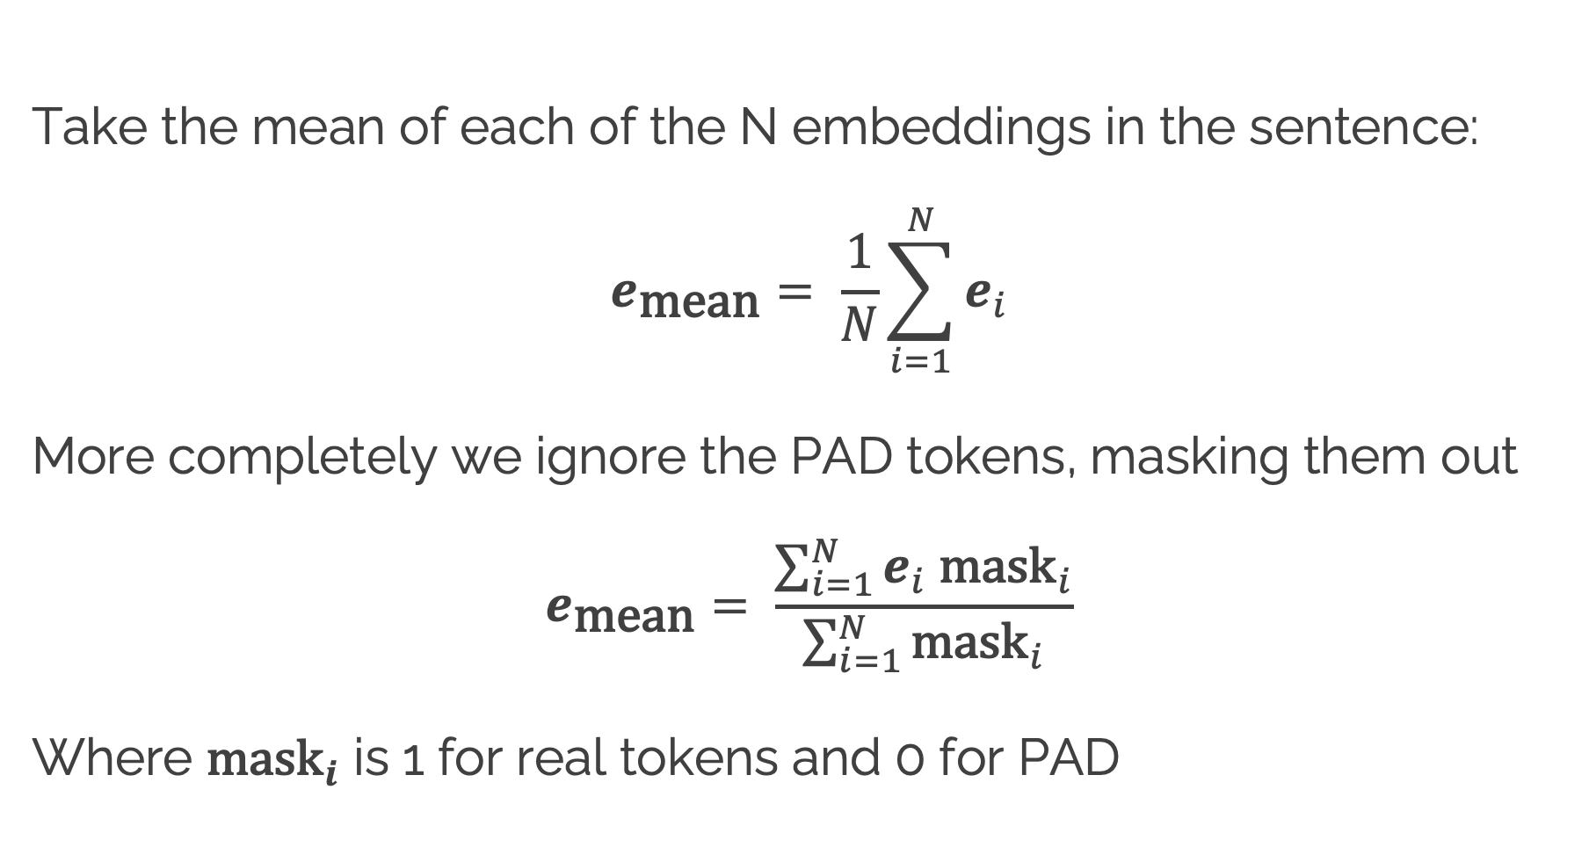
Mean pooling
Take the mean of each of the N embeddings in the sentence:
$$e_{\text{mean}}= \frac{1}{N}\sum_{i=1}^{N}{e_{i}}$$
More completely we ignore the PAD tokens, masking them out
$$e_{\text{mean}}= \frac{\sum_{i=1}^{N}{e_{i} {\text{mask}}_{i}}}{\sum_{i=1}^{N}{{\text{mask}}_{i}}}$$
Where ${\text{mask}}_{i}$ is 1 for real tokens and 0 for PAD

Slide 119

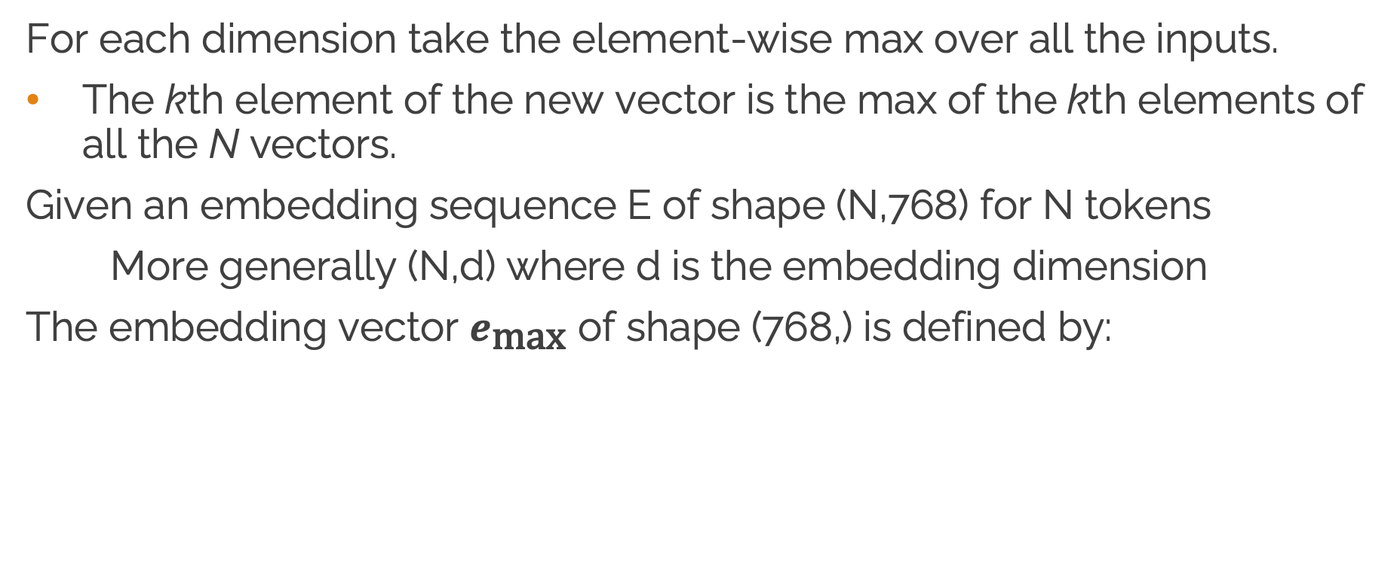
Max pooling
For each dimension take the element-wise max over all the inputs.
The kth element of the new vector is the max of the kth elements of all the N vectors.
Given an embedding sequence E of shape (N,768) for N tokens
More generally (N,d) where d is the embedding dimension
The embedding vector $e_{\text{max}}$ of shape (768,) is defined by:
$$e_{\text{max}}[j]=\max_{1≤i≤N}{E[i,j]}$$

Slide 120
Mean pooling vs max pooling
Mean pooling takes all the words into equal consideration
Max pooling focuses on the most salient feature for each dimension
Max may be useful when we care about outliers more than the mean
Perhaps strong sentiment words

Slide 121
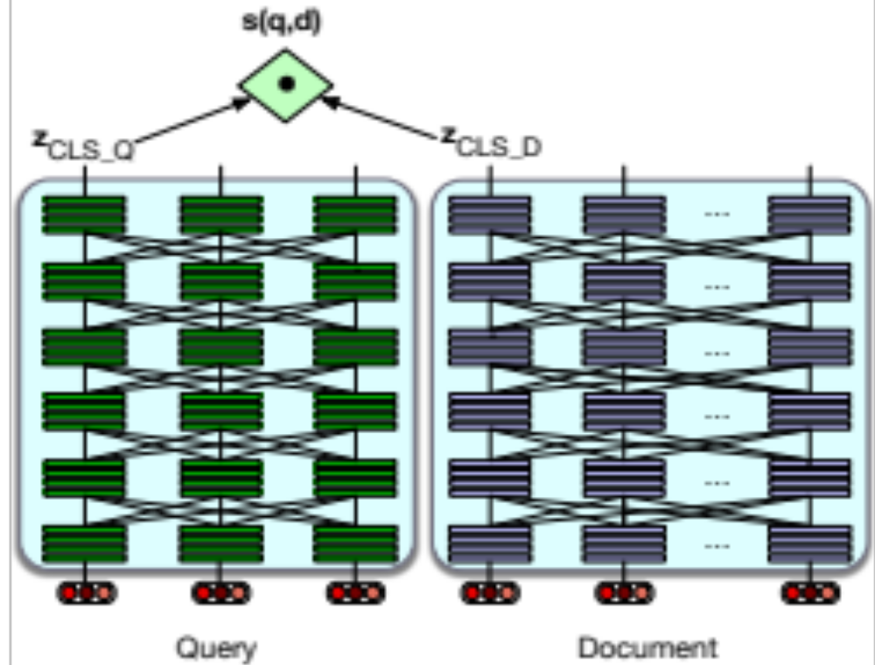
Next, take the cosine between the CLS tokens!
cosine
z_{CLS1}
z_{CLS2}
Run each sentence through BERT
Take each CLS token vector (768,)
Compute their cosine
Sentence 1
Sentence 2

Slide 122
Mean pooling
cosine
mean1
mean2
z_{CLS1}
z₁
z_{n}
z_{CLS2}
z₁
z_{m}
Run each sentence through BERT
Average the vectors for all the tokens in the sentence
Compute the cosine
Sentence 1
Sentence 2

Slide 123
Max pooling
cosine
Max 1
Max 2
z_{CLS1}
z₁
z_{n}
z_{CLS2}
z₁
z_{m}
Run each sentence through BERT
For each sentence, for each dimension, take the max value across tokens.
Compute the cosine
Sentence 1
Sentence 2

Slide 124
Embeddings
Computing token and sentence similarity with contextual embeddings

