Slide 1
Speech Recognition
Speech Recognition
Introduction

Slide 2

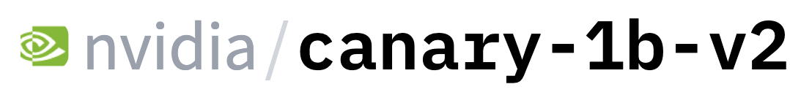



Multimodal LLMs: speech
LLMs can now deal with text, images, video and speech!
Whisper
Gemini 2.5 Pro
PHI-4
wav2vec 2.0

Slide 3
Common Speech tasks
Automatic Speech Recognition (ASR): Speech in, text out
Text-to-Speech (TTS/Speech Synthesis): Text in, speech out
Voice Morphing: Speech in, speech out
Automatic Speech Translation: Speech in, speech out
Language ID: Speech in, language name out
Speaker ID: Speech in, speaker name out
Diarization: Speech in, a script (who talked when) out
Voice Activity Detection: audio in, output: speech regions

Slide 4
Automatic Speech Recognition
The task: Map from a wavefile to a text string.
How do we do it: Transformers! Plus encoder-decoder!

Slide 5

Conversational speech is harder than you realize
A piece of an utterance without context
A piece of an utterance with context
I was like, "It's just a stupid bug"

Slide 6
Why are accents hard?
A word by itself
The word in context
I think that great strides are being made nowadays in, in caring for the elderly, you know, in several, in

Slide 7
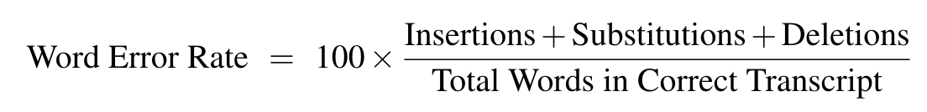
A metric for errors: Word Error Rate (WER)
= (length-normalized) Minimum Edit Distance
Reference: Um I left this phone upstairs last night
Hypothesis: My sister her phone it stores less nine

Slide 8
We'll need a metric for errors:
Use MinEditDist to compute best alignment of reference and hypothesis, then count errors:
Reference: Um I left this --- phone -- upstairs last night
Hypothesis: My -- --- sister her phone it stores less nine
Score S D D S I I S S S
WER = 100 x 9/8 = 112.5

Slide 9
We use WER despite many problems
Isn't semantically aware
Doesn’t distinguish between function words (of, they, he, she) and more important content words
Not necessarily comparable across languages (assumes a shared notion of words)
Requires really careful text normalization details
Spelling conventions must be identical
Apostrophes for contractions like "can't",
Lots of non-standard words uh-huh/m-hmm/

Slide 10

Librispeech
Read speech from public domain audio books LibriVox
Latest version (Multilingual Librispeech) has
44,000 hours of English
6,000 hours of German, Dutch, French, Spanish, Italian, Portuguese, and Polish.

Slide 11

Common Voice
Multilingual crowdsourced dataset
33,000 hours in 133 languages
Still read speech, but anyone can record utterances
Noisier than LibriSpeech
終有一日，所有嘢 都會變

Slide 12
FLEURS: Parallel speech and text in 100+ languages
Speech version of FloRes-101 benchmark
2009 sentences extracted from English Wikipedia and translated into 101 other languages, with 3 read recordings of each sentence
12 hours of speech per language.
Conneau et. al, 2022

Slide 13
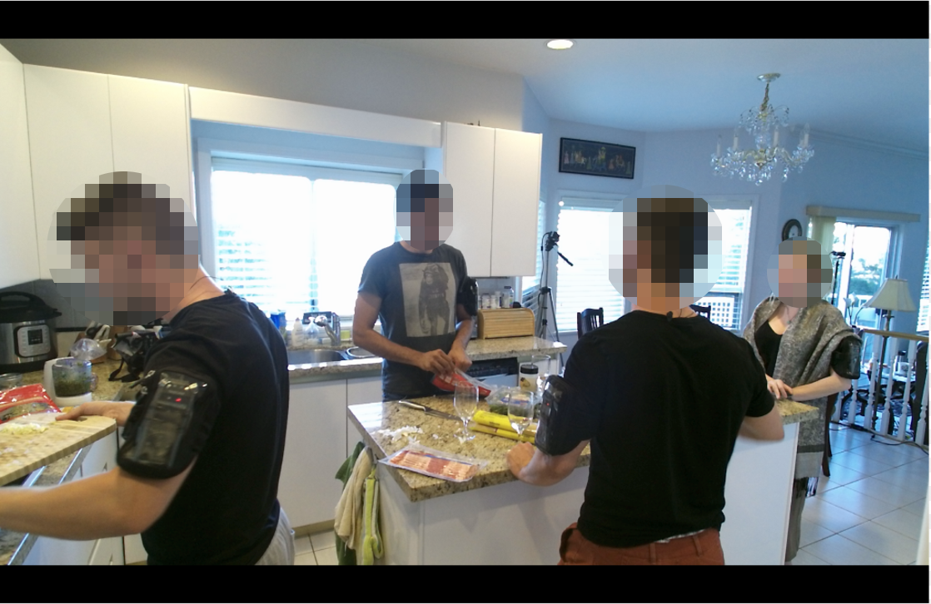
CHiME
Audio in difficult situations
CHiME 6: ASR of conversational speech in real home environments

Slide 14
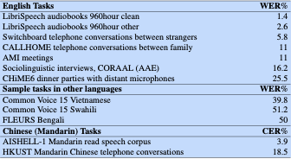
Modern word error rates

Slide 15
Automatic Speech Recognition
As we'll see, ASR still fails for many tasks and domains
  Noisy speech
  Multiple overlapping speakers
  Low-resource languages
  Some speakers (children, old people, people who stutter)
Can't fix what we don't understand!
  Understanding errors can help inform how to fix them
We should build speech technology that works well for everyone!

Slide 16



Some basic ethics when working on speech technologies
Don’t record someone without their consent
In California, all parties to any phone conversation (or any live confidential conversation) must give their consent to be recorded.
Don’t use someone’s speech data without consent. Especially with synthesis/ voice cloning
It might be fun, but it’s creepy. People get upset.
Use existing speech datasets
Do consider subgroup and language bias in systems
Poor performance on subgroups e.g. non-native speakers. Many languages are under-served relative to English/Mandarin.
Slide adapted from Andrew Maas, cs224S!

Slide 17
Speech Recognition
Speech Recognition Introduction

Slide 18
Speech Recognition
Phonetics: Transcription

Slide 19
Why phonetics?
Understanding phonetics and speech production helps with:
Interpretability
  Gives us a language to describe system internal representations
Debugging.
  If you can't describe the error you can't measure it.
Generality
  For multilinguality, helps to know the space of possible speech sounds.

Slide 20
ARPAbet
An alphabet for transcribing American English phones
Developed for early English-focused ASR research
that dh ae t
Thad th ae d
bead b iy d
clack k l ae k
clock k l aa k
supper s ah p axr
super s uw p axr

Slide 21
ARPAbet
A simple subset of the ARPAbet
http://web.stanford.edu/class/cs124/arpabetsmall.html
The CMU Pronouncing Dictionary
http://www.speech.cs.cmu.edu/cgi-bin/cmudict

Slide 22
Practice
stage: s t ey d zh
hacky: h ae k iy
Jackie:
haste:
plaid

Slide 23
Practice
stage: s t ey d zh
hacky: h ae k iy
Jackie: j ae k iy
haste: h ey s t
played : p l ey d

Slide 24
English Vowels in ARPAbet
 | b_d | ARPA |  | b_d | ARPA
1 | bead | iy | 9 | bode | ow
2 | bid | ih | 10 | booed | uw
3 | bayed | ey | 11 | bud | ah
4 | bed | eh | 12 | bird | er
5 | bad | ae | 13 | bide | ay
6 | body | aa | 14 | bowed | aw
7 | (baud), board | ao | 15 | Boyd | oy
8 | pudding | uh
From the UC Berkeley phonetics lab and Andrew Maas's CS224S Winter 2025

Slide 25
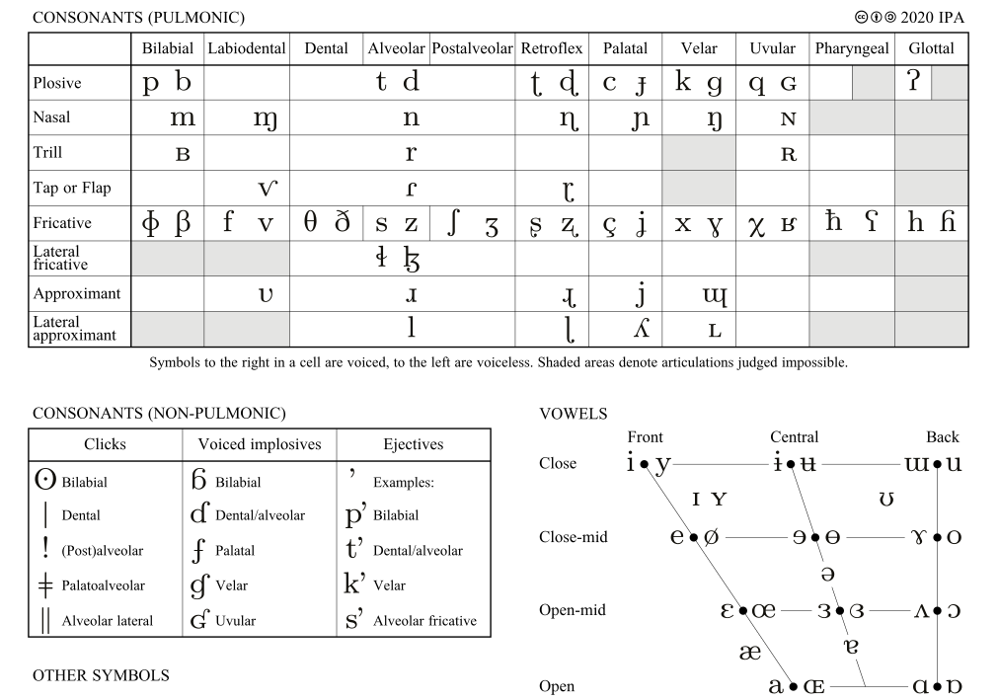
IPA – International Phonetic Alphabet
ARPAbet only has American English phones!
Not used in multi-lingual systems
What we use instead for phonetic analysis
International Phonetic Alphabet:
http://en.wikipedia.org/wiki/International_Phonetic_Alphabet

Slide 26
Speech Recognition
Phonetics: Transcription

Slide 27
Speech Recognition
Phonetics:
Articulatory Phonetics
How speech sounds are made by articulators (biology in motion)

Slide 28
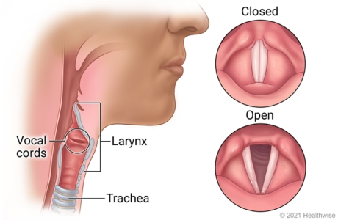
How speech is made!
Air come up from from the lungs
Makes the vocal cords vibrate
Resulting pressure waves shaped by tongue, mouth, lips
Figure from Ignite Healthwise, LLC Staff

Slide 29
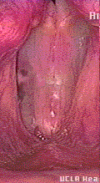
Vocal Fold Vibration
Air comes up from lungs
Forces its way through vocal cords, pushing open (2,3,4)
This causes air pressure in glottis to fall:
  when gas runs through constricted passage, its velocity increases (Venturi tube effect)
  this increase in velocity results in a drop in pressure (Bernoulli principle)
Because of drop in pressure, vocal cords snap together again (6-10)
Single cycle: ~1/100 of a second

Slide 30
Warning: gross video on next slide

Slide 31
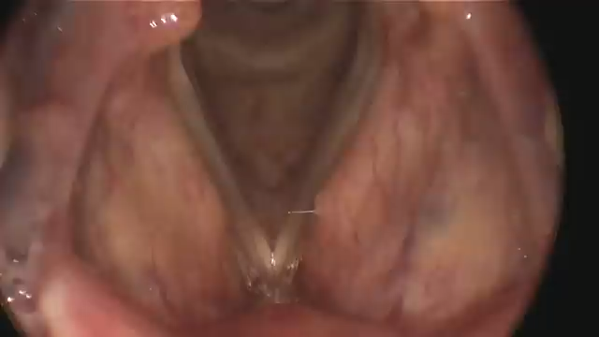
Vocal Folds
Thanks to SPS, the Society of Physics students https://www.youtube.com/watch?v=wYnPA7IXFIU

Slide 32
Voicing
The vocal cords vibrate for some sounds
All vowels
"voiced" consonants like d/b/g/z/dh/m/n
But not for others
t/p/k/s/th/f
Exercise:
hold your hand on your larynx and say:
sssssssss vs zzzzzzzzzzzzzzzz

Slide 33
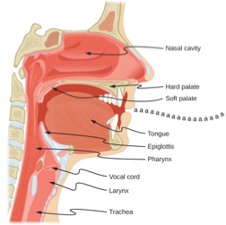
Sagittal View of Vocal Tract
Figure from OpenStax University Physics CC BY 4.0

Slide 34
Consonants and Vowels
Consonants:
sounds with
audible noise produced by a constriction
Vowels:
sounds without
audible noise produced by a constriction

Slide 35
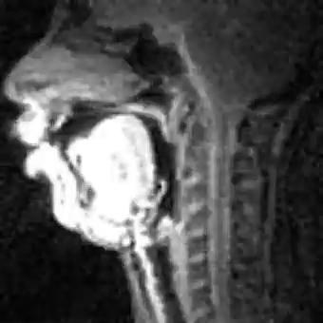
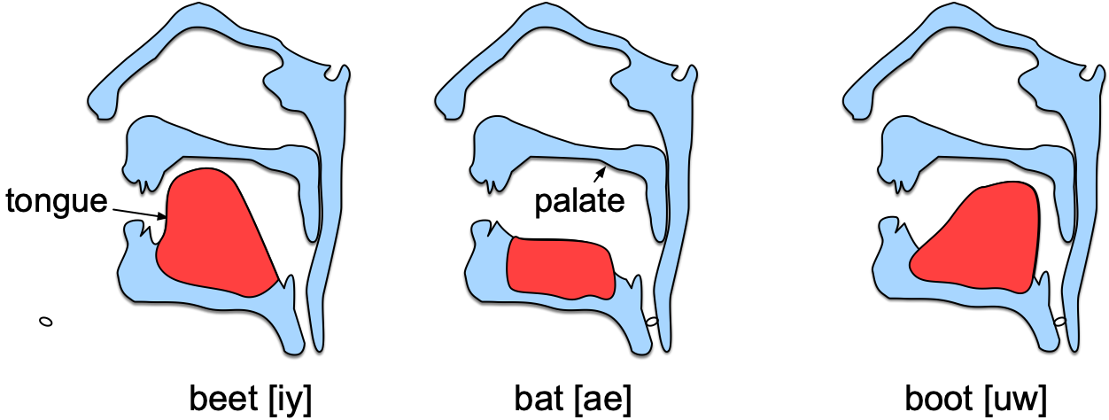
Vowels and the Tongue
USC SAIL

Slide 36
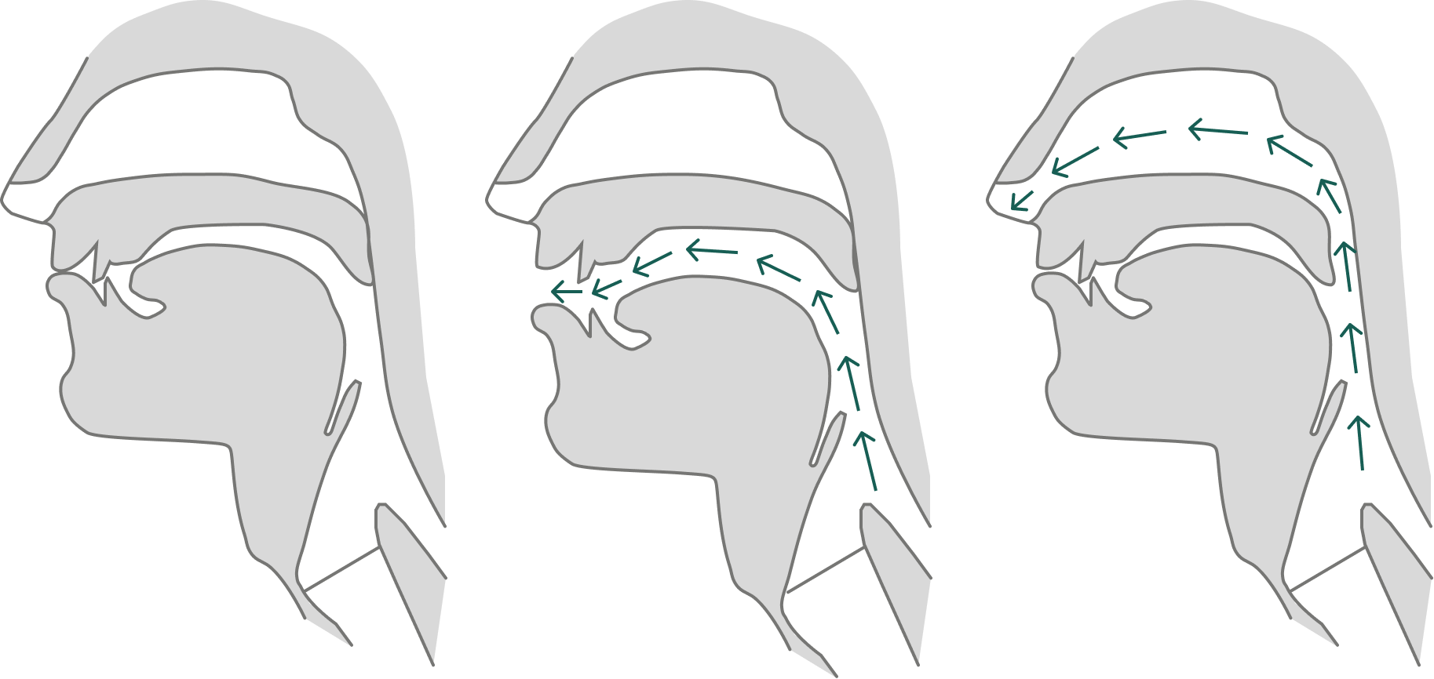
Stop consonant example "p": passage is closed, then released
Closure: Lips close so no air escapes through mouth
Release: Air pressure builds up behind closure, explodes when released
  p, t, k, b, d, g
p closure
p release
CS224S

Slide 37
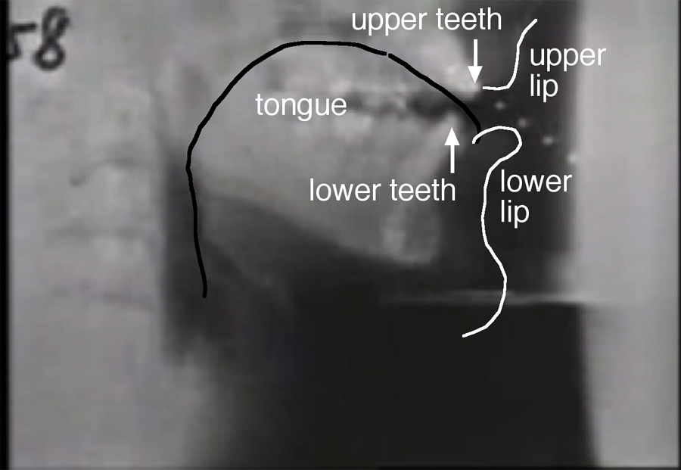
X-Ray of Ken Stevens, labels from Peter Ladefoged’s web site

Slide 38
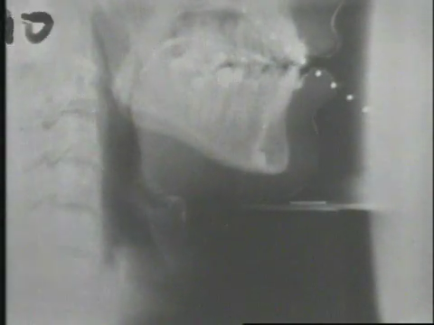
20th Century Vocal tract movie (high speed x-ray)
Figure of Ken Stevens, from Peter Ladefoged's web site at UCLA

Slide 39
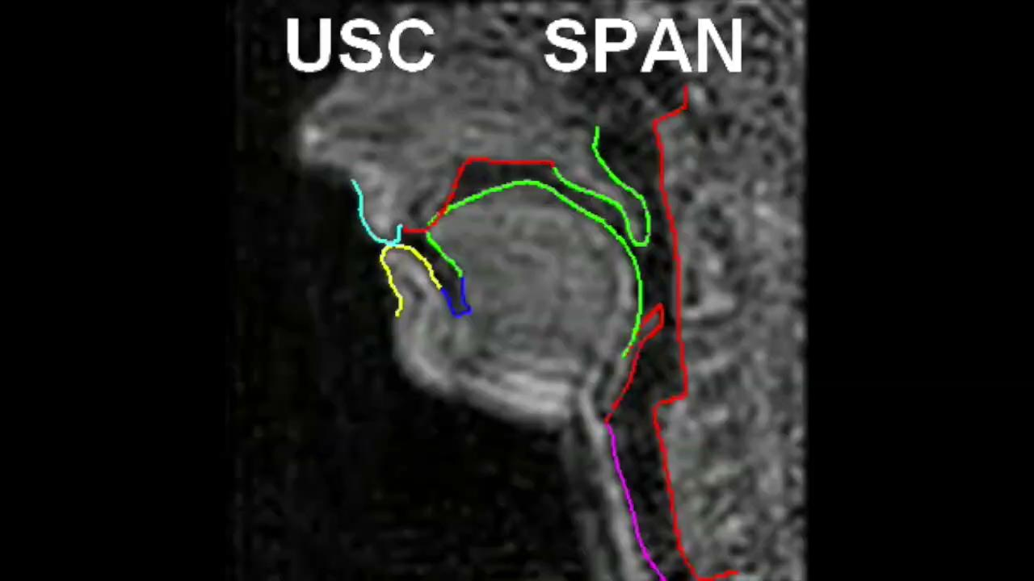
USC’s SAIL Lab
Shri Narayanan
Modern
MRI
Analysis

Slide 40
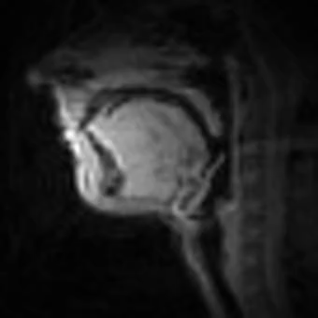
English
USC's Signal Analysis and Interpretation Lab, Shri Narayanan

Slide 41

Tamil
USC's Signal Analysis and Interpretation Lab, Shri Narayanan

Slide 42
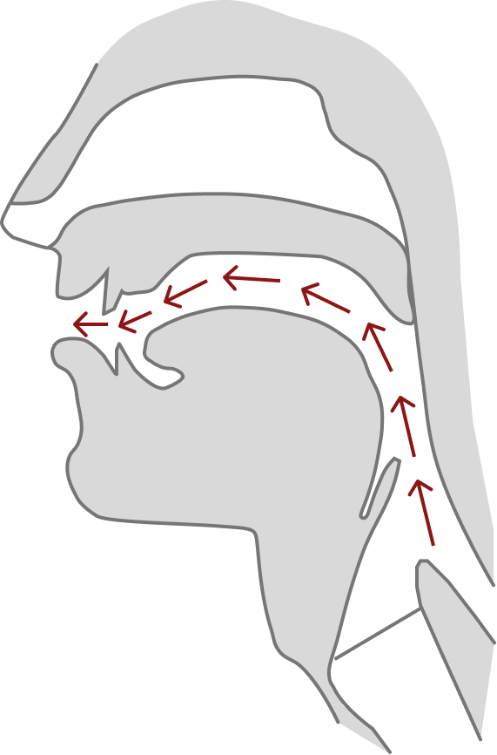
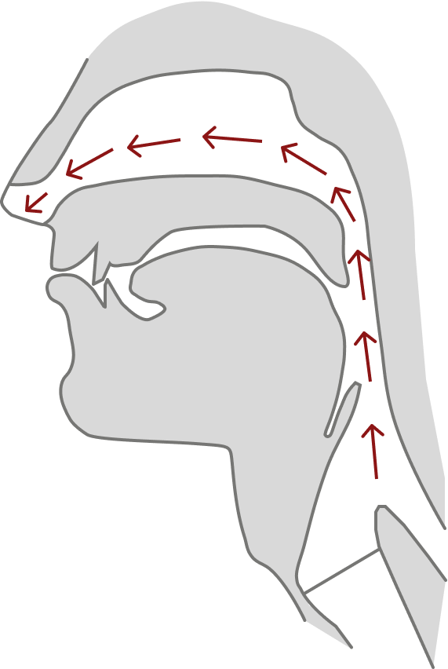
Oral vs Nasal Sounds

Slide 43

The Art of Language Invention
Fun, informative book that includes phonetics and phonotactics
David Peterson Talk at Google

Slide 44
Speech Recognition
Articulatory Phonetics

Slide 45
Speech Recognition
Acoustic Phonetics

Slide 46
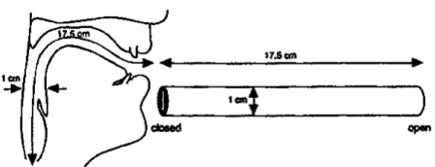
The waveform: resonances of the vocal tract
The human vocal tract as an open tube
Air in a tube of a given length will tend to vibrate at the resonance frequency of tube.
Closed end
Open end
Length 17.5 cm.
Figure from Ladefoged (1962) p 117

Slide 47
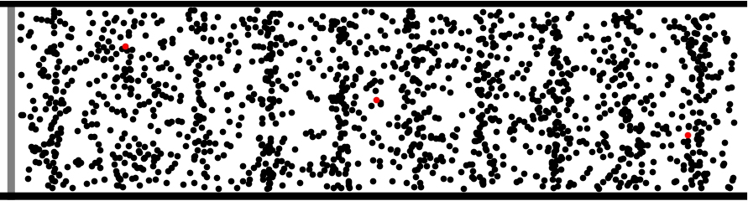
Sound is compression waves of air particles
Image: Dan Russell (2011)

Slide 48
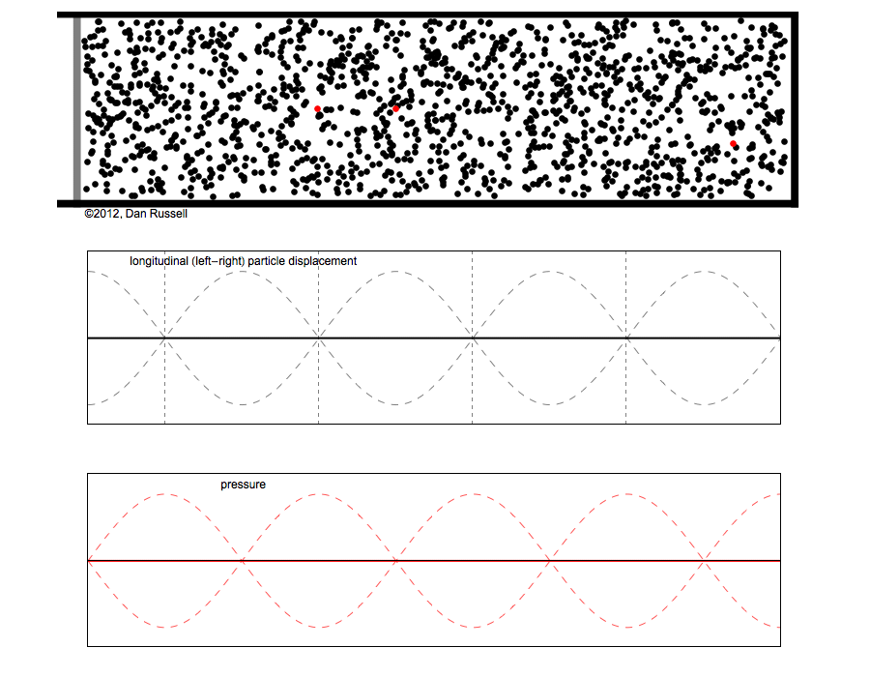
Sound Waves are Longitudinal Waves
Particle
Displacement
Pressure
Image: Dan Russell (2011)

Slide 49
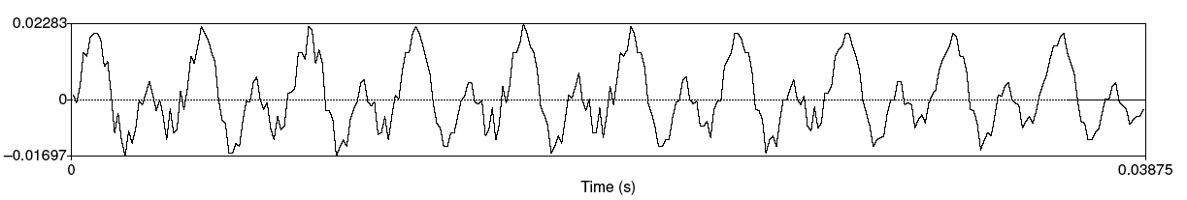
Speech sound waves
The shape of the mouth enhances some frequences and dampens others
A little piece from the waveform of the vowel [iy]
X axis: time.
Y axis: Amplitude = air pressure at that time
    +: compression
    0: normal air pressure,
    -: rarefaction

Slide 50
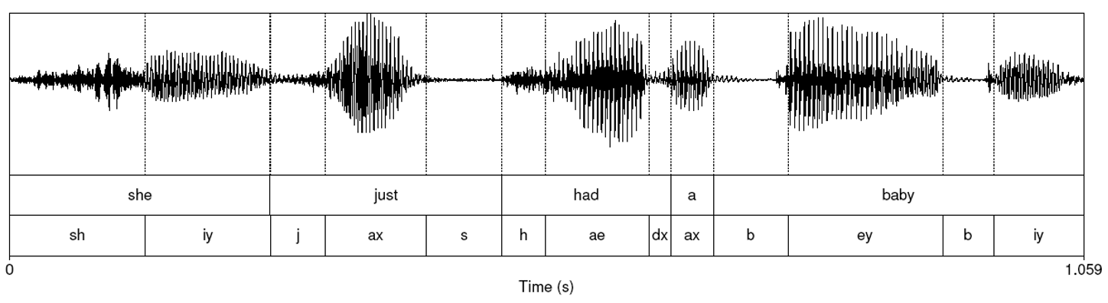
She Just Had a Baby
Vowels vowels have voicing, regular peaks
Stop consonants like "b" have closure followed by release

Slide 51
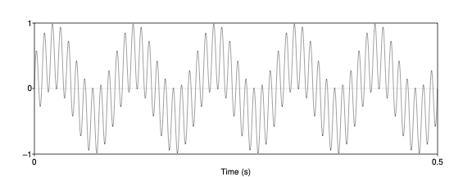
The concept of a spectrum
Every complex wave can be represented as
a sum of sine waves of different frequencies
One of 10 Hz (repeats 5 times in 0.5 seconds)
One of 100 Hz

Slide 52
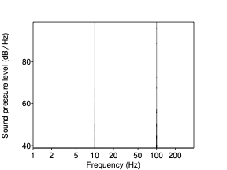
The concept of a spectrum
Every complex wave can be represented as a sum of sine waves of different frequencies
One of 10 Hz
One of 100 Hz

Slide 53
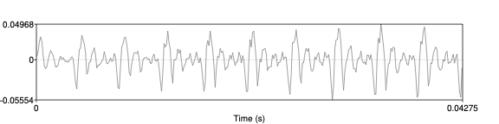
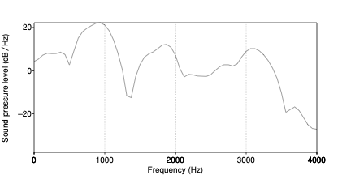
A wavfile frame and its spectrum
Part of the vowel ae in "had"

Slide 54
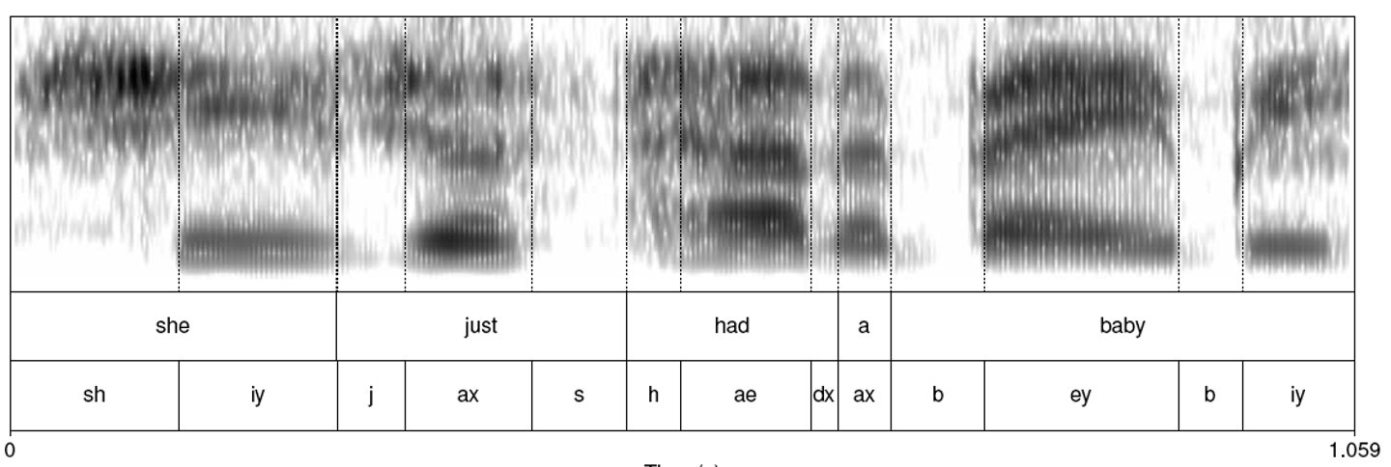
Spectrogram: Spectrum + Time Dimension
4000

Slide 55
Summary steps : getting a frame of speech

Slide 56
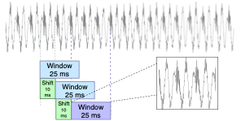
Extracting a frame of speech

Slide 57
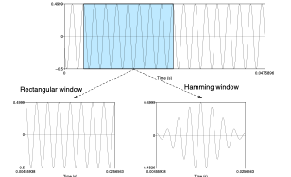
Windowing the frame

Slide 58
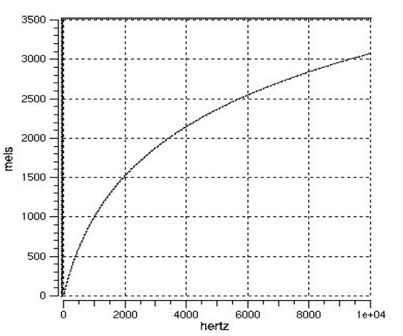
Mel-scale spectrum
Human hearing is not equally sensitive to all frequency bands
Less sensitive at higher frequencies, > 1000 Hz
I.e. human perception of frequency is non-linear:

Slide 59

Mel Filter Bank Processing
Mel Filter bank
  Fine resolution at low frequencies
  Less resolution at high frequencies
Mel-scale energy

Slide 60
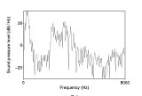
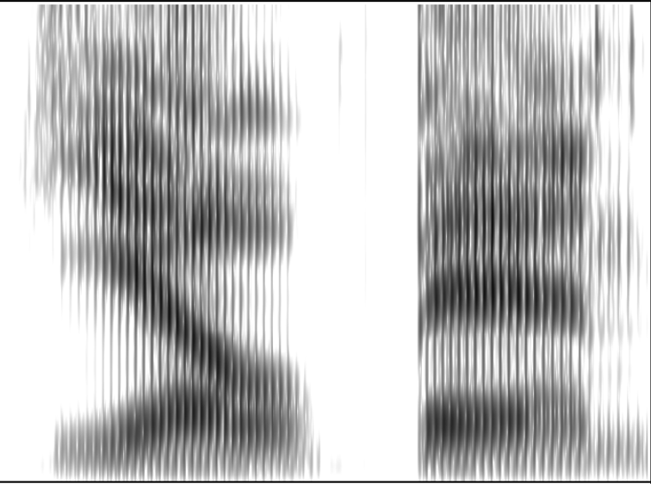
Mel Filter Bank Processing
Mel Filter bank
  Fine resolution at low frequencies
  Less resolution at high frequencies
Mel-scale energy
time

Slide 61
Speech Recognition
Acoustic Phonetics

Slide 62
Speech Models
Convolution Networks

Slide 63
A convolutional layer
Passes a "kernel" over the input to extract features
Speech: 1 dimensional, slide kernel over signal in time dimension
Images: 2 dimensional, slide kernel horizontally and vertically over input

Slide 64
Basic assumptions
Input a sequence of vectors x₁ . . . x_{t}
Output a sequence of vectors z₁ . . . z_{t} (same length t)
A kernel = small vector of weights w₁ . . . w_{k}
We'll convolve the kernel with the input
  Flip the kernel left-to-right
  Pass the kernel frame by frame (temporally) across the input
    At each frame take dot product of kernel with input
  The output is the resulting sequence of dot products

Slide 65
Basic assumptions
Input a sequence of vectors x₁ . . . x_{t}
Output a sequence of vectors z₁ . . . z_{t} (same length t)
A kernel = small vector of weights w₁ . . . w_{k}
We'll convolve the kernel with the input
  Flip the kernel left-to-right
  Pass the kernel frame by frame (temporally) across the input
    At each frame take dot product of kernel with input
  The output is the resulting sequence of dot products

Slide 66
Intuition of convolution
  What is convolution?
    Pass the kernel frame by frame (temporally) across the input, at each frame taking dot product with input
  Convolution is finding regions in the signal that are similar to the kernel
    The dot product is high when two vectors are similar

Slide 67
Example
How to compute x ∗ w:
the convolution of
a single vector x
with a kernel vector w of width (receptive field) k
Simplest case: Convolution with width-1 kernel:
z_{j} = x_{j} w₀ ∀j : 1 ≤ j ≤ t
(dot product is just scalar product)

Slide 68
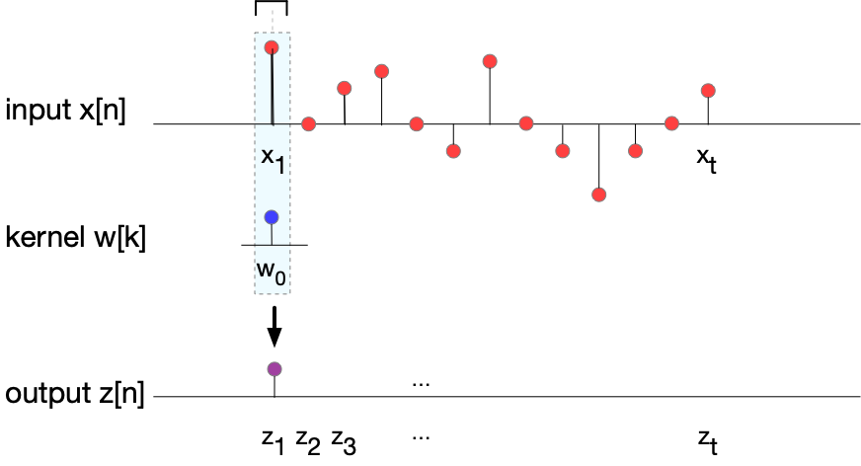
Computing x ∗ w : z_{j} = x_{j} w₀ ∀j : 1 ≤ j ≤ t
z₁ = x₁ w₀

Slide 69
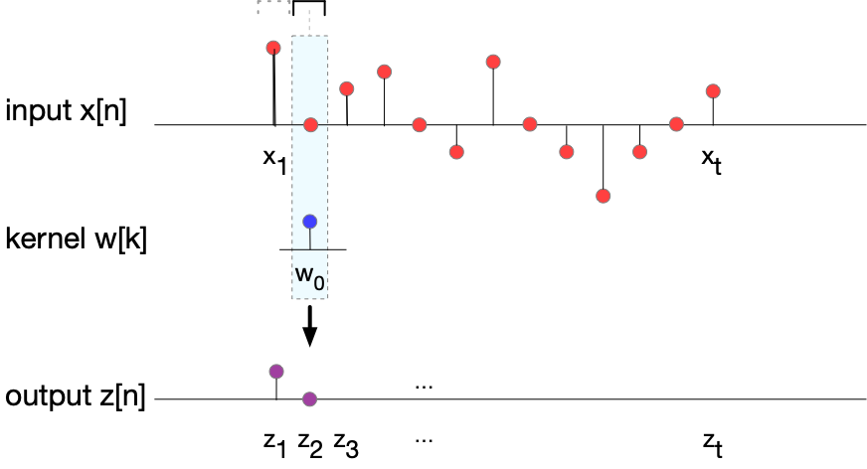
Computing x ∗ w : z_{j} = x_{j} w₀ ∀j : 1 ≤ j ≤ t
z₂ = x₂ w₀

Slide 70
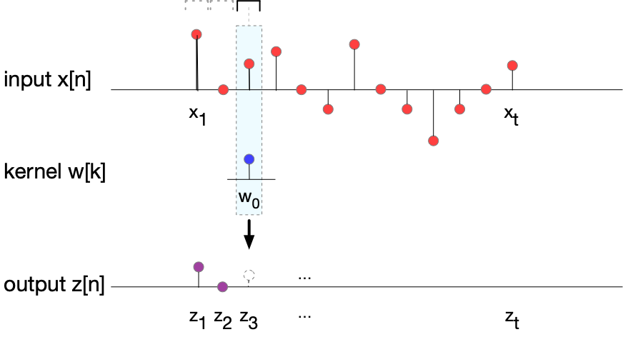
Computing x ∗ w : z_{j} = x_{j} w₀ ∀j : 1 ≤ j ≤ t
z₃ = x₃ w₀

Slide 71
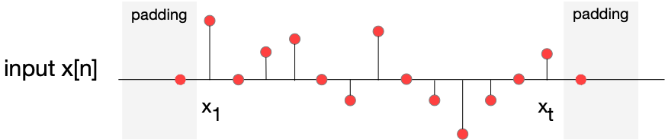
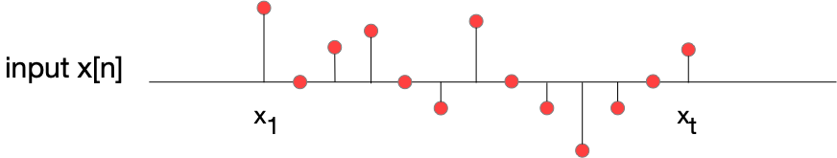
More complex example with a longer kernel
Convenient to have output length = input length
We pad the input by adding p zeros at the beginning and end of the signal.
We start the center of the kernel at the first element x1,

Slide 72

More complex example with a longer kernel
Convenient to define the kernel vector w as having an odd number of elements of length k = 2 p + 1,
center element has p elements on either side.
z_{j} = dot product of x [ j-p : j+p+1 ] with w[ 0 : 2p+1 ]
So for a kernel w of a receptive field of 3, p = 1

Slide 73
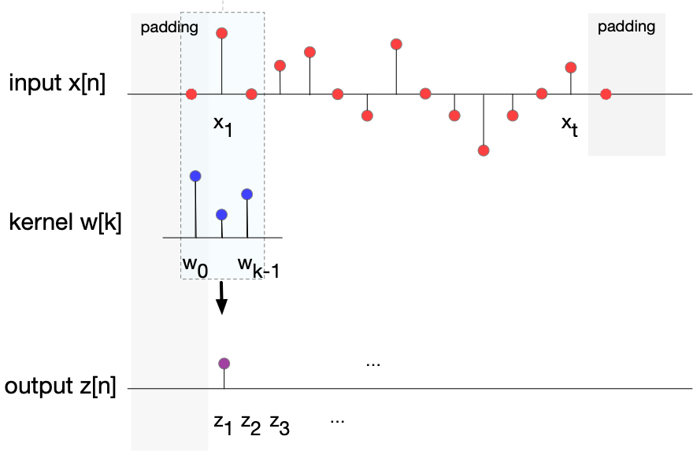
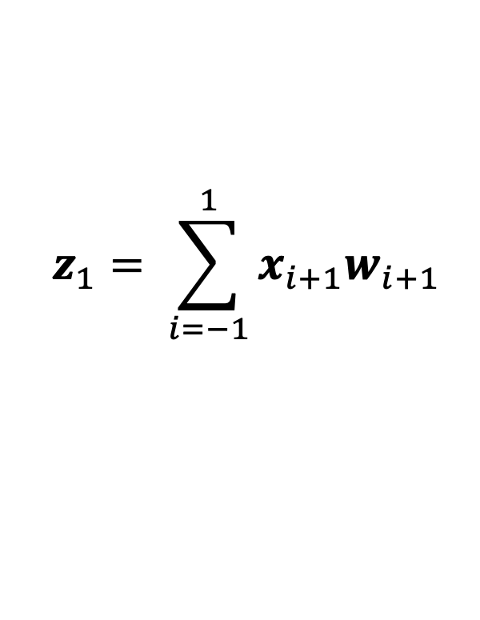
$$z_{1}= \sum_{i=−1}^{1}{x_{i+1}w_{i+1}}$$

Slide 74
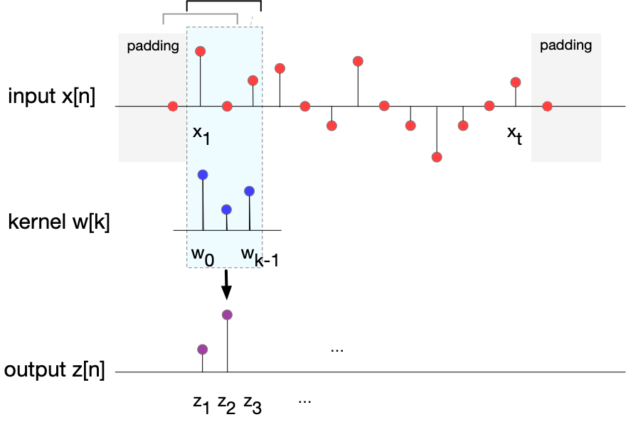
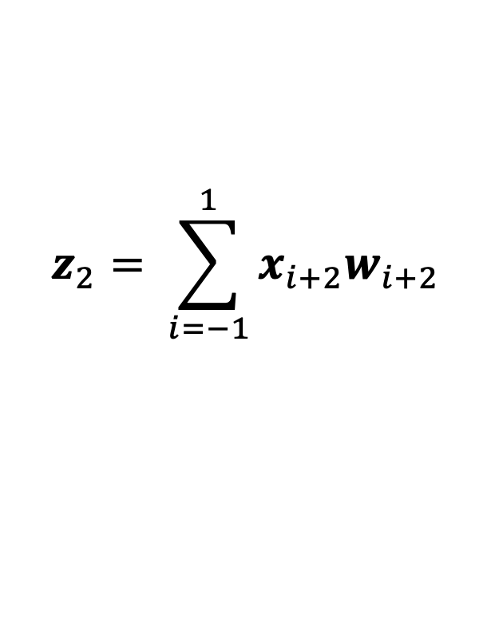
$$z_{2}= \sum_{i=−1}^{1}{x_{i+2}w_{i+2}}$$

Slide 75
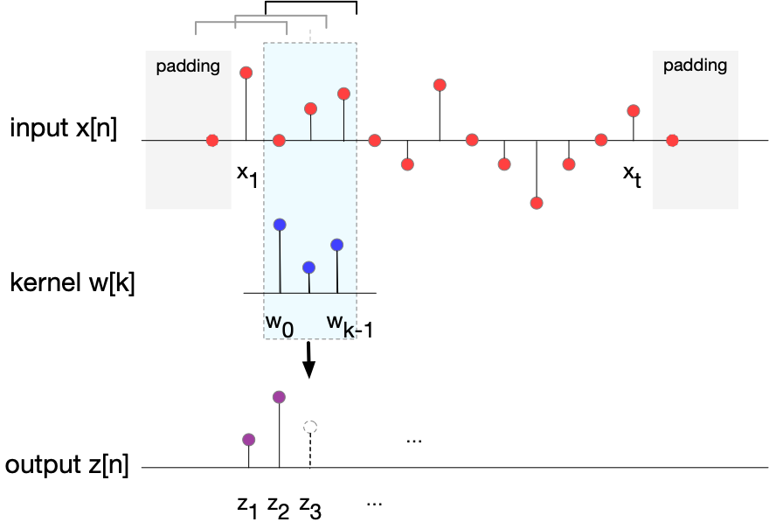
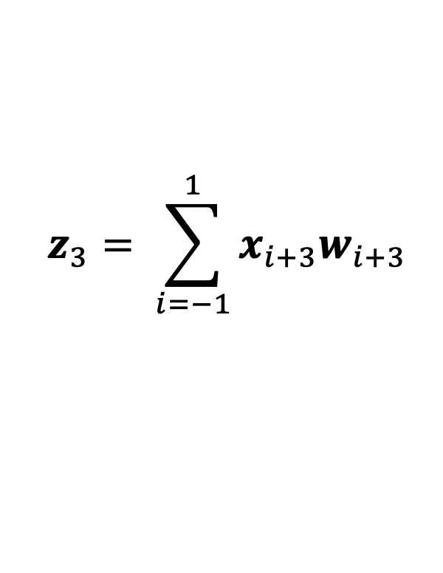
$$z_{3}= \sum_{i=−1}^{1}{x_{i+3}w_{i+3}}$$

Slide 76
Convolution in Whisper
Receptive field is 3, so kernel is compared to 3 frames of speech
Whisper frame is 25 ms of speech, separated by 10 ms stride
So each kernel extracts 45 ms of speech

Slide 77

Input is not one number per frame!
Conv layer input has 128 input channels, each
Each of the 128 values from the 128 log mel filters in spectrum.
Kernel has separate vector for each of these input channels
Kernel has depth 128
The convolution sums over those 128 dot products

Slide 78
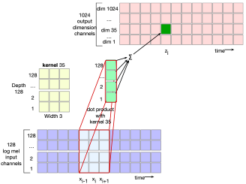
Output is 1024-dim embedding per frame
Convnet has 1024 output channels

Slide 79
Speech Models
Convolution Networks

Slide 80
Speech Models
Whisper Introduction

Slide 81
Many architectures for ASR
Encoder-decoder
Self-supervised + CTC
Speech encoder bolted onto LLM backend

Slide 82
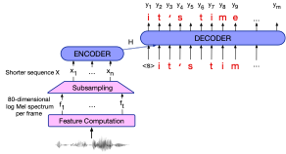
The Encoder-Decoder architecture for speech
Ouput: sequence of BPE tokens (or letters
Input: sequence of acoustic vectors X = x1, x2, x3,…, xt for each 10ms frames

Slide 83
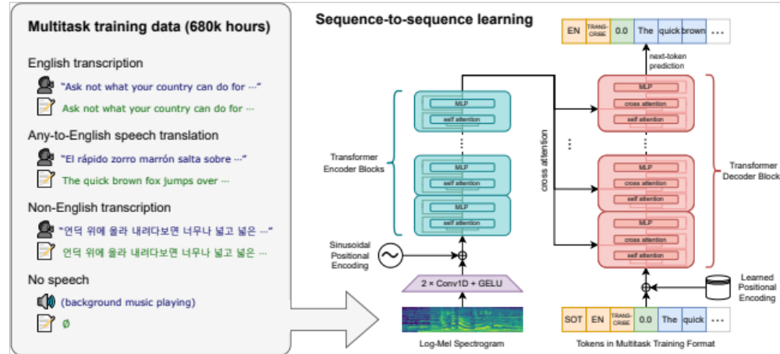
Whisper
Radford, Alec, Jong Wook Kim, Tao Xu, Greg Brockman, Christine McLeavey, and Ilya Sutskever. "Robust speech recognition via large-scale weak supervision." ICML 2022

Slide 84
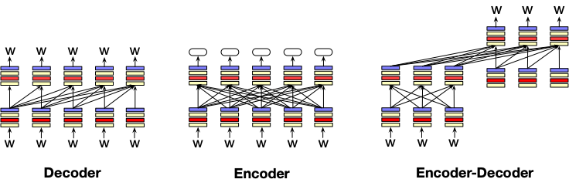
Three architectures for large language models
Decoders Encoders Encoder-decoders
GPT, Claude, BERT family, Flan-T5, Whisper
Llama HuBERT
Mixtral

Slide 85
What is an encoder-decoder?
Enc-dec is useful when the input and output sequences are very different
different in length
different in vocabulary
Written words are on average 1.3 tokens (BPE)
Spoken words 250 milliseconds = 25 frames of 10 ms
  So speech can be 19 times longer (=25/1.3) than text

Slide 86
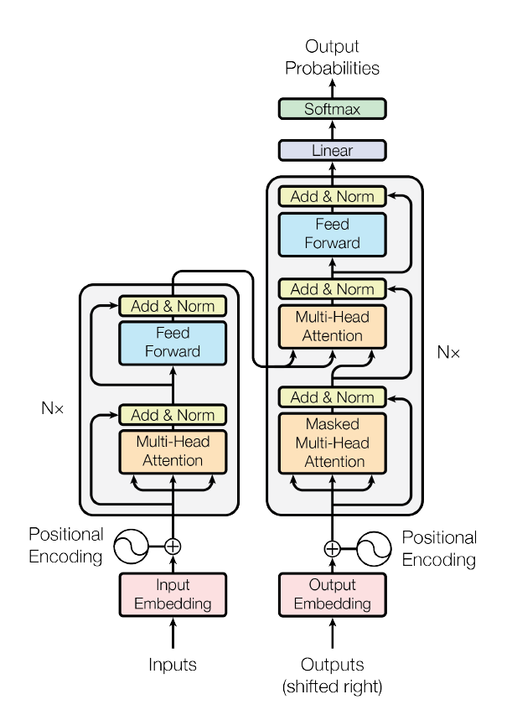
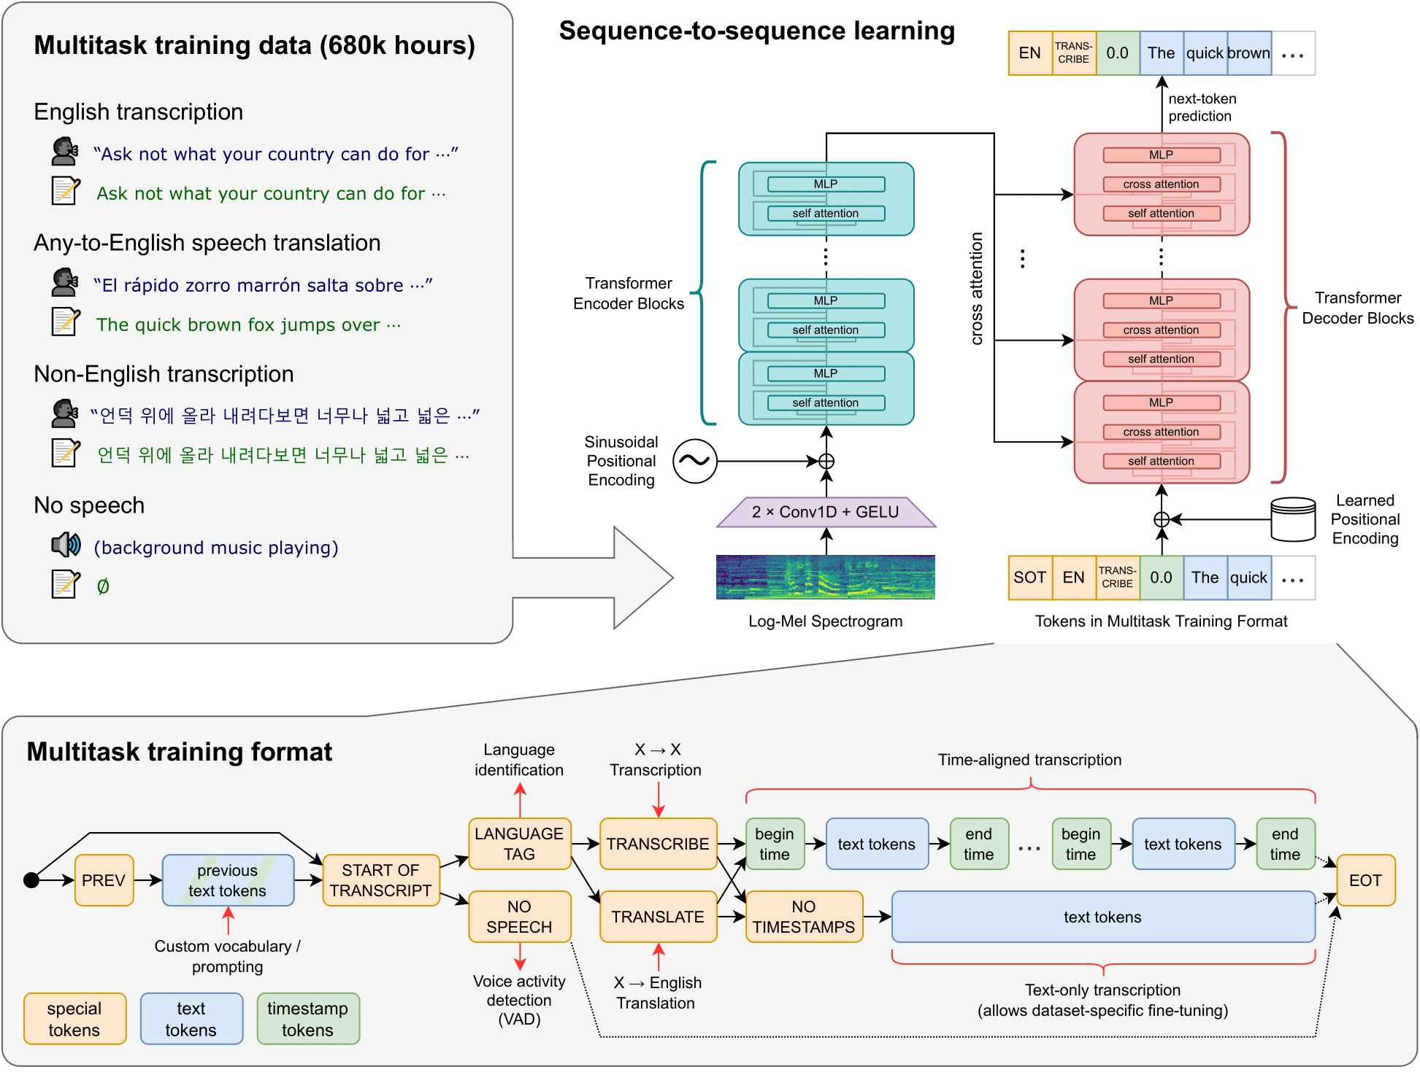
Whisper is a encoder-decoder transformer model
Text encoder-decoder transformer for translation
Whisper speech encoder-decoder transformer
Notes:
Made one slide with general encoder decode architecture, To

Slide 87
Whisper encoder
Pass through transformer blocks
Add position embeddings
Pass through conv nets to extract features, downsample to every 20 ms
Run a 128-channel Mel spectrogram, every 10 ms
Notes:
Made one slide with general encoder decode architecture, To

Slide 88
Output of Whisper encoder
The language modeling head
The output of the last block is an embedding
We need to instead get a distribution over tokens.
We multiple by a matrix that turns an embedding [1x1280] into the vocabulary dimension [1 x 50,000]
Then we do softmax over that vector to get probabilities

Slide 89
Speech Models
Whisper Introduction

Slide 90
Speech Models
Whisper: Cross-attention in the Encoder-Decoder

Slide 91
Reminder of attention

Slide 92



Attention:
test
x1 x2 x3 x4 x5 x6 x7 xi
Notes:
D

Slide 93
An Actual Attention Head: slightly more complicated
High-level idea: instead of using vectors (like x_{i} and x₄) directly, we'll represent 3 separate roles each vector x_{i} plays:
query: As the current element being compared to the preceding inputs.
key: as a preceding input that is being compared to the current element to determine a similarity
value: a value of a preceding element that gets weighted and summed
Notes:
The word head is used in transformers to refer to specific structured layers

Slide 94
Attention intuition
query
x1 x2 x3 x4 x5 x6 x7 xi
values
Notes:
D

Slide 95
Attention:
q_{i} ⋅ k_{j}
v_{j})
q
query
x1 x2 x3 x4 x5 x6 x7 xi
keys
k
k
k
k
k
k
k
k
values
v
v
v
v
v
v
v
v
Notes:
D

Slide 96
How do we get 3 vectors q_{i}, k_{i}, v_{i} for each x_{i}?
We'll use matrices to project each vector x_{i} into a representation of its role as query, key, value:
query: W^{Q}
key: W^{K}
value: W^{V}

Slide 97

Final equations for one attention head
we also normalize the dot product
Notes:
the result of a dot product can be an arbitrarily large (positive or negative) value, and exponentiating large values can lead to numerical issues and loss of gradients during training. To avoid this, we scale the dot product by a factor related to the size of the embeddings, via diving by the square root of the dimensionality of the query and key vectors (dk).

Slide 98
Parallelizing computation using X
We can pack the N tokens of the input sequence into a single matrix X of size [N × d].
  Each row of X is the embedding of one token of the input.
  X can have 1K-32K rows, each of the dimensionality of the embedding d (the model dimension)

Slide 99

Attention:
X
V
K
Q
q_{i} ⋅ k_{j}
Thanks
x1
v1
k1
q1
v_{j}
for
x2
v2
k2
q2
all
x3
v3
k3
q3
the
x4
v4
k4
q4
fish
x5
v5
k5
q5
x1 x2 x3 x4 x5 x6 x7 xi
Notes:
D

Slide 100

QK^{T}
We can do a single matrix multiply to combine Q and K^{T}

Slide 101


Slide 102


v_{j}

Slide 103

Parallelizing attention
Scale the scores, take the softmax, and then multiply the result by V resulting in a matrix of shape N × d
  An attention vector for each input token

Slide 104
Masking out the future
What is this mask function?
QK^{T} has a score for each query dot every key, including those that follow the query.
Guessing the next word is pretty simple if you already know it!

Slide 105

Masking out the future
Add –∞ to cells in upper triangle
The softmax will turn it to 0

Slide 106

A regular transformer block
Notes:
The weights are the same for each token position i , but are different from layer to layer. It is common to make the dimensionality dff of the hidden layer of the feedforward network be larger than the model dimensionality d. (For example in the original transformer model, d = 512 and dff = 2048.)

Slide 107
Reminder: Whisper

Slide 108

A encoder-decoder decoder-side block with cross-attention
Cross-attend
to the speech encoder output

Slide 109

Whisper encoder/decoder components

Slide 110
Cross-attention
Attention in a decoder (or encoder) builds up a new representation at layer l from layer l-1
By attending to all the other tokens in l-1
Cross-attention in a decoder builds up a new representation at layer l from layer l-1
By attending to the encoder output + other tokens in l-1)

Slide 111
Whisper encoder/decoder components

Slide 112
Cross-attention equations
The output of encoder is H_{enc} = h₁,...,h_{n} of shape [n × d]
Cross attention takes the query from the decoder
But the key and value from the encoder:
So "attend to the speech input informed by the text representation from my previous layer"
Multiplies them all together to get the attention value

Slide 113
Speech Models
Whisper: Cross-attention in the Encoder-Decoder

Slide 114
Speech Models
Whisper: Training

Slide 115
Whisper training: Loss function
Standard language-modeling loss:
L_{CE} = −log p(y_{i} | y₁, …, y_{i-1}, X)
The probability of the next token y_{i} given all the previous tokens and the acoustic input X

Slide 116
Whisper training: Data
680,000 hours of multilingual and multitask supervision
Including 118,000 hours from 96 other languages.
All the data is audio paired with a transcript
Scraped from the web, with lots of filtering
Broken into chunks:
30 second audio, paired with transcript of words

Slide 117
Actually, it's multitask training setup

Slide 119

Whisper (Multitask Training)

Slide 120
Whisper: task tags

Slide 121
Speech Models
Whisper: Training

Slide 122
Speech Models
Whisper: Conclusion

Slide 123
Speech recognition!
Transformers work for speech as well as text!
Speech transcription performance is good enough to be useful in many practical situations
Huge improvements in technology in 10 years.

Slide 124
So is speech recognition solved?

Slide 125

Not yet. Whisper is much worse than humans on slightly noisy speech

Slide 126

And even worse on very noisy speech
Whisper (Transcription): Allez, il va y aller, il va y aller, il va y aller, il va y aller, il va y aller, il va y aller, il va y aller, il va y aller, il va y aller, il va y aller, il va y aller, il va y aller, il va y aller, il va y aller, il va y aller, il va y aller, il va y aller, il va y aller, il va y aller, il va y aller, il va y aller, il va y aller, il va y aller, il va y aller, il va y aller, il va y aller, il va y aller………..
Whisper (Translation): Come on, come on, come on, come on, come on, come on, come on, come on, come on, come on, come on, come on, come on, come on, come on, come on, come on, come on, come on, come on, come on, come on, come on, come on, come on, come on, come on, come on, come on,,...............
Ground truth: “Allez, allez, allez, alleeeeez….. Martinez! Qui vient de sauver…. Face à Randal Kolo Muani. Mais c’est fou ! Et ça repart de l'autre côté, et ça repart de l'autre côté !
Example from Tolúlọpẹ́ Ògúnrẹ̀mí

Slide 127

And only works on languages with enough data
Transcription performance on FLEURS dataset (lower is better)
WER below 10 if 1000 hours of training data
(English, Spanish, French, German, etc.)
Low resource languages (top left) have a WER above 100 (Burmese, Lao, Tajik)
High WER for Chinese

Slide 128
Speech recognition!
ASR performance good enough to be useful in many practical situations
Huge improvements over last 10 years.
But still fails on many tasks and domains
  Noisy speech
  Multiple overlapping speakers
  Low-resource languages
  Some speakers (children, old people, people who stutter)

Slide 129
Speech Models
Whisper

