Slide 1
Social Networks & Power Laws
Social Networks
Notes:
Information is in the structure of networks, not just text. Here we introduce some basic properties and metrics for social networks.

Slide 2
What is a social network?
A graph metaphor for studying the relationships/interactions among a group of people
People: vertices/nodes
Relationship: edges
System: network, graph
V
E
G(V,E)
Notes:
What is a social network? The term social network is commonly used to mean a company or an app that connects people in a graph. Here we mean something more abstract: the actual graph metaphor for studying the relationships among a group of people.
The nodes or vertices of the graph will represent people.
And various specific relationships between people will be represented by the edges or links between the nodes
So the whole system of people and their relationships

Slide 3
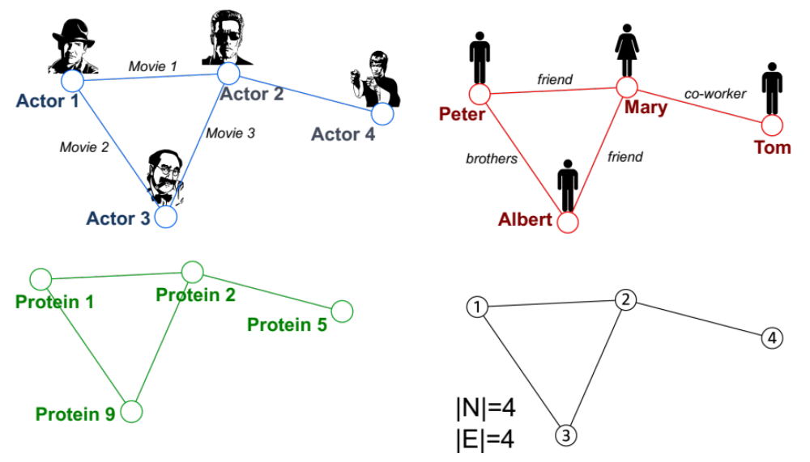
3 Sample Graphs
Figures from Jure Leskovec, CS224W
Notes:
Here's a graph where the nodes are actors and the edges are movies they appeared in together.
CLICK
Here's one where nodes are people and the edges are social relationships like brother or friend.
CLICK
And for some quesitons we can abstract away to just talk about the structure of these 4 nodes and 4 edges.

Slide 4
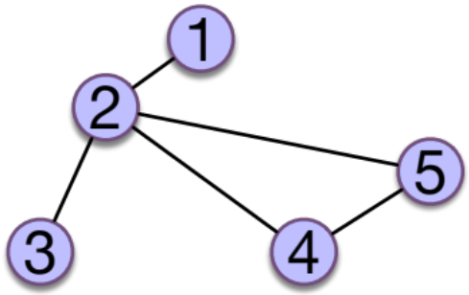
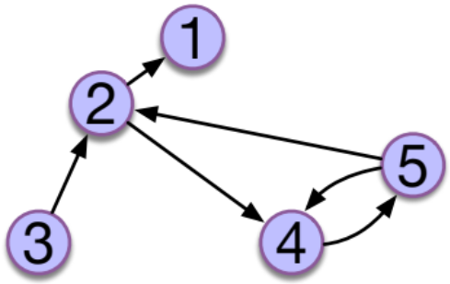
Networks can be undirected or directed
Undirected
Friendship on Facebook
Actor Collaborations
Twitter conversations
Directed
Citations
Following on Twitter or IG
Notes:
Networks can be undirected or directed. In undirected networks the edges between nodes are symmetric; things like CLICK friendship on facebook CLICK actor collaborations CLICK twitter conversaitons.
CLICK In directed networks the edges are assymtric. So in CLICK citation graphs, the nodes are papers, and the edges point from paper A to paper B if paper A cites paper B. Following someone on Twitter or Instagram is a directed relation

Slide 5
Some useful properties of nodes
Centrality Measures
Degree (Undirected, in-degree, out-degree)
Betweenness Centrality
Clustering Coefficient
Notes:
Let's introduce some useful properties of nodes: 2 kinds of measures of how important or central a node is in a graph: node degree snd node betweenness. And we'll introduce the important clustering coefficient

Slide 6

Measuring Centrality: Degree
Node degree k_{i}: the number of edges touching node i
k₂=4
k₁=k₃=1
k₄=k₅=2
Notes:
The degree of a node I in an undirected graph is the number of edges touching i So in this graph node 2… And nodes 1 and 3… and nodes 4 and 5…

Slide 7
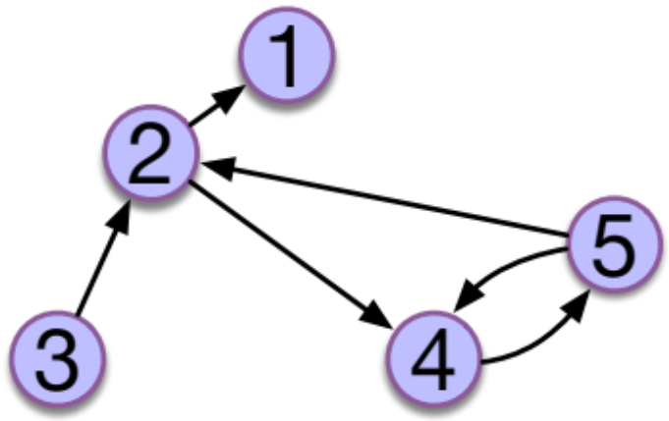
Measuring Centrality: in-degree
Node in-degree k^{in}_{i}: the number of edges into node i
k^{in}₂=k^{in}₄=2
k^{in}₁=k^{in}₅=1
k^{in}₃=0
Notes:
In a directed graph we can measure a node I's in-degree (how many people point to i), or out-degree (how many nodes does I point to).
For example node 2… node 4… nodes 1 and 5…. Node 3…

Slide 8
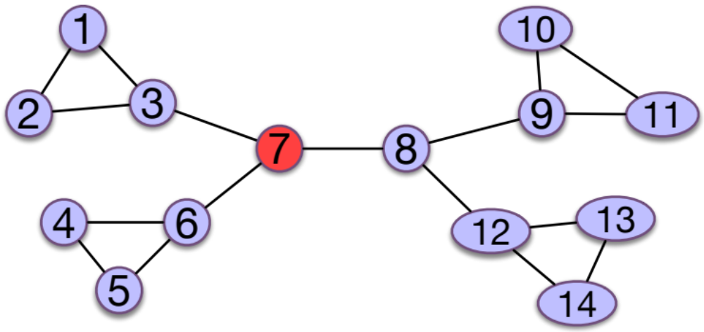
Betweenness Centrality
  A node with high betweenness
  lots of shortest paths between nodes must pass through it
  is a bottleneck for information flow in the network
  Betweenness of node 7 should be high
Notes:
Another kind of centrality is betweenness centrality. A node has high betweenness if lots of the shortest paths between pairs of nodes must pass through it.
So for example in this graph the betweenness of node 7 is high, because many of the shortest paths between pairs of nodes, like 2 and 11 or 4 and 8, pass through 7

Slide 9
Betweenness Centrality
The betweenness of a node A (or an edge A-B)=
  number of shortest paths that go through A (or A-B)
  ___________________________________________________________________________
  total number of shortest paths that exist between all pairs of nodes
Notes:
The betweenness of a node A (and we can also compute betweenness for an edge like A-B) is:

Slide 10
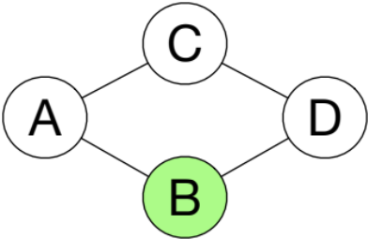
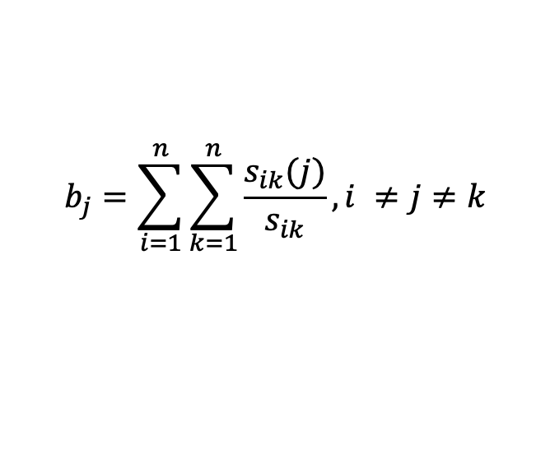
Betweenness
b_{A} =
  number of shortest paths that go through A
  total number of shortest paths between all pairs of nodes
$$b_{j}=\sum_{i=1}^{n}{\sum_{k=1}^{n}{\frac{s_{ik}(j)}{s_{ik}}}},i ≠j≠k$$
More formally:
Where: s_{ik} = the # of shortest paths between i and k
s_{ik}(j) = the # of shortest paths between i and k that go through j
Betweenness of B?
# sh. paths
through B
# shortest
paths
A,C
0
1
Centrality b_{B}
=
A,D
1
2
1/4
C,D
0
1
Notes:
Let's more formally define b_a to mean the betweenness of node A. CLICK We can define this more formally as the sum over all pairs of nodes I and k that aren't j, of the total number of shortest paths between I and k, how many of them go through j
CLICK. Let's walk through the betweenness computation for this node B. Let's take the pair of nodes A and C. The shortest path between A and C is this one, and it doesn't go through B, so that's a 0, out of 1. There are two shortest paths between A and D, and one of them, this one, goes through B. CLICK So in sum, we have 4 shortest paths between all pairs of nodes that aren't B, and 1 of them goes through B, so that's a centrality of ¼ or .25.

Slide 11
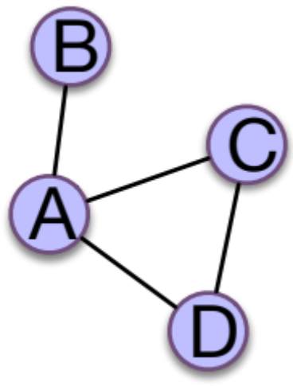
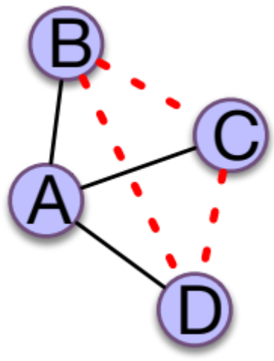
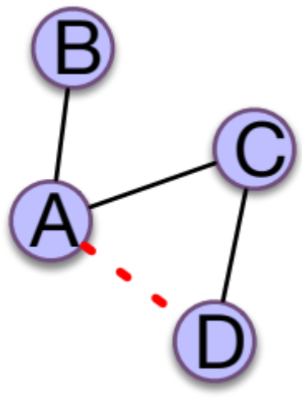
Clustering coefficient
C_{A} for a node A: what % of my friends know each other?
A has 3 friends (B,C,D), 3 possible links (B-C, B-D, C-D)
Only C-D exists
C_{A} = 1/3
How about C_{C}?
C_{C}=1/1
Ranges from 0 (no friends know each other) to 1 (all do)
# of edges between A's friends
C =
n_{A} * (n_{A} -1)/2
Notes:
Finally, let's introduce a very important property of a node called its clustering coefficient.
The clustering coefficient for a node measure a property of its neighbors, the nodes that are adjacent to it (connected to it by an edge), how about I'll informally call them its friends. The clustering coefficient C_A for a node A measures the % of my friends that are friends with each other; the % of the nodes adjacent to me, that are also adjacent to each other.
For example, let's compute the clustering coefficient for node A. CLICK. A has the friends, B,C,D. So there are 3 possible links among those friends: B-C, B-D, and C-D. Of those 3, only C-D exists. CLICK So C_A = 1/3. CLICK. How about C_C? CLICK. Here there are two neighbors, A and D, and one possible link, the link A-D, and it's there, so the clustering coefficient is 1/1 = 1
CLICK the clustering coefficient ranges from 0 (no friends know each other) to 1 (all do). Here's the equation we just described. If n is the number of neighbors of A, Out of the n * n-1 over 2 possible edges between those neighbors, what percentage of those exist?

Slide 12
Social Networks & Power Laws
Social Networks
Notes:
We've seen some important metrics for nodes in social networks, include their degree, betweenness, and clustering coefficient.

Slide 13
Social Networks & Power Laws
Small Worlds
Notes:
Here we define a small world network, and talk about 6 degrees of separation.

Slide 14
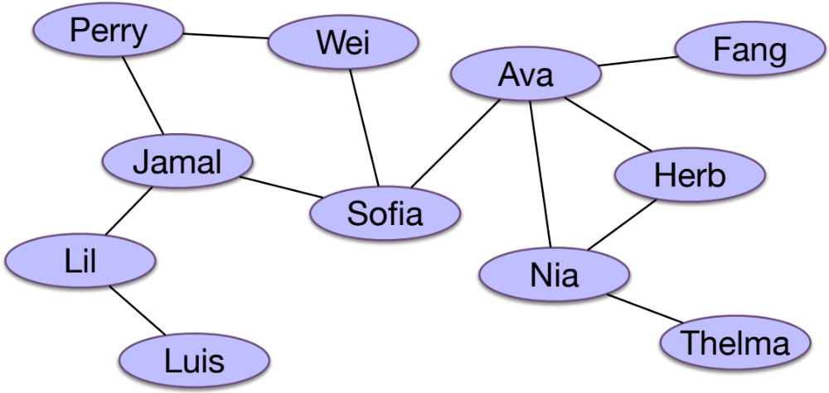
"6 Degrees of Separation"?
Small world: people are connected by small # of links
Notes:
A small world network is one in which all people are connected by a short path consisting of a small number of edges. For example, here's an undirected graph of people, lets say the links correspond to who knows who. Jamal is directly connected to Sofia. Lil has to go through one hop (Jamal) to get to Sofia. So we say that Lil is 2 edges or hops away from Sofia, but 1 degree of Separation. Herb has 3 intermediate people to get to Perry (Ava, Sofia, Wei). In this graph, the most distant people are Thelma and Luis, who have 6 hops or 5 intermediate people in between them. So we say that Thelma and Luis have 5 degrees of separation. We often hear the saying that all people are "connected by six degrees of separation". Is this true?

Slide 15
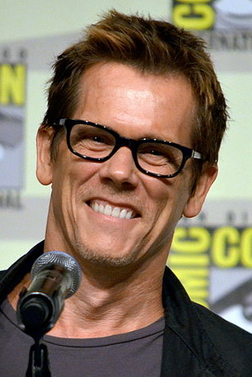
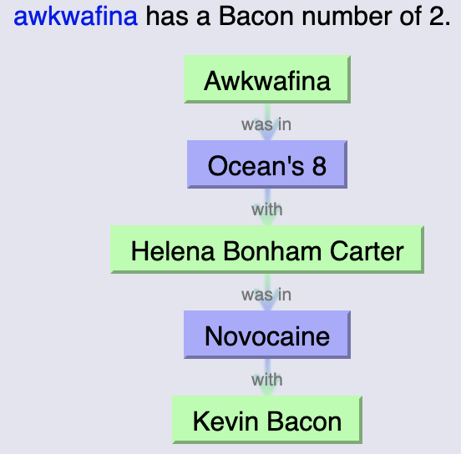
The Kevin Bacon number
Genevieve,
Wikimedia Commons
Create a network of movie actors
Connect 2 actors if they're in the same movie
Count the number of steps to Kevin Bacon
Almost all actors have Bacon numbers <= 4
Notes:
This idea of measuring distance between people in a social network can be applicable in all sorts of networks. There's a well-known game using the prolific actor Kevin Bacon in which we create a network of movie actors and connect any 2 actors if they're in the same movie. Now from that graph we count the distance between actors and see the distance between any actor and Kevin Bacon. So in this version, Kevin Bacon is distance 0 from himself, distance 1 from Helena Bonham Carter, because they both acted in Novocaine, and distance two from Akwafina, because Awkwafine and Helena Bonham Carter appeared together in Ocean's 8. It turns out almost all actors have small Bacon numbers of 4 or less.

Slide 16
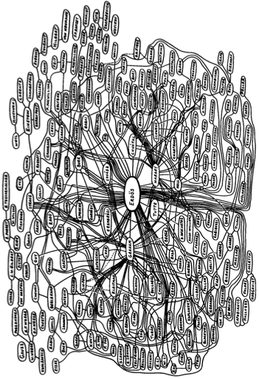
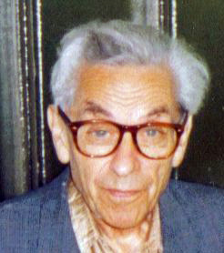
Erdös numbers are small too
Topsy Kretts
Wikimedia Commons
Ron Graham. 1979. On Properties of a Well-Known Graph. Annals N.Y. Acad. Sci. 328 (1979), 166-172.
Notes:
Another kind of network is the academic co-authorship network. A commonly discussed network is the network of people who have collaborated with the prolific and peripatetic Hungarian mathematician Paul Erdös. In this network, Erdos himself has Erdos number 0, people who have written papers with him have Erdos number 1, and people who have written papers with Erdos's coauthors have Erdos number 2, and so on. Most mathematicians have very small Erdos numbers

Slide 17
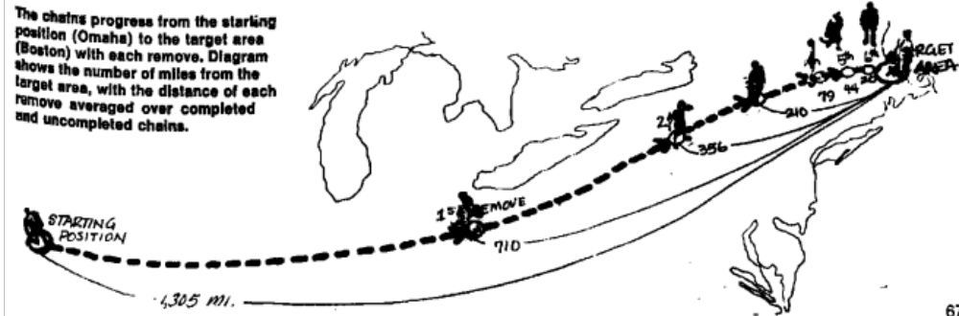
The Milgram Small World Experiment
How to find the typical shortest path between any two people?
Milgram, Stanley. "The small world problem." Psychology today 2, no. 1 (1967): 60-67.
Travers and Milgram (1969): Asked 300 people in Omaha NE and Boston
  Get a letter to a stock-broker in Boston by passing it through friends
How many steps did it take?
Travers, J., & Milgram, S. (1969). An exploratory study of the small world problem. Sociometry, 32, 425-43.
Notes:
A famous experiment designed to measure exactly how many degrees of separation there are, testing how connected the real-world network of people in one country are, was a series of experiments run by psychologist Stanley Milgram and colleagues starting in 1967. In one of their experiments, for example, they asked people in various places like Omaha Nebraska to get a letter to a particular stockbroker in Boston. Participants had to mail the letter only to someone they knew personally on a first-name basis. Then the experiments would measure the number of intermediates to get an estimate of the average shortest path.

Slide 18
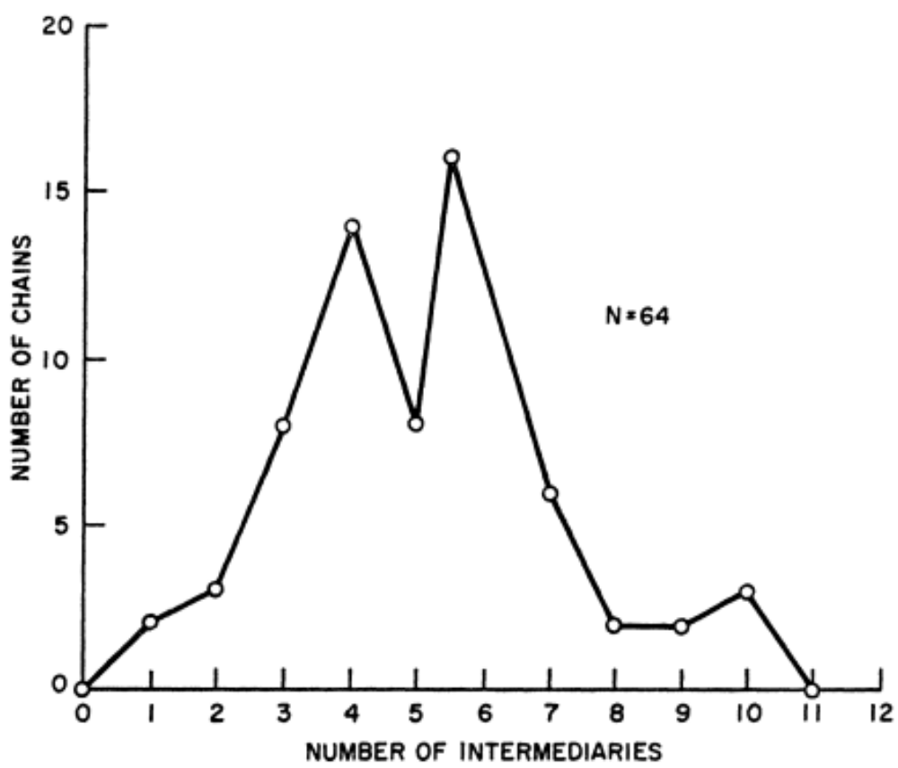
The Milgram small world experiments
It took 4.4-5.7 intermediaries on average
“Six degrees of separation”
Most letters passed through 2 "hub" people
Travers, J., & Milgram, S. (1969). An exploratory study of the small world problem. Sociometry, 32, 425-43.
Notes:
On average, depending on the experiment, it took between 4.4 and 5.7 intermediaries to get the letter to the stockbroker. So if we take the higher number, that's 6 degrees of separation. As an aside, most of the letters got to the stockbroker only through 2 hubs, friends of his who were connected to lots of people. That suggests that the actual social network has some people with very high betweenness.

Slide 19
Problems with Milgram experiment
Not enough data
Only 300 observations to start
Of those, only 64 letters made it through
Almost certainly an overestimate
People may not find actual shortest path
Notes:
The Milgram experiment was important, but limited. There wasn't much data, only 300 observations to start, and of those, only 64 letters made it through. Furthermore, the estimate of 5.7 degrees of separation is probably an overestimate, since it only measures the shortest path people were able to find, but there might well have been a shorter path had they known more about who to send through.

Slide 20
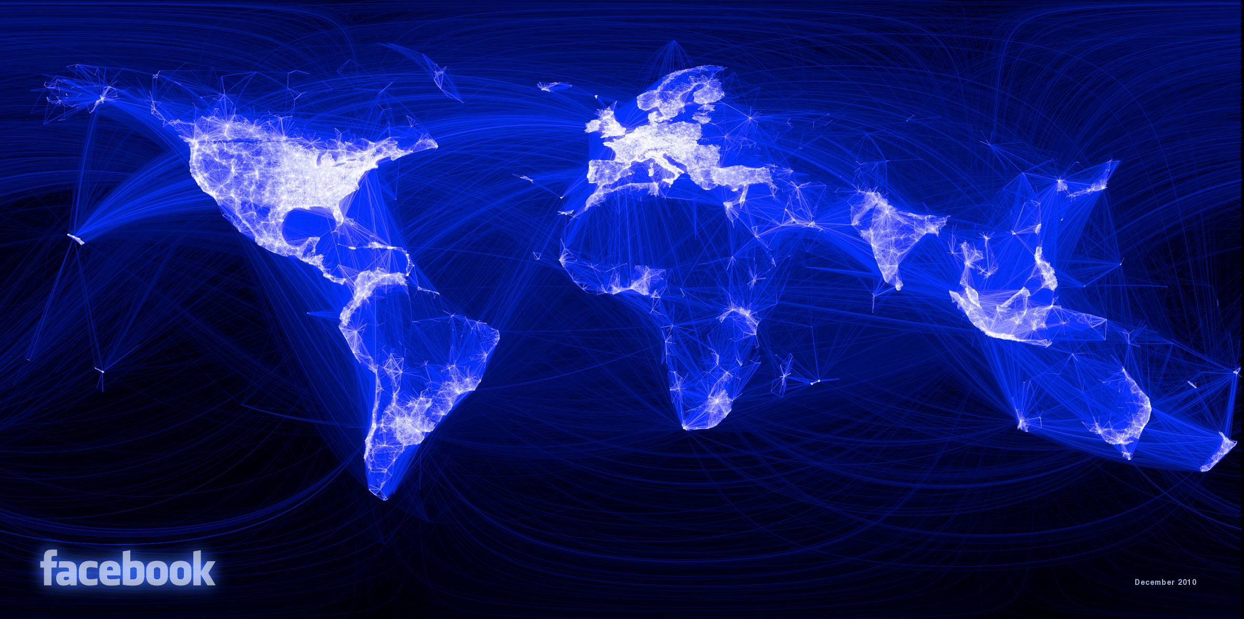
Online small world: Facebook friends
721 million users
69 billion friendship links
Paul Butler, Facebook
99.6% of all pairs of users connected by paths of 5 degrees (6 hops)
92% are connected by only four degrees (5 hops).
Average: 3.74 intermediaries/degrees (4.74 hops)
Four degrees of separation
Backstrom, Lars, Paolo Boldi, Marco Rosa, Johan Ugander, and Sebastiano Vigna. "Four degrees of separation." In Proceedings of the 4th Annual ACM Web Science Conference, pp. 33-42. 2012.
Notes:
In 2012, Backstrom and colleagues asked the same question about the graph of Facebook friends, computing the number of intermediate friends between any 2 random people on the entire Facebook graph of what was then 700 million users. They found that almost all pairs of users were connected by paths of 5 degrees. The average number of intermediaries was 3.74, so they called their paper "Four degrees of separation".

Slide 21
Fun facts: Origins of the “Six degrees” hypothesis
Hungarian writer Karinthy’s 1929 play “Chains” (Láncszemek)
  https://djjr-courses.wdfiles.com/local--files/soc180%3Akarinthy-chain-links/Karinthy-Chain-Links_1929.pdf
Notes:
A fun fact is that the hypothesis that all people are connected by six degrees of separation came from a 1929 play by Hungarian writer Karinthy Frigyes.

Slide 22
Why is the world small? What are the implications?
Duncan Watts: Small world is interesting because:
The network is large - O(Billions)
The network is sparse - people are connected to a small fraction of the total network
The network is decentralized -- no single (or small #) of stars
The network is highly clustered -- most friendship circles are overlapping
Slide from James Moody
Notes:
Why is the world small? Why is this interesting? Duncan Watts points out that it's the fact that the networks of friendship or acquantanceship is so enormous and sparse (most people only have a reasonably small number of friends). And furthermore, most friendships are clustered; my friends mostly know each other. So given these facts about how human friendships work, how could it be that nonetheless we are all so connectded by , say, less than 6 degrees of separation?

Slide 23
Watts and Strogatz (1998) Model
A small world graph: very clustered (high C) but small path-length (low L)
Clustering coefficient C
  How many of my friends know each other
  Averaged over all nodes: the average local density
Characteristic path length L
  The average length of the shortest paths connecting any two nodes.
(Note: this is not quite the same as the diameter of the graph, which is the maximum shortest path connecting any two nodes)
Watts, D., Strogatz, S. Collective dynamics of ‘small-world’ networks. Nature 393, 440–442 (1998).
Notes:
A formal understanding of this fact came from the influential Watts and Strogatz model from 1998. Here they defined a small world graph as one that despite between very clustered, that is, having a high clustering coefficient, still has a very small path-length, a low L.
We've already seen the clustering coefficient C, which measures how many of my friends know each other. If we average this clustering coefficient over all the nodes in a graph, we get an average measure of the local desnity of the graph.
And Watts and Strogatz introduce a second statistic, the characteristic path length L. This is the average length of the shortest path connecting any two nodes. Note that this is not quite the same as the diameter of the graph, which is the maximum shortest path connecting any two nodes.
So again, given these two nodes, a small world graph is one that has a high C, is very clustered, but still has a small L.

Slide 24
Watts and Strogatz (1998) "Caveman Network"
Everyone in a cave knows each other
A few people make connections
Are C and L high or low?
C high, L high
Slide from Lada Adamic
Notes:
To visualize how this is possible, let's start with what we might call the caveman network. Here we have 5 people in a cave, everyone is each cave knows each other, and maybe a few people have connections to neighboring caves. Think for a moment whether C and L are high or Low in this setting? Here C and L are both high. Clustering coefficient is high since in most cases, your friends all know each other. Characteristic path length L is high, since on average, if I choose two random nodes, we will have to go halfway around the world to link them up!

Slide 25
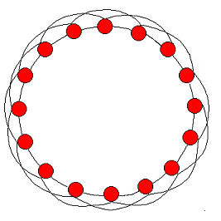
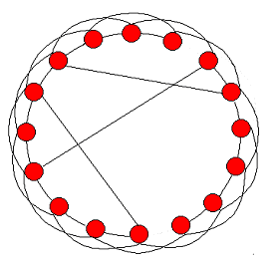
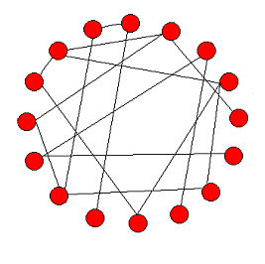
Watts and Strogatz 1998 model
Start with a ring, where every node is connected to the next z nodes ( a regular lattice)
With probability p, rewire every edge (or, add a shortcut) to a random, uniformly chosen destination.
p = 0
0 < p < 1
p = 1
Slide from
Lada Adamic
lattice
small world
random
Notes:
Watts and Strogatz proposed that we formalize this as a regular lattice, a ring where every node is connected to the next z nodes. Here in this picture, every node is connected to the next 2 nodes. Now, with probability p, we rewire every edge to a random destination. If p=0, we don't do any rewiring. If p=1 we rewire all the edges and we get a random graph. Watts and Strogatz showed that if p is inbetween, we get a small world network with High C but low L

Slide 26
Why does this work? Key is fraction of shortcuts in the network
In a highly clustered, ordered network, a single random connection will create a shortcut that lowers L dramatically
Without big changes in C
Small world: very clustered (high C) but small path-length (low L)
Small world properties can be created by a small number of shortcuts
Slide from
Lada Adamic
Notes:
What's going on. A singl random connection basically creates a shortcut, lowering L dramatically without making big changes in C. The result is a small world: very clustered (high C) but short average path length (low L).

Slide 27
Clustering and Path length
Lattice
Small world
High C
High L
High C
Low L
Figures from
Lada Adamic
Notes:
The original graph, High C and high L. Add some random links, we drop L and now we have a graph that has the human small-world characteristics.

Slide 28
Small World: Summary
Can a network with high clustering be a small world?
  Yes! You don’t need more than a few random links
The Watts Strogatz Model:
Provides insight on the interplay between clustering and the small-world
Captures the structure of many realistic networks
Accounts for the high clustering of real networks
Slide from Jure Leskovec
Notes:
In summary, a highly clustered network can be a small world, just by adding a few random links. The Watts Strogatz formal model gives us some insight into how the more complex human social network might be functioning.

Slide 29
Social Networks & Power Laws
Small Worlds
Notes:
We've seen some properties and models for small world networks

Slide 30
Social Networks & Power Laws
Weak Links
Notes:
Not all edges in a social network are the same. Here we learn about the surprising strength of weak links.

Slide 31
Weak links
In the 1960s, Mark Granovetter studied how people find jobs.
He found out that most job referrals were through personal contacts.
But more by acquaintances and not close friends.
Why didn’t jobs come from close friends?
Mark Granovetter. The strength of weak ties. American Journal of Sociology, 78:1360– 1380, 1973.

Slide 32
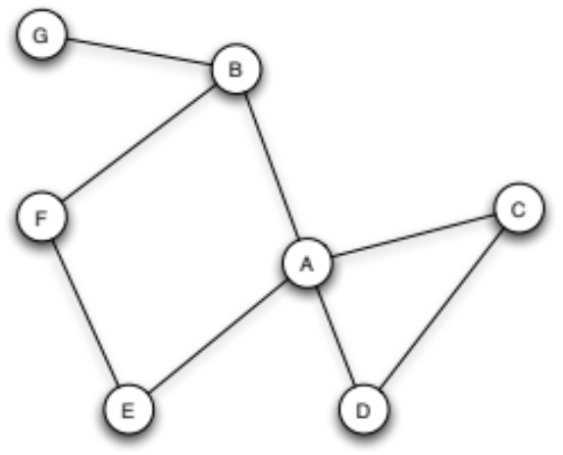
Triadic Closure
“If two people in a social network have a friend in common, then there is an increased likelihood that they will become friends themselves at some point in the future.” (Anatol Rapoport 1953)
Figure from D. Easley and J.Kleinberg. 2010.
Networks, Crowds, and Markets. Cambridge
Notes:
To see the answer, it will help to define some useful properties and mechanisms on graphs.
One is called triadic closure. The idea comes from social network pioneer Anatol Rapoport, who suggested that:
So consider person A here. A has two friends, B and C, but they don't know each other; there is no link between them Triadic closure is the idea that such open triangles tend to close. Hence the name triadic closure.

Slide 33
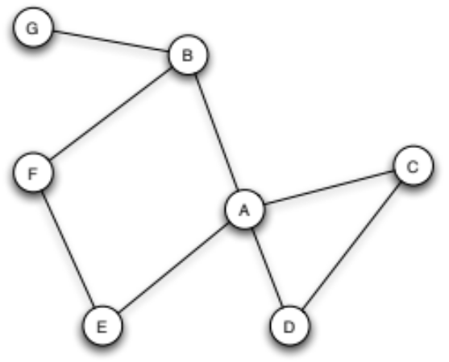
Reminder: clustering coefficient C
C_{A} of a node A is the percentage of friends of A who are friends themselves
C_{A} before new edge = 1/6
(of B-C, B-D, B-E, C-D, C-E, D-E)
C_{A} after new edge?
Triadic closure leads to higher clustering coefficients
= 2/6
Figure from D. Easley and J.Kleinberg. 2010.
Networks, Crowds, and Markets. Cambridge
Notes:
How does triadic closure affect the clustering coefficient C?
Let's recall the definition of the clustering coefficient C, the % of friends of A who are friends themselves. C_A before adding this new edge is 1/6; of the 6 possible links ….. Only 1 is there.
After the new edge, C_A is 2/6. So Triadic closure leads to higher clustering coefficients

Slide 34
Why Triadic Closure?
We meet our friends through other friends
  B and C have opportunity to meet through A
B and C’s mutual friendship with A gives them a reason to trust A
A has incentive to bring B and C together to avoid stress:
  if A is friends with two people who don’t like each other it causes stress
Notes:
Why does triadic closure happen? It could just be opportunity: we meet our friends through other frineds, and B and C have the opportunity to meet through A.
Or it could be trust; B and C’s mutual friendship with A gives them a reason to trust A
Or A has incentive to bring B and C together to avoid stress:
Since if A is friends with two people who don’t like each other it causes stress

Slide 35
An aside about the importance of triangles
Bearman, Peter S., and James Moody. "Suicide and friendships among American adolescents." American Journal of Public Health 94, no. 1 (2004): 89-95.
Famous, replicated Bearman and Moody result
Adolescents with low clustering coefficients in their friend network more likely to consider suicide.
Lack of triangles correlates with lack of social groups
Notes:
This idea of open triangles and the importance of closed triangles has been studied for mental health. Bearman and Moody found that teens with low clustering coefficients in their friend network are more likely to consider suicide. This could be because lack of closed triangles correlates with lack of social groups; you might have lots of individual friends, but if they don't know each other you may not have the support of a coherent group, or because of the stress caused by open triangles, by friends who themselves are not friends.

Slide 36
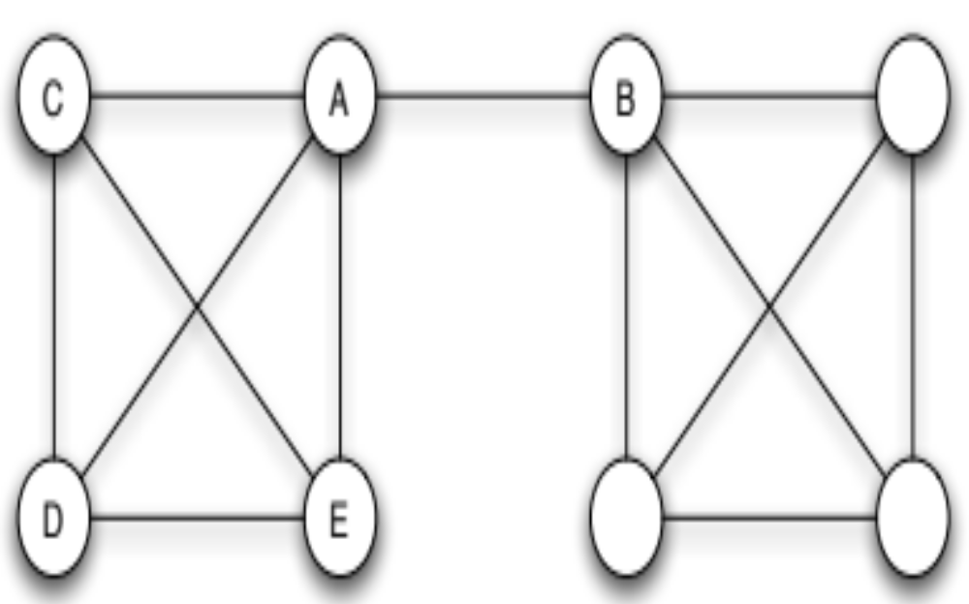
Bridges
A bridge is an edge whose removal places A and B in different components
If A is going to get new information (like a job) that she doesn’t already know about, it might come from B
Figure from D. Easley and J.Kleinberg. 2010.
Networks, Crowds, and Markets. Cambridge
Notes:
OK, we're still on the way to explaining Granovetter's result about why jobs came through acquaintances rather than through close friends. We'll need one more definition: a bridge.

Slide 37
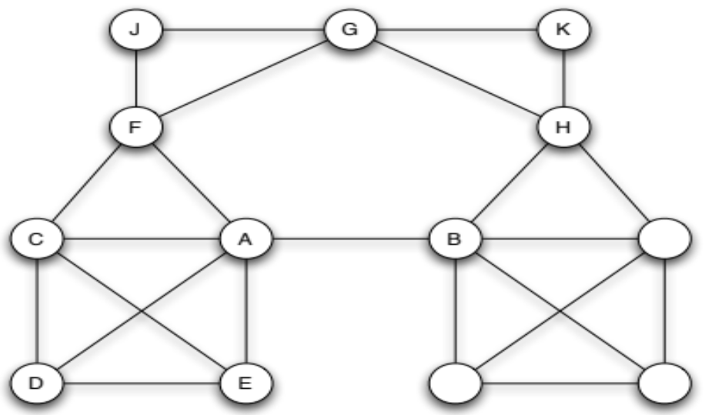
Local Bridge
A local bridge is an edge X-Y where X,Y have no friends in common (a local bridge does not form the side of any triangle)
If A is going to get new information (like a job) that she doesn’t already know about, it might come from B
Figure from D. Easley and J.Kleinberg. 2010.
Networks, Crowds, and Markets. Cambridge
Notes:
In actual social networks true bridges are rare, since people are pretty connected. More likely is what we'll call a local bridge.

Slide 38
Strong and Weak Ties
Some ties are stronger
closer friendships
more time spent together
Simplifying assumption
ties are either strong (s) or weak (w)
Notes:
Let's enrich our model a bit further. We know that some ties are stronger than others, we have scloser friends as compared with acquaintances, people we spend more time with. Let's say that we'll label every edge on the graph with s for a strong tie and w for weak tie.

Slide 39
Strong ties and triadic closure
The new B-C edge more likely to form if A-B and A-C are strong ties
More extreme: if A has strong ties to B and to C, there must be an edge B-C
s
s
Figure from D. Easley and J.Kleinberg. 2010.
Networks, Crowds, and Markets. Cambridge
Notes:
Now let's define a relationship between strong ties and triadic closure. We'll say that a new edge, like this B-C edge, is more likely to form if A-B and A-C are strong ties.
A extreme version of this rule might be, if A …

Slide 40
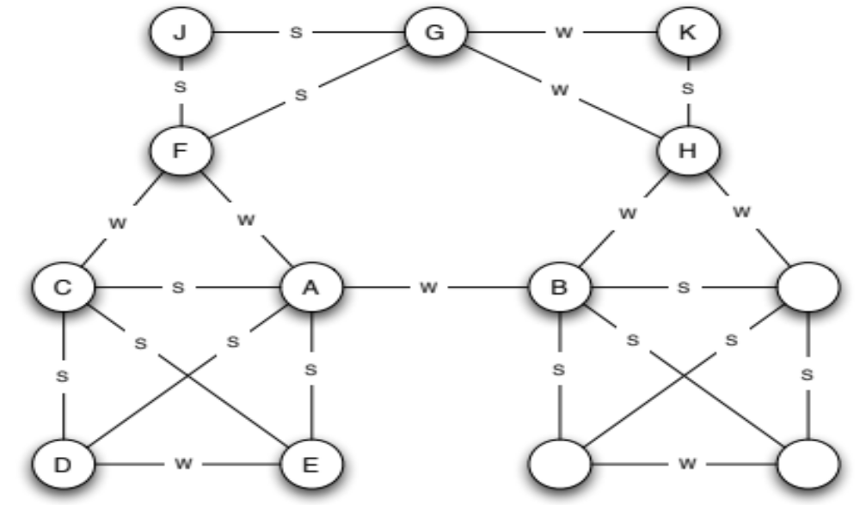
Strong triadic closure
If a node 1 has two strong ties to nodes 2 and 3, there is an edge between 2 and 3
Figure from D. Easley and J.Kleinberg. 2010.
Networks, Crowds, and Markets. Cambridge
Notes:
We'll call this rule "strong triadic closure": if a node 1 has two strong ties to nodes 2 and 3, there is an edge between 2 and 3.
In this graph we see J has strong ties with F and with G and sure enough there is an edge between F and G. B is linked to both A and H, but A and H don't know each other, but that's ok because A-B and B-H are weak ties.

Slide 41
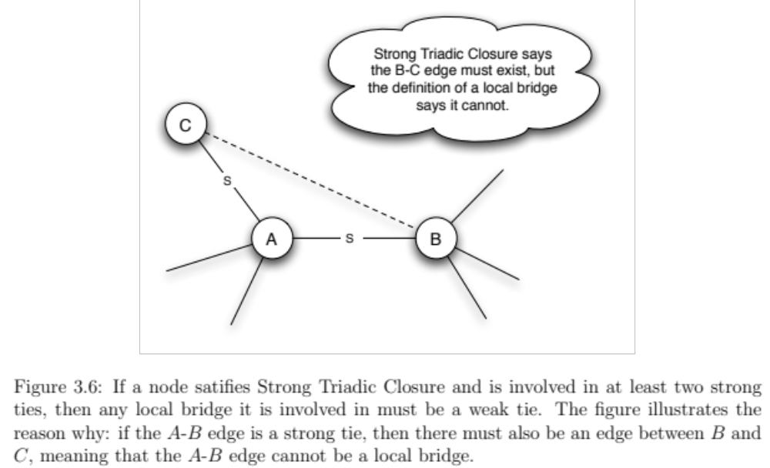
Closure and bridges
If a node A in a network satisfies the Strong Triadic Closure Property and is involved in at least two strong ties, then any local bridge it is involved in must be a weak tie.
Figure from D. Easley and J.Kleinberg. 2010.
Networks, Crowds, and Markets. Cambridge
Notes:
It turns out that …
We can see this by contradiction. Imagine node A has two strong ties, say to B and to C, and let's say one of these is a local bridge . Strong triadic closure says the B-C edge must exist, but the definition of a local bridge says it can't, because a local bridge says that A and B cannot have any friends in common. So the local bridge can't be over a strong tie.

Slide 42
Closure and bridges
So local bridges are likely to be weak ties
Explaining why jobs came from weak ties
Figure from D. Easley and J.Kleinberg. 2010.
Networks, Crowds, and Markets. Cambridge
Notes:
That means that local bridge are likely to be weak ties. That explains why jobs came from weak ties: the local bridge is the source of new information (people across the bridge know different people than me).

Slide 43
The Strength of Weak Ties
Weak ties can occur between cohesive groups: low transitivity
  old college friend
  former colleague from work
Weak ties have different information than close contacts
Granovetter found weak ties were short paths
Compatible with Watts/Strogatz small world model
Notes:
Weak ties can occur between two cohesive groups, like a former colleague from work, or an old college friend. And these ties have different information than close contacts. Indeed Granovetter found that the jobs came from weak ties along very short paths between the job-seeker and the job, compatible with the Watts and Strogatz small world model.

Slide 44
Summary
Triangles (triadic closure) lead to higher clustering coefficients
  Your friends will tend to befriend each other
Local bridges will often be weak ties
Information comes over weak ties

Slide 45
Social Networks & Power Laws
Weak Links
Notes:
We've learned about the surprising strength of weak links.

Slide 46
Social Networks & Power Laws
Power Laws
Notes:
Here we introduce the idea of power laws

Slide 47
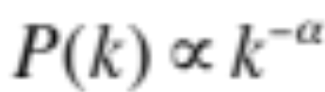
Degree of nodes
Many nodes on the internet have low degree
  One or two connections
A few (hubs) have very high degree
P(k), # of nodes with degree k, follows a power law:
Where α for the internet is about 2.1
So the fraction of web pages with k in-links is proportional to 1/k²

Slide 48
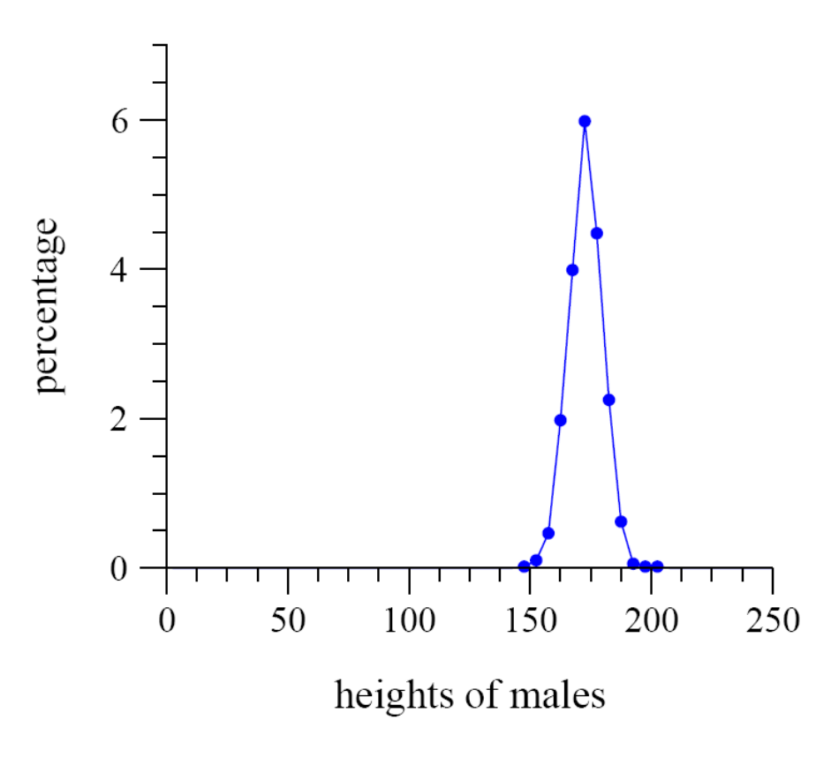
Gaussian (normal) distribution of human heights
average value close to
most typical
distribution close to
symmetric around
average value
Figure from Newman, Mark. "Power laws, Pareto distributions and Zipf's law." Contemporary physics 46, no. 5 (2005): 323-351. Slide from Lada Adamic
Heights of males in US

Slide 49
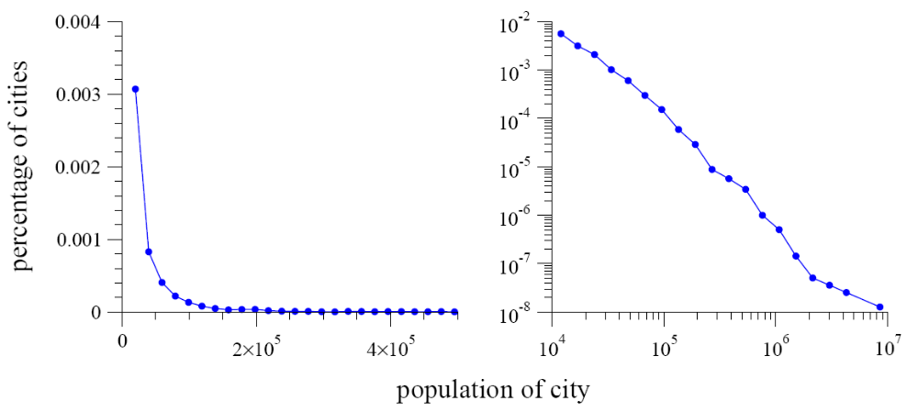
Power-law distribution
Skew (asymmetry)
High ratio of max to min
population of cities
Figure from Newman, Mark. "Power laws, Pareto distributions and Zipf's law." Contemporary physics 46, no. 5 (2005): 323-351. Slide from Lada Adamic
Notes:
The histogram is highly right-skewed, meaning that while the bulk of the distribu- tion occurs for fairly small sizes—most US cities have small populations—there is a small number of cities with a population much higher than the typical value, producing
the long tail to the right of the histogram. This right-skewed
form is qualitatively quite different from the histograms of
people’s heights,

Slide 50
Power-law distributions
Right skew
  normal distribution is centered on mean
  power-law or Zipf distribution is not
High ratio of max to min
  Populations of cities are power-law distributed
  Contrast: human heights are not (max and min not that different)
Slide from Lada Adamic

Slide 51
Power-law distribution
log-log scale
straight line on a log-log plot
Figure from Newman, Mark. "Power laws, Pareto distributions and Zipf's law." Contemporary physics 46, no. 5 (2005): 323-351. Slide from Lada Adamic
Notes:
Here's a new fact: the right panel shows the histogram of city sizes again, but this time replotted with logarithmic horizontal and vertical axes. Now a remarkable pattern emerges: the histogram when plotted in this fashion, follows quite closely a straight line.

Slide 52
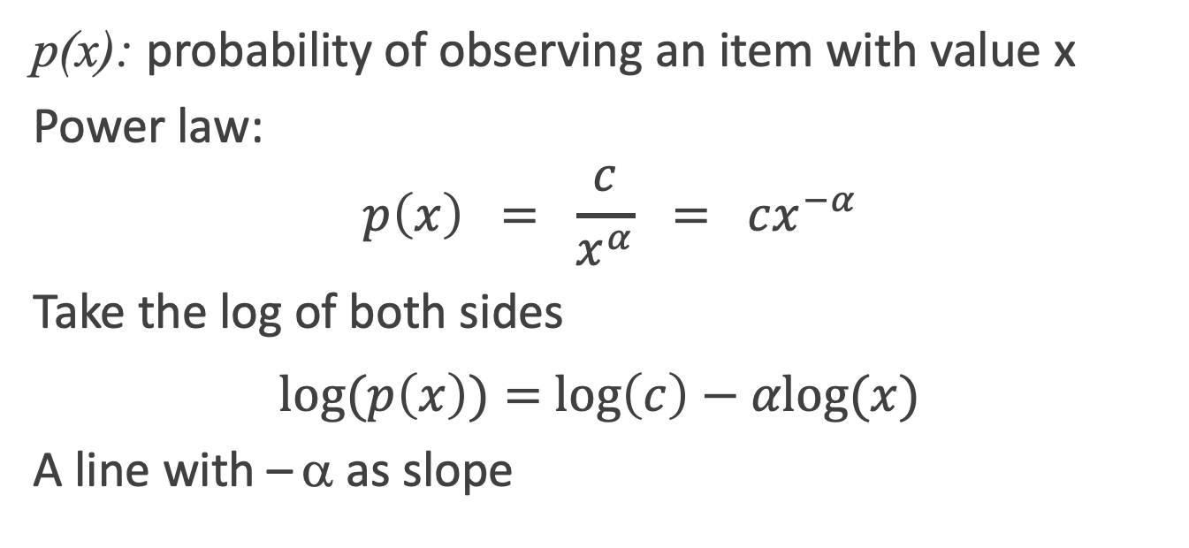
Power law distribution are straight lines on log-log plots
p(x): probability of observing an item with value x
Power law:
$$p\left(x\right) = \frac{c}{x^{α}} = cx^{−α}$$
Take the log of both sides
$\text{log}⁡(p\left(x\right))=$ $\text{log}\left(c\right)−αlog⁡(x)$
A line with – α as slope
power law exponent α
Slide from Lada Adamic
Notes:
What does it mean?
Again, distributions that follow a power law have the form
The constant alpha is called the exponent of the power law.

Slide 53
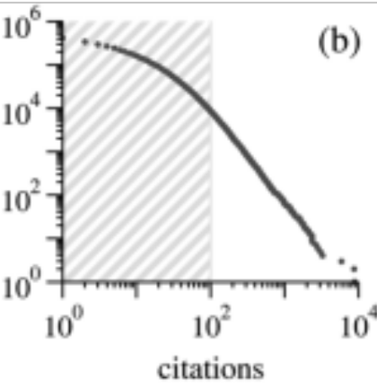
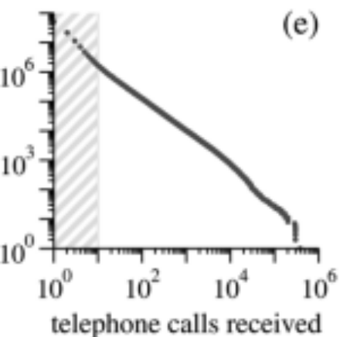
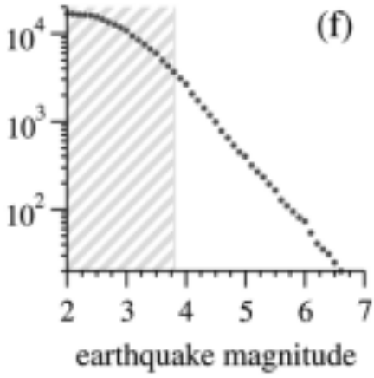
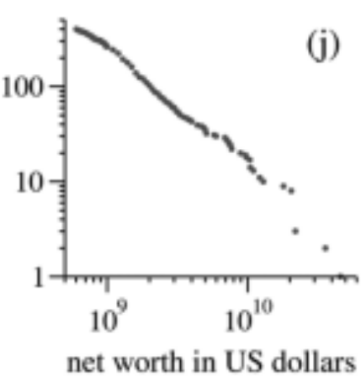
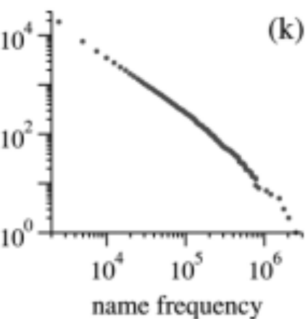
Power laws are everywhere!
Figures from Newman, Mark. "Power laws, Pareto distributions and Zipf's law." Contemporary physics 46, no. 5 (2005): 323-351
Notes:
Power-law distributions occur in an extraordinarily diverse range of phenomena. In addition to city populations, the sizes of earthquakes, the number of telephone calls, the frequency of occurrence of personal names in most cultures, the number of
citations received by papers, people’s net worth and a host of other variables all follow power-law distributions . Here are some cumulative distributions of some of these phenomena.

Slide 54
Power laws are "scale free"
A power law looks the same no mater what scale we look at it on (2 to 50 or 200 to 5000)
Only true of a power-law distribution!
p(bx) = g(b) p(x)
Shape of the distribution unchanged except for a multiplicative constant
p(bx) = (bx)^{-α} = b^{−α} x^{−α}
log(p(x))
x →b*x
log(x)
Slide from Lada Adamic
Notes:
A power-law distribution is also sometimes called a scale- free distribution. Why? Because a power law is the only distribution that is the same whatever scale we look at it on. By this we mean the following.
Suppose we have some probability distribution p(x) for a quantity x, and suppose we discover or somehow deduce that it satisfies the property that That is, if we increase the scale or units by which we measure x by a factor of b, the shape of the distribution p(x) is unchanged, except for an overall multiplicative constant. Thus for instance, we might find that computer filesofsize2kBare14 ascommonasfilesofsize1kB. Switching to measuring size in megabytes we also find that filesofsize2MBare14 ascommonasfilesofsize1MB. Thus the shape of the file – size distribution curve (at least for these particular values) does not depend on the scale on which we measure file size.

Slide 55
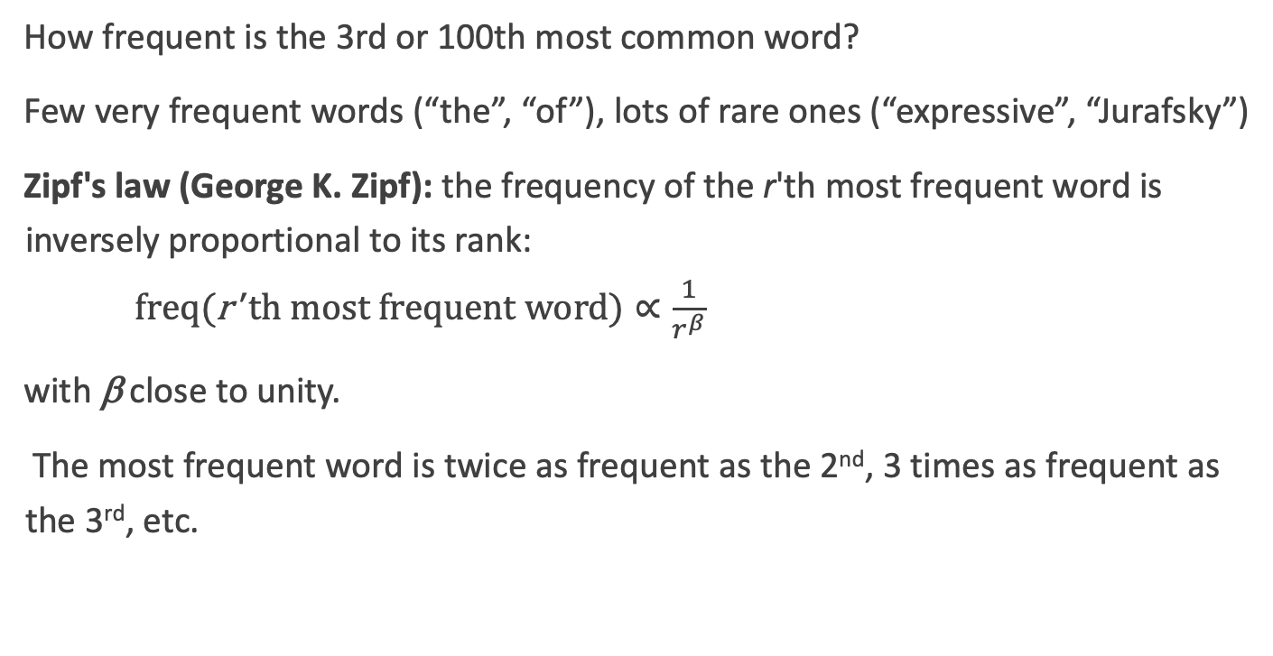
Language: Zipf's law is a power-law
How frequent is the 3rd or 100th most common word?
Few very frequent words (“the”, “of”), lots of rare ones (“expressive”, “Jurafsky”)
Zipf's law (George K. Zipf): the frequency of the r'th most frequent word is inversely proportional to its rank:
$\text{freq}(\text{r}\text{' }\text{th} \text{most} \text{frequent} \text{word})∝\frac{1}{r^{β}}$
with β close to unity.
The most frequent word is twice as frequent as the 2nd, 3 times as frequent as the 3rd, etc.

Slide 56
Pareto’s law and power-laws
Pareto
  The Italian economist Vilfredo Pareto was interested in the distribution of income.
  Pareto’s law is expressed in terms of the cumulative distribution (the probability that a person earns X or more).
  P[X > x] ~ x^{-k}
Slide from Lada Adamic

Slide 57

Income
The fraction i of the income going to the richest P of the population:
  i= (100/P)^{η-1}
  if η = 0.5
    top 1 percent gets 100^{-0.5} = .10
  In 2015, η = 0.6 top 1 percent gets 100^{-0.4} = .16
  (higher η = more inequality)
Thomas Piketty’s book, #1 on NY Times best seller list in 2014, studies how η relates to rise of wealth inequality
Charles Jones. "Pareto and Piketty: The Macroeconomics of Top Income and Wealth Inequality" Journal of Economic Perspectives, Winter 2015.

Slide 58
Where do power laws come from?
Many different processes can lead to power laws
There is no one unique mechanism
Slide from Lada Adamic

Slide 59
Preferential attachment
Price (1965) model for citation networks
  new citations to a paper are proportional to the number it already has
  each new paper is generated with m citations
  new papers cite previous papers with probability proportional to their in-degree (citations)
Slide from Lada Adamic

Slide 60
Preferential attachment is a “Rich get Richer” Model
Explanation for various power law effects
Citations: randomly draw citations from the reference section of papers
Assume cities are formed at different times, and that, once formed, a city grows in proportion to its current size simply as a result of people having children
Words: people are more likely to use a word that is frequent (perhaps it comes to mind more easily or faster)

Slide 61
Power laws: Summary
Many processes are distributed as power laws
  Word frequencies, citations, web hits
Power law distributions have interesting properties
  scale free, skew, high max/min ratios
Various mechanisms explain their prevalence
  rich-get-richer, etc.
Explain lots of phenomena we have been dealing with
  the use of stop words lists (a small fraction of word types cover most tokens in running text)

Slide 62
Social Networks & Power Laws
Power Laws
Notes:
We've learned about power law distributions and their role and properties

