Slide 1
Networks and Link Analysis
Web Anchor Text

Slide 2
The Web as a Directed Graph
Page A
Page B
hyperlink
Anchor
Assumption 1:
A hyperlink between pages denotes author perceived relevance (quality signal)
Assumption 2:
The anchor of the hyperlink describes
the target page (textual context)

Slide 3
Anchor Text
For ibm how to distinguish between:
  IBM’s home page (mostly graphical)
  IBM’s copyright page (high term frequency for “ibm”)
  Rival’s spam page (arbitrarily high term frequency)
“ibm.com”
“IBM home page”
“ibm”
A million pieces of anchor text with “ibm” send a strong signal
www.ibm.com

Slide 4
Indexing anchor text
When indexing a document D, include anchor text from links pointing to D.
Armonk, NY-based computer
giant IBM announced today
www.ibm.com
Solutions, Services, Products, MyIBM
Question Answering Systems:
Apple’s Siri
IBM’s Watson
Big Blue today announced
record profits for the quarter

Slide 5
Indexing anchor text
Can sometimes have unexpected side effects –
  Google bombing
Can score anchor text with weight depending on the authority of the anchor page’s website
  E.g., if we were to assume that content from cnn.com or yahoo.com is authoritative, then trust the anchor text from them

Slide 6
Many NLP Applications of Anchor Text
Finding synonyms
  Federal Reserve: “Fed”, “U.S. Federal Reserve Board", “U.S. Federal Reserve System”, “Federal Reserve Bank”
Finding translations of named entities
Providing constituent boundaries for parsers

Slide 7
Networks and Link Analysis
Web Anchor Text

Slide 8
Networks and Link Analysis
PageRank: Overview and Markov Chains

Slide 9
Combining link structure with text
A good search result looks at more than just query-document text overlap
One factor: page popularity.
  Pages that are pointed to by lots of other pages are popular.
  We can use link counts as a measure of static goodness,
  Combine link counts with the text match score

Slide 10
Using link structure to measure page importance
Simplest: use link counts as popularity measure
  Undirected popularity:
    Page score= degree: the number of in-links plus the number of out-links (3+2=5).
  Directed popularity:
    Page score = number of in-links (3).

Slide 11
Spamming simple popularity
Simple popularity heuristics can be spammed to give your page a high score, whether it’s:
      the number of in-links plus the number of out-links
      number of in-links

Slide 12
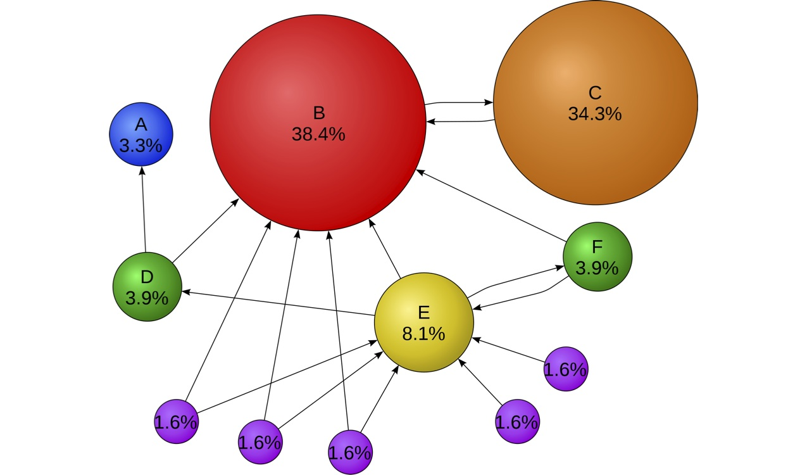
Intuition of PageRank
C has higher PageRank than E, even though E has more inlinks

Slide 13
PageRank scoring
Imagine a browser doing a random walk on web pages:
  Start at a random page
  At each step, go out of the current page along one of the links on that page, equiprobably
“In the steady state” each page has a long-term visit rate - use this as the page’s score.
1/3
1/3
1/3

Slide 14
Not quite enough
The web is full of dead-ends.
  Random walk can get stuck in dead-ends.
  Makes no sense to talk about long-term visit rates.
??

Slide 15
Teleporting
At a dead end, jump to a random web page.
At any non-dead end, with probability 10%, jump to a random web page.
  With remaining probability (90%), go out on a random link.
  10% - a parameter.

Slide 16
Result of teleporting
Now cannot get stuck locally.
There is a long-term rate, the Pagerank, at which any page is visited

Slide 17
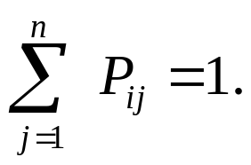
Markov chains
A Markov chain:
  N states,
  An N×N transition probability matrix P.
At each step, we are in exactly one of the states.
For 1 ≤ i,j ≤ n, the matrix entry P_{ij} tells us the probability of j being the next state, given we are currently in state i.
For all i,
i
j
P_{ij}

Slide 18
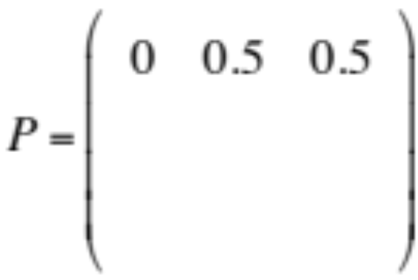
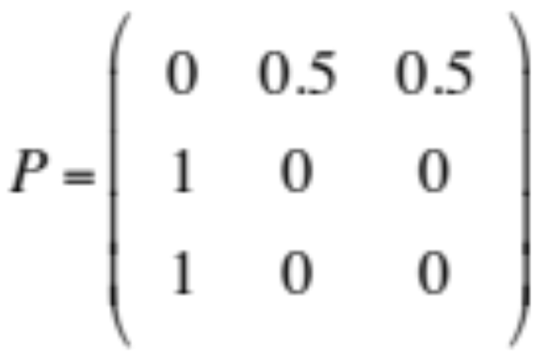
Markov chains
1
0.5
C
A
B
0.5
1
Transition probability matrix P

Slide 19
Random Surfers and Markov chains
Markov chains are abstractions of random walks.
Each state
  represents one web page
Each transition probability
  represents the probability of moving from one page to another
We can derive the transition probability P from the adjacency matrix A of the web graph.

Slide 20
Teleporting, more formally
If a node has no out-links, the random surfer teleports:
  the transition probability to each node in the N-node graph is 1/N
If a node has K>0 outgoing links:
  with probability 0 < α < 1 the surfer teleports to a random node
    probability is α/N
  with probability 1- α the surfer takes a normal random walk
    probability is (1- α)/K

Slide 21
Deriving transition probability matrix P from adjacency matrix A
A is the adjacency matrix of the web graph
  A_{ij} is 1 if there is a hyperlink from page i to page j
If a row of A has no 1's, then replace each element by 1/N.
For all other rows proceed as follows.
Divide each 1 in A by the number of 1's in its row. Thus, if there is a row with three 1's, then each of them is replaced by 1/3
Multiply the resulting matrix by (1-α)
Add α/N to every entry of the resulting matrix, to obtain P.

Slide 22
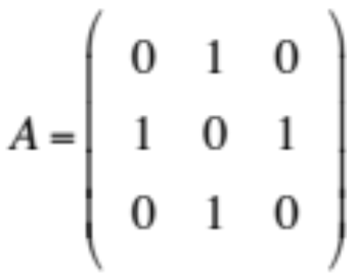
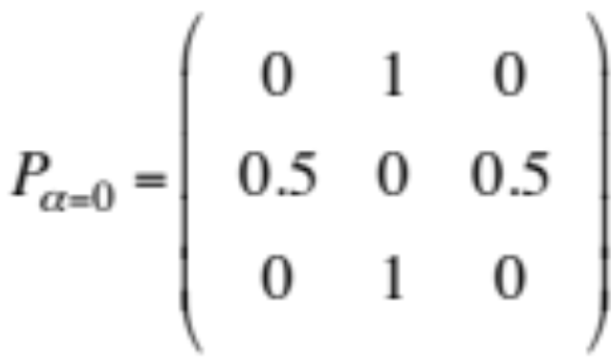
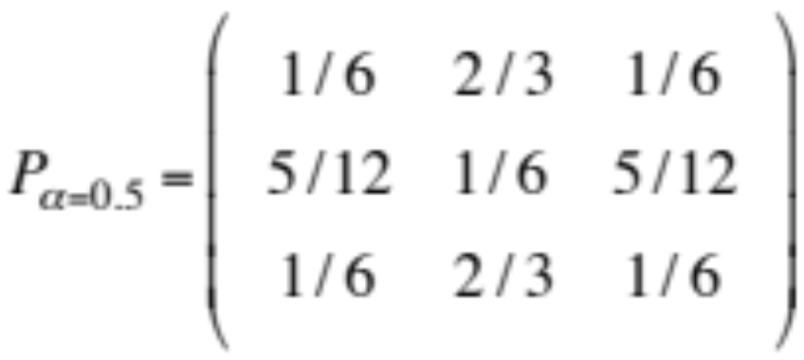
Computing P with teleportation
0.5
1
1
2
3
1
0.5
P[1,*] = (1-α) (0 1 0) + α (1/N 1/N 1/N)
P[1,*] = 0.5 (0 1 0) + 0.5(1/3 1/3 1/3)

Slide 23
Networks and Link Analysis
PageRank: Overview and Markov Chains

Slide 24
Networks and Link Analysis
PageRank: Computation

Slide 25
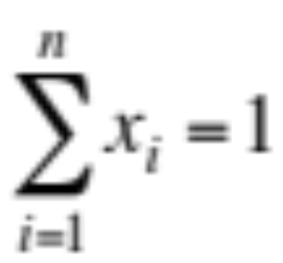
Computing PageRank:
The probability of being in a state
A probability (row) vector x = (x₁, … x_{n}) tells us where the walk is at any point.
E.g., (000…1…000) means we’re in state i.
1
i
n
More generally, the vector x = (x₁, … x_{n}) means the walk is in state i with probability x_{i}.

Slide 26
Computing PageRank:
Change in probability vector
If the probability vector is x = (x₁, … x_{n}) at this step, what is it at the next step?
Recall that row i of transition matrix P tells us where we go next from state i.
So from x, our next state is distributed as xP.

Slide 27
Ergodic Markov chains
A Markov chain is ergodic if
  you have a path from any state to any other
  For any start state, after a finite transient time T₀, the probability of being in any state at a fixed time T>T₀ is nonzero.
Not ergodic
(even/odd).

Slide 28
Ergodic Markov chains
For any ergodic Markov chain, there is a unique long-term visit rate for each state.
  A steady-state probability distribution π = (π₁, … π_{n}).
  Over a long time-period, we visit each state in proportion to this rate.
  Thus π_{i} is the PageRank of state i.
It doesn’t matter where we start.

Slide 29
Steady state example
The steady state looks like a vector of probabilities π = (π₁, … π_{n}):
  π_{i} is the probability that we are in state i.
3/4
1/4
1
2
3/4
1/4
For this example, π₁=1/4 and π₂=3/4.

Slide 30
How do we compute this vector?
Let π = (π₁, … π_{n}) denote the row vector of steady-state probabilities
If our current position is described by π, then the next step is distributed as πP.
But π is the steady state, so π=πP.
Solving this matrix equation gives us π.
  So π is the (left) eigenvector for P.
  (Corresponds to the “principal” eigenvector of P with the largest eigenvalue.)
  Transition probability matrices always have largest eigenvalue 1.

Slide 31
The power iteration method of computing π
Recall, regardless of where we start, we eventually reach the steady state π.
Start with any distribution (say x=(10…0)).
After one step, we’re at xP;
after two steps at xP² , then xP³ and so on.
“Eventually” means for “large” k, xP^{k} = π.
Algorithm: multiply x by increasing powers of P until the product looks stable.

Slide 32
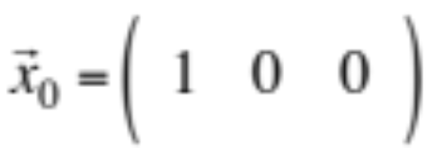
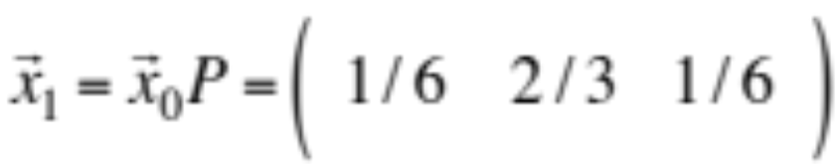

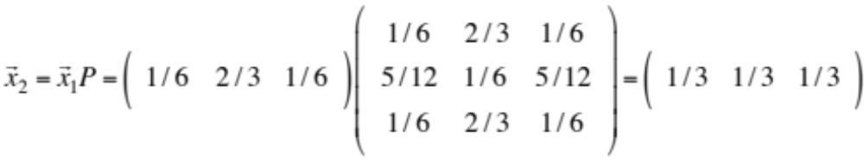
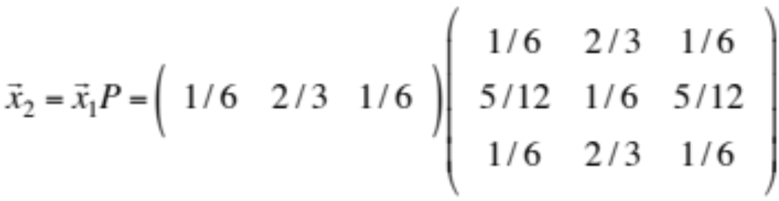

Example of power iteration
Let’s say surfer starts in state 1:

Slide 33






Power iteration example (continued)
 | 1 | 0 | 0
 | 1/6 | 2/3 | 1/6
 | 1/3 | 1/3 | 1/3
 | 1/4 | 1/2 | 1/4
 | 7/24 | 5/12 | 7/24
… | … | … | …
 | 5/18 | 4/9 | 5/18
Node 1
PageRank
Node 2
PageRank
Node 3
PageRank

Slide 34
PageRank summary
Preprocessing:
  Given graph of links, build matrix P.
  From it compute the PageRank vector π.
  The PageRank of page i, π_{i} is between 0 and 1
Query processing:
  Retrieve pages meeting query.
  Rank them by their PageRank.
  Order is query-independent.

Slide 35
Networks and Link Analysis
PageRank: Computation

