Slide 1
CS 124/LINGUIST 180
From Languages to Information
Dan Jurafsky
Professor of Computer Science
Professor of Linguistics
Stanford University
Winter 2026
Introduction and Course Overview

Slide 2
What is this class?
LLMs and their components
  Transformers, Neural Networks, Attention, Conv Nets, Sampling, Language Model Loss, RAG, Tokenization
LLMs and their relation to society
  Ethical Issues in the use of LLMs
  LLMs/other tools for computational social science
Other language-related tools
  Social networks
  Information retrieval
  Recommendation engines
  Speech recognition

Slide 3
What is this class?
The very broad undergrad intro to (at least) 12 grad classes!
cs224C: NLP for Computational Social Science (Yang)
cs224N: Natural Language Processing with Deep Learning (Choi/Yang)
cs224U: Natural Language Understanding (Potts)
cs224V: Conversational Virtual Assistants with Deep Learning (Lam)
cs224S: Spoken Language Processing (Maas)
cs246: Mining Massive Data Sets (Leskovec)
cs224W: Graph Neural Networks (Leskovec)
cs276: Information Retrieval (Manning)
cs329R: Race and Natural Language Processing (Jurafsky/Eberhardt)
cs329X: Human-Centered LLMs (Yang)
cs336: Language modeling from scratch (Hashimoto/Liang)
cs384: Social and Ethical Issues in NLP (Jurafsky)

Slide 4











What is this class? The Commercial World

Slide 5
What is this class?
The rise of LLMs has completely changed everything in
  Natural Language Processing (NLP)
  AI
  Information Retrieval (IR)
  Recommendation Systems
  Speech Recognition
This class starts from scratch and builds up how LLMs work and how they are applied!

Slide 6
What is this class?
Intro to the algorithmic components of LLMs
PA 1
BPE Tokenization
Logistic Regression
Word embeddings
Neural Networks
Gradient Descent/Backprop
Cross-entropy loss
Transformers
Language Modeling Loss
Conv Nets
PA 2
PA 4
PA5
PA 6

Slide 7
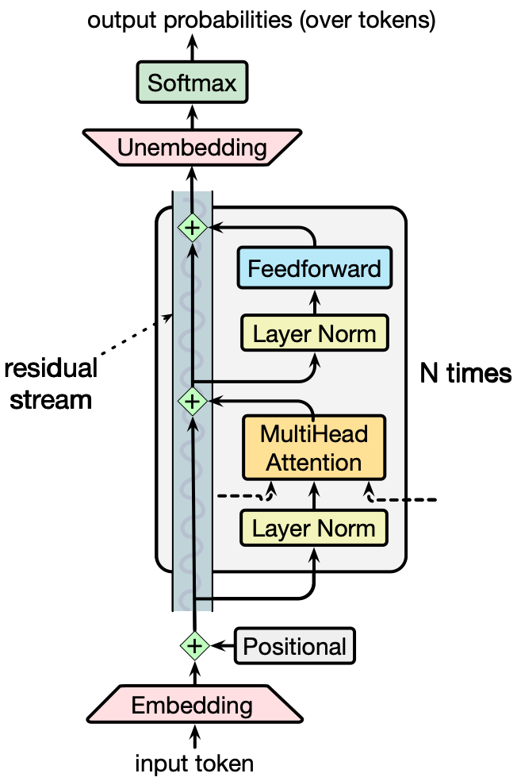
Example Topic: LLMs and Transformers
What is attention and how does the transformer work?
How are language models trained?
How is text tokenized
Programming Assignment 6: Transformers!
Programming Assignment 1: Tokens!

Slide 8
Example Topic: Speech
How does speech recognition work?
What different algorithms do we need to deal with speech than text?
Programming Assignment 6b: Speech!

Slide 9



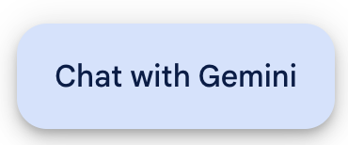
Large language models!
What can LLMs do?
What can't they do?
Llama 3
Lab 4
PA 7

Slide 10

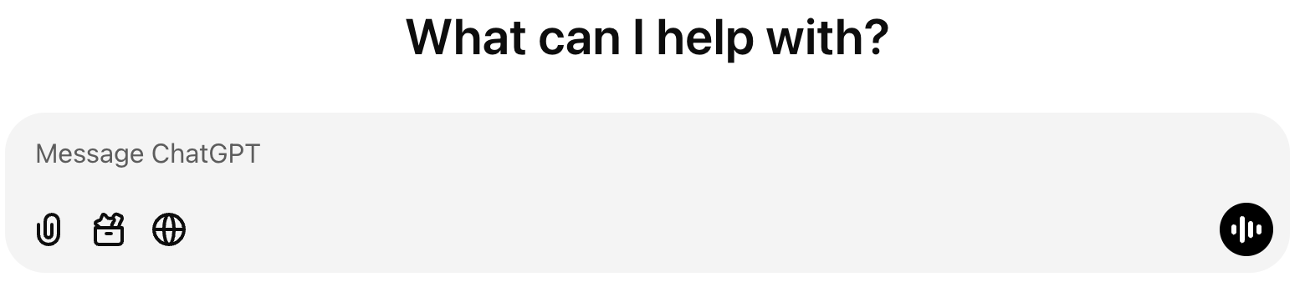

Agentic LLMs and Personal Assistants
PA 7

Slide 11
What is this class?
Intro to more crucial language algorithms
Regular Expressions
Minimum Edit Distance
Information Retrieval/ WebSearch
Network algorithms
  PageRank & Centrality
  Power Laws & Clustering
Recommendation engines
  Collaborative filtering

Slide 12
Example Topic: Information Retrieval
Text-based information retrieval (IR) for web search
Probably the most frequently used algorithm in the history of the planet
6,586,013,574 web searches every day
How does it work? We'll learn:
classic TF/IDF
modern dense retrieval
LLM-based RAG
Programming Assignment 3: Search!

Slide 13
Computational Biology: Comparing Sequences
AGGCTATCACCTGACCTCCAGGCCGATGCCC
TAGCTATCACGACCGCGGTCGATTTGCCCGAC
-AGGCTATCACCTGACCTCCAGGCCGA--TGCCC---
| | | | | | | | | | | | | x | | | | | | | | | | |
TAG-CTATCAC--GACCGC--GGTCGATTTGCCCGAC
Sequence comparison is key to
Finding genes
Determining function
Uncovering evolutionary processes
This is also how we evaluate LLM functions like speech recognition
Minimum edit distance (Quiz 1)

Slide 14

Example Topic: Logistic Regression for Text Classification
Disaster Response!
Haiti Earthquake 2010
Classifying SMS messages
Mwen thomassin 32 nan pyron mwen ta renmen jwen yon ti dlo gras a dieu bo lakay mwen anfom se sel dlo nou bezwen
  I am in Thomassin number 32, in the area named Pyron. I would like to have some water. Thank God we are fine, but we desperately need water.
Programming Assignment 2: Triage!

Slide 15

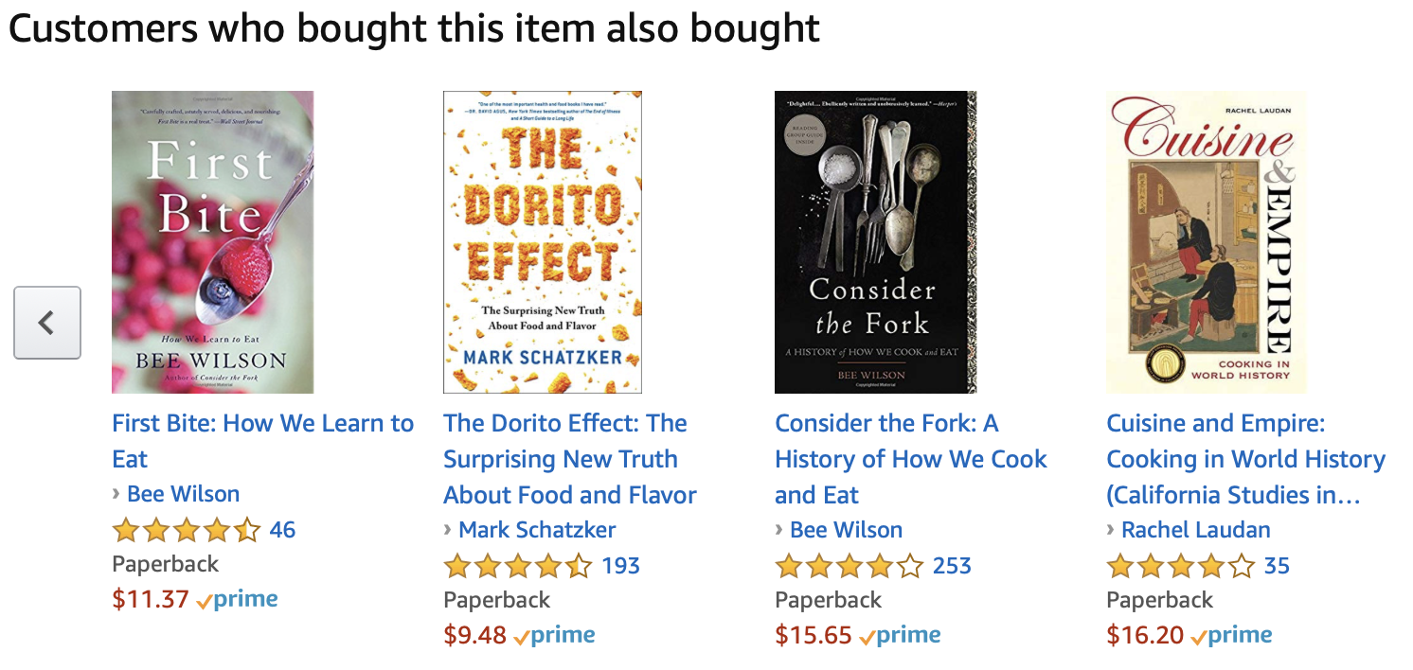
Recommendation Engines: The Good
If you bought….

Slide 16
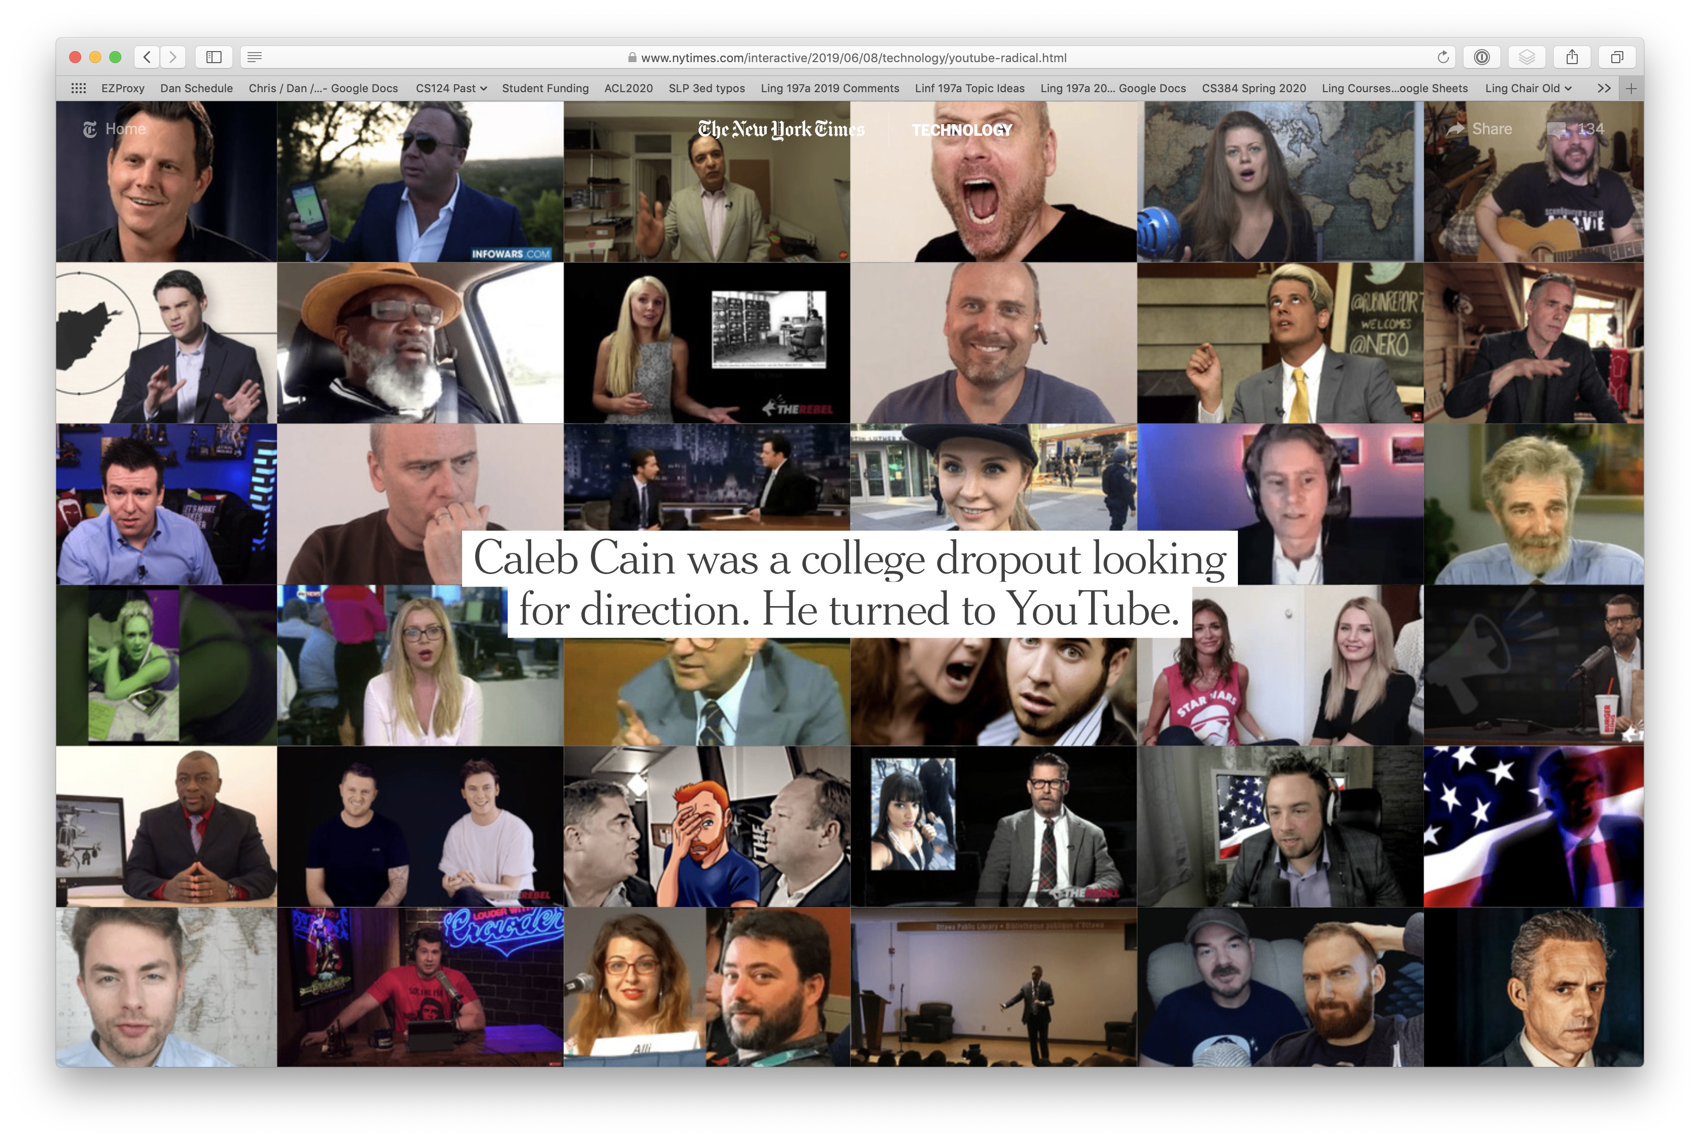
And the dark side: YouTube Radicalization

Slide 17
You'll implement LLM agents
Using the collaborative filtering algorithm for recommendations
PA 7 and Quiz 8

Slide 18
What is this class?
Introduction to Social NLP and Computational Social Science
NLP and LLMs can be socially aware and social actors.
This can lead them to be biased
But we can also use them to analyze human biases

Slide 19
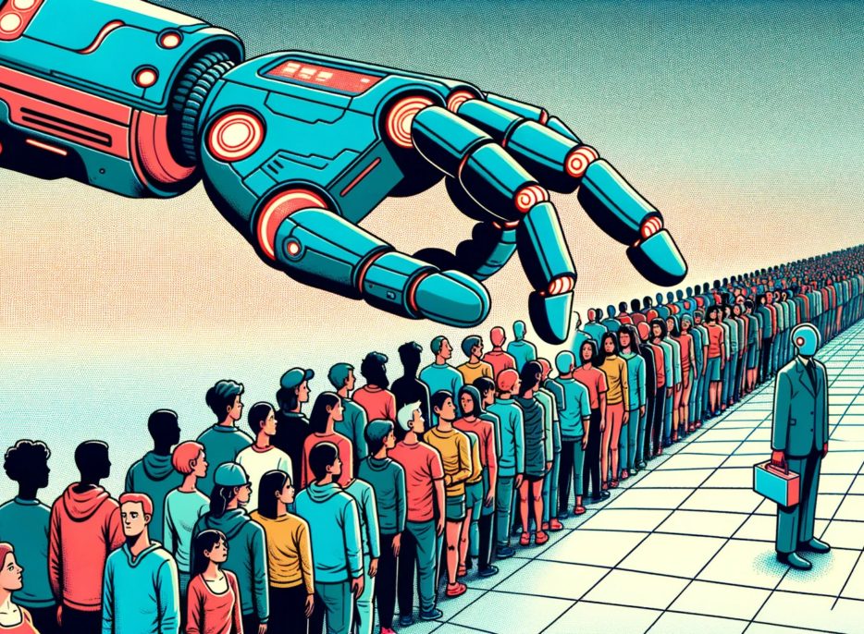
We'll study social flaws in LLM
LLMs hallucinate
LLMs are overconfident
LLMs are sycophantic
LLMs display stereotypes about every group (Asians, Muslim, Blacks, women)
The Decoder, Matthias Bastian, created by Dall-E

Slide 20





Example topic: Applying social NLP to humanities, social science, cultural analytics, text data science!
  Detecting latent meaning

Slide 21
Sentiment in Restaurant Reviews
Dan Jurafsky, Victor Chahuneau, Bryan R. Routledge, and Noah A. Smith. 2014. Narrative framing of consumer sentiment in online restaurant reviews. First Monday 19:4
  900,000 Yelp reviews online
A very bad (one-star) review:
  The bartender....... absolutely horrible........ we waited 10 min before we even got her attention........ and then we had to wait 45 - FORTY FIVE! - minutes for our entrees… stalk the waitress to get the cheque… she didn't make eye contact or even break her stride to wait for a response ……..

Slide 22
What is the language of bad reviews?
Negative sentiment language
  horrible awful terrible bad disgusting
Past narratives about people
  waited, didn’t, was
  he, she, his, her,
  manager, customer, waitress, waiter
Frequent mentions of we and us
  ... we were ignored until we flagged down a waiter to get our waitress …

Slide 23
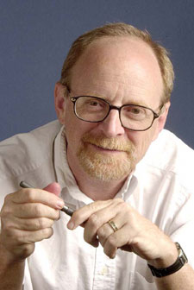
Other narratives with this language
A genre using:
Past tense, we/us, negative, people narratives
Texts written by people suffering trauma
  James Pennebaker lab at UT Austin
  Past tense is used for "distancing"
  Use of “we”: seeking solace in community
1-star reviews are trauma narratives!
The lesson of reviews:
  It’s all about personal interaction

Slide 24
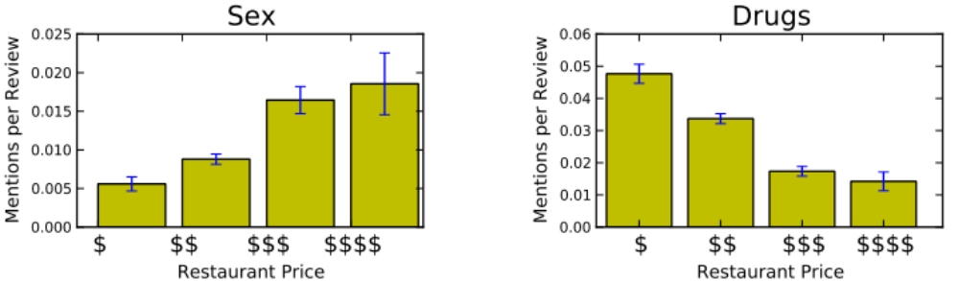
What about positive reviews?
Sex, Drugs, and Dessert
addicted to pepper shooters
garlic noodles… my drug of choice
the fries are like crack
orgasmic pastry
sexy food
seductively seared fois gras

Slide 25
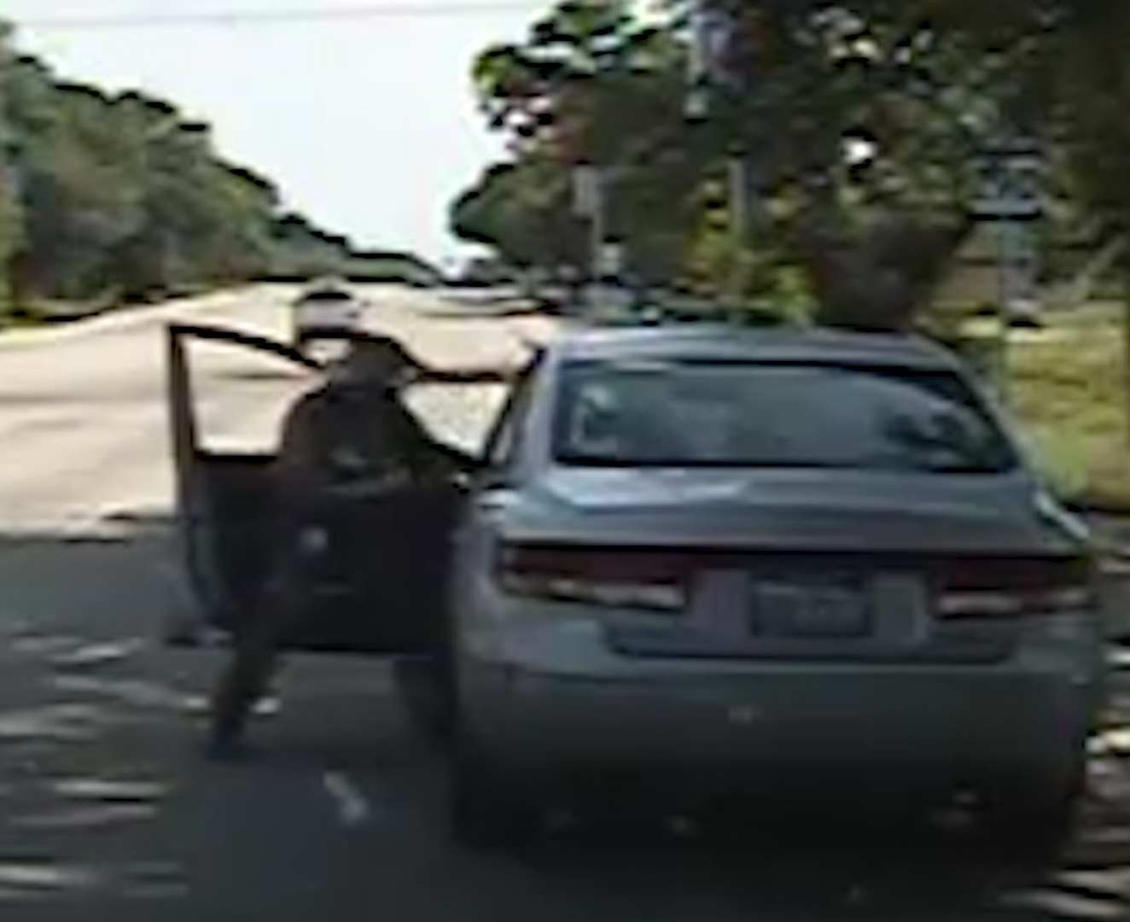

Computational Social Science
Help improve Police-Community Interaction
Problem:
  Inappropriate use of force by police, especially to Black Americans
  NLP can help!
  Prof. Jennifer Eberhardt (Psych and GSB) has shown to measure and improve police-community relations.
  Together we apply NLP to do this at scale!
    Analyze speech from body-worn cameras to quantify police-community interactions
    Develop officer training
    Reduce the chances of violence

Slide 26
Yet another topic: Social Networks
The network formed by your friends or other relations offline or online
  Can we compute properties of these networks?
  Extract information from them?
  Network algorithms (Quiz 9)

Slide 27
How does language modeling work?
Let's start by thinking about the language modeling task.
Why is it so remarkable?
What makes language interpretation hard?

Slide 28
Ambiguity
Language is ambiguous
Often as language users we don't even notice this
Resolving ambiguity is hard
Yet language models do this efficiently

Slide 29
Some very simple kinds of ambiguity
There are at least half a dozen meanings of this sentence:
  The chef made her duck
Go here and type (and vote for) some definitions
https://pollev.com/danjurafsky451

Slide 31
Ambiguity
create
the chef
cook
identify
someone else
waterfowl
  The chef made her duck
The cook cooked waterfowl for a different woman X (person using "she/her" pronouns) to eat
The cook cooked waterfowl belonging to X
The cook cooked waterfowl belonging to the cook
The cook created the (plaster?) waterfowl that X owns
The cook caused X to quickly lower X's head or body
The cook uncovered the true identity of the cook's spy waterfowl
The cook waved their magic wand and turned X into undifferentiated waterfowl
lower

Slide 32
How do LLMs deal with the complexity of meaning?

Slide 33
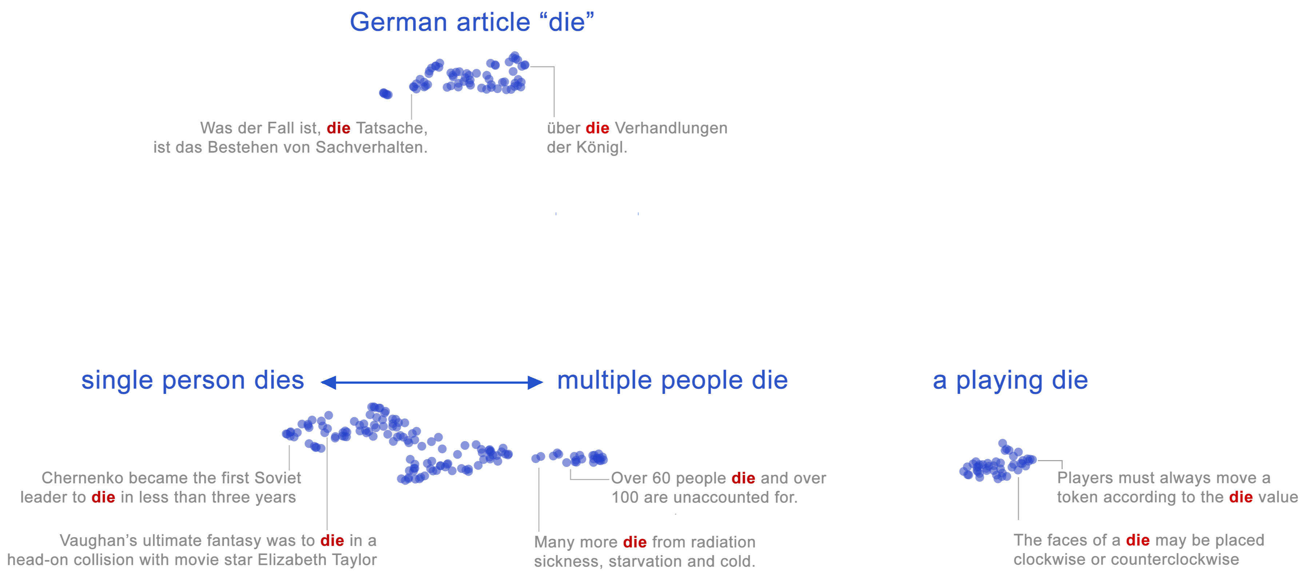
Neural word embeddings
A word's meaning represented as a region in 1000-dim space!
Here's the word "die" in 2D:

Slide 34
Word embeddings
But not just two discrete senses

Slide 35
Embeddings: not just one language

Slide 36
LLMs and Embeddings
LLMs learn to develop vector models of meaning through training
These models let them represent sophisticated and subtle differences in meaning
We can also use these for computational social science!
  PA 4 (Embeddings!)

Slide 37
What is this class?
Evidence Based Pedagogy!

Slide 38
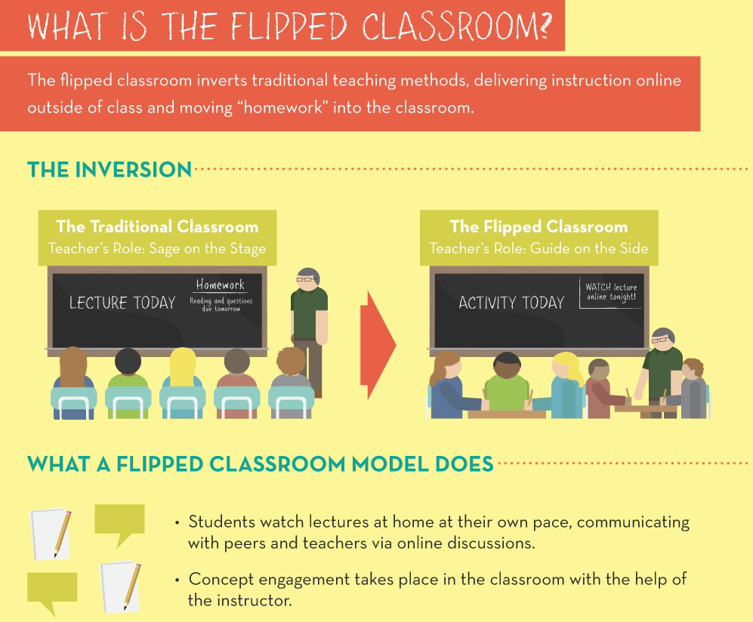
From (defunct) www.knewton.com/flipped-classroom/

Slide 39

Why the flipped classroom (1)
Mastery learning: Learn until you master
Benjamin Bloom, 1968

Slide 40
Bloom's mastery learning
Personalized, goal-driven practice, driven by feedback
Watch (and re-watch) lectures at your own pace and learn when it's best for you
Videos have embedded miniquizzes. If you get it wrong, it gives you feedback about why you misunderstood.
You have infinite chances at each weekly Tuesday Quiz, so you can go back to the lecture and retake them.
With programming assignments you can see your performance on the training and dev set to see what you might be doing wrong on the test set!

Slide 41
Master learning: Grading
I don't grade on a curve.
Your grade describes whether you mastered the material.
I expect you all to master the material.
It is very easy to get an A in this class, most people do

Slide 42
Why the videos have embedded quizzes:
“summative” vs “formative” assessment
Summative assessment
  Final exams/midterms: goal is grading
Formative assessment
  Along the way: goal is for you to find out what you don’t know so you can learn

Slide 43
Why I don't have a midterm or final
Multiple-choice timed tests don't reflect real life tasks
Scores don't correlate well with ability to do the task
They are stressful and annoying
They invite cheating
They waste an entire week that we instead use for content

Slide 44
Why the flipped classroom (2)
Attention span: everyone spaces out during long lectures
  Middendorf and Kalish, 1995, Johnstone and Percival 1976, Burns 1985
“the class started 1:00. The student sitting in front of me took copious notes until 1:20. Then he just nodded off… motionless, with eyes shut for about a minute and a half, pen still poised. Then he awoke and continued his rapid note-taking as if he hadn’t missed a beat.”
Student remembered only the first 15-20 minutes

Slide 45
Why the flipped classroom (3)
Active learning: Be in charge of your learning
  Most important: programming assignments
  Active learning (“constructivism”), learning by doing
Collaborative learning: Learn from each other
  Use class lab time for group problem-solving
  “Small group active learning”
  You must do PA7 in groups of 3-4
  We encourage pair programming on PA1-6 and quizzes

Slide 46
Why the flipped classroom (4)
Constructivism and Labs
Labs tend to involve working through algorithms on mini-problems by hand so you understand them deeply

Slide 47
cs124: Flipped classroom
Prerecorded video lectures on Canvas:
    About 80 ~10-minute lectures by me
    About ~90 minutes/week of video lectures
    Another 10 lectures by the TAs
Live sessions: (none are recorded)
  5 required in-person lectures
  5 required in-class labs(“active learning”)
    Lab #1 (Unix text tools) next Tuesday is required in person
    Labs #2, #3, #4 are required but attendance is extra credit (you can do at home).
    Lab #4 February 24(Git and PA7) is required in person

Slide 48
Logistics More Specifically
Online Video Lectures w/embedded non-graded questions (watch before relevant class/lab/quiz)
20 pages of reading a week (read before quiz is due)
Weekly online quizzes (due Tue of following week)
7 Python programming assignments (PAs) (due Fri of following week)
  Except PA 7 you get extra time, 2+ weeks

Slide 49
Why you should read the textbook and watch the videos and come to class
Students who do everything report learning more
Also: because we put so much effort into making all the materials!!!
The textbook: gets updated every summer and every fall, taking 100s of hours
The videos: a large percentage get updated every year, each suite of 8 10-minute lectures takes about 40 hours to develop every summer and fall.
The live lectures: change from year to year
(Why so much updating? Our field is in massive flux!!!!!!)

Slide 50
Learning Goals
At the end of this course, you will be able to:

Slide 51
Learning goals
Understand training and inference of large language models and their social implications

Slide 52
Learning goals
Be able to prompt large language models, reason about what they can and can't do, and about their social implications

Slide 53
Learning goals
Write efficient regular expressions to solve any kind of text-based extraction task

Slide 54
Learning goals
Build a supervised classifier to do classification

Slide 55
Learning goals
Build a neural network and train it using stochastic gradient descent

Slide 56
Learning goals
Build a search engine

Slide 57
Learning goals
Build a recommendation engine

Slide 58
Learning goals
Build a computational model of word meaning using neural word embeddings

Slide 59
Learning goals
Understanding agent-based LLM modeling

Slide 60
Learning goals
Understand and implement PageRank and other social network functions

Slide 61
Learning goals
Become expert at working together on computational projects and use group tools like github
Work in our field is rarely done alone!
PA1-6: Pair programming is encouraged
PA7: Must be done in groups of 3-4

Slide 62
Can I use LLMs to do my homeworks?
The class policy is:
You should use LLMs like you use the TA: to give you help, answer your questions, improve your understanding.
Don't directly paste LLM code.
Why:
Learning Goals! If the LLM does your homeworks for you, you won't achieve your learning goals
And then you will have a very bad time when you have to whiteboard during job interviews.

Slide 63
What is this class?
The very broad undergrad intro to (at least) 12 grad classes!
cs224C: NLP for Computational Social Science (Yang)
cs224N: Natural Language Processing with Deep Learning (Choi/Yang)
cs224U: Natural Language Understanding (Potts)
cs224V: Conversational Virtual Assistants with Deep Learning (Lam)
cs224S: Spoken Language Processing (Maas)
cs246: Mining Massive Data Sets (Leskovec)
cs224W: Graph Neural Networks (Leskovec)
cs276: Information Retrieval (Manning)
cs329R: Race and Natural Language Processing (Jurafsky/Eberhardt)
cs329X: Human-Centered LLMs (Yang)
cs336: Language modeling from scratch (Hashimoto/Liang)
cs384: Social and Ethical Issues in NLP (Jurafsky)

Slide 64
Should I take 124 or 224N or something else?
CS124 is designed for sophomores or juniors
  It's gentle (I explain everything) and broad (covering many topics, not just NLP/LLMs but also recommendation engines, IR, social networks, social computing)
  Mastery learning, quizzes, programming assignments with starter code and scaffolding.
  No research project, but a fun chatbot final homework
CS224N is a deeper, laser focused, grad course
  They assume you are very familiar with ML; 1st homework jumps right into optimization
  More focus on systems/implementation/scaling, you code more advanced things
CS224N/U/V/S/W, 246, 336, 329R
  Learning via research: novel research projects as a large component
CS324X (Human Centered NLP), CS346 (Social and Ethical Issues in NLP) require 224N or 224U
CS224C: more applied focus, applying NLP to social science: (NLP for Computational Social Science)
(You should of course take all of them!!)

Slide 65

Logistics: Instructor
Instructor: Dan Jurafsky (he/him)
Professor in CS and Linguistics
My office hours:
  This week and next week
    Tuesday after class 4:30-5:30
  Then every Thursday classtime 3-4:20
  Margaret Jacks Hall 117
  Book times at calendly.com/jurafsky
How to pronounce my name:
Picture by Ross Petukhov

Slide 66


Slide 67
More logistics: Prereqs
CS106B,
Python (at the level of CS106A),
CS109 (or equivalent background in probability),
Programming maturity and knowledge of UNIX equivalent to CS107 (this can be waived for PhD students)

Slide 68
Should I come to class if I am sick?
No!

Slide 69
Grading:
A: 93% and above of the total points
A-: 90% and above of the total points
B+: 87% and above of the total points
B: 83% and above of the total points
B-: 80% and above of the total points
C+: 77% and above of the total points
C: 73% and above of the total points
C- (= Credit): 70% and above of the total points

Slide 70
Grading: A+
A+: It is very very easy to get an A in this class but hard to get an A+. For an A+ you must do all of the following:
  Have perfect scores on all the PAs and quizzes
  Have perfect attendance (or absences excused) at 12 classes (that means all lectures, all labs, and all tutorials, i.e., even the non-required labs and tutorials)
  Have given at least 5 substantive and helpful answers to students on the class Ed forum
  Have turned in and gotten credit on extra credit problems on at least 3 of the labs, quizzes, or PAs

Slide 71
Syllabus
cs124.stanford.edu

Slide 72
Where do I find all the programming assignments and quizzes and readings?
Everything is on the webpage cs124.stanford.edu
Except the videos which are on Canvas Modules!
In other words:
  Lectures slides: webpage
  Lab instructions: webpage (points to git where they live)
  Tutorial information: webpage
  Readings: webpage
  Programming assignments: webpage (points to git where they live)
  Weekly quizzes: webpage (points to gradescope where they live)
  Videos: Canvas

Slide 73
Coming up this week: Thursday
Optional tutorial on jupyter notebooks and PA0, getting ready for PA1
Come to class with your laptops and we'll go through PA0 together!
This tutorial will be led by amazing TA Sri Jaladi!!! But I and many other CAs will be there!

Slide 74
Action Items Before Thursdays class!
1) Read the syllabus webpage at cs124.stanford.edu
2) Look at PA0 (you can find it from the webpage)
3) Watch Canvas Videos on "PA0 Mac Setup" (or "PA0 Windows Setup"), also pointed to by webpage

Slide 75
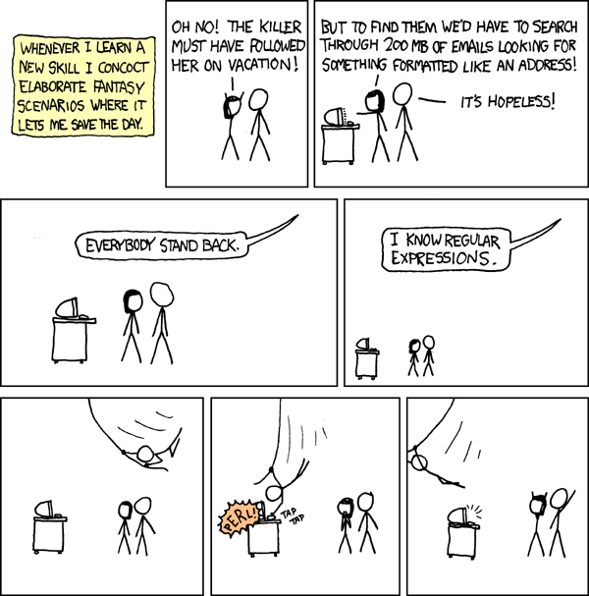
Coming up next week (Tuesday)
"Unix for poets":
grep
sort
Key UNIX tools for dealing with text files and regular expressions.
Plus a brief exercise on n-gram LMs

Slide 76
Action Items before next Tuesday's class!
1) Watch the "week 1" videos on Canvas by Sunday (since the quiz is also due Tuesday)
3) Download this file to your laptop
  http://cs124.stanford.edu/nyt_200811.txt
4) If you don't know UNIX yet (haven't had cs107):
  For people using a Windows 10 machine, if you don't have Ubuntu on your machine:
    Watch the pa0 Windows video about how to download and install Ubuntu (it's pointed to from the website)
  Watch Chris Gregg's excellent UNIX videos here: Logging in, first 7 File System, and first 8 useful commands
    https://web.stanford.edu/class/archive/cs/cs107/cs107.1186/unixref/

Slide 77
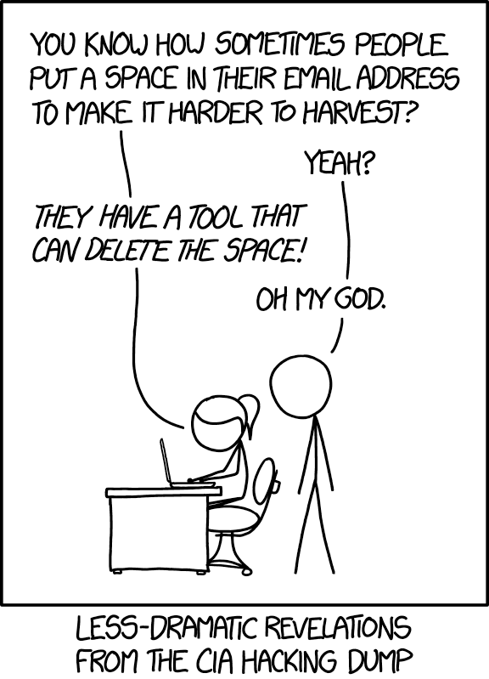
PA1: Spam Lord and Tokenize!
Write regular expressions to spread evil* throughout the galaxy!
By extracting email addresses from the web!
jur a fs ky at st anford dot e d u
Also learn how to tokenize like an LLM
Goes live Friday 5pm!
*Just kidding; don't be evil

