Slide 1
N-gram Language Modeling
Introduction to N-gram Language Models
Notes:
In this series of lectures we'll introduce the n-gram language model, the simplest member of a family of important algorithms called language models that also includes the neural large language models we'll introduce in later lectures.

Slide 2
Predicting words
The water of Walden Pond is beautifully ...
blue
green
clear
*refrigerator
*that
Notes:
The intuition of language models lies in the task of predicting words. What word is likely to follow…? … But probably not "refrigerator" or "that".

Slide 3
Language Models
A language model is a machine learning model that predicts upcoming words.
More formally:
  An LM assigns a probability to each potential next word
    = gives a probability distribution over possible next words
  An LM assigns a probability to a whole sentence
  Two paradigms
  N-gram language models (this lecture)
  Large language models (LLMs, neural models, future lectures)
Notes:
In this chapter we formalize this intuition about word prediction by introducing Language Models.

Slide 4
Why word prediction?
It's a helpful part of language tasks
Grammar or spell checking
  Their are two midterms Their There are two midterms
  Everything has improve Everything has improve improved
Speech recognition
  I will be back soonish I will be bassoon dish
Notes:
One reason we might want to predict words is because it plays a role in useful tasks

Slide 5
Why word prediction?
It's how large language models (LLMs) work!
LLMs are trained to predict words
Left-to-right (autoregressive) LMs learn to predict next word
LLMs generate text by predicting words
  By predicting the next word over and over again
Notes:
But a more subtle and perhaps deeper reason is that word prediction is how LLMs work

Slide 6
Language Modeling (LM) more formally
Goal: compute the probability of a sentence or sequence of words W:
  P(W) = P(w₁,w₂,w₃,w₄,w₅…w_{n})
Related task: probability of an upcoming word:
  P(w₅|w₁,w₂,w₃,w₄) or P(w_{n}|w₁,w₂…w_{n-1})
An LM computes either of these:
  P(W) or P(w_{n}|w₁,w₂…w_{n-1})
*Note: let's call these words for now, but for LLMs we instead use tokens
Notes:
Let's see how language models work more formally. For all language models, whether large language models or the n-gram models we consider in this chapter, our goal is to.

Slide 7
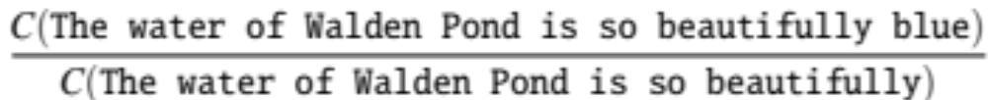
How to estimate these probabilities
Could we just count and divide?
No! Too many possible sentences!
We’ll never see enough data for estimating these
=
Notes:
We'll talk in later lectures about how these probabilities are computed, but let's just start with an intuition that motivates what the n-gram model is.

Slide 8
How to compute P(W) or P(w_{n}|w₁, …w_{n-1}) with an N-gram Language Model
First let's do the joint probability P(W):
  P(The, water, of, Walden, Pond, is, so, beautifully, blue)
Intuition: let’s rely on the Chain Rule of Probability

Slide 9
Reminder: The Chain Rule
Recall the definition of conditional probabilities
  P(B|A) = P(A,B)/P(A) Rewriting: P(A,B) = P(A) P(B|A)
More variables:
  P(A,B,C,D) = P(A) P(B|A) P(C|A,B) P(D|A,B,C)
The Chain Rule in General
P(x₁,x₂,x₃,…,x_{n}) = P(x₁)P(x₂|x₁)P(x₃|x₁,x₂)…P(x_{n}|x₁,…,x_{n-1})

Slide 10
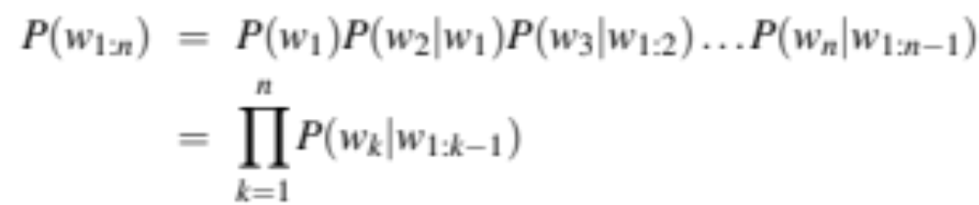
The Chain Rule applied to compute joint probability of words in sentence
P(“The water of Walden Pond”) =
P(The) × P(water|The) × P(of|The water)
× P(Walden|The water of) × P(Pond|The water of Walden)

Slide 11
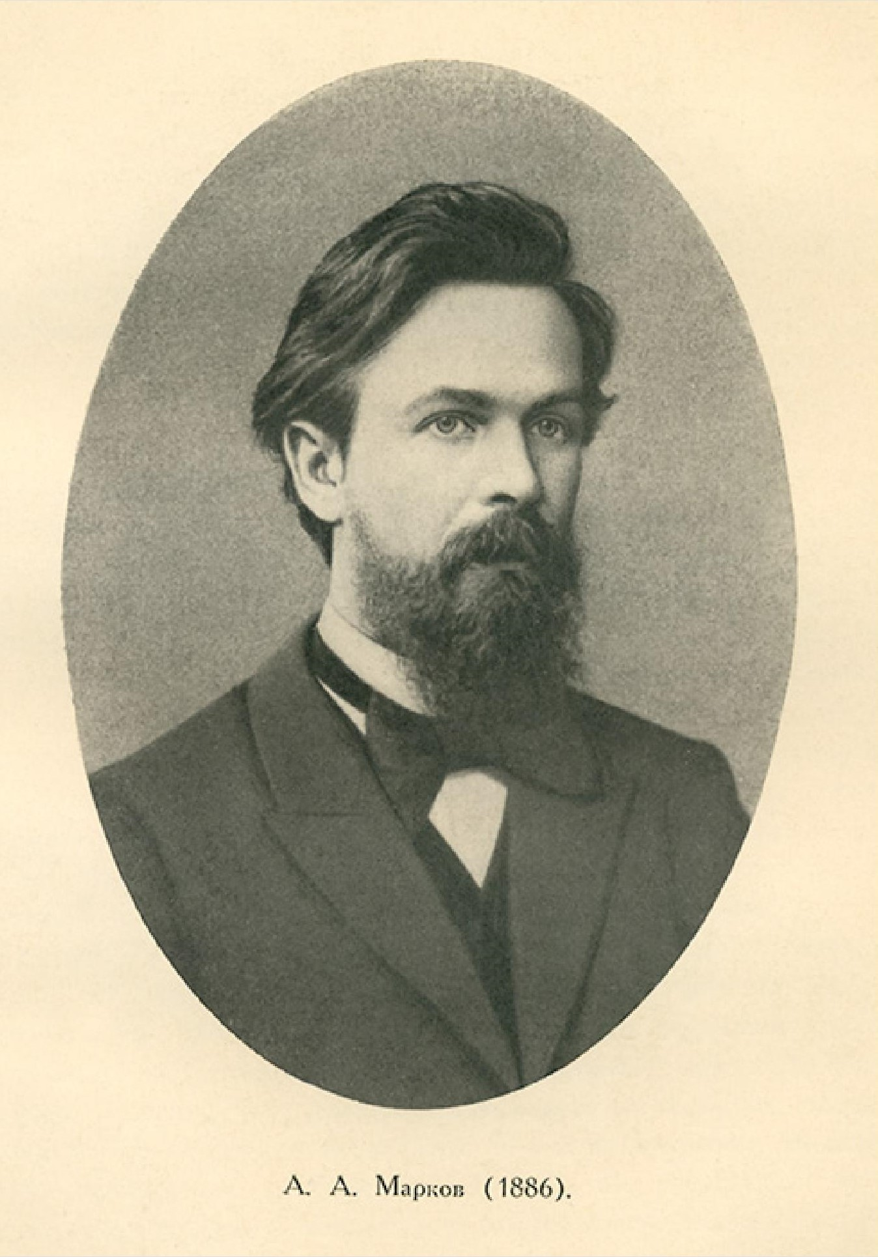
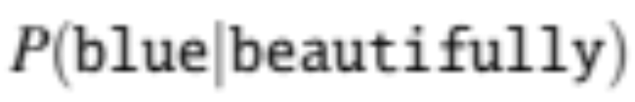
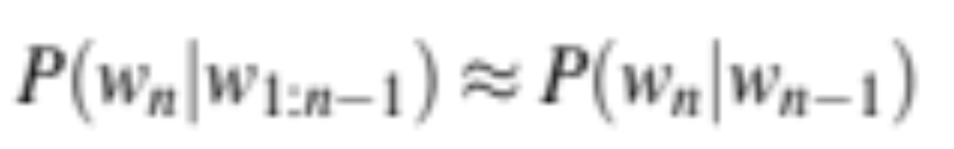
Markov Assumption
Simplifying assumption:
Andrei Markov
≈
Wikimedia commons
Notes:
Let's approximate the probability of a word given all the previous words P(wn|w1:n−1) by using only the conditional probability given the preceding word P(wn|wn−1). Markov models are the class of probabilistic models that assume we can predict the probability of some future unit without looking too far into the past. So here we're just using the one previous word, so we'll call this a bigram model.

Slide 12
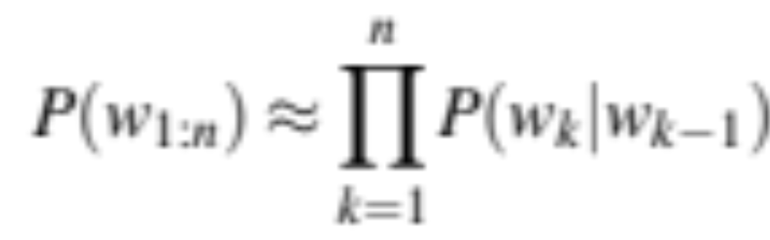
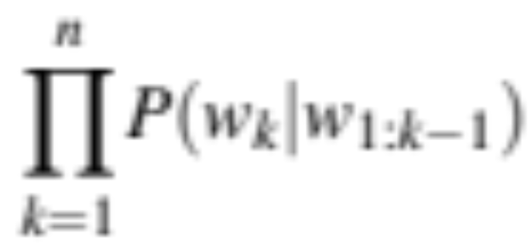
Bigram Markov Assumption
instead of:
  We approximate each component in the product
Notes:
This probability wk|wk-1 is simple enough that it's going to be easy to estimate., as we'll see in the next lecture!

Slide 13
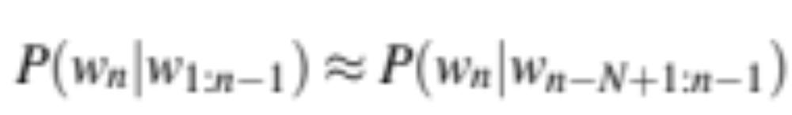
General N-gram model for each component
Notes:
And we'll see in the next lecture how to train these models.

Slide 14
Bigram model
Some automatically generated sentences from Shakespeare bigram models
Why dost stand forth thy canopy, forsooth; he is this palpable hit the King Henry. Live king. Follow.
What means, sir. I confess she? then all sorts, he is trim, captain.
Notes:
One useful way to visualize a bigram model is to use it to generate sentences and see what they look like! We'll see in following lectures how to do this generation of sentences by sampling from the language model, but for now let's just look at the output sentences.

Slide 15
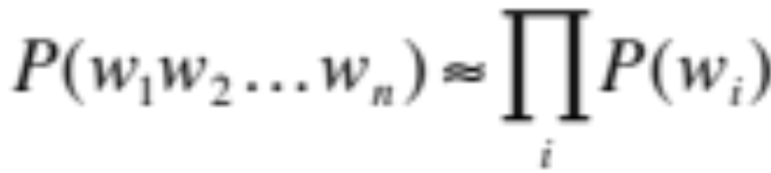
Even simpler Markov assumption: Unigram model
Some automatically generated sentences from Shakespeare unigram models
To him swallowed confess hear both . Which . Of save on trail for are ay device and rote life have
Hill he late speaks ; or ! a more to leg less first you enter

Slide 16
More complex Markov assumption: Trigram model
$$P\left(w_{i} | w_{1}w_{2}…w_{i−1}\right) ≈P\left(w_{i} | w_{i−2}w_{i−1}\right)$$
Some automatically generated sentences from Shakespeare trigram models
Fly, and will rid me these news of price. Therefore the sadness of parting, as they say, ’tis done.
This shall forbid it should be branded, if renown made it empty

Slide 17
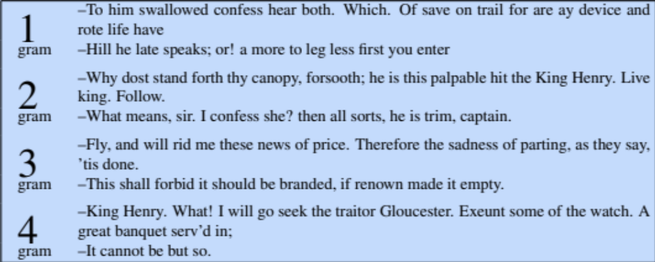
4 different N-gram models
Notes:
We can put all these examples in one chart to see how as we give the model the ability to see more context, the sentences get more and more like English

Slide 18
Problems with N-gram models
N-grams can't handle long-distance dependencies:
  “The soups that I made from that new cookbook I bought yesterday were amazingly delicious."
N-grams don't do well at modeling new sequences (even if they have similar meanings to sequences they've seen)
The solution: Large language models
can handle much longer contexts
because they use neural embedding spaces, can model meaning better

Slide 19
Why study N-gram models?
They are the "fruit fly of NLP", a simple model that introduces important topics for large language models
training and test sets
the perplexity metric
sampling to generate sentences
ideas like interpolation and backoff
N-grams are efficient and fast and useful in situations where LLMs are too heavyweight

Slide 20
N-gram Language Modeling
Introduction to N-gram Language Models
Notes:
We've seen the intuition of the n-gram language model, the simplest member of the language model family. In following lectures, we'll see the details of how to train, apply, and evaluate these models.

Slide 21
N-gram Language Modeling
Estimating N-gram Probabilities

Slide 22
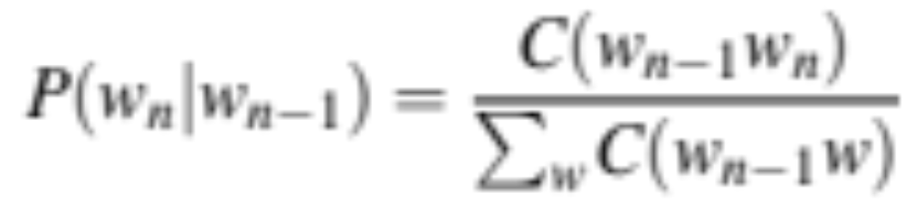
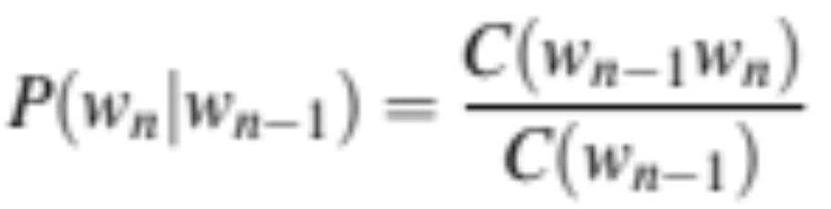
Estimating bigram probabilities
The Maximum Likelihood Estimate

Slide 23
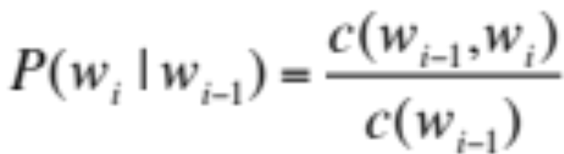

An example
<s> I am Sam </s>
<s> Sam I am </s>
<s> I do not like green eggs and ham </s>

Slide 24
More examples:
Berkeley Restaurant Project sentences
can you tell me about any good cantonese restaurants close by
tell me about chez panisse
i’m looking for a good place to eat breakfast
when is caffe venezia open during the day

Slide 25
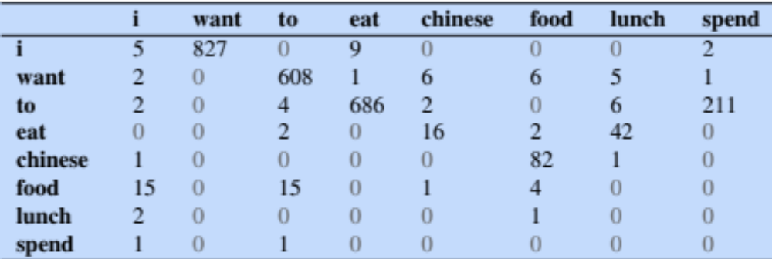
Raw bigram counts
Out of 9222 sentences

Slide 26
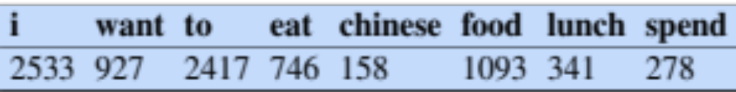
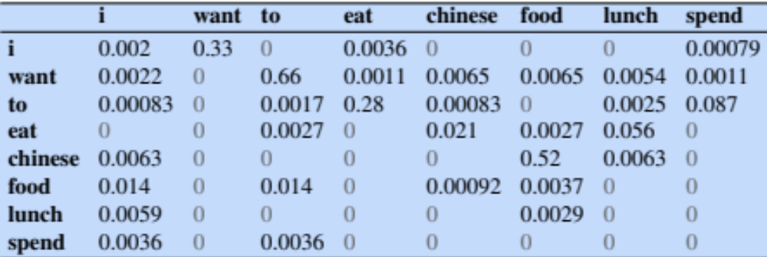
Raw bigram probabilities
Normalize by unigrams:
Result:

Slide 27
Bigram estimates of sentence probabilities
P(<s> I want english food </s>) =
P(I|<s>)
× P(want|I)
× P(english|want)
× P(food|english)
× P(</s>|food)
= .000031

Slide 28
What kinds of knowledge do N-grams represent?
P(to|want) = .66
P(want | spend) = 0
P(of | to) = 0
P (dinner|lunch or) = .83
P(dinner|for) ~ P(lunch|for)
P(chinese|want) > P(english|want)
Knowledge of grammar
("want" is followed by infinitive "to")
("of" is not a verb)
Knowledge of meaning
The words "dinner" or "lunch" are semantically related.
Knowledge about the world
Chinese food is very popular
Notes:
Knowledge of meaning: this idea that words that occur in similar places have similar meanings is called "distributional similarity"; we'll return to this when we introduce Vector Semantics.
And later we'll see that large language models can represent even more sophisticated forms of each of these kinds of knowledge

Slide 29
Dealing with scale in large n-grams
LM probabilities are stored and computed in log format, i.e. log probabilities
This avoids underflow from multiplying many small numbers
If we need probabilities we can do one exp at the end

Slide 30
Larger ngrams
4-grams, 5-grams
Large datasets of large n-grams have been released
  N-grams from Corpus of Contemporary American English (COCA) 1 billion words (Davies 2020)
  Google Web 5-grams (Franz and Brants 2006) 1 trillion words)
  Efficiency: quantize probabilities to 4-8 bits instead of 8-byte float
  Newest model: infini-grams (∞-grams) (Liu et al 2024)
  No precomputing! Instead, store 5 trillion words of web text in suffix arrays. Can compute n-gram probabilities with any n!

Slide 31
N-gram LM Toolkits
SRILM
  http://www.speech.sri.com/projects/srilm/
KenLM
  https://kheafield.com/code/kenlm/

Slide 32
N-gram Language Modeling
Estimating N-gram Probabilities

Slide 33
Language Modeling
Evaluation and Perplexity
Notes:
Language models, like all NLP tools, need to be evaluated. Here we introduce the standard evaluation tools for ngram language models as well as large language models: training sets, test sets, and the perplexity metric.

Slide 34
How to evaluate N-gram models
"Extrinsic (in-vivo) Evaluation"
To compare models A and B
  Put each model in a real task
    Machine Translation, speech recognition, etc.
  Run the task, get a score for A and for B
    How many words translated correctly
    How many words transcribed correctly
  Compare accuracy for A and B
Notes:
The best way to evaluate any NLP component like an N-gram language model is called extrinsic or in-vivo evaluation, meaning a live or real application. If we have two models, A, and B, that we want to evaluate, we put each in a real task that we care about, run the task, get a score for each of the two language models, such as the number of words translated or transcribed correctly, and then we just compare the scores or accuracies.

Slide 35
Intrinsic (in-vitro) evaluation
Extrinsic evaluation not always possible
  Expensive, time-consuming
  Doesn't always generalize to other applications
Intrinsic evaluation: perplexity
  Directly measures language model performance at predicting words.
  Doesn't necessarily correspond with real application performance
  But gives us a single general metric for language models
  Useful for large language models (LLMs) as well as n-grams
Notes:
Extrinsic evaluation isn't always possible. It's often time-consuming and expensive to run real tasks, involving human scoring, but that's a problem because we often want to evaluate thousands of versions of our systems. Also, we might want to see how well our n-gram language model works more generally, and not just in a particular application.
For this reason, we often use an intrinsic, or in-vitro evaluation metric called perplexity. We call it intrinsic or in-vitro because it's not embedded in a real application in the world, so it's sort of a test-tube evaluation. Perplexity directly measuring language model performance at predicting words. This may not always correspond with real application performance, but it gives us a single general metric. We use perplexity for simple n-gram language models but also for the most advanced neural Large Language Models.

Slide 36
Training sets and test sets
We train parameters of our model on a training set.
We test the model’s performance on data we haven’t seen.
  A test set is an unseen dataset; different from training set.
    Intuition: we want to measure generalization to unseen data
  An evaluation metric (like perplexity) tells us how well our model does on the test set.
Notes:
To evaluate, we'll need some data. We always train the parameters of our model, like the n-gram counts, on a training set. And we test the model's performance on data we haven't seen. A test set is an unseen dataset that is different from our training set, no part of it should have been used in training. The intuition is that we care about generalization of our model. A machine learning model that perfectly captured the training data, but doesn't generalize well to unseen data, wouldn't be much use! And then we'll need an evaluation metric, like perplexity, that tells us how well our model does on the test set.

Slide 37
Choosing training and test sets
If we're building an LM for a specific task
  The test set should reflect the task language we want to use the model for
If we're building a general-purpose model
  We'll need lots of different kinds of training data
  We don't want the training set or the test set to be just from one domain or author or language.
Notes:
How do we create a training set? Sometimes we're building an LM for a specific task, like legal language or medical language, and then the test set should reflect the task that we care about. Other times, we're building a general-purpose language model, and then we'll want to make sure we get balanced data from lots of different genres and authors. And of course lots of data from many different languages, if we're building a multilingual LM.

Slide 38
Training on the test set
We can’t allow test sentences into the training set
  Or else the LM will assign that sentence an artificially high probability when we see it in the test set
  And hence assign the whole test set a falsely high probability.
  Making the LM look better than it really is
This is called “Training on the test set”
Bad science!
Notes:
Again, the test set and the training set must be non-overlapping. If we have a test sentence in the training set, the n-gram (or any other language model) will learn which words follow which words in that sentence, and then when we see it in the test set, we will assign it a very probabilkity, and that will falsely make the language model seem more accurate than it is. Training on the test set is always a bad idea. It seems obvious, but it requires a lot of dataset care to keep this from happening, since often we get duplicate documents in our dataset, and one might find its way into the training set, and one into the test set.

Slide 39
Dev sets
If we test on the test set many times we might implicitly tune to its characteristics
  Noticing which changes make the model better.
So we run on the test set only once, or a few times
That means we need a third dataset:
  A development test set or, devset.
  We test our LM on the devset until the very end
  And then test our LM on the test set once
Notes:
Even a test set isn't enough. If we keep adjusting our LM, re-testing it on the same test set, we will implicitly be tuning it to the test set, improving it in ways that are fit too exactly to that particularly test set. So we try to reserve the test set to just run once or twice. Thus we'll need an intermediate test set to use while we are developing. That test set is hence called the development testset or devset.

Slide 40
Intuition of perplexity as evaluation metric: How good is our language model?
Intuition: A good LM prefers "real" sentences
Assign higher probability to “real” or “frequently observed” sentences
Assigns lower probability to “word salad” or “rarely observed” sentences?
Notes:
Let's now turn to the perplexity metric. The intuition of perplexity is that a good language model should prefer reall, or frequently observed sentences, and assign lower probably to rarely observed sentences, or just random sequences of words that we might call "word salad".

Slide 41
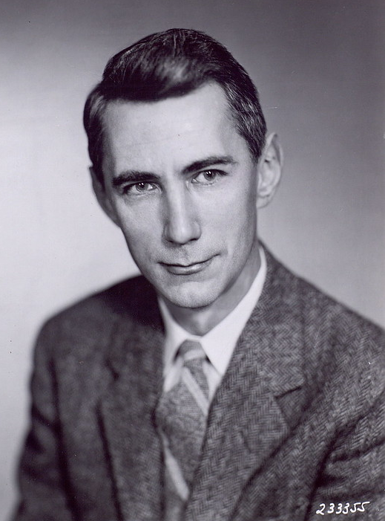
Intuition of perplexity 2:
Predicting upcoming words
time 0.9
dream 0.03
midnight 0.02
…
and 1e-100
The Shannon Game: How well can we predict the next word?
Once upon a ____
That is a picture of a ____
For breakfast I ate my usual ____
Unigrams are terrible at this game (Why?)
Claude Shannon
A good LM is one that assigns a higher probability to the next word that actually occurs
Picture credit: Historiska bildsamlingen
https://creativecommons.org/licenses/by/2.0/
Notes:
We can think of this predicting task first just for individual words. The idea of asking an LM, or a person, to look at the start of a sentence, and predict the next upcoming word is called the Shannon Game, because it was invented by information theorist Claude Shannon in 1951 as a way of measuring the entropy of English. So if we see the prefix "Once upon a", we might guess "time" as a very likely next word, and maybe we would assign dream, or midnight as possible but less likely, while words like "and" should be extremely unlikely, because "Once upon a and" is an unlikely sentence. People are pretty good at this, as are language models, the longer the better. Unigrams are terrible at this time. Think about why this is? intuition of perplexity is that a good LM is one that is good at the Shannon game: it assigns a higher probability to the next word that actually occurs

Slide 42
Intuition of perplexity 3: The best language model is one that best predicts the entire unseen test set
We said: a good LM is one that assigns a higher probability to the next word that actually occurs.
Let's generalize to all the words!
  The best LM assigns high probability to the entire test set.
When comparing two LMs, A and B
  We compute P_{A}(test set) and P_{B}(test set)
  The better LM will give a higher probability to (=be less surprised by) the test set than the other LM.
Notes:
Let's generalize this idea that a good LM assigns a higher probability to the next word that actually occurs, to say that A good LM assigns high probability to the entire test set. Let's just think of the test set as if it was one very long sentence. So when comparing to LMs, A, and B, we ask each to tell us the probability of the entire testset. Now the better LM is the one that gives a higher probability to the test set, or in other words is less surprised by the test set than the other LM.

Slide 43
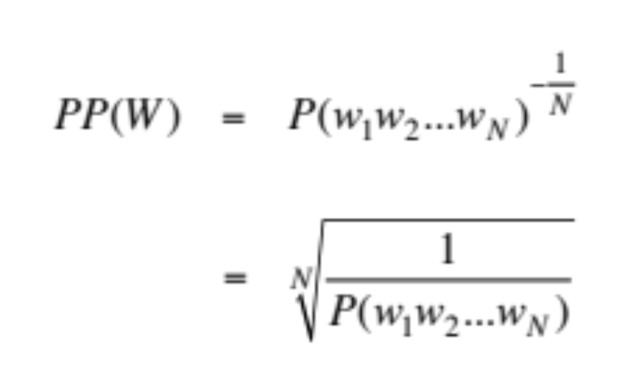
Intuition of perplexity 4: Use perplexity instead of raw probability
Probability depends on size of test set
  Probability gets smaller the longer the text
  Better: a metric that is per-word, normalized by length
Perplexity is the inverse probability of the test set, normalized by the number of words
Notes:
There's a problem with using probability. And that is that the probability of a test set depends very directly on the length of the test set. This is because probability gets smaller the longer the text. For n-gram models, this is very clear; the chain rule of probability means that for a test set of N words we are multiplying together N n-gram probabilities! It would be better to normalize the probabilities by length to get a metric that is per-word. Perplexity is just such a metric. Perplexity is the inverse probability of the test set, normalized by the number of words. We normalize by taking the N-th root of the probability of the test set.

Slide 44
Intuition of perplexity 5: the inverse
  Perplexity is the inverse probability of the test set, normalized by the number of words
  (The inverse comes from the original definition of perplexity from cross-entropy rate in information theory)
  Probability range is [0,1], perplexity range is [1,∞]
  Minimizing perplexity is the same as maximizing probability
Notes:
Notice that I slipped something in there. Perplexity isjust just the probability of the test set normalized by the number of words. It's the inverse probability. There is this little minus-sign here, or a 1/x here. This inverse turns out to come from part of the original definition of perplexity from the idea of cross-entropy rate in information theory. We won't go into that here, but you can look at it in the textbook). We'll just say that because of that inverse, minimizing perplexity is the same as maximizing probability. So the better LM has a higher probability but a lower perplexity on the test set.

Slide 45
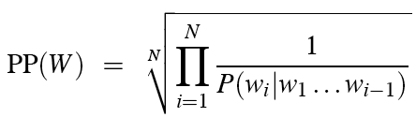
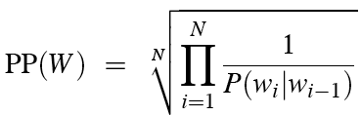
Intuition of perplexity 6: N-grams
Chain rule:
Bigrams:
Notes:
Let's see perplexity with n-gram language models. We can use the chain rule to turn the probability of the entire test set into N separate probabilities. Now we can make the n-gram assumption, such as the bigram simplification, to help us compute each of these individual probabilities.

Slide 46
Intuition of perplexity 7:
Weighted average branching factor
Perplexity is also the weighted average branching factor of a language.
Branching factor: number of possible next words that can follow any word
Example: Deterministic language L = {red,blue, green}
Branching factor = 3 (any word can be followed by red, blue, green)
Now assume LM A where each word follows any other word with equal probability ⅓
Given a test set T = "red red red red blue"
  Perplexity_{A}(T) = P_{A}(red red red red blue)^{-1/5} =
But now suppose red was very likely in training set, such that for LM B:
  P(red) = .8 p(green) = .1 p(blue) = .1
We would expect the probability to be higher, and hence the perplexity to be smaller:
  Perplexity_{B}(T) = P_{B}(red red red red blue)^{-1/5}
  ((⅓)⁵)^{-1/5}
  = (⅓)⁻¹
  =3
= (.8 * .8 * .8 * .8 * .1) ^{-1/5}
=.04096 ^{-1/5}
= .527⁻¹
= 1.89
Notes:
Finally, perplexity turns out to also correspond to the weigthed average branching factor of a language. The Branching factor of a language is the number of possible next words that can follow any word.

Slide 47
Holding test set constant:
Lower perplexity = better language model
Training 38 million words, test 1.5 million words, WSJ
N-gram Order | Unigram | Bigram | Trigram
Perplexity | 962 | 170 | 109
Notes:
So if we hold the test set constant, the better, more predictive the language model, the lower the perplexity will be. Here we can see this with some text from the US Wall Street Journal newspaper text corpus. A unigram LM has a perplexity of 962, a bigram of 170, and a trigram of 109. The better the model, the higher the probability it assigns to the test set, and since perplexity goes inversely with probability, lower the perplexity.

Slide 48
Language Modeling
Evaluation and Perplexity
Notes:
You now have seen the perplexity metric which is central to language modeling, since we use it to evaluate LMs from n-grams to the most powerful neural large language models. And you've learned the concepts of training, dev, and test sets that we'll use for every supervised machine learning NLP algorithm.

Slide 49
Language Modeling
Sampling and Generalization
Notes:
In this lecture we introduce the idea of sampling from a language model: generating sentences according to their probabilities, and see how this allows us to talk about how well the language model generalizes (or doesn't) from its training data.

Slide 50
The Shannon (1948) Visualization Method
Sample words from an LM
Claude Shannon
Unigram:
REPRESENTING AND SPEEDILY IS AN GOOD APT OR COME CAN DIFFERENT NATURAL HERE HE THE A IN CAME THE TO OF TO EXPERT GRAY COME TO FURNISHES THE LINE MESSAGE HAD BE THESE.
Bigram:
THE HEAD AND IN FRONTAL ATTACK ON AN ENGLISH WRITER THAT THE CHARACTER OF THIS POINT IS THEREFORE ANOTHER METHOD FOR THE LETTERS THAT THE TIME OF WHO EVER TOLD THE PROBLEM FOR AN UNEXPECTED.
Notes:
One important way to visualize what kind of knowledge a language model embodies is to sample from it. Sampling from a distribution means to choose random points according to their likelihood. Sampling from a language model means to generate sentence according to their likelihoods as defined by the model. Thus we are more likely to generate sentences that the model thinks have a high probability and less likely to generate sentences that the model thinks have a low probability. Here are some sentences generated by Claude Shannon in 1948 from a unigram and a bigram model. You can see that the unigram model is just word salad, but the bigram model, while still pretty random, it starting to look a bit more coherent in its sequences, at least locally.

Slide 51

How Shannon sampled those words in 1948
"Open a book at random and select a letter at random on the page. This letter is recorded. The book is then opened to another page and one reads until this letter is encountered. The succeeding letter is then recorded. Turning to another page this second letter is searched for and the succeeding letter recorded, etc."
Notes:
Here's how Shannon sampled those words in 1948, although describing the process for letters rather than words. How could we implement the same process computationally given an n-gram language model?

Slide 52
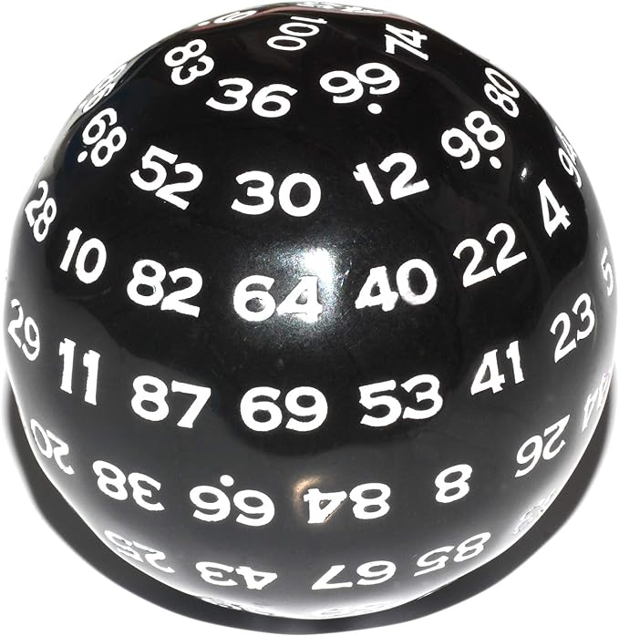
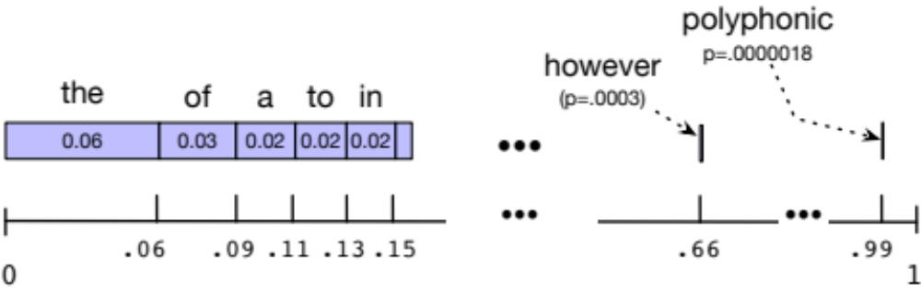
Sampling a word from a distribution
Notes:
It’s simplest to visualize how this works for the unigram case. Imagine all the words of the English language covering the probability space between 0 and 1, each word covering an interval proportional to its frequency. We choose a random value between 0 and 1, find that point on the probability line, and print the word whose interval includes this chosen value. So let's suppose we choose a random number, it's 0.12, we look on our number line, and that's the word "to", so we generate "to" as the next word. We continue choosing random numbers and generating words until we randomly generate the end-of-sentence token.

Slide 53
Visualizing Bigrams the Shannon Way
Choose a random bigram (<s>, w)
according to its probability p(w|<s>)
Now choose a random bigram (w, x) according to its probability p(x|w)
And so on until we choose </s>
Then string the words together
<s> I
I want
want to
to eat
eat Chinese
Chinese food
food </s>
I want to eat Chinese food
Notes:
We can extend this idea to n-grams. For example for the bigram case, we first choose a random bigram whose first token is the start-of-sentence token, according to its probability

Slide 54
Note: there are other sampling methods
Used for neural language models
Many of them avoid generating words from the very unlikely tail of the distribution
We'll discuss when we get to neural LM decoding:
  Temperature sampling
  Top-k sampling
  Top-p sampling
Notes:
There are other, more sophisticated sampling algorithms, that we'll discuss when we get to neural language model decoding, methods like temperature or top-k sampling. They are mainly used to avoid generating really really rare words.

Slide 55
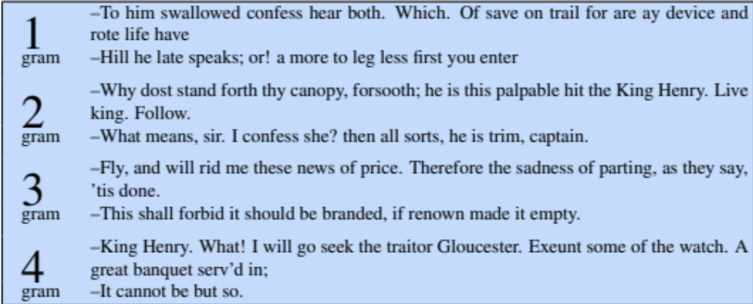
Approximating Shakespeare
Notes:
This figure shows some random sentences generated from unigram, bigram, trigram, and 4- gram models trained on the works of William Shakespeare.
The longer the context, the more coherent the sentences. In these unigram sentences, there's no coherent relation between words. The bigram sentences have some local word-to-word coherence, and sensible punctuation. The 3 and 4-gram sentences are beginning to look a lot like Shakespeare. In fact, they look a little too much like Shakespeare. The words It cannot be but so are directly from King John.

Slide 56
Shakespeare as corpus
N=884,647 tokens, V=29,066
Shakespeare produced 300,000 bigram types out of V²= 844 million possible bigrams.
  So 99.96% of the possible bigrams were never seen (have zero entries in the table)
  That sparsity is even worse for 4-grams, explaining why our sampling generated actual Shakespeare.
Notes:
Just choosing one author, Shakespeare, makes for a pretty small corpus; under a million words from a vocabulary of 29,000 words. The vocab 29,000 squared is somewhat under a billion. So that means there are a billion possible bigrams whose counts have to come from only a million word corpus, and 10^17 possible 4-grams. So when training on any corpus, the vast majority of all the n-gram counts will be zero!

Slide 57
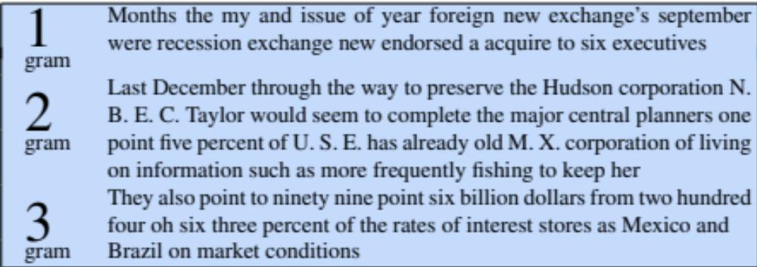
The Wall Street Journal is not Shakespeare
Notes:
To get an idea of the dependence of a grammar on its training set, let’s look at an n-gram grammar trained on a completely different corpus: the Wall Street Journal (WSJ) newspaper. Shakespeare and the Wall Street Journal are both English, so we might expect some overlap between our n-grams. There is no overlap even in small phrases, let alone entire sentences. Statistical models are use- less as predictors when the training sets and the test sets are as different as Shakespeare and WSJ.

Slide 58
Can you guess the author? These 3-gram sentences are sampled from an LM trained on who?
1) They also point to ninety nine point six billion dollars from two hundred four oh six three percent of the rates of interest stores as Mexico and gram Brazil on market conditions
2) This shall forbid it should be branded, if renown made it empty.
3) “You are uniformly charming!” cried he, with a smile of associating and now and then I bowed and they perceived a chaise and four to wish for.
Notes:
And just to make this absolutely clear, look at these 3 sentences. It should be very clear which one is sampled from the WSJ, which from Shakespeare, and which from Jane Austen.

Slide 59
Choosing training data
If task-specific, use a training corpus that has a similar genre to your task.
  If legal or medical, need lots of special-purpose documents
Make sure to cover different kinds of dialects and speaker/authors.
  Example: African-American Vernacular English (AAVE)
    One of many varieties that can be used by African Americans and others
    Can include the auxiliary verb finna that marks immediate future tense:
    "My phone finna die"
Notes:
To deal with this problem we should always use a training corpus that has a similar genre to whatever task we are trying to accomplish. To build a language model for translating legal documents, we need a training corpus of legal documents. To build a language model for a question-answering system, we need a training corpus of questions. It is equally important to get training data in the appropriate dialect or variety, especially when processing social media posts or spoken transcripts. For example some tweets will use features of African American English (AAE)— the name for the many varieties of language used in African American communities. Such features can include words like finna—an auxiliary verb that marks immediate future tense.

Slide 60
The perils of overfitting
N-grams only work well for word prediction if the test corpus looks like the training corpus
  But even when we try to pick a good training corpus, the test set will surprise us!
  We need to train robust models that generalize!
  One kind of generalization: Zeros
    Things that don’t ever occur in the training set
      But occur in the test set
Notes:
In summary, n-grams only work well if the training set is chosen carefully to provide the right kind of language for the test setting. But matching genres and dialects is still not sufficient. Our models may still be subject to the problem of sparsity! Even a good training set might simply be missing some n-grams that appear in the test set.

Slide 61
Zeros
Training set:
  … ate lunch
  … ate dinner
  … ate a
  … ate the
  P(“breakfast” | ate) = 0
Test set
  … ate lunch
  … ate breakfast
Notes:
For example, consider a training set that has the phrases "ate lunch", "ate dinner", "ate a", and "ate the", but happens not to have had the phrase "ate breakfast". The P("breakfas|ate) in the test set will be 0!

Slide 62
Zero probability bigrams
Bigrams with zero probability
  Will hurt our performance for texts where those words appear!
  And mean that we will assign 0 probability to the test set!
And hence we cannot compute perplexity (can’t divide by 0)!
Notes:
These zeros are a problem for two reasons. First, they mean we are underestimating the probability of all sorts of words that might occur, which will hurt the performance of any application we want to run on this data. Second, if the probability of any word in the test set is 0, the entire probability of the test set is 0. And perplexity is based on the inverse probability of the est set. Thus if some words have zero probability, we can’t compute perplexity at all, since we can’t divide by 0! The solution to this problem is called smoothing, and we'll see it in the next lecture!

Slide 63
Language Modeling
Sampling and Generalization
Notes:
In this lecture we've seen how to sample from a language model and how this allows us to talk about how well a language model generalizes (or doesn't) from its training data.

Slide 64
N-gram Language Modeling
Smoothing, Interpolation, and Backoff
Notes:
N-gram models are based on learning from the training corpus. But any finite training corpus will miss things! In this lecture we introduce multiple ways to deal with this problem: smoothing, interpolation, and backoff.

Slide 65
The problem of sparsity
Maximum likelihood estimation has a problem
Sparsity! Our finite training corpus won't have some perfectly fine sequences
  Perhaps it has "ruby" and "slippers"
  But happens not to have "ruby slippers"

Slide 66
This sparsity can take many forms
Verbs have direct objects; those can be sparse too!
Count(w | denied the)
Counts:
3 allegations
2 reports
1 claims
1 request
0 attack
0 outcome
7 total
allegations
attack
man
reports
outcome
…
claims
request

Slide 67
The intuition of smoothing
(Example modified from Dan Klein!)
When we have sparse statistics:
Count(w | denied the)
3 allegations
2 reports
1 claims
1 request
7 total
allegations
attack
man
reports
outcome
…
claims
request
Steal probability mass to generalize better
Count(w | denied the)
2.5 allegations
1.5 reports
0.5 claims
0.5 request
2 other
7 total
attack
man
allegations
outcome
…
reports
claims
request

Slide 68
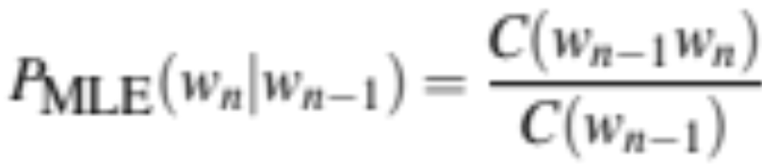
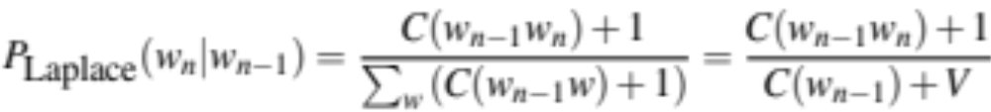
Add-one estimation
Also called Laplace smoothing
Pretend we saw each word one more time than we did
Just add one to all the counts!
MLE estimate:
Add-1 estimate:
Notes:
Note that for add-one smoothed bigram counts, we are augmenting the denominator by one for each possible next word w, which means we're adding V, the number of total word types in the vocabulary.

Slide 69
Maximum Likelihood Estimates
The maximum likelihood estimate
  of some parameter of a model M from a training set T
  maximizes the likelihood of the training set T given the model M
Suppose the word “bagel” occurs 400 times in a corpus of a million words
What is the probability that a random word from some other text will be “bagel”?
MLE estimate is 400/1,000,000 = .0004
This may be a bad estimate for some other corpus
  But it is the estimate that makes it most likely that “bagel” will occur 400 times in a million word corpus.

Slide 70
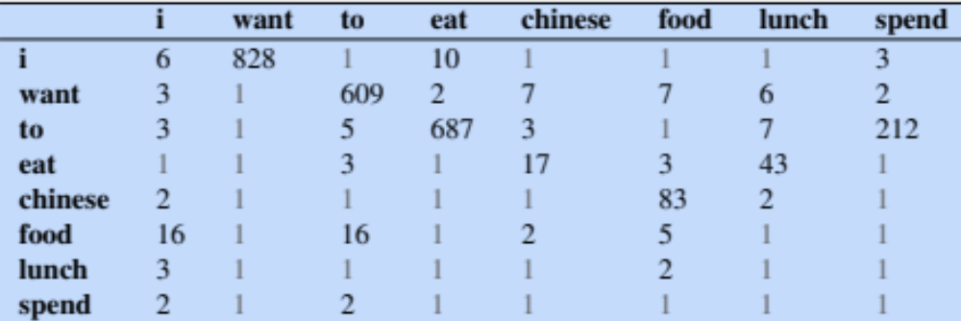
Berkeley Restaurant Corpus: Laplace smoothed bigram counts

Slide 71
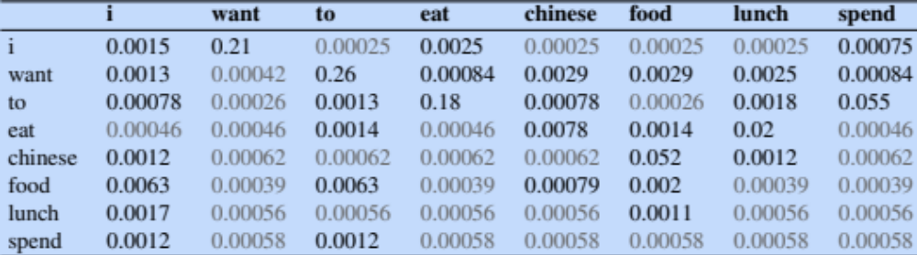
Laplace-smoothed bigrams

Slide 72
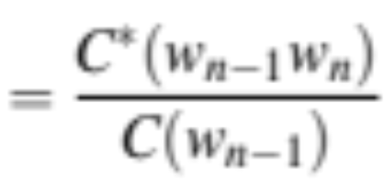
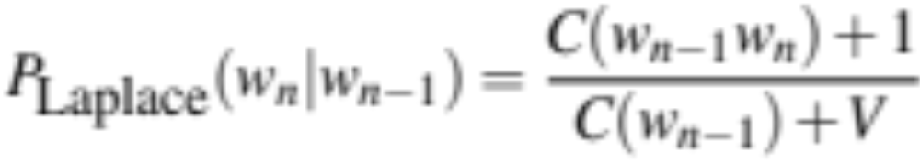
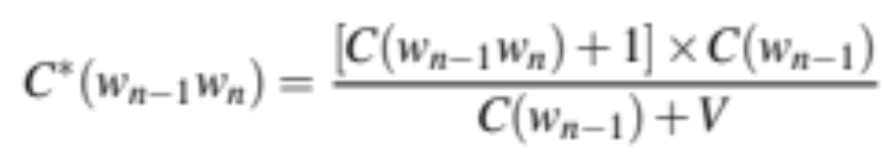
Visualization Technique: Reconstituted counts
Notes:
One useful visualization technique is to reconstruct an adjusted count matrix so we can see how much a smoothing algorithm has changed the original counts. This adjusted count C∗ is the count that, if divided by C(wn−1), would result in the smoothed probability. This adjusted count is easier to compare directly with the MLE counts. That is, the Laplace probability can equally be expressed as the adjusted count divided by the (non-smoothed) denominator.
Rearranging terms, we can solve for C∗(wn−1wn) :

Slide 73
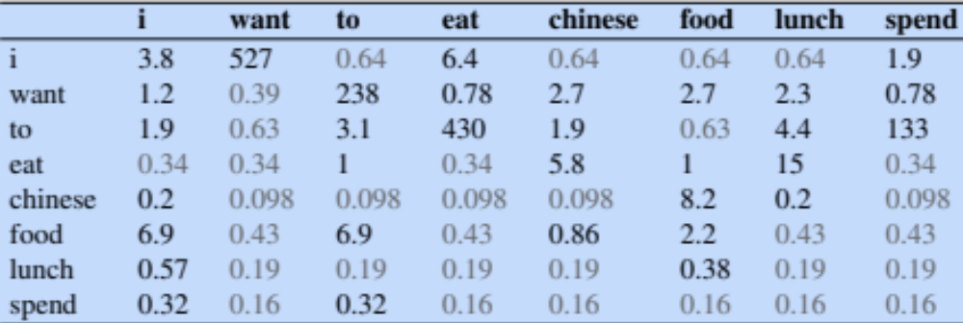
Reconstituted counts C*
C*:
Notes:
Here are the resulting C* counts. Let's see how they compare to the original counts

Slide 74
Compare with raw bigram counts
original
add-1
smoothed
Notes:
Aha! add-one smoothing has made a very big change in the counts
C(Chinese food) went from 82 to 8.2. We call d= c*/c the discount
d for “chinese food” =.10!!! A 10x reduction . That's a big change!!

Slide 75
Add-1 estimation is a blunt instrument
So add-1 isn’t used for N-grams:
  Generally we use interpolation or backoff instead
But add-1 is used to smooth other NLP models
  Or we can use add-k where 0<k<1
  It's used in naive bayes text classification
  In domains where the number of zeros isn’t so huge.
Notes:
Add-1 is a blunt instrument!

Slide 76
Backoff and Interpolation
Sometimes it helps to use a simpler model
  Condition on less context for contexts you know less about
Backoff:
  If enough evidence, use trigram P(w_{n}|w_{n−2}w_{n−1})
  If not, use bigram P(w_{n}|w_{n−1})
  Else unigram P(w_{n})
Interpolation:
  mix unigram, bigram, trigram
Interpolation works better
Notes:
There are other methods we can use to deal with zero-count ngrams. If we have no examples of a trigram to estimate the probability of a word, we could estimate its probability from the bigram probability, or the unigram. This is called backoff
Or we could mix them, interpolating the probabilities, which often works better than backoff.
Let's see backoff and interpolation in more detail.

Slide 77
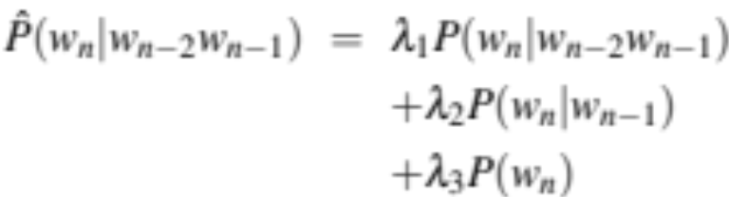
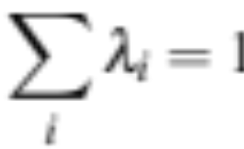
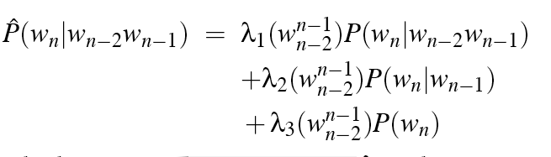
Linear Interpolation
Simple interpolation
Lambdas conditional on context:
Notes:
In simple linear interpolation, we com- bine different order n-grams by linearly interpolating them. Thus, we estimate the trigram probability P(wn|wn−2wn−1) by mixing together the unigram, bigram, and trigram probabilities, each weighted by a λ : The λs must sum to 1, making this equation equivalent to a weighted average.
In a slightly more sophisticated version of linear interpolation, each λ weight is com- puted by conditioning on the context.

Slide 78
How to set λs for interpolation?
Use a held-out corpus
Choose λs to maximize probability of held-out data:
  Fix the N-gram probabilities (on the training data)
  Then search for λs that give largest probability to held-out set
Training Data
Held-Out Data
Test
Data
Notes:
How are these λ values set? λs are learned from a held-out corpus. A held-out corpus is an additional training corpus, so-called because we hold it out from the training data, that we use to set these λ values. Held-out corpora are generally used to set hyperparameters, which are special parameters, unlike regular counts that are learned from the training data; we’ll discuss hyperparameters when we introduce neural networks.

Slide 79
Backoff
  Suppose you want:
  P(pancakes| delicious soufflé)
If the trigram probability is 0, use the bigram
P(pancakes| soufflé)
If the bigram probability is 0, use the unigram
P(pancakes)
Complication: need to discount the higher-order ngram so probabilities don't sum higher than 1 (e.g., Katz backoff)
Notes:
An alternative to interpolation is backoff. In a backoff model, if the n-gram we need has zero counts, we approximate it by backing off to the (n-1)-gram.

Slide 80
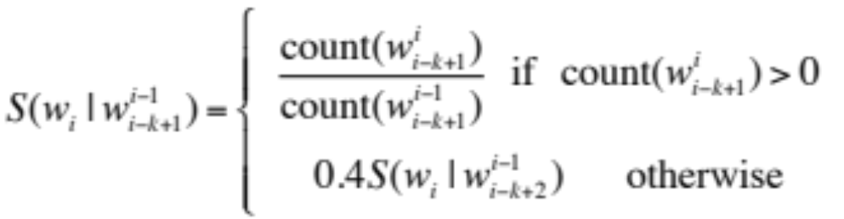
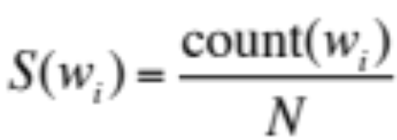
Stupid Backoff
Backoff without discounting (not a true probability)

Slide 81
Summary: What to do if you never saw an n-gram in training
  Smoothing: Pretend you saw every n-gram one (or k) times more than you did
  A blunt instrument (replacing a lot of zeros) but sometimes useful
  Backoff: If you haven't seen the trigram, use the (weighted) bigram probability instead
  Weighting is messy; "stupid" backoff works fine at web-scale
  Interpolation: (weighted) mix of trigram, bigram, unigram
  Usually the best! We also use interpolation to combine multiple LLMs

Slide 82
N-gram Language Modeling
Smoothing, Interpolation, and Backoff
Notes:
In summary, this lecture introduced multiple ways to make n-gram language models generalize better given sparsity in our training data.

