Slide 1
Transformers
Introduction to Transformers

Slide 2

LLMs are built out of transformers
Transformer: a specific kind of network architecture, like a fancier feedforward network, but based on attention
Notes:
D

Slide 3
A very approximate timeline
1990 Static Word Embeddings
2003 Neural Language Model
2008 Multi-Task Learning
2015 Attention
2017 Transformer
2018 Contextual Word Embeddings and Pretraining
2019 Prompting
2019 RLHF Alignment
2021 Instruction Tuning

Slide 4
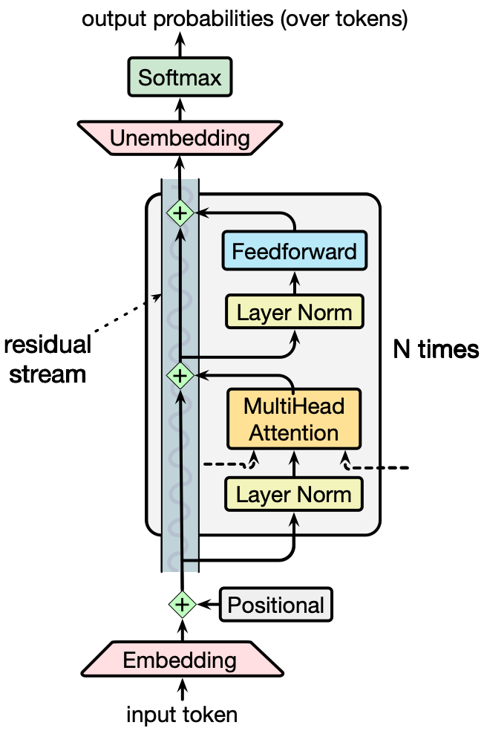
The transformer

Slide 5
Transformers
Attention

Slide 6
How to compute contextual embeddings
Contextual embeddings: Each word has a different vector in each different context that represents different meanings depending on surrounding words
How to compute contextual embeddings?
  Attention

Slide 7
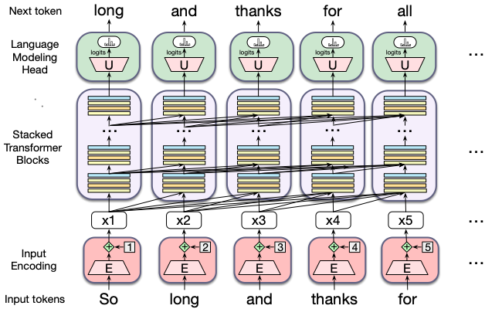

Reminder: contextual embeddings
Let's consider the embeddings for an individual word from a particular layer

Slide 8

Reminder: problem with static embeddings (word2vec)
They are static! The embedding for a word doesn't reflect how its meaning changes in context.
The chicken didn't cross the road because it was too tired
What is the meaning represented in the static embedding for "it"?
Notes:
D

Slide 9
Contextual Embeddings
The chicken didn't cross the road because it
What should be the properties of "it"?
The chicken didn't cross the road because it was too tired
The chicken didn't cross the road because it was too wide
At this point in the sentence, it's probably referring to either the chicken or the street
Notes:
But the static meaning of "it" can't represent that, it just means "I am a non-human pronoun".

Slide 10
Intuition of attention
Build up the contextual embedding from a word by selectively integrating information from all the neighboring words
We say that a word "attends to" some neighboring words more than others

Slide 11
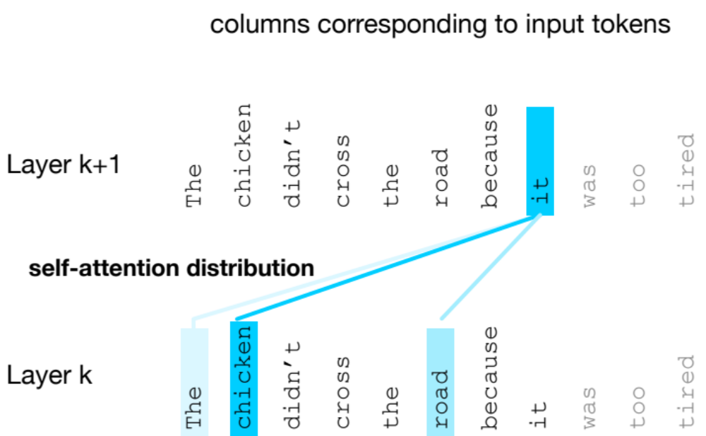
Intuition of attention:
test
Notes:
D

Slide 12
Attention definition
A mechanism for helping compute the embedding for a token by selectively attending to and integrating information from surrounding tokens (at the previous layer).
More formally: a method for doing a weighted sum of vectors.
Notes:
D

Slide 13
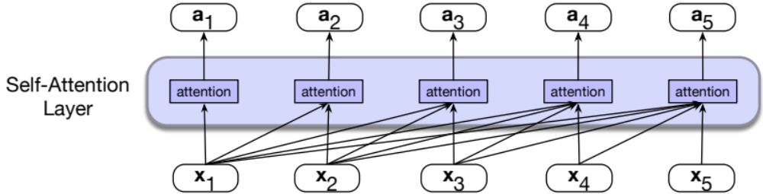
Attention is left-to-right

Slide 14
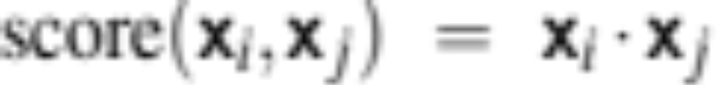
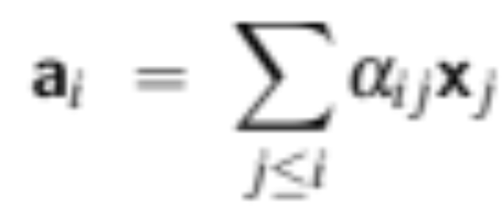
Simplified version of attention: a sum of prior words weighted by their similarity with the current word
Given a sequence of token embeddings:
x₁ x₂ x₃ x₄ x₅ x₆ x₇ x_{i}
Produce: a_{i} = a weighted sum of x₁ through x₇ (and x_{i})
Weighted by their similarity to x_{i}
Notes:
D

Slide 15
Intuition of attention:
test
x1 x2 x3 x4 x5 x6 x7 xi
Notes:
D

Slide 16
An Actual Attention Head: slightly more complicated
High-level idea: instead of using vectors (like x_{i} and x₄) directly, we'll represent 3 separate roles each vector x_{i} plays:
query: As the current element being compared to the preceding inputs.
key: as a preceding input that is being compared to the current element to determine a similarity
value: a value of a preceding element that gets weighted and summed
Notes:
The word head is used in transformers to refer to specific structured layers

Slide 17
Attention intuition
query
x1 x2 x3 x4 x5 x6 x7 xi
values
Notes:
D

Slide 18
Intuition of attention:
query
x1 x2 x3 x4 x5 x6 x7 xi
keys
k
k
k
k
k
k
k
k
values
v
v
v
v
v
v
v
v
Notes:
D

Slide 19
An Actual Attention Head: slightly more complicated
We'll use matrices to project each vector x_{i} into a representation of its role as query, key, value:
query: W^{Q}
key: W^{K}
value: W^{V}

Slide 20
An Actual Attention Head: slightly more complicated
Given these 3 representation of x_{i}
To compute similarity of current element x_{i} with some prior element x_{j}
We’ll use dot product between q_{i} and k_{j}.
And instead of summing up x_{j} , we'll sum up v_{j}

Slide 21
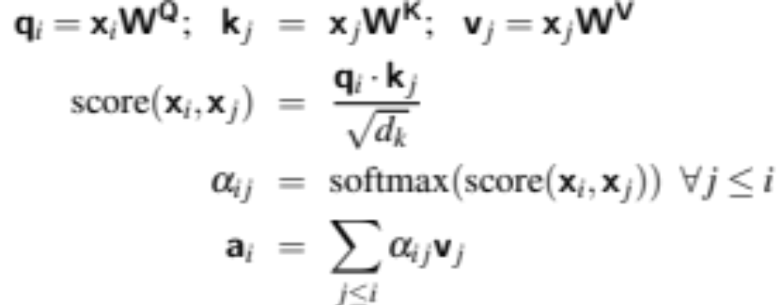
Final equations for one attention head
Notes:
the result of a dot product can be an arbitrarily large (positive or negative) value, and exponentiating large values can lead to numerical issues and loss of gradients during training. To avoid this, we scale the dot product by a factor related to the size of the embeddings, via diving by the square root of the dimensionality of the query and key vectors (dk).

Slide 22
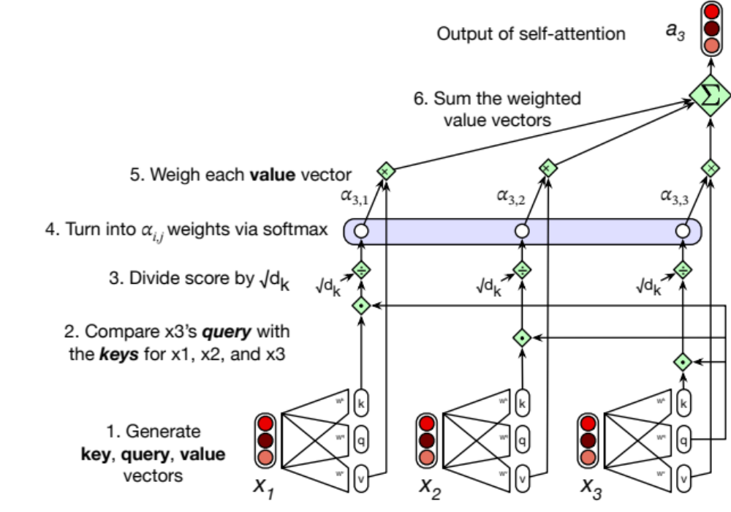
Calculating the value of a3

Slide 23
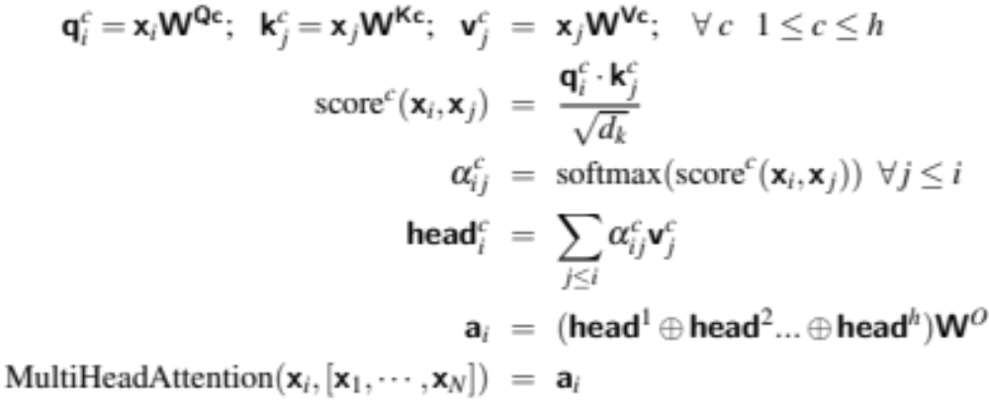
Actual Attention: slightly more complicated
Instead of one attention head, we'll have lots of them!
Intuition: each head might be attending to the context for different purposes
  Different linguistic relationships or patterns in the context
Notes:
Up to 128 in Lllama3 405B

Slide 24
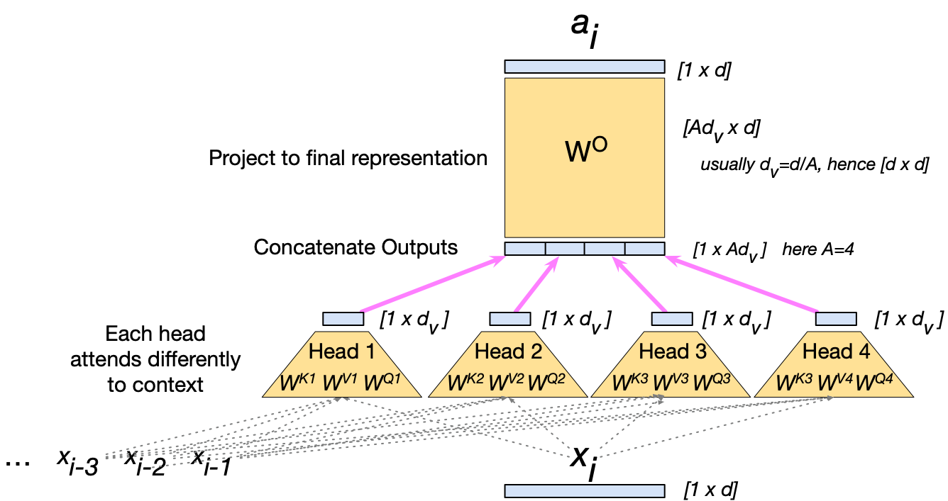
Multi-head attention

Slide 25
Summary
Attention is a method for enriching the representation of a token by incorporating contextual information
The result: the embedding for each word will be different in different contexts!
Contextual embeddings: a representation of word meaning in its context.
We'll see in the next lecture that attention can also be viewed as a way to move information from one token to another.

Slide 26
Transformers
Attention

Slide 27
Transformers
The Transformer Block

Slide 28
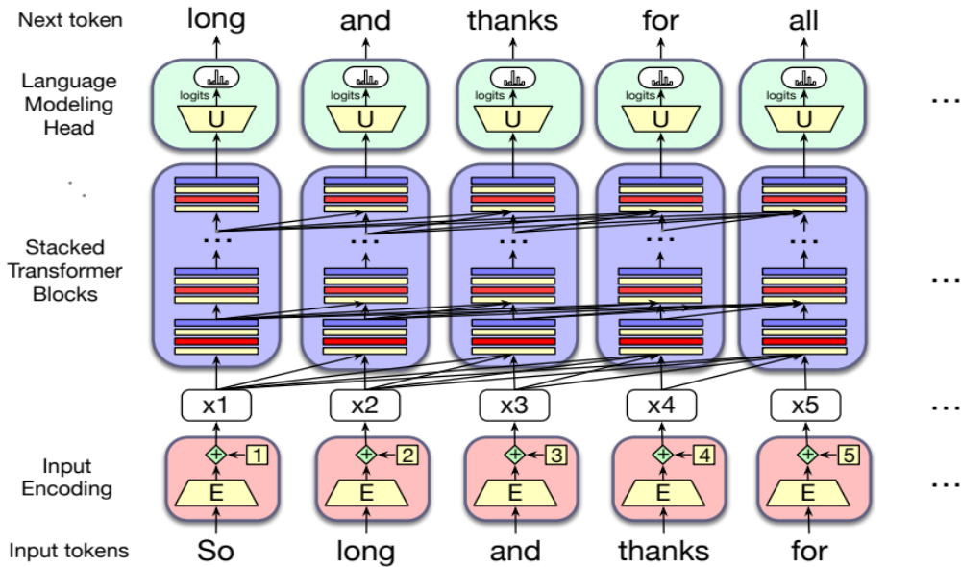

Reminder: transformer language model

Slide 29
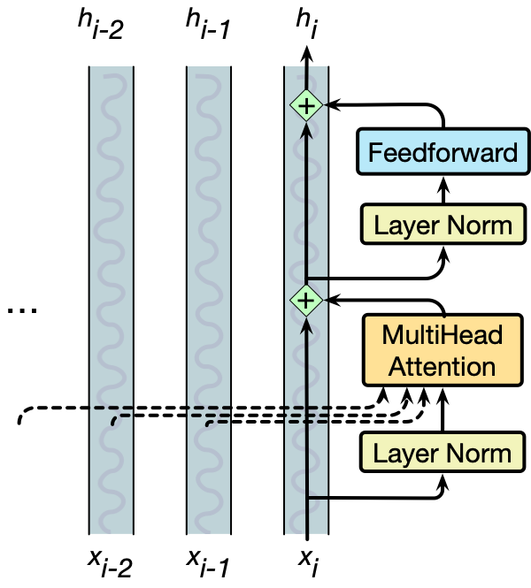
The residual stream: each token gets passed up and modified
Notes:
Technically this is the prenorm arechitrecture; there is an older "postnorm" architecture with the layer norms after the feedforward.

Slide 30
We'll need nonlinearities, so a feedforward layer
Notes:
The weights are the same for each token position i , but are different from layer to layer. It is common to make the dimensionality dff of the hidden layer of the feedforward network be larger than the model dimensionality d. (For example in the original transformer model, d = 512 and dff = 2048.)

Slide 31
Layer norm: the vector x_{i} is normalized twice
Notes:
The weights are the same for each token position i , but are different from layer to layer. It is common to make the dimensionality dff of the hidden layer of the feedforward network be larger than the model dimensionality d. (For example in the original transformer model, d = 512 and dff = 2048.)

Slide 32
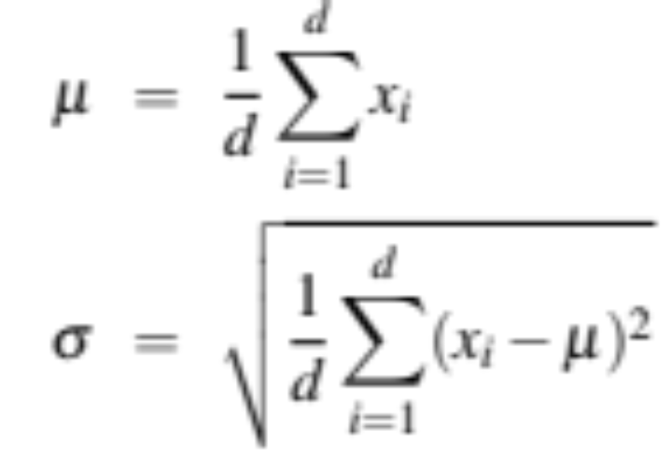
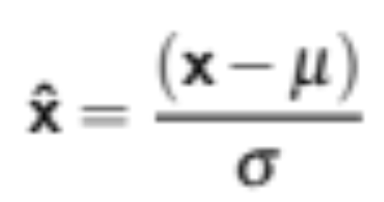
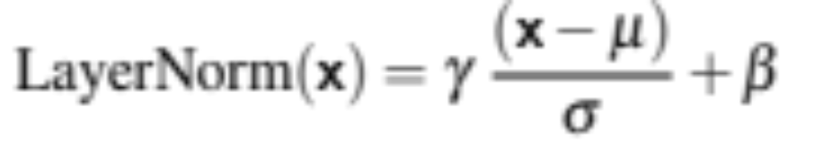
Layer Norm
Layer norm is a variation of the z-score from statistics, applied to a single vec- tor in a hidden layer
Notes:
the term layer norm is a bit confusing; layer norm is not applied to an entire transformer layer, but just to the embedding vector of a single token. Thus the input to layer norm is a single vector of dimensionality d and the output is that vector normalized, again of dimensionality d

Slide 33
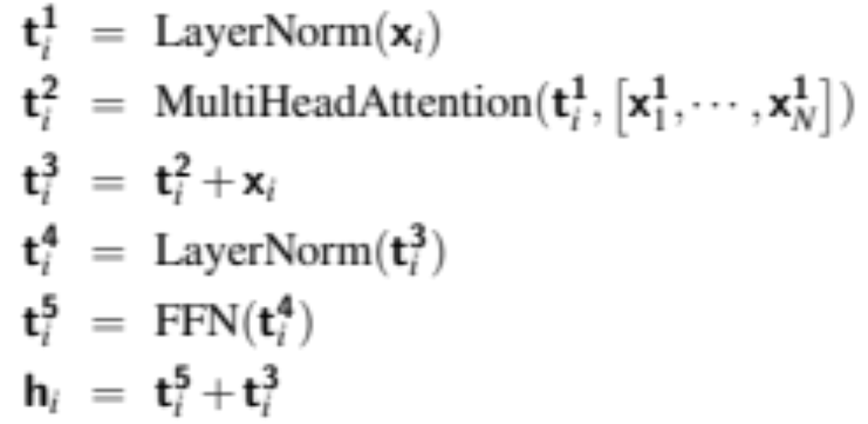
Putting together a single transformer block

Slide 34
A transformer is a stack of these blocks so all the vectors are of the same dimensionality d
Block 2
Block 1

Slide 35
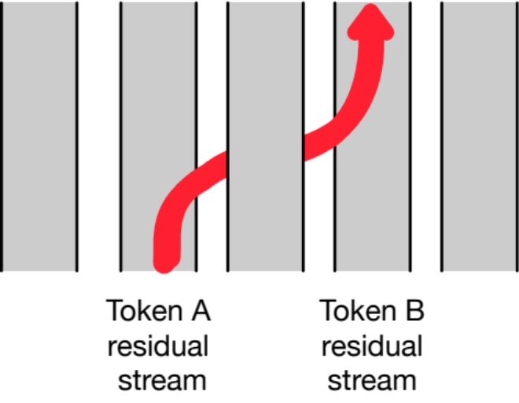
Residual streams and attention
Notice that all parts of the transformer block apply to 1 residual stream (1 token).
Except attention, which takes information from other tokens
Elhage et al. (2021) show that we can view attention heads as literally moving information from the residual stream of a neighboring token into the current stream .

Slide 36
Transformers
The Transformer Block

Slide 37
Transformers
Parallelizing Attention Computation

Slide 38
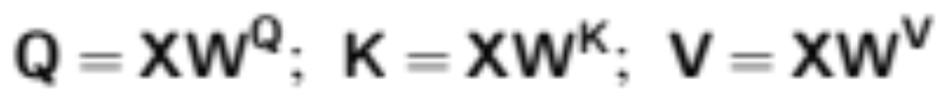
Parallelizing computation using X
For attention/transformer block we've been computing a single output at a single time step i in a single residual stream.
But we can pack the N tokens of the input sequence into a single matrix X of size [N × d].
Each row of X is the embedding of one token of the input.
X can have 1K-32K rows, each of the dimensionality of the embedding d (the model dimension)

Slide 39
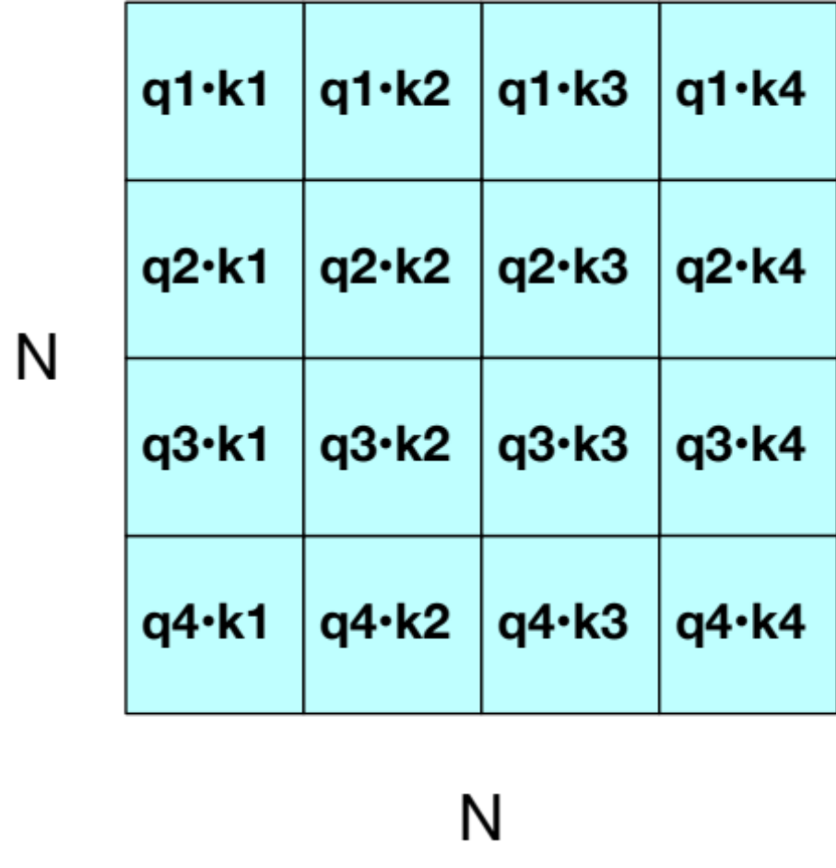
QK^{T}
Now can do a single matrix multiply to combine Q and K^{T}

Slide 40
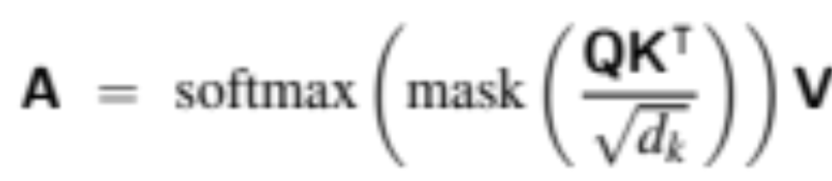
Parallelizing attention
Scale the scores, take the softmax, and then multiply the result by V resulting in a matrix of shape N × d
  An attention vector for each input token

Slide 41
Masking out the future
What is this mask function?
QK^{T} has a score for each query dot every key, including those that follow the query.
Guessing the next word is pretty simple if you already know it!

Slide 42
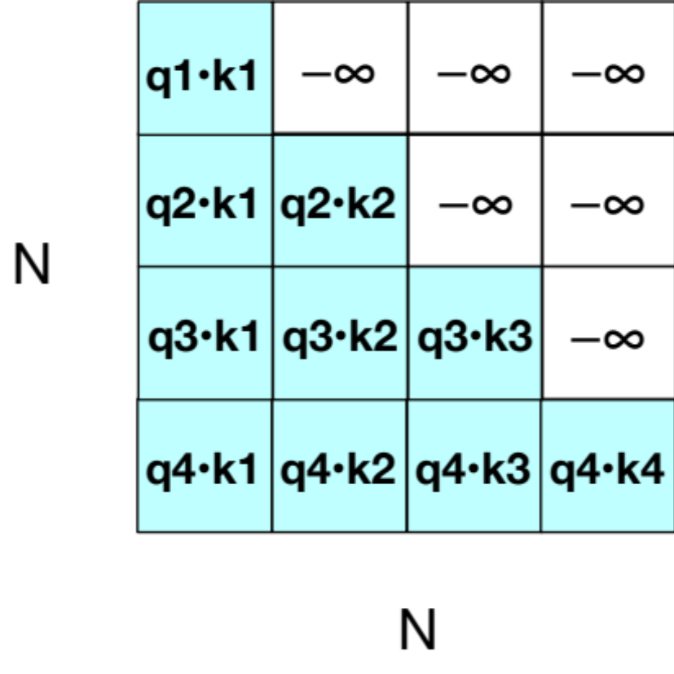
Masking out the future
Add –∞ to cells in upper triangle
The softmax will turn it to 0

Slide 43
Another point: Attention is quadratic in length

Slide 44
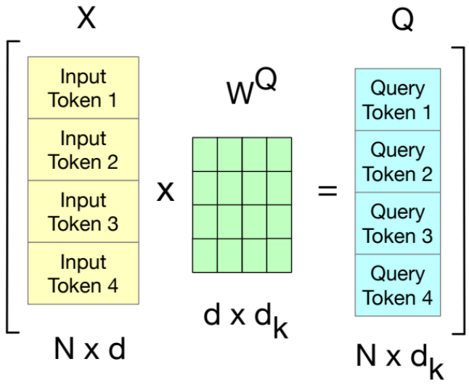
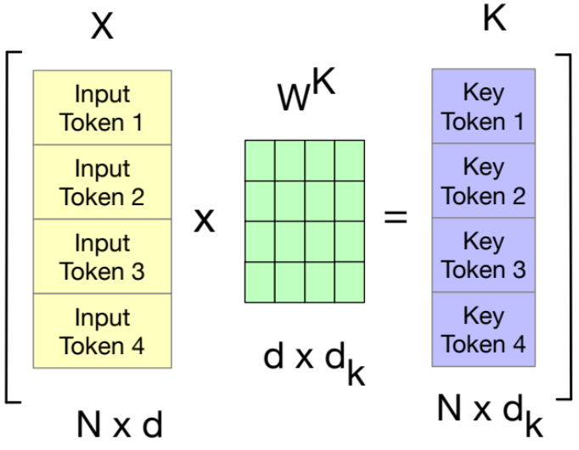
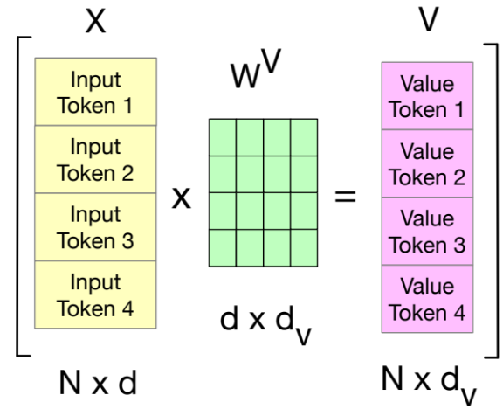
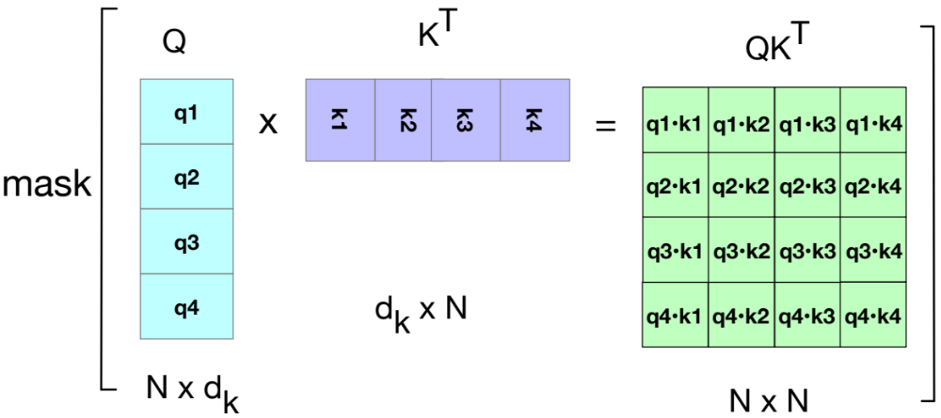
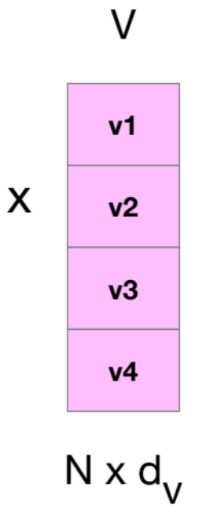
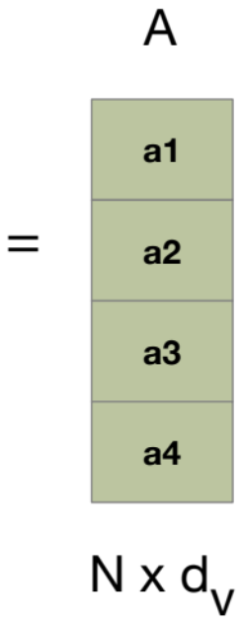
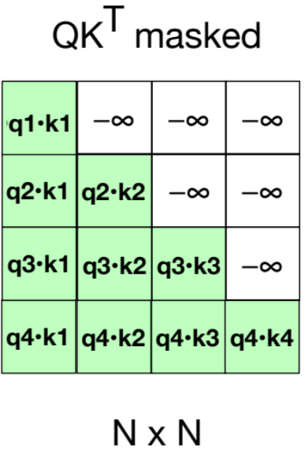
Attention again

Slide 45
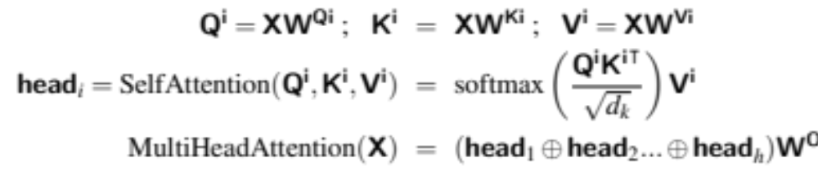
Parallelizing Multi-head Attention

Slide 46
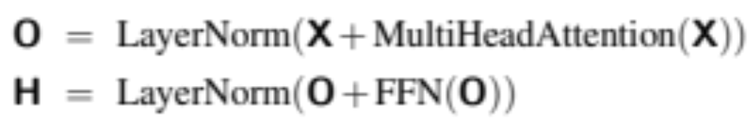
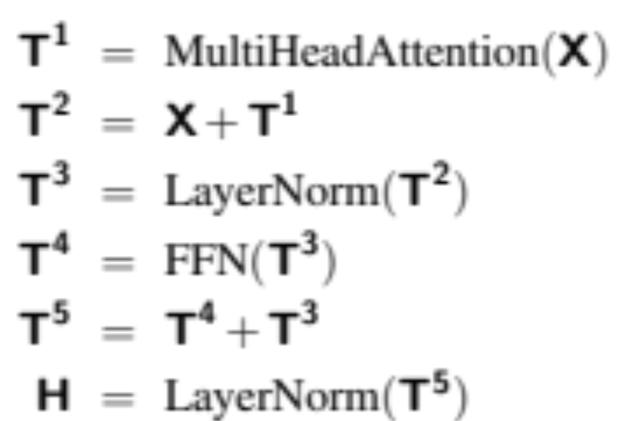
Parallelizing Multi-head Attention
or

Slide 47
Transformers
Parallelizing Attention Computation

Slide 48
Transformers
Input and output: Position embeddings and the Language Model Head

Slide 49
Token and Position Embeddings
The matrix X (of shape [N × d]) has an embedding for each word in the context.
This embedding is created by adding two distinct embedding for each input
token embedding
positional embedding

Slide 50
Token Embeddings
Embedding matrix E has shape [|V | × d ].
One row for each of the |V | tokens in the vocabulary.
Each word is a row vector of d dimensions
Given: string "Thanks for all the"
1. Tokenize with BPE and convert into vocab indices
w = [5,4000,10532,2224]
2. Select the corresponding rows from E, each row an embedding
(row 5, row 4000, row 10532, row 2224).

Slide 51
Position Embeddings
There are many methods, but we'll just describe the simplest: absolute position.
Goal: learn a position embedding matrix Epos of shape [1 × N ].
Start with randomly initialized embeddings
one for each integer up to some maximum length.
i.e., just as we have an embedding for token fish, we’ll have an embedding for position 3 and position 17.
As with word embeddings, these position embeddings are learned along with other parameters during training.

Slide 52
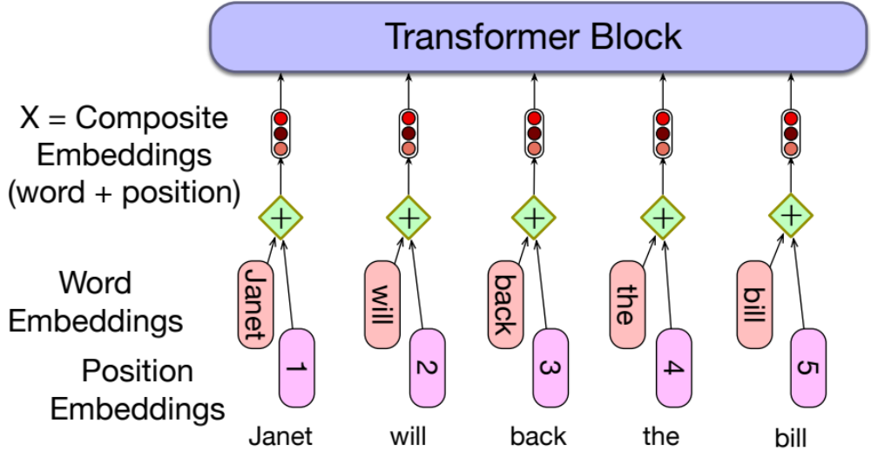
Each x is just the sum of word and position embeddings

Slide 53
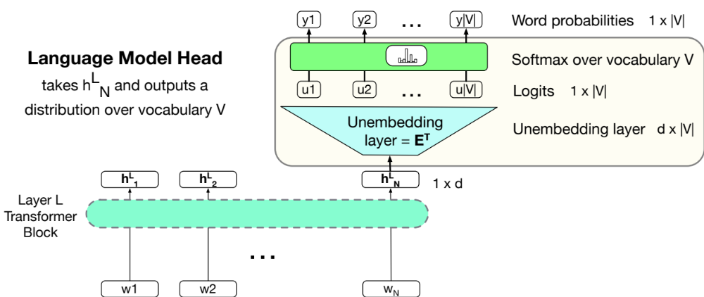
Language modeling head

Slide 54
Language modeling head
Unembedding layer: linear layer projects from h^{L}_{N} (shape [1 × d]) to logit vector
Why "unembedding"? Tied to E^{T}
Weight tying, we use the same weights for two different matrices
Unembedding layer maps from an embedding to a 1x|V| vector of logits

Slide 55
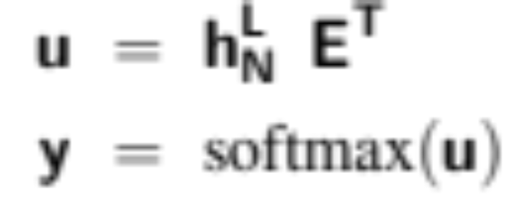
Language modeling head
Logits, the score vector u
One score for each of the |V | possible words in the vocabulary V . Shape 1 × |V |.
Softmax turns the logits into probabilities over vocabulary. Shape 1 × |V |.

Slide 56
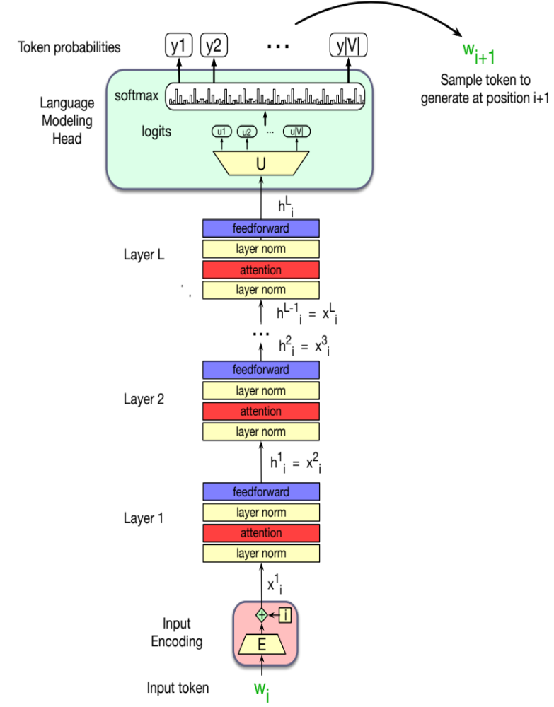
The final transformer model

Slide 57
Transformers
Input and output: Position embeddings and the Language Model Head

