Slide 1
PyTorch, Initialization, and Normalization
Lecture 14
Tensors, autograd, modules, and training loops in PyTorch. Parameter initialization, batch normalization, and layer normalization.

Slide 2
Do not edit
How to change the design
Join at slido.com
#1809914
The Slido app must be installed on every computer you’re presenting from

Slide 3
Roadmap for Today
PyTorch
Parameter Initialization
Normalization

Slide 4

The most widely used framework for building and training deep neural networks.
Related frameworks: JaX, TensorFlow, …
Important features:
Automatic differentiation (covered in Lecture 13)
Intuitive support for hardware accelerators
Easy to use APIs for state-of-the-art model architectures
Learning on your own:
Basics: https://docs.pytorch.org/tutorials/beginner/basics
Tutorials: https://docs.pytorch.org/tutorials/

Slide 5
Big Concepts in PyTorch
torch.tensor is the basic datatype used to encode data, weights, and activations; it is very similar to numpy.ndarrays.
Neural networks are built using the many primitives in the torch.nn module and defining the forward process of making a prediction.
PyTorch uses automatic differentiation to efficiently compute the gradient (already covered in Lecture 13).
Training is accomplished by (you) implementing some variation of gradient descent.
  Doesn’t have a built in ‘fit’ function like scikit-learn

Slide 6
torch.tensor
The basic building block of PyTorch is the torch.tensor which is very similar to the numpy.ndarray.
Construction: torch.tensor([[1.0], [2.0]]); torch.ones(2,3)
Indexing and slicing: x[:, 3]
Shape and type: x.shape; x.dtype
Operations: torch.mean(x, dim=1); a.T @ x
Key differences:
Greater emphasis on dtype (often torch.bfloat16, torch.float16)
Device Placement: x.to("cuda"); x.to("cpu")
Tensors (can) track how they were computed to enable automatic differentiation: x.grad_fn

Slide 7
torch.nn.functional and torch.nn
The torch.nn.functional Python module contains the basic stateless neural network functions (e.g., relu).
The torch.nn Python module contains the basic building blocks of neural networks.
nn.Module is the base class which all models and layers extend.
  __init__: defines all the model parameters.
  forward (__call__): defines the model/layer logic
nn.Parameter is used to define model parameters (in __init__)
  Used to wrap parameter tensors so they can be automatically tracked
There are hundreds of layer modules: nn.Linear; nn.Softmax; ...

Slide 8
torch.nn.Module
When building a new model you extend the nn.Module
class MLP(nn.Module):
def __init__(self, dims, activation="relu"):
super().__init__()
self.layers = nn.ModuleList(
[nn.Linear(dims[i], dims[i+1]) for i in range(len(dims)-1)])
if activation == "relu": self.act = nn.functional.relu
else: self.act = torch.tanh
def forward(self, x):
for i, layer in enumerate(self.layers):
x = layer(x)
if i < len(self.layers)-1:
x = self.act(x)
return x
Extend nn.Module
Add modules to your module. These add parameters.
Compute the forward pass using the layer modules.

Slide 9
Computing Gradients using Autograd
PyTorch uses automatic differentiation to automatically (and efficiently) compute the gradient of the loss with respect to all parameters.
Reset the Gradient
(gradients accumulate)
model.zero_grad()
pred = model(x)
loss = loss_fn(pred, t)
loss.backward()
print(model.layers[0].weight.grad)
Compute the loss
Compute the gradient of the loss
Gradients are attached to each parameter

Slide 10
Training Loop with an Optimizer
In PyTorch you implement your own gradient descent loop but you can use built in update rules (e.g., Adam) called optimizers.
Minibatch SGD DataLoader
loader = DataLoader(train_data, batch_size=32, shuffle=True)
optimizer = torch.optim.Adam(model.parameters(), lr=eta)
for epoch in range(n_epochs):
for x, t in loader:
optimizer.zero_grad()
loss = loss_fn(model(x), t)
loss.backward()
optimizer.step()
Epoch is one pass over data
Adam optimizer
Load one minibatch at a time
Compute the gradient of the loss
Use optimizer to update all the parameters (1-step)

Slide 11
Demo
Notebook, Part 1: tensors, autograd, data loaders, modules, losses, and the training loop.
Notes:
[Fa26 changes] NEW
- Demo slide for notebooks/lec14/lec14.ipynb, Part 1 (Lecture Demo 1). No screenshot yet: add one from the executed notebook if wanted.

Slide 12
Roadmap
PyTorch
Parameter Initialization
Normalization

Slide 13
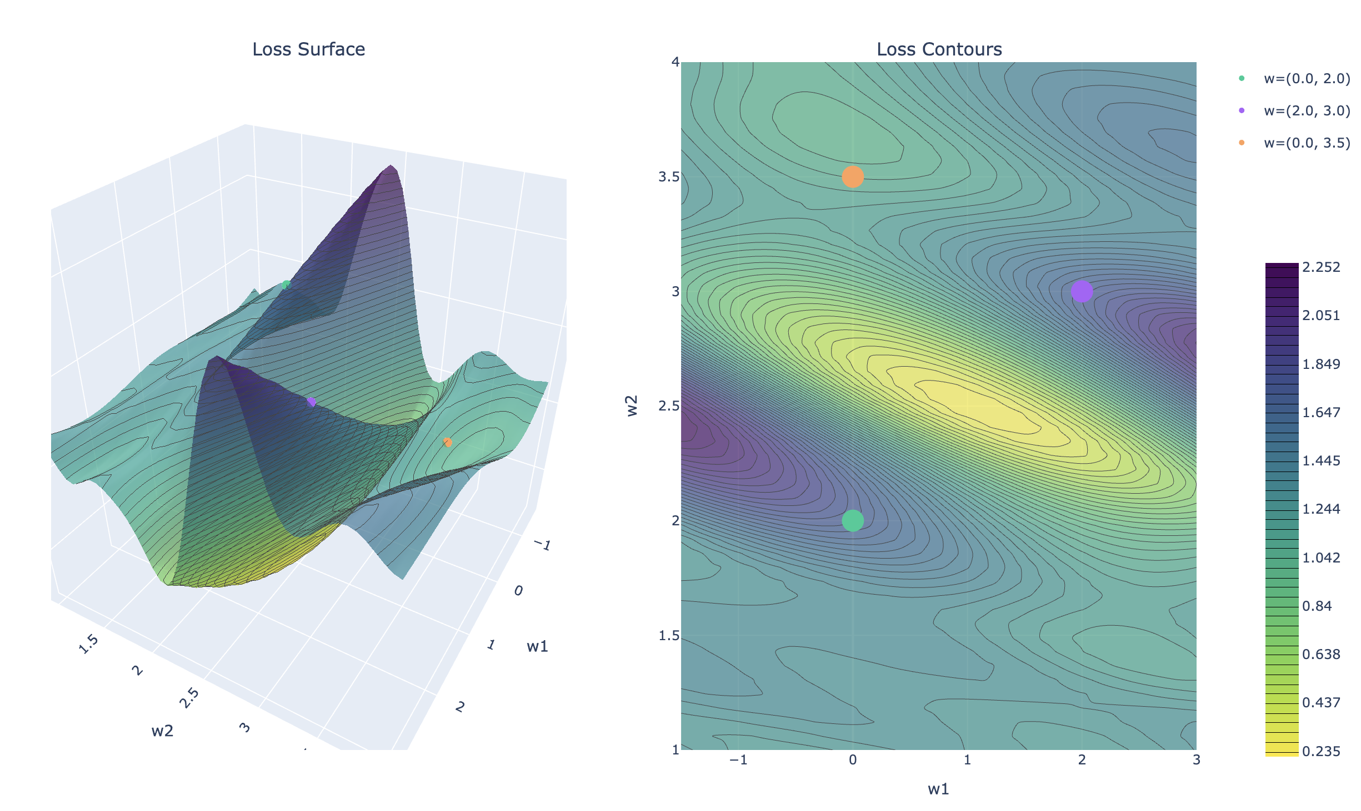
Choice of Initial Parameters Matters
The neural network loss surface is highly non-convex so choice of starting point can result in:
diverging solutions
slow convergence
bad local minima
What makes a good starting
point?

Slide 14
“Sweet-spot” of the Non-Linearity
Sweet-spot is near the transition point in the non-linear transformation.
Non-zero gradient
Typically, near zero
pre-activations
Outside the transition point the activation is saturated.
Small changes don’t change activation.

Slide 15










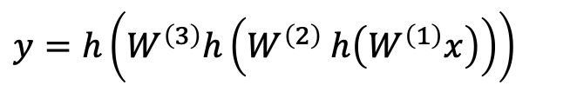

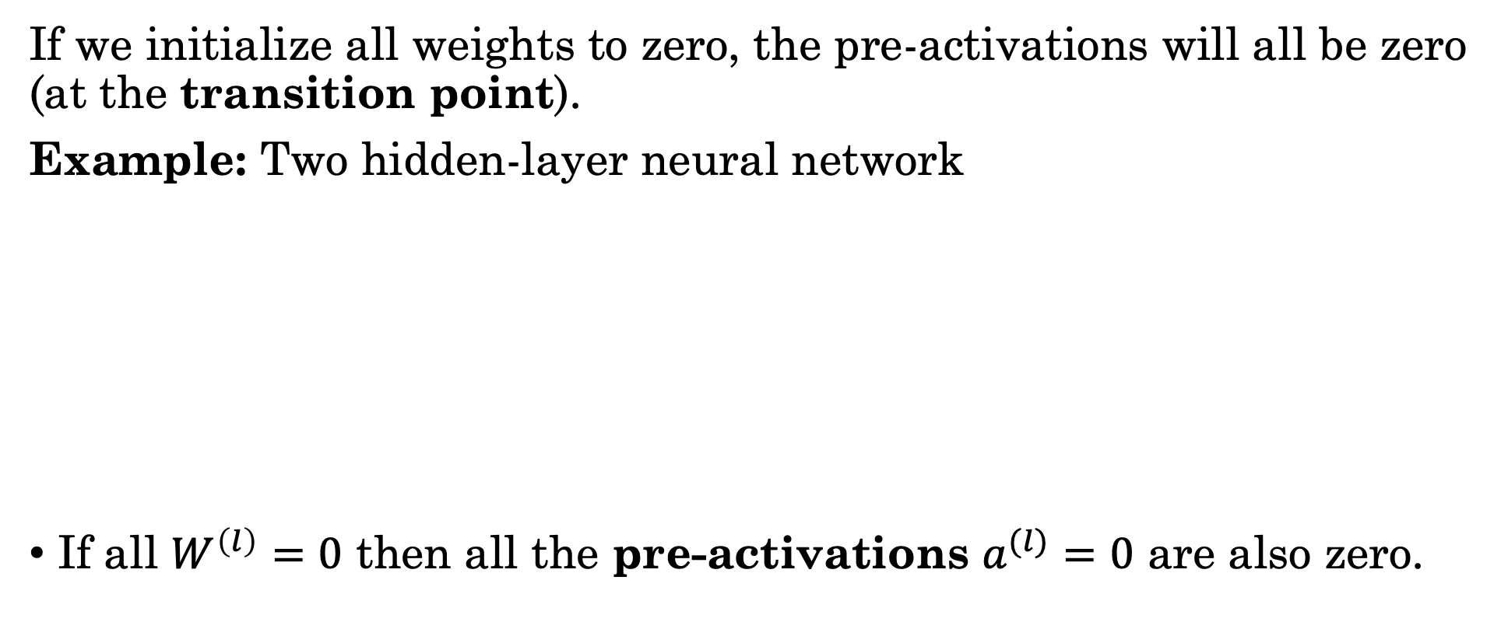

























Starting at Zero-Weights
If we initialize all weights to zero, the pre-activations will all be zero (at the transition point).
Example: Two hidden-layer neural network
If all $W^{\left(l\right)}=0$ then all the pre-activations $a^{(l)}=0$ are also zero.
$$W^{(1)}$$
$$a_{1}^{\left(1\right)}$$
$$z_{1}^{\left(1\right)}$$
$$W^{(2)}$$
$$a_{1}^{\left(2\right)}$$
$$z_{1}^{\left(2\right)}$$
$$W^{(3)}$$
$$a_{1}^{\left(3\right)}$$
$$y_{1}$$
$$a^{(1)}=W^{\left(1\right)}x$$
$$z^{(1)}=h\left(a^{\left(1\right)}\right)$$
+
$$h$$
+
$$h$$
+
$$h$$
$$x_{1}$$
$$a^{(2)}=W^{\left(2\right)}z^{(1)}$$
$$z^{(2)}=h\left(a^{\left(2\right)}\right)$$
$$x_{2}$$
$$a_{2}^{\left(1\right)}$$
$$h$$
$$z_{2}^{\left(1\right)}$$
$$a_{2}^{\left(2\right)}$$
$$h$$
$$z_{2}^{\left(2\right)}$$
$$a_{2}^{\left(3\right)}$$
$$h$$
$$y_{2}$$
+
+
+
$$a^{(3)}=W^{\left(3\right)}z^{(2)}$$
$$y=h\left(a^{\left(3\right)}\right)$$
$$x_{D}$$
$$a_{M^{(1)}}^{\left(1\right)}$$
$$z_{M^{(1)}}^{\left(1\right)}$$
$$a_{M^{(2)}}^{\left(2\right)}$$
$$z_{M^{(2)}}^{\left(2\right)}$$
$$a_{K}^{\left(3\right)}$$
$$y_{K}$$
$$y=h\left(W^{\left(3\right)}h\left(W^{\left(2\right)} h\left(W^{\left(1\right)}x\right)\right)\right)$$
+
$$h$$
+
$$h$$
+
$$h$$

Slide 16
Do not edit
How to change the design
Why is initializing all neural network weights to zero generally a bad idea?
The Slido app must be installed on every computer you’re presenting from

Slide 17



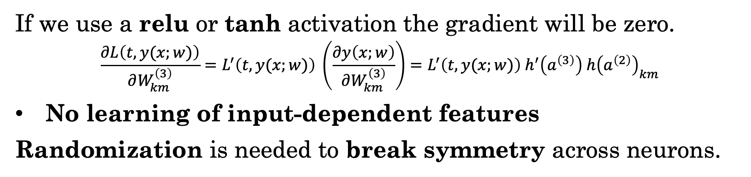









Unbroken Symmetry at Zero-Weights
If we initialize all weights to zero, neurons within each hidden layer produce identical activations and remain identical during training.
$$W^{(1)}$$
$$a_{1}^{\left(1\right)}$$
$$z_{1}^{\left(1\right)}$$
$$W^{(2)}$$
$$a_{1}^{\left(2\right)}$$
$$z_{1}^{\left(2\right)}$$
$$W^{(3)}$$
$$a_{1}^{\left(3\right)}$$
$$y_{1}$$
+
$$h$$
+
$$h$$
+
$$h$$
$$x_{1}$$
$$x_{2}$$
$$x_{D}$$
If we use a relu or tanh activation the gradient will be zero.
$$\frac{∂L\left(t,y(x;w)\right)}{∂W_{km}^{\left(3\right)}}=L^{′}\left(t,y(x;w)\right) \left(\frac{∂y\left(x;w\right)}{∂W_{km}^{\left(3\right)}}\right)=L^{′}\left(t,y(x;w)\right) h^{′}\left(a^{\left(3\right)}\right) h{\left(a^{\left(2\right)}\right)}_{km}$$
No learning of input-dependent features
Randomization is needed to break symmetry across neurons.
0

Slide 18


























Weight Symmetry In Neural Networks
For any layer in the neural network, we could “re-arrange” the neurons to obtain an identical network.
$$W^{(1)}$$
$$a_{1}^{\left(1\right)}$$
$$z_{1}^{\left(1\right)}$$
$$W^{(2)}$$
$$a_{1}^{\left(2\right)}$$
$$z_{1}^{\left(2\right)}$$
$$W^{(3)}$$
$$a_{1}^{\left(3\right)}$$
$$y_{1}$$
+
$$h$$
+
$$h$$
+
$$h$$
$$x_{1}$$
$$x_{2}$$
$$a_{2}^{\left(1\right)}$$
$$h$$
$$z_{2}^{\left(1\right)}$$
$$a_{2}^{\left(2\right)}$$
$$h$$
$$z_{2}^{\left(2\right)}$$
$$a_{2}^{\left(3\right)}$$
$$h$$
$$y_{2}$$
+
+
+
$$x_{D}$$
$$a_{M^{(1)}}^{\left(1\right)}$$
$$z_{M^{(1)}}^{\left(1\right)}$$
$$a_{M^{(2)}}^{\left(2\right)}$$
$$z_{M^{(2)}}^{\left(2\right)}$$
$$a_{K}^{\left(3\right)}$$
$$y_{K}$$
+
$$h$$
+
$$h$$
+
$$h$$
Bishop 6.2.4

Slide 19





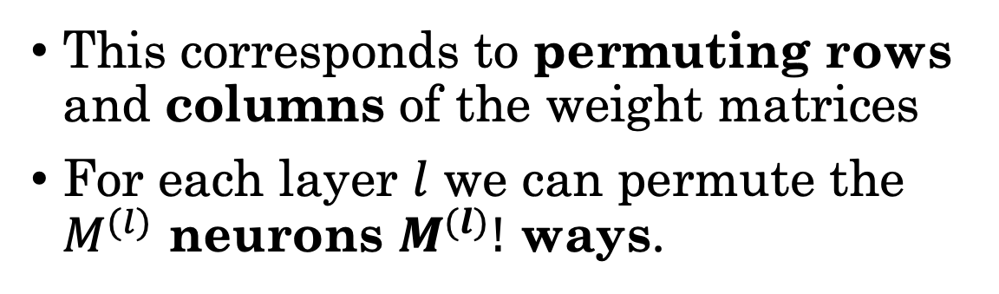

Weight Symmetry In Neural Networks
For any layer in the neural network, we could “re-arrange” the neurons to obtain an identical network.
$$W^{(1)}$$
$$a_{2}^{\left(1\right)}$$
$$z_{2}^{\left(1\right)}$$
$$W^{(2)}$$
$$a_{1}^{\left(2\right)}$$
$$z_{1}^{\left(2\right)}$$
$$W^{(3)}$$
$$a_{1}^{\left(3\right)}$$
$$y_{1}$$
+
$$h$$
+
$$h$$
+
$$h$$
$$x_{1}$$
$$x_{2}$$
$$a_{1}^{\left(1\right)}$$
$$h$$
$$z_{1}^{\left(1\right)}$$
$$a_{2}^{\left(2\right)}$$
$$h$$
$$z_{2}^{\left(2\right)}$$
$$a_{2}^{\left(3\right)}$$
$$h$$
$$y_{2}$$
+
+
+
$$x_{D}$$
$$a_{M^{(1)}}^{\left(1\right)}$$
$$z_{M^{(1)}}^{\left(1\right)}$$
$$a_{M^{(2)}}^{\left(2\right)}$$
$$z_{M^{(2)}}^{\left(2\right)}$$
$$a_{K}^{\left(3\right)}$$
$$y_{K}$$
+
$$h$$
+
$$h$$
+
$$h$$
This corresponds to permuting rows
and columns of the weight matrices
For each layer $l$ we can permute the $M^{(l)}$ neurons $M^{(l)}!$ ways.
$$W^{(1)}$$
$$W^{(2)}$$
2
2
1
3
4
1
3
4
Bishop 6.2.4

Slide 20




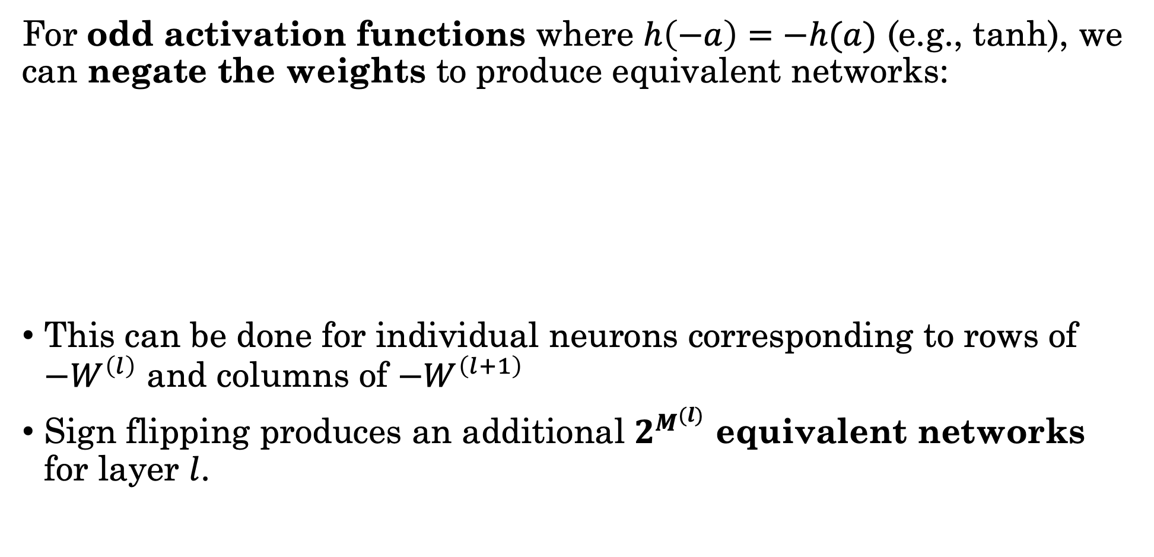















Sign Flipping Equivalence in Networks
For odd activation functions where $h\left(−a\right)=−h(a)$ (e.g., tanh), we can negate the weights to produce equivalent networks:
This can be done for individual neurons corresponding to rows of ${−W}^{\left(l\right)}$ and columns of $−W^{\left(l+1\right)}$
Sign flipping produces an additional $2^{M^{(l)}}$ equivalent networks for layer $l$.
$$a_{1}^{\left(l−1\right)}$$
$$h$$
$$z_{1}^{\left(l−1\right)}$$
$$W^{(l)}$$
$$W^{(l+1)}$$
$$a_{2}^{\left(l+1\right)}$$
$$h$$
$$z_{2}^{\left(l+1\right)}$$
+
-1
-1
+
$$a^{(l+1)}=W^{(l+1)} h\left(W^{\left(l\right)}z^{\left(l−1\right)}\right)$$
$$a_{2}^{\left(l−1\right)}$$
$$z_{2}^{\left(l−1\right)}$$
-1
$$a_{m}^{\left(l\right)}$$
$$h$$
$$z_{m}^{\left(l\right)}$$
-1
$$a_{1}^{\left(l+1\right)}$$
$$h$$
$$z_{1}^{\left(l+1\right)}$$
$$=\left(−W^{\left(l+1\right)}\right) h\left(\left({−W}^{\left(l\right)}\right)z^{\left(l−1\right)}\right)$$
+
$$h$$
+
+
-1
-1
$$a_{M^{(l−1)}}^{\left(l−1\right)}$$
$$h$$
$$z_{M^{(l−1)}}^{\left(l−1\right)}$$
$$a_{M^{(l+1)}}^{\left(l+1\right)}$$
$$h$$
$$z_{M^{(l+1)}}^{\left(l+1\right)}$$
+
+
Bishop 6.2.4

Slide 21
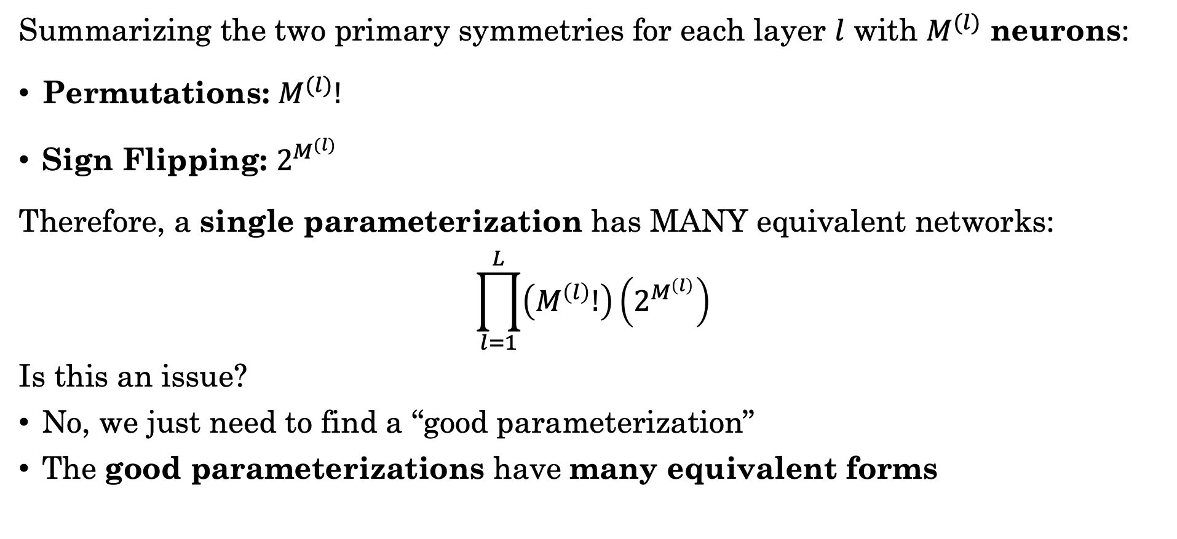
Counting Network Symmetries
Summarizing the two primary symmetries for each layer $l$ with $M^{(l)}$ neurons:
Permutations: $M^{(l)}!$
Sign Flipping: $2^{M^{(l)}}$
Therefore, a single parameterization has MANY equivalent networks:
$$\prod_{l=1}^{L}{\left(M^{\left(l\right)}!\right)\left(2^{M^{\left(l\right)}}\right)}$$
Is this an issue?
No, we just need to find a “good parameterization”
The good parameterizations have many equivalent forms

Slide 22
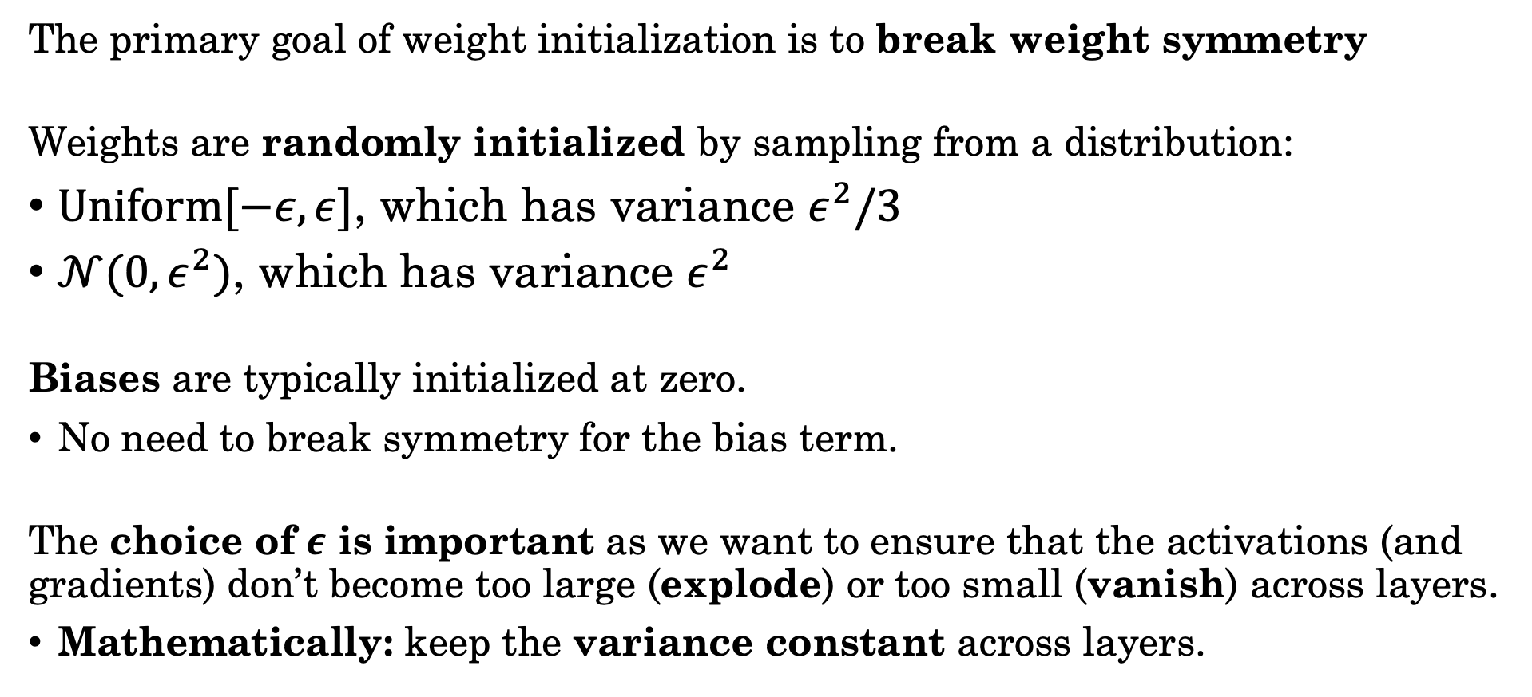
Breaking Symmetry with
Random Weight Initialization
The primary goal of weight initialization is to break weight symmetry
Weights are randomly initialized by sampling from a distribution:
$Uniform[−ε,ε]$, which has variance $ε^{2}/3$
$𝒩(0,ε^{2})$, which has variance $ε^{2}$
Biases are typically initialized at zero.
No need to break symmetry for the bias term.
The choice of $ε$ is important as we want to ensure that the activations (and gradients) don’t become too large (explode) or too small (vanish) across layers.
Mathematically: keep the variance constant across layers.

Slide 23



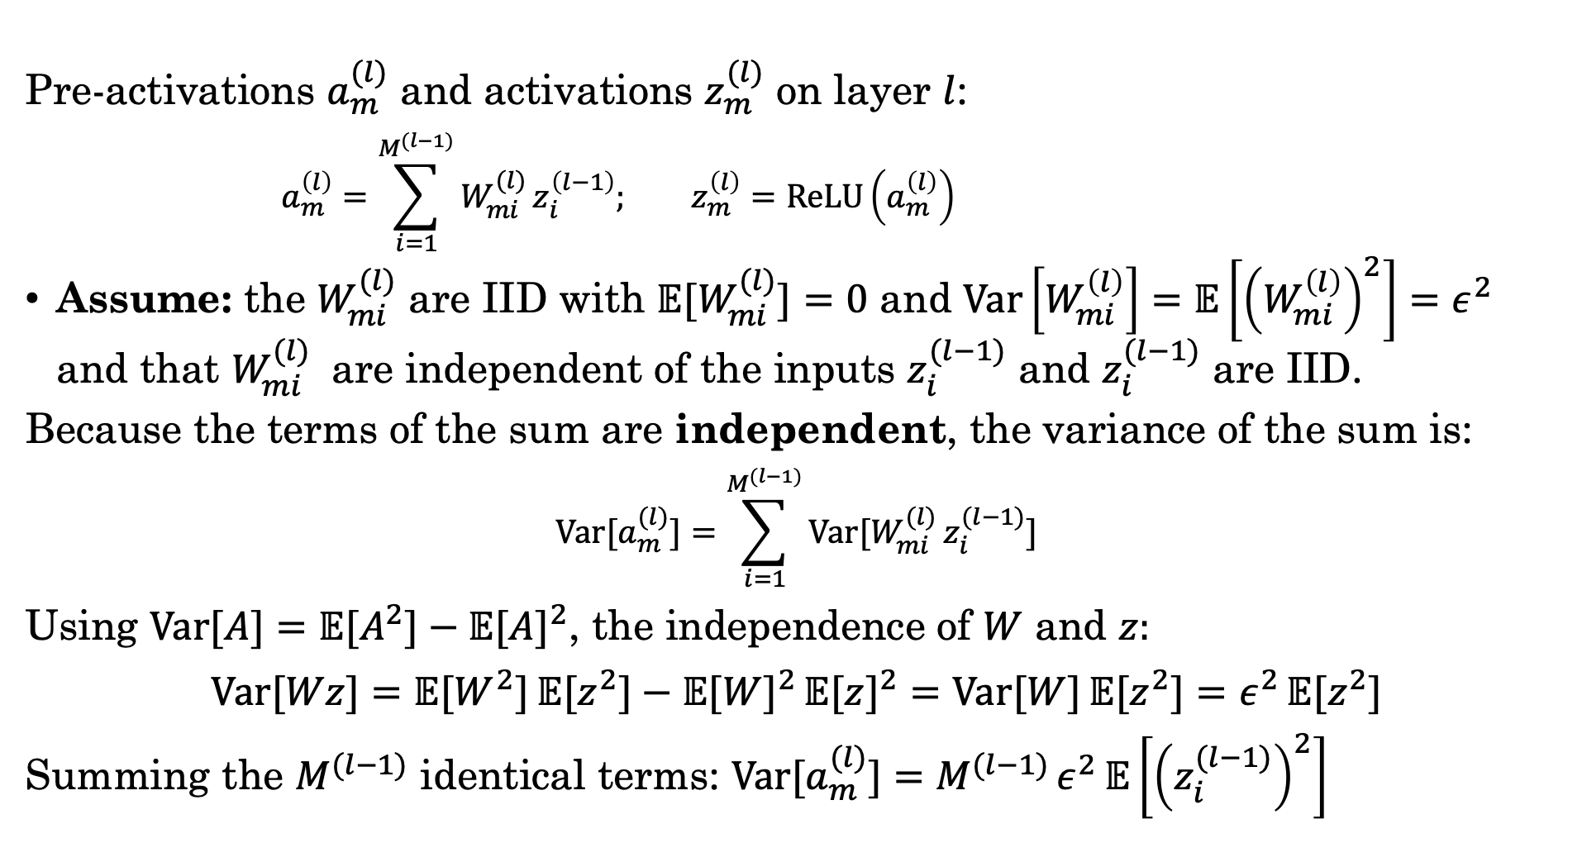










Variance of the Pre-activations
$$a_{1}^{\left(1\right)}$$
$$h$$
$$z_{1}^{\left(1\right)}$$
$$W^{(2)}$$
$$a_{1}^{\left(2\right)}$$
$$h$$
$$z_{1}^{\left(2\right)}$$
Pre-activations $a_{m}^{(l)}$ and activations $z_{m}^{(l)}$ on layer $l$:
$$a_{m}^{\left(l\right)}=\sum_{i=1}^{M^{(l−1)}}{W_{mi}^{(l)}}z_{i}^{\left(l−1\right)}; z_{m}^{\left(l\right)}=\text{ReLU}\left(a_{m}^{\left(l\right)}\right)$$
Assume: the $W_{mi}^{(l)}$ are IID with $𝔼[W_{mi}^{(l)}]=0$ and $Var\left[W_{mi}^{\left(l\right)}\right]=𝔼\left[{\left(W_{mi}^{\left(l\right)}\right)}^{2}\right]=ε^{2}$ and that $W_{mi}^{(l)}$ are independent of the inputs $z_{i}^{(l−1)}$ and $z_{i}^{(l−1)}$ are IID.
Because the terms of the sum are independent, the variance of the sum is:
$$Var[a_{m}^{(l)}]=\sum_{i=1}^{M^{(l−1)}}{Var[W_{mi}^{(l)} z_{i}^{(l−1)}]}$$
Using $Var[A]=𝔼[A^{2}]−𝔼[A]^{2}$, the independence of $W$ and $z:$
$$Var[Wz]=𝔼[W^{2}] 𝔼[z^{2}]−𝔼[W]^{2} 𝔼[z]^{2}=Var[W] 𝔼[z^{2}]=ε^{2} 𝔼[z^{2}]$$
Summing the $M^{(l−1)}$ identical terms: $Var[a_{m}^{(l)}]=M^{(l−1)} ε^{2} 𝔼\left[{\left(z_{i}^{(l−1)}\right)}^{2}\right]$
+
+
+
$$a_{2}^{\left(1\right)}$$
$$h$$
$$z_{2}^{\left(1\right)}$$
+
$$a_{2}^{\left(2\right)}$$
$$h$$
$$z_{2}^{\left(2\right)}$$
+
$$a_{M^{(1)}}^{\left(1\right)}$$
$$h$$
$$z_{M^{(1)}}^{\left(1\right)}$$
+
$$a_{M^{(2)}}^{\left(2\right)}$$
$$h$$
$$z_{M^{(2)}}^{\left(2\right)}$$
Bishop 7.2.5

Slide 24
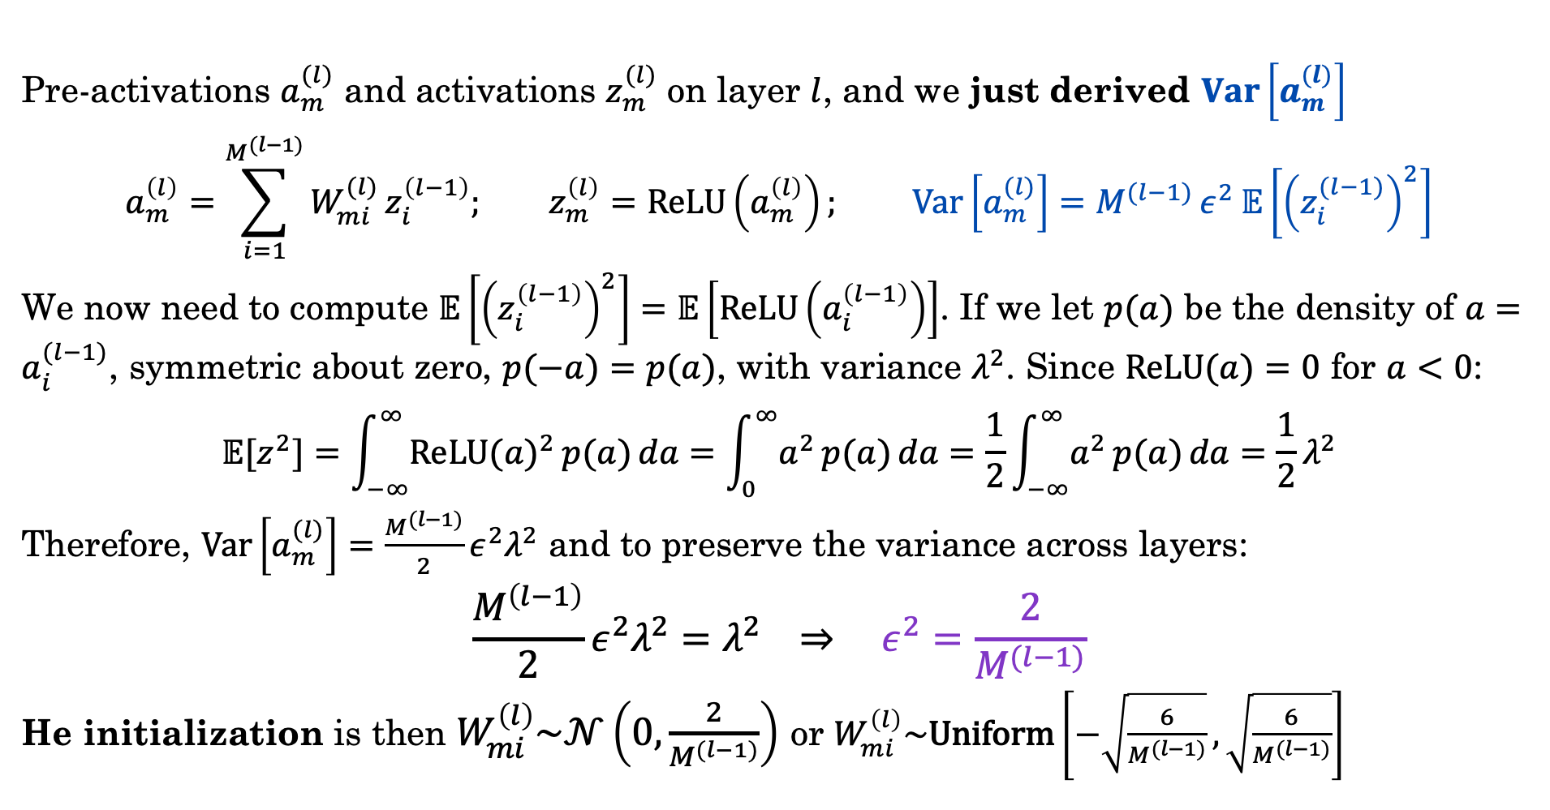
He Initialization for ReLU Activations
Pre-activations $a_{m}^{(l)}$ and activations $z_{m}^{(l)}$ on layer $l$, and we just derived $Var\left[a_{m}^{(l)}\right]$
$$a_{m}^{\left(l\right)}=\sum_{i=1}^{M^{(l−1)}}{W_{mi}^{(l)}}z_{i}^{\left(l−1\right)}; z_{m}^{\left(l\right)}=\text{ReLU}\left(a_{m}^{\left(l\right)}\right); Var\left[a_{m}^{(l)}\right]=M^{(l−1)} ε^{2} 𝔼\left[{\left(z_{i}^{(l−1)}\right)}^{2}\right]$$
We now need to compute $𝔼\left[{\left(z_{i}^{\left(l−1\right)}\right)}^{2}\right]=𝔼\left[ReLU\left(a_{i}^{\left(l−1\right)}\right)\right]$. If we let $p(a)$ be the density of $a=a_{i}^{(l−1)}$, symmetric about zero, $p(−a)=p(a)$, with variance $λ^{2}$. Since $ReLU(a)=0$ for $a<0$:
$$𝔼[z^{2}]=\int_{−∞}^{∞}{ReLU(a)^{2} p(a) da}=\int_{0}^{∞}{a^{2} p(a) da}=\frac{1}{2}\int_{−∞}^{∞}{a^{2} p(a) da}=\frac{1}{2}λ^{2}$$
Therefore, $Var\left[a_{m}^{(l)}\right]=\frac{M^{(l−1)}}{2}ε^{2}λ^{2}$ and to preserve the variance across layers:
$$\frac{M^{\left(l−1\right)}}{2}ε^{2}λ^{2}=λ^{2} ⇒ ε^{2}=\frac{2}{M^{(l−1)}}$$
He initialization is then $W_{mi}^{\left(l\right)}\sim 𝒩\left(0,\frac{2}{M^{(l−1)}}\right)$ or $W_{mi}^{\left(l\right)}\sim \text{Uniform}\left[−\sqrt{\frac{6}{M^{(l−1)}}},\sqrt{\frac{6}{M^{(l−1)}}}\right]$
Bishop 7.2.5

Slide 25
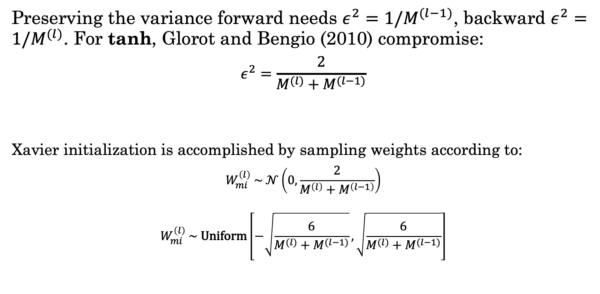
Xavier Initialization for Tanh Activations
Preserving the variance forward needs $ε^{2}=1/M^{(l−1)}$, backward $ε^{2}=1/M^{(l)}$. For tanh, Glorot and Bengio (2010) compromise:
$$ε^{2}=\frac{2}{M^{(l)}+M^{(l−1)}}$$
Xavier initialization is accomplished by sampling weights according to:
$$W_{mi}^{\left(l\right)} \sim 𝒩\left(0,\frac{2}{M^{\left(l\right)}+M^{\left(l−1\right)}}\right)$$
$$W_{mi}^{\left(l\right)} \sim \text{Uniform}\left[−\sqrt{\frac{6}{M^{(l)}+M^{(l−1)}}},\sqrt{\frac{6}{M^{(l)}+M^{(l−1)}}}\right]$$
Fan-out
Fan-in
Glorot & Bengio, 2010

Slide 26
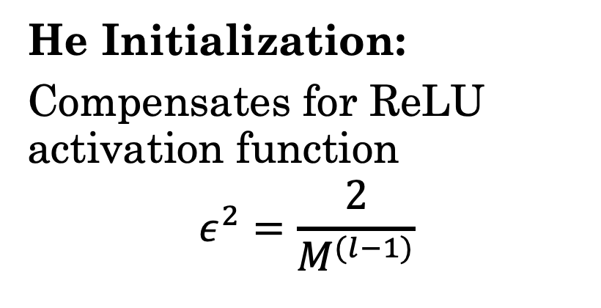
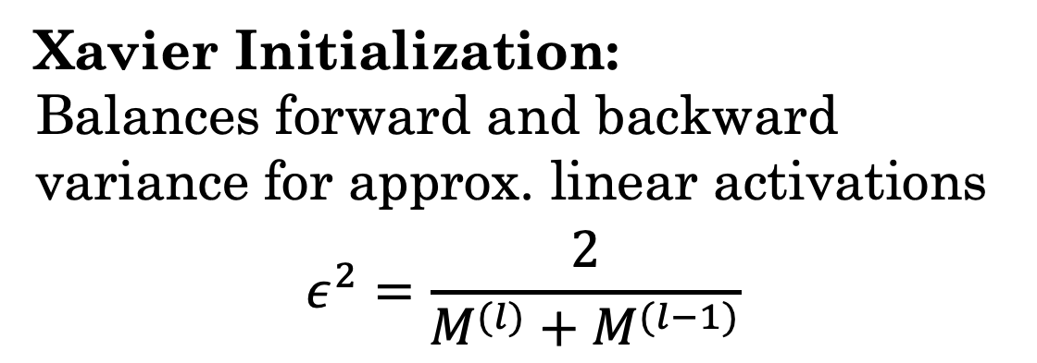
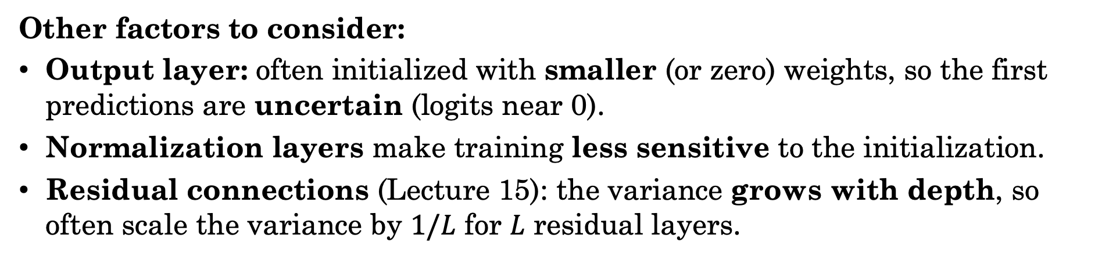
Comparison Between Xavier and He
He Initialization:
Compensates for ReLU activation function
$$ε^{2}=\frac{2}{M^{(l−1)}}$$
Xavier Initialization:
Balances forward and backward variance for approx. linear activations
$$ε^{2}=\frac{2}{M^{(l)}+M^{(l−1)}}$$
Other factors to consider:
Output layer: often initialized with smaller (or zero) weights, so the first predictions are uncertain (logits near 0).
Normalization layers make training less sensitive to the initialization.
Residual connections (Lecture 15): the variance grows with depth, so often scale the variance by $1/L$ for $L$ residual layers.

Slide 27
Weight Initialization in PyTorch
class MLPModel(nn.Module):
def __init__(self, dims, activation="relu"):
super().__init__()
self.activation = activation
self.layers = nn.ModuleList(
[nn.Linear(dims[i], dims[i + 1]) for i in range(len(dims) - 1)])
self.act = torch.relu if activation == "relu" else torch.tanh
self.reset_parameters()
def reset_parameters(self):
for layer in self.layers:
if self.activation == "relu":
nn.init.kaiming_normal_(layer.weight, nonlinearity="relu") # He
else:
nn.init.xavier_normal_(layer.weight) # Xavier
nn.init.zeros_(layer.bias)
def forward(self, x):
for i, layer in enumerate(self.layers):
x = layer(x)
if i < len(self.layers) - 1:
x = self.act(x)
return x

Slide 28
Roadmap
PyTorch
Parameter Initialization
Normalization

Slide 29
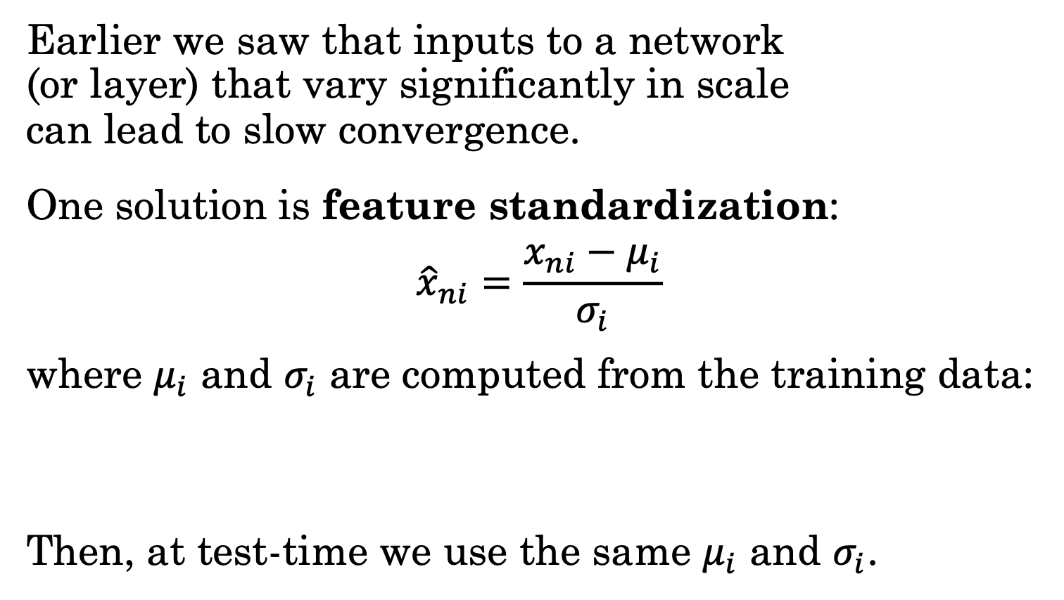
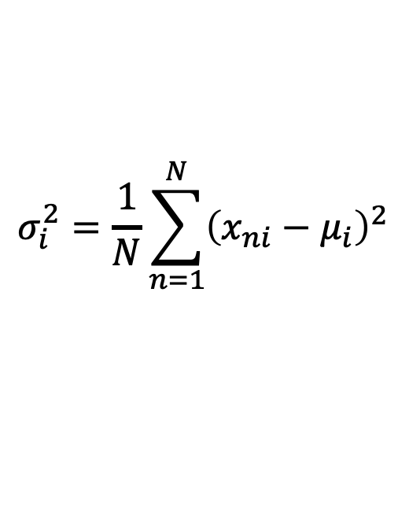
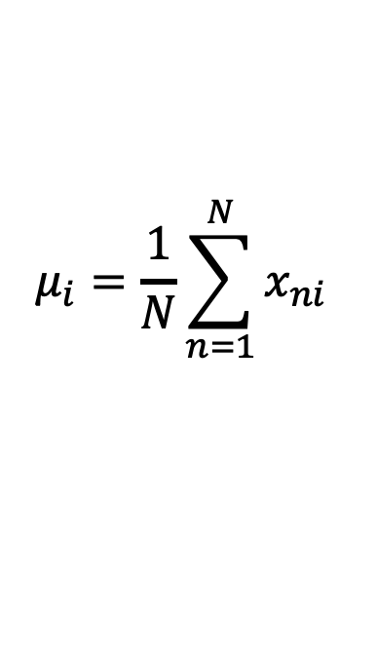
Data Normalization
Earlier we saw that inputs to a network
(or layer) that vary significantly in scale
can lead to slow convergence.
One solution is feature standardization:
$${\hat{x}}_{ni}=\frac{x_{ni}−μ_{i}}{σ_{i}}$$
where $μ_{i}$ and $σ_{i}$ are computed from the training data:
Then, at test-time we use the same $μ_{i}$ and $σ_{i}$.
Example
$$μ_{i}=\frac{1}{N}\sum_{n=1}^{N}{x_{ni}}$$
$$σ_{i}^{2}=\frac{1}{N}\sum_{n=1}^{N}{{\left(x_{ni}−μ_{i}\right)}^{2}}$$
Bishop 7.4.1

Slide 30



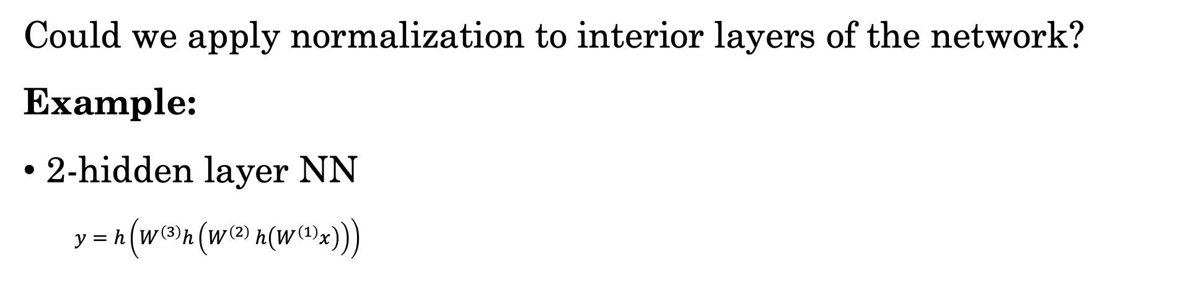






















Normalization in the Network
Could we apply normalization to interior layers of the network?
Example:
2-hidden layer NN
$y=h\left(W^{\left(3\right)}h\left(W^{\left(2\right)} h\left(W^{\left(1\right)}x\right)\right)\right)$
$$W^{(1)}$$
$$a_{1}^{\left(1\right)}$$
$$z_{1}^{\left(1\right)}$$
$$W^{(2)}$$
$$a_{1}^{\left(2\right)}$$
$$z_{1}^{\left(2\right)}$$
$$W^{(3)}$$
$$a_{1}^{\left(3\right)}$$
$$y_{1}$$
+
$$h$$
+
$$h$$
+
$$h$$
$$x_{1}$$
$$x_{2}$$
$$a_{2}^{\left(1\right)}$$
$$h$$
$$z_{2}^{\left(1\right)}$$
$$a_{2}^{\left(2\right)}$$
$$h$$
$$z_{2}^{\left(2\right)}$$
$$a_{2}^{\left(3\right)}$$
$$h$$
$$y_{2}$$
+
+
+
$$x_{D}$$
$$a_{M^{(1)}}^{\left(1\right)}$$
$$z_{M^{(1)}}^{\left(1\right)}$$
$$a_{M^{(2)}}^{\left(2\right)}$$
$$z_{M^{(2)}}^{\left(2\right)}$$
$$a_{K}^{\left(3\right)}$$
$$y_{K}$$
+
$$h$$
+
$$h$$
+
$$h$$
Why would hidden layer normalization help?
Ensure internal activations are similar scale
  Chain rule → gradients stay similar scale
Problem: internal activations change during learning (SGD)!
Bishop 7.4.2

Slide 31



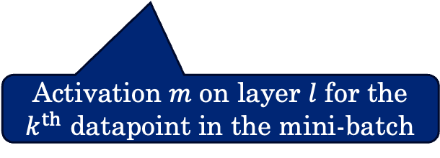








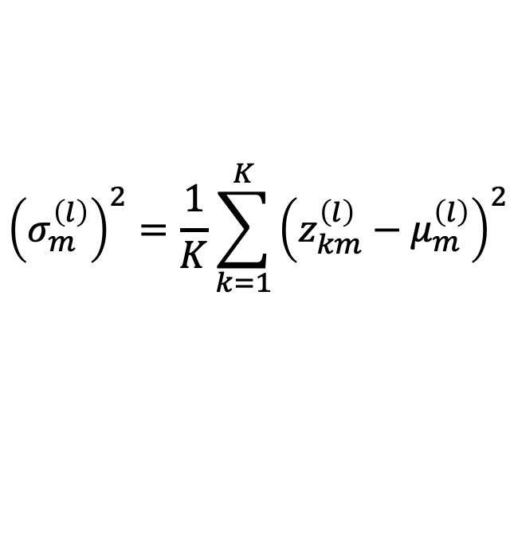




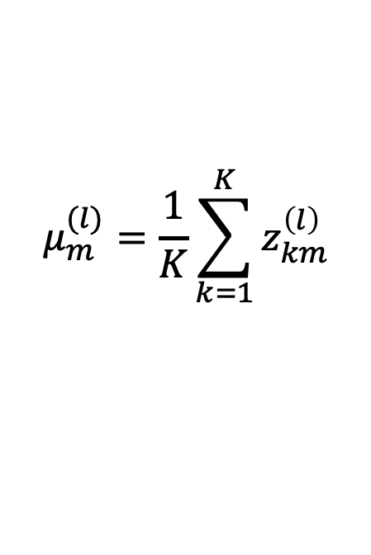





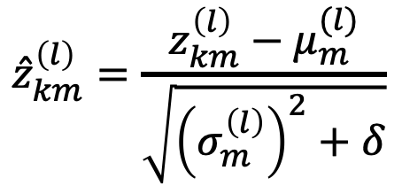







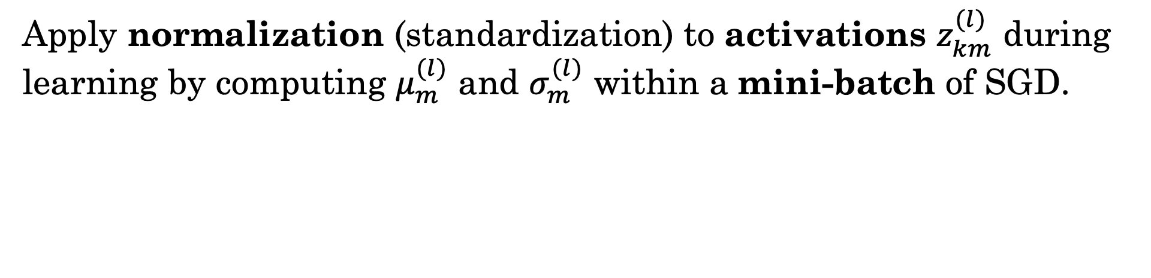
Batch Normalization
Apply normalization (standardization) to activations $z_{km}^{(l)}$ during learning by computing $μ_{m}^{(l)}$ and $σ_{m}^{(l)}$ within a mini-batch of SGD.
$${\hat{z}}_{km}^{\left(l\right)}=\frac{z_{km}^{\left(l\right)}−μ_{m}^{(l)}}{\sqrt{{\left(σ_{m}^{\left(l\right)}\right)}^{2}+δ}}$$
$$μ_{m}^{(l)}=\frac{1}{K}\sum_{k=1}^{K}{z_{km}^{\left(l\right)}}$$
$${\left(σ_{m}^{\left(l\right)}\right)}^{2}=\frac{1}{K}\sum_{k=1}^{K}{{\left(z_{km}^{\left(l\right)}−μ_{m}^{\left(l\right)}\right)}^{2}}$$
Activation $m$ on layer $l$ for the
$k^{th}$ datapoint in the mini-batch
Mean over the mini-batch of $K$ datapoints
Variance over the mini-batch of $K$ datapoints
$$W^{(1)}$$
$$a_{1}^{\left(1\right)}$$
$$z_{1}^{\left(1\right)}$$
$$W^{(2)}$$
$$a_{1}^{\left(2\right)}$$
$$z_{1}^{\left(2\right)}$$
$$W^{(3)}$$
$$a_{1}^{\left(3\right)}$$
$$y_{1}$$
+
$$h$$
BN
+
$$h$$
BN
+
$$h$$
$$x_{1}$$
$$x_{2}$$
$$a_{2}^{\left(1\right)}$$
$$h$$
$$z_{2}^{\left(1\right)}$$
BN
$$a_{2}^{\left(2\right)}$$
$$h$$
$$z_{2}^{\left(2\right)}$$
BN
$$a_{2}^{\left(3\right)}$$
$$h$$
$$y_{2}$$
+
+
+
$$x_{D}$$
$$a_{M^{(1)}}^{\left(1\right)}$$
$$z_{M^{(1)}}^{\left(1\right)}$$
$$a_{K}^{\left(3\right)}$$
$$y_{K}$$
$$h$$
BN
$$a_{M^{(2)}}^{\left(2\right)}$$
$$h$$
$$z_{M^{(2)}}^{\left(2\right)}$$
BN
$$h$$
+
+
+
Notes:
[Fa26 changes] MODIFIED
- Statistics named mu_i, sigma_i in the text but mu_m^(l), sigma_m^(l) in the equations; now consistent. Pre-activation index a_nm -> a_km (k indexes the mini-batch here). Bishop normalizes pre-activations (Eqs. 7.52-7.54); the PyTorch code later does the same.

Slide 32
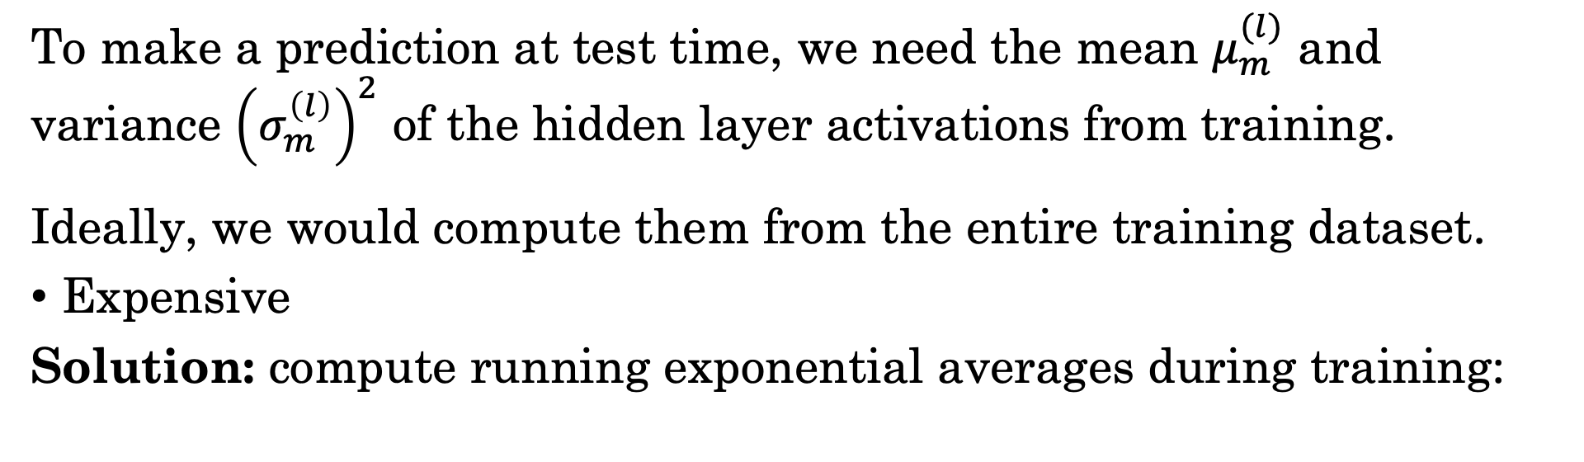
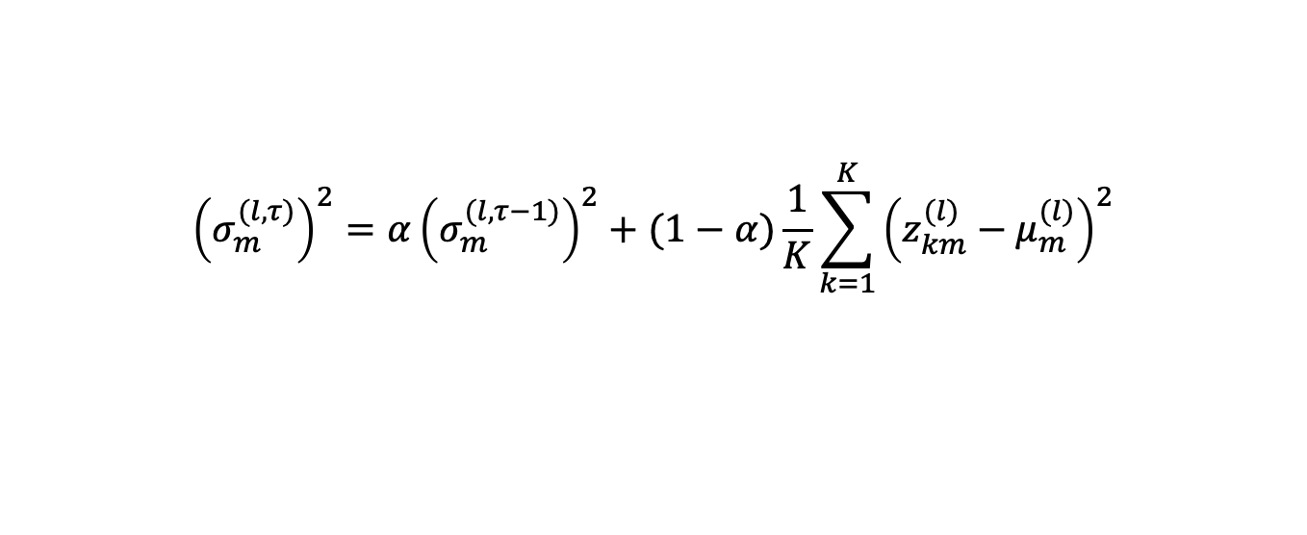
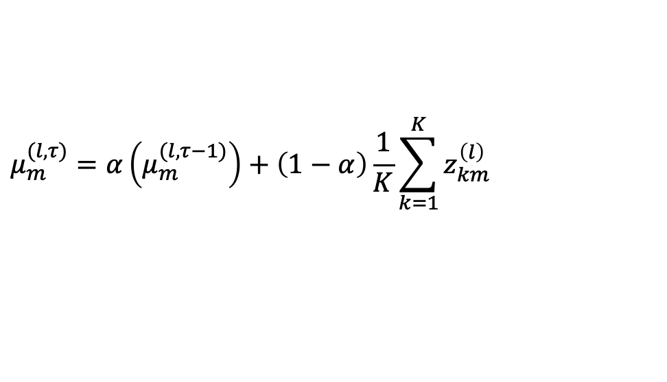
Making Predictions with Batch Norm.
To make a prediction at test time, we need the mean $μ_{m}^{(l)}$ and variance ${\left(σ_{m}^{\left(l\right)}\right)}^{2}$ of the hidden layer activations from training.
Ideally, we would compute them from the entire training dataset.
Expensive
Solution: compute running exponential averages during training:
$$μ_{m}^{(l,τ)}=α\left(μ_{m}^{(l,τ−1)}\right)+\left(1−α\right)\frac{1}{K}\sum_{k=1}^{K}{z_{km}^{\left(l\right)}}$$
$${\left(σ_{m}^{(l,τ)}\right)}^{2}=α{\left(σ_{m}^{(l,τ−1)}\right)}^{2}+(1−α)\frac{1}{K}\sum_{k=1}^{K}{{\left(z_{km}^{(l)}−μ_{m}^{(l)}\right)}^{2}}$$
Notes:
PyTorch: momentum $=1−α=0.1$; the running variance is unbiased ($K−1$).

Slide 33
Batch Normalization is Difficult to Parallelize
Data-parallel stochastic gradient descent
Mini-batch
Data 1
Data 2
GPU 1
GPU 2

Slide 34
Batch Normalization is Difficult to Parallelize
Data-parallel stochastic gradient descent
GPU 1
GPU 2
Data 1
Data 2
Gradient 1
Gradient 2

Slide 35
Batch Normalization is Difficult to Parallelize
Data-parallel stochastic gradient descent
GPU 1
GPU 2
Data 1
Data 2
GPUs share gradients and compute sum (called all-reduce).
Gradient 1
+
Gradient 2

Slide 36
Batch Normalization is Difficult to Parallelize
Batch normalization couples the data points of a mini-batch.
Cannot compute gradients independently across GPUs
GPU 1
GPU 2
Data 1
Data 2
Notes:
[Fa26 changes] MODIFIED
- "couples the layers" -> couples the data points of the mini-batch (that is what crosses GPUs in the diagram). Added the two practical workarounds.

Slide 37
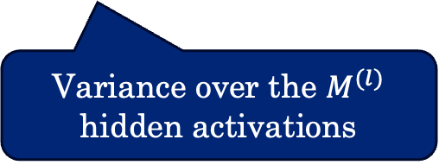
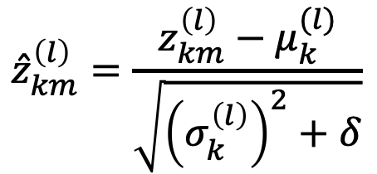
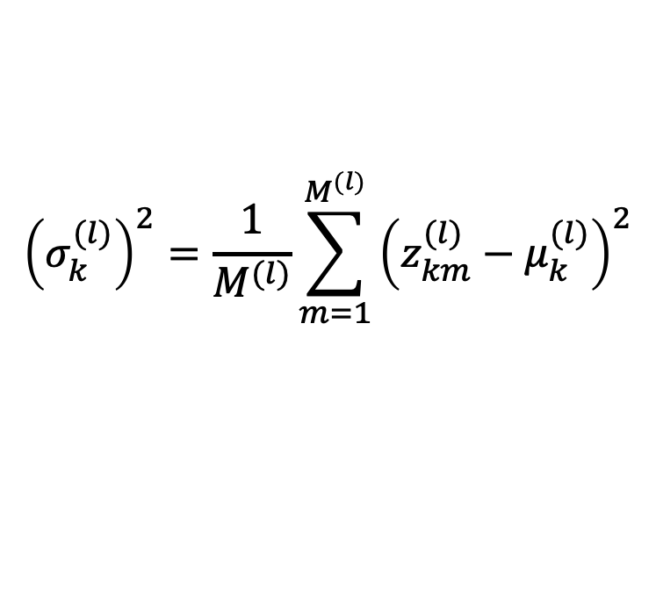

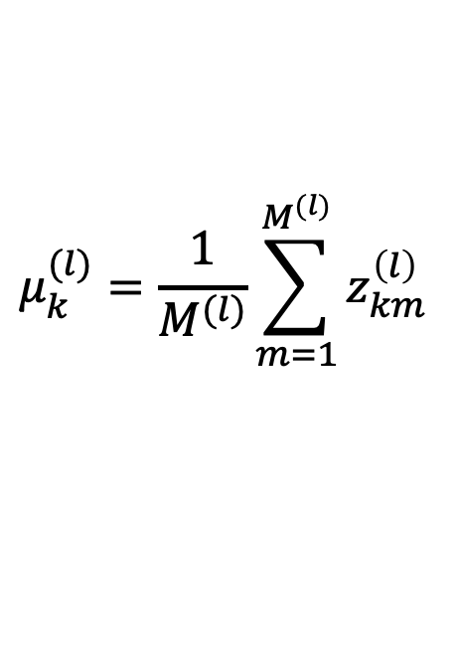
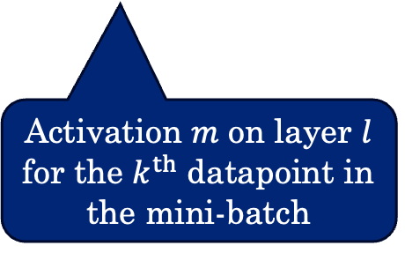
Layer Normalization
Layer Normalization computes the layer mean and variance across the neurons in the layer instead of across the mini-batch:
$${\hat{z}}_{km}^{\left(l\right)}=\frac{z_{km}^{\left(l\right)}−μ_{k}^{(l)}}{\sqrt{{\left(σ_{k}^{\left(l\right)}\right)}^{2}+δ}}$$
$$μ_{k}^{(l)}=\frac{1}{M^{(l)}}\sum_{m=1}^{M^{(l)}}{z_{km}^{\left(l\right)}}$$
$${\left(σ_{k}^{(l)}\right)}^{2}=\frac{1}{M^{(l)}}\sum_{m=1}^{M^{(l)}}{{\left(z_{km}^{(l)}−μ_{k}^{(l)}\right)}^{2}}$$
Mean over the $M^{(l)}$ hidden activations
Variance over the $M^{(l)}$ hidden activations
Activation $m$ on layer $l$ for the $k^{th}$ datapoint in the mini-batch
Normalization is applied the same way at test-time.
No need to estimate on training data.
Layer norm (or RMSNorm) is used in transformers and LLMs.

Slide 38
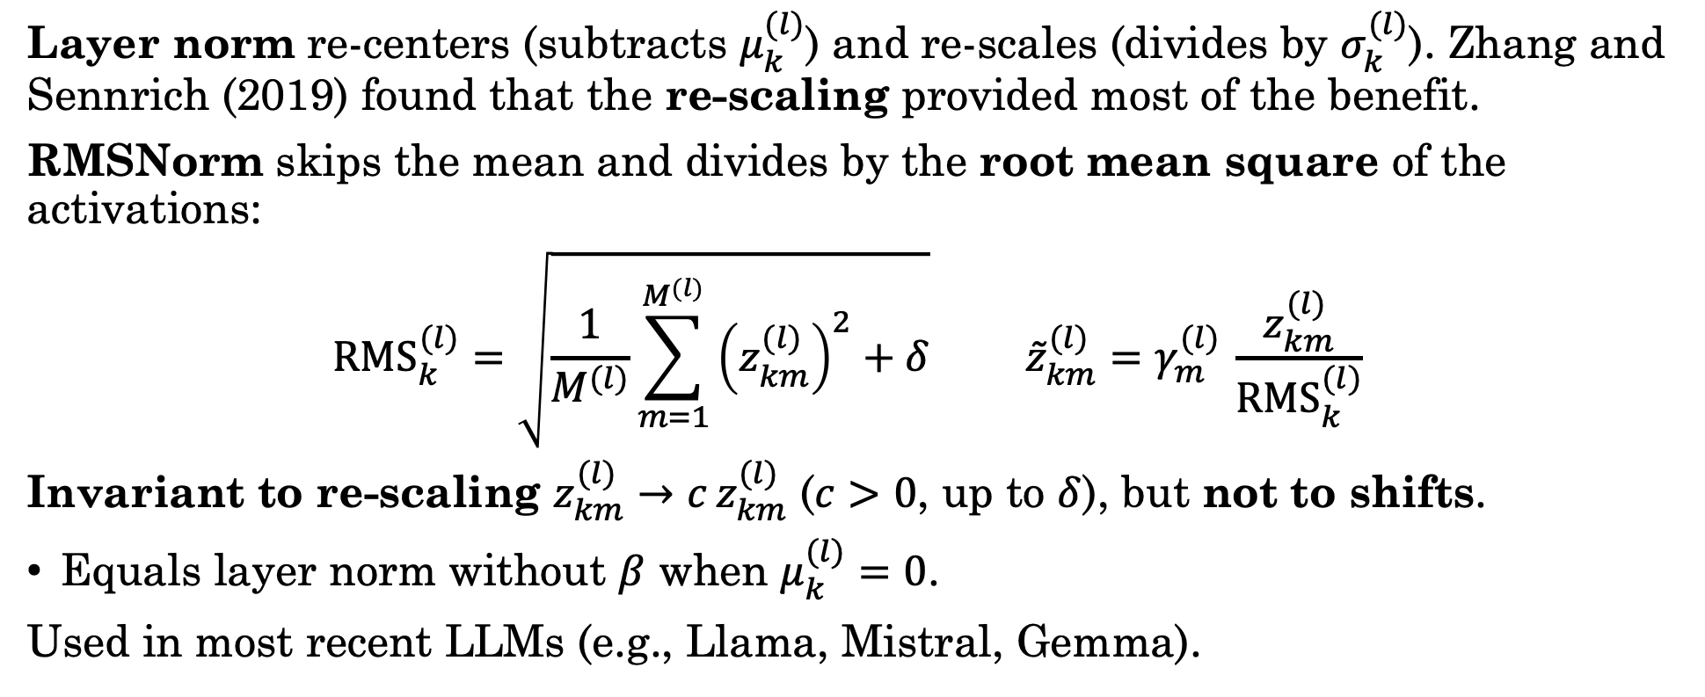
RMS Normalization (RMSNorm)
Layer norm re-centers (subtracts $μ_{k}^{(l)}$) and re-scales (divides by $σ_{k}^{(l)}$). Zhang and Sennrich (2019) found that the re-scaling provided most of the benefit.
RMSNorm skips the mean and divides by the root mean square of the activations:
$${RMS}_{k}^{(l)}=\sqrt{\frac{1}{M^{(l)}}\sum_{m=1}^{M^{(l)}}{{\left(z_{km}^{(l)}\right)}^{2}+δ}} {\tilde{z}}_{km}^{(l)}=γ_{m}^{(l)} \frac{z_{km}^{(l)}}{{RMS}_{k}^{(l)}}$$
Invariant to re-scaling $z_{km}^{(l)}→c z_{km}^{(l)}$ ($c>0$, up to $δ$), but not to shifts.
Equals layer norm without $β$ when $μ_{k}^{(l)}=0$.
Used in most recent LLMs (e.g., Llama, Mistral, Gemma).
norm = nn.RMSNorm(c) # learned gamma, no beta

Slide 39



























































































































Layer Normalization vs Batch Normalization
$$W^{(1)}$$
$$a_{1}^{\left(1\right)}$$
$$z_{1}^{\left(1\right)}$$
$$W^{(2)}$$
$$a_{1}^{\left(2\right)}$$
$$z_{1}^{\left(2\right)}$$
$$W^{(3)}$$
$$a_{1}^{\left(3\right)}$$
$$y_{1}$$
+
$$h$$
BN
+
$$h$$
BN
+
$$h$$
$$x_{1}$$
$$W^{(1)}$$
$$a_{1}^{\left(1\right)}$$
$$z_{1}^{\left(1\right)}$$
$$W^{(2)}$$
$$a_{1}^{\left(2\right)}$$
$$z_{1}^{\left(2\right)}$$
$$W^{(3)}$$
$$a_{1}^{\left(3\right)}$$
$$y_{1}$$
+
$$h$$
BN
+
$$h$$
BN
+
$$h$$
$$a_{2}^{\left(1\right)}$$
$$z_{2}^{\left(1\right)}$$
$$W^{(2)}$$
$$W^{(3)}$$
$$x_{1}$$
$$h$$
BN
$$a_{2}^{\left(2\right)}$$
$$z_{2}^{\left(2\right)}$$
$$a_{2}^{\left(3\right)}$$
$$h$$
$$y_{2}$$
$$x_{2}$$
+
$$W^{(1)}$$
$$a_{1}^{\left(1\right)}$$
$$h$$
$$z_{1}^{\left(1\right)}$$
$$h$$
$$a_{1}^{\left(2\right)}$$
BN
$$z_{1}^{\left(2\right)}$$
+
$$a_{1}^{\left(3\right)}$$
$$h$$
$$y_{1}$$
+
BN
+
+
$$h$$
BN
+
$$a_{2}^{\left(1\right)}$$
$$z_{2}^{\left(1\right)}$$
$$W^{(2)}$$
$$W^{(3)}$$
$$x_{1}$$
$$h$$
BN
$$a_{2}^{\left(2\right)}$$
$$z_{2}^{\left(2\right)}$$
$$a_{2}^{\left(3\right)}$$
$$h$$
$$y_{2}$$
$$x_{2}$$
+
$$W^{(1)}$$
$$a_{1}^{\left(1\right)}$$
$$h$$
$$z_{1}^{\left(1\right)}$$
$$h$$
$$a_{1}^{\left(2\right)}$$
BN
$$z_{1}^{\left(2\right)}$$
+
$$a_{1}^{\left(3\right)}$$
$$h$$
$$y_{1}$$
+
BN
+
+
$$h$$
BN
+
$$a_{2}^{\left(1\right)}$$
$$z_{2}^{\left(1\right)}$$
$$W^{(2)}$$
$$W^{(3)}$$
$$x_{1}$$
$$h$$
BN
$$a_{2}^{\left(2\right)}$$
$$z_{2}^{\left(2\right)}$$
$$a_{2}^{\left(3\right)}$$
$$h$$
$$y_{2}$$
$$x_{D}$$
$$x_{2}$$
+
$$W^{(1)}$$
$$a_{1}^{\left(1\right)}$$
$$h$$
$$z_{1}^{\left(1\right)}$$
$$h$$
$$a_{1}^{\left(2\right)}$$
BN
$$z_{1}^{\left(2\right)}$$
+
$$a_{1}^{\left(3\right)}$$
$$h$$
$$y_{1}$$
$$a_{M^{(1)}}^{\left(1\right)}$$
$$z_{M^{(1)}}^{\left(1\right)}$$
BN
+
$$h$$
BN
$$h$$
+
$$a_{M^{(2)}}^{\left(2\right)}$$
$$h$$
$$z_{M^{(2)}}^{\left(2\right)}$$
BN
$$a_{K}^{\left(3\right)}$$
$$h$$
$$y_{K}$$
+
BN
+
+
$$x_{1}$$
$$a_{2}^{\left(1\right)}$$
$$h$$
$$z_{2}^{\left(1\right)}$$
+
$$a_{2}^{\left(2\right)}$$
$$z_{2}^{\left(2\right)}$$
+
$$a_{2}^{\left(3\right)}$$
$$h$$
$$y_{2}$$
$$x_{D}$$
BN
$$h$$
$$x_{2}$$
+
Layer Dimension
BN
+
$$a_{M^{(1)}}^{\left(1\right)}$$
$$h$$
$$z_{M^{(1)}}^{\left(1\right)}$$
BN
$$a_{M^{(2)}}^{\left(2\right)}$$
$$h$$
+
$$z_{M^{(2)}}^{\left(2\right)}$$
BN
$$a_{K}^{\left(3\right)}$$
$$h$$
$$y_{K}$$
+
$$a_{2}^{\left(1\right)}$$
$$h$$
$$z_{2}^{\left(1\right)}$$
+
$$a_{2}^{\left(2\right)}$$
$$z_{2}^{\left(2\right)}$$
+
$$a_{2}^{\left(3\right)}$$
$$h$$
$$y_{2}$$
$$x_{D}$$
$$x_{2}$$
+
BN
+
$$h$$
BN
+
$$a_{M^{(1)}}^{\left(1\right)}$$
$$h$$
$$z_{M^{(1)}}^{\left(1\right)}$$
BN
$$a_{M^{(2)}}^{\left(2\right)}$$
$$h$$
$$z_{M^{(2)}}^{\left(2\right)}$$
BN
$$a_{K}^{\left(3\right)}$$
$$h$$
$$y_{K}$$
$$x_{D}$$
+
+
+
$$a_{M^{(1)}}^{\left(1\right)}$$
$$h$$
$$z_{M^{(1)}}^{\left(1\right)}$$
BN
$$a_{M^{(2)}}^{\left(2\right)}$$
$$h$$
$$z_{M^{(2)}}^{\left(2\right)}$$
BN
$$a_{K}^{\left(3\right)}$$
$$h$$
$$y_{K}$$
Mini-batch Dimension
+
+
+
$$x_{D}$$
$$a_{M^{(1)}}^{\left(1\right)}$$
$$z_{M^{(1)}}^{\left(1\right)}$$
$$a_{K}^{\left(3\right)}$$
$$y_{K}$$
$$h$$
BN
$$a_{M^{(2)}}^{\left(2\right)}$$
$$h$$
$$z_{M^{(2)}}^{\left(2\right)}$$
BN
$$h$$
+
+
+

Slide 40































Layer Normalization vs Batch Normalization
Mini-batch Dimension
Batch
Norm.
$$z_{1}^{\left(1\right)}$$
$$z_{1}^{\left(1\right)}$$
$$z_{1}^{\left(1\right)}$$
$$z_{1}^{\left(1\right)}$$
$$z_{1}^{\left(1\right)}$$
$$μ_{1}^{(l)}$$
$$σ_{1}^{(l)}$$
Layer Dimension
$$z_{2}^{\left(1\right)}$$
$$z_{2}^{\left(1\right)}$$
$$z_{2}^{\left(1\right)}$$
$$z_{2}^{\left(1\right)}$$
$$z_{2}^{\left(1\right)}$$
$$μ_{2}^{(l)}$$
$$σ_{2}^{(l)}$$
$$z_{M^{(1)}}^{\left(1\right)}$$
$$z_{M^{(1)}}^{\left(1\right)}$$
$$z_{M^{(1)}}^{\left(1\right)}$$
$$z_{M^{(1)}}^{\left(1\right)}$$
$$z_{M^{(1)}}^{\left(1\right)}$$
$$μ_{M^{(1)}}^{(l)}$$
$$σ_{M^{(1)}}^{(l)}$$
Layer
Norm.
$$μ_{1}^{(1)}$$
$$μ_{2}^{(1)}$$
$$μ_{3}^{(1)}$$
$$μ_{4}^{(1)}$$
$$μ_{5}^{(1)}$$
$$σ_{1}^{\left(l\right)}$$
$$σ_{2}^{\left(l\right)}$$
$$σ_{3}^{\left(l\right)}$$
$$σ_{4}^{\left(l\right)}$$
$$σ_{5}^{\left(l\right)}$$

Slide 41
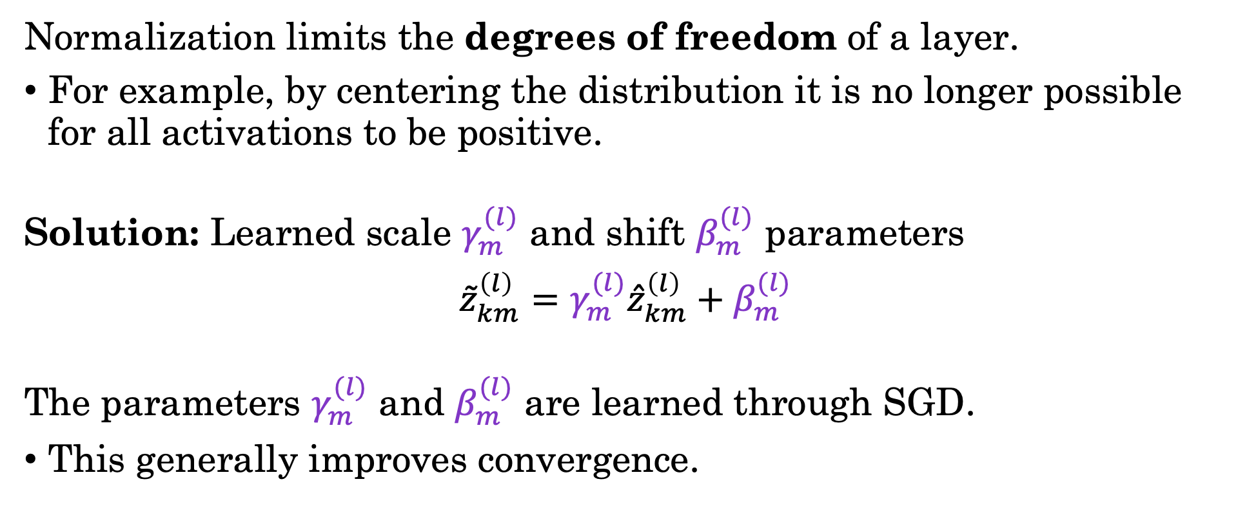
Re-Scaling with Normalization
Normalization limits the degrees of freedom of a layer.
For example, by centering the distribution it is no longer possible for all activations to be positive.
Solution: Learned scale $γ_{m}^{(l)}$ and shift $β_{m}^{(l)}$ parameters
$${\tilde{z}}_{km}^{\left(l\right)}=γ_{m}^{(l)}{\hat{z}}_{km}^{\left(l\right)}+β_{m}^{(l)}$$
The parameters $γ_{m}^{(l)}$ and $β_{m}^{(l)}$ are learned through SGD.
This generally improves convergence.

Slide 42
Batch-Norm and Layer-Norm in PyTorch
Creating norm layers:
if norm_kind == "batch":
self.norms = nn.ModuleList([nn.BatchNorm1d(c) for c in dims[1:-1]])
else: # norm_kind == "layer"
self.norms = nn.ModuleList([nn.LayerNorm(c) for c in dims[1:-1]])
Using norm layers:
def forward(self, x):
for i, layer in enumerate(self.layers):
x = layer(x)
if i < len(self.layers) - 1:
x = self.norms[i](x)
x = self.act(x)
return x
Notes:
[Fa26 changes] MODIFIED
- Code as editable code boxes matching notebooks/lec14/lec14.ipynb. One norm layer per hidden layer (dims[1:-1]); the old code also built an unused norm for the output layer. The norm is applied to the pre-activations, as in Bishop.

Slide 43
Demo
Notebook, Part 3: batch and layer normalization by hand and in PyTorch.
Notes:
[Fa26 changes] NEW
- Demo slide for notebooks/lec14/lec14.ipynb, Part 3 (Lecture Demo 3).

Slide 44
PyTorch, Initialization, and Normalization
Lecture 14
Reading: Bishop, Sections 6.2.4, 7.2.5, and 7.4. PyTorch basics: docs.pytorch.org/tutorials/beginner/basics

