Slide 1
Do not edit
How to change the design
Join at slido.com
#3400896
The Slido app must be installed on every computer you’re presenting from

Slide 2
Conv. + Momentum + Adam +
Stochastic Gradient Descent
Action Packed
Lecture
Lecture 11
The core algorithm of modern machine learning

Slide 3
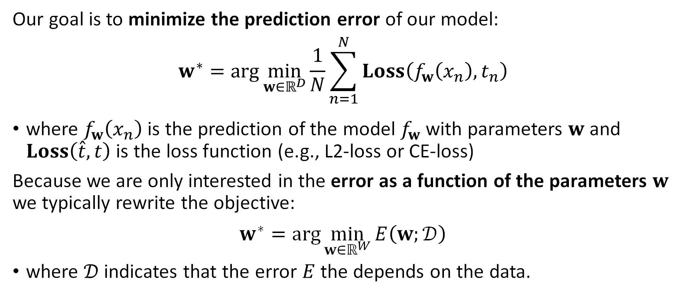
Error Minimization
Our goal is to minimize the prediction error of our model:
$$w^{∗}=\arg{\min_{w∈ℝ^{D}}{\frac{1}{N}\sum_{n=1}^{N}{Loss\left(f_{w}\left(x_{n}\right), t_{n}\right)}}}$$
where $f_{w}\left(x_{n}\right)$ is the prediction of the model $f_{w}$ with parameters $w$ and $Loss\left(\hat{t},t\right)$ is the loss function (e.g., L2-loss or CE-loss)
Because we are only interested in the error as a function of the parameters $w$ we typically rewrite the objective:
$$w^{∗}=\arg{\min_{w∈ℝ^{W}}{E\left(w;𝒟\right)}}$$
where $𝒟$ indicates that the error $E$ the depends on the data.

Slide 4
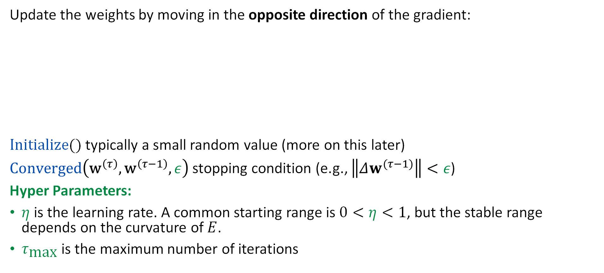
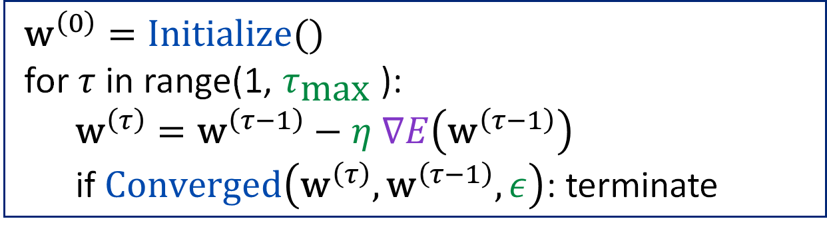
The (Batch) Gradient Descent Alg.
Update the weights by moving in the opposite direction of the gradient:
$Initialize()$ typically a small random value (more on this later)
$Converged\left({\text{w}}^{\left(τ\right)},{\text{w}}^{\left(τ−1\right)},ε\right)$ stopping condition (e.g., $\left\|Δw^{(τ−1)}\right\|<ε$)
Hyper Parameters:
$η$ is the learning rate. A common starting range is $0<η<1$, but the stable range depends on the curvature of $E$.
$τ_{\text{max}}$ is the maximum number of iterations
$${\text{w}}^{\left(0\right)}=Initialize()$$
for $τ$ in range(1, $τ_{\text{max}}$):
$${\text{w}}^{\left(τ\right)}={\text{w}}^{\left(τ−1\right)}−η ∇E\left({\text{w}}^{\left(τ−1\right)}\right)$$
if $Converged\left({\text{w}}^{\left(τ\right)},{\text{w}}^{\left(τ−1\right)}, ε\right)$: terminate

Slide 5
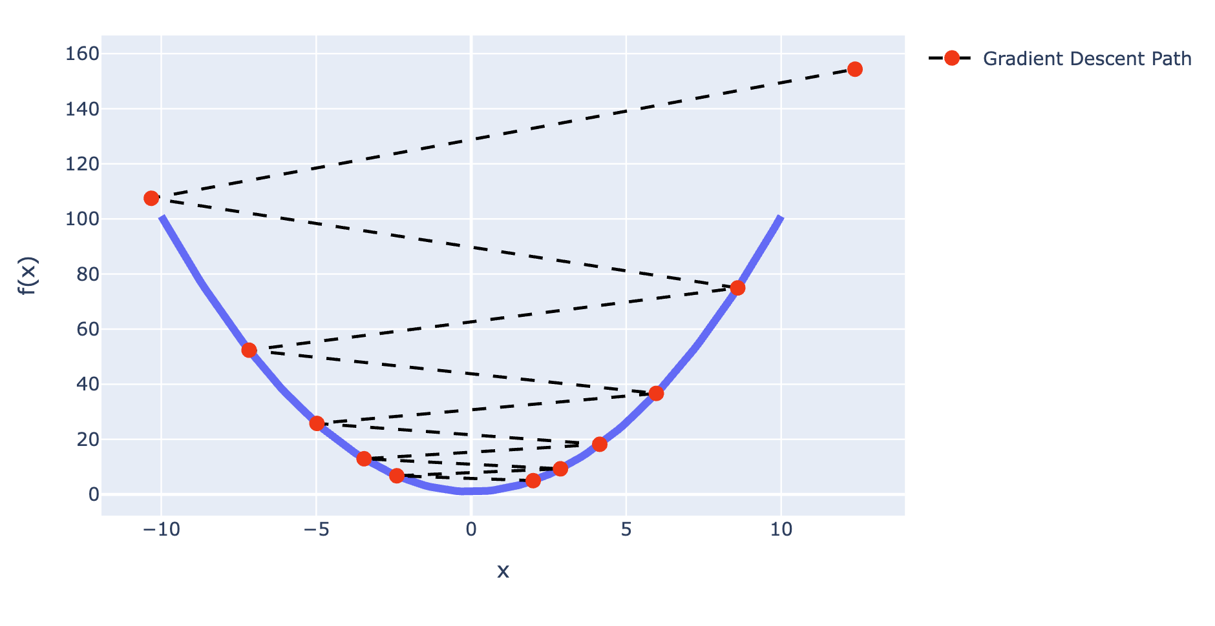
What are the conditions for convergence?
Learning rate seemed to affect convergence even on a simple parabola.

Slide 6
Convergence Assuming
Quadratic Approximation

Slide 7
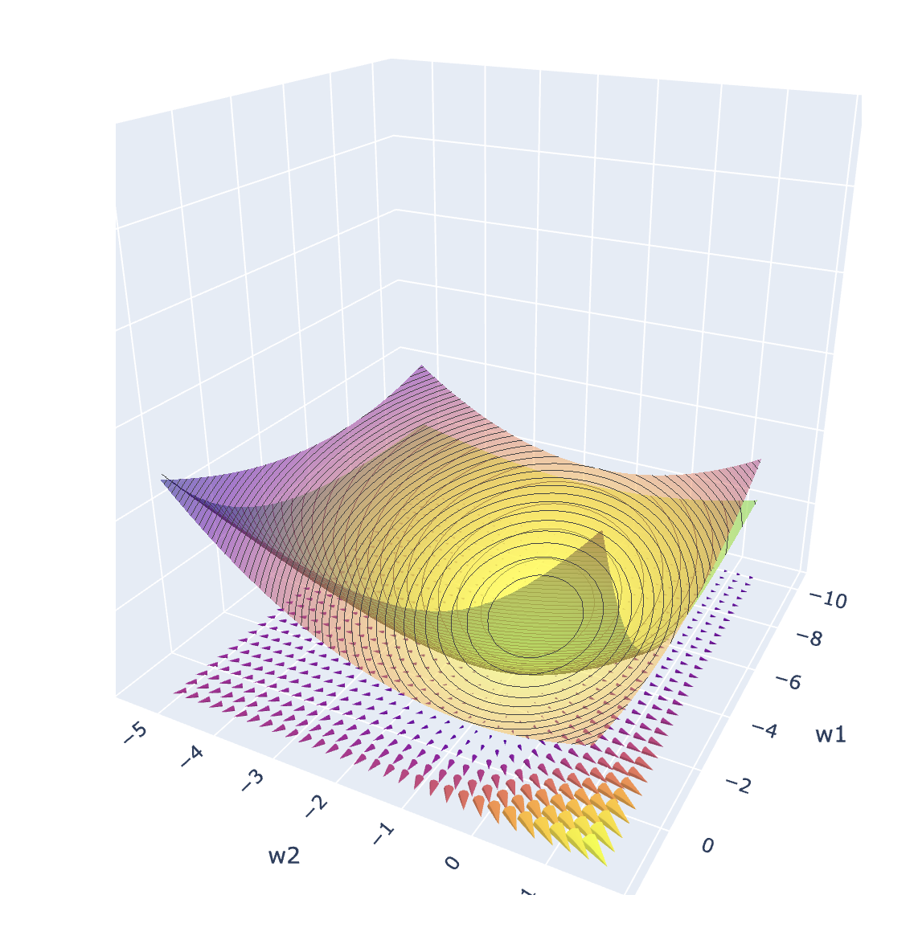
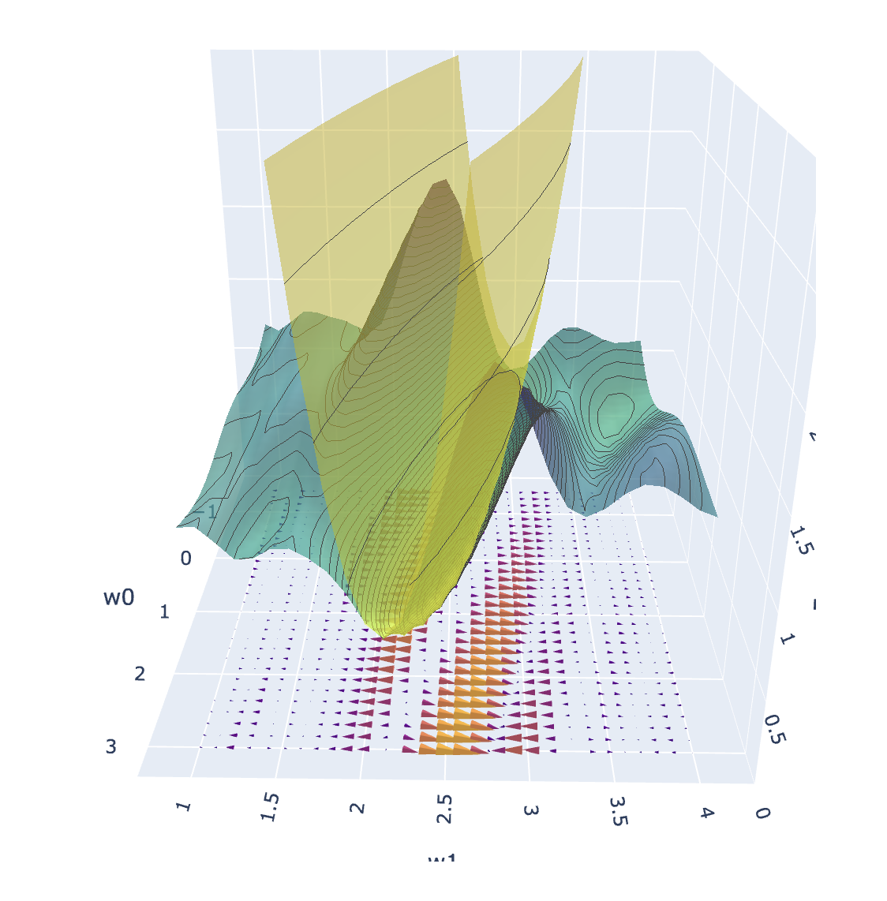
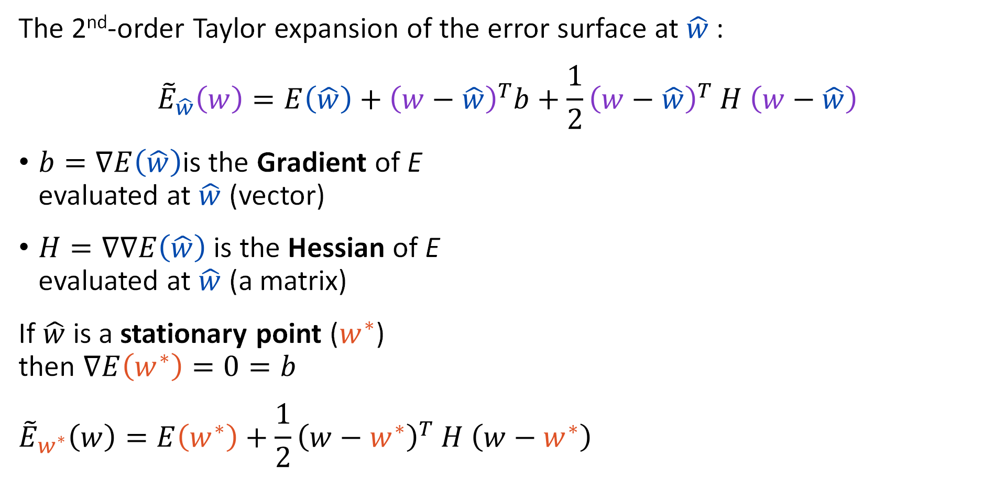
Recap: Taylor Expansion of the Error Surface
The 2nd-order Taylor expansion of the error surface at $\hat{w}$:
$${\tilde{E}}_{\hat{w}}\left(w\right)=E\left(\hat{w}\right)+{\left(w−\hat{w}\right)}^{T}b+\frac{1}{2}{\left(w−\hat{w}\right)}^{T} H \left(w−\hat{w}\right)$$
$b=∇E\left(\hat{w}\right)$is the Gradient of E
evaluated at $\hat{w}$ (vector)
$H=∇∇E\left(\hat{w}\right)$ is the Hessian of E
evaluated at $\hat{w}$ (a matrix)
If $\hat{w}$ is a stationary point ($w^{∗}$)
then $∇E\left(w^{∗}\right)=0=b$
$${\tilde{E}}_{w^{∗}}\left(w\right)=E\left(w^{∗}\right)+\frac{1}{2}{\left(w−w^{∗}\right)}^{T} H \left(w−w^{∗}\right)$$
Use a change of variables to better understand this part.

Slide 8
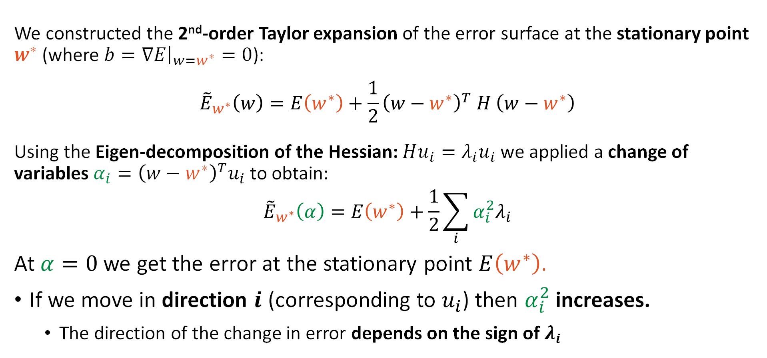
Recap: Quadratic Approx. Error
We constructed the 2nd-order Taylor expansion of the error surface at the stationary point $w^{∗}$ (where $b=∇E{\left.​\right|}_{w=w^{∗}}=0$):
$${\tilde{E}}_{w^{∗}}\left(w\right)=E\left(w^{∗}\right)+\frac{1}{2}{\left(w−w^{∗}\right)}^{T} H \left(w−w^{∗}\right)$$
Using the Eigen-decomposition of the Hessian: $Hu_{i}=λ_{i}u_{i}$we applied a change of variables $α_{i}={\left(w−w^{∗}\right)}^{T}u_{i}$ to obtain:
$${\tilde{E}}_{w^{∗}}\left(α\right)=E\left(w^{∗}\right)+\frac{1}{2}\sum_{i}{α_{i}^{2}λ_{i}}$$
At $α=0$ we get the error at the stationary point $E\left(w^{∗}\right)$.
If we move in direction $i$ (corresponding to $u_{i}$) then $α_{i}^{2}$ increases.
  The direction of the change in error depends on the sign of $λ_{i}$

Slide 9

Recap: Quadratic Approx. Error
We constructed the 2nd-order Taylor expansion of the error surface at the stationary point $w^{∗}$ (where $b=∇E{\left.​\right|}_{w=w^{∗}}=0$):
$${\tilde{E}}_{w^{∗}}\left(w\right)=E\left(w^{∗}\right)+\frac{1}{2}{\left(w−w^{∗}\right)}^{T} H \left(w−w^{∗}\right)$$
Using the Eigen-decomposition of the Hessian: $Hu_{i}=λ_{i}u_{i}$we applied a change of variables $α_{i}={\left(w−w^{∗}\right)}^{T}u_{i}$ to obtain:
$${\tilde{E}}_{w^{∗}}\left(α\right)=E\left(w^{∗}\right)+\frac{1}{2}\sum_{i}{α_{i}^{2}λ_{i}}$$
At $α=0$ we get the error at the stationary point $E\left(w^{∗}\right)$.
If we move in direction $i$ (corresponding to $u_{i}$) then $α_{i}^{2}$ increases.
  The direction of the change in error depends on the sign of $λ_{i}$
Therefore, if the eigenvalues are
all positive → local minimum
all negative → local maximum
mixed →
saddle point

Slide 10
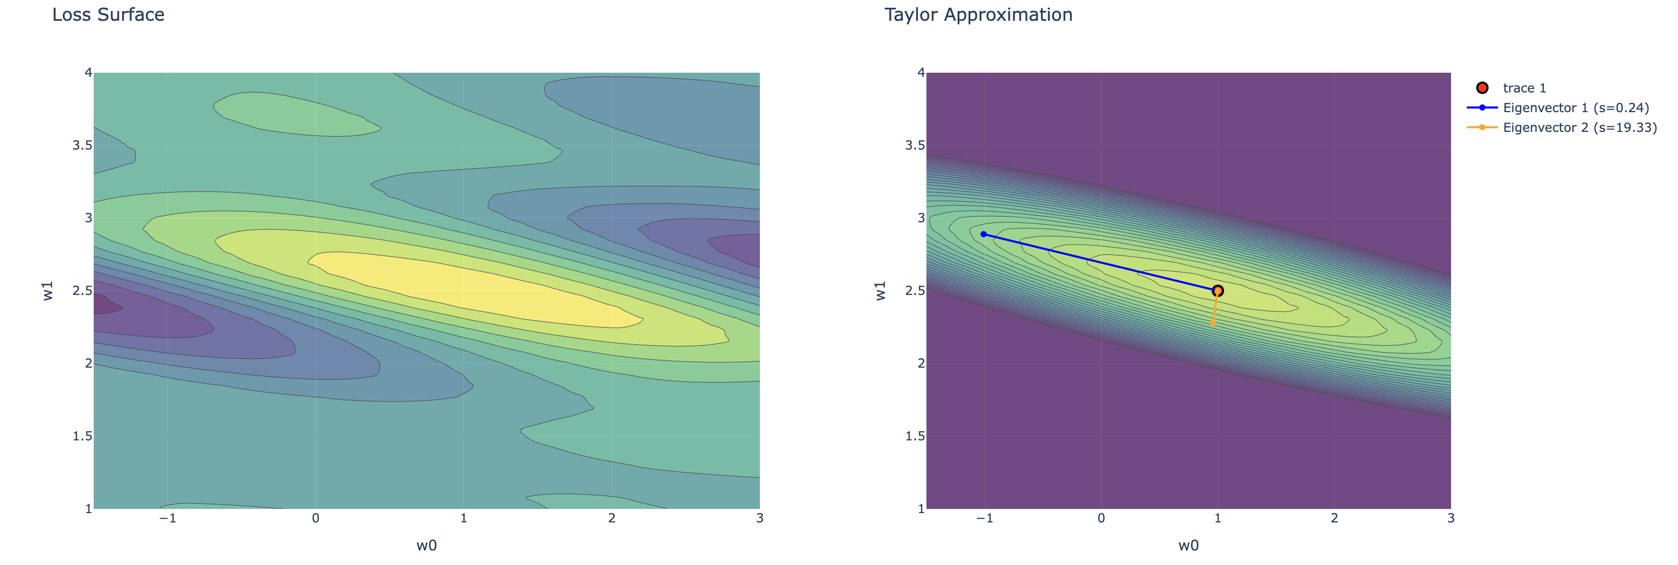



Eigenvectors of the Hessian
Elliptical iso-contours of constant error in the Taylor approximation align with the eigenvectors of the Hessian matrix.
$$u_{1}$$
$$w^{∗}$$
$$u_{2}$$
Plots in demo notebook.

Slide 11
Do not edit
How to change the design
The eigenvector u1 corresponds to the:
The Slido app must be installed on every computer you’re presenting from

Slide 12
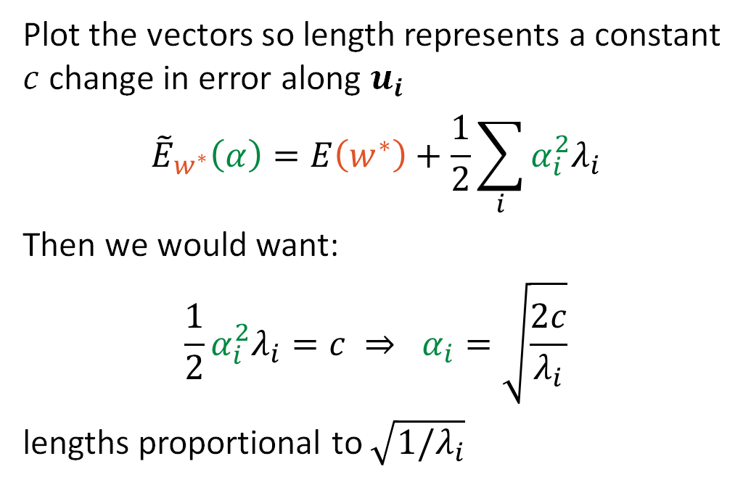
Eigenvectors of the Hessian
Elliptical iso-contours of constant error in the Taylor approximation align with the eigenvectors of the Hessian matrix.
Plot the vectors so length represents a constant $c$ change in error along $u_{i}$
$${\tilde{E}}_{w^{∗}}\left(α\right)=E\left(w^{∗}\right)+\frac{1}{2}\sum_{i}{α_{i}^{2}λ_{i}}$$
Then we would want:
$$\frac{1}{2}α_{i}^{2}λ_{i}=c ⇒ α_{i}=\sqrt{\frac{2c}{λ_{i}}}$$
lengths proportional to $\sqrt{1/λ_{i}}$
Direction with Smallest Eigenvalue
$$u_{1}$$
$$w^{∗}$$
$$u_{2}$$
Direction with Largest Eigenvalue
Plots in demo notebook.

Slide 13
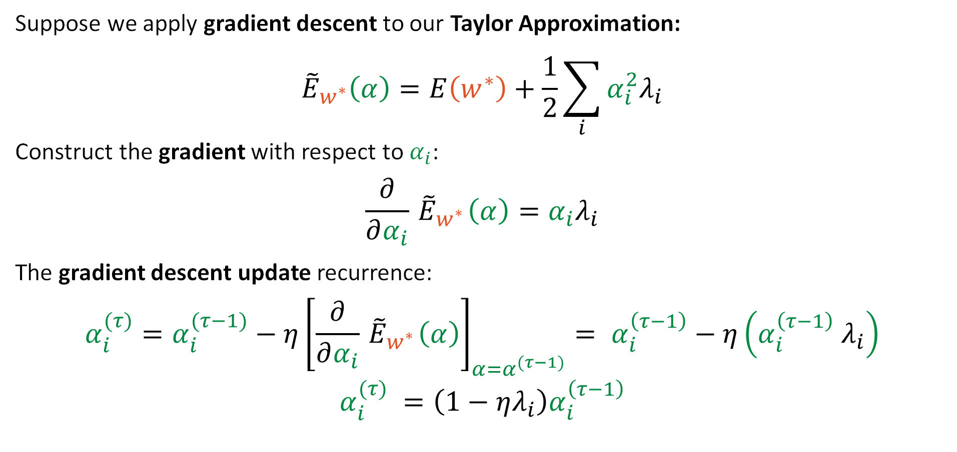
Grad. Descent on the Quadratic Approx.
Suppose we apply gradient descent to our Taylor Approximation:
$${\tilde{E}}_{w^{∗}}\left(α\right)=E\left(w^{∗}\right)+\frac{1}{2}\sum_{i}{α_{i}^{2}λ_{i}}$$
Construct the gradient with respect to $α_{i}$:
$$\frac{∂}{∂α_{i}}{ \tilde{E}}_{w^{∗}}\left(α\right)=α_{i}λ_{i}$$
The gradient descent update recurrence:
$$α_{i}^{(τ)}=α_{i}^{(τ−1)}−η{\left[\frac{∂}{∂α_{i}}{ \tilde{E}}_{w^{∗}}\left(α\right)\right]}_{α=α^{(τ−1)}}= α_{i}^{\left(τ−1\right)}−η\left(α_{i}^{\left(τ−1\right)} λ_{i}\right)$$
$$α_{i}^{(τ)} =\left(1−ηλ_{i}\right)α_{i}^{\left(τ−1\right)}$$

Slide 14

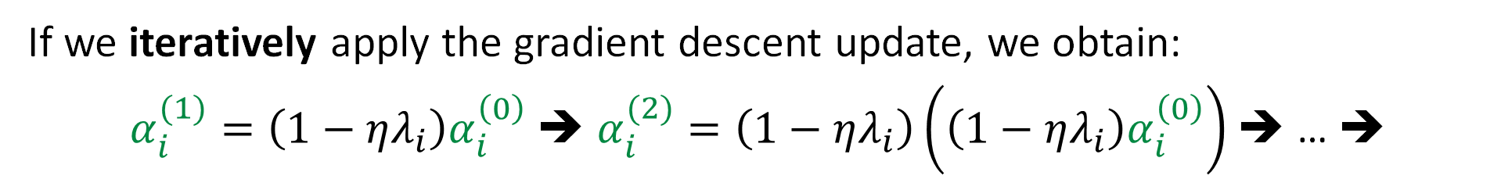

Grad. Descent on the Quadratic Approx.
Suppose we apply gradient descent to our Taylor Approximation:
$${\tilde{E}}_{w^{∗}}\left(α\right)=E\left(w^{∗}\right)+\frac{1}{2}\sum_{i}{α_{i}^{2}λ_{i}}$$
Construct the gradient with respect to $α_{i}$:
$$\frac{∂}{∂α_{i}}{ \tilde{E}}_{w^{∗}}\left(α\right)=α_{i}λ_{i}$$
The gradient descent update recurrence:
$$α_{i}^{(τ)}=α_{i}^{(τ−1)}−η{\left[\frac{∂}{∂α_{i}}{ \tilde{E}}_{w^{∗}}\left(α\right)\right]}_{α=α^{(τ−1)}}= α_{i}^{\left(τ−1\right)}−η\left(α_{i}^{\left(τ−1\right)} λ_{i}\right)$$
$$α_{i}^{(τ)} =\left(1−ηλ_{i}\right)α_{i}^{\left(τ−1\right)}$$
If we iteratively apply the gradient descent update, we obtain:
$α_{i}^{(1)}=\left(1−ηλ_{i}\right)α_{i}^{\left(0\right)}$ ➔ $α_{i}^{(2)}=\left(1−ηλ_{i}\right)\left(\left(1−ηλ_{i}\right)α_{i}^{\left(0\right)}\right)$ ➔ … ➔
$$α_{i}^{(τ)}={\left(1−ηλ_{i}\right)}^{τ}α_{i}^{\left(0\right)}$$

Slide 15
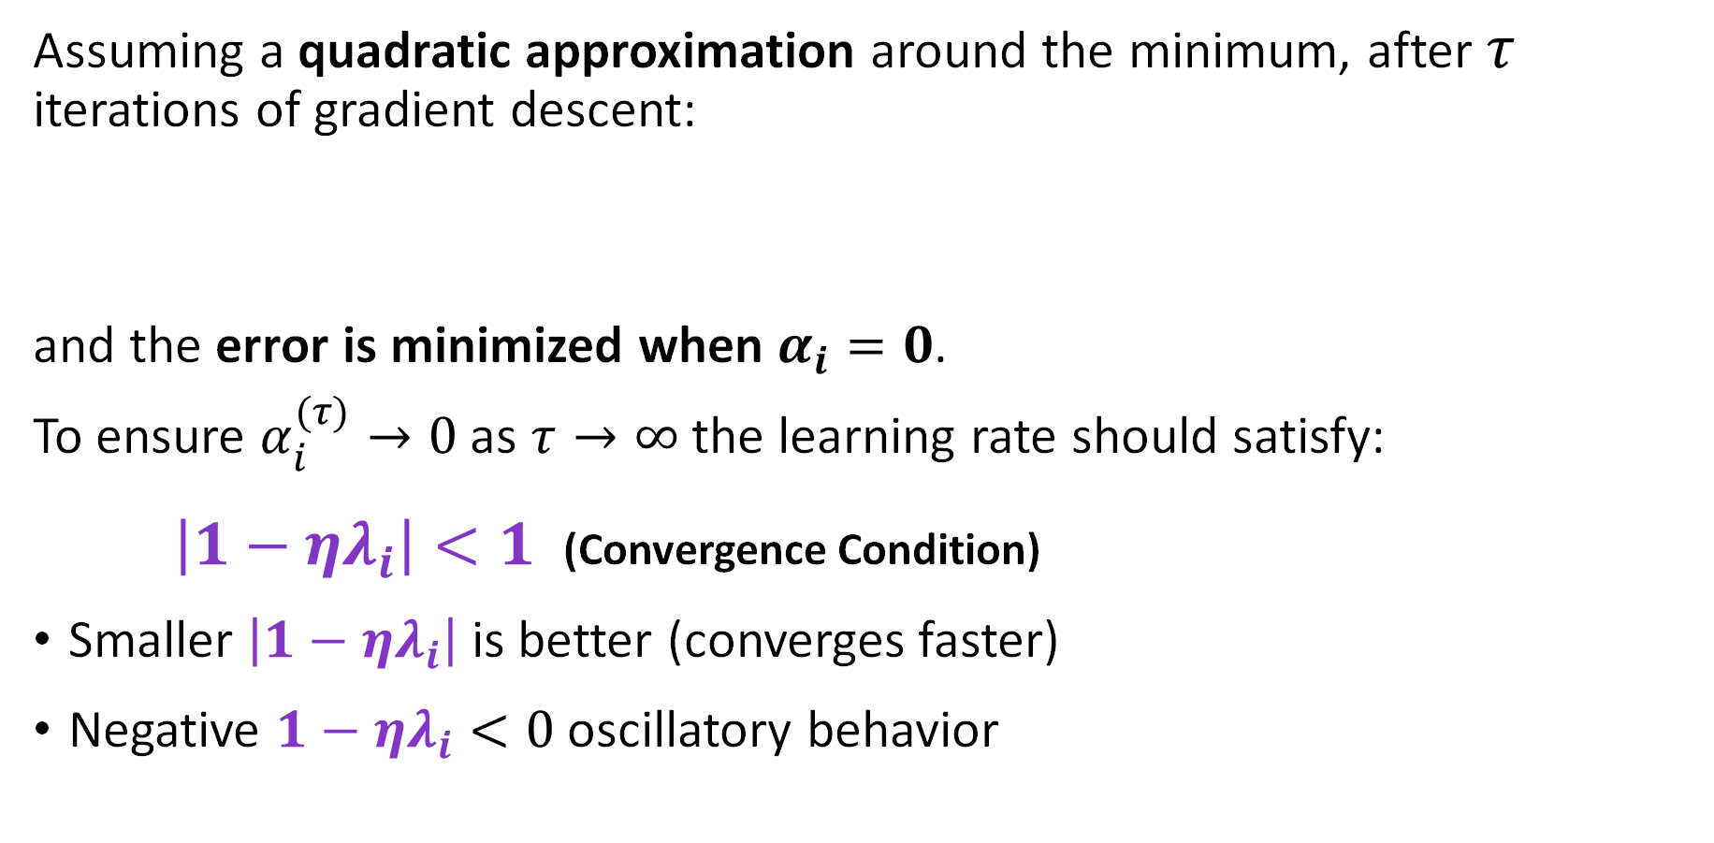

Grad. Descent on the Quadratic Approx.
Assuming a quadratic approximation around the minimum, after $τ$ iterations of gradient descent:
and the error is minimized when $α_{i}=0$.
To ensure $α_{i}^{(τ)}→0$ as $τ→∞$ the learning rate should satisfy:
$\left|1−ηλ_{i}\right|<1$ (Convergence Condition)
Smaller $\left|1−ηλ_{i}\right|$ is better (converges faster)
Negative $1−ηλ_{i}<0$ oscillatory behavior
$$α_{i}^{(τ)}={\left(1−ηλ_{i}\right)}^{τ}α_{i}^{\left(0\right)}$$

Slide 16
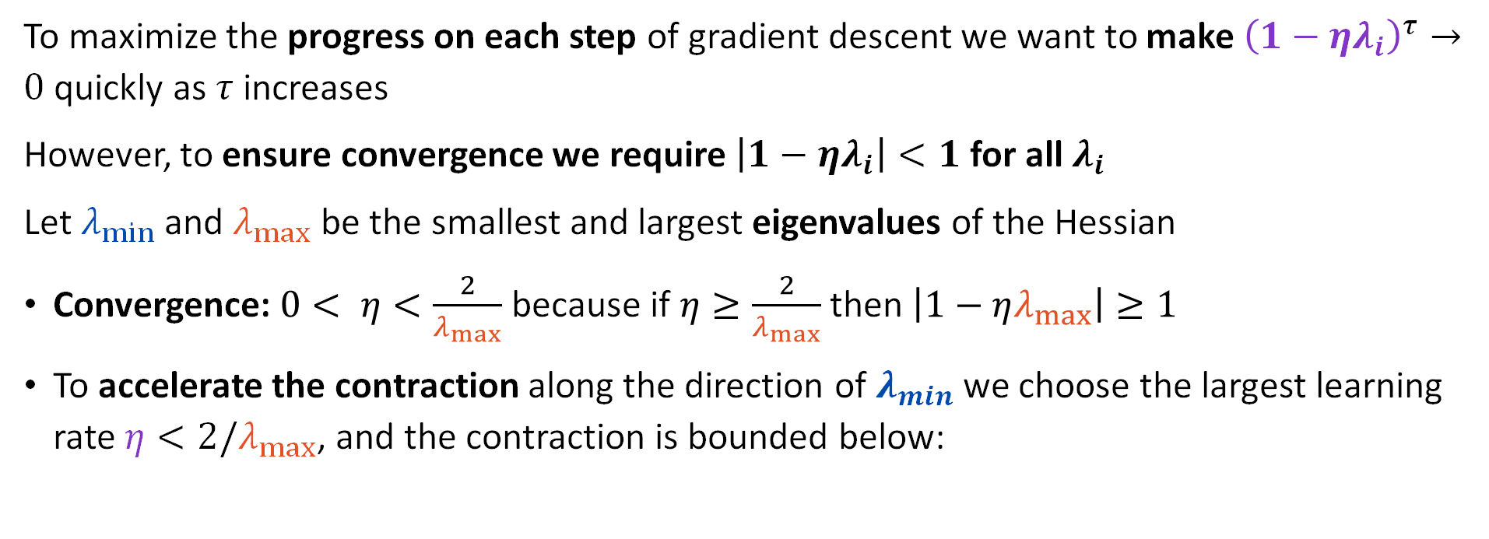
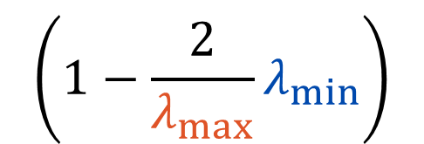
Learning Rate Impact on Convergence
To maximize the progress on each step of gradient descent we want to make ${\left(1−ηλ_{i}\right)}^{τ}→0$ quickly as $τ$ increases
However, to ensure convergence we require $\left|1−ηλ_{i}\right|<1$ for all $λ_{i}$
Let $λ_{min}$ and $λ_{max}$ be the smallest and largest eigenvalues of the Hessian
Convergence: $0< η<\frac{2}{λ_{max}}$ because if $η≥\frac{2}{λ_{max}}$ then $\left|1−ηλ_{max}\right|≥1$
To accelerate the contraction along the direction of $λ_{min}$ we choose the largest learning rate $η<2/λ_{max}$, and the contraction is bounded below:
$$\left(1−\frac{2}{λ_{max}}λ_{min⁡}\right)$$

Slide 17
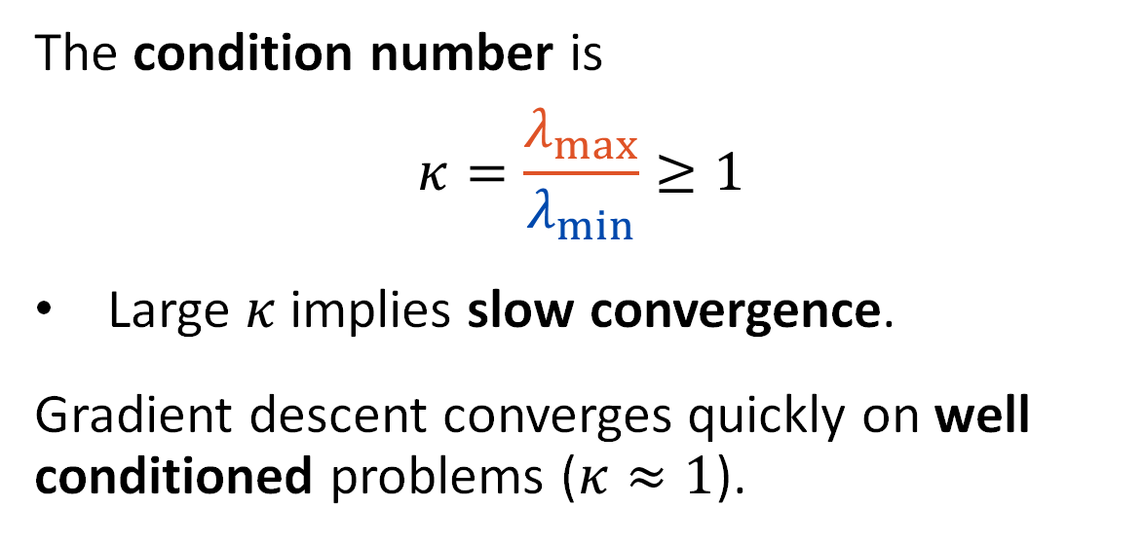
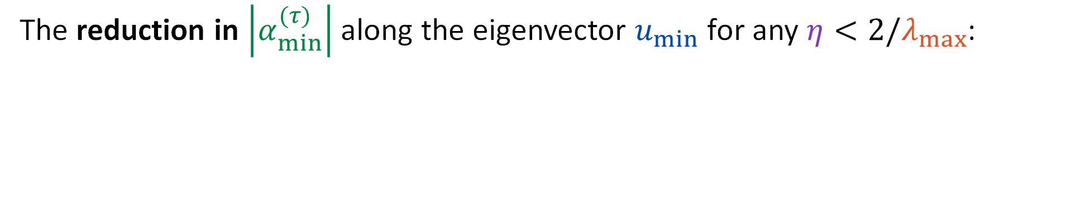



Condition Number and Loss Surface
The reduction in $\left|α_{min}^{(τ)}\right|$ along the eigenvector $u_{min}$ for any $η<2/λ_{max}$:
$$\left|α_{min}^{(τ)}\right|≥{\left(1−\frac{2λ_{min}}{λ_{max}}\right)}^{τ}\left|α_{min}^{(0)}\right|$$
Direction with Smallest Eigenvalue
The condition number is
$$κ=\frac{λ_{max}}{λ_{min}}≥1$$
Large $κ$ implies slow convergence.
Gradient descent converges quickly on well conditioned problems ($κ≈1$).
$$u_{min}$$
$$w^{∗}$$
$$u_{max}$$
Direction with Largest Eigenvalue

Slide 18

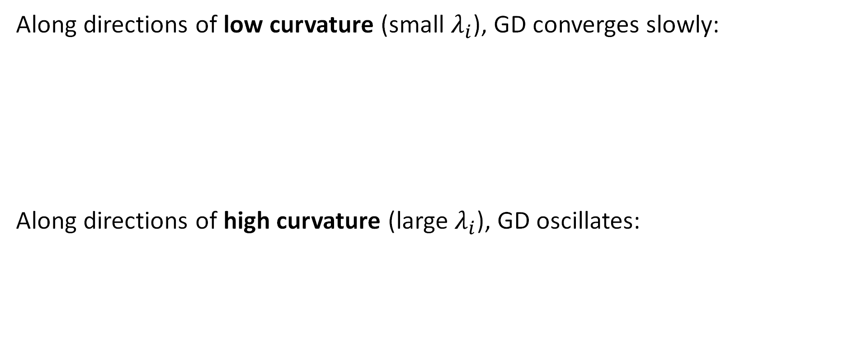


Issues with Gradient Descent (GD)
Along directions of low curvature (small $λ_{i}$), GD converges slowly:
Along directions of high curvature (large $λ_{i}$), GD oscillates:
Step size $η$ is
too small for this direction.
Step size $η$ is
close to $2/λ_{max}$.
No single $η$ is ideal for all directions.

Slide 19
Demo
Oscillating convergence

Slide 20


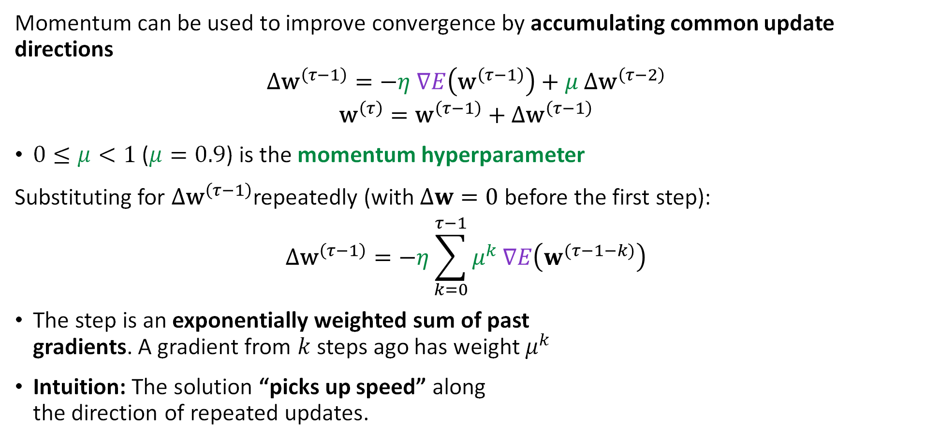








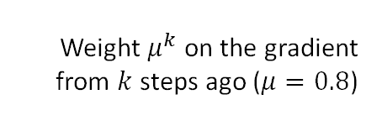
Momentum
Momentum can be used to improve convergence by accumulating common update directions
$$Δ{\text{w}}^{\left(τ−1\right)}=−η ∇E\left({\text{w}}^{\left(τ−1\right)}\right)+μ Δ{\text{w}}^{\left(τ−2\right)}$$
$${\text{w}}^{\left(τ\right)}={\text{w}}^{\left(τ−1\right)}+Δ{\text{w}}^{\left(τ−1\right)}$$
$0≤μ<1$ ($μ=0.9$) is the momentum hyperparameter
Substituting for $Δ{\text{w}}^{\left(τ−1\right)}$repeatedly (with $Δw=0$ before the first step):
$$Δ{\text{w}}^{\left(τ−1\right)}=−η\sum_{k=0}^{τ−1}{μ^{k} ∇E\left(w^{(τ−1−k)}\right)}$$
The step is an exponentially weighted sum of past
gradients. A gradient from $k$ steps ago has weight $μ^{k}$
Intuition: The solution “picks up speed” along
the direction of repeated updates.
Weight $μ^{k}$ on the gradient from $k$ steps ago ($μ=0.8$)
$$0$$
$$1$$
$$2$$
$$3$$
$$4$$
$$5$$
$$6$$
$$7$$
$$8$$
$k$ (steps into the past)

Slide 21
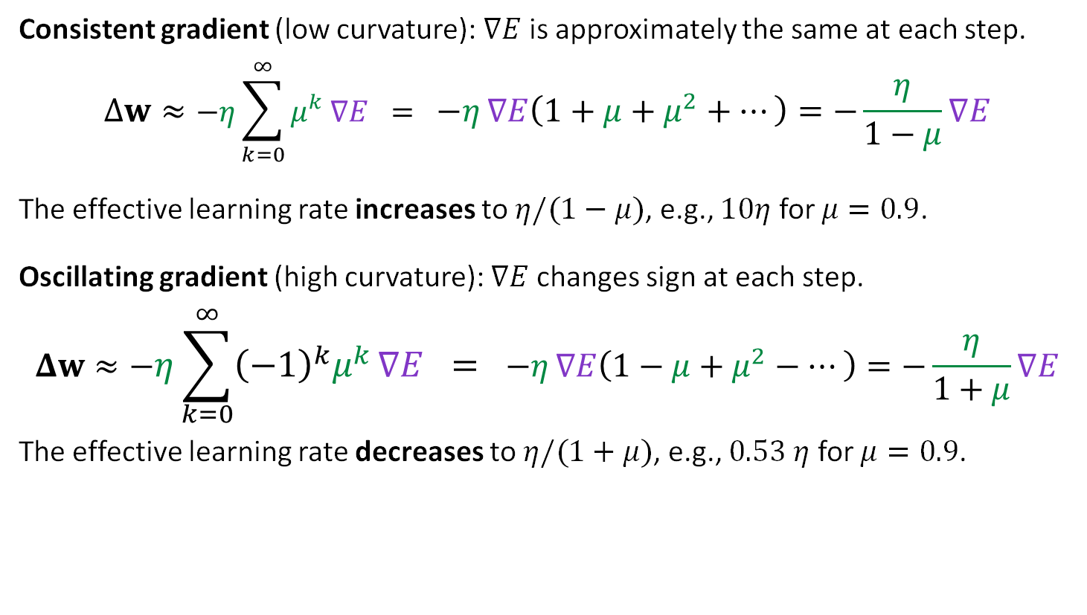

Consistent and Oscillating Gradients
Consistent gradient (low curvature): $∇E$ is approximately the same at each step.
$$Δw≈−η\sum_{k=0}^{∞}{μ^{k} ∇E} = −η ∇E\left(1+μ+μ^{2}+…\right)=−\frac{η}{1−μ}∇E$$
The effective learning rate increases to $η/(1−μ)$, e.g., $10η$ for $μ=0.9$.
Oscillating gradient (high curvature): $∇E$ changes sign at each step.
$$Δw≈−η\sum_{k=0}^{∞}{{\left(−1\right)}^{k}μ^{k} ∇E} = −η ∇E\left(1−μ+μ^{2}−…\right)=−\frac{η}{1+μ}∇E$$
The effective learning rate decreases to $η/(1+μ)$, e.g., $0.53 η$ for $μ=0.9$.
Sign of $∇E$ over the last 5 steps
agree: accumulate
alternate: cancel

Slide 22
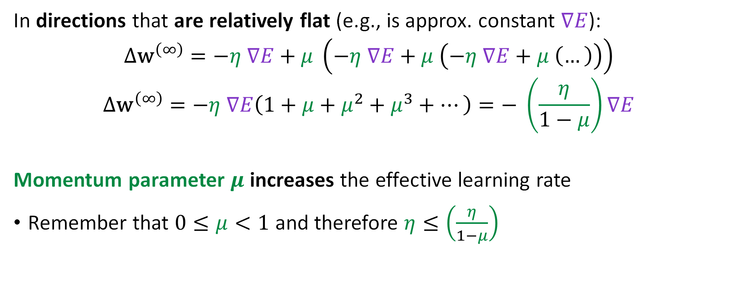
How Momentum Helps with Flat Dir.
In directions that are relatively flat (e.g., is approx. constant $∇E$):
$$Δ{\text{w}}^{\left(∞\right)}=−η ∇E+μ \left(−η ∇E+μ \left(−η ∇E+μ \left(…\right)\right)\right)$$
$$Δ{\text{w}}^{\left(∞\right)}=−η ∇E\left(1+μ+μ^{2}+μ^{3}+…\right)=− \left(\frac{η}{1−μ}\right)∇E$$
Momentum parameter $μ$ increases the effective learning rate
Remember that $0≤μ<1$ and therefore $η≤\left(\frac{η}{1−μ}\right)$
Geometric Series

Slide 23
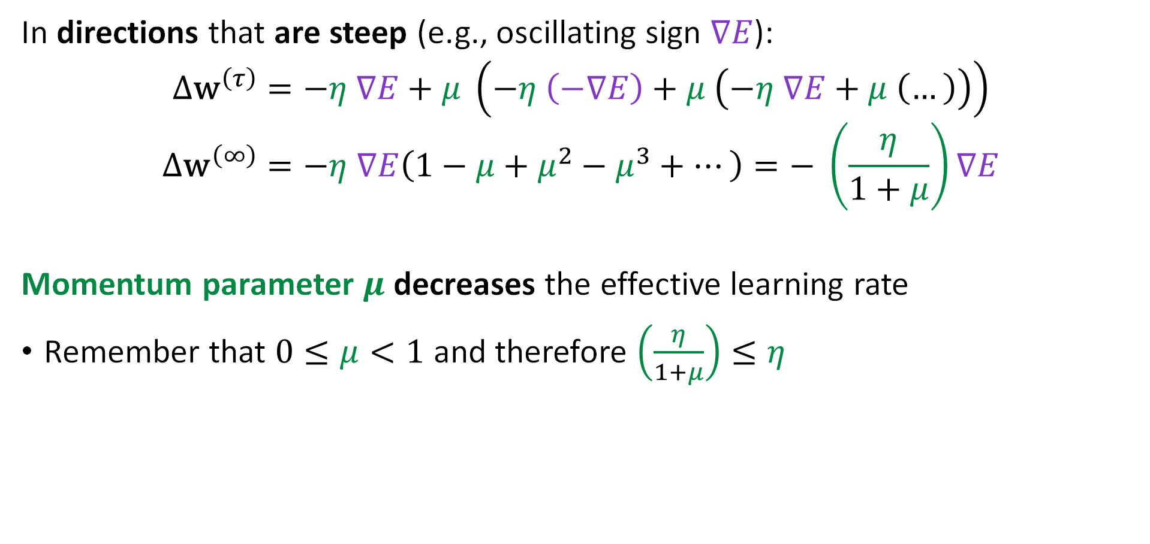
How Momentum Helps with Oscillations
In directions that are steep (e.g., oscillating sign $∇E$):
$$Δ{\text{w}}^{\left(τ\right)}=−η ∇E+μ \left(−η \left(−∇E\right)+μ \left(−η ∇E+μ \left(…\right)\right)\right)$$
$$Δ{\text{w}}^{\left(∞\right)}=−η ∇E\left(1−μ+μ^{2}−μ^{3}+…\right)=− \left(\frac{η}{1+μ}\right)∇E$$
Momentum parameter $μ$ decreases the effective learning rate
Remember that $0≤μ<1$ and therefore $\left(\frac{η}{1+μ}\right)≤η$
Alternating Geometric Series

Slide 24
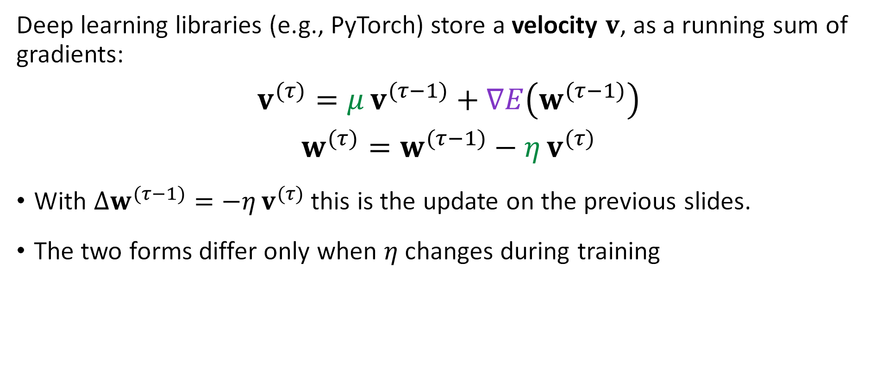
Momentum in Code
Deep learning libraries (e.g., PyTorch) store a velocity $v$, as a running sum of gradients:
$$v^{(τ)}=μ v^{(τ−1)}+∇E\left(w^{(τ−1)}\right)$$
$$w^{(τ)}=w^{(τ−1)}−η v^{(τ)}$$
With $Δw^{(τ−1)}=−η v^{(τ)}$ this is the update on the previous slides.
The two forms differ only when $η$ changes during training

Slide 25
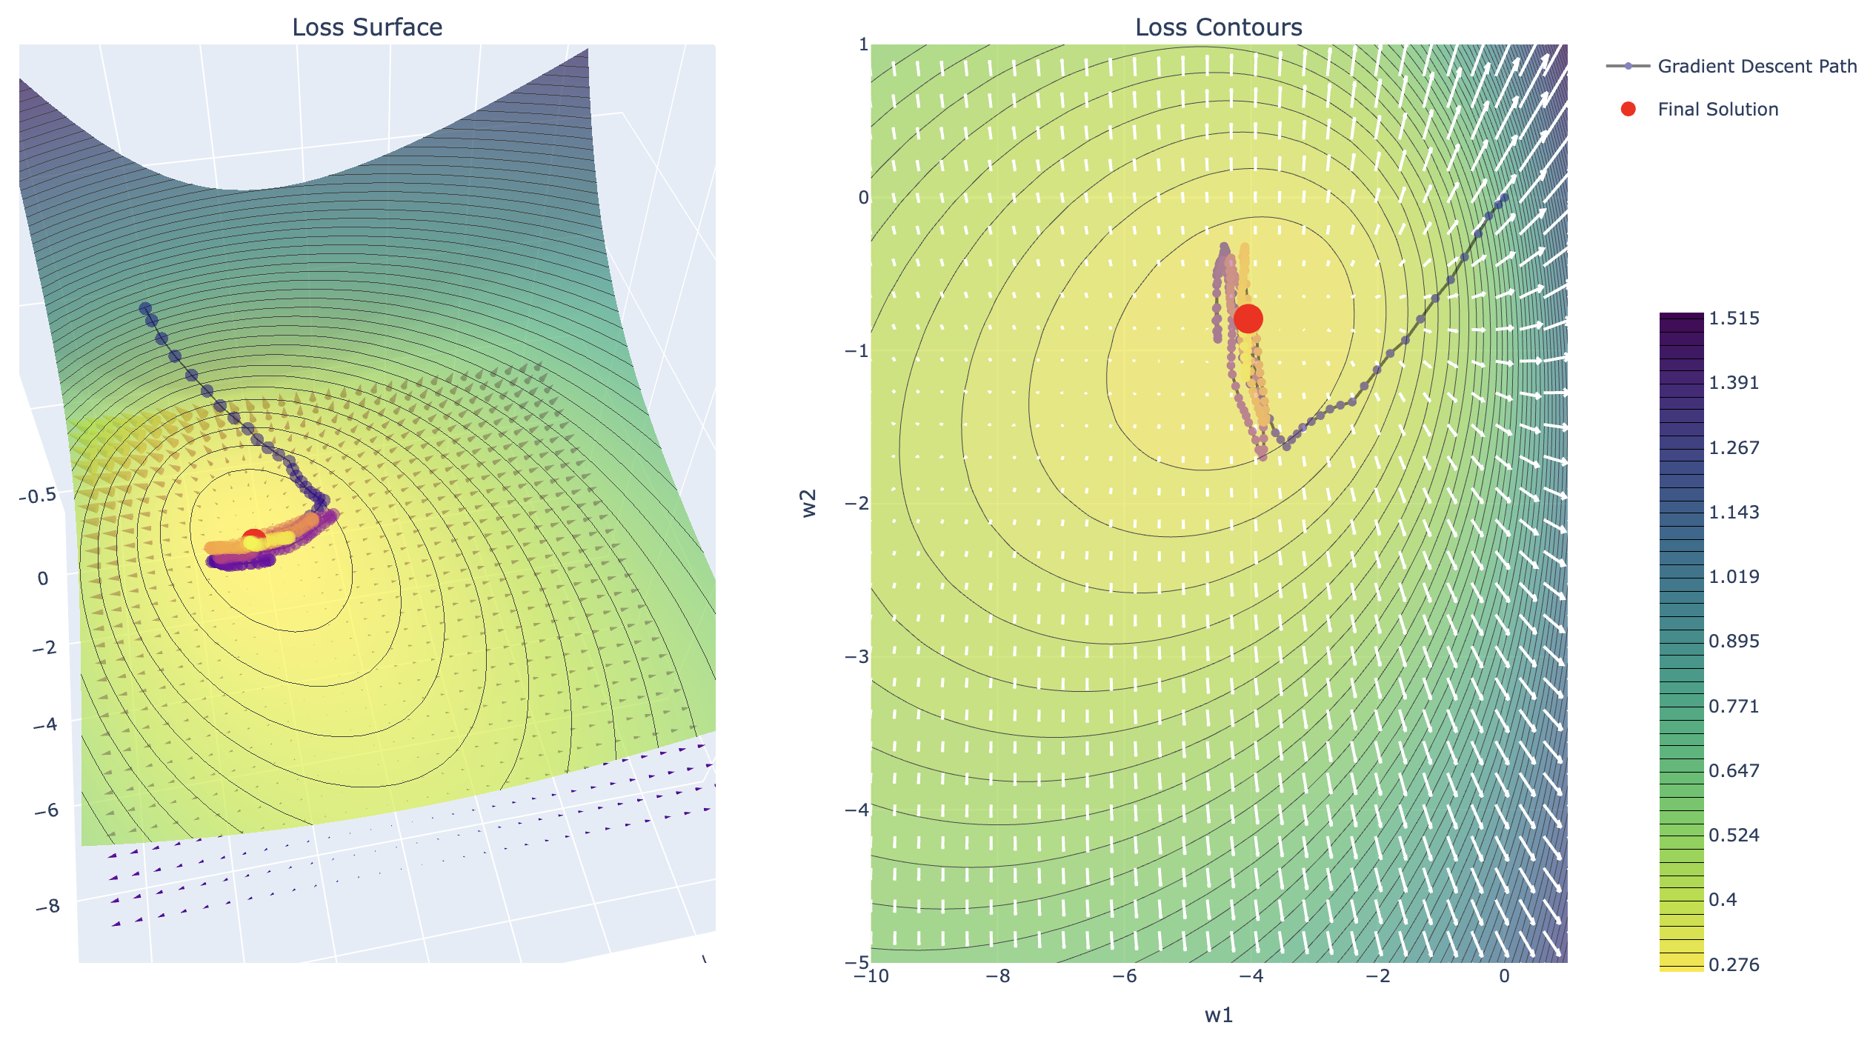
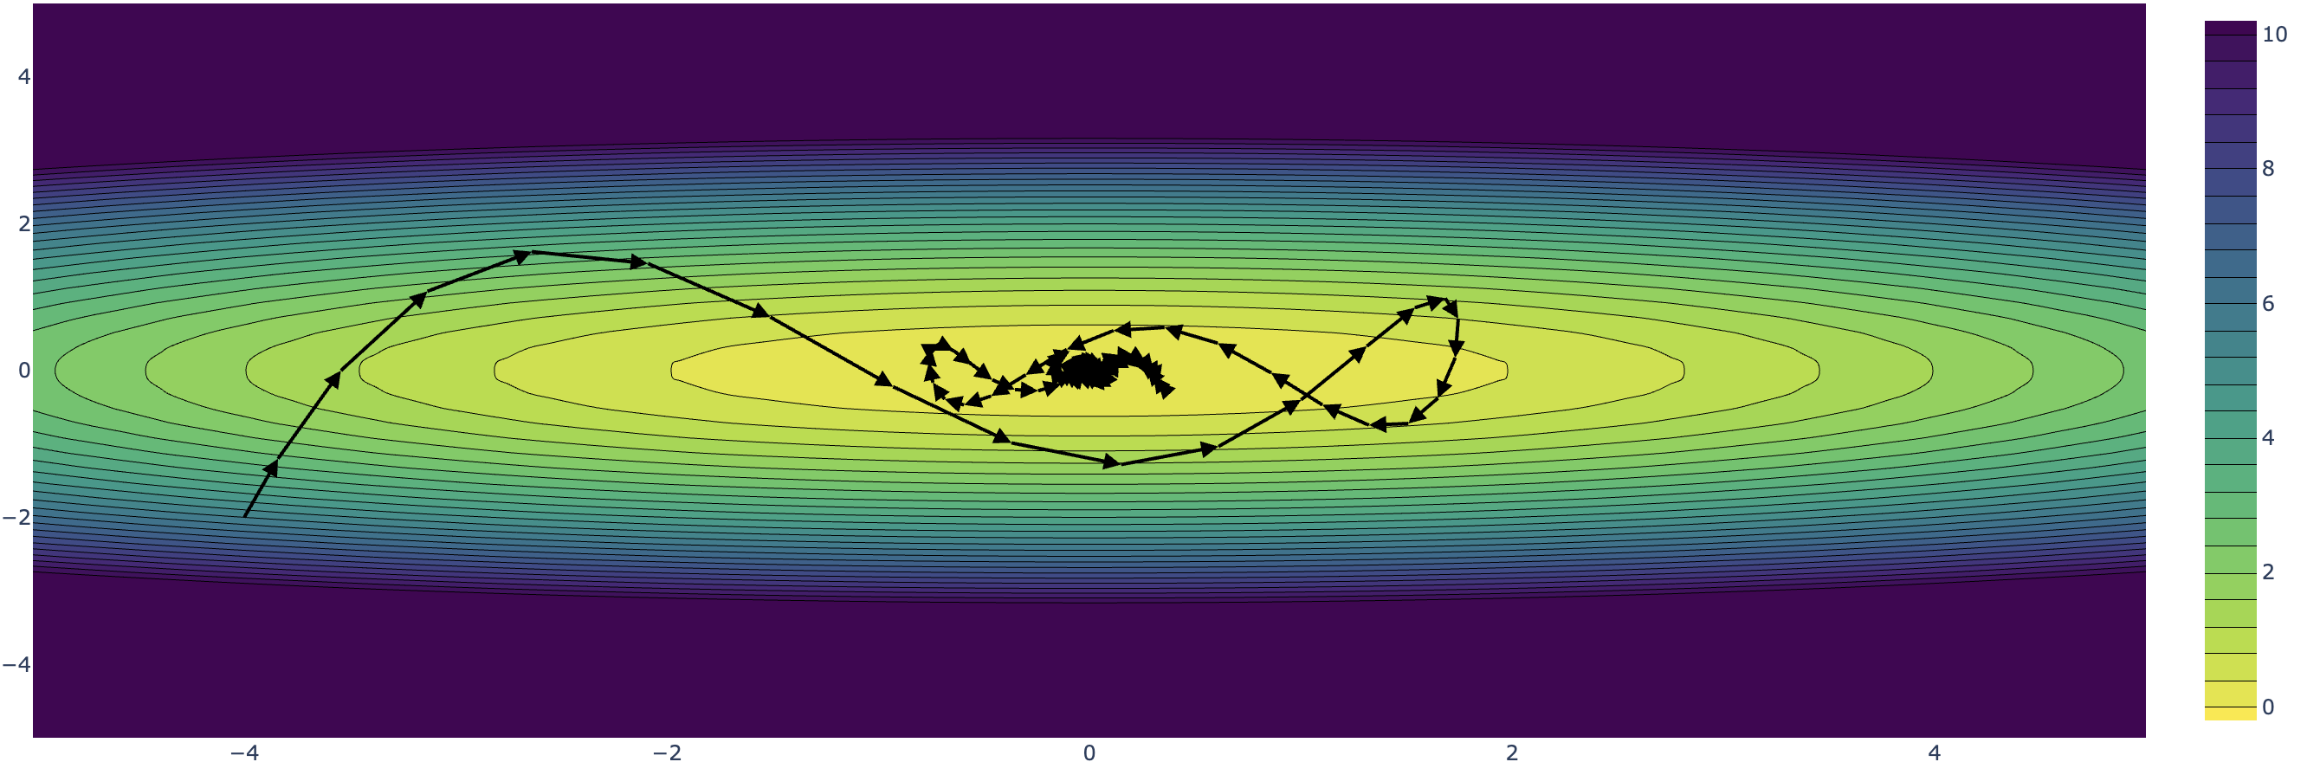
Demo
Momentum

Slide 26
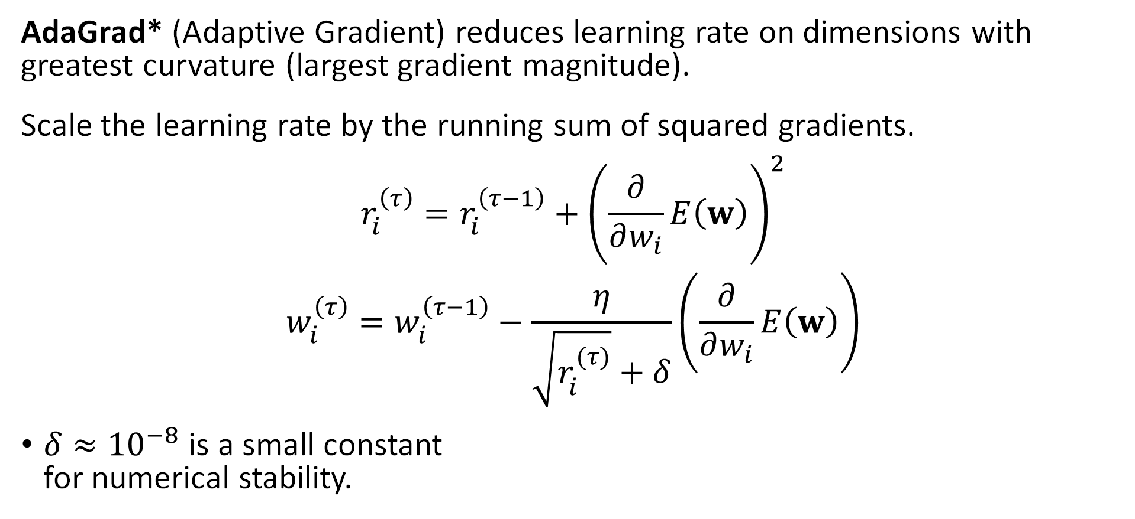
Adaptive Learning Rates – AdaGrad
AdaGrad* (Adaptive Gradient) reduces learning rate on dimensions with greatest curvature (largest gradient magnitude).
Scale the learning rate by the running sum of squared gradients.
$$r_{i}^{\left(τ\right)}=r_{i}^{\left(τ−1\right)}+{\left(\frac{∂}{∂w_{i}}E\left(w\right)\right)}^{2}$$
$$w_{i}^{\left(τ\right)}=w_{i}^{\left(τ−1\right)}−\frac{η}{\sqrt{r_{i}^{(τ)}}+δ}\left(\frac{∂}{∂w_{i}}E\left(w\right)\right)$$
$δ≈{10}^{−8}$ is a small constant
for numerical stability.
Tracking Magnitude
(terms squared)
Issue:
Large initial gradients result in overly small learning rates near convergence.
Scaled Learning Rate
*Developed at UC Berkeley

Slide 27
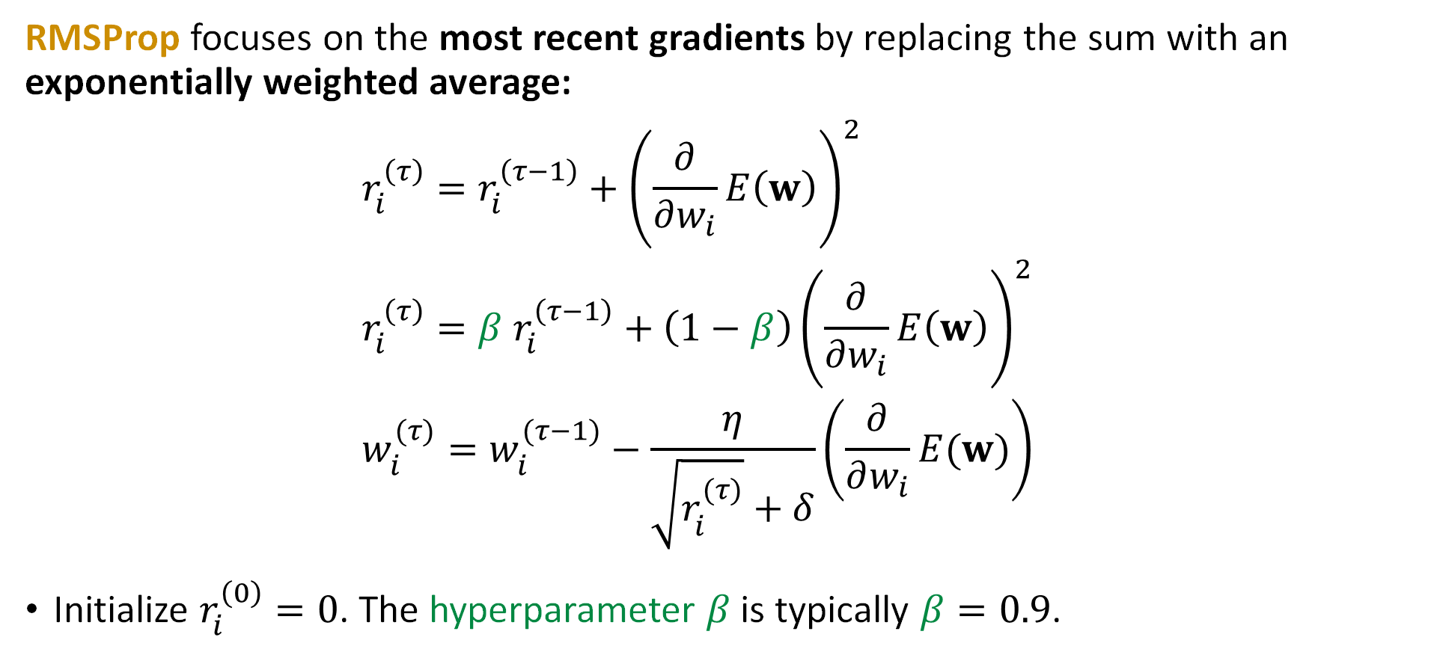
Adaptive Learning Rates – RMSProp
RMSProp focuses on the most recent gradients by replacing the sum with an exponentially weighted average:
$$r_{i}^{\left(τ\right)}=r_{i}^{\left(τ−1\right)}+{\left(\frac{∂}{∂w_{i}}E\left(w\right)\right)}^{2}$$
$$r_{i}^{\left(τ\right)}=β r_{i}^{\left(τ−1\right)}+\left(1−β\right){\left(\frac{∂}{∂w_{i}}E\left(w\right)\right)}^{2}$$
$$w_{i}^{(τ)}=w_{i}^{(τ−1)}−\frac{η}{\sqrt{r_{i}^{(τ)}}+δ}\left(\frac{∂}{∂w_{i}}E(w)\right)$$
Initialize $r_{i}^{\left(0\right)}=0$. The hyperparameter $β$ is typically $β=0.9$.
AdaGrad
RMSProp

Slide 28
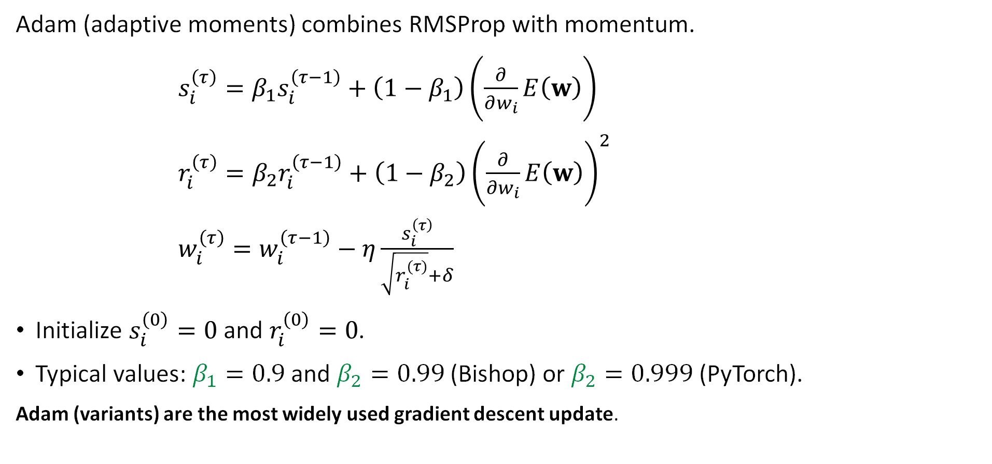
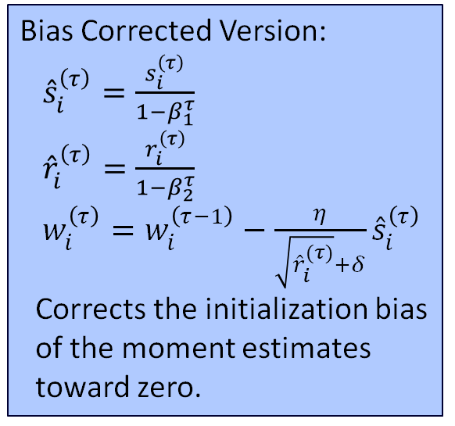
Adam = RMSProp + Momentum
Adam (adaptive moments) combines RMSProp with momentum.
$s_{i}^{\left(τ\right)}=β_{1}s_{i}^{\left(τ−1\right)}+\left(1−β_{1}\right)\left(\frac{∂}{∂w_{i}}E\left(w\right)\right)$
$r_{i}^{\left(τ\right)}=β_{2}r_{i}^{\left(τ−1\right)}+\left(1−β_{2}\right){\left(\frac{∂}{∂w_{i}}E\left(w\right)\right)}^{2}$
$w_{i}^{\left(τ\right)}=w_{i}^{\left(τ−1\right)}−η\frac{s_{i}^{\left(τ\right)}}{\sqrt{r_{i}^{(τ)}}+δ}$
Initialize $s_{i}^{\left(0\right)}=0$ and $r_{i}^{\left(0\right)}=0$.
Typical values: $β_{1}=0.9$ and $β_{2}=0.99$ (Bishop) or $β_{2}=0.999$ (PyTorch).
Adam (variants) are the most widely used gradient descent update.
Momentum
Bias Corrected Version:
${\hat{s}}_{i}^{\left(τ\right)}=\frac{s_{i}^{\left(τ\right)}}{1−β_{1}^{τ}}$
${\hat{r}}_{i}^{\left(τ\right)}=\frac{r_{i}^{\left(τ\right)}}{1−β_{2}^{τ}}$
$w_{i}^{\left(τ\right)}=w_{i}^{\left(τ−1\right)}−\frac{η}{\sqrt{{\hat{r}}_{i}^{(τ)}}+δ}{\hat{s}}_{i}^{\left(τ\right)}$
Corrects the initialization bias of the moment estimates toward zero.
RMSProp
Gradient
Update

Slide 29
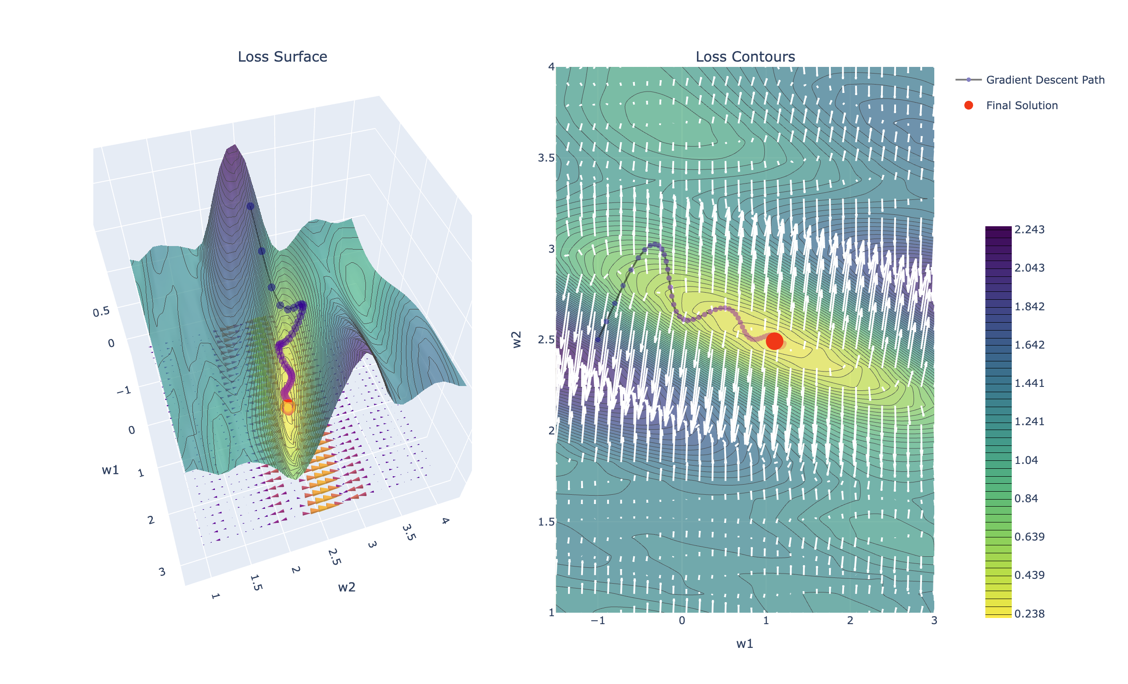
Demo
Adam

Slide 30
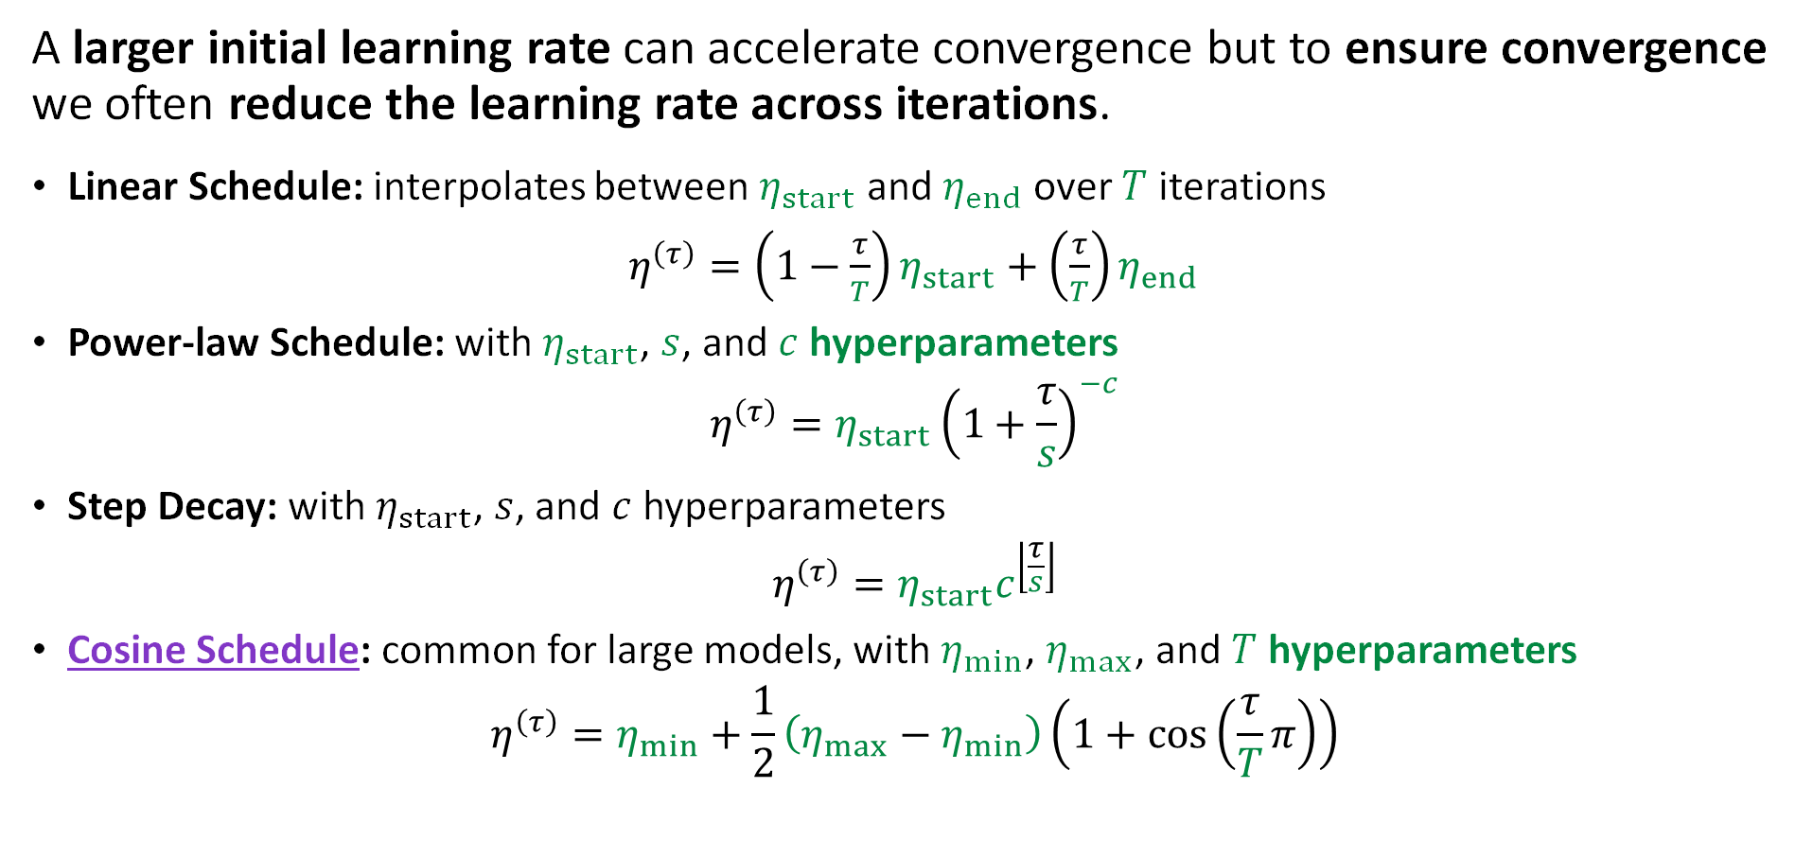
Learning Rate Schedules
A larger initial learning rate can accelerate convergence but to ensure convergence we often reduce the learning rate across iterations.
Linear Schedule: interpolates between $η_{start}$ and $η_{end}$ over $T$ iterations
$η^{\left(τ\right)}=\left(1−\frac{τ}{T}\right)η_{start}+\left(\frac{τ}{T}\right)η_{end}$
Power-law Schedule: with $η_{start}$, $s$, and $c$ hyperparameters
$$η^{\left(τ\right)}=η_{start}{\left(1+\frac{τ}{s}\right)}^{−c}$$
Step Decay: with $η_{start}$, $s$, and $c$ hyperparameters
$$η^{\left(τ\right)}=η_{start}c^{\left\lfloor \frac{τ}{s}\right\rfloor }$$
Cosine Schedule: common for large models, with $η_{min}$, $η_{max}$, and $T$ hyperparameters
$$η^{\left(τ\right)}=η_{min}+\frac{1}{2}\left(η_{max}−η_{min}\right)\left(1+\cos\left(\frac{τ}{T}π\right)\right)$$

Slide 31
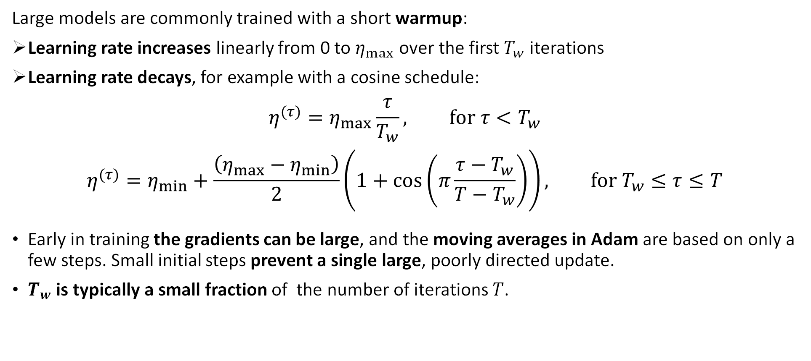
Learning Rate Warmup
Large models are commonly trained with a short warmup:
Learning rate increases linearly from 0 to $η_{max}$ over the first $T_{w}$ iterations
Learning rate decays, for example with a cosine schedule:
$$η^{(τ)}=η_{max}\frac{τ}{T_{w}}, for τ<T_{w}$$
$$η^{(τ)}=η_{min}+\frac{\left(η_{max}−η_{min}\right)}{2}\left(1+cos\left(π\frac{τ−T_{w}}{T−T_{w}}\right)\right), for T_{w}≤τ≤T$$
Early in training the gradients can be large, and the moving averages in Adam are based on only a few steps. Small initial steps prevent a single large, poorly directed update.
$T_{w}$ is typically a small fraction of the number of iterations $T$.

Slide 32
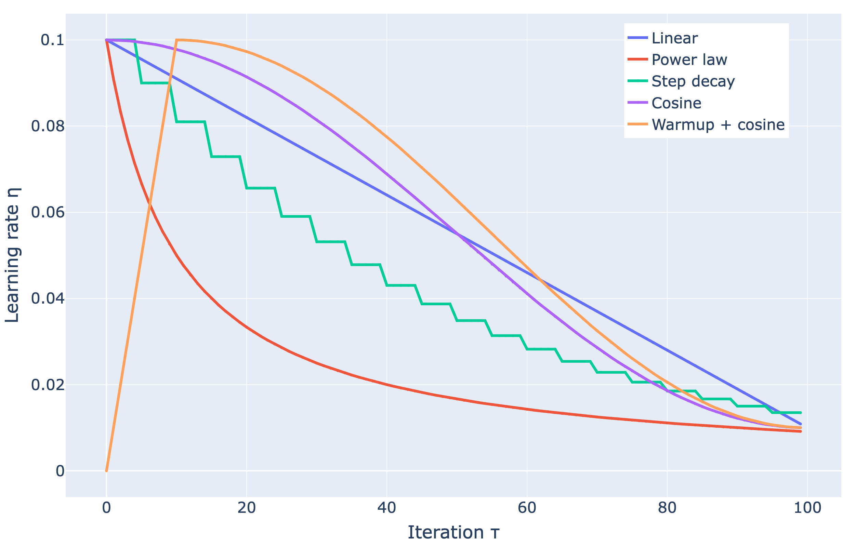
Demo
Learning Rate Schedules

Slide 33
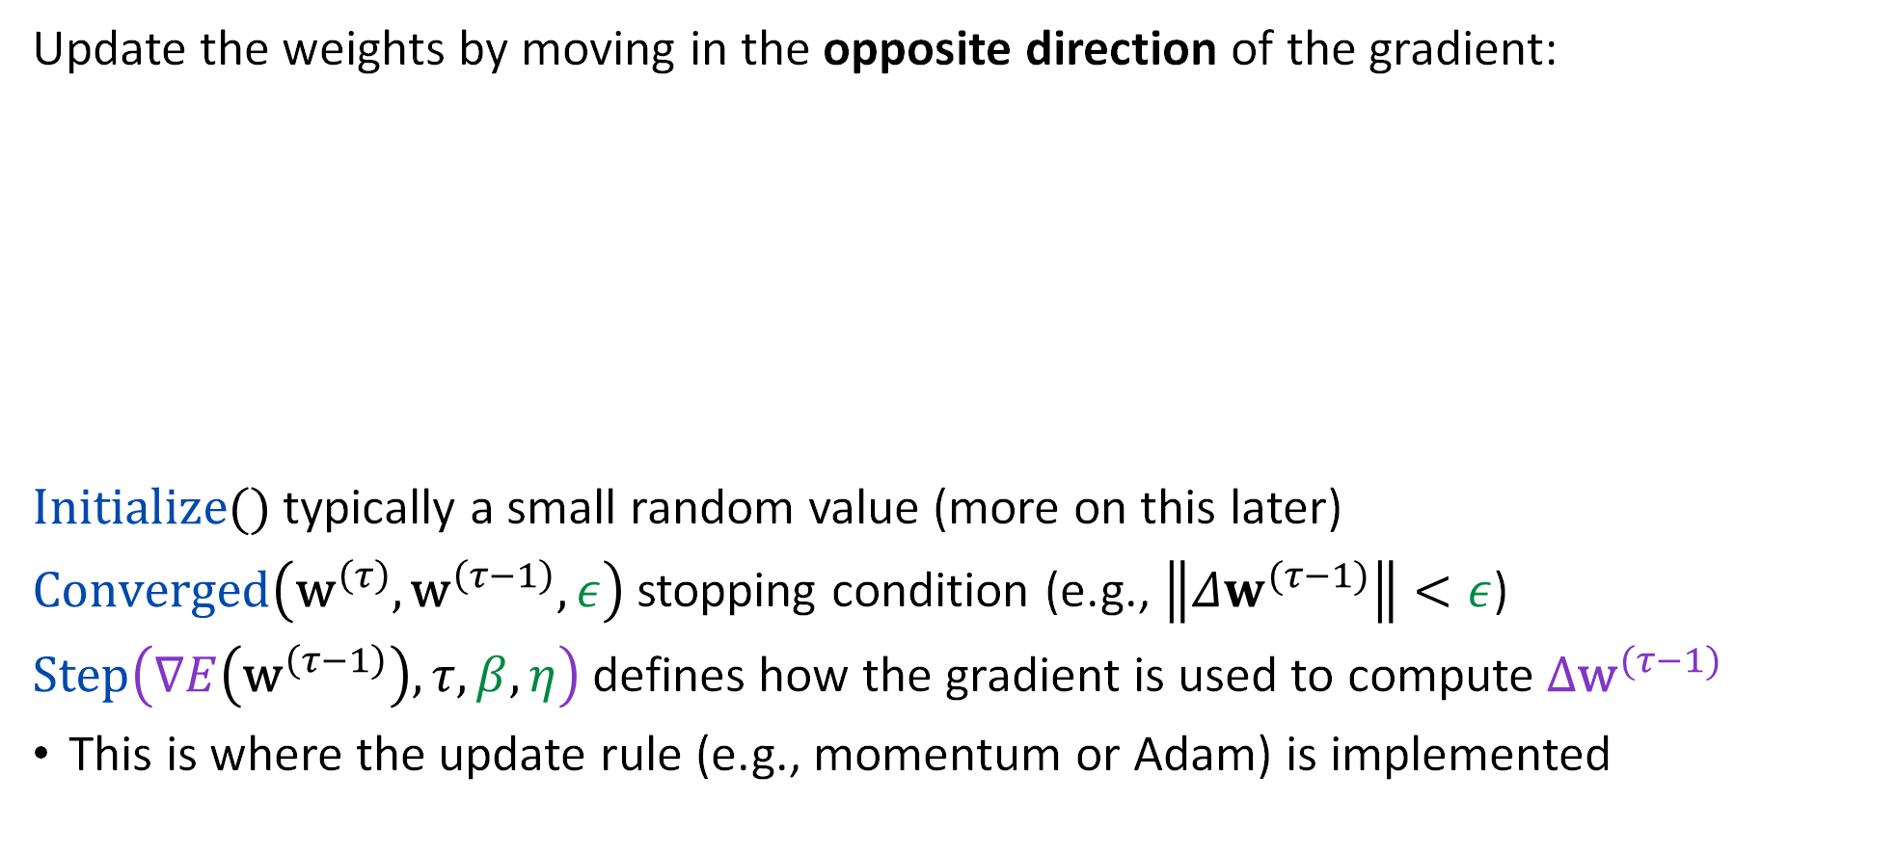
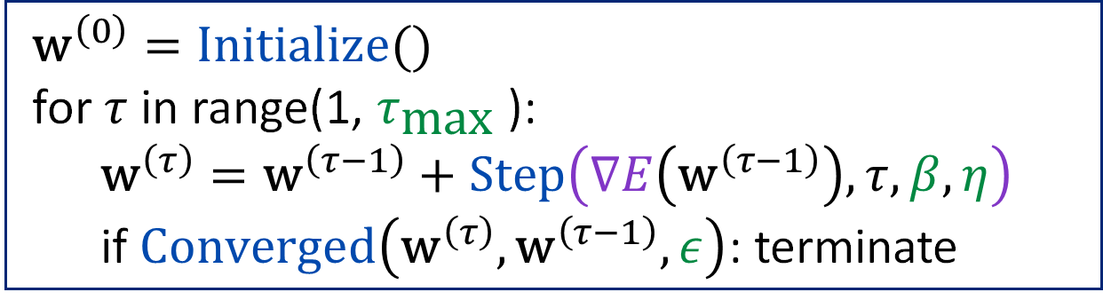
Recap: Batch Gradient Descent
Update the weights by moving in the opposite direction of the gradient:
$Initialize()$ typically a small random value (more on this later)
$Converged\left({\text{w}}^{\left(τ\right)},{\text{w}}^{\left(τ−1\right)},ε\right)$ stopping condition (e.g., $\left\|Δw^{(τ−1)}\right\|<ε$)
$Step\left(∇E\left({\text{w}}^{\left(τ−1\right)}\right),τ, β,η\right)$ defines how the gradient is used to compute${Δ\text{w}}^{(τ−1)}$
This is where the update rule (e.g., momentum or Adam) is implemented
$${\text{w}}^{\left(0\right)}=Initialize()$$
for $τ$ in range(1, $τ_{\text{max}}$):
$${\text{w}}^{\left(τ\right)}={\text{w}}^{\left(τ−1\right)}+Step\left(∇E\left({\text{w}}^{\left(τ−1\right)}\right),τ, β,η\right)$$
if $Converged\left({\text{w}}^{\left(τ\right)},{\text{w}}^{\left(τ−1\right)}, ε\right)$: terminate

Slide 34
Stochastic Gradient Descent
Approximating Gradient Descent

Slide 35
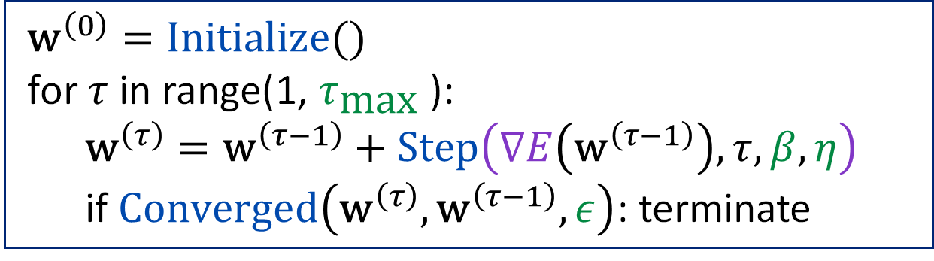
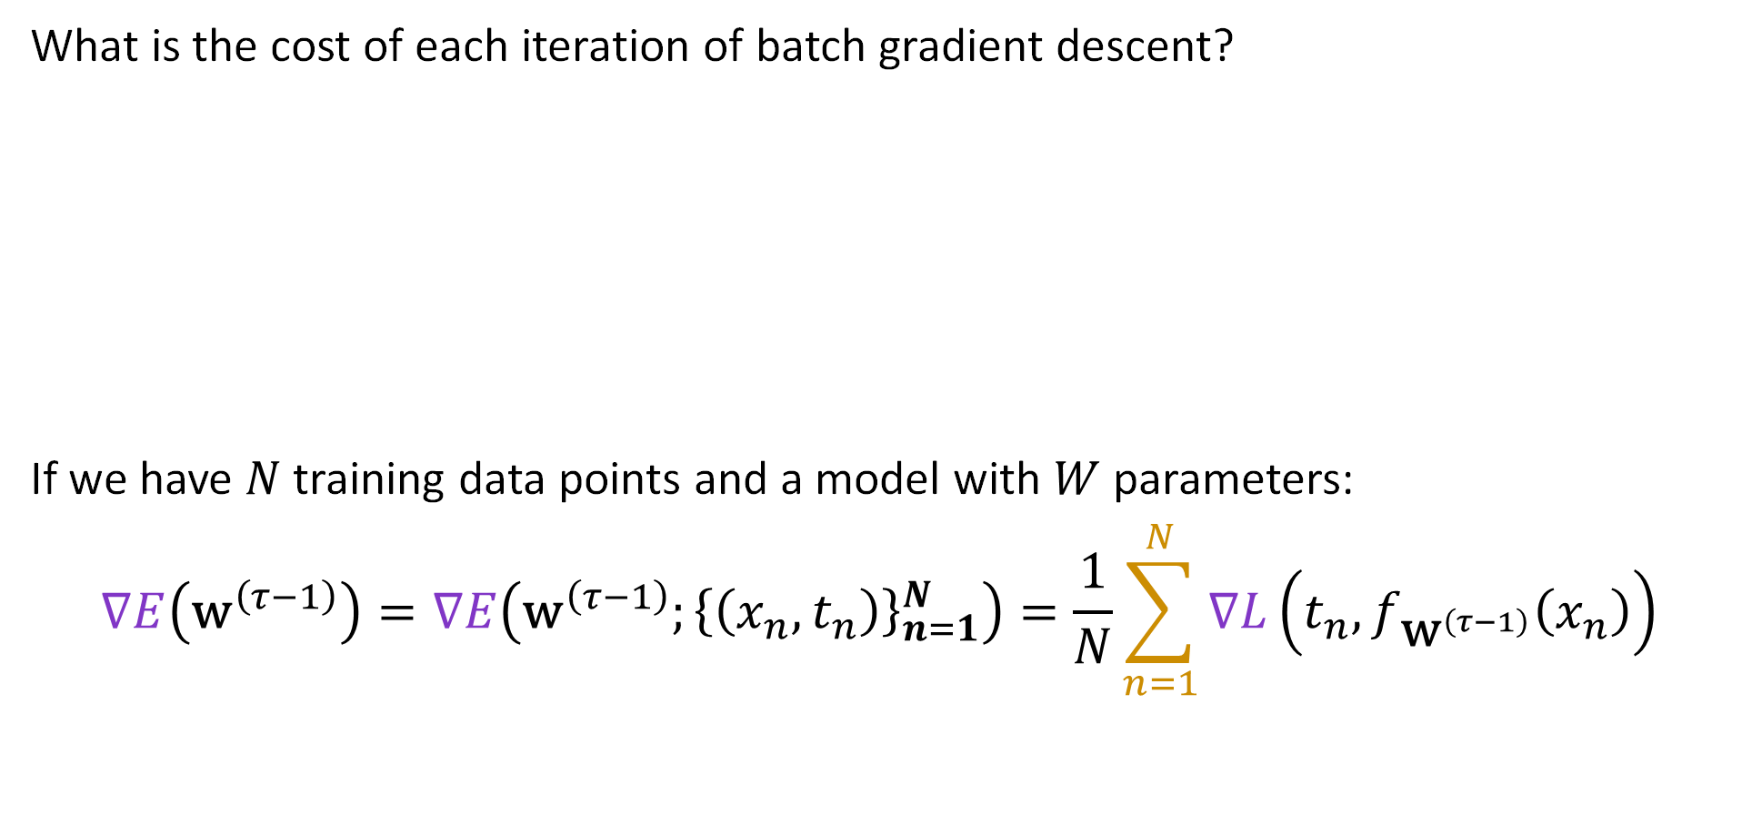
The Cost of Batch Gradient Descent
What is the cost of each iteration of batch gradient descent?
If we have $N$ training data points and a model with $W$ parameters:
$$∇E\left({\text{w}}^{\left(τ−1\right)}\right)=∇E\left({\text{w}}^{\left(τ−1\right)};{\left\{\left(x_{n},t_{n}\right)\right\}}_{n=1}^{N}\right)=\frac{1}{N}\sum_{n=1}^{N}{∇L\left(t_{n}, f_{{\text{w}}^{\left(τ−1\right)}}\left(x_{n}\right)\right)}$$
$${\text{w}}^{\left(0\right)}=Initialize()$$
for $τ$ in range(1, $τ_{\text{max}}$):
$${\text{w}}^{\left(τ\right)}={\text{w}}^{\left(τ−1\right)}+Step\left(∇E\left({\text{w}}^{\left(τ−1\right)}\right),τ, β,η\right)$$
if $Converged\left({\text{w}}^{\left(τ\right)},{\text{w}}^{\left(τ−1\right)}, ε\right)$: terminate

Slide 36
Do not edit
How to change the design
What is the cost for a single gradient update assuming N data points in W dimensions and the basic gradient update equation.
The Slido app must be installed on every computer you’re presenting from

Slide 37

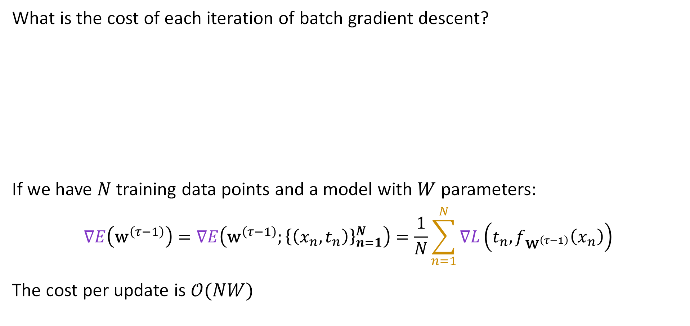

The Cost of Batch Gradient Descent
What is the cost of each iteration of batch gradient descent?
If we have $N$ training data points and a model with $W$ parameters:
$$∇E\left({\text{w}}^{\left(τ−1\right)}\right)=∇E\left({\text{w}}^{\left(τ−1\right)};{\left\{\left(x_{n},t_{n}\right)\right\}}_{n=1}^{N}\right)=\frac{1}{N}\sum_{n=1}^{N}{∇L\left(t_{n}, f_{{\text{w}}^{\left(τ−1\right)}}\left(x_{n}\right)\right)}$$
The cost per update is $𝒪(NW)$
$${\text{w}}^{\left(0\right)}=Initialize()$$
for $τ$ in range(1, $τ_{\text{max}}$):
$${\text{w}}^{\left(τ\right)}={\text{w}}^{\left(τ−1\right)}+Step\left(∇E\left({\text{w}}^{\left(τ−1\right)}\right),τ, β,η\right)$$
if $Converged\left({\text{w}}^{\left(τ\right)},{\text{w}}^{\left(τ−1\right)}, ε\right)$: terminate
$$𝒪(N)$$
$$𝒪(W)$$

Slide 38
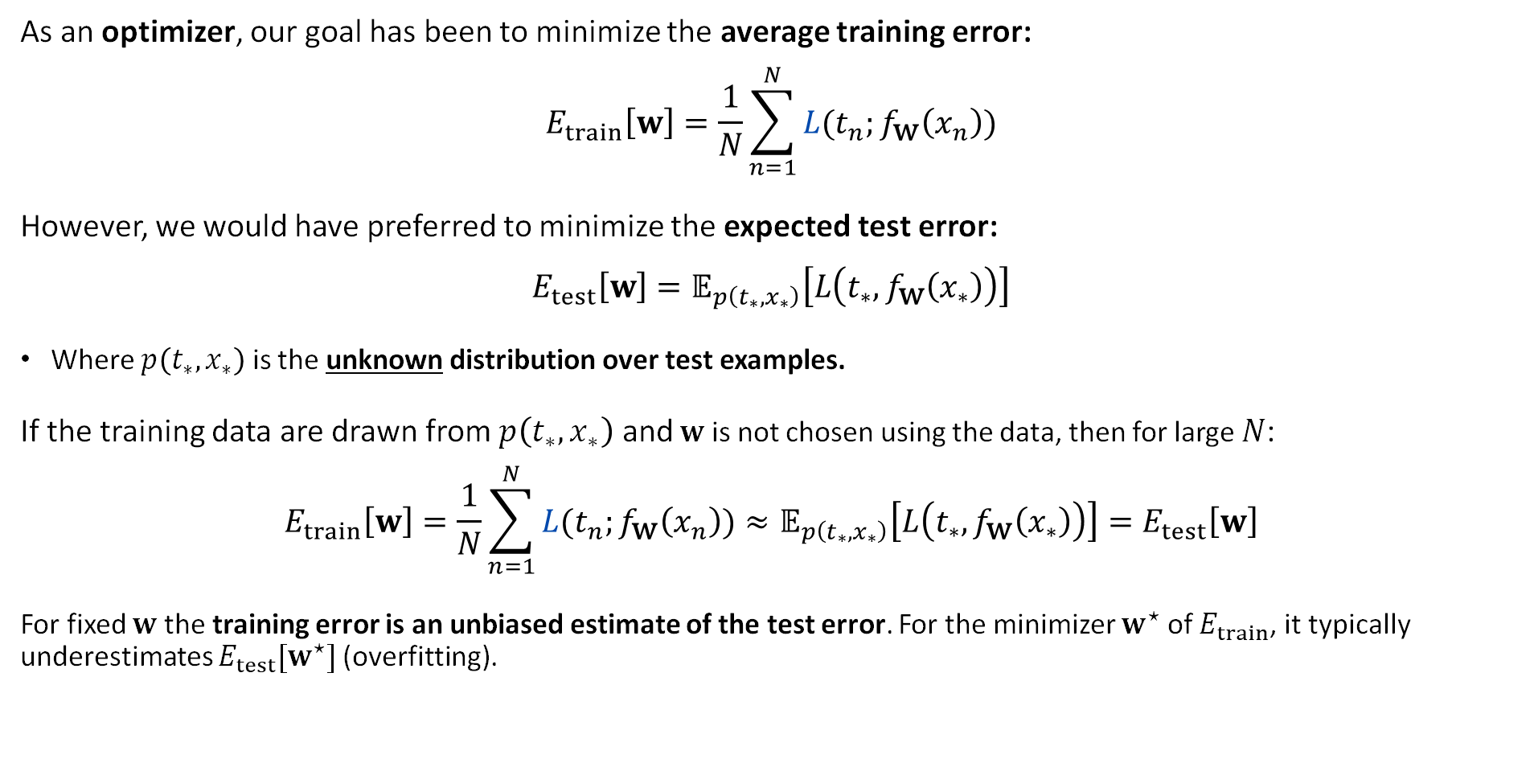
The Training Error Estimates the Test Error
As an optimizer, our goal has been to minimize the average training error:
$$E_{train}\left[w\right]=\frac{1}{N}\sum_{n=1}^{N}{L(t_{n};f_{\text{w}}\left(x_{n}\right))}$$
However, we would have preferred to minimize the expected test error:
$$E_{test}\left[w\right]=𝔼_{p\left({t_{∗},x}_{∗}\right)}\left[L\left(t_{∗},f_{\text{w}}\left(x_{∗}\right)\right)\right]$$
Where $p\left({t_{∗},x}_{∗}\right)$ is the unknown distribution over test examples.
If the training data are drawn from $p\left({t_{∗},x}_{∗}\right)$ and $w$ is not chosen using the data, then for large $N$:
$$E_{train}\left[w\right]=\frac{1}{N}\sum_{n=1}^{N}{L(t_{n};f_{\text{w}}\left(x_{n}\right))}≈𝔼_{p\left({t_{∗},x}_{∗}\right)}\left[L\left(t_{∗},f_{\text{w}}\left(x_{∗}\right)\right)\right]=E_{test}\left[w\right]$$
For fixed $w$ the training error is an unbiased estimate of the test error. For the minimizer $w^{⋆}$ of $E_{train}$, it typically underestimates $E_{test}[w^{⋆}]$ (overfitting).

Slide 39
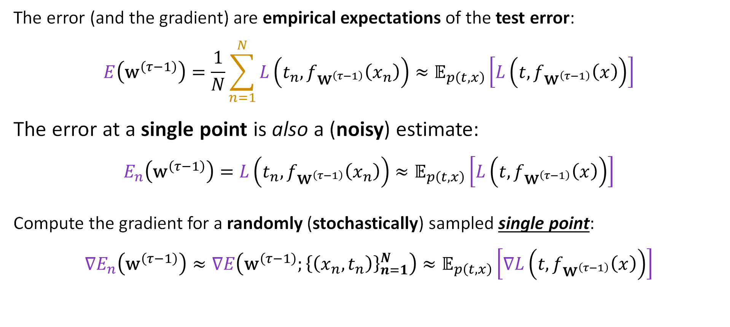

Approximating the Gradient
The error (and the gradient) are empirical expectations of the test error:
$$E\left({\text{w}}^{\left(τ−1\right)}\right)=\frac{1}{N}\sum_{n=1}^{N}{L\left(t_{n}, f_{{\text{w}}^{\left(τ−1\right)}}\left(x_{n}\right)\right)}≈𝔼_{p\left(t,x\right)}\left[L\left(t, f_{{\text{w}}^{\left(τ−1\right)}}\left(x\right)\right)\right]$$
The error at a single point is also a (noisy) estimate:
$$E_{n}\left({\text{w}}^{\left(τ−1\right)}\right)=L\left(t_{n}, f_{{\text{w}}^{\left(τ−1\right)}}\left(x_{n}\right)\right)≈𝔼_{p\left(t,x\right)}\left[L\left(t, f_{{\text{w}}^{\left(τ−1\right)}}\left(x\right)\right)\right]$$
Compute the gradient for a randomly (stochastically) sampled single point:
$$∇E_{n}\left({\text{w}}^{\left(τ−1\right)}\right)≈∇E\left({\text{w}}^{\left(τ−1\right)};{\left\{\left(x_{n},t_{n}\right)\right\}}_{n=1}^{N}\right)≈𝔼_{p\left(t,x\right)}\left[∇L\left(t, f_{{\text{w}}^{\left(τ−1\right)}}\left(x\right)\right)\right]$$
Cheap approx.
Best estimate (but expensive)
Ideal but don’t know $p\left(t,x\right)$

Slide 40
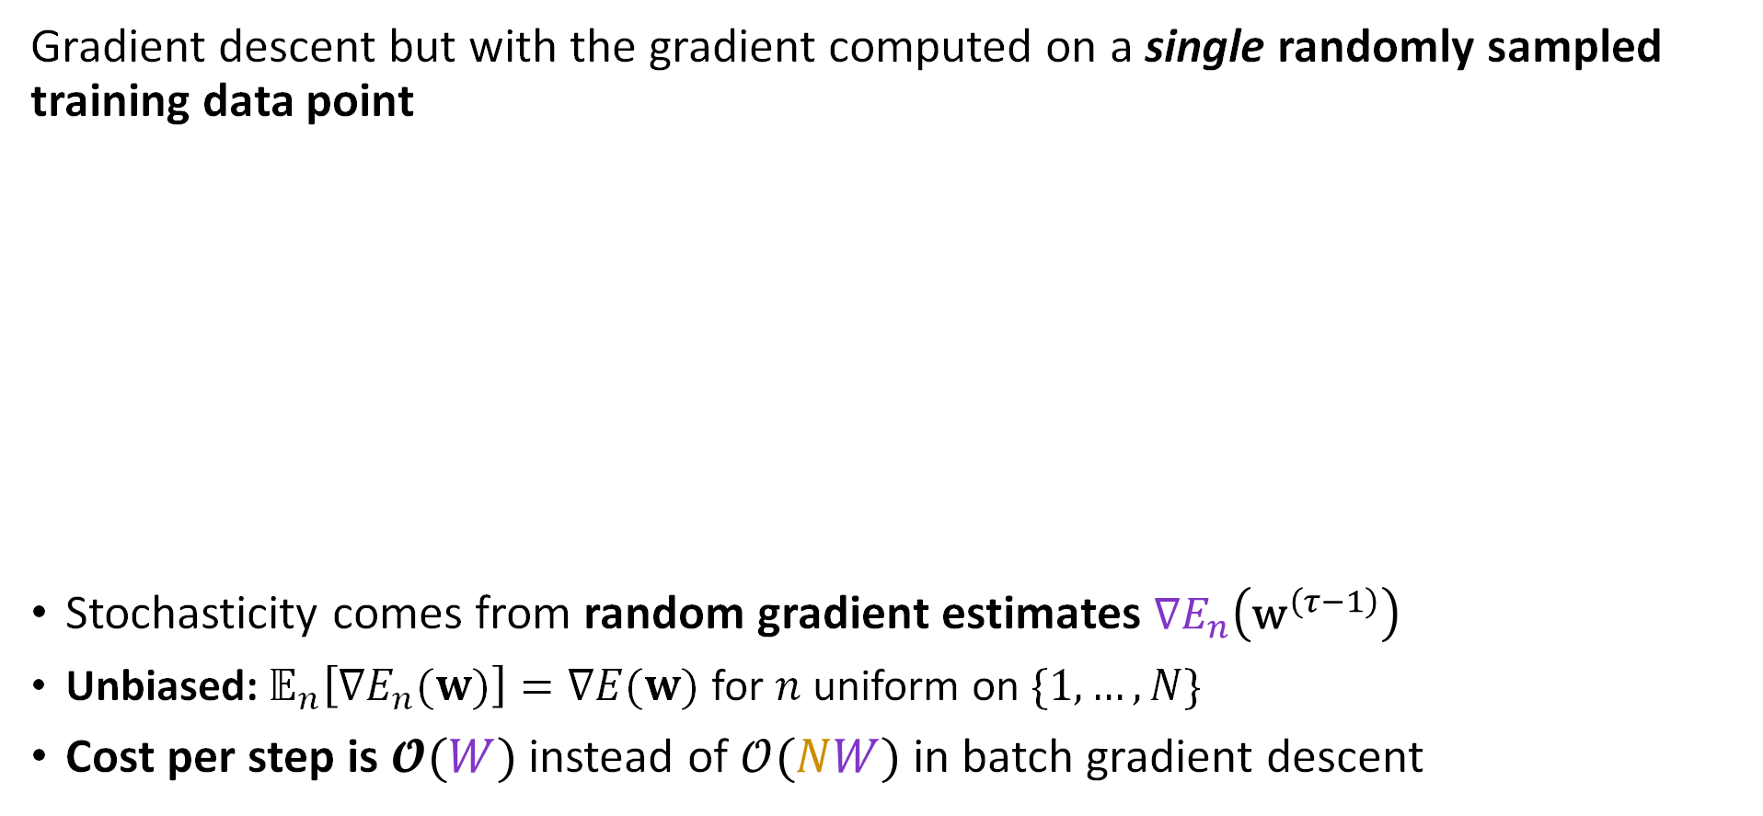

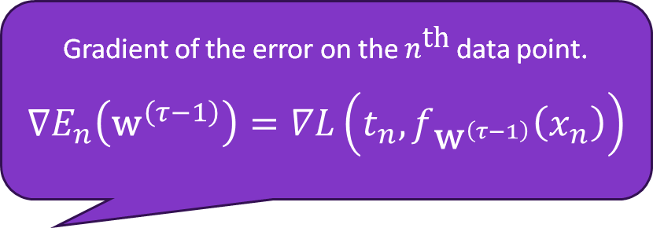
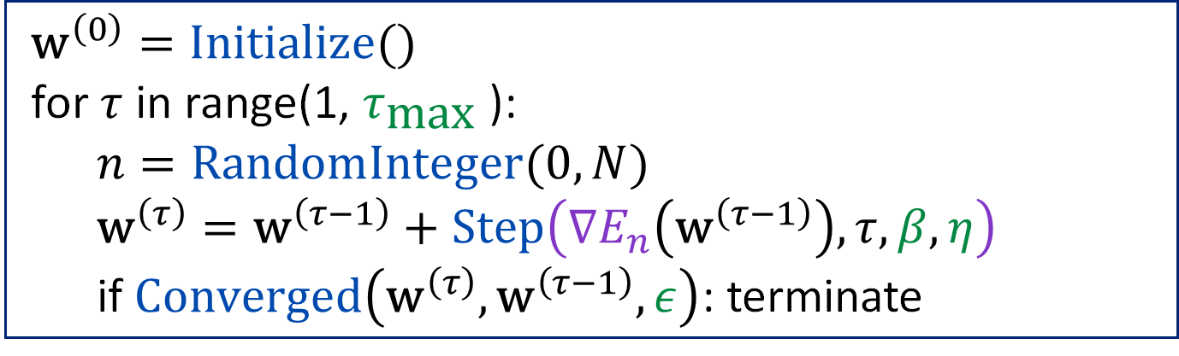
Stochastic Gradient Descent
Gradient descent but with the gradient computed on a single randomly sampled training data point
Stochasticity comes from random gradient estimates $∇E_{n}\left({\text{w}}^{\left(τ−1\right)}\right)$
Unbiased: $𝔼_{n}\left[∇E_{n}(w)\right]=∇E(w)$ for $n$ uniform on $\{1,…,N\}$
Cost per step is $𝓞(W)$ instead of $𝒪(NW)$ in batch gradient descent
Gradient of the error on the $n^{\text{th}}$ data point.
$$∇E_{n}\left({\text{w}}^{\left(τ−1\right)}\right)=∇L\left(t_{n}, f_{{\text{w}}^{\left(τ−1\right)}}\left(x_{n}\right)\right)$$
$${\text{w}}^{\left(0\right)}=Initialize()$$
for $τ$ in range(1, $τ_{\text{max}}$):
$$n=\text{RandomInteger}(0,N)$$
$${\text{w}}^{\left(τ\right)}={\text{w}}^{\left(τ−1\right)}+Step\left(∇E_{n}\left({\text{w}}^{\left(τ−1\right)}\right),τ, β,η\right)$$
if $Converged\left({\text{w}}^{\left(τ\right)},{\text{w}}^{\left(τ−1\right)}, ε\right)$: terminate
Bishop defines $E=\sum_{n}{E_{n}}$ as a sum. With the average used here, $η$ differs by the factor $N$.

Slide 41
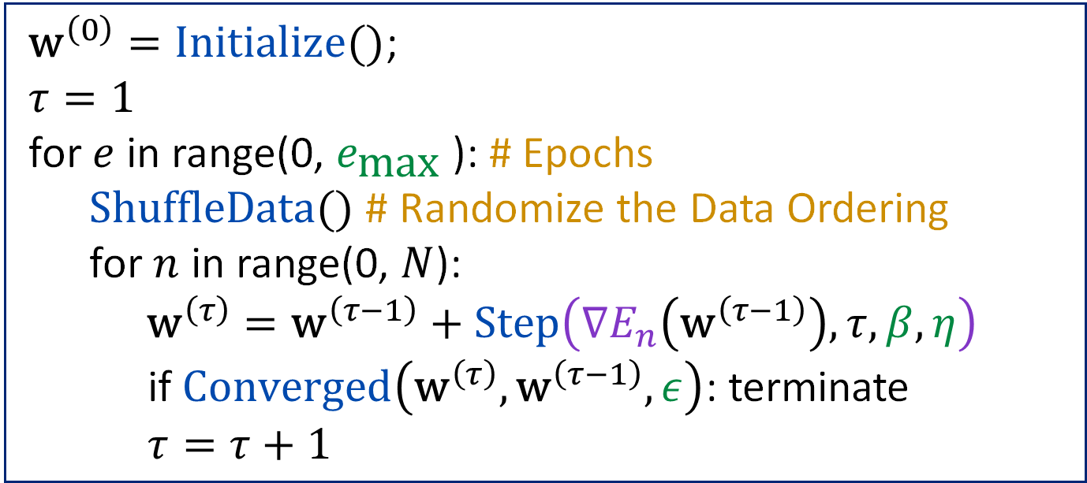
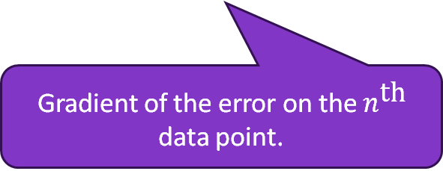
Stochastic Gradient Descent (Shuffling)
In practice, we often shuffle and then iterate over the entire dataset
One epoch is a complete pass over all the data points.
${\text{w}}^{\left(0\right)}=Initialize()$;
$$τ=1$$
for $e$ in range(0, $e_{\text{max}}$): # Epochs
$ShuffleData()$ # Randomize the Data Ordering
for $n$ in range(0, $N$):
${\text{w}}^{\left(τ\right)}={\text{w}}^{\left(τ−1\right)}+Step\left(∇E_{n}\left({\text{w}}^{\left(τ−1\right)}\right),τ, β,η\right)$
if $Converged\left({\text{w}}^{\left(τ\right)},{\text{w}}^{\left(τ−1\right)},ε\right)$: terminate
$$τ=τ+1$$
Some code shuffles only once.
Gradient of the error on the $n^{\text{th}}$ data point.

Slide 42
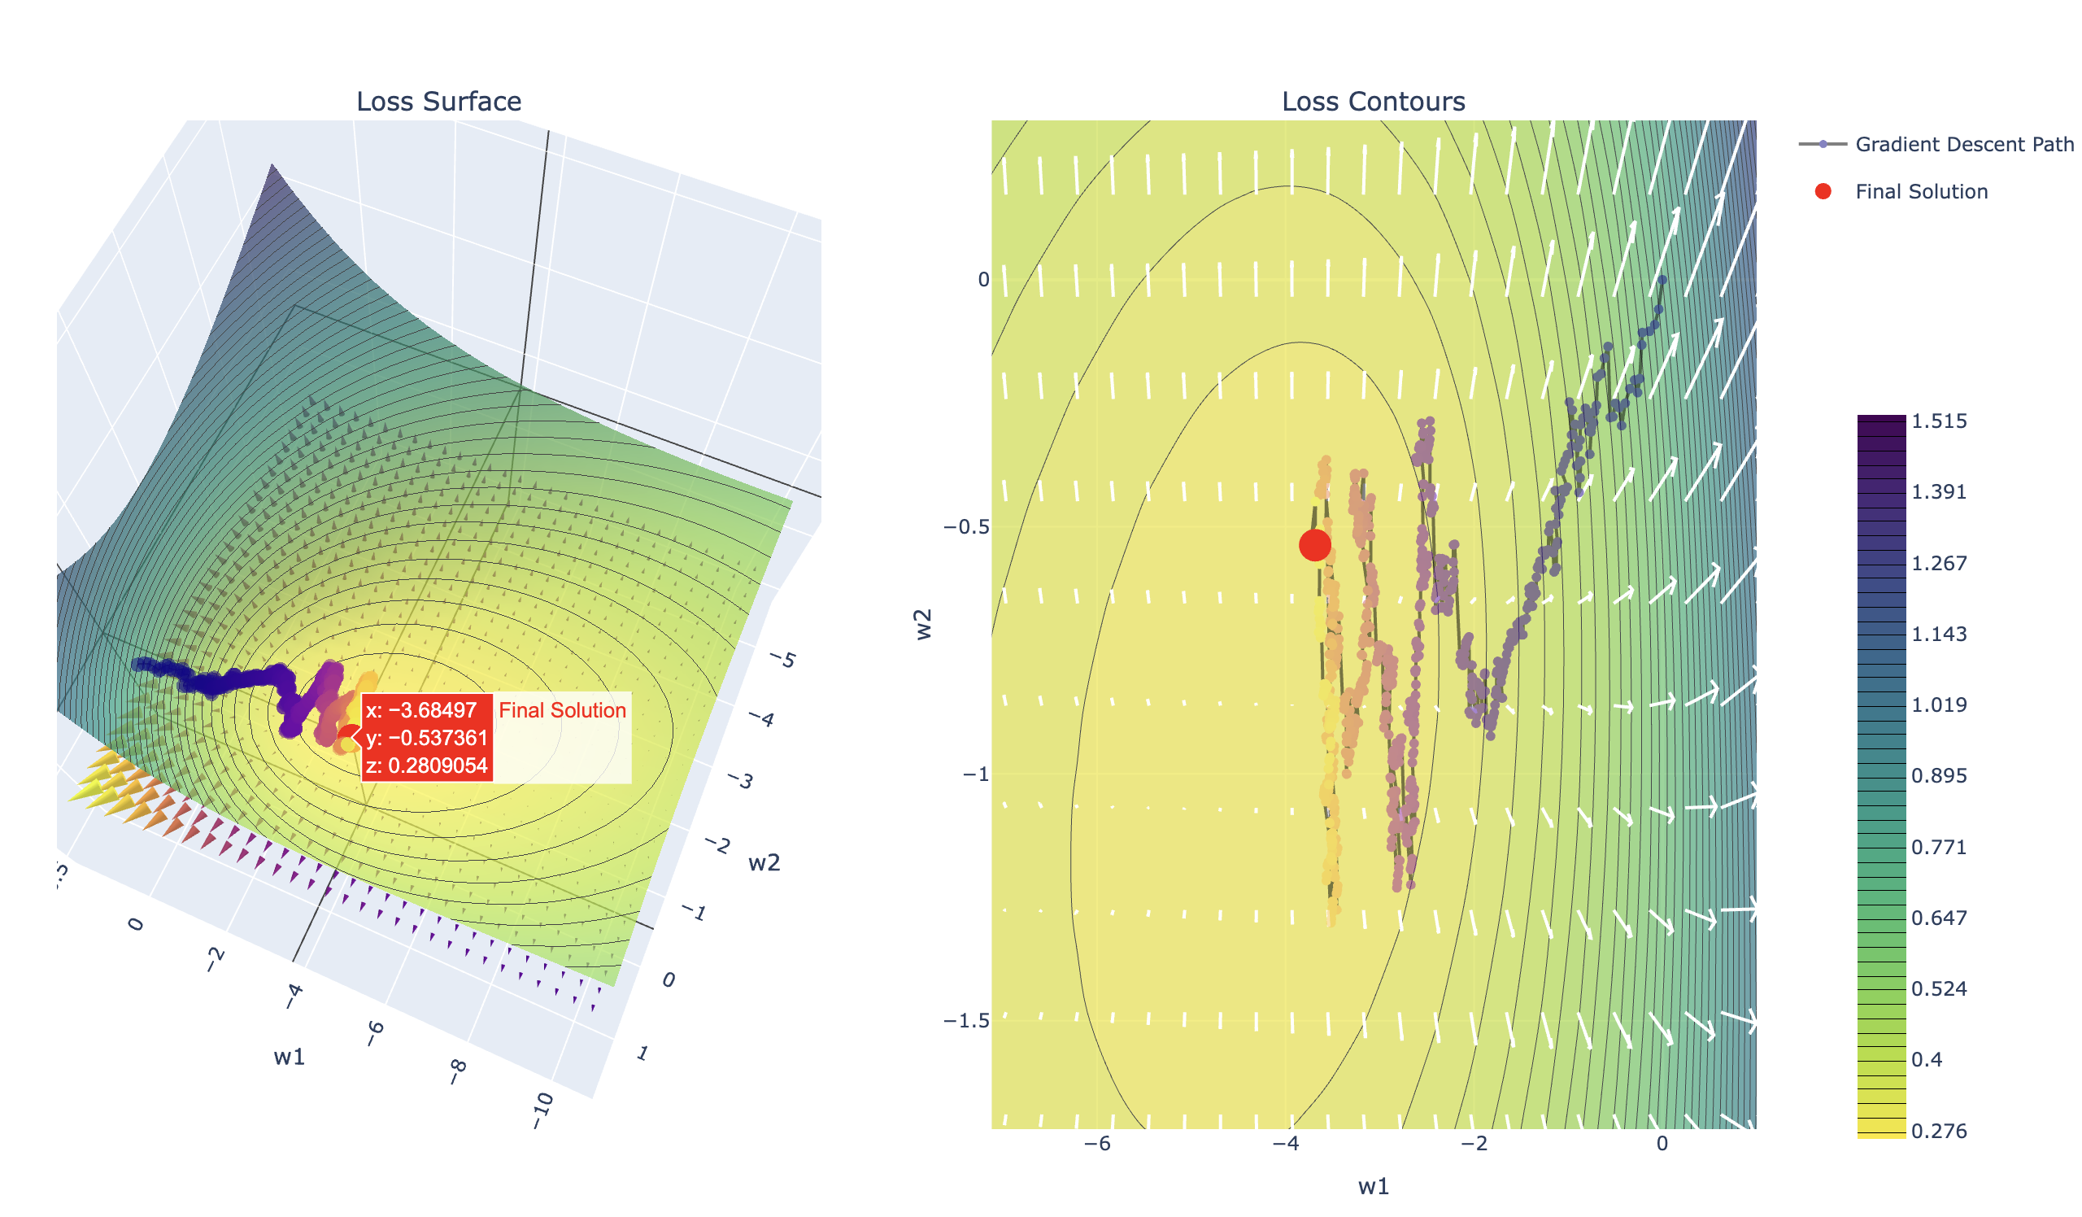
Demo
Stochastic Gradient Descent

Slide 43
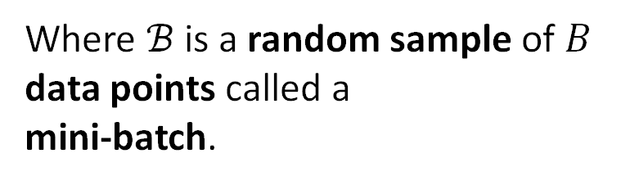

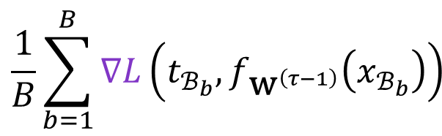
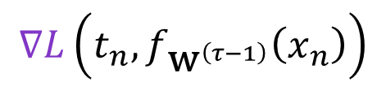


A Better Gradient Approximation
Estimating the gradient using a single data point results in noisy estimates.
$$𝔼_{p\left(t,x\right)}\left[∇L\left(t, f_{{\text{w}}^{\left(τ−1\right)}}\left(x\right)\right)\right]$$
Noisy but Cheap
Accurate but Expensive
$$\frac{1}{N}\sum_{n=1}^{N}{∇L\left(t_{n}, f_{{\text{w}}^{\left(τ−1\right)}}\left(x_{n}\right)\right)}$$
Ideal but don’t
know $p\left(t,x\right)$
$$∇L\left(t_{n}, f_{{\text{w}}^{\left(τ−1\right)}}\left(x_{n}\right)\right)$$
?
Stochastic
Gradient Descent
Batch
Gradient Descent
Mini-Batch Stochastic
Gradient Descent
$$\frac{1}{B}\sum_{b=1}^{B}{∇L\left(t_{ℬ_{b}}, f_{{\text{w}}^{\left(τ−1\right)}}\left(x_{ℬ_{b}}\right)\right)}$$
Where $ℬ$ is a random sample of $B$ data points called a
mini-batch.

Slide 44








A Spectrum of Stochastic Gradients
We typically refer to any of the sampling based gradient estimation procedures as Stochastic Gradient Descent (SGD)
Noisy but Cheap
Accurate but Expensive
$$𝔼_{p\left(t,x\right)}\left[∇L\left(t, f_{{\text{w}}^{\left(τ−1\right)}}\left(x\right)\right)\right]$$
$$\frac{1}{B}\sum_{b=1}^{B}{∇L\left(t_{ℬ_{b}}, f_{{\text{w}}^{\left(τ−1\right)}}\left(x_{ℬ_{b}}\right)\right)}$$
$$\frac{1}{N}\sum_{n=1}^{N}{∇L\left(t_{n}, f_{{\text{w}}^{\left(τ−1\right)}}\left(x_{n}\right)\right)}$$
Ideal but don’t
know $p\left(t,x\right)$
$$∇L\left(t_{n}, f_{{\text{w}}^{\left(τ−1\right)}}\left(x_{n}\right)\right)$$
Stochastic
Gradient Descent
Mini-Batch Stochastic
Gradient Descent
Batch
Gradient Descent
$𝒪(W)$
$𝒪(BW)$
$𝒪(NW)$
Stochastic Gradient Methods

Slide 45



Mini-batch Stochastic Gradient Descent
Gradient descent but with the gradient computed on a
batch of randomly sampled training points
Cost per step is $𝓞(BW)$ instead of $𝒪(NW)$ in batch gradient descent
Note that at batch size $B=1$ mini-batch is the same as SGD
  We often call both algorithms SGD (just with a batch-size hyperparameter)
$$∇E_{ℬ}\left({\text{w}}^{\left(τ−1\right)}\right)=\frac{1}{B}\sum_{b=1}^{B}{∇L\left(t_{ℬ_{b}}, f_{{\text{w}}^{\left(τ−1\right)}}\left(x_{ℬ_{b}}\right)\right)}$$
$${\text{w}}^{\left(0\right)}=Initialize()$$
for $τ$ in range(1, $τ_{\text{max}}$):
$$ℬ=\text{RandBatch}(0,N, \text{size}=B)$$
$${\text{w}}^{\left(τ\right)}={\text{w}}^{\left(τ−1\right)}+Step\left(∇E_{ℬ}\left({\text{w}}^{\left(τ−1\right)}\right),τ, β,η\right)$$
if $Converged\left({\text{w}}^{\left(τ\right)},{\text{w}}^{\left(τ−1\right)},ε\right)$: terminate

Slide 46


Shuffling for Minibatch Gradient Descent
In practice, we often shuffle and then iterate over the entire dataset
One epoch is a complete pass over all the data points.
${\text{w}}^{\left(0\right)}=Initialize()$;
$$τ=1$$
for $e$ in range(0, $e_{\text{max}}$): # Epochs
$ShuffleData()$ # Randomize the Data Ordering
for $n$ in range(0, $N$, step=$B$):
$${\text{w}}^{\left(τ\right)}={\text{w}}^{\left(τ−1\right)}+Step\left(∇E_{n,…,n+B−1}\left({\text{w}}^{\left(τ−1\right)}\right),τ, β,η\right)$$
if $Converged\left({\text{w}}^{\left(τ\right)},{\text{w}}^{\left(τ−1\right)},ε\right)$: terminate
$$τ=τ+1$$
Some code shuffles only once.
Gradient of the error on the next $B$ data points.

Slide 47
Do not edit
How to change the design
If I have N data points and a choose a batchsize B=2. In one epoch how many gradient steps will I take?
The Slido app must be installed on every computer you’re presenting from

Slide 48

How do I Pick the Batch Size?
Larger batch size:
Better gradient estimate, but the noise decreases only as $1/\sqrt{B}$
Enables hardware parallelism – can compute gradient for each point in parallel
Smaller batch size:
Cheap to compute → take more steps
Greater stochasticity can help with local minima
Typical design decision:
Increase batch size to saturate hardware parallelism
Increase the learning rate in proportion to $B$ (a heuristic for SGD, used with warmup; it breaks down for very large $B$)

Slide 49

Demo
Mini-batch Gradient Descent

Slide 50
Stochastic Gradient Descent
Lecture 11
Credit: Joseph E. Gonzalez and Narges Norouzi
Reference Book Chapters: Chapter 7

